Slide 1
Integration:
P42 line and SHiP skeletons
HI-ECN3 Integration
Beatriz Martínez Sutil (BE-EA-DC), Pablo Santos Díaz (EP-SME-SHP)
30/01/2025

Slide 2
INDEX
P42 beamline integration
SHiP skeleton
Next steps

Slide 3
P42 beamline integration

Slide 4
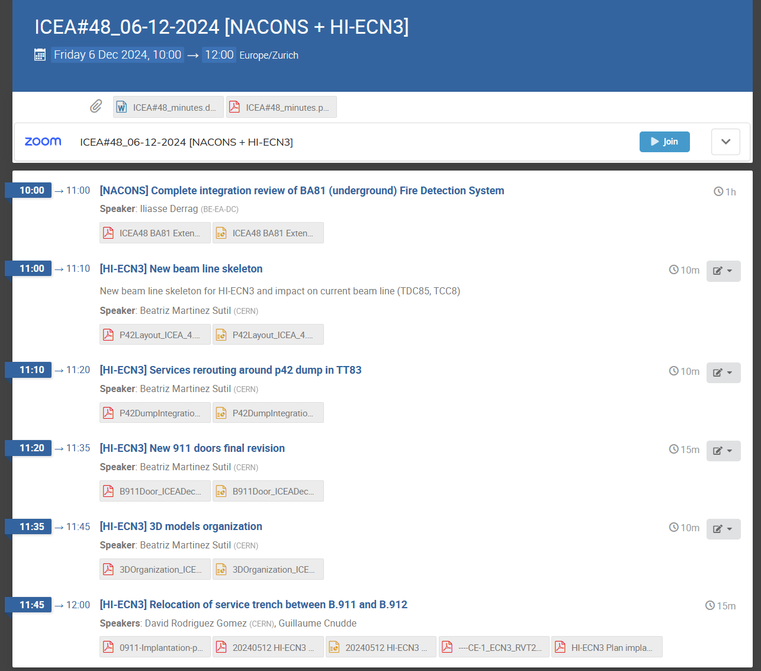
Reminder: WP4 integration status
First proposal of the P42 line presented
911 new door integration validated
HI-ECN3 models location
https://indico.cern.ch/event/1485956/

Slide 5
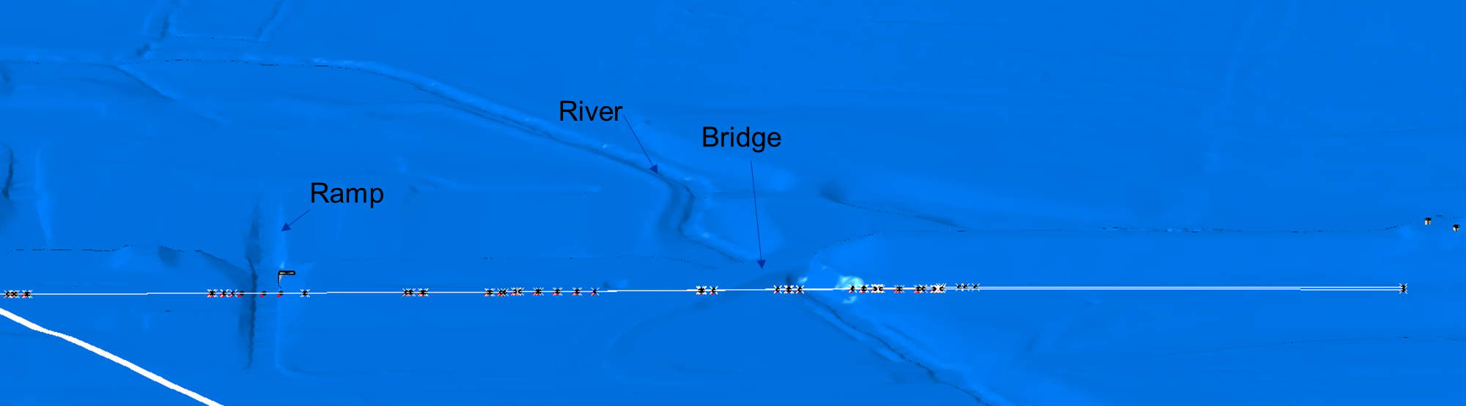
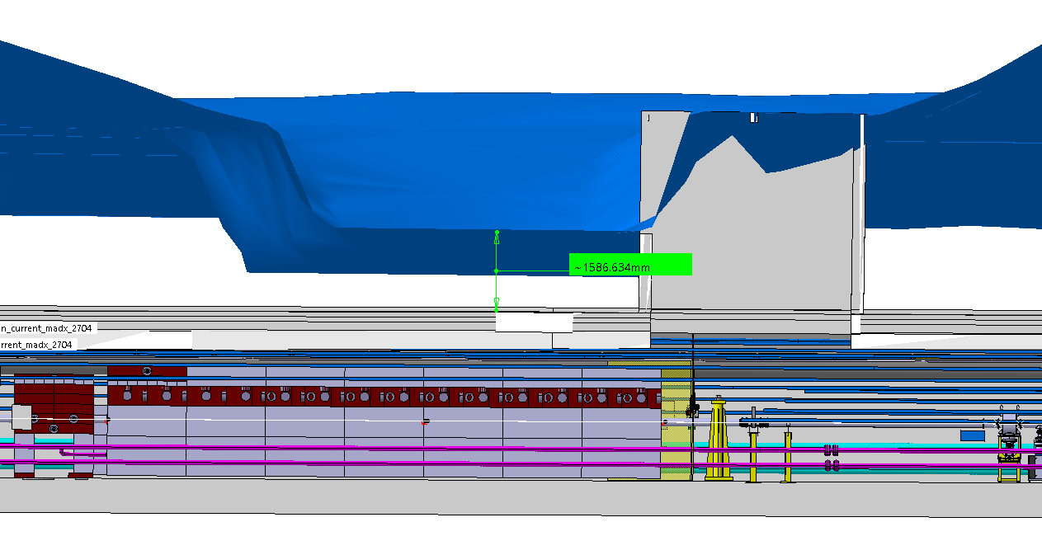
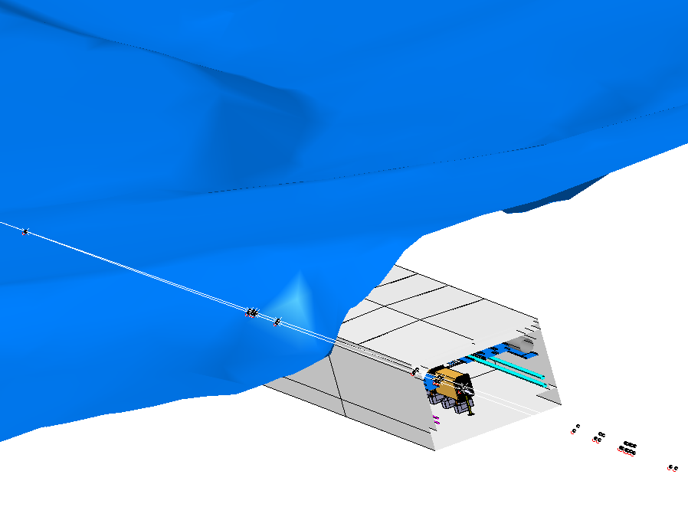


P42 beamline constraints
P42 v.1 beamline MADX file received on November 2024 where a few modifications were needed.
New P42 line MADX files will be provided with:
Last bend: Vertical angle adjusted.
MBNH.X0450792 and MBNH.X0450795 relocated.
Beam dilution system.
BSG upstream the target,
New position of the target start
along the beam line.
2
1
Checked the soil level above the elements
1
Ramp on top of shielding
Bridge on top of MBNH.X0450792 and MBNH.X0450795
TBC by integration
2

Slide 6
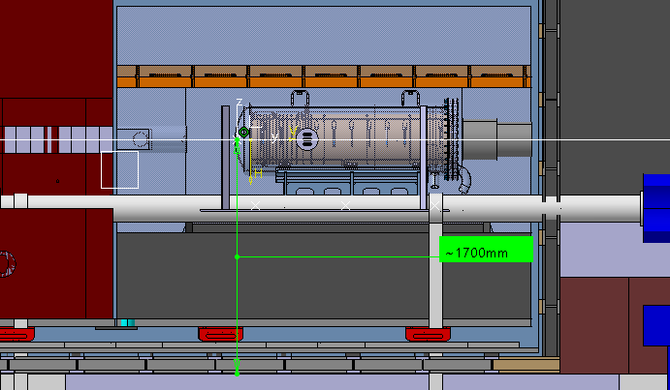
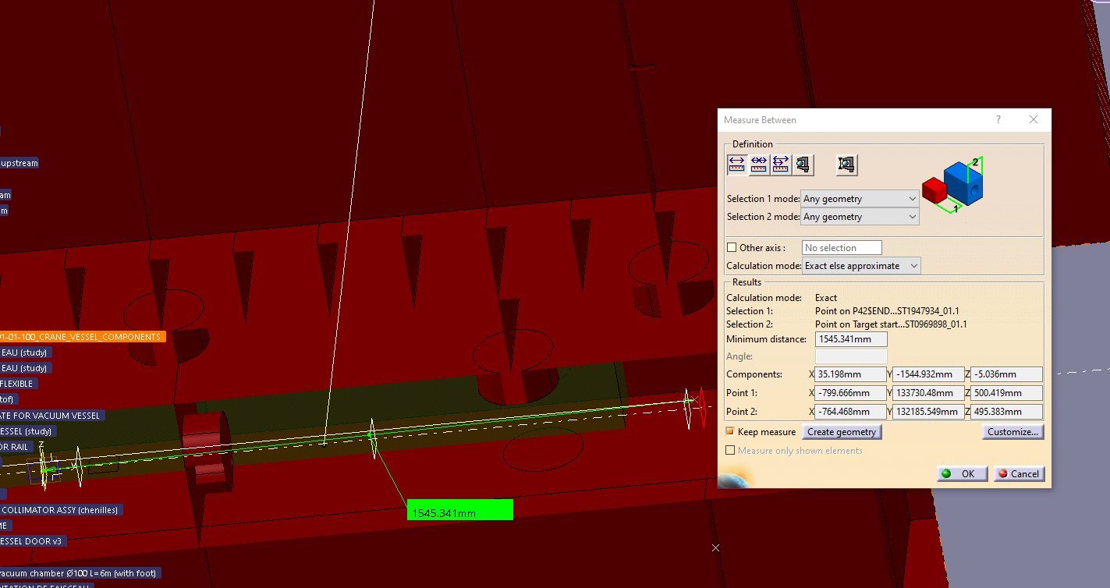
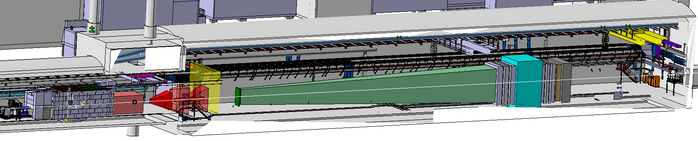
P42 v.1 beamline integration I
P42 v.1 END is 1.5m downstream respect to P42 v.0 END skeleton.
In X and Z there is almost no difference.
(Y) along the beam line to be defined depending in the integration constraints
z
y
x

Slide 7
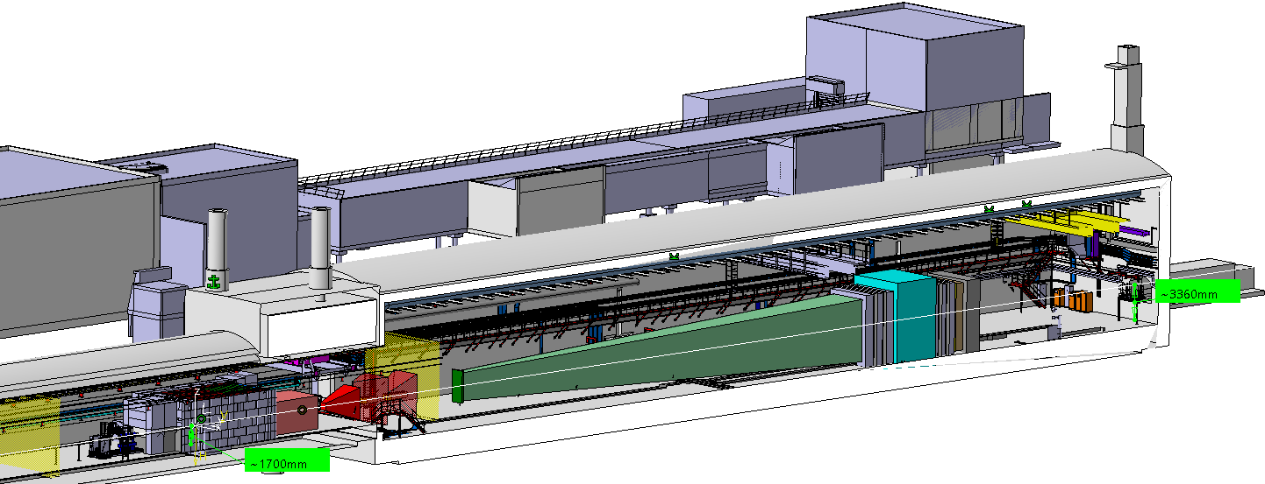
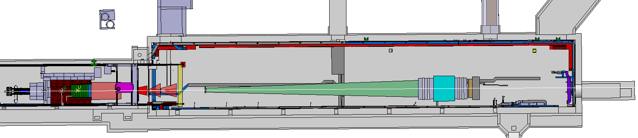
P42 v.1 beamline integration II
1.7m beam line height respect to the floor.
Beam line parallel to the TCC8 and ECN3 walls and floor.

Slide 8
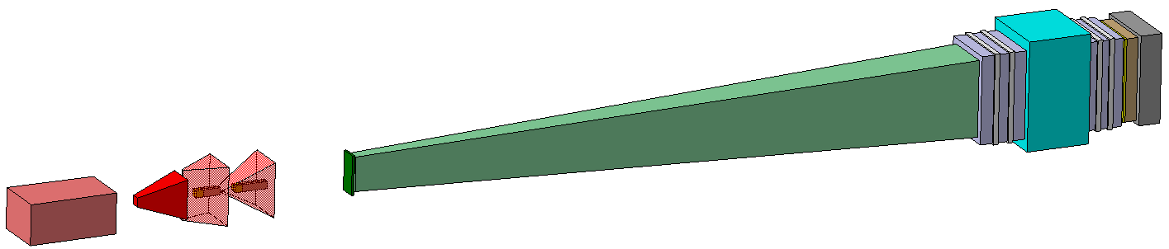
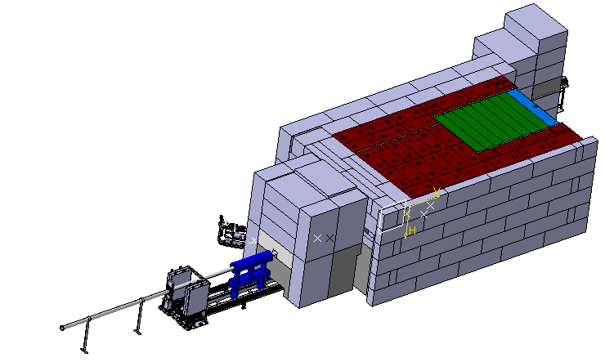
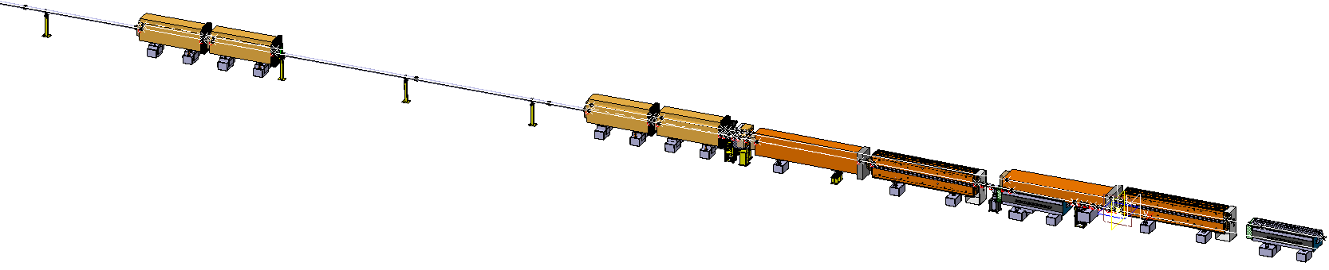
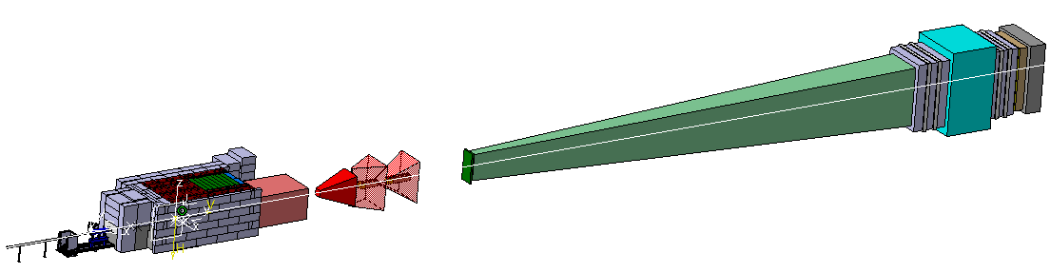
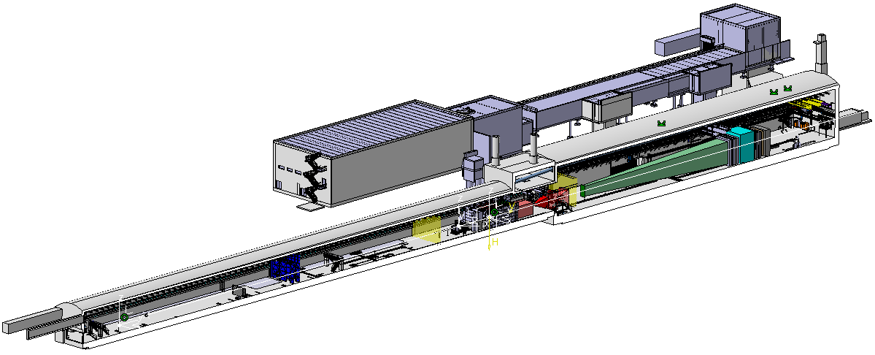
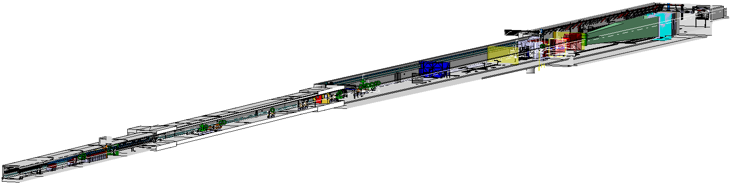
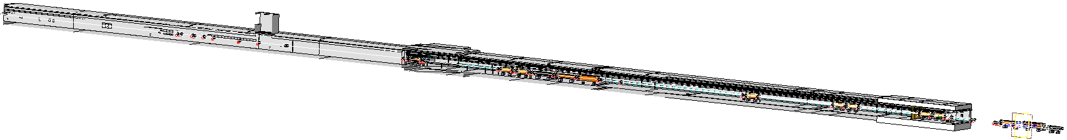
Overview of baseline models I
SHiP detector preliminary layout
(EP)
Layout_P42line_PostLS3_2704
(EA)
BDF TARGET COMPLEX ASSY (current)
(STI)
SHiP target and detector preliminary layout
(EP)
TCC8-ECN3_IntegrationStudy_2705
(EA)
TT85-ECN3_IntegrationStudy_2704
(EA)
TT85-ECN3_IntegrationStudy_2704
(EA)

Slide 9
Overview of baseline models II
Name | Reference | C.S. | Responsability | Description
BDF TARGET COMPLEX ASSY (current) | ST1884082_01 |  | SY-STI | Study of the new target design.
SHiP detector preliminary layout | ST1718677_01 |  | EP-SME | Study of the detector design.
SHiP target and detector preliminary layout | ST1606501_01 | 2705 | EP-SME | Integration detector + target in the SHiP skeleton.
TCC8+ECN3_IntegrationStudy_2705 | ST1967028_01 | 2705 | BE-EA | Integration of ‘’SHiP target and detector preliminary layout’’ in TCC8-ECN3 cavern. Integration of the new C.Eng. models.
Layout_P42line_PostLS3_2704 | ST1949012_01 | 2704 | BE-EA | New P42 line layout study.
TT85+TDC85_IntegrationStudy_2704 | ST1950060_01 | 2704 | BE-EA | Integration of ‘’SHiP target and detector preliminary layout’’ in TT85-TDC85 cavern.
TCC8-ECN3_IntegrationStudy_2704 | ST1967062_01 | 2704 | BE-EA | Integration of ‘’TCC8+ECN3’’ and ‘’TT85+TDC85’’ studies
Table 1.- Summary of the HI-ECN3 study models

Slide 10
Beamline & SHiP skeletons

Slide 11

Beam skeletons overview
  Understand the different skeleton used in the model.
  Agree on the integration skeletons.
Name | Reference | C.S. | Responsability | Description
P42lineSkeleton_PostLS3_v.2_2704 | ST1947934_01 | 2704 | BE-EA | New P42 line imported from MADX files.
Beatch p42_2021 | ST1538313_01 | 2704 | BE-EA | Current P42 line imported from beatch files.
SHiP detector preliminary layout | ST1718677_01 |  | EP-SME | Detector design study with the skeleton inside as geometrical set.
CER-699-001-02-001_SKELETON | ST0969898_01 |  | SY-STI | Separate part. Used in the BDF target.
Beam SHiP Skeleton - 2705 | ST1987588_01 | 2705 | BE-EA, EP-SME | Simplified skeleton used to place SHiP inside ECN3 respect to 2705 origin.
Table 2.- Summary of the skeletons used in TCC8-ECN3.

Slide 12
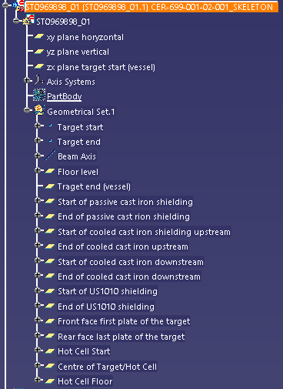
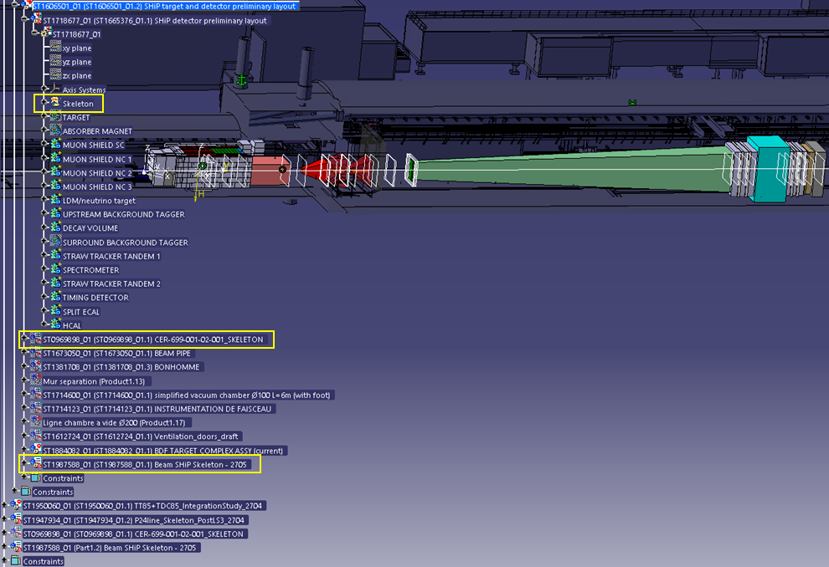
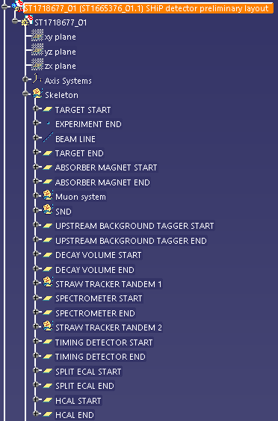
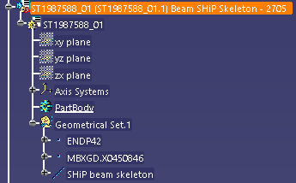
SHiP skeleton definition
  Proposal:
    Target skeleton inserted in BDF TARGET COMPLEX ASSY.
    Detector skeleton in an independent part from SHiP detector preliminary layout
    Relation of SHiP respect to the P42 line, can be integrated in the MADX P42 beamline in 2705?
Target skeleton
Relation of SHiP respect
to the P42 line
Detector skeleton

Slide 13
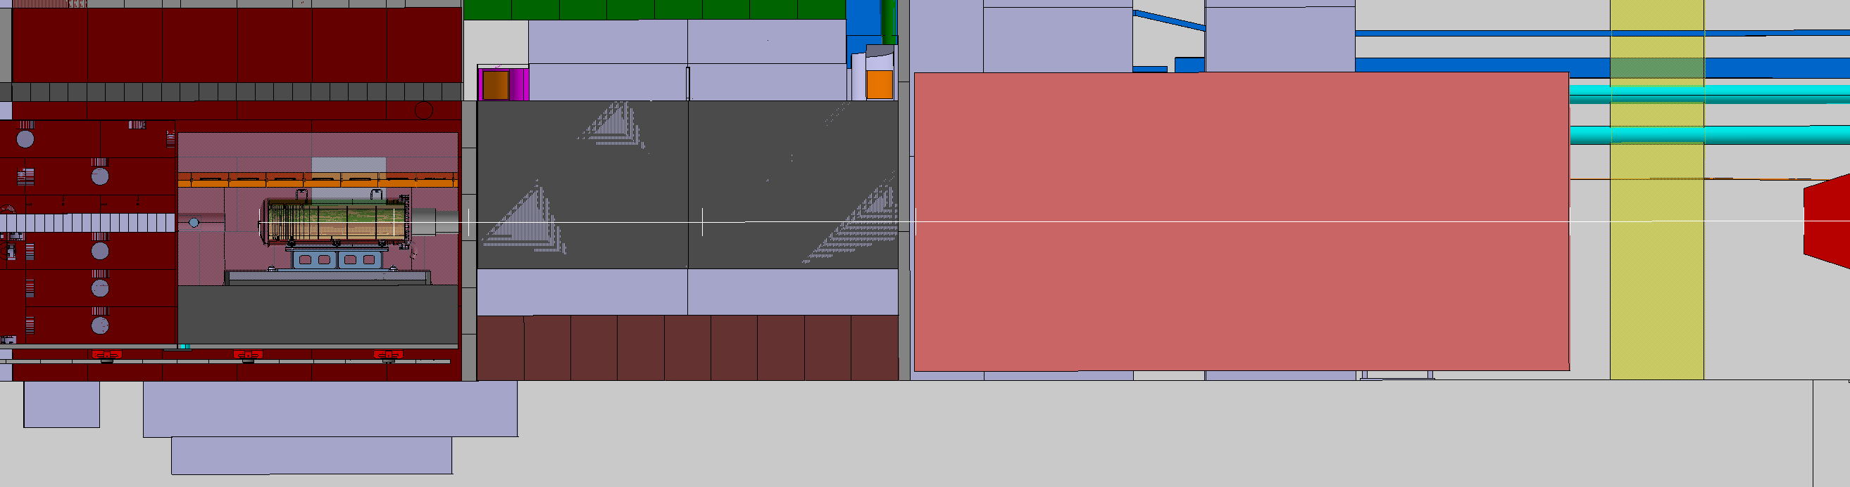
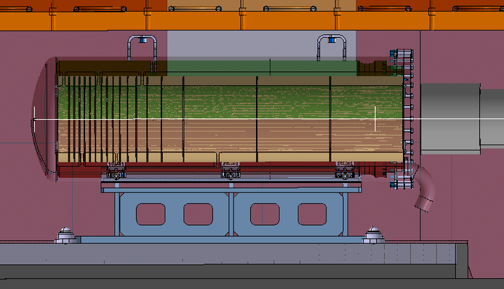
SHiP origin
  SHiP origin at the target front face centered in the target first disc.

Slide 14
Next steps

Slide 15
Next steps
Define the target SHiP origin position along the beamline.
  Integrate the ECN3 drainage system.
  Update spectrometer magnet pit dimensions.
  Look at the ventilation doors position.
Reorganise the SHiP & target skeletons.
Implement then the new P42 MADX files with the updated SHiP origin and all the mentioned changes.

Slide 17
BACK UP SLIDES

Slide 18
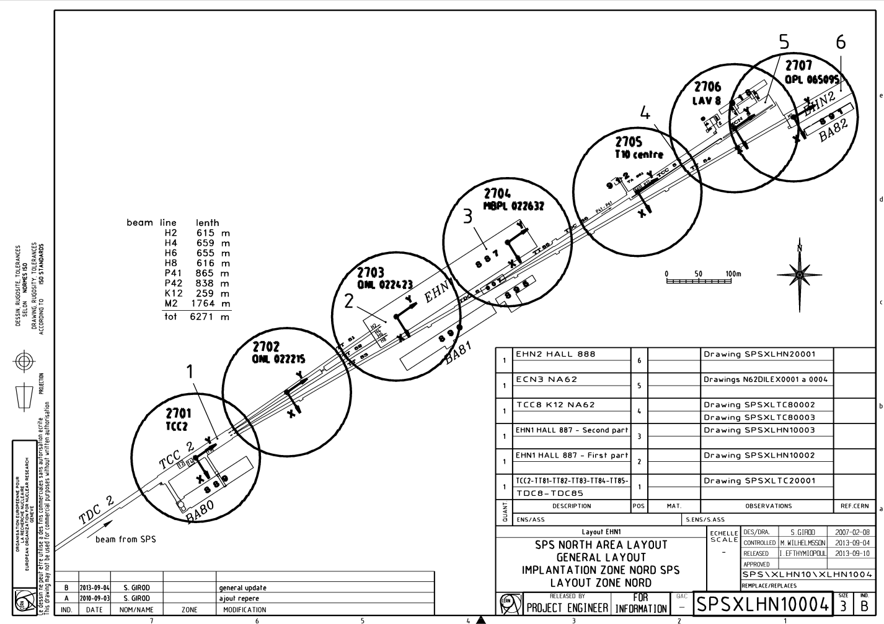
Introduction: NA CATIA coordinate systems
TCC8-ECN3
TT85-TDC85
S. Girod

Slide 19
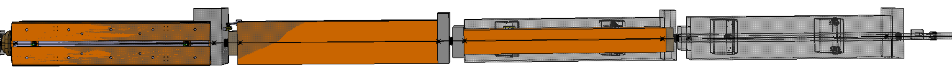
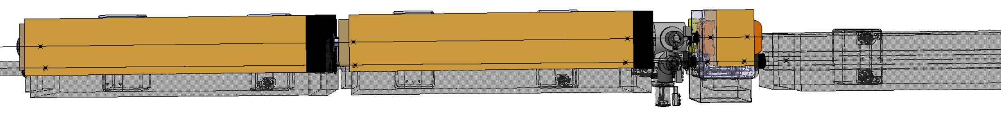
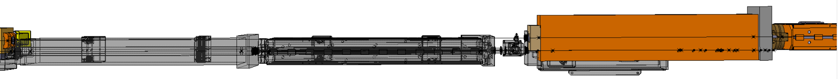
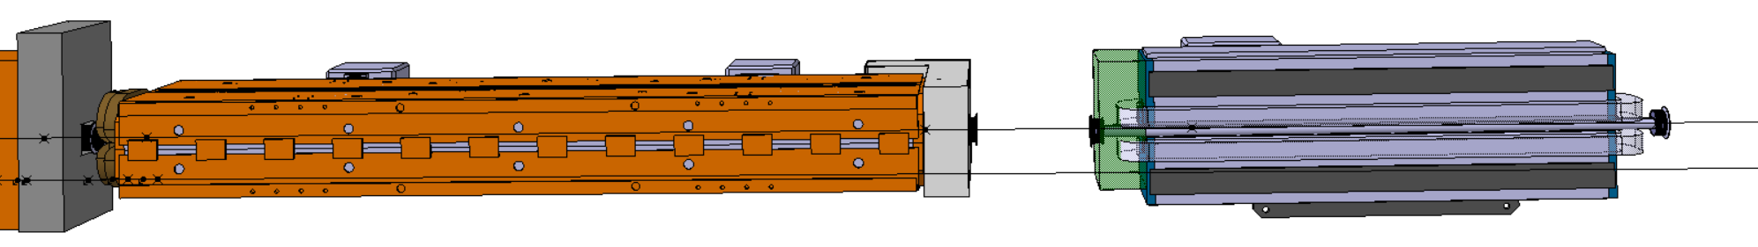
Introduction: First proposal of the P42 line
MBNH.X0430718
MBNH.X0430724
MBNV.X0430730
MBNH.X0430735 removed
BSP.X0430769
QNL.X0450770
MBNH.X0450792
MBNH.X0450795
MBNH.X0450814
MBNH.X0450817
BSM.X0450819
MCXCA.X0450820
Shifted ~12m from MBNV.X0450823
MBNH.X0450835 (MBNV.X0450823)
MBNH.X0450840
MBXGD.X0450846
Old layout
Integration: ST950060_01
Layout: ST194012_01

