Slide 1
Developing a 3 GHz HTS rf pulse compressor: Background

Slide 2
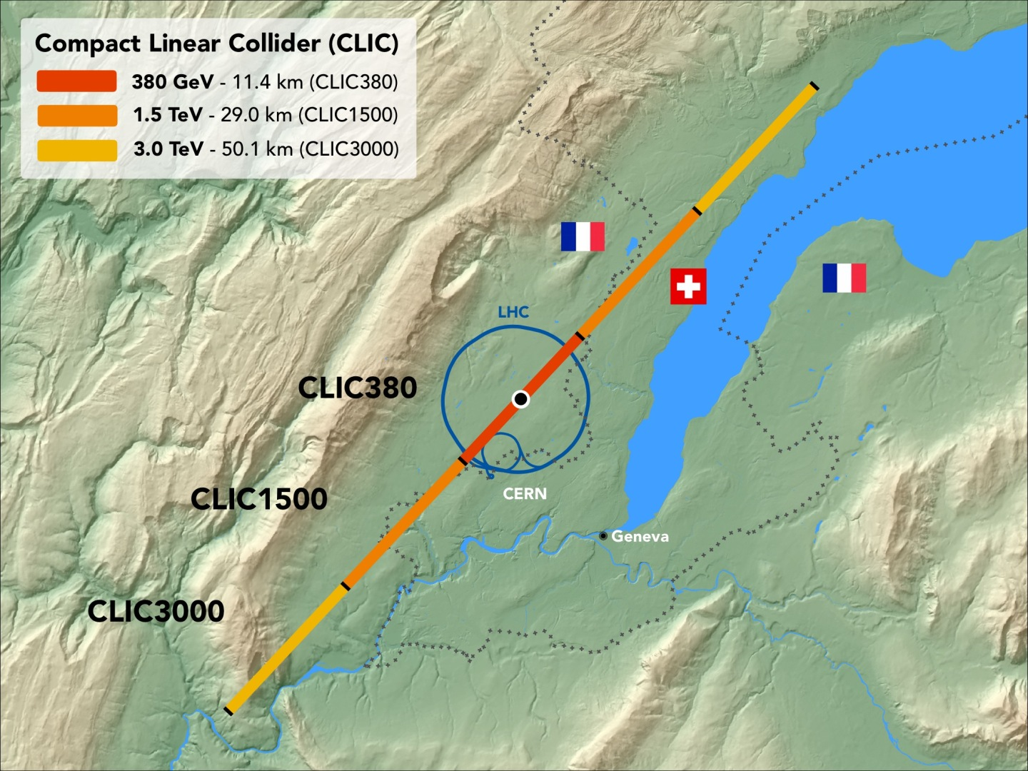
High accelerating gradient

Slide 3
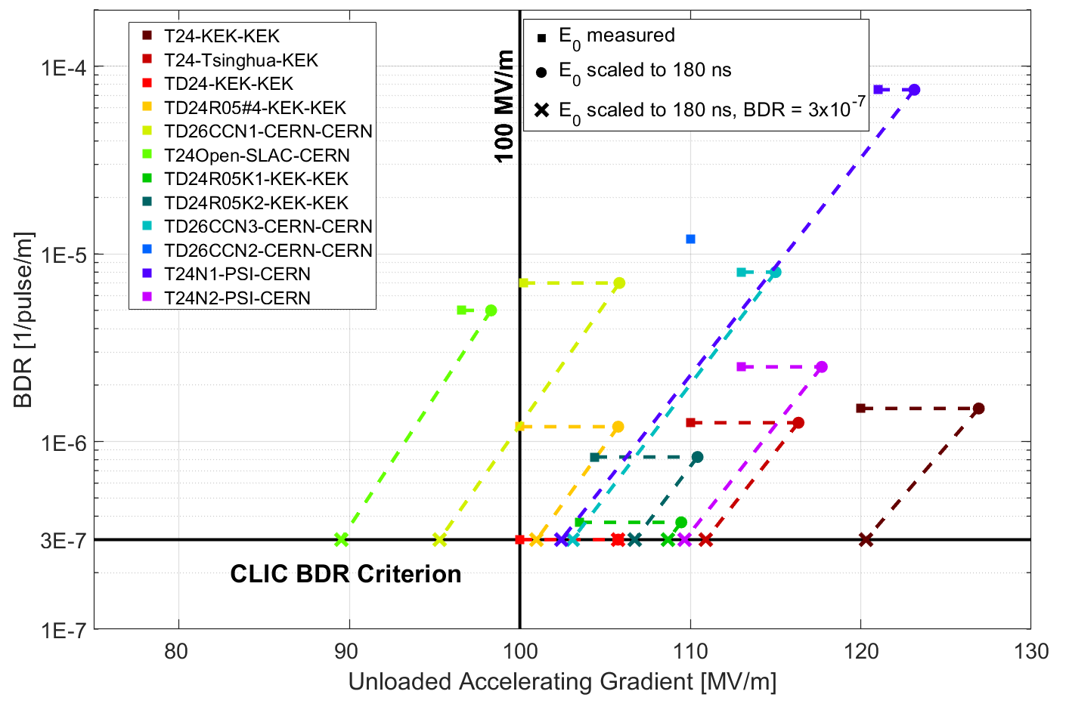
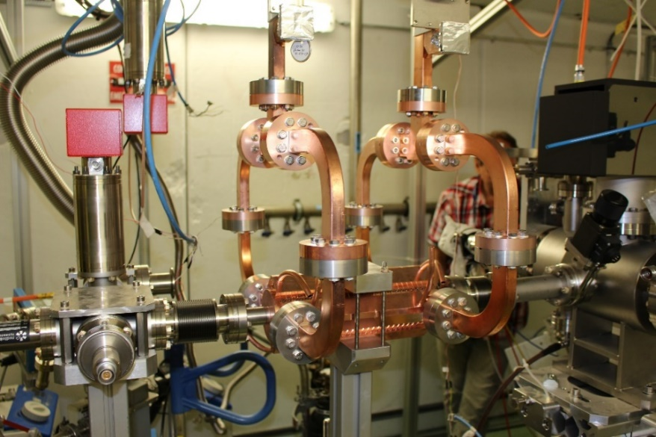
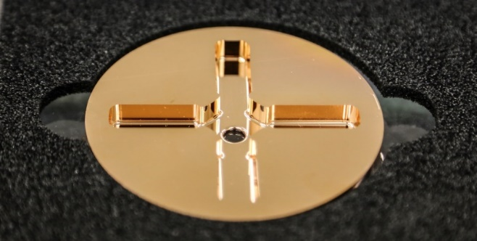
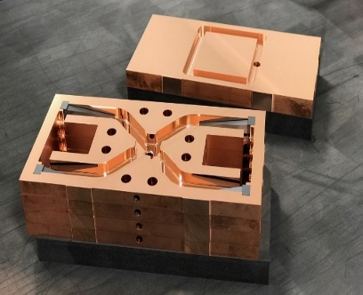
Normal Conducting High Gradient
Peak surface electric fields about x 2.5 higher
https://doi.org/10.1103/PhysRevAccelBeams.21.061001,
https://doi.org/10.1103/PhysRevAccelBeams.20.052001 etc.

Slide 4
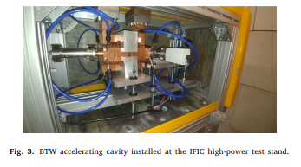
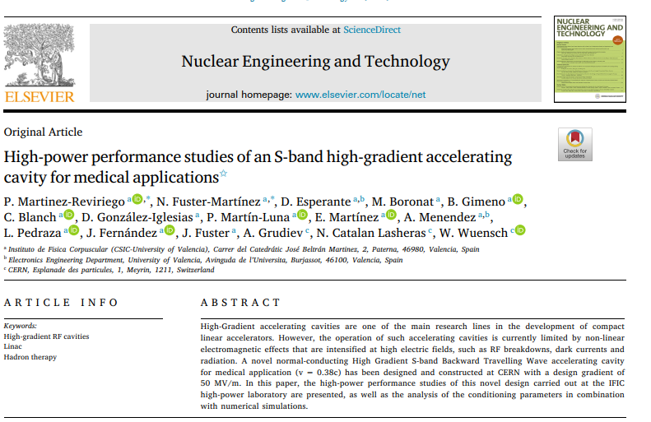
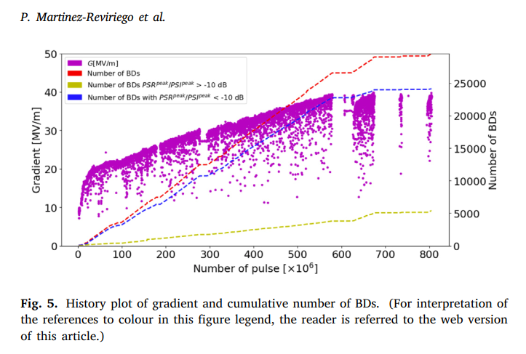
Here in Valencia!

Slide 5
Even higher-gradient through cooling to cryogenic temperatures

Slide 6
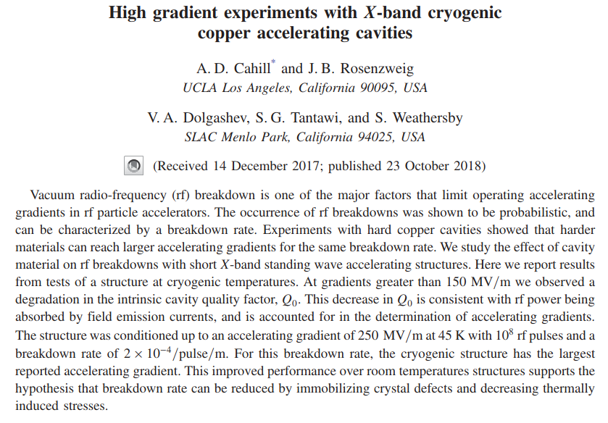
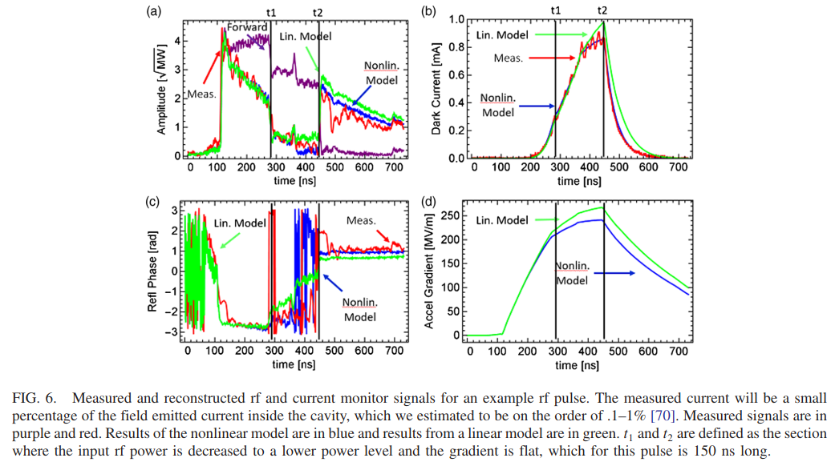
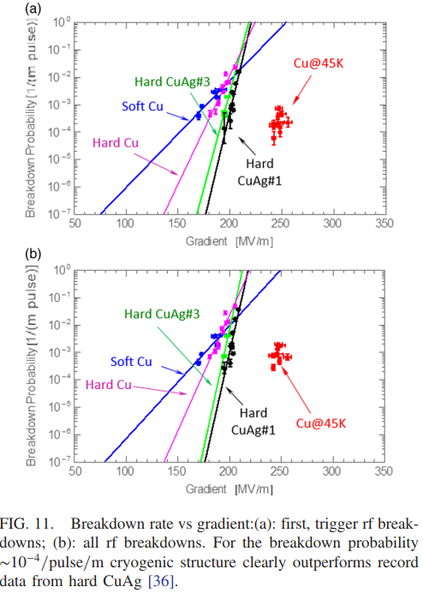
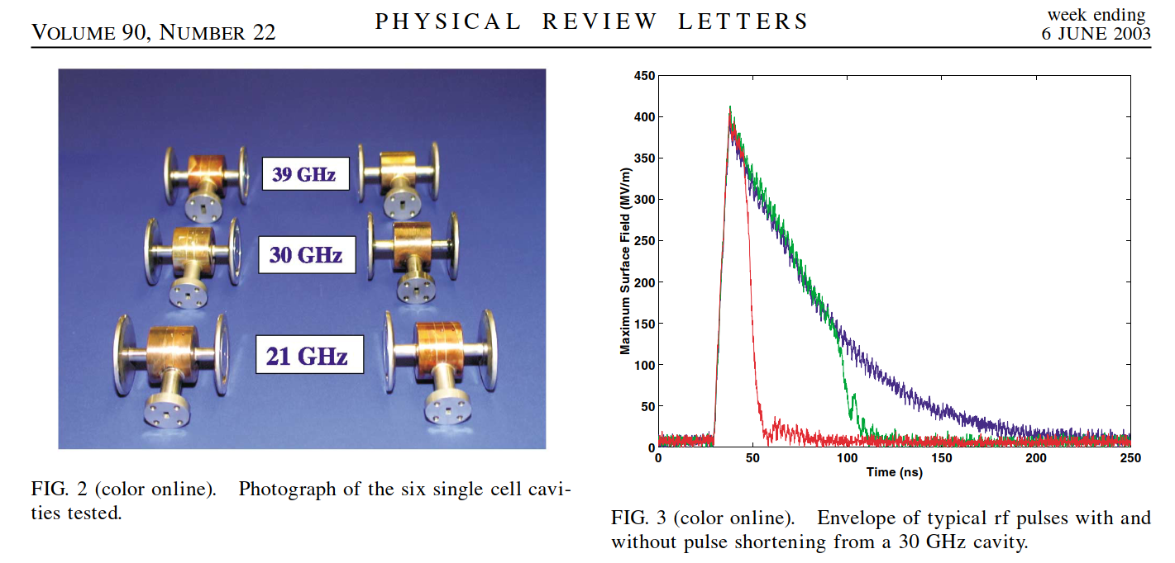
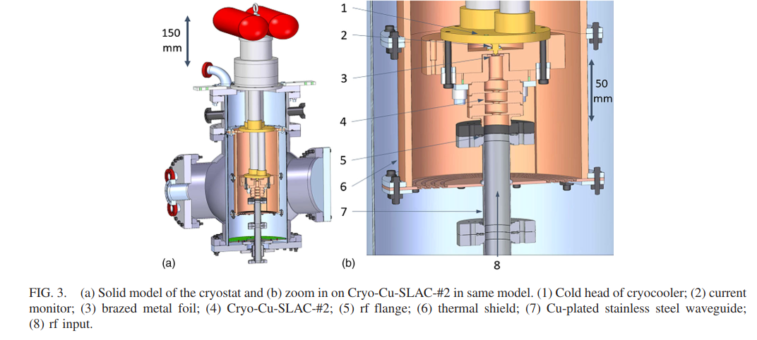
Cryogenic copper - RF
https://doi.org/10.1103/PhysRevAccelBeams.21.102002
https://doi.org/10.1103/PhysRevLett.90.224801

Slide 7
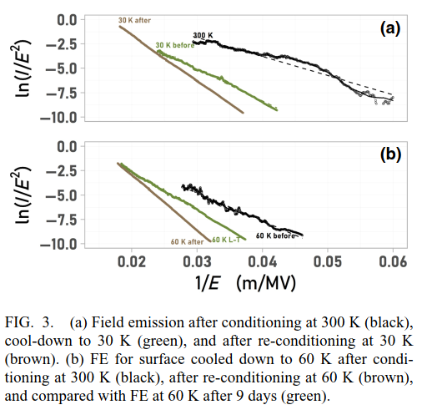
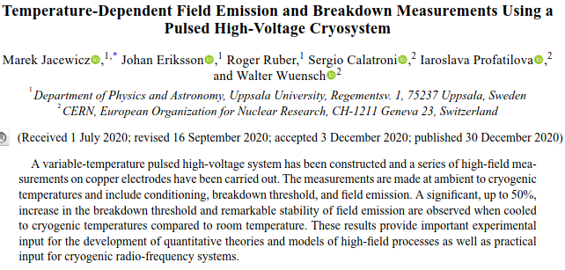
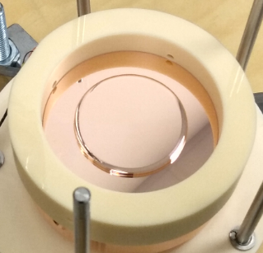
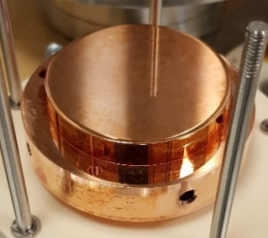
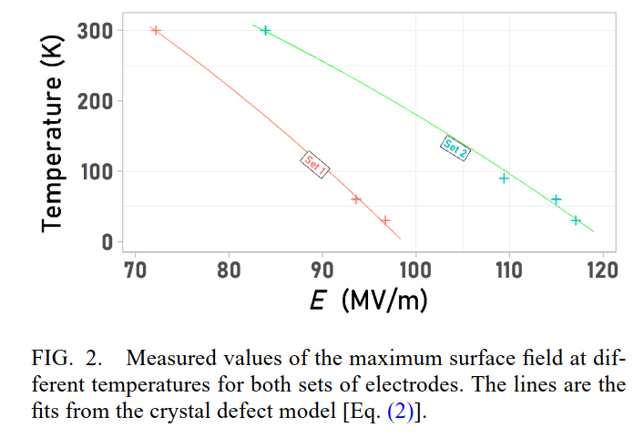
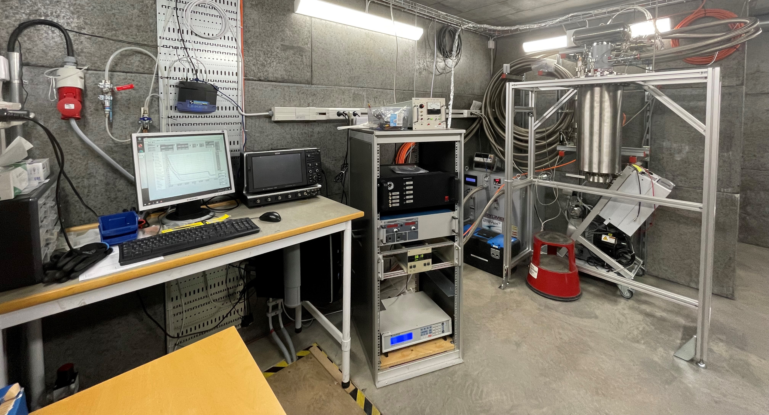
Cryogenic copper – Pulsed dc
https://doi.org/10.1103/PhysRevApplied.14.061002

Slide 8
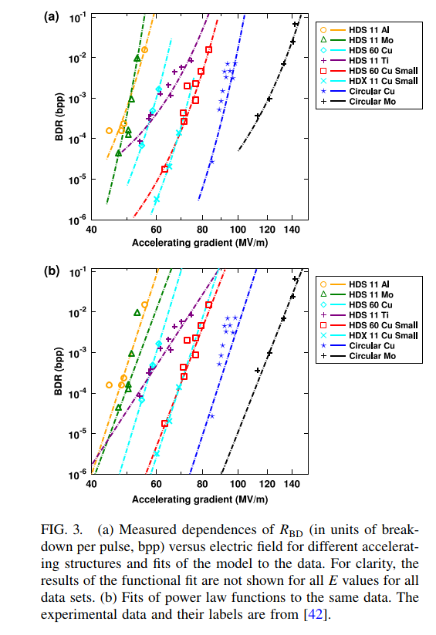
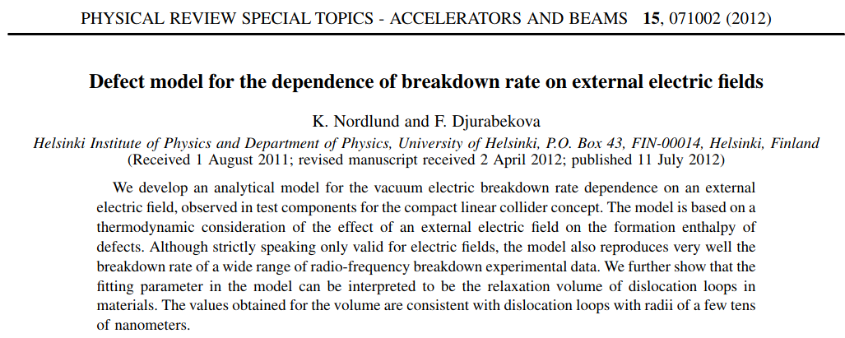
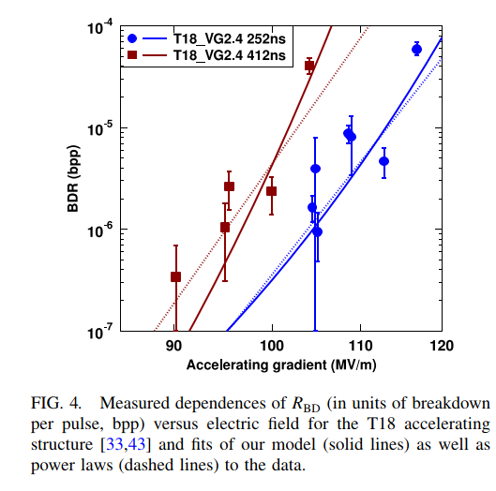
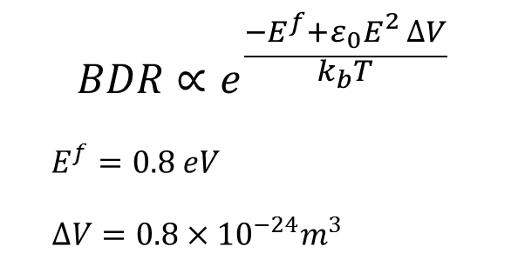
Breakdown rate – Vacancy model
https://doi.org/10.1103/PhysRevSTAB.15.071002

Slide 9
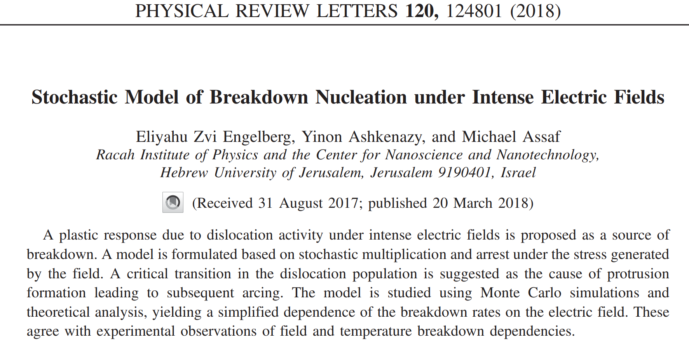
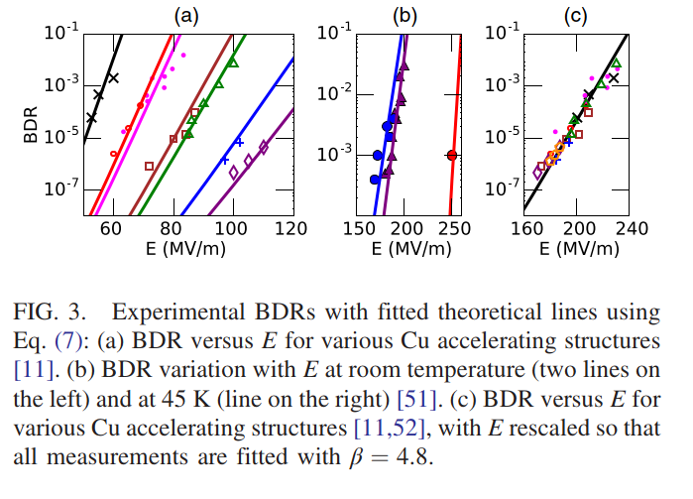
Breakdown rate – Dislocation dynamics model
Describing mobile dislocation population evolution:
https://doi.org/10.1103/PhysRevLett.120.124801

Slide 10
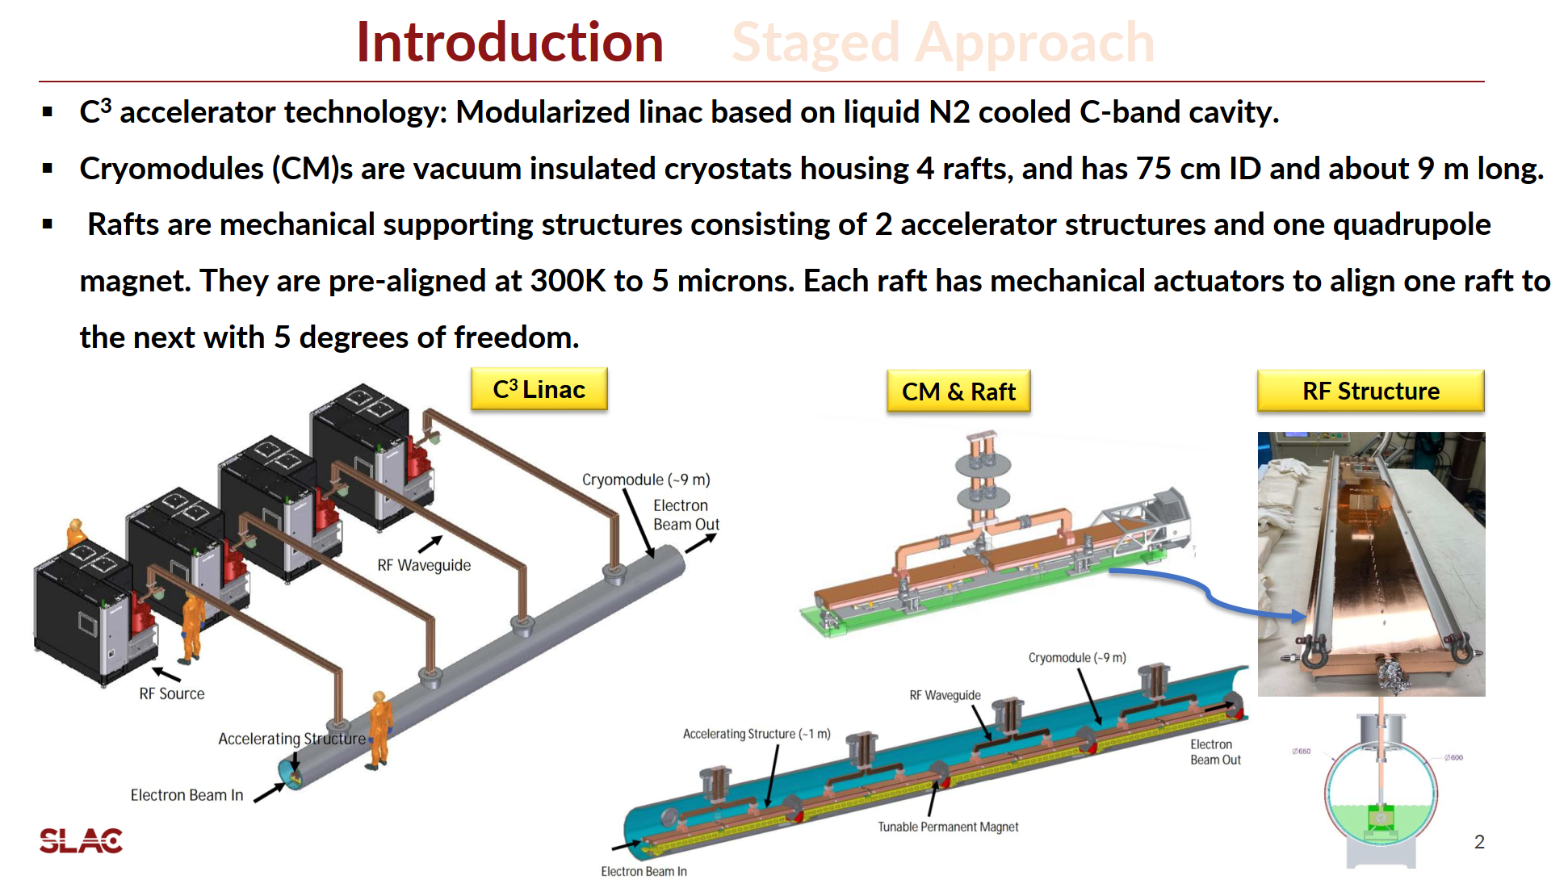
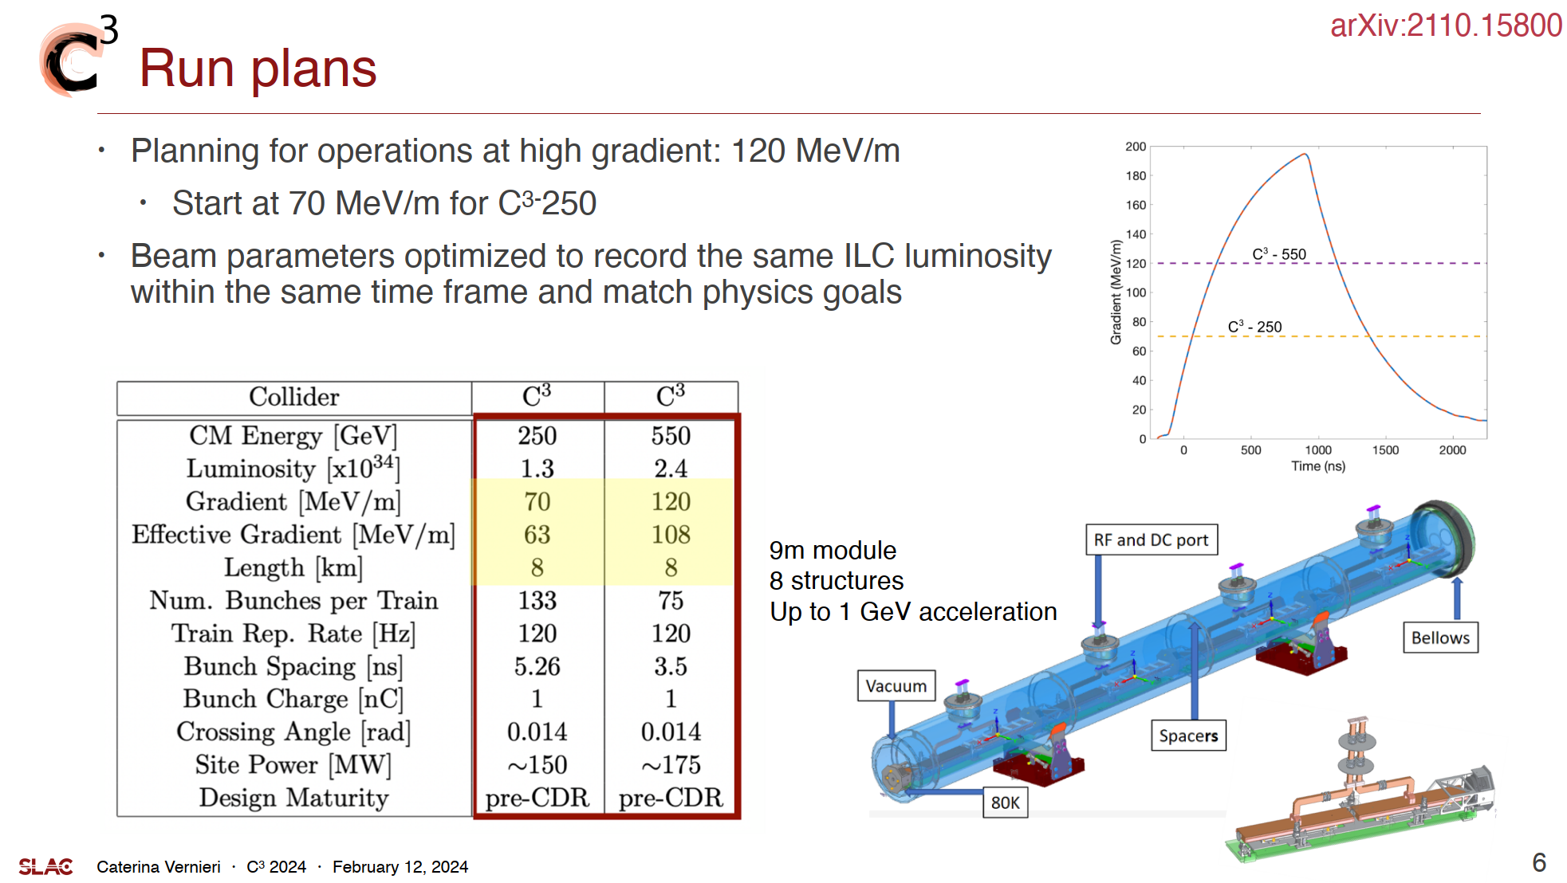
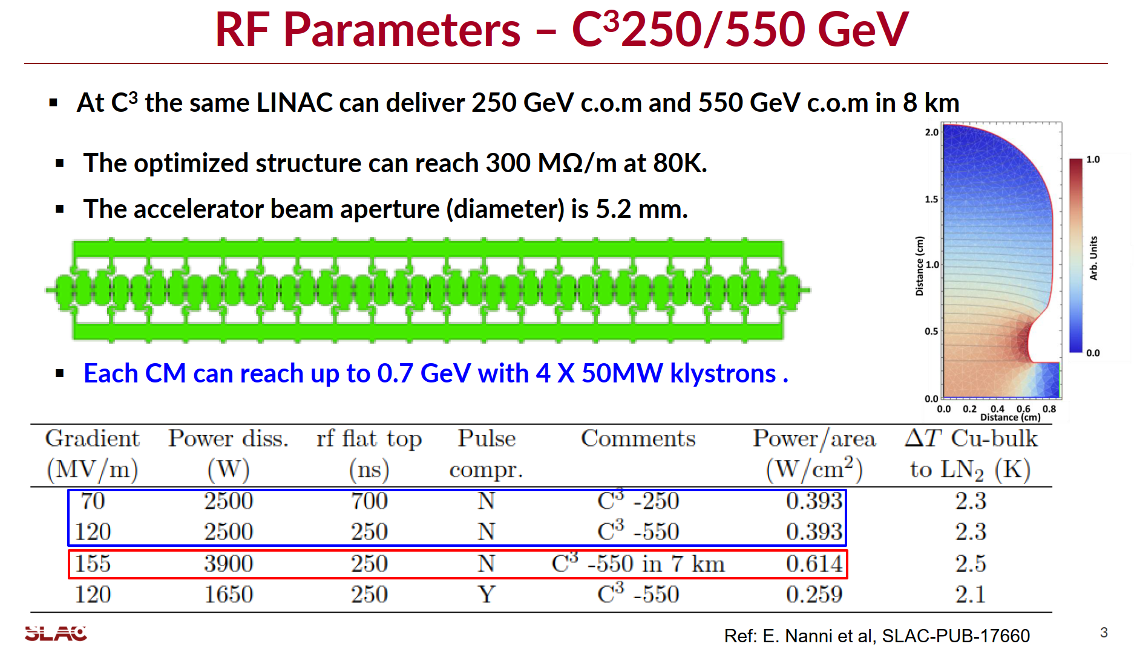
C³ – Cool Copper Collider
Person view:
Advantage – Lower peak power requirement, fewer power sources.
Disadvantage – Lower efficiency. Limited increase in copper conductivity compared to Carnot cooling cost.
Challenge – Micron-level alignment in LN2 environment.

Slide 11
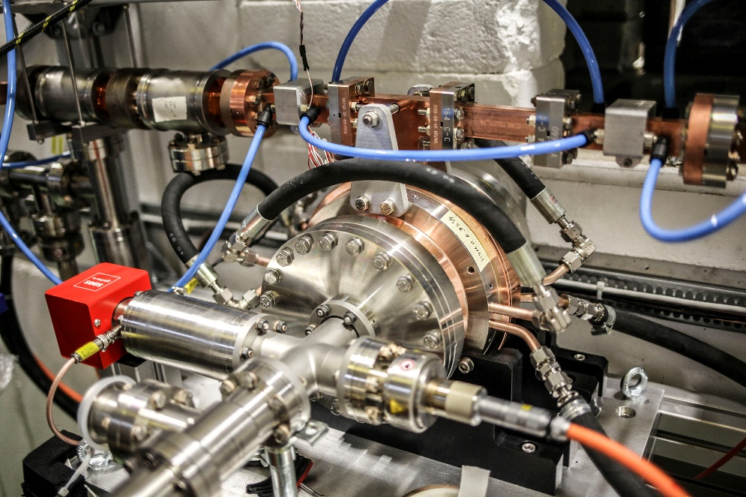
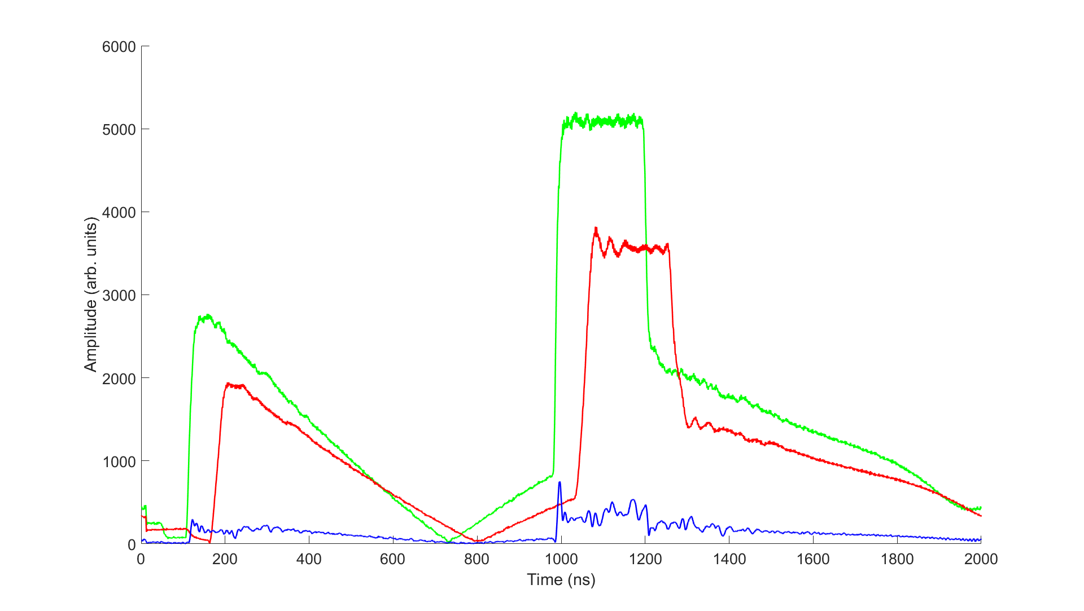
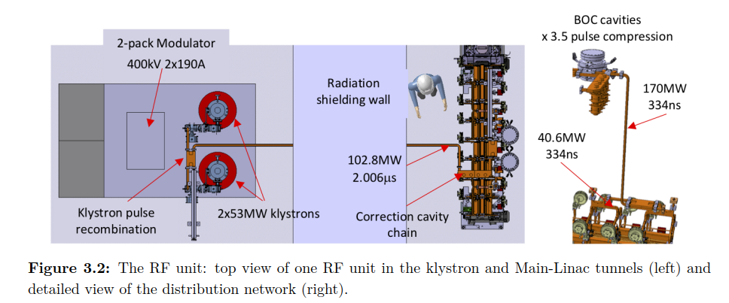
RF pulse compressors
RF pulse compressors are high Q cavities that can store and quickly discharge RF energy, giving a power gain. High Q₀ is crucial for this application, usually around 200,000.

Slide 12
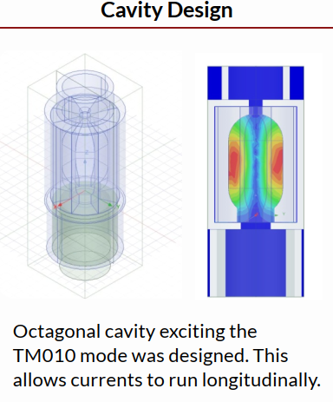
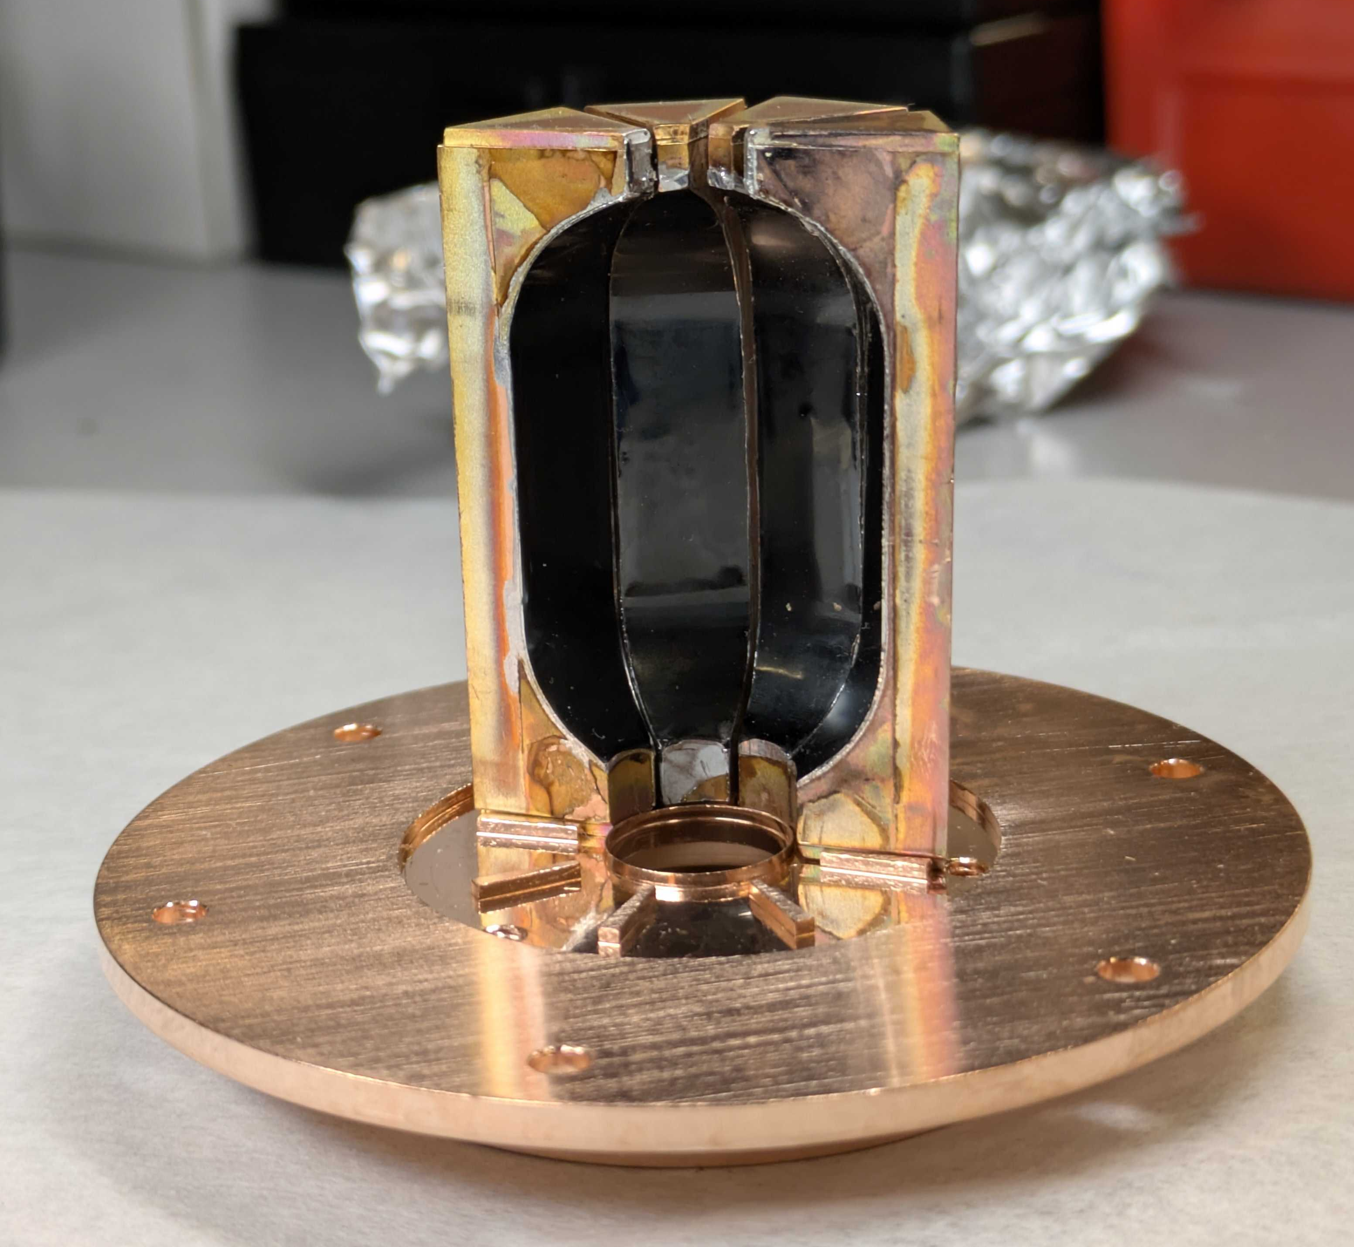
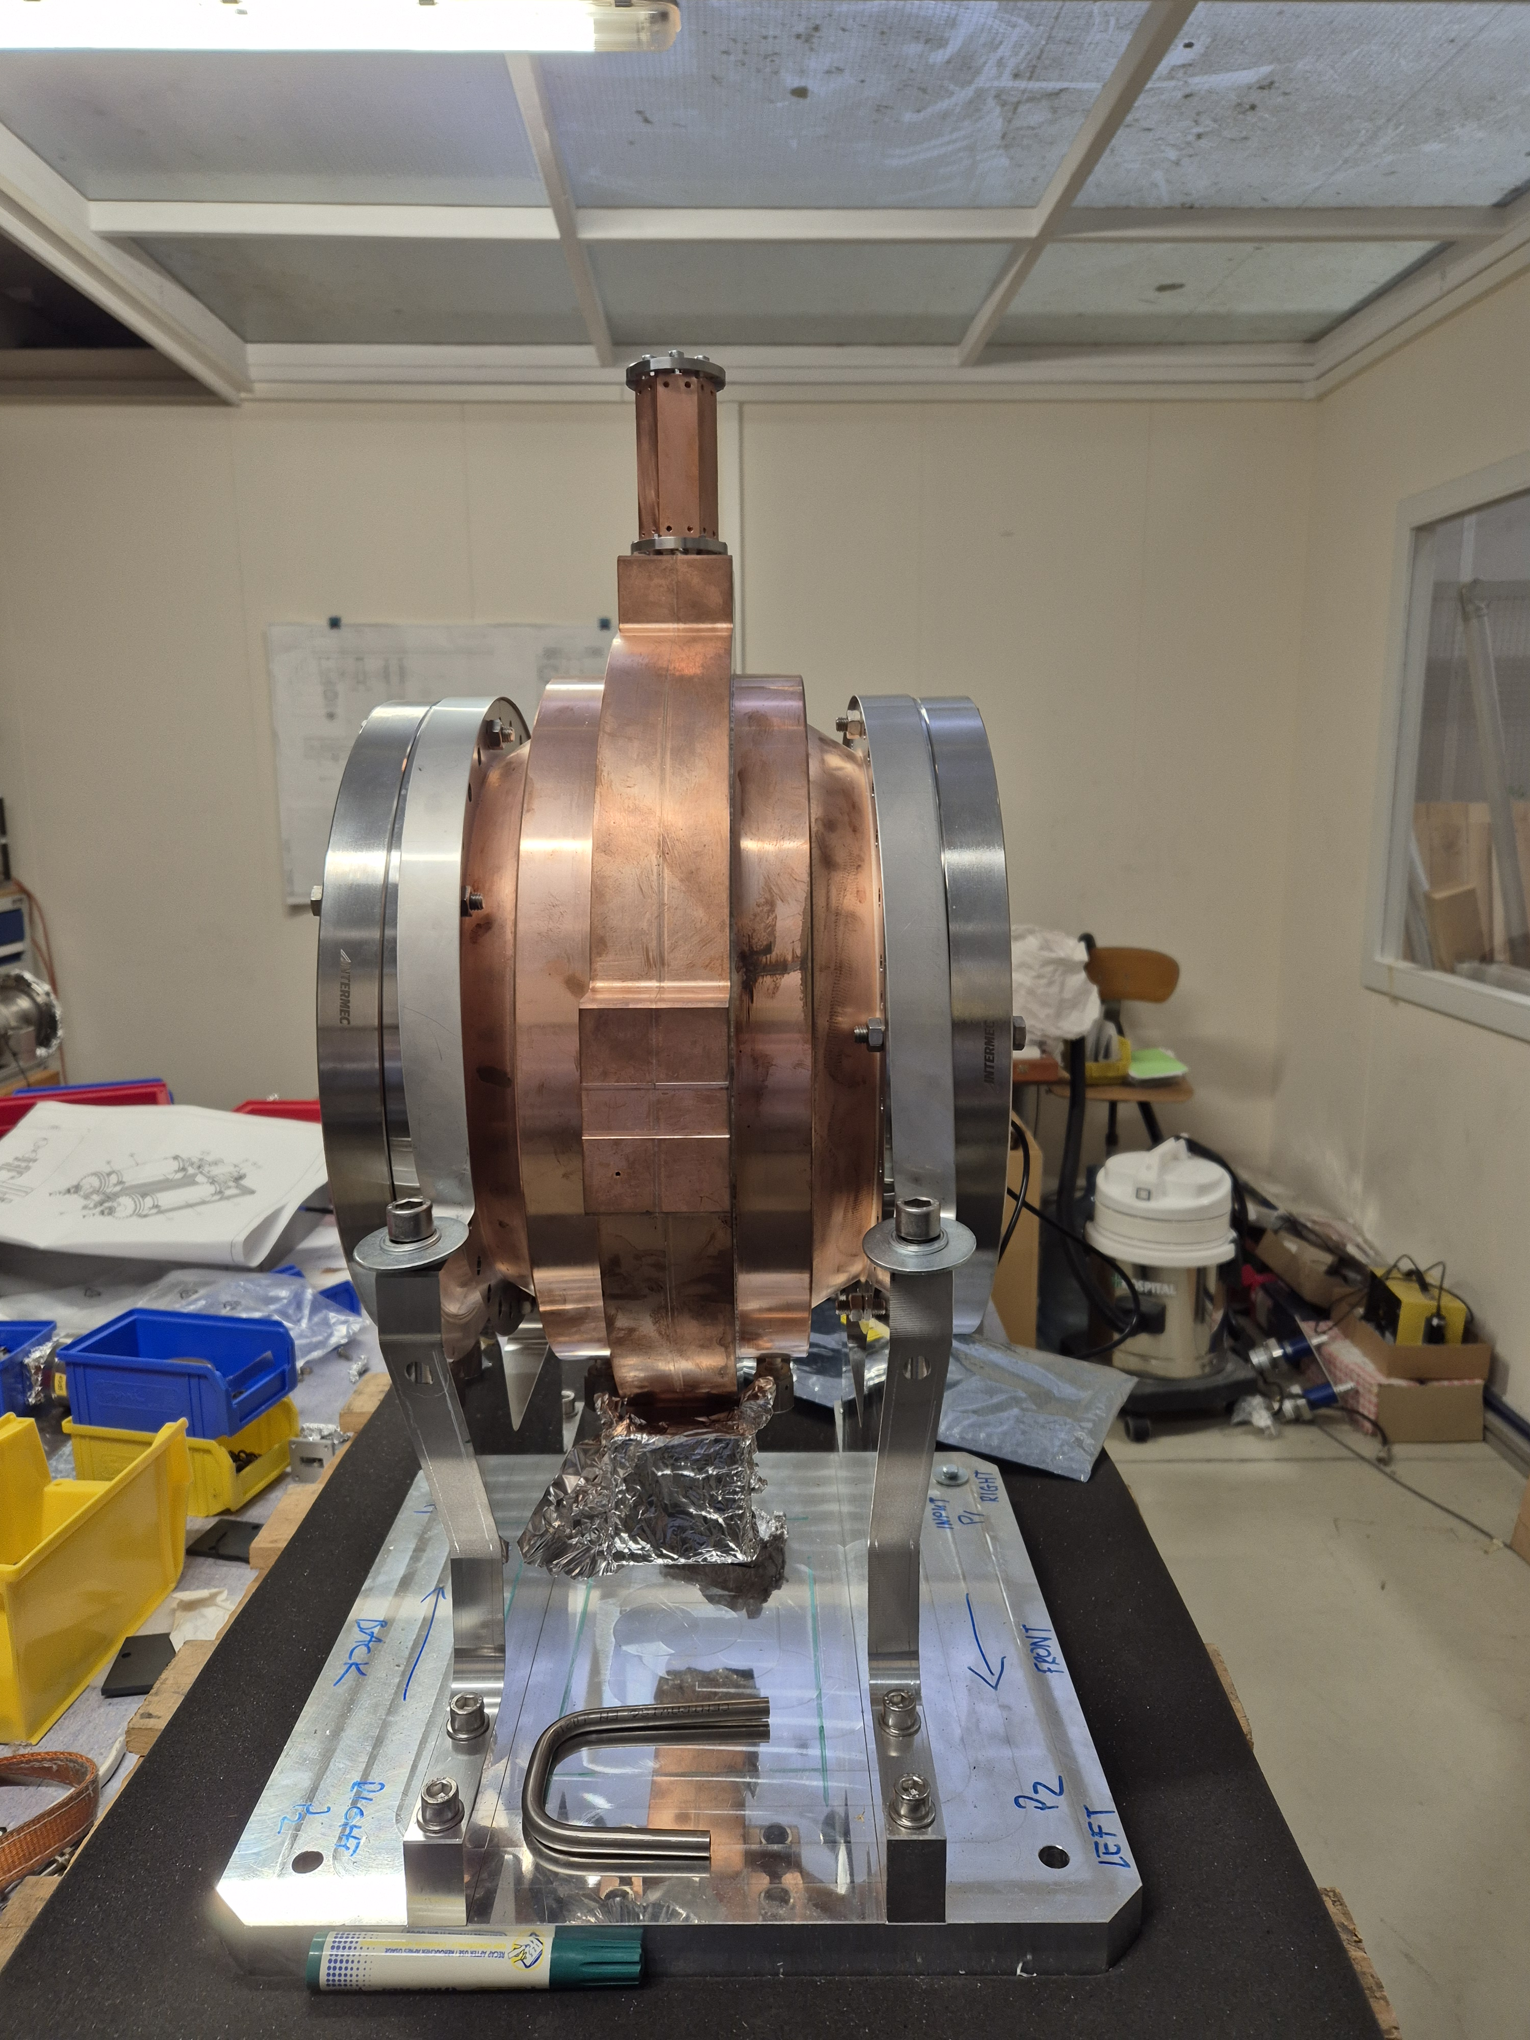
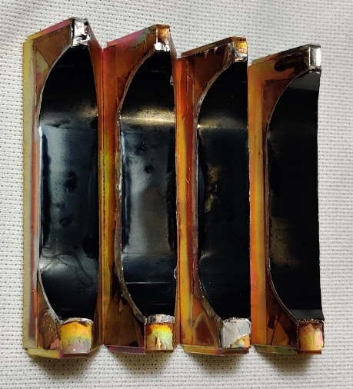
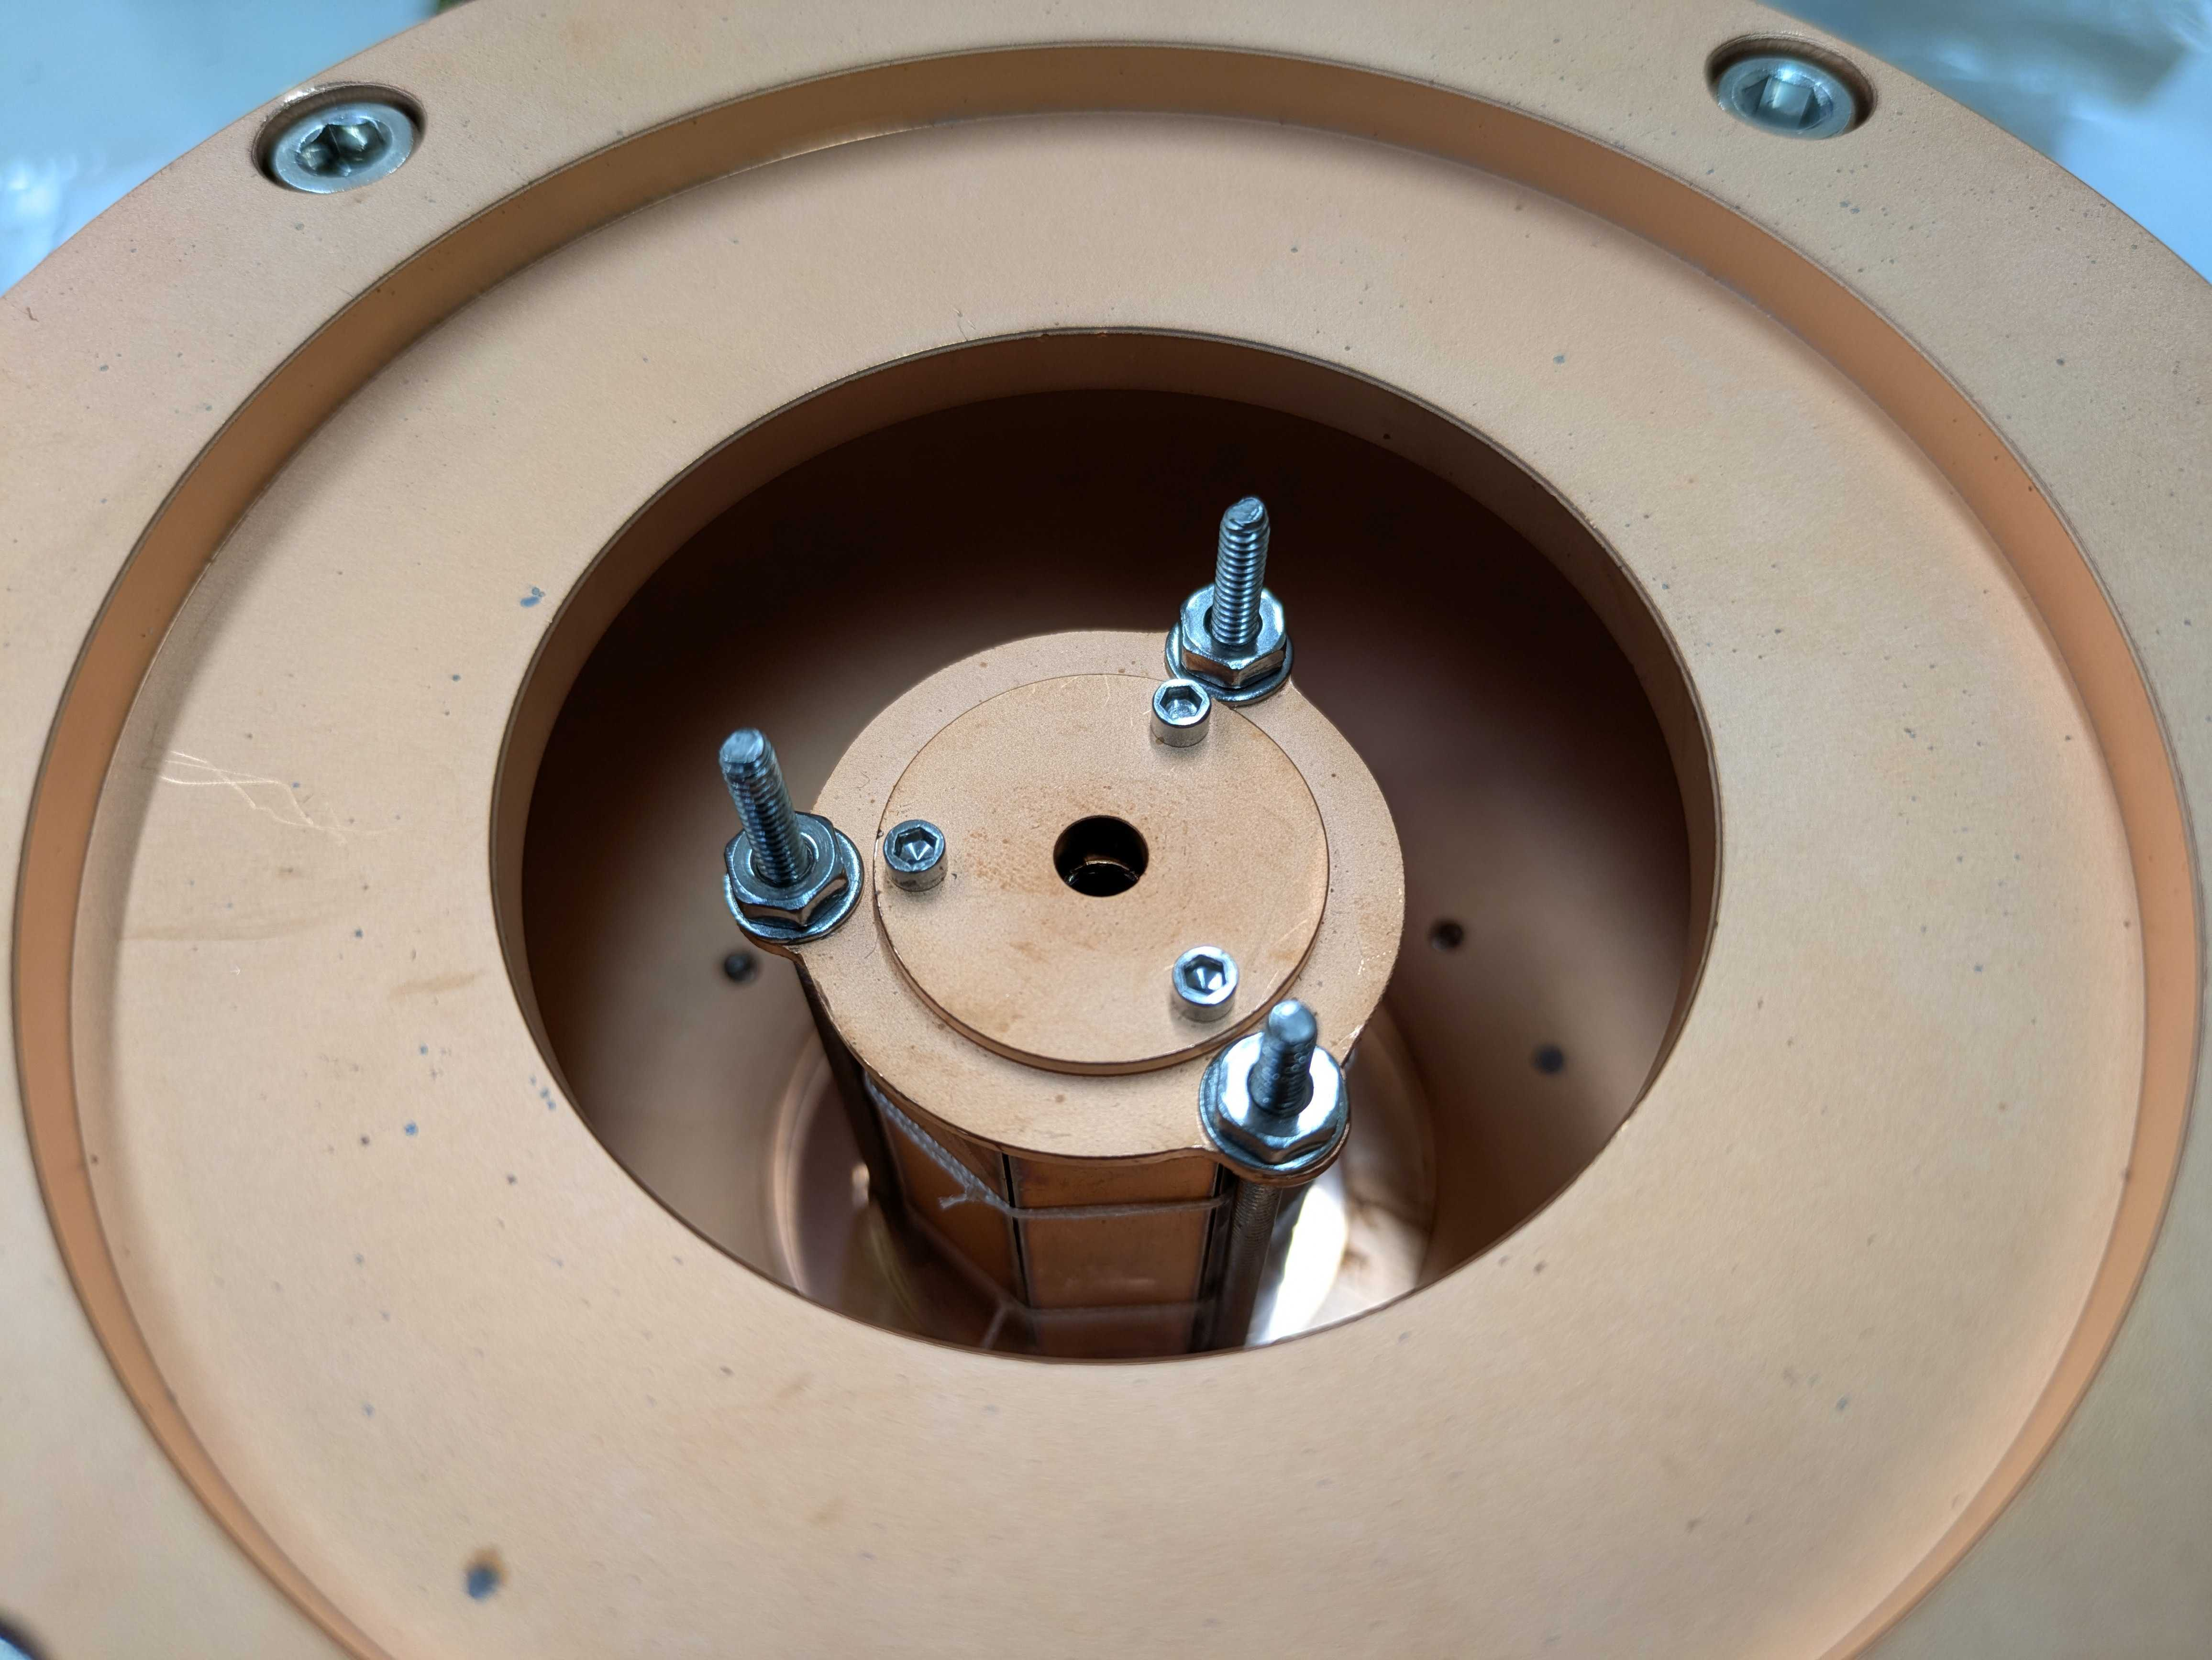
Accelerator Outlook: Pulse Compressor
G.Le Sage
Pulse compressor tests (11.4 GHz) with HTS tape at SLAC coming soon
Photo by Ankur Dhar

Slide 13
Axion haloscope cavities and high quality factor from HTS
Low temperature first

Slide 14
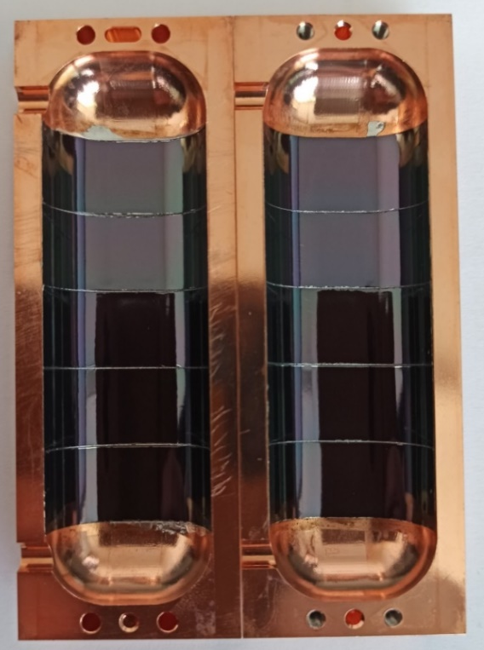

Motivation and Cavity preparation
Motivation:
Axion haloscope
4) Substrate extraction
3) Soldering
Solder
Ag
REBCO
Buffer layers
Cu
Substrate
Cu
Cu
Ag
Ag
Substrate
$$ℱ \sim { g}_{Aγ}^{4}{ Q T}_{sys}^{−2}{V^{2}G}^{4}m_{A}^{2} B^{4}$$
Substrate
Ag
Cu
Tape attached at ICMAB by G. Telles, N. Lamas, X. Granados, T. Puig, J. Gutierrez
Buffer layers
Buffer layers
REBCO
REBCO
Ag
Increase Q
copper coating → superconducting coating
Requirement: High quality factor in a high external DC magnetic field
Ag
Cu
Cu
Solder
Solder
Cu
Cu
Surface to coat
Surface to coat

Slide 15
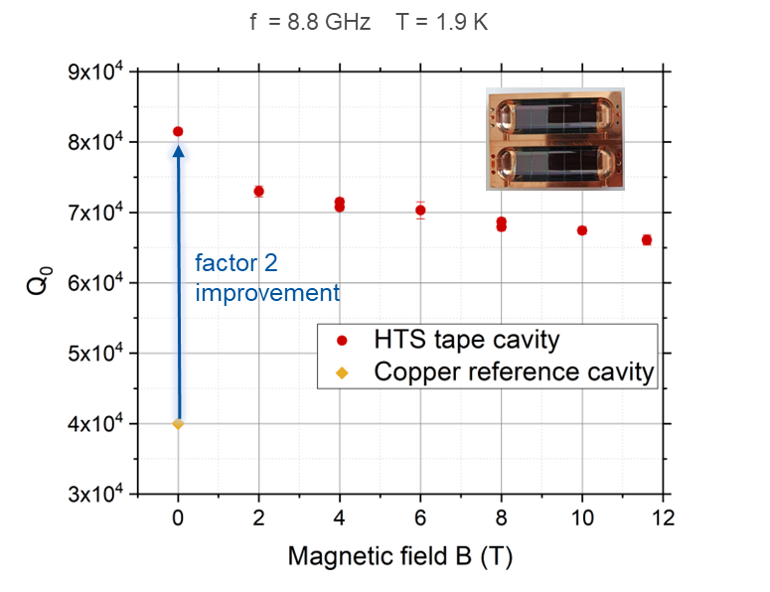
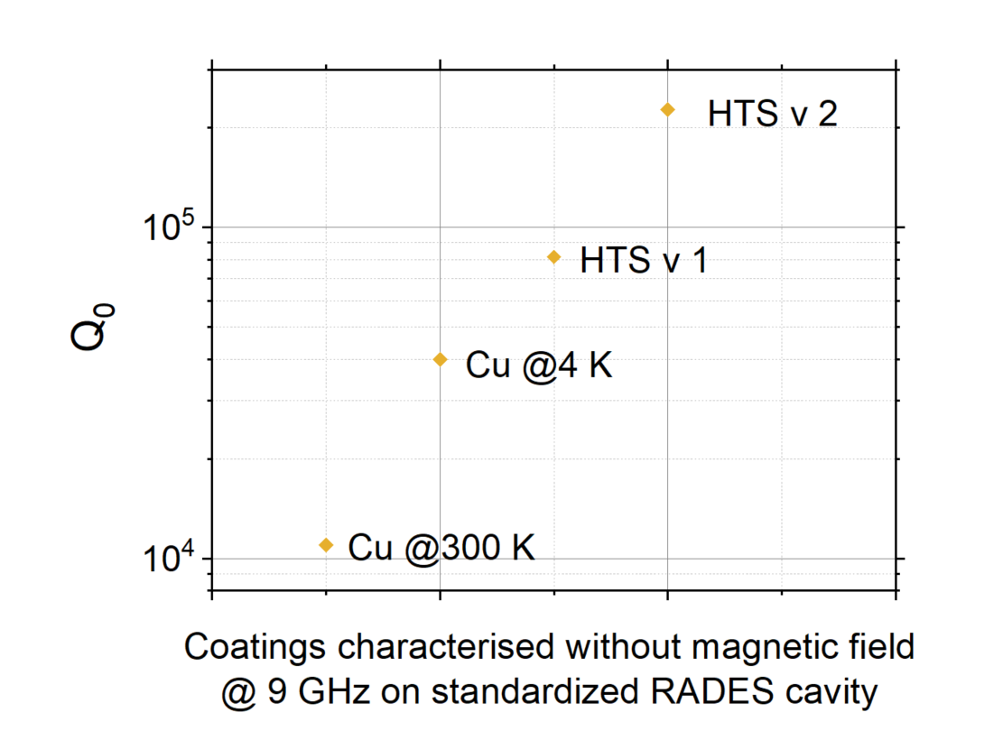
Achievements
Factor of 20 improvement from room temperature Cu to 4 K HTS
Factor of 6 improvement from 4 K Cu to 4 K HTS

Slide 16
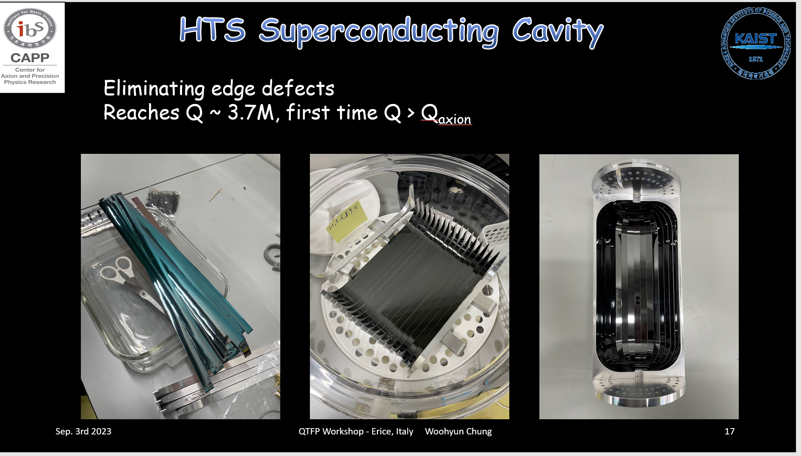
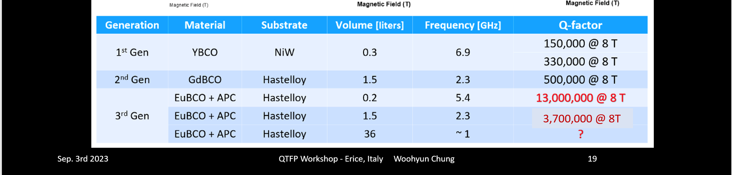
Achievements from other Experiments
CAPP Experiment: Q0 of 1.3 E7 achieved @ 5.4 GHz and at 8 T
Differences to RADES:
Geometric factor
Almost no bending of tape
Low frequency and f² scaling of Q

Slide 17
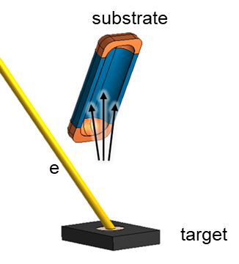
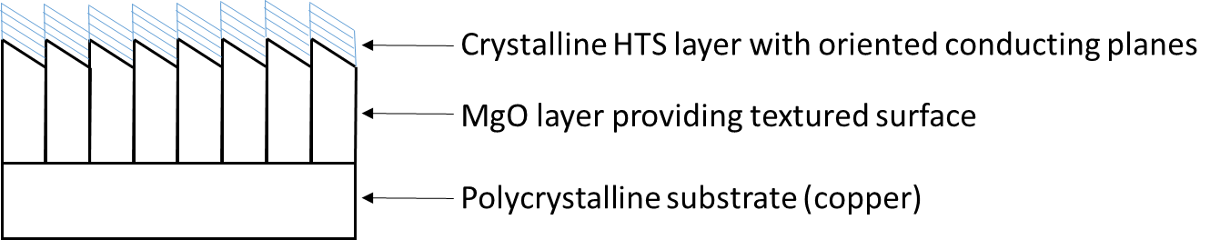
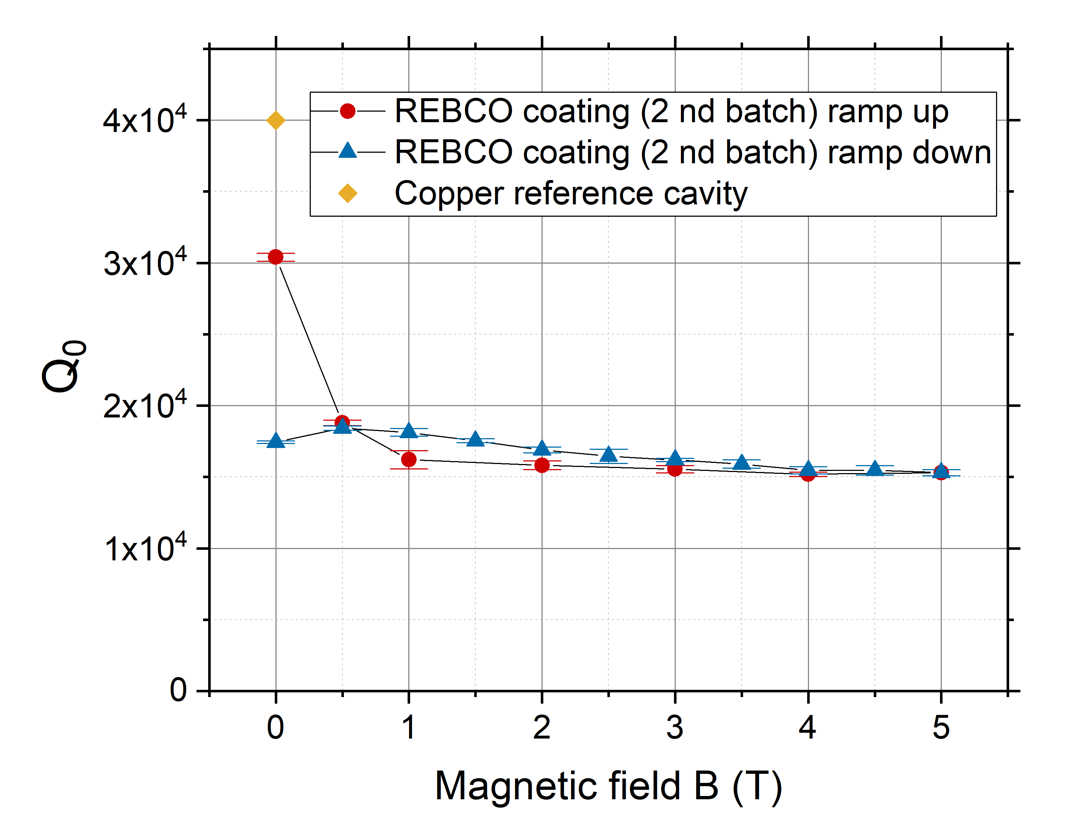
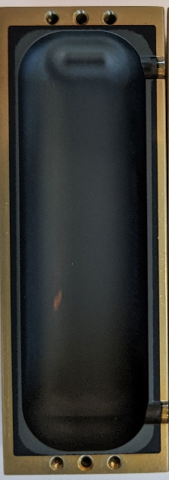
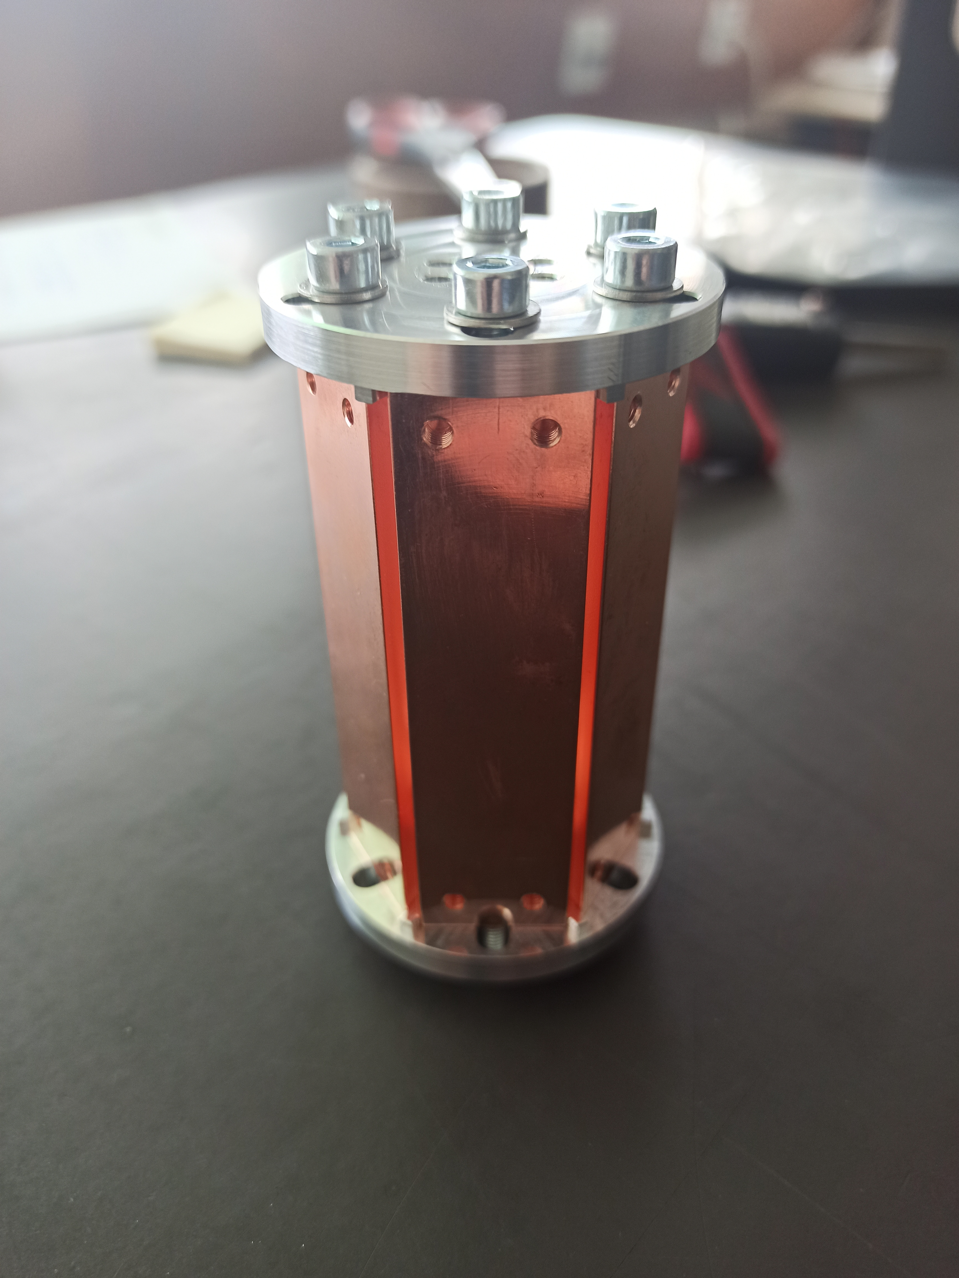
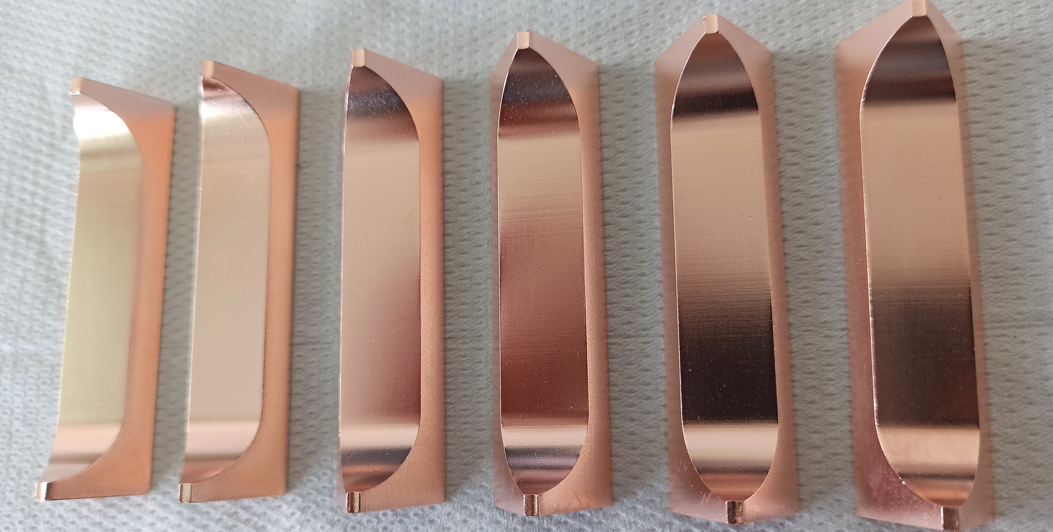
Outlook: HTS direct coating for axion detectors
Layer architecture
ISD deposition
    - buffer layer is required , which provides a biaxially textured surface
    - Deposition of MgO layer on an inclined substrate
Cavity made of flat pieces would have been more advantageous for this coating
Coated by THEVA and Ceraco by
EB- PVD
Notes:
EB- PVD
For growth on polycristalline substrates a buffer layer is required which provides a biaxially textured surface
A hysteresis can be seen between ramp-up and ramp-down. Surprising was the fact that the quality factor during ramp-down was always larger than during ramp-down at the same field and reaches a maximum at 0.5 T. The effect comes probably due to the shielding currents that flow within the superconductor to and concentrate the magnetic field lines. When ramping down the magnetic field from 5 T some of the currents flowing may continue flowing and reduce the magnetic field in the superconductor

Slide 18
Now moving from low-power and low-temperature to high-temperature and high-power

Slide 19
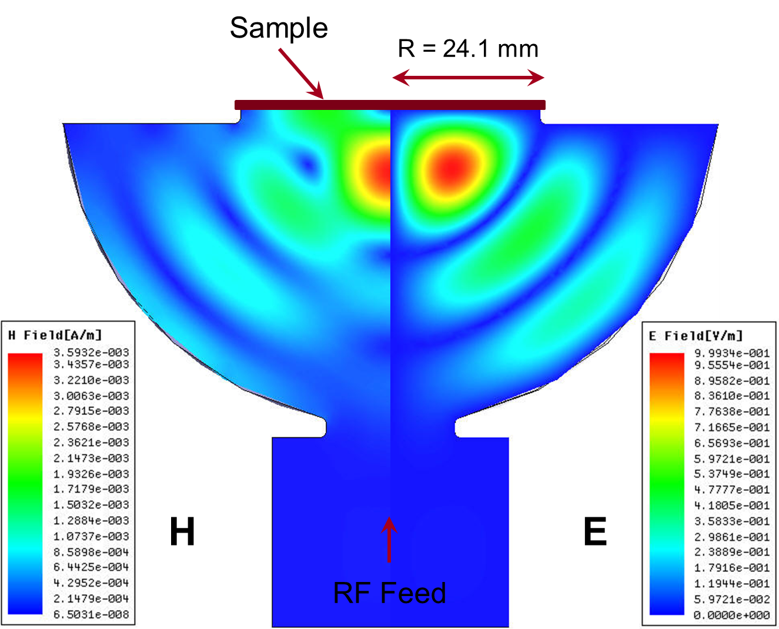
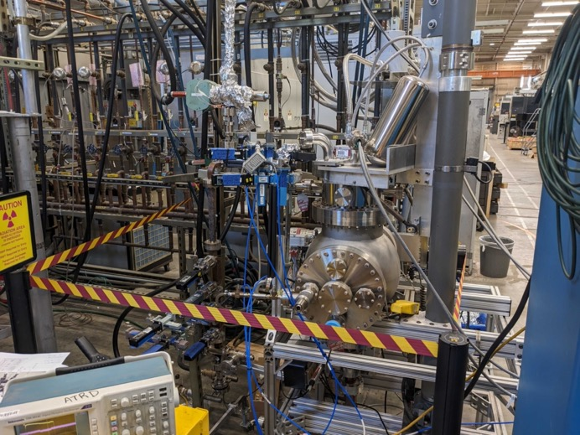
HTS high power characterisation test stand
Test stand
at SLAC:
High-Q X-band hemispheric cavity with a TE₀₃₂-like mode at 11.4 GHz.
Zero E-field and maximum H-field on the sample
Sample accounts for ⅓ of total cavity loss
Can achieve H_{peak} of about 360 mT using 50 MW XL-4 Klystron.

Slide 20
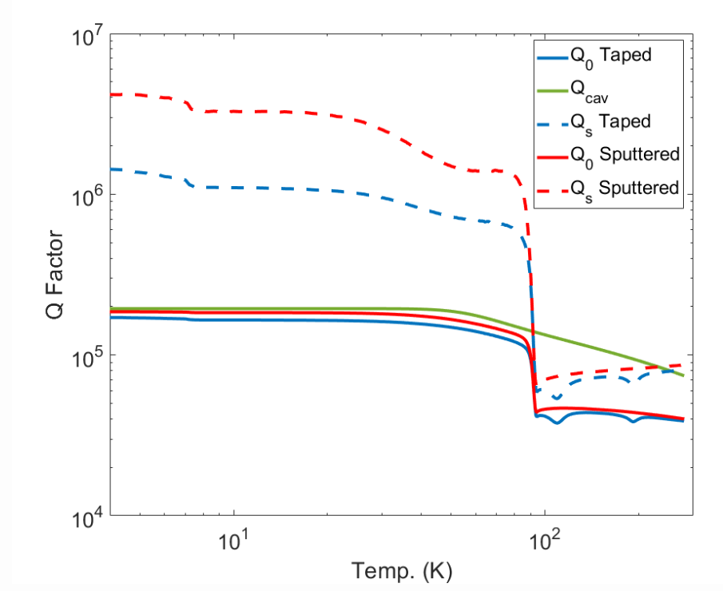


HTS low power characterisation of flat samples
Experiment at SLAC,
plots by:
E. Nanni
M. Schneider
A. Dhar
Coating on Cu+MgO
Improvement compared to | (a) HTS tape | (b) HTS coating
Cu disc @ 4 K | 10 | 16
Cu disc @ 80 K | 4 | 5

Slide 21




Summary and Conclusion
High power RF use of HTS looks extremely promising
So far no hints of performance limit in RF current up to the maximum power available in the test
The next step is to go from TWT to a Klystron to see where the limits are
cavities have different geometries
Fig 1: Summary of low-power HTS characterisation results

Slide 22
We have all the key scientific and technological elements to build a 3 GHz HTS pulse compressor!

