Slide 1
Impact of accelerator issues on absolute luminosity calibrations at the LHC
W. Kozanecki (University of Oregon)
for the LHC Luminosity-Calibration and -Monitoring Working Group (LLCMWG)
Introduction
Beam conditions: vdM scans vs. physics
Overview of accelerator-related vdM-calibration uncertainties
Selected accelerator-physics issues
Summary & outlook
Selected bibliography
Speaker's bias: a large fraction of the examples shown in this presentation are taken from ATLAS,
if only because I know these best. In many cases, equivalent observations or analyses
can be found in ALICE [3, 13], CMS [2, 9, 10] or LHCb [4] reports or papers.

Slide 2
Introduction
Physics motivation
  State of the art for the Run-2 combined uncertainty on ∫L dt (pp, √s = 13 TeV): ATLAS: 0.83 % [1] CMS: 1.6 % prelim. [2] ALICE: 1.6 % [3] LHCb: 2 % prelim. [4]
  Even so, uncertainties on SM reference cross-sections are already dominated (pp → W/Z + X), or significantly affected (pp → ttbar +X), by the uncertainty on the integrated L
  The HL-LHC physics program calls for σ_{L} /L ≤ 1% ( → Higgs self-coupling)
Breakdown of L uncertainties: the ATLAS Run-2 example
vdM calibration | Calibration transfer (non-linearity correct'n from vdM to physics) | Cross-calibration of relative-L monitors (“anchoring”) | Long-term stability & consistency of L monitors | Total uncertainty on Run-2 ∫L dt
0.65 % ** | 0.50 % ** | 0.13 % ** | 0.08 % ** | 0.83 % **
0.65 % = 0.58 % (+) 0.29 %
Tot. vdM uncert’y = [acc. physics + beam instrumentation] [luminometer & operational issues]
This presentation
** 2015-2018 combined, taking uncertainty correlations into account.

Slide 3
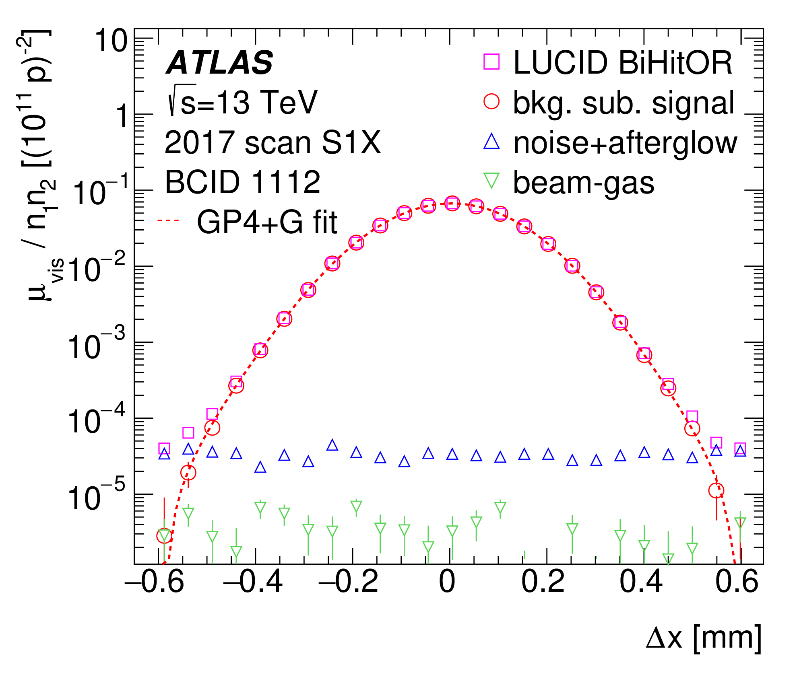
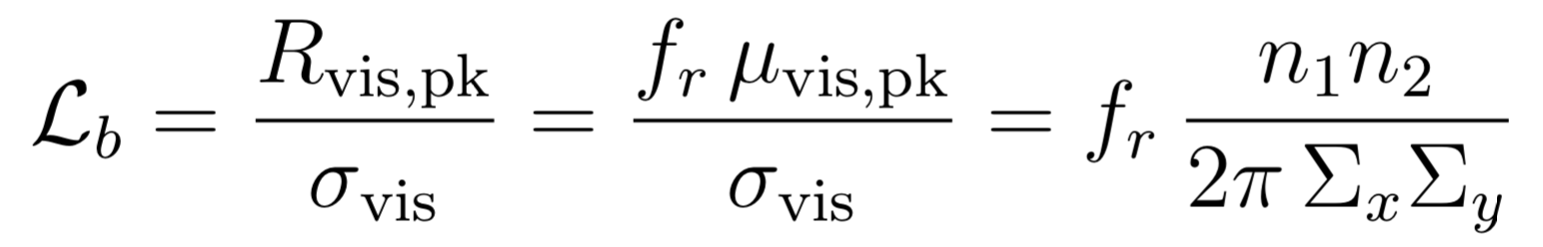
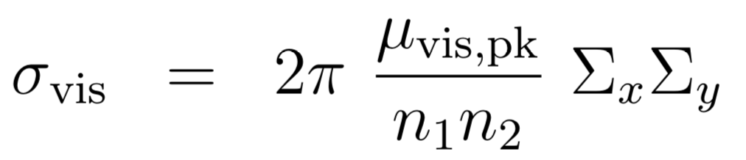
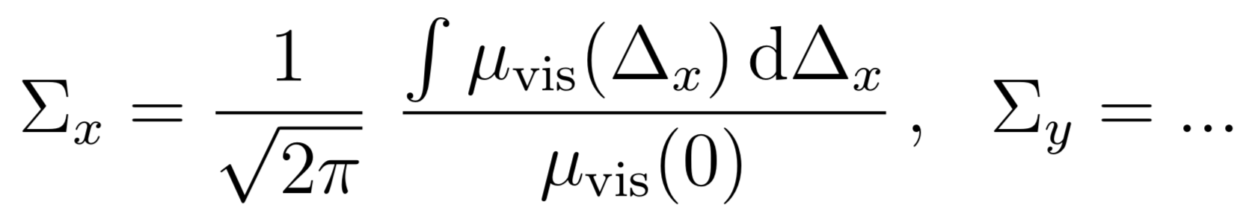
Principle of vdM-calibration method
Principle : extract calibration constant σ_{vis} from the comparison of
the collision rate R_{vis, pk} reported by luminometer, with
the bunch luminosity L_{b} calculated from measured beam parameters: bunch-population product n₁ n₂ , effective area Σ_{x} Σ_{y}
This procedure assumes that factorization holds,
i.e. that μ_{vis} (Δx, Δy) = g_{x} (Δx) * g_{y} (Δy):
not always true…

Slide 4
Beam conditions: vdM scans vs. physics
P. Grafström & W. Kozanecki, PPNP 81 (2015), 97-148
Also
at HL-LHC
Parameter | vdM setting | Motivation [5]: accelerator issues | Motivation [5]: L-meter / operat'nl issues | Physics setting
Bunch pattern | isolated | ⟷ parasitic Xings (b-b!) → allows θ_{c} = 0 | ⟷ out-of-time elx pileup | trains
# bunches | ≤ 152 | → allows θ_{c} = 0 | → statistics (some expts) | 2450
Crossing angle θ_{c} | 0 | ⟷ Orbit drift (geom. factor) ⟷ Beam-beam (b-b) biases | - | 270 - 340
Pile-up parameter μ | ≤ 0.5 - 1 | - | ⟷ L-meter non-linearities | 65 - 30
Beam-beam par. ξ [10⁻³] | ≤ 3 - 5 | Minimize b-b effects | - | 8 - 3
Bunch populations n₁, n₂ [10¹¹ p/bunch] | 0.7 - 0.9 | → Minimize ghost charge & satellites from injectors → μ, ξ as low as possible | Combination of bunch population, β* and ε_{N} is a balance between: minimizing μ maximizing σ_{L} ensuring adequate L-meter statistics | 1.5 – 0.9
β* [m] | 19 - 24 | → μ, ξ as low as possible → σ_{L} as large as possible |  | 1.2 - 0.3
Emittance ε_{N} [μm.rad] | 2.5 - 3.5 | → μ, ξ as low as possible → σ_{L} as large as possible |  | 2 - 2.5
Transverse luminous size σ_{L} [μm] | ~ 60 | Estimate non-factorization correction | As large as possible wrt vertex-position resolution | ~ 8
Beam tailoring in injectr | Empirical | Minimize non-factorization | - | N/A
Head-on L [10³⁴ cm⁻² s⁻¹] | ~ 0.001 |  |  | 2 - 1

Slide 5
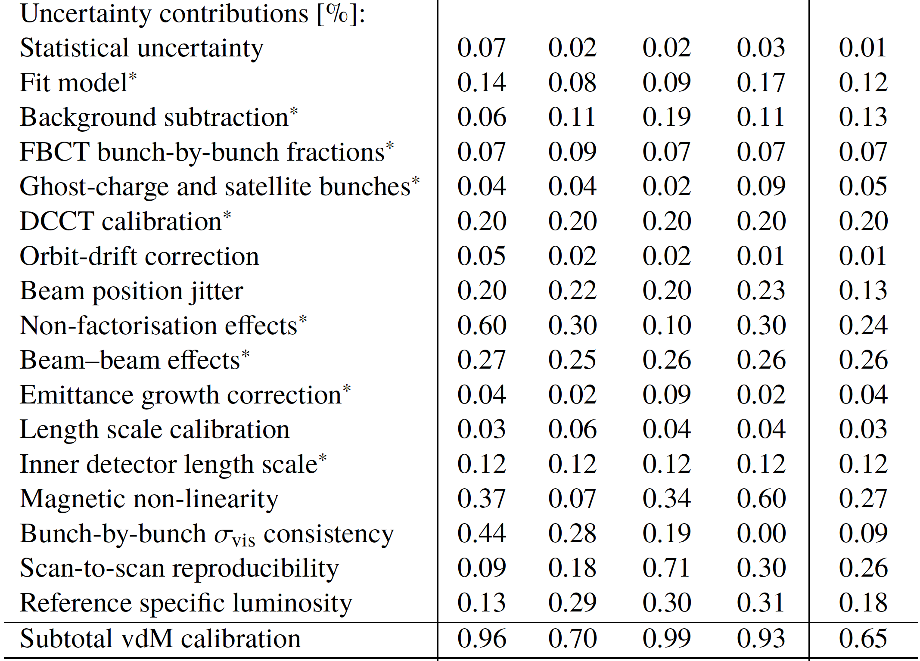
Summary of ATLAS Run-2 vdM uncertainties (pp @ √s = 13 TeV)
ATLAS Collaboration,
Eur. Phys. J. C (2023) 83:982
Summary of the vdM-calibration uncertainties for each individual year of the Run-2 pp data sample at sqrt(s) = 13 TeV, and for the full combined sample. Contributions marked * are considered fully correlated between years; the other uncertainties are considered uncorrelated. Excerpted from Ref. [1].

Slide 6
Summary of ATLAS Run-2 vdM uncertainties (pp @ √s = 13 TeV)
Beam
instrum’ntn
Accel. physics
ATLAS Collaboration,
Eur. Phys. J. C (2023) 83:982
Summary of the vdM-calibration uncertainties for each individual year of the Run-2 pp data sample at sqrt(s) = 13 TeV, and for the full combined sample. Contributions marked * are considered fully correlated between years; the other uncertainties are considered uncorrelated. Excerpted from Ref. [1].

Slide 7
Bunch-population measurements and their uncertainties
3 LHC instruments
  DCCT: absolute scale of total beam intensity → σ^{syst}_{n1 n2} ~ 0.2 % (conservative)
    Periodic checks (in tunnel?) of absolute-calibration stability during TS/YETS important
  FBCT (+ BPTX): bunch-by-bunch fractions → σ^{syst}_{n1 n2} ~ 0.07 %
    stay alert for surprises (even/odd BCIDs, 1st bunch in train, FBCT-LDM correlations,…)
  LDM, aka BSRL → σ^{syst}_{n1 n2} ~ 0.02-0.09 % in pp, but can be several % in P_{b} P_{b}
    Ghost charge: intrinsic baseline issues, systematic uncertainty hard to estimate
      Typically not a problem in pp vdM
        except in case of anomalous debunching (e.g. pp @ √s = 900 GeV in Oct 2018: 35% correction!?)
      Can be a significant issue in HI vdM, where ghost-charge fractions reached > 4 % /beam
    Satellite bunches: the LDM is the only instrument that can measure them!
      typically not an issue in pp vdM, but BCID-dep’ndt satellite fractions can be a big issue in HI vdM
    Operational issues during scans often required expert presence → plan accordingly!
Beam-gas vtx counting in LHCb → bbb ghost-charge fractions
    The most accurate estimate of ghost charge – but requires dedicated, significant effort by our LHCb colleagues both at scanning (data-taking) time and at analysis time: essential!
Alex’s talk (Session 3A)
Martino’s talk
(Session 3A)
Niall’s talk (Session 3A)

Slide 8
Impact of orbit drifts on absolute L calibration: in numbers
Rule of thumb [± 6 σ vdM scan, ε ~ 3 μm, β* ~ 19 m, √s = 13.6 TeV → Σ ~ 120 μm]
Bias on σ_{vis} (for one x-y scan pair), if left uncorrected:
  In-plane drift: 10 μm total → ~ 1 % on Σ (per plane, ±)
  Peak-to-peak drift: 10 μm → ~ 0.15 % on σ_{vis} (x or y, always -ve)
  Out-of-plane drift: 10 μm total → ~ 0.004 % on σ_{vis} (per plane, always +ve)
    x-y coupling seen by BPMs ~ 6-7 μm total → negligible for 1D scans, serious issue for 2D
Orbit-related systematic uncertainties on absolute L (2015-18, 13 TeV)
  Main issue: scan-to-scan consistency of bunch-averaged σ_{vis} values
  Orbit-drift correction (ODC) critical to reducing these inconsistencies:
    2.2 / 1.2 % (1.2 / 0.7 %) peak-to-peak S-to-S inconsistency in 2017/2018 w/o (with) ODC
  Uncertainties on orbit-drift correction
    vdM scans: < 0.1% on per-year, scan-averaged σ_{vis} value (← Σ_{x/y}, μ_{peak, x/y})
      note that ATLAS & CMS group errors differently (e.g. magnetic non-linearity, vdM/LSC orbit drifts)
      in view of GP's CMS presentation yesterday, an in-depth review of OD-related systs may be wise…
Beam-position jitter: from rapid position jumps within a scan step
    evaluated using sample-to sample IP-position jitter reported by the Arc BPMs
    RMS jitter (~ 0.2 Hz): 0.5 - 1 μm → Δσ_{vis} / σ_{vis} ~ 0.2 %

Slide 9
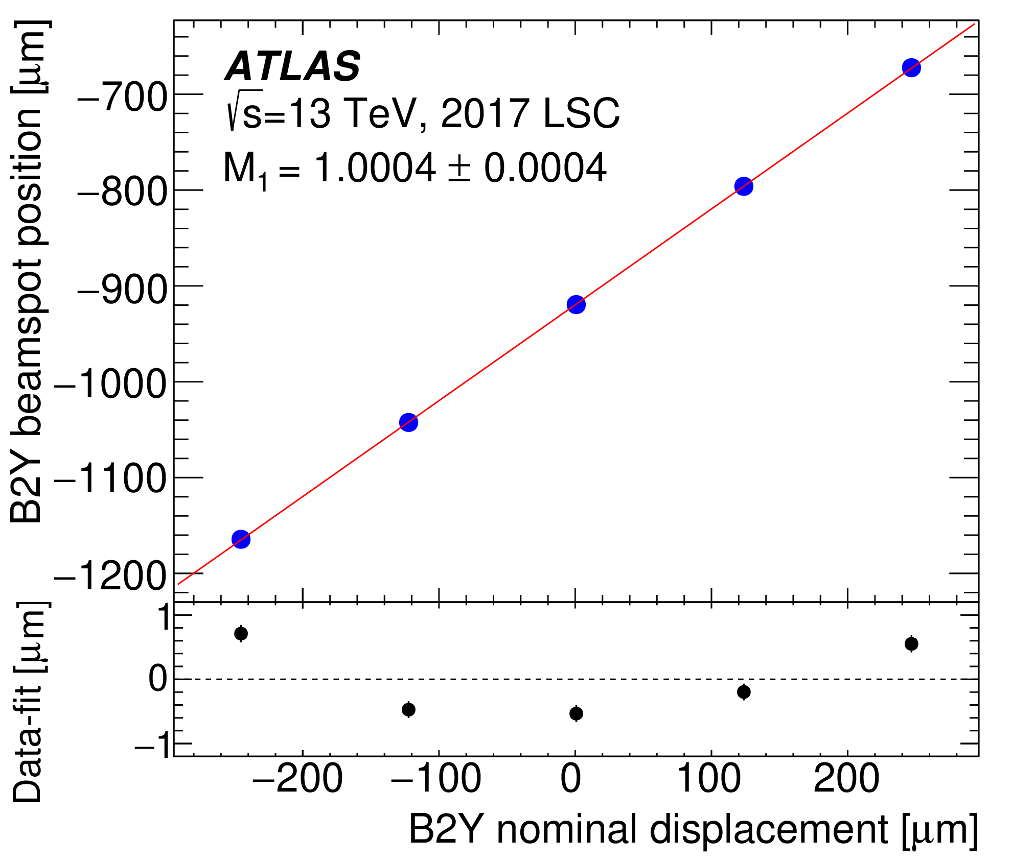
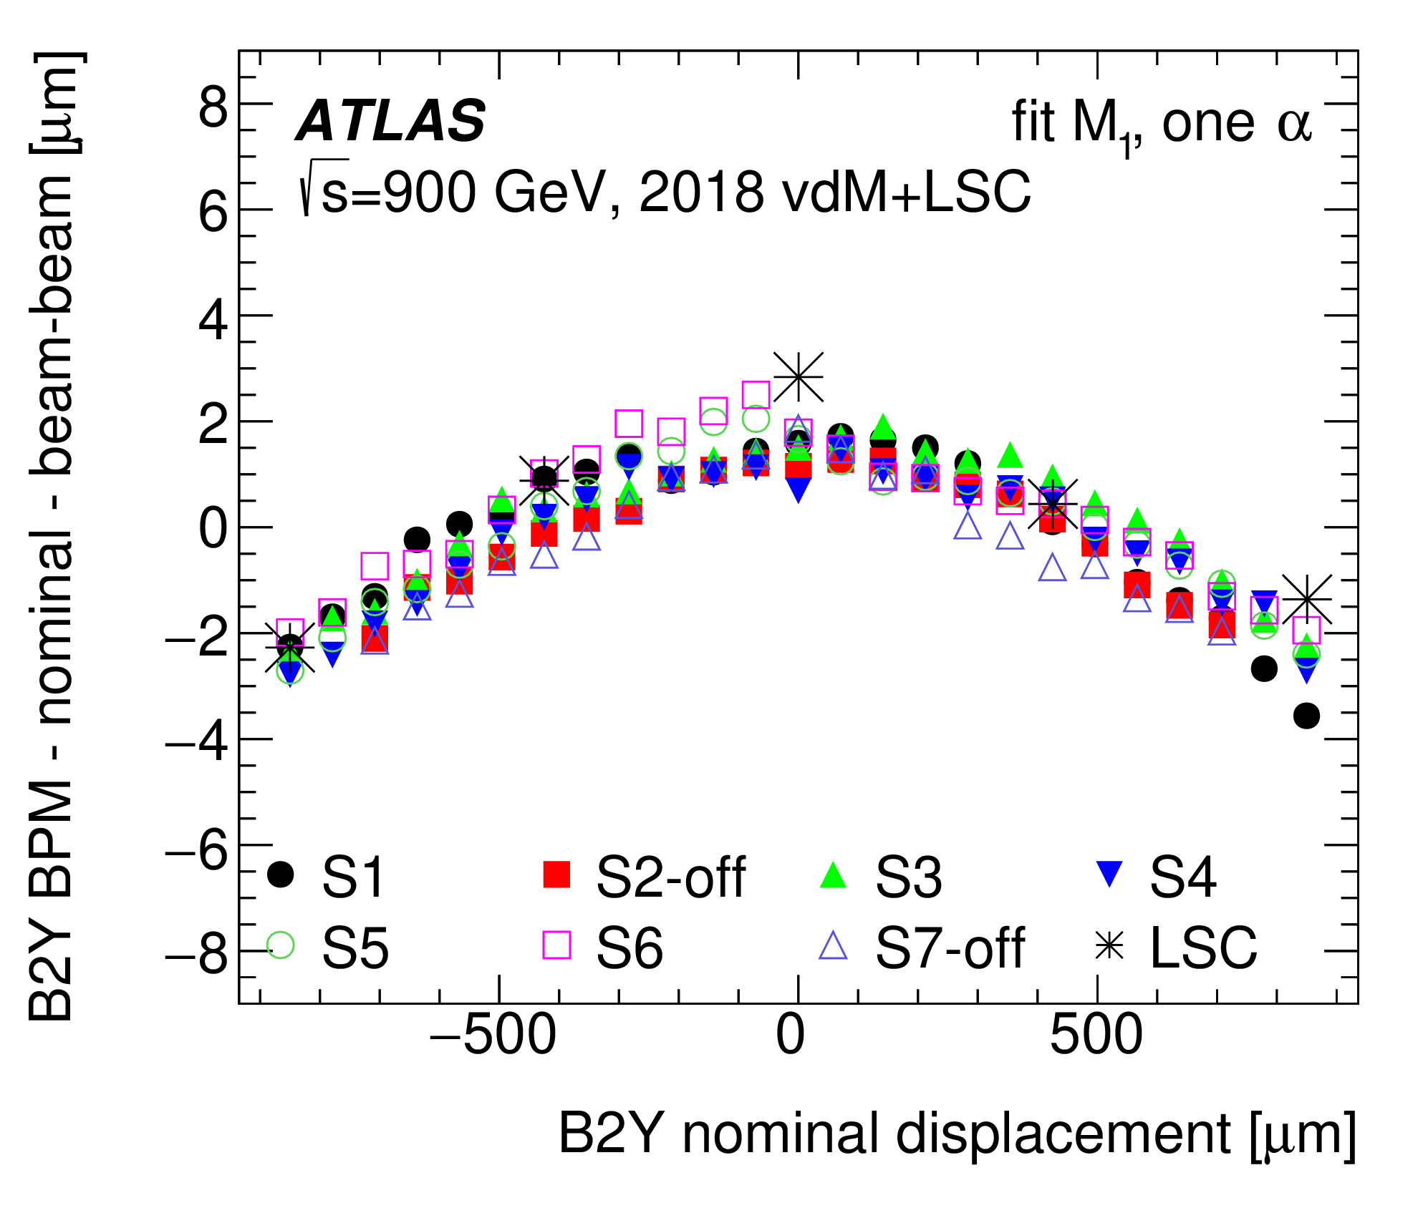
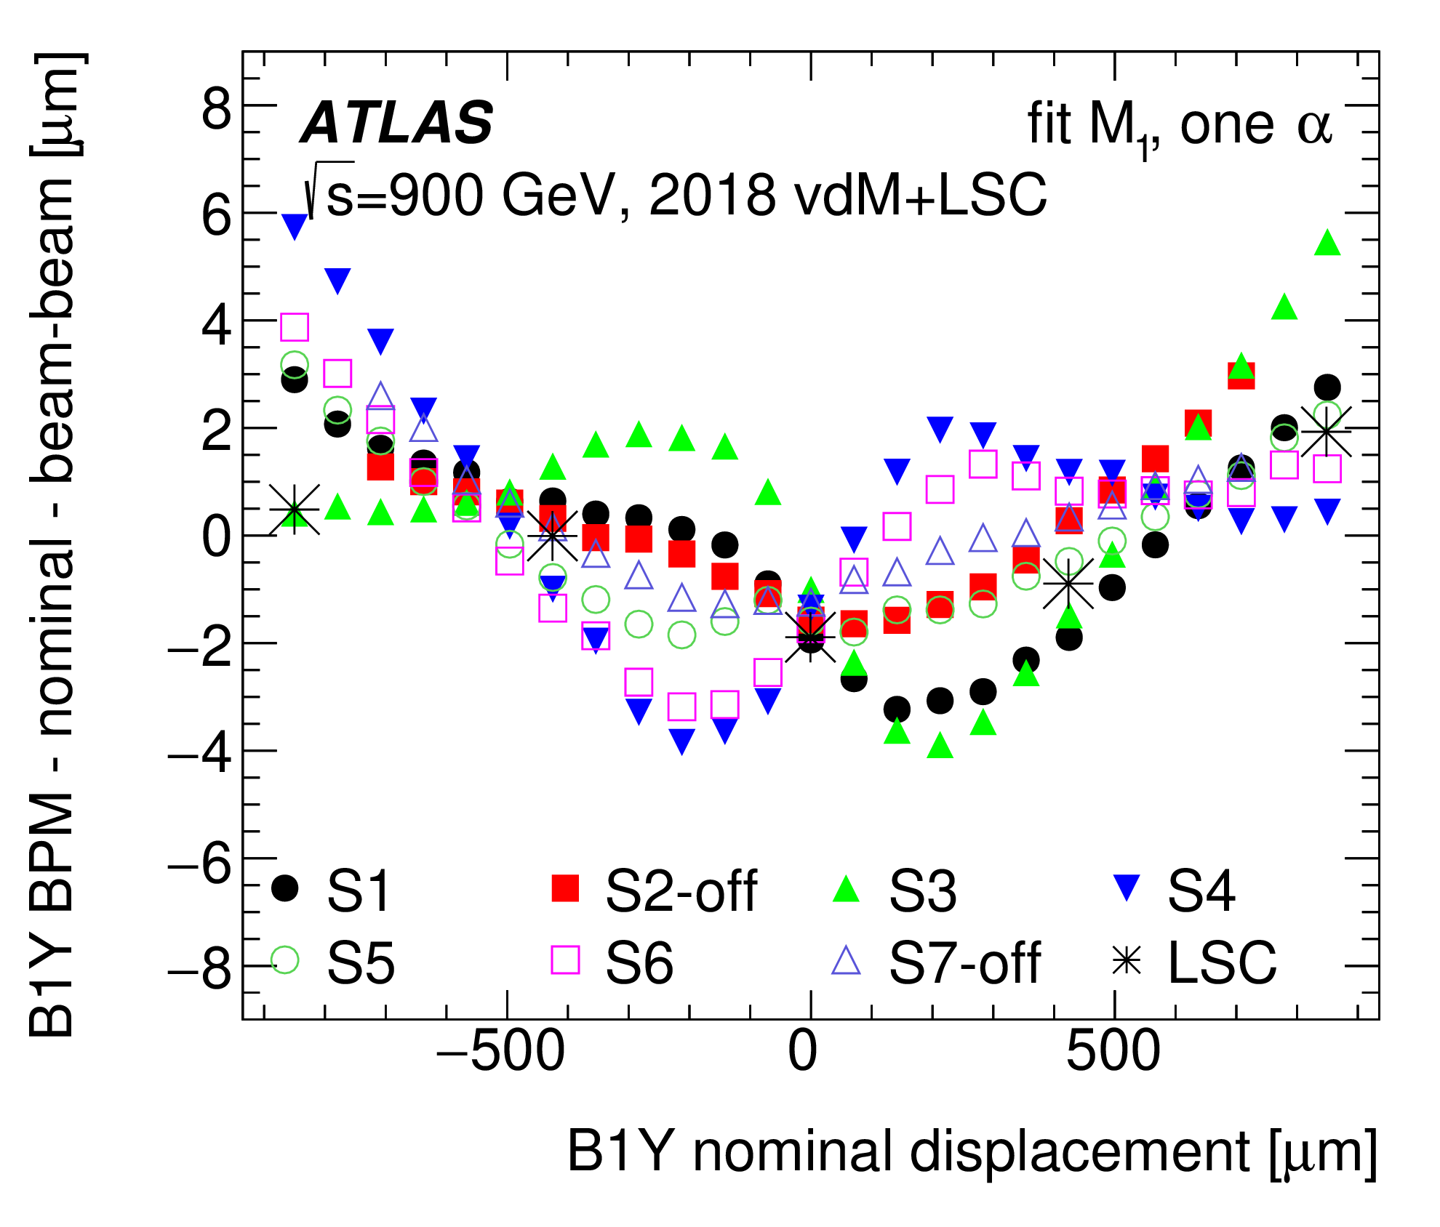
Magnetic non-linearity & hysteresis in vdM closed-orbit bumps
ATLAS collaboration, Eur. Phys. J. C (2023) 83:982
Length-scale calibration: // scan (beams colliding)
More in
Richard’s talk
(Session 3B)
Non-linearity is beam-, plane-, beam-energy & year-dependent
± 0.6 μm
Presumably irreproducibility of BPM response.
[Field of bump correctors reproducible to < 0.04%]
vdM calibration: separation scans (beams colliding)
vdM calibration: separation scans (beams colliding)

Slide 10
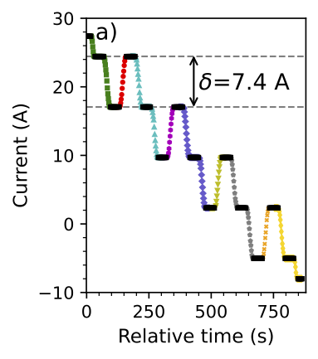
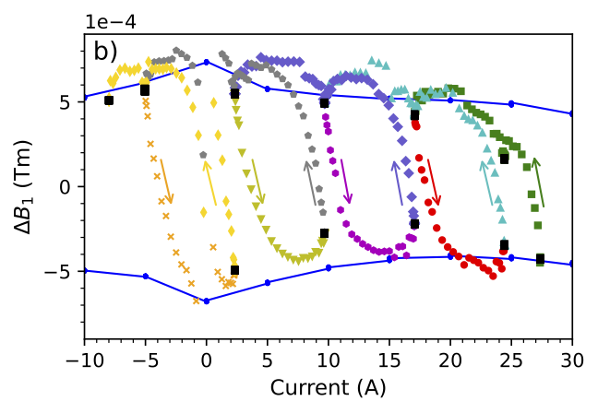
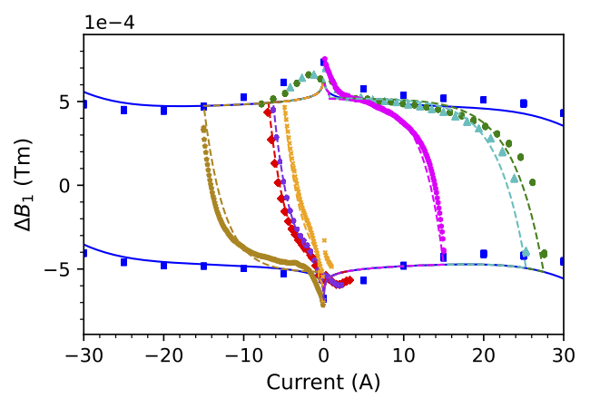
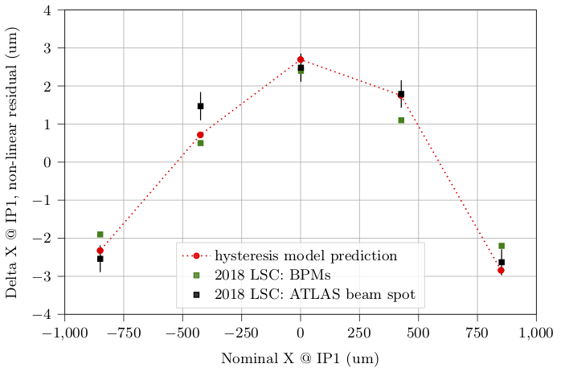
Magnetic-measurement campaign & proposed non-linearity model
A. Chmielinska, L. Fiscarelli, M. Hostettler, W. Kozanecki, S. Russenschuck & E. Todesco, Eur. Phys. J. Plus (2023) 138:796
Measurement results for length-scale calibration scan (witness beam only). Left: excitation profile of the weakest (i.e. the most sensitive) corrector, with the plateaus indicated by black markers and variations in the ramp direction indicated by different colors. Right: deviation ΔB₁ of the measured field from the fitted linear response, evaluated for the corresponding time intervals. The major magnetization loop for the reference (full-amplitude) cycle is the solid blue curve. In this regime, the non-linearities and the hysteresis are dominated by persistent currents in the superconducting filaments.
Deviation ΔB₁ from linearity (Tm)
Deviation ΔB₁ from linearity (Tm)
Deviation ΔX_{IP1} from linearity (μm)
Impressive agreement btwn model, beamspot & BPMs.
Predictive power for 13.6 TeV scans?
Nominal beam displacement X_{IP1} (μm)
Comparison of the measured magnetization-branch transitions and of the proposed extended FiDeL model for the MCBC magnet. The measurements are indicated by markers, the numerical-model results by solid and dashed curves.
Predicted & measured impact of magnetic non-linearities on the transverse displacement of beam 2 at IP1 of the LHC, with respect to the nominal dialed-in displacement during length-scale calibration scans at √s = 900 GeV. Only the nonlinear component of the residuals is shown; the linear component has been subtracted.

Slide 11
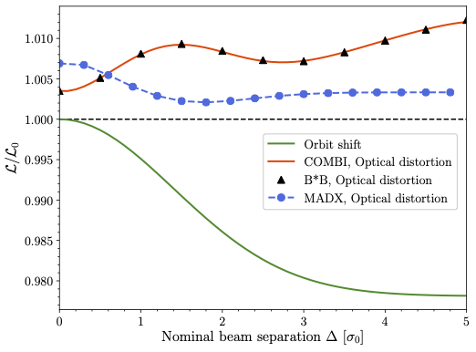
Impact of beam-beam effects on vdM L calibrations at the LHC
V. Balagura, Eur. Phys. J. C (2021) 81:26; A. Babaev et al., Eur. Phys. J. C (2024) 84:17
Bias type | Orbit shift | Optical distortions
Physical effect (L₀, Δ₀: no beam-beam) | Δ₀-dependent beam-beam deflection: |Δ| > |Δ₀| ⇒ L (Δ₀)/L₀ (Δ₀) < 1 | Δ₀-dependent focusing (~ dyn.-β effect): ⇒ L/L₀ > 1
Modelled using | Analytical (Bassetti-Erskine), validated by B*B/COMBI multiparticle simulations | B*B simulation (weak-strong) [6] COMBI simulation (strong-strong) [7]
Typical σ_{vis} bias [%] | -1.8 % (if left uncorrected) | +1.4 % (if left uncorrected)
Corr'ctn = f(ξ, q_{x}, q_{y}, Δ₀) | Δ^{x,y}₀ ◊ Δ^{x,y} = Δ^{x,y}₀ + δ^{x,y}_{bb}^{Bassetti-Erskine} | L_{meas} → L_{meas} * [L/L₀]⁻¹
ξ = 2.6 10⁻³
B*B & COMBI:
perfect agreement
1%
MAD-X underestimates optical distortions because does not model
amplitude detuning (in the way needed for this particular use case)
bb-induced non-linear shape distortions (→ non-Gaussian tails)
⇒ pre-2021: absolute L scale (pp) biased down by ~ 1%
0

Slide 12
Systematic uncertainties on beam-beam correction to vdM calibrations: dominant contributions
A. Babaev et al., Eur. Phys. J. C (2024) 84:17
Both the magnitude of the beam-beam correction, and its uncertainty,
scale almost linearly with the beam-beam parameter ξ;
they also depend sensitively on the number N_{NSIP} of non-scanning IPs
(i.e. of additional head-on collisions besides those at the scanning IP)
Beam-beam (b-b) uncertainty source | b-b parameter ξ | σ_{vis} systematic uncertainty [%] for number of non-scanning IPs (N_{NSIP}) =
 |  | 0 | 1 | 2
Nominal frac. tunes q_{x}, q_{y} (fully separated beams) | 5.6 10⁻³ ( = max. value in Run-2 vdM scans) | 0.26 | 0.23 | 0.20
Multi-IP effects (from addt'l b-b tune shift) |  | 0 | < 0.20 | < 0.20
Initially non-Gaussian p-density distributions |  | 0.13 | 0.22 | 0.30
Other sources: see [7] |  | 0.13 | 0.16 | 0.20
Tot. b-b uncertainty [%] |  | 0.32 | 0.41 | 0.46
Total b-b correction [%] |  | +0.52 | +0.86 | +1.17
WK’s, Joanna’s & Ivan’s talks (Session 2C)
Tom’s & Tatiana talks (Session 3A)

Slide 13
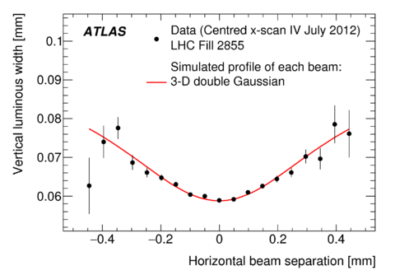
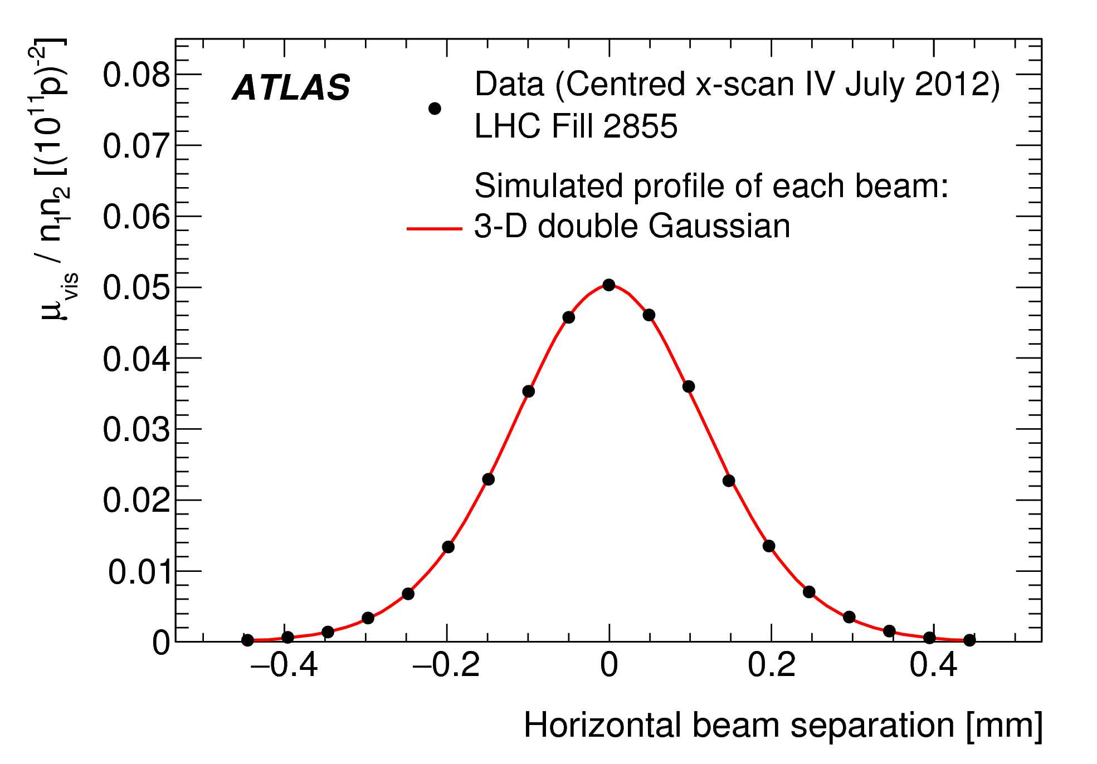
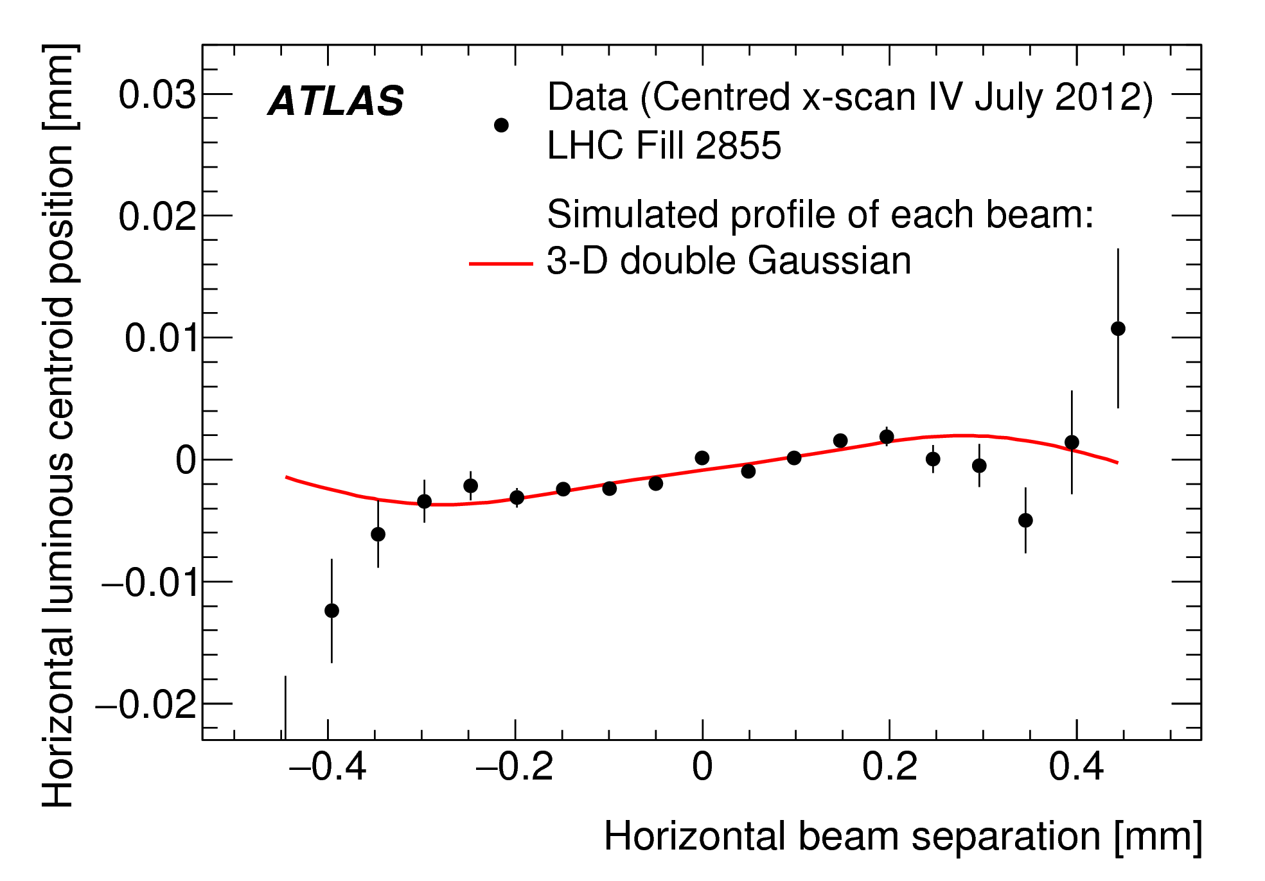
Evidence for non-factorization: L(Δx, Δy) ≠ g_{x}(Δx) * g_{y}(Δy) ?
ATLAS collaboration, Eur. Phys. J. C (2016) 76:653
Non-factorization: signalled by a dependence of
  the vertical convolved width Σ_{y} ~ (σ²_{B1y} + σ²_{B2y})^{1/2} , and/or
  the vertical luminous width σ_{yL} ~ (1/σ²_{B1y} + 1/σ²_{B2y})^{-1/2}
  on the horizontal separation Δx, and vice-versa (x ↔︎ y)
Both signatures
  indicate non-linear x-y correlations in the bunch-density distributions
  can vary bunch-to-bunch, within a fill, and from fill to fill
    indicates that non-factorization is not dominated by non-linear optical elements in the LHC rings (since the settings of these magnets are time-independent)
Mitigation
  Luminous-region evolution (LRE) method [1, 8]
    correct the bias using the “measured” 3-D density distributions of the B1 & B2 bunches, as reconstructed from a combined fit to the separation dependence of the collision rate and to that of the shape, size, orientation and position of the luminous region (aka “beam spot”)
  2-D vdM scans: automatically account for correlations – but!
  Bunch-tailoring in the LHC injector chain
20%

Slide 14
Accelerator-related vdM-calibration corrections & uncertainties (R2)
ATLAS Collaboration, Eur. Phys. J. C (2023) 83:982
Bias or uncertainty source | Typ. correction to σ_{vis} , per scan [%] | Typical uncert’nty (per year )[%] | Comments
Absolute DCCT calibrt'n* | - | ~ 0.20 (on n₁ n₂) | Total beam intensity (all bunches)
Bunch-by-bunch fractions* | -0.05 to +0.40 | 0.07 to 0.09 | Uncert'y ← compare FBCT/BPTX
Ghost charge & satellites* | +0.10 to +0.40 | 0.02 to 0.09 | Correction + uncert'y larger in HI !
Orbit-drift correction | -0.80 to +2.60 | 0.01 to 0.05 | Uncertainty ← BPM performance. ⟹ Michi: OFB on during scans ??
Beam position jitter | - | 0.20 to 0.23 | Fast jitter within indiv. scan steps
Magnetic non-linearity of closed-orbit bumps | - | 0.07 to 0.60 | Correction capability limited by imperfect BPM reproducibility
ε-growth correction* | +0.15 to +0.39 | 0.02 to 0.09 | From: dε_{x}/dt ≠ dε_{y}/dt
Beam–beam effects* | +0.38 to +0.67 | 0.25 to 0.27 | Correction + uncert'y smaller in HI
Non-factorization effects* | -0.20 to +0.60 | ~ 0.60 | Under intense study
b-by-b σ_{vis} inconsistency | - | < 0.01 to 0.44 | Residual inconsistency / non-reproducibility after all corrections: not stat; luminometer-independent
Scan-to-scan non-reproducibility | - | 0.09 to 0.71
Total | < 0.01 to +1.86 | 0.61 to 0.93 | Uncertainties marked * are treated as correlated year-to-year

Slide 15
Summary & outlook
As will be illustrated in the following presentations, our understanding of accelerator-related vdM-calibration systematics has improved significantly since LumiDays'19. These uncertainties are dominated by:
  Non-factorization biases [1, 2, 5, 8, 9, 10]
    probably the most challenging long-term issue for vdM calibrations at the LHC
    significant progress since LD'2019: accelerator sources & mitigation, 2-D vdM scans
  Beam-beam corrections [6, 7]
    well established, validated by MD, being generalized to 2-D vdM scans
    even more important in emittance scans than in vdM scans, but often neglected
  Orbit control at the scanning IP
    orbit drifts, beam-position jitter, insufficient BPM reproducibility
      potentially larger impact for 2-D than for 1-D vdM scans
      do the 4 Experiments wish to follow-up on Michi’s proposal for an “OFB-during-scans” MD?
    magnetic-hysteresis in orbit-bump correctors: mitigations exist, implemented @ some IPs
  Imperfect bunch-to-bunch and scan-to-scan reproducibility of σ_{vis}
    not associated with instrumental (luminometer) issues
    may be due to (yet-to-be-identified) non-factorization or orbit effects, at least in part

Slide 16
Summary & outlook (2)
While the 2-D vdM scans (either an x-y grid scan, or a combination of on-axis, off-axis and/or diagonal scans) are attracting growing interest as a tool to quantify the non-factorization biases, one must be aware that they are potentially more sensitive to several systematic effects
  magnetic-hysteresis in orbit-bump correctors
    severely constrains the scan sequence [→ RH's talk]
  x-y coupling in the closed-orbit bumps
    distorts the scan grid [→ RH's talk]
  orbit drifts
    distort the scan grid
    affect the 2-D beam separation (hence also the measured collision rate) at each scan step
    appear more complicated to account for than in 1-D scans [→ BPM systs? better OFB?]
  emittance growth
    the correlated impact on the normalized scan grid (separation in units of σ_{B}), and the measured collision rate, appears more complicated to account for than in 1-D scans [→ use measured relative-ε evolution from BSRT (Sofia’s talk) to correct for impact?]
  beam-beam corrections
    different for 1-D and 2-D vdM scans, but presumably under control [→ IK's talk]

Slide 17
Selected bibliography
[1] ATLAS Collaboration, Luminosity determination in pp collisions at √s = 13 TeV using the ATLAS detector at the LHC, arXiv:2212.09379, Eur. Phys. J. C (2023) 83:982
[2] A. Giraldi for the CMS Collaboration, Precision luminosity measurement with proton-proton collisions at the CMS experiment in Run 2, Proc. ICHEP 2022, Bologna, Italy (2022)
[3] ALICE Collaboration, ALICE 2016-2017-2018 luminosity determination for pp collisions at √s = 13 TeV, ALICE-PUBLIC-2021-005
[4] LHCb Collaboration, Precision measurement of forward Z boson production in proton-proton collisions at √s = 13 TeV, JHEP 07 (2022) 026
[5] P. Grafström & W. Kozanecki, Luminosity determination at proton colliders, Progr. Nucl. Part. Phys. 81 (2015) 97–148
[6] V. Balagura, van der Meer scan luminosity measurement and beam–beam correction, Eur. Phys. J. C (2021) 81: 26
[7] A. Babaev et al., Impact of Beam-Beam Effects on Absolute Luminosity Calibrations at the CERN Large Hadron Collider, arXiv2306.10394, Eur. Phys. J. C (2024) 84:17
[8] ATLAS Collaboration, Luminosity determination in pp collisions at √s = 8 TeV using the ATLAS detector at the LHC, Eur. Phys. J. C (2016) 76: 653
[9] CMS Collaboration, Precision luminosity measurement in proton–proton collisions at √s = 13 TeV in 2015 and 2016 at CMS, Eur. Phys. J. C (2021) 81: 800
[10] CMS Collaboration, Luminosity measurement in proton-proton collisions at 13.6 TeV in 2022 at CMS, CMS-PAS-LUM-22-001 (2024)
[11] A. Chmielinska et al., Magnetization in superconducting corrector magnets and impact on luminosity-calibration scans in the Large Hadron Collider, Eur. Phys. J. Plus (2023) 138:796
[12] H. Bartosik and G. Rumolo, Production of single Gaussian bunches for van der Meer scans in the LHC injector chain, CERN-ACC-Note-2013-0008, 2013
[13] ALICE Collaboration, ALICE luminosity determination for Pb–Pb collisions at √s_{NN} = 5.02 TeV, JINST 19 P02039 (2024)

Slide 18
Supplementary material

Slide 19
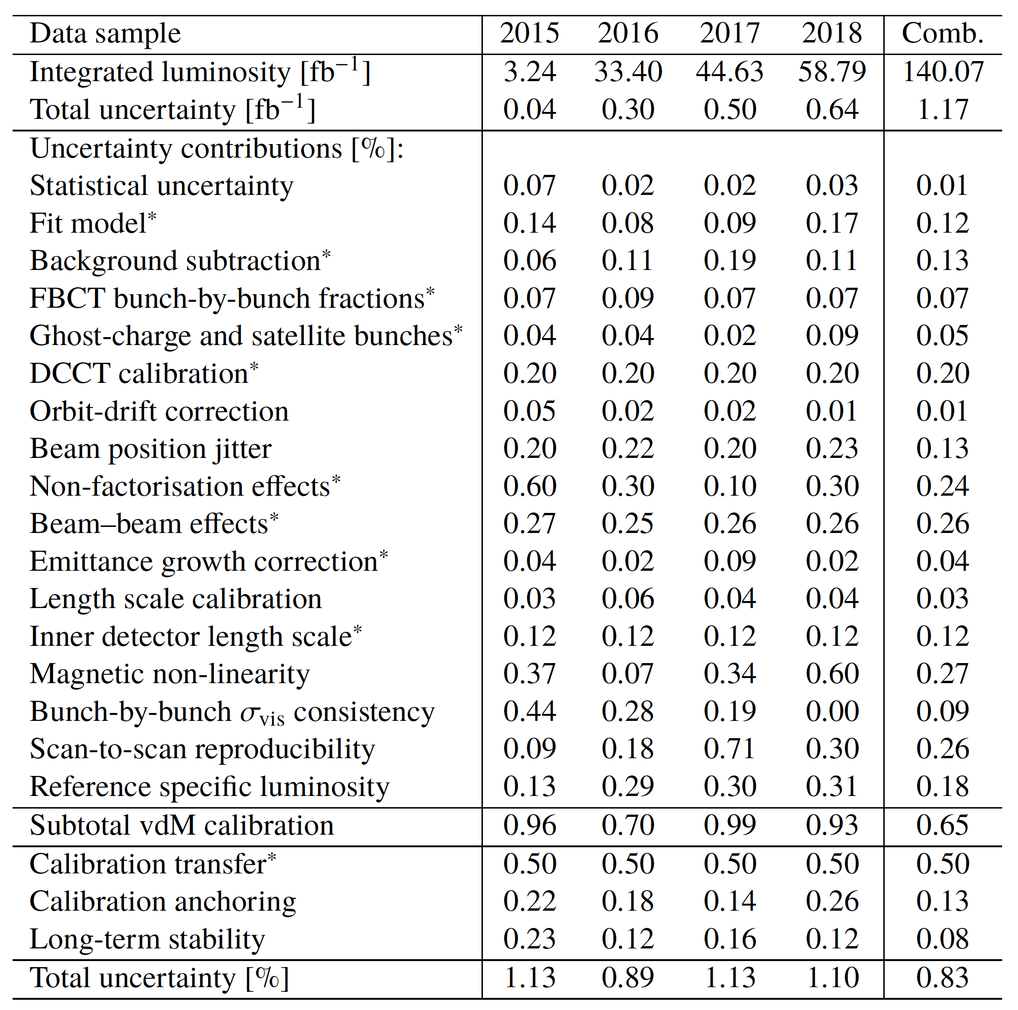
Summary of ATLAS Run-2 L uncertainties (pp @ √s = 13 TeV)
ATLAS collaboration, Eur. Phys. J. C (2023) 83:982
Summary of the integrated luminosities and uncertainties for the calibration of each individual year of the Run 2 pp data sample at sqrt(s) = 13 TeV and the full combined sample. As well as the integrated luminosities and total uncertainties, the table gives the breakdown and total of contributions to the absolute vdM calibration, the additional uncertainties for the physics data sample, and the total relative uncertainty in percent. Contributions marked * are considered fully correlated between years; the other uncertainties are considered uncorrelated.

Slide 20
Summary of ATLAS Run-2 vdM uncertainties (pp @ √s = 13 TeV)
Beam
instrum’ntn
ATLAS Collaboration,
Eur. Phys. J. C (2023) 83:982
Summary of the vdM-calibration uncertainties for each individual year of the Run-2 pp data sample at sqrt(s) = 13 TeV, and for the full combined sample. Contributions marked * are considered fully correlated between years; the other uncertainties are considered uncorrelated. Excerpted from Ref. [1].

Slide 21
Summary of ATLAS Run-2 vdM uncertainties (pp @ √s = 13 TeV)
Beam
instrum’ntn
Accel. physics
ATLAS Collaboration,
Eur. Phys. J. C (2023) 83:982
Summary of the vdM-calibration uncertainties for each individual year of the Run-2 pp data sample at sqrt(s) = 13 TeV, and for the full combined sample. Contributions marked * are considered fully correlated between years; the other uncertainties are considered uncorrelated. Excerpted from Ref. [1].

Slide 22
for pp vdM sessions.
Can be
much larger in HI scans, see e.g. [13]

Slide 24
Impact of orbit drifts (OD) on vdM calibration: 2 +1 effects
In-plane drift: x [y] during x [y] scan → Σ _{x [y]}
  equivalent to a change in calibration of closed-orbit bump (i.e. in length scale)
  +ve {-ve} drift in Δx [Δy] → increase {decrease} of Σ _{x [y]}
  L_{peak, x/y} unaffected (in 1D scans)
Peak-to-peak drift [x &/or y] → μ_{peak, x & y}
  → beams poorly centered in y during x scan (and/or v-v) → L ➘
  Σ_{x/y} unaffected (in 1D scans)
Out-of-plane drift: y [x] during x [y] scan → Σ _{x [y]} ➘ : negligible for 1D scans
2D scans: impact & correction can no longer be separated in x & y → expect larger biases and uncertainties
Pure-gaussian calculation
Pure-gaussian calculation

Slide 25
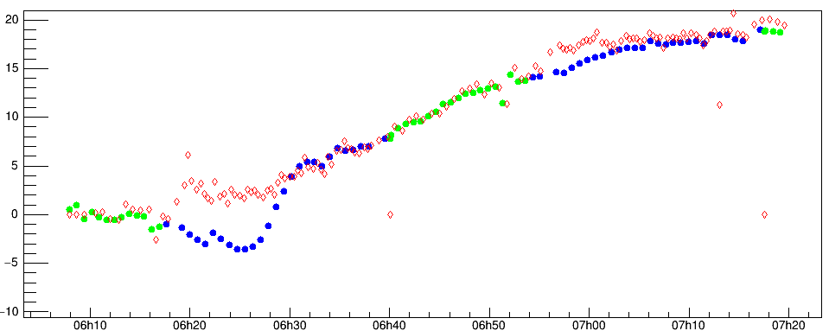
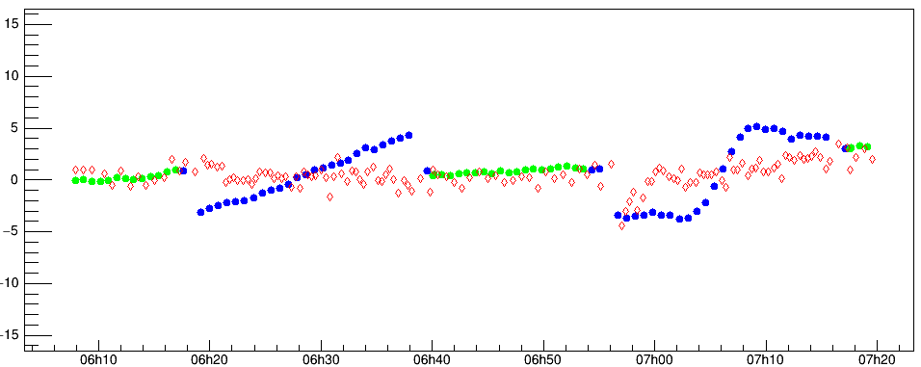
Orbit drifts during 1-D vdM scans: the real world
W. K., Impact of orbit perturbations on luminosity calibrations, 2019 L-days Workshop, CERN, 4-5 June 2019
IP1
vdM scan 1
28 Jul 2017
Hor. (x) scan
Horiz. separation @ IP1 {μm]
Drift consistent btwn Q1 (DOROS) & Arc BPMs
(this time – but not always!)
Q1 (DOROS): "head-on" (!)
Q1 (DOROS): scanning
Arc BPMS extrap → IP
Beam-beam deflection
+ magnetic non-linearity
Vertical drift often smaller,
consistent btwn Q1 (DOROS) & Arc BPMs
(this time – but not always!)
Vert. (y) scan
Vert. separation @ IP1 {μm]
30 μm total span
x→ y coupling: apparent or real?
Beam-beam deflection
Time on 28 Jul 2017

Slide 26
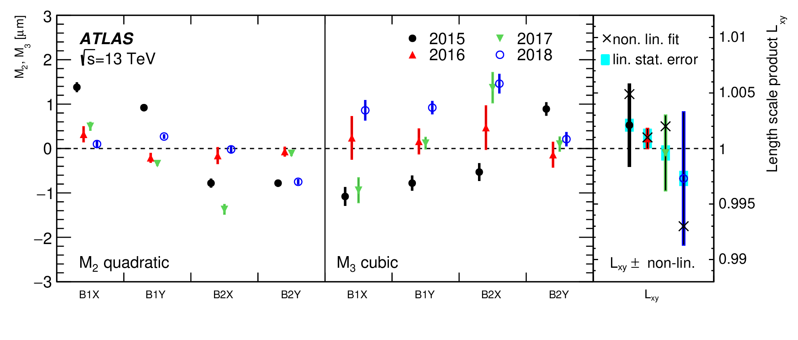
Magnetic non-linearity & hysteresis: impact on vdM uncertainties
ATLAS collaboration, Eur. Phys. J. C (2023) 83:982
For each beam B (B = 1, 2) and each plane, the non-linearity between the nominal (x_{nom,B}) and the actual (x_{act,B}) beam displacement is parameterized as: x_{act,B} = M_{1B} x_{nom,B} + M_{2B} (x_{nom,B} / x_{max})² + M_{3B} (x_{nom,B} / x_{max})³
  Only M_{1B} ( ~ “linear length scale”) and M_{3B} impact the L scale; the even terms cancel out
  The fits uses BPM (and luminous-centroid) data from the vdM (and LSC) scans; they include BPM-scale, orbit-drift and beam-deflection corrections as nuisance parameters
Summary of the non-linear length scale determination for the √s=13 TeV vdM+LSC datasets. The left and middle panels show the quadratic M₂ and cubic M₃ terms fitted for each beam and plane from the combined vdM and LSC data for each data-taking year, with error bars indicating the statistical uncertainties. The right panel shows the linear length scale product L_{xy} for each year, together with its statistical error (cyan band), the central value of the baseline non-linear fit incorporating the M₂ and M₃ terms (black cross), and the total uncertainty in L_{xy} , that encompasses the central values of the baseline and of the alternative non-linear fits.

Slide 27
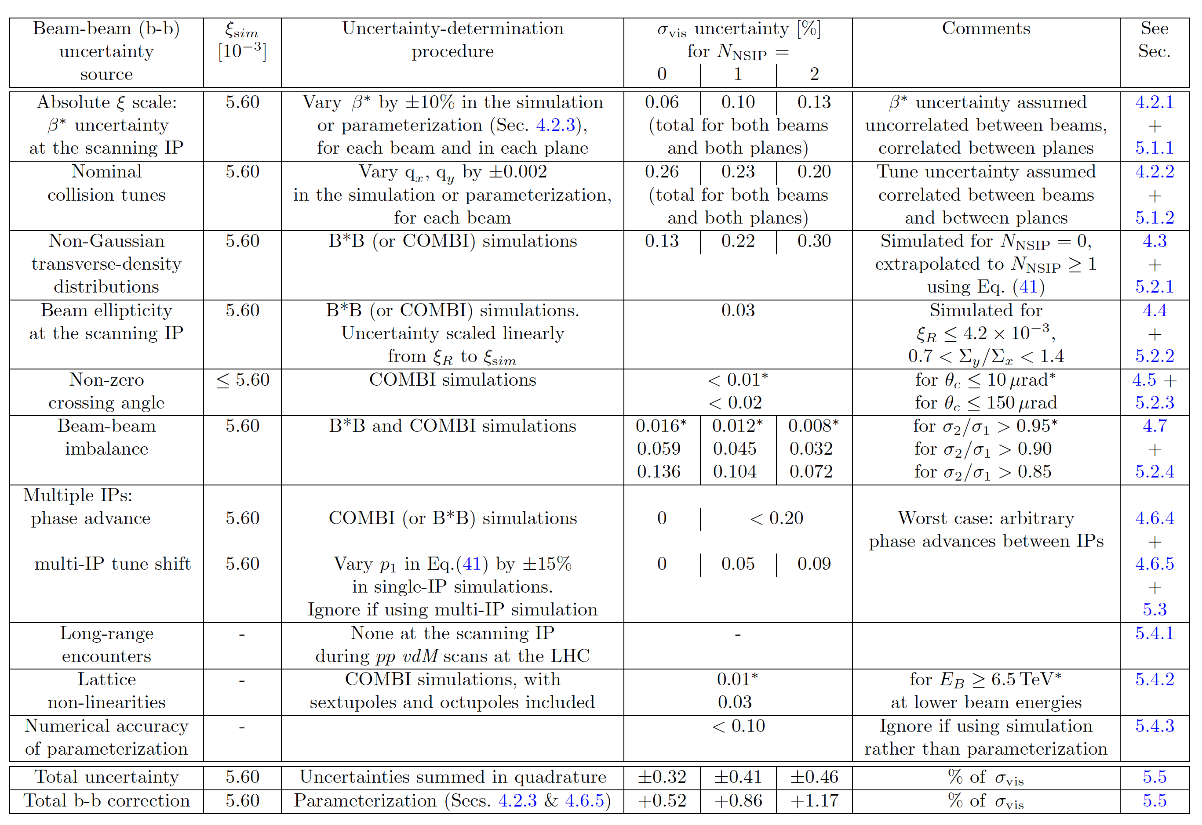
Systematic uncertainties on beam-beam correction to vdM calibrations
A. Babaev et al., Eur. Phys. J. C (2024) 84:17
Typical systematic uncertainties affecting beam-beam corrections to a hypothetical pp vdM calibration in a fully symmetric Gaussian-beam configuration, with the round–beam-equivalent beam-beam parameter set equal to ξ_{sim}, for three values of N_{NSIP} . For each source, the uncertainty is either evaluated at, or scaled linearly to, the value of ξ_{sim} indicated in the second column; if no value of ξ_{sim} is specified, the uncertainty listed covers the full range of ξ values encountered during pp vdM scans at the LHC. When an uncertainty is assumption-dependent, the value flagged by an asterisk is that used in computing the total uncertainty; the latter is compared to the overall beam-beam correction itself in the bottom two rows of the Table.

Slide 28
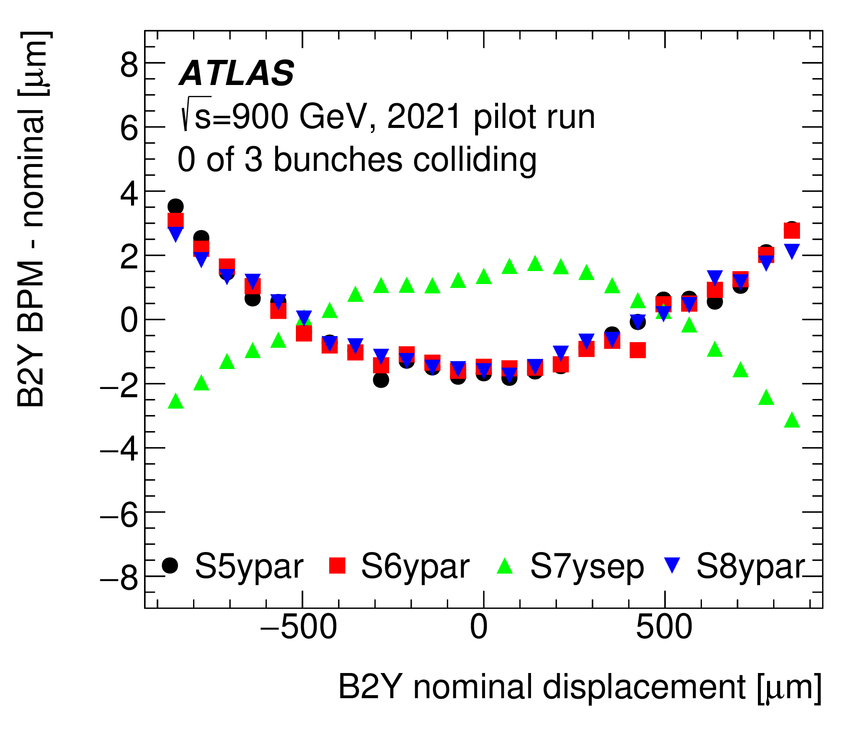
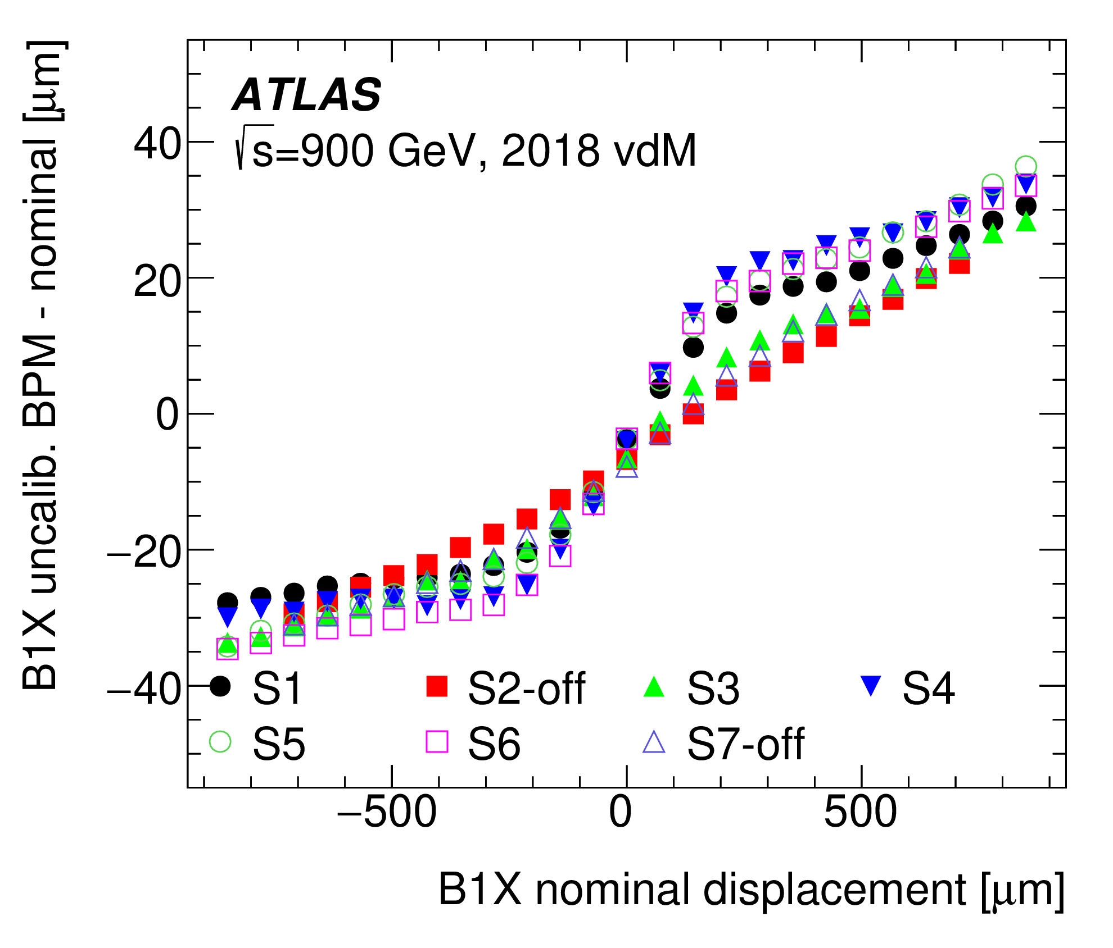
Magnetic non-linearity & hysteresis in vdM closed-orbit bumps
ATLAS collaboration, Eur. Phys. J. C (2023) 83:982
Length-scale calibration: // scan (beams colliding)
// & separation scans (no collisions)
Non-linearity is
beam-, plane- and year-dependent
± 0.6 μm
vdM calibration: separation scans (beams colliding)
vdM calibration: separation scans (beams colliding)
Irreproducibility
of BPM response

Slide 29
Beam-beam biases: nomenclature
Beam-beam bias parameters and “figures of merit” (FoMs): definitions
  wrt no beam-beam anywhere: “L_{o} normalization”
    b-b bias parameters: L (Δ) / L_{o} (Δ) - 1, σ_{iB} (Δ) / σº - 1, L_{u} (Δ) / L_{o} (Δ) - 1, σ^{u}_{iB} (Δ) / σº - 1
      typically expressed in %, and
      where Δ is the nominal separation in the scanning plane in units of the single-beam size σº
    FoMs (= integrated bias parameters): Σ_{x,y} / Σ⁰ - 1, μ / μ⁰ - 1, σ_{vis} / σ⁰_{vis} – 1, Σ^{u}_{x,y} / Σ⁰ - 1
      typically expressed in %
  wrt no beam-beam at the scanning IP only: “L_{u} normalization”
    b-b bias parameters = L (Δ) / L_{u} (Δ) - 1, σ_{iB} (Δ) /σ^{u}_{iB} - 1
    FoMs: Σ_{x,y} / Σ^{u}_{x,y} - 1 , μ / μ^{u} - 1, σ_{vis} / σ^{u}_{vis} - 1
"Full beam-beam" broken down into "orbit shift " & "optical distortion"
  Full beam-beam = b-b bias parameter or FoM as predicted by the simulation
  Orbit-shift effect = impact of beam-beam deflection on closed-orbit of the 2 beams, assuming rigid beams. Modifies the beam separation only
  Optical-distortion effect = impact of changes in beam-overlap integral arising from anything else than the orbit shift (e.g. changes in transverse distribution)
  [L (Δ) / L_{o} (Δ)] _{opt. dist.} = [L (Δ) / L_{o} (Δ)] _{full b-b} / [L (Δ) / L_{o} (Δ)] _{orb. shift}

Slide 30
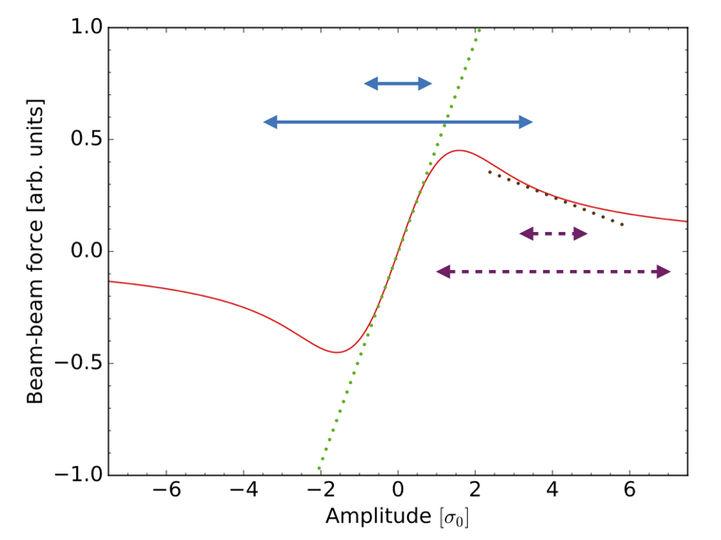
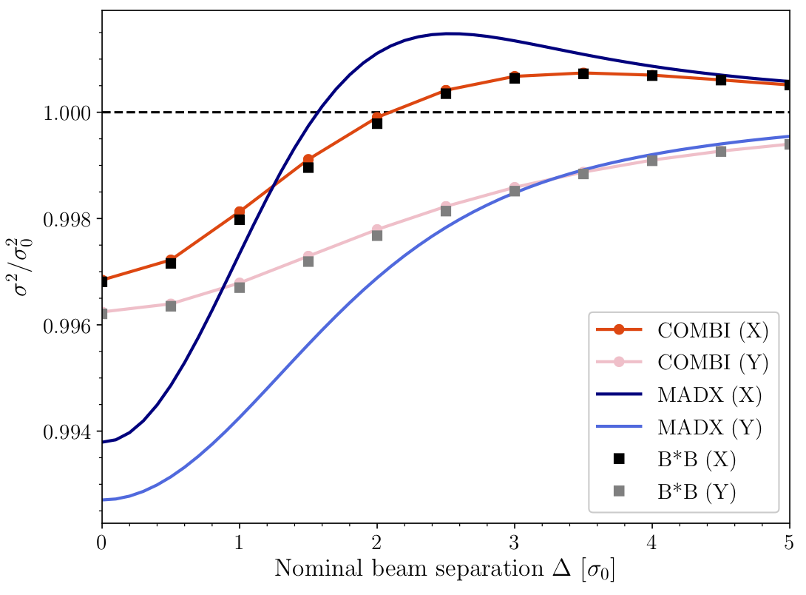
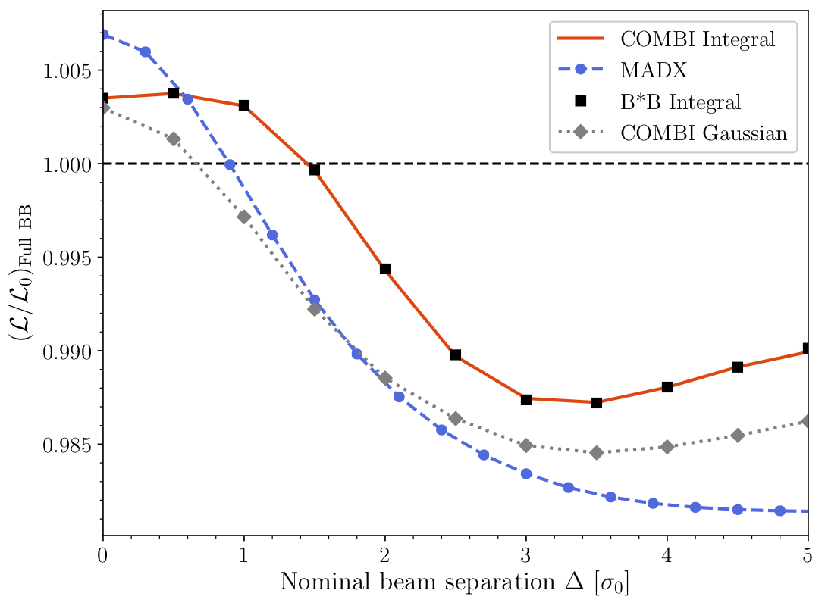
Beam-beam biases: optical distortions (single-IP mode)
A. Babaev et al., Eur. Phys. J. C (2024) 84:17
Beam-beam force exerted by the B1 (B2) source bunch as a whole (red curve), as a function of the betatron amplitude of a B2 (B1) test particle, for equally sized round beams. The amplitude is in units of the RMS beam size. The green and brown lines correspond to the linear component of the force at amplitudes of zero and 4σ respectively, and are akin to the effect of a quadrupole. The short (long) double arrows illustrate the range of transverse kicks experienced by a small (large) amplitude particle for beams either in head-on collision (solid blue lines), or transversely separated by 4σ (dashed magenta lines).
ξ = 2.6 10⁻³
ξ = 2.6 10⁻³
Beam-separation dependence of the transverse RMS beam sizes during a simulated vdM scan. The unperturbed beams are assumed to be round and perfectly Gaussian. The vertical axis is the ratio squared of the actual beam size σ to its unperturbed value σ₀. The MAD-X calculation of the single-particle dynamic-β effect (blue curves) is compared to the results of the B*B (squares) and COMBI (red curves) multiparticle codes.
Beam-separation dependence of the luminosity-bias factor L/L₀ during a simulated vdM scan. The unperturbed beams are assumed to be round and perfectly Gaussian. The MAD-X (dashed blue) and COMBI (dotted grey) curves are valid only in the Gaussian-bunch approximation; the COMBI (red curve) and the B*B markers (black squares) are obtained from the overlap integrals of the multiparticle distributions.

Slide 31
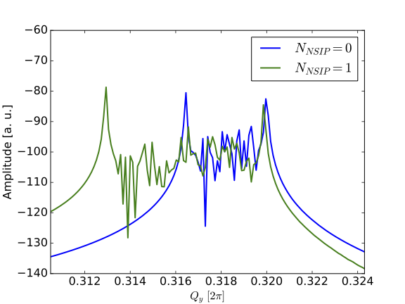
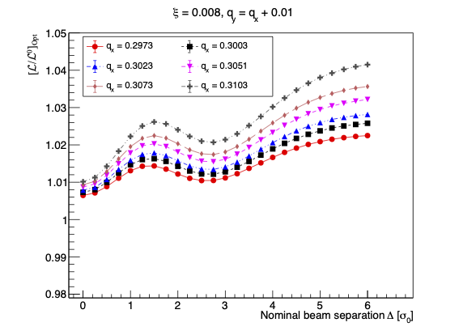
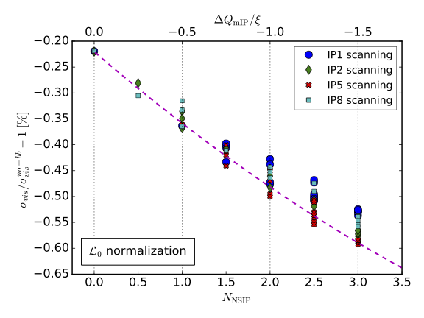
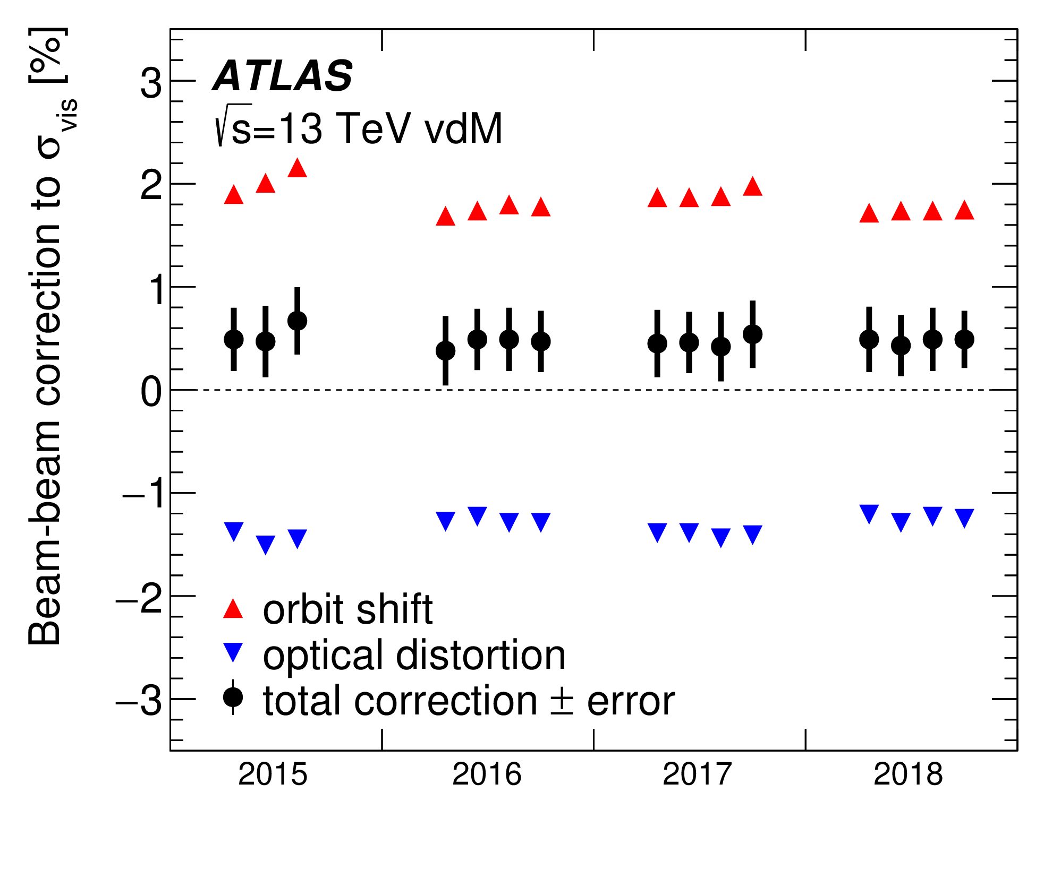
Beam-beam biases to vdM calibrations (pp @ 13 TeV)
A. Babaev et al., Eur. Phys. J. C (2024) 84:17
[L/L₀] (Δ₀) = f(ξ, q_{x}, q_{y})
  scale with ξ = ξ (ε, β*, n₁, n₂)
  depend sensitively on (q_{x}, q_{y})
Typical b-b corrections to σ_{vis}
Collisions @ other IP(s) →
Beam-beam corrections to σ_{vis}
  scale ~ linearly w/ N_{NSIP} ( = non-scanning IPs)
  deviations from naïve scaling due to different phase advances btwn IPs
ΔQ ~ 2ξ * Y
ΔQ ~ ξ * Y
COMBI simulation
Head-on collisions
N_{IP} = N_{NSIP} + 1
= 1 or 2
ξ = 0.0032 per IP
1.5 − 2 %
Δq_{x}, Δq_{y}
= 0.013
For bunches that collide
at the scanning IP only
ξ ~ 0.0034 - 0.0042
Strong
mutual
cancellation
ξ = .0032 (per IP)
0.4 − 0.5 %
Single-IP simulation
w/ Q⁰_{x}, Q⁰_{y} shifted
by -0.5 ξ N_{NSIP}

Slide 32
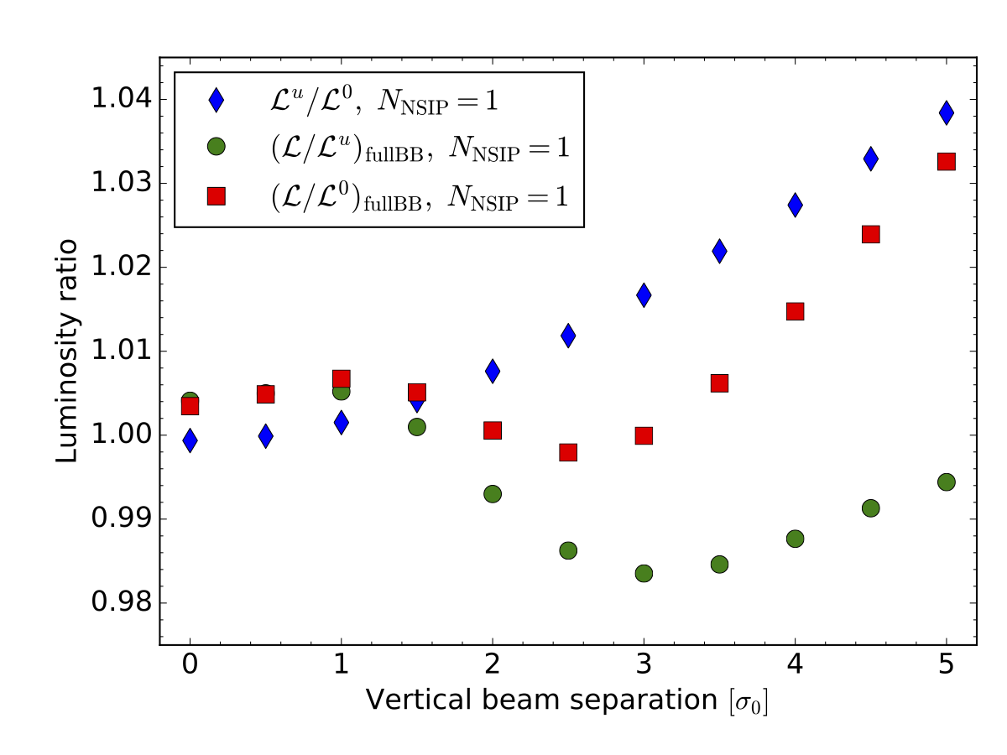
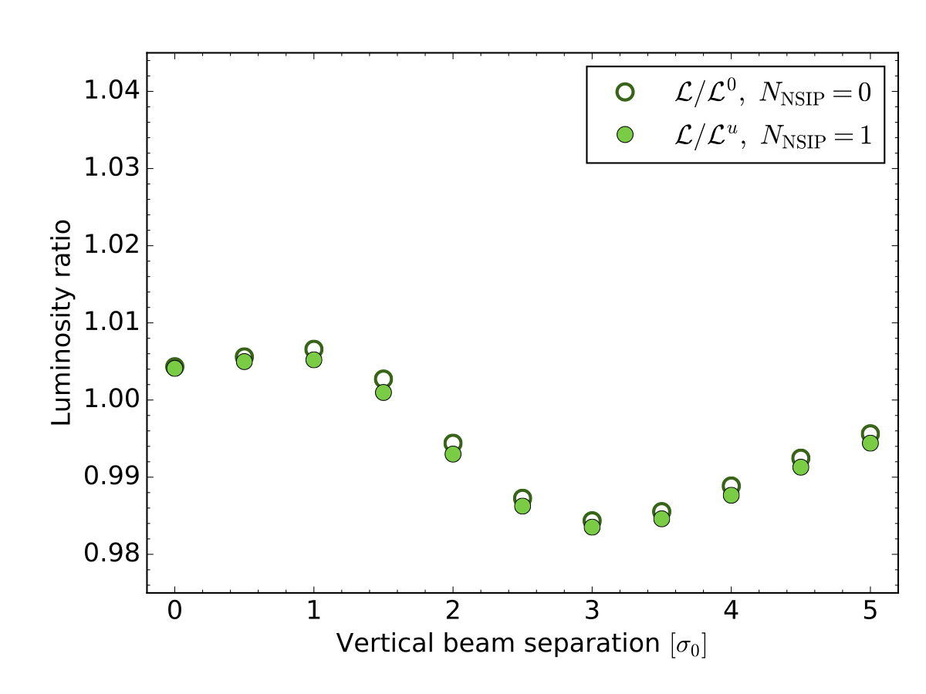
Beam-beam biases: multi-IP effects, choice of reference (1)
A. Babaev et al., Eur. Phys. J. C (2024) 84:17
2 possible reference configurations for “no beam-beam”
  no beam-beam anywhere: “L_{o} normalization”
    b-b bias parameters: L (Δ) / L_{o} (Δ) - 1, σ_{iB} (Δ) / σº - 1, L_{u} (Δ) / L_{o} (Δ) - 1, σ^{u}_{iB} (Δ) / σ⁰ - 1
      where Δ is the nominal separation in the scanning plane in units of the single-beam size σº
  no beam-beam at the scanning IP only: “L_{u} normalization”
    b-b bias parameters = L (Δ) / L_{u} (Δ) - 1, σ_{iB} (Δ) /σ^{u}_{iB} - 1
Beam-separation dependence, during a simulated vertical vdM scan in the Run-2 configuration with 1 non-scanning IP, of the luminosity-bias factors at the scanning IP associated with the unperturbed luminosity (L_{u}/L₀ , blue), with the full beam-beam effect in the L₀ normalization ([L/L₀]_{Full BB} , red), and with the full beam-beam effect in the L_{u} normalization ([L/L_{u}]_{Full BB} , green). The horizontal axis is the beam separation in units of the nominal transverse beam size σ₀.
Beam-separation dependence, during a simulated vertical vdM scan, of the luminosity-bias factors at the scanning IP associated with the full beam-beam effect, for N_{NSIP} = 0 using the L₀ normalization (open circles), and for N_{NSIP} = 1 using the L_{u} normalization (filled green circles). The horizontal axis is the beam separation in units of the nominal transverse beam size σ₀.

Slide 33
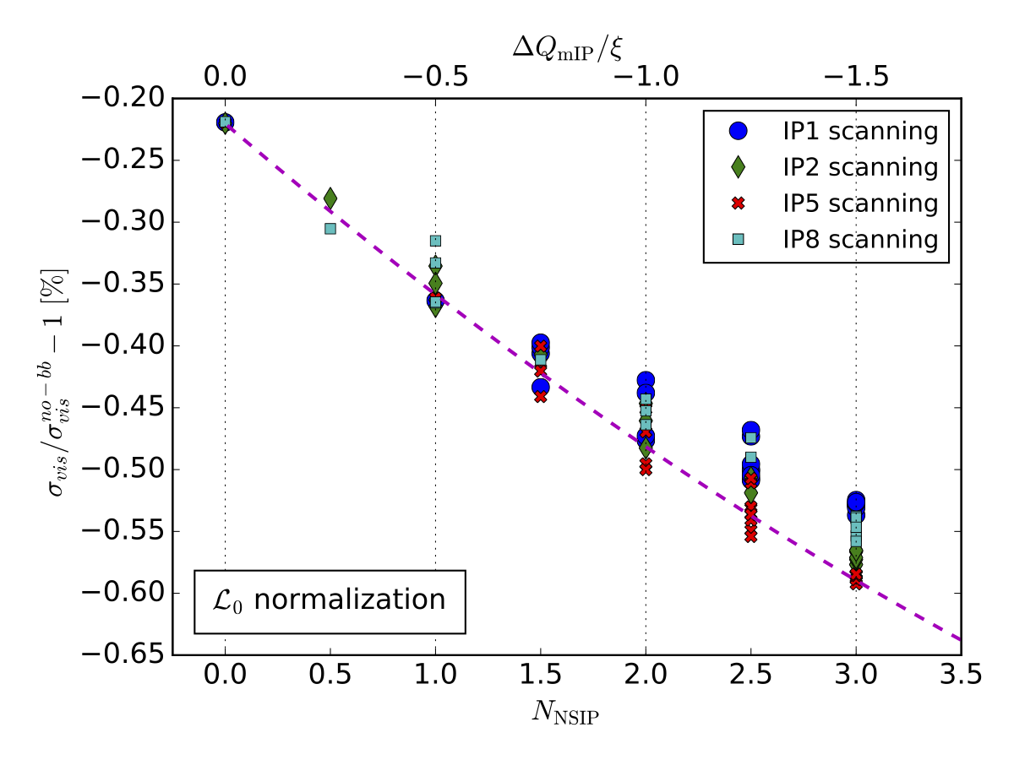
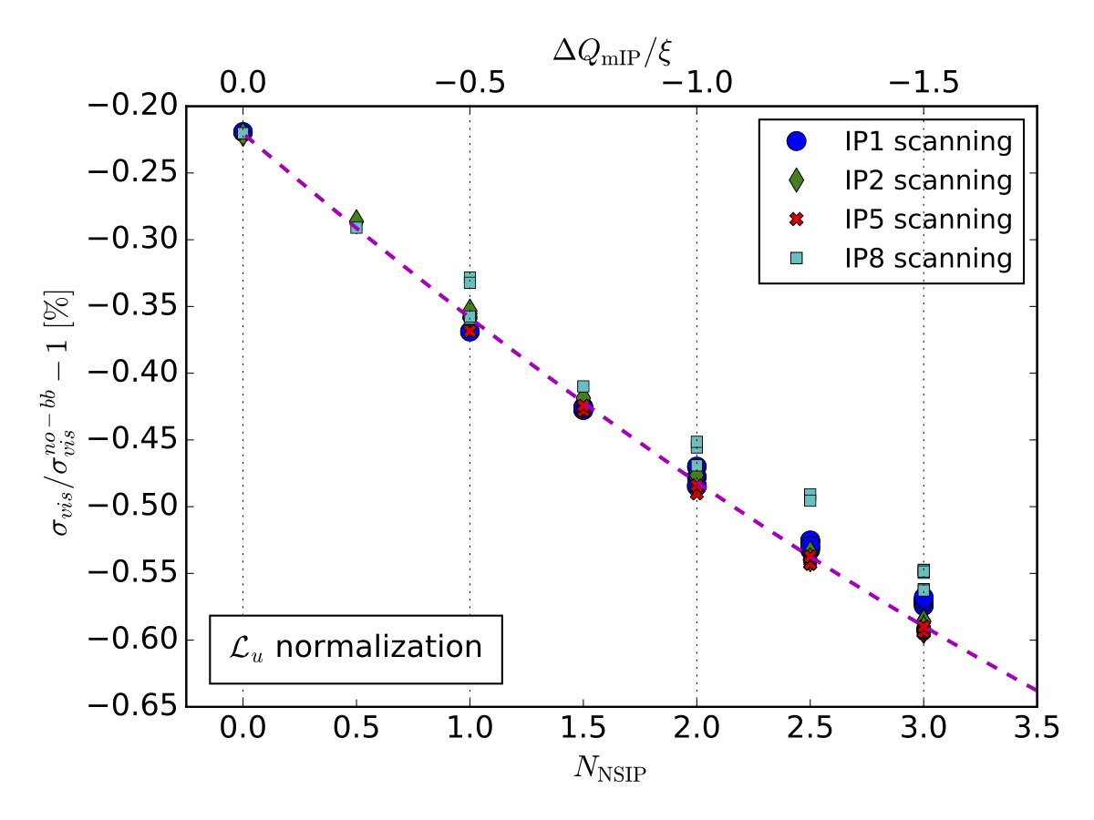
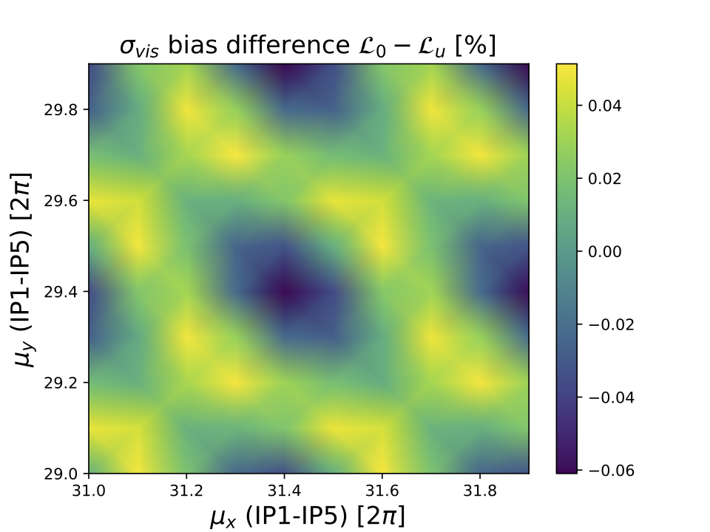
Beam-beam biases: multi-IP effects, choice of reference (2)
A. Babaev et al., Eur. Phys. J. C (2024) 84:17
Visible cross-section bias in the L₀ normalization as a function of the number of non-scanning IPs, for the four possible choices of scanning IP.
Visible cross-section bias in the L_{u} normalization as a function of the number of non-scanning IPs (lower horizontal axis), for the four possible choices of scanning IP. The curve represents the dependence of the σ_{vis} bias in the N_{NSIP} = 0 case, but with the horizontal and vertical unperturbed tunes shifted down by ΔQ_{mIP} / ξ = -0.5 N_{NSIP} (upper horizontal axis). For a given scanning IP, there exist several B1-B2 bunch-collision patterns that yield the same value of N_{NSIP}.
Phase-advance dependence of the difference, between the L₀ and the L_{u} normalization, of the beam-beam induced σ_{vis} bias. The horizontal and vertical axes represent the betatron phase advance between IP1 and IP5, here assumed to be the same for B1 and B2. The color scale quantifies the fractional inconsistency in σ_{vis} bias between the two reference configurations; it ranges from -0.06 to 0.05 % of σ_{vis}.

Slide 34
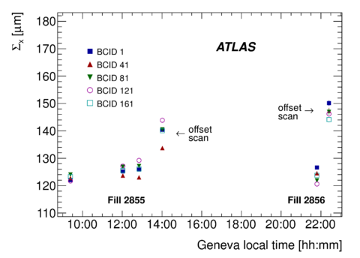
Non-factorization: symptoms
ATLAS collaboration, EPJC (2016) 76:653
Σ_{x} (resp. Σ_{y}) depends on Δy (resp. Δx)
  Σ_{x} in off-axis scans larger than in on-axis
  [in this example: 10-20%]
Vertical luminous width σ_{yL} depends on horizontal separation Δx, & vice-versa
Both signatures
  indicate non-linear x-y correlations in the transverse-density distributions
  vary within a fill, and from fill to fill
    indicates that non-factorization is not caused by non-linear optical elements in the LHC rings
July 2012 vdM scans
20%

Slide 35
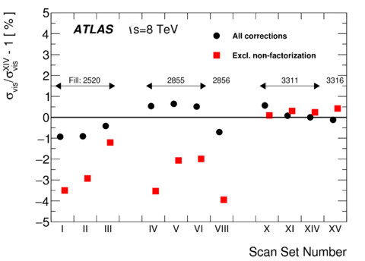
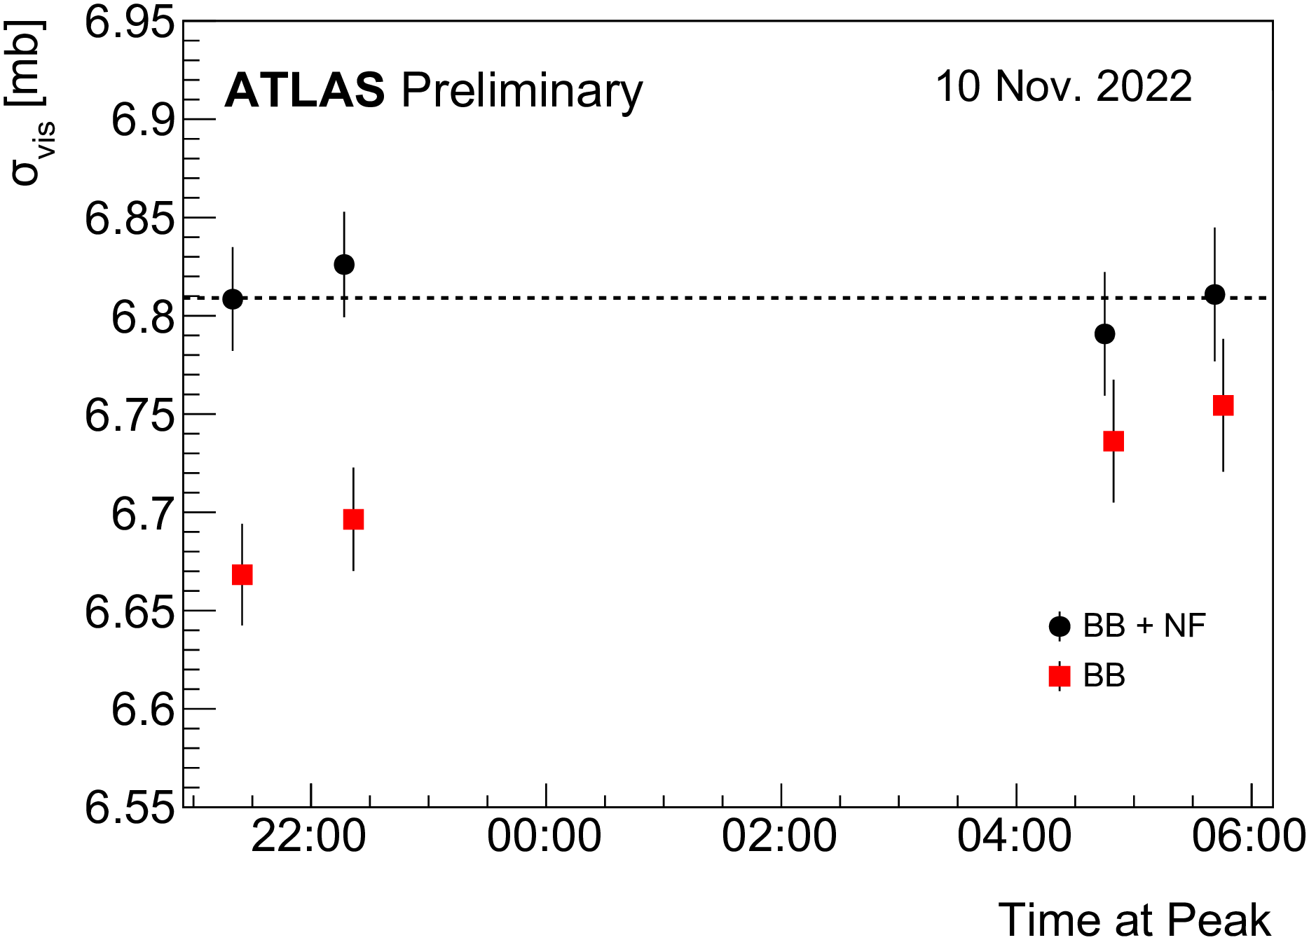
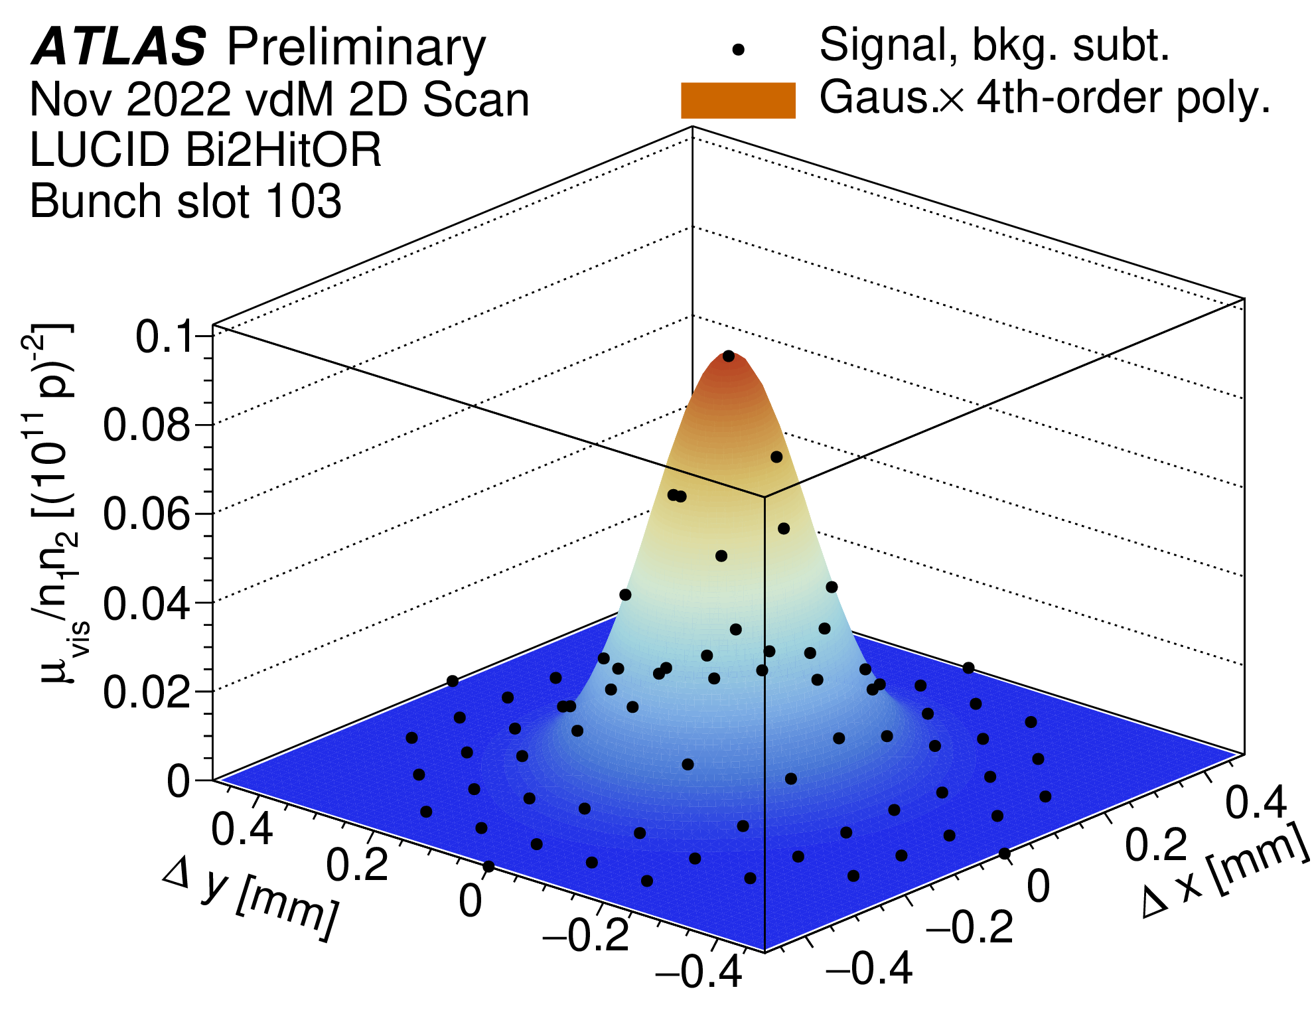
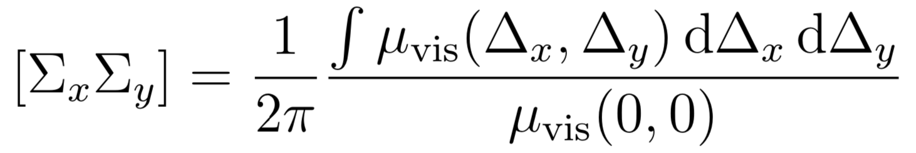
Impact of non-factorization biases: Run 1, Run 2,…and Run 3
ATLAS collaboration, Eur. Phys. J. C (2016) 76:653 ; ATLAS Collaboration, ATL-DAPR-PUB-2023-001
Before/after non-factorization correction
Before/after non-factorization correction
with bunch tailoring
(upgraded injectors)
with beam tailoring
(upgraded injectors)
C_{NF} =
-0.6 ± 0.3 % (2016)
2 %
Ref.
April 2012 July 2012 Nov 2012
(no beam tailoring in Apr & Jul) with bunch tailoring
→ generalized vdM scan (1st proposed by Rubbia, pioneered by LHCb)
Run-2 non-factorization corrections to σ_{vis} (pp, 13 TeV)
 | 2015 | 2016 | 2017 | 2018
C_{NF} [%] | 0.0 | -0.6 | +0.2 | -0.3
σ(C_{NF}) [%] | 0.6 | 0.3 | 0.1 | 0.3
automatically accounts for non-factorization
(with bunch tailoring)
A lot more in
Foteimi’s, Elleanor’s, Vladik’s, Peter’s & Tim’s talks
(Session 2A)

Slide 39
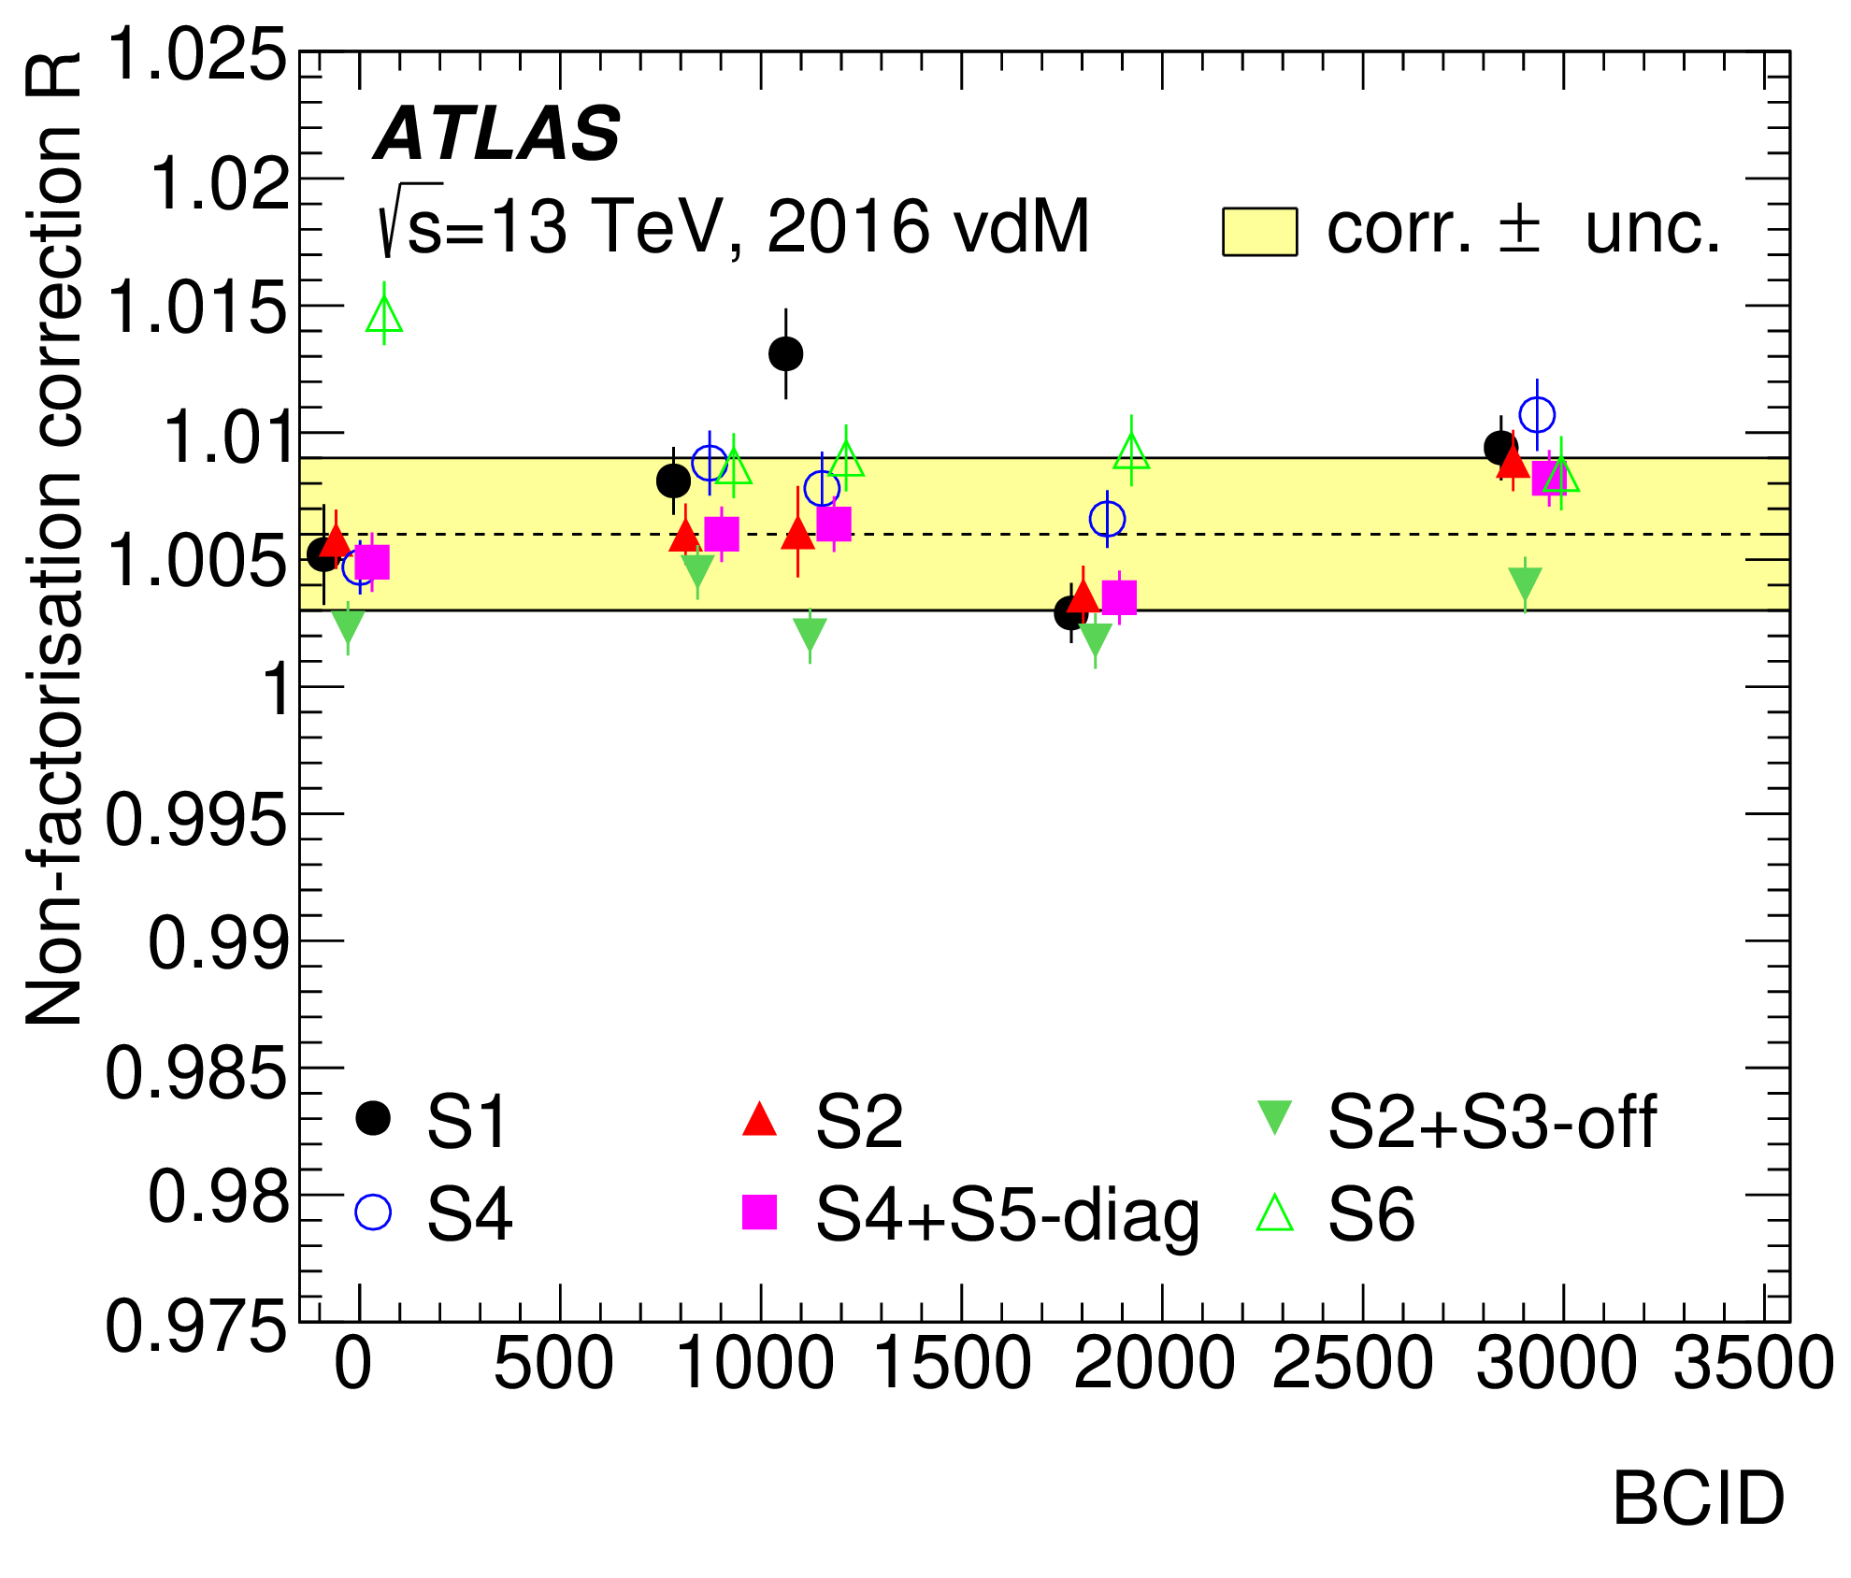
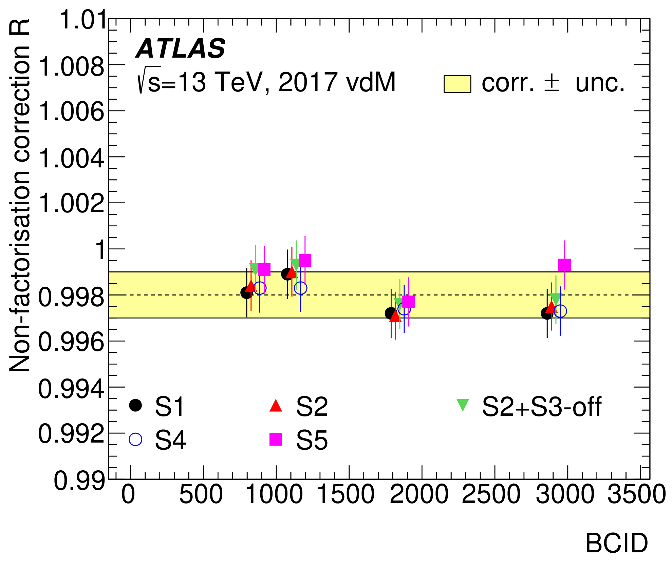
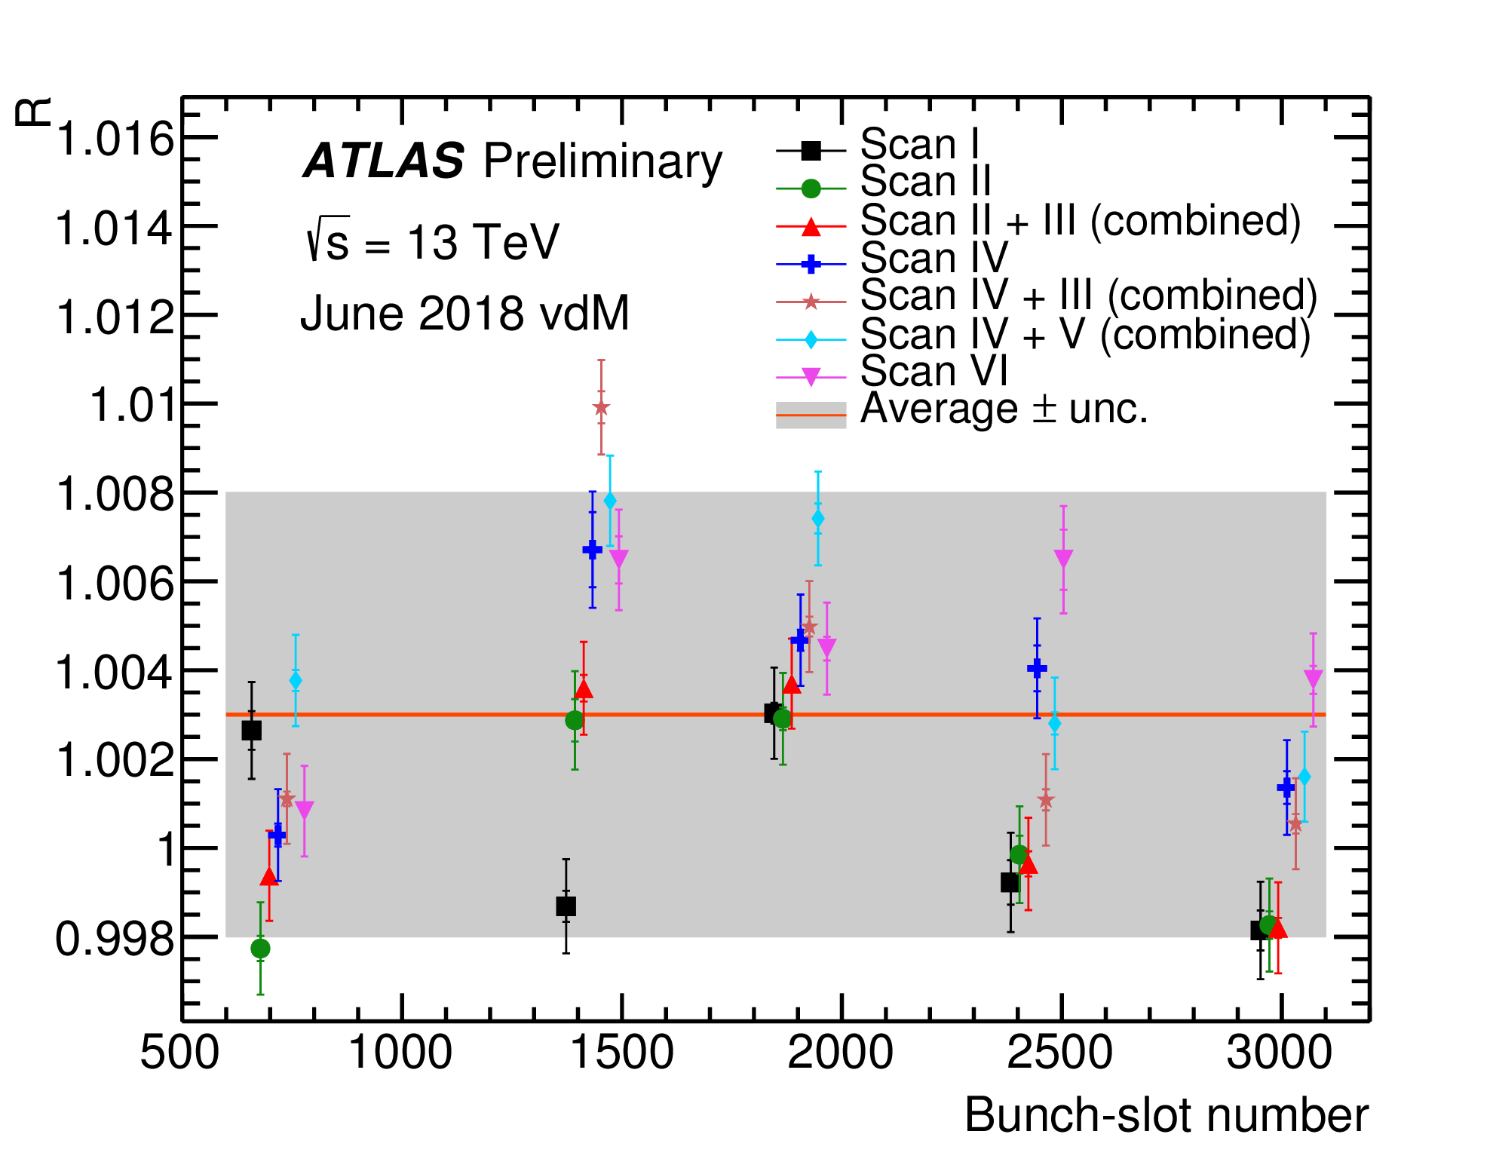
Run-2 non-factorization corrections, per year
Largest net correction seen in Run 2 (pp):
0.6 % (bunch- & scan-averaged)
Non-factorization correction factors R for several colliding bunch pairs and vdM scan sets in the 2016, 2017 and 2018 vdM sessions. The results are extracted from combined fits to the luminosity scan curves and reconstructed primary-vertex data, using either on-axis scans or combined fits to on- and off-axis scans. The dashed (or red) line shows the error-weighted mean corrections, and the bands the uncertainties assigned from the spread of the measured R values. The results from different scans for each colliding bunch pair are slightly offset on the horizontal axis for clarity.

Slide 40
Mitigating non-factorization: beam tailoring in the injector chain (LHC Run 2)
H. Bartosik & G. Rumolo, CERN-ACC-NOTE-2013-008-MD
Principle
  Non-factorization biases arise if
  Mathematically, perfectly Gaussian bunches are factorizable
    ⟹ strategy: produce isolated bunches that are as Gaussian as possible in the LHC
      purely empirical: does not address/mitigate primary cause of non-factorization!
Implementation
  Controlled generation of a relatively low intensity (~ 10¹¹ p) & large-emittance (ε_{N} ≥ 3 μm) single bunch (“indiv”) in the PS-Booster
  Vertical “shaving” →
    reduce intensity close to requested spec (0.7 - 0.9 10¹¹ p)
    platykurtic tails (fall faster than Gaussian)
  Diffusion during transport (Booster ⇾ CPS ⇾ SPS) should restore “perfectly Gaussian” shape
    Additional scraping in SPS if needed

Slide 41
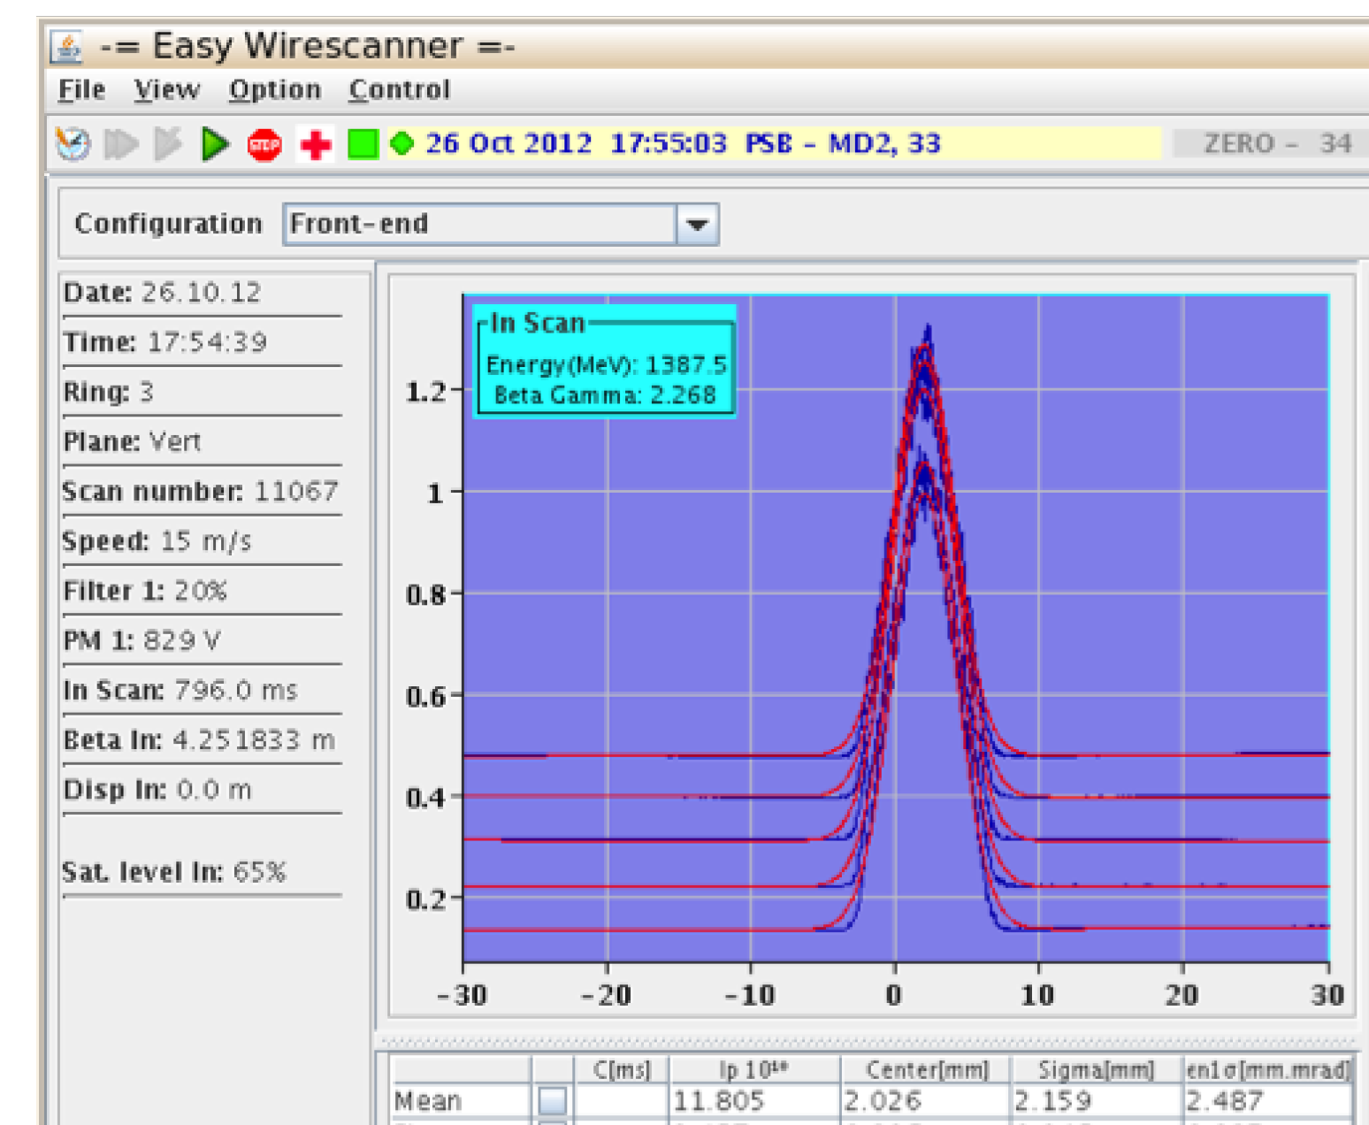
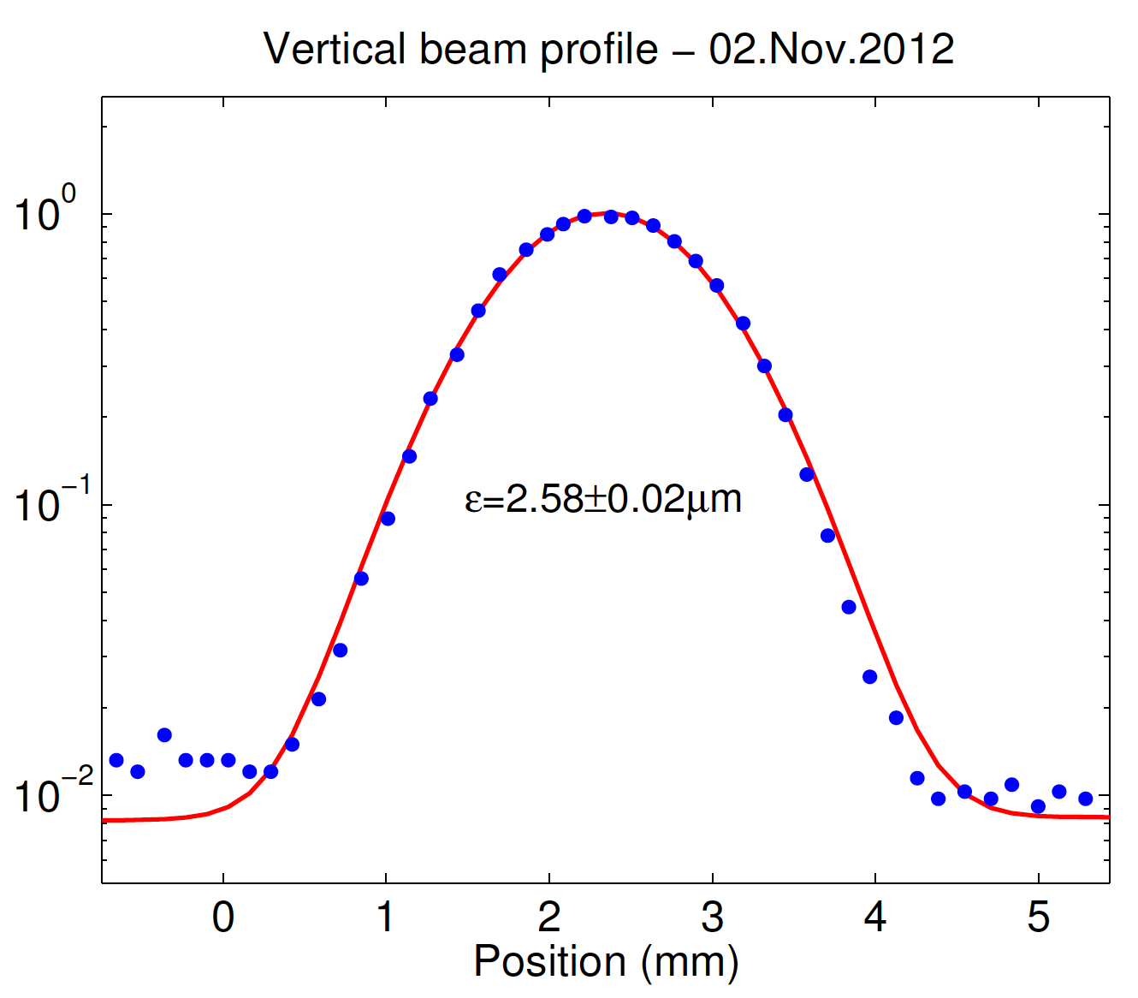
Mitigating non-factorization: beam tailoring in the injector chain (2)
H. Bartosik & G. Rumolo, CERN-ACC-NOTE-2013-008-MD
Transverse distributions measured shortly before the extraction from the PS-Booster to the PS. The less-than-Gaussian tails are apparent.
Transverse beam distributions measured shortly before the SPS extraction (after the scraping). The logarithmic scale highlights the quality of the Gaussian tails.

