Slide 1
Sources and mitigation of non-factorization in the injectors and the LHC
LumiDays 25
11/03/2025
F. Asvesta, H. Bartosik, E. Lamb, G. Sterbini
Acknowledgements: F. Antoniou, C. Bracco, G. Franchetti, G.P. Di Giovanni,
S. Kostoglou, K. Li, E. Renner, G. Rumolo, Y. Wu, P. Zisopoulos, PSB-PS-SPS Operations

Slide 2
Overview
CERN Accelerator Complex
Intro to accelerators
  Synchrotrons
  Transverse & Longitudinal motion
  Hamiltonian description
Sources of non-factorization
  Space charge & Resonances
Requirements for vdM beams
Production scheme for vdM beams
  Run 2
  Run 3
Summary

Slide 3
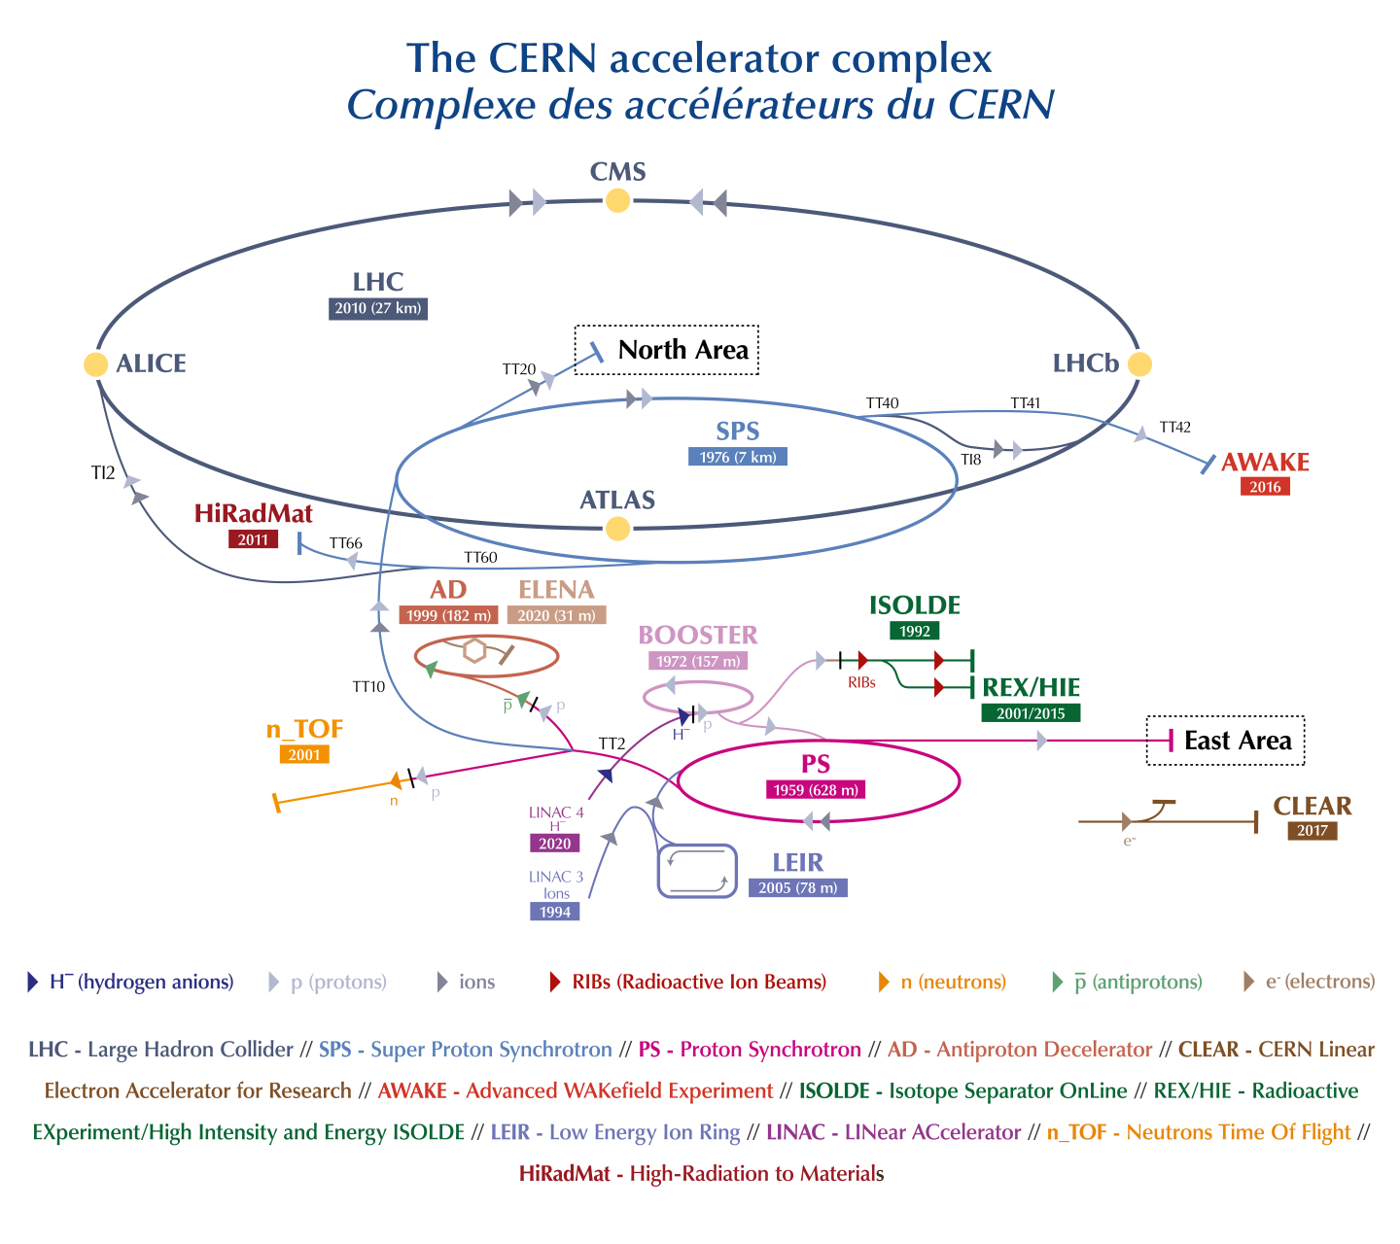
CERN Accelerator Complex
CERN Proton chain
LINAC-4 160MeV (H-)
Proton Synchrotron Booster 2GeV
Proton Synchrotron 26GeV
Super Proton Synchrotron 450 GeV
Large Hadron Collider 7TeV
Proton beams:
  start as H-
  accelerated in stages
  significant time in low energy machines
History affects the beam at all stages

Slide 4
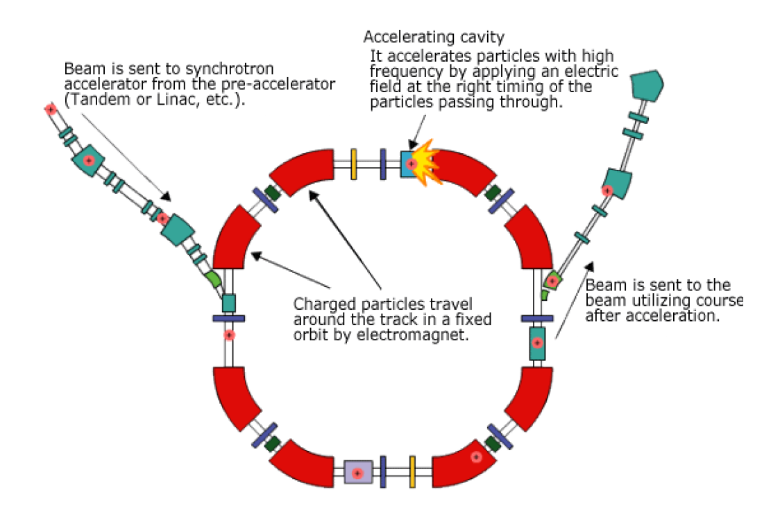
Intro to accelerators: Synchrotrons
The most common accelerator
Fixed beam trajectory | magnetic field changes synchronous to the energy
Magnets around the beam path to control the motion | bending (dipoles) & focusing (quadrupoles), higher order (sextupoles, octupoles etc) for corrections (chromaticity, resonances etc)
Electric fields used to accelerate (RF cavity) the beam
Particles perform periodic oscillations in transverse & longitudinal planes
Transverse
Longitudinal

Slide 5
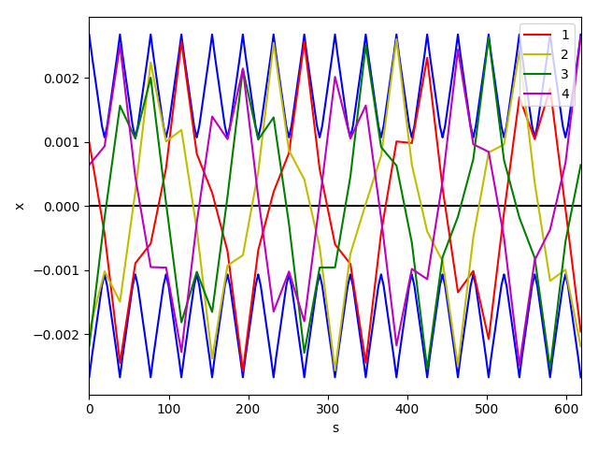
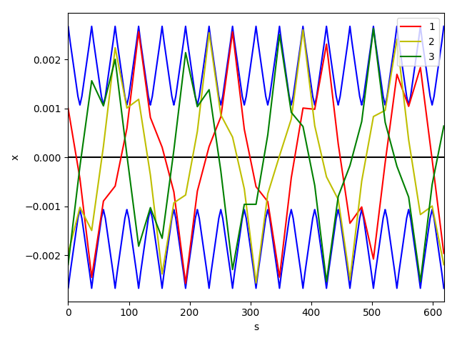
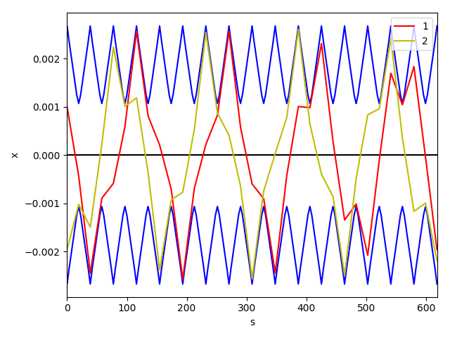
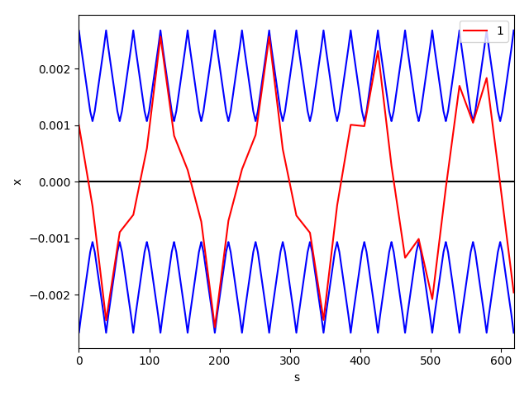
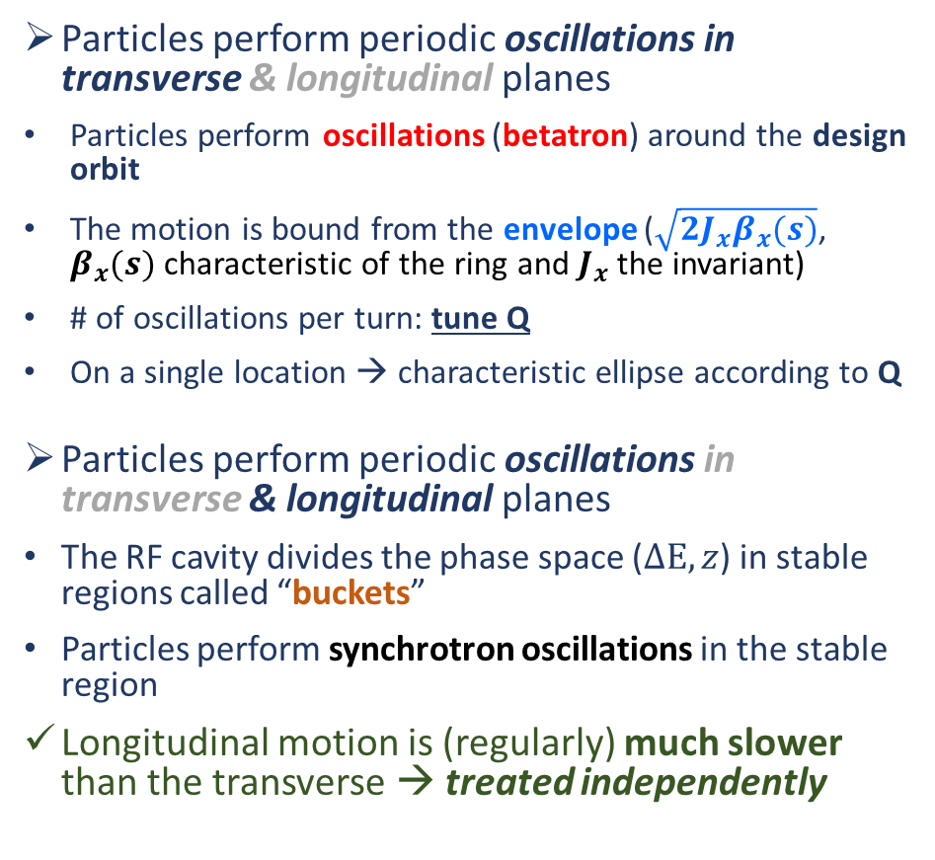
Intro to accelerators: Transverse & Longitudinal
Particles perform periodic oscillations in transverse & longitudinal planes
Particles perform oscillations (betatron) around the design orbit
The motion is bound from the envelope ($\sqrt{2J_{x}β_{x}(s)}$, $β_{x}(s)$ characteristic of the ring and $J_{x}$ the invariant)
# of oscillations per turn: tune Q
On a single location → characteristic ellipse according to Q
Particles perform periodic oscillations in transverse & longitudinal planes
The RF cavity divides the phase space ($ΔΕ, z$) in stable regions called “buckets”
Particles perform synchrotron oscillations in the stable region
Longitudinal motion is (regularly) much slower than the transverse → treated independently
Transverse
x’
x
x [m]
s [m]
Longitudinal
dE
`
`
z

Slide 6
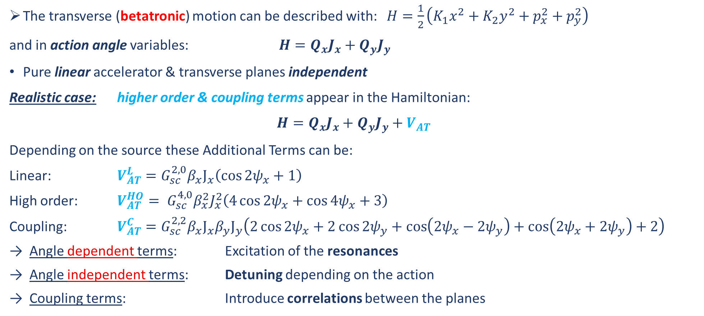
Intro to accelerators: Hamiltonian description
The transverse (betatronic) motion can be described with: $H=\frac{1}{2}\left(K_{1}x^{2}+K_{2}y^{2}+p_{x}^{2}+p_{y}^{2}\right)$
and in action angle variables: $H=Q_{x}J_{x}+Q_{y}J_{y}$
Pure linear accelerator & transverse planes independent
Realistic case: higher order & coupling terms appear in the Hamiltonian:
$$H=Q_{x}J_{x}+Q_{y}J_{y}+V_{AT}$$
Depending on the source these Additional Terms can be:
Linear: $V_{AT}^{L}=G_{sc}^{2,0}β_{x}J_{x}\left(\cos{2ψ_{x}}+1\right)$
High order: $V_{AT}^{HO}= G_{sc}^{4,0}β_{x}^{2}J_{x}^{2}\left(4\cos{2ψ_{x}}+\cos{4ψ_{x}}+3\right)$
Coupling: $V_{AT}^{C}=G_{sc}^{2,2}β_{x}J_{x}β_{y}J_{y}\left(2\cos{2ψ_{x}}+2\cos{2ψ_{y}}+\cos\left(2ψ_{x}−2ψ_{y}\right)+\cos\left(2ψ_{x}+2ψ_{y}\right)+2\right)$
Angle dependent terms: Excitation of the resonances
Angle independent terms: Detuning depending on the action
Coupling terms: Introduce correlations between the planes
Depending on source
Terms can co-exist

Slide 7

Sources of non-factorization
$$H=Q_{x}J_{x}+Q_{y}J_{y}+V_{AT}$$
$$H=Q_{x}J_{x}+Q_{y}J_{y}+V_{MI}+V_{CE}$$
Magnet Imperfections
→ Edge effects
→Misalignments
→ Systematic errors
Collective effects
→ Space charge
→ Impedance
→ Beam-beam
Space charge & resonances → Dominant in the full injector chain
Such sources co-exist & the interplay among the terms can lead to non-factorization
Example:
Space charge introduces detuning: Angle independent terms
Edge effect of a quadrupole introduces resonances: Angle dependent terms
Roll of a quadrupole introduces correlations: Coupling terms

Slide 8
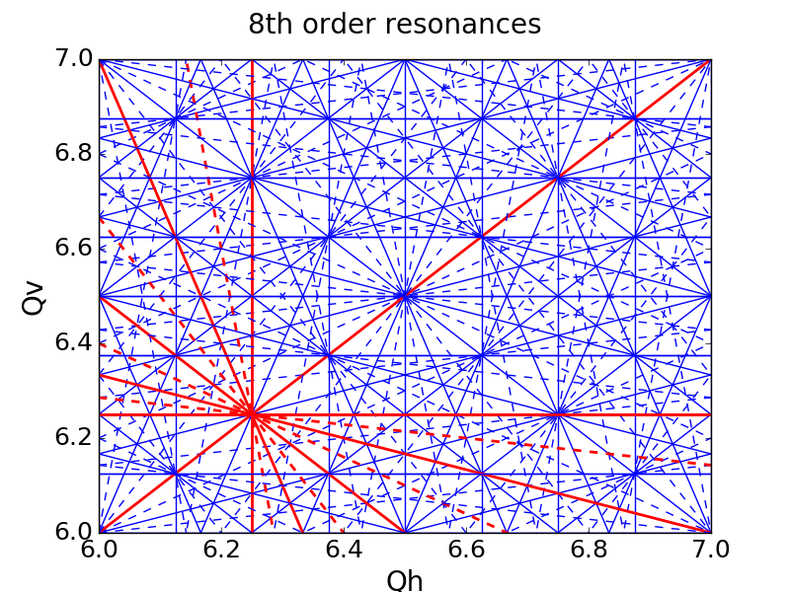
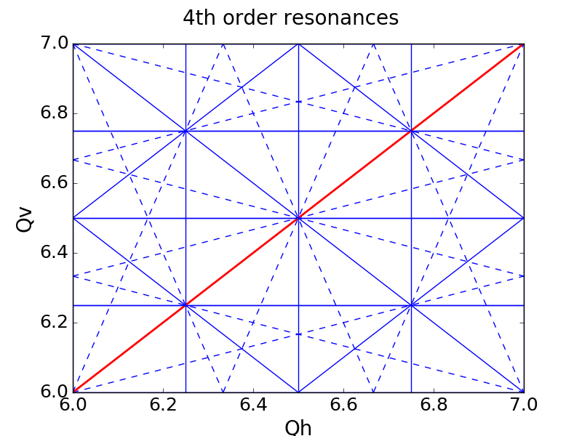
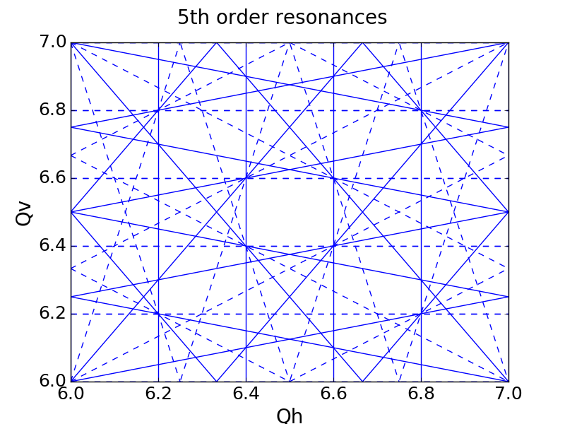
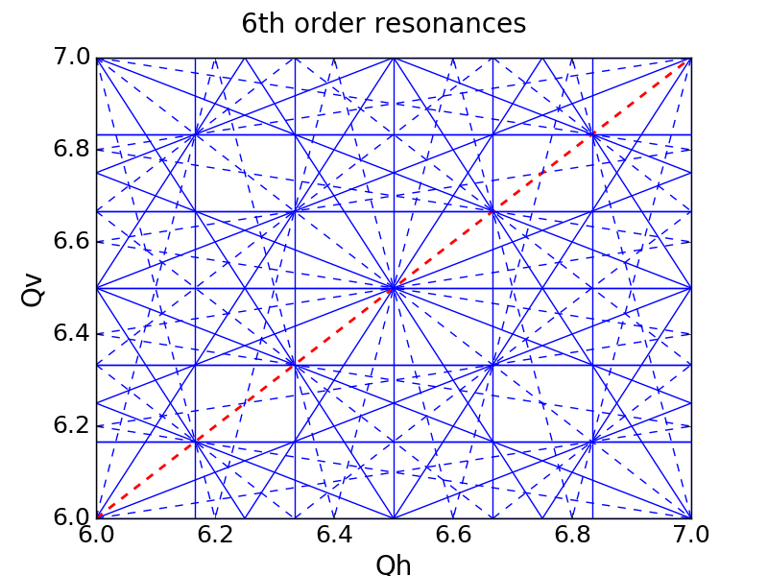
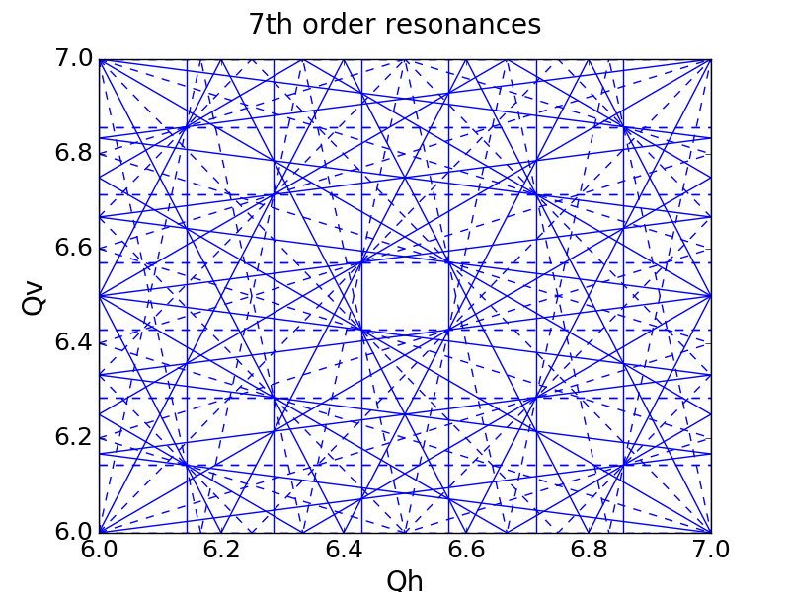
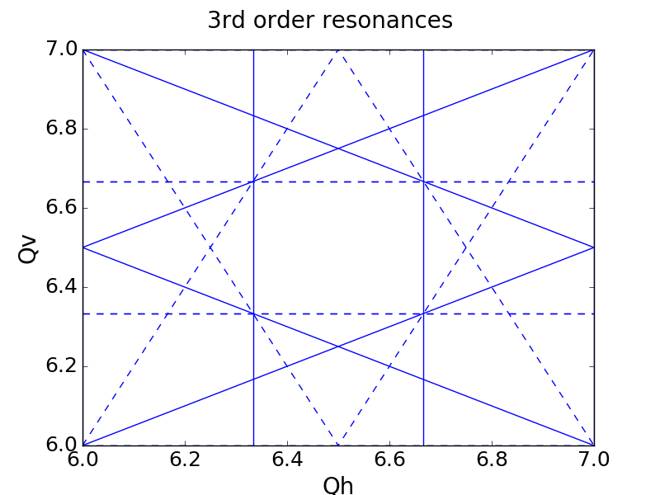
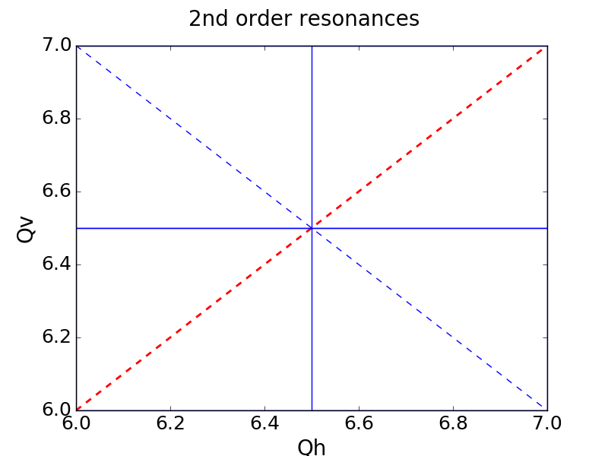
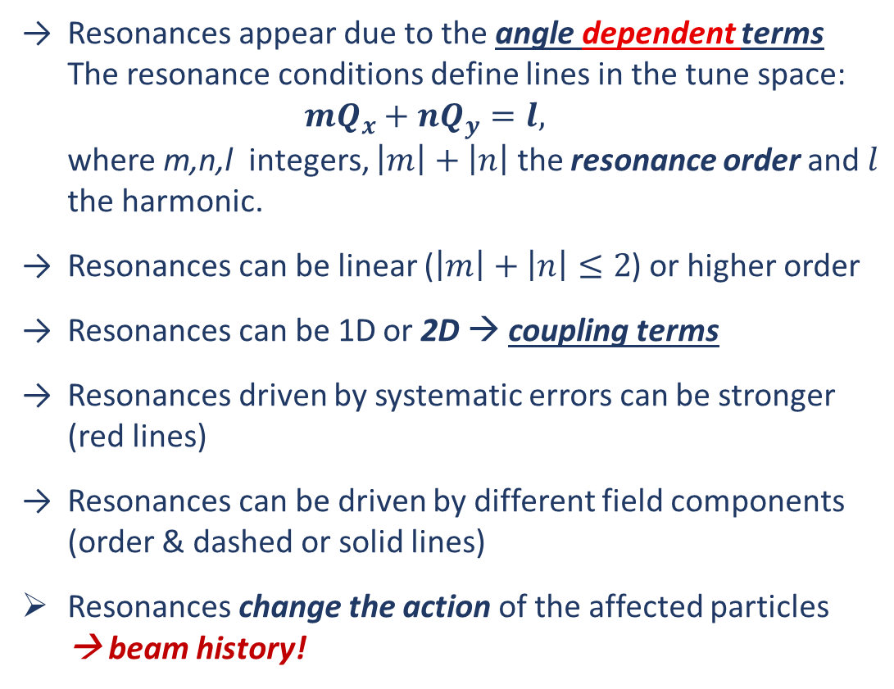
Sources of non-factorization: Space charge & Resonances
Resonances appear due to the angle dependent terms The resonance conditions define lines in the tune space:
$mQ_{x}+nQ_{y}=l,$
where m,n,l integers, $\left|m\right|+\left|n\right|$ the resonance order and $l$ the harmonic.
Resonances can be linear ($\left|m\right|+\left|n\right|≤2$) or higher order
Resonances can be 1D or 2D → coupling terms
Resonances driven by systematic errors can be stronger
(red lines)
Resonances can be driven by different field components (order & dashed or solid lines)
Resonances change the action of the affected particles
→ beam history!

Slide 9

Sources of non-factorization: Space charge & Resonances
Space charge: Coulomb interactions among particles
Introduces linear and higher order systematic resonances:
angle dependent terms
  Strong resonances but can be avoided
Introduces linear & nonlinear detuning:
angle independent terms
  Strong detuning in all injectors at low energy
Introduces nonlinear coupling:
coupling terms
  Coupling from detuning terms alone don’t lead to correlations that propagate along the chain
Dominant effect for low energy & high brightness (dense)
For Gaussian Distributions:
$V_{sc}\left(x,y\right)=\frac{r_{o}N_{B}}{β^{2}γ^{3}\sqrt{2π}σ_{s}}\int_{0}^{∞}{\frac{−1+e^{−\frac{x^{2}}{2σ_{x}^{2}+t}−\frac{y^{2}}{2σ_{y}^{2}+t}}}{\sqrt{\left(2σ_{x}^{2}+t\right)\left(2σ_{y}^{2}+t\right)}}dt}$
Energy
Transverse Beam Size
Bunch Intensity
Transverse Action
Longitudinal Parameters/Action
Scaling

Slide 10
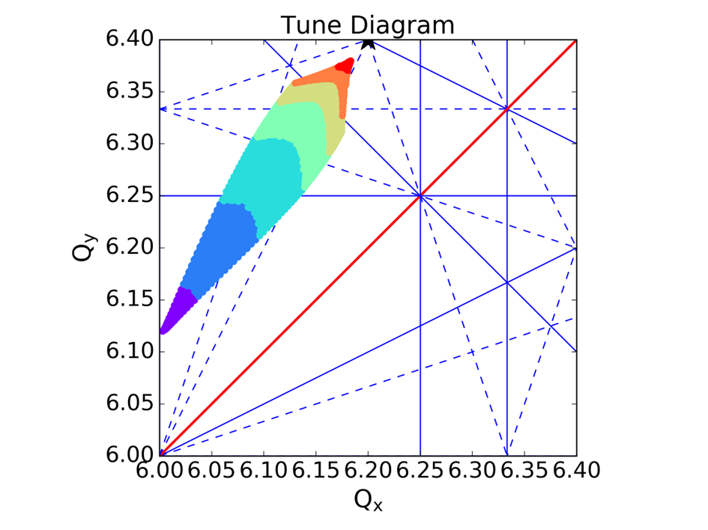
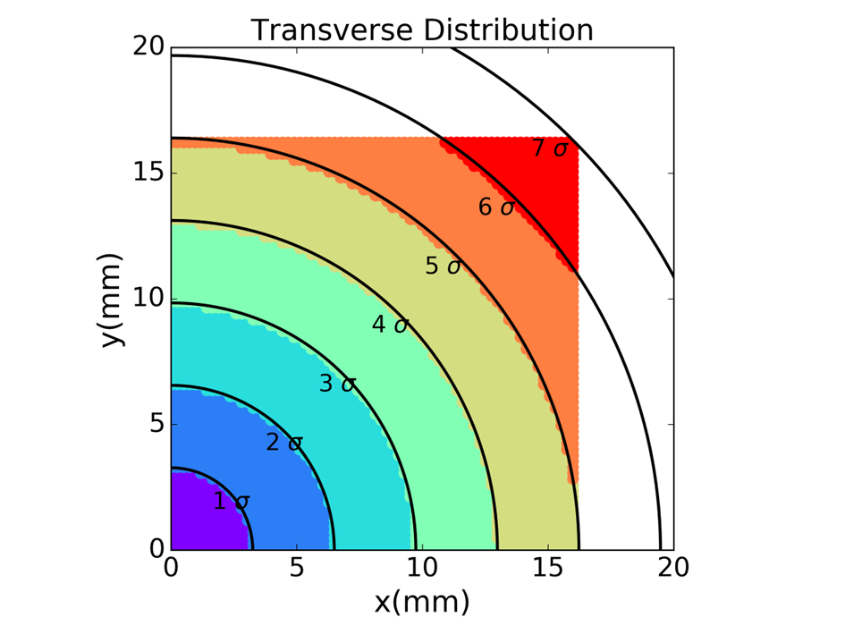
Sources of non-factorization: Space charge & Resonances
Transverse Action→ “Tune spread”
Different tunes lead to different dynamics (resonances)

Slide 11
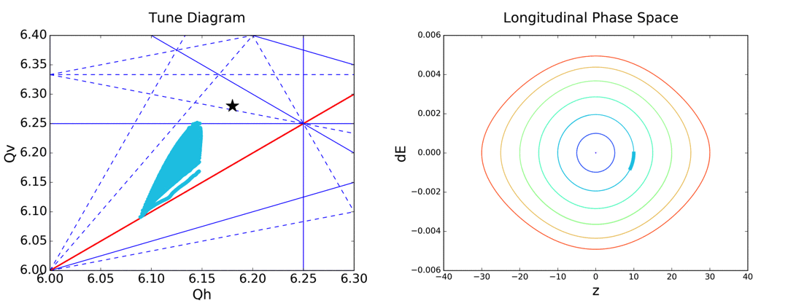
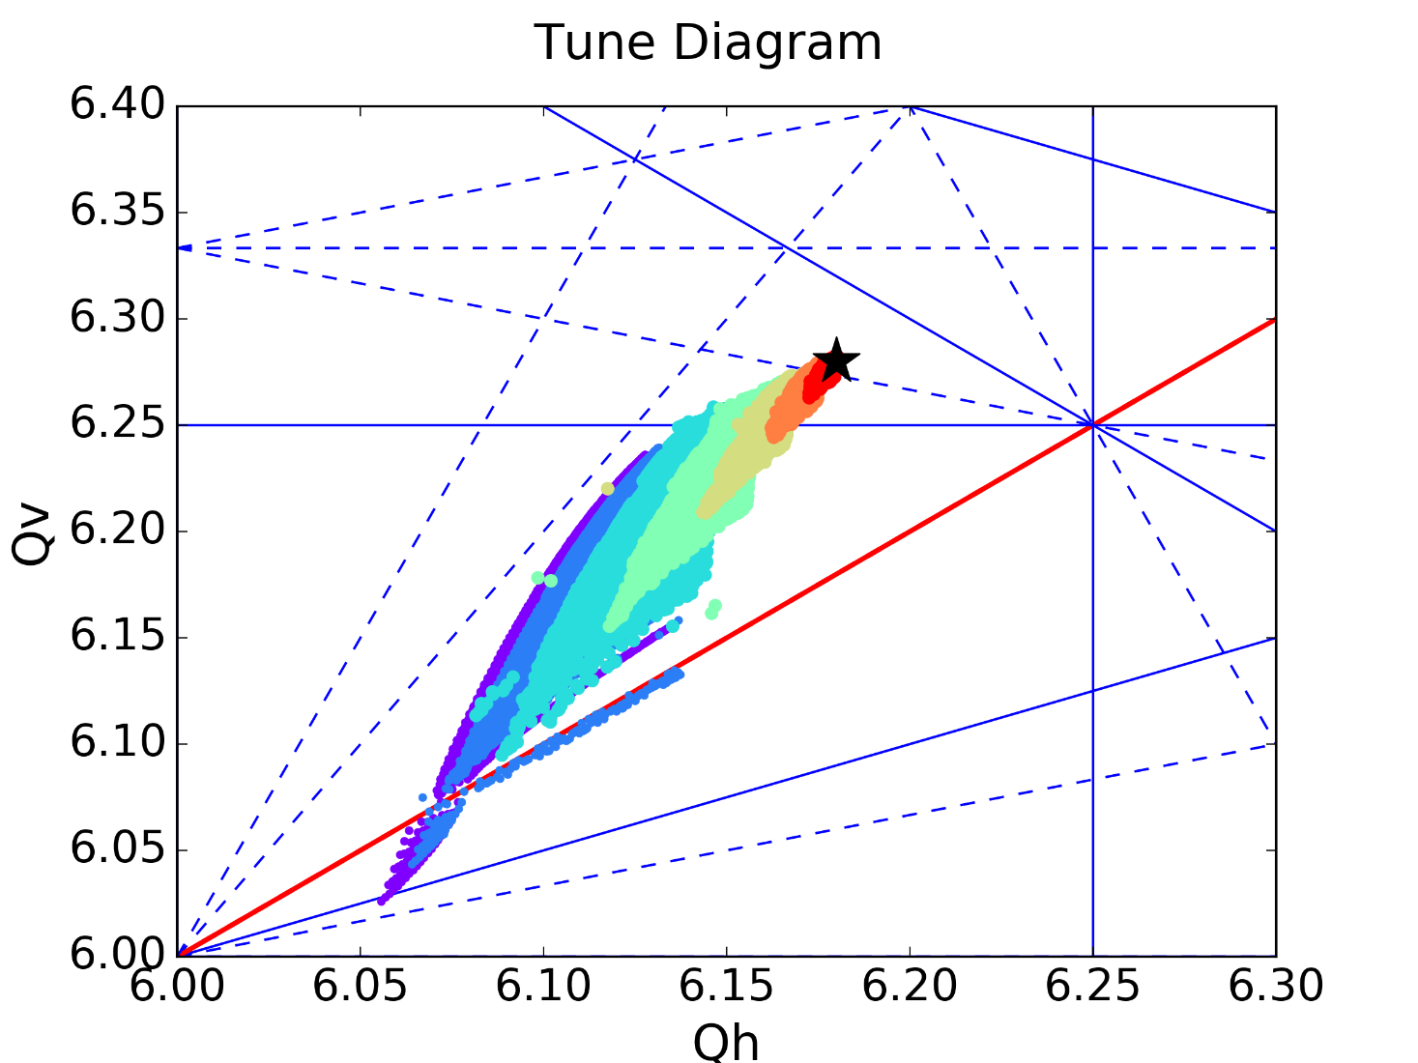
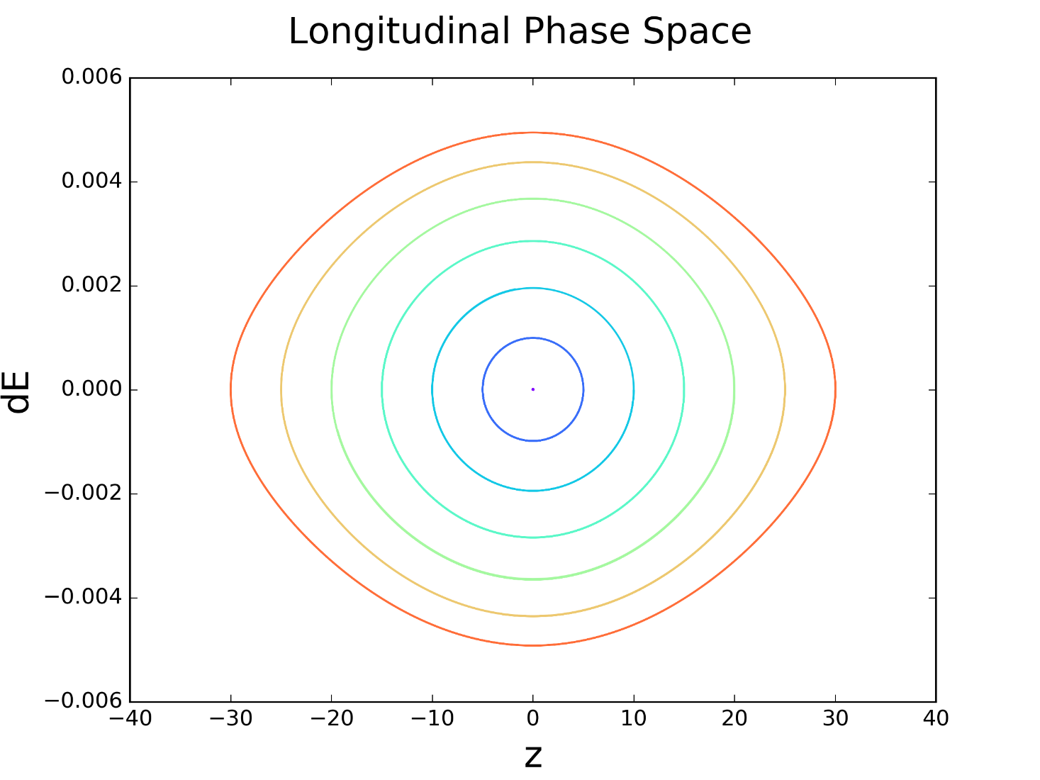
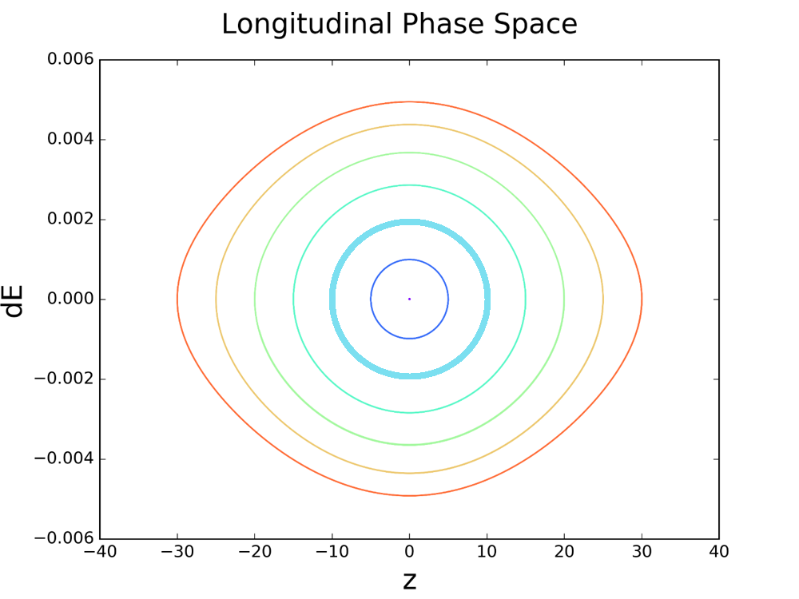
Sources of non-factorization: Space charge & Resonances
Longitudinal Parameters/Action → Different tune spread
Synchrotron motion → Periodic resonance crossing (coupling with longitudinal)

Slide 12
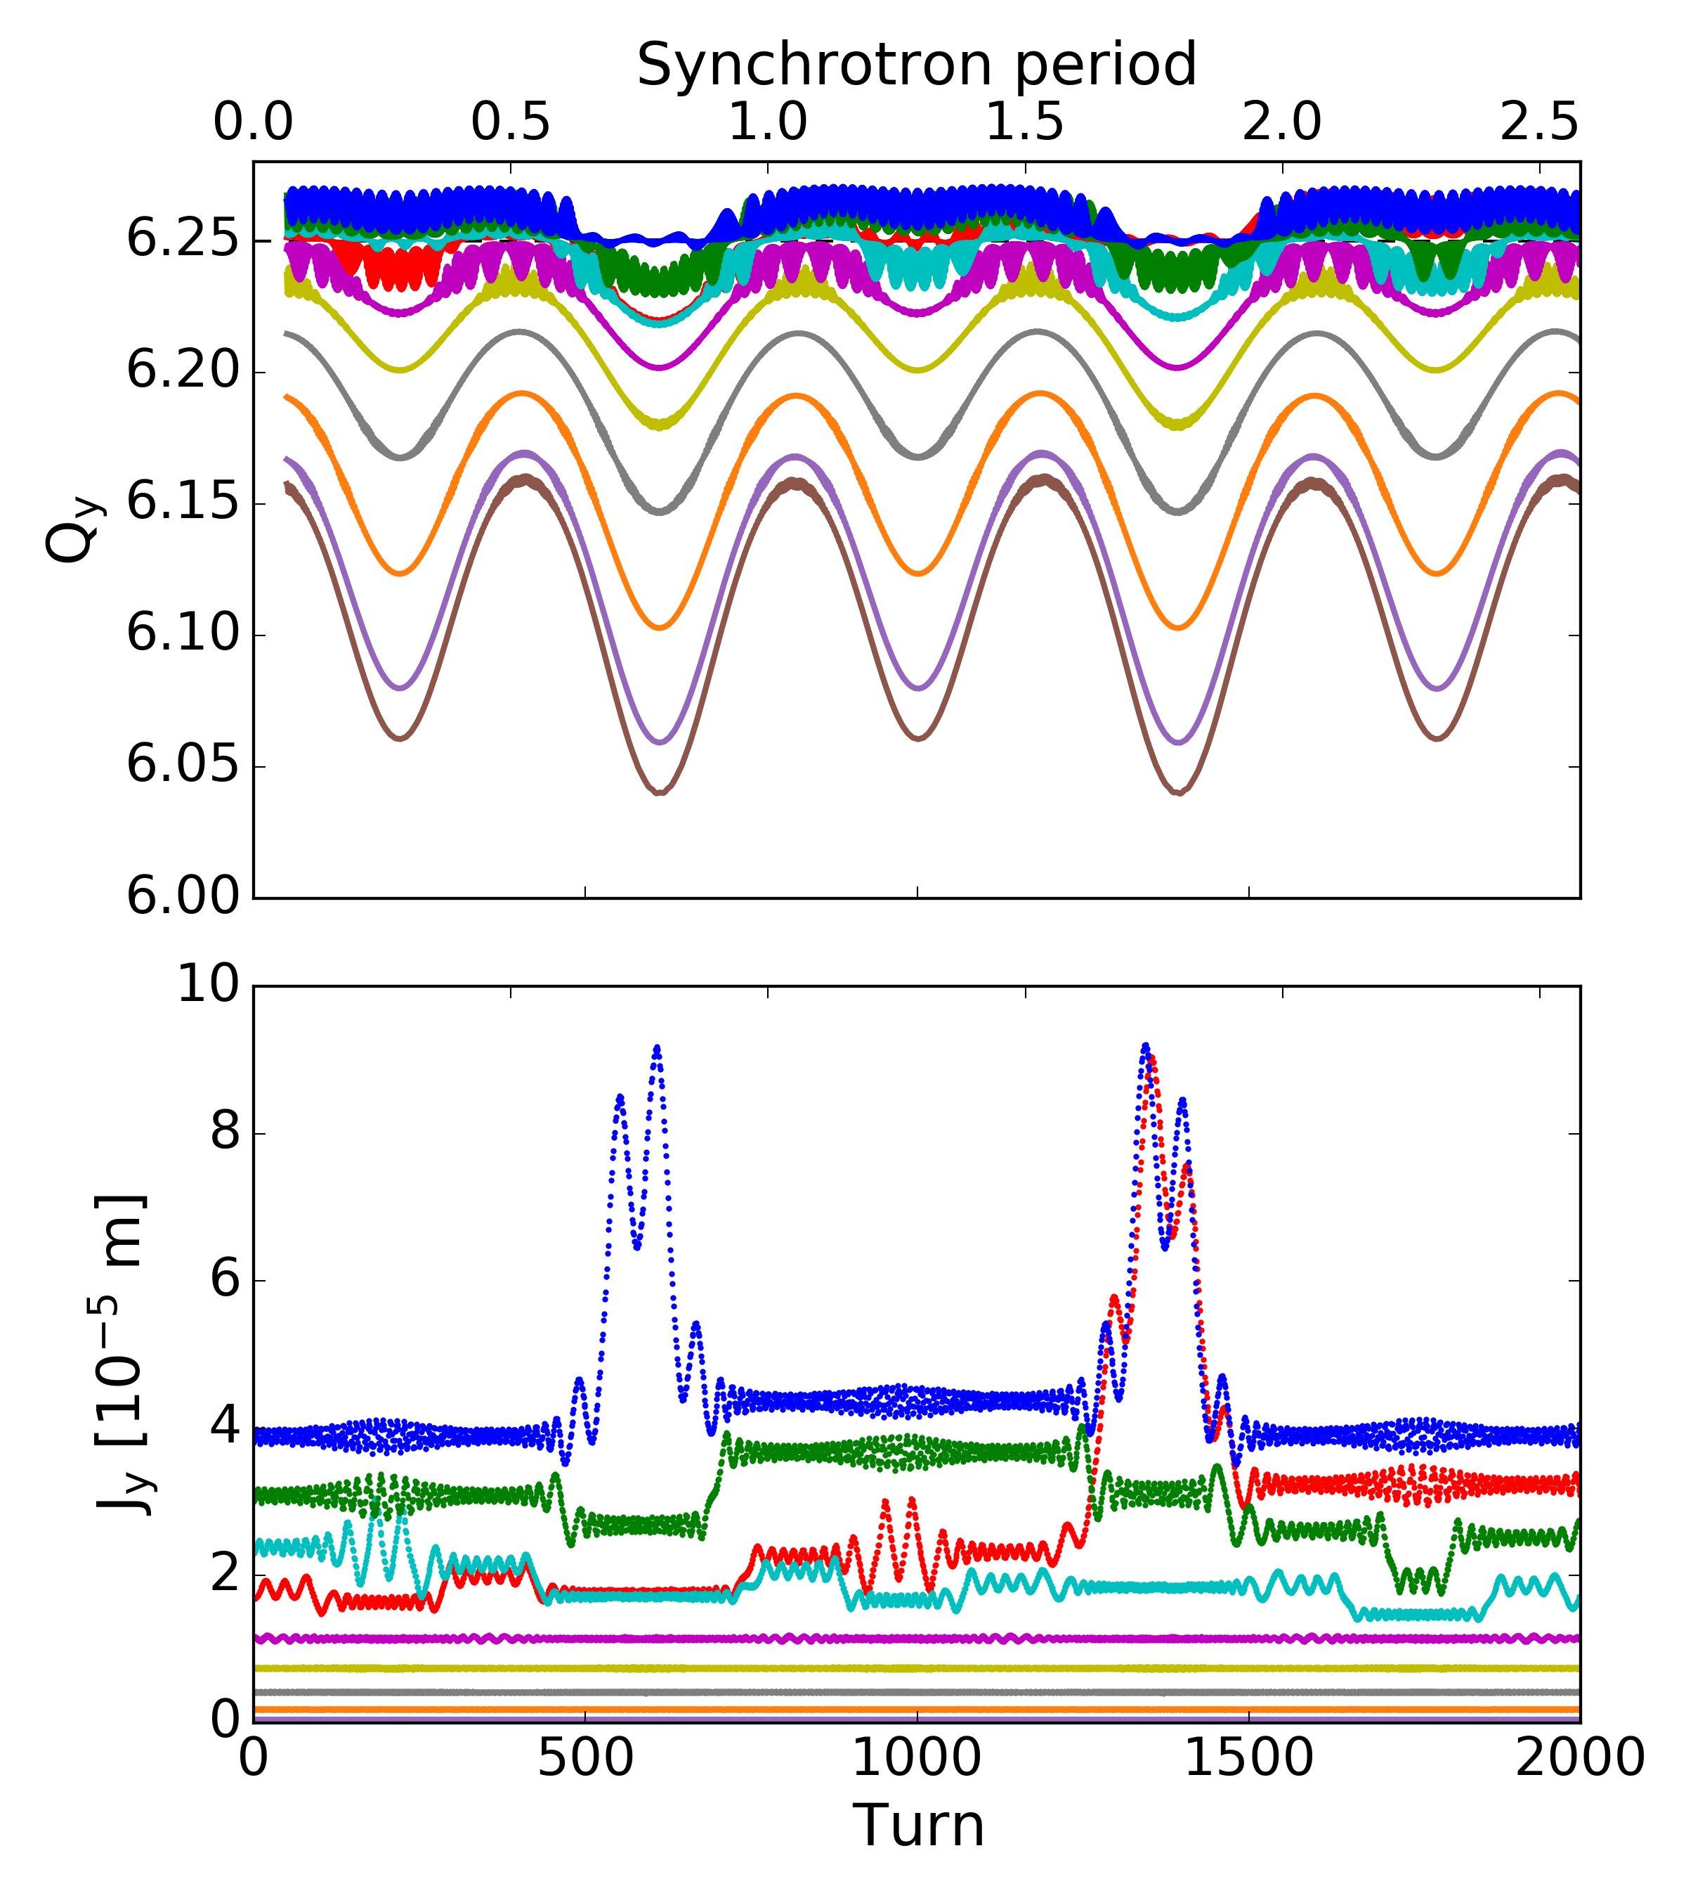
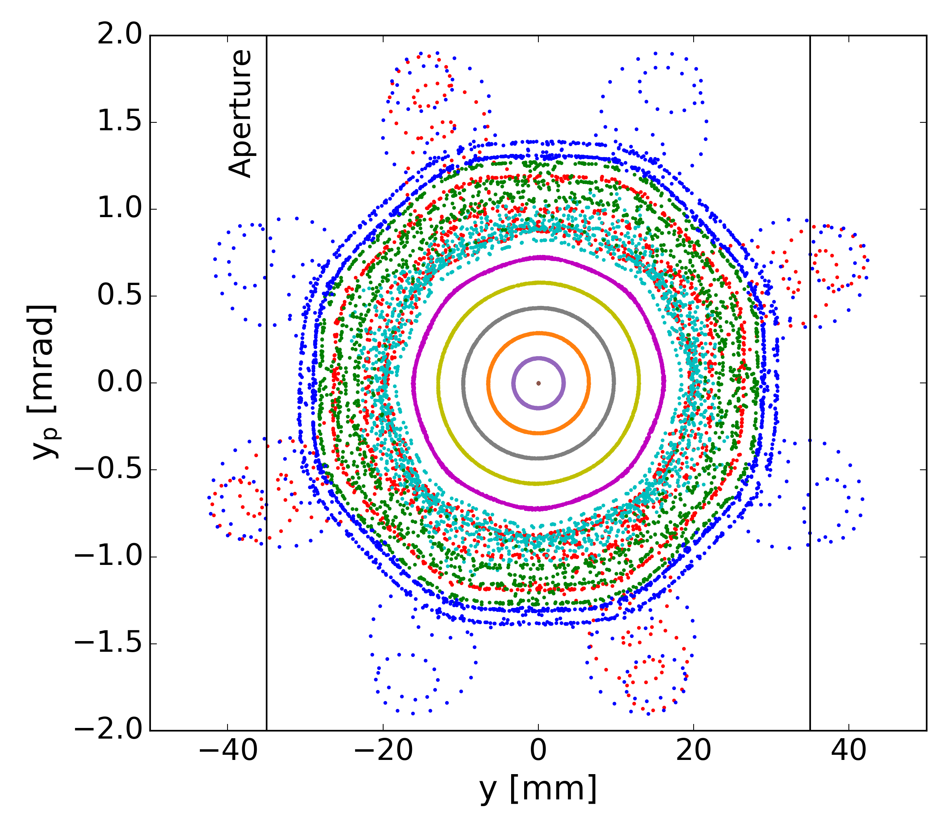
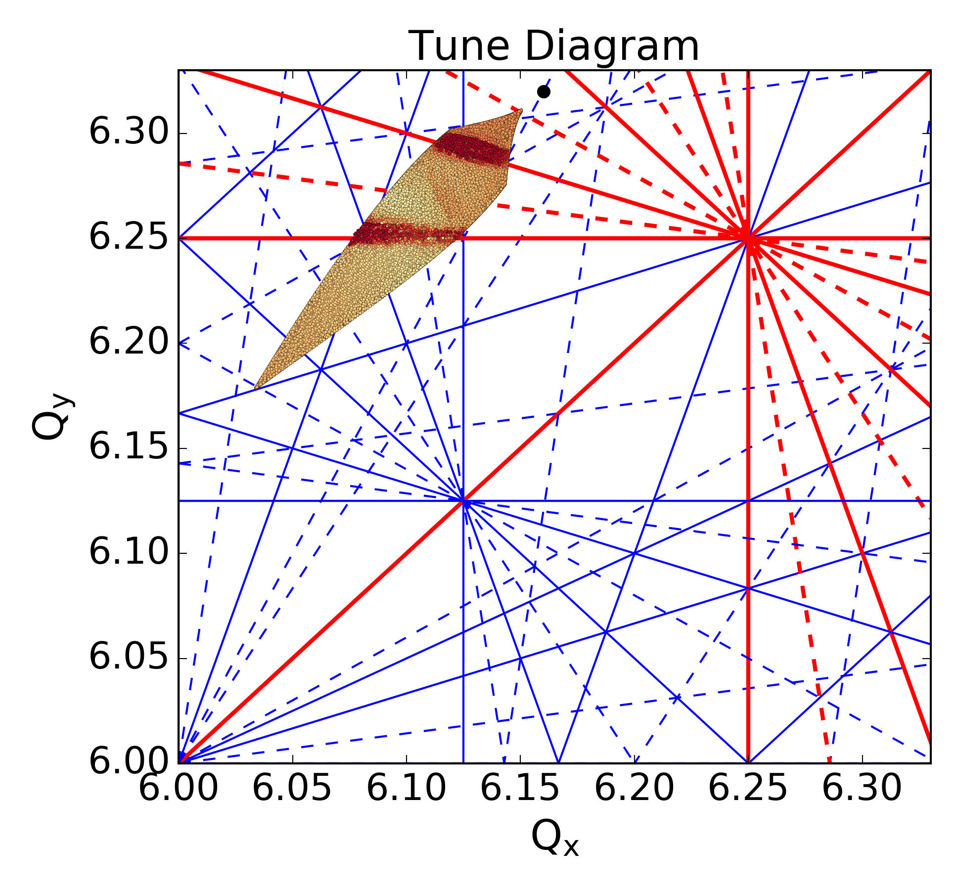
Sources of non-factorization: Space charge & Resonances
Driven resonances under space charge:
1D resonance
Tune modulation away from driven resonance
→ Constant Action
Tune modulation approaching driven resonance
→ Action Modulated: “scattering”
Tune modulation crossing driven resonance
→ Action Increase: “trapping” (islands)

Slide 13
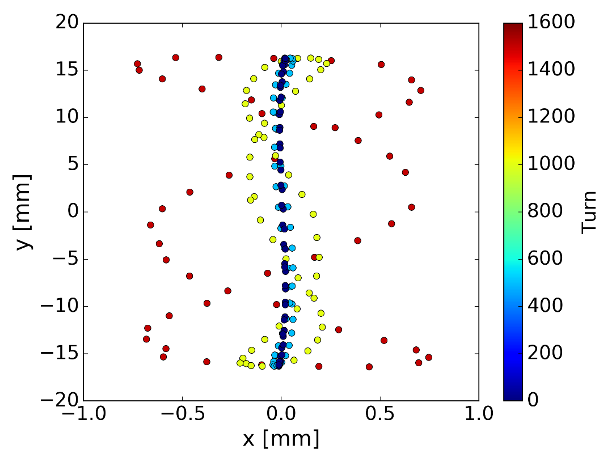
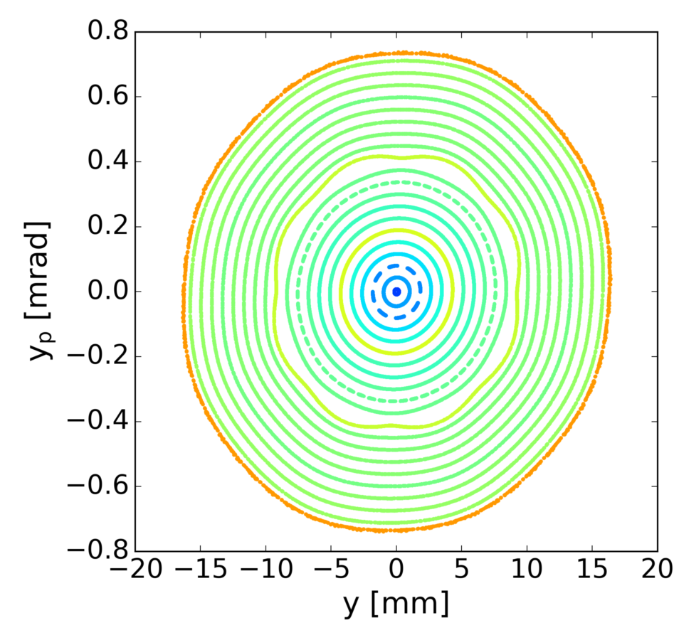
Sources of non-factorization: Space charge & Resonances
Driven resonances under space charge:
1D resonance
2D resonance
Similar tune regimes & observations
No clear patterns (islands) on individual planes
Fixed lines form in the x-y plane
→ Strong correlation : action change in both planes
“New” action propagated along the chain
History including correlations!

Slide 14
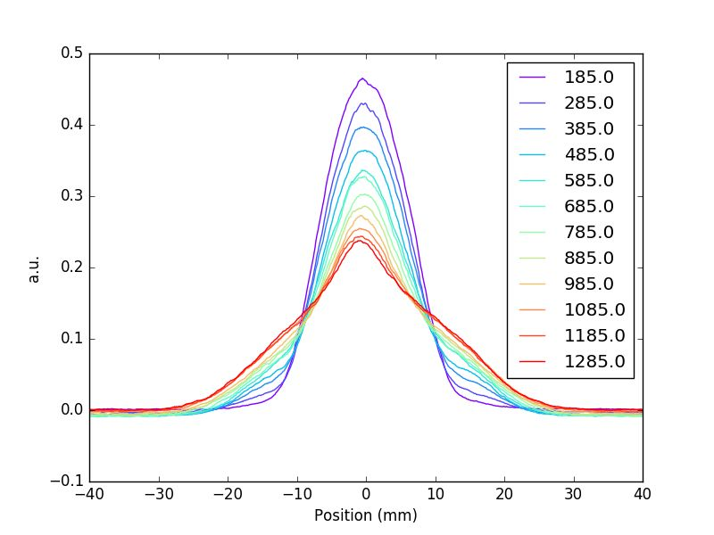
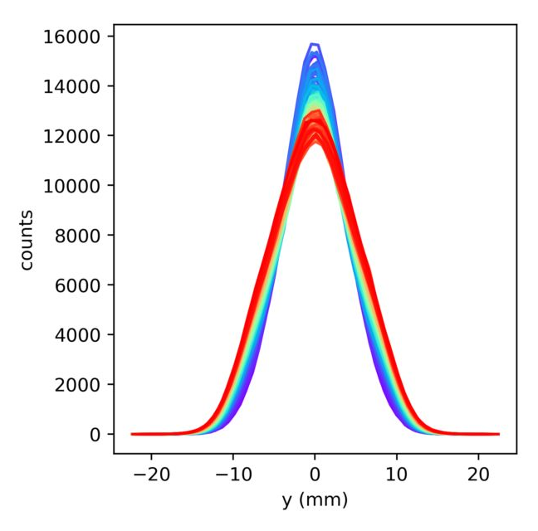
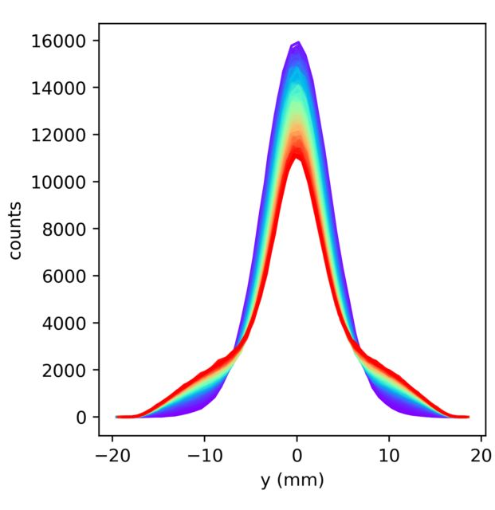
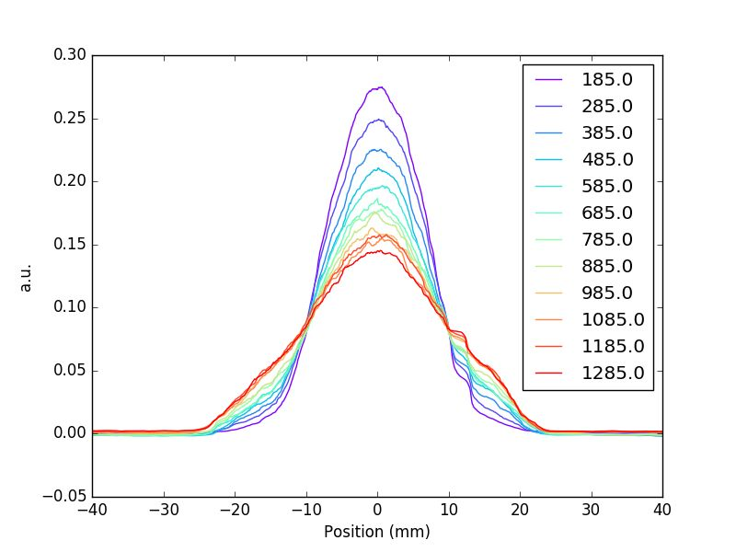
Sources of non-factorization: Space charge & Resonances
Impact on profiles depending on tune spread & resonances:
Emittance increase
Tail formation
1D or 2D
x
y

Slide 15
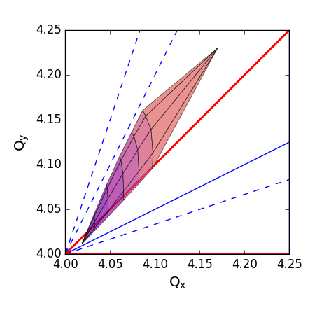
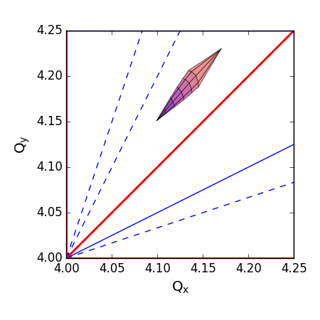
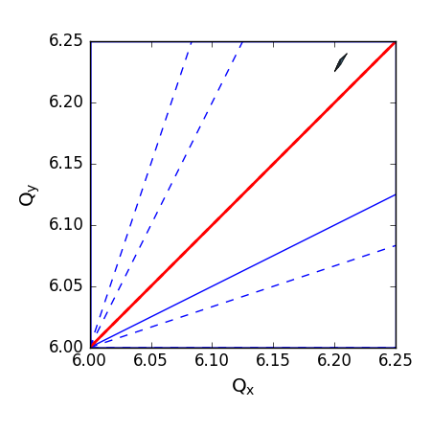
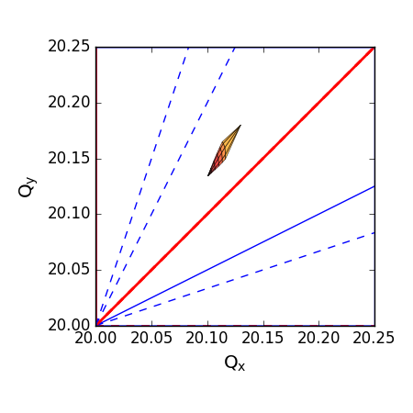
Requirements for vdM beams
Special preparation for vdM beams:
INDIV type: Each bunch created in a different PSB ring
No splitting or other manipulations in the PS & SPS
Low intensity & high emittance: Low space charge
  Beam from the LINAC: ~0.5um → manipulation in the PSB to increase the emittance!
Factorizable distributions: Avoid correlations in the distributions
  Critical during PSB manipulations
PSB
PSB
PS
SPS
During
manipulations

Slide 16
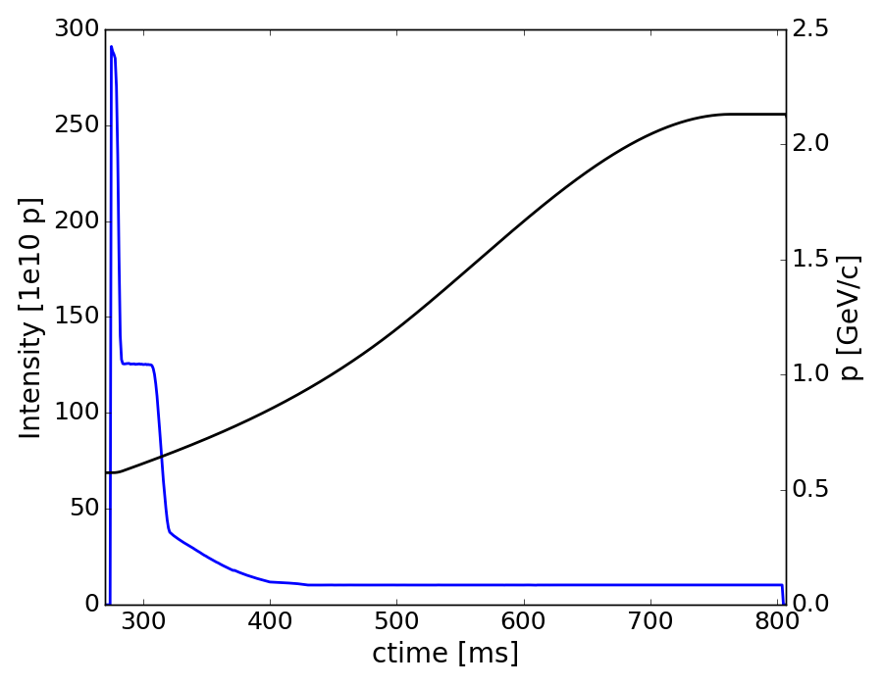
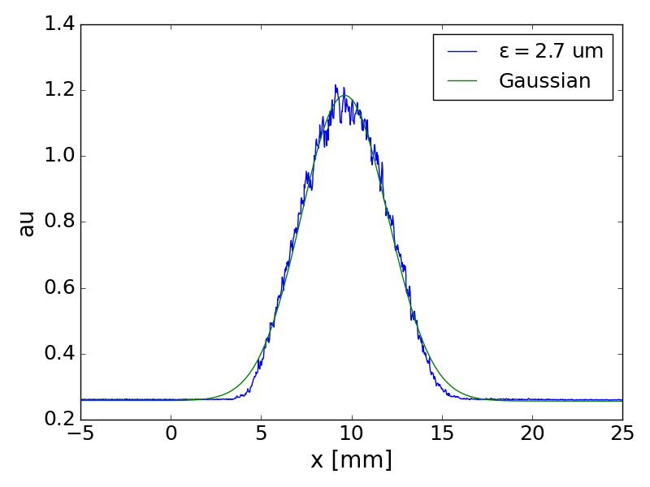
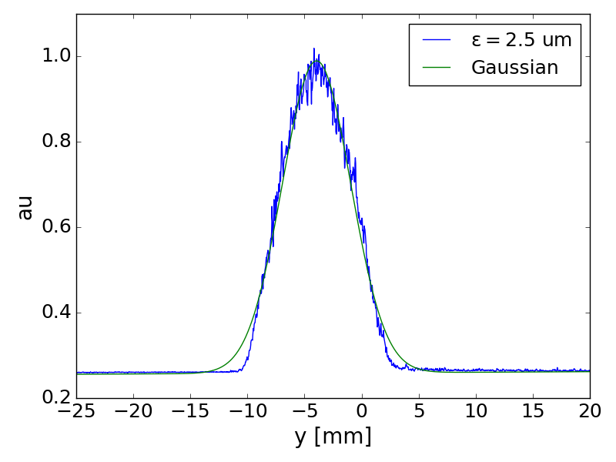
Production scheme for vdM beams: Run 2
Pre-LIU PSB: Limited options for manipulations
Production scheme:
  High intensity injected: ~300e10 protons
  Space charge & resonances used to blow-up the beam
  Large scraping to remove tails: >90%
Are the planes independent?

Slide 17
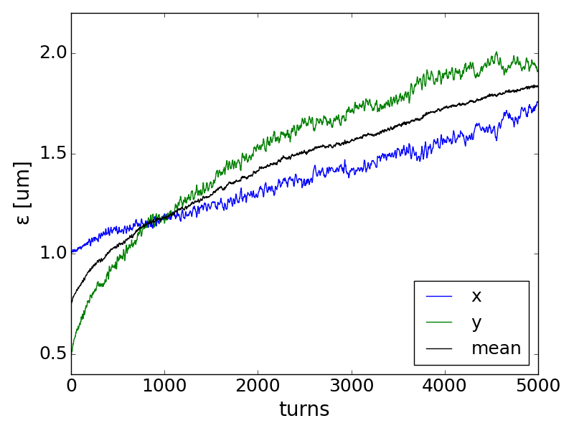
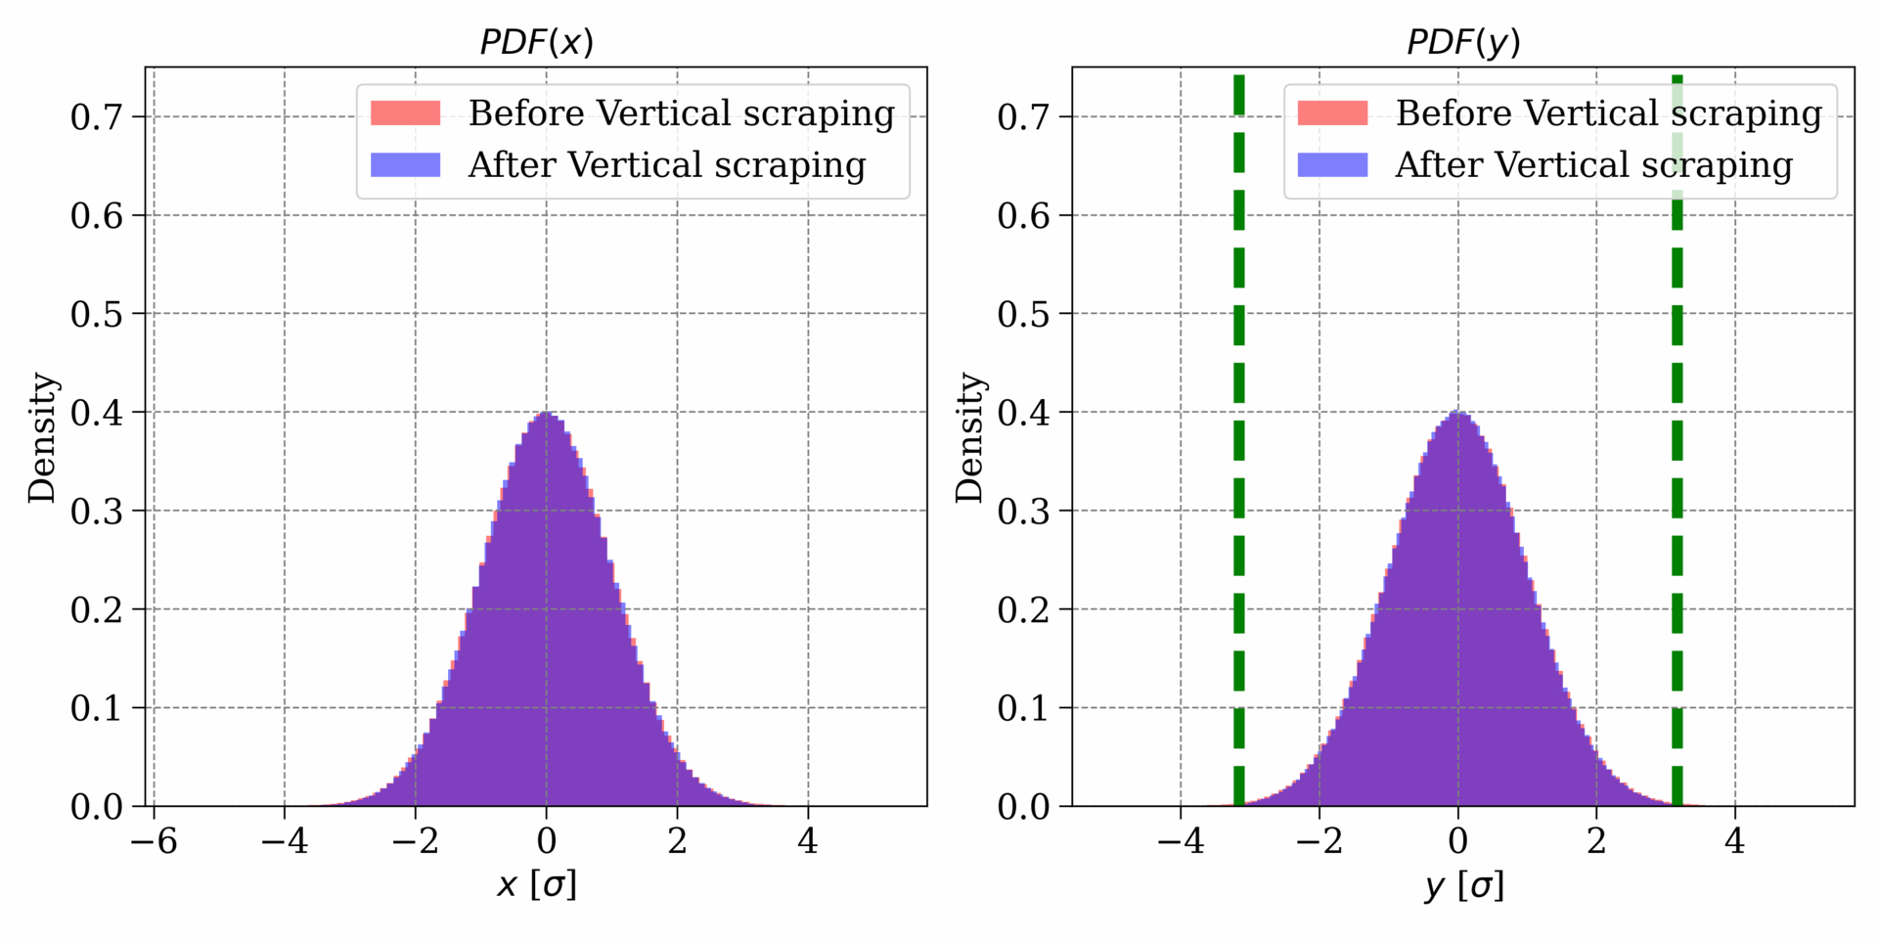
Production scheme for vdM beams: Run 2
Simulations show that the emittances increase but the planes are coupled
Emittances exchange and then are modulating in the transverse planes
Scrapping in one plane affects the other!

Slide 18
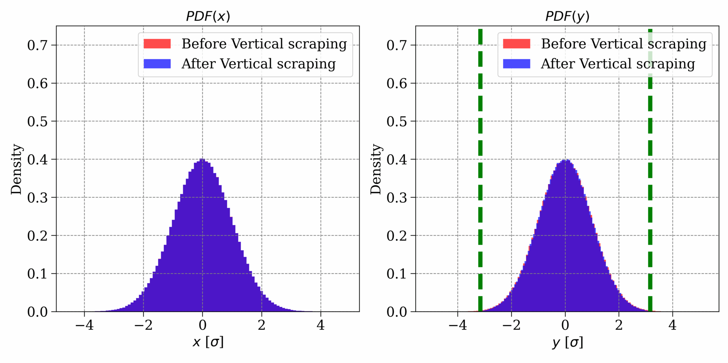
From Non-Factorizable to Factorizable
LIU PSB offers the flexibility of blowing-up the emittances without using resonances

Slide 19
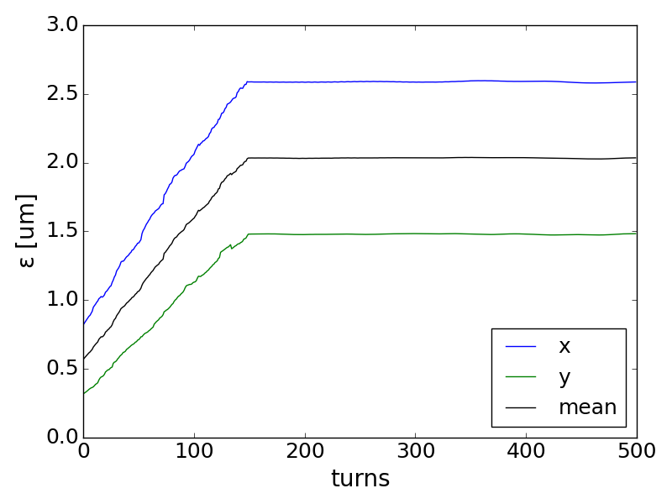
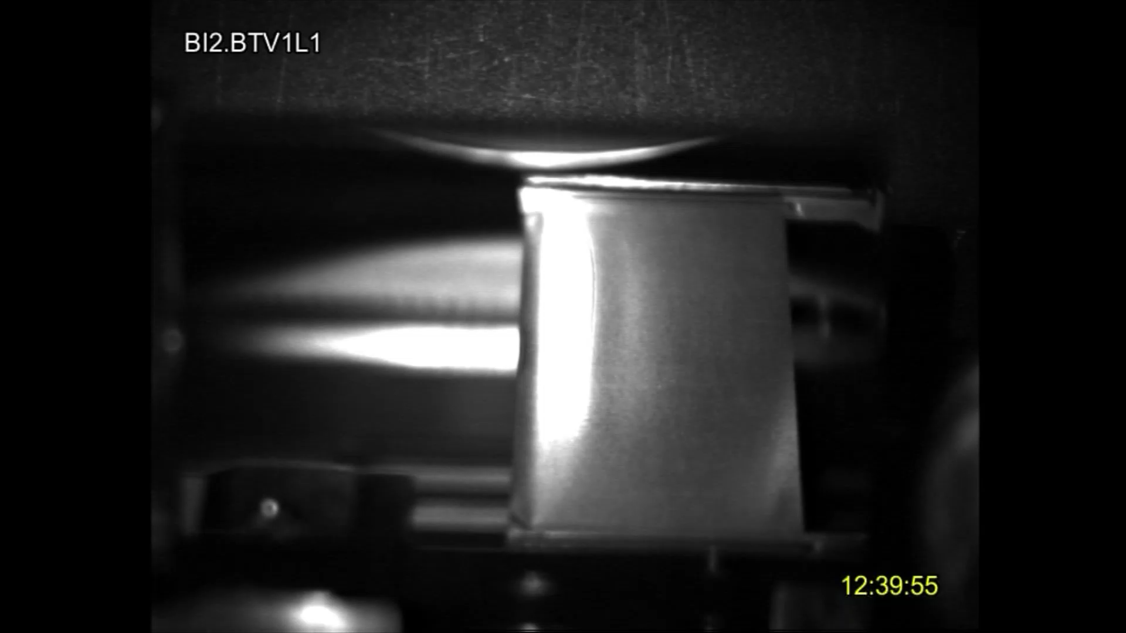
Production scheme for vdM beams: Run 3
LIU PSB offers the flexibility of blowing-up the emittances without using resonances
New H- exchange injection system → Stripping foil
Keeping the beam on the foil for 150 turns: emittance blow-up due to scattering
  Emittances increase independently in both planes

Slide 20
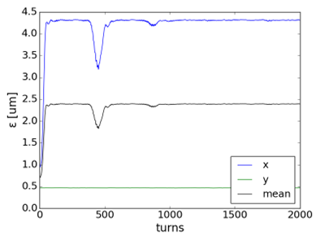
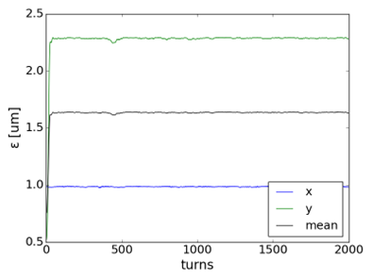
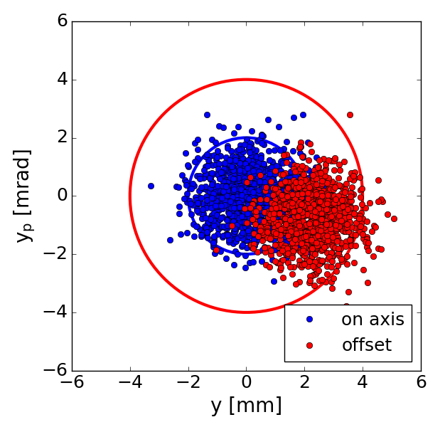
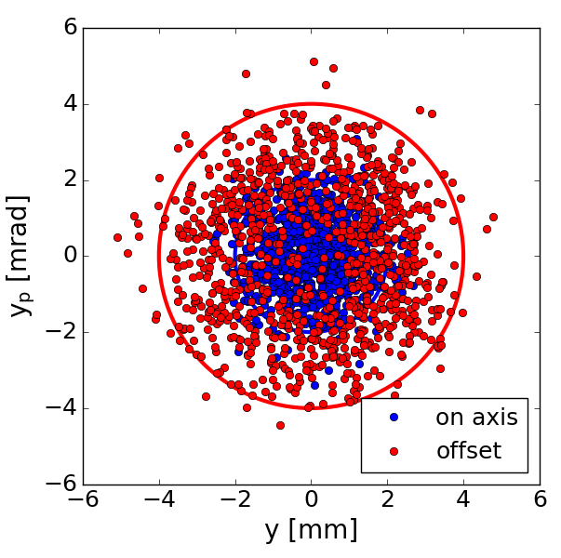
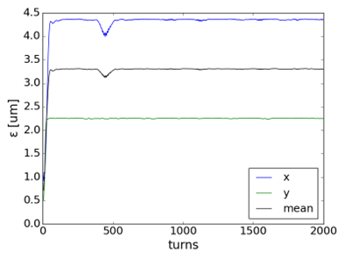
Production scheme for vdM beams: Run 3
LIU PSB offers the flexibility of blowing-up the emittances without using resonances
Injection offset in x,y or both planes
Particles in phase space follow larger eclipse → emittance blow-up
Emittances increase independently in the two planes
  Fluctuations disappear out within a few turns
x-offset
y-offset
x- & y- offsets

Slide 21
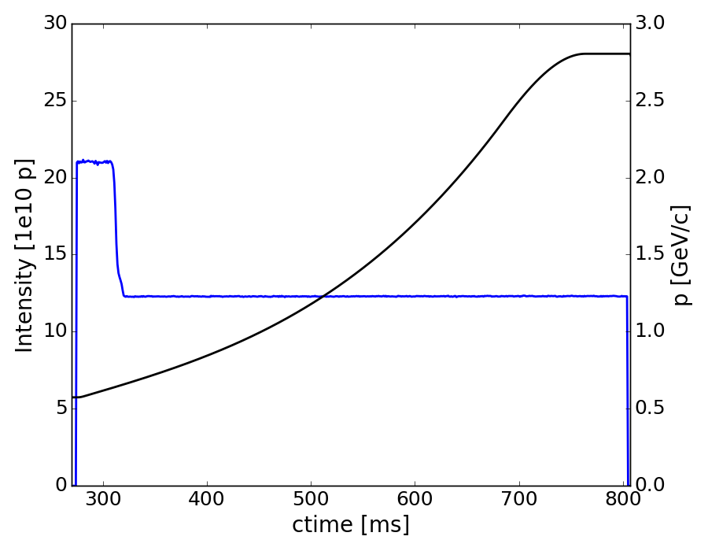


Production scheme for vdM beams: Run 3
LIU PSB offers the flexibility of blowing-up the emittances without using resonances
Re-Introduced scraping to avoid tails and possible correlations coming from Linac 4 (following your feed-back)
scraping much less aggressive than in Run 2
Less than Gaussian tails at PSB extraction

Slide 22




Production scheme for vdM beams: Run 3
LIU PSB offers the flexibility of blowing-up the emittances without using resonances
Scraping also in the SPS to ensure Gaussian profiles
  Removing tails that populate downstream of the PSB
Long flat bottom storage (needed for certain injection schemes) degrades the beam performance and can introduce correlations

Slide 23
Production scheme for vdM beams: Run 3
LIU PSB offers the flexibility of blowing-up the emittances without using resonances
New H- exchange injection system → Stripping foil
Injection offset in x and y planes
Re-Introduced scraping to avoid tails and possible correlations coming from Linac 4 (following your feed-back)
Scraping in the SPS to remove tails downstream of the PSB
This beam production should have the best performance in terms of factorization
Long storage in the SPS degrades the beam quality
Differences coming from the new Linac (Linac 4) cannot be excluded
follow-up on distributions from the Linac 4 also in the context of optimizing nominal beams

Slide 24
Summary
vdM beams challenging in the injectors requiring special setup
Strong space charge tune spread due to low energy in the PSB & SPS
Linear and nonlinear resonances can induce correlations in the planes of motion that propagate along the chain
In Run 3 “LIU complex”: H⁻ & Linac 4 (instead of p & Linac2)
LIU PSB offers additional flexibility for cleaner production of vdM beams
Beam produced avoiding mechanisms that can lead to non-factorization
(only scattering on the foil & injection steering)
Scrapping in both PSB & SPS to maintain beam quality (following feedback)
Long SPS flat bottom should be avoided
Recent studies along the full chain confirm the expectations on the beam dynamics side→ E. Lamb
Dedicated slots in the Injector Schedule in 2025 to confirm beam quality
Additional studies (LHC scraping etc) only if needed!
How did the 2024 vdM beam look like on your side?

Slide 25



Production schema for vdM beams: LIU (2023)
LIU PSB offers the flexibility of blowing-up the emittances without using resonances
Stripping foil
Injection offset in x,y planes
No scraping in 2022 and 2023

