Slide 1
Results of the 2024 Non-factorization MD accelerator measurements
F. Asvesta, H. Bartosik, S. Kostoglou, E. Lamb, G. Sterbini
With thanks to: S. Albright, M. Bozatzis, E. De la Fuente Garcia, G. Franchetti, M. Giovannozzi, P. Hermes, L. Intelisano, A. Lasheen I. Mases, D. Miriarchi, C.E. Montanari, G. Papotti, K. Paraschou, T. Persson, T. Pieloni, T. Prebibaj, M. Seidel, G. Trad, F. Van der Veken, J. Wanczyk, PSB-PS-SPS-LHC-OP, CMS, ATLAS, LHCb

Slide 2
Contents
Introduction
Results from injectors
LHC MD / Non-Factorization MD
Summary

Slide 3
Introduction

Slide 4

LINAC4 PSB PS SPS LHC
Sources related to bunch’s history only
  Joint measurements with experiments to improve understanding:
    → If there can be non-factorization contribution from the bunch’s history
    → Can we control/measure the non-factorization along the accelerator chain?
Preliminary injector measurements
LHC injection energy
Joint LHC
‘Non-Factorization MD’

Slide 5
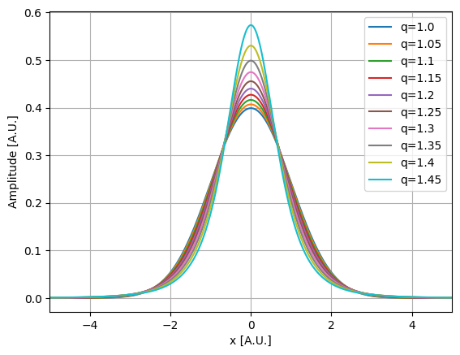
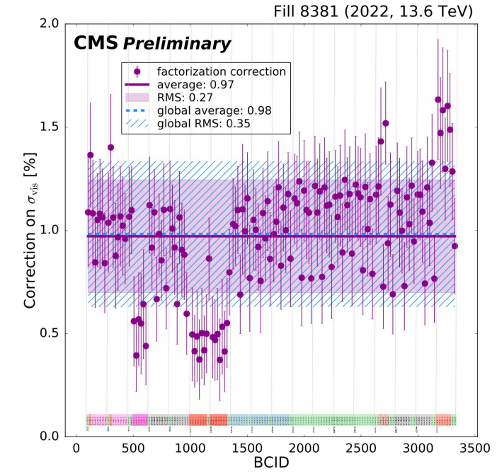
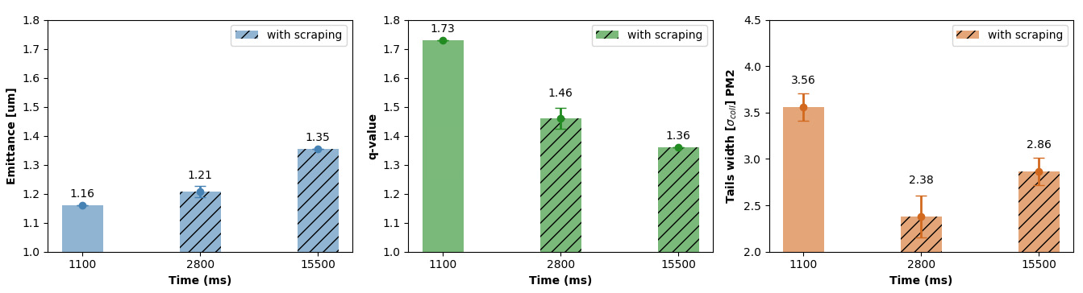
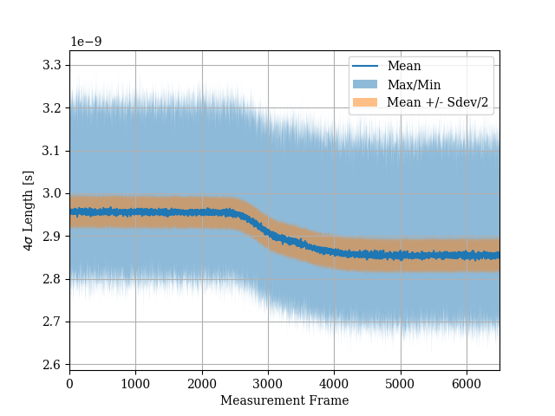
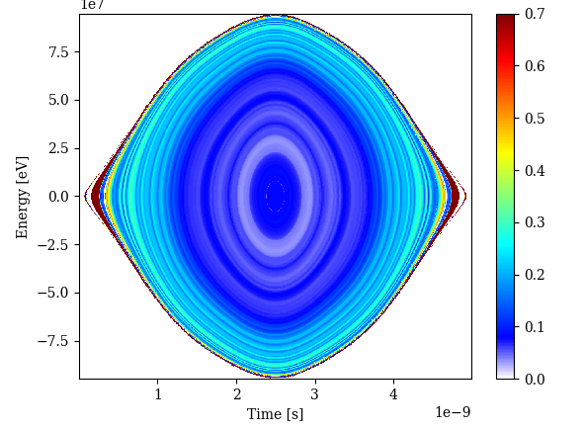
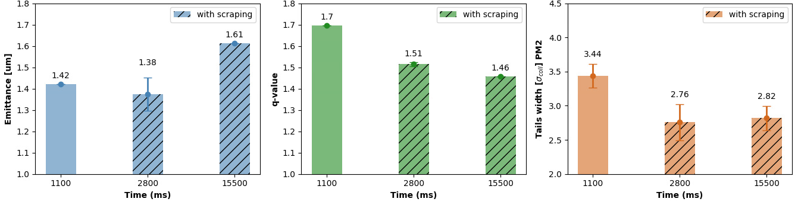
Motivation
V
…and the longitudinal bunch length
Vertical scraping @ 1800ms in SPS
H
Scraping changes distribution in both planes
Longitudinal correlation
BCID pattern
LINAC4/PSB upgrades

Slide 6
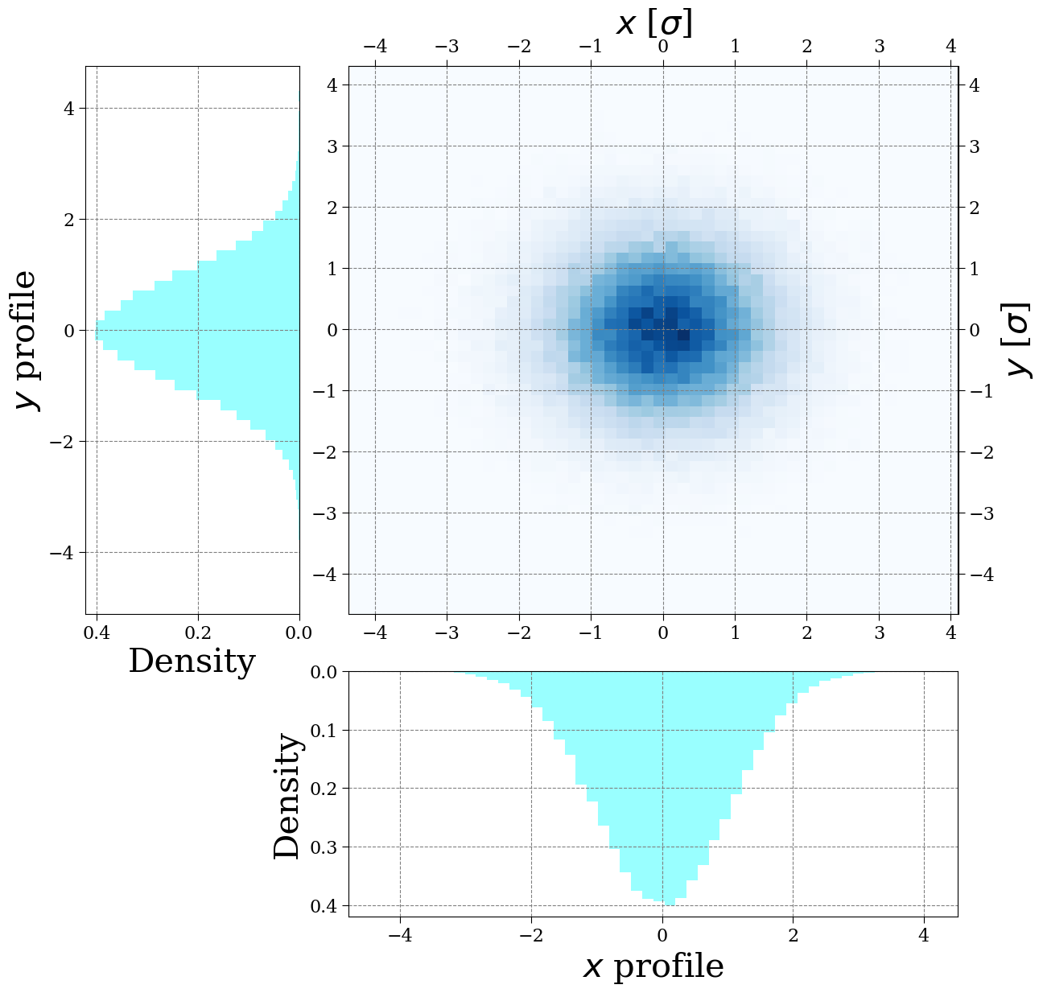
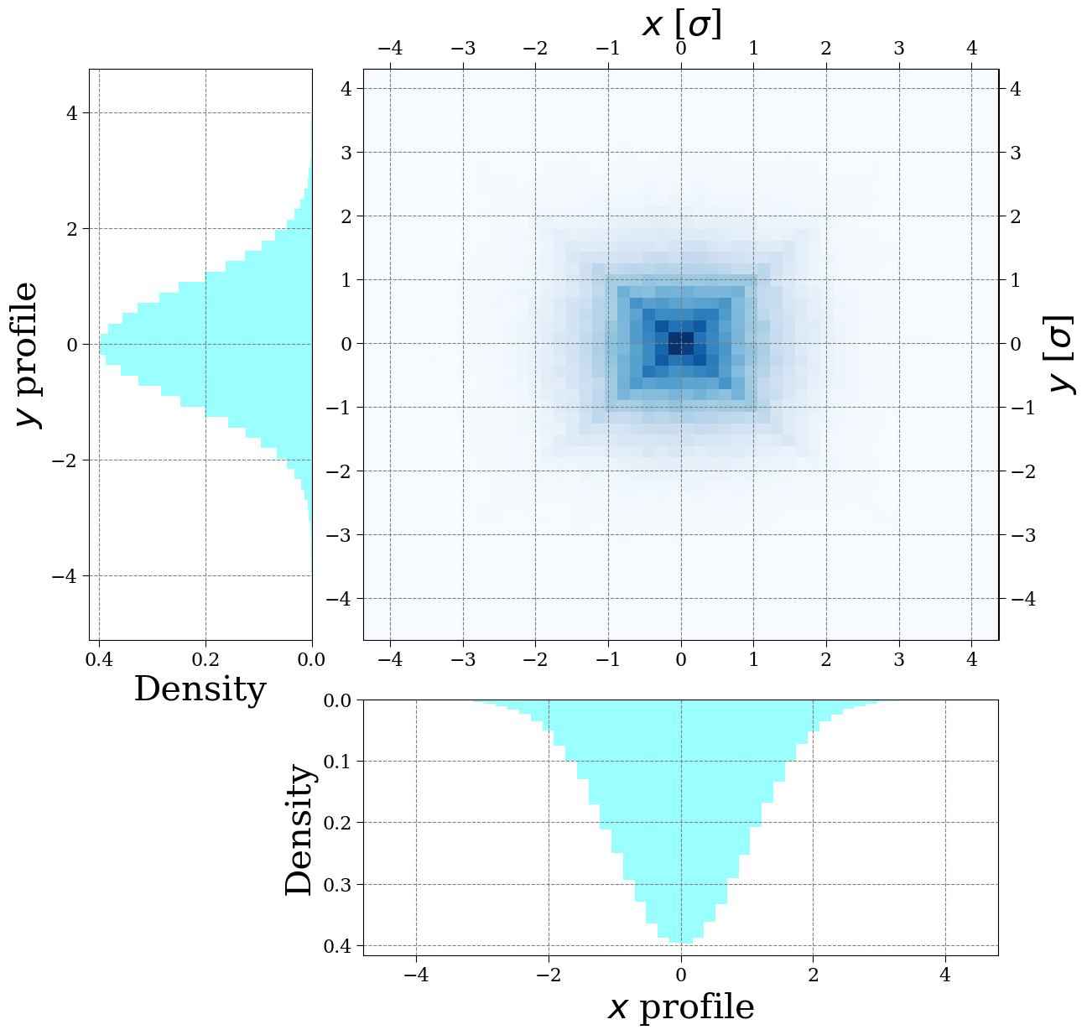

Measurement instrument
Same beam profile, $PDF(x),$but different $PDF(x,y)$
Factorizable$ρ\left(x,y\right)=ρ\left(x\right)ρ(y)$
Non-Factorizable$ρ\left(x,y\right)≠ρ\left(x\right)ρ(y)$

Slide 7
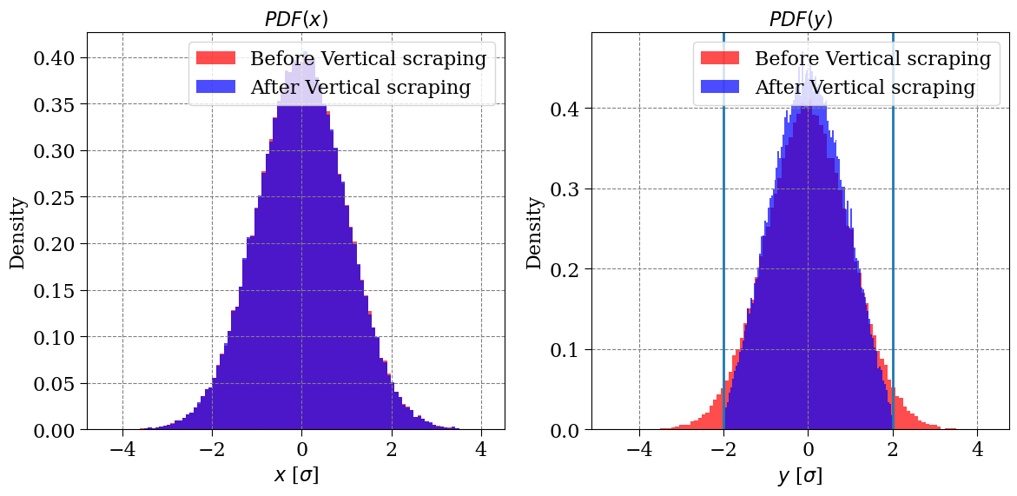




Measurement instrument
Scraping in $y$plane $→$ wire scanner $→$ normalisation
wire scan in $x$
Wire scan in $y$
Scraping in $y$
$$PDF\left(x | condition y\right)=PDF(x)$$

Slide 8
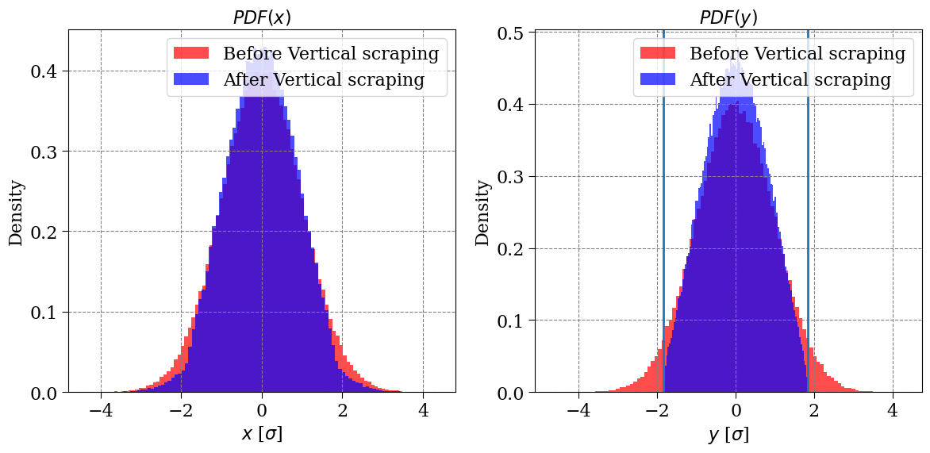
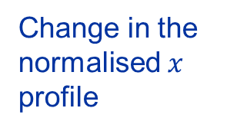


Measurement instrument
Scraping in $y$plane $→$ wire scanner $→$ normalisation
Change in the normalised $x$ profile
Scraping in $y$
$$PDF\left(x | y\right)≠PDF(x)$$

Slide 9
Injector measurements

Slide 10
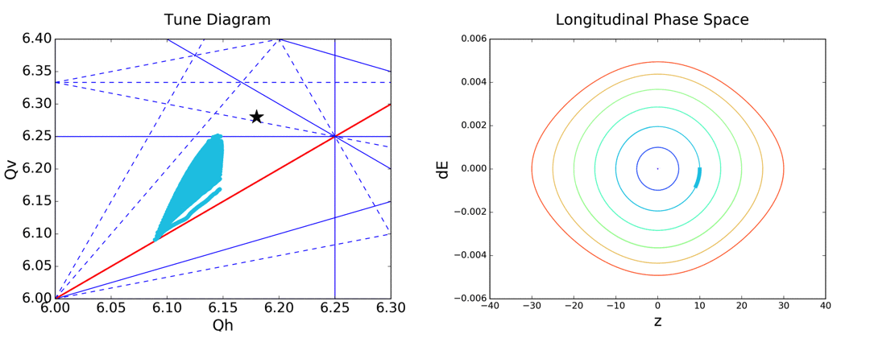
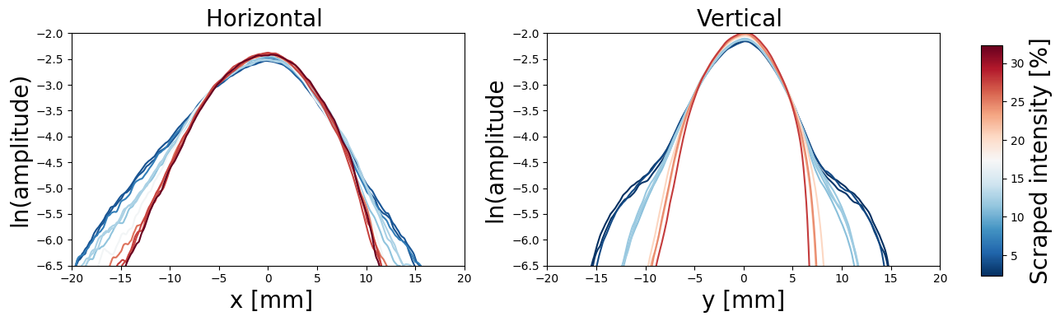
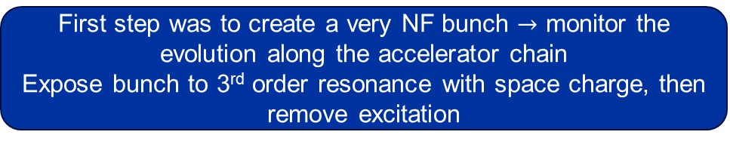
PSB
LINAC4 PSB PS SPS LHC
First step was to create a very NF bunch $→$ monitor the evolution along the accelerator chain
Expose bunch to 3rd order resonance with space charge, then remove excitation
Measurement after exposure to coupling resonances, showed lasting NF
Asymmetry could be due to non-linear dispersion

Slide 11
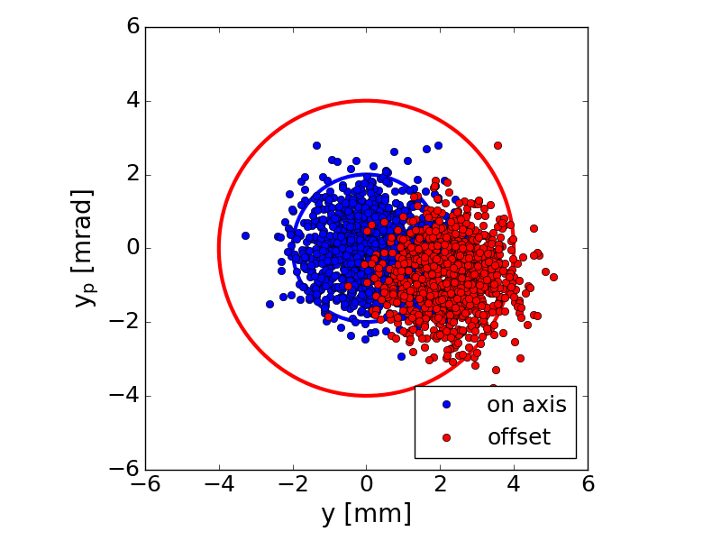
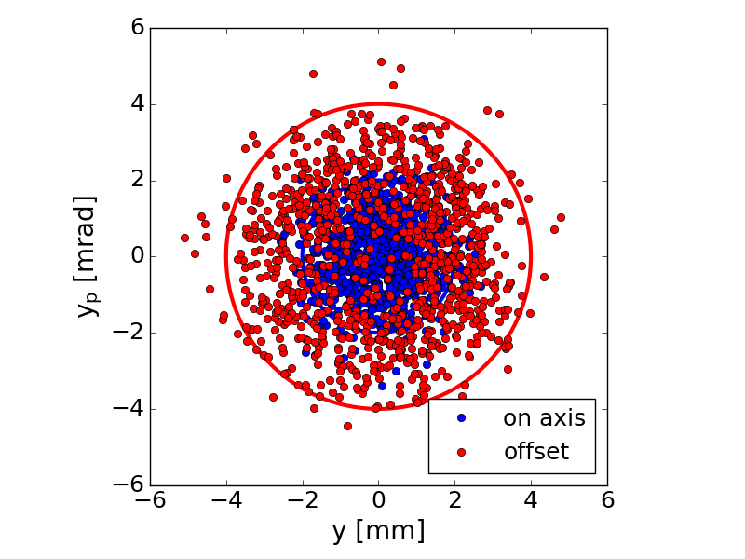
Non-factorization transfer
LINAC4 PSB PS SPS LHC
PS: No scraping instrument, cannot measure non-factorization
SPS: Scraping instrument available
SPS, measured NF of:
→ A: vdM missteer:
required vdM emittance made with injection missteering
→ B: Coupling resonance:
excite 3rd order resonance to increase NF in PSB
Both used in vdM NF MD

Slide 12
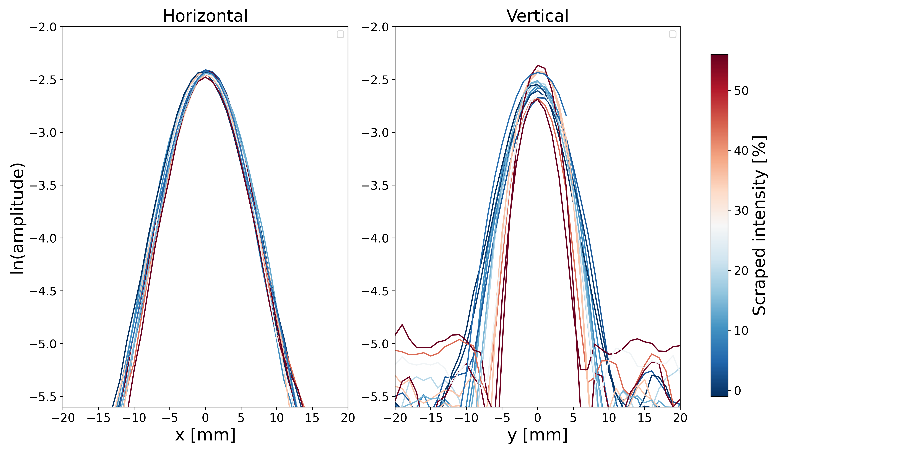
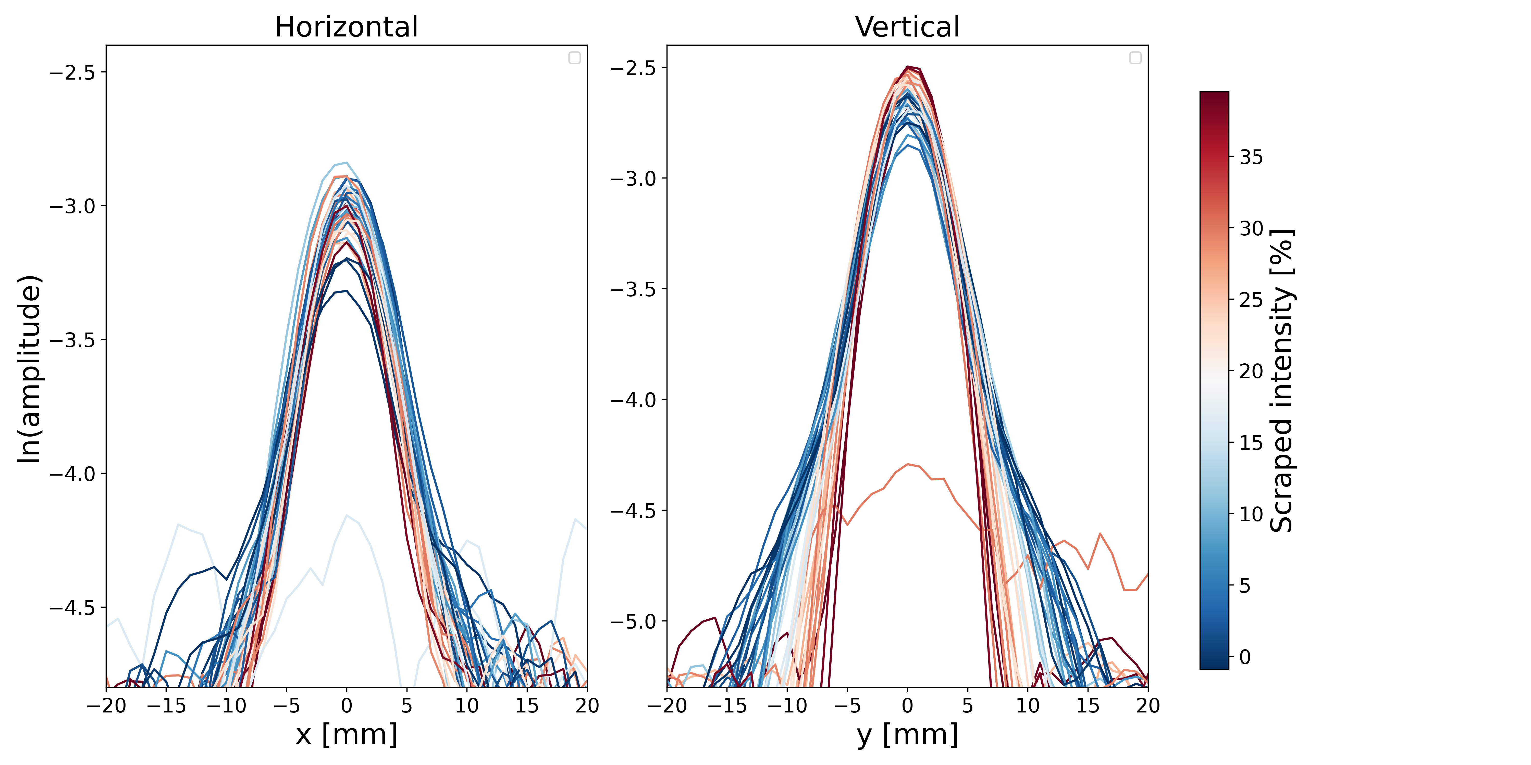
SPS
LINAC4 PSB PS SPS LHC
  A: vdM missteer
  B: NF
→ NF / lack of NF preserved along transfer PSB to SPS

Slide 13
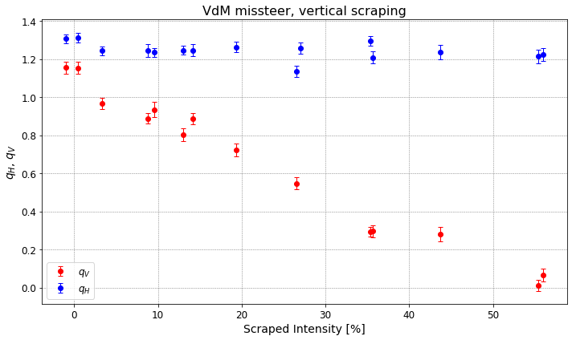
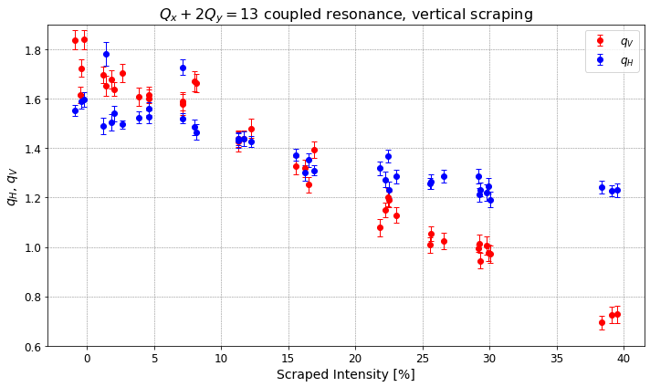
SPS
LINAC4 PSB PS SPS LHC
  A: vdM missteer
  B: NF
Parabolic in vertical plane
q-Gaussian fit
→ NF characterized by $q$-value, is larger at tails of distribution
→ Consistent with PSB results

Slide 14
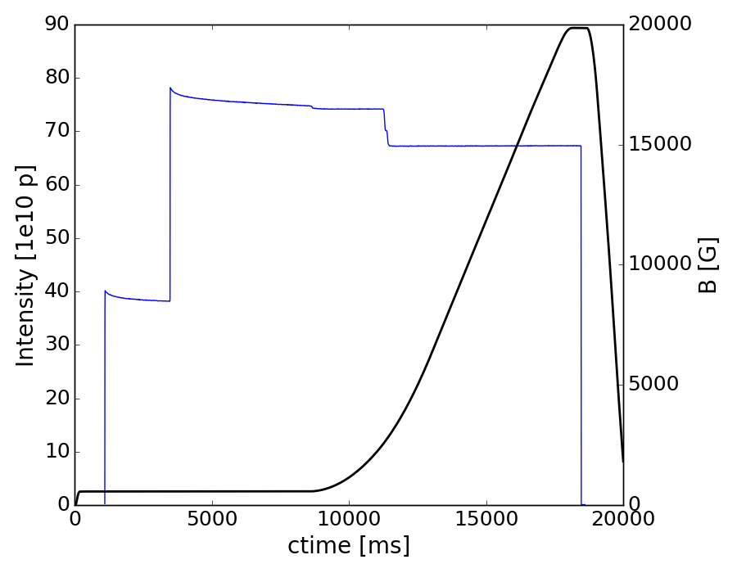
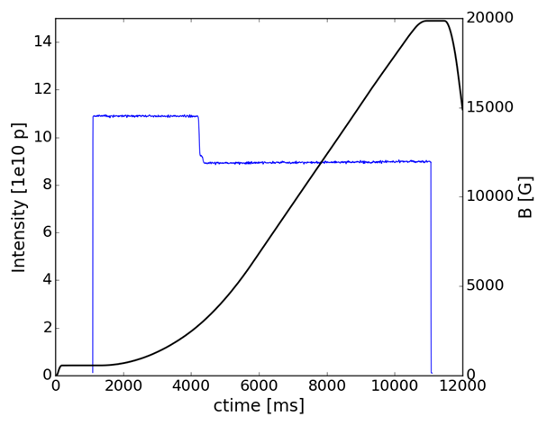
Observations of PSB-SPS transfer
LINAC4 PSB PS SPS LHC
Beam distribution and NF affected by:
Resonance crossing
SPS long flat bottom
→ Change tune to move away from coupling resonance in SPS
→ Shortened long flat bottom for the vdM bunches for NF MD
Injection oscillations (PS, SPS)
→ Correct oscillations
SPS magnetic cycle

Slide 15
LHC MD / Non-Factorization MD

Slide 16
LHC injection experiment
LINAC4 PSB PS SPS LHC
Procedure
Beam types prepared in the PSB, SPS
2 type A, 2 type B injected into the LHC
Beams scraped at injection in steps, in one plane only (V)
Horizontal, and vertical profiles measured to see any non-factorization
  A: ‘Best beam’ can make in PSB + scraping in SPS (vdM missteer)
  B: NF by coupled resonance crossing in the PSB

Slide 17
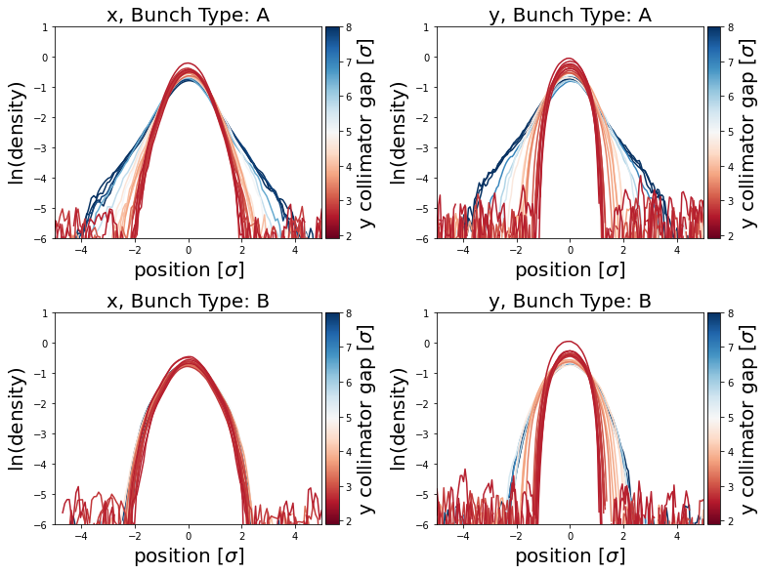
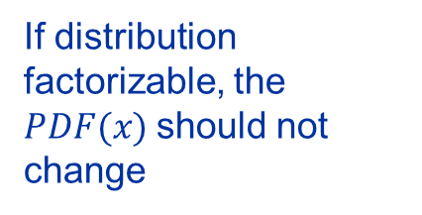
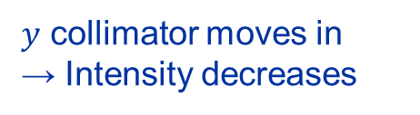
LHC injection experiment
LINAC4 PSB PS SPS LHC
Horizontal
Vertical
If distribution factorizable, the $PDF(x)$should not change
$y$ collimator moves in
→ Intensity decreases
Relative NF preserved up to LHC injection
Bunch history counts
60% intensity lost

Slide 18
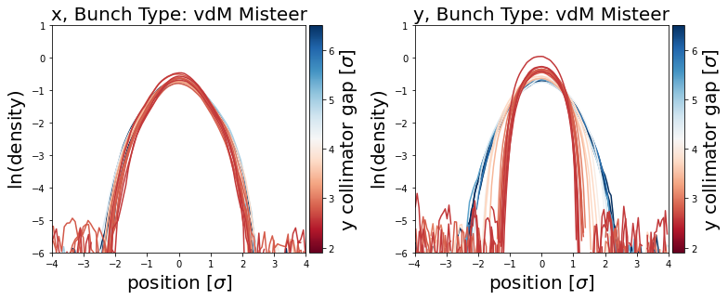
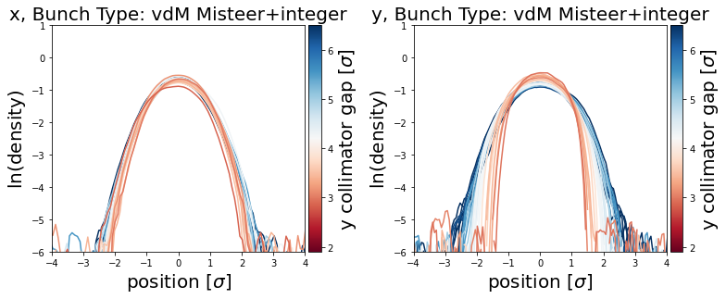
vdM bunches
LINAC4 PSB PS SPS LHC
Horizontal
Vertical
2024
2024
At LHC injection energy, measured different vdM bunches
Finer scale
Pre LS2 style
Pre LS2 style
→ Both vdM variants are parabolic
→ The best variant was used in 2024 vdM run

Slide 19
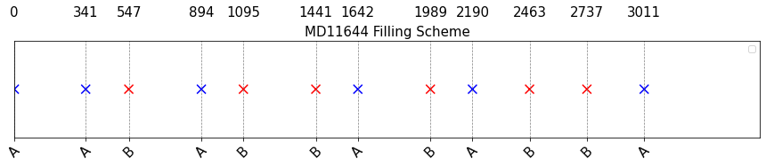
LHC after vdM (NF MD)
LINAC4 PSB PS SPS LHC
Procedure
Beam type prepared in the PSB/SPS
A, B injected into the LHC, VdM type and coupled resonance type
Beams ramped, in stable beams VdM scans performed in ATLAS and CMS, BGI in LHCb
Beam mode set to adjust
Beams scraped in steps, in V plane only, until beam dumped
Horizontal, vertical profiles measured
  A: ‘Best beam’ can make in PSB + scraping in SPS (vdM missteer)
  B: NF by coupled resonance crossing in the PSB
Will NF be preserved after the ramp and during stable beams?

Slide 20
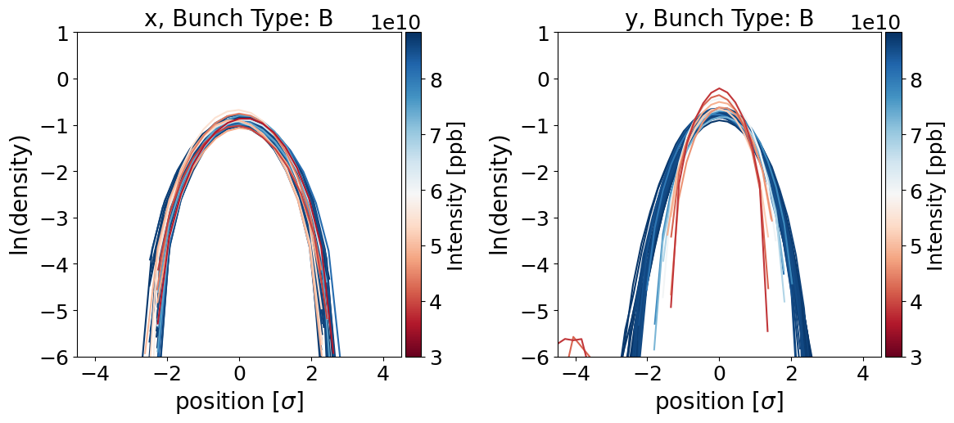
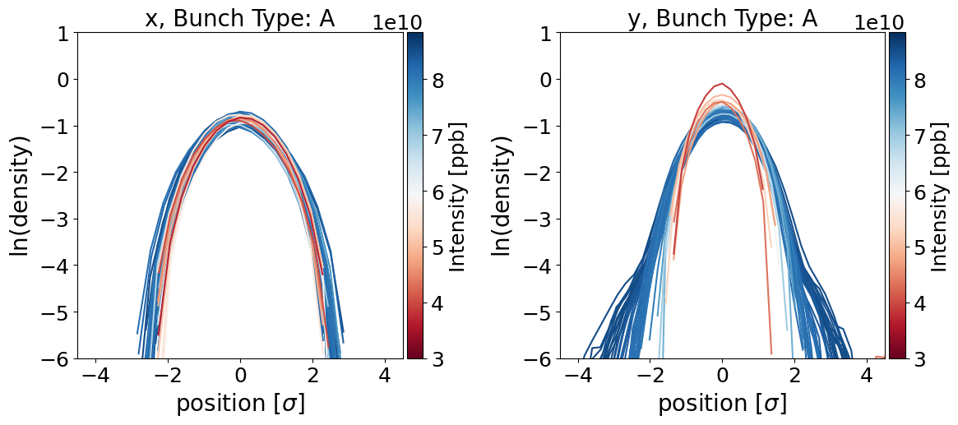
LHC after vdM
LINAC4 PSB PS SPS LHC
Horizontal
  A: vdM
Vertical
After 5 hours in stable beams, the scraping and wire scan method was used to measure the NF at the end of fill
B: NF
→ Both A, B have similar NF at end of fill after vdM scans
→ Could be limitation of measurement, or a due to time dependent NF

Slide 21
Summary
LINAC4 PSB PS SPS LHC
Observations:
Bunch history can contribute up to at least LHC injection → preserve large NF from PSB
Tail seems to contain NF → scrape in the PSB and SPS
2024 variant used was the least NF → up to LHC injection, measured destructively
End of NF MD (vdM fill) measurements show NF has changed over ~ 5 hours in stable beams
Sources of bunch history NF:
SPS long flat bottom, injection oscillations, transition crossing, resonance crossing
Mitigation: efforts to provide best factorizable bunches (resonance compensation, scraping, tune, along the chain measurements)

Slide 22
Thank you

Slide 23
q-Gaussian

Slide 24
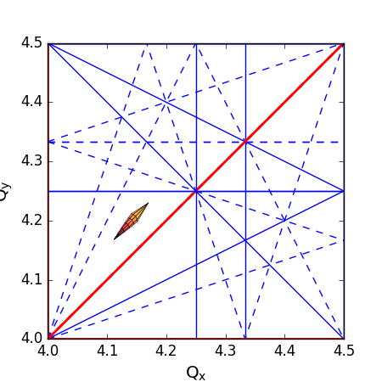
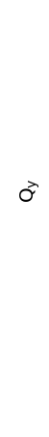
Type: VdM Missteer (low NF)
Experimental beam to minimise NF (Modified from 2023 VdM)
Existing tails from LINAC4 are scraped
Tune is set away from resonances
Beam is blown up in emittance via injection missteering into the PSB
Beam is passed to PS, and SPS nominally

Slide 25
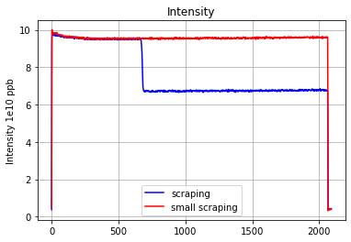
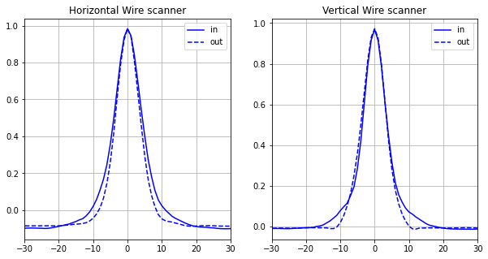
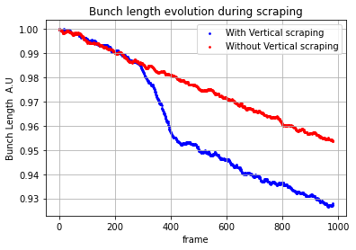
Coupling resonance (NF)
The tails are scraped in the vertical plane

Slide 26
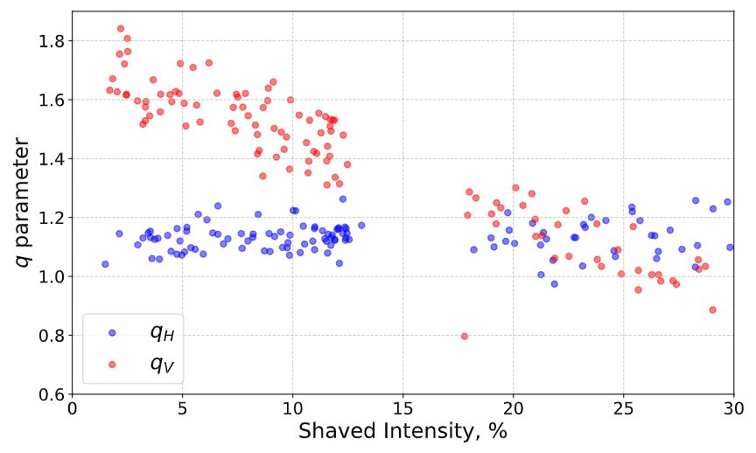
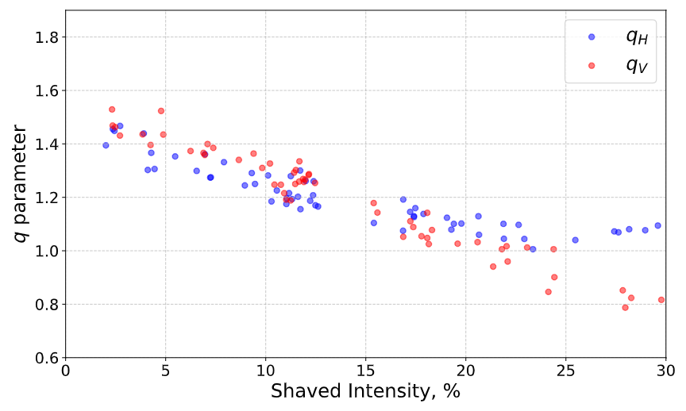
PSB

Slide 27
