Slide 1
Tune Measurements in vdM fills, before and during collisions
Tune measurement experts: M. Gasior (analogue), T. Levens (digital), S. Jackson (software), D. Alves (feedbacks)
LumiDays 25, 11th March 2025

Slide 2
Introduction
LHC is equipped with a high-sensitivity tune-measurement system.
  Base Band Tune → BBQ
Generally, the LHC tune-measurement operates without any external excitation to avoid blow-up of emittances.
  Only possible due to the very high sensitivity of the BBQ.
BBQ tune-measurements feed into the tune-feedback system.
  Precise control of tunes during snapback and start of ramp is critical.
  Otherwise tune-feedback is generally disabled.

Slide 3
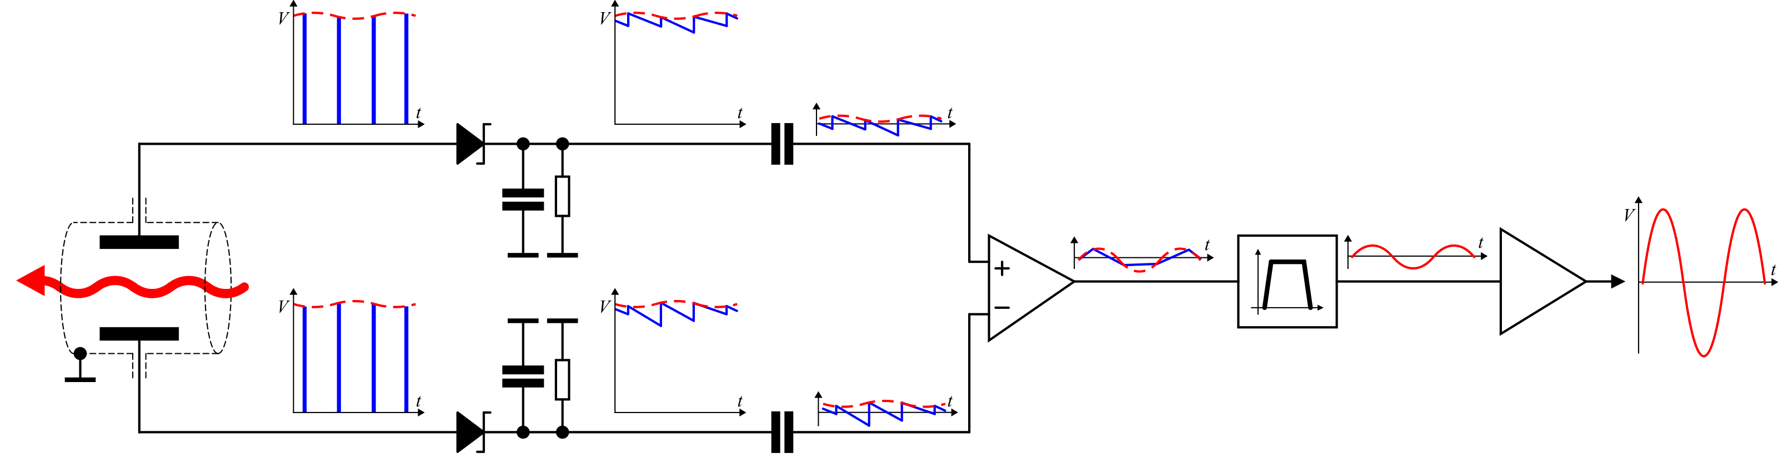
BBQ System Overview
Diode detectors (1) perform peak detection of BPM electrode signals.
DC common mode removed with blocking capacitors (2).
Difference made with low-frequency op-amp (3).
Signal filtered (4) and amplified (5).
Digitized in base-band with 24-bit ADC sampling synchronous to the revolution frequency.
Diagram courtesy M. Gasior
(1)
(2)
(4)
(5)
(3)

Slide 4
Challenges for BBQ in LHC
Beam conditions in LHC physics fills are not favourable to tune measurements!
  High transverse feedback gain ☹
  High chromaticity ☹
  High octupoles ☹
It was found during run 1 that measurements during the physics cycle were difficult with the “classical” BBQ system.
“Gated” BBQ system introduced:
  System gated to only measure the first 45 bunch slots (“witness region”).
  Typically: 12 non-colliding bunches per beam are injected in this region.
  These slots have lower transverse feedback gain.

Slide 5
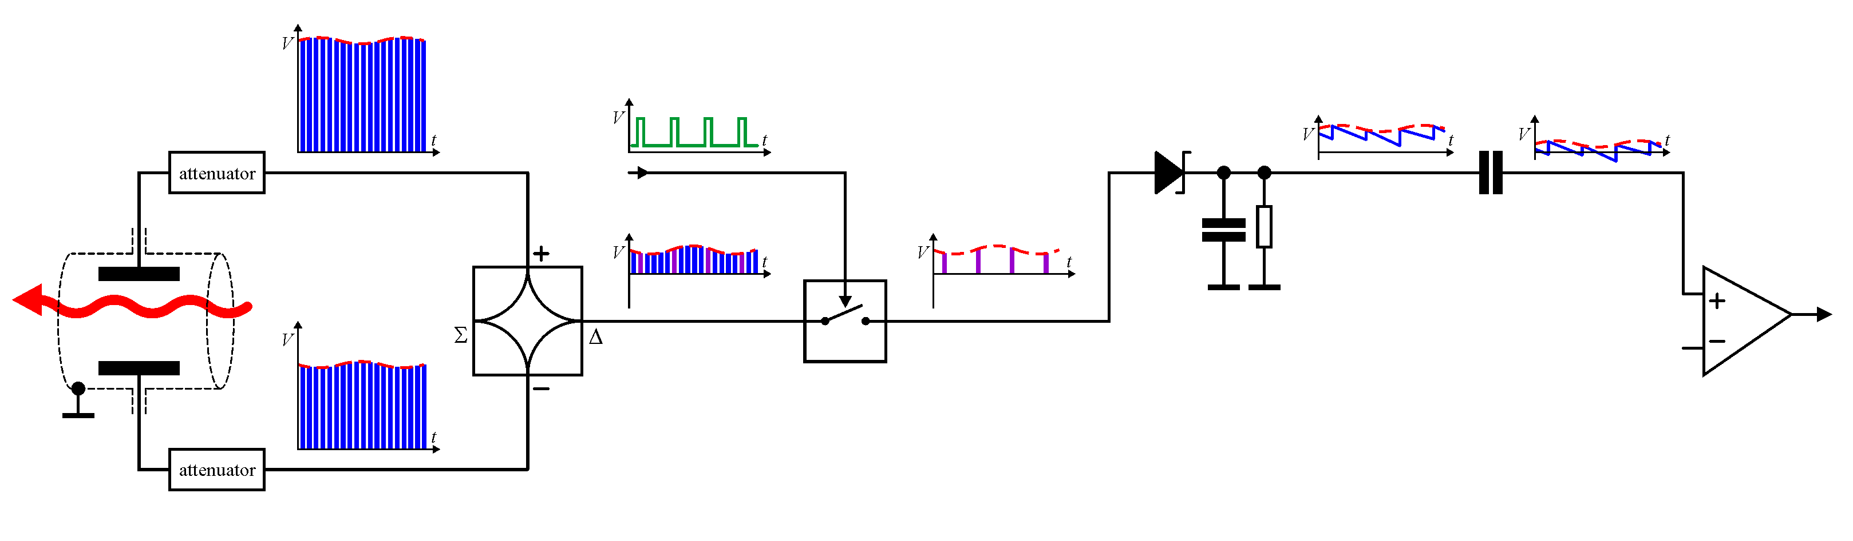
“Gated” BBQ System Overview
Analogue RF 180° hybrid (1) used to calculate difference signal of electrodes.
RF switch (2) used for bunch selection in front of diode detector (3).
Attenuators (4) are needed to protect hybrid and switches from high BPM signal levels.
  Results in a lower sensitivity than the “high-sensitivity” BBQ.
Downstream signal processing and digitization identical to classical BBQ.
Diagram courtesy M. Gasior
(4)
(3)
(1)
(2)

Slide 6
LHC BBQ Systems
Each “flavour” of BBQ system has two instances, named for their intended use:
“Continuous” → intended to be used with fixed settings for tune feedback
“On-Demand” → intended to be used when needed for ad-hoc measurements (MDs, etc), possibly with different settings
In practice, both are typically operated with identical settings.
For historical reasons, there is a mismatch between the system names, device names and logging variable (NXCALS) names:
System Name | Device Name | NXCALS Name
Continuous High Sensitivity | LHC.BQ.CONT.Bx | LHC.BQBBQ.CONTINUOUS_HS.Bx
On-Demand High Sensitivity | LHC.BQ.ONDEMAND.Bx | LHC.BQBBQ.ONDEMAND_HS.Bx
Continuous Gated | LHC.BQ.GATED.Bx | LHC.BQBBQ.CONTINUOUS.Bx
On-Demand Gated | LHC.BQ.GATED_OD.Bx | LHC.BQBBQ.ONDEMAND.Bx

Slide 7
LHC BBQ Systems
Typical settings
  New acquisition every 160ms (6.25Hz)
  Each acquisition is 2048 points, giving 1024 frequency bins from 0..0.5*Frev
  As 160ms ~= 1797 points at 11.245 kHz there is an overlap of 251 points between measurements
Main logging variables per system:
  ACQ_DATA_H/V – raw time domain data
  FFT_DATA_H/V – FFT magnitude (dB scale) before filtering
  MAG_DATA_H/V – FFT magnitude (dB scale) after filtering
  EIGEN_FREQ_1/2 – raw tune peak
  TUNE_H/V – calculated tune, including coupling correction

Slide 8
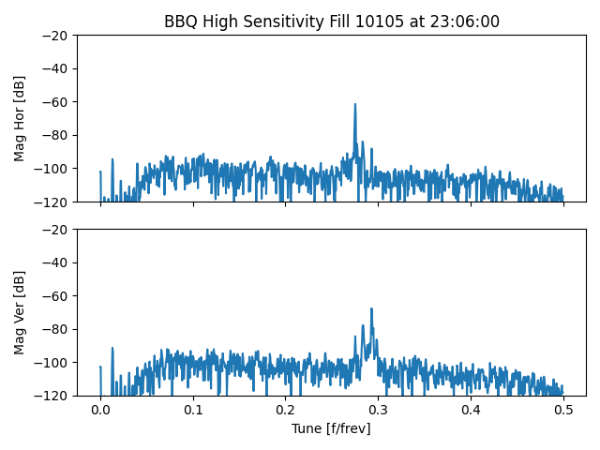
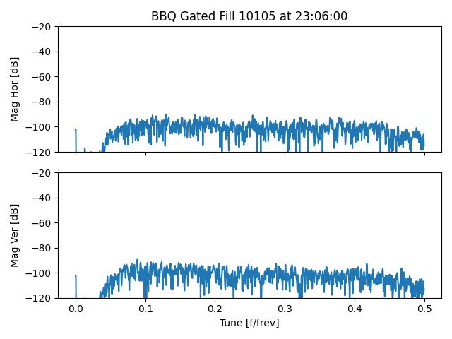
Physics fill – pilot injection
Clear tune peaks in both H & V
Traditional peak finding works well (?)
No signal as pilot is outside witness region

Slide 9
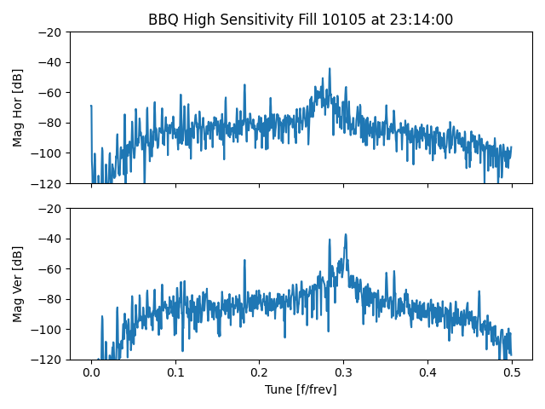
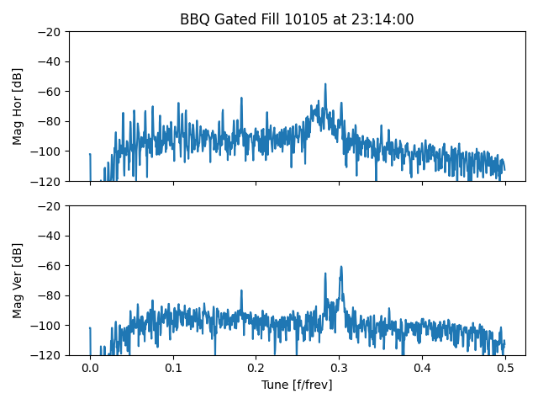
Physics fill – 12b injection
50 Hz lines start to appear
Wide tune “hump”
Similar signal to HS at this point
Lower sensitivity of system is visible

Slide 10
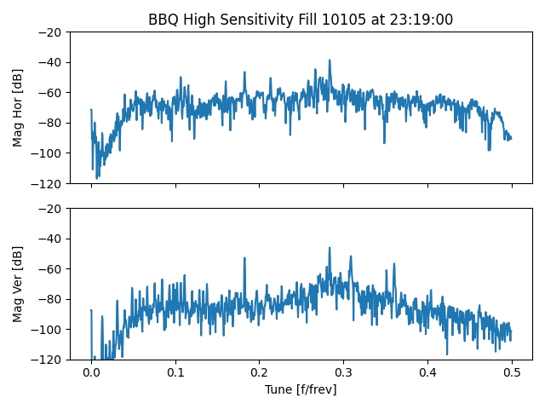
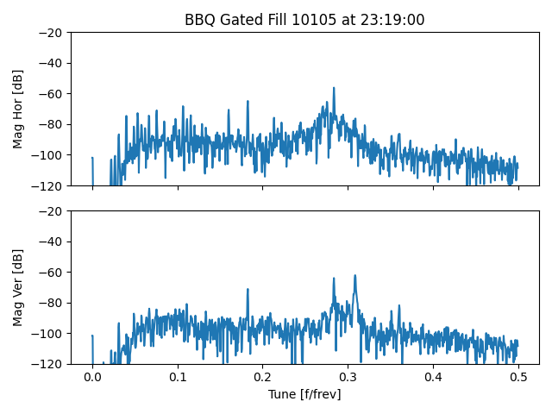
Physics fill – first nominal injection
Wide tune “hump” and 50Hz lines make peak finding difficult

Slide 11
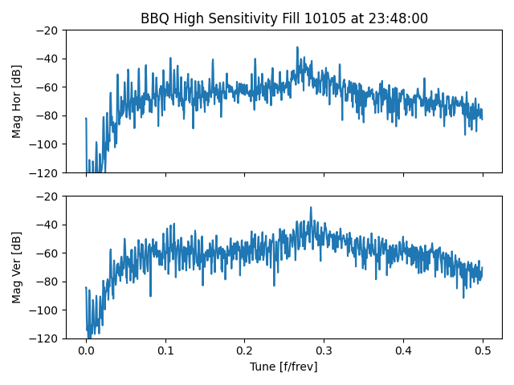
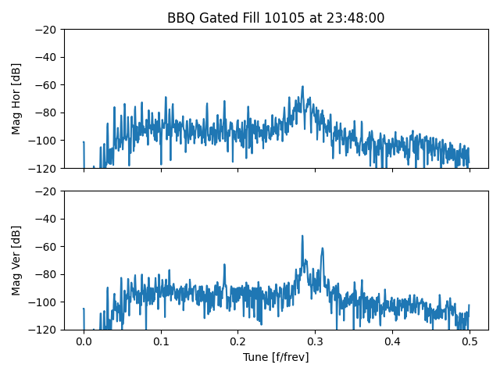
Physics fill – last injection
Wide tune “hump” and 50Hz lines make peak finding difficult

Slide 12
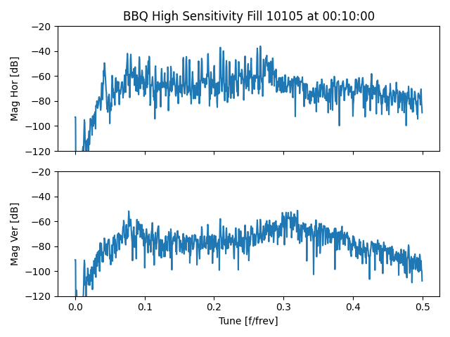
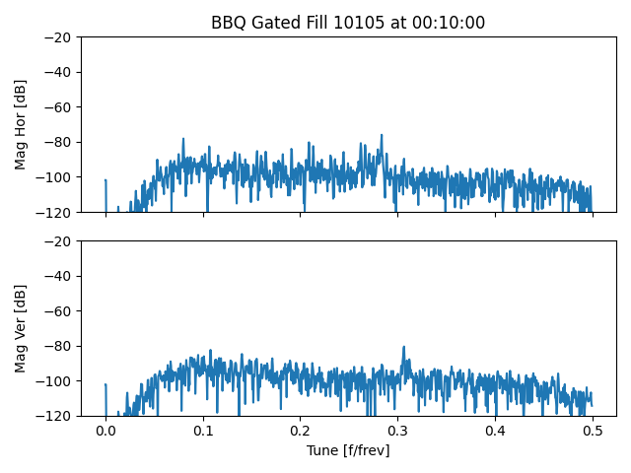
Physics fill – flat top
Low signal levels

Slide 13
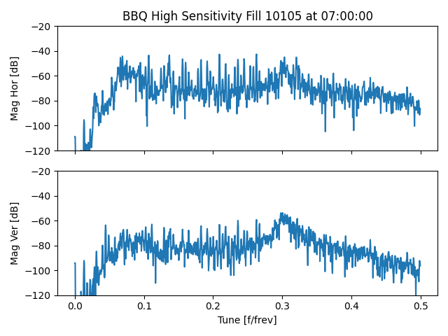
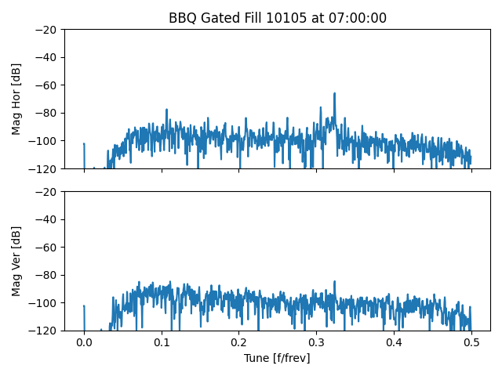
Physics fill – stable beams
Low signal levels

Slide 14
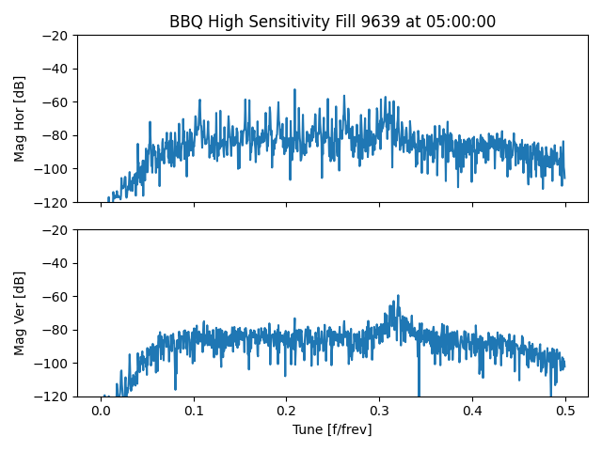
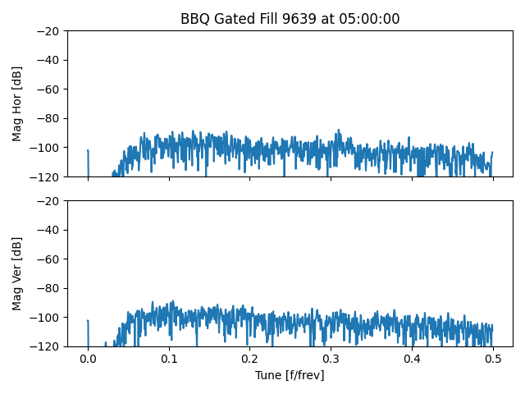
Difference in VDM fills
Typically: only 1 bunch in the witness region… very challenging to measure the tune…
Little signal from the gated system
Strong 50Hz lines and wide peak on high-sensitivity

Slide 15
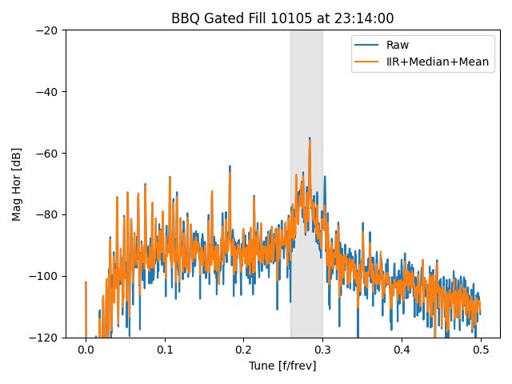
Spectral processing algorithm
A number of steps are applied to “clean-up” the spectrum before finding the tune peak:
IIR filter over successive spectra (typical setting alpha=0.5)
Median filter across spectrum (typical setting bins=16)
Mean filter across spectrum (typical setting bins=5)
Tune peak can then be found:
An initial tune index is found as the maximum peak
in filtered data within tune window (set by OP)
A refined index is found by looking back to raw data
for a higher peak close to the initial peak
A 3-point gaussian fit around this index to find frequency
Still, presence of strong 50Hz lines and wide hump makes
this peak finding inadequate…
Gaussian fit of “hump” in tune window added in run 3
Tune value now taken from peak of this gaussian fit…

Slide 16
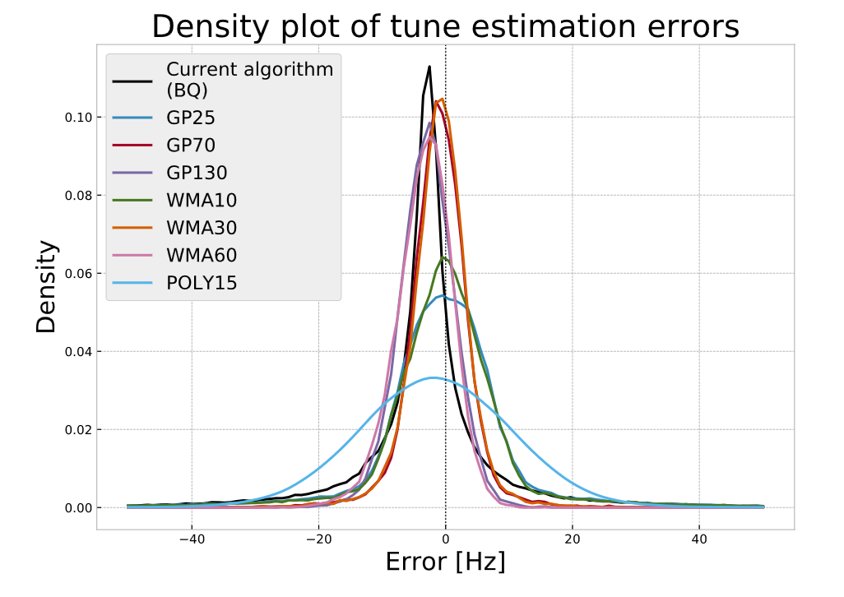
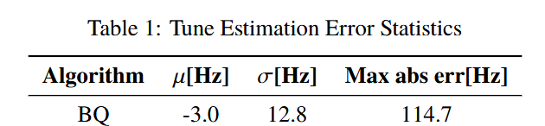
Accuracy of the processing
L. Gretch et. al.
IBIC2020 (WEPP27)
Some studies of accuracy of the tune fitting algorithm by L. Gretch during the development of more advanced tune fitting algorithms.
  Published at IBIC and MDPI.
Found a 3 Hz (~0.1%) error of current algorithm using simulated spectra.
  Note that his analysis was done before the addition of the gaussian fitting.
Topic to be followed up

Slide 17
Conclusion
Tune measurements with the BBQ system during LHC physics fills are very challenging due to machine parameters and requirement not to excite the beam.
  Gated BBQ and “witness region” with lower transverse feedback gain added in run 1 to provide usable measurements.
  Still difficult to measure at various points during the cycle due to strong 50Hz lines and wide tune hump.
  Assumption that the 12 non-colliding bunches in the witness region are representative of the rest of the bunches!
VDM fills are especially challenging.
  Only 1 bunch in the witness region gives little signal on the gated BBQ.
Better signal quality certainly achievable with excitation.
  But the trade-off of this is a blow-up of the bunch emittances.
  Bunch-by-bunch measurements with the transverse feedback also possible with excitation.

