Slide 1
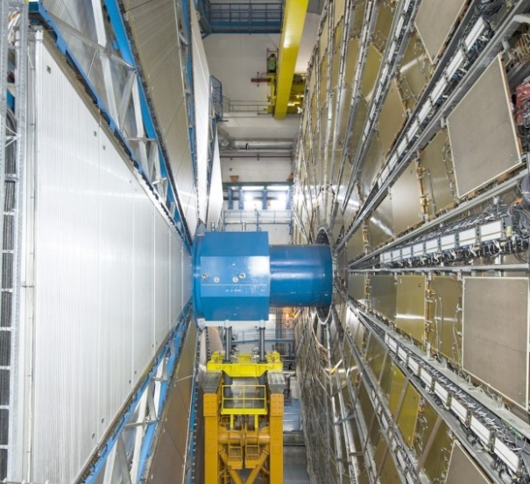
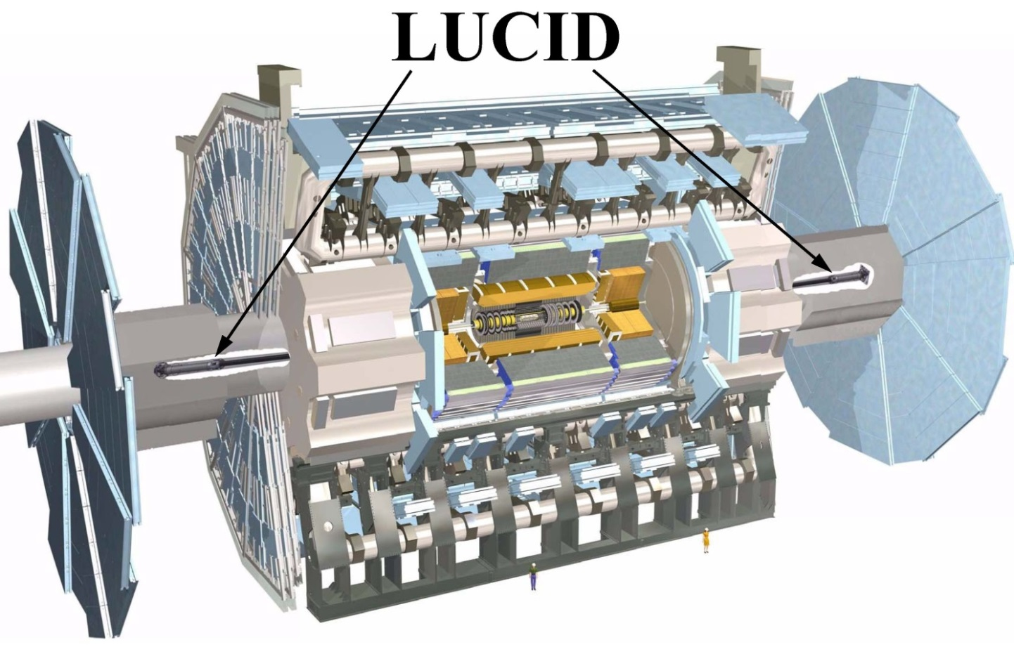

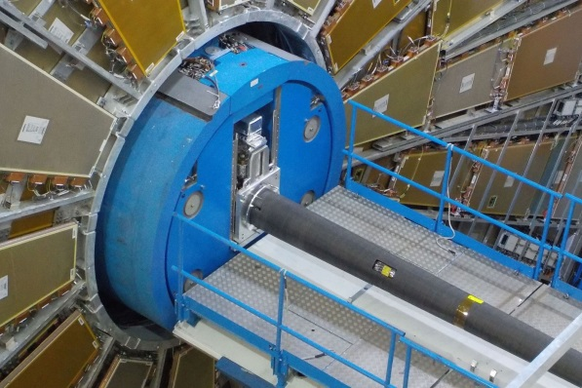
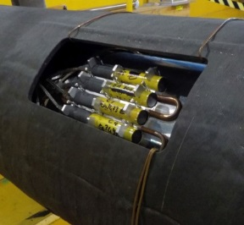
LUCID-3: the upgrade of the ATLAS luminosity detector for High Luminosity LHC
LUCID-2
Vincent Hedberg
on behalf of the ATLAS collaboration

Slide 2
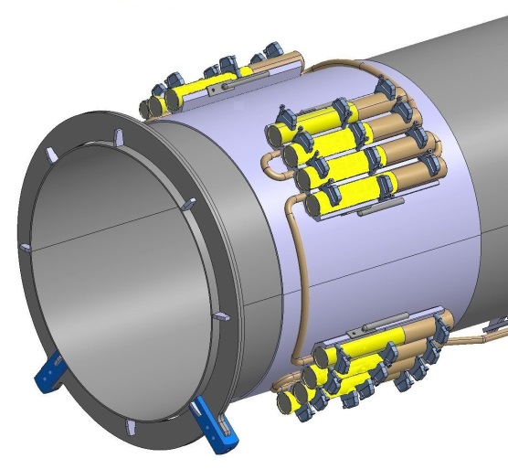
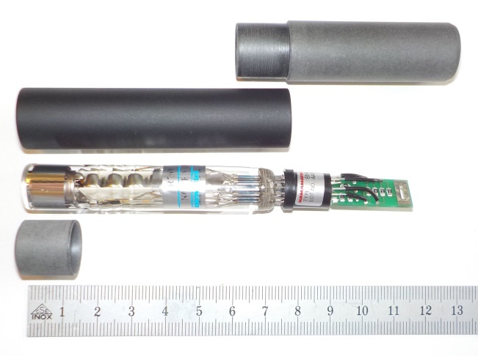
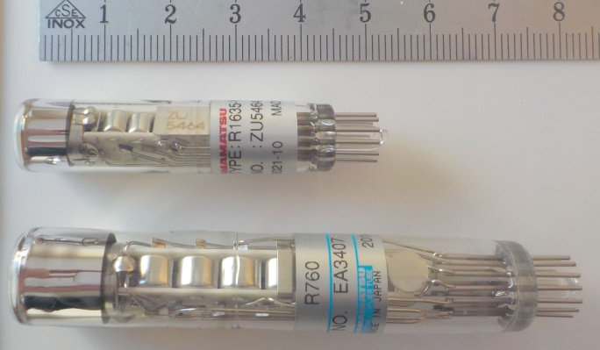
The LUCID-2 detector
A high acceptance is important for a detector that aims to measure luminosity for single bunch crossings in the tails of the van-der-Meer scans.
However, a too large acceptance gives hit-saturation (hits in every bunch crossing) which kills the measurement during high luminosity physics running.
Base cover
Mu metal shield
Base
The R1635 PMT has been specially made for LUCID with a flat quartz window.
The smaller cathode results
in 50% smaller acceptance and less hit-saturation.
R1635 - 8 mm cathode
R760 photomultiplier
Source cover
R760 - 10 mm cathode
Quartz window with radioactive Bi-207 source is used as Cherenkov medium.
2

Slide 3
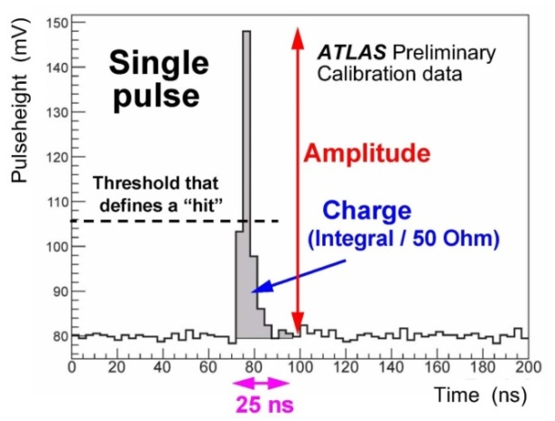
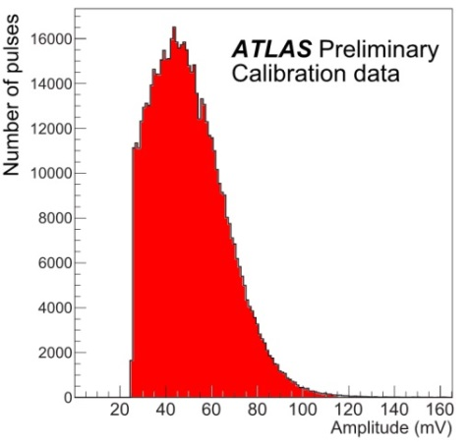
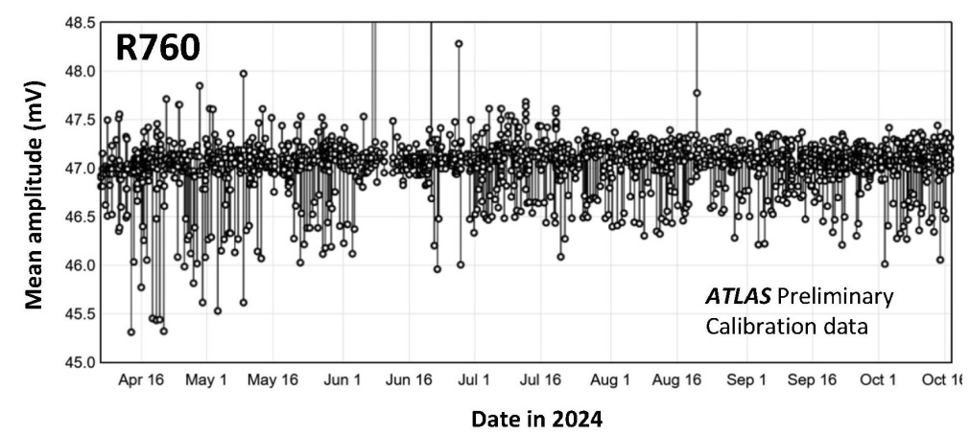
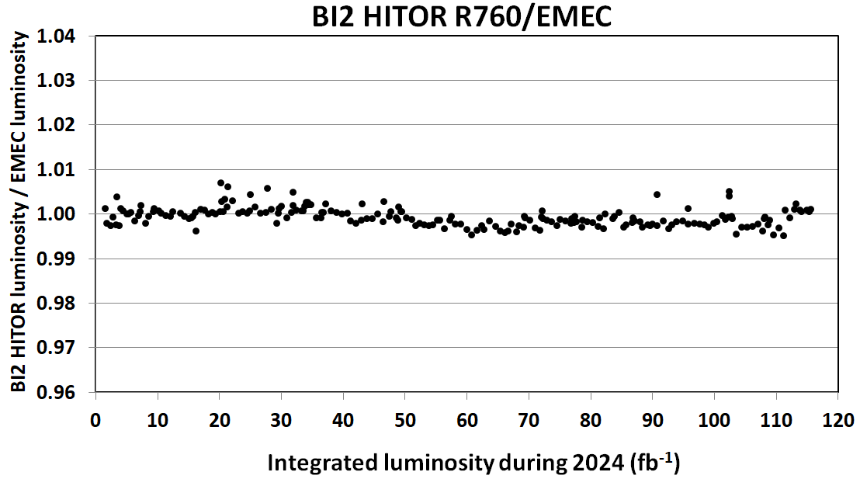
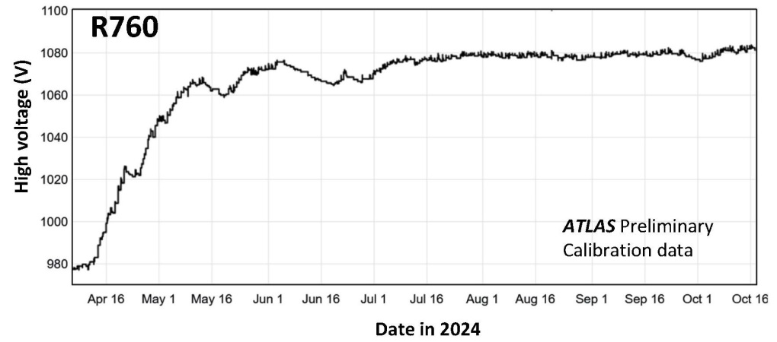
Gain monitoring of R760 PMTs with Bi-207 sources
Frequent gain monitoring calibrations using the Bi-207 sources are crucials to maintaining stability in the luminosity measurements. The high voltage is automatically changed if a calibration shows a change of the mean amplitude.
Mean = 47 mV

Slide 4
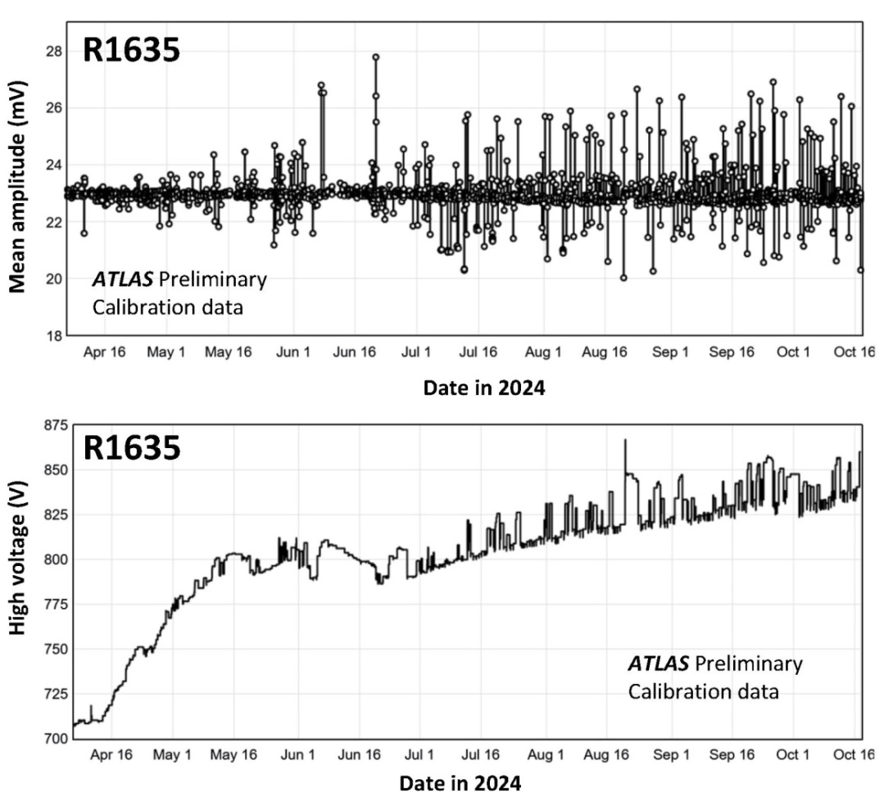
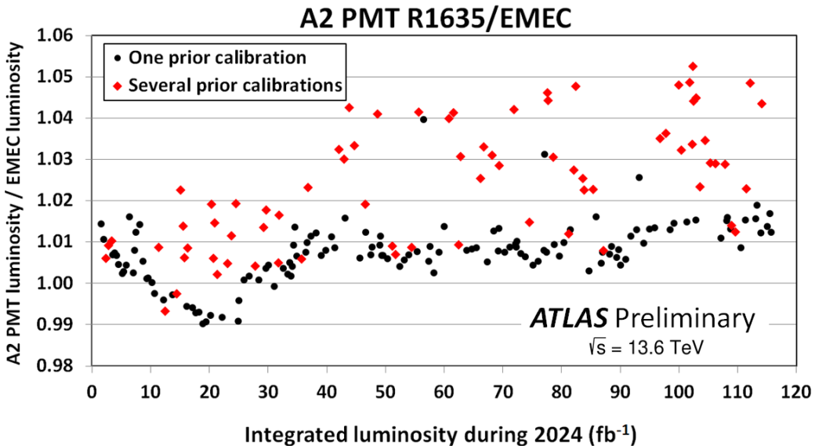
Gain monitoring of R1635 PMTs with Bi-207 sources
The stability of the luminosity measurements with the R1635 PMTs in LUCID-2 shows a much worse result compared to the R760 PMTs due to problems with the Bi-207 calibrations.
If one divides the physics runs into one group with exactly one prior Bi-207 calibration and another group with several prior calibrations then one can see a clear difference between the two groups.

Slide 5
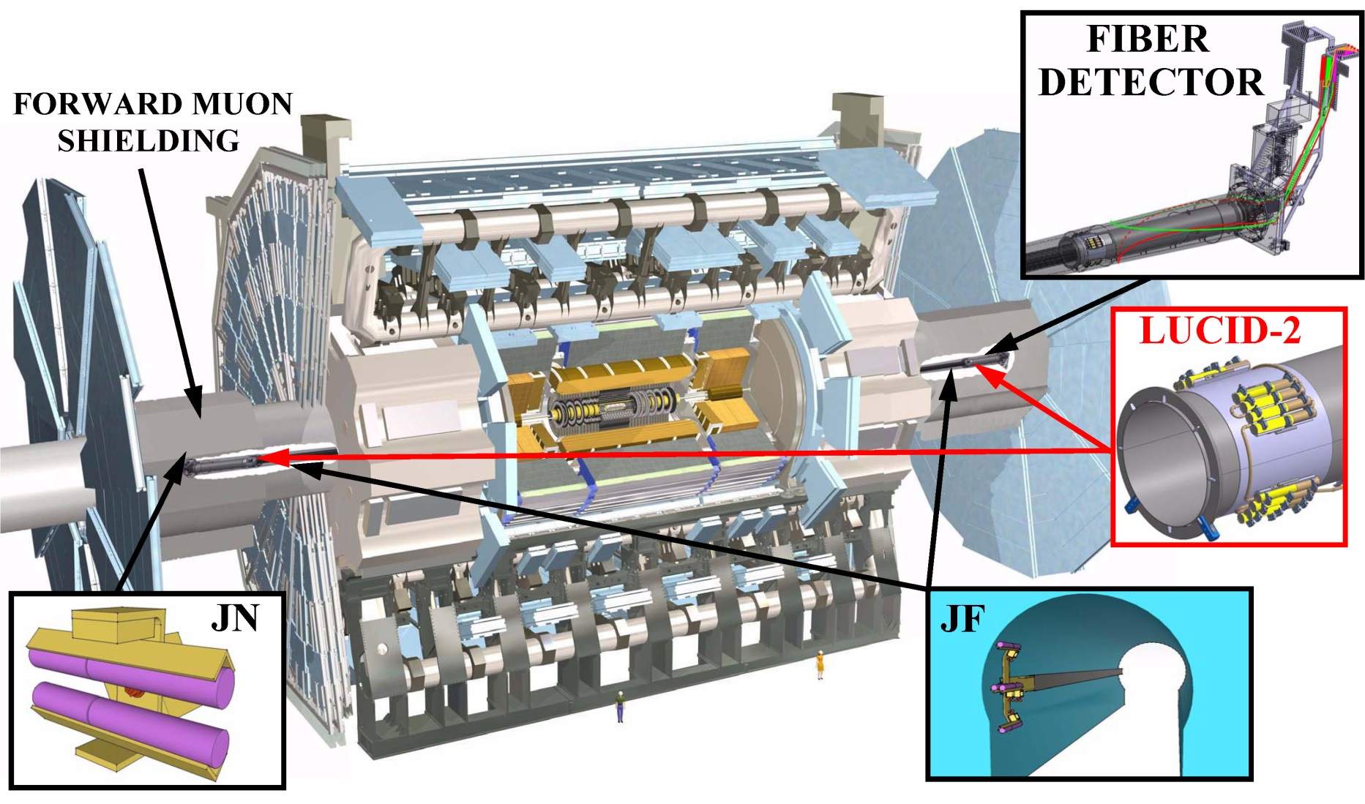
LUCID-3 prototype detectors
Charge measurements
2 R7459 PMTs
Charge counting
Location not available in run 4
24 R760 PMTs (ε = 8.6%)
8 R1635 PMTs (ε = 4.1%)
3 R760 PMTs (ε = 6.1%)
3 R1635 PMTs (ε = 2.9%)
2 R760 PMTs (ε = 0.39% & 0.60%)
LUCID-3 – Vincent Hedberg

Slide 6
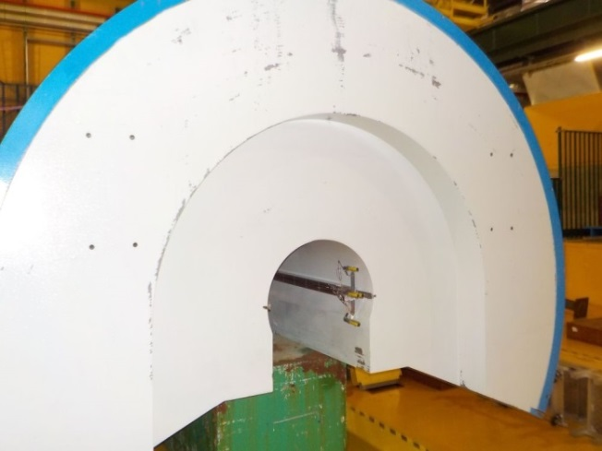
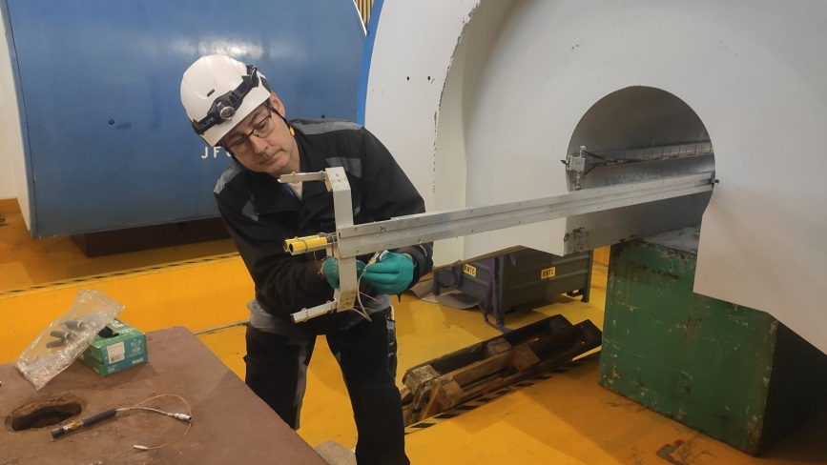
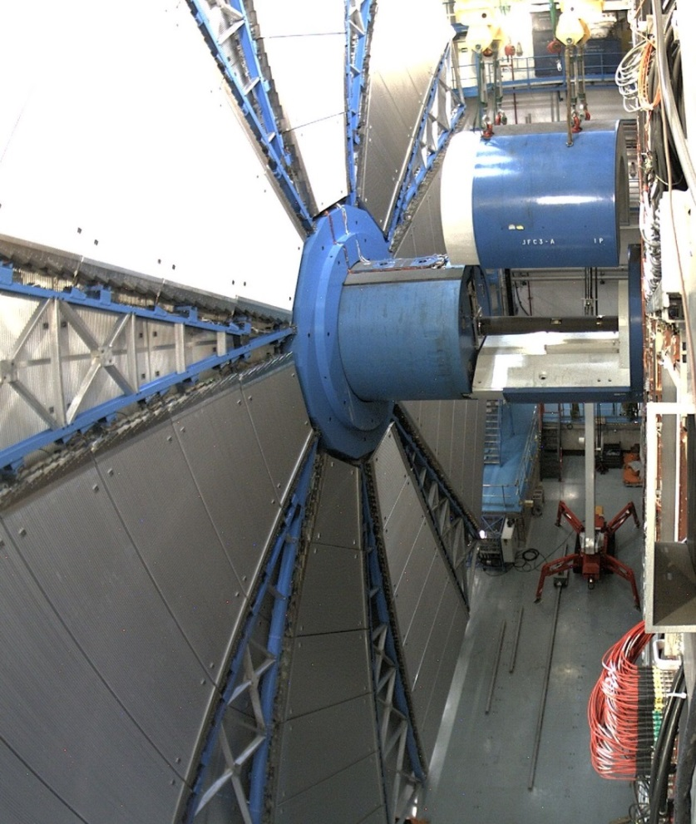
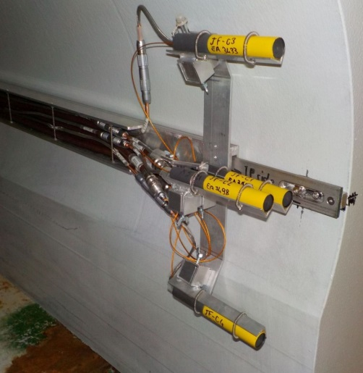
LUCID-3 prototypes attached to the shielding
R760
160 μSv/h
12 μSv/h
R1635
R1635
R760
Prototype detectors have been attached to the shielding on both sides of ATLAS.
The new location (R = 12.6 -> 29.1 cm) reduced the measured efficiency by 30%.
The two detectors have R760 PMTs with 10 mm diameter and R1635 PMTs with 8 mm cathodes.
The detector sits on rails and can be pulled out of the shielding.
2025
Side C
4 R1635
12 R760
R1635
R760
R760
R1635

Slide 7
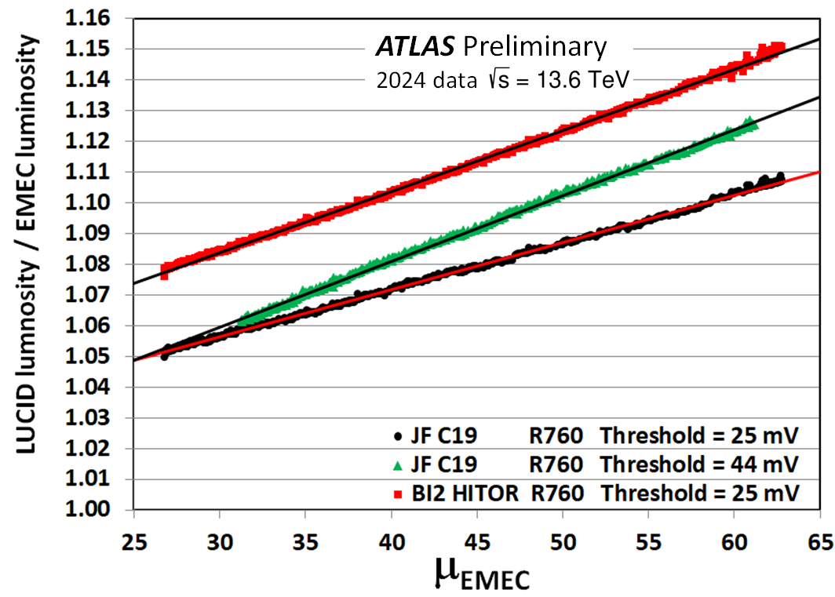
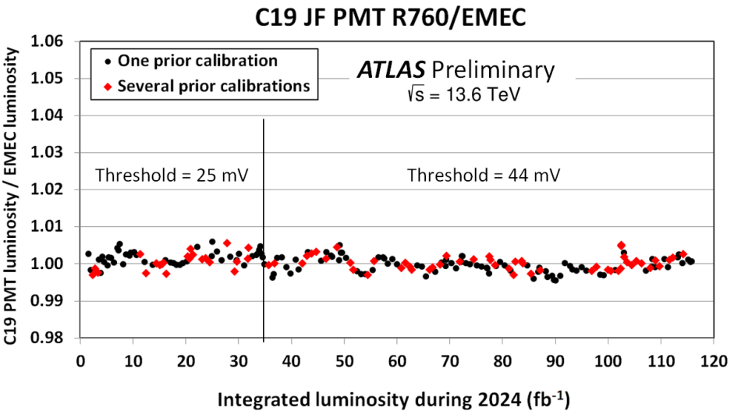
The R760 JF detector on the shielding
LUCID-2
Thr. 25 mV
Eff. 8.6%
JF
Thr. 44 mV
Eff. 5.3%
JF
Thr. 25 mV
Eff. 6.1%
The R760 PMTs attached to the shielding has a 30% lower efficiency than the same PMTs attached to the beampipe.
An increase of the hit threshold from 25 to 44 mV decreases the efficiency by another 14%.
The μ-dependence looks linear with a larger threshold but it has a larger slope.
A study of a high-μ special run showed that the C19 PMT did not saturate at a μ of 134 with the higher threshold.

Slide 8
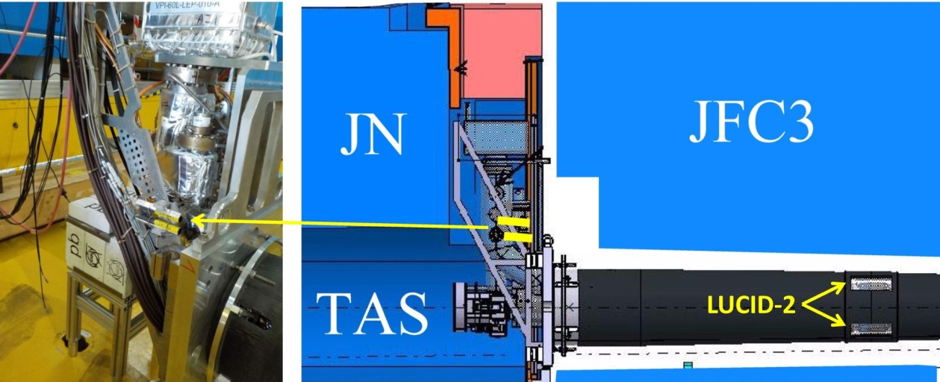
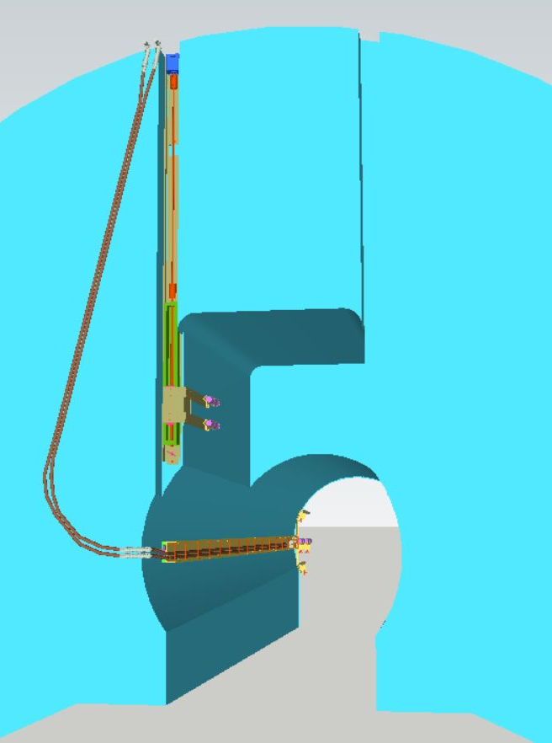
The JN detector
Stepping motor
Services
R760 PMTs
Actuator
The present JN detector consists of two R760 PMTs that sits behind and in the shadow of the JFC3 forward shielding.
The two photomultipliers have an efficiency of only 0.39% and 0.60% compared to 8.6% for the LUCID-2 PMTs.
For the HL-LHC it is suggested to build a detector with four R760 PMTs on each side that can be moved remotely by actuators and stepping motors.
The detector would be attached to the back of the JFC3 forward shielding.
R760 PMTs
JF detector

Slide 9
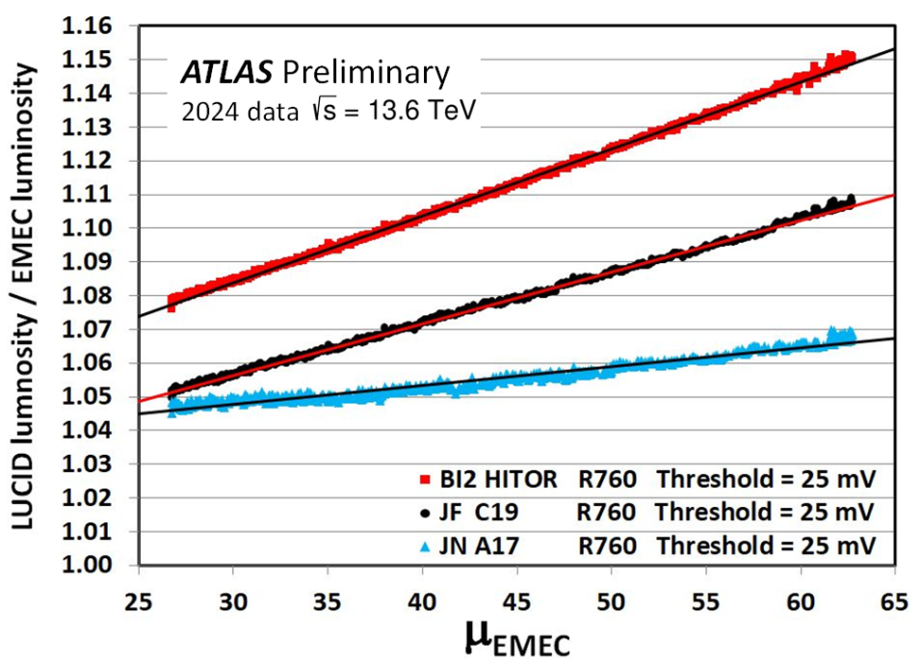
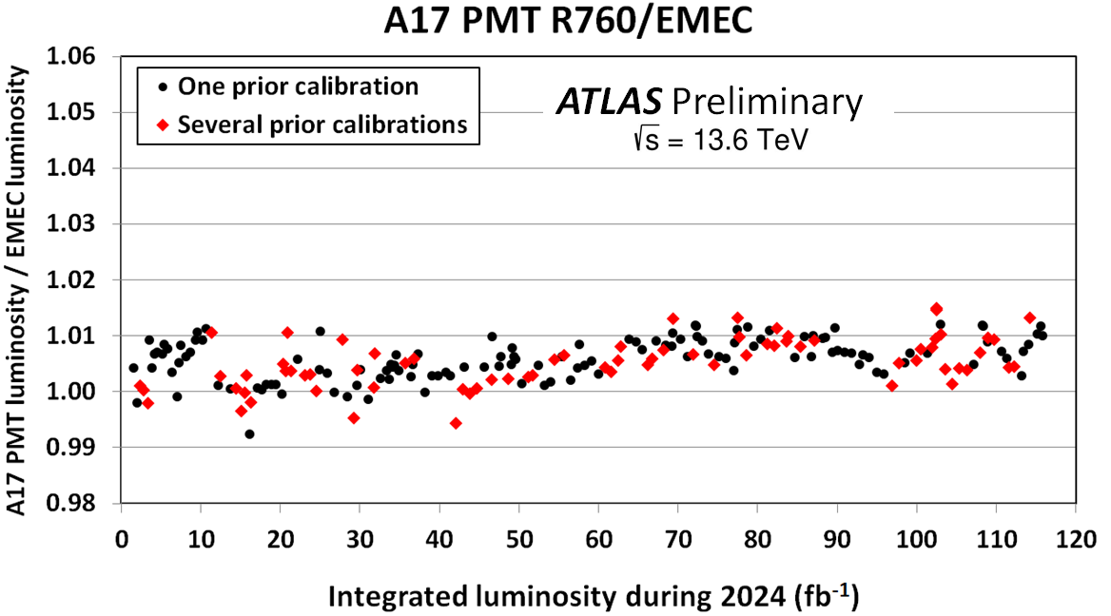
Stability and pile-up of the JN detector
LUCID-2
JF
JN
The low efficiency of the JN detector results in smaller pile-up and smaller μ-dependence than LUCID-2 and the JF detector.
The JN detector is using R760 PMTs and has therefore no problem with Bi-207 calibrations.
The long-term stability is similar to LUCID-2 but the run-to-run variations are larger. This can be improved by using eight PMTs instead of only one.

Slide 10
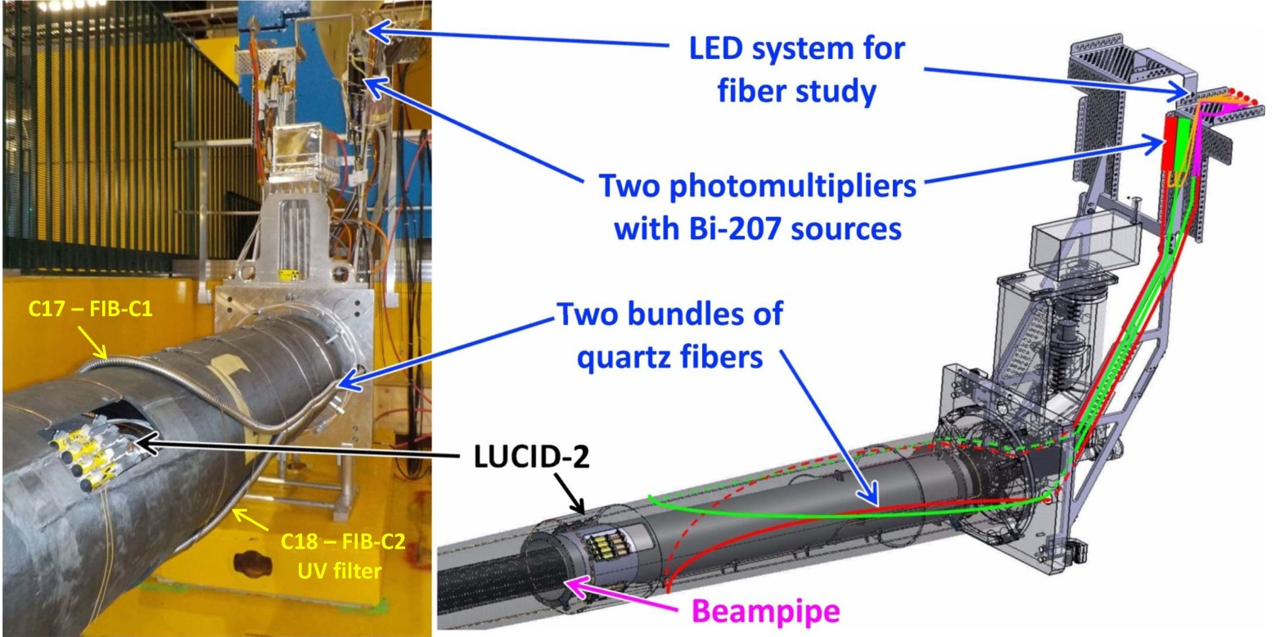
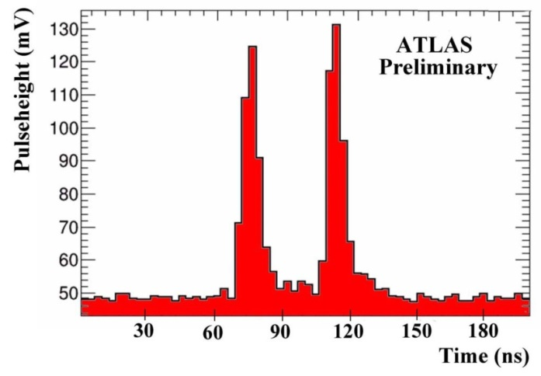
The prototype fiber detector
FADC measurements of LED calibration signals
LED light sent directly to the PMT.
LED light sent via fiber bundle to the PMT.
Two bundles of radiation-hard quartz fibers provide the Cherenkov medium.
The lower fiber bundle has a UV filter.
R7459 photomultipliers (25 mm diameter) are placed in a shielded location and see 200 times less radiation than the photomultipliers in the PMT detector.
10

Slide 11
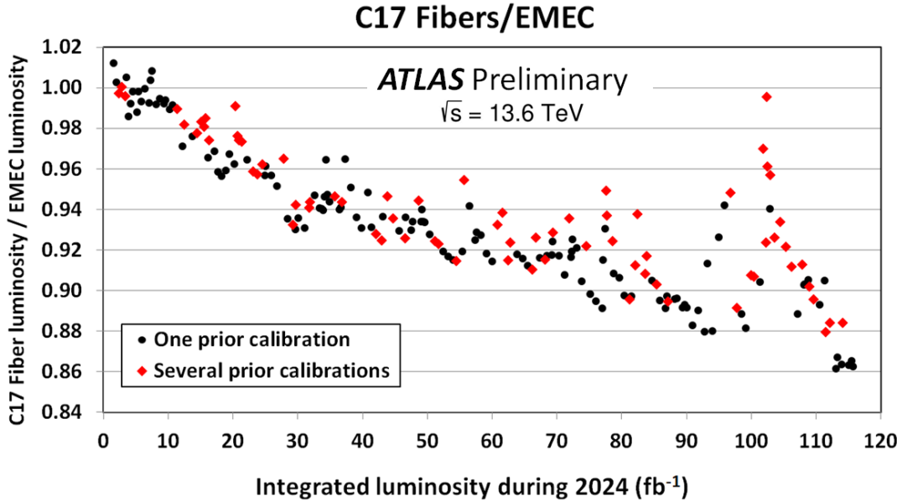
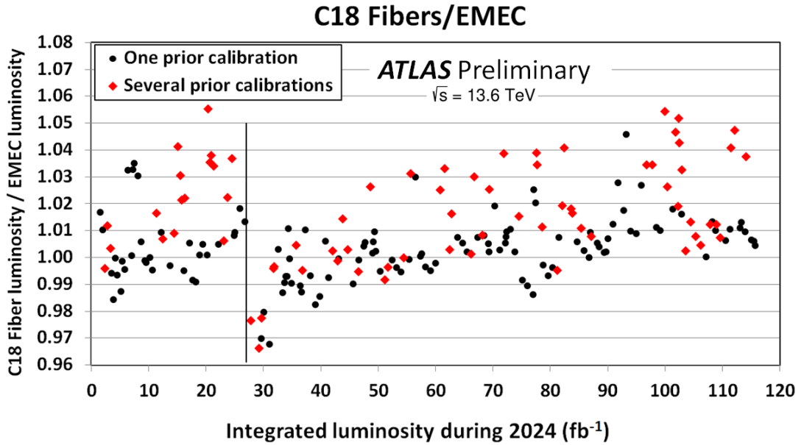
Stability of the fiber detector
The stability of the fiber detector has been studied without corrections using the LED system.
The fiber detector is using charge measurements and not hit measurements.
+60V
The C17 measurement without a UV filter shows a large long-term decrease of the luminosity measurement.
The C18 measurement with a UV filter shows a reasonable long-term stability but large run-to-run fluctuations. The high voltage was increased by 60 V at one point to see if that improved the stability.
Many Bi-207 calibrations in interfill periods seem to produce large fluctuations.

Slide 12
Summary
The acceptance of the LUCID detector has to be reduced in order to avoid hit saturation at the HL-LHC. This can be done by attaching the PMTs further away from the beampipe and by increasing the threshold used to define a hit.
Prototype detectors have therefore been built with R760 PMTs that are attached to beampipe hole in the forward muon shielding and even behind this shielding. The results from these detectors are promising.
New smaller R1635 photomultipliers with quartz windows have been manufactured and installed in an attempt to reduce the hit-rate even further. The hit-rate measured with these PMTs makes them a perfect choice but they seem to be unstable during Bi-207 calibrations in the interfill periods.
A detector using optical quartz fibers has also been built and installed in ATLAS for tests during run 3. It counts charge (integration of pulses) instead of hits (pulses above an amplitude threshold).
The fiber detector has a novel calibration system with both Bi-207 used to keep the photomultiplier gain constant and LED signals that are used to monitor any fiber degradation due to radiation. One of the fiber bundles is equipped with a UV filter which seems to eliminate most problems due to fiber degradation.
The stability obtained with the fiber detector is, however, not as good as the one obtained with R760 PMT detectors.

