Slide 1
Impact of beam-beam effects on vdM L calibrations at the LHC: summary of simulation studies during LS2
W. Kozanecki (University of Oregon)
for the LHC Luminosity-Calibration and -Monitoring Working Group (LLCMWG)
Introduction: where it all began…
Beam-beam biases to vdM calibrations in the single-IP case
Multi-IP effects
Systematic uncertainties affecting beam-beam corrections
Summary & outlook

Slide 2
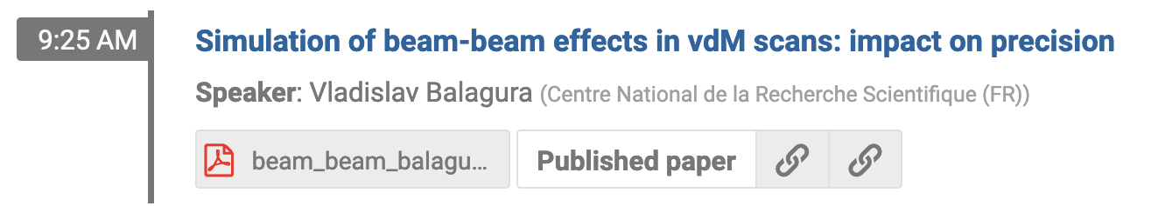

Introduction: where it all began…
Lumi Days 2012: 1st complete (but not quite correct) BB corrections
  deflection-induced orbit shift: distorts beam separ'tn Δ_{x,y} (Bassetti-Erskine) [1]
  dynamic-β effect (in linear approximation) : distorts L(Δ_{x}, Δ_{y}) (W. Herr) [2]
Lumi Days 2019: linear approx. → dyn.-β correction underestimated
  when the dust settled (~ 2022): shift all pre-2021 pp L scales ➚ by ~ 1%
  … but also: much deeper and more quantitative understanding of systematics
B*B:
weak-strong simulation
COMBI:
multiparticle
strong-strong simulation

Slide 3
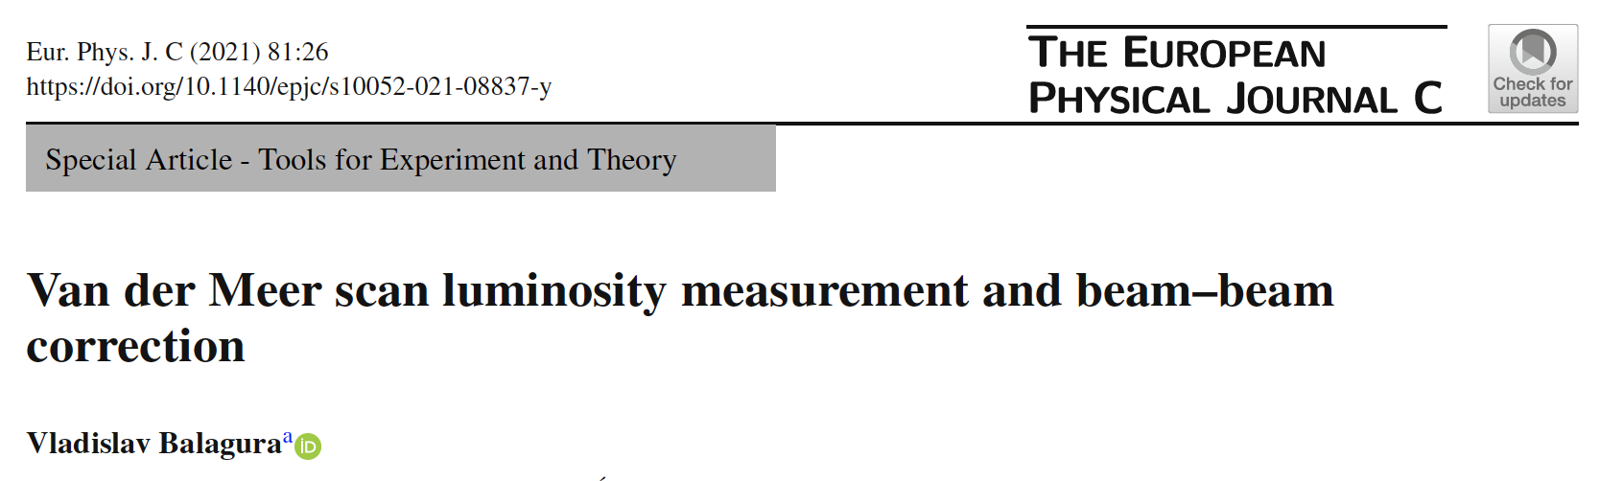
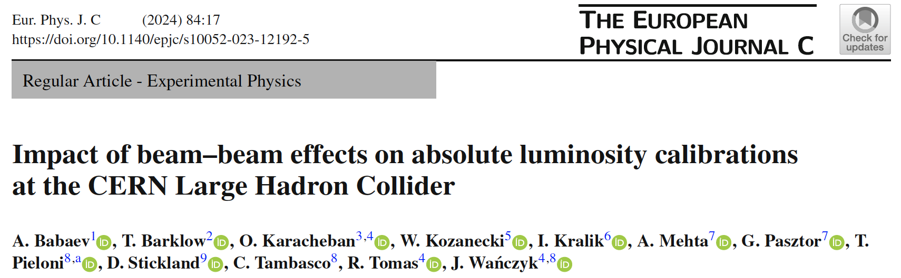
Contributions from all of ALICE, ATLAS, CMS & LHCb + LHC experts (EPFL)
in the context of the LLCMWG (LHC Luminosity-Measurement & -Calibration Working Group)

Slide 4
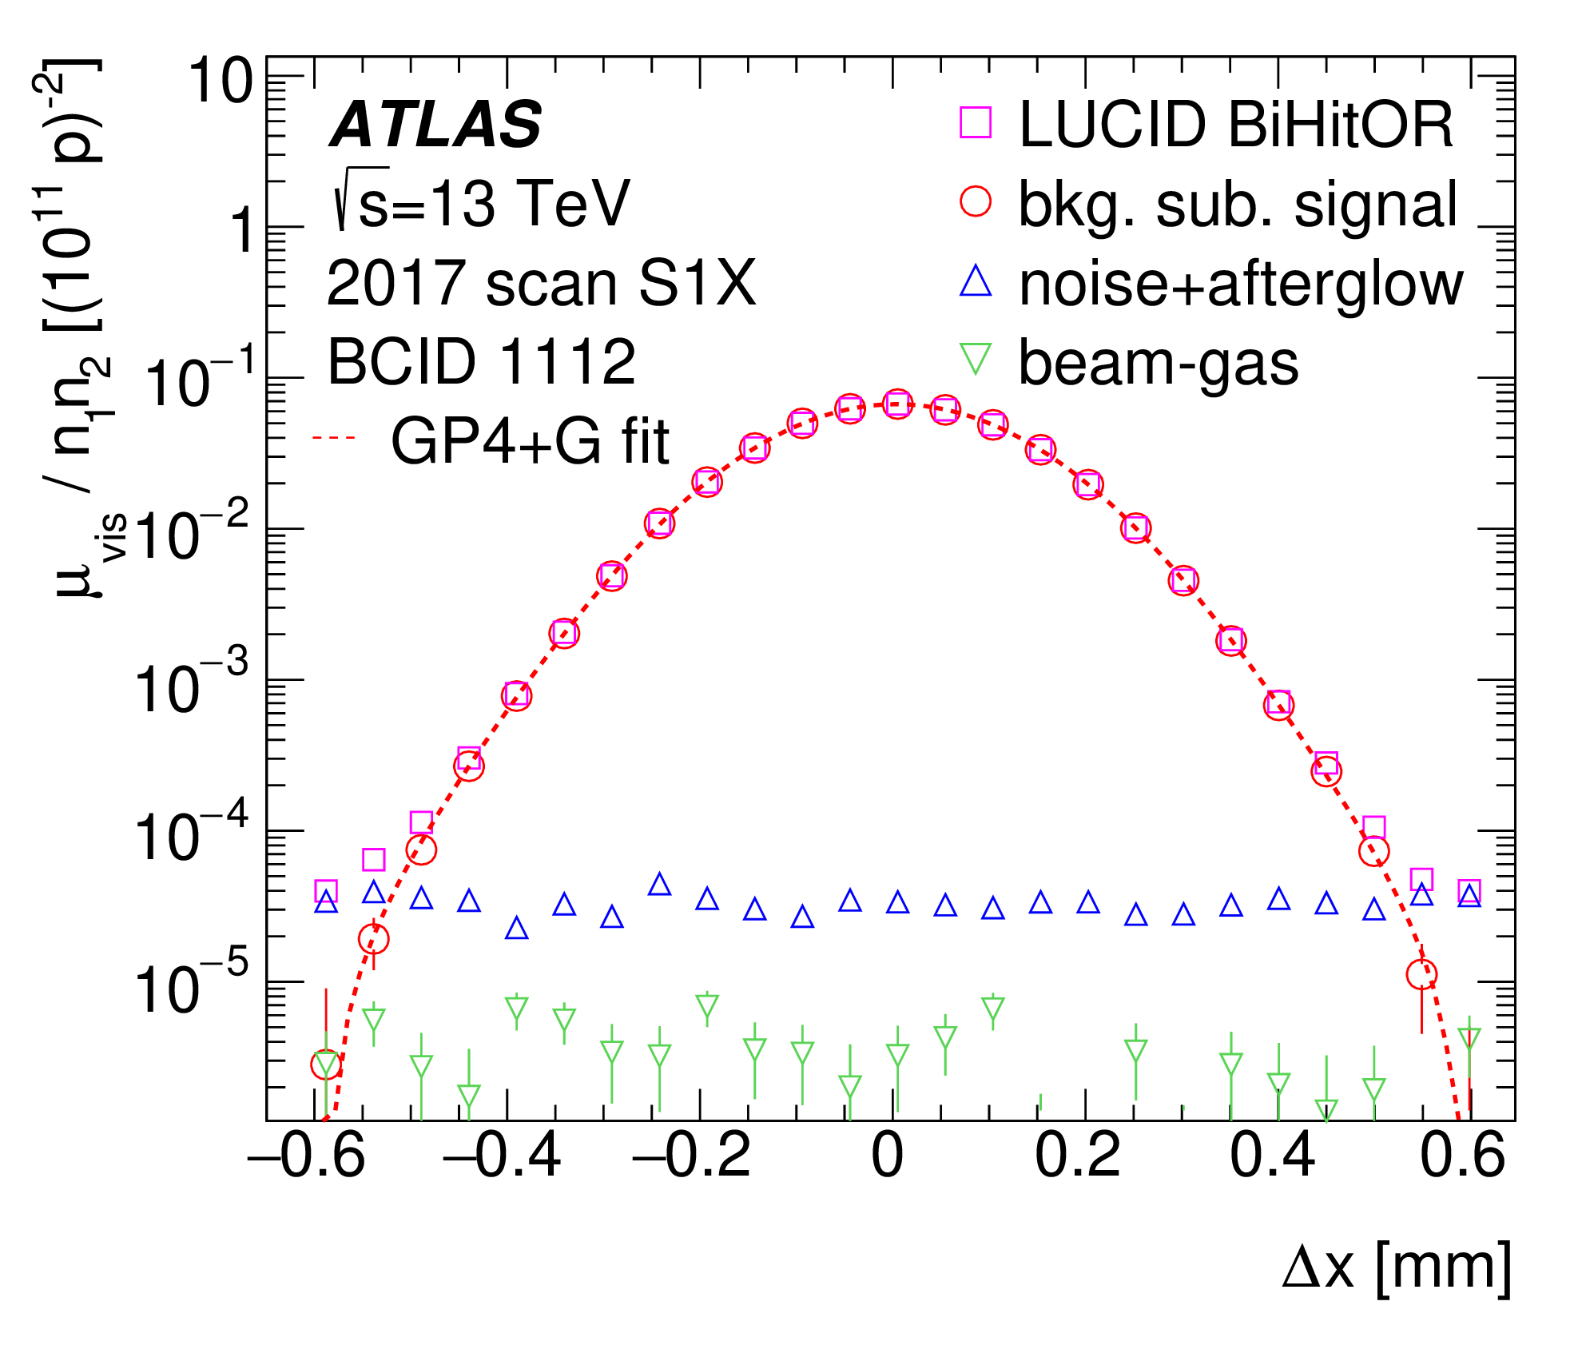
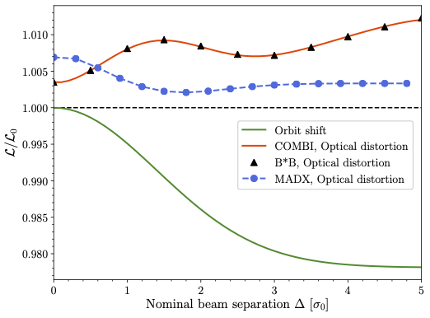
Impact of beam-beam effects on vdM L calibrations at the LHC
Bias type | Orbit shift | Optical distortions
Physical effect (L₀, Δ₀: no beam-beam) | Δ₀-dependent beam-beam deflection: |Δ| > |Δ₀| ⇒ L (Δ₀)/L₀ (Δ₀) < 1 | Δ₀-dependent focusing (~ dyn.-β effect): ⇒ L/L₀ > 1
Modelled using | Analytical (Bassetti-Erskine), validated by B*B/COMBI multiparticle simulations | B*B simulation (weak-strong) [3] COMBI simulation (strong-strong) [4]
Typical σ_{vis} bias [%, 1IP] | -1.8 % (if left uncorrected) | +1.4 % (if left uncorrected)
Corr'ctn = f(ξ, q_{x}, q_{y}, Δ₀) | Δ^{x,y}₀ ◊ Δ^{x,y} = Δ^{x,y}₀ + δ^{x,y}_{bb}^{Bassetti-Erskine} | L_{meas} → L_{meas} * [L/L₀]⁻¹
ξ = 2.6 10⁻³
B*B & COMBI:
perfect agreement
1%
MAD-X underestimates optical distortions because it does not model:
the amplitude-dependence of the beam-beam kick (in the way needed for this particular use case)
the bb-induced non-linear shape distortions (→ non-Gaussian tails)
⇒ pre-2021: absolute L scale (pp) biased down by ~ 1%
0

Slide 5
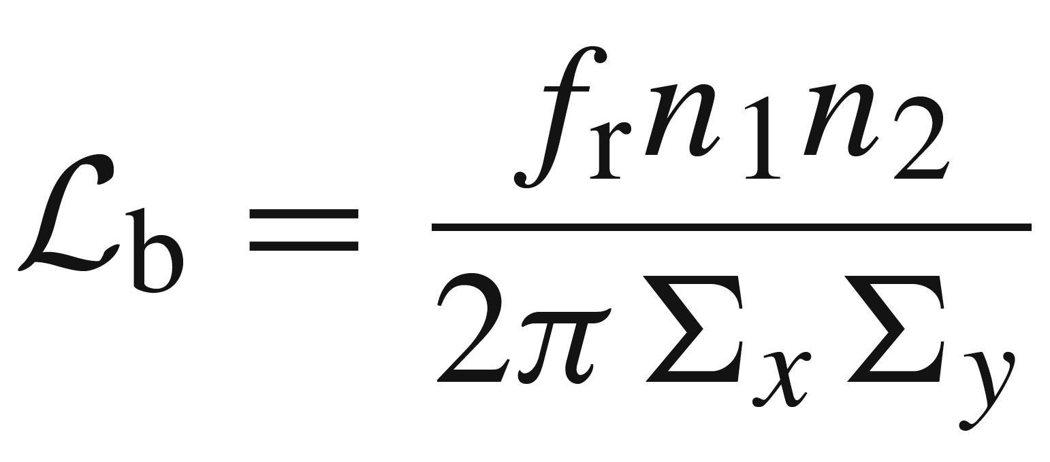
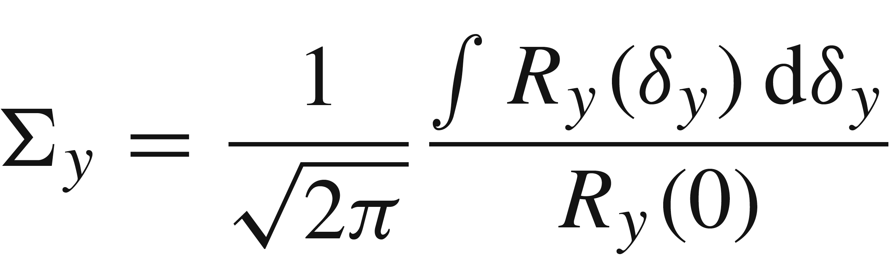
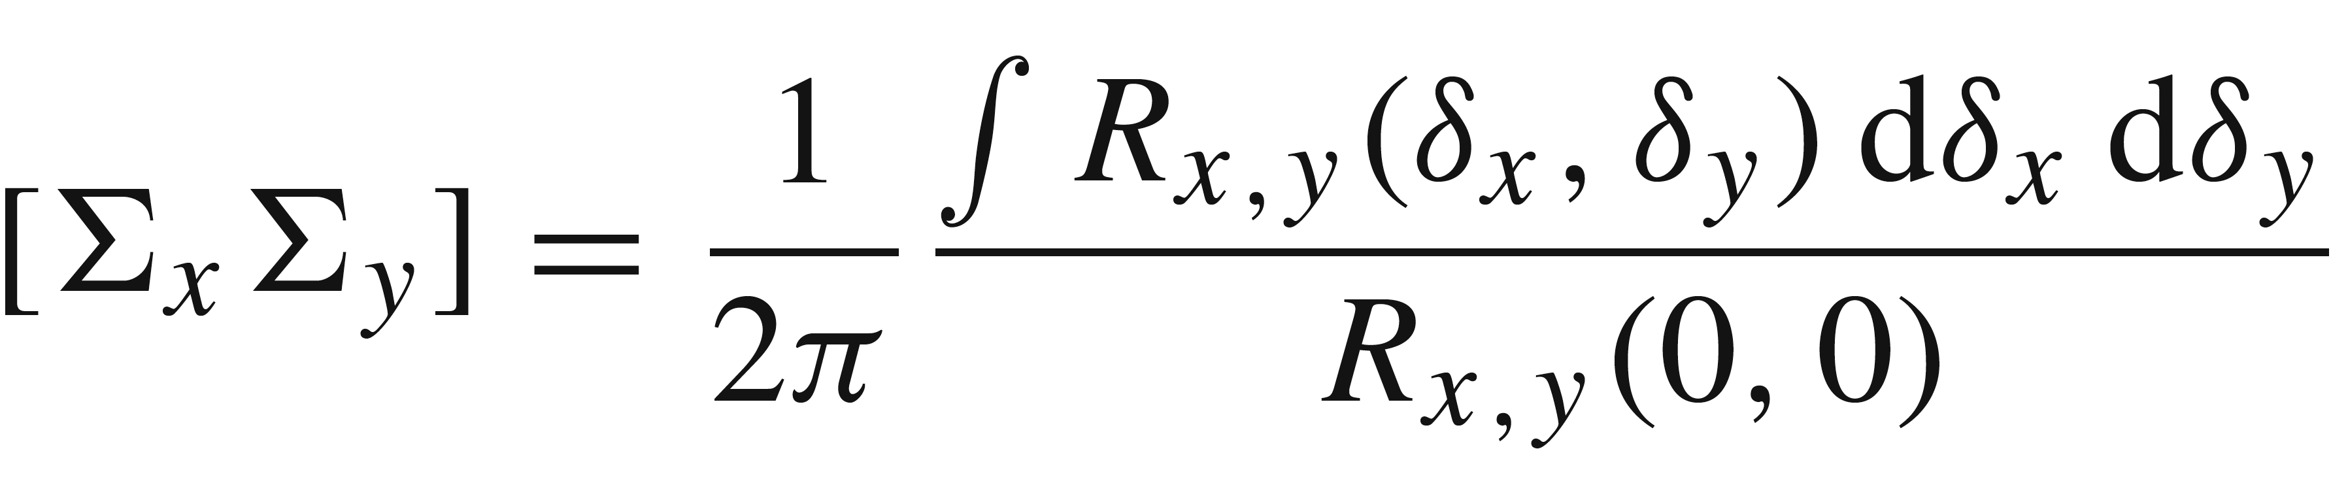
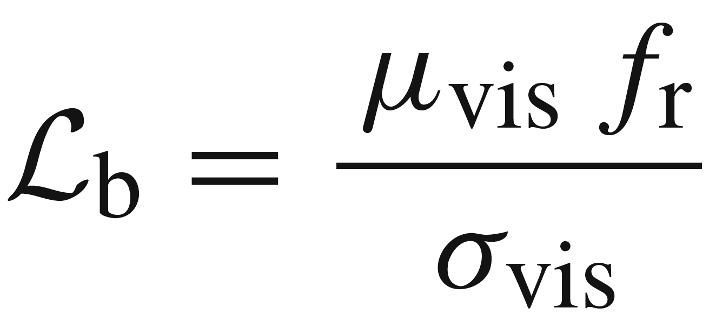
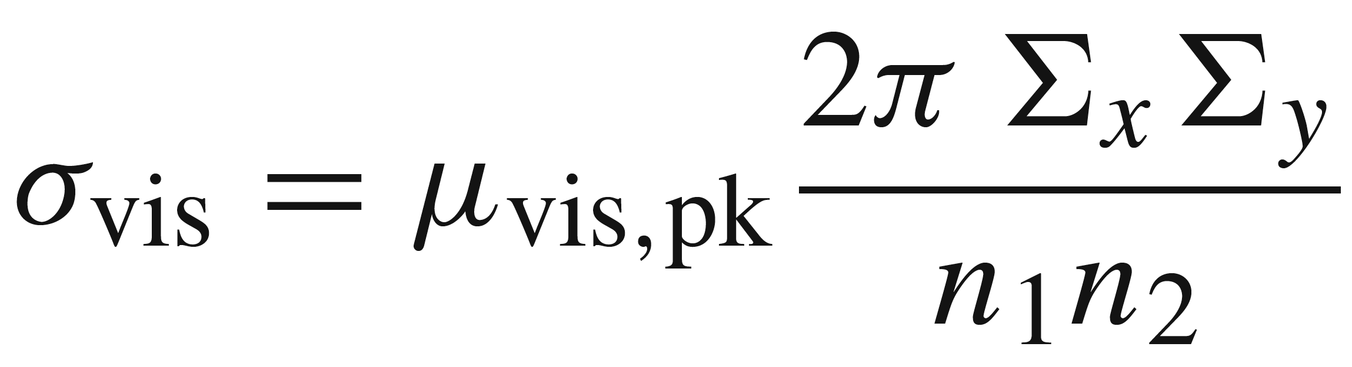
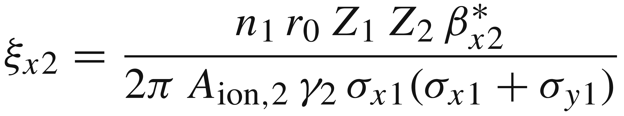
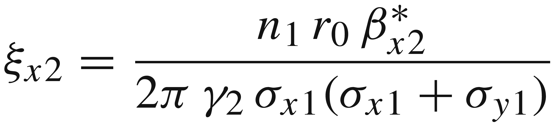
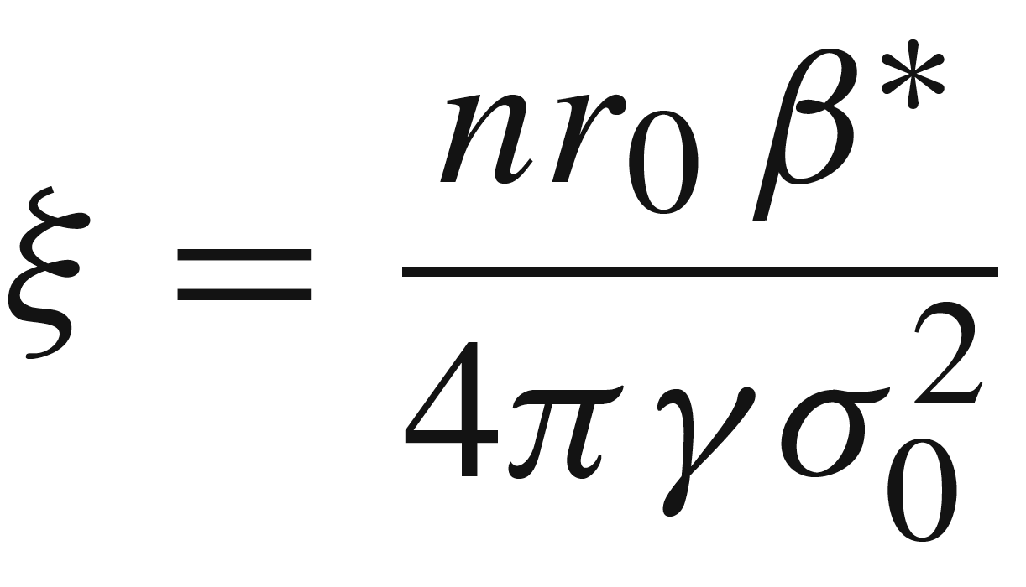
Beam-beam biases: fundamental observables
Bunch L @ scan peak
from acc. observables
(1-D vdM)
(2-D vdM)
from luminometer
δ_{x} [mm]
Beam-beam parameter ξ_{iB} (i = x, y; B =1, 2)
General case (ion beams): arbitrary particle masses (A_{ion1}, A_{ion2}) amd charges (Z₁, Z₂), unequal bunch populations (n₁, n₂), unequal upright elliptical beams. Note that r₀ is the classical proton radius in all three formulas.
Most frequent case: p beams (Z₁ = Z₂ = 1), unequal bunch populations (n₁, n₂), unequal upright elliptical beams
~ n / ε_{N}
Most simulations: p beams, equally populated & equal-radius round beams. Deviations treated as systematics.

Slide 6
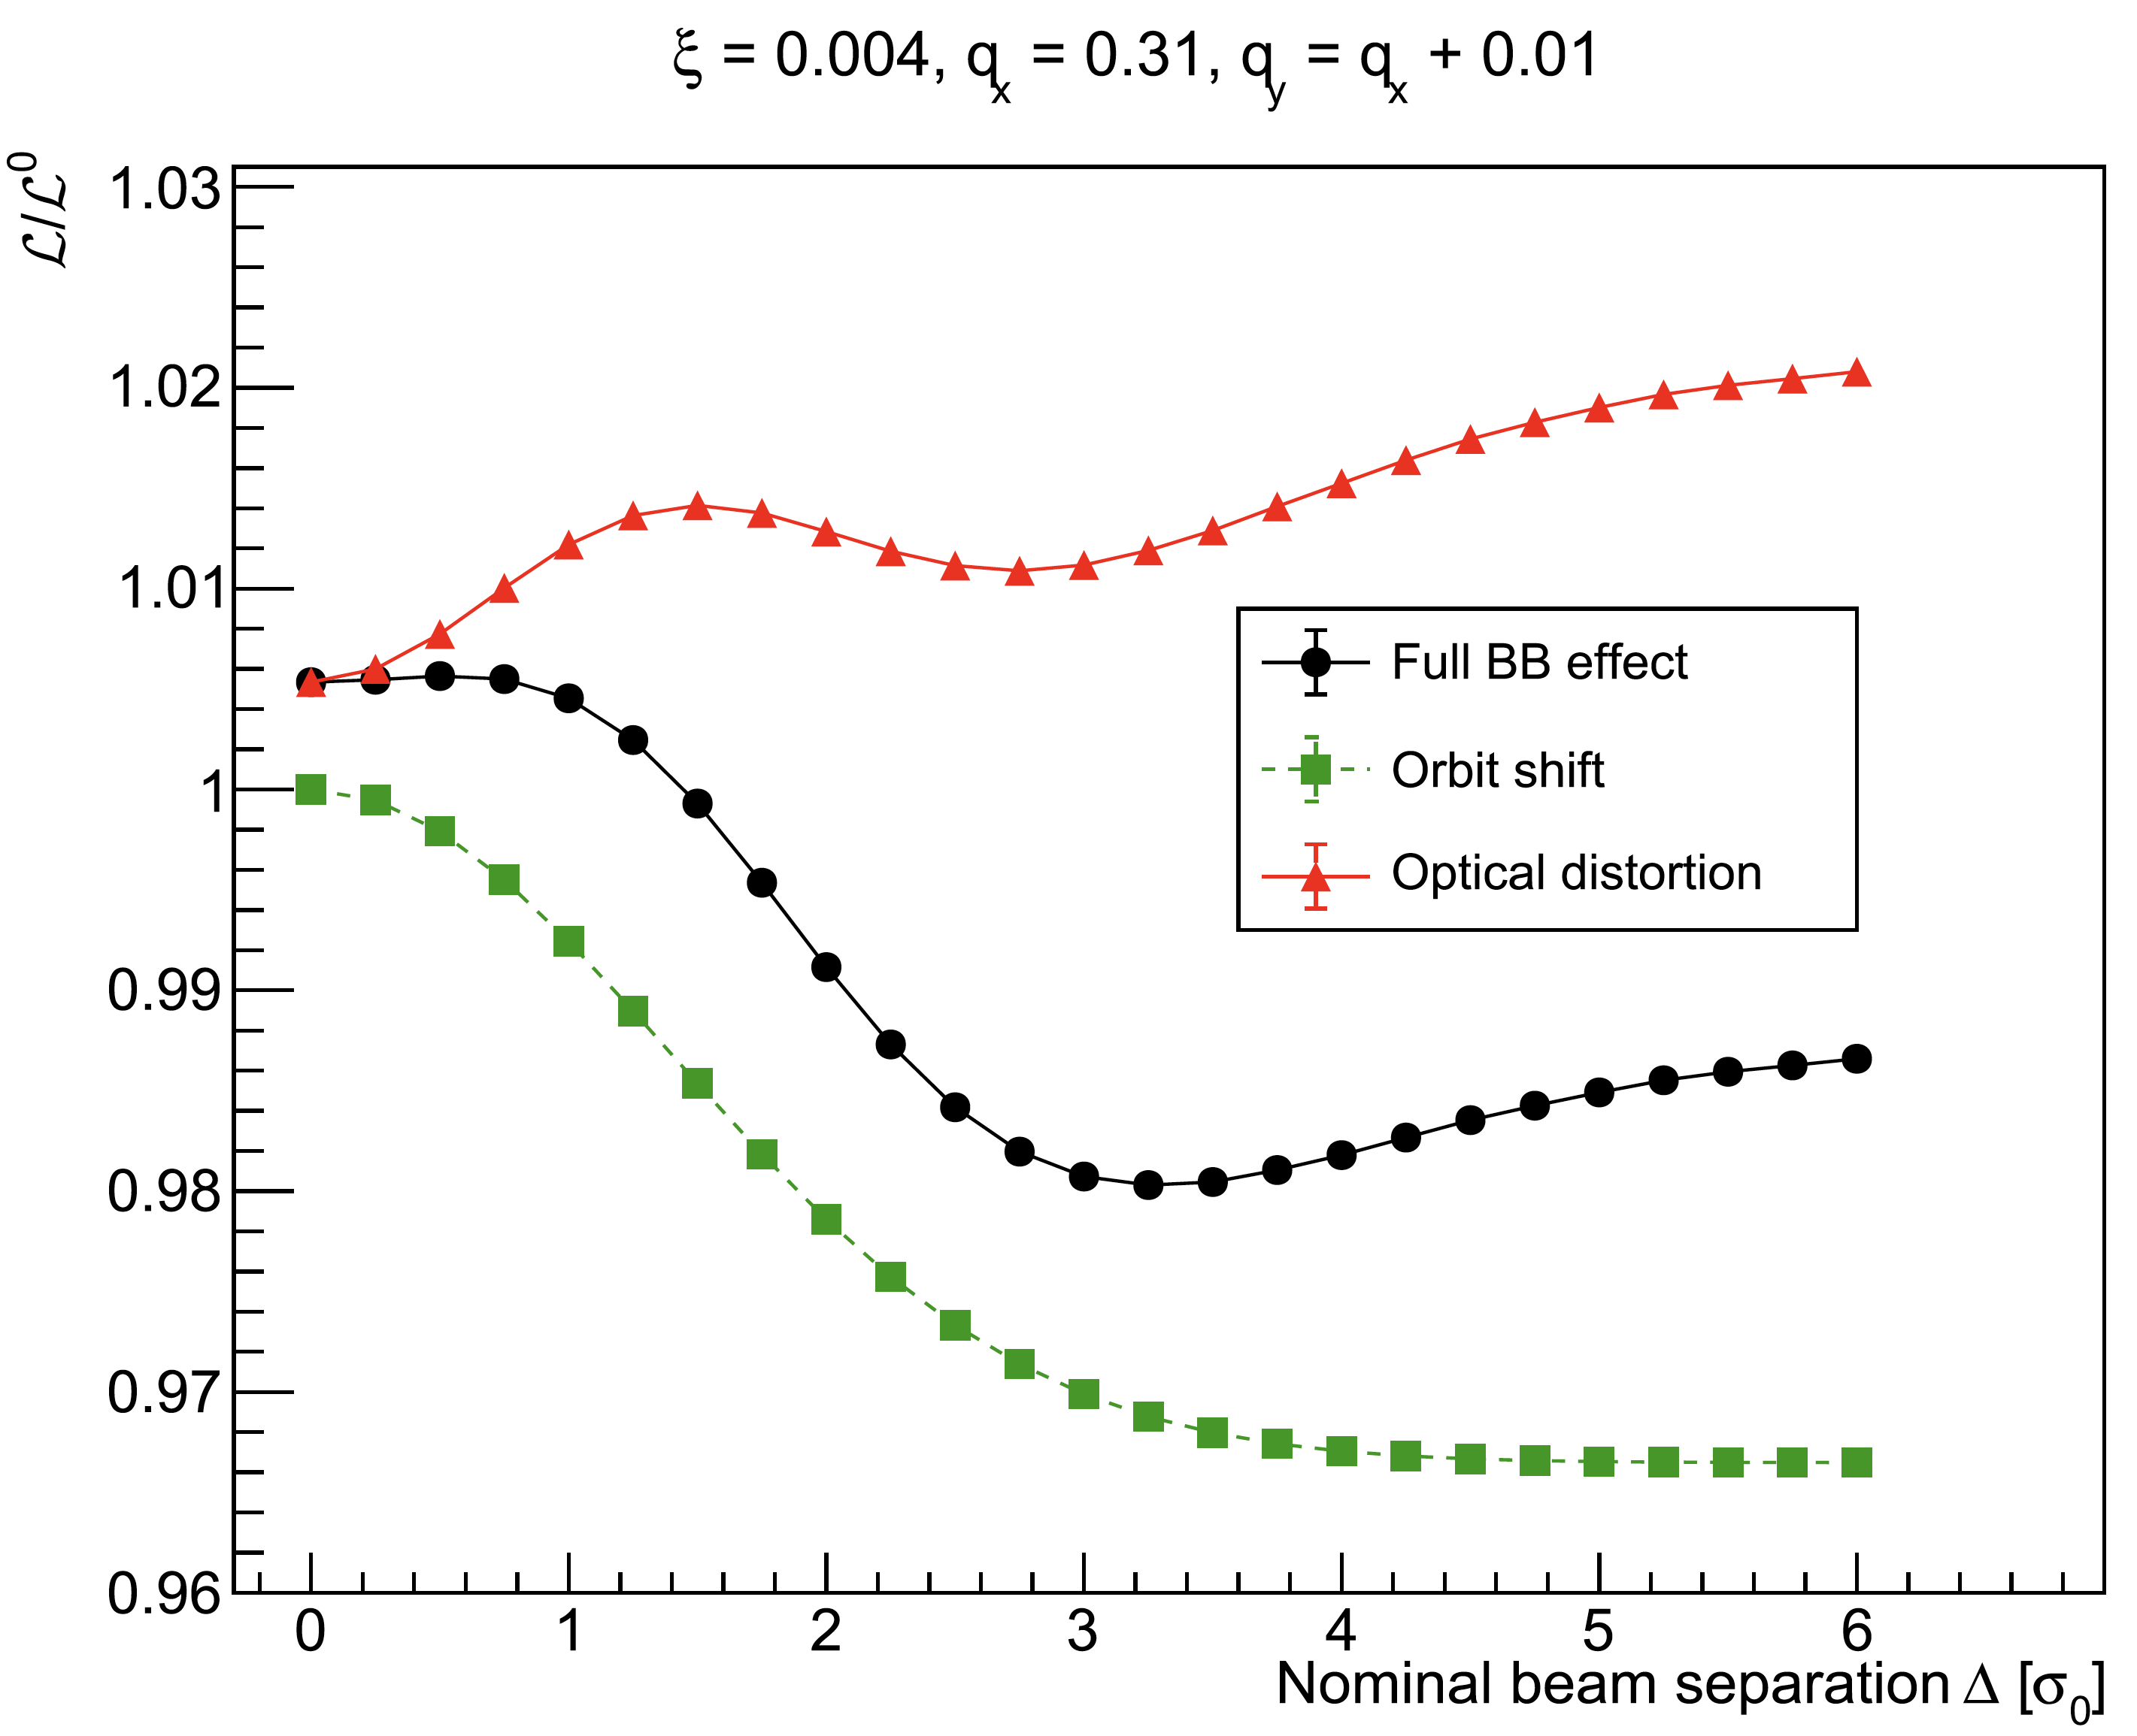
Beam-beam biases: nomenclature (collisions @ scanning IP only)
Beam-beam bias parameters and “figures of merit” (FoMs): definitions
  wrt no beam-beam anywhere: “L_{o} normalization”
    b-b bias parameters: L (Δ_{i}) / L_{o} (Δ _{i}) – 1, i = x, y
      where Δ is the nominal separation in the scanning plane in units of the single-beam size σº
      typically expressed in %
    Figures of merit (= integrated-bias parameters): Σ_{x,y} / Σ⁰ - 1, μ_{pk} / μ_{pk} ⁰ - 1, σ_{vis} / σ⁰_{vis} – 1
      typically expressed in %
Beam-beam biases broken down into:
  "Optical-distortion effect" = changes in beam-overlap integral arising from anything else than the orbit shift (e.g. changes in transverse distribution)
  "Full beam-beam" = b-b bias parameter or FoM as predicted by the simulation
  "Orbit-shift effect" = impact of beam-beam deflection on closed-orbit of the 2 beams, assuming rigid beams. Modifies the beam separation only
No
beam-beam
[L (Δ) / L_{o} (Δ)] _{opt. dist.} = [L (Δ) / L_{o} (Δ)] _{full bb} / [L (Δ) / L_{o} (Δ)] _{orb. shift}

Slide 7
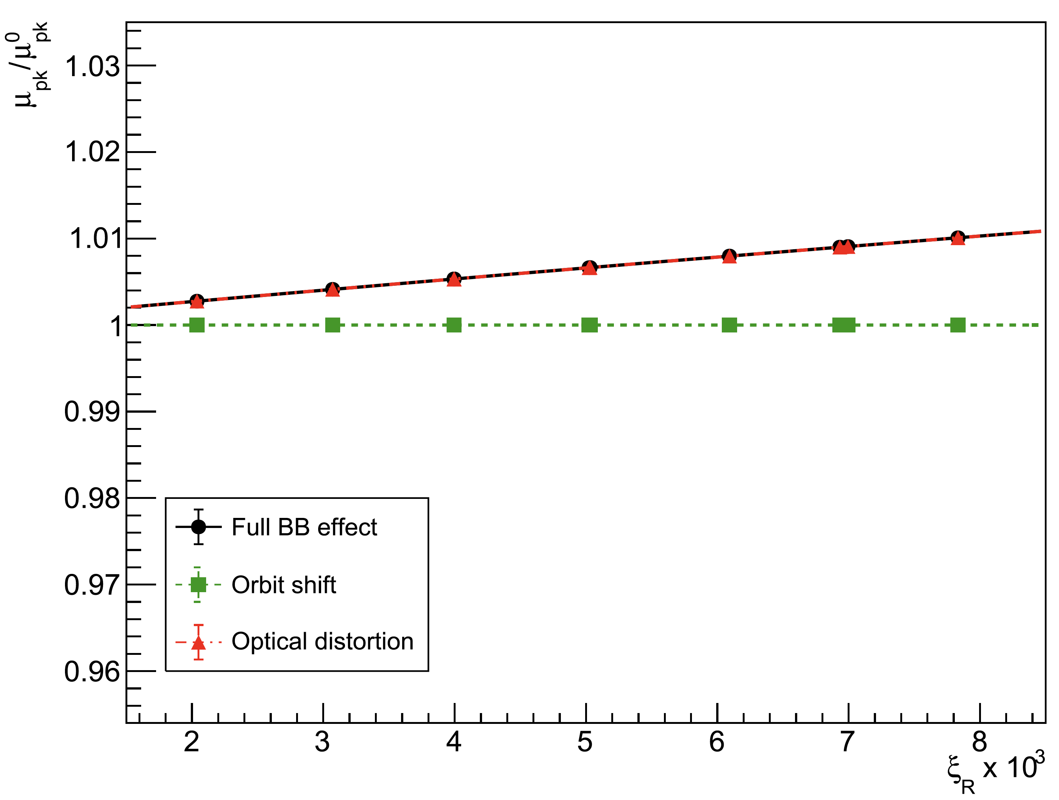
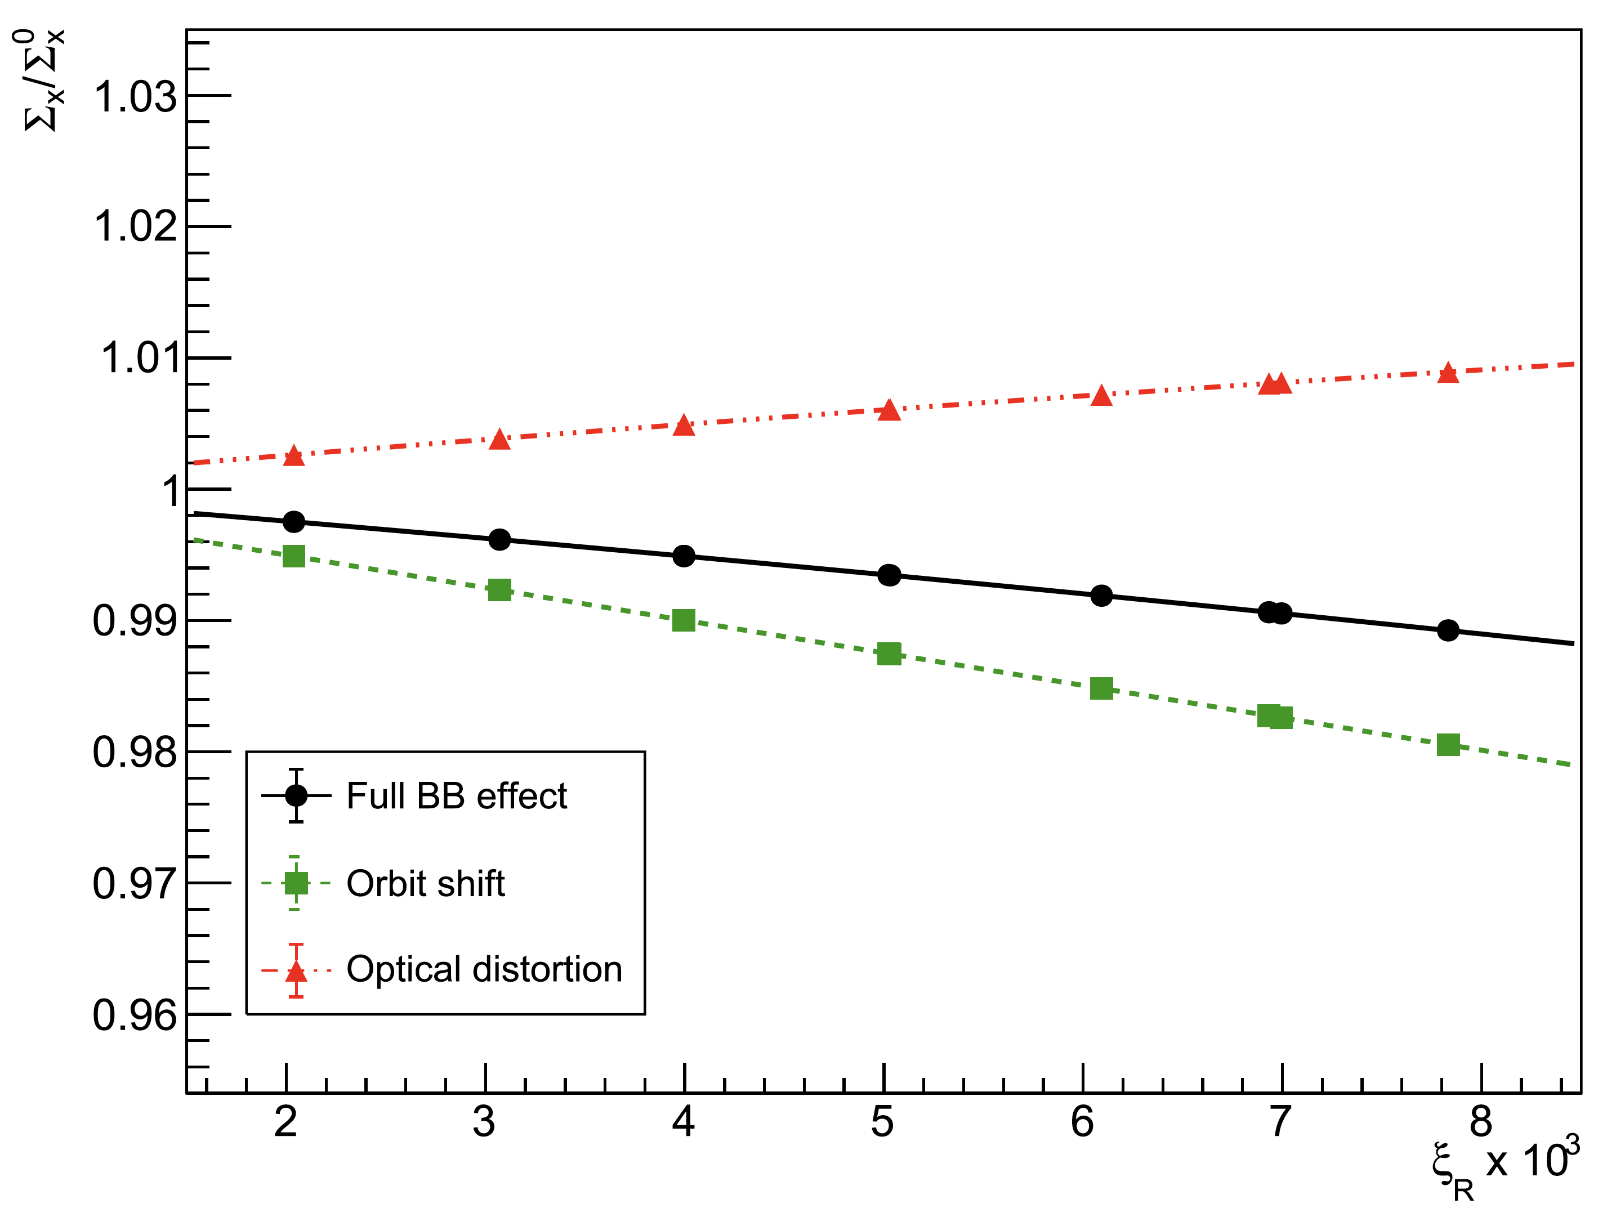
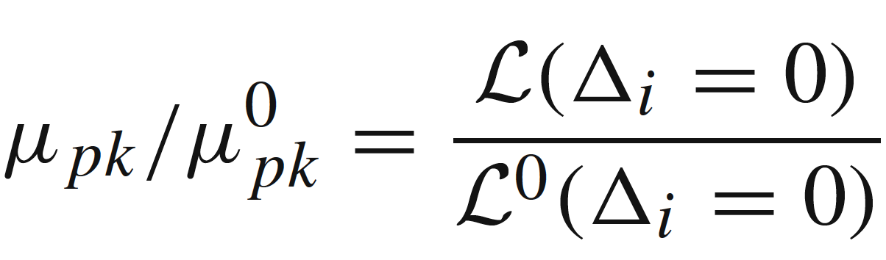
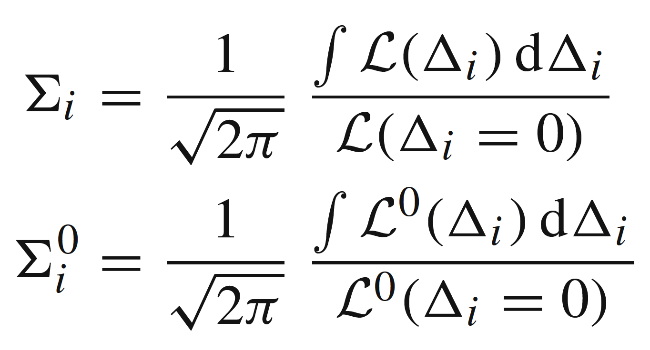
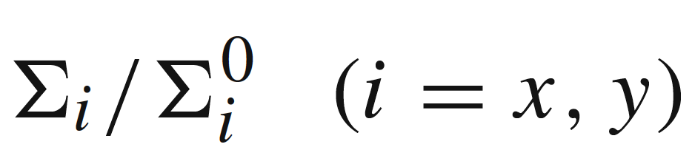
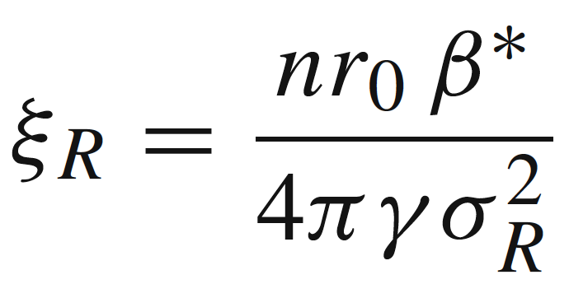
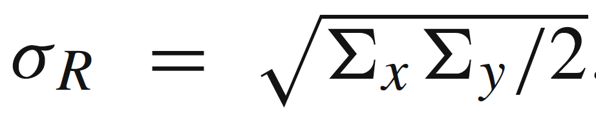
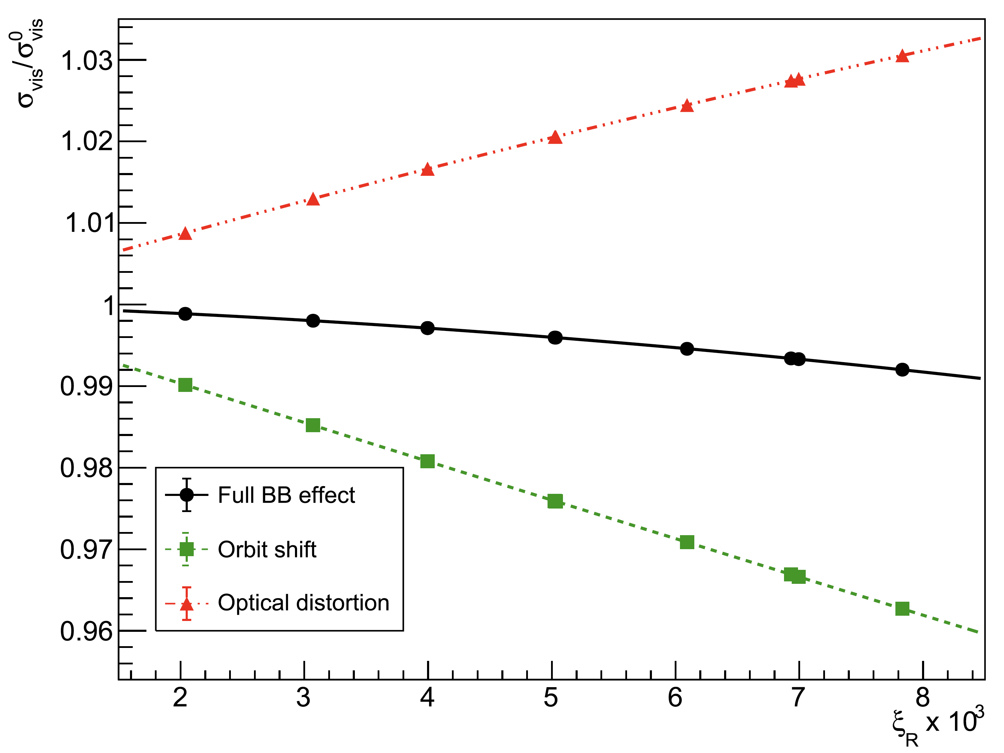
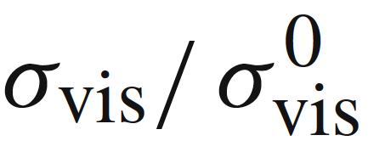
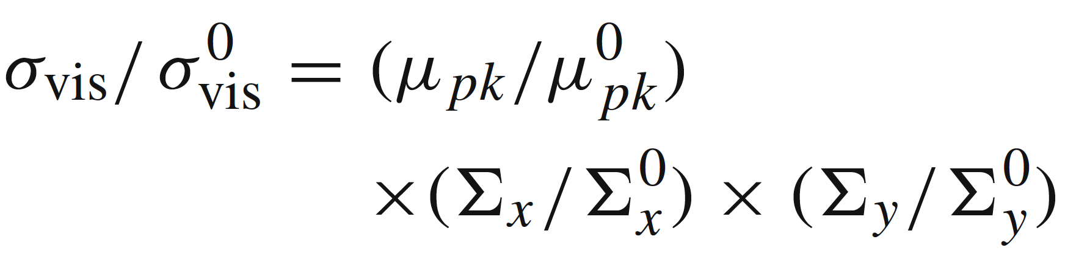
ξ-dependence of beam-beam biases (collisions @ scanning IP only)
Parameterization:
2nd-order polynomials
of (ξ_{R}, q_{x}, q_{y})

Slide 8
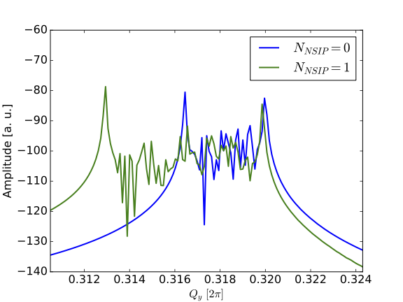
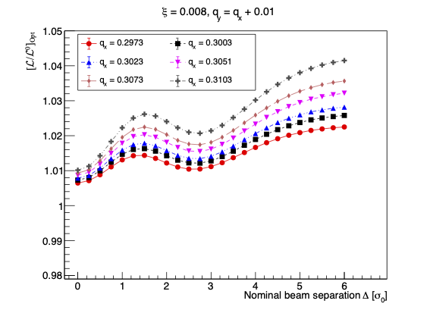
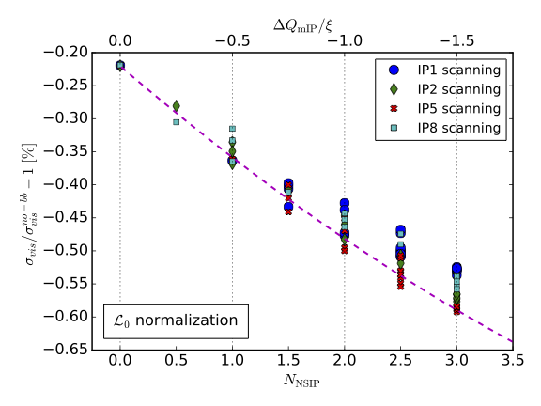
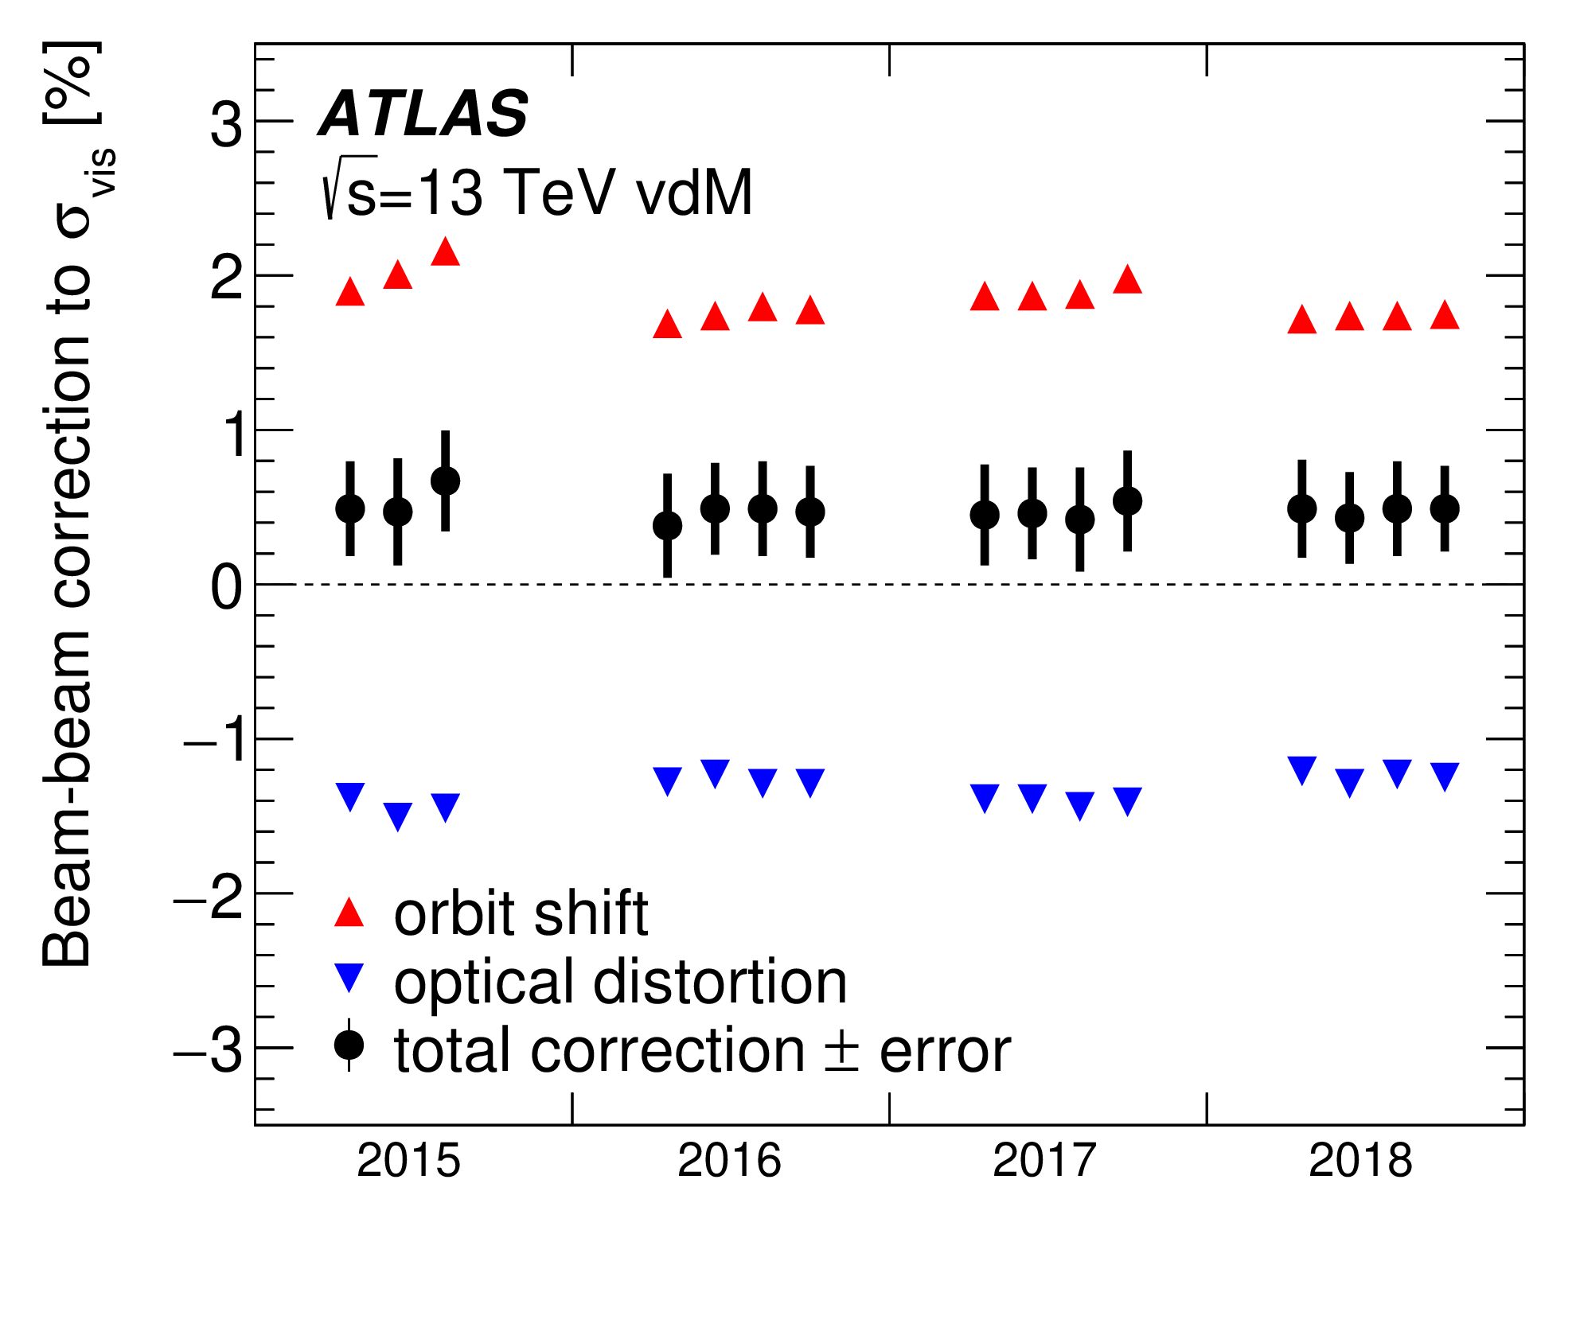
Tune dependence & multi-IP effects
[L/L₀] (Δ) = f(ξ, Δ, q_{x}, q_{y})
  Scales ~ linearly w/ ξ = ξ (ε, β*, n₁, n₂)
  depends sensitively on (q_{x}, q_{y})
Typical b-b corrections to σ_{vis}
Collisions @ "other" IP(s) →
Beam-beam corrections to σ_{vis}
  scale ~ linearly w/ N_{NSIP} ( = # non-scanning IPs)
  deviations from naïve scaling due to different phase advances btwn IPs
ΔQ ~ 2ξ * Y
COMBI simulation
Head-on collisions
N_{IP} = N_{NSIP} + 1
N_{IP} = 1 or 2
N_{NSIP} = 0 or 1
ξ = 0.0032 per IP
ΔQ ~ ξ * Y
1.5 − 2 %
Δq_{x}, Δq_{y}
= 0.0130
For bunches that collide
at the scanning IP only
ξ ~ 0.0034 - 0.0042
Strong
mutual
cancellation
ξ = .0032 (per IP)
0.4 − 0.5 %
Single-IP simulation
w/ Q⁰_{x}, Q⁰_{y} shifted
by -0.5 ξ N_{NSIP}

Slide 9
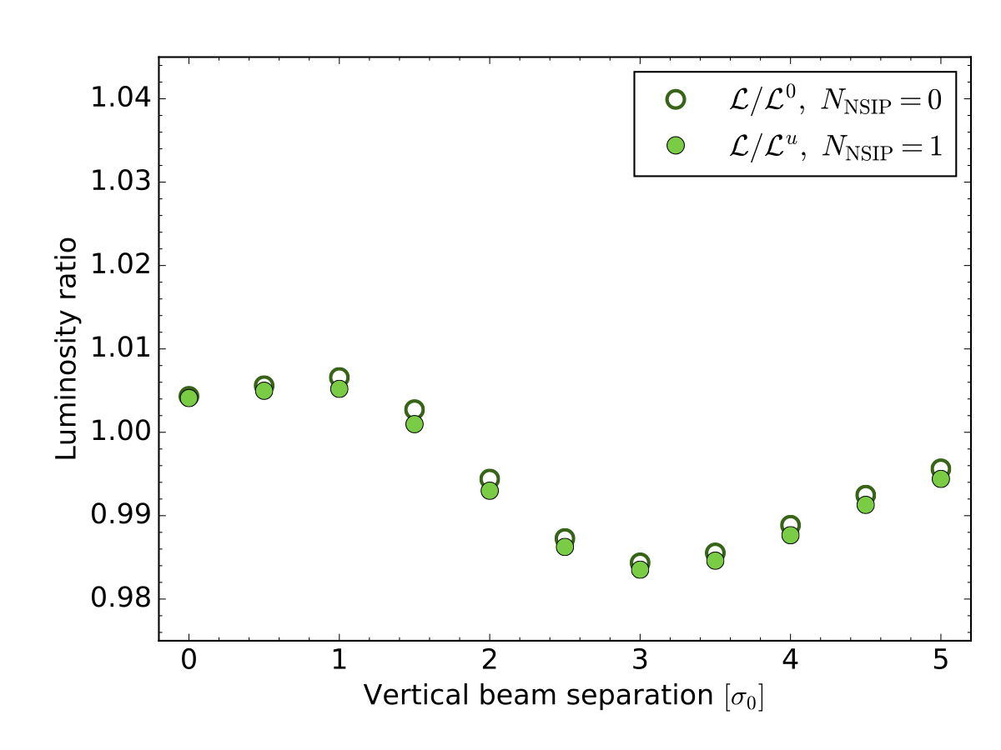
Multi-IP effects, choice of reference (1)
2 possible reference configurations for “no beam-beam”
  no beam-beam anywhere: “L_{o} normalization”
    b-b bias parameters: L (Δ) / L_{o} (Δ) - 1, σ_{iB} (Δ) / σº - 1, L_{u} (Δ) / L_{o} (Δ) - 1, σ^{u}_{iB} (Δ) / σ⁰ - 1
      where Δ is the nominal separation in the scanning plane in units of the single-beam size σº
  no beam-beam at the scanning IP only: “L_{u} normalization”
    b-b bias parameters = L (Δ) / L_{u} (Δ) - 1, σ_{iB} (Δ) /σ^{u}_{iB} – 1
  if bunches collide at the scanning IP only, the L_{o} and L_{u} normalizations are identical
Beam-separation dependence, during a simulated vertical vdM scan, of the luminosity-bias factors at the scanning IP associated with the full beam-beam effect, for N_{NSIP} = 0 using the L₀ normalization (open circles), and for N_{NSIP} = 1 using the L_{u} normalization (filled green circles). The horizontal axis is the beam separation in units of the nominal transverse beam size σ₀ .

Slide 10
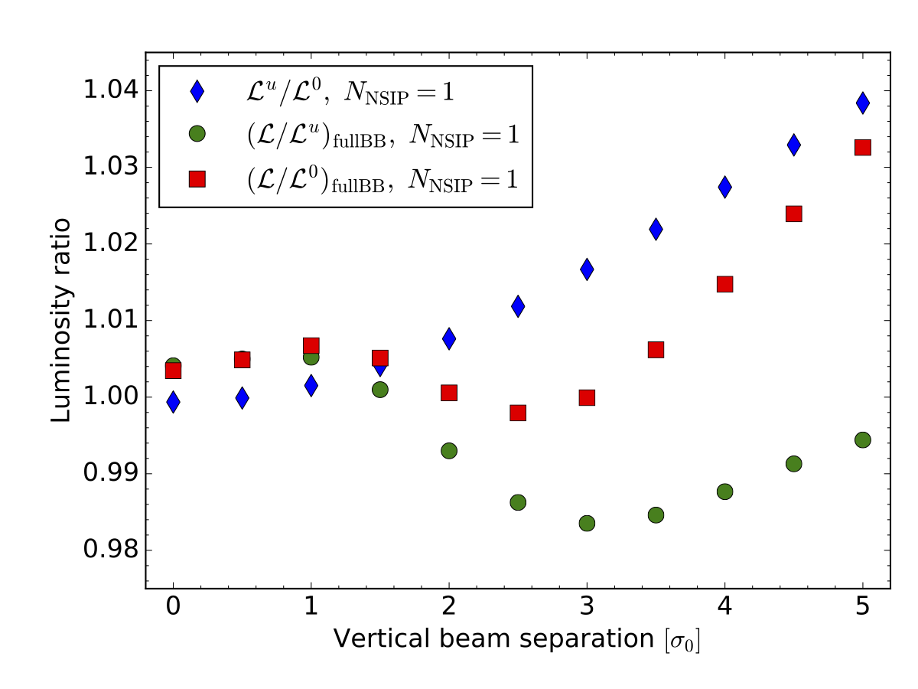
Multi-IP effects, choice of reference (1)
2 possible reference configurations for “no beam-beam”
  no beam-beam anywhere: “L_{o} normalization”
    b-b bias parameters: L (Δ) / L_{o} (Δ) - 1, σ_{iB} (Δ) / σº - 1, L_{u} (Δ) / L_{o} (Δ) - 1, σ^{u}_{iB} (Δ) / σ⁰ - 1
      where Δ is the nominal separation in the scanning plane in units of the single-beam size σº
  no beam-beam at the scanning IP only: “L_{u} normalization”
    b-b bias parameters = L (Δ) / L_{u} (Δ) - 1, σ_{iB} (Δ) /σ^{u}_{iB} – 1
  if bunches collide at the scanning IP only, the L_{o} and L_{u} normalizations are identical
Two-IP configuration:
1 scanning IP (e.g. IP1), 1 witness IP ( e.g. IP5)
L_{u} / L₀: luminosity-bias factor wrt no b-b anywhere; b-b “on” @ witness IP, “off” @ scanning IP
Red =
green x blue
L / L₀: luminosity-bias factor wrt no b-b anywhere; b-b “on” @ both witness IP & scanning IP
L / L_{u}: luminosity-bias factor wrt no b-b @ scanning IP; b-b “on” @ witness IP only
The beam-separation-dependence, at the scanning IP, of the L_{u} / L₀ ratio (no b-b @ scanning IP), and
the difference between the L / L₀ and L / L_{u} curves,
are both caused by the optical distortion (aka dynamic β , or β-beating) induced by b-b at the witness IP, and to its phase-advance-dependent propagation from the witness IP to the scanning IP.
Beam-separation dependence, during a simulated vertical vdM scan in the Run-2 configuration with 1 non-scanning IP, of the luminosity-bias factors at the scanning IP associated with the unperturbed luminosity (L_{u}/L₀ , blue), with the full beam-beam effect in the L₀ normalization ([L/L₀]_{Full BB} , red), and with the full beam-beam effect in the L_{u} normalization ([L/L_{u}]_{Full BB} , green).

Slide 11
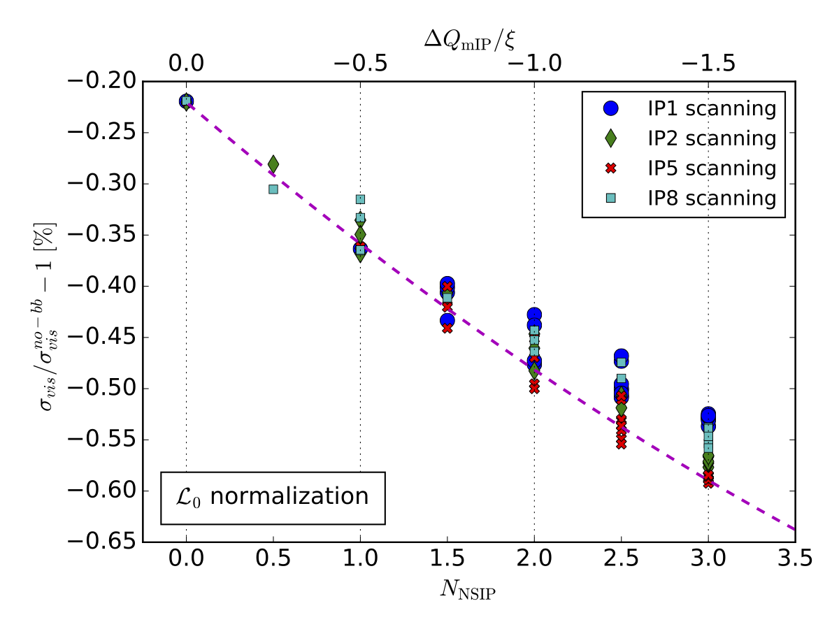
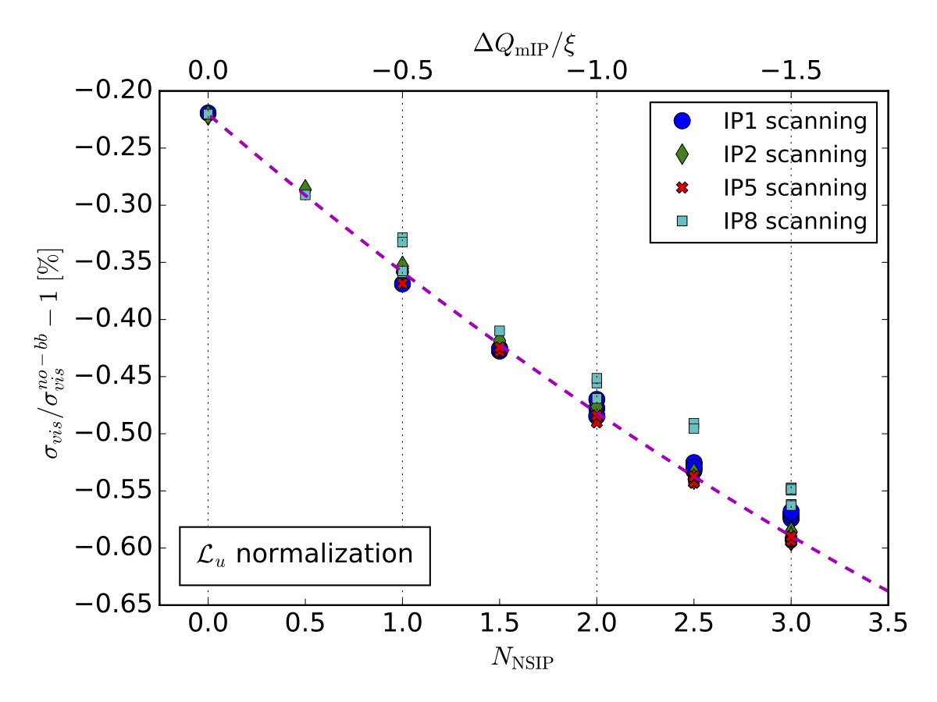
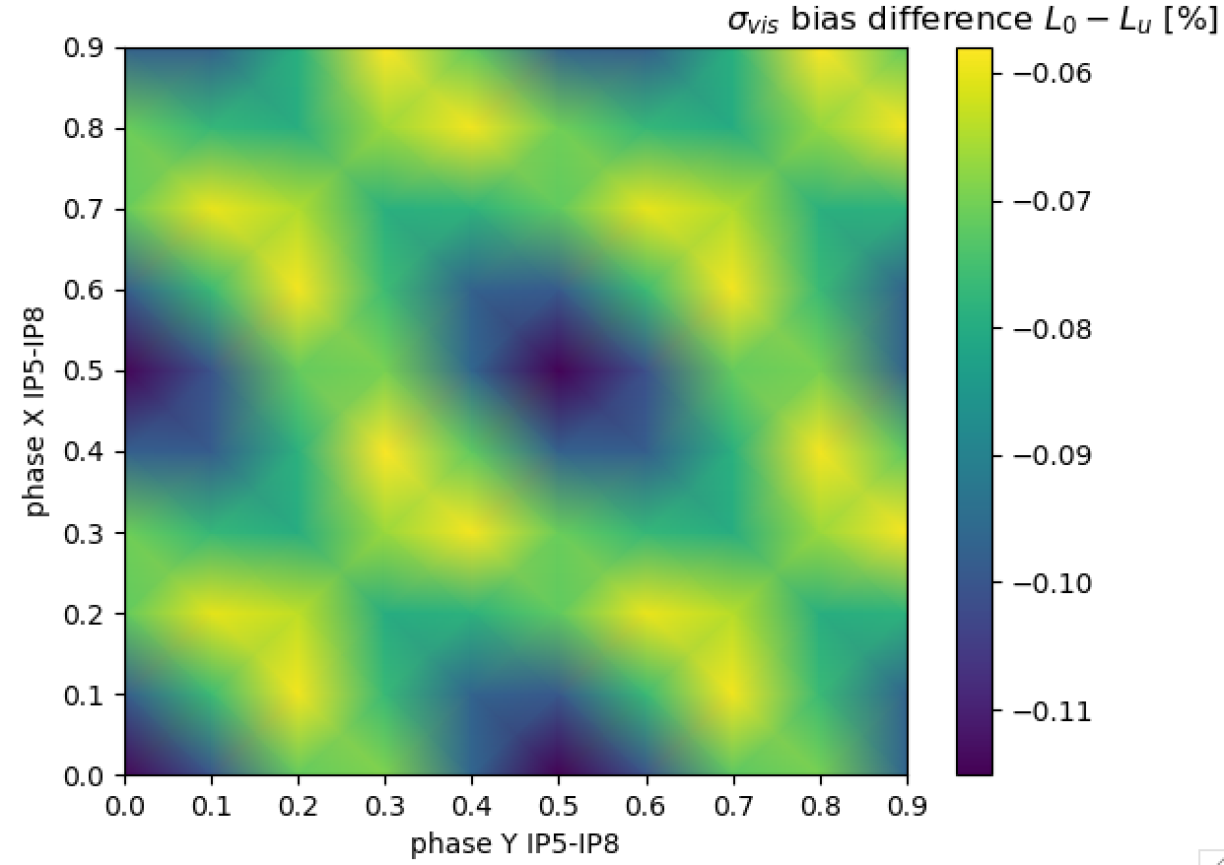
Multi-IP effects, choice of reference (2)
Spread reflects that in the phase advance between the scanning IP and the various associated non-scanning IPs
→ BCID dependent
Single-IP simulation
w/ Q⁰_{x}, Q⁰_{y} shifted
by -0.5 ξ N_{NSIP}
Visible cross-section bias in the L₀ normalization as a function of the number of non-scanning IPs, for the four possible choices of scanning IP.
Visible cross-section bias in the L_{u} normalization as a function of the number of non-scanning IPs (lower horizontal axis), for the four possible choices of scanning IP. The curve represents the dependence of the σ_{vis} bias in the N_{NSIP} = 0 case, but with the horizontal and vertical unperturbed tunes shifted down by ΔQ_{mIP} / ξ = -0.5 N_{NSIP} (upper horizontal axis). For a given scanning IP, there exist several B1-B2 bunch-collision patterns that yield the same value of N_{NSIP}.
σ_{vis} –bias difference, L₀ - L_{u} [%]
Why is there a difference between the L₀ and L_{u} normalizations?
Why is the spread (at fixed N_{NSIP} ) significantly smaller in the L_{u} normalization?
Unresolved at time of publication.
Phase-advance dependence of the difference, between the L₀ and the L_{u} normalization, of the beam-beam induced σ_{vis} bias. The scans are simulated at IP5, with bunches remaining in head-on collision at two other IPs (N_{NSIP} = 2). The horizontal and vertical axes represent the betatron phase advance between IP8 and IP5, here assumed to be the same for B1 and B2. The color scale quantifies the fractional inconsistency in σ_{vis} bias between the two reference configurations; in this example, it ranges from -0.06 to -0.11 % of σ_{vis}.

Slide 12
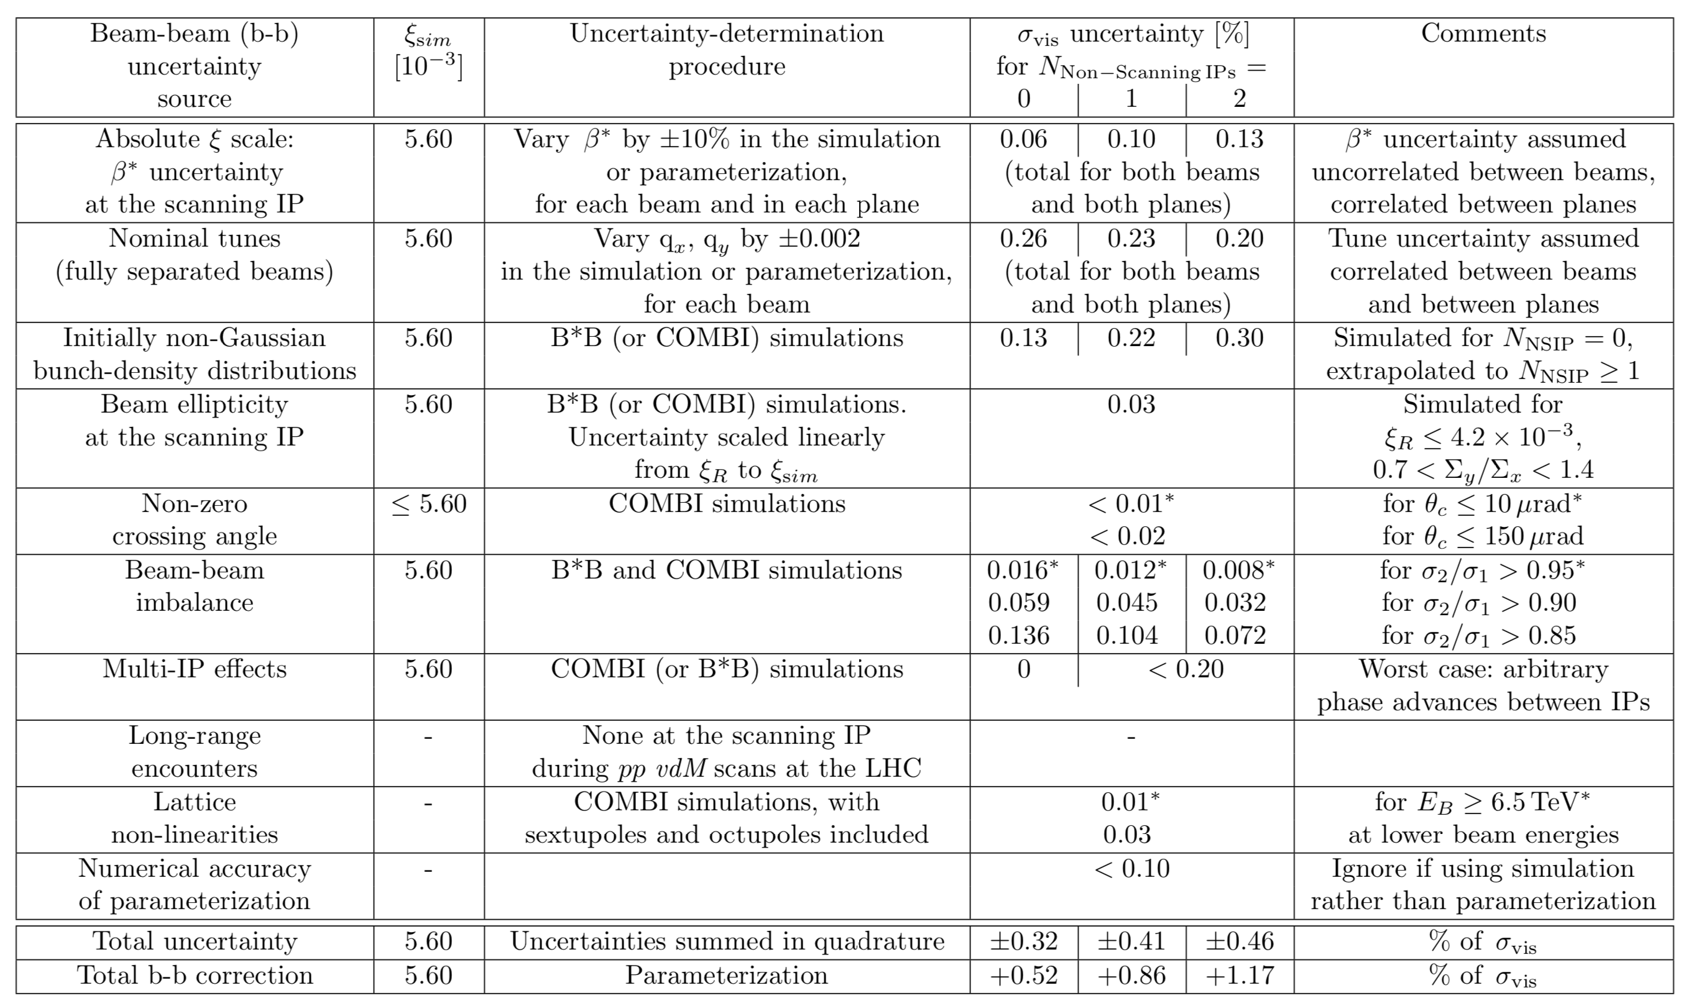
Systematic uncertainties on beam-beam correction to vdM calibrations: the complete list

Slide 13
Systematic uncertainties on beam-beam correction to vdM calibrations: dominant contributions
Both the magnitude of the beam-beam correction, and its uncertainty, roughly scale
with the beam-beam parameter ξ;
they also depend sensitively on the number N_{NSIP} of non-scanning IPs
(i.e. of additional head-on collisions besides those at the scanning IP)
Beam-beam (b-b) uncertainty source | b-b parameter ξ | σ_{vis} systematic uncertainty [%] for number of non-scanning IPs (N_{NSIP}) =
 |  | 0 | 1 | 2
Nominal frac. tunes q_{x}, q_{y} (fully separated beams) | 5.6 10⁻³ ( = max. value in Run-2 vdM scans) | 0.26 | 0.23 | 0.20
Multi-IP effects (from addt'l b-b tune shift) |  | 0 | < 0.20 | < 0.20
Initially non-Gaussian p-density distributions |  | 0.13 | 0.22 | 0.30
Other sources: see [4] |  | 0.13 | 0.16 | 0.20
Tot. b-b uncertainty [%] |  | 0.32 | 0.41 | 0.46
Total b-b correction [%] |  | +0.52 | +0.86 | +1.17

Slide 14
Summary & outlook (1)
During pp vdM scans at the LHC, beam--beam-induced orbit shifts & optical distortions, if left uncorrected, bias the absolute L scale by an amount comparable to the total L-uncertainty budget
  The scope of this study was limited to beam-separation scans in the vdM regime (ξ ≤ 0.006), under beam conditions that deviate only moderately from round, initially Gaussian bunches of equal brightness that collide with a zero or small nominal crossing angle → not necessarily applicable to ε-scans
The magnitude of the correction, which ranges from approx. 0.2% to 1.2%, mainly depends on ξ and on the number of non-scanning IPs
The total uncertainty in the beam-beam correction amounts to roughly half of the correction itself
  This uncertainty is dominated by tune-related effects, either directly (accuracy & reproducibility of nominal-tune settings) or indirectly (beam-beam tune shift at non-scanning IPs, phase advance btwn consecutive IPs)
  The next two most important sources of uncertainty are
    potential deviations of the initial, unperturbed transverse bunch-density distributions from a perfectly Gaussian shape
    transverse beam-size (i.e. emittance) differences between the 2 bunches in a colliding-bunch pair

Slide 15
Summary & outlook (2)
Several areas of further study have been identified, most notably:
  the ambiguity affecting the choice of the reference ``no beam-beam'' configuration, i.e. the difference between the L_{o} & L_{u} normalizations
  the extension of parameterized b-b corrections to 2-D vdM scans
  improved single-bunch models of non-Gaussian tails, both factorizable and non-factorizable, that are more sophisticated than the simple double-Gaussian functions considered in the present study
  the interplay btwn non-factorization, non-Gaussian tails, and b-b corrections
  the potential interplay between the impact of non-Gaussian beams, beam ellipticity, crossing angle, and multi-IP effects, that have so far been treated as fully uncorrelated
  the characterization of optical distortions at large Xing angle in vdM scans
  the extension of the ξ-scaling laws to the physics regime (ξ ≤ 10⁻²), with emittance scans as the primary use case
  the combined impact, during emittance scans at low β* in the physics regime, of higher beam-beam parameter values and of the hourglass effect on the crossing-angle dependence of beam-beam biases
  the impact of parasitic crossings on the absolute accuracy of emittance scans during routine physics running
→ Joanna’s talk today
→ Ivan’s talk today

Slide 16
Selected bibliography
[1] M. Bassetti, G.A. Erskine, Closed expression for the electrical field of a two-dimensional Gaussian charge. CERN-ISRTH/80-06 (1980). https://cds.cern.ch/record/122227
[2] W. Herr, Beam–beam effects and dynamic β∗, Proc. LHC Lumi Days (2012). https://indico.cern.ch/event/162948/contributions/1417430/attachments/191879/269237/S3_WH.pdf
[3] V. Balagura, van der Meer scan luminosity measurement and beam–beam correction, Eur. Phys. J. C (2021) 81: 26
[4] A. Babaev et al., Impact of Beam-Beam Effects on Absolute Luminosity Calibrations at the CERN Large Hadron Collider, arXiv2306.10394, Eur. Phys. J. C (2024) 84:17

Slide 17
Supplementary material

Slide 18
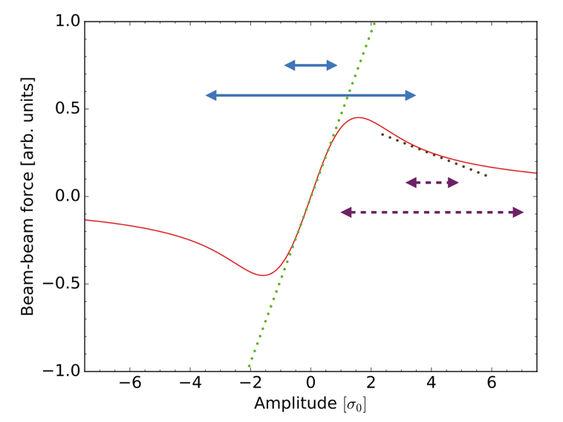
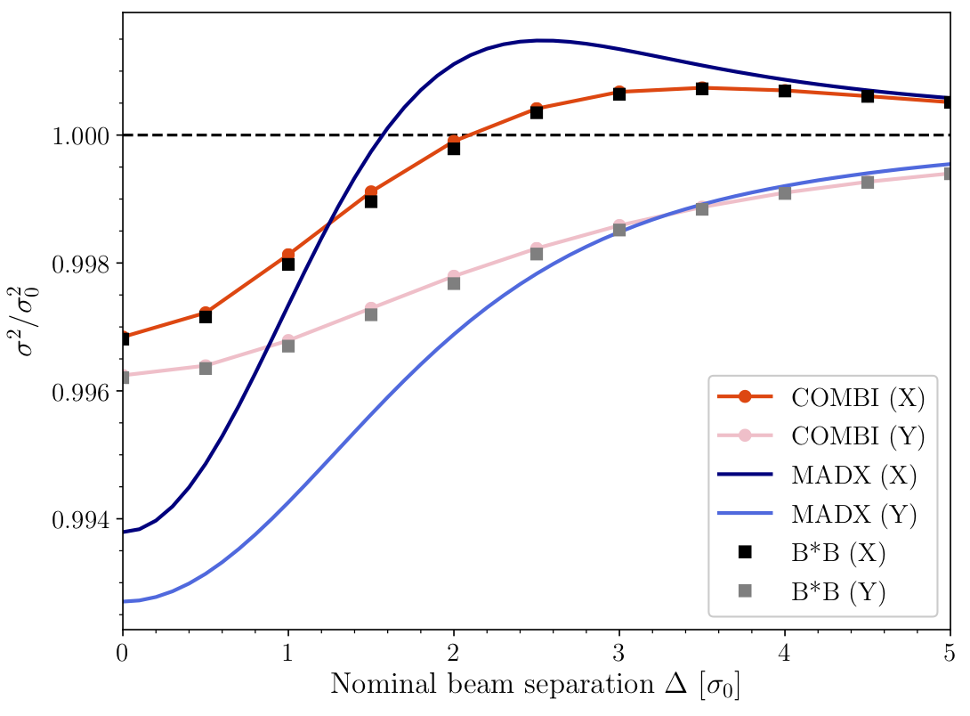
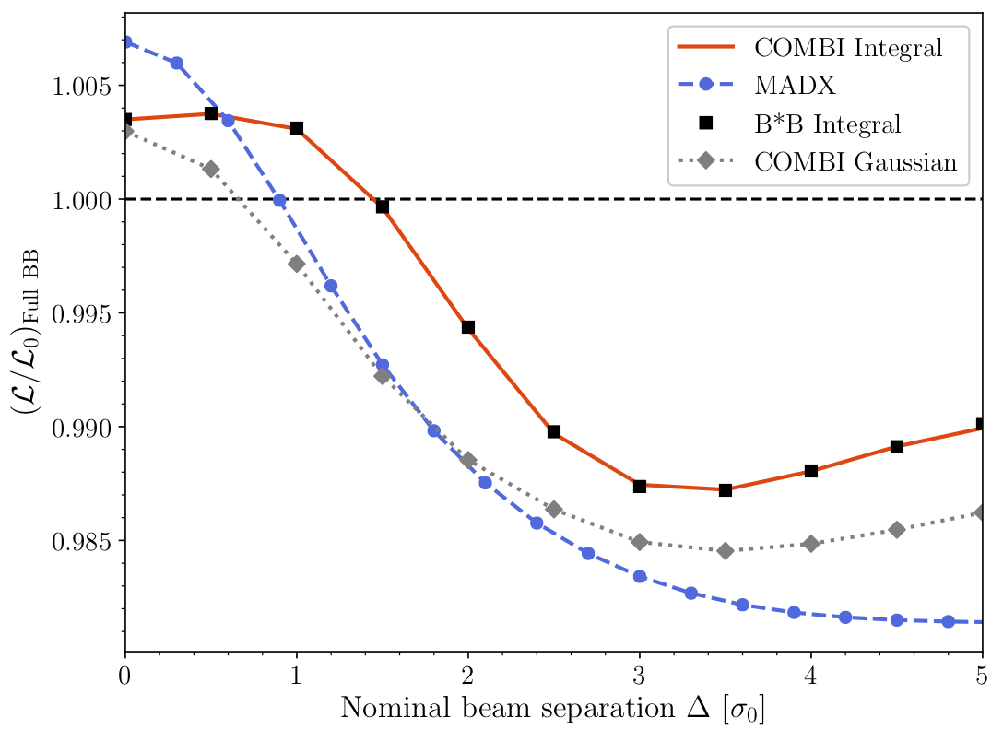
Beam-beam biases: optical distortions (single-IP mode)
A. Babaev et al., Eur. Phys. J. C (2024) 84:17
Beam-beam force exerted by the B1 (B2) source bunch as a whole (red curve), as a function of the betatron amplitude of a B2 (B1) test particle, for equally sized round beams. The amplitude is in units of the RMS beam size. The green and brown lines correspond to the linear component of the force at amplitudes of zero and 4σ respectively, and are akin to the effect of a quadrupole. The short (long) double arrows illustrate the range of transverse kicks experienced by a small (large) amplitude particle for beams either in head-on collision (solid blue lines), or transversely separated by 4σ (dashed magenta lines).
ξ = 2.6 10⁻³
ξ = 2.6 10⁻³
Beam-separation dependence of the transverse RMS beam sizes during a simulated vdM scan. The unperturbed beams are assumed to be round and perfectly Gaussian. The vertical axis is the ratio squared of the actual beam size σ to its unperturbed value σ₀. The MAD-X calculation of the single-particle dynamic-β effect (blue curves) is compared to the results of the B*B (squares) and COMBI (red curves) multiparticle codes.
Beam-separation dependence of the luminosity-bias factor L/L₀ during a simulated vdM scan. The unperturbed beams are assumed to be round and perfectly Gaussian. The MAD-X (dashed blue) and COMBI (dotted grey) curves are valid only in the Gaussian-bunch approximation; the COMBI (red curve) and the B*B markers (black squares) are obtained from the overlap integrals of the multiparticle distributions.

Slide 19
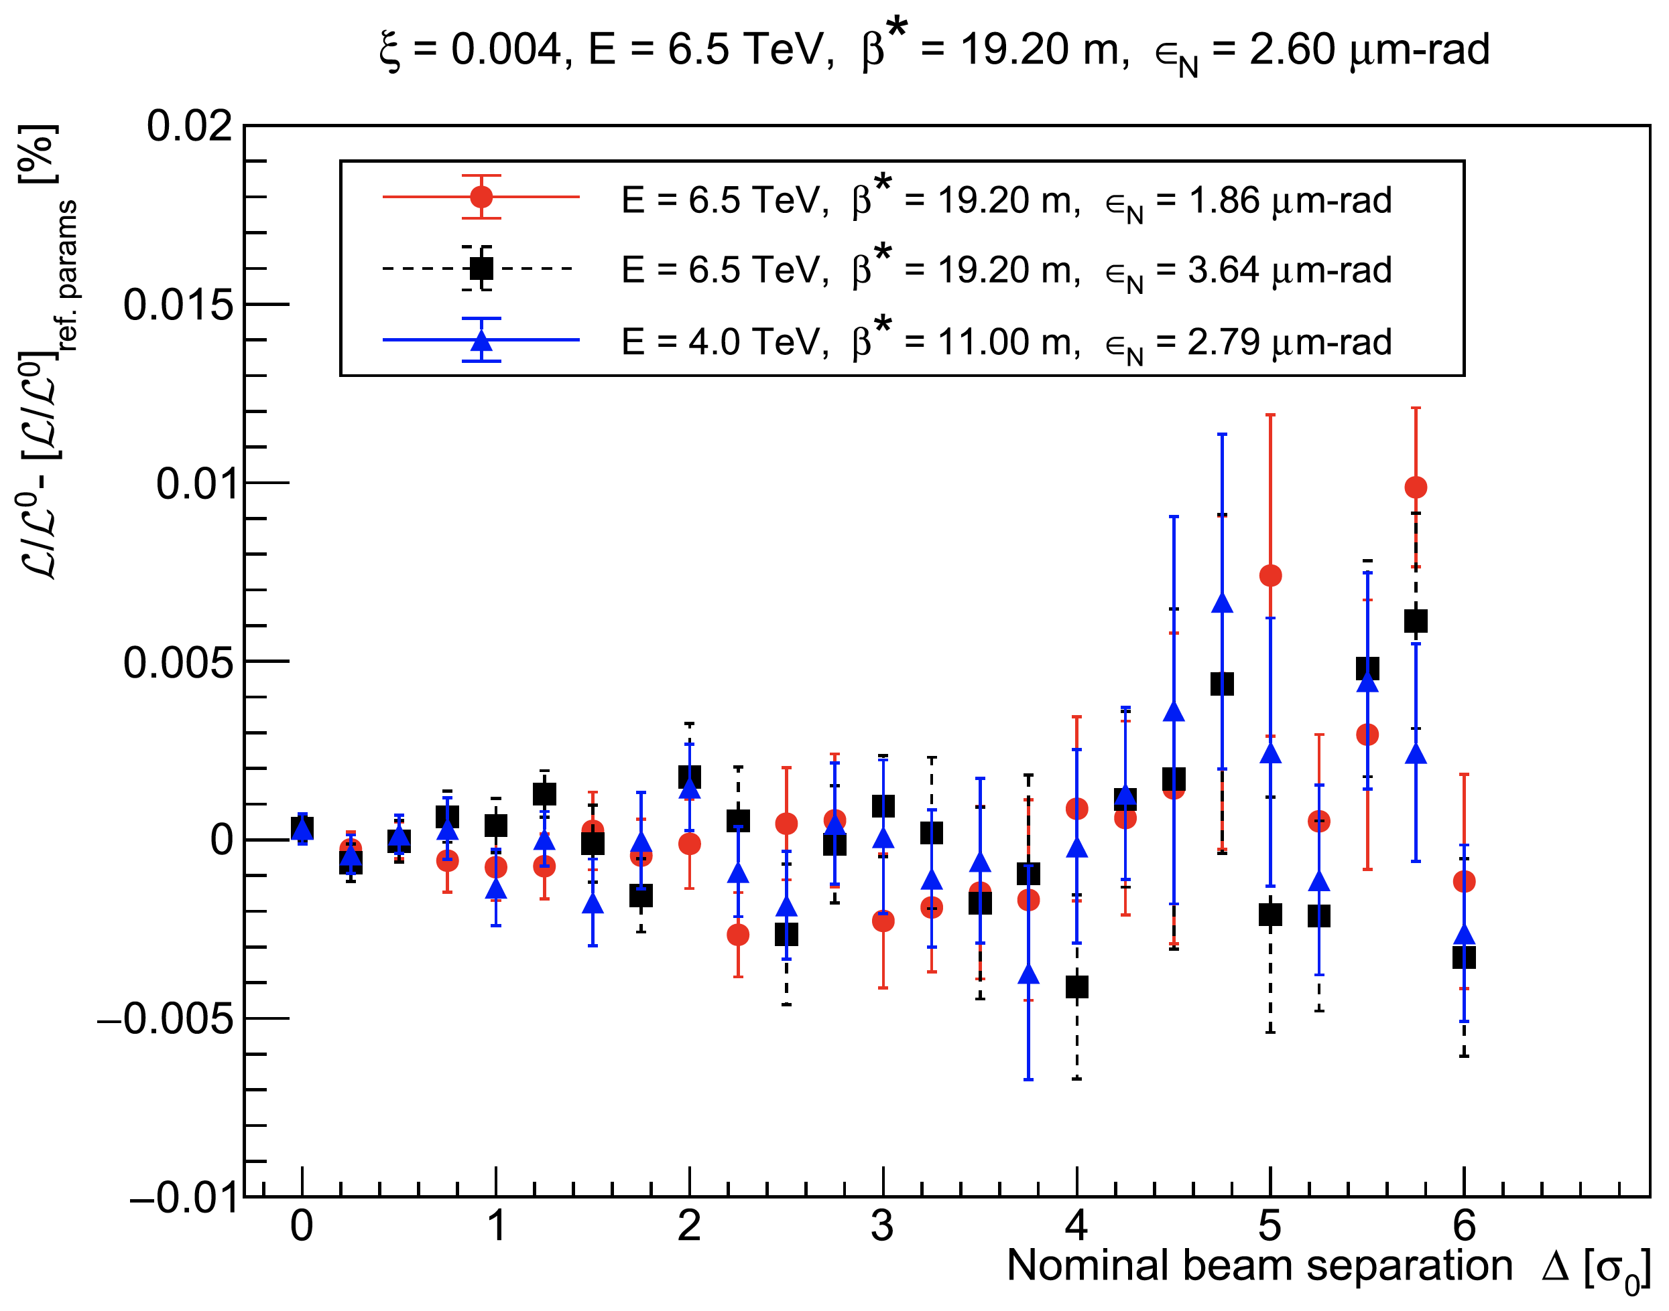
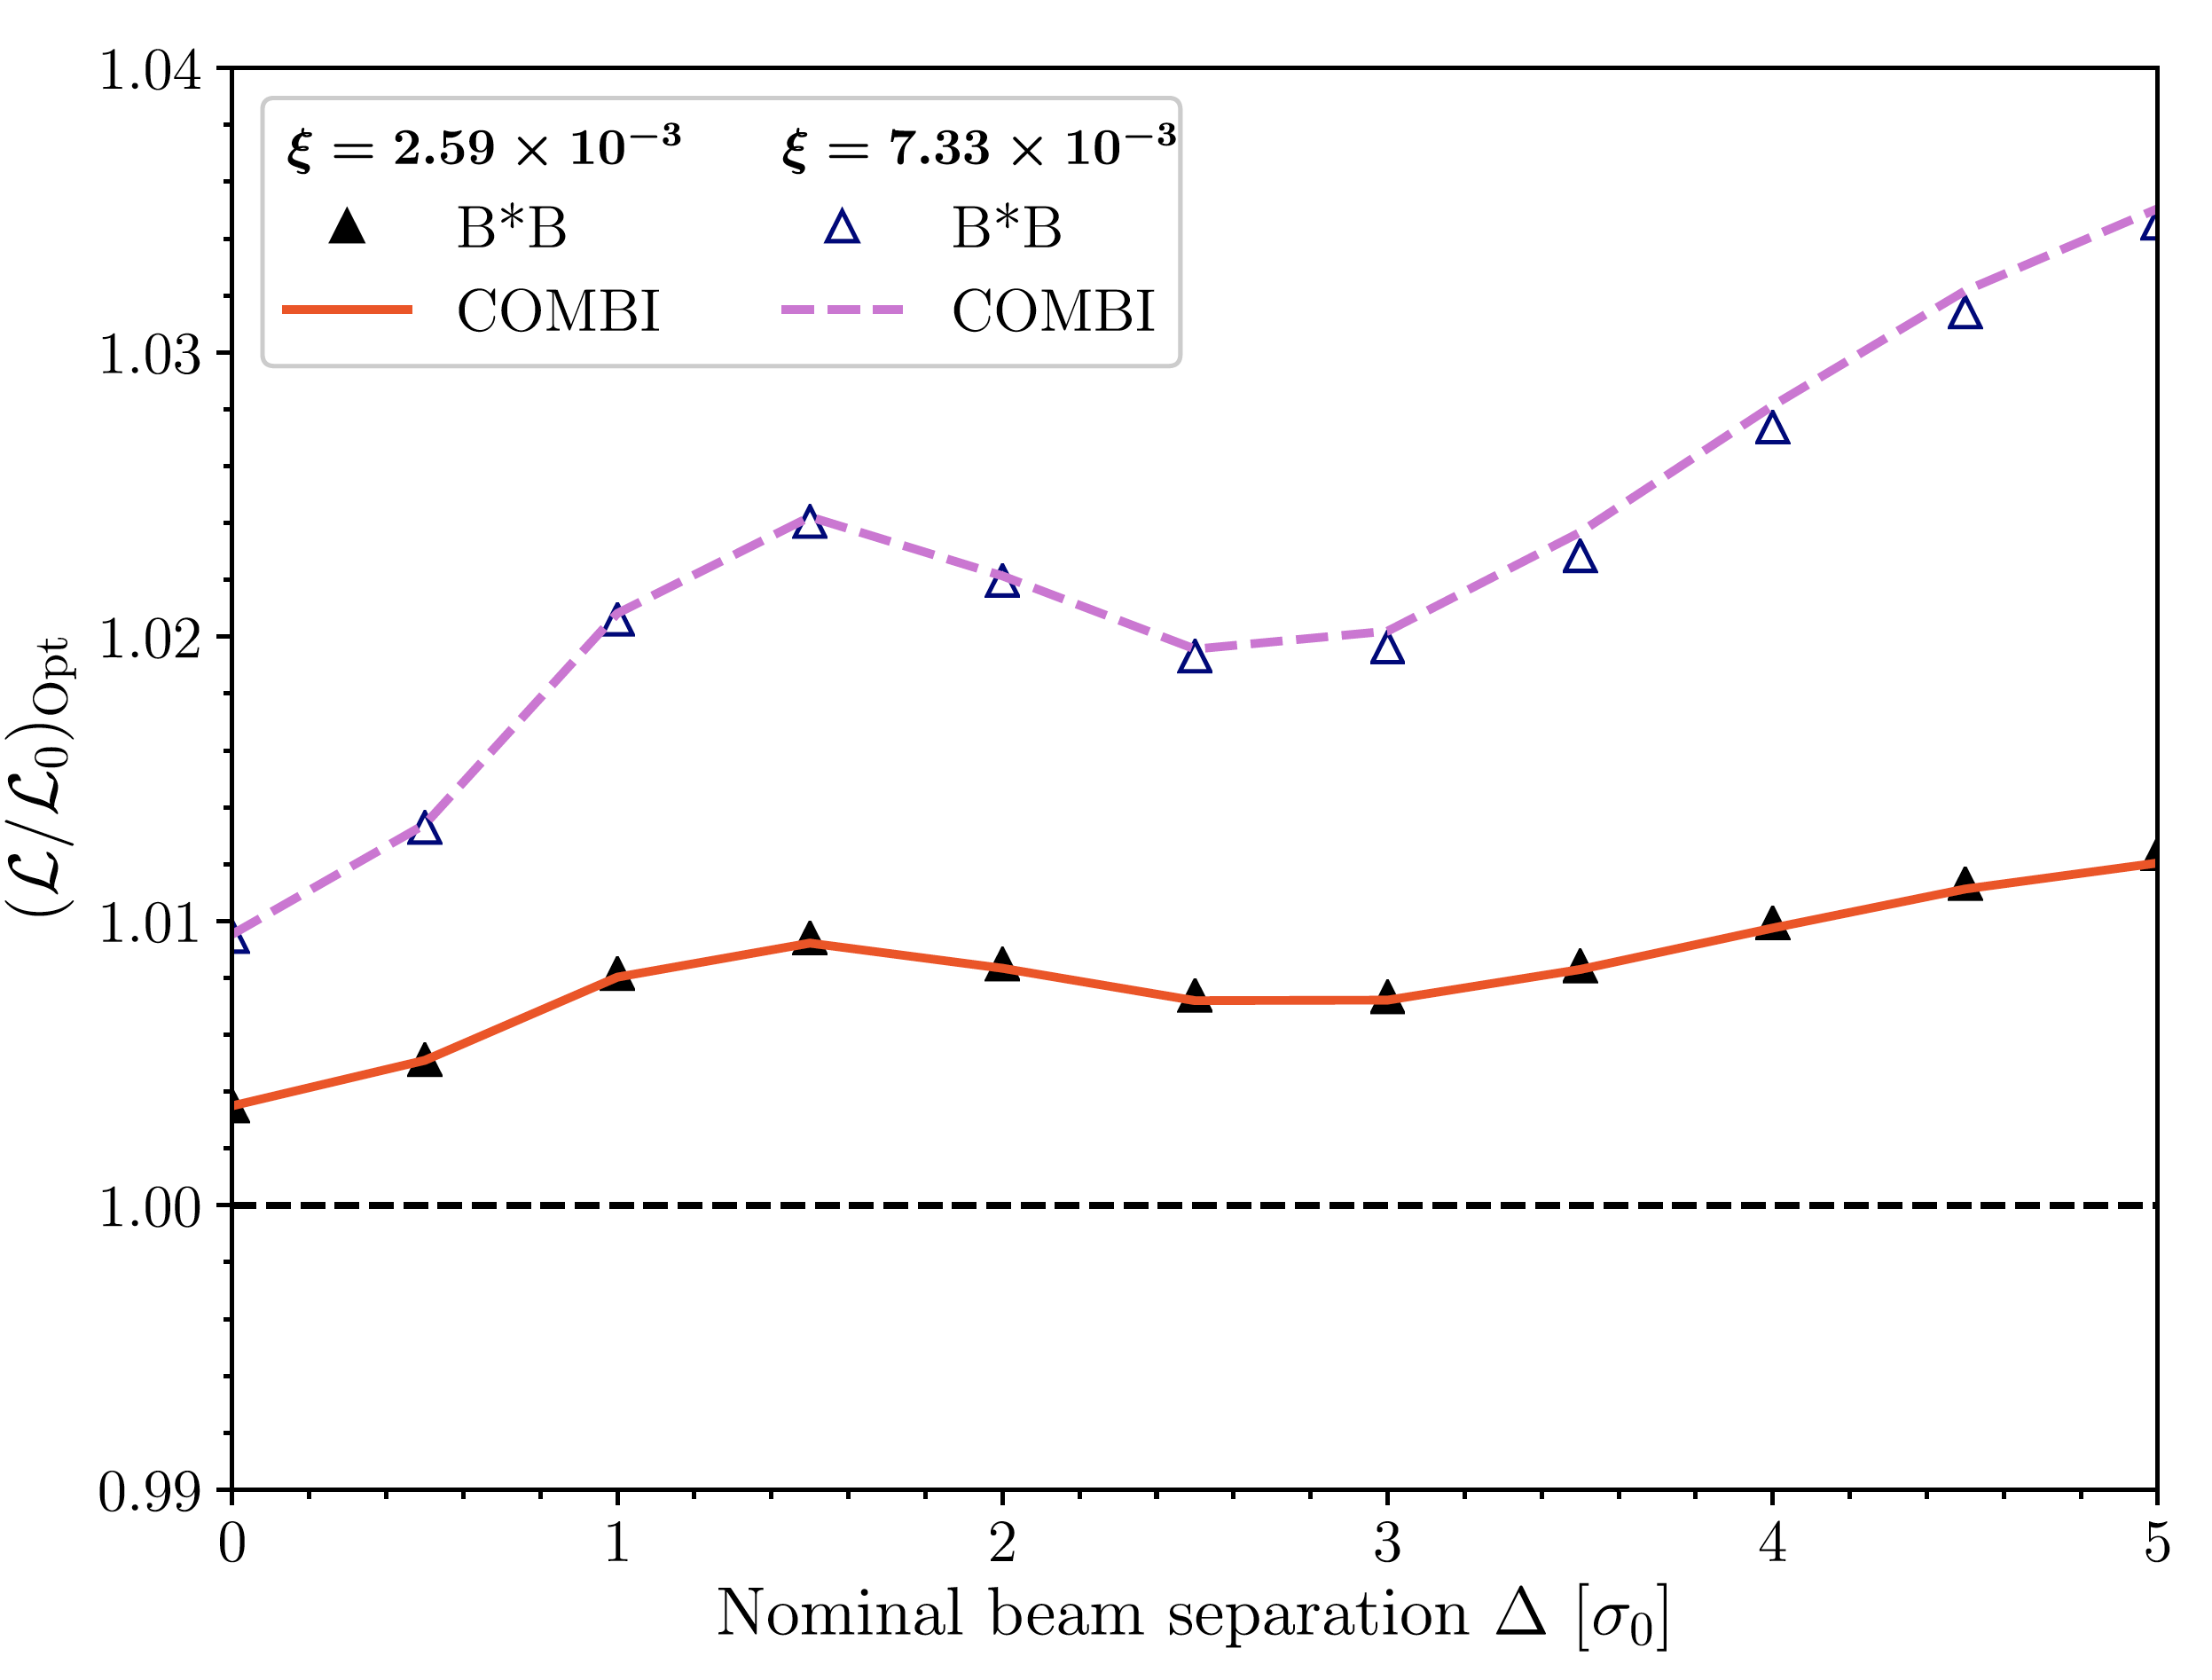
Beam-beam biases: scaling with ξ (single-IP mode)
A. Babaev et al., Eur. Phys. J. C (2024) 84:17
Beam-separation dependence, during a simulated horizontal vdM scan, of the luminosity-bias factor [L/L⁰]_{Opt} associated with optical distortions, for the vdM reference parameter set (ξ = 2.59 × 10⁻³, solid red curve and black filled triangles), and for a beam–beam parameter typical of routine physics running (ξ = 7.33×10⁻³, dashed purple curve and blue open triangles). The COMBI (B*B) results are shown by the straight-line segments (markers). The horizontal axis is the nominal beam separation in units of the unperturbed transverse beam size σ₀ .
Beam-separation dependence, during simulated horizontal vdM scans, of the difference between the luminosity-bias factor (full beam–beam effect) calculated for the collision parameters shown in the legend, and that computed using the reference parameters listed at the top of the present figure. For each parameter set, the bunch intensity is adjusted such that the value of ξ remains the same. The error bars are explained in the text.

Slide 20
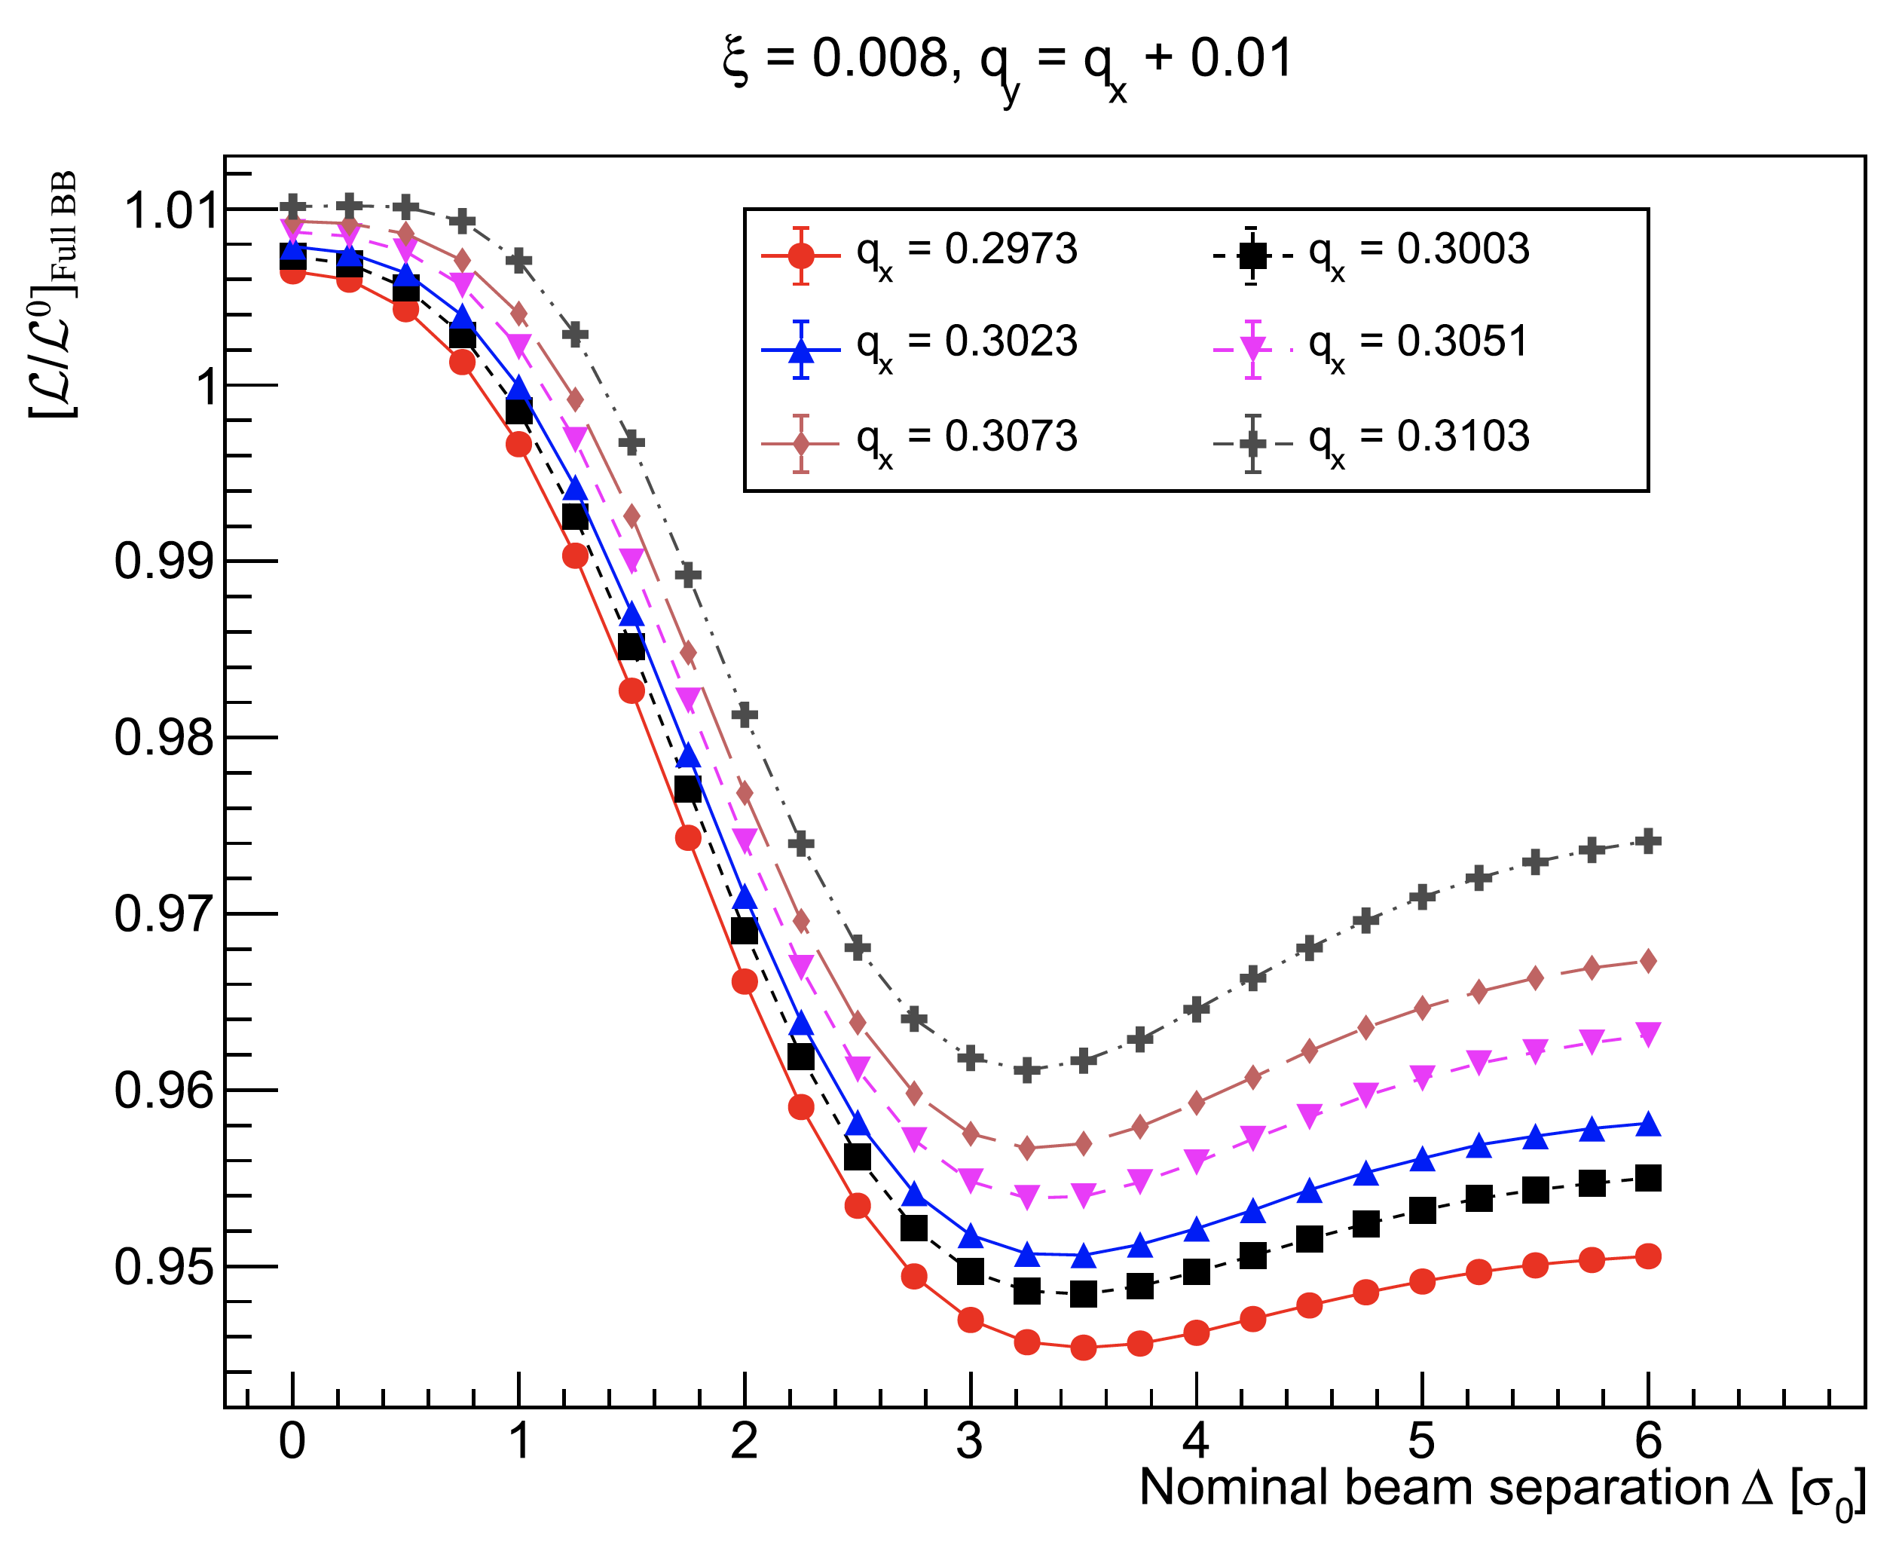
Beam-beam biases: tune dependence (single-IP mode)
A. Babaev et al., Eur. Phys. J. C (2024) 84:17
Beam-separation dependence, during simulated horizontal vdM scans, of the luminosity-bias factor [L/L⁰]_{Opt} associated with optical distortions, for several values of the unperturbed fractional tunes (q_{x}, q_{y}). The horizontal axis is the nominal beam separation in units of the unperturbed transverse beam size σ₀. The input ξ value is indicated at the top. For each curve, the value of the horizontal tune is indicated in the legend; the value of the vertical tune is set to q_{y} = q_{x} + 0.01. The points are the results of the simulation; the lines are intended to guide the eye
.
Beam-separation dependence, during simulated horizontal vdM scans, of the luminosity-bias factor [L/L⁰]_{Full BB} associated with the full beam–beam effect, for several values of the unperturbed fractional tunes (q_{x}, q_{y}). The horizontal axis is the nominal beam separation in units of the unperturbed transverse beam size σ₀. The input ξ value is indicated at the top. For each curve, the value of the horizontal tune is indicated in the legend; the value of the vertical tune is set to q_{y} = q_{x} + 0.01. The points are the results of the simulation; the lines are intended to guide the eye

Slide 21
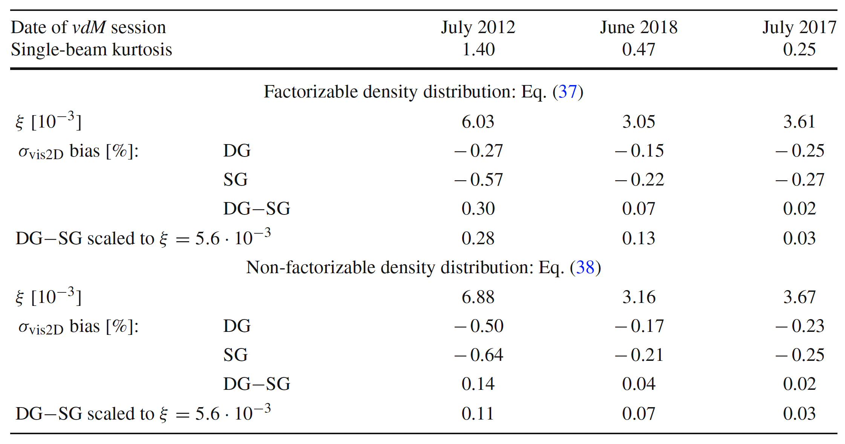
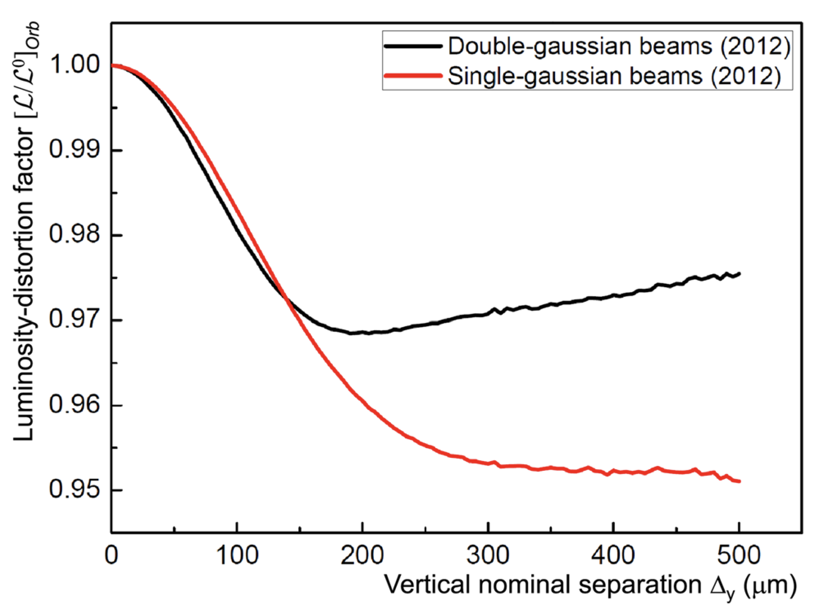
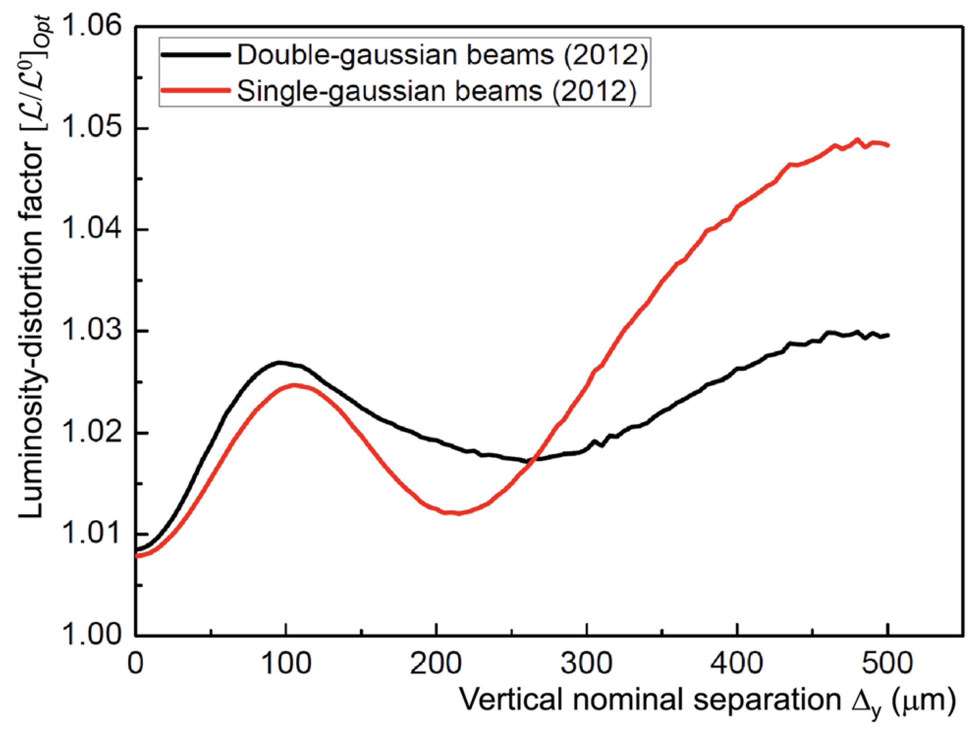
Beam-beam biases: impact of non-Gaussian tails (single-IP mode)
A. Babaev et al., Eur. Phys. J. C (2024) 84:17
Visible cross-section bias associated with the full beam–beam effect, calculated using B*B, for double- (DG) and single- (SG) Gaussian beams yielding the same Gaussian-equivalent beam–beam parameter ξ, and difference between the two (DG−SG). The unperturbed DG transverse-density distributions are described either by a factorizable or by a non-factorizable function
Beam-separation dependence, during simulated vertical vdM scans, of the luminosity-bias factor [L/L⁰]_{Orb} associated with the deflection-induced orbit shift, for single-Gaussian (red) and factorizable double-Gaussian (black) bunch-density distributions that yield the same unperturbed convolved beam size. The horizontal axis is the nominal vertical beam separation.
Beam-separation dependence, during simulated vertical vdM scans, of the luminosity-bias factor [L/L⁰]_{Opt} associated with optical distortions, for single-Gaussian (red) and factorizable double-Gaussian (black) bunch-density distributions that yield the same unperturbed convolved beam size. The horizontal axis is the nominal vertical beam separation.

Slide 22
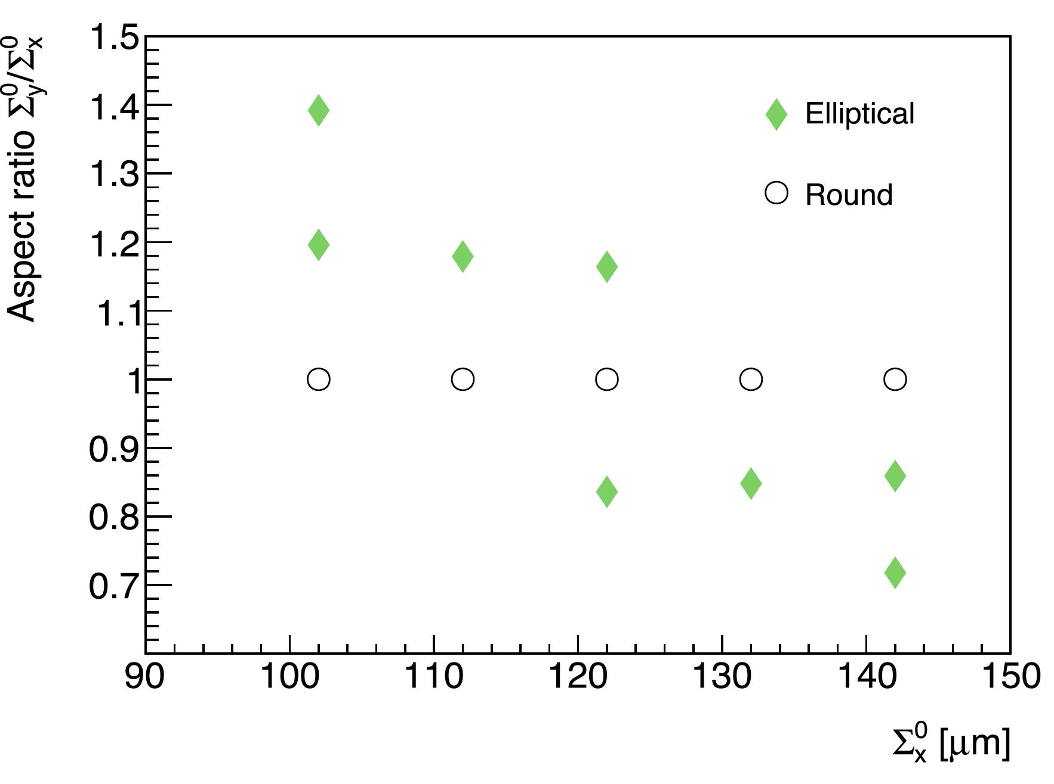
Beam-beam biases: impact of elliptical beams (single-IP mode) (1)
A. Babaev et al., Eur. Phys. J. C (2024) 84:17
Grid of unperturbed transverse convolved beam sizes used to characterize the impact of beam ellipticity on beam–beam corrections, and their vertical/horizontal aspect ratio. The diamonds (circles) correspond to elliptical (round) beams. The beam energy, bunch intensity, IP-β function and unperturbed tunes are fixed at, respectively, E_{B} = 6.5TeV, n_{p} = 0.777 × 10¹¹ protons/bunch, β∗ = 19.2 m and (Q_{x} ,Q_{y} ) = (64.31, 59.32)

Slide 23
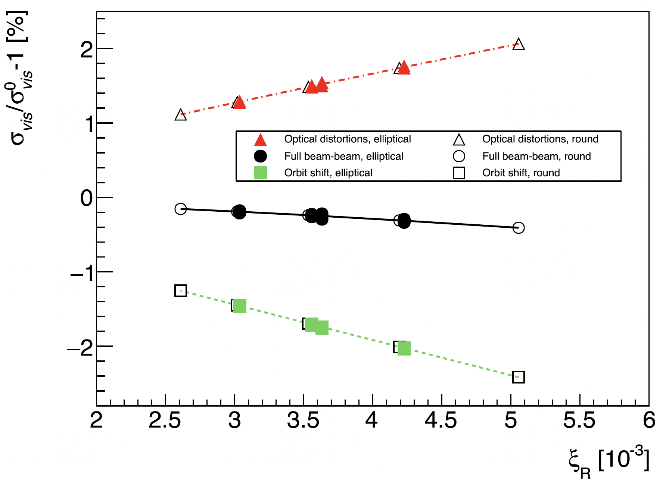
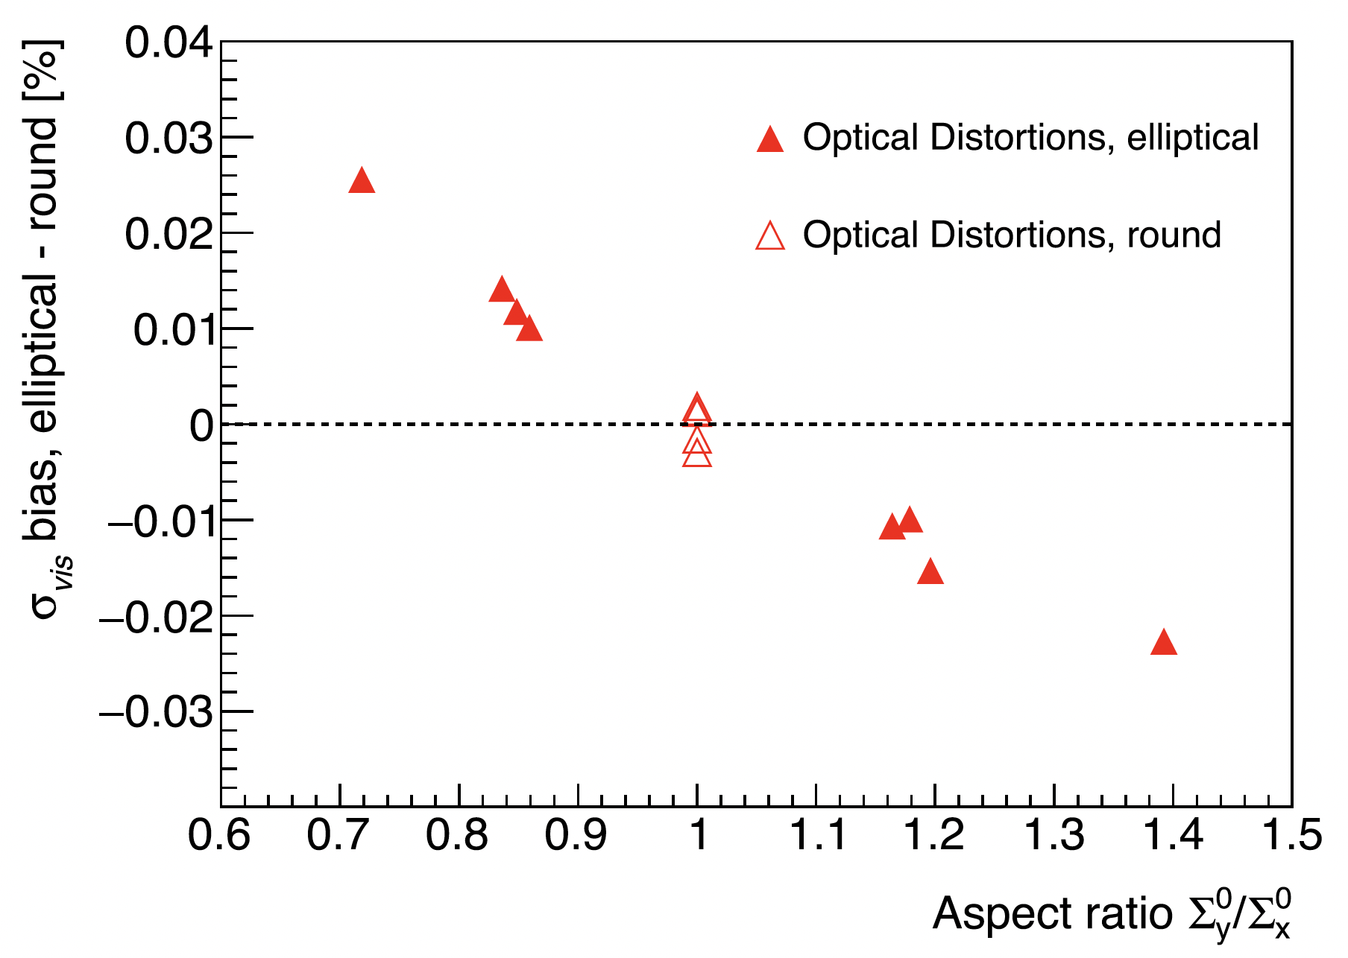
Beam-beam biases: impact of elliptical beams (single-IP mode) (2)
A. Babaev et al., Eur. Phys. J. C (2024) 84:17
Dependence of the visible cross-section bias on the round-beam equivalent beam–beam parameter ξ_{R}, for optical distortions only (red), orbit shift only (green), and full beam–beam effect (black). The filled (open) markers tag the results of individual B*B simulations assuming upright elliptical (round) beams; the orbit-shift bias is calculated analytically using the elliptical-beam, Bassetti-Erskine formula. The curves show the round-beam estimates based on the polynomial parameterization. The points clustered around each ξ_{R} value correspond to different settings of the Σ⁰_{y} / Σ⁰_{x} aspect ratio
Aspect-ratio dependence of the difference in σ_{vis} bias associated with optical distortions, between the result of B*B elliptical-beam simulations, and the corresponding round-beam estimate based on the polynomial parameterization. The filled (open) markers tag the results of individual simulations assuming upright elliptical (round) beams. The points clustered around each value of the aspect ratio correspond to different ξ_{R} settings. The horizontal dashed line corresponds to no difference in σ_{vis} bias between round and elliptical beams. The spread of the round-beam simulation results (open triangles) reflects the numerical accuracy of the subtracted parameterization

Slide 24
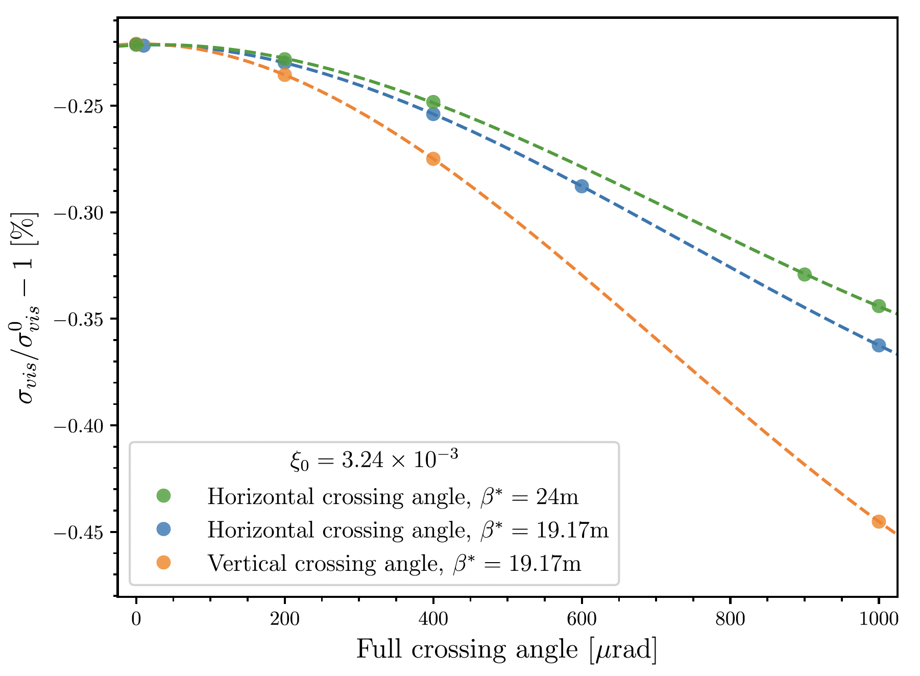
Beam-beam biases: impact of non-zero crossing angle (single-IP mode)
A. Babaev et al., Eur. Phys. J. C (2024) 84:17
Crossing-angle dependence of the visible cross-section bias predicted by COMBI strong-strong, 6-dimensional simulations, for a horizontal (blue) and a vertical (orange) crossing angle at β∗ = 19.17 m, and for a horizontal crossing angle at β∗ = 24m (green). The beam–beam parameter value at zero crossing angle is indicated in the legend. The beam energy, bunch intensity, normalized emittance, bunch length and tunes are fixed at, respectively, E_{B} = 6.5TeV, n_{p} = 0.783 × 10¹¹ p/bunch, ε_{N} = 2.95 μm·rad, σ_{z} = 7.5 cm, Q_{x} = 64.31, Q_{y} = 59.32, Q_{s} = 0.0023. The bunches are assumed to collide only at the IP where the vdM scans are performed. The points are the results of the simulation; the lines are meant to guide the eye

Slide 25
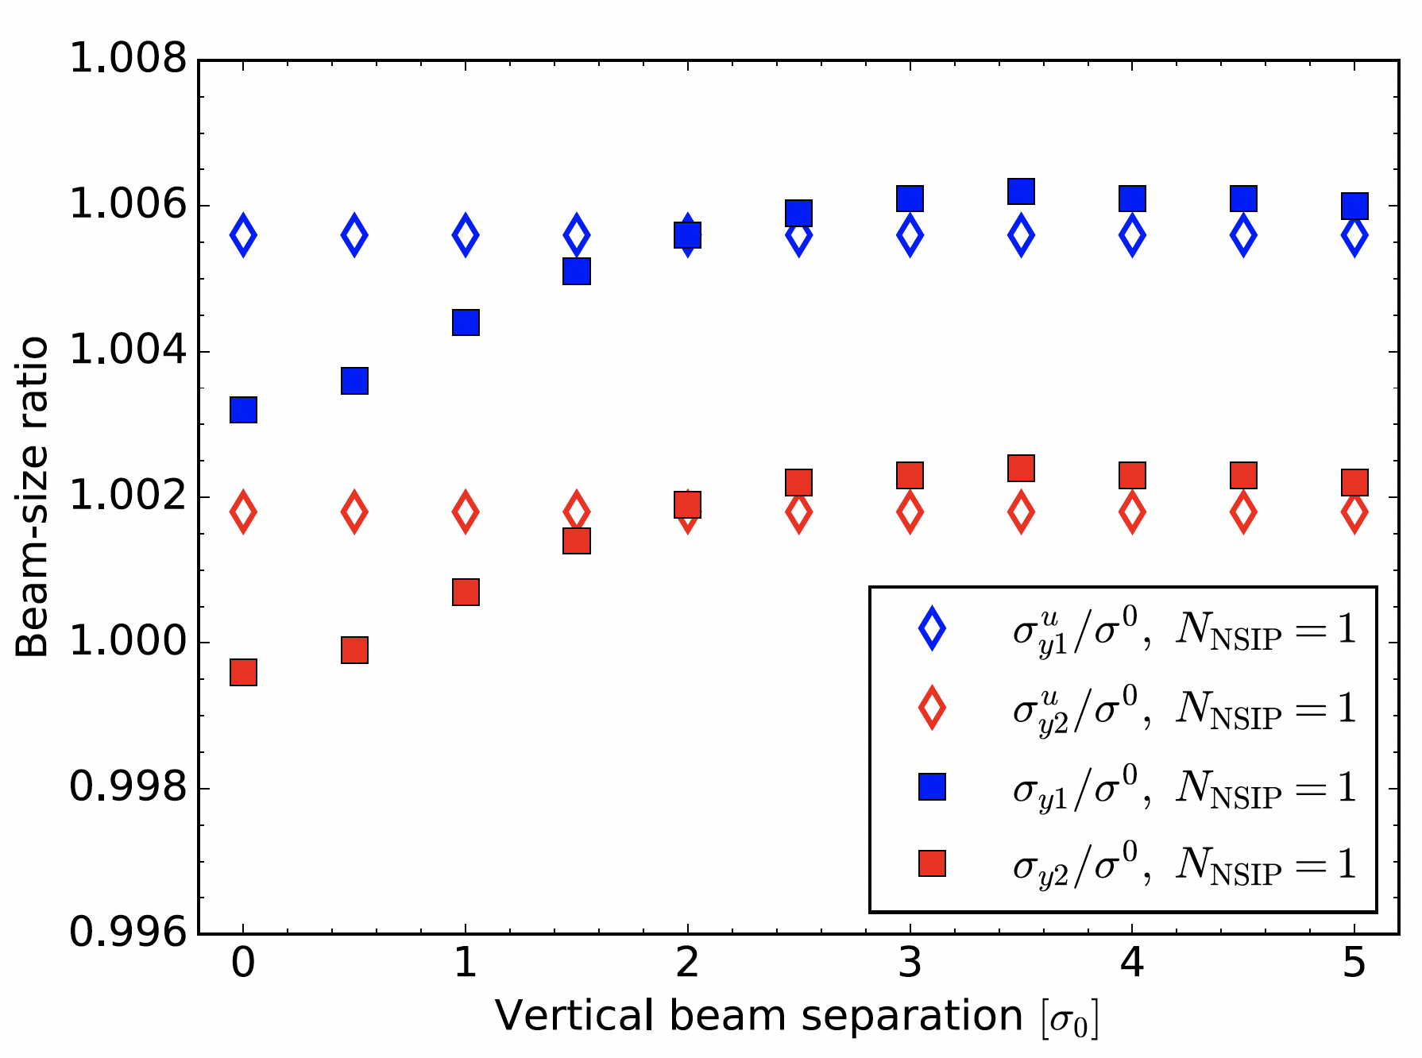
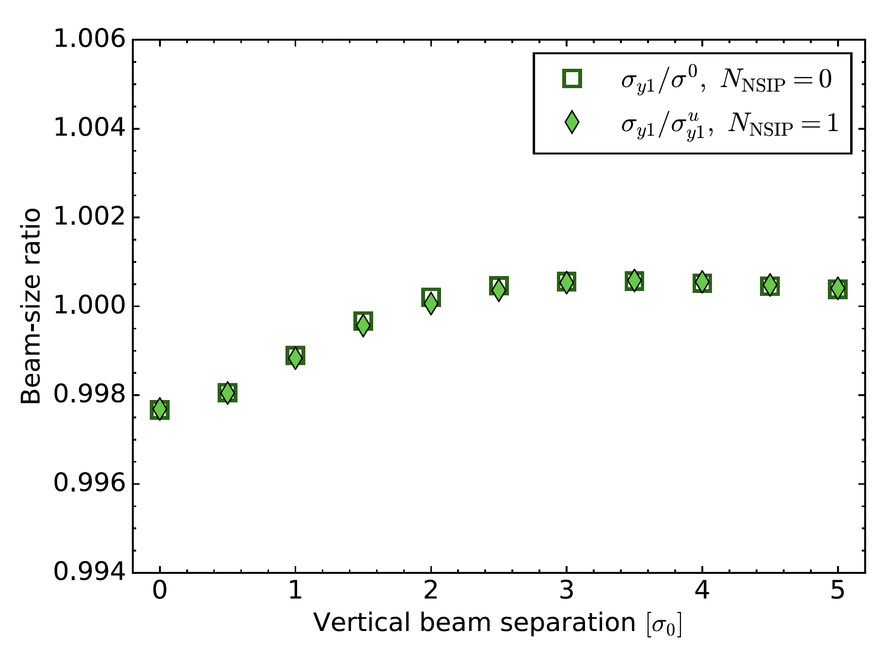
Multi-IP case: beam—size-bias factors
A. Babaev et al., Eur. Phys. J. C (2024) 84:17
Beam-separation dependence, during a simulated vertical vdM scan, of the beam–size-bias factors at the scanning IP associated with the full beam–beam effect (σ_{yB}/σ⁰, filled squares) and of the corresponding unperturbed quantities (σ ^{u}_{yB}/σ⁰, open lozenges), separately for B = beam 1 (blue) and B = beam 2 (red), using the L⁰ normalization and in the presence of collisions at one non-scanning IP (N_{NSIP} = 1). The horizontal axis is the beam separation in units of the nominal transverse beam size σ⁰
Beam-separation dependence, during a simulated vertical vdM scan, of the beam–size-bias factors at the scanning IP associated with the full beam–beam effect for N_{NSIP} = 0 using the L⁰ normalization (σ_{y1} /σ⁰, open squares), and for N_{NSIP} = 1 and using the L^{u} normalization (σ_{y1} / σ^{u}_{y1} , filled green lozenges). For the sake of clarity, only beam-1 results are displayed; the beam-2 points would be indistinguishable. The horizontal axis is the beam separation in units of the nominal transverse beam size σ⁰

Slide 26
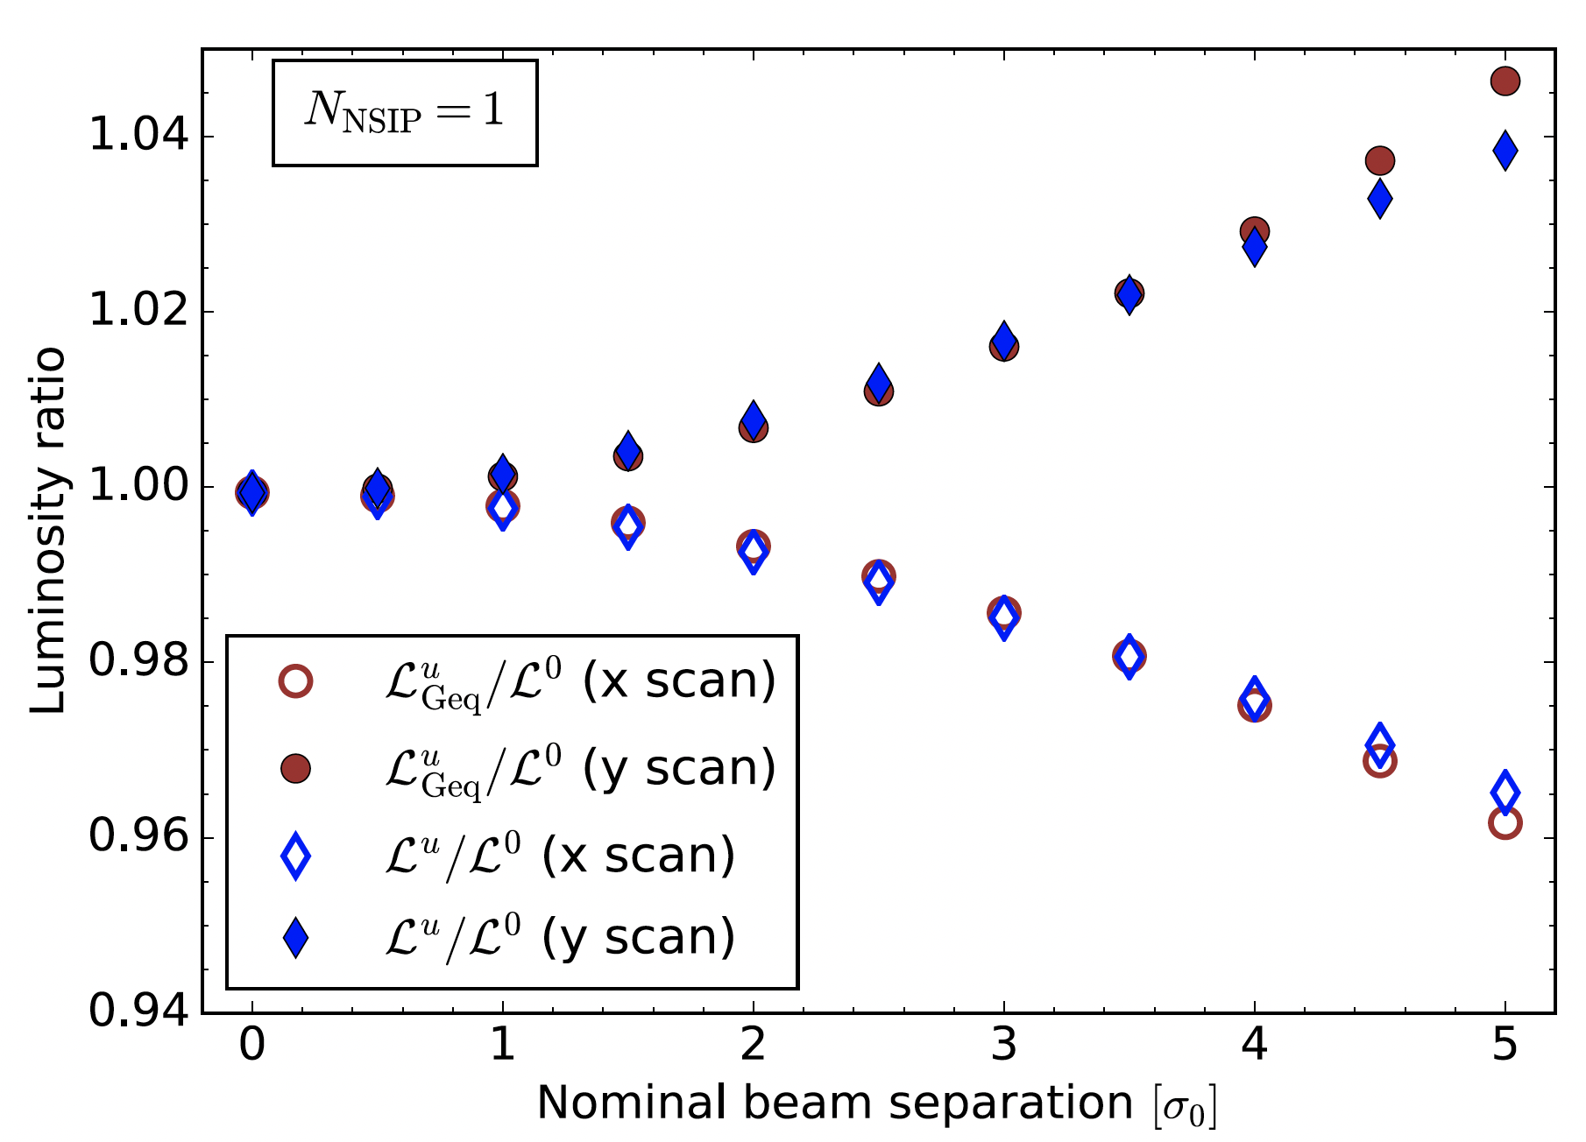
Multi-IP case: impact of tails induced at non-scanning IPs
A. Babaev et al., Eur. Phys. J. C (2024) 84:17
Beam-separation dependence, during vdM scans simulated in the Run-2 configuration with one non-scanning IP, of the luminosity-bias factors at the scanning IP associated with the unperturbed luminosity (L^{u}/L⁰, lozenges), and with the Gaussian-equivalent unperturbed luminosity (L^{u}_{Geq} /L⁰, circles). The horizontal axis is the beam separation in units of the nominal transverse beam size σ⁰. The filled (open)symbols corresponds to a vertical (horizontal) scan

Slide 27

Multi-IP effects: L₀ vs. L_{u} , 1 vs 2 non-scanning IPs
Scanning @IP1, 2 non-scanning IPs
σ_{vis} –bias difference, L₀ - L_{u} [%]
Phase-advance dependence of the difference, between the L₀ and the L_{u} normalization, of the beam-beam induced σ_{vis} bias. The scans are simulated at IP5, with bunches remaining in head-on collision at two other IPs (N_{NSIP} = 2). The horizontal and vertical axes represent the betatron phase advance between IP8 and IP5, here assumed to be the same for B1 and B2. The color scale quantifies the fractional inconsistency in σ_{vis} bias between the two reference configurations; in this example, it ranges from -0.06 to -0.11 % of σ_{vis}.
Scanning @IP1, 1 non-scanning IP
A. Babaev et al., Eur. Phys. J. C (2024) 84:17
σ_{vis} –bias difference, L₀ - L_{u} [%]
Phase-advance dependence of the difference, between the L₀ and the L_{u} normalization, of the beam-beam induced σ_{vis} bias. The scans are simulated at IP1, with beams remaining in head-on collision at IP5; no collisions occur in IPs 2 and 8. The horizontal and vertical axes represent the betatron phase advance between IP1 and IP5, here assumed to be the same for B1 and B2. The color scale quantifies the fractional inconsistency in σ_{vis} bias between the two reference configurations; it ranges from -0.06 to 0.05 % of σ_{vis}.

Slide 28


Beam-size asymmetry: L-bias factors (single-IP case)
A. Babaev et al., Eur. Phys. J. C (2024) 84:17
Single-beam contributions to the beam-separation dependence, during a horizontal vdM scan simulated using B*B, of the luminosity-bias factor associated with the optical distortions ([L/L⁰]_{Opt}, red curve and triangles), and of that induced by the beam– beam orbit shift ([L/L⁰]_{Orb}, green curve and squares). The unperturbed beams are assumed to be round and perfectly Gaussian. Their bunch populations are assumed equal (n₁ = n₂ = 0.78 × 10¹¹ p/bunch), and their transverse beam sizes differ by a factor of √2 (σ₁ = 99.6 μm, σ₂ = 70.5 μm). The wide-beam contributions are shown by the filled markers, the narrow-beam contributions by the dashed curves. The beams collide only at the IP where the scan is taking place. The horizontal axis is the nominal beam separation in units of the effective transverse beam size σ_{R} = Σ_{R} / √2
Beam-separation dependence, during a horizontal vdM scan simulated using B*B, of the luminosity-bias factor associated with the optical distortions ([L/L⁰]_{Opt}, red solid curve), and of that induced by the beam–beam orbit shift ([L/L⁰]_{Orb}, green dot-dashed curve), in the presence of a beam-size asymmetry corresponding to ξ₁/ξ₂ = 2. The beams collide only at the IP where the scan is taking place. The horizontal axis is the nominal beam separation in units of the effective transverse beam size σ_{R} = Σ_{R} / √2

Slide 29


Beam-size asymmetry: σ_{vis} bias
A. Babaev et al., Eur. Phys. J. C (2024) 84:17
Dependence on the transverse beam-size ratio σ₂/σ₁ of the visible cross-section bias σ_{vis}/σ⁰_{vis} −1 associated with optical distortions, as predicted by B*B (diamonds) or COMBI (triangles) simulations, for low-intensity (red and blue bottom curves) and high-intensity (green top curve) colliding-bunch configurations that cover a wide range of beam-size asymmetries at constant Σ_{R} . The beams collide at the scanning IP only. The σ_{vis} bias in the fully symmetric configuration (σ₁ = σ₂) is indicated by a horizontal black line in each group. The curves are third-order polynomial fits to the points, and are intended to guide the eye. The arrows indicate the impact on the absolute luminosity scale of a 20% beam-size imbalance (σ₂ / σ₁ = 0.8)
Impact of the beam-size asymmetry on the visible cross-section bias σ_{vis}/σ⁰_{vis} −1 associated with optical distortions, as simulated using either B*B (diamonds and circles) or COMBI (triangles). Shown is the change is σ_{vis} bias between an asymmetric beam–beam configuration characterized by a given setting of σ₂ / σ₁ < 1, and the corresponding symmetric configuration (σ₂ = σ₁). The top three curves (green diamonds, red triangles and blue diamonds) correspond to the data displayed in the left figure, when the beams collide at the scanning IP only. The bottom two curves (circles) show the same results when the beams also collide head-on at two non-scanning IPs. The open (filled) symbols correspond to the low- (high-) intensity bunches. The curves are third-order polynomial fits to the points, and are intended to guide the eye

Slide 30

Systematic uncertainties on beam-beam correction to vdM calibrations
A. Babaev et al., Eur. Phys. J. C (2024) 84:17
Typical systematic uncertainties affecting beam-beam corrections to a hypothetical pp vdM calibration in a fully symmetric Gaussian-beam configuration, with the round–beam-equivalent beam-beam parameter set equal to ξ_{sim}, for three values of N_{NSIP} . For each source, the uncertainty is either evaluated at, or scaled linearly to, the value of ξ_{sim} indicated in the second column; if no value of ξ_{sim} is specified, the uncertainty listed covers the full range of ξ values encountered during pp vdM scans at the LHC. When an uncertainty is assumption-dependent, the value flagged by an asterisk is that used in computing the total uncertainty; the latter is compared to the overall beam-beam correction itself in the bottom two rows of the Table.

