Slide 1
Recent developments in beam-beam studies
Lumi Days 2025
Joanna Wanczyk (CERN, OP-LHC, previously at CMS/EPFL)
11.03.25

Slide 2
Outline of the presentation
The contents of this presentation focuses on more recent studies - after the publication [*] for the beam-beam corrections and uncertainties
  Dedicated beam-beam experiment to verify the pure simulation studies used in the current correction strategy with measurements
  First application of dedicated beam-beam correction in the nominal physics conditions for the evaluation of intrinsic detector non-linearities
  Investigations in simulation on the L_{u}/L₀ normalization ambiguity
  Understanding the interplay between beam-beam and non-factorization
  Hints from simulation for additional beam-beam systematic effects dependent on the original beam distribution
  Simulation studies for beam-beam and global or local coupling
measurements
simulations
[*] DOI: 10.1140/epjc/s10052-023-12192-5 - for details see previous presentation

Slide 3
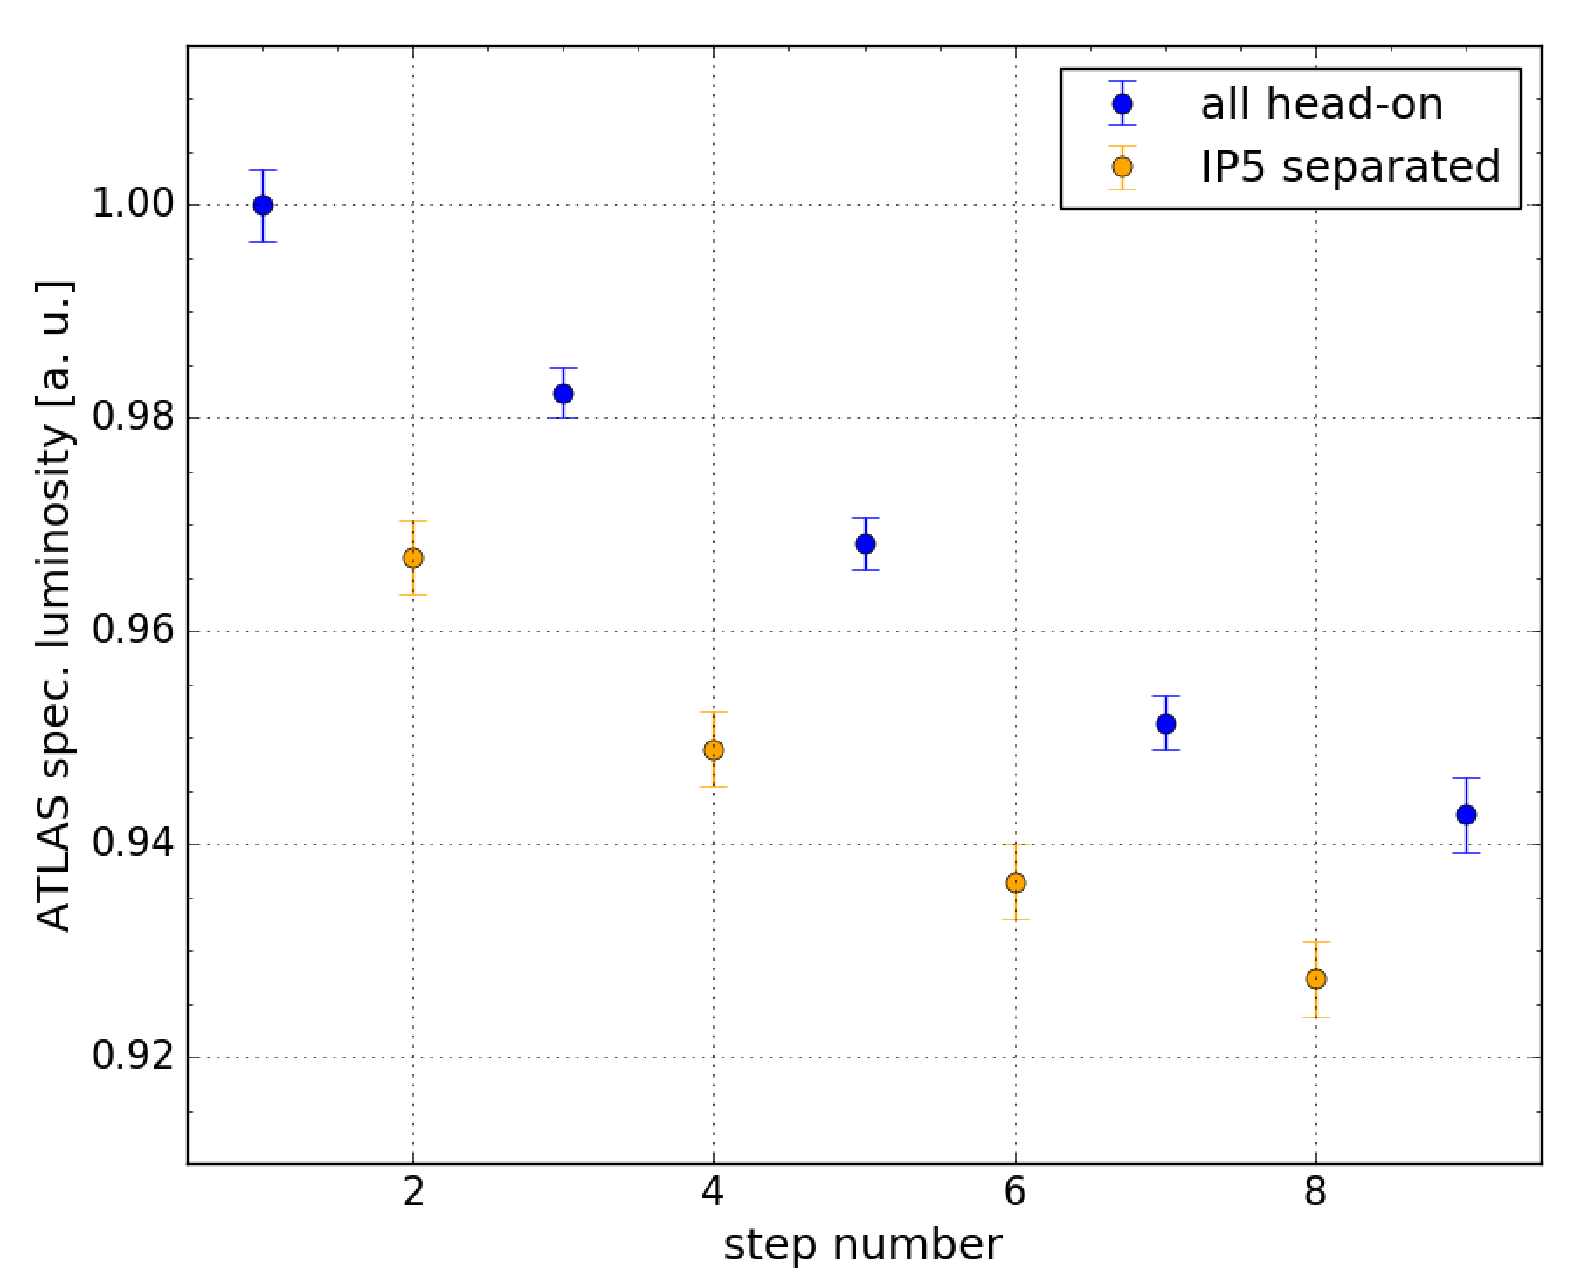
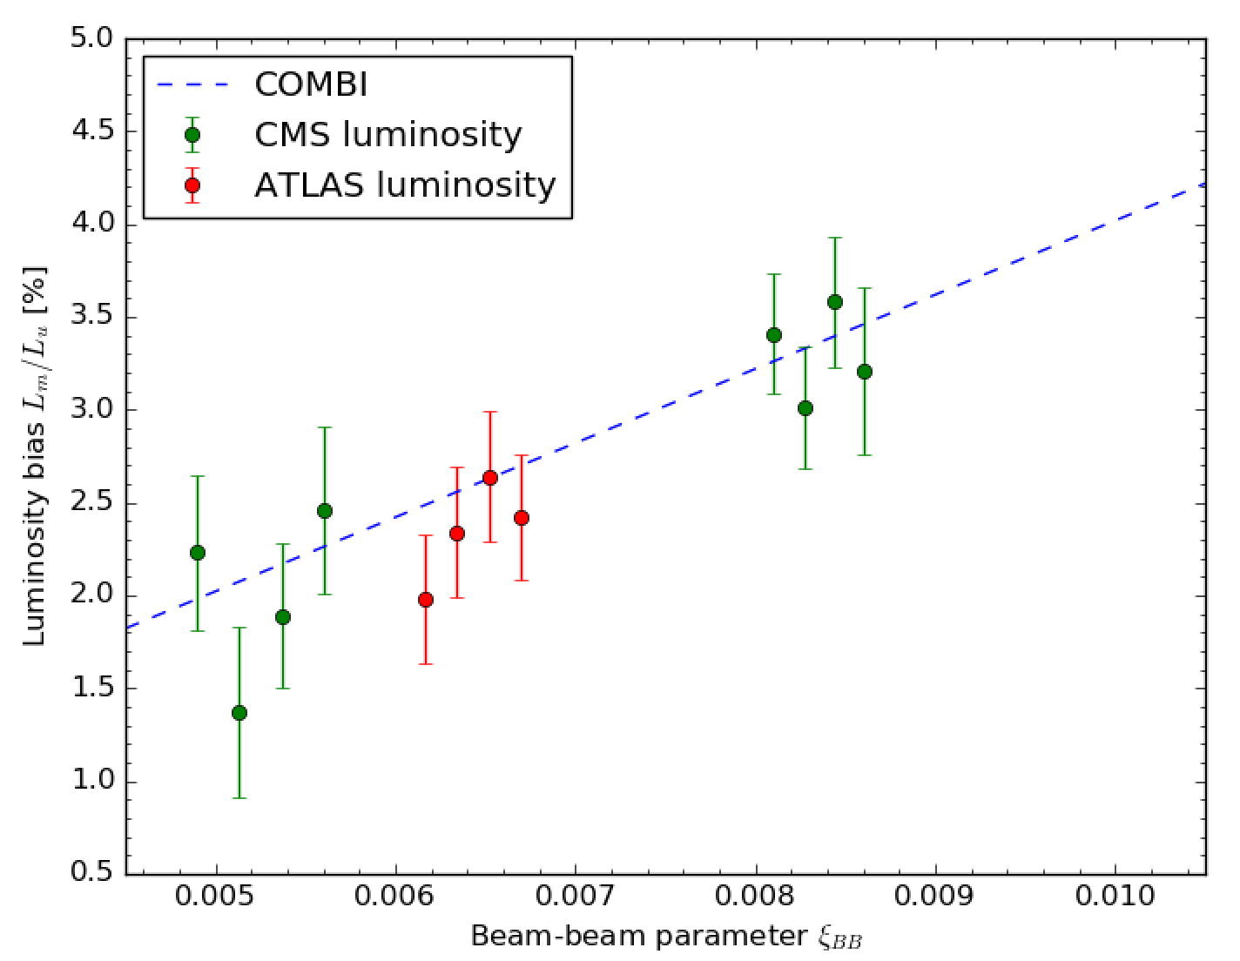
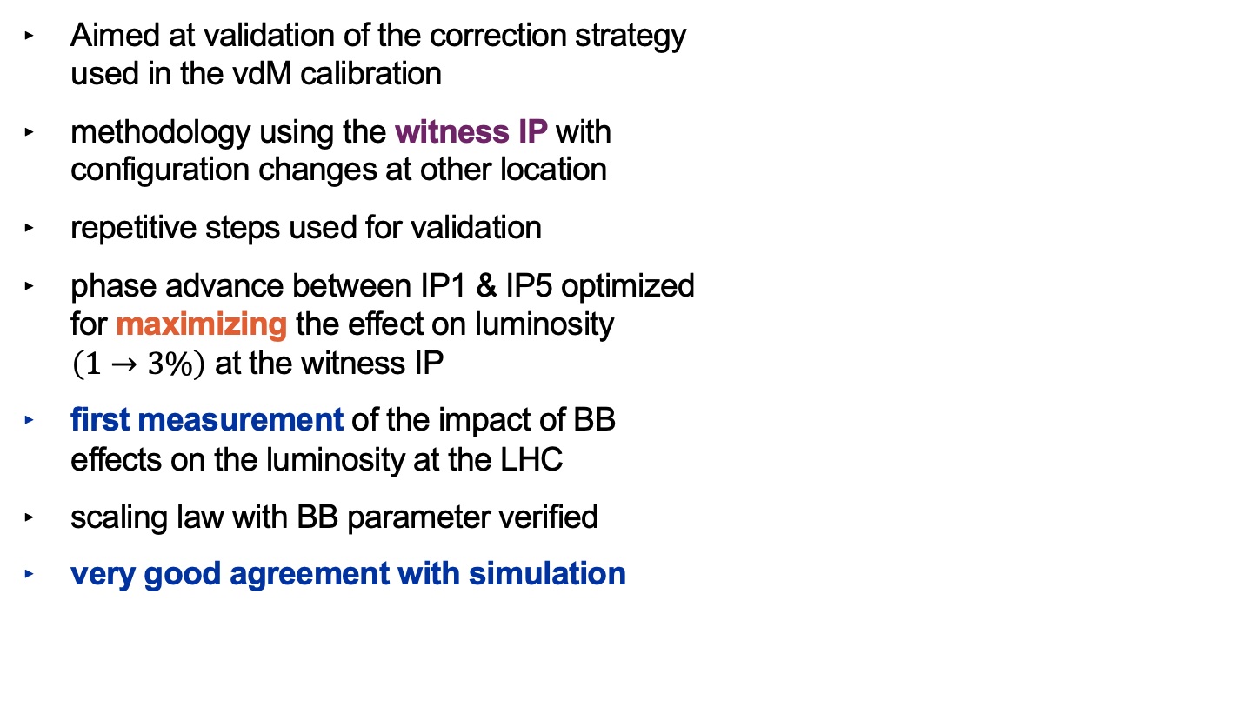
Beam-beam measurement
Aimed at validation of the correction strategy used in the vdM calibration
methodology using the witness IP with configuration changes at other location
repetitive steps used for validation
phase advance between IP1 & IP5 optimized for maximizing the effect on luminosity $\left(1→3\%\right)$ at the witness IP
first measurement of the impact of BB effects on the luminosity at the LHC
scaling law with BB parameter verified
very good agreement with simulation
repetitive change of configuration
witness
separation at another location
Luminosity enhancement in head-on configuration caused by additional BB interaction (at another IP) as measured by both ATLAS and CMS (observer IP), as a function of the single-IP BB parameter, compared to COMBI simulation predictions
Luminosity enhancement [%]
Recent developments in beam-beam studies
11/03/2025
3
Notes:
- now moving from the simulation world to the real measurement...
The method of using the witness IP was based on the non-changing configuration at that IP
- make connection between plots!!! - explain the bottom

Slide 4
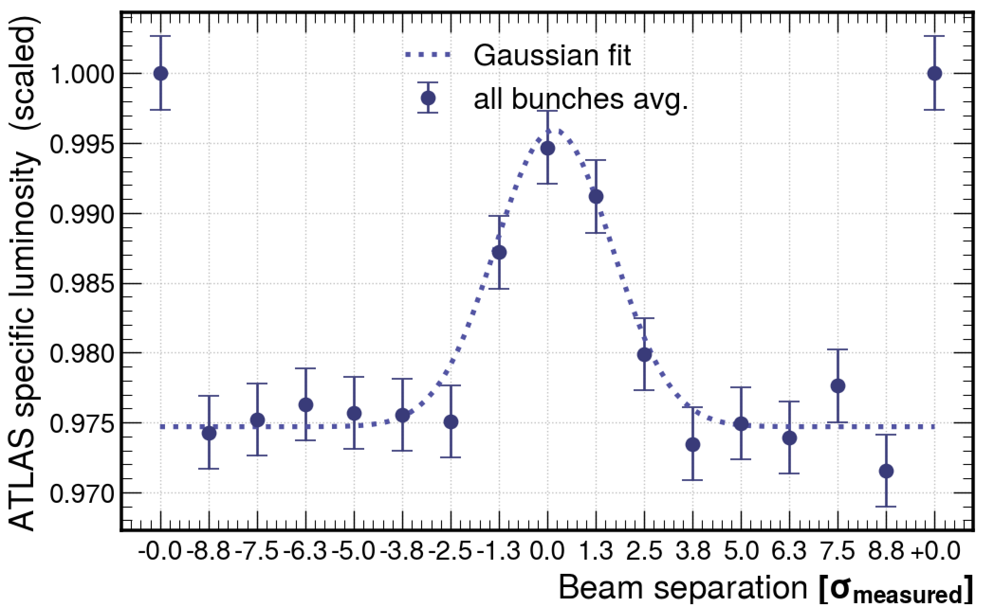
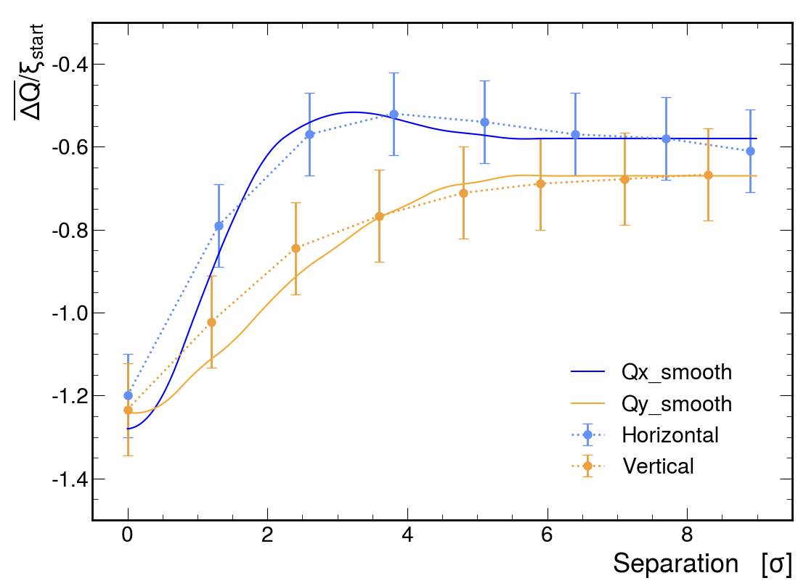
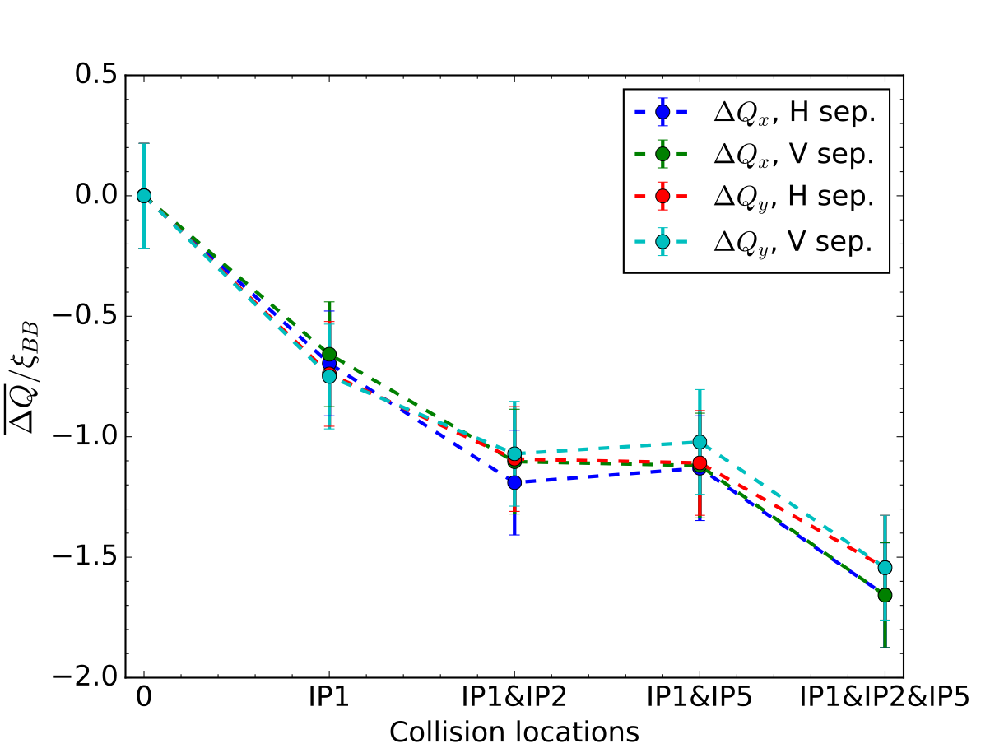
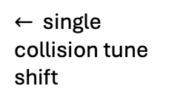
BB experiment - results
observations of BB-induced changes during a separation scan
  very clear on the mean tunes extracted from the spectra as well as on the luminosity and beam widths
observed scaling with the number of collision supports the multi-IP modeling strategy
results could be expanded with another experiment to test the tune scaling for multi-IP cases
overall good agreement of all beam-beam tests with expectations
$←$ single collision tune shift
Tune shift as a function of the number of collisions, measured in multiple tests
Tune shift:
induced by BB during horizontal-separation scan
measured using the ADT
Paper in preparation
Recent developments in beam-beam studies
11/03/2025
4
Notes:
- We also managed to make some observations during the separation scans, which turned out to be more challenging
- example on the tune shift and luminosity
- also measured the tune shift scaling with the number of collisions
- overall good agreement with COMBI simulations

Slide 5
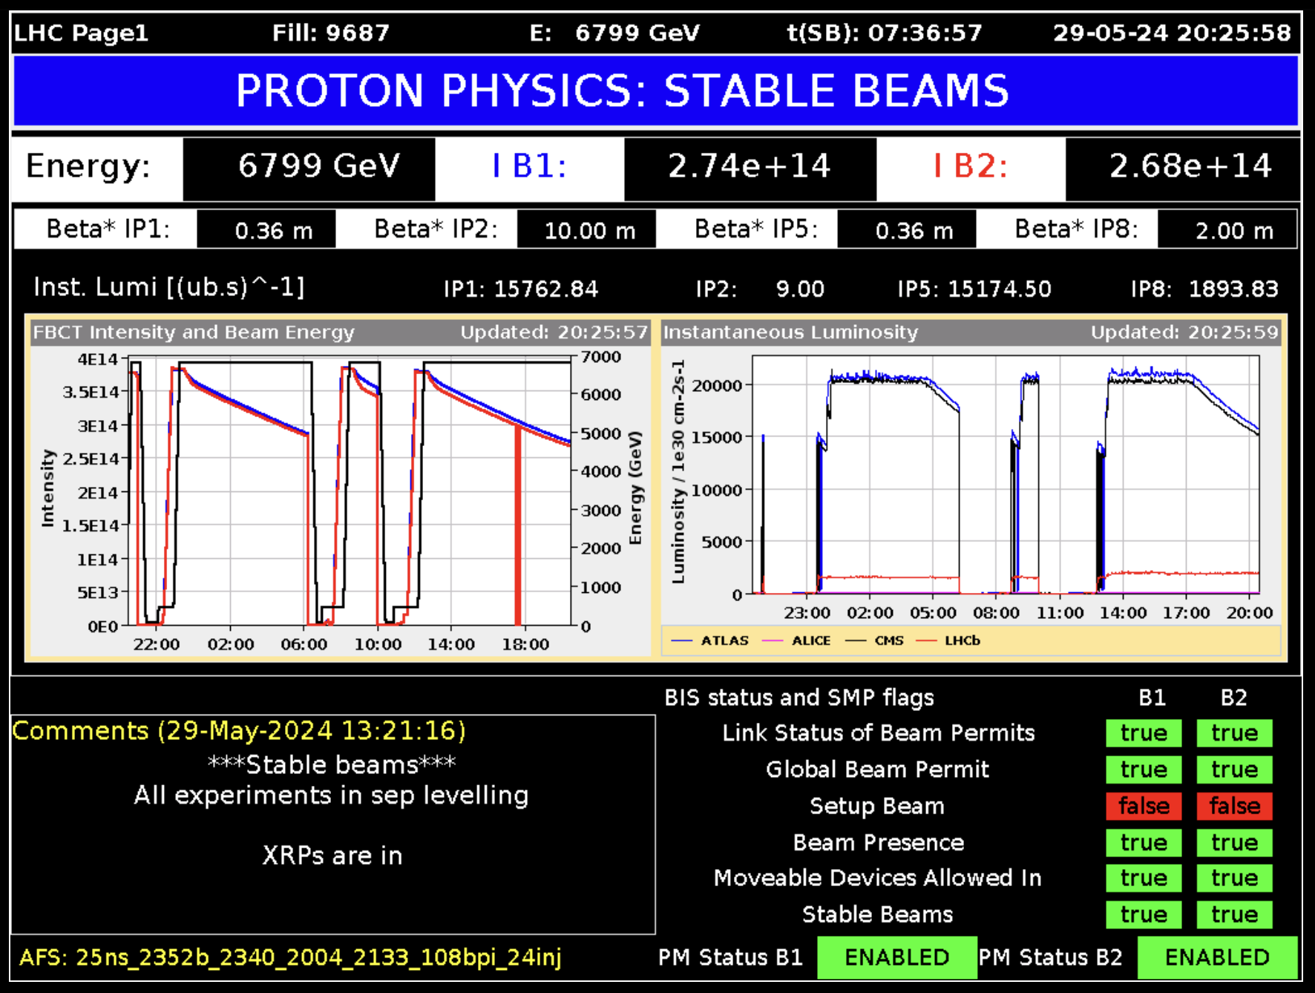
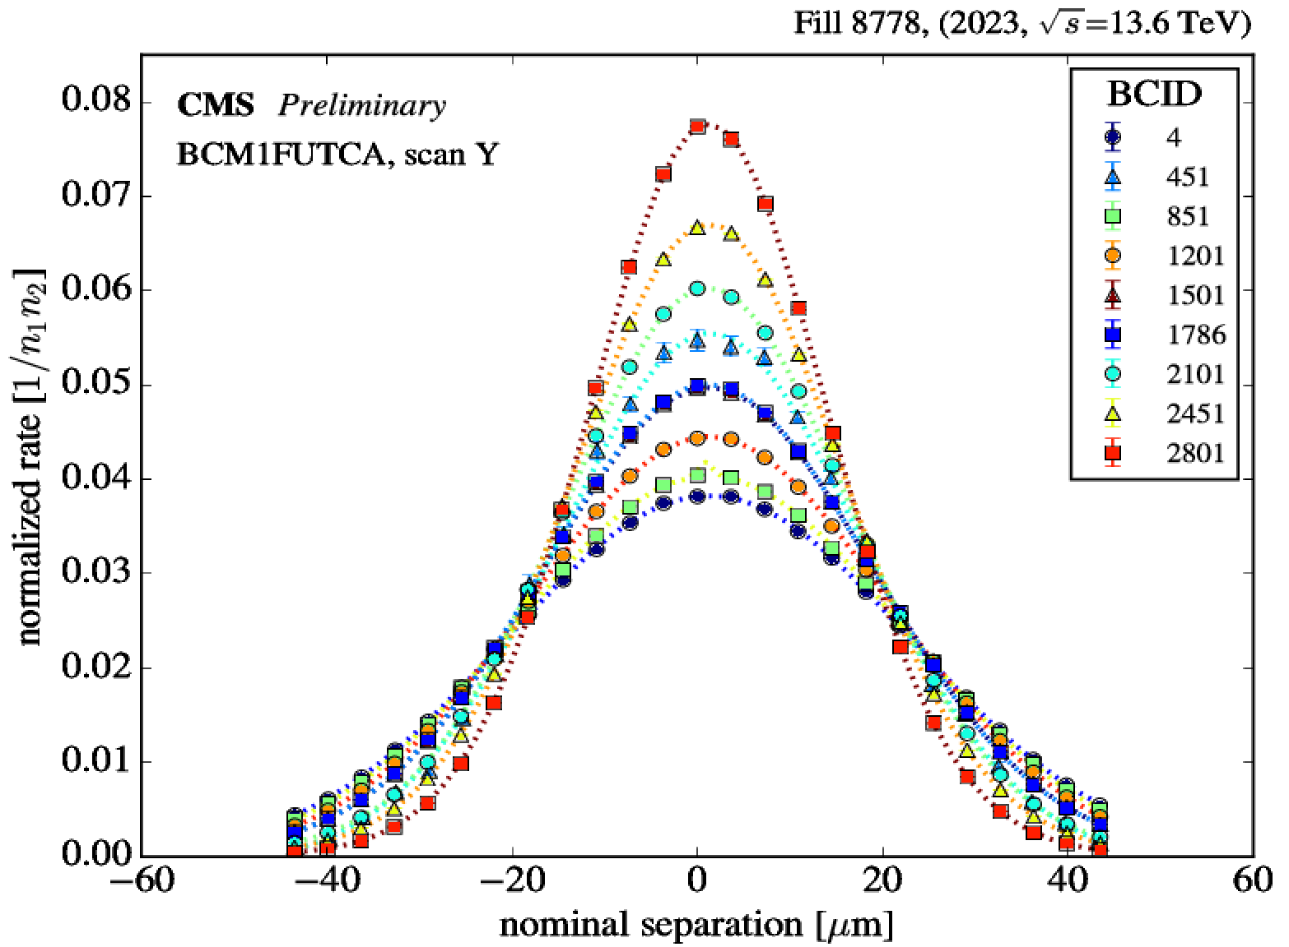
Application in the nominal conditions
Possible to evaluate impact of beam-beam interaction in the high pileup conditions with 6D implementation: CERN-ACC-NOTE-2019-0032
Emittance scans are performed regularly at the LHC
Used to study the luminometer response linearity
Corrections needed to remove the systematic bias
By reconstructing the vdM-like calibration constant it is possible to study its dependence on the pileup (luminosity)
Special case: BSRT fill
DOI: https://doi.org/10.1051/epjconf/201920104001
Notes:
- another interesting question is how applicable are the simulations to the nominal conditions of the LHC
- with COMBI its possible to evaluate the 6D impact..
- this can be applied to emittance scans, which are perfomed regularly to track the performance
- and we can apply it to the data, similarly as it is done in vdm, which is very interesting when studying the detector performance as a function of pile up (pp interactions)

Slide 6
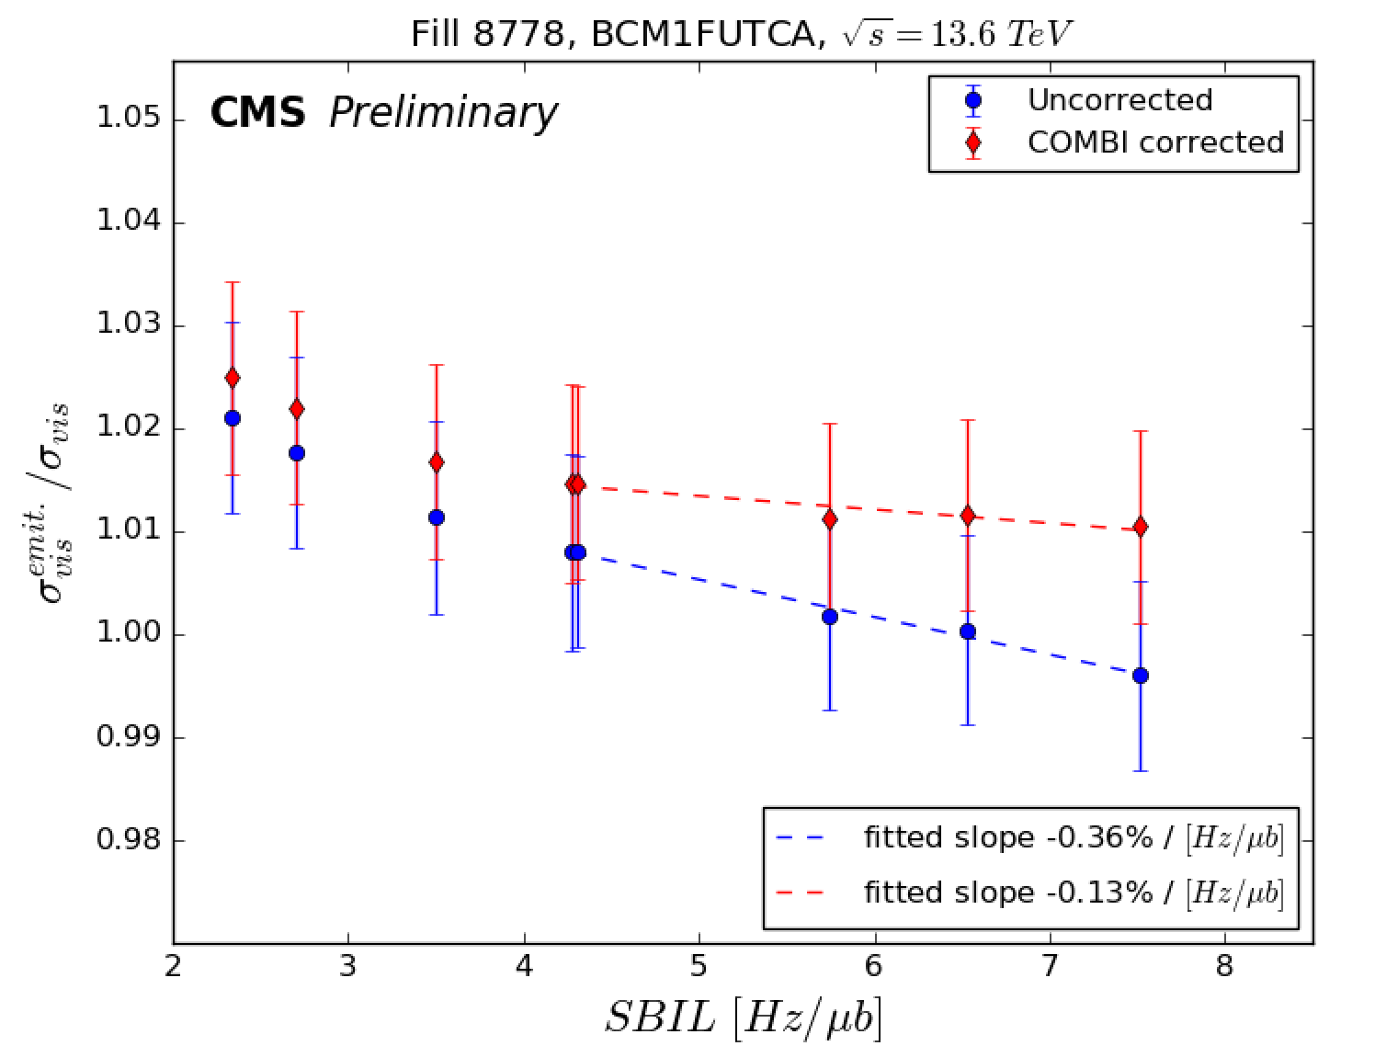
Application in the nominal conditions
perfectly linear luminometer = flat response across SBIL
Main contributions to the measured non-linearity:
  apparent BB-induced slope - removed with COMBI simulation,
  intrinsic detector response inefficiencies,
  possible additional biases from non-factorization etc.,
  challenging fit quality,
  operational limitations - to be improved in the future.
Possibility for an independent measurement
Valuable for HL-LHC conditions
Further studies needed to make it precise
Need to estimate the contribution from long-range interactions
increasing BB parameter
Pile-up (PU) = ~7 x Single
Bunch Instantaneous
Luminosity (SBIL)
Very interesting case to study further in a dedicated experiment?
DOI: https://doi.org/10.22323/1.449.0624
Recent developments in beam-beam studies
11/03/2025
6
Notes:
- in the case of ideally linear detector we expect ...
- as we apply the corrections the apparent BB induced slope is removed ...
- we can study detector non-linearities independently of another system
- of course there are still some limitations to this method
- but could be very valuable

Slide 7

Back to simulation world

Slide 8
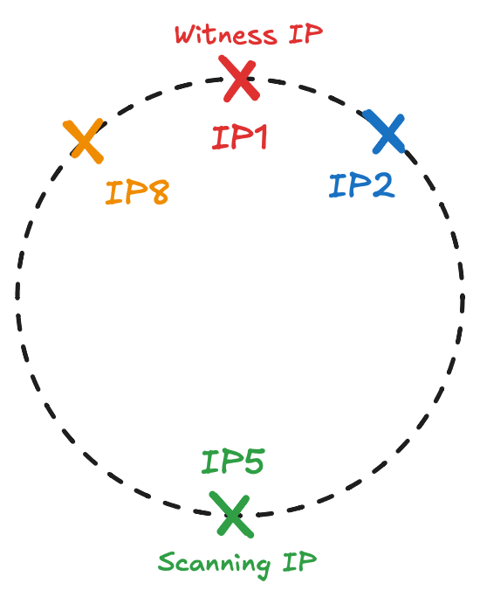
Nomenclature used in the following slides
Symbols used are consistent with the previous presentation
Definitions:
L₀ – no beam-beam (BB) interactions anywhere, numerical value equivalent to the analytical calculation from beam parameters
L_{u} – ‘unperturbed luminosity’ – introduced in the 2 IP configuration, normalization value that include BB interaction on only at the witness IP/IPs, but NOT at the scanning IP
L_{m} – ‘measured luminosity’ – BB interaction on at both scanning and witness IPs (or just at the scanning IP if no witness present)
Both L_{m} and L_{u} can be observed at the scanning or witness IP
BB effects propagate around the ring

Slide 9
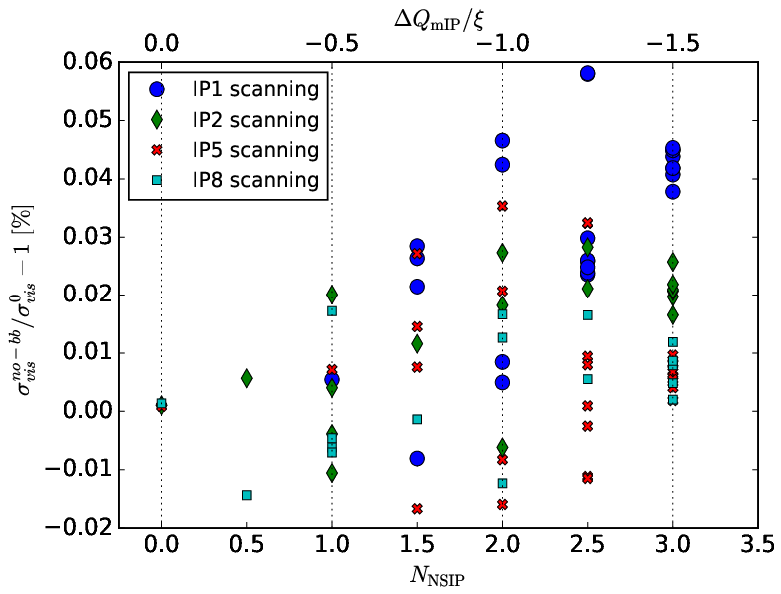
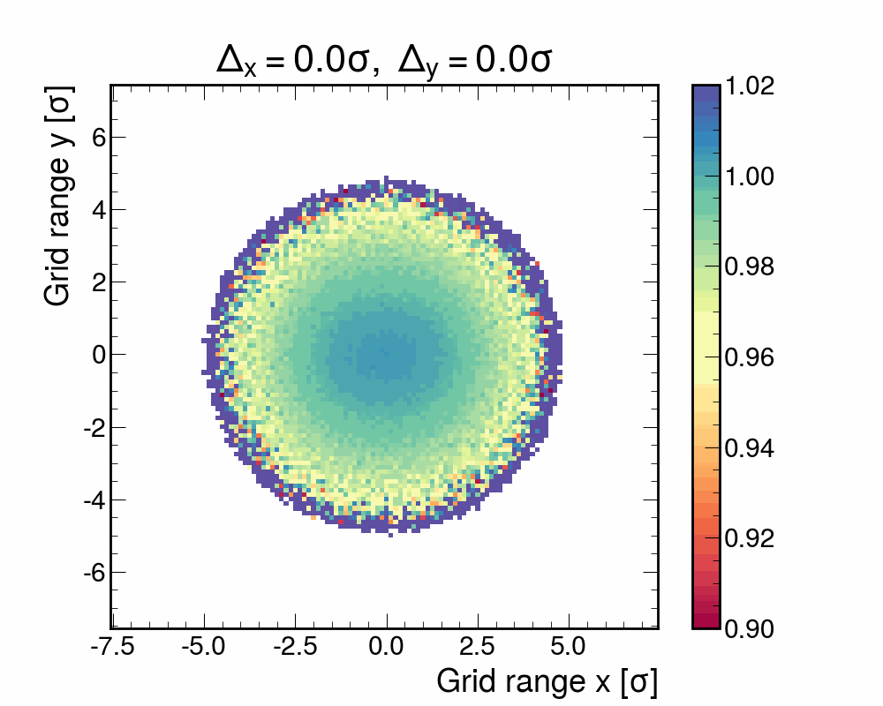
Introduction
Motivation explained previously by Witold see s. 11
Small discrepancy between simulation results when using different types of normalization,
This issue does not exist in simplified 1 IP simulations (L_{u} = L₀),
Associated with the choice of phase advance setpoint [*].
Beam-beam interaction perturbs the beam transverse density distributions in non-linear way, that depends on the beams’ separation,
This can lead to correlation in x-y,
Not possible to separate this effect from the so-called optical distortion,
  Always included in the beam-beam correction for the 1IP case.
  Not obvious for the multi-IP case.
Single beam x-y distribution ratio BB/noBB (single IP configuration)
[*] Previous discussion in the LLCMWG meeting

Slide 10
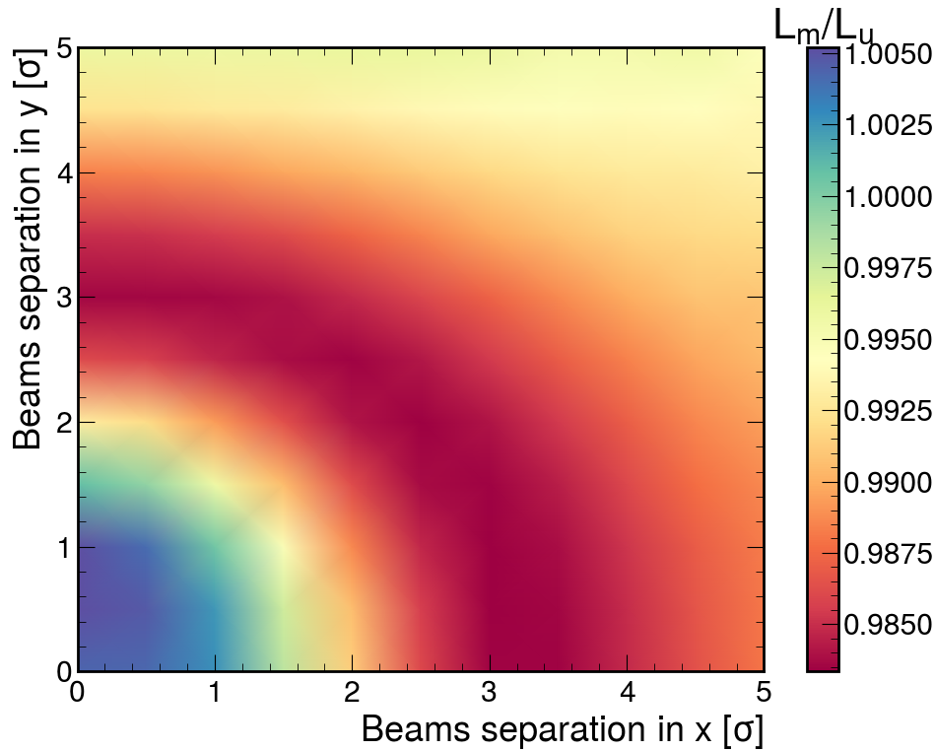
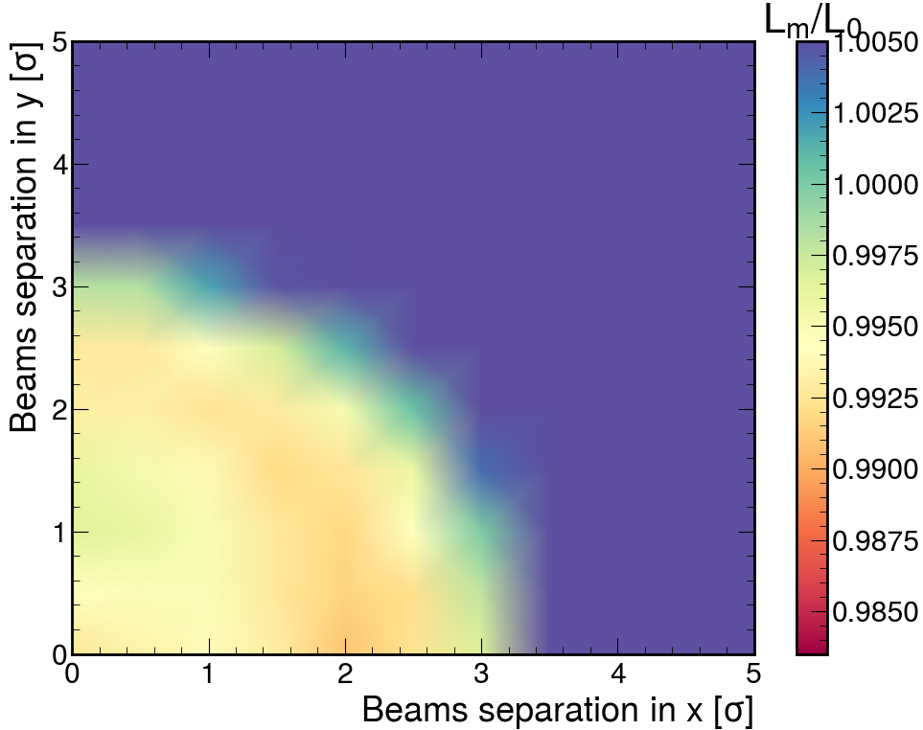
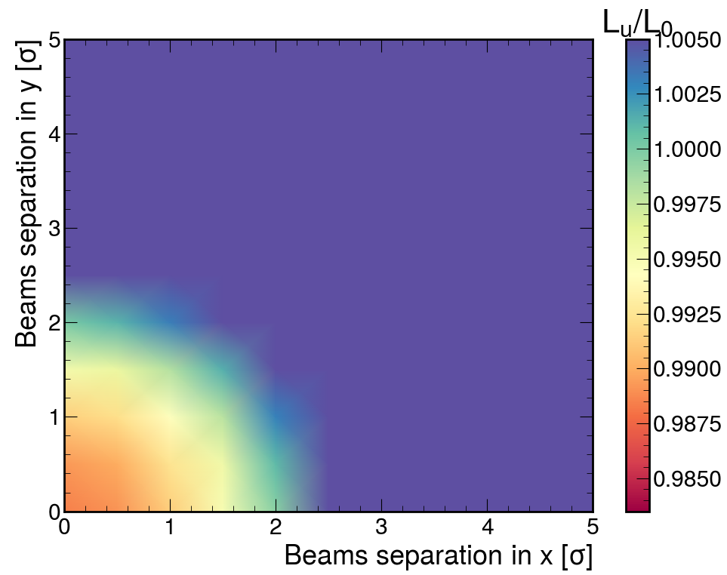
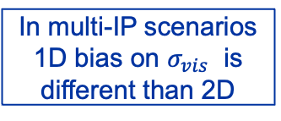
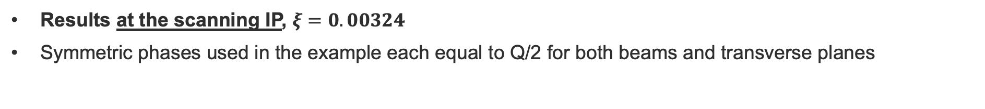
2D scans in 2 IPs scenario
Results at the scanning IP, $ξ=0.00324$
Symmetric phases used in the example each equal to Q/2 for both beams and transverse planes
Effect of scanning IP
Effect of scanning+witness IPs
Effect of witness IP
X+Y scans: -0.40%
Full XY scans: -0.42%
Plot dominated by the big effect at high separation, but not very relevant for the integrals:
X+Y scans: -0.40%
Full XY scans: -0.45%
X+Y: -0.009%
Full XY: -0.03%
In multi-IP scenarios 1D bias on $σ_{vis}$ is different than 2D
Notes:
Would it be interesting to add grid distribution for Lu/L0?
Lm_1IP = 6.752
Lu_1IP = 6.723 <- correct L0
Lm_2IP = 6.675
Lu_2IP = 6.646 – smaller than 1IP
Lm_2IP_w = 6.671
Lu_2IP_w = 6.748
I also got the same values when simulating BB just at the witness

Slide 11
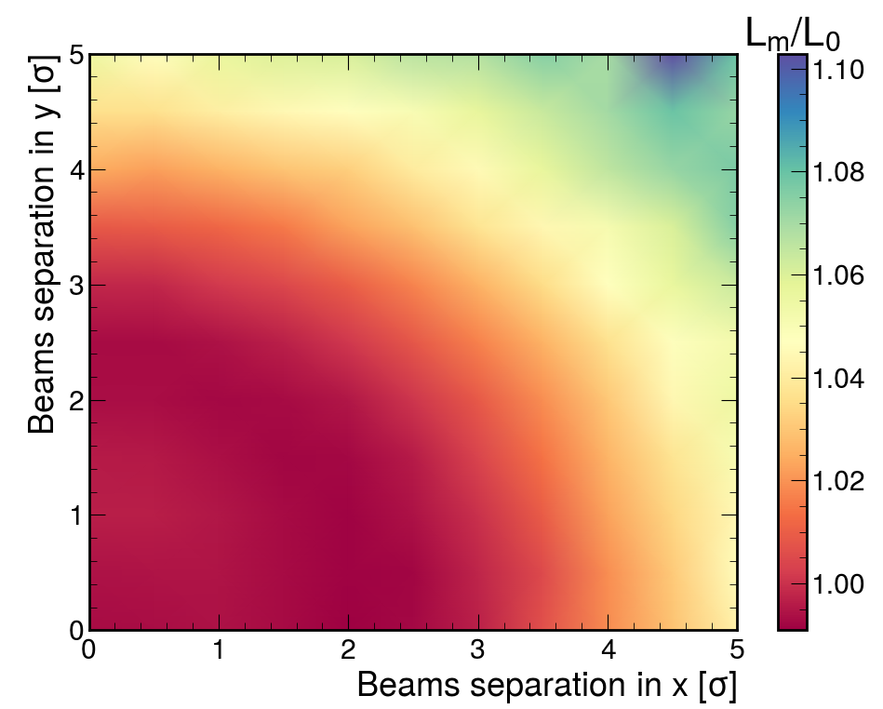
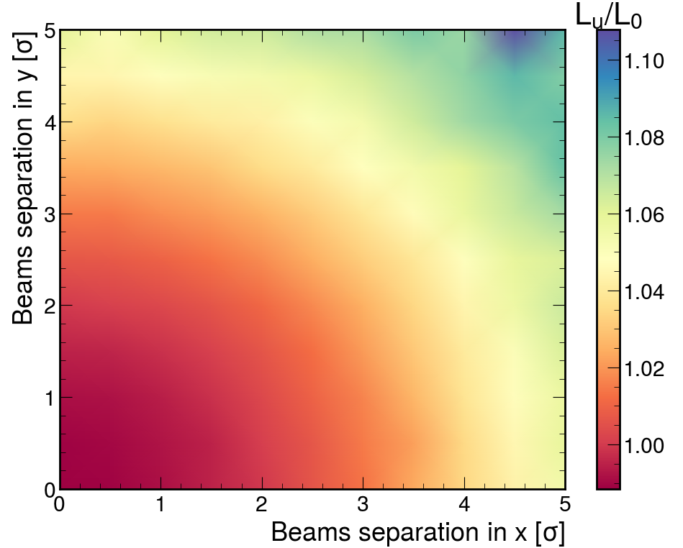
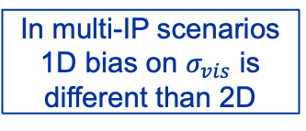
2D scans in 2 IPs scenario
Results at the scanning IP, $ξ=0.00324$
Symmetric phases used in the example each equal to Q/2 for both beams and transverse planes
Effect of scanning IP
Effect of scanning+witness IPs
Effect of witness IP
Dominated by the effect on the tails
X+Y scans: -0.40%
Full XY scans: -0.42%
Plot dominated by the big effect at high separation, but not the sigvis:
X+Y scans: -0.40%
Full XY scans: -0.45%
X+Y: -0.009%
Full XY: -0.03%
In multi-IP scenarios 1D bias on $σ_{vis}$ is different than 2D
L_{u}/L₀ discrepancy enhanced when full 2D grid is considered
=
Non-factorization from the witness IP propagated to the scanning IP
Notes:
Would it be interesting to add grid distribution for Lu/L0?
Lm_1IP = 6.752
Lu_1IP = 6.723 <- correct L0
Lm_2IP = 6.675
Lu_2IP = 6.646 – smaller than 1IP
Lm_2IP_w = 6.671
Lu_2IP_w = 6.748
I also got the same values when simulating BB just at the witness

Slide 12
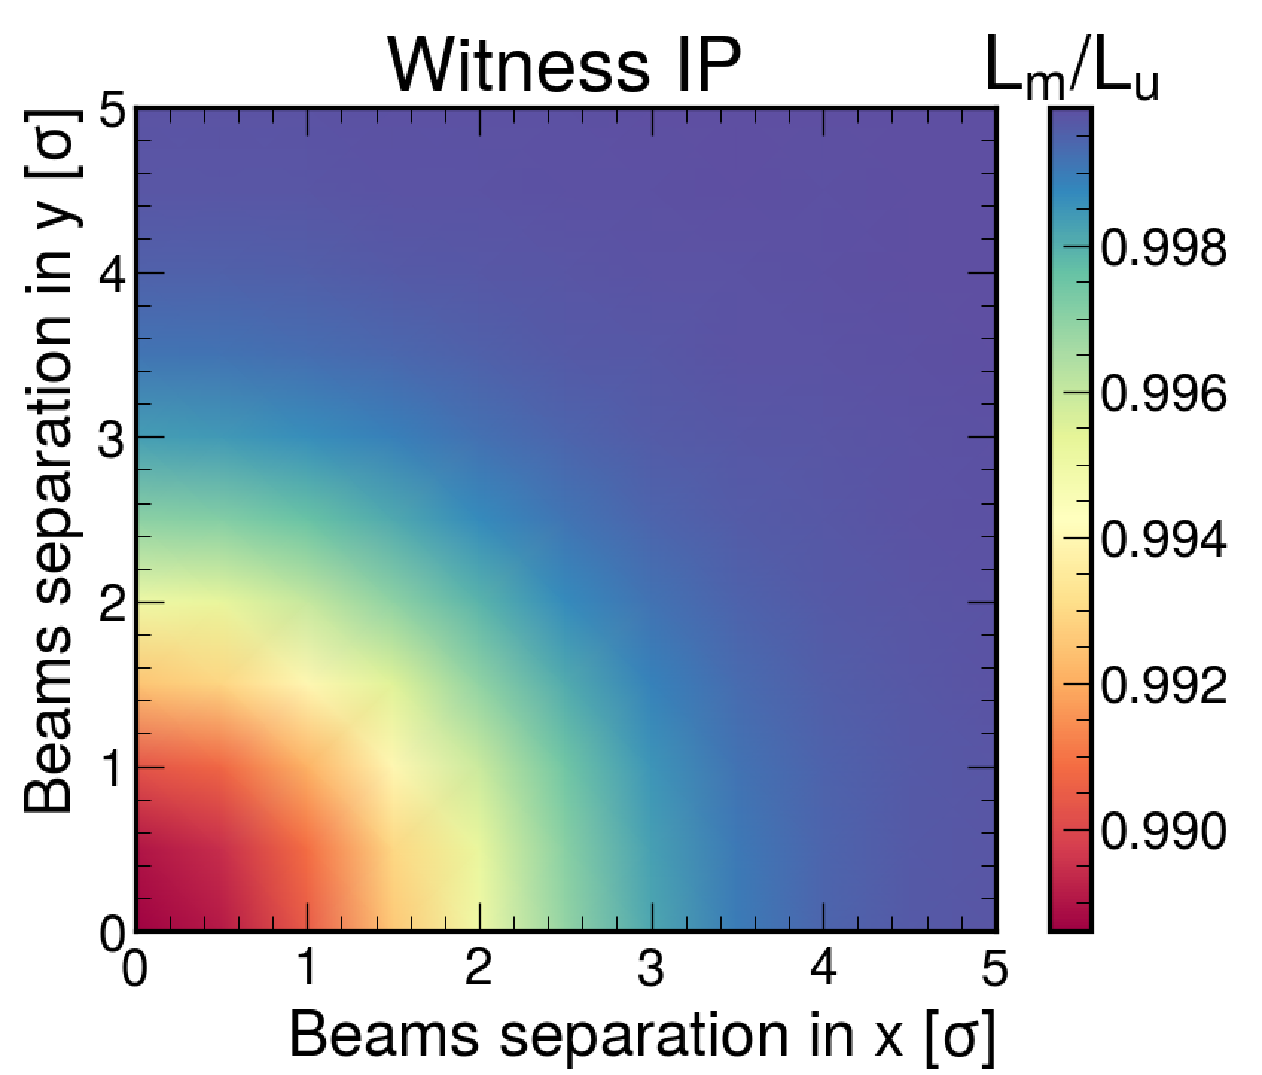
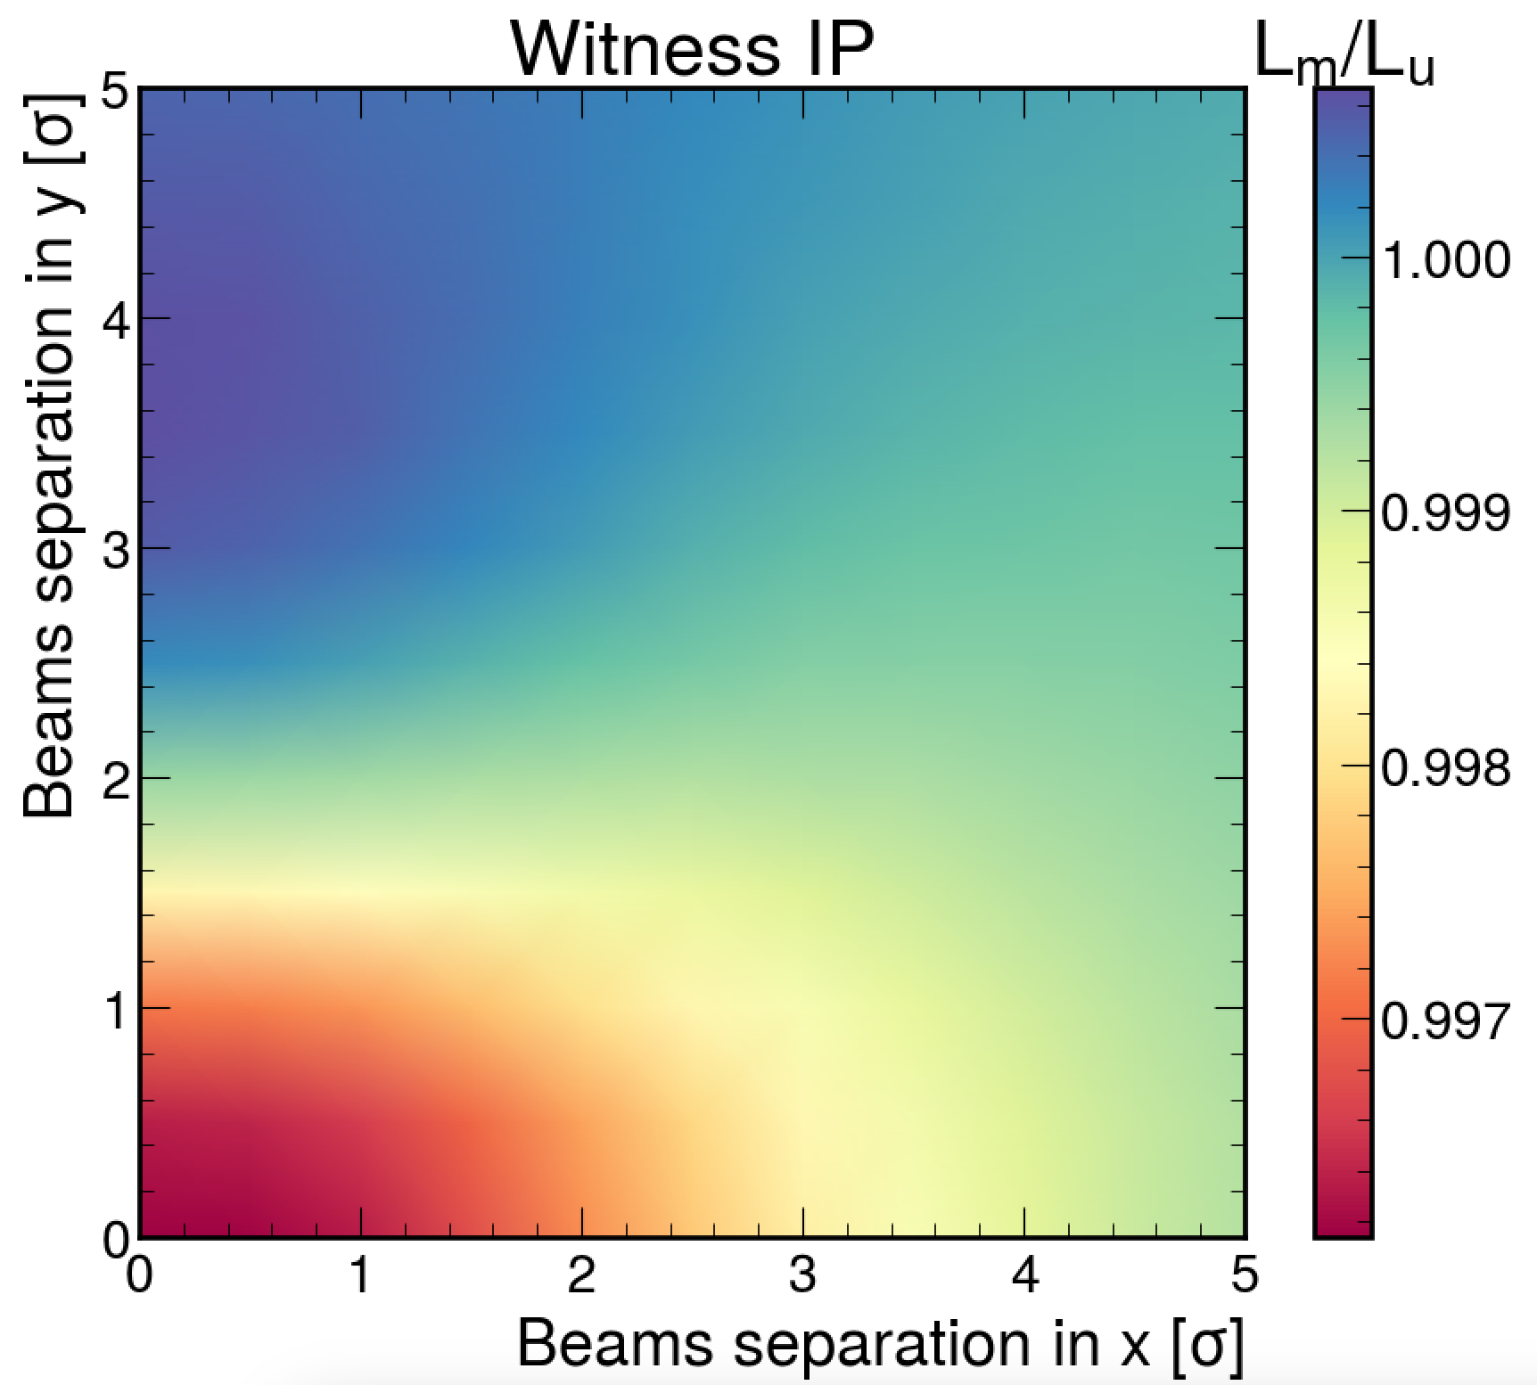
What happens at the witness IP?
Effect of the beam-beam interaction at the scanning IP propagated into the witness IP
While scanning IP looks the same as with symmetric cases, the witness IP doesn’t – much more asymmetric (in x-y) patterns are present
Symmetric phases
Run 3 vdM phases
Significantly smaller effect than at the scanning IP
This separation is present at the scanning IP, no separation is present at the witness IP

Slide 13
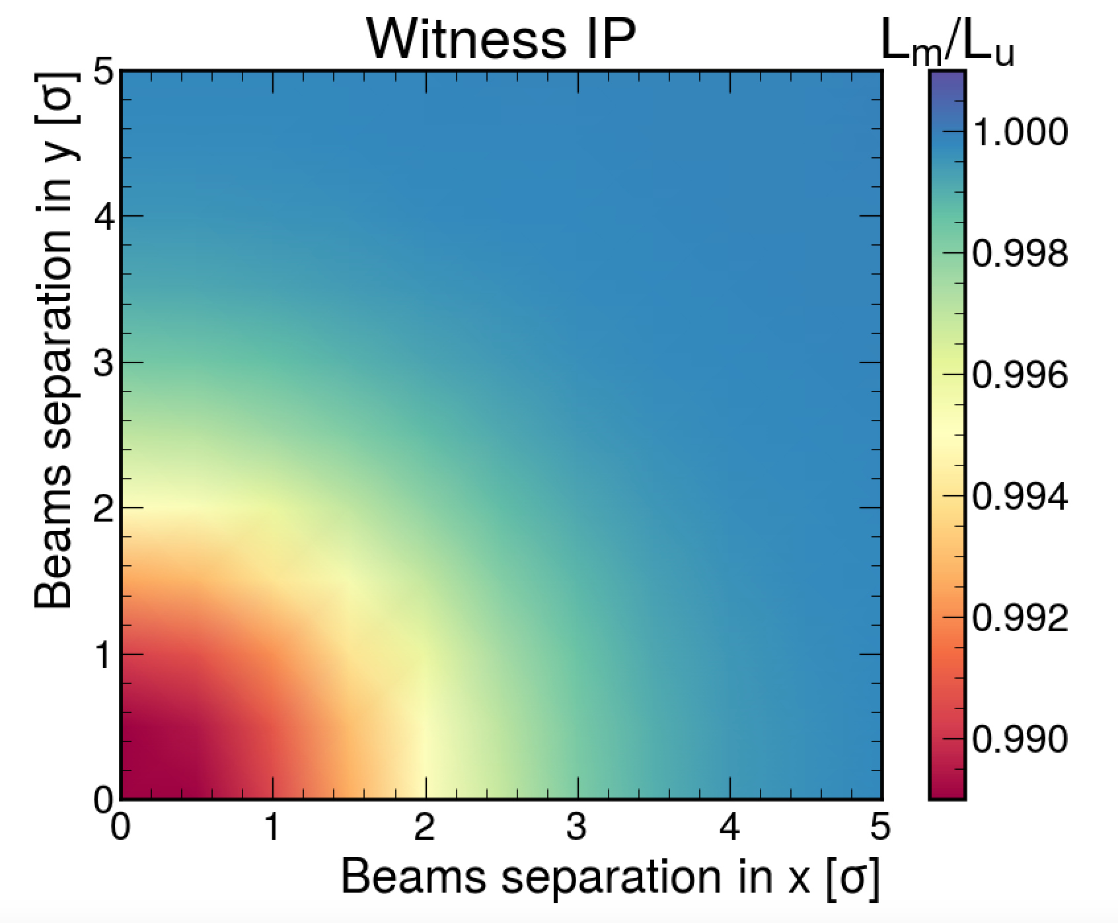
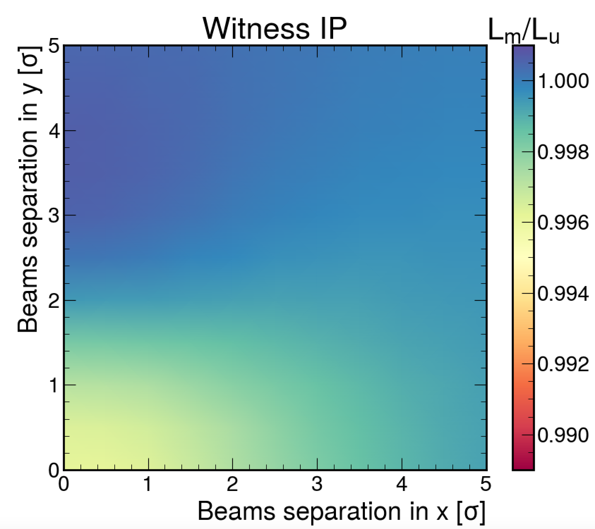
What happens at the witness IP?
Effect of the beam-beam interaction at the scanning IP propagated into the witness IP
While scanning IP looks the same as with symmetric cases, the witness IP doesn’t – much more asymmetric (in x-y) patterns are present
Symmetric phases
Run 3 vdM phases
Significantly smaller effect than at the scanning IP
Range of the effect for realistic phases ~twice smaller than for arbitrary symmetric phases
Phase advance sensitive non-factorization from witness IP at the scanning IP
This separation is present at the scanning IP, no separation is present at the witness IP

Slide 14
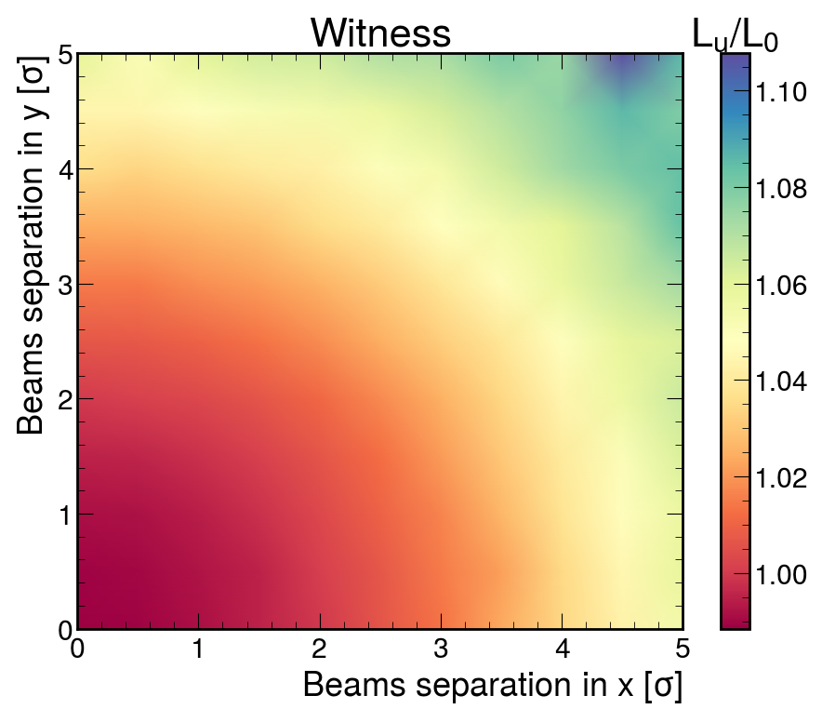
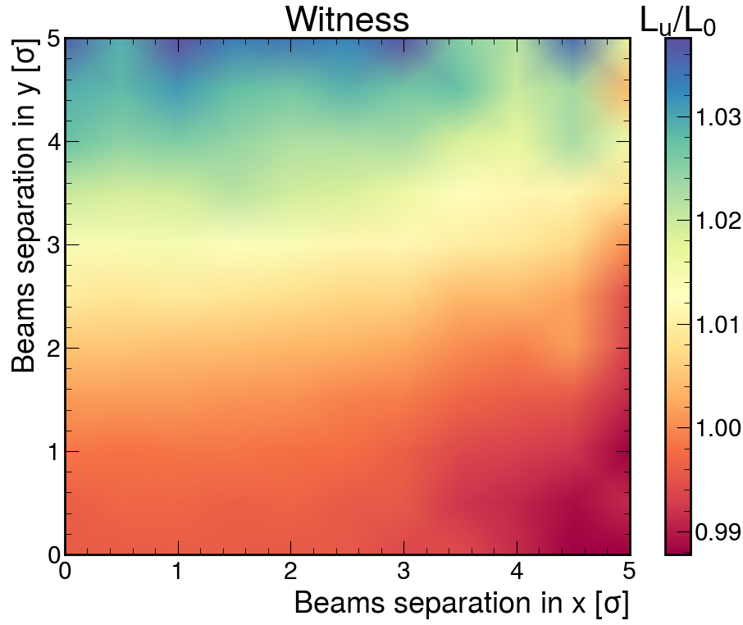
What happens at the witness?
Effect of the witness beam-beam interaction at the witness IP
Symmetric phases
Run 3 vdM phases
Order of magnitude bigger effect than from the scanning IP BB
Strongest changes in the tails, visible at high beam separation
Strong dependence on the scan direction
* Some details in the pattern in these plots come from the random seed

Slide 15
Distinction of the non-factorization sources
Beam-beam parameter dependent
Beam history, optics = present before the scan, can evolve in time [*]
Induced by the witness beam-beam interactions
Induced during vdM scan
[*] not covered here, more details in presentation by F. Asvesta
Included in the non-factorization analyses?
YES
YES
Depends on the method = corrections required
Non-factorization analyses are potentially sensitive to the beam-beam induced changes at any number of witness interactions,
Thus, correcting beam-beam effects in vdM scan to L₀ does not make sense,
Using L_{u} normalization allows to avoid the overlap in the corrections.
In this way the BB effects at the scanning IP are corrected and witness IP changes are treated fully as non-factorization,
This is consistent with the assumptions of the currently employed parametrized correction model,
But the BB effects at the scanning IP should be corrected for in NF analyses (if sensitive).
Notes:
Separate contributions from the witness IP and scanning IP to non-factorization
Both effects depend on the phase advance configuration

Slide 16
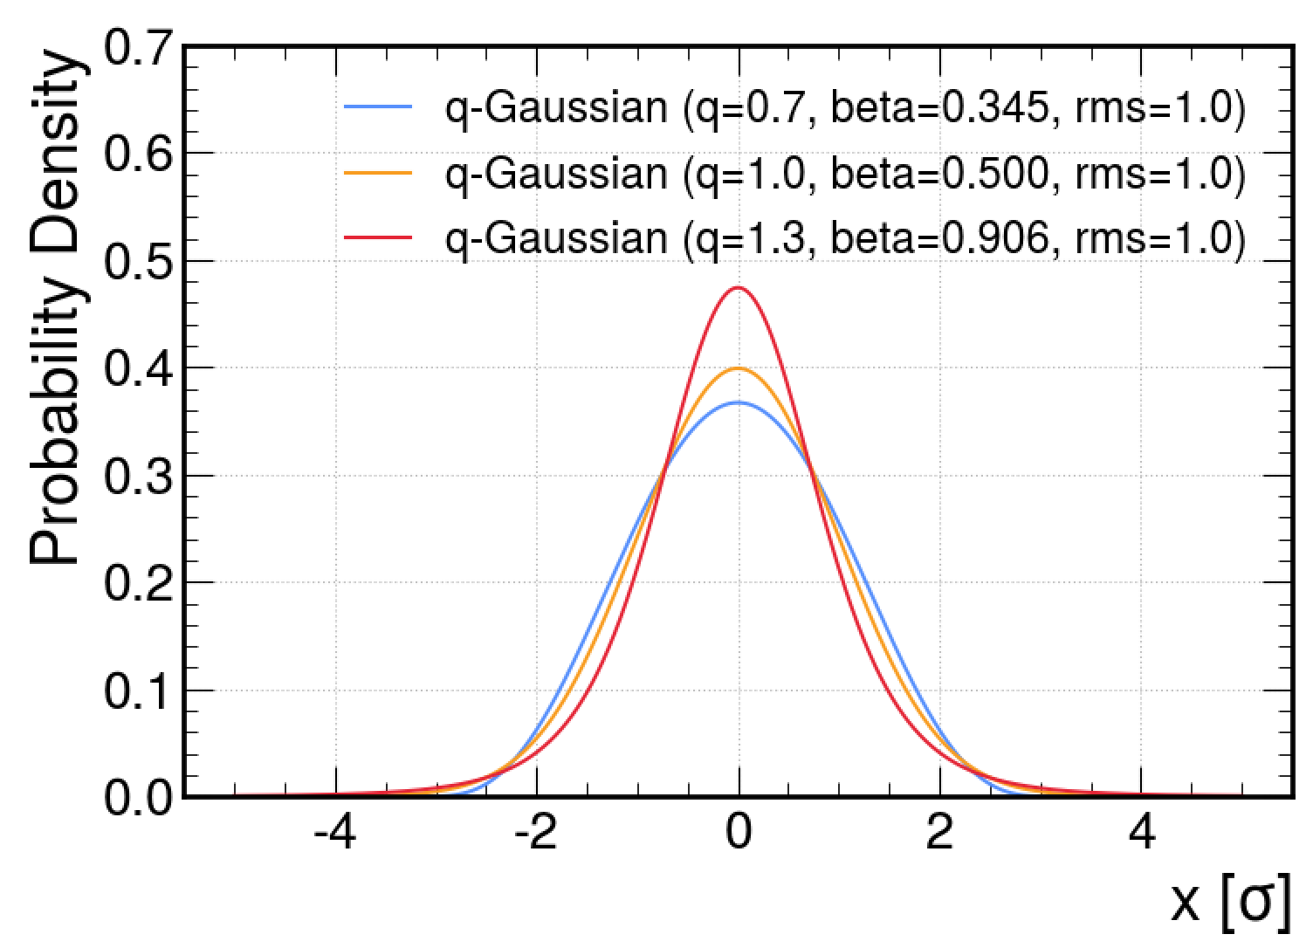
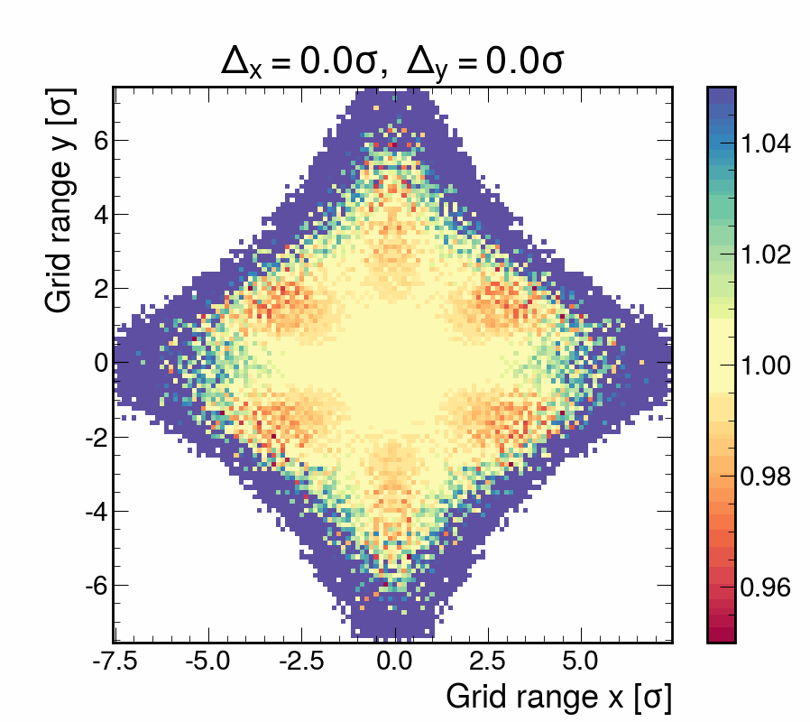

Beam distribution effects
Preliminary study
Example for beam with heavy tails, single beam q=1.3 (this would give around q_{product}=1.15 on the luminosity scan curve)
Using simplified definition to artificially get the same rms:
RMS beam size is constant
$$fqG\left(x\right)={[1−\left(1−q\right)βx^{2}]}^{\frac{1}{1−q}}$$
Single beam x-y distribution with q=1.3 shown as ratio BB/noBB
Beam-beam induced transverse distribution changes are sensitive to the initial beam distribution (example for 1IP configuration)

Slide 17
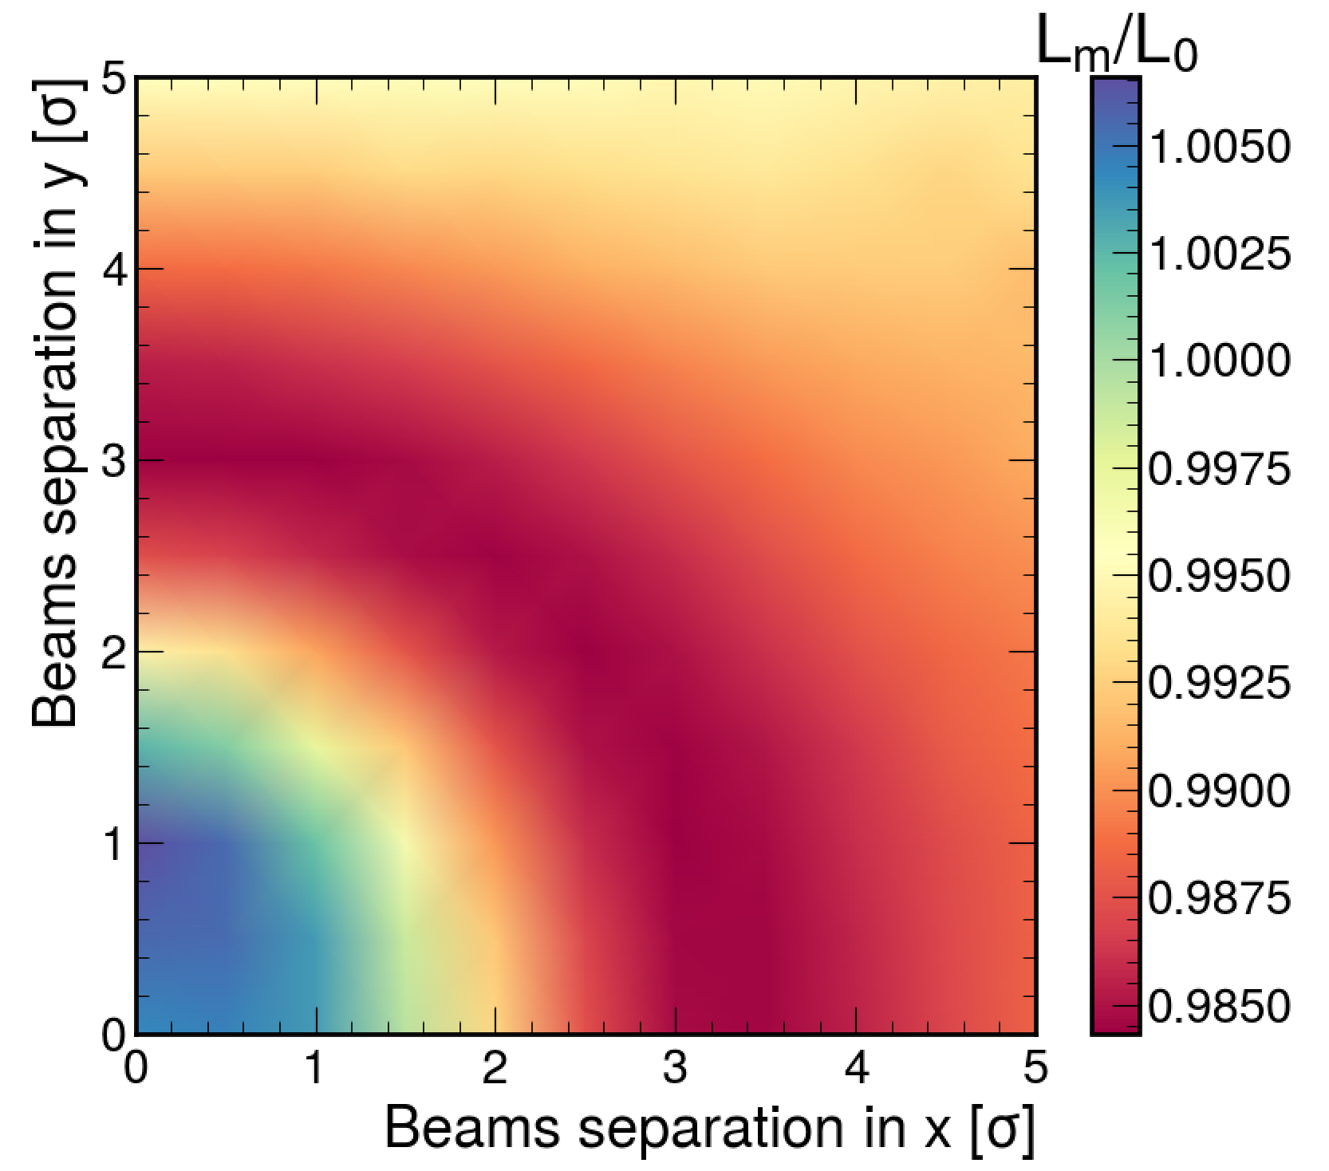
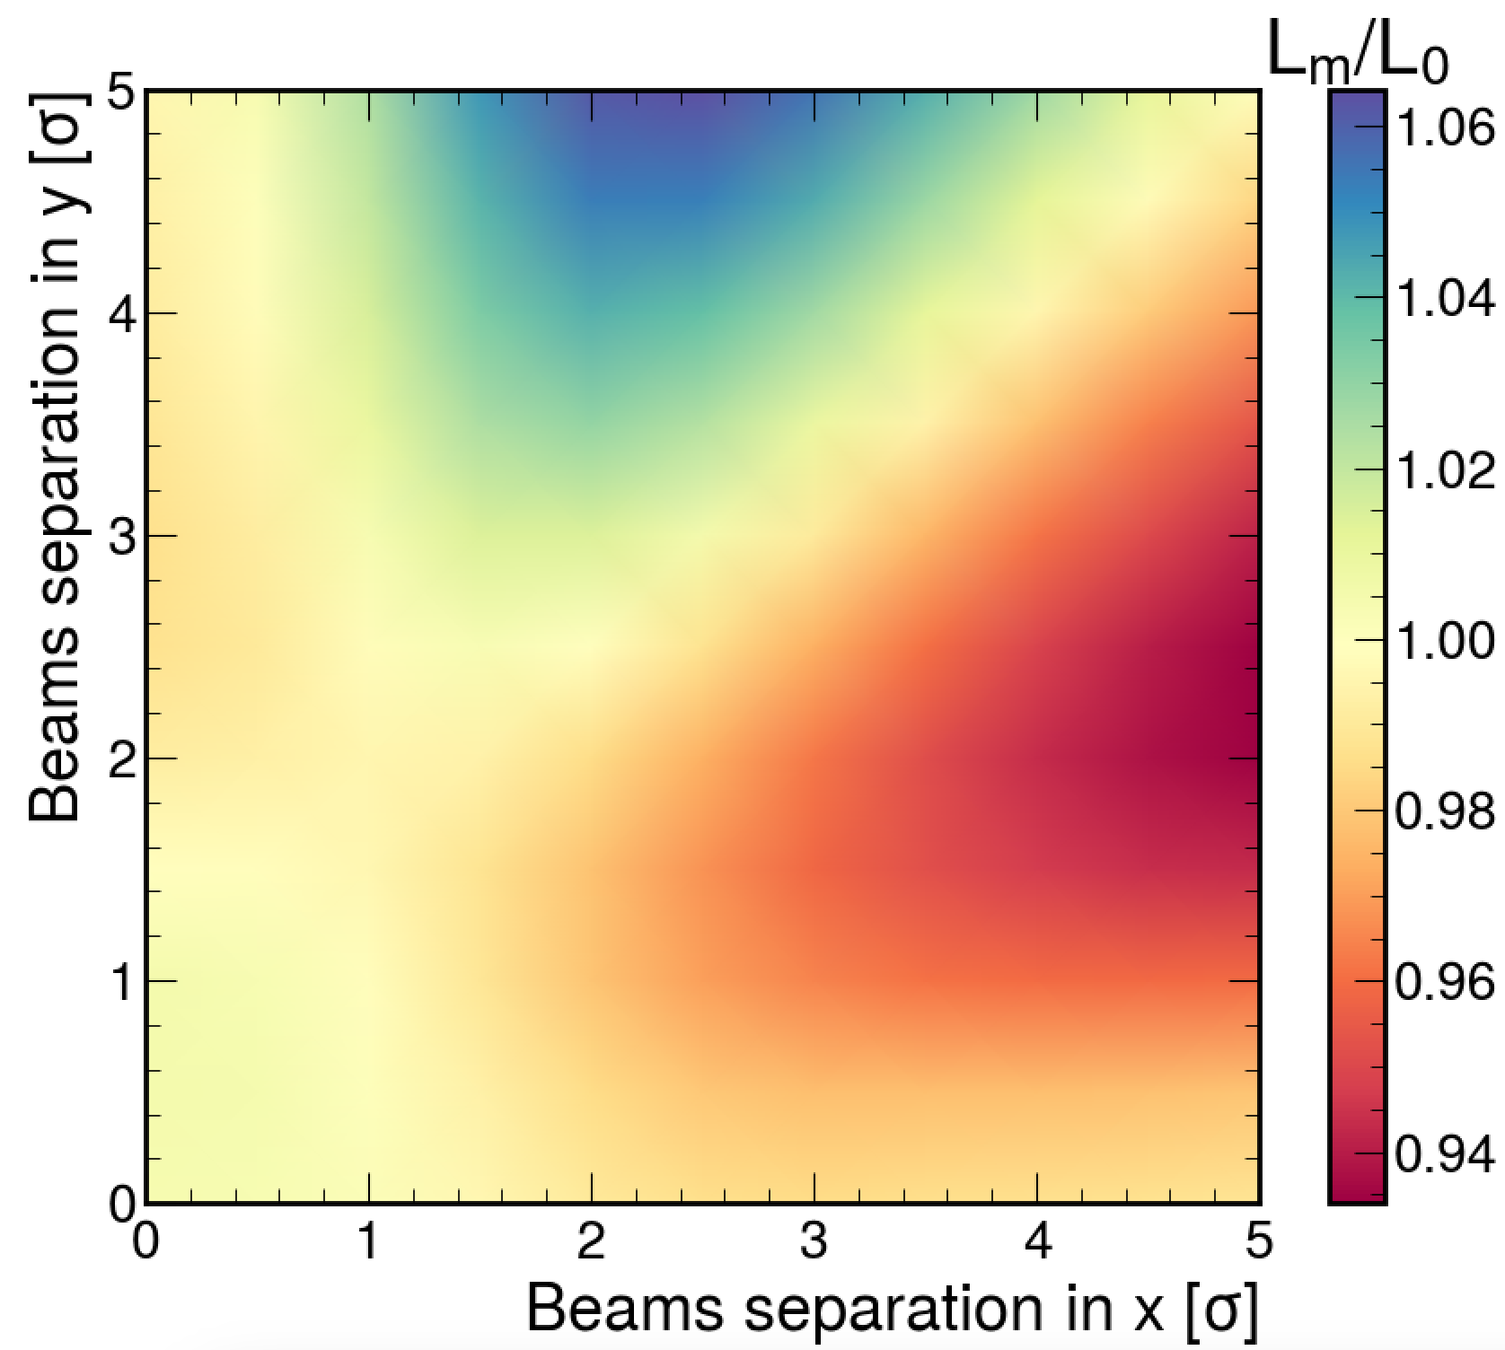
Beam distribution effects
Comparison of Gaussian (q=1) and qGaussian (q=1.3) distribution with the same RMS beam size for single IP case
q=1
q=1.3
2%
12%
Very strong effect on the tails
Indicates possible caveats in the current estimation of the beam-beam systematic uncertainty associated with heavy tails
*the BB kick used still includes Gaussian approximation in the EM field calculation

Slide 18

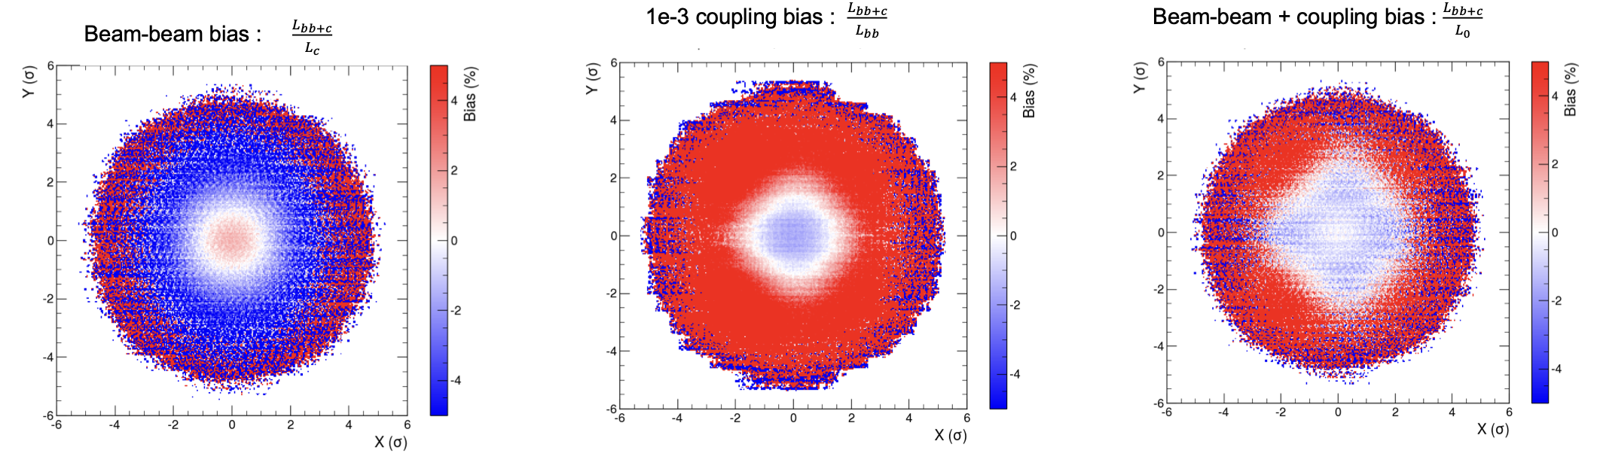

Luminous region with beam-beam and coupling
Ongoing studies on the interplay of beam-beam and global or local coupling
Indicate opposing effects of beam-beam and coupling
In the example extreme local coupling value used leads to significant impact on the transverse distributions
Local coupling can lead to differences between the IPs
Ch. Zhang,
L. Lammert with XSUITE
Very interesting case to study in a dedicated experiment?
More details in presentation by T. Pieloni

Slide 19
Conclusions
Successful benchmark at the LHC of the simulation-based corrections to beam-beam induced changes on the luminosity calibration
  Possible further experiment in 2025?
Simulation studies for nominal conditions have applications in emittance scans to correct for beam-beam induced slopes in detector non-linearity measurements
  Possible further experiment in 2025?
The discrepancy between L_{u} and L₀ normalization is explained by the non-factorization induced by the static beam-beam interaction at the witness IP that is propagated to the scanning IP
  Currently, this effect is excluded in the correction strategy, treated as the extra systematic uncertainty
  Assuming that the non-factorization measurement methods are sensitive to this non-factorization, it can be removed from the beam-beam related systematic uncertainties
  However, it is important to be able to remove the scanning-IP related beam-beam biases in the non-factorization measurement
The original beam distribution might have a significant impact on this effect that was not considered up to now
  Indicates that the beam-beam systematic uncertainty associated with the high Gaussian tails might be underestimated
Simulation studies ongoing for the interplay between BB and global and local coupling
  Possible experiment in 2025?

Slide 21
Summary in terms of bias on the visible cross-section
Separate contributions from the witness IP and scanning IP to non-factorization
Both effects depend on the phase advance configuration
Comparison with early Run 3 vdM phase advances
 | 1 IP | 2 IPs / Lu | 2 IPs / L0 | Lu / L0
Symmetric phases
X+Y | -0.21% | -0.40% | -0.40% | -0.01%
Full XY | -0.21% | -0.42% | -0.45% | -0.03%
Early Run 3 vdM phases
X+Y | -0.21% | -0.38% | -0.36% | +0.01%
Full XY | -0.21% | -0.41% | -0.41% | 0.00%
Phase advance sensitive non-factorization from witness IP at the scanning IP
Notes:
Scan phases? To see what is the dependence of lu on phase +symmetric xy tunes + would quad give the same result?
Ratios not the same as the difference?

Slide 22
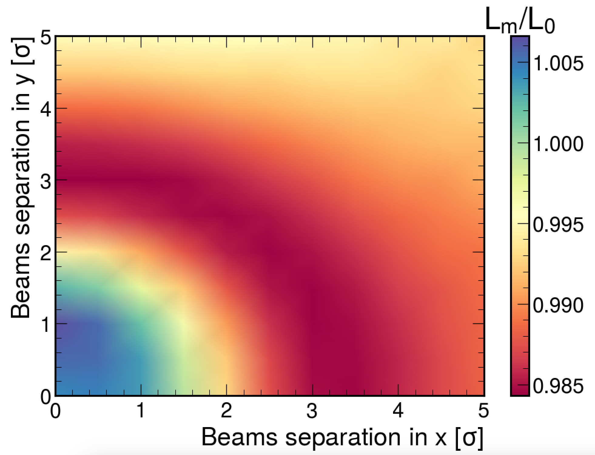
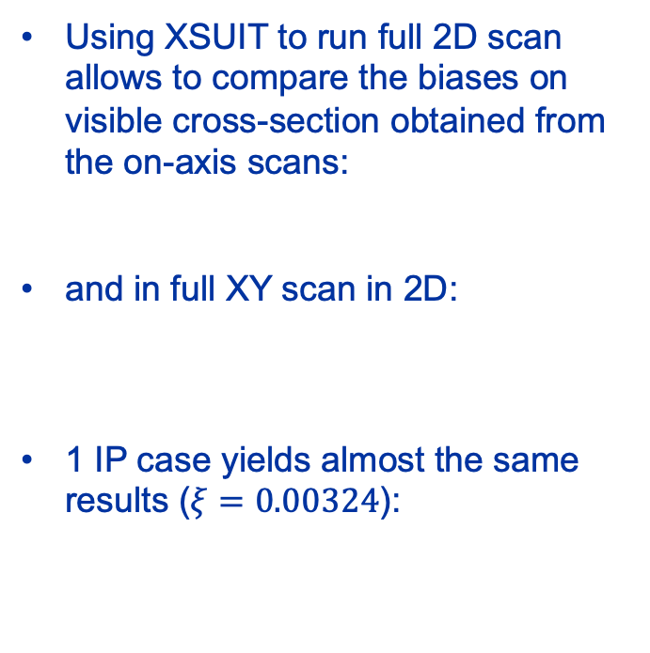
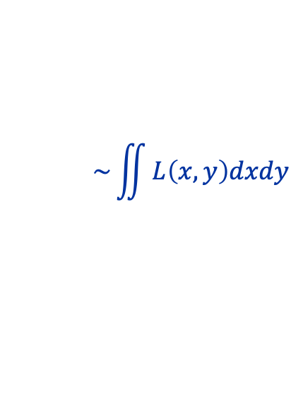

Single IP scenario and vdM integrals
Using XSUIT to run full 2D scan allows to compare the biases on visible cross-section obtained from the on-axis scans:
and in full XY scan in 2D:
1 IP case yields almost the same results ($ξ=0.00324$):
$$\sim {1/μ}_{pk}\int{L\left(x,0\right)dx}\int{L\left(0,y\right)dy}$$
$$\sim \iint{L\left(x,y\right)dxdy}$$
X + Y scans: -0.214 %
Full XY scan: -0.297 %

Slide 23
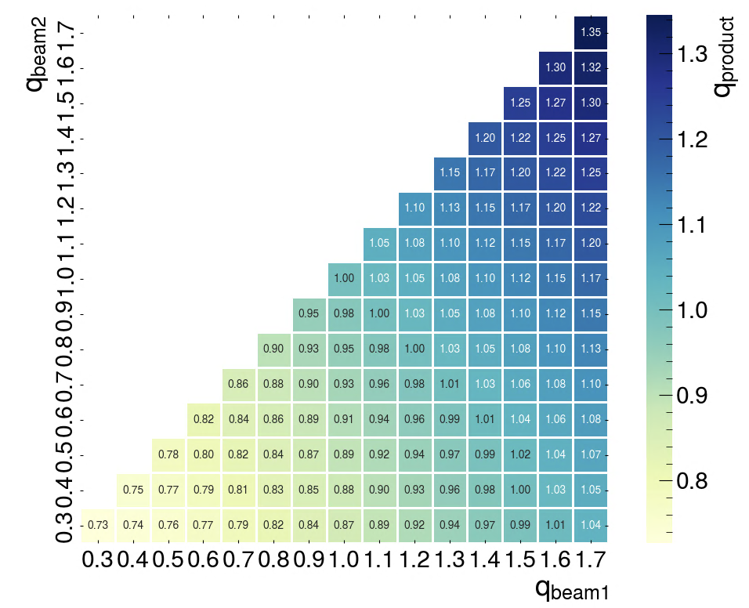
Backup – q factor for single beam vs 2 beams product
Single beam q=1.3 will give much smaller q_{product} factor from the fitted luminosity scan curve

