Slide 1


Numerical Tools for Studying Beam Dynamics Effects on Luminosity Calibration: COMBI to XSUITE
Linear coupling and Beam-beam case
L. Lammert, T. Pieloni, J. Wanczyk and C. Zhang
Acknowledgements: T. Persson, R. Tomas, G. Iadarola, P. Kicsiny, W. Kozanecki
7th March 2025
Work supported by the Swiss Accelerator Research and Technology (CHART)

Slide 2
Contents
COMBI→XSUITE
  XSUITE
  Benchmark of Luminosity BIAS due to beam-beam
  New analysis: Beam Imaging, Luminous region, 2D fit rates
Linear Coupling in LHC
Beam-beam luminosity bias + linear coupling preliminary results:
  Local Linear Coupling
  Global coupling
  Half corrected local coupling
Summary and Future Plans

Slide 3
Contents
COMBI→XSUITE
  XSUITE
  Benchmark of Luminosity BIAS due to beam-beam
  New analysis: Beam Imaging, Luminous region, 2D fit rates
Linear Coupling in LHC
Beam-beam luminosity bias + linear coupling preliminary results:
  Local Linear Coupling
  Global coupling
  Half corrected local coupling
Summary and Future Plans

Slide 4
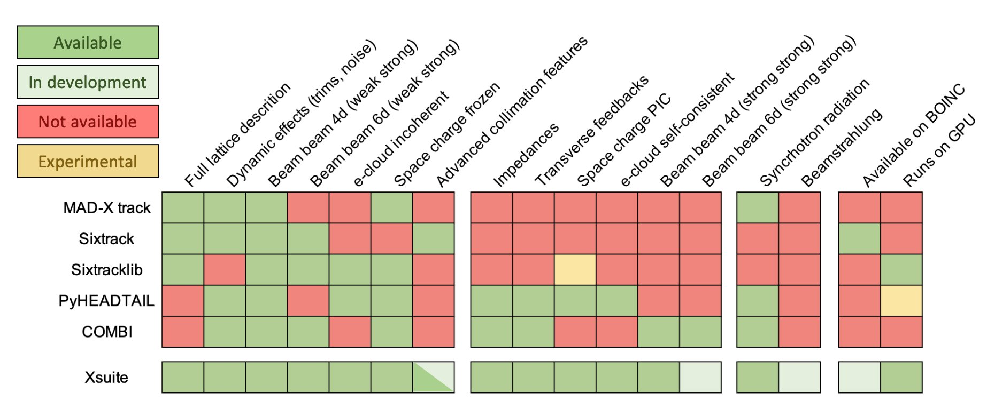

COMBI→XSUITE
XSUITE: ABP Initiative to combine all capabilities of different accelerator tools developed at CERN in a single flexible and modern framework​. Webpage
EPFL PhD P. Kicsiny: Beam-beam models for hadron and lepton colliders implemented in XSUITE
Master Project C. Zhang to develop 2D luminosity integrator (like in COMBI), private version
Master Project L. Lammert develop analysis of beam imaging, local coupling and beam-beam effects private version

Slide 5
Benchmark 1: Luminosity Bias 1 and 2 Ips case
A numerical integrator was developed in Xsuite based on previous studies
There is good agreement between the two results, and clear differences with the Gaussian calculation
Results for 2 IPs are similar to those for 1 IP
Slight deviations at the tails for 2 interaction points, to be understood and reduced.
Notes:
In this project a numerical integrator was developed in Xsuite, which is a new beam simulation code framework at CERN that aims to unite many of the functions of all the various predecessor codes that exist. The luminosity numerical integrator in this case was based on Joanna’s numerical integrator in COMBI. As vdM scans were the topic of investigation there are no crossing angles in the integrator.
The luminosity bias are compared in the case of vdM scans for one interaction point. The luminosity bias means the difference in luminosity between the luminosity with beam-beam effects and without, normalised over the luminosity without beambeam effects. The dashed dark pink line shows results from COMBI, light blue shows the results from Xsuite. For the 1IP case the results seem to be well matched, however with 2IPs there are slight deviations at the tails. One theory is that the grids are defined differently in the two codes, and there is more granularity in the COMBI results. However this could be investigated further.

Slide 6
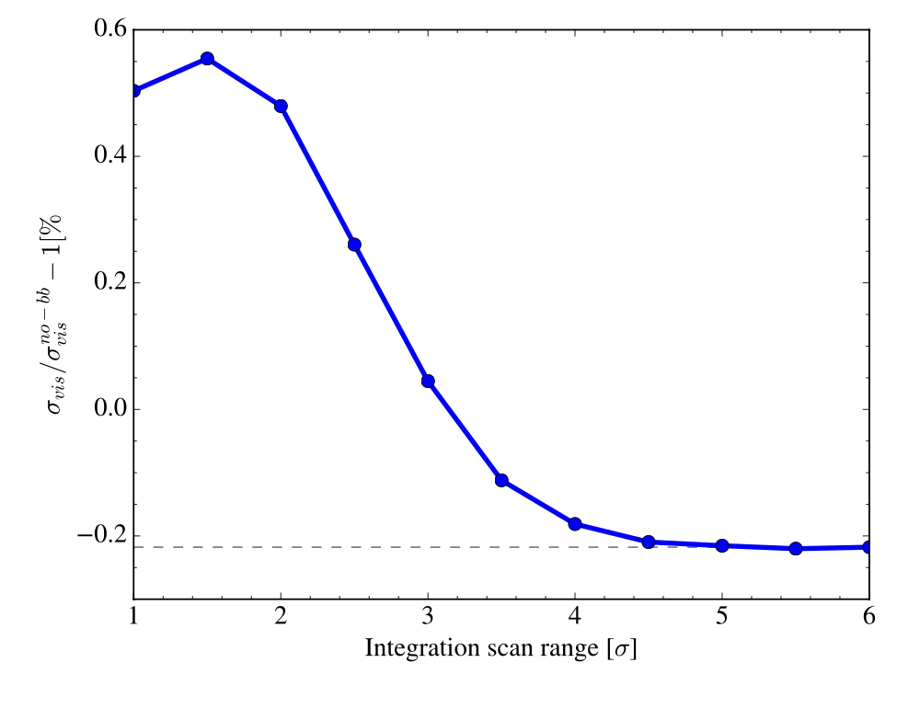
Benchmark 2: Sigma visible
Sigma visible is comparable despite deviations in the tails for 2IPs
Differences are below the significance level of 0.1%
Results of A. Babaev et al. BB studies reproduced
Notes:
Although there are differences in luminosity between my integrator for 2 interaction points and the integrator in COMBI, when comparing the sigma visible obtained they are comparable. This is because following the convergence of sigma visible bias seen in the curve here we can see that the sigma visible is calculated with an integral that will weight according to the particle distributions which are more centred around the centroid. At 4.5 sigma there is already some convergence to the final value. Although the differences between the two simulation results are larger for 2 Ips than 1 Ips as can be seen here. Both differences are much smaller than the 0.1% uncertainty level that is significant in absolute luminosity calibration studies.
Sigma vis with beam beam without beambeam
- Explain the normalization and the plots
Extra: In the 1IP case a 0.00333% effect on $σ_{vis}$ with beam-beam effects and 0.00608% without for 1 interaction point. For 2 interaction points 0.0397% with beam-beam effects and 0.012% effect without. This is much smaller than the 0.1% uncertainty level that is significant in absolute luminosity calibration studies.

Slide 7
Benchmark 2: Sigma visible
Sigma visible is comparable despite deviations in the tails for 2IPs
Differences are below the significance level of 0.1%
Results of A. Babaev et al. BB studies reproduced
XSUITE 2D luminosity calculation is comparable to COMBI and can be now used
Notes:
Although there are differences in luminosity between my integrator for 2 interaction points and the integrator in COMBI, when comparing the sigma visible obtained they are comparable. This is because following the convergence of sigma visible bias seen in the curve here we can see that the sigma visible is calculated with an integral that will weight according to the particle distributions which are more centred around the centroid. At 4.5 sigma there is already some convergence to the final value. Although the differences between the two simulation results are larger for 2 Ips than 1 Ips as can be seen here. Both differences are much smaller than the 0.1% uncertainty level that is significant in absolute luminosity calibration studies.
Sigma vis with beam beam without beambeam
- Explain the normalization and the plots
Extra: In the 1IP case a 0.00333% effect on $σ_{vis}$ with beam-beam effects and 0.00608% without for 1 interaction point. For 2 interaction points 0.0397% with beam-beam effects and 0.012% effect without. This is much smaller than the 0.1% uncertainty level that is significant in absolute luminosity calibration studies.

Slide 8
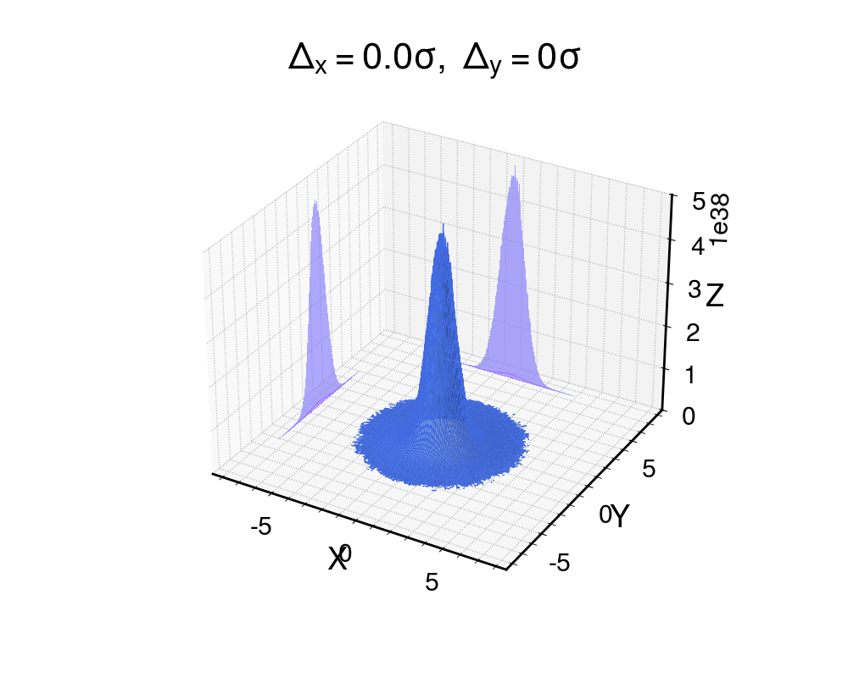
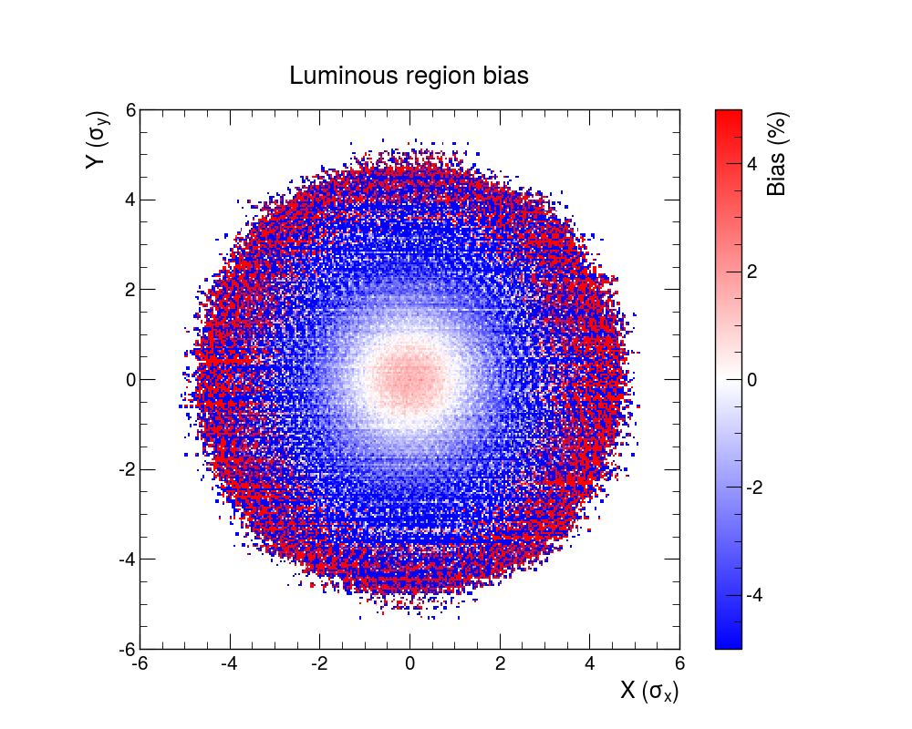
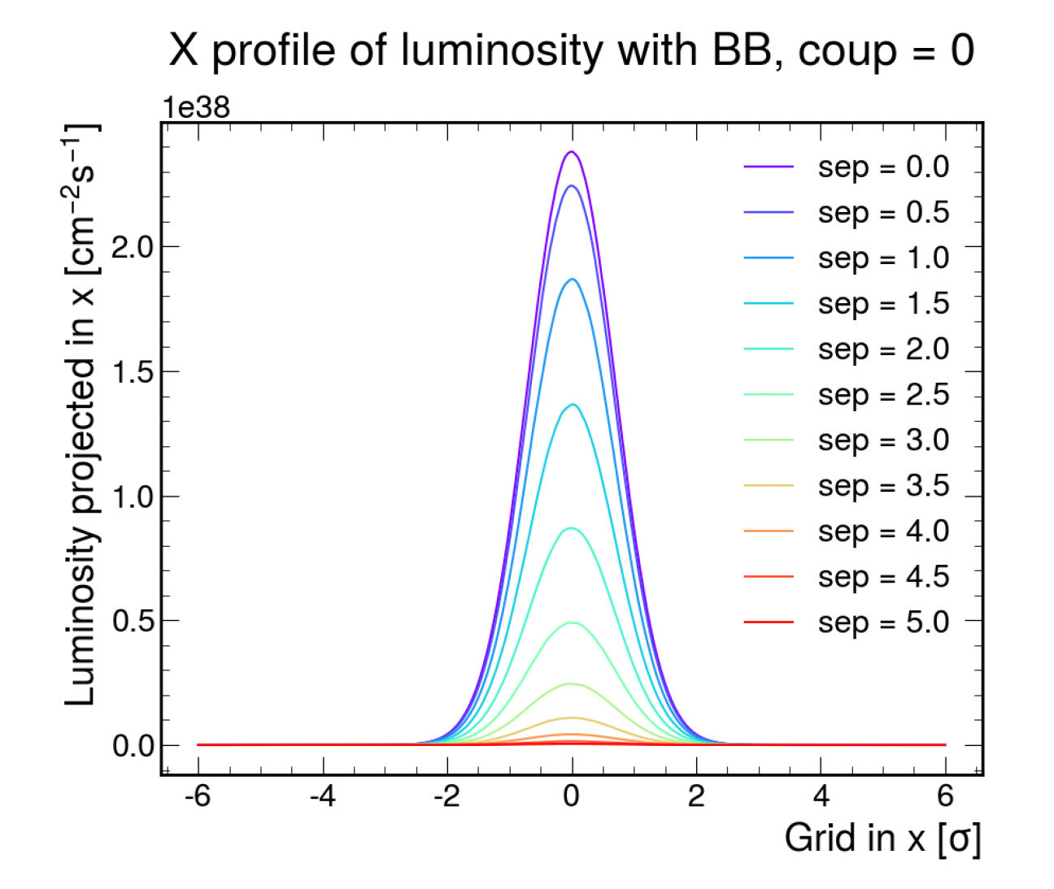
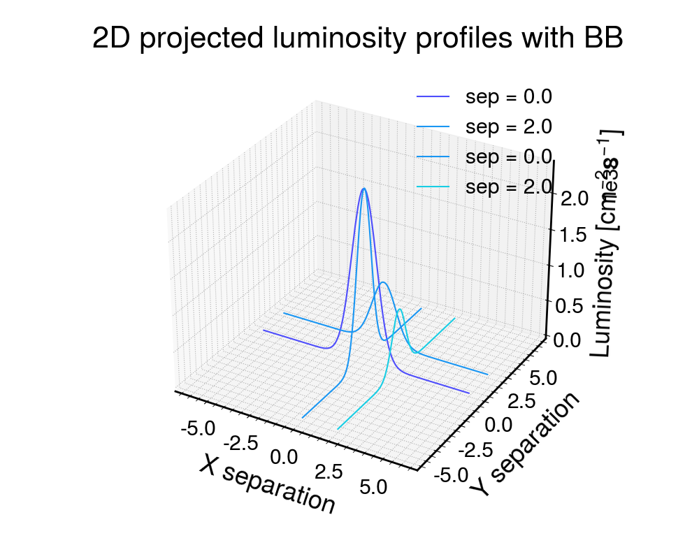
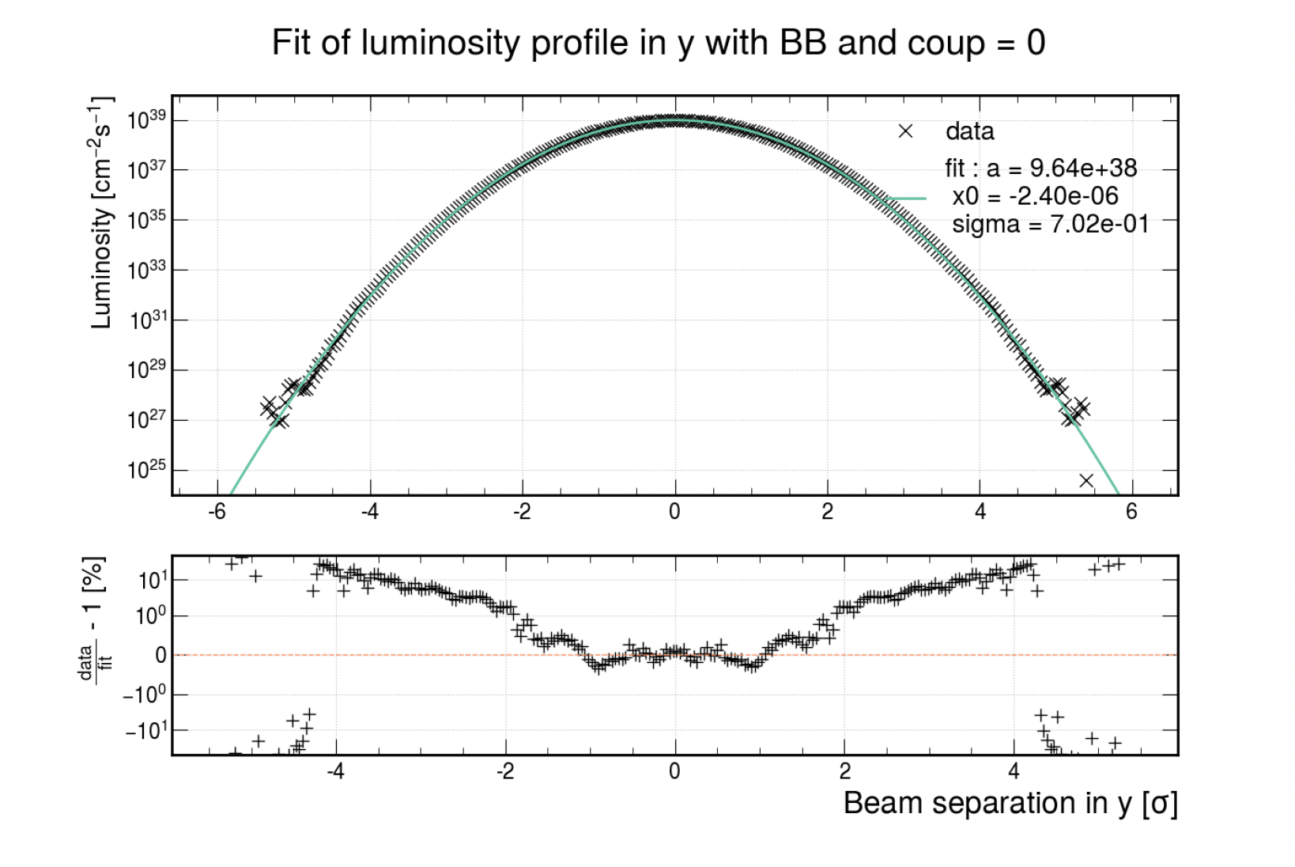
New Features
Beam Imaging
Luminous Region
2D rate fit
Curtesy of Anne-Clemence Piveteau

Slide 9
Contents
COMBI→XSUITE
  XSUITE
  Benchmark of Luminosity BIAS due to beam-beam
  New analysis: Beam Imaging, Luminous region, 2D fit rates
Linear Coupling in LHC
Beam-beam luminosity bias + linear coupling preliminary results:
  Local Linear Coupling
  Global coupling
  Half corrected local coupling
Summary and Future Plans

Slide 10
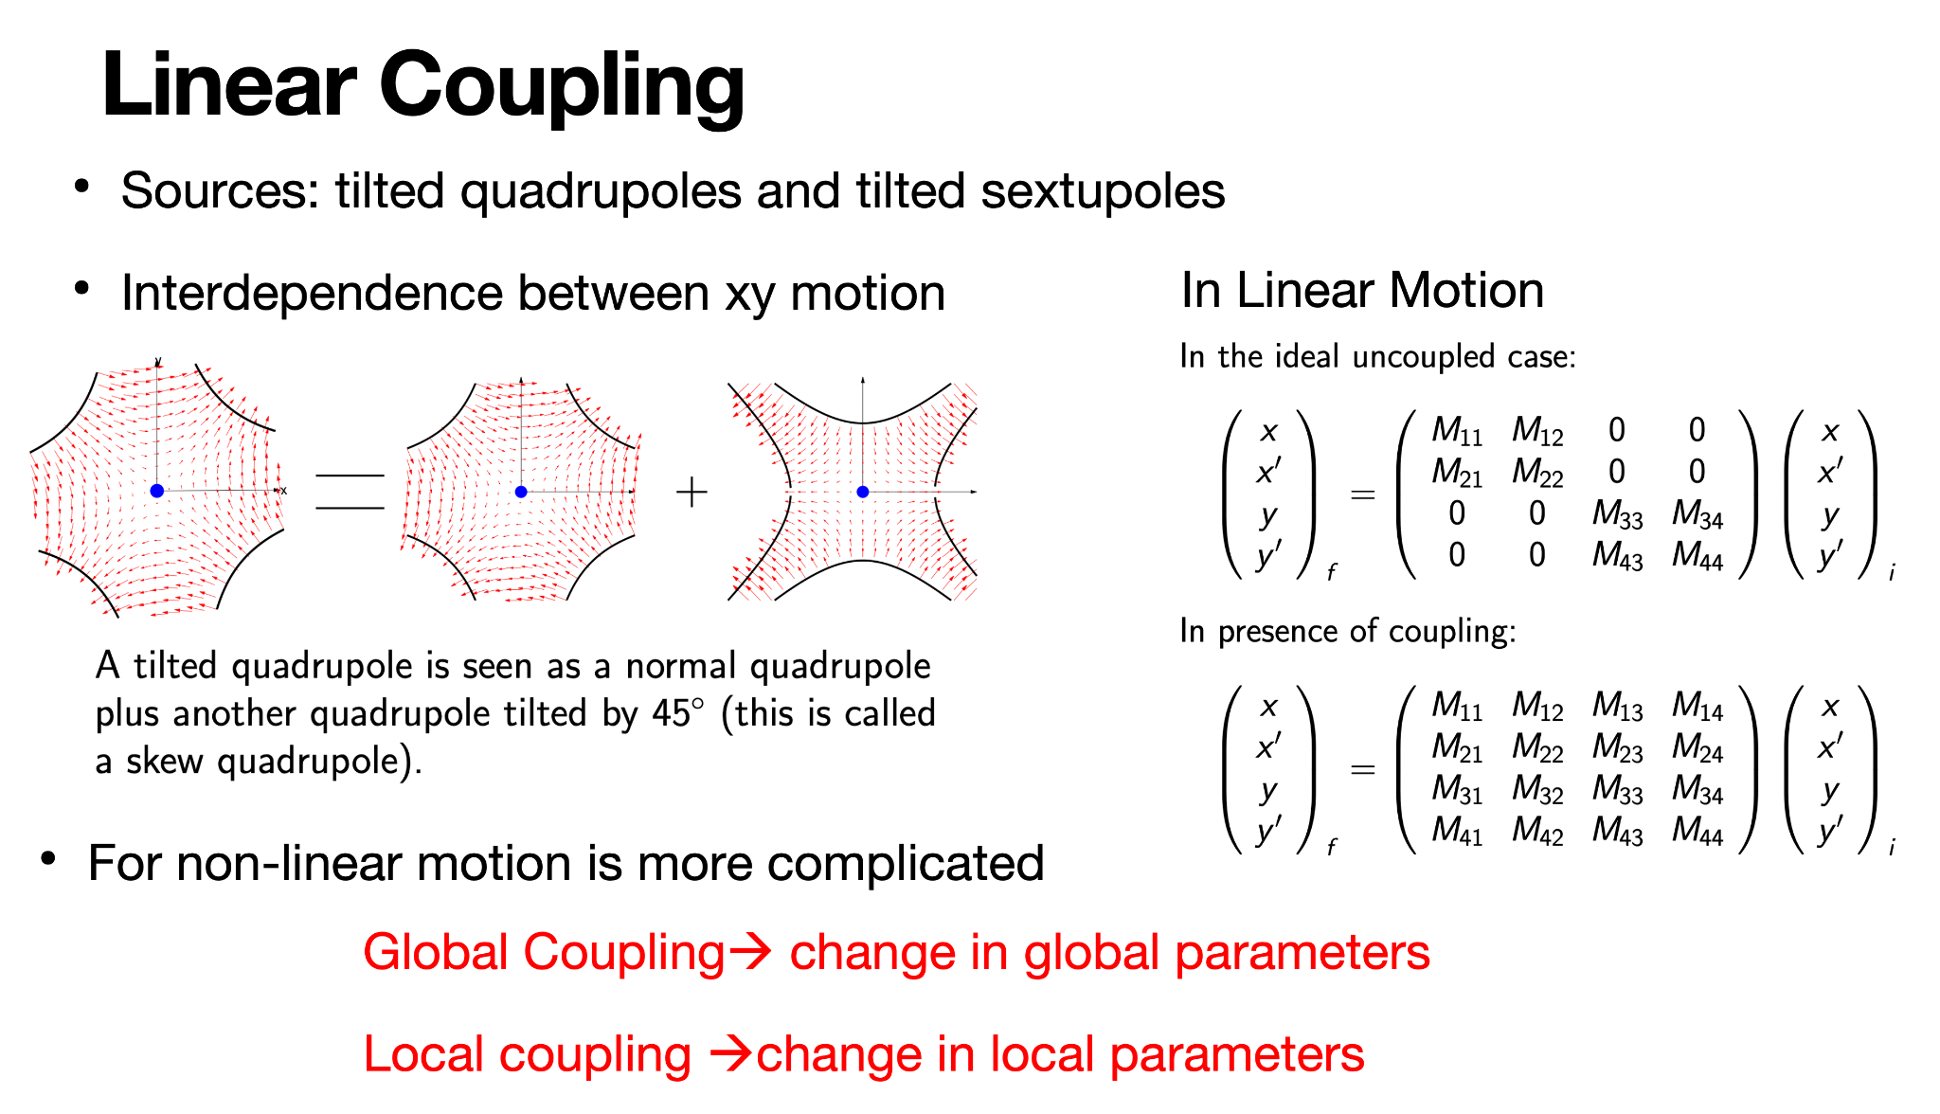

Sources : tilted quadrupoles
Interdependence between xy motion
Effects depend on strenght of resonance and frequency space the beams occupy
[9]
Local coupling $→$ change in local parameters
Global coupling $→$ change in global parameters

Slide 11
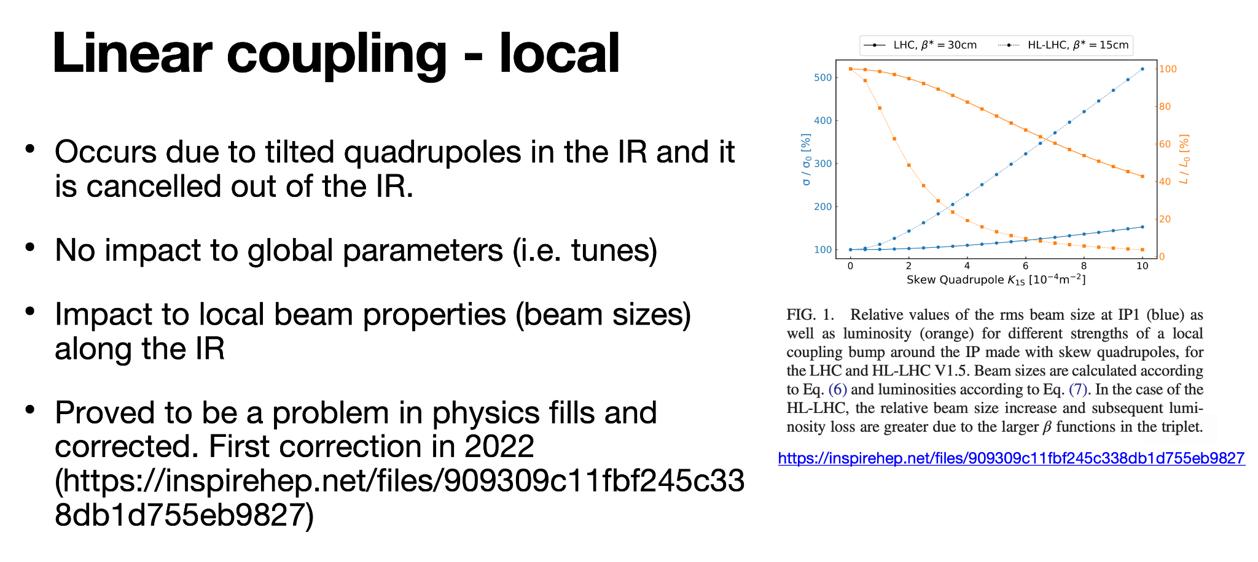
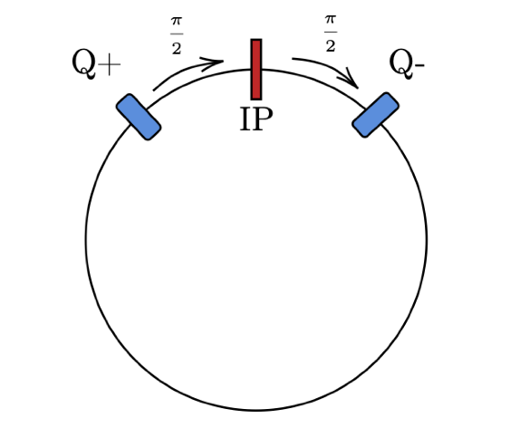

[3]
$$K⋅\sqrt{β_{x}β_{y}}$$
Scaling factor

Slide 12
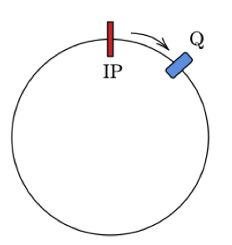
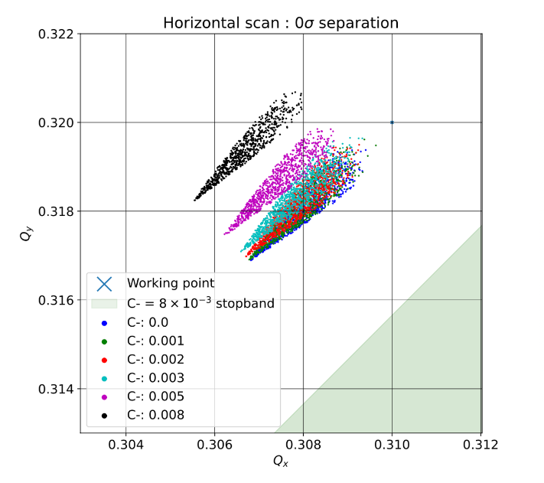
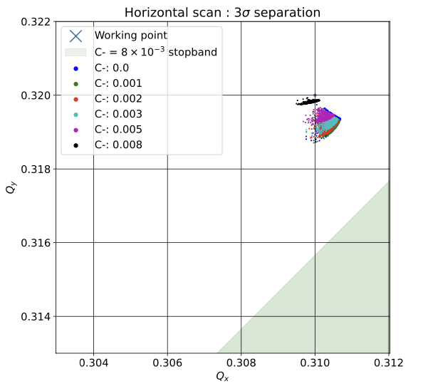
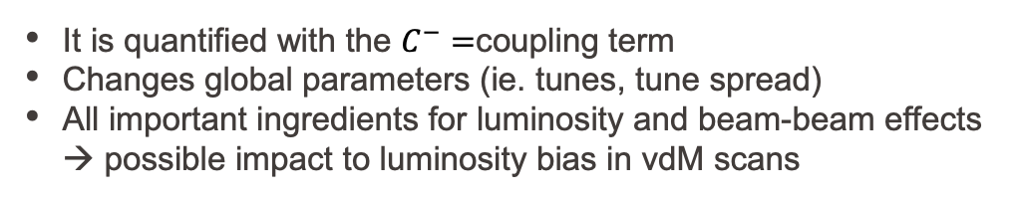
Global linear coupling
It is quantified with the $C^{−}=$coupling term
Changes global parameters (ie. tunes, tune spread)
All important ingredients for luminosity and beam-beam effects → possible impact to luminosity bias in vdM scans
Beam-beam
footprints

Slide 13
Contents
COMBI→XSUITE
  XSUITE
  Benchmark of Luminosity BIAS due to beam-beam
  New analysis: Beam Imaging, Luminous region, 2D fit rates
Linear Coupling in LHC
Beam-beam luminosity bias + linear coupling preliminary results:
  Local Linear Coupling
  Global coupling
  Half corrected local coupling
Summary and Future Plans

Slide 14
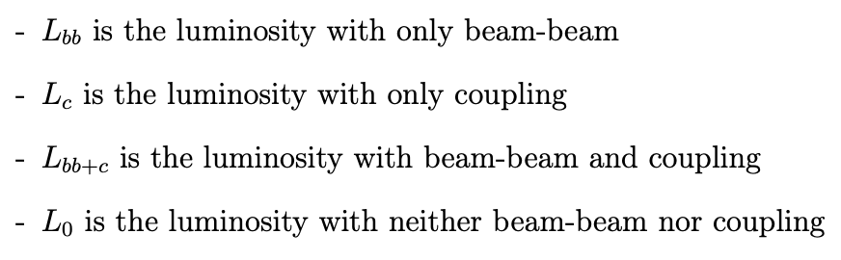
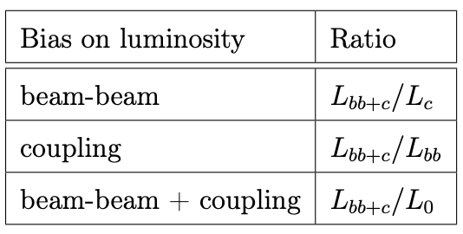
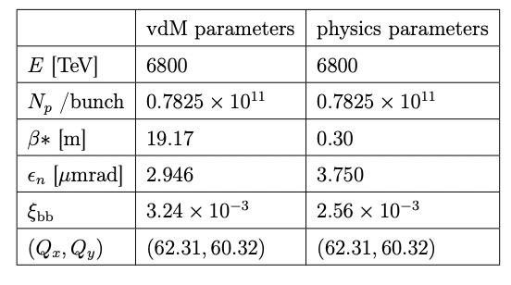
Nomenclature
Simulation parameters

Slide 15
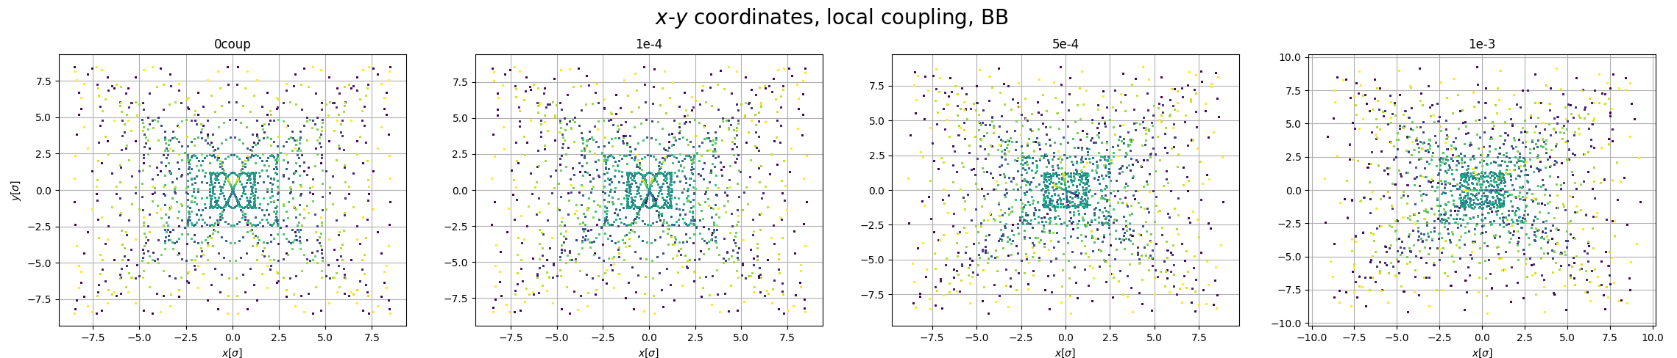
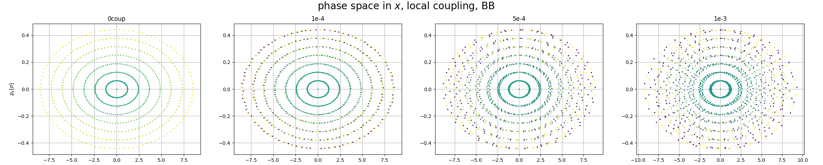
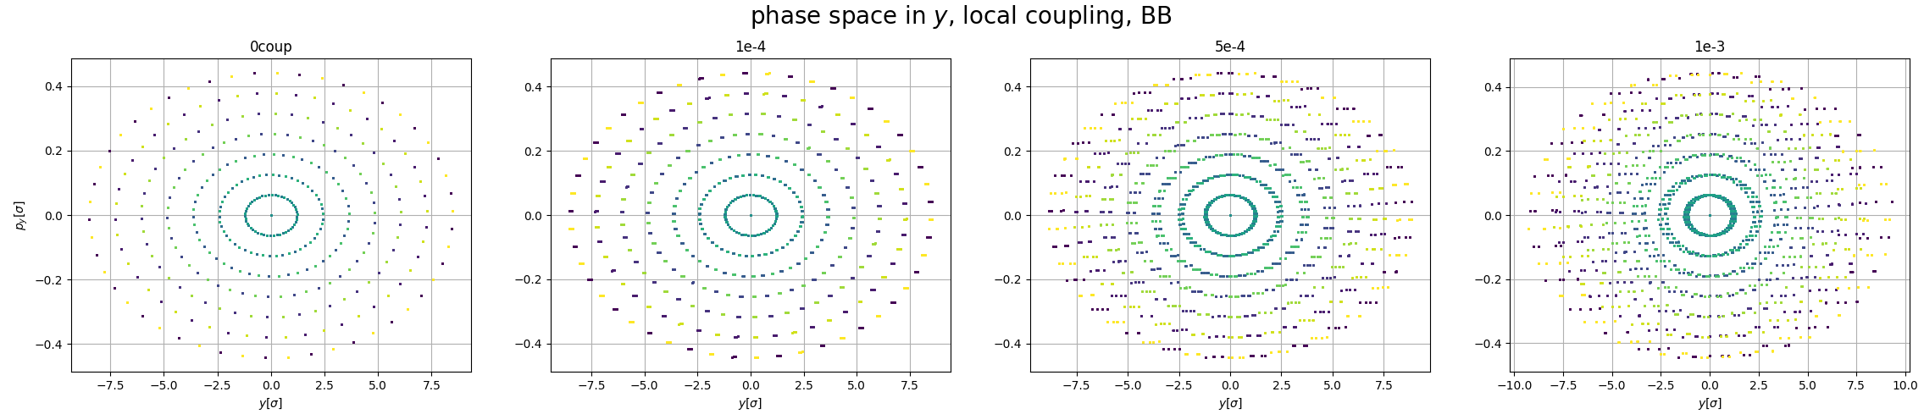
Local Coupling: Phase space - vdM parameters
Particle dynamics affected by increasing values of coupling

Slide 16
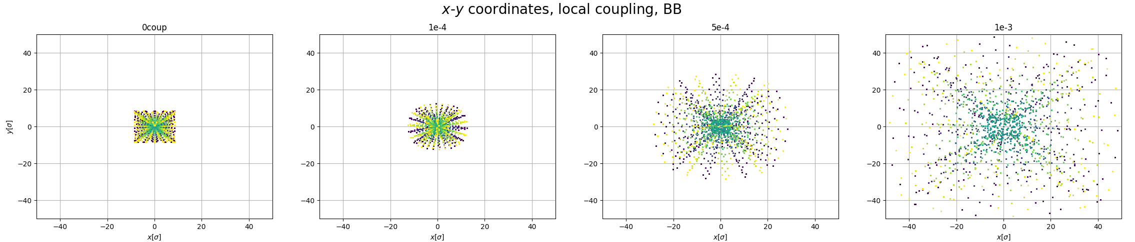
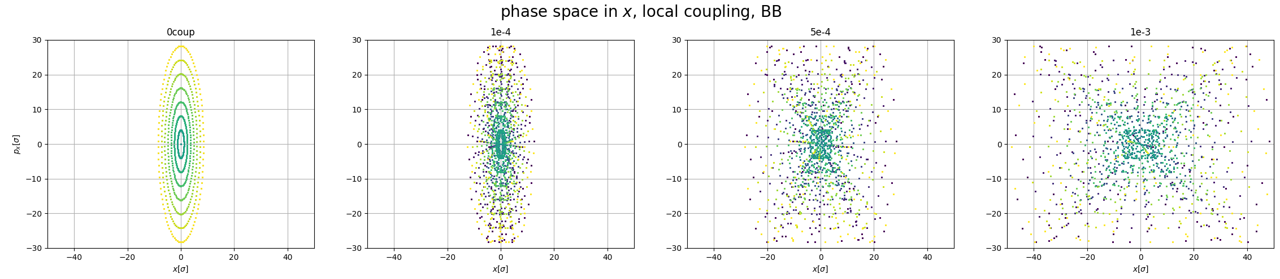
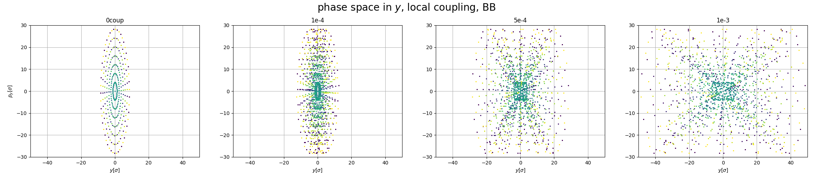
Local Coupling: Phase space– physics parameters
Beam-size blow up with increasing coupling => particles being pushed out of the center

Slide 17
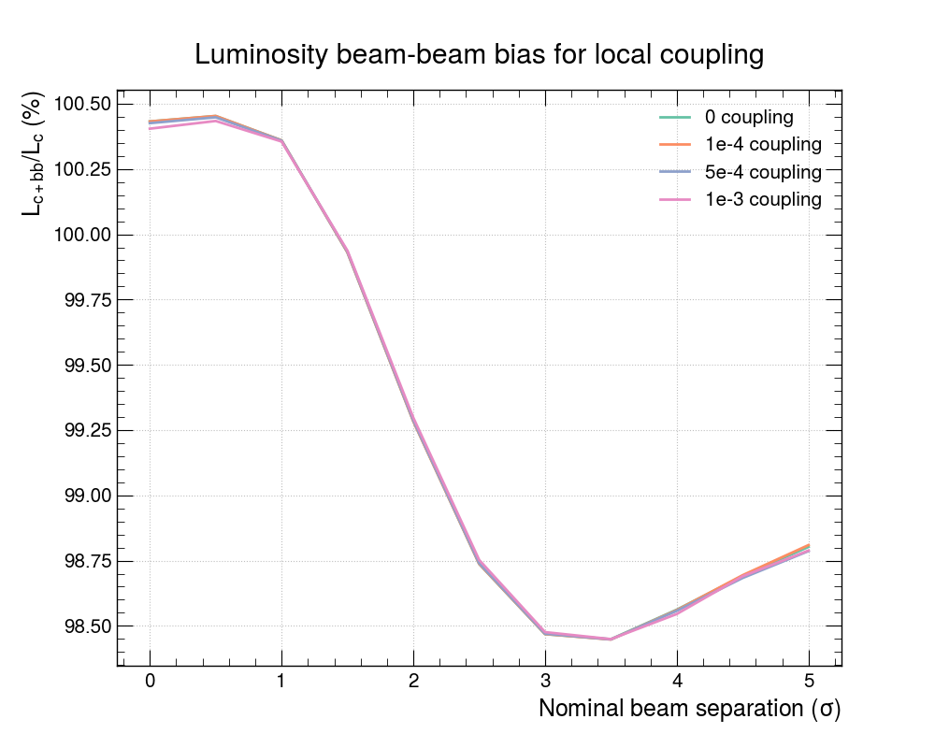
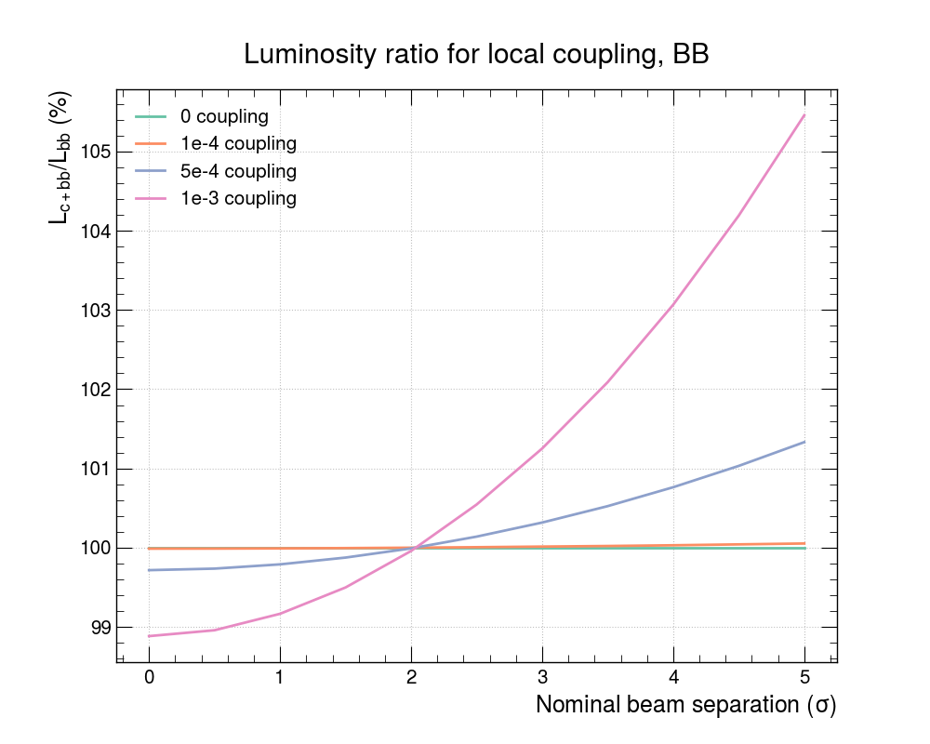


Luminosity bias: BB + local coupling
beam-beam bias
Beam-beam bias : order of 1% effect (green curve : only BB)
$$\frac{L_{bb+c}}{L_{c}}$$
Coupling bias (normalised to bb) : order of 5% effect for highest value -> negative bias for low separation and positive bias for high separation
coupling bias
$$\frac{L_{bb+c}}{L_{bb}}$$

Slide 18
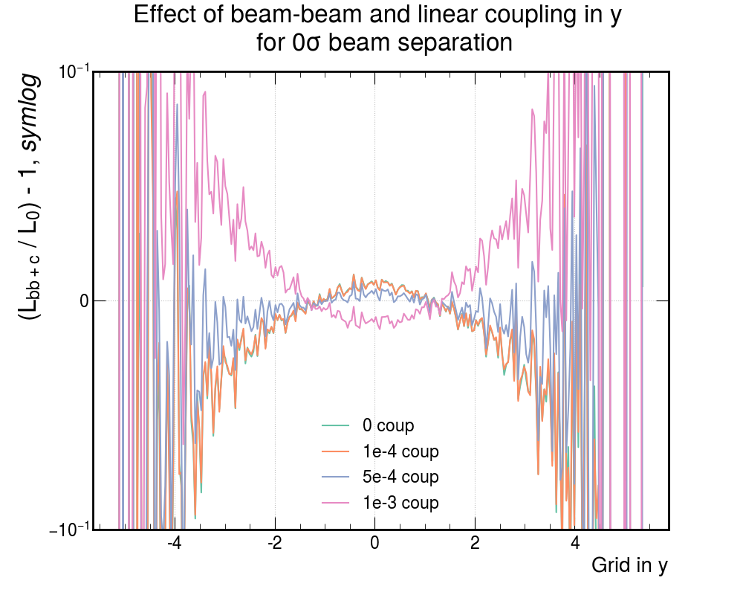
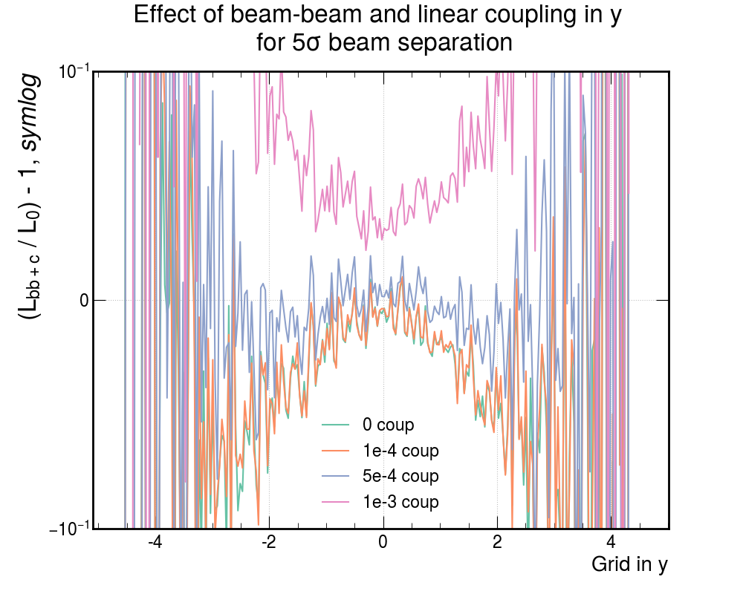
Local Coupling + BB impact to profiles
At 0 separation: The BB effect manifests itself when coupling = 0 or very small and increases L in the central region. Coupling drives particles out of the center and into the tails
  => coupling and BB have opposing effects and counteract each other
At 5 σ separation
Increase in L over the whole overlap

Slide 19
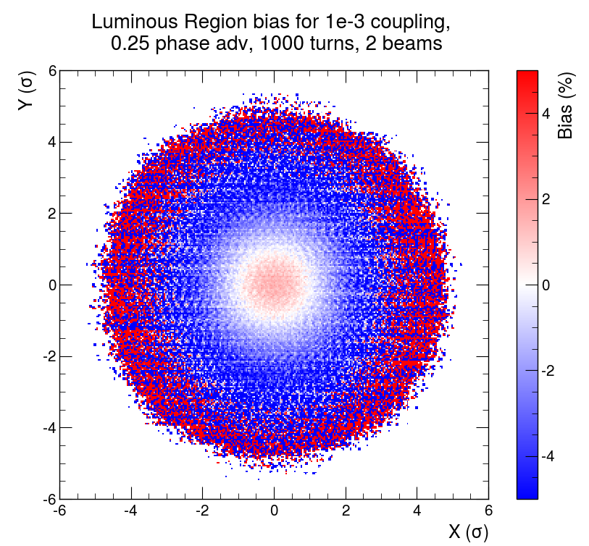
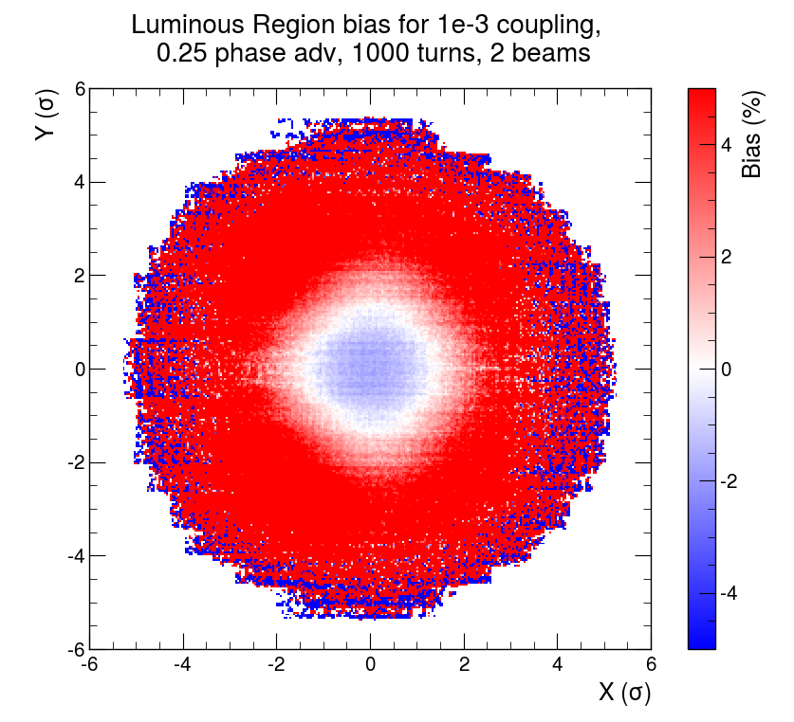
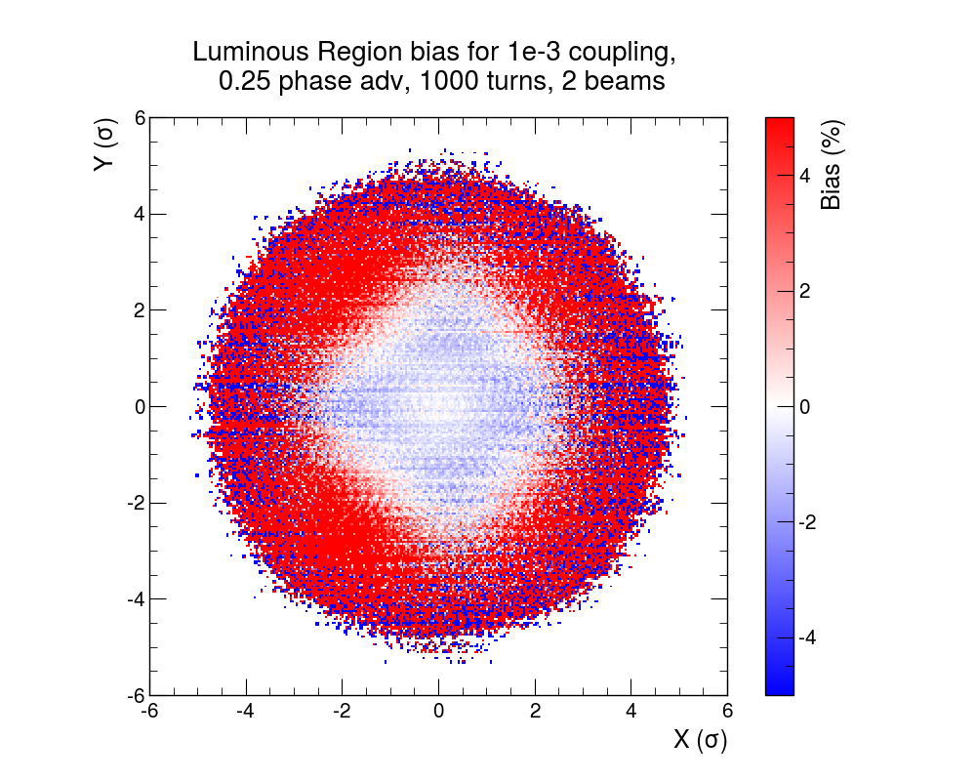



Luminous region bias – round beams
Sum over all separations (BI)
Beam-beam bias : $\frac{L_{bb+c}}{L_{c}}$
1e-3 coupling bias : $\frac{L_{bb+c}}{L_{bb}}$
Beam-beam + coupling bias : $\frac{L_{bb+c}}{L_{0}}$
Opposing effects of beam-beam and coupling
Interplay of the two effects : negative bias in the central region
  => coupling has a stronger effect than beam-beam

Slide 20
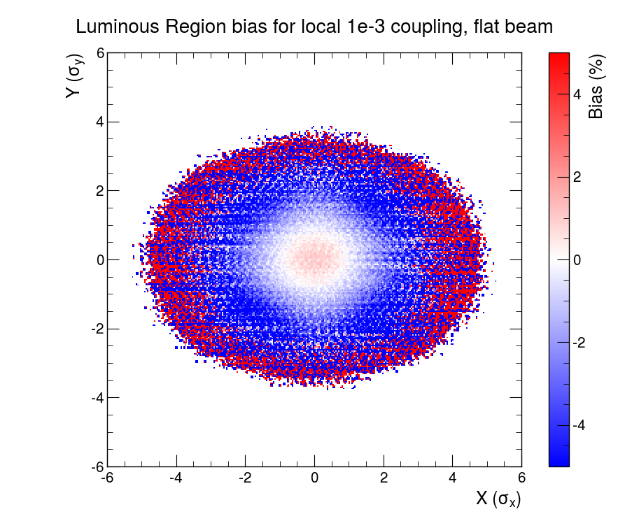
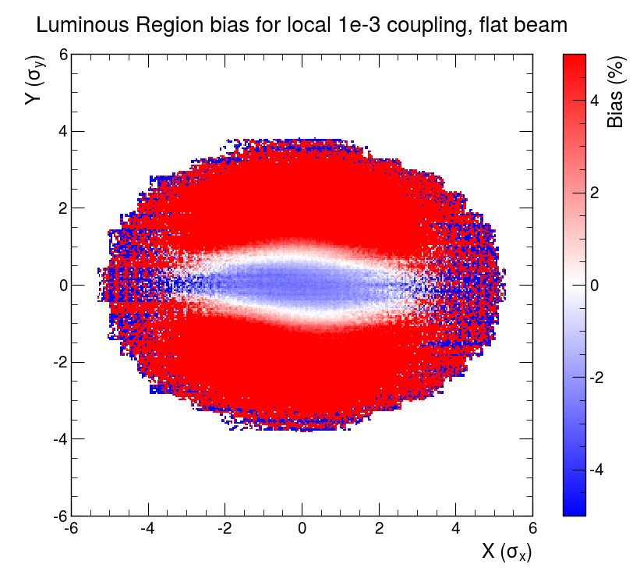
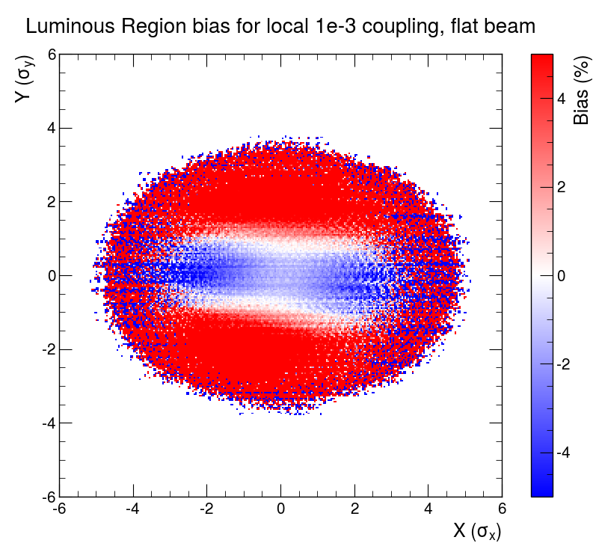
Luminous region bias - flat beams
Sum over all separations (BI)
Beam-beam bias : $\frac{L_{bb+c}}{L_{c}}$
1e-3 coupling bias : $\frac{L_{bb+c}}{L_{bb}}$
Beam-beam + coupling bias : $\frac{L_{bb+c}}{L_{0}}$
Opposing effects of beam-beam and coupling
Interplay of the two effects : negative bias in the central region
  => coupling has a stronger effect than beam-beam

Slide 21
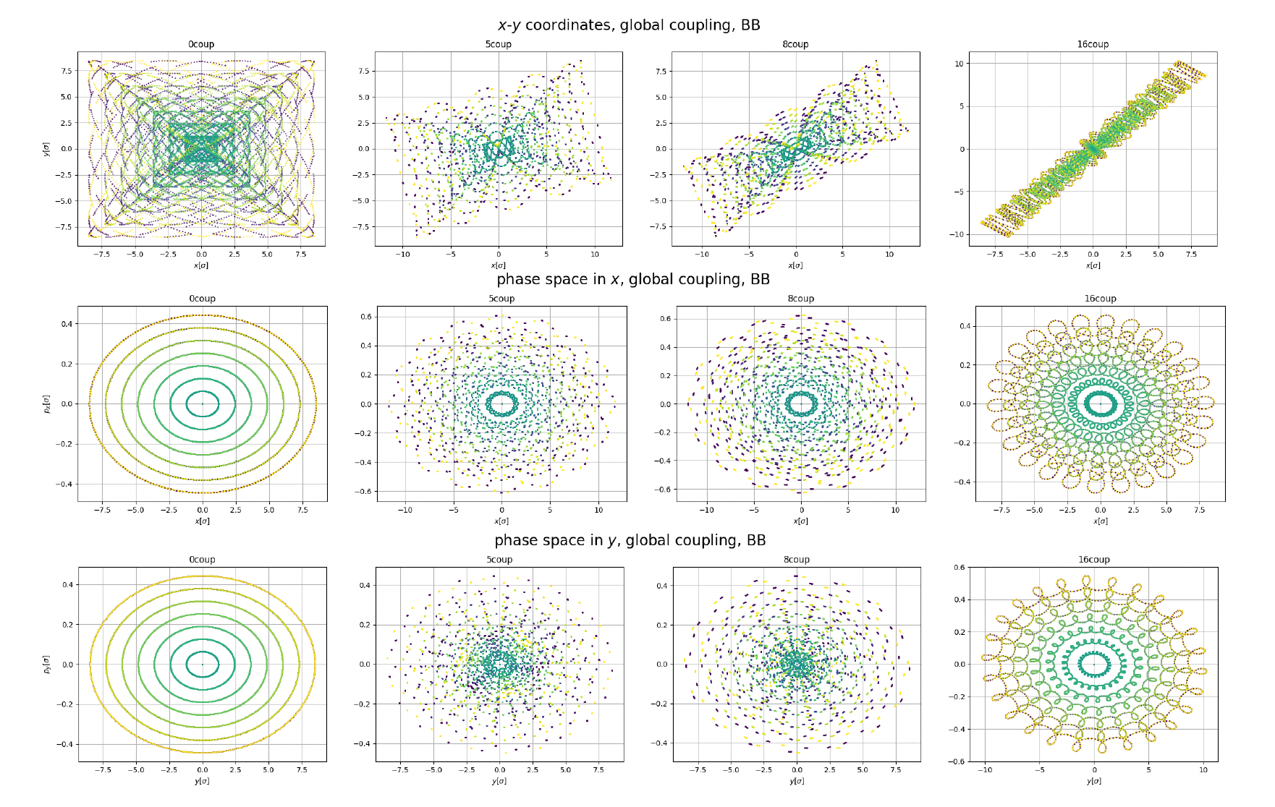
Global Coupling: Phase space - vdM parameters
Particle dynamics affected by increasing values of global coupling

Slide 22
Luminosity bias: BB + global coupling
Luminosity biases for different effects and with different normalizations are shown for 1 IP
There is a difference in luminosity bias by introducing linear coupling resonance
:
:
:
:
:
:
:
Notes:
Luminosity was calculated by simulating 10 million particles per beam and taking the luminosity averaged over the last 500 of 1000 turns. These numbers for simulation were determined using convergency tests. Particle distributions were randomized to a Gaussian and tracked through the lattice. In these luminosity bias calculations the same particle distributions are used for one line to take out statistical uncertainties from the distributions. The slide shows the bias from just introducing coupling in blue: i.e. the difference between luminosity measured with coupling between the beams and without coupling is normalized to luminosity without coupling. This is carried out for different coupling strengths of 5 times 10 to the minus 3 and 8 times 10 to the minus 3. Also important to mention that in this case the correction were applied. Luminosity bias in red and orange shows the bias from coupling and beam-beam effects normalized to the case with no coupling and in green to the case with coupling.
Observing the blue lines show that by including coupling there is an initial small negative bias which then increases to a positive bias at larger separations. With stronger coupling there is a stronger effect. The red lines start with smaller positive bias than the black, where there is no coupling, but at 2σ the red lines have a smaller negative bias. The green lines show the bias from beam-beam effects and coupling normalized to results from a lattice that only has coupling.. The difference between the green and black lines should demonstrate the impact on luminosity from the interplay of beam-beam and coupling effects.
Explain what the couples are
Increasing coupling changes the curve – maybe take one picture and magnify, then say same happens for vertical plane
Lumi changes based on beambeam – black line – point it out
Compare black, orange and red – change in luminosity defined on beambeam based on coupling
Reducing the bias all along
Redo the plots so that all I have are orange, black and red – show there is a bias from bias from beam beam – shown in combi
Then orange intermediate coupling effect has an effect
And then red too a higher level
-- it increases with c minus strength
Another slide with vertical – same thing occurs – get rid of the other lines!!!!!!
Same valid of 2IPs – footprint is totally different, different place in tune diagram but bis/impact of coupling is still seen
For the first time bias in diagonal scan I have now shown – can now get bias for any separation/scan
Legend is not good
Explain this step by step? – the biases are hard to follow at the same time as the speech

Slide 23
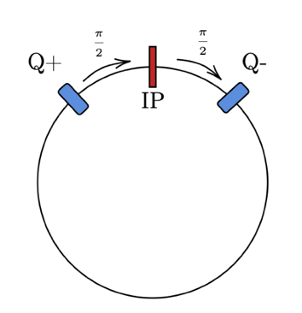
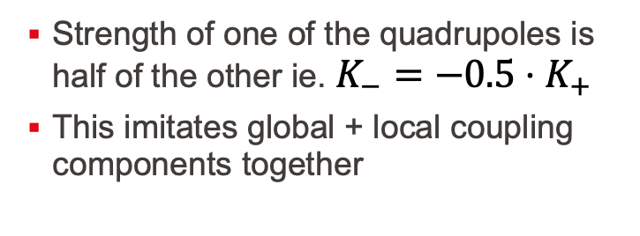
Half-corrected coupling: local + global
Strength of one of the quadrupoles is half of the other ie. $K_{−}=−0.5⋅K_{+}$
This imitates global + local coupling components together

Slide 24
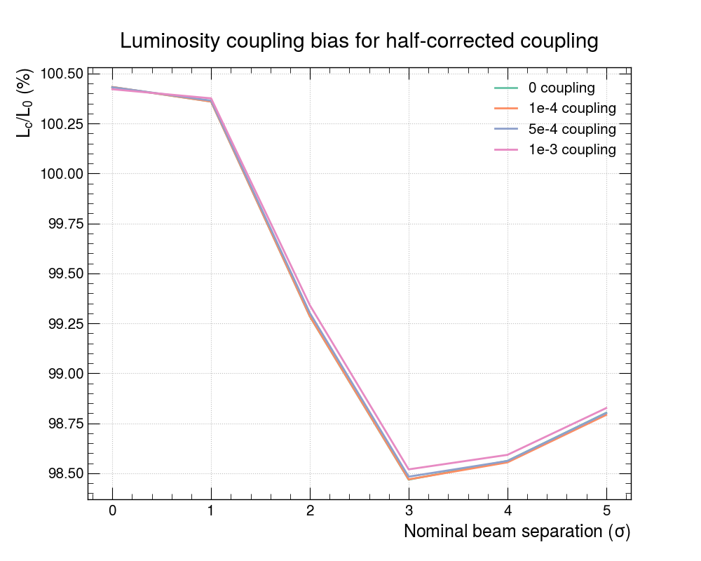
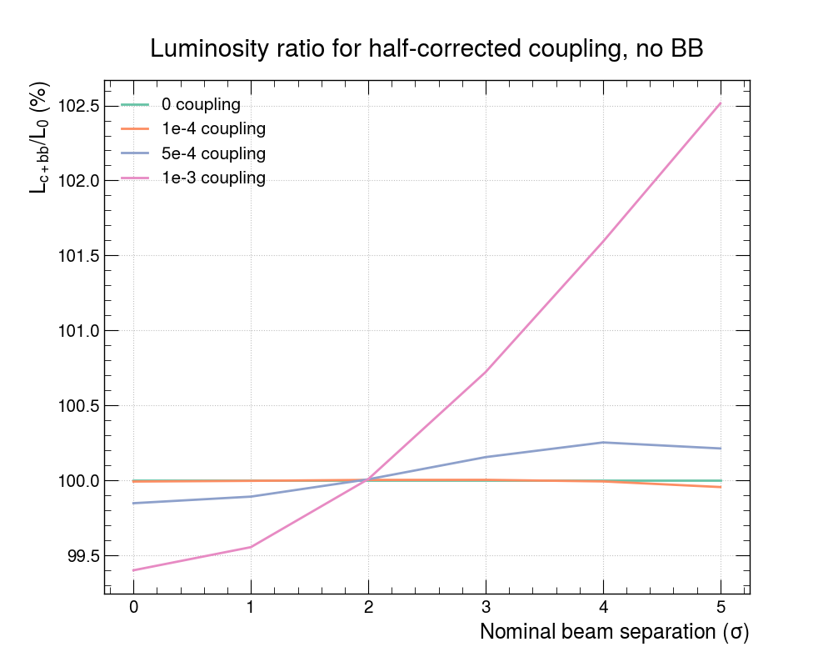


Luminosity for half-corrected coupling
beam-beam bias
$$\frac{L_{bb+c}}{L_{c}}$$
Beam-beam bias : order of 1% effect (green curve : only BB)
Coupling bias (normalised to bb) : order of 2% effect for highest value -> negative bias for low separation and positive bias for high separation
coupling bias
$$\frac{L_{bb+c}}{L_{bb}}$$

Slide 25
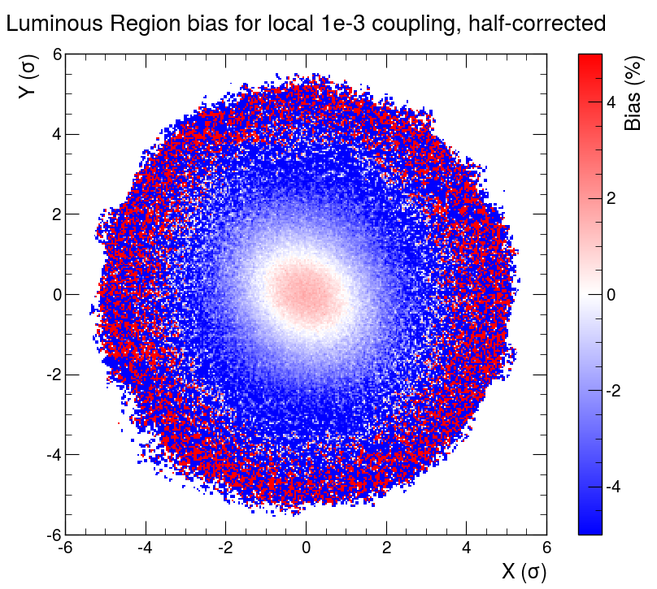
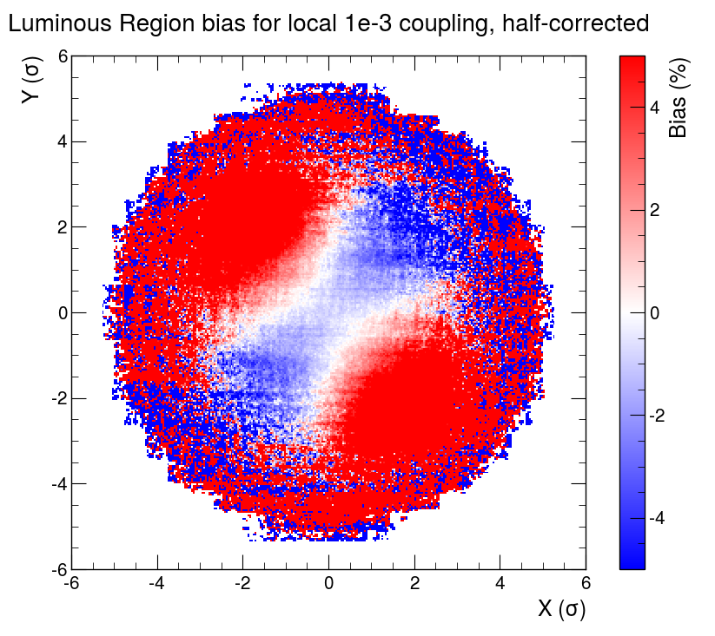
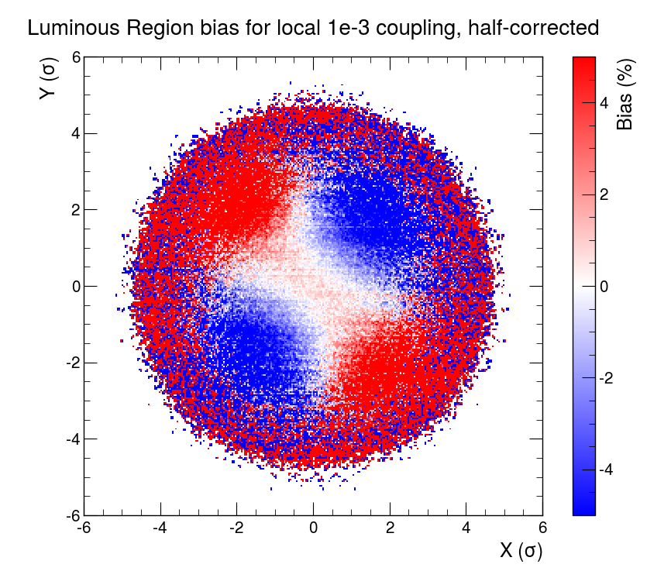
Luminous region bias - half-corrected coupling
Sum over all separations
Beam-beam bias : $\frac{L_{bb+c}}{L_{c}}$
1e-3 coupling bias : $\frac{L_{bb+c}}{L_{bb}}$
Beam-beam + coupling bias : $\frac{L_{bb+c}}{L_{0}}$
Asymmetry (tilt) in bias, very peculiar shape
To be explored further

Slide 26
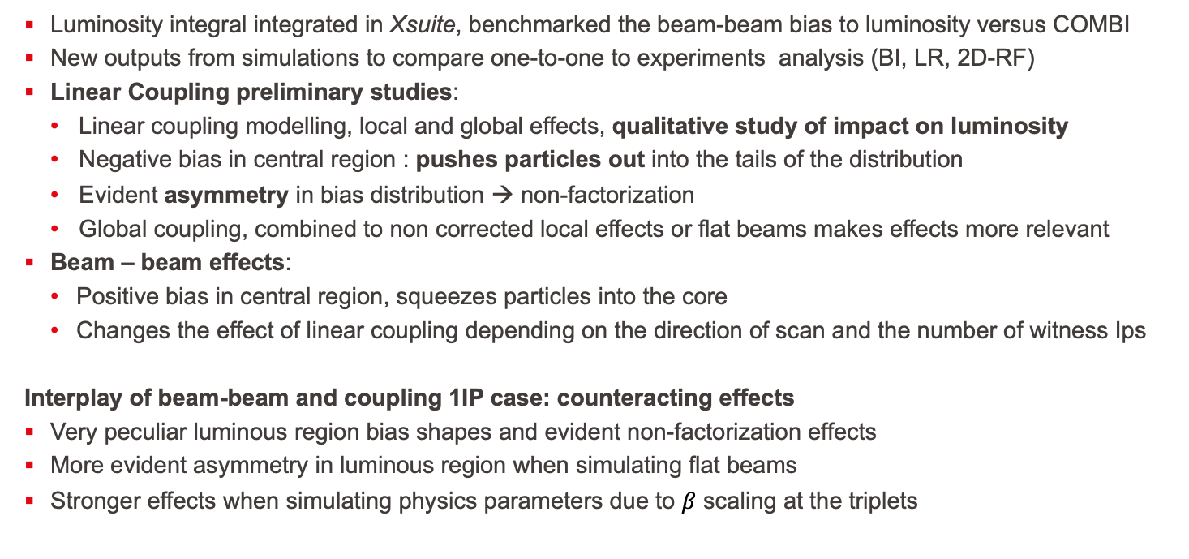
Summary
Luminosity integral integrated in Xsuite, benchmarked the beam-beam bias to luminosity versus COMBI
New outputs from simulations to compare one-to-one to experiments analysis (BI, LR, 2D-RF)
Linear Coupling preliminary studies:
  Linear coupling modelling, local and global effects, qualitative study of impact on luminosity
  Negative bias in central region : pushes particles out into the tails of the distribution
  Evident asymmetry in bias distribution → non-factorization
  Global coupling, combined to non corrected local effects or flat beams makes effects more relevant
Beam – beam effects:
  Positive bias in central region, squeezes particles into the core
  Changes the effect of linear coupling depending on the direction of scan and the number of witness Ips
Interplay of beam-beam and coupling 1IP case: counteracting effects
Very peculiar luminous region bias shapes and evident non-factorization effects
More evident asymmetry in luminous region when simulating flat beams
Stronger effects when simulating physics parameters due to $β$ scaling at the triplets

Slide 27
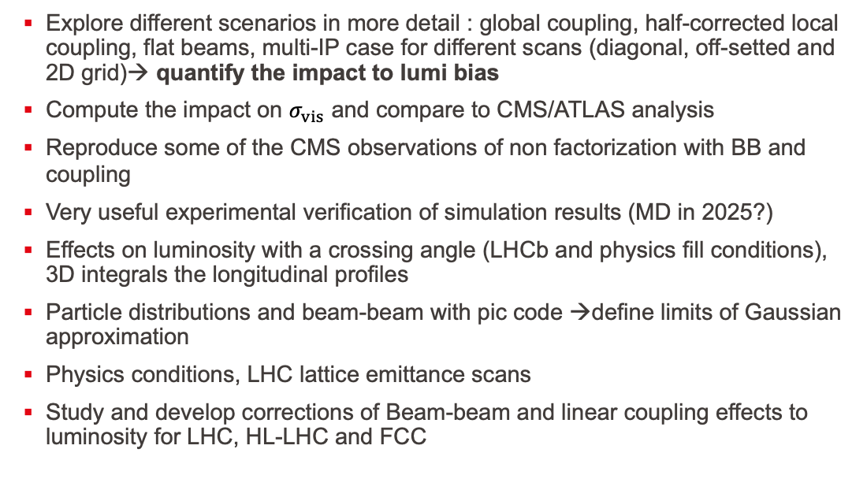
Next steps, outlook
Explore different scenarios in more detail : global coupling, half-corrected local coupling, flat beams, multi-IP case for different scans (diagonal, off-setted and 2D grid)→ quantify the impact to lumi bias
Compute the impact on $σ_{vis}$ and compare to CMS/ATLAS analysis
Reproduce some of the CMS observations of non factorization with BB and coupling
Very useful experimental verification of simulation results (MD in 2025?)
Effects on luminosity with a crossing angle (LHCb and physics fill conditions), 3D integrals the longitudinal profiles
Particle distributions and beam-beam with pic code →define limits of Gaussian approximation
Physics conditions, LHC lattice emittance scans
Study and develop corrections of Beam-beam and linear coupling effects to luminosity for LHC, HL-LHC and FCC
Master Project
A. Piveteau
PhD Project

Slide 28
Thank you!

Slide 29
Back up Slides

Slide 30
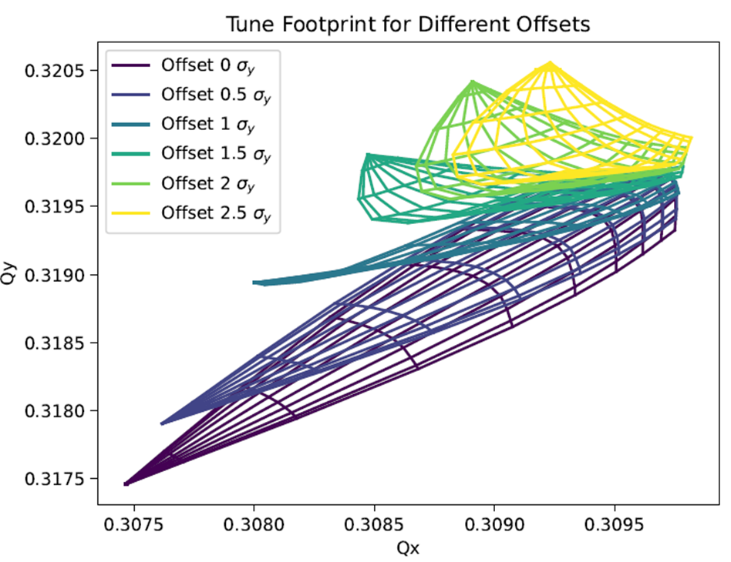
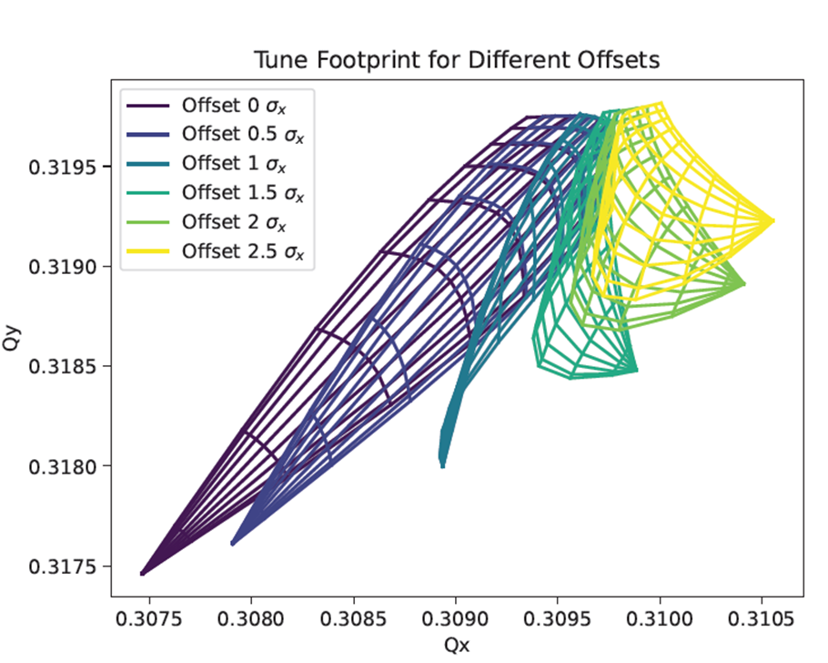
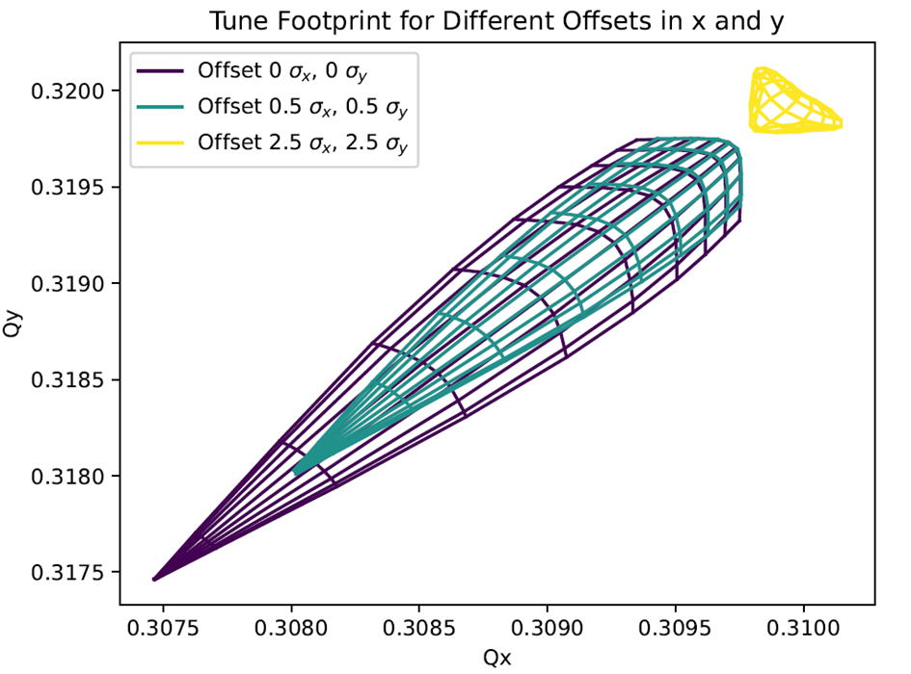
Different scans in frequency domain
Y scan
X scan
XY scan
Each scan moves particles closer or far away from the resonance
Impact of linear coupling will be different due to the BB force
Bunches colliding in different IPs will be sitting at different locations in the tune diagram
Not strange to have different frequency response (tune spectra) depending on the scan direction

Slide 31
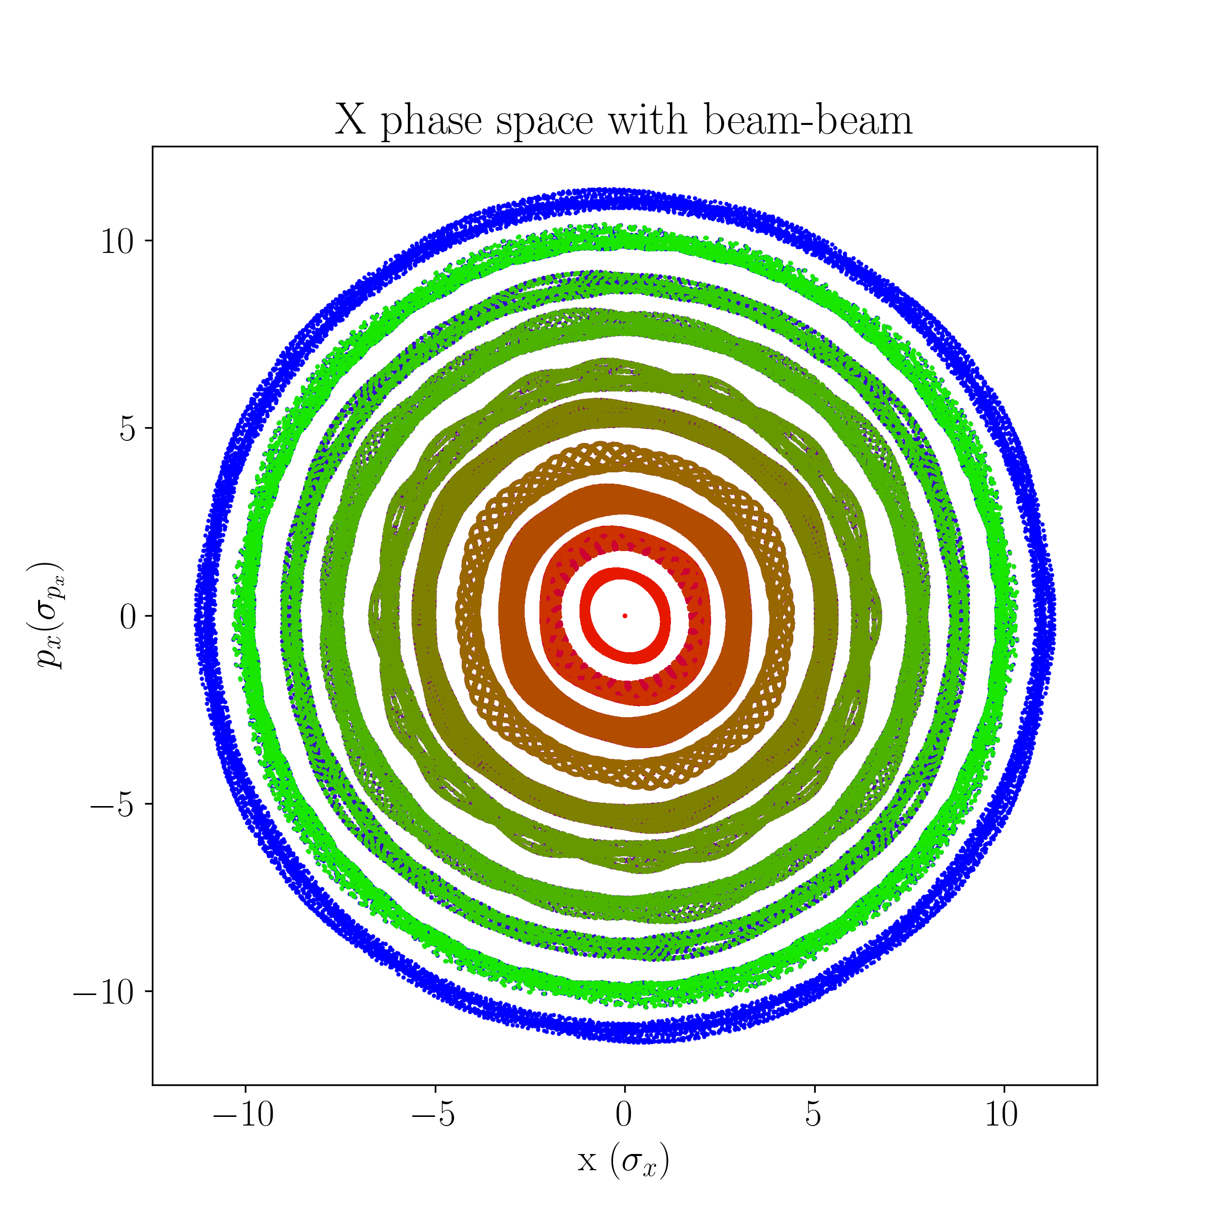
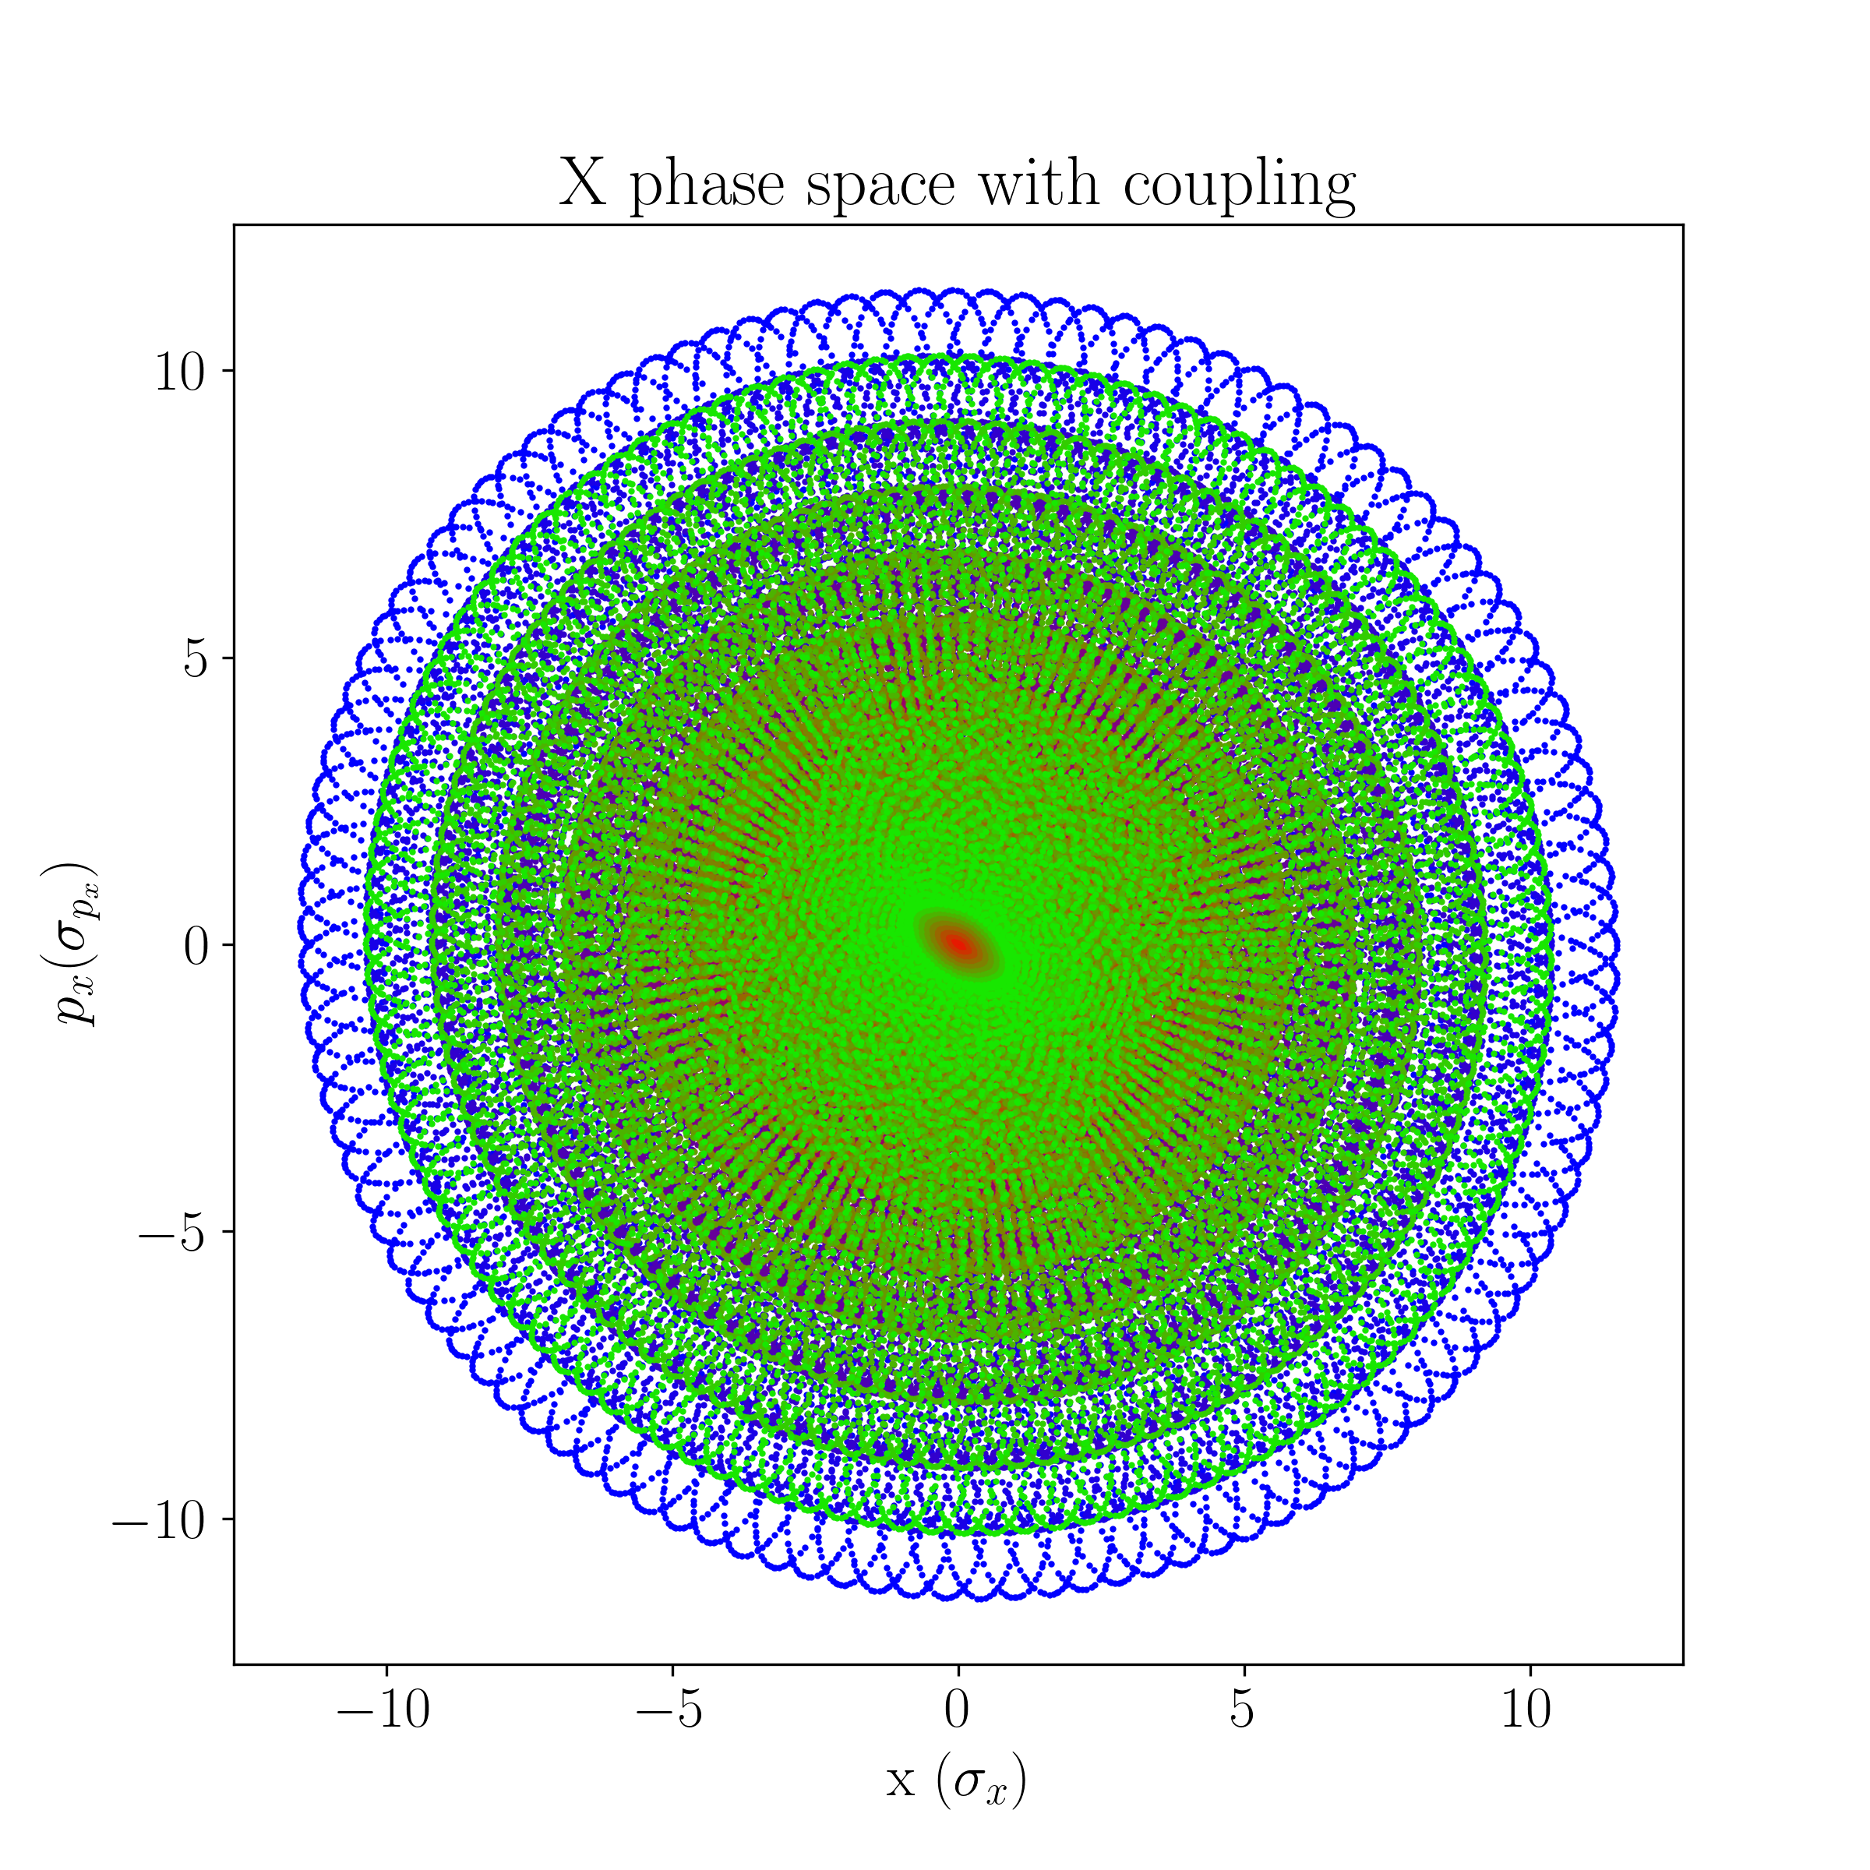
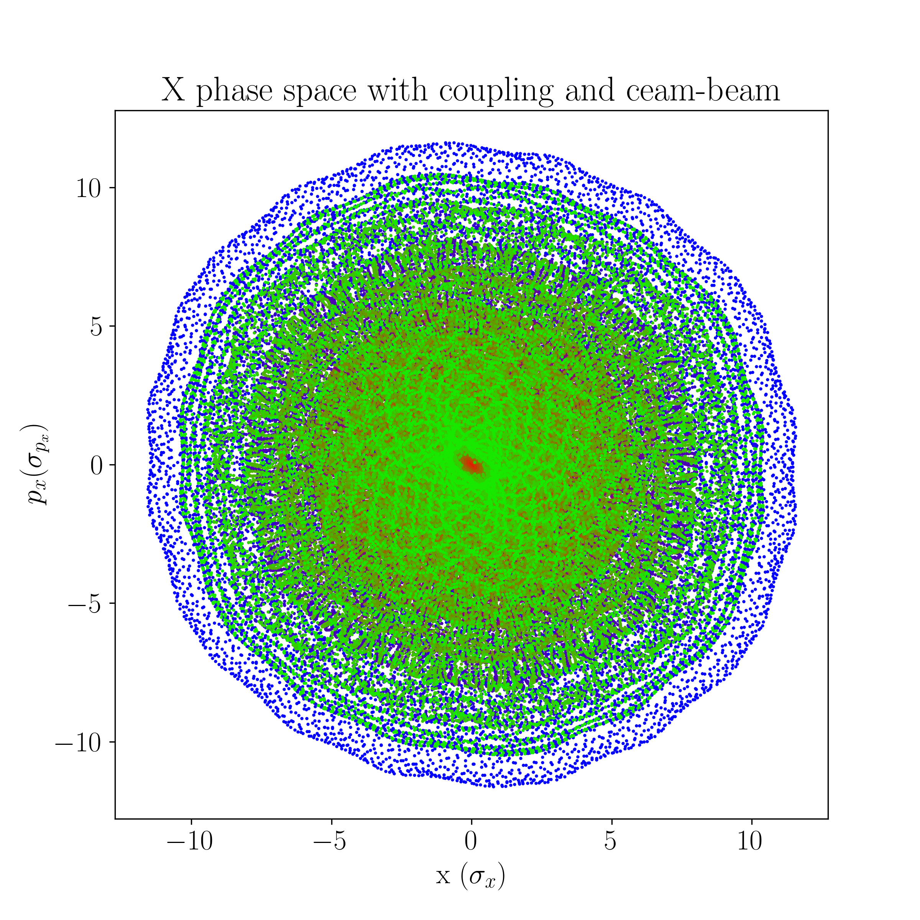
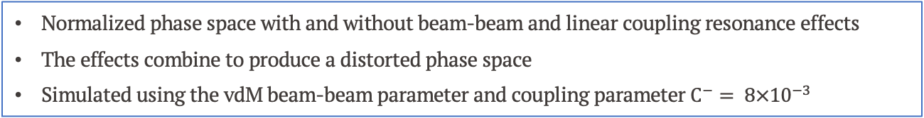
Phase space
Normalized phase space with and without beam-beam and linear coupling resonance effects
The effects combine to produce a distorted phase space
Simulated using the vdM beam-beam parameter and coupling parameter $C^{−}= 8×{10}^{−3}$
Notes:
The normalized phase space is seen with beam-beam effects and linear coupling resonance. Firstly the beams will oscillate in normalized phase space when beam-beam interactions are introduced. Then a tilt to the phase space is seen with linear coupling. In the last phase space plot the two effects combined are seen and there is a beam-beam enhancement to the linear coupling effect. Here the vdM beam-beam parameter is used as well as the coupling parameter 8 times 10 to the minus 3.

Slide 32
Luminosity bias with coupling: 1 IP Vertical
Luminosity biases for different effects and with different normalizations are shown for 1 IP
There is a difference in luminosity bias by introducing linear coupling resonance
:
:
:
:
:
:
:
Notes:
Luminosity was calculated by simulating 10 million particles per beam and taking the luminosity averaged over the last 500 of 1000 turns. These numbers for simulation were determined using convergency tests. Particle distributions were randomized to a Gaussian and tracked through the lattice. In these luminosity bias calculations the same particle distributions are used for one line to take out statistical uncertainties from the distributions. The slide shows the bias from just introducing coupling in blue: i.e. the difference between luminosity measured with coupling between the beams and without coupling is normalized to luminosity without coupling. This is carried out for different coupling strengths of 5 times 10 to the minus 3 and 8 times 10 to the minus 3. Also important to mention that in this case the correction were applied. Luminosity bias in red and orange shows the bias from coupling and beam-beam effects normalized to the case with no coupling and in green to the case with coupling.
Observing the blue lines show that by including coupling there is an initial small negative bias which then increases to a positive bias at larger separations. With stronger coupling there is a stronger effect. The red lines start with smaller positive bias than the black, where there is no coupling, but at 2σ the red lines have a smaller negative bias. The green lines show the bias from beam-beam effects and coupling normalized to results from a lattice that only has coupling.. The difference between the green and black lines should demonstrate the impact on luminosity from the interplay of beam-beam and coupling effects.
Explain what the couples are
Increasing coupling changes the curve – maybe take one picture and magnify, then say same happens for vertical plane
Lumi changes based on beambeam – black line – point it out
Compare black, orange and red – change in luminosity defined on beambeam based on coupling
Reducing the bias all along
Redo the plots so that all I have are orange, black and red – show there is a bias from bias from beam beam – shown in combi
Then orange intermediate coupling effect has an effect
And then red too a higher level
-- it increases with c minus strength
Another slide with vertical – same thing occurs – get rid of the other lines!!!!!!
Same valid of 2IPs – footprint is totally different, different place in tune diagram but bis/impact of coupling is still seen
For the first time bias in diagonal scan I have now shown – can now get bias for any separation/scan
Legend is not good
Explain this step by step? – the biases are hard to follow at the same time as the speech

Slide 33





Global linear coupling
C. Zhang
$$Q_{x}$$
Scaled by length $l$ of the quadrupole, such that : $K=k⋅l$
Strength $K$ in $[m^{−2}]$, defined by a linear relationship with $C^{−}$
Effects corrected up to $C^{−}≈{10}^{−3}−{10}^{−2}$ but constant updates are needed to minimise this
$$Q_{y}$$

Slide 34



Local coupling strength scan

Slide 35
Benchmark: Luminosity Bias: 1 IP
A numerical integrator was developed in Xsuite based on previous studies [J. Wanczyk]
There is good agreement between the two results, and clear differences with the Gaussian calculation
Notes:
In this project a numerical integrator was developed in Xsuite, which is a new beam simulation code framework at CERN that aims to unite many of the functions of all the various predecessor codes that exist. The luminosity numerical integrator in this case was based on Joanna’s numerical integrator in COMBI. As vdM scans were the topic of investigation there are no crossing angles in the integrator.
The luminosity bias are compared in the case of vdM scans for one interaction point. The luminosity bias means the difference in luminosity between the luminosity with beam-beam effects and without, normalised over the luminosity without beambeam effects. The dashed dark pink line shows results from COMBI, light blue shows the results from Xsuite. For the 1IP case the results seem to be well matched, however with 2IPs there are slight deviations at the tails. One theory is that the grids are defined differently in the two codes, and there is more granularity in the COMBI results. However this could be investigated further.

Slide 36
Benchmark 2: Luminosity Bias for 2 IPs
Results for 2 IPs are similar to those for 1 IP
Slight deviations at the tails for 2 interaction points, to be understood and reduced.
Notes:
In this project a numerical integrator was developed in Xsuite, based on Joanna’s numerical integrator in COMBI.
As vdM scans were the topic of investigation there are no crossing angles
The luminosity bias was compared in the case of vdM scans for one and two interaction points, horizontal and vertical scans. The dashed line shows results from COMBI, light blue shows the results from Xsuite. For the 1IP case the results seem to be well matched, however with 2IPs there are slight deviations at the tails. One theory is that the grids are defined differently in the two codes, and there is more granularity in the COMBI results. However this could be investigated further.
Prepare as a question: why are they different for 2IPs
- Why is that intuition

Slide 37


Local Linear coupling: simulation model
Insight from optics : ${10}^{−4}$ uncorrected
Local coupling strength [3] varying over
vdM and physics parameters
Simulation of a simplified LHC lattice, composed of an Interaction Point (IP) and skew Quadrupoles (Q) :

Slide 38


Slide 39


