Slide 2
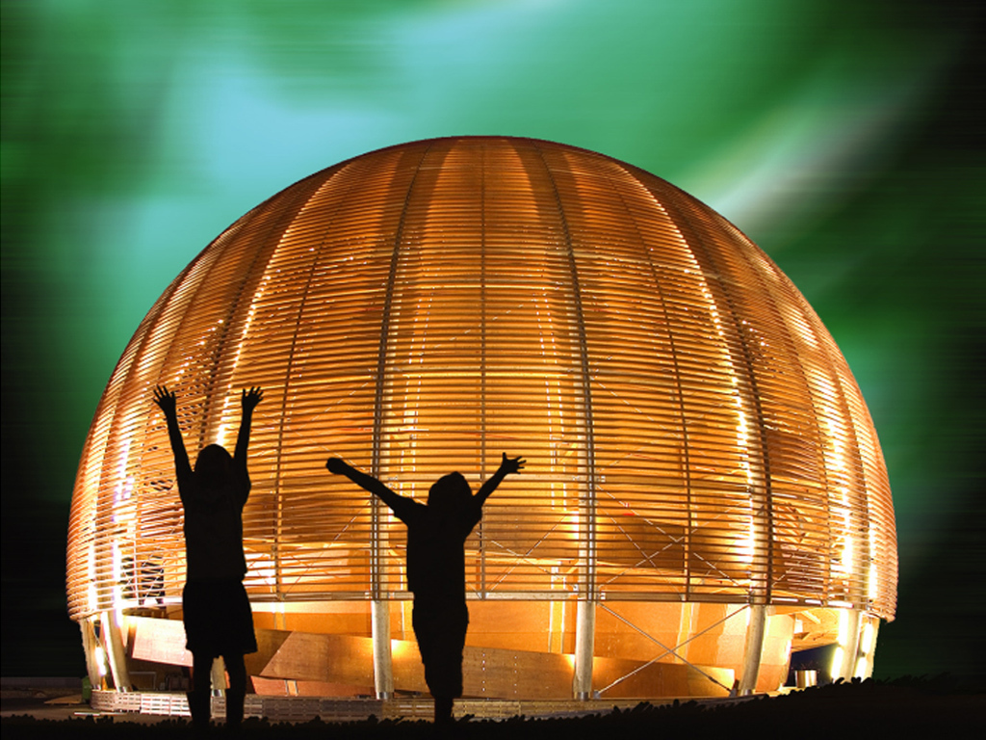
Welcome @ CERN
© CERN Photo

Slide 3
Welcome Bienvenue
Florence Licci-Ounnough
HR Department,
Talent Acquisition Group
Barbara Binder
HR Department,
Talent Acquisition Group

Slide 4
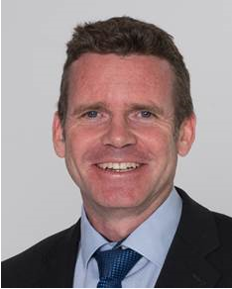
Bienvenue
Welcome
James PURVIS
Chef du département des ressources humaines
Head, Human Resources Department
Link to video on Indico

Slide 5
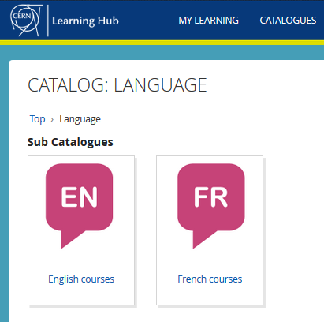


Logistics - language
Tandem
→ link
Find a partner
to practice speaking
each other’s language
Different levels, different formulas
classroom on site
virtual classroom (online)
blended (mix)
self-study with online platform
→ Learning Hub

Slide 6

Logistics - slides
Available at any time
direct link : https://indico.cern.ch/category/10150/

Slide 7
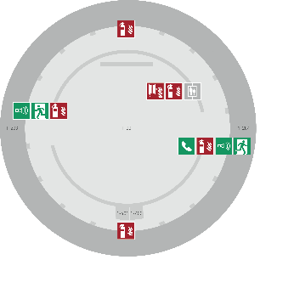
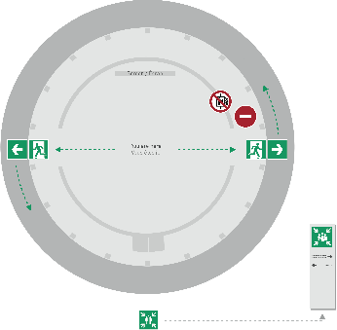
Emergency Procedure d’Urgence
When the alarm sounds
Lorsque le signal d’évacuation retentit
Evacuate immediately
Évacuez immédiatement
Don’t use the lift
N’utilisez pas l’ascenseur
Follow the signs
Suivez le balisage
Go to assembly point
Rendez-vous au point de rassemblement
74444
Escape routes
Voies d’évacuation
Fire hose
Lance d’incendie
Extinguisher
Extincteur
Assembly point
Point de rassemblement

Slide 8
Programme of the morning
08.50 Quiz – Part 1 : CERN as organization
09.15 Group photo, coffee break and networking
09.55 Quiz – Part 2 : Daily life at CERN
10.25 Meet colleagues from your department
Transfer to department
11.00 Welcome in your department

Slide 9
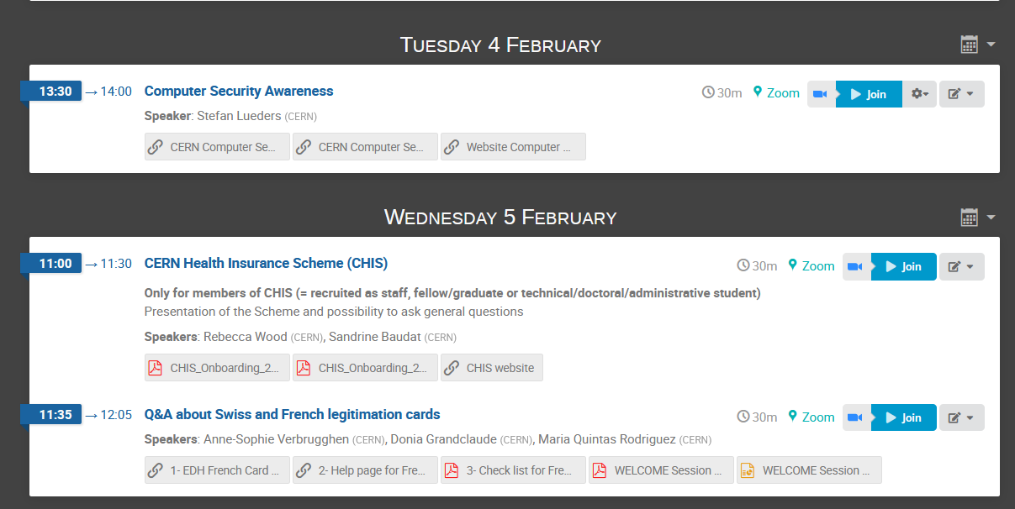


Also Tuesday 4 Feb & Wednesday 5 Feb

Slide 10

Ready to learn
more about CERN
via a quiz ?

Slide 11
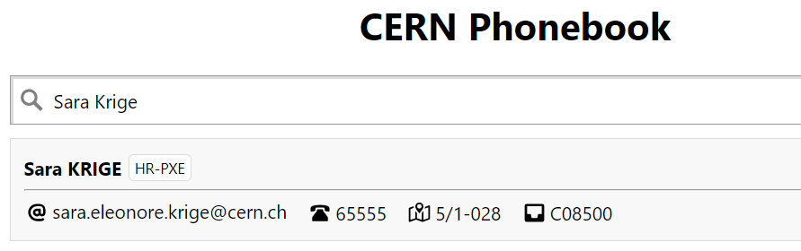


Building 5,
1st floor
office 028
R = ground floor (rez de chaussee)
S = basement (sous-sol)
<<<<<<<<<<<<<<<<<<<

Slide 12

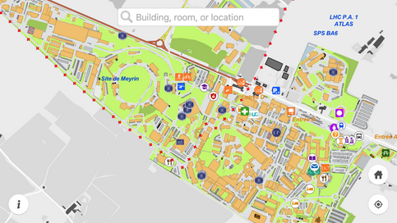
MapCERN

Slide 13
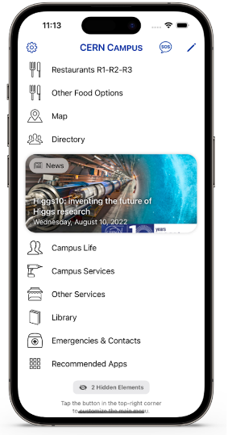
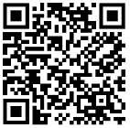
New
CERN Campus app
centralizes all your most important campus services in one place

Slide 14
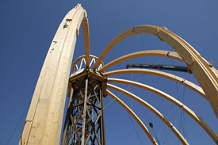
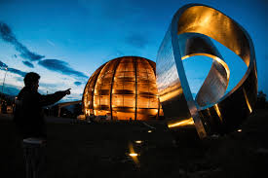
© CERN Photo
https://visit.cern/globe
© CERN Photo

Slide 15

CERN as an international organization
Quiz – part 1

Slide 16






CERN MoP
~16 950
Contractors
> 4 500
Employed MPE
~ 3 560
Associated MPA
~ 13 400
Staff
~ 2 660
Fellows/ Graduates
~ 900
Users
~ 11 900
Associates
~ 950
Students
~ 540

Slide 17
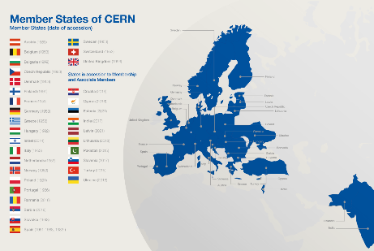
Revenues 2022
Member State contributions 84 %
Associate Member State contributions 2 %
Special contributions 3.7%
(to HL-LHC, specific experiments, from EU)
Other 10 %
(e.g. knowledge transfer, donations, …)
Principle =
proportional to Gross National Income
→ equal effort for every country

Slide 18
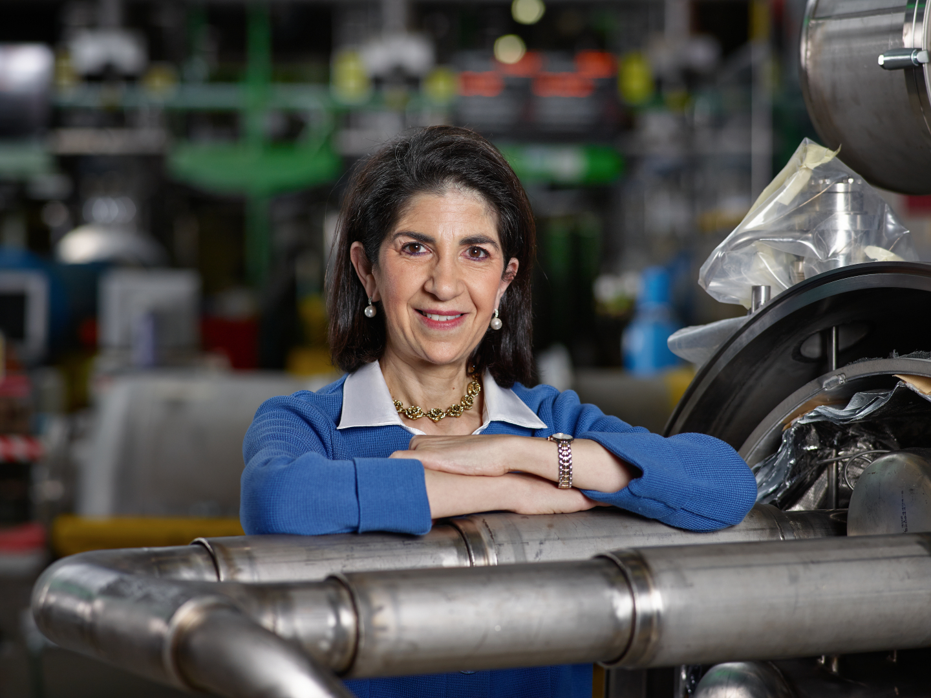
Link to biography
© CERN Photo, 2015

Slide 19
Health, Safety & Environment
Director General
Internal Audit
Legal Service
Pension Fund
Accelerators & Technology
Beams
Technology
Finance & Human Resources
International Relations
Research & Computing
Engineering
Finance & Administrative Processes
Industry, Procurement & Knowledge Transfer
Human Resources
Site & Civil Engineering
Experimental Physics
Theory
Information Technology
AcceleratorSystems
Diplomatic & Stakeholder Relations
Education, Communication & Outreach
Science Gateway Operations
Sector
Department
Group

Slide 20
HSE
PF
DG
Benoit Delille
Doug Heron
Fabiola Gianotti
ATS
BE
TE
FHR
IR
RCS
EN
FAP
IPT
HR
SCE
EP
TH
IT
SY
Sector
Mike Lamont
Raphael Bello
Charlotte Warakaulle
Joachim Mnich
Rhodri Jones
Florian Sonneman
Manfred Krammer
Department
J. Miguel Jiménez
Christopher Hartley
Gian Giudice
Katy Foraz
James Purvis
Enrica Porcari
Brennan Goddard
Mar Capeans

Slide 21
Sector
Director
Department
Department Head
DAO
DPO
DSO
DTO
…
Group
Group
Group
Group Leader
Section
Section
Section
Section Leader

Slide 22
Working at CERN when Nobel prize
1992 : Georges Charpak
1988 : Carlo Rubbia & Simon van der Meer
1984 : Jack Steinberger (with Lederman and Schwartz)
Working at CERN after Nobel prize
1952 : Felix Bloch
1976 : Sam Ting
Nobel prize thanks to discoveries at CERN
2013 : Peter Higgs & Francois Englert

Slide 23
Welcome to HR-PXE colleagues
Opportunity to ask questions during coffee break
Collective induction session by type of contract
  Graduates (Origin, Quest, …)
  Tech & Admin students in the 2nd week
  Doctoral students
Individually contacted by HRA : Staff

Slide 24


Slide 25
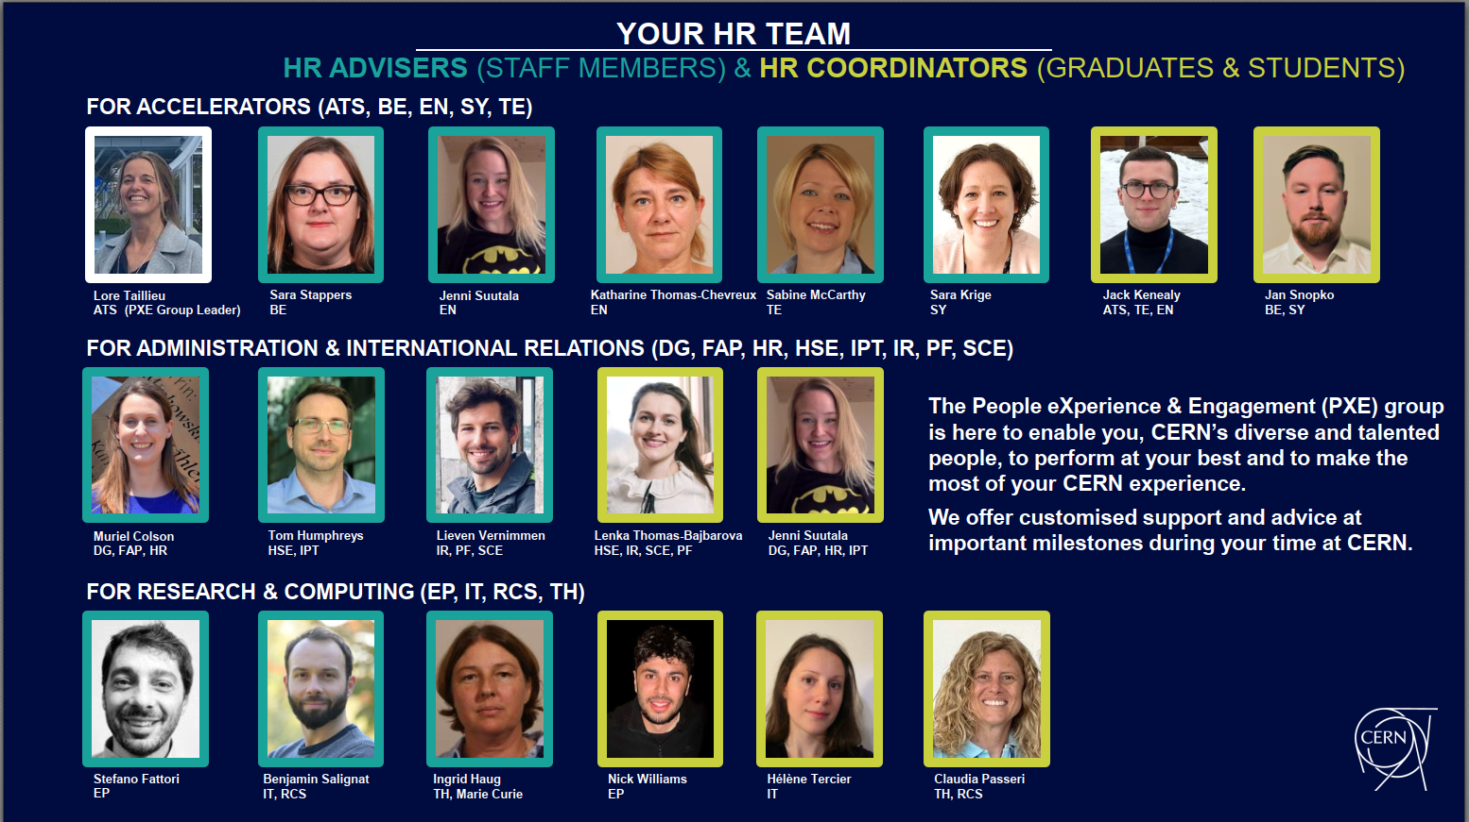

Slide 26
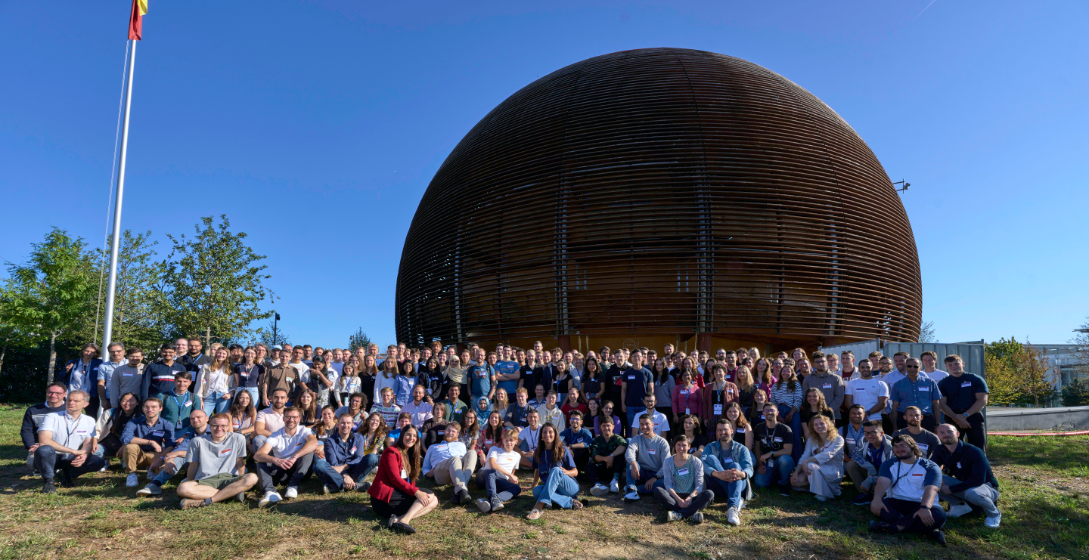
Time for a group photo !
© CERN Photo
Notes:
2
***************

Slide 27
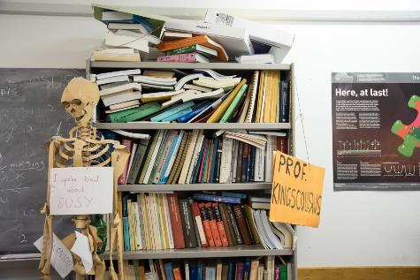
Daily life at CERN
Quiz part 2

Slide 28
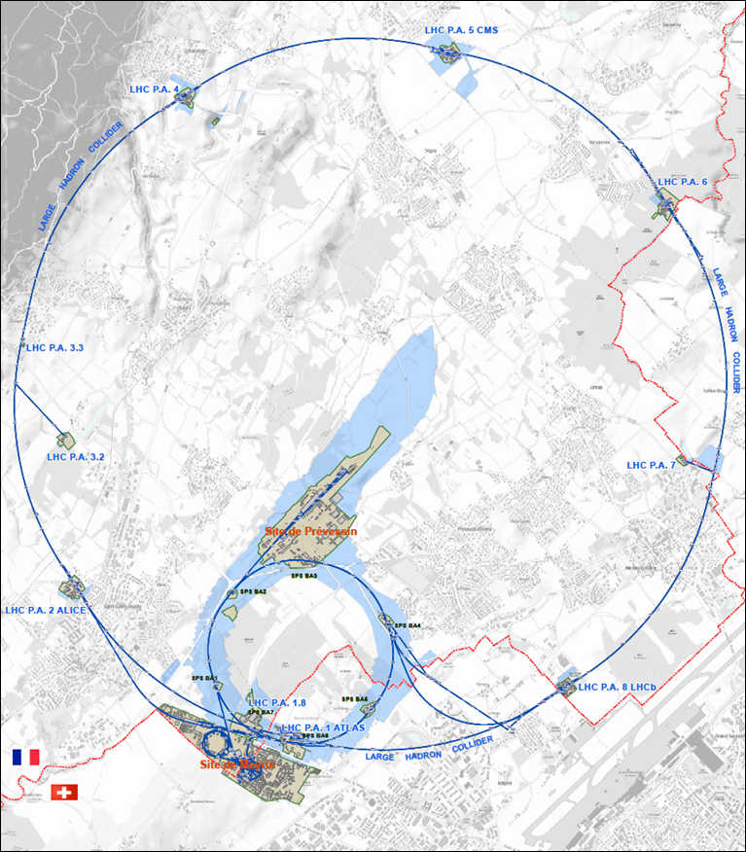




625 ha
515 ha
fenced : 220
110 ha
… 700+ buildings
accounting for
500.000 m²
5 900 parking spots
101 ha
green
spaces
30 km roads

Slide 29
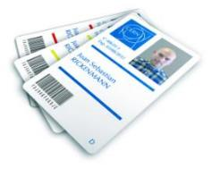
CERN access card
CERN access card
CERN Community Support Centre
buidling 33- Meyrin site,
7.00 am to 6.30 pm, Monday to Friday
vehicle registration
biometrics registration
https://sce-dep.web.cern.ch/security/access

Slide 30




Gates | Days
Meyrin A | Mon-Fri | 24/24 |  | 7-20
Porte Jura Bldg 33 |  | 24/24
Meyrin B (Main entrance) |  | 24/24
Meyrin C | Mon-Fri | 24/24 |  | 7-20
Meyrin D (goods only) | Mon-Fri |  |  |  | 08-12 13-16
Meyrin E (Only Authorised Personnel and contractors. Rules of Use) | Mon-Fri | In : 7-9.30 Out : 16.30-20
Intersites tunnel (restrictions) | Mon-Fri |  |  | 7-18
Prevessin Main entrance |  | 24/24 |  |  | 08-12 13-16
Prevessin Route du Maroc |  | 24/24
Prevessin Moulin des Ponts |  | 24/24

Slide 31

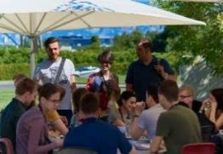
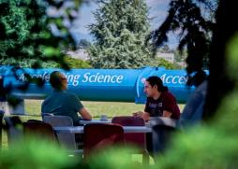
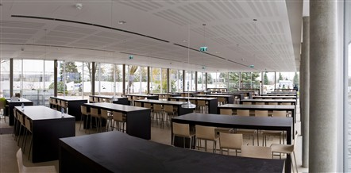
Restaurants
2 in Meyrin (resto 1 & 2)
1 in Prevessin (resto 3)
Cafeteria (snacks)
Building 13, 30, 40, 54, …
Click for more info
© CERN Photo

Slide 32
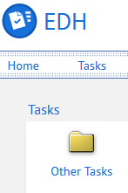
CERN Car
Requires
CERN driving authorization :
Valid driving licence
OK Department Head
Private vehicle
Not requiring registration
  Bike, “trottinette”
Requiring registration
  Must be registered in member state or EU country
  “Tourist” cars only
  Not allowed :
  Scooter, moto, lorry, bus, …

Slide 33
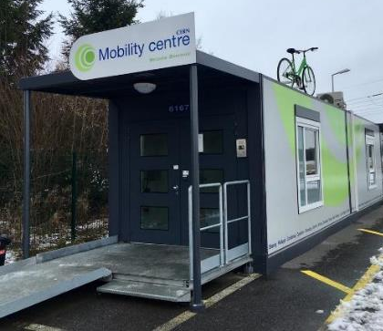
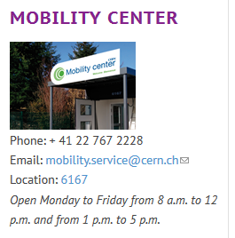
CERN Mobility Centre
Located next to Entrance A
Services offered
Bike rental
Car rental
Car sharing
Bike sharing
Shuttles
….
https://sce-dep.web.cern.ch/campus-life/mobility

Slide 34


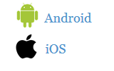
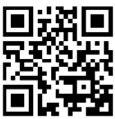
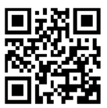
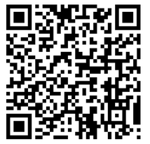
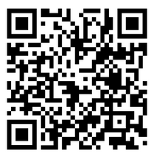
Mobility apps
Car sharing
glide.io
login with CERN SSO
Bike sharing
www.mobility-parc.net/
login with CERN SSO

Slide 35
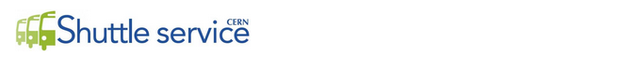
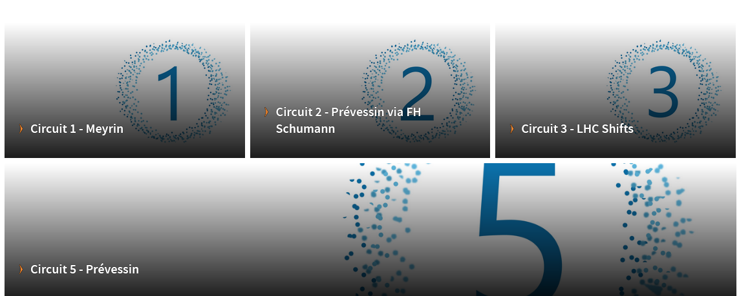
https://sce-dep.web.cern.ch/cern-shuttle-service

Slide 36
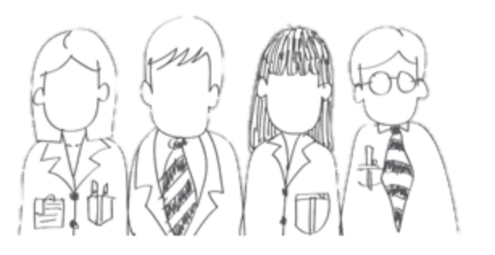

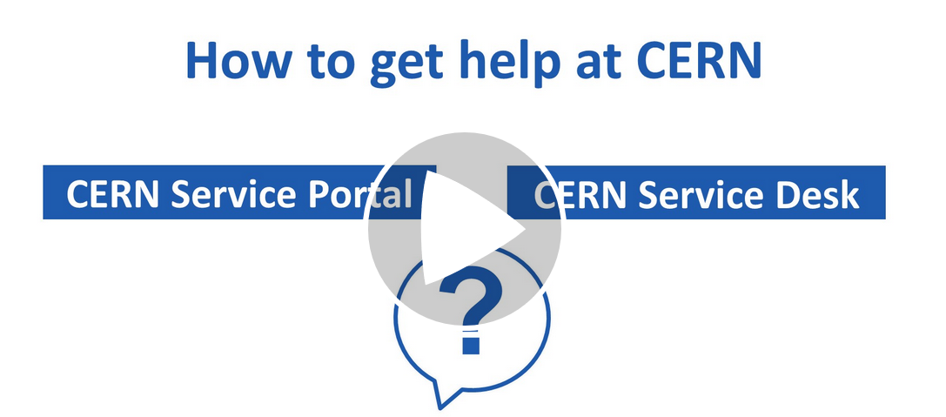




CERN Service Desk
Phone: +41 22 76 77777
Email: service-desk@cern.ch
Monday to Friday
from 7.30 to 18:30
( Geneva time )
CERN Service Portal
Services
Service overview in a glance
Online forms
Report an incident, submit a request
Knowledge articles
Find your answer!
Feedback
Your feedback matters!
https://cern.ch/service-portal

Slide 37
Accident on site – different cases
In all cases
Inform supervisor
In case of
Injury
Environmental hazard
Disruption traffic
3rd party involved
CERN Fire & Rescue 74444
(+ 41 22 767 44 44)
+
Internal accident report (EDH)
+
European Union Car Accident form

Slide 38
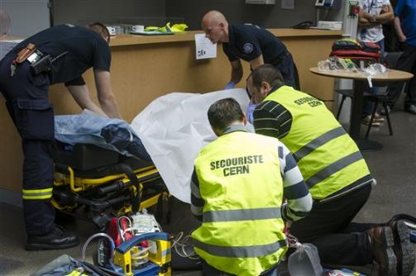
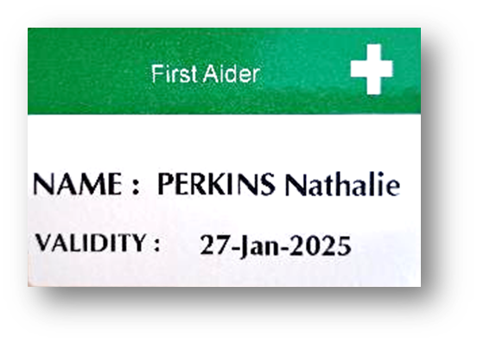
CERN Fire and Rescue Service
assisted by local First Aiders
Find out who
are closest to
your office / usual work places
© CERN Photo

Slide 39

Click on the picture to download the flyer

Slide 40


Defends all personnel
on a collective and on an individual basis
Become member : Website
Network of people who work(ed) at CERN
Become member : Website

Slide 41
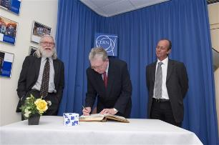
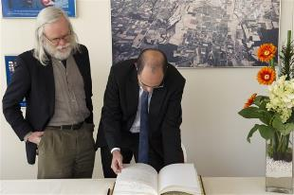
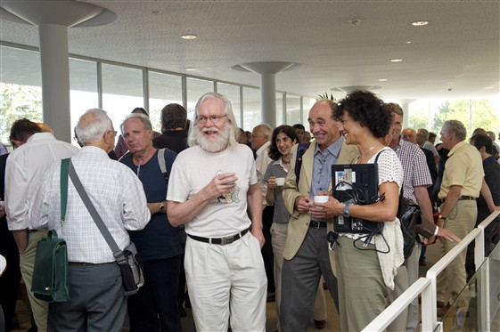
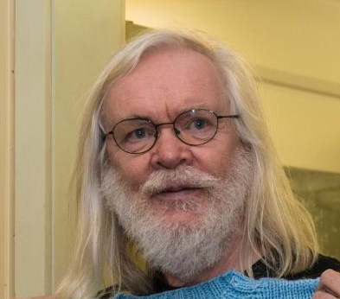
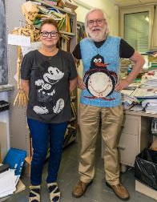
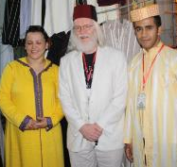
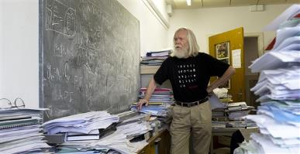
© CERN Photo

Slide 42

Code of Conduct
Link to Code of Conduct

Slide 43

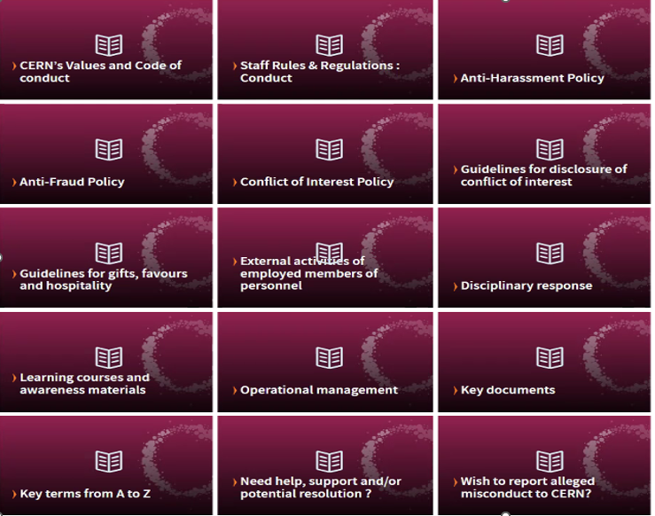
https://hr.web.cern.ch/ethics

Slide 44



CERN tools
Phone (audio only) : CERNphone
  Mobile client (iOS and Android)
  Desktop client (Windows, macOS, Linux)
Videocalls and videoconferencing cern.zoom
Messaging – individual and public/private ”channels”
integration with Zoom
dedicated channel New @ CERN

Slide 45
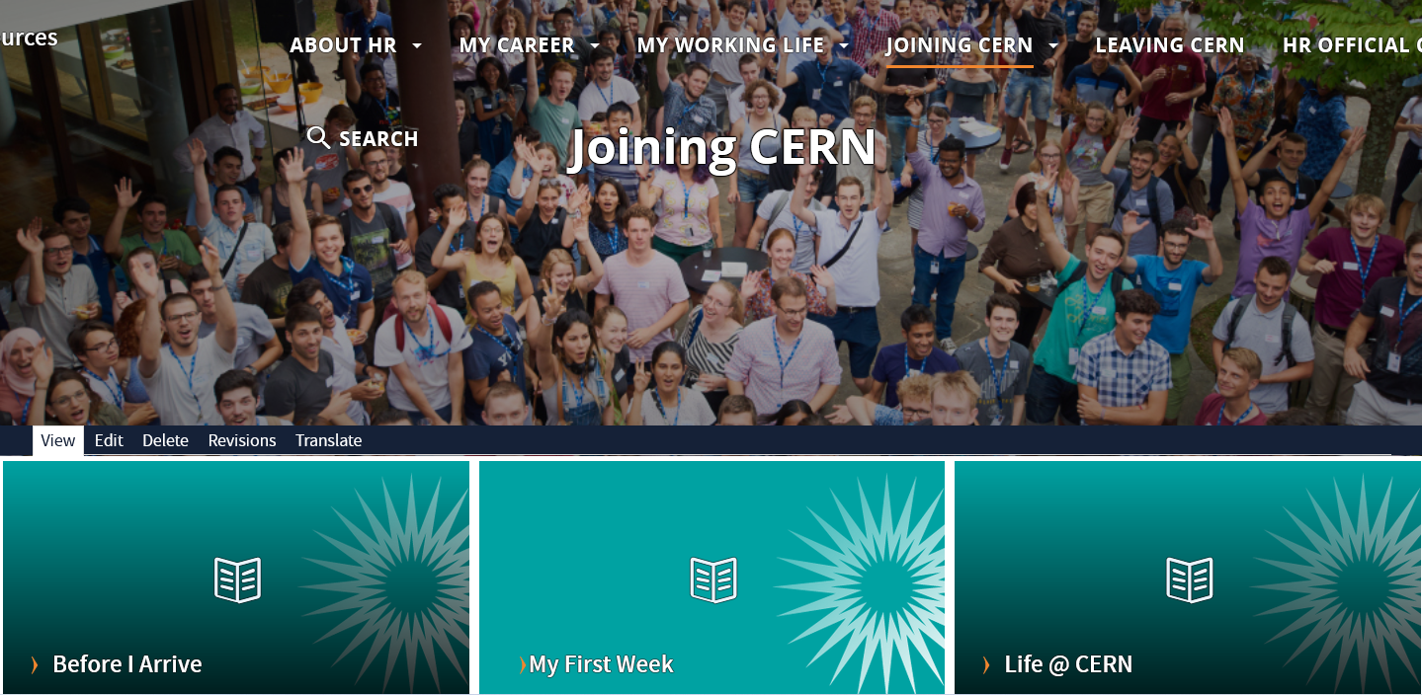
Newcomers website
https://hr.web.cern.ch/joining-cern

Slide 46



Many questions, answers are …
  Your departmental secretariat
  Your supervisor, your colleagues
  Specific question for personal situation?
  → Make appointment with the expert services
  Pension Fund, Health Insurance, Installation Service, Housing Service, Social Service, …
  HR Website > Welcome > my first week

Slide 47

Public meetings
Click for past and future events (agenda, slides, recordings)
Directorate
Highlights of Council Week and other recent news.
HR
Focus on one topic (eg. flexibility)
Staff Association
Latest information on priorities and current issues

Slide 48

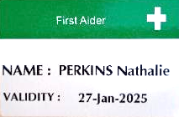
Important info to remember
Download CERN Campus app on your phone
Enter full number Fire and rescue service in your phone
Find out who are closest first-aiders
+ 41 22 76 74444

Slide 49
Onboarding continues with …
Welcome session in your department
Meet the experts (online – Zoom)
  Computer security 4 Feb, 13.30 – 14.00
  CERN Health Insurance (CHIS) 5 Feb, 11.00 – 11.30
  Legitimation cards 5 Feb, 11.35 – 12.05
More short sessions with experts (online – Zoom)
  Pension Fund* 17 Feb, 13.30 – 14.00
  Library and Open Science* 25 Feb, 13.30 – 14.00
Connecting the dots* 25 Feb, 13.15 – 18.00
Spouse welcome session* 18 Mar, 16.00 – 18.00
Collective induction session or Individual contact by HRA
Visit* of CERN installations – register via Indico
Part of
Welcome session
see Indico
* You will be invited
* You need to register

Slide 50
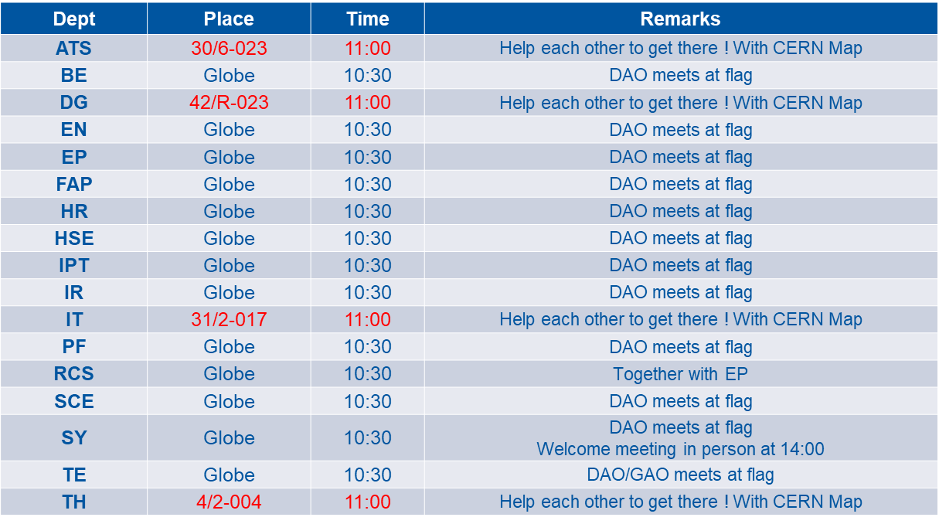
Meeting points

Slide 51


