Slide 1

Magnet Working Group Meeting
Detector Interface Section
Magnet Services
July 2025
X. Pons on behalf of the DT-DI Section

Slide 2
Detector Interface Section
The Detector Interface provides hardware and software support in control, safety and data acquisition systems for experiments infrastructure.
Magnet
Support
Detector
Support
Experiments
Data Acquisition Support

Slide 3
Detector Interface Section – Magnet Services
EP-DT has a long tradition supporting the experimental magnets
Since the initial design phases of the ATLAS and CMS magnet control in the 90’s with the old TA3 group
DT-DI has been responsible of the Magnet Control Project (MCP) for the LHC Experimental Magnets
Later, during the operation of the LHC, and agreement (WP) was established with the experiments to define the DT-DI’s support in terms of operation and maintenance.
This agreement also included the support for the Detector Safety Systems (DSS)

Slide 4
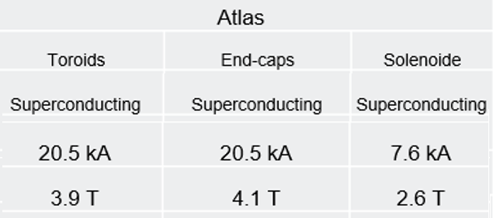
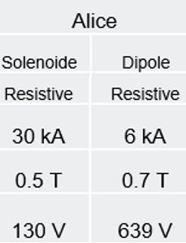
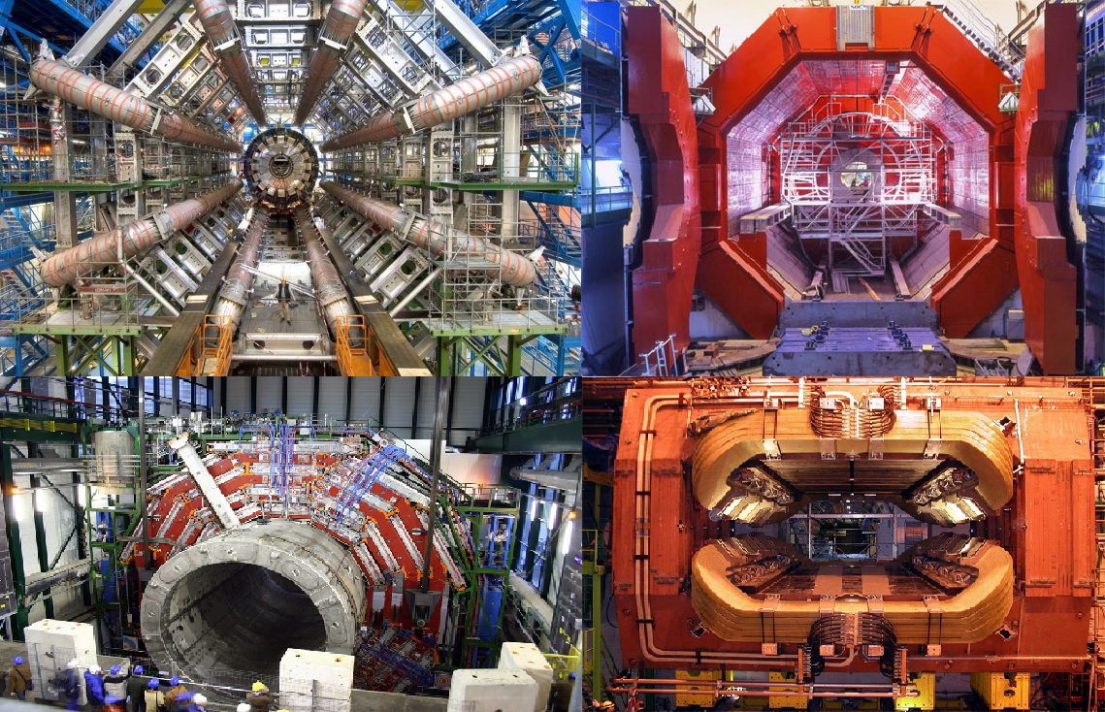
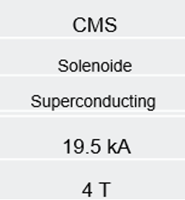
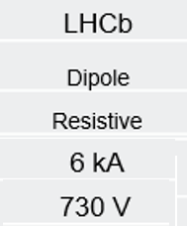
LHC Experimental Magnets
1.1 T

Slide 5
Magnet Control Project
Supervision / Operation
WINCC OA Scada
Auxiliary
Systems
Protection
Control
Monitoring
Magnet Safety System
MSS
Magnet Control System
MCS
Magnet Diagnostic System
MDS
Vacuum
Safety Heaters
Power Distribution

Slide 6
Magnet Safety System
The role of the MSS is to keep the magnet in a safe state, taking the appropriate action (Fast Dump, Slow Dump, Idle,…) according to the magnet conditions
Based on FPGA – Compact Rio Technology from National Instruments that contains the safety logic
I/O electronic interfaces and integration designed by EP-DT
Redundancy at all levels for ATLAS and CMS superconducting magnets
Connected to the LHC Beam Interlock System (BIS)
Major upgrade on LS1 to MSS2

Slide 7
Magnet Safety System - Environment
RED, MSS components
MSS/ Magnet Instrumentation
Magnet Emergency Stops. ACR/MCR
Power Supplies
Batteries
Sensor Signals
Circuit Breaker / Contactor
MCR
ACR
Status
Command
Status
MSS
Quench Heaters
MCS
Status
Trigger
Commands, tests
Status
Logs, FastAq
Status, DCCT, PC_Failure
WINCC OA
Scada
Reset
PC_Permit
Power
Converter
Status
Status
SD Request
Status
PCS_Ready
DSS
Vacuum
Cryogenics

Slide 8
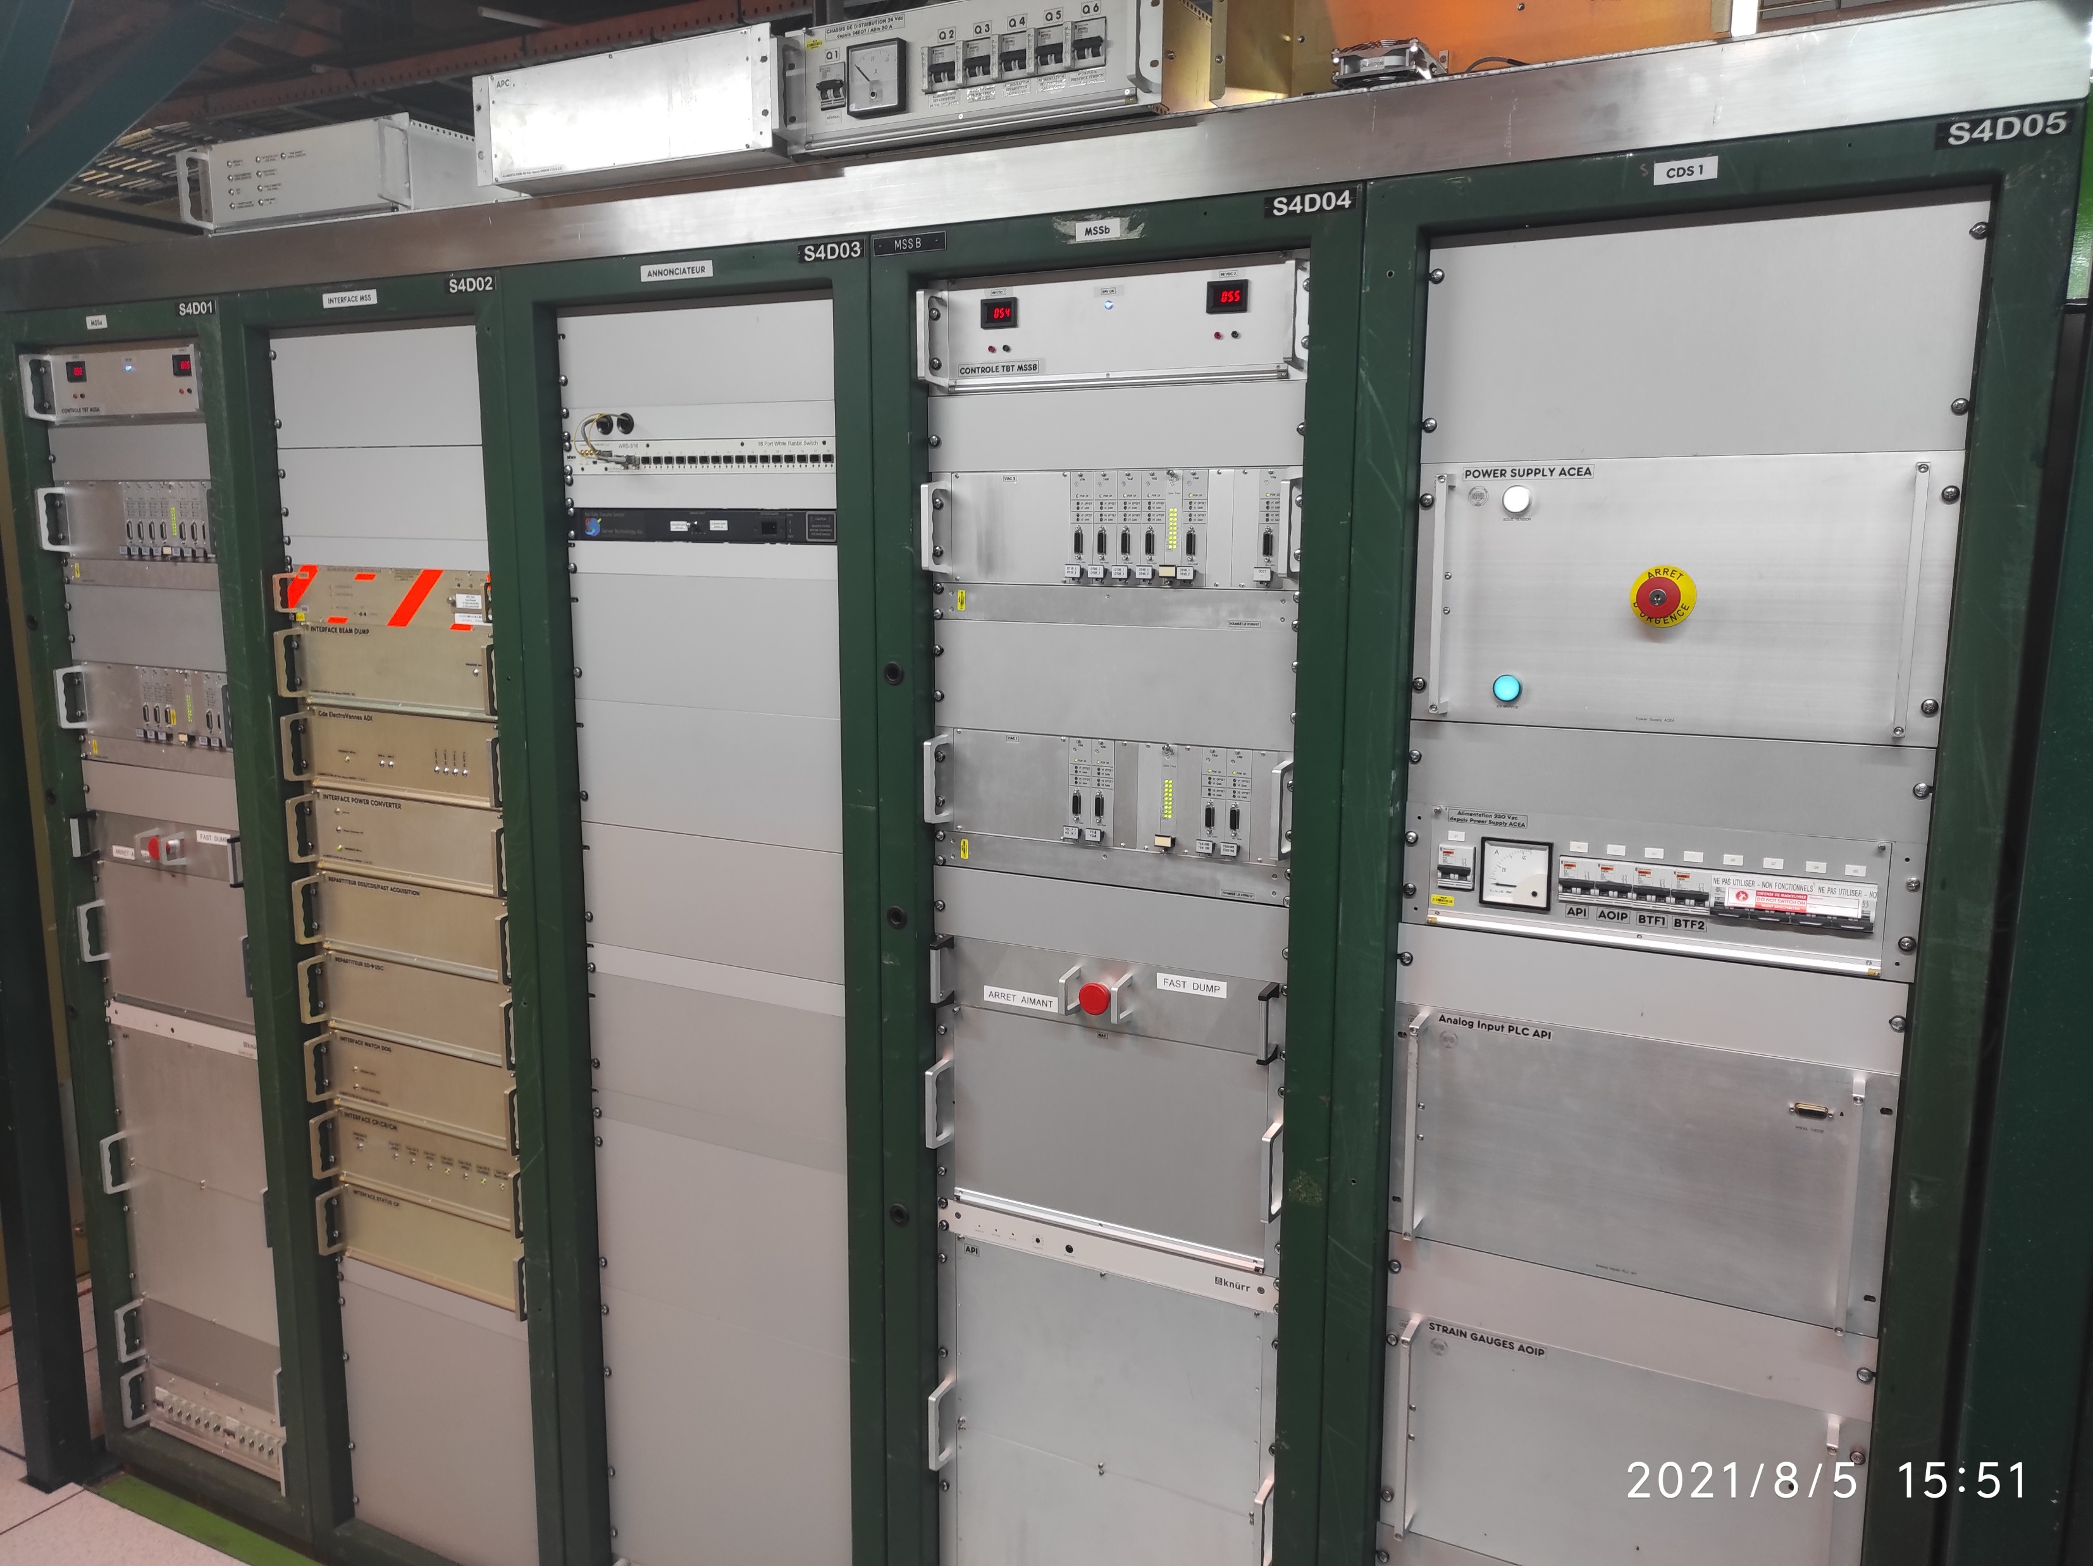
Magnet Safety System Architecture
Magnet Safety System Parts:
  Format 19’ rack crate
  Main crate (MAC) – FPGA crate
  Digital Input Interface Board
  Digital Output Interface Board
  Versatile Analogue Crate (VAC)
  Versatile Analogue Interface (VAM)
CMS Solenoid MSSa and MSSb

Slide 9
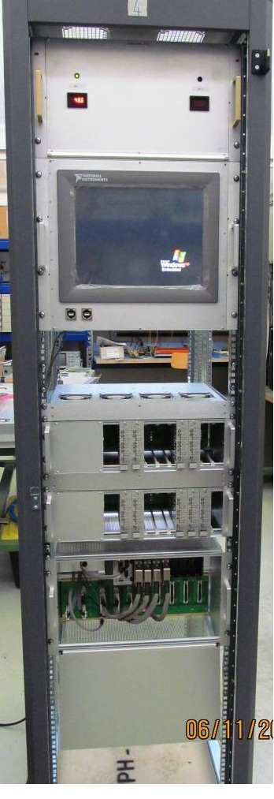
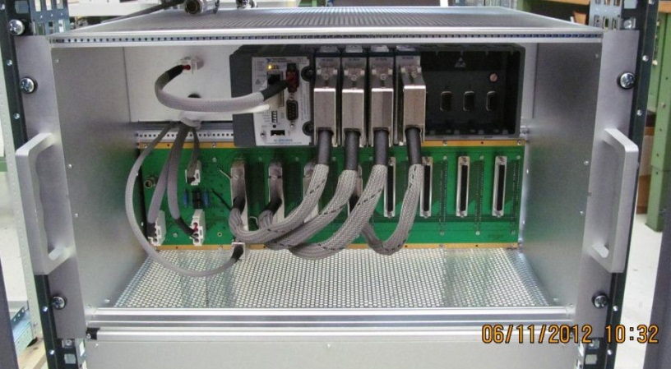
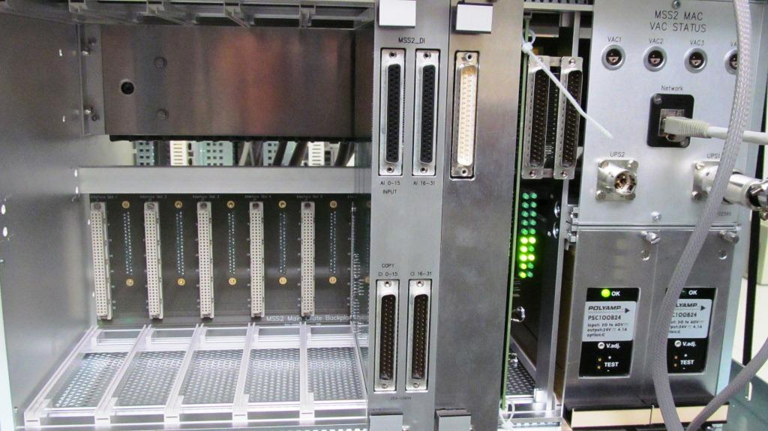
Magnet Safety System Architecture
MSS2 Main crate
  Following L. Deront design
  6U crate size for 19’ rack assembly compatible with all MSS
  cRIO FPGA installed in the front side
  Input/Output Interface board in the back side
  Redundant Power supply
MSS2 Prototype
MSS2 cRIO crate. Front Side view
MSS2 cRIO crate. Front Back Side view

Slide 10
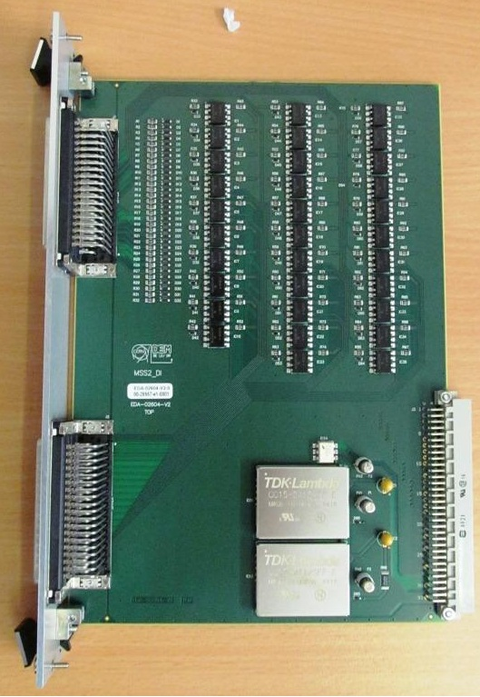
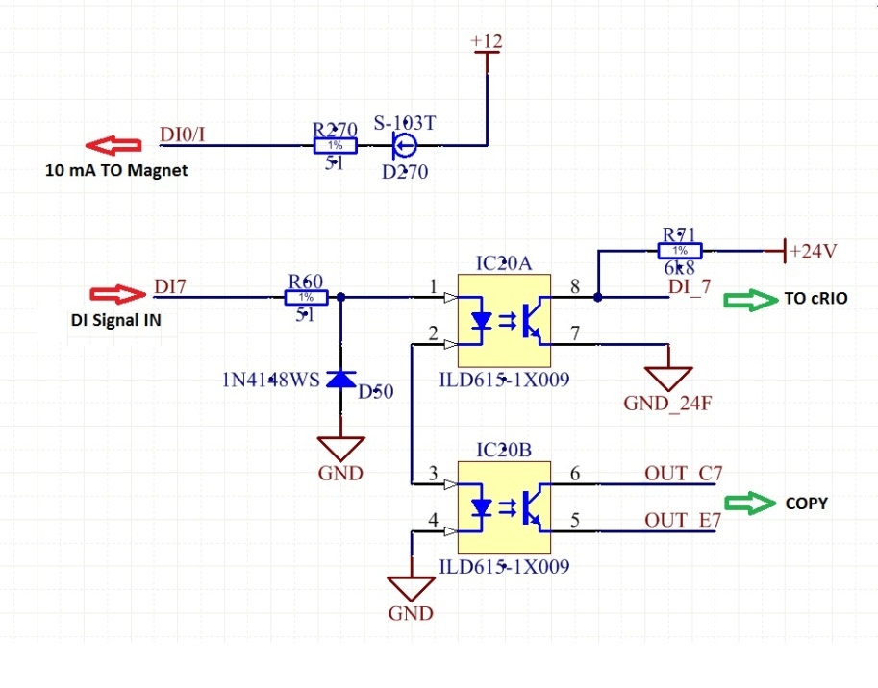
Magnet Safety System Architecture
MSS2 Digital Interface Board
  Capacity of 32 isolated DI
  Copy of the 32 signals sent to MCS
  Isolated to 5.3 kV, by dual optocoupler ILD615
  Redundant DC-DC converter
  Redundant Power supply
  EDMS
MSS2 DI board
MSS2 DI board

Slide 11
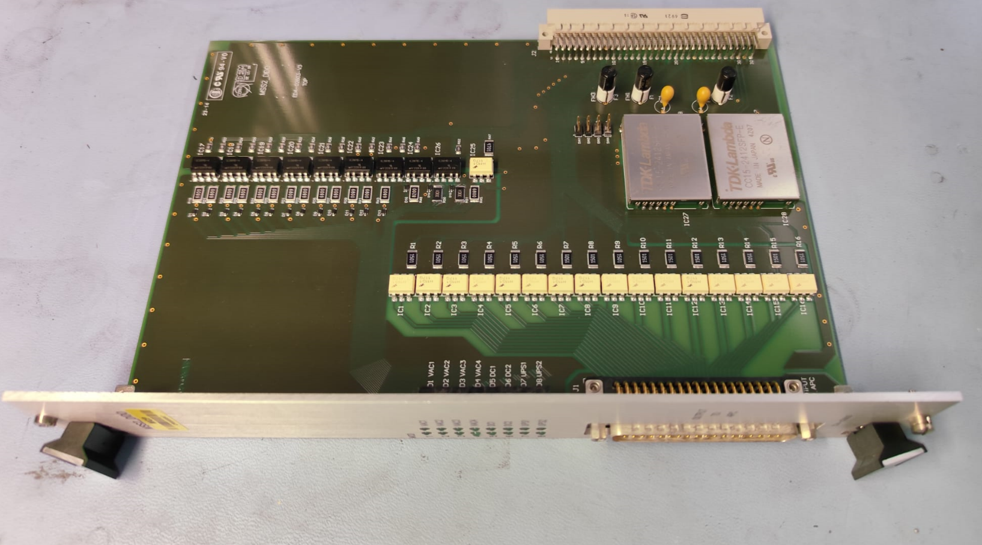
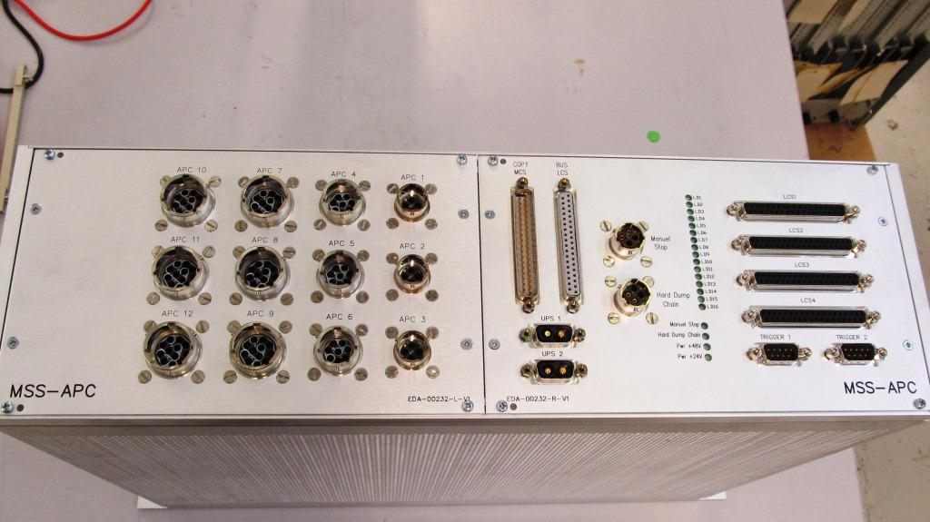
Magnet Safety System Architecture
MSS2 Digital Output Board => APC (Application Interface Control)
  Capacity of 16 isolated DO
  Copy of the 16 signals sent to MCS
  APC contains the 16 Safety Relays according to EN 50205
  Interface with LHC-BIS with optocoupler
  Redundant DC-DC converter
  EDMS
MSS2 DO Interface board
MSS2 APC Crate

Slide 12
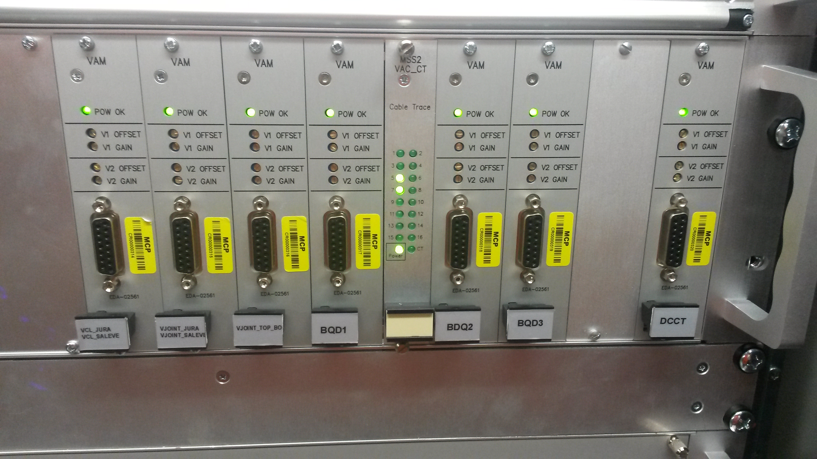
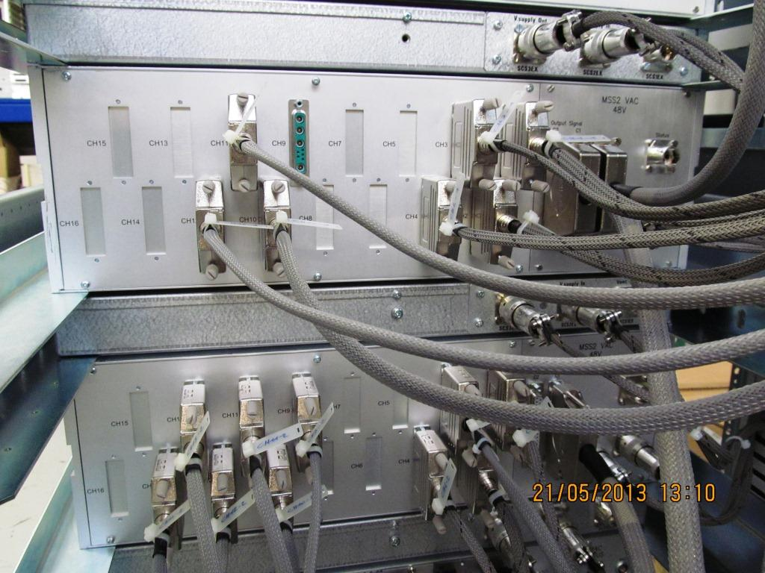
Magnet Safety System Architecture
Versatile Analogue Crate (VAV)
  Capacity Up to 8 dual analogue input board = 16 AI channels
  Signal isolation up to 3 kV
  Cable trace signal
  Independent redundant Power supply
  Signals connected to cRIO-FPGA crate by passive board/cable
VERTEX MSS2 VAC crate front view
MSS2 VAC crate rear side view

Slide 13
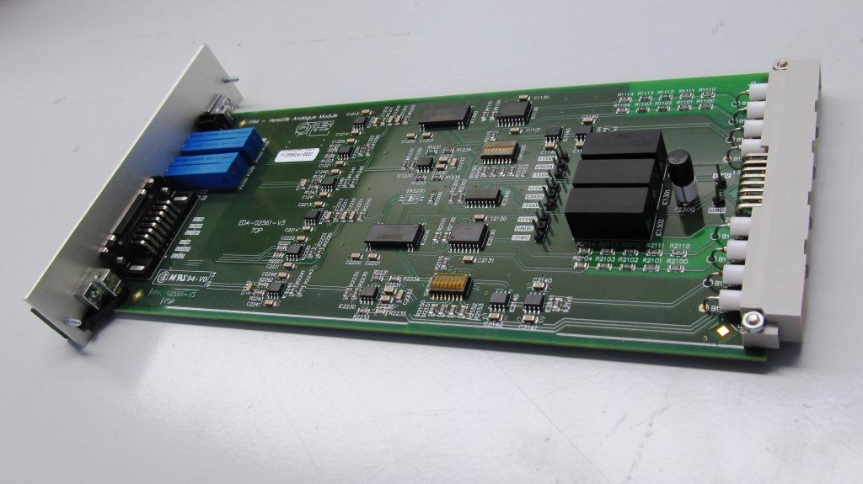
Magnet Safety System Architecture
Versatile Analogue Module (VAM)
  Dual Analogue Input
  Selectable gain: x1, x10, x100, x1000 by DIP switch.
  Signal isolation 1500Vrms.
  Power supply circuit isolated 3 kV by DC-DC
  selectable current source: 0.01 mA, 0.1 mA, 1mA, 10 mA
  Optional low pass filter
  Gain and offset adjustment
  Time and threshold discrimination at FPGA level
  EDMS
MSS2 Versatile Analogue Module (VAM)

Slide 14
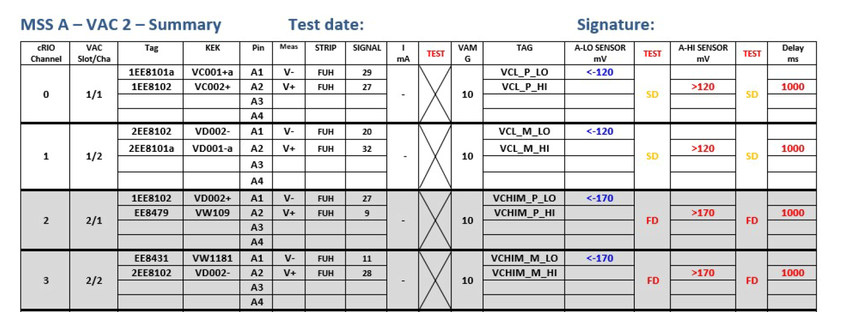
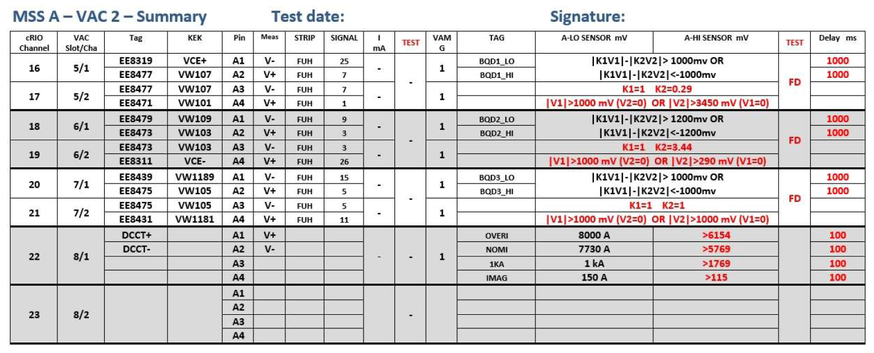
Magnet Safety System Calibration
ATLAS Central Solenoid Instrumentation Calibration Tables
The ATLAS and CMS magnets instrumentation channels are calibrated every YETS
Morpurgo, Vertex and Compass according to operations

Slide 15

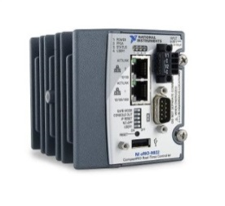
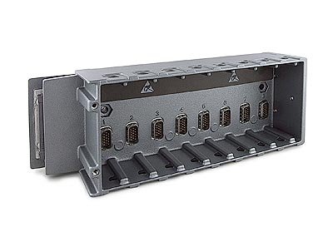
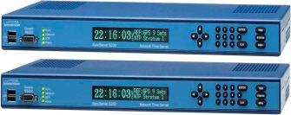

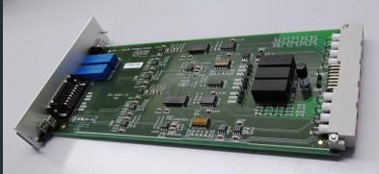
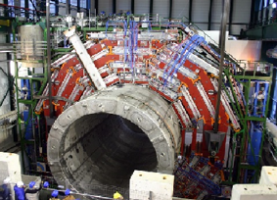
Magnet Safety System Software
WINCCOA
Flow State Chart
Changing the state according to the safety logic conditions programmed in the FPGA
FPGA
TN Network
Event log
Idle
Real Time Controller
FIFO
FIFO
Ethernet (TN)
Fast Acquisition
Circular buffer
CERN Time server
FPGA
Fast Dump
Slow Dump
Local Storage
Interfaces
Fast Dump action triggers the fast acquisition of the circular buffer
Storing all signals at 10 kHZ with 1sec pre-buffer and 6 seconds
Magnet
Signals

Slide 16
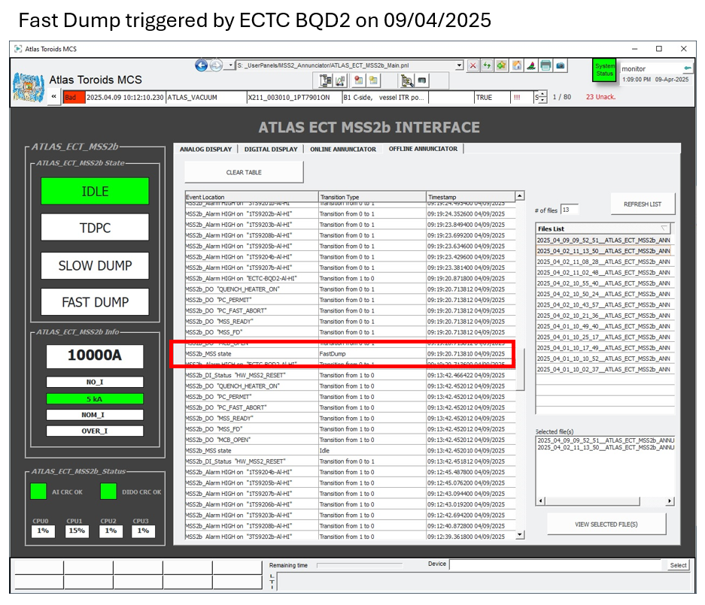
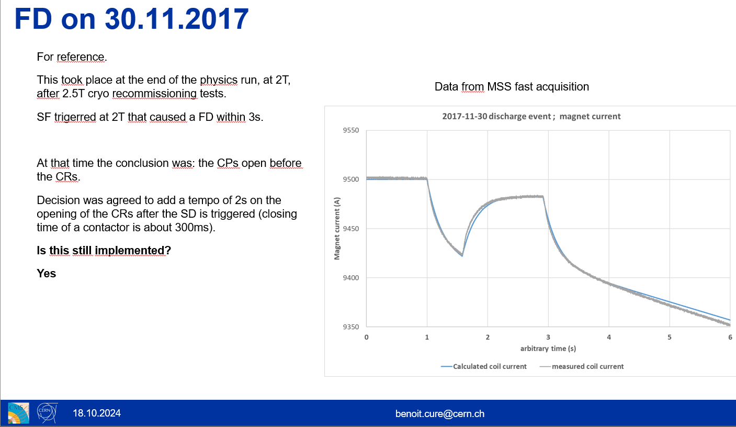
Magnet Control System Software
Event Log
FastAcquisition

Slide 17
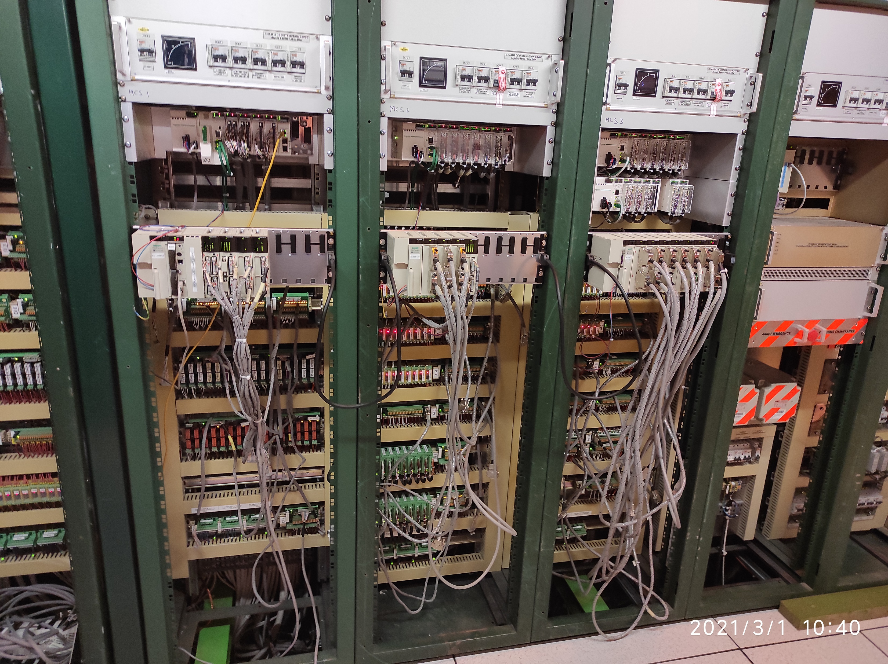
Magnet Control System
  The MCS controls and supervise all the auxiliary systems involved in the magnet operation : EN-CV, EN-EL, TE-CRG , SY-EPC, Experiments facilities
  Based on SIEMENS, SCHNEIDER PLC technology.
  With CERN UNICOS framework from BE-ICS
  WINCC-OA SCADA on top for supervision and operation
  Connected to MSS only with a Slow Dump request
  Connected to Auto Notification System (ANS) for the piquet
  Major upgrade in the LS2 from Schneider Premium to M580
MCS to MCS2 CMS upgrade

Slide 18
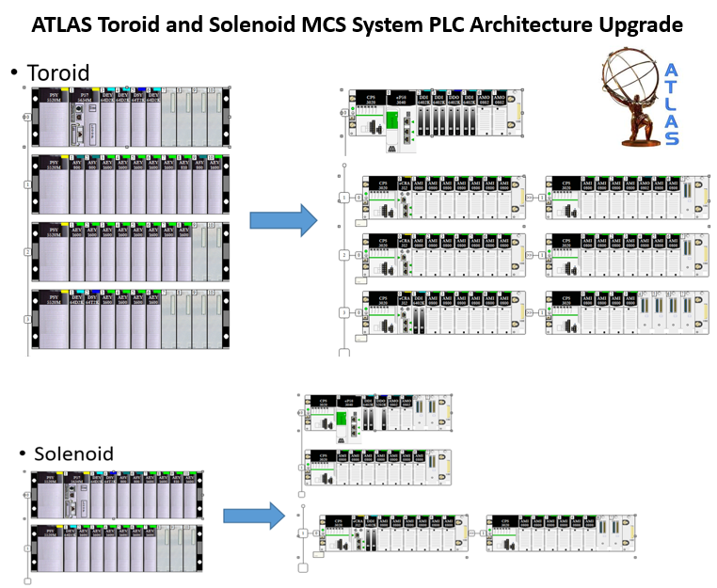
Magnet Control System
  Layouts often involve a high of complexity.
  The upgrade is not an easy operation.

Slide 19
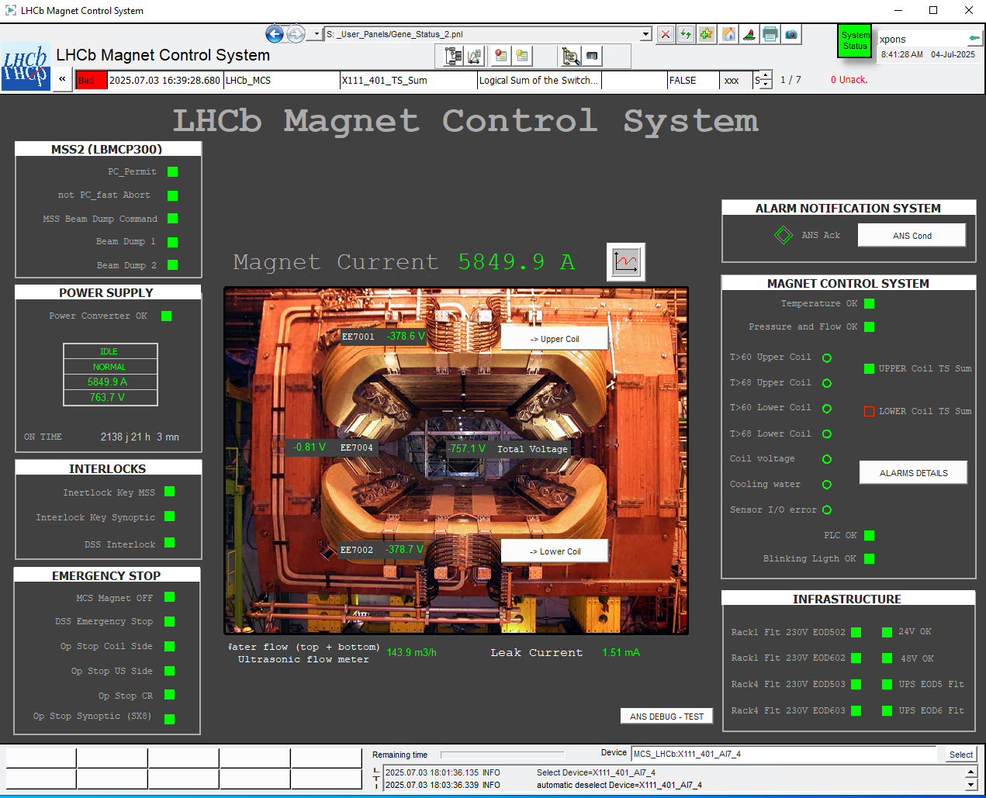
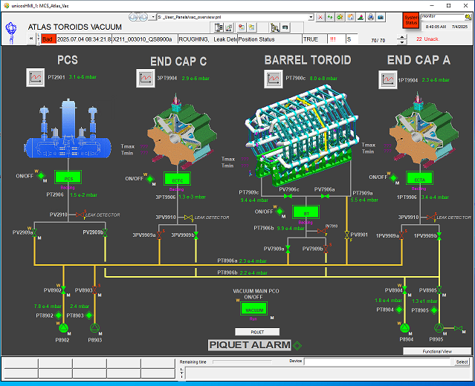
Magnet Control System
ATLAS Vacuum Control System
LHCb MCS
WINCC OA Scada on top for user operation

Slide 20
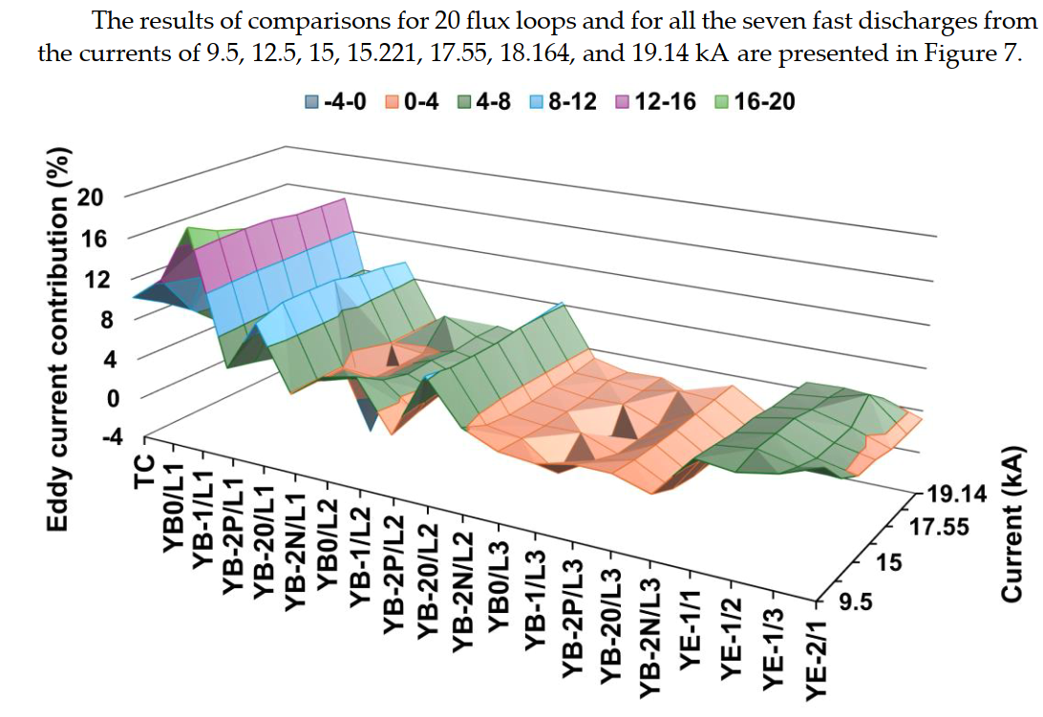
Magnet Diagnostic System
The Magnet Diagnostic System includes all magnet auxiliary systems that do not have an action on the MCS (Magnet Control System) or MSS (Magnet Safety System).
It covers:
  Additional magnet instrumentation
  Spare channels
  ATLAS busbar measurements,…
  CMS: strain gauges, temperature sensors, level meters, flux loops
  LHCb: strain gauges
  ALICE solenoid: 1,400 temperature readouts
  Different technologies
Credits Vyacheslav Klyukhin - CMS

Slide 21
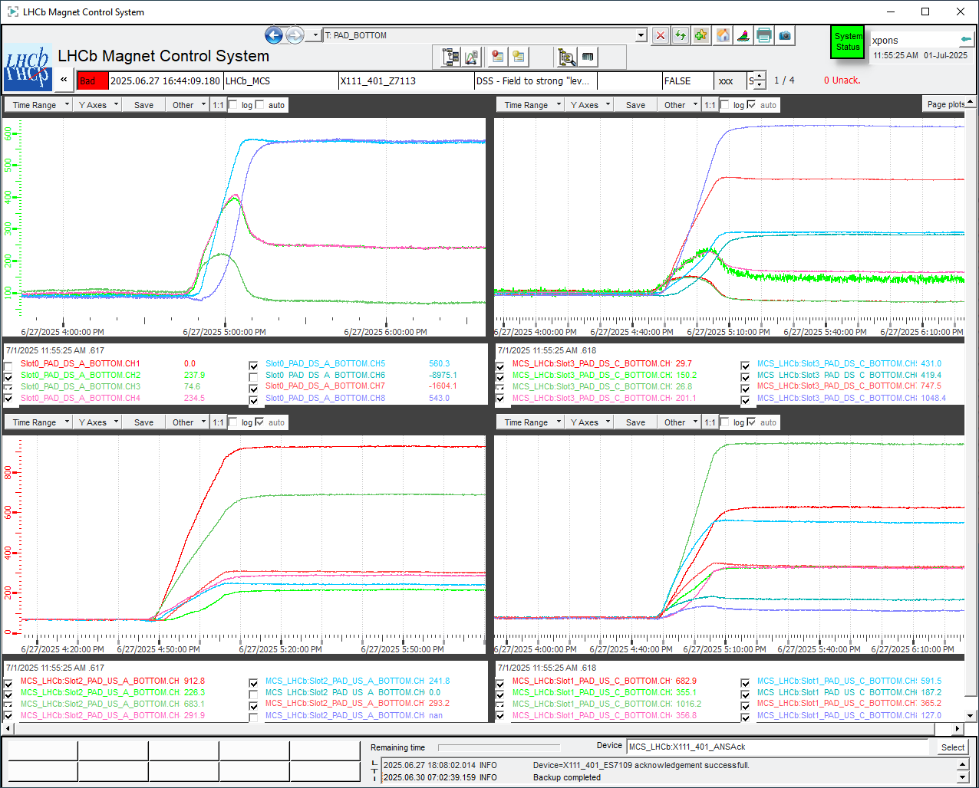
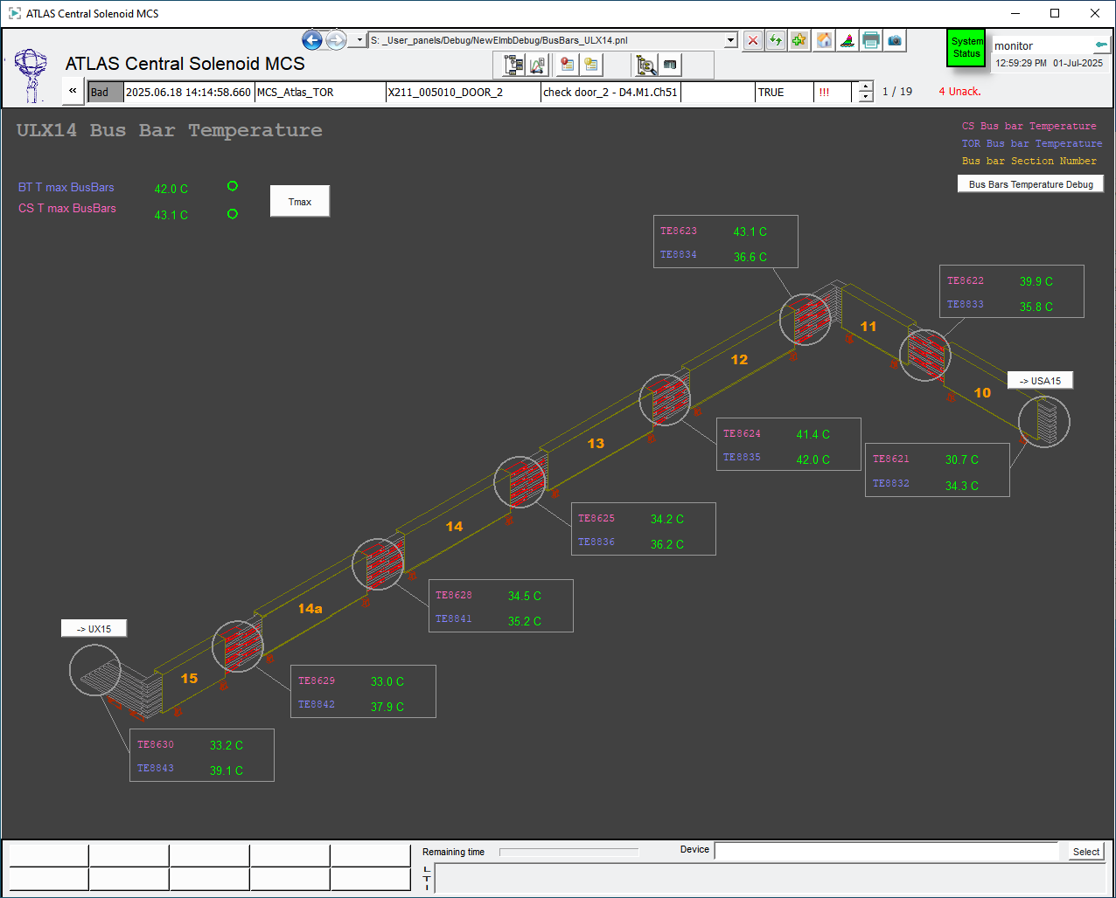
Magnet Diagnostic System
LHCb Strain Gauges signal on 27/06/2025 ram up
ATLAS Bussbar temperature monitoring

Slide 22
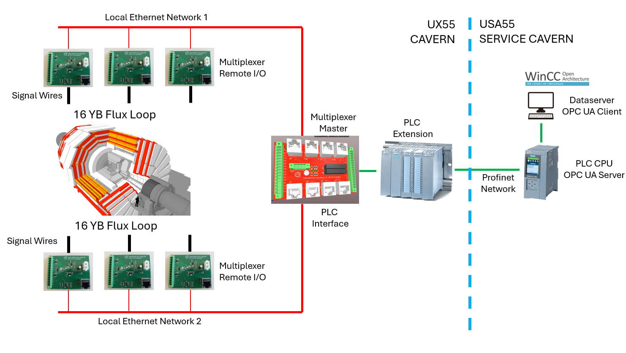
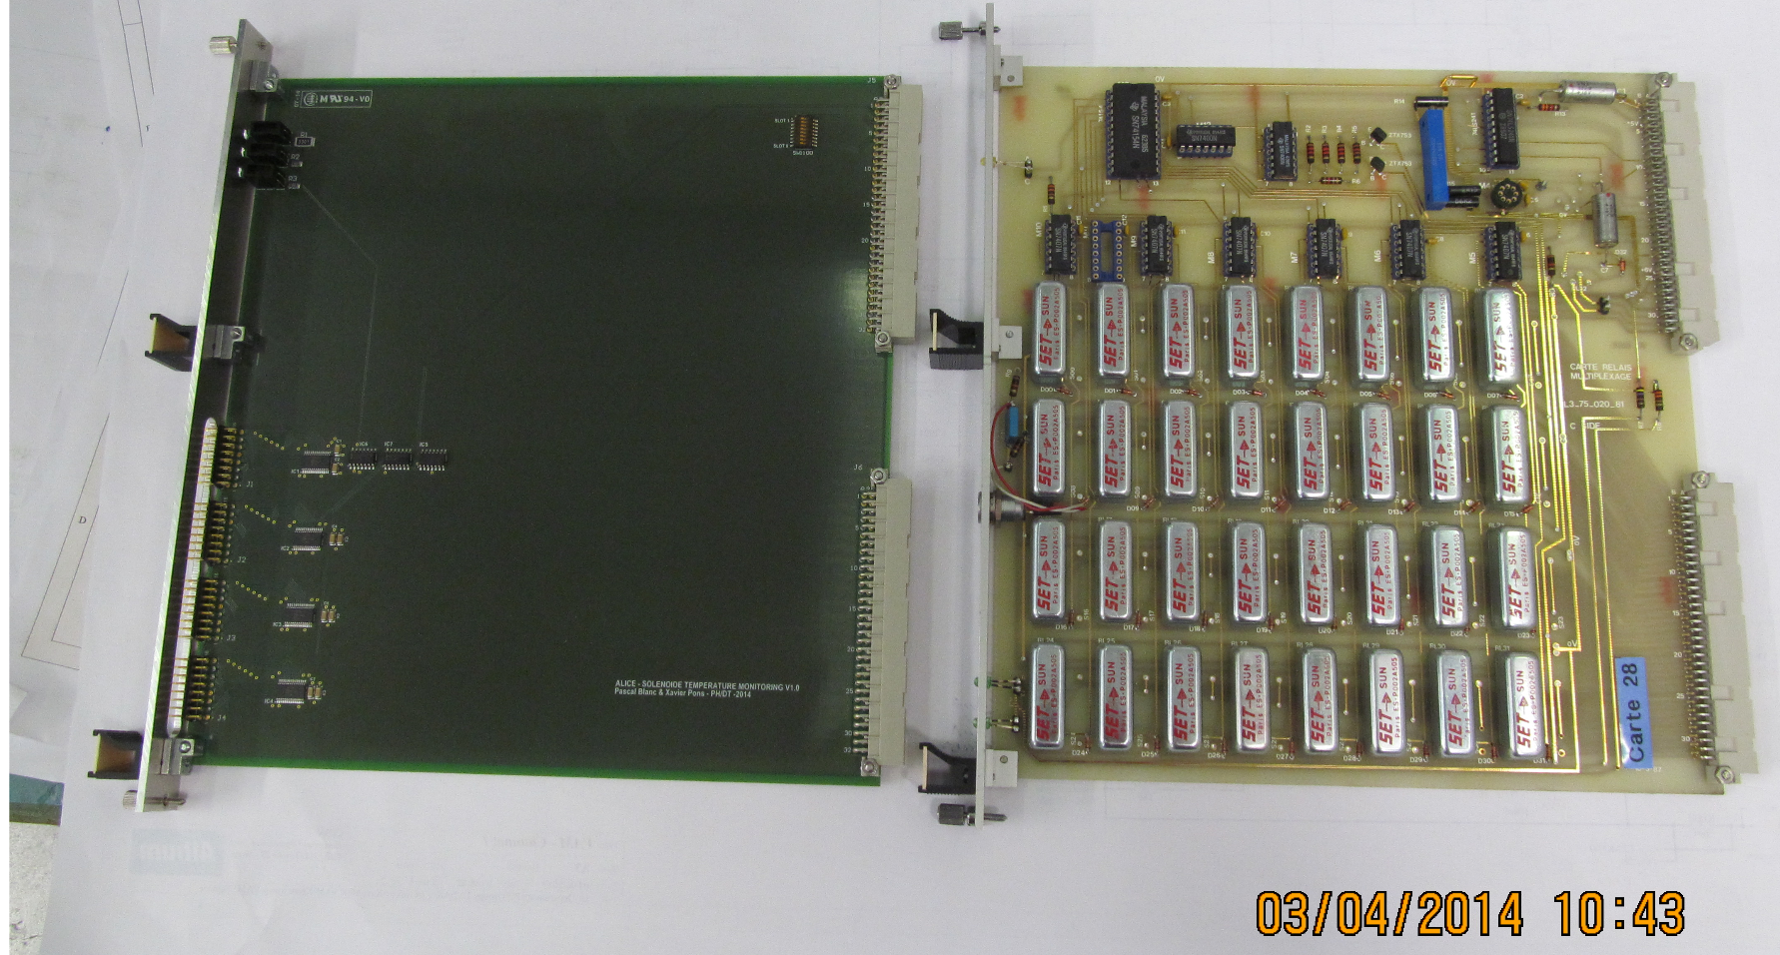
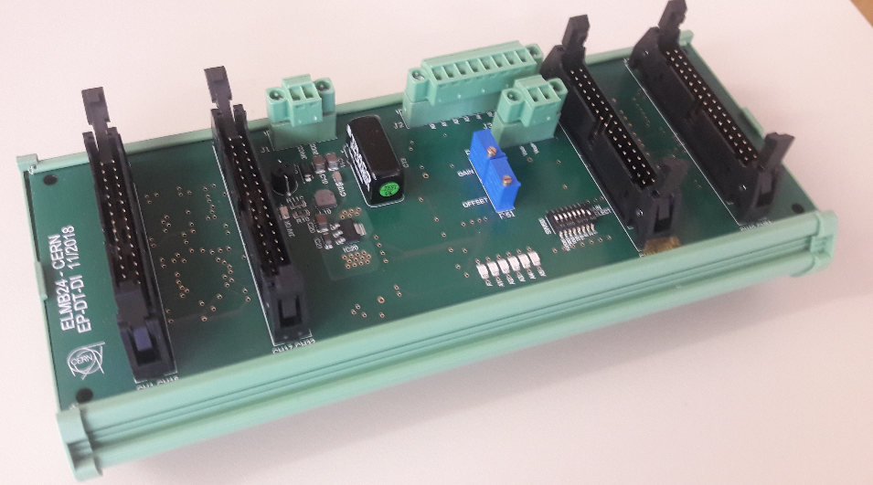
Magnet Diagnostic System
CMS Flux Loop readout layout
ALICE L3 temperature monitoring upgrade
ATLAS ELMB to PLC readout – Bussbar Monitoring

Slide 23
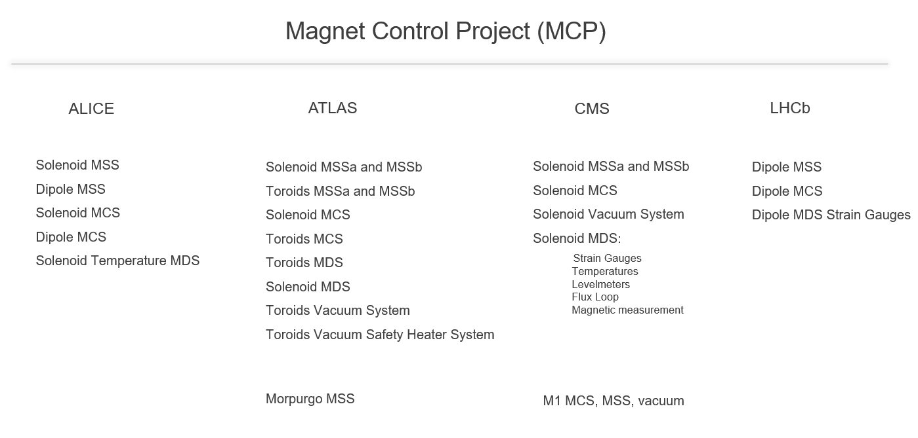
DT-DI is also providing support to the: Compass, AeGis, Vertex 1 and 2, M1 and M2 and T2K (Old UA1) magnets

Slide 24











EP-DT-DI Magnet Control Project (MCP 2025)
ALICE
ATLAS
CMS
LHCb
Workshop / FSU
Giulio Malaguti
Laurent Deront
Jarl Pettersen
Maciej Ostrega
Giulio Malaguti
Jerome Bourachot
Bayram Dinger
MSS Software Experts
MCS/MSS Hardware Experts
MCS Software Experts
Murat Dinger
Sylvain Ravat
Laurent Deront
Xavier Pons
Maciej Ostrega
Sylvain Ravat
Valentina Reynaud
Marc Carrichon

Slide 25
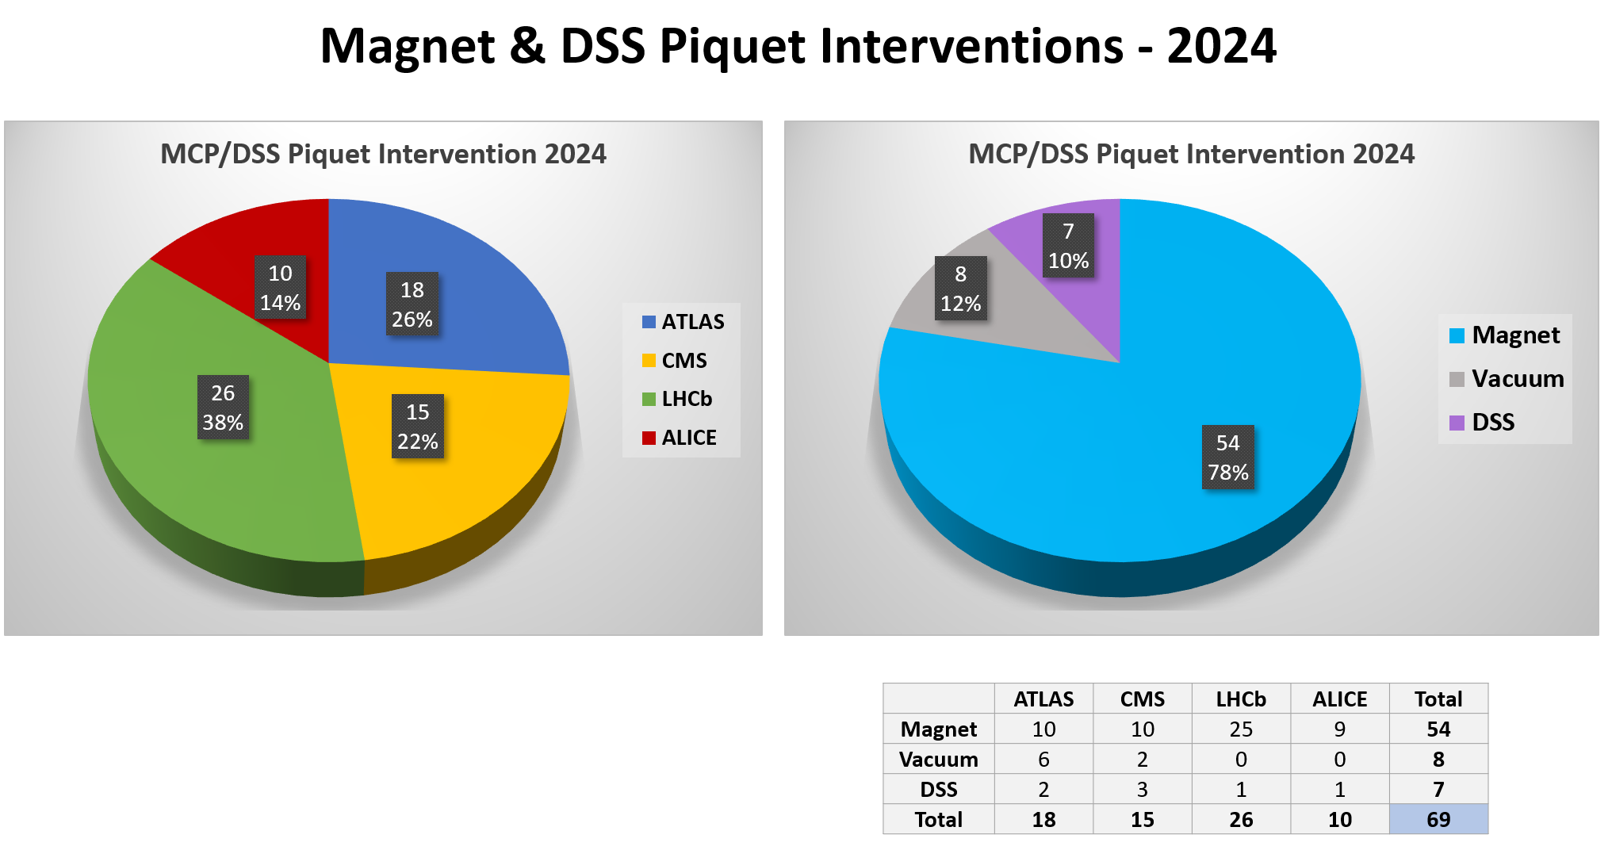




Maciej Ostrega
G. Malaguti
J Pettersen
X Pons
K Barth
(ALICE)
A Meynet
(CMS)
J Vizdal
(ATLAS)
L Roy
(LHCb)

Slide 26
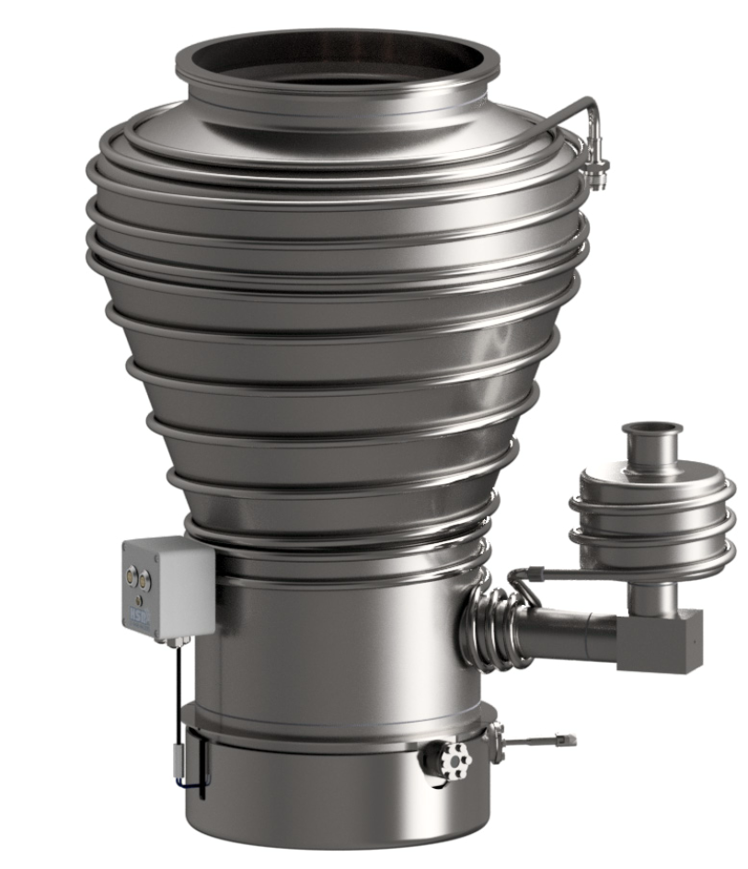
LS3 Activities
1- Replace the battery charger of the MSS and QH
2- Replace the batteries
3- MDS: New updated MDS in Atlas
4- MSS Interfaces:
- Update of the DI Interfaces
- Updated of the DI/DO Interfaces
- VAM
5- Replace the cRIO-FPGA + modules
VAM – Quench detection board
Vacuum Activities
1- To install the diffusion pumps
2- To Install the DC power for these diffusion pumps =>
2.1 New DC power supply rack
2.2 New EXD6 power cabinet
3- Maintenance of the primary pumps (replace by new ?)
4- Maintenance of the diffusion pumps (last year before run)
5- Replacement of the Vacuum gauges
ATLAS new diffusion pump

Slide 27
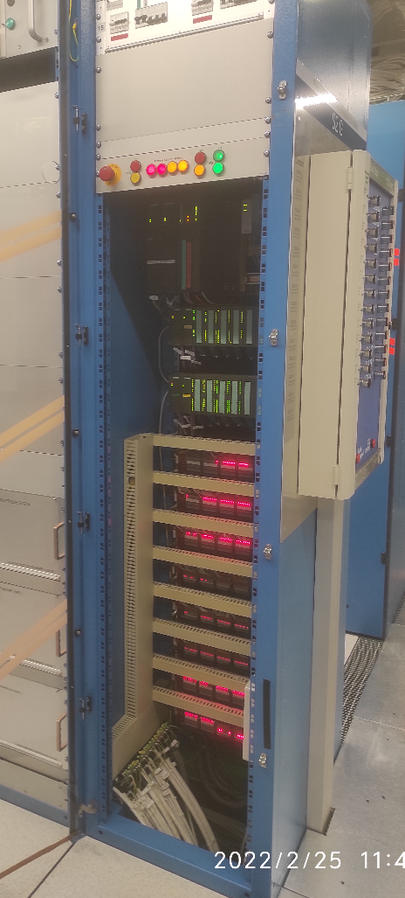
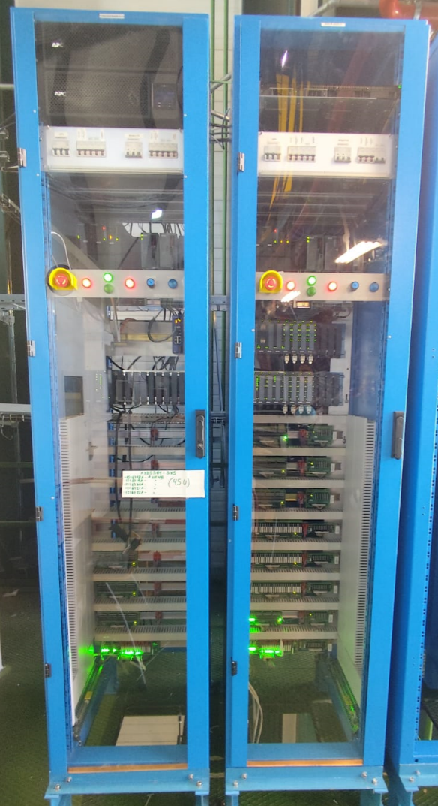
About Detector Safety System
Recently DT-DI established an agreement with the LHC Experiments and in collaboration with BE-ICS in order to provide support for the LS3 upgrade of the Detector Safety System (DSS) to the new version DSS2
Basically, consist in a production of 50 racks with the new redundant PLC based on Siemens S7-1500 and the replacement of all the connections
OLD DSS
Siemens S7-300
New DSS – CMS P5 Surface Tests
Siemens S7-1500

Slide 28
Conclusion
DT-DI is collaborating closely with the Experiments to ensure optimal magnet operating conditions after LS3.
Special thanks to Matthias Mentink, Anna Kario, Benoit Cure, Alexey Dudarev, and Herman Ten Kate for their continuous support.

Slide 29
Thank you for your attention, questions?

Slide 30
Backup

Slide 31
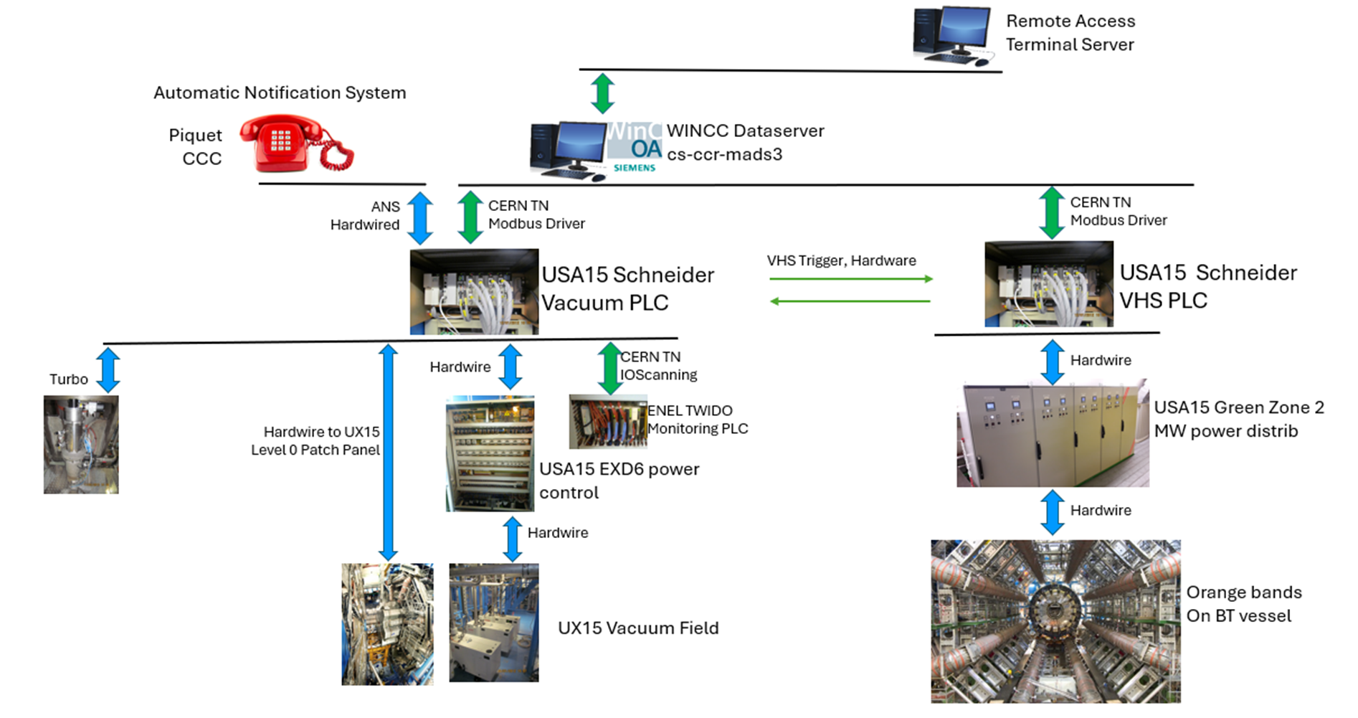
Magnet Control System
ATLAS Vacuum Control System Layout

Slide 32
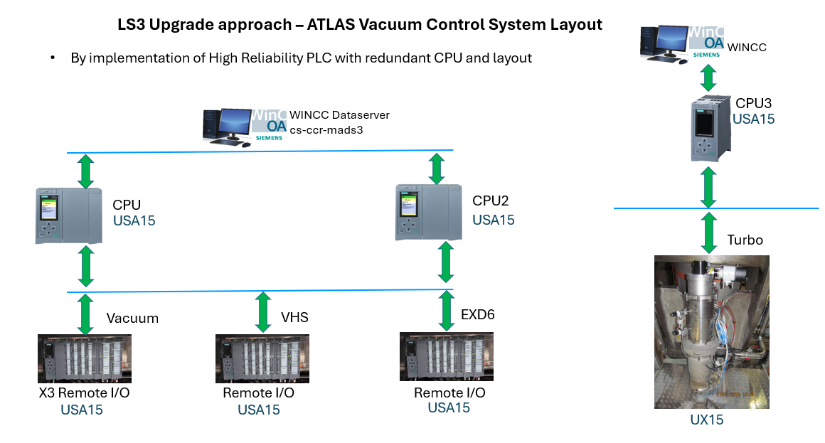
Magnet Control System Upgrade

Slide 33
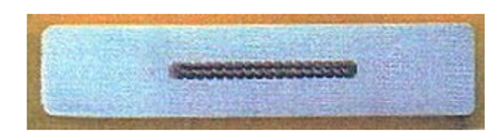
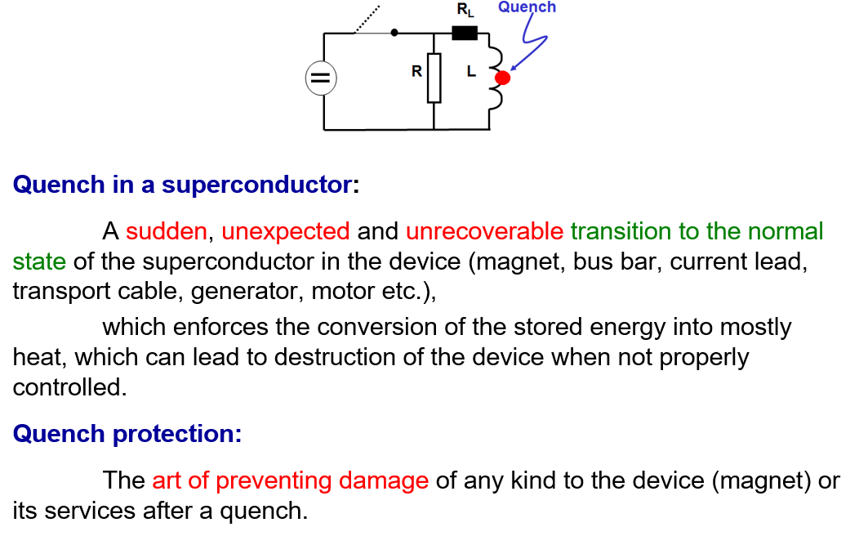
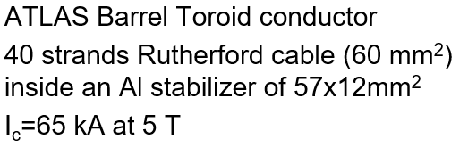
Why a Magnet Safety System?
Prof. H Ten Kate: CERN Accelerator School on Superconductivity for Accelerators, Erice 2013

Slide 34
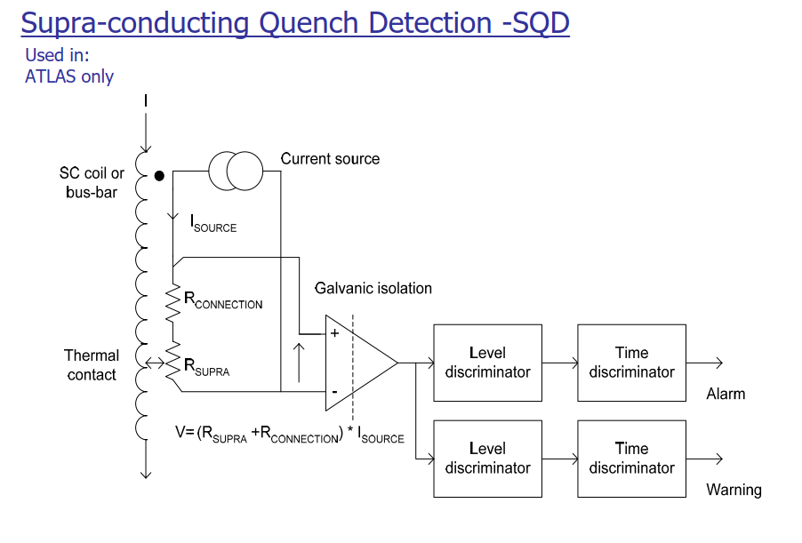

Slide 35
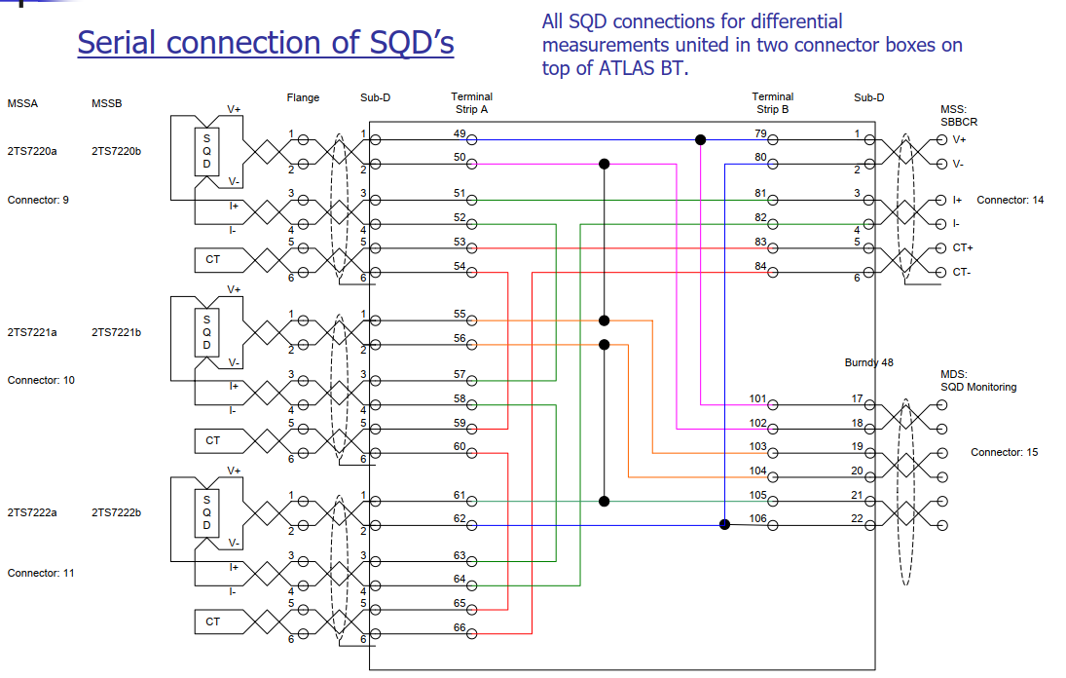

Slide 36
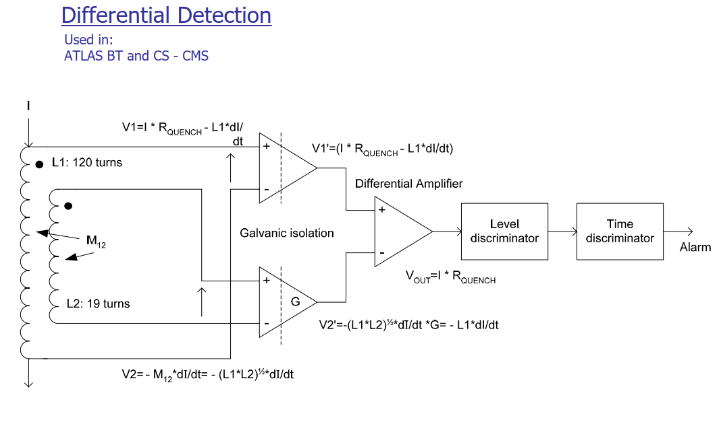

Slide 37
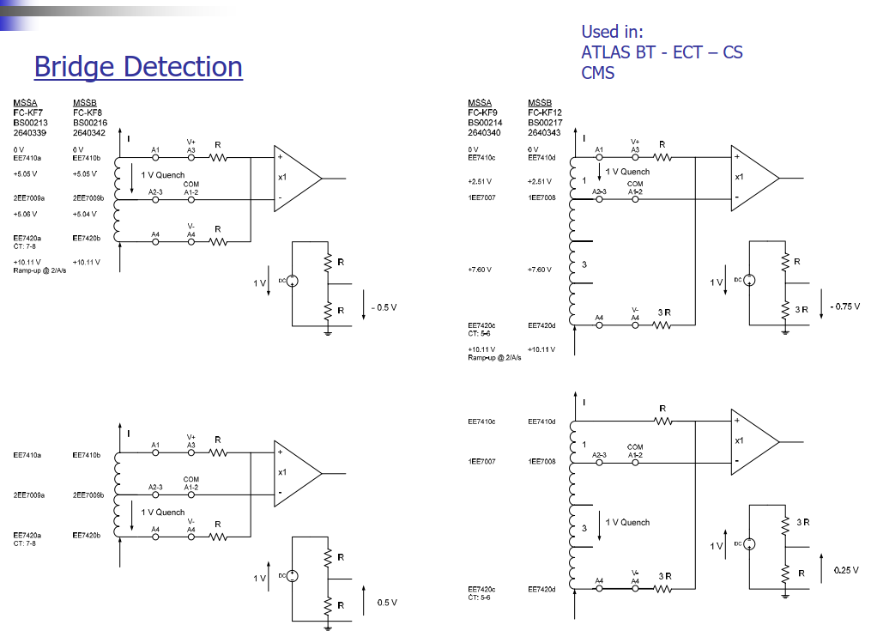

Slide 38
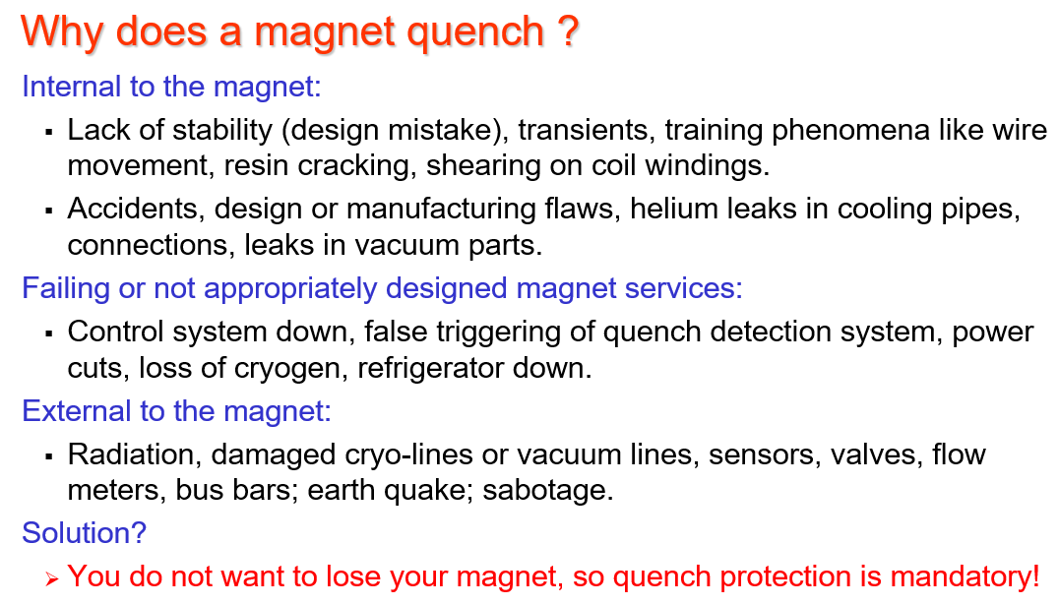
Introduction 2. Why a Magnet Safety System?
Prof. H Ten Kate: CERN Accelerator School on Superconductivity for Accelerators, Erice 2013
DT-DI MSS is a quench protection system

Slide 39

Why a Magnet Safety System?

Slide 40
MSS2 Hardware Architecture Overview
ANALOGUE INPUT INTERFACE BOARD
Dual Analogue Input Range
Multiple signal range, hardware programmable range:
x1, x10, x100, x1000
set by DIP switch.
Signal isolation 1500Vrms.
Power supply circuit isolated 3 kV by DC-DC converter between channel - channel-FPGA_AI - Power_Supply
Each channel has its own selectable current source by DIP_SWITCH.
0.01 mA, 0.1 mA, 1mA, 10 mA.
MSS2 Analogue Input interface board
Optional low pass filter
Optional gain and offset adjustment
Time and level discrimination done at FPGA level
EDMS

Slide 41
MSS2 Hardware Architecture Overview
MSS2 Main crate
  Following L. Deront design
  6U crate size for 19’ rack assembly compatible with all MSS
  cRIO FPGA installed in the front side
  Input/Output Interface board in the back side
  Redundant Power supply
MSS2 cRIO crate. Front Side view
MSS2 cRIO crate. Front Back Side view
MSS2 Prototype

Slide 42


Why a Magnet Safety System?
LHC Dipole interconnection September 2008

Slide 43











Remote Access
Terminal Server
Automatic Notification System
Piquet
CCC
WINCC Dataserver cs-ccr-mads3
ANS
Hardwired
CERN TN
Modbus Driver
CERN TN
Modbus Driver
USA15 Schneider Vacuum PLC
VHS Trigger, Hardware
USA15 Schneider VHS PLC
Hardwire
CERN TN
IOScanning
Hardwire
Turbo
ENEL TWIDO
Monitoring PLC
USA15 Green Zone 2 MW power distrib
Hardwire to UX15 Level 0 Patch Panel
USA15 EXD6 power control
Hardwire
Hardwire
Orange bands
On BT vessel
UX15 Vacuum Field

Slide 44




LS3 Upgrade approach – ATLAS Vacuum Control System Layout
By implementation of High Reliability PLC with redundant CPU and layout
WINCC
CPU3
WINCC Dataserver cs-ccr-mads3
USA15
CPU
CPU2
USA15
USA15
Turbo
Vacuum
VHS
EXD6
X3 Remote I/O
Remote I/O
Remote I/O
USA15
USA15
USA15
UX15

Slide 45


8 inputs 0-10V or 4..20mA
Possible to mix
45 mm wide
9 inputs RTD, PT100, PT1000
For Siemens 6ES7531-7PF00-0AB0
45 mm wide

Slide 46


32 Digital Inputs – logic 0-24V
Optocoupled Toshiba TLP627M (=DSS)
Input overvoltage protection TVS 33V
Status LED for each DI
72 mm wide
Optocouplers individually replaceable
Module fuse protected
For Siemens 6ES77521-1BL00-0AB0

Slide 47

I/O Interfaces – Digital Output
32 Digital Output – Relay with COM, NO, NC contacts
Key Switch Override function, closes all the relays
Status LED for each DO
72 mm wide
Design finished,
Both Digital Input and Output interfaces are on endurance test
They require a new version wit cables entering from top

Slide 48
MSS Deployment
 |  | cRIO Crate | DI/DO | DI | Analogue Crate | Analogue Boards
ATLAS | BT | 2 | 1 | 2 | 4 | 32
 | ECTA | 2 | 1 | 0 | 4 | 32
 | ECTC | 2 | 1 | 0 | 4 | 32
 | Solenoid | 2 | 1 | 2 | 4 | 32
CMS | Solenoid | 2 | 1 | 2 | 4 | 32
Alice | Dipole | 1 | 1 | 2 | 0 | 0
 | Solenoid | 1 | 1 | 2 | 0 | 0
LHCb | Dipole | 1 | 1 | 2 | 1 | 2
M1 |  | 1 | 1 | 1 | 2 | 16
Vertex |  | 2 | 1 | 1 | 3 | 20
Compass |  | 1 | 1 | 1 | 2 | 16
Morpurgo |  | 1 | 1 | 1 | 1 | 8
SUM |  | 18 | 12 | 16 | 29 | 222

Slide 49

FD on 17.10.2024

Slide 50

FD on 17.10.2024
CRs close command at 20:15:30.030
DSS alarm at 20:14:57.
FD took place after trigerring an SD, within 3s.
Magnet current was 16977 A (3.55T at IP).
CPs open command at 20:15:32.030
FD at 8:15:32.100
CRs open at 20:15:33.905 after quench detection on DT3a

