Slide 1

Status of ESPPU preparation
One document is in preparation by the IMCC, describing achievements and status (evaluation) and a proposal for the next step (R&D). Main contributors so far are LB, SSF, BB, MS, FB, SM and BC

Slide 2
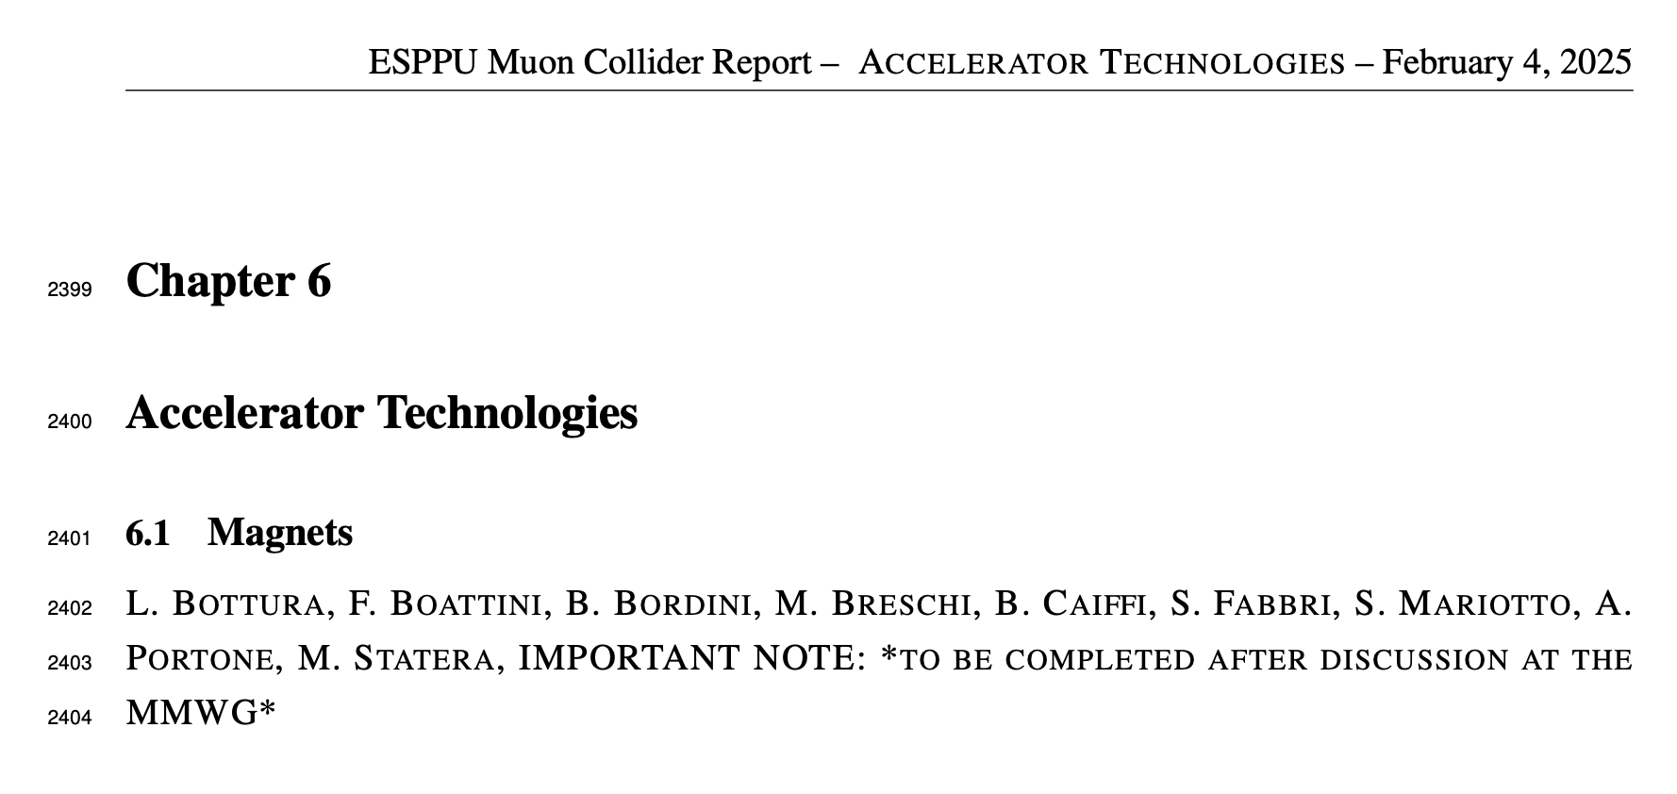
Evaluation
Extensive description of work (over 40 pages), still being polished and reviewed. The document is uploaded in the indico page of this meeting
IMPORTANT: review authorship, please announce yourself to LB and SSF

Slide 3
Magnet R&D for the Muon Collider
A stand-alone document is in preparation, for independent submission to the ESPPU. Why a separate document ? (mail to F. Meloni, Ch. Rogers, D. Schulte, 5/2/2025)
“The pathway we have identified is challenging and broad, with many implications that are vital for the muon collider, but not only.
As from the full document, working on these magnet technologies we have the potential to impact many other fields of science and societal applications, and I think this deserves a special place in the discussion, possibly even a special discussion in Venice.
Part of the full R&D narrative and proposal is obviously also entering in the Muon Collider ESPPU document

Slide 4
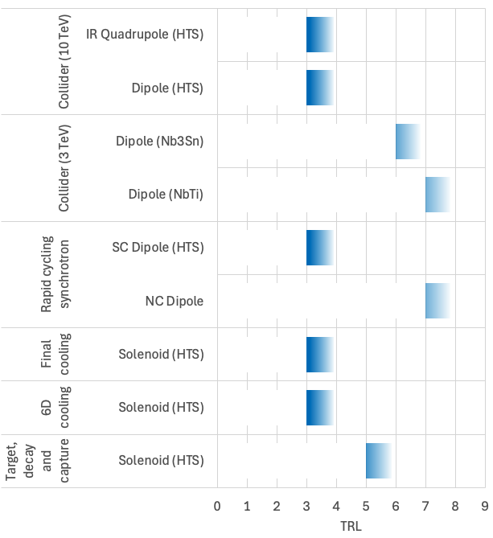
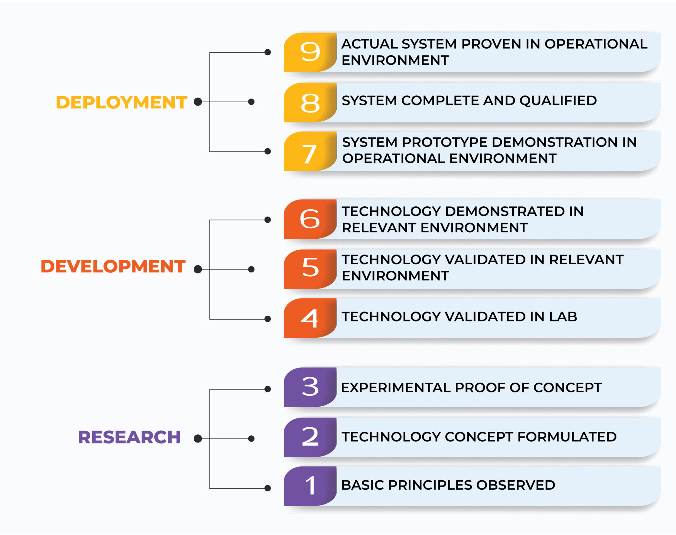
TRL driven R&D
We wish to reach a TRL 6 for decision

Slide 5
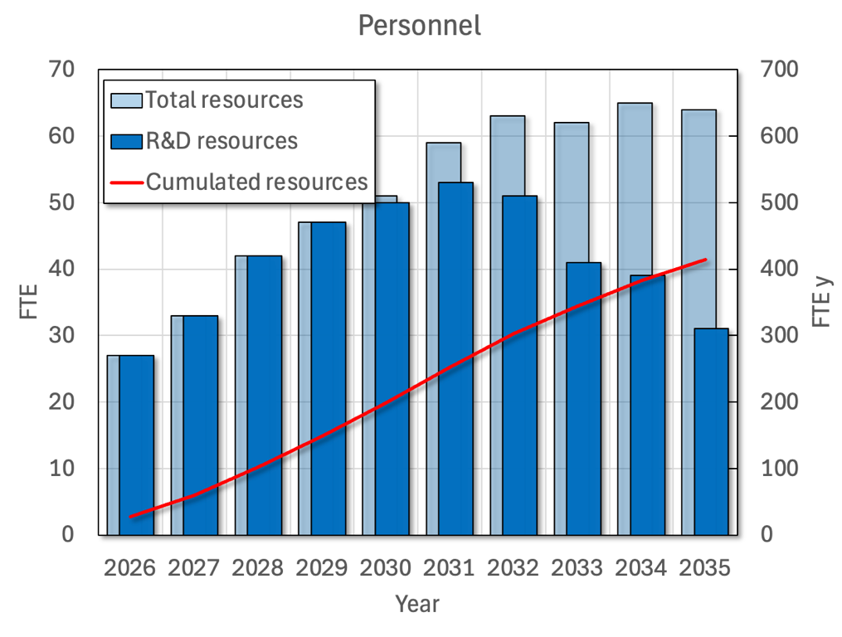
R&D personnel resources

Slide 6
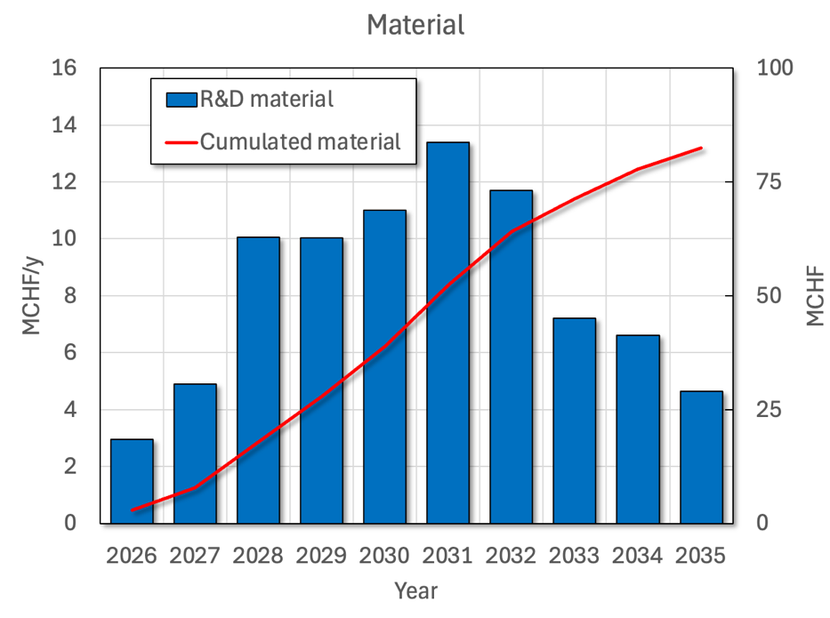
R&D material

Slide 7
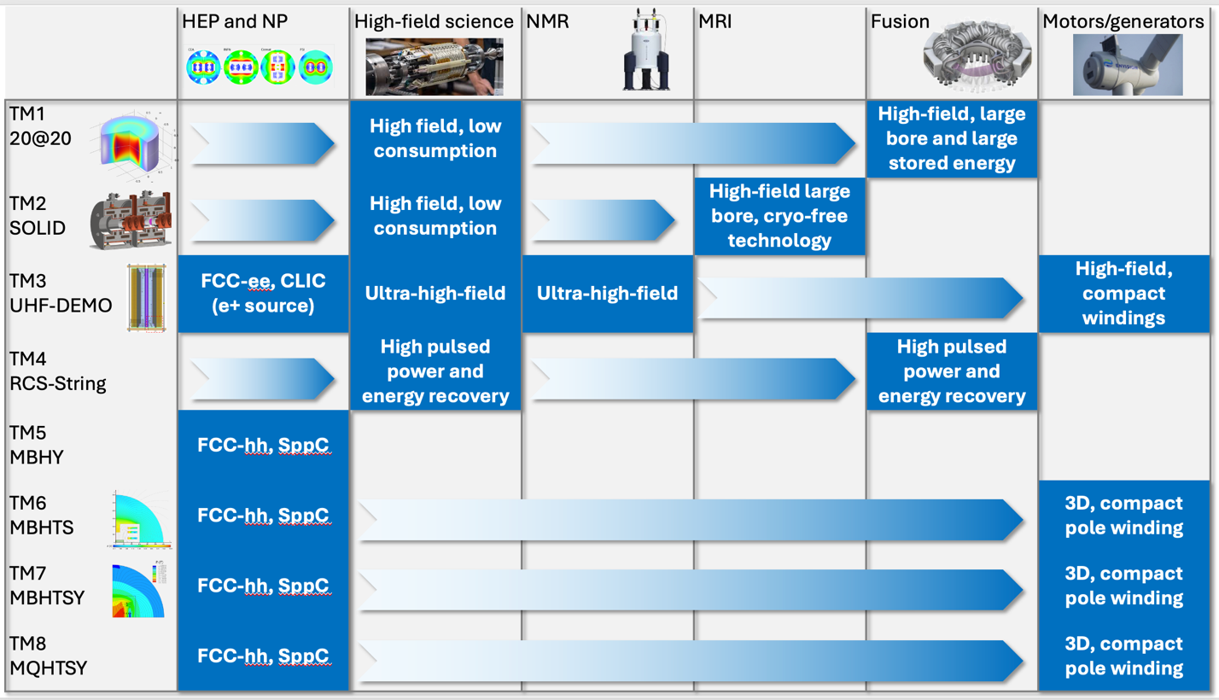
R&D impact

Slide 8
Questions and actions
Read evaluation part, declare authorship. The document is uploaded on the indico site
More on R&D in our next meeting (discussion on the detailed R&D items and potential participation). Present tables of resources are uploaded on the indico site

