Slide 1
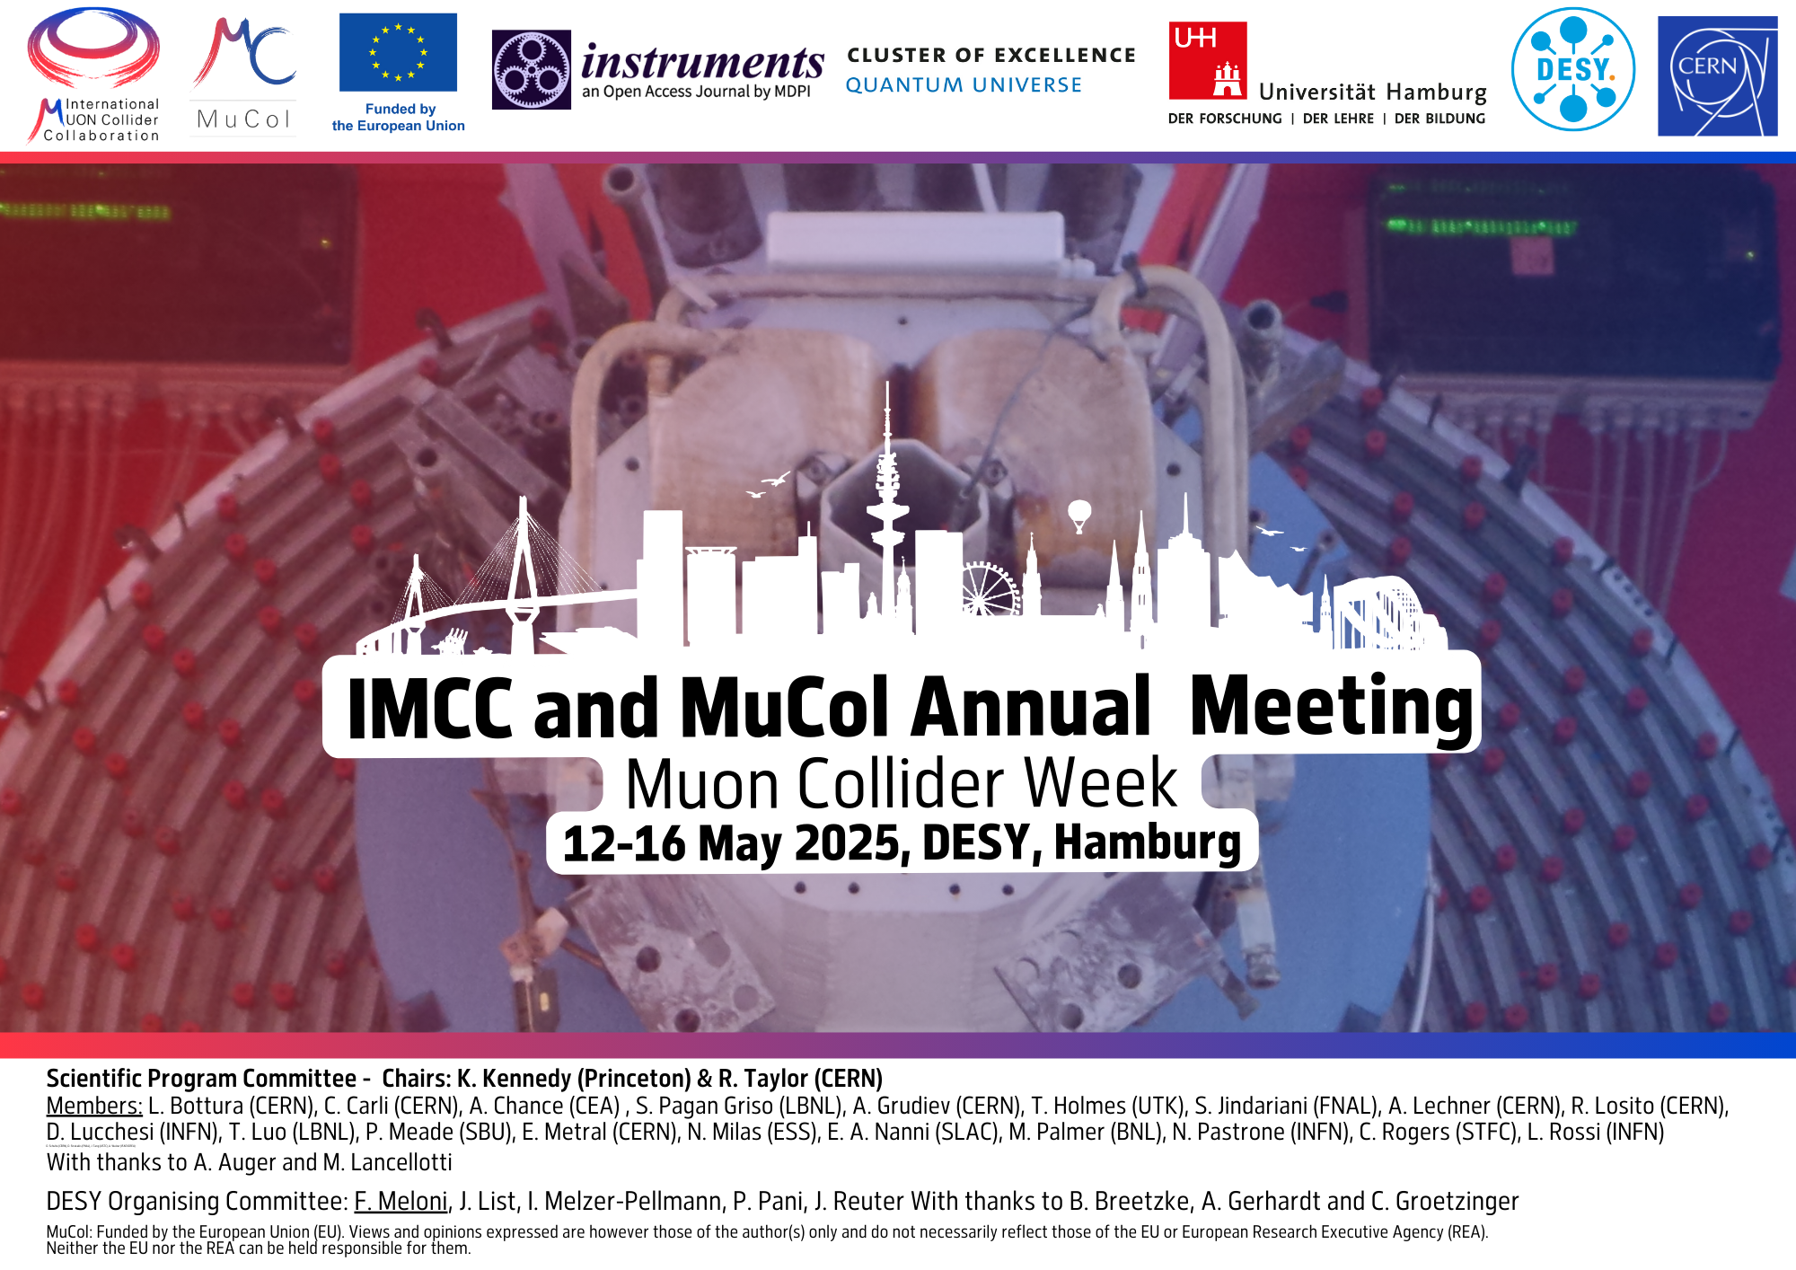

Slide 2
Present plan
Tentative

Slide 3
Questions and actions
Seek input for parallel session: Accelerator Technologies 1- Magnets, Cryogenics & Powering
We probably would need a parallel magnet-only session to discuss (tentative)
  Technical highlights
  ESPPU submission and plans (preparatory to Venice)
  AOB

