Slide 1








Performance Limits of Combined Function
Magnets
mmWG, 20 February 2025
D. Novelli^{1,2}, L. Alfonso², A. Bersani², L. Bottura⁵, B. Caiffi²,
S. Farinon², F. Mariani¹, S. Mariotto³ , A. Pampaloni², T. Salmi⁴
¹Sapienza University of Rome, ²INFN – Genoa , ³INFN and University of Milan
⁴Tampere University, ⁵CERN
Funded by the European Union (EU). Views and opinions expressed are however those of the author only and do not necessarily reflect those of the EU or European Research Executive Agency (REA). Neither the EU nor the REA can be held responsible for them.

Slide 2
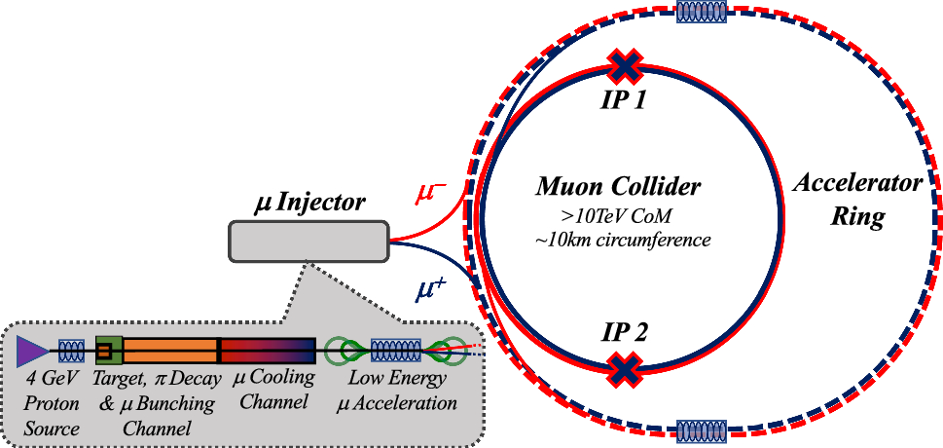
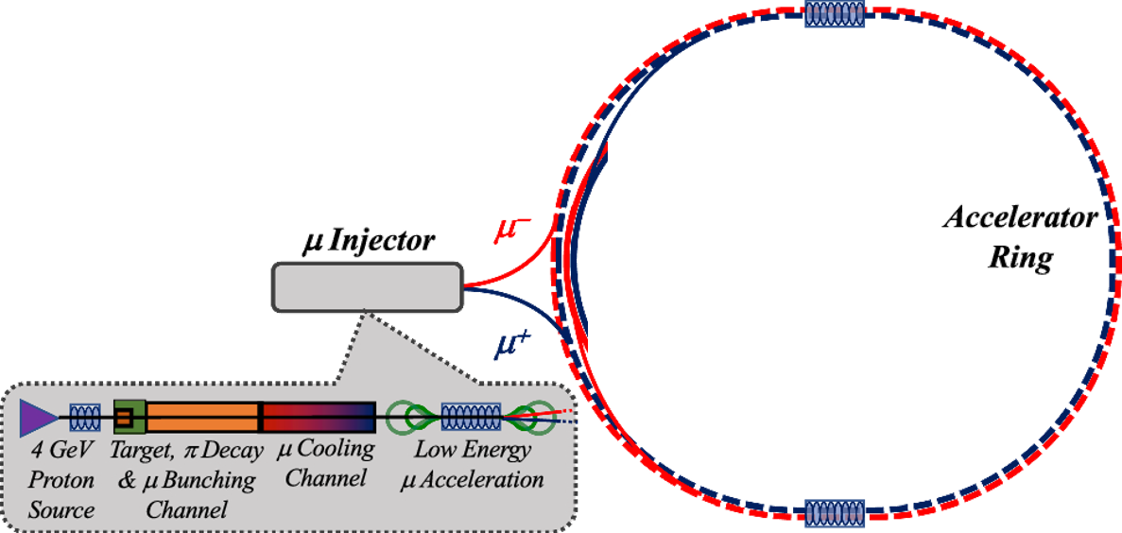
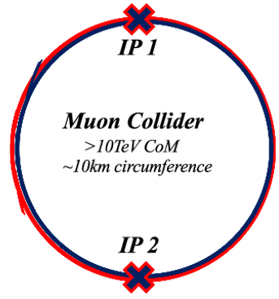
Overview
Main stages of a muon collider complex
Magnets:
Dipoles
Quadrupoles
Sextupoles
Combined Dip+Quad
Combined Dip+Sext
Purpose:
Evaluate realistic performance targets for the collider magnets, in close collaboration with studies of beam physics, cryogenics, and energy storage.
Produce a credible and affordable design study (contain costs, energy efficiency, sustainable operation).
Task 7.4

Slide 3
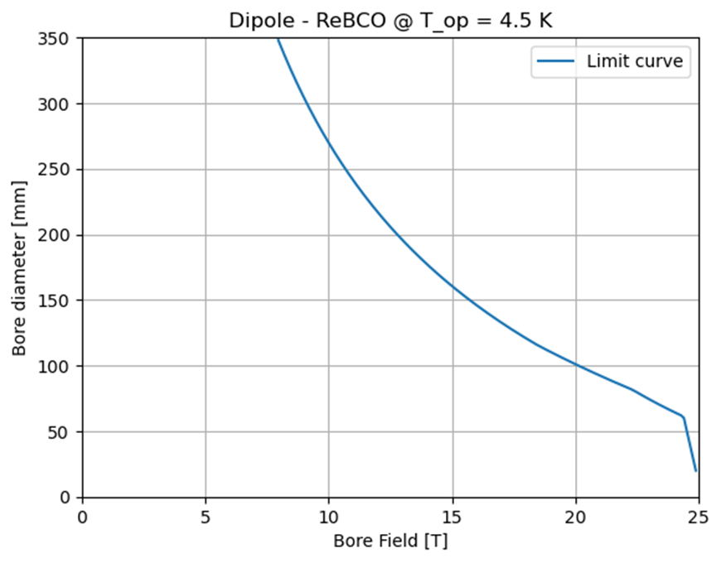
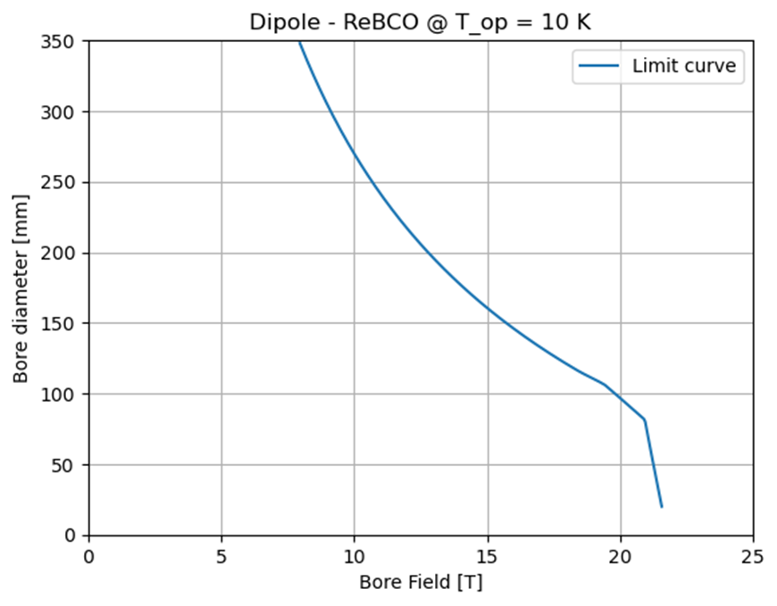
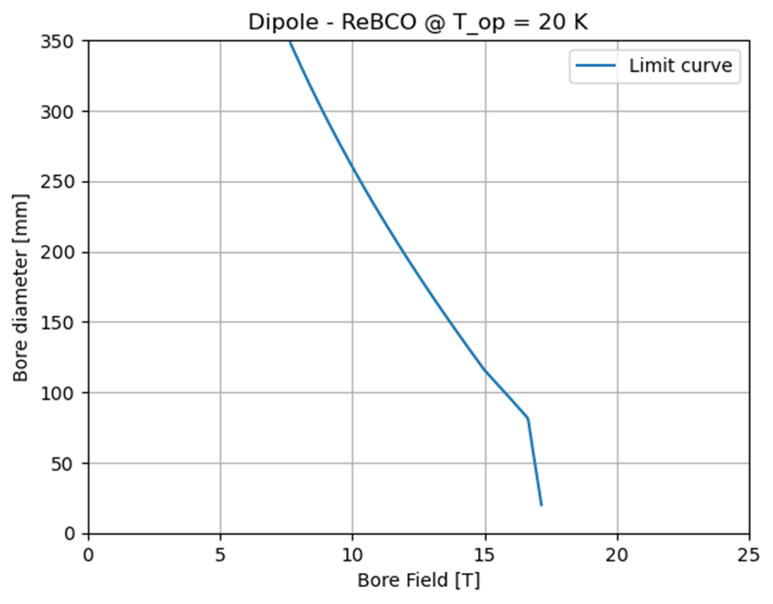
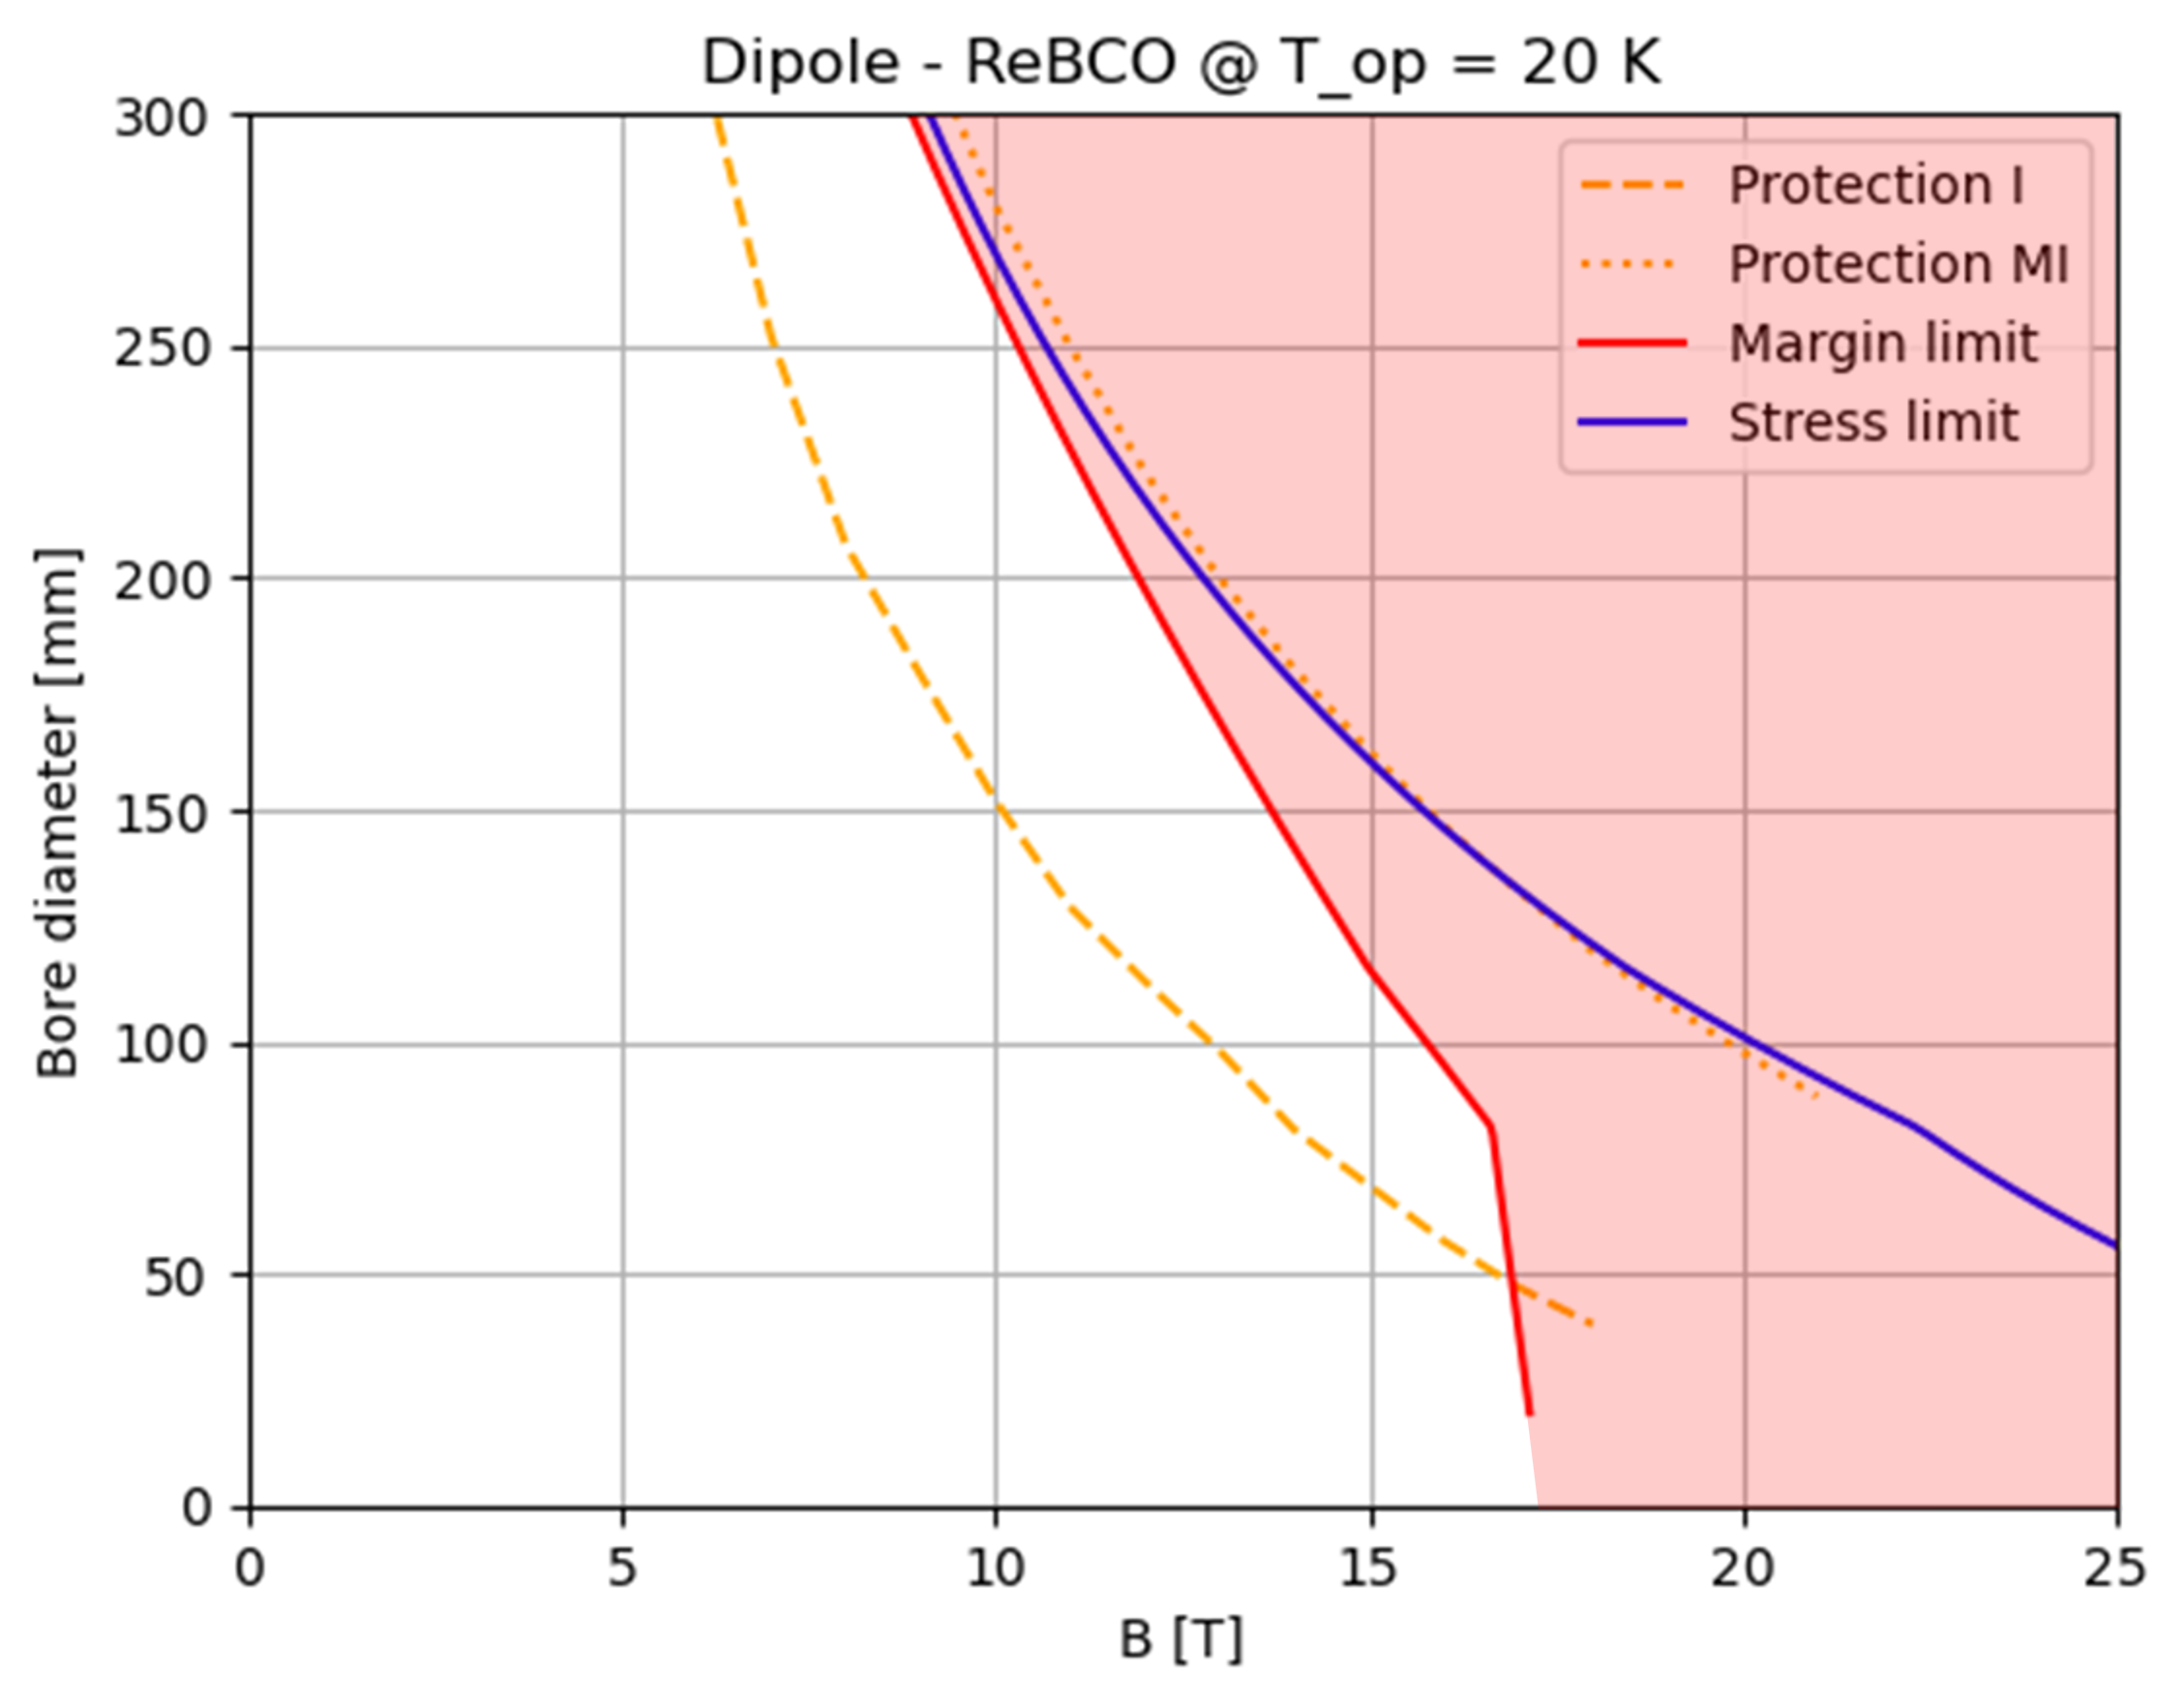
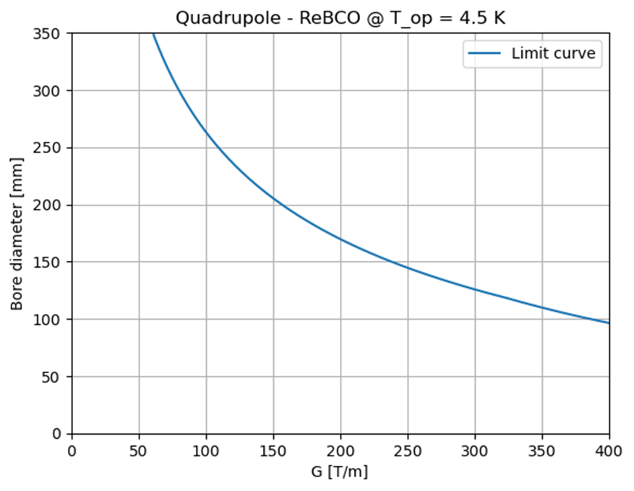
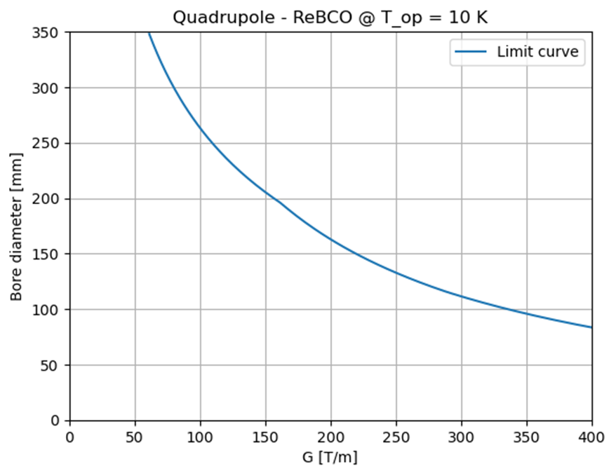
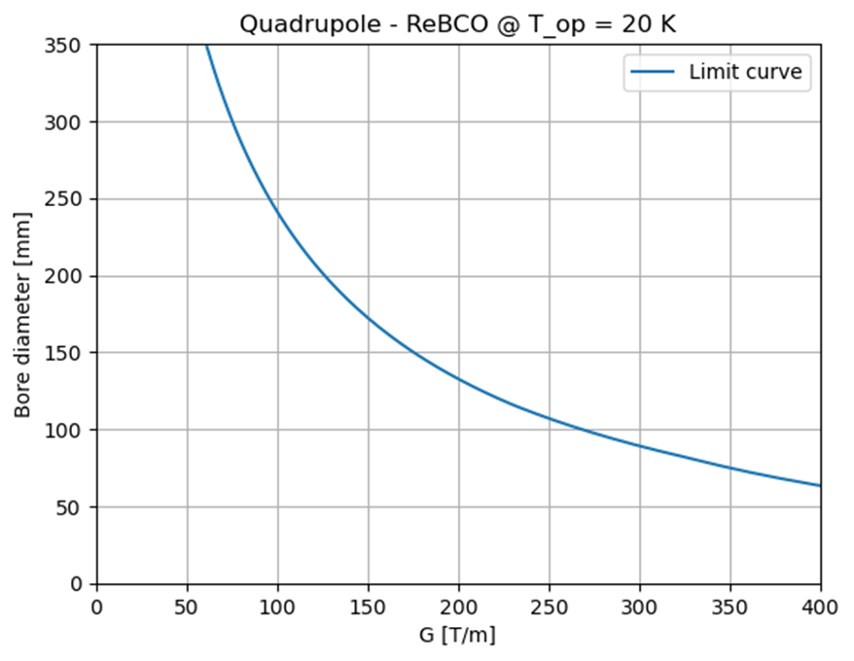
HTS arc A-B and A-G plots
Main assumptions:
– Budget: 400 kEUR/m for each magnet.
– These plots apply to ARC magnets. For the IR quadrupoles, a double budget is assumed.
– SC cost: 2500 EUR/kg (aspirational value).
– Max. coil width: 80 mm
– Max. stress: 400 MPa
– Protection: MI or NI
– Tungsten screen: 3 cm at 20K, increasing to 4 cm if below 20K.
– HTS as baseline for the 10 TeV, NbTi and Nb₃Sn as options for the 3 TeV.
– Filling factor = 0.011
Forbidden area
Forbidden area
Forbidden area
Allowed area
Allowed area
Allowed area
ANALYTICAL STUDY
Limit curves are introduced by mechanical challenges (stress limit), critical current density (margin limit) and stored magnetic energy (quench protection), depending on the superconducting material.
More details here:
https://indico.cern.ch/event/1325963/contributions/5791457/
Forbidden area
Forbidden area
Allowed area
Allowed area
Forbidden area
Allowed area
Notes:
A-B plots show the performance limits as a function of aperture diameter (A) and bore field (B) or gradient (G).
This is an innovative approach, useful for interfacing the needs of beam dynamics with the technological limits (of today and the near future) related to superconducting magnets.
Could provide an immediate feedback capable of analyzing many possible configurations in a single plot.

Slide 4
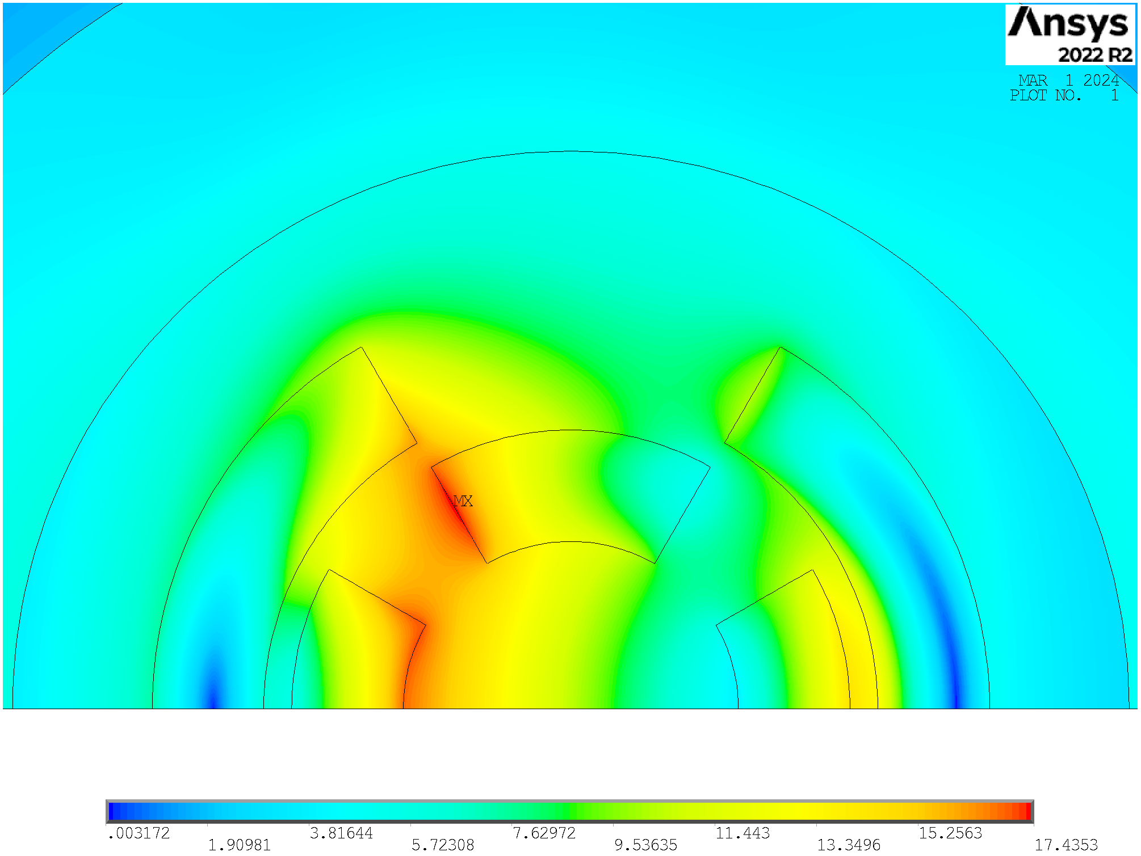
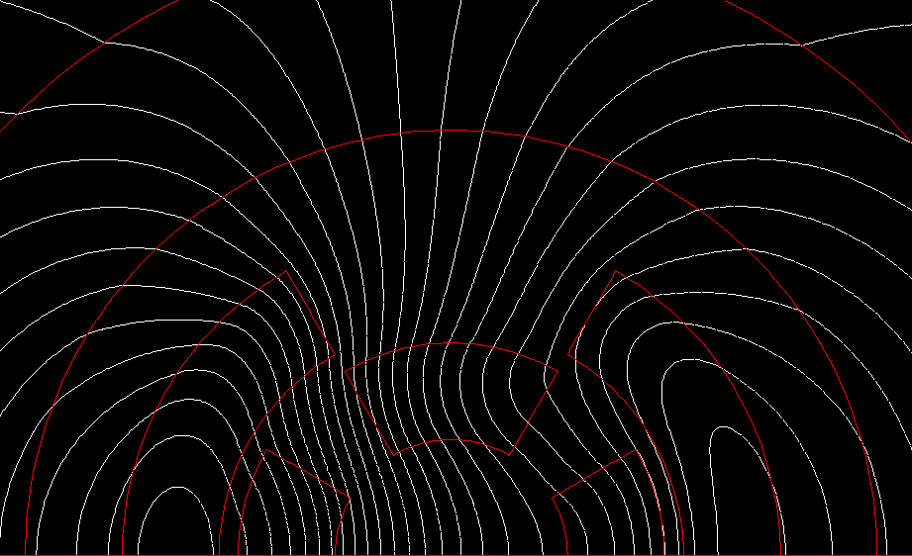
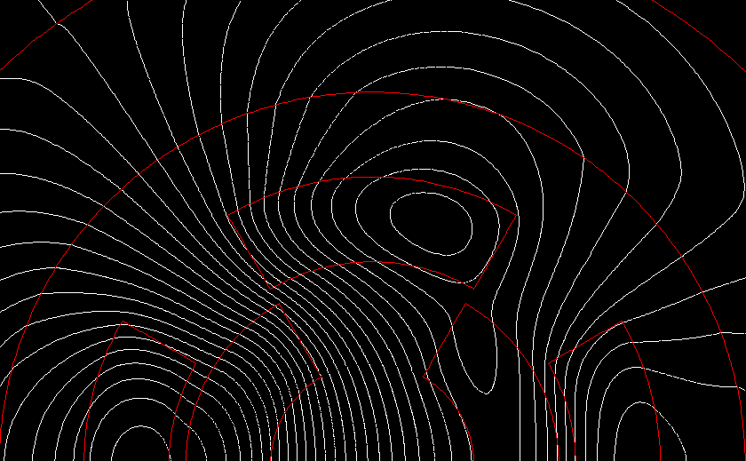
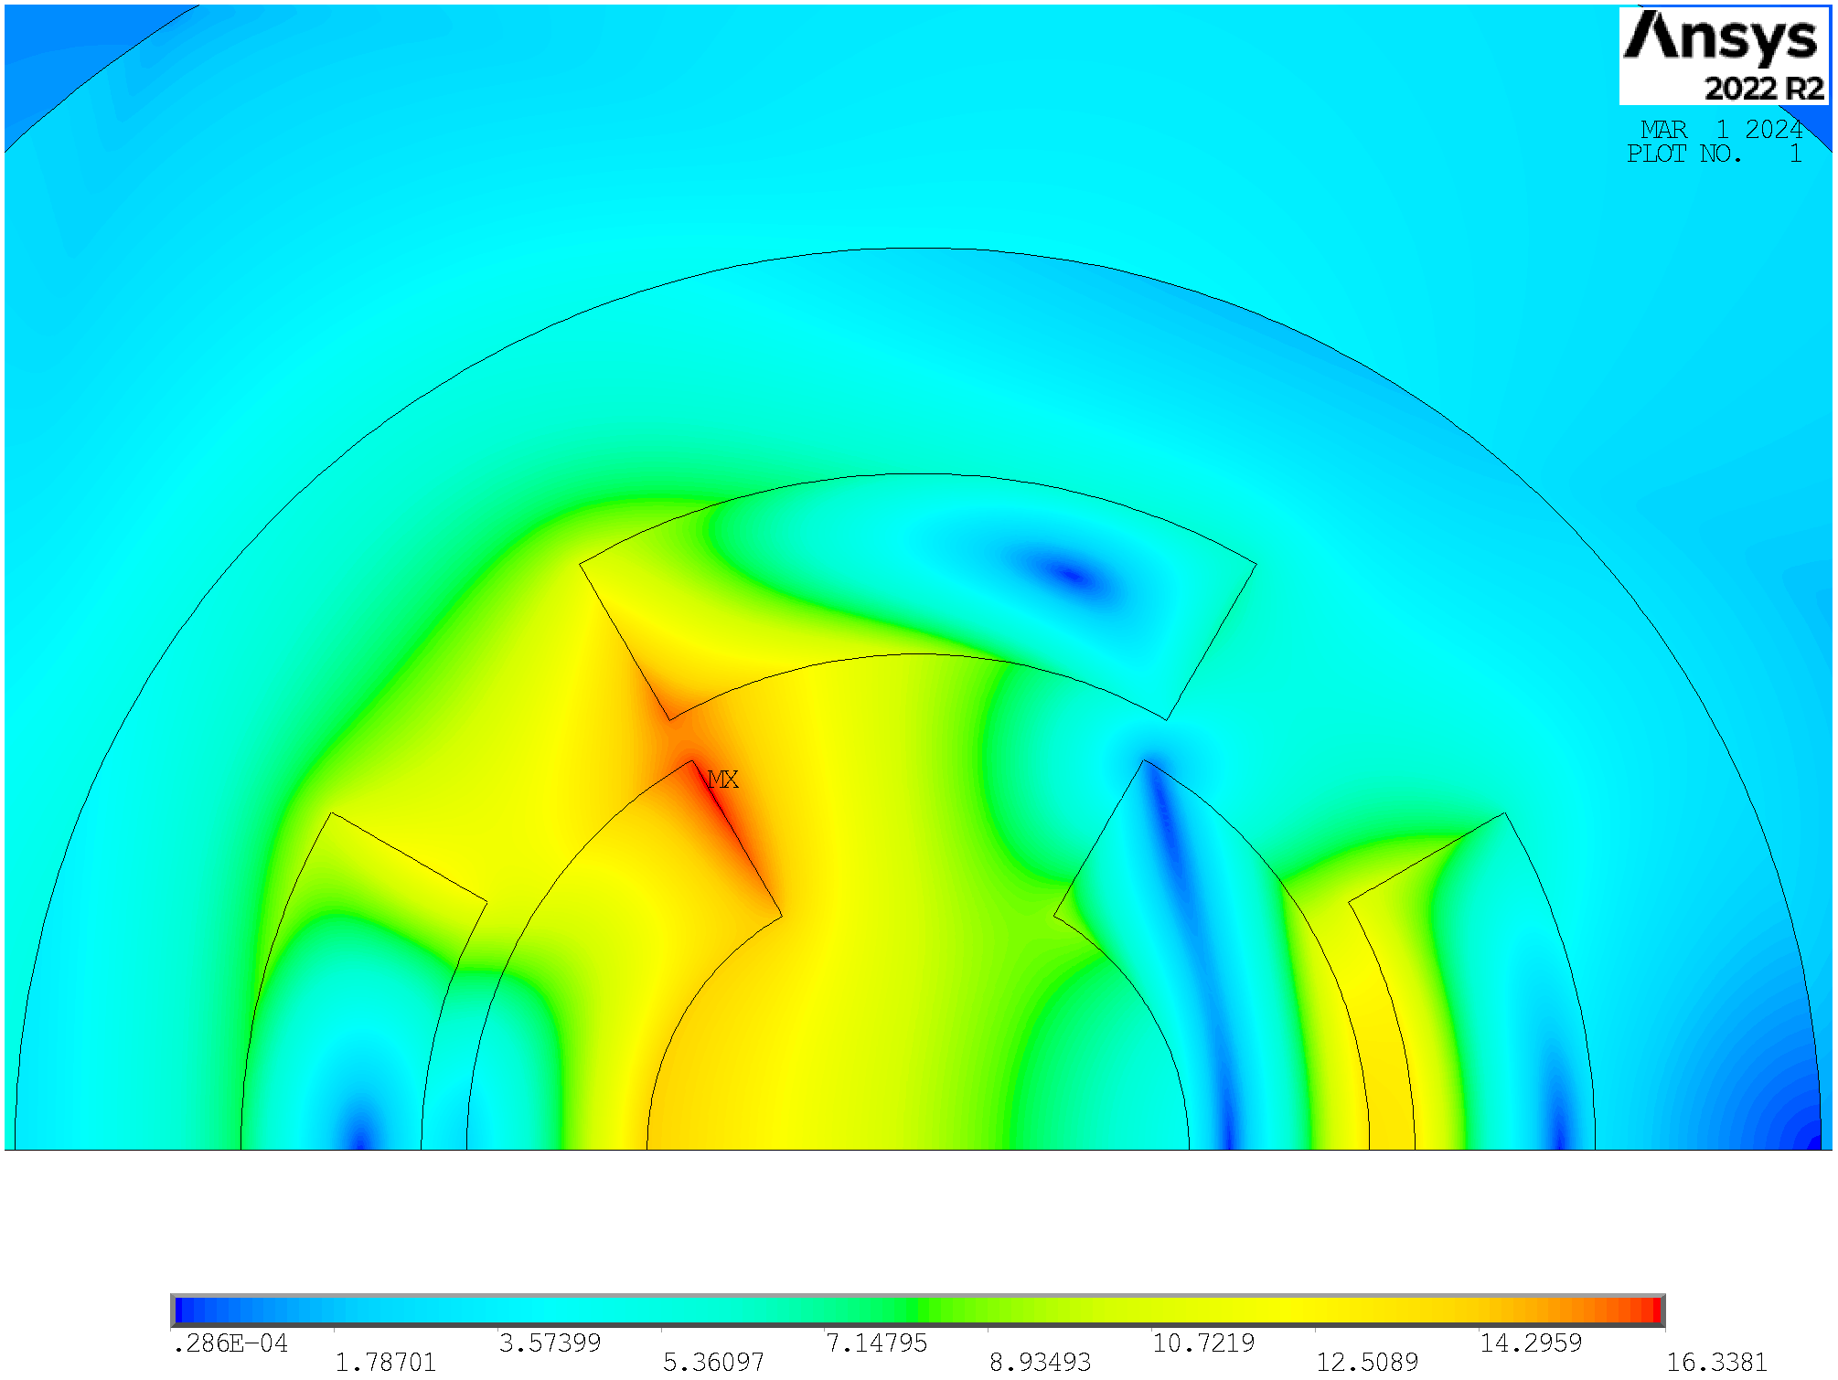
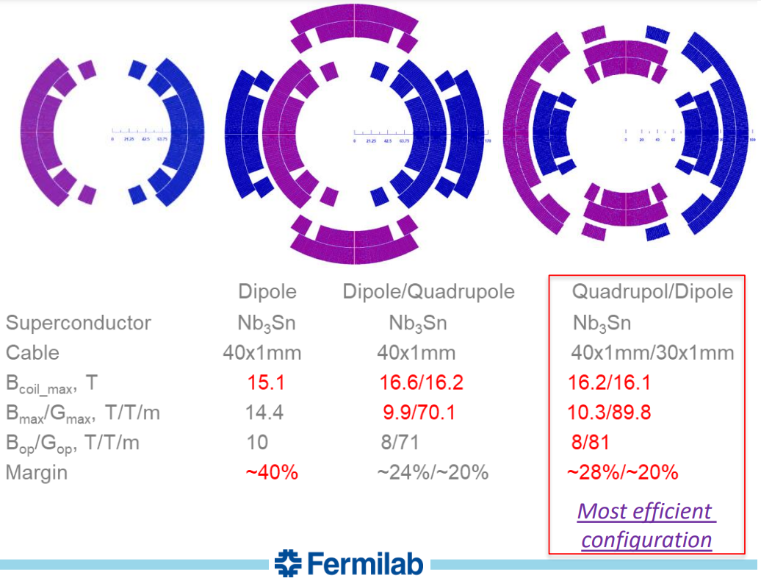
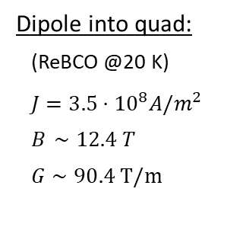
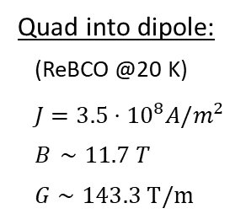
Combined: Nested Configuration
Quad into dipole:
(ReBCO @20 K)
$J=3.5⋅{10}^{8}A/m^{2}$
$B_{ }∼11.7 T$
$G∼143.3 T/m$
Dipole into quad:
(ReBCO @20 K)
$J=3.5⋅{10}^{8}A/m^{2}$
$B_{ }∼12.4 T$
$G∼90.4 T/m$
These two configurations are NOT realistic.
Arc:
Combined function magnets: B1, B1+B2 and B1+B3
B ≈ 8…16 T; G ≈ 320 T/m; G’ ≈ 7100 T/m²
Aperture ≈ 160 mm
Final focus:
Combined function magnets: B1, B2, B1+B2 , B1+B3
B ≈ 4…16 T; G ≈ 100…300 T/m; G’ ≈ 12000 T/m²
Aperture ≈ 120…300 mm
The quadrupole into dipole configuration is the most efficient one, in accordance with US-MAP. Additionally, for combined function magnets in the muon collider, quadrupoles are generally required to be stronger than dipoles.

Slide 5
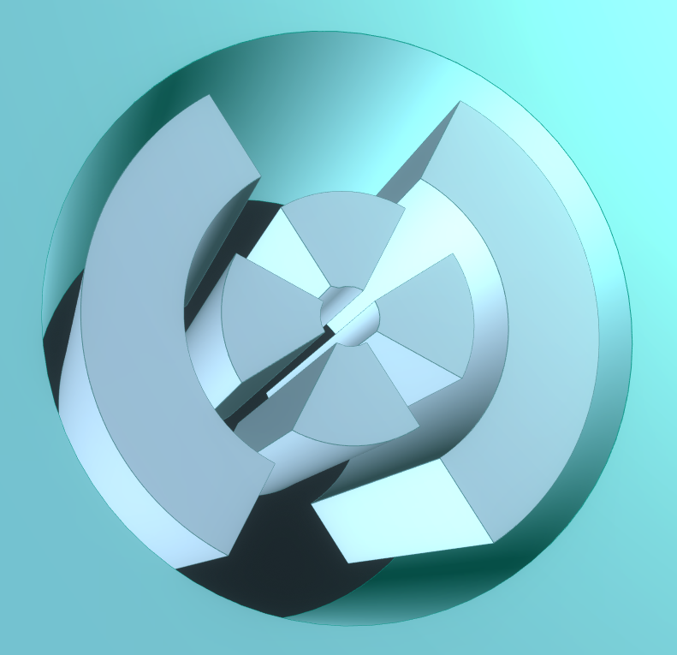
Python-Ansys Interface
A Python-ANSYS interface was developed to run FEM configurations capable of providing the electromagnetic performance of various designs.
Loops were implemented by varying the temperature, a1_quad and w_quad. For each fixed value, the maximum w_dip was calculated using a cost model, and an optimization code for electromagnetic performance was executed. This code aimed to maximize the current density while staying within stress and margin limits.
As anticipated, the performance limits for combined function magnets are significantly more stringent compared to those for dipoles and quadrupoles individually. Extending the curves along the axes reveals the boundaries defined by the A-B and A-G plots.
a1_quad
w_quad
w_dip

Slide 6
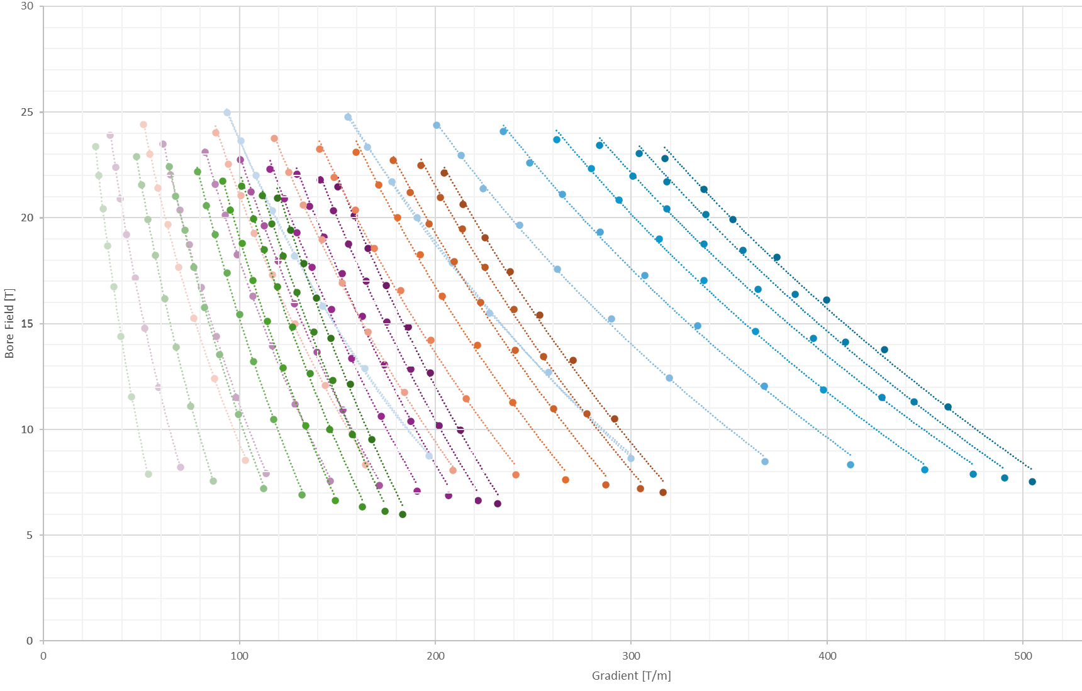
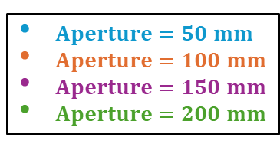
Method: B-G plot at 4.5K
Only EM optimization
$Aperture=50 mm$
$Aperture=100 mm$
$Aperture=150 mm$
$Aperture=200 mm$
Current density
Optimization (1%)
Optimize J_quad​ and J_dip​ to be close to the critical current density:
….
while not ( 0.99 < f < 1.01 ):
…..
→ ANSYS input (a1, w_quad, J_quad, w_dip, J_dip)
Run ANSYS
ANSYS output →
f = J_c (B_peak) / J
if f > 1: J=J*1.01
else: J = J*0.99
…..
…..
the optimization acts on J_quad and J_dip
with corrections of 1%,
and the cycle closes when either
J_quad or J_dip is within 1% of J_c
w_dip
w_quad
Limitations on stress and cost are still missing

Slide 7
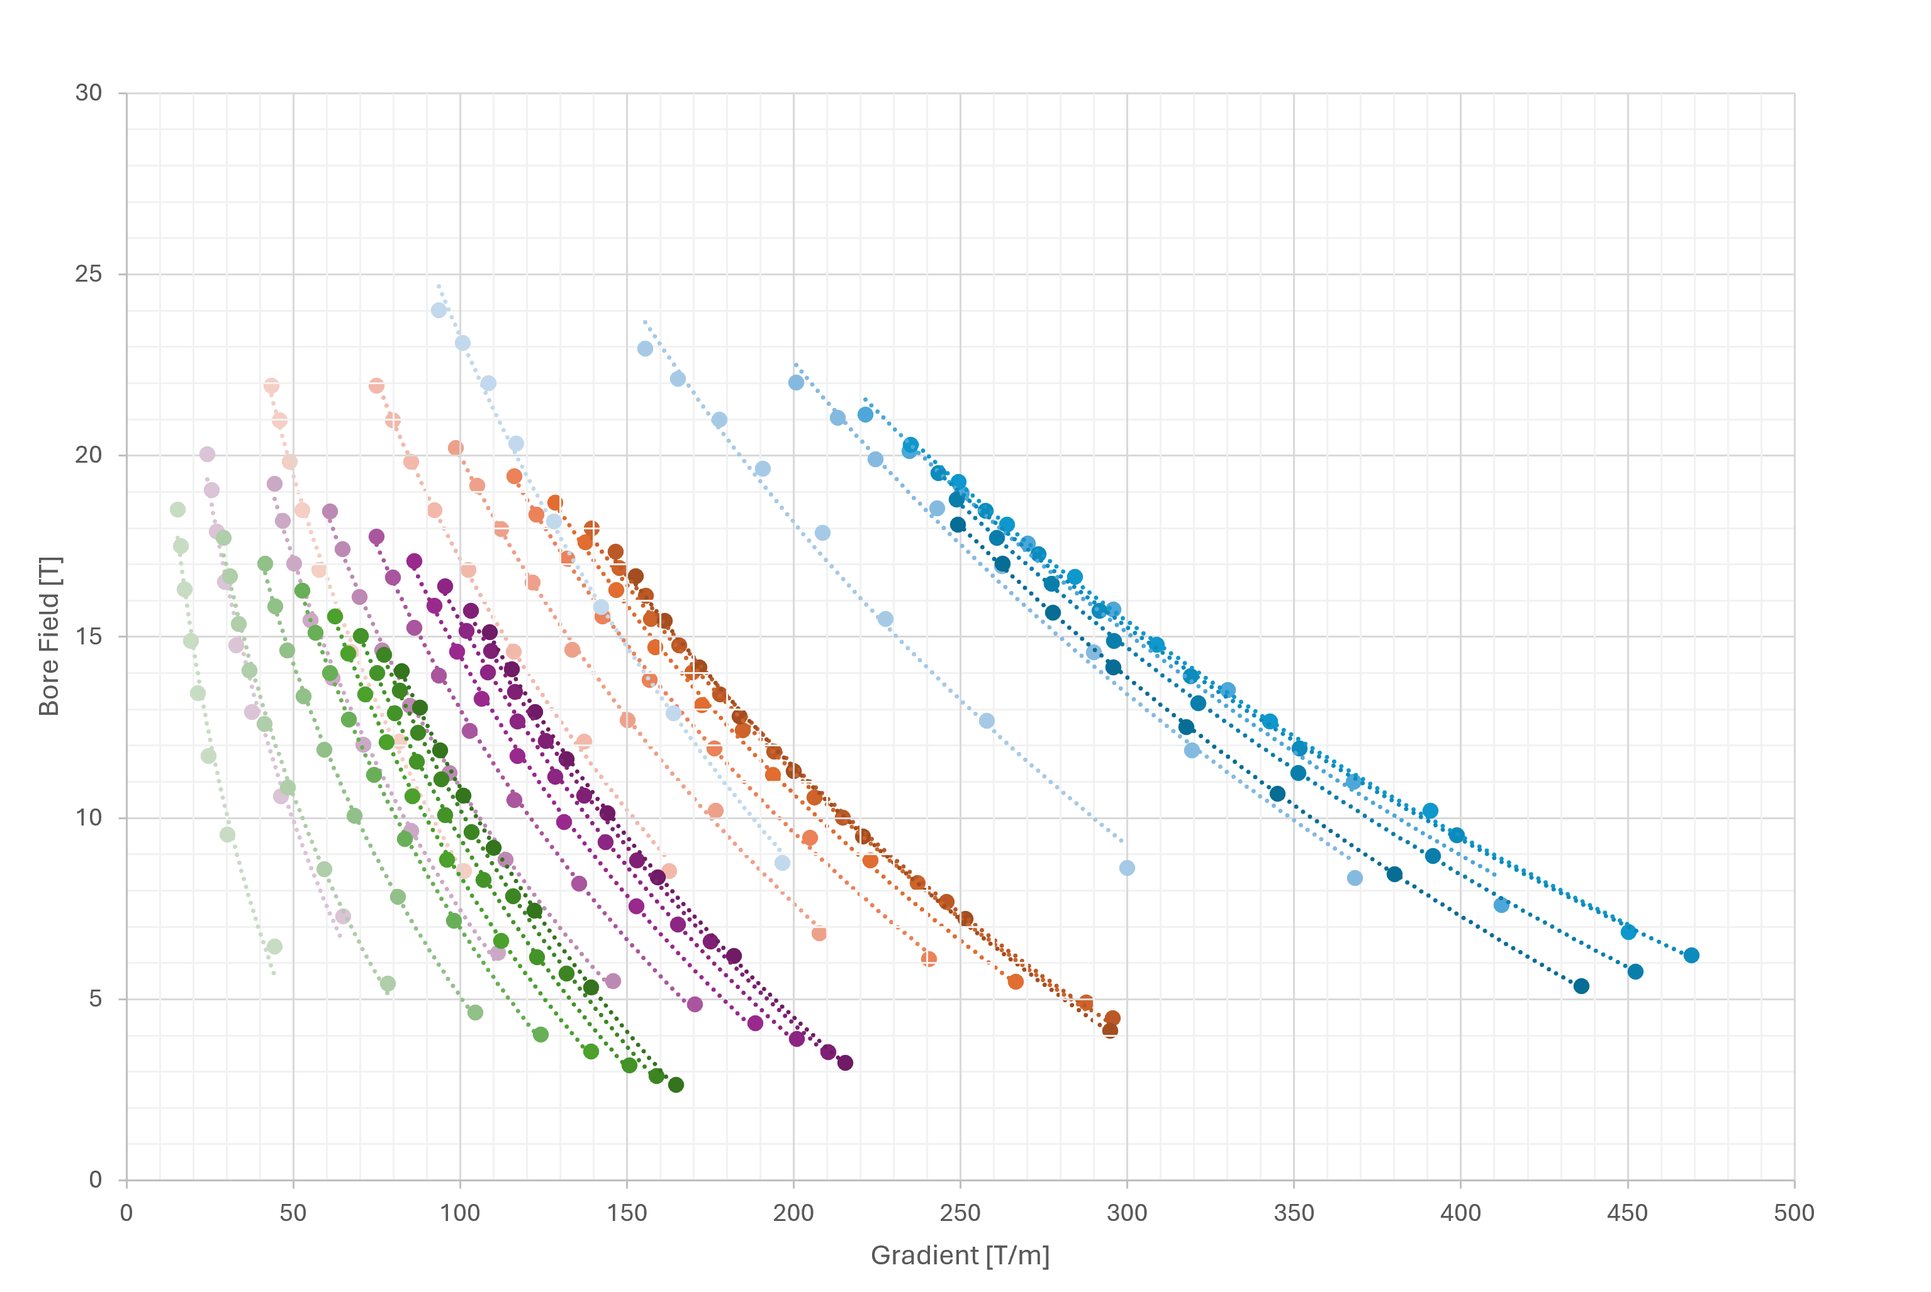
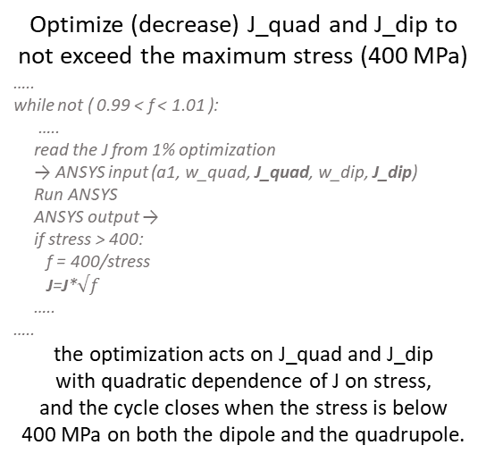
Method: B-G plot at 4.5K
EM and Stress optimization
$Aperture=50 mm$
$Aperture=100 mm$
$Aperture=150 mm$
$Aperture=200 mm$
Midplane pressure
Optimization (1%)
Optimize (decrease) J_quad​ and J_dip​ to not exceed the maximum stress (400 MPa)
…..
while not ( 0.99 < f < 1.01 ):
…..
read the J from 1% optimization
→ ANSYS input (a1, w_quad, J_quad, w_dip, J_dip)
Run ANSYS
ANSYS output →
if stress > 400:
f = 400/stress
J=J*$√f$
…..
…..
the optimization acts on J_quad and J_dip
with quadratic dependence of J on stress,
and the cycle closes when the stress is below
400 MPa on both the dipole and the quadrupole.
Limitation on cost is still missing

Slide 8
Method: B-G plot at 4.5K
EM, Stress and Cost optimization
$Aperture=50 mm$
$Aperture=100 mm$
$Aperture=150 mm$
$Aperture=200 mm$
Cost
Optimization
The dipole coil width (w_dip) can be computed if the aperture radius (a1_quad) and the quadrupole coil width (w_quad) are known.
…..
for a1_quad in range(25,151,25):
…..
for w_quad in range(10, 81, 10):
w_dip = round(cost_model(a1_quad,w_quad),0)
…..
…..
…..
The cost value for the structures and iron is taken from HL-LHC, while the cost of the superconducting material (ReBCO) is based on the aspirational value of 2500 EUR/kg.
  The cost model saves one point for each curve with the same aperture.

Slide 9
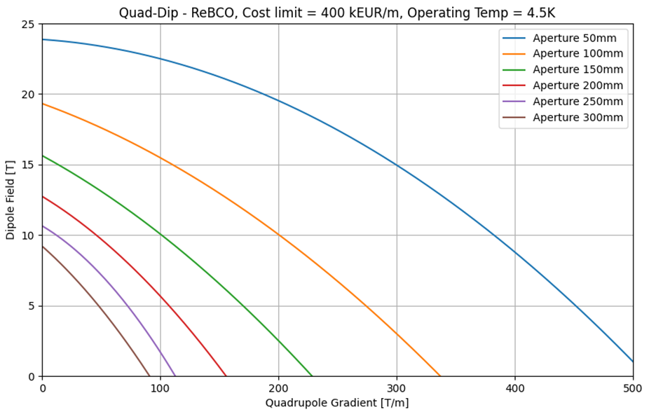
Results: B-G plot at 4.5K
From v0.7:
8 T, 100 T/m, aperture of 310 mm (FF)
8 T, 320 T/m, aperture of 130 mm (ARC)
4 T, 240 T/m, aperture of 170 mm (Corr.)
4 T, 330 T/m, aperture of 130 mm (Corr.)
Courtesy of Kyriacos Skoufaris
https://indico.cern.ch/event/1351046/
Maximum budget = 400 kEUR/m
Labour = 20 kEUR/m
Iron and Structures = 60 kEUR/m
↓
Budget for the SC = 320 kEUR/m
The radial build might change: a solution needs to be studied to address the issue of the quadrupole moving inward.

Slide 10
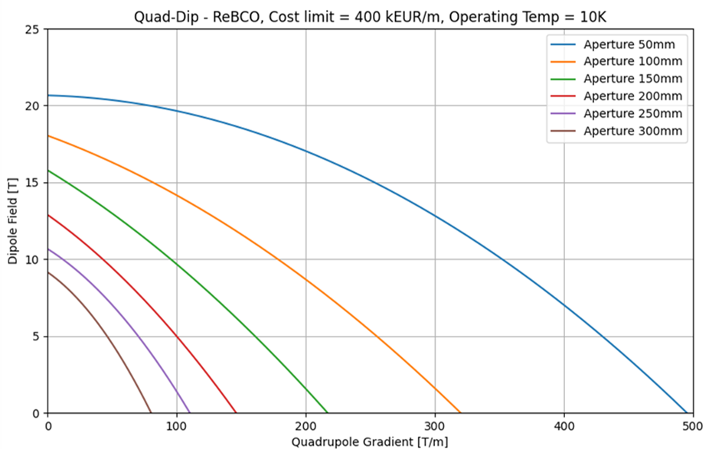
Results: B-G plot at 10K
From v0.7:
8 T, 100 T/m, aperture of 310 mm (FF)
8 T, 320 T/m, aperture of 130 mm (ARC)
4 T, 240 T/m, aperture of 170 mm (Corr.)
4 T, 330 T/m, aperture of 130 mm (Corr.)
Courtesy of Kyriacos Skoufaris
https://indico.cern.ch/event/1351046/
Maximum budget = 400 kEUR/m
Labour = 20 kEUR/m
Iron and Structures = 60 kEUR/m
↓
Budget for the SC = 320 kEUR/m
The radial build might change: a solution needs to be studied to address the issue of the quadrupole moving inward.

Slide 11
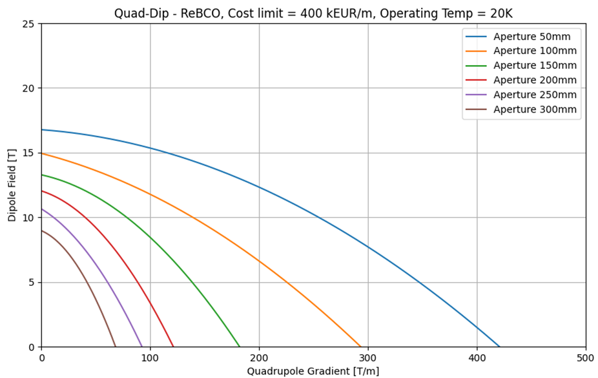
Results: B-G plot at 20K
From v0.7:
8 T, 100 T/m, aperture of 310 mm (FF)
8 T, 320 T/m, aperture of 130 mm (ARC)
4 T, 240 T/m, aperture of 170 mm (Corr.)
4 T, 330 T/m, aperture of 130 mm (Corr.)
Courtesy of Kyriacos Skoufaris
https://indico.cern.ch/event/1351046/
Maximum budget = 400 kEUR/m
Labour = 20 kEUR/m
Iron and Structures = 60 kEUR/m
↓
Budget for the SC = 320 kEUR/m
The radial build might change: a solution needs to be studied to address the issue of the quadrupole moving inward.

Slide 12
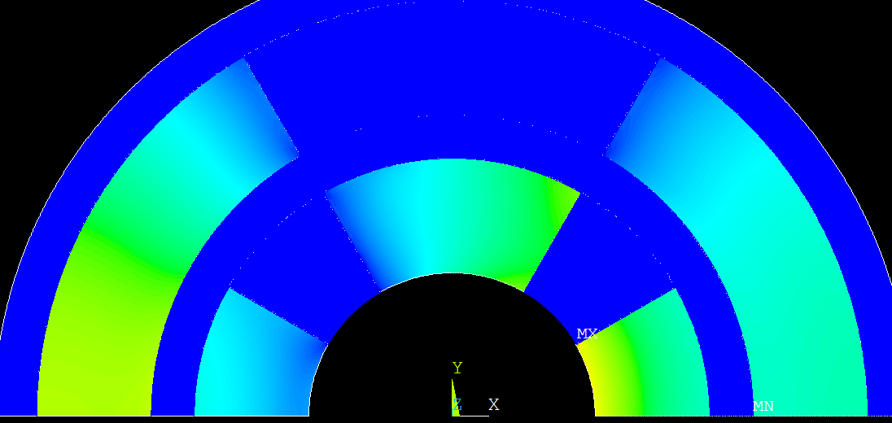
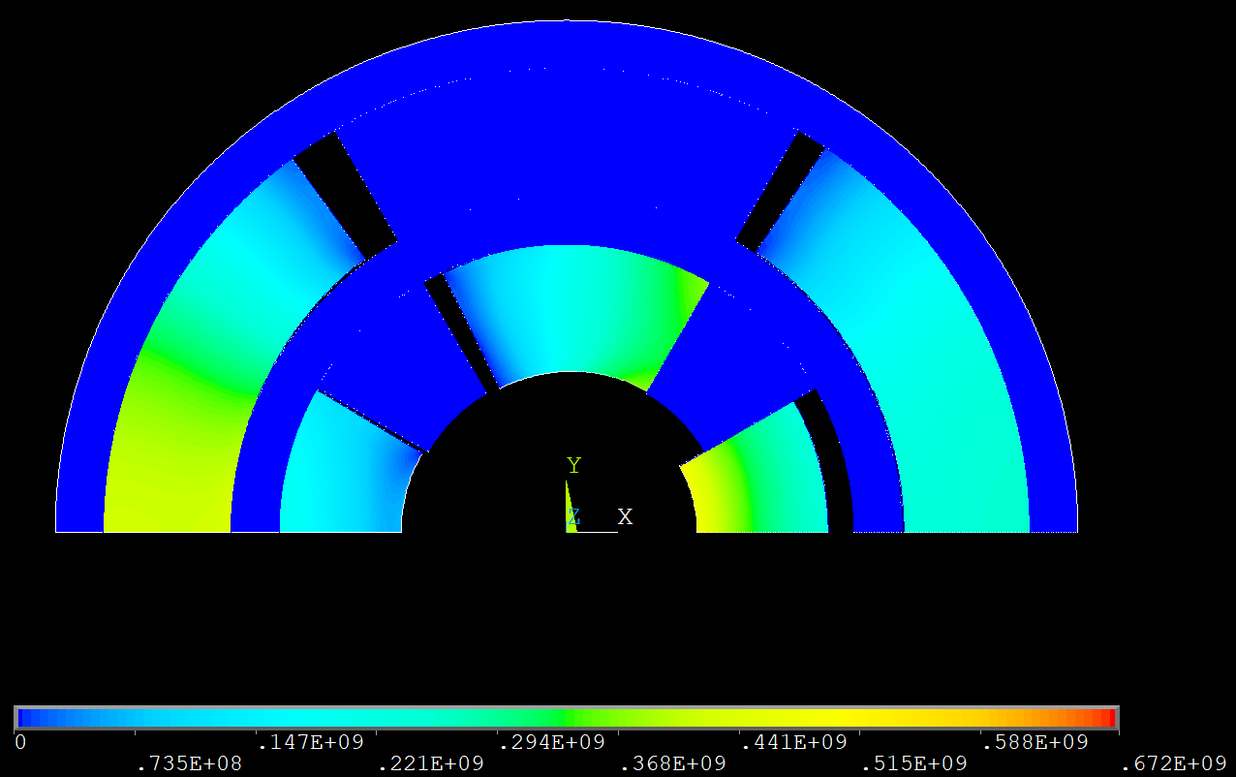
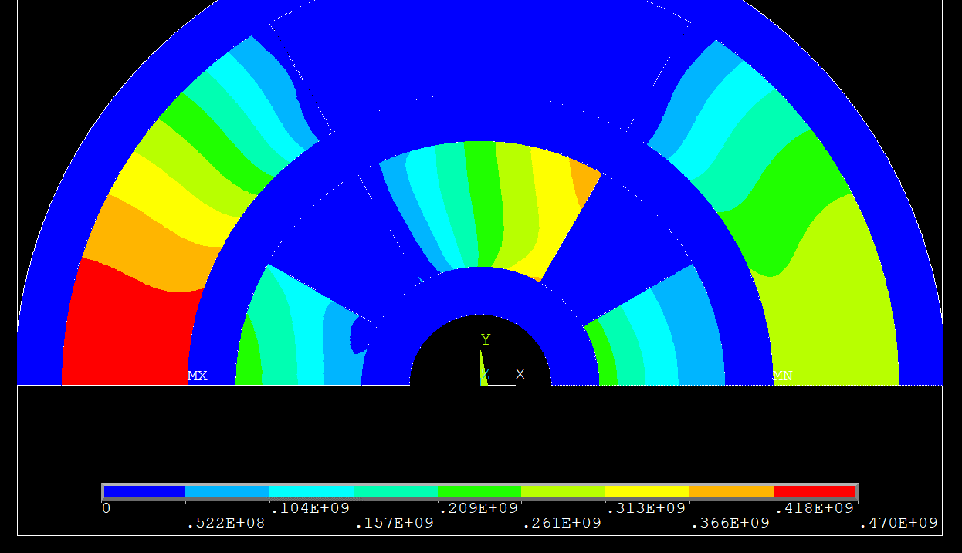
Stress Issue
$$a_{1}=75mm, w_{quad}=80mm,w_{dip}=80mm, T_{op}=20K$$
Zoom-in on the displacements
To address the issue, we insert an infinitely rigid internal structure to enable the study of stress behavior in the coils.

Slide 13
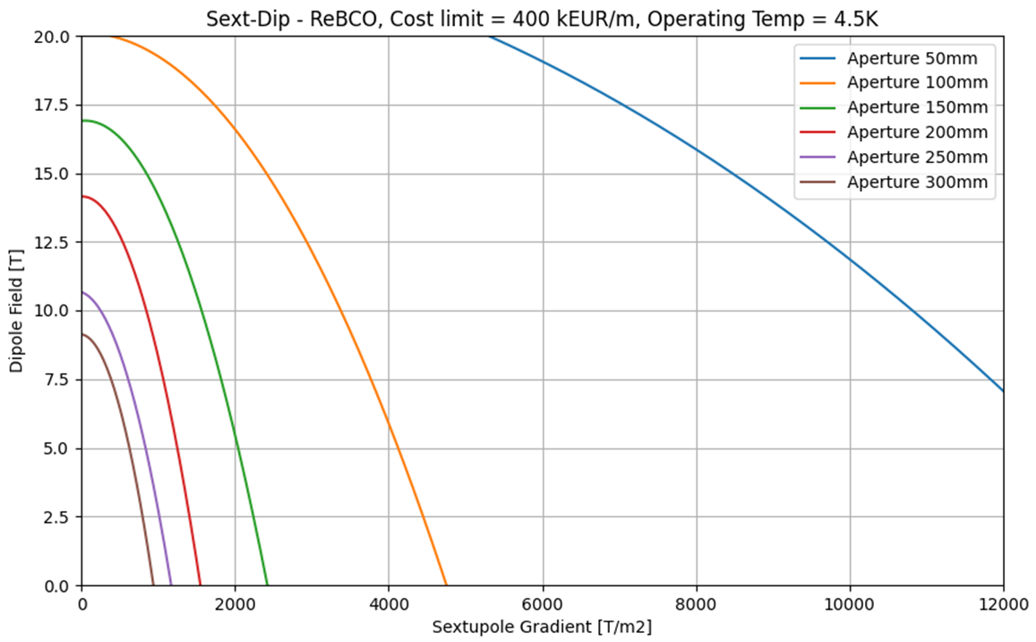
Results: B-G2 plot at 4.5K
The same method used for B-G plots is applied to B-G2 plots.
From v0.7:
14 T, 7100 T/m2, aperture of 130 mm (ARC)
4 T, 11555 T/m2, aperture of 170 mm (Corr.)
Courtesy of Kyriacos Skoufaris
https://indico.cern.ch/event/1351046/
Maximum budget = 400 kEUR/m
Labour = 20 kEUR/m
Iron and Structures = 60 kEUR/m
↓
Budget for the SC = 320 kEUR/m

Slide 14
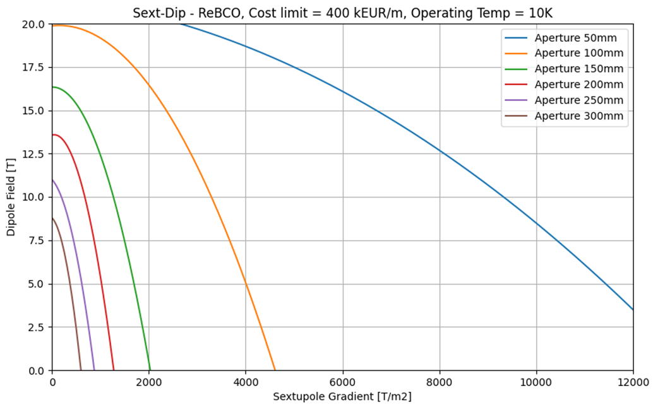
Results: B-G2 plot at 10K
The same method used for B-G plots is applied to B-G2 plots.
From v0.7:
14 T, 7100 T/m2, aperture of 130 mm (ARC)
4 T, 11555 T/m2, aperture of 170 mm (Corr.)
Courtesy of Kyriacos Skoufaris
https://indico.cern.ch/event/1351046/
Maximum budget = 400 kEUR/m
Labour = 20 kEUR/m
Iron and Structures = 60 kEUR/m
↓
Budget for the SC = 320 kEUR/m

Slide 15
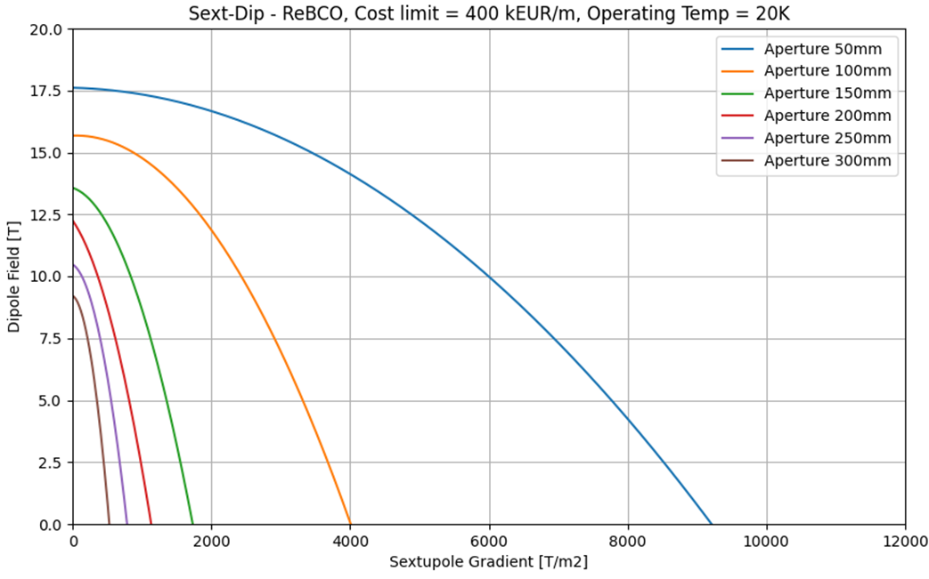
Results: B-G2 plot at 20K
The same method used for B-G plots is applied to B-G2 plots.
From v0.7:
14 T, 7100 T/m2, aperture of 130 mm (ARC)
4 T, 11555 T/m2, aperture of 170 mm (Corr.)
Courtesy of Kyriacos Skoufaris
https://indico.cern.ch/event/1351046/
Maximum budget = 400 kEUR/m
Labour = 20 kEUR/m
Iron and Structures = 60 kEUR/m
↓
Budget for the SC = 320 kEUR/m

Slide 16
Summary of final results

Slide 17
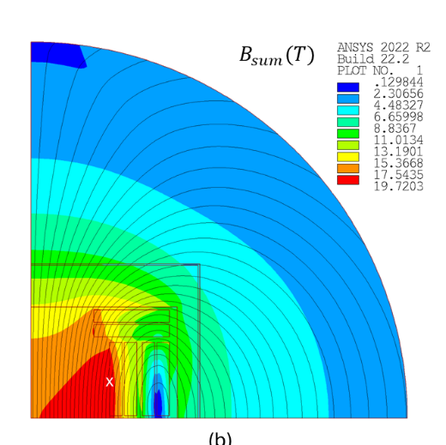
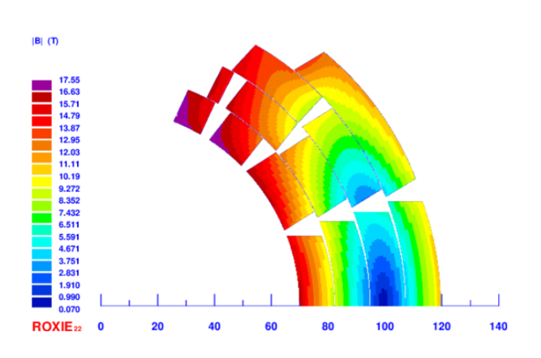
Conclusions
The A-B, A-G, B-G, and B-G2 plots are provided and discussed, using both analytical and FEM approaches, representing the starting point to define possible beam optics that are also acceptable from a technological point of view.
The allowed phase spaces do not imply that the magnet is feasible, but rather that it is possible to start studying a specific design for that magnet. In this regard, in line with this work, we are studying a specific cos-theta and block coil design for the main arc dipoles.
Following the same approach, we will begin to study the specific design of a combined function magnet (starting with the arc quad-dip magnet) and will integrate quench protection into the limit curves.
The allowed phase spaces do not imply that the magnet is feasible, but rather that it is possible to start studying a specific design for that magnet. In this regard, in line with this work, we are studying a specific cos-theta and block coil design for the main arc dipoles.
Courtesy of L. Alfonso
Courtesy of F. Mariani

Slide 18
Thank you
for your attention
mmWG, 20 February 2025
D. Novelli^{1,2}, L. Alfonso², A. Bersani², L. Bottura⁵, B. Caiffi²,
S. Farinon², F. Mariani¹, S. Mariotto³ , A. Pampaloni², T. Salmi⁴
¹Sapienza University of Rome, ²INFN – Genoa , ³INFN and University of Milan
⁴Tampere University, ⁵CERN

