Slide 1


Hengpei Liao
Research Associate, University of Strathclyde
Superconducting magnets & Superconducting machines
Email： hengpeiliao@outlook.com
Phone: +44 07752572734

Slide 2

Development of trapped field magnets using 2G HTS coated conductors
13 March 2025

Slide 3
What are the trapped field magnets and their applications
2. Trapped field magnets using 2G HTS coated conductors
3. Magnetization of the HTS-stacked ring magnet
Contents
4. Mechanical analysis of the hybrid HTS-stacked ring magnet
5. Magnetization of the HTS double-pancake coil with joints
6. Introduction of Applied Superconductivity Lab at Strathclyde

Slide 4
What are the trapped field magnets and their applications

Slide 5
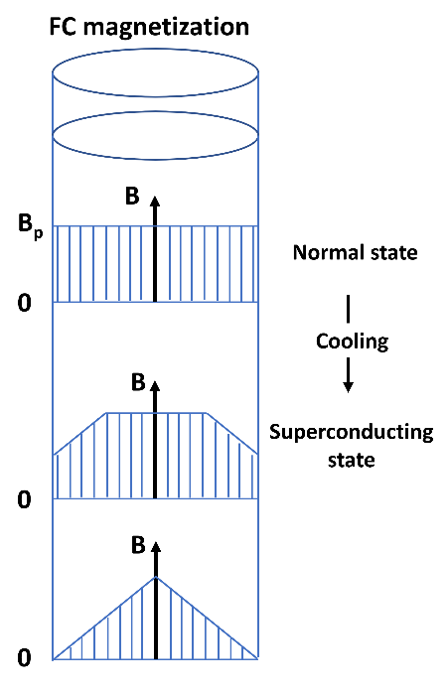
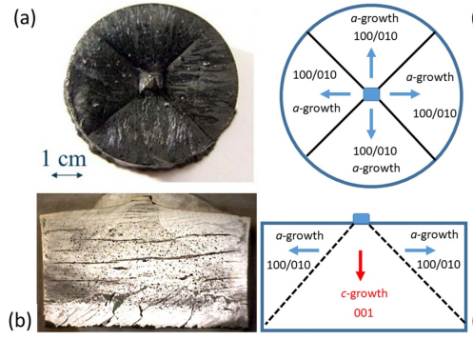
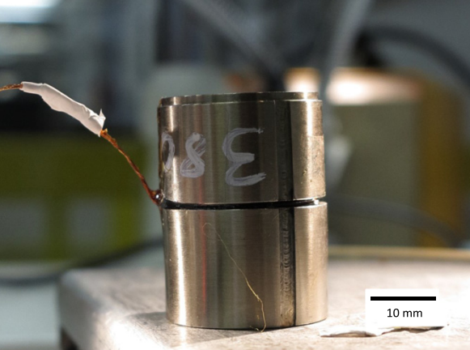
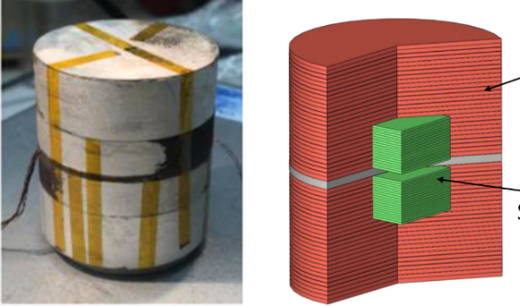
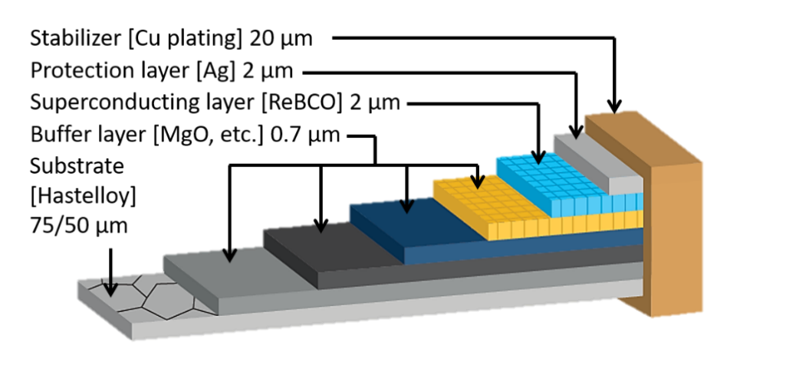
What are the trapped field magnets
Top seeded melting growth
Two GdBCO bulk trapped 17.6 T at the centre at 25 K
17.89 T trapped by HTS stacks at 6.5 K
Typical HTS tape structure
Field cooling magnetization and trapped field magnets
Type-II superconductors

Slide 6
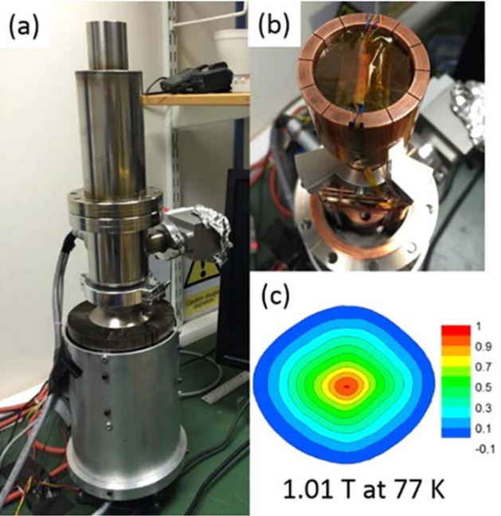
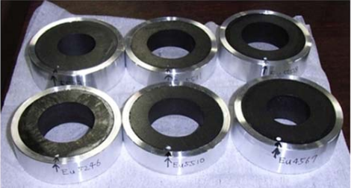
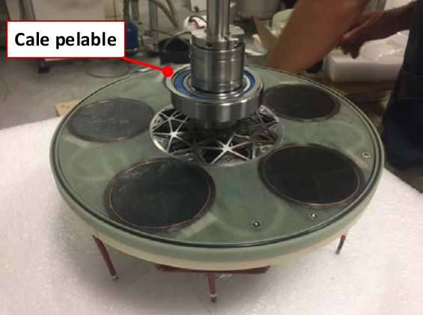
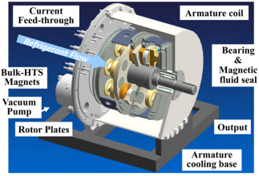
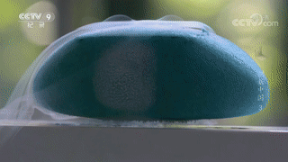
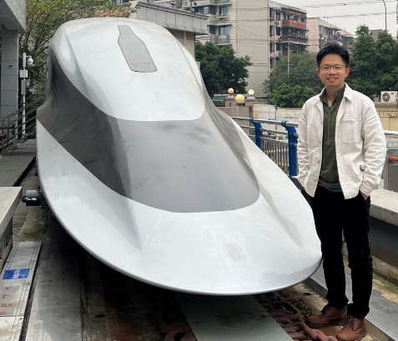
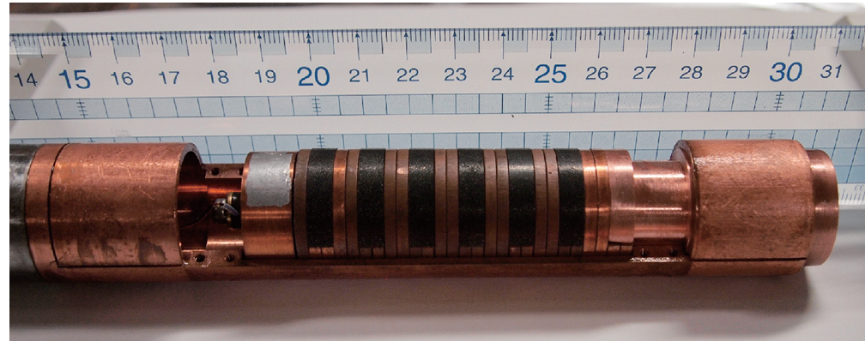
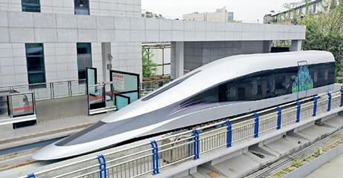
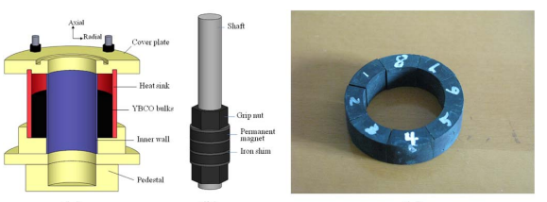
Applications of trapped field magnets
High power density HTS machines
Portable high field medical devices
High speed transportation
Maintain strong magnetic field without external power supply
Bearings for energy storage flying wheels
HTS undulator with bulk superconductors

Slide 7
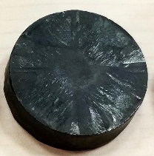
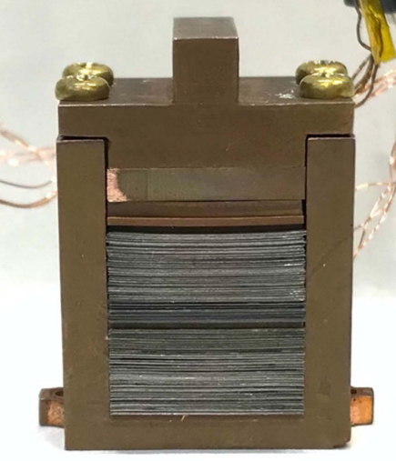
The challenges of current HTS trapped field magnets
Traditional HTS trapped field magnets
HTS bulk materials
Size:
There are inherent limitations due to the unique growth fabrication method. As the size increases, there can be significant microstructural changes which negatively affect the superconducting and mechanical properties.
Limited solutions: Multi-seed TSMG can be used for growing larger bulks with inferior performance.
Mechanical strength:
For typical ReBCO bulks, the axial tensile strength ranges between 5–10 MPa, while the strength perpendicular to the axis lies between 20–30 Mpa. As the bulk grows larger, the strength decreases further.
Limited solutions: Impregnation with resin, metal ring pre-tightening, structure optimization.
HTS stacks
Size:
Thanks to the progress in manufacturing HTS coated conductors (tapes), HTS stacks fabricated by stacking HTS tapes have demonstrated the potential in achieving high trapped field as HTS bulk materials.
The thickness of the HTS stacks is not limited.
Since the width of available HTS tapes is limited (12 mm), to further expand HTS stacks with homogeneous properties can not be achieved.

Slide 8
2. Trapped field magnets using 2G HTS coated conductors

Slide 9
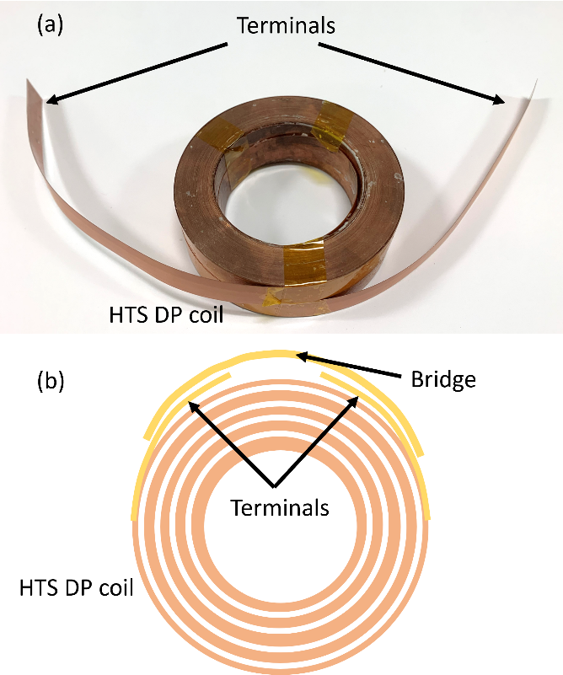
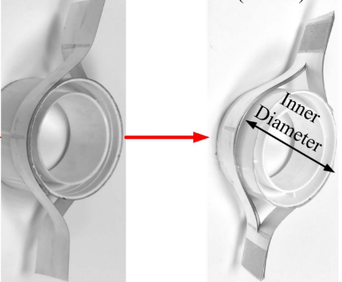
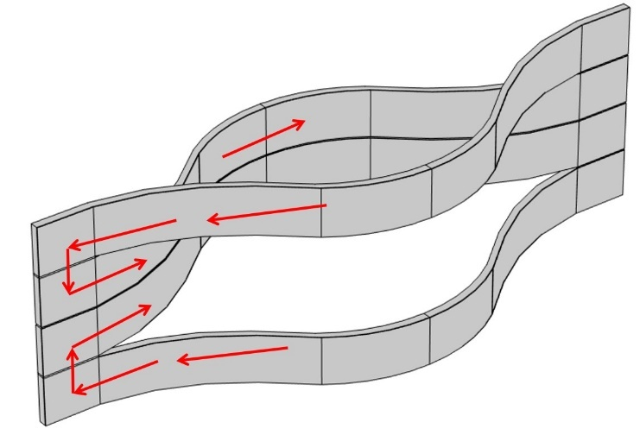
2. Trapped field magnets using 2G HTS coated conductors
Closed-loop HTS coils
HTS-Stacked ring magnet
Advantages of HTS-stacked ring magnets :
Flexible geometry
Quality controlled by standard coated conductor manufacture
Higher reliability by stacking independent HTS tapes
Advantages of Closed-loop HTS coils:
Regulated shapes
Quality controlled by standard coated conductor manufacture
Slow current decay due to joint resistance

Slide 10
3. Magnetization of the HTS-stacked ring magnet

Slide 11
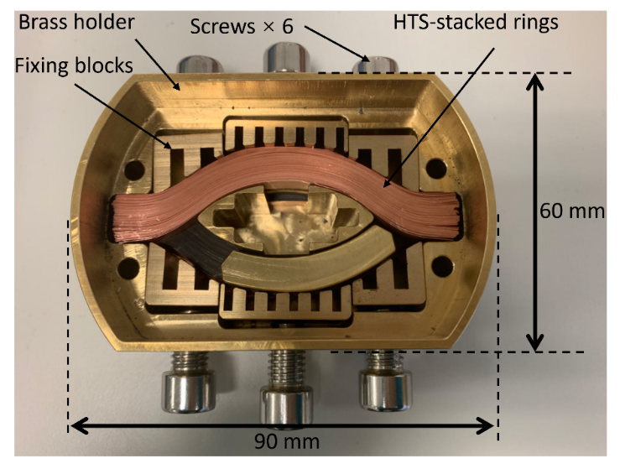
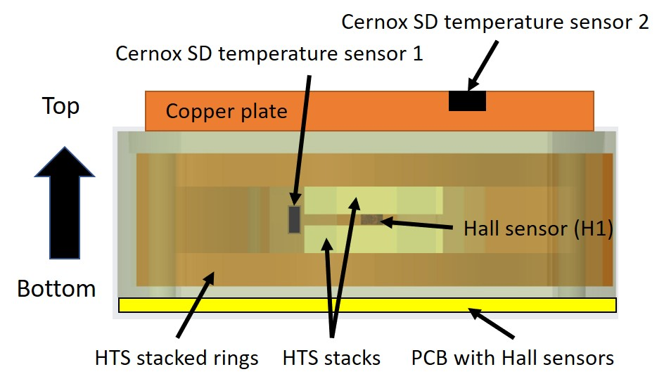
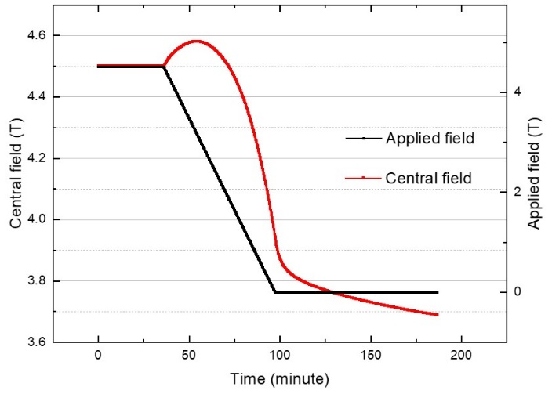
3. Magnetization of the HTS-stacked ring magnet
An HTS-stacked ring magnet with reinforcement was developed with 160 12-mm Fujikura HTS tapes
It was measured with field cooling magnetization and achieved a trapped field of 3.7 T at 25 K.
During magnetization process, it was noticed that the central field showed an ascent phenomenon, which was not observed in traditional HTS material magnetization
Sample before impregnation
Hengpei Liao, et al. Journal of Applied Physics 134, 083902 (2023)

Slide 12
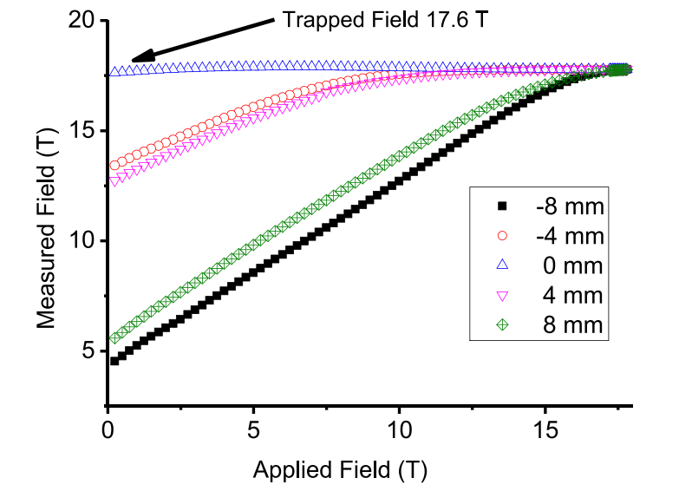
3. Magnetization of the HTS-stacked ring magnet
During magnetization process, it was noticed that the central field showed an ascent phenomenon, which was not observed in traditional HTS material magnetization

Slide 13
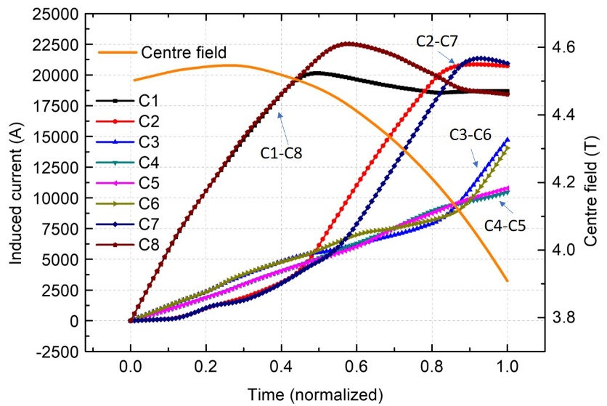
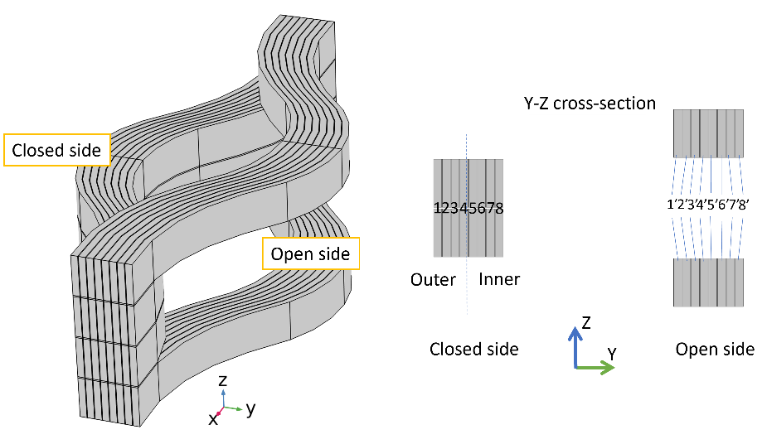
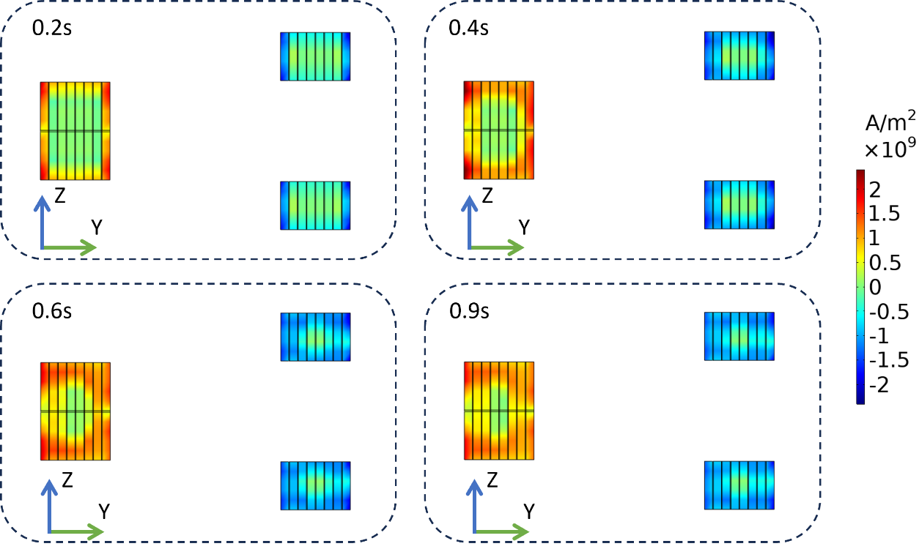
3. Magnetization of the HTS-stacked ring magnet
Induced current in each domains
Numerical analysis was employed to investigate the reason of the ascent phenomenon
Penetration sequence of HTS-stacked ring magnets is different from that of traditional HTS bulks
The inner layers and outer layers are penetrated (magnetized) simultaneously
Induced current density distribution

Slide 14
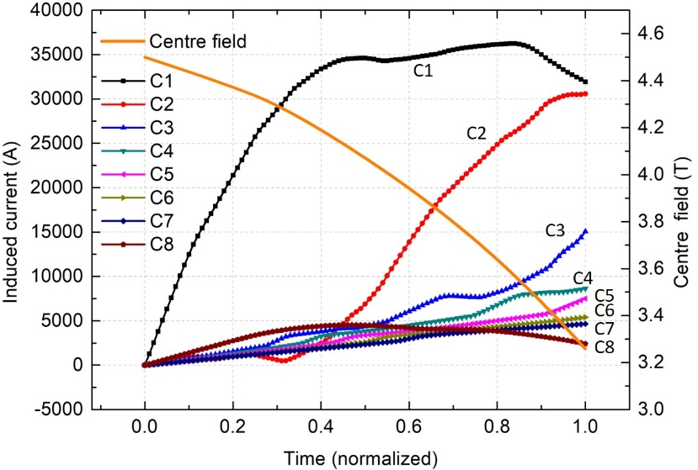
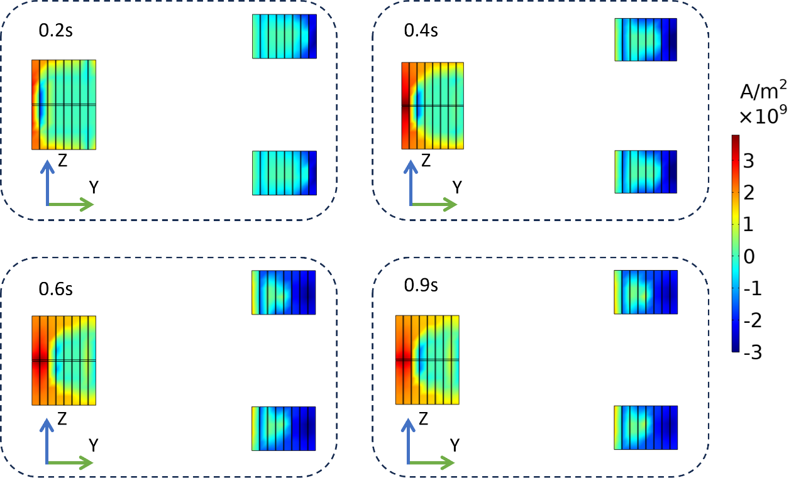
3. Magnetization of the HTS-stacked ring magnet
Induced current in each domains
Considering an HTS bulk material with the same geometry of the HTS-stacked ring magnet
The outer layers are firstly penetrated and the induced current in outer layers is much higher than the inner layers.
The central field doesn’t show ascent during magnetization
The unique stacking method and penetration sequence lead to the central field ascent of the HTS-stacked ring magnet
Induced current density distribution

Slide 15
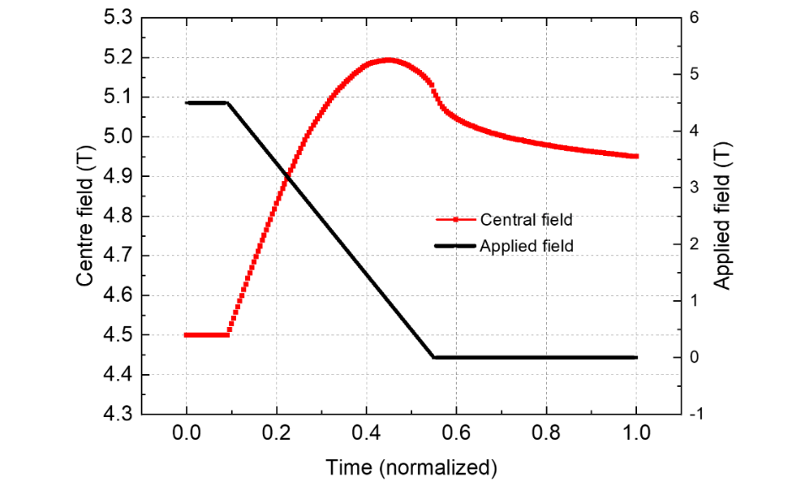
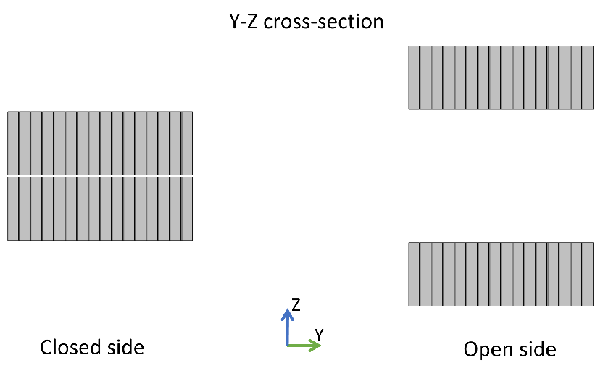
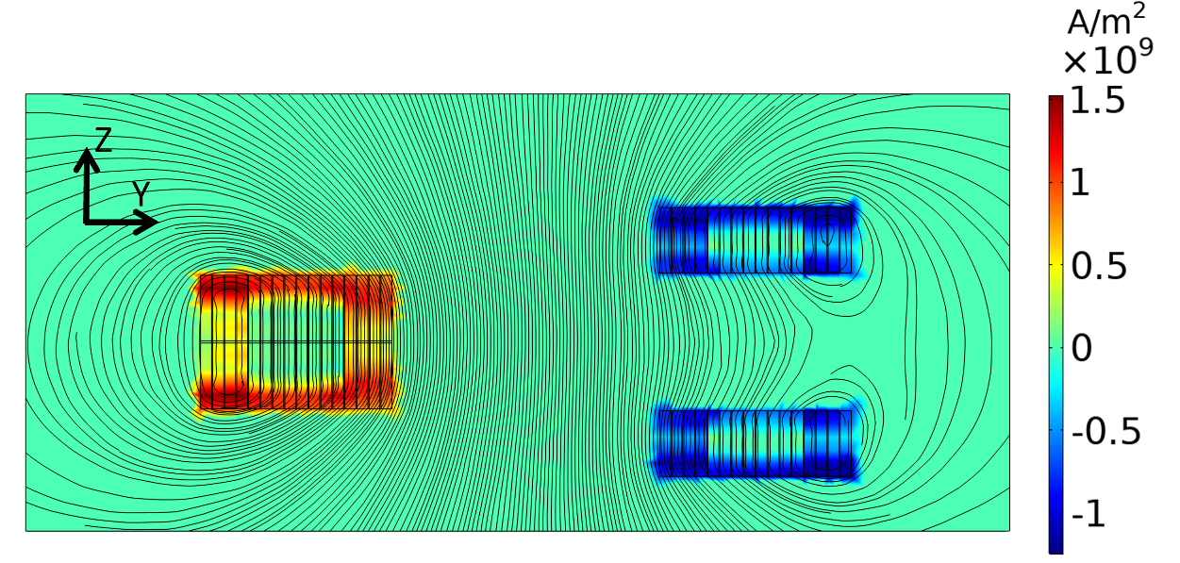
3. Magnetization of the HTS-stacked ring magnet
Potential of achieving higher trapped field than applied field
Based on previous analysis, a model with the number of tapes doubled was investigated
In this configuration, the final central field (4.95T) is higher than the initial applied field (4.5T)

Slide 16
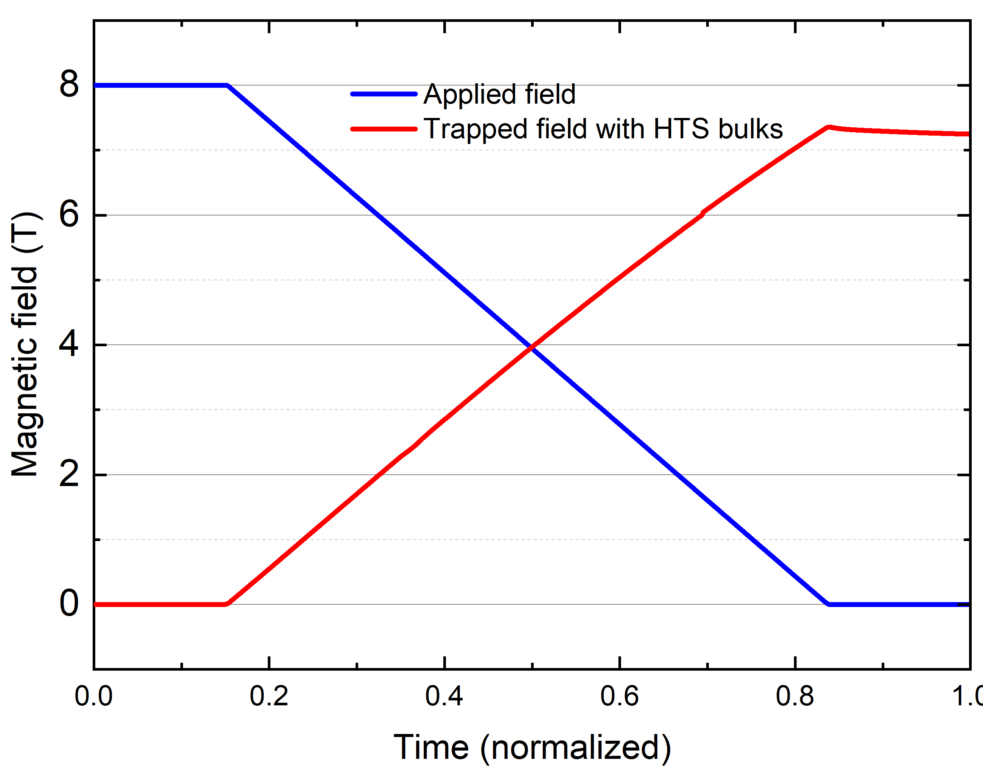
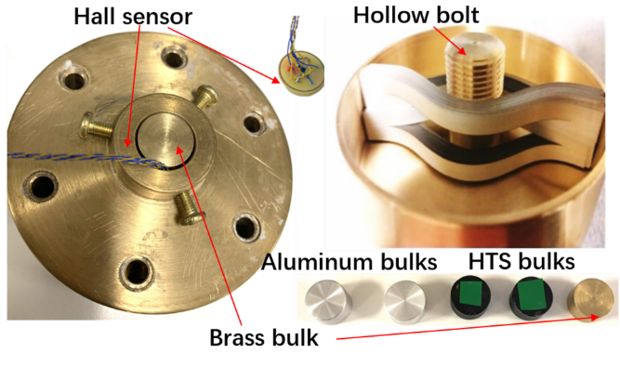
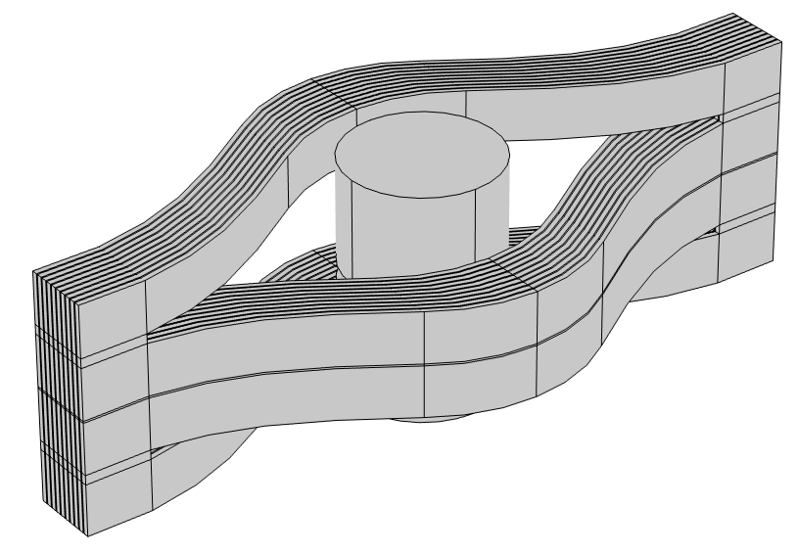
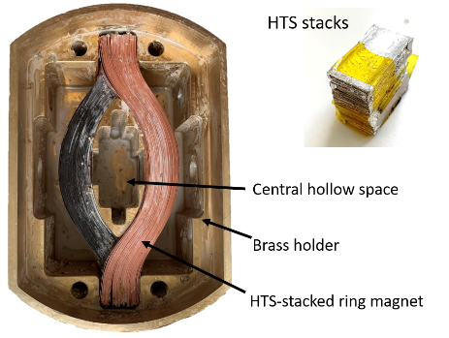
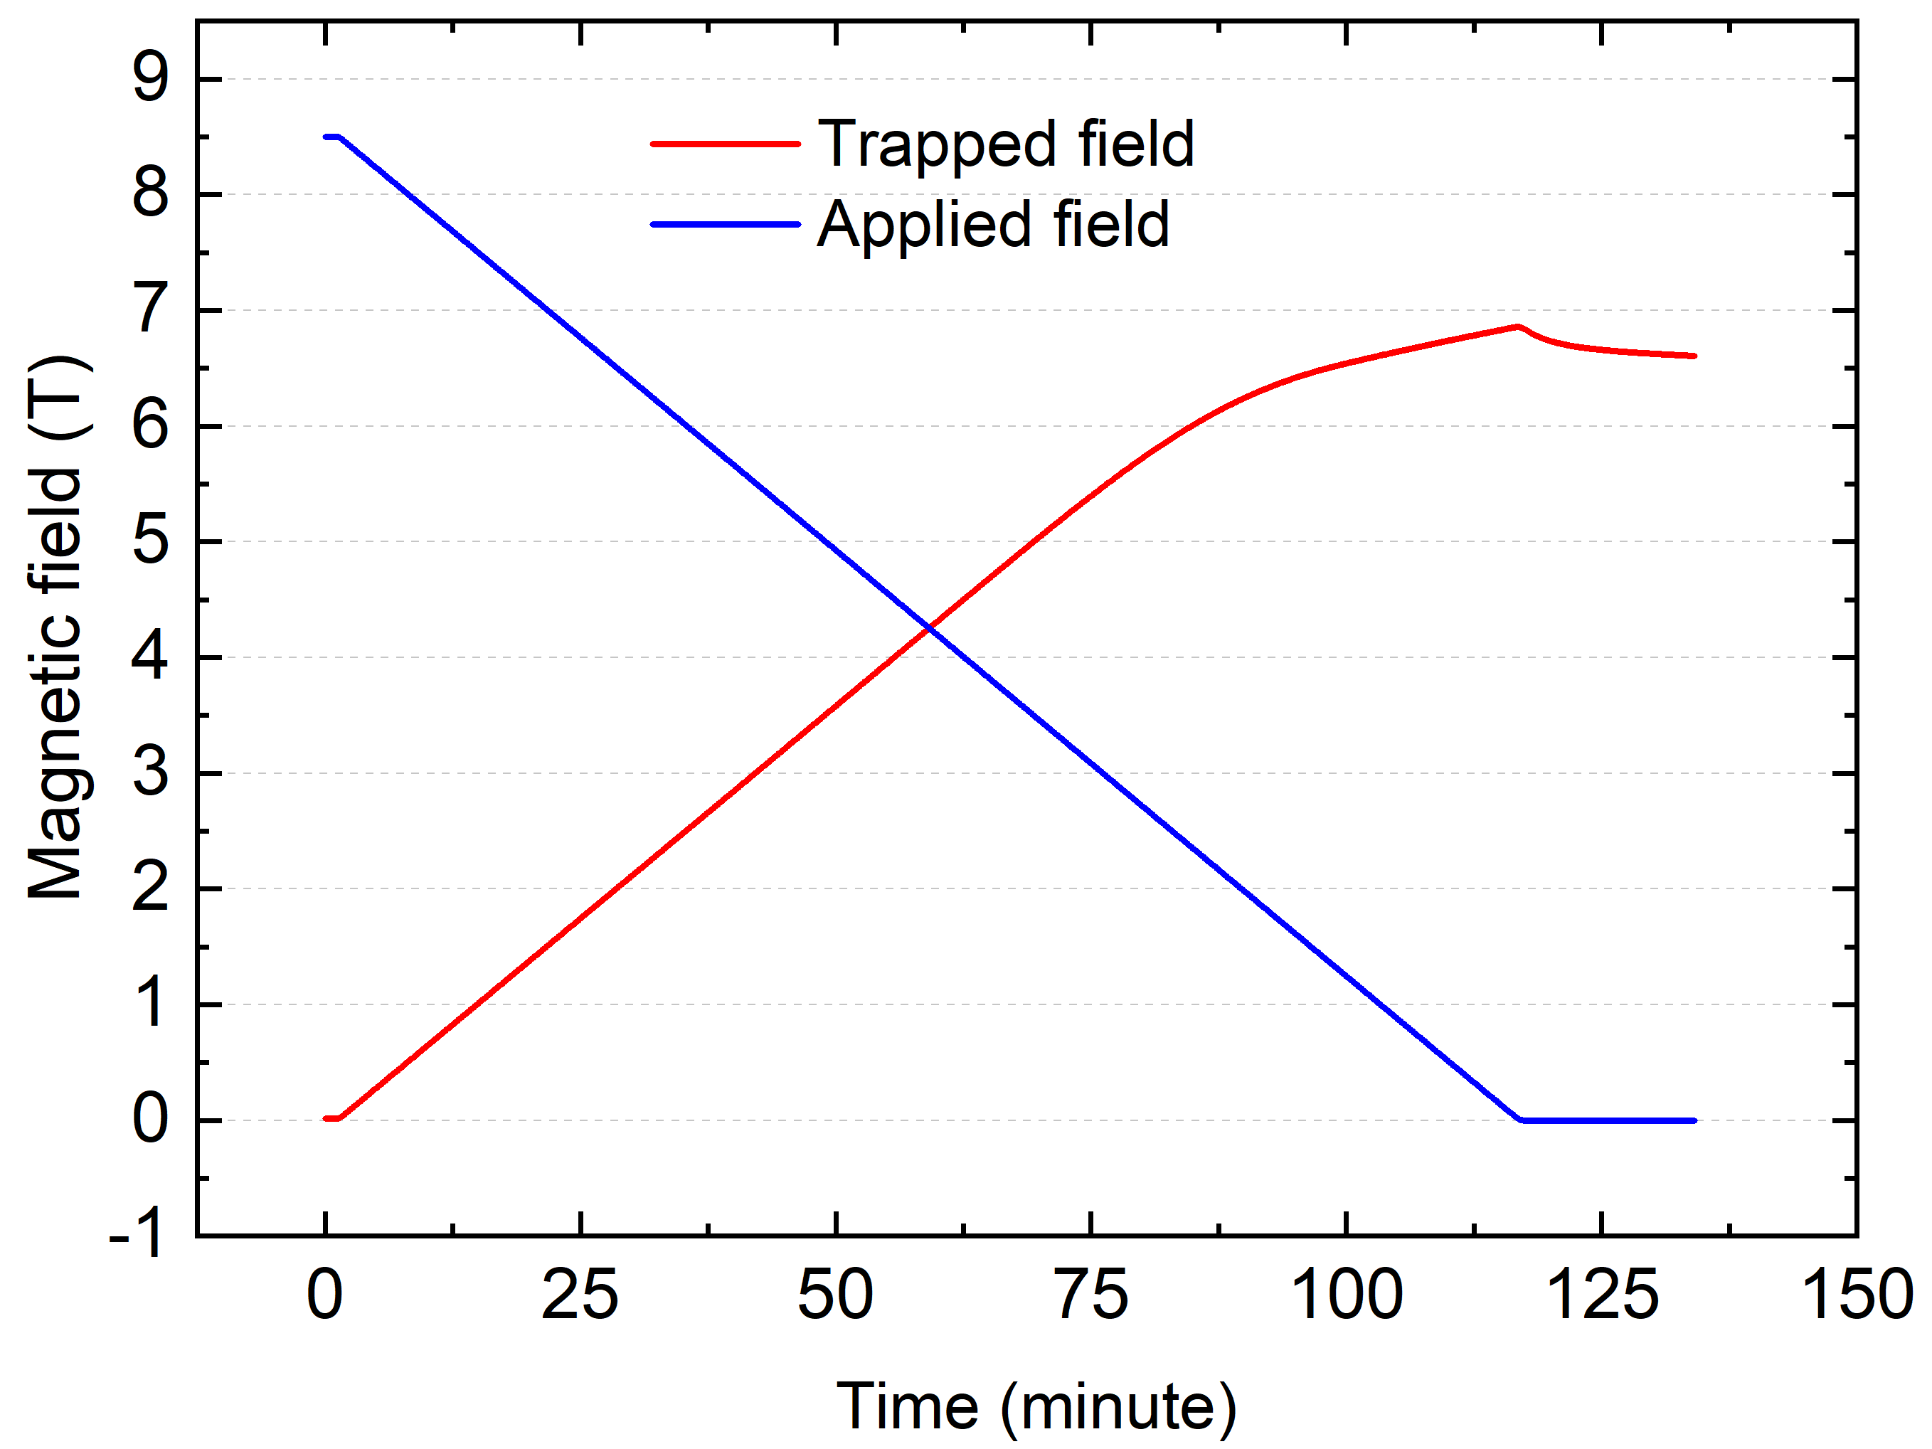
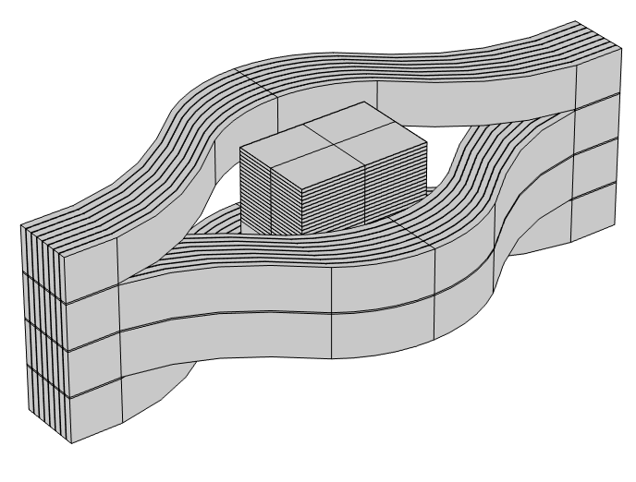
3. Magnetization of the HTS-stacked ring magnet
HTS bulks
7.35 T
HTS-stacked rings
HTS stacks
6.6 T
HTS bulks and HTS stacks are used as the inserts for HTS rings to increase the trapped field (25 K):
HTS bulk inserts: 3.35 T 7.35 T
HTS stack inserts: 3.79 T 6.6 T
Hengpei Liao, Journal of Applied Physics 133, 023902 (2023)
Hengpei Liao, Journal of Applied Physics 134, 083902 (2023)

Slide 17
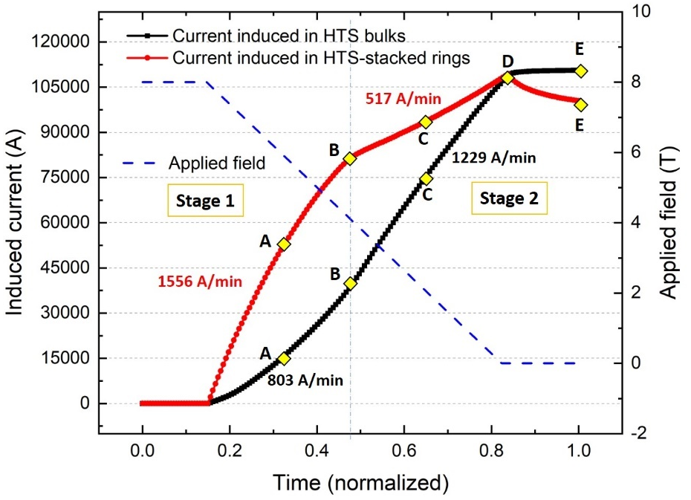
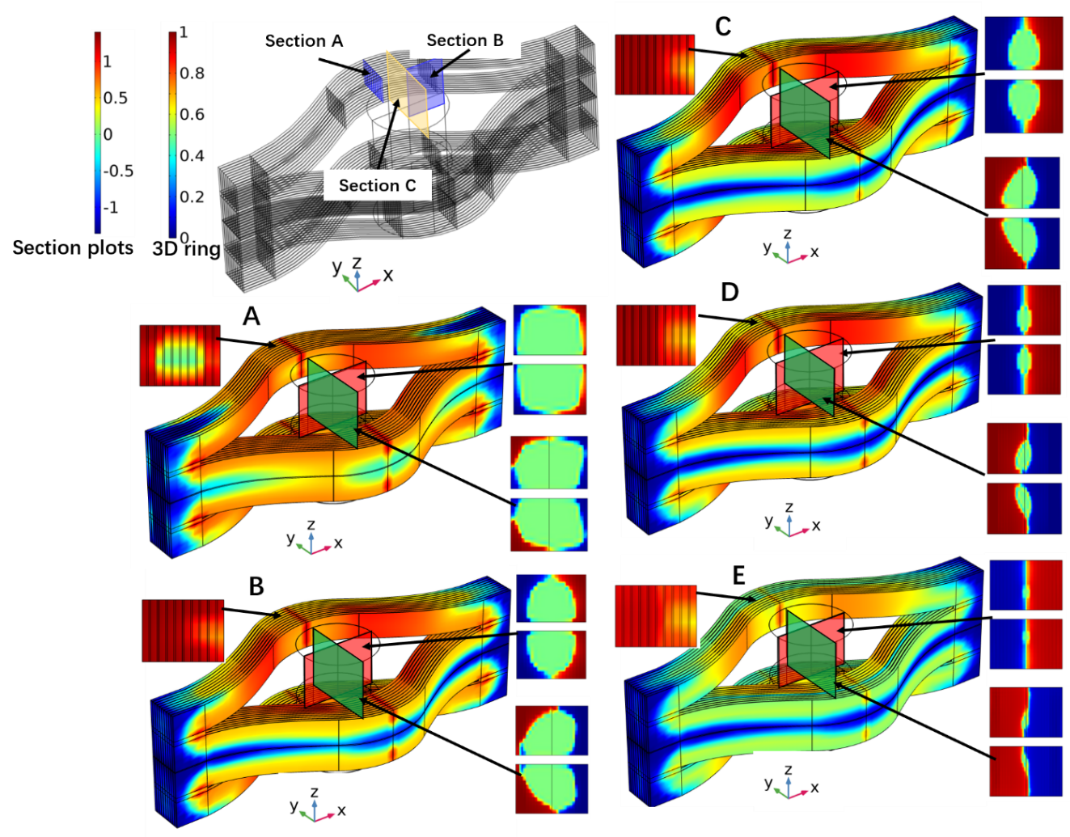
3. Magnetization of the HTS-stacked ring magnet
2-stage magnetization of hybrid HTS-stacked ring magnet
Post time step B, even as the HTS-stacked rings' magnetization pace decelerates, induced current continues to increase due to increased Ic.
Step A, both the HTS-stacked rings and HTS bulks start penetration. However, some parts inside these magnets still remain untouched, meaning no current is flowing there yet.
The transition from the first to the second phase occurs at time step B, where the HTS-stacked rings achieve full penetration
This full penetration in the HTS-stacked rings remains consistent through rest time steps

Slide 18
4. Mechanical analysis of the hybrid HTS-stacked ring magnet

Slide 19

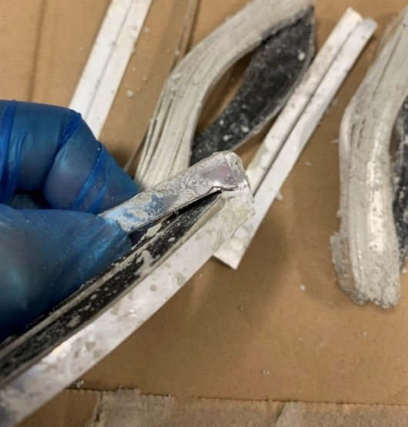
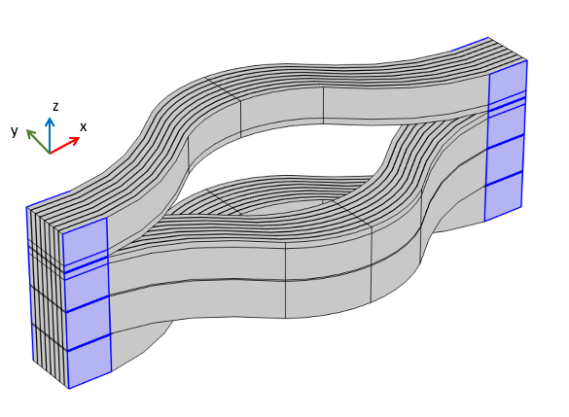
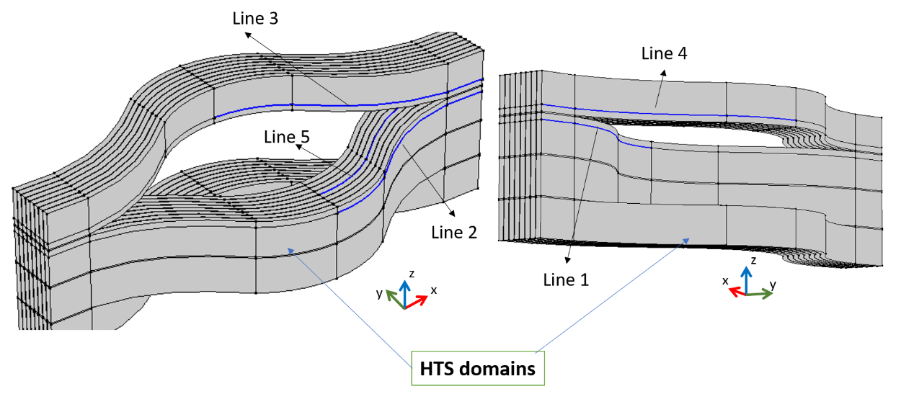
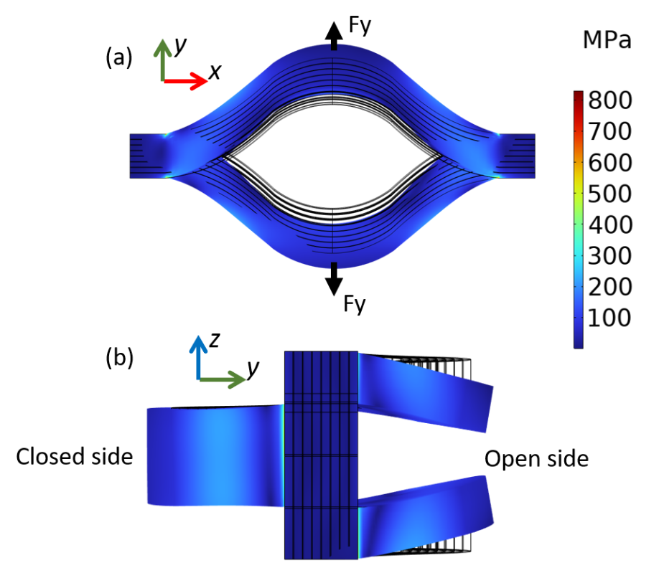
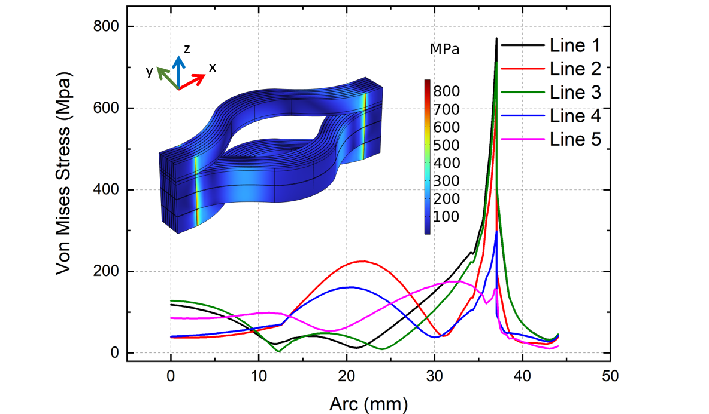
4. Mechanical analysis of the hybrid HTS-stacked ring magnet
Only the ends of the HTS tapes are fixed
The open sides are pushed towards the middle
Significant stress concentration is observed at the end of splits

Slide 20
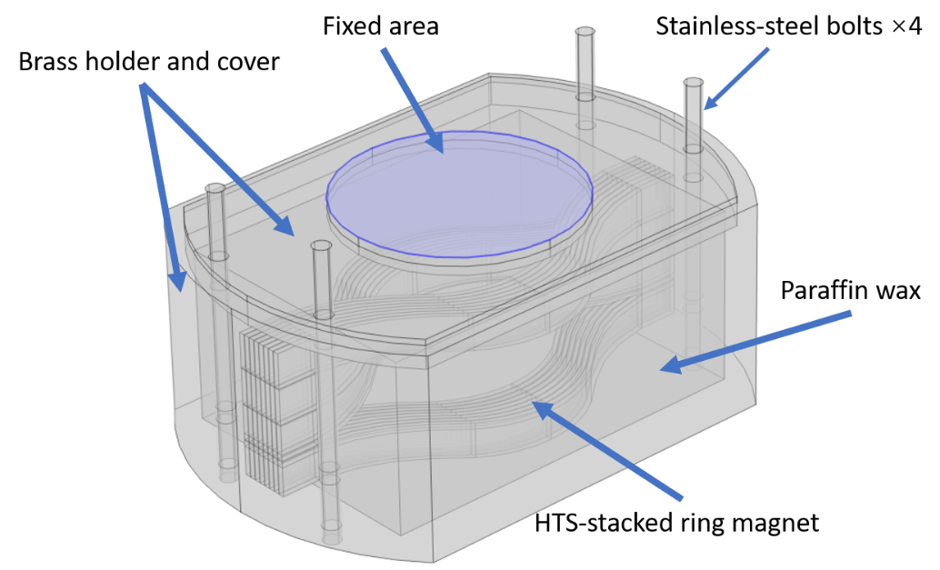
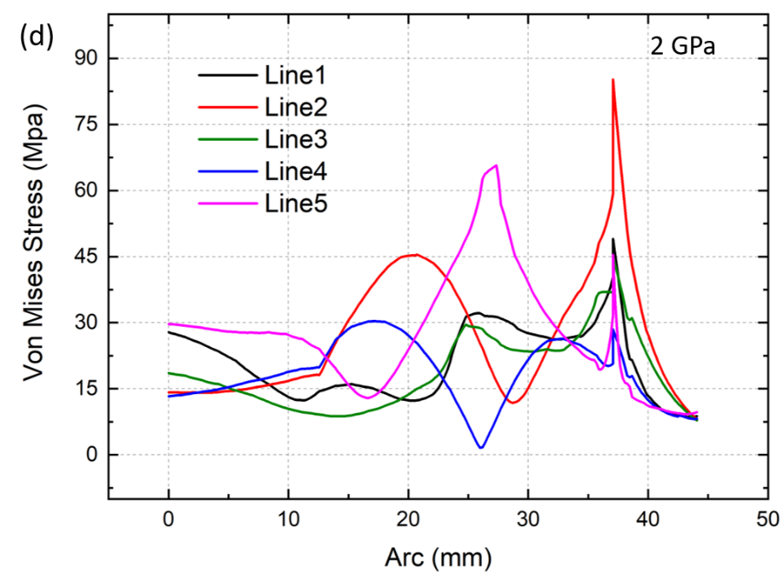
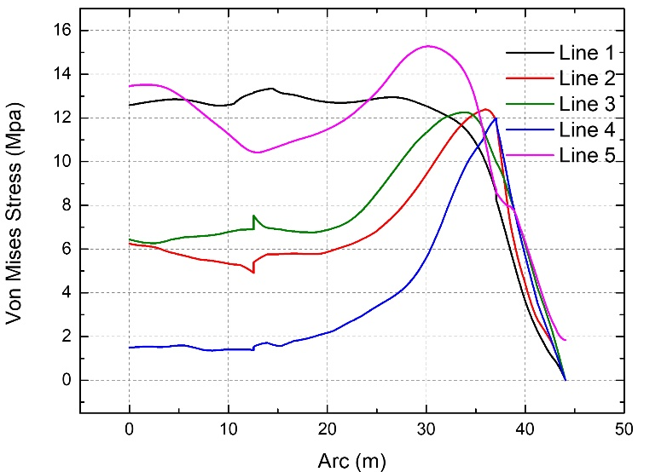
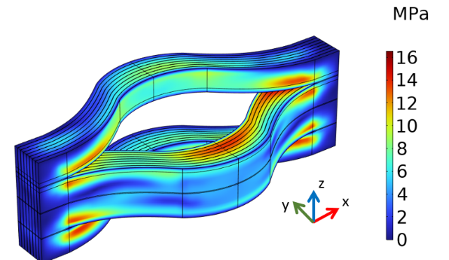
4. Mechanical analysis of the hybrid HTS-stacked ring magnet
After impregnation and mechanical press
The stress concentration is reduced significantly, especially at the end of splits
Assuming the magnet’s boundaries are all fixed, the stress concentration disappears
Hengpei Liao, Weijia Yuan and Min Zhang. Mechanical Analysis of Trapped Field HTS-stacked Ring Magnets with and without HTS Stack Inserts, Acta Mech. Sin. 40, 723281 (2024)

Slide 21
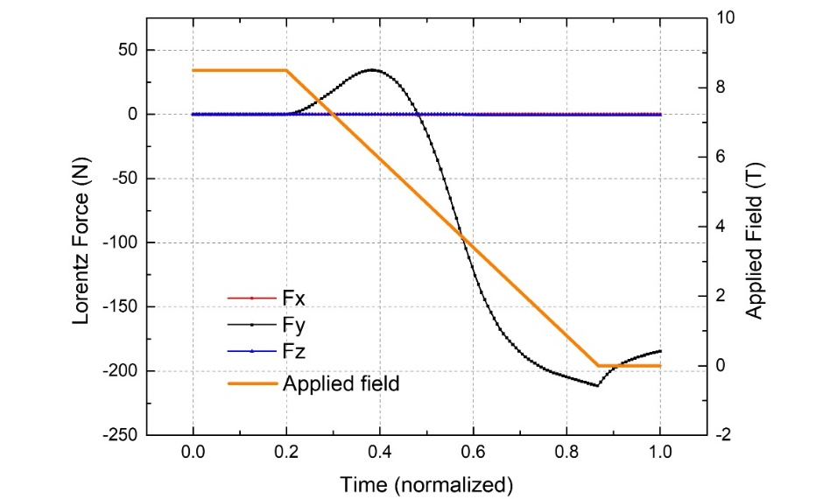
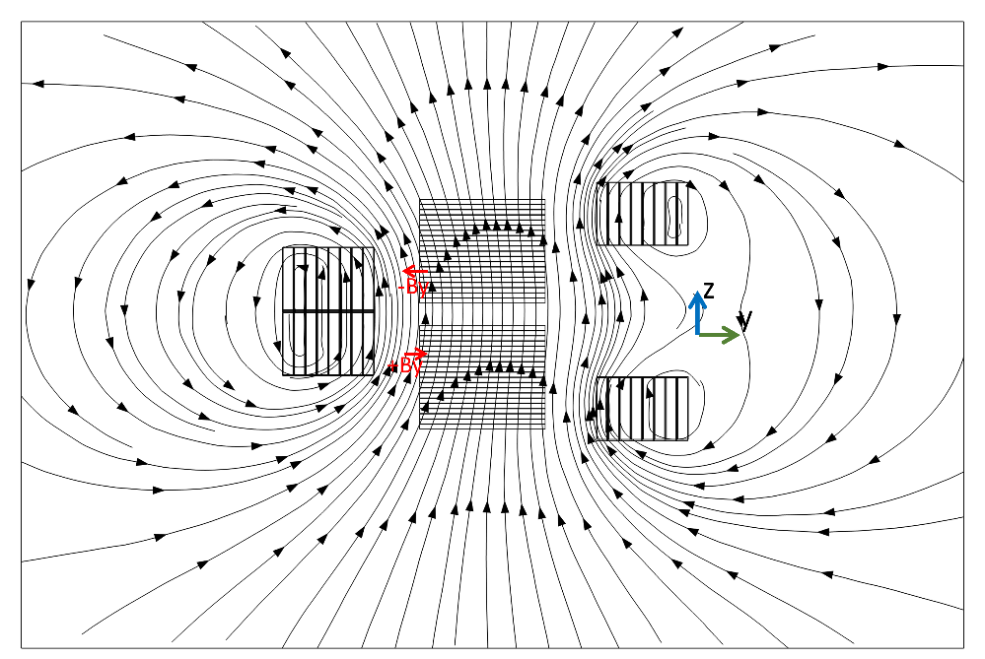


4. Mechanical analysis of the hybrid HTS-stacked ring magnet
Asymmetric magnetic flux (-By, +By) generated by HTS-stacked rings affecting the HTS stack inserts
Lorentz force experienced during the magnetization of the HTS stacks
Y-axis Lorentz force load distribution in the z-y cross-section of HTS stacks
Stress distribution in the cross-sections of HTS stacks

Slide 22
5. Magnetization of the HTS double-pancake coil with joints

Slide 23





5. Magnetization of the HTS double-pancake coil with joints
A bridge-type joint was chosen for ensuring the resistance between superconducting layers is minimized and proper mechanical strength
After soldering, the resistance of the joints were measured with the coil kept outside the LN2
The total resistance at 77 K of the two joints: 12 nΩ ±1 nΩ

Slide 24



5. Magnetization of the HTS double-pancake coil with joints
The HTS coil was then impregnated with wax and aluminum nitride powder
Central field is 4.58 T after 4.5 T field cooling magnetization
Both magnetizations see a higher trapped field than the applied one
Field decayed to 4.54 T (-0.87%) after 30 minutes
Our 4K magnetization experiment was supported by LNCMI-CNRS, a member of the European Magnetic Field Laboratory (EMFL)
Hengpei Liao, Xavier Chuad, Jung-Bin Song, Weijia Yuan and Min Zhang. A novel trapped field magnet enabled by a quasi-operational HTS coil. iEnergy. Vol 3. 261–267 (2024)

Slide 25




5. Magnetization of the HTS double-pancake coil with joints
Current of each turn is constrained as the same
No current constraints for each HTS domain
Field distributions of the DP coil model and the bulk model along the central line
There are both negative and positive current density in the outer turn of the HTS DP coil
There are only positive components
The cause of the negative current density can be considered as the reversed magnetization which coincides with the rising trapped field.

Slide 26


Comparison
 | HTS ring with/without insert | HTS coil with joints | HTS bulk
Charging method | FC magnetization | FC magnetization Thermal switch charging | FC/pulsed magnetization
Field distribution | Asymmetrical | Symmetrical | Subject to fabrication quality and grain boundary
Current decay | Subject to flux flow | Subject to joint resistivity/flux flow | Subject to flux flow
Quality control | Medium | Easy | Hard
Size flexibility | Good | Good | Limited
Mechanical strength | High | Medium | Low

Slide 27
6. Introduction of Applied Superconductivity Lab at Strathclyde

Slide 28





University of Strathclyde
Glasgow, UK
Core strengths in engineering, science, and business
Home to 22,000 students
Electronic and Electrical Engineering
  500 academic/research plus support staff and PhD students
  1,000 undergraduate and MSc students
  Largest power systems research institute in Europe

Slide 29






Applied Superconductivity Laboratory
Research focus:
fundamental research of high temperature superconductors;
Cryogenic aviation propulsion, future grid and fusion generation.
Research Team:
2 Professors, 10 PhDs, 4 Post-docs
Related projects:
ERC: superconducting machines for zero emission aviation
ATI Zero Emission Sustainable Transportation ZEST 1
H2020: Investigation and Maturation of Technologies for Hybrid Electric Propulsion
Industrial projects:
Spirits Aerospace: LH2 tank testing
Collins Aerospace: cryogenic converters
GKN: HTS busbars

Slide 30






25 K cryostat for experiments
Aviation propulsion
HTS fusion
HTS for power applications
Experiment results with N2
We plan to test neon liquid/gas circulation
Boiling point of Neon: 27.1K

Slide 31







* Cryogenic drive in presentation

Slide 32
Thank you

