Slide 1
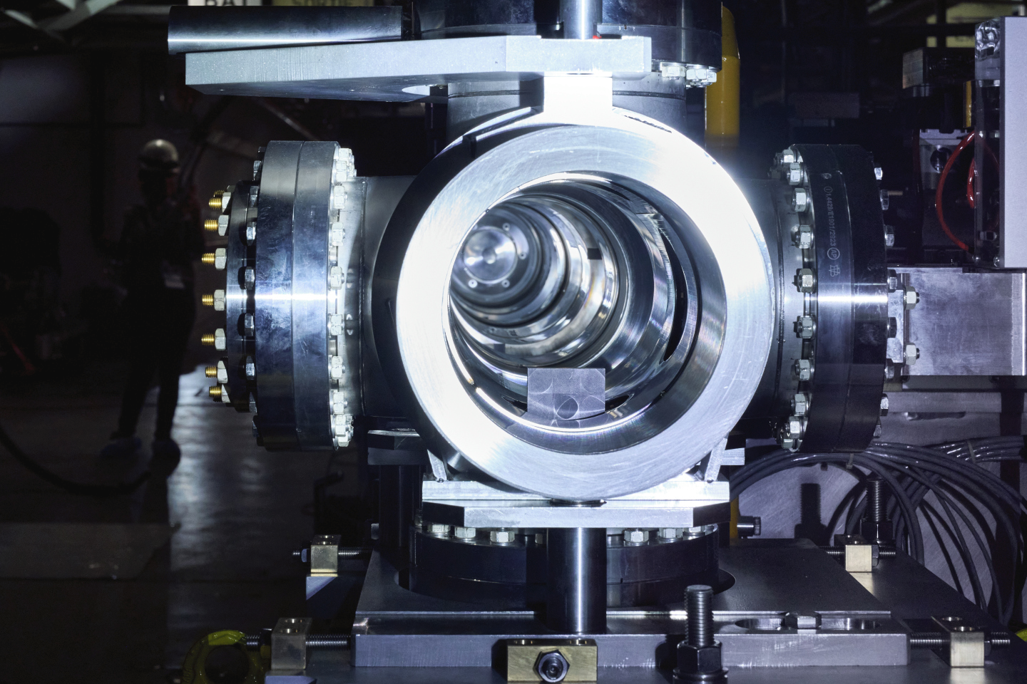

Beam Intercepting Devices
Ida Zarei Johansen (SY-STI-TCD)
10.04.2025

Slide 2


My background
Mechatronics engineering bachelor from the University of Agder – Graduated June 2023
Specialties during university – Mathematics and mechanics
Bachelor thesis- Dynamic modeling and simulations of jumping asteroid explorers in microgravity

Slide 3
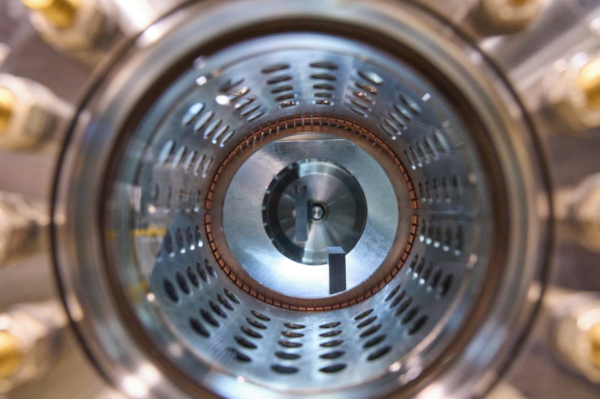
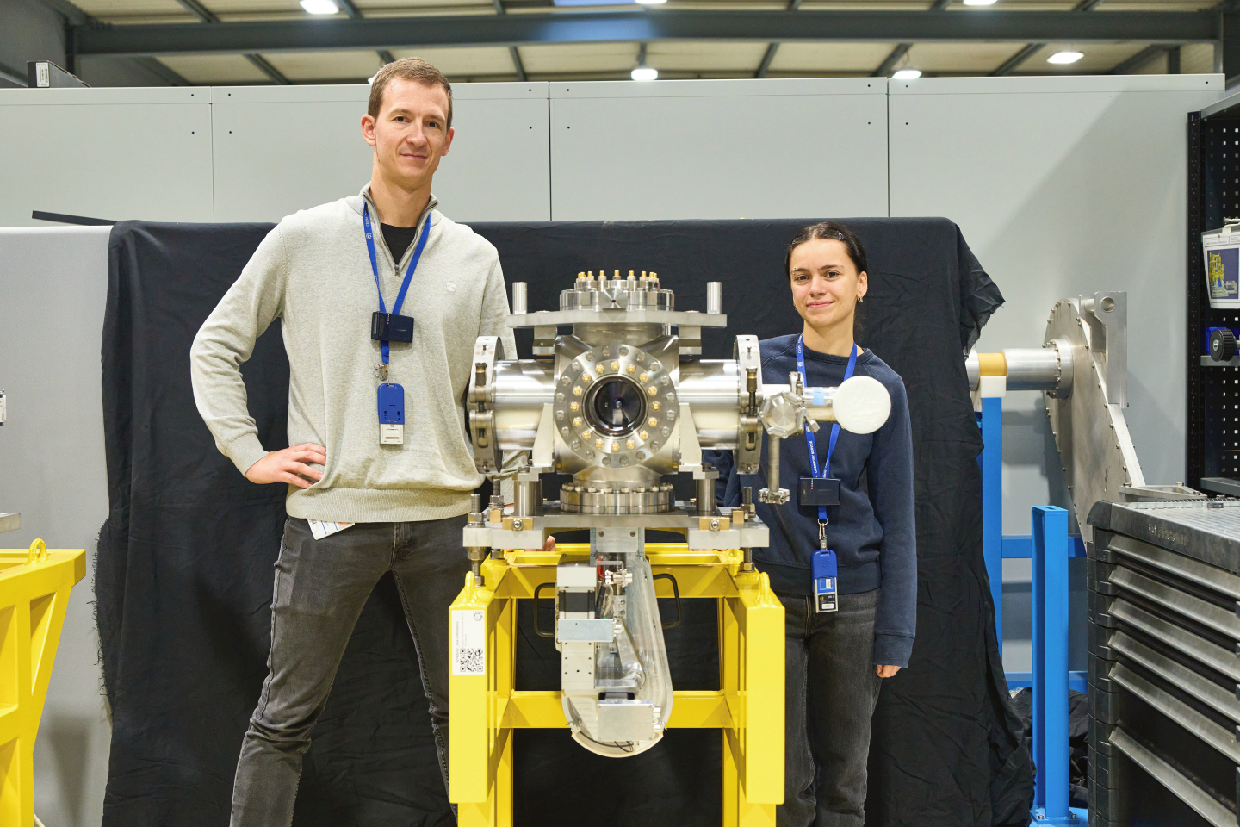
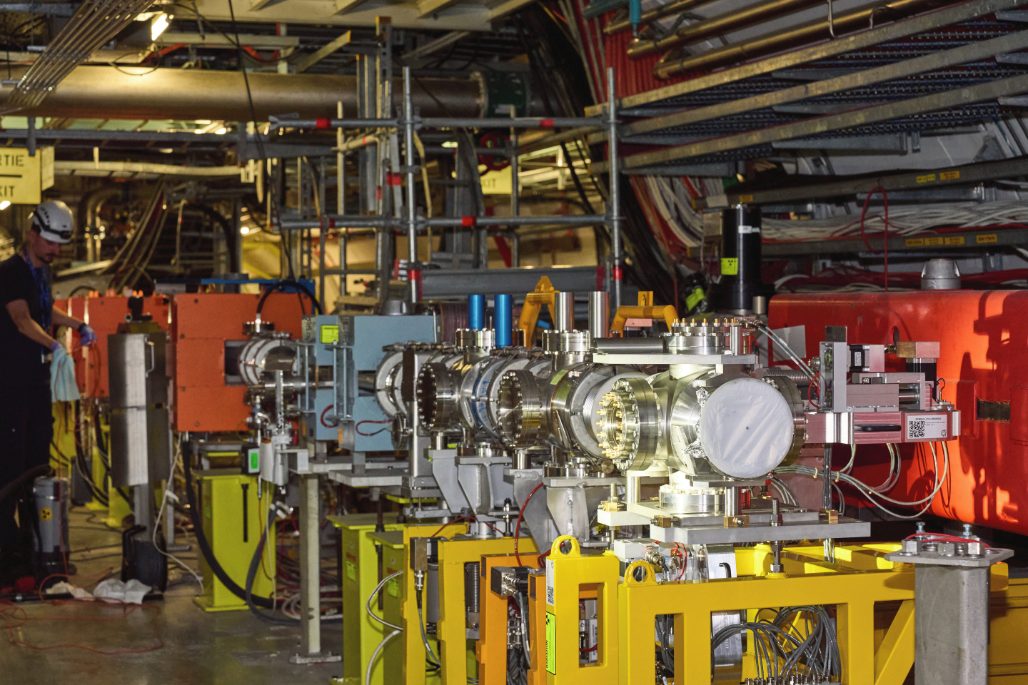
Currently
Working at CERN since July 2023 as a graduate through the ORIGIN program.
2 + 1 year contract, that ends in June 2026.
Working for the TCD (Targets, Collimators and Dumps) section as a Mechanical Engineer to produce “Beam Intercepting Devices”.

Slide 4

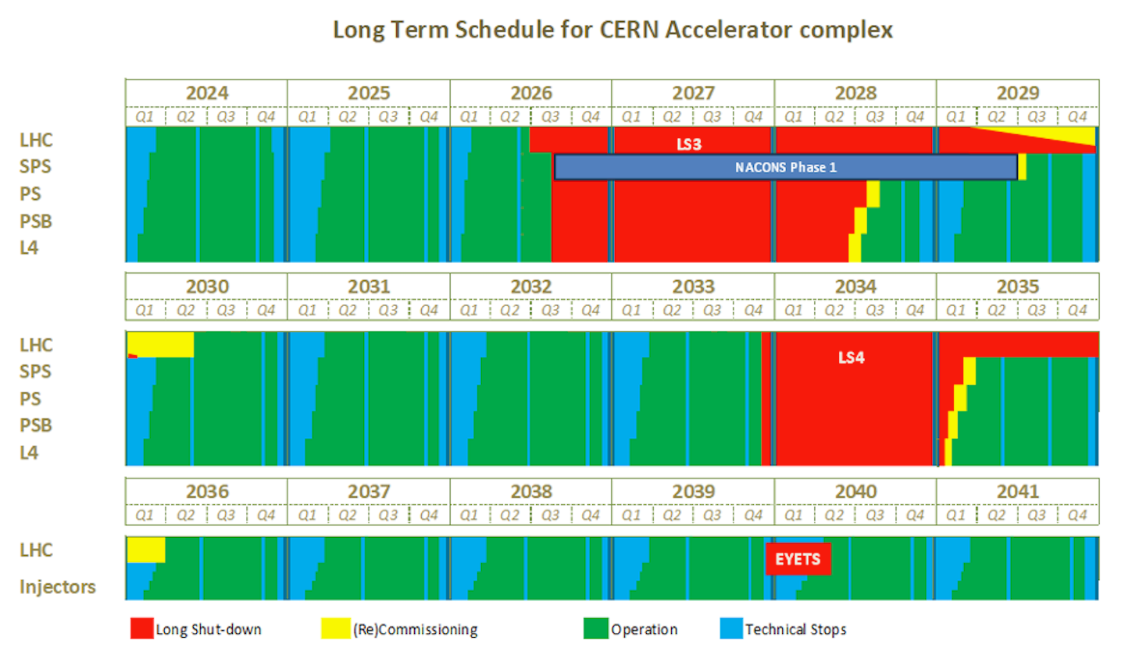
HiLumi & LS3
High- Luminosity LHC
Luminosity: measure of how many collisions can happen, “ability to produce required number of interactions”. Brighter beams → more collisions → more physics & discoveries
Upgrade in the LHC (and across the accelerator complex) to deal with higher energies and intensities to achieve brighter beams.
Long Shutdown 3
2026-2029
Hardware and software will be exchanged as a part of the HiLumi upgrade
Development and production of new systems are already ongoing

Slide 5
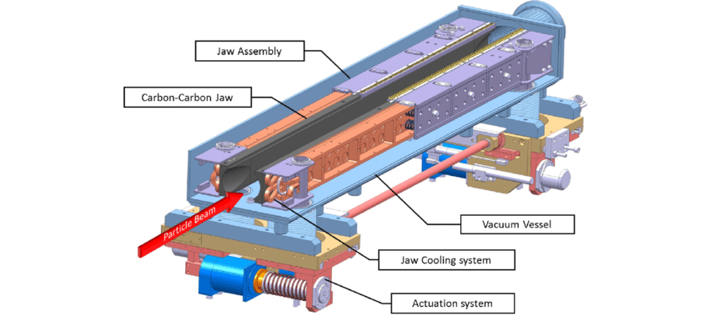
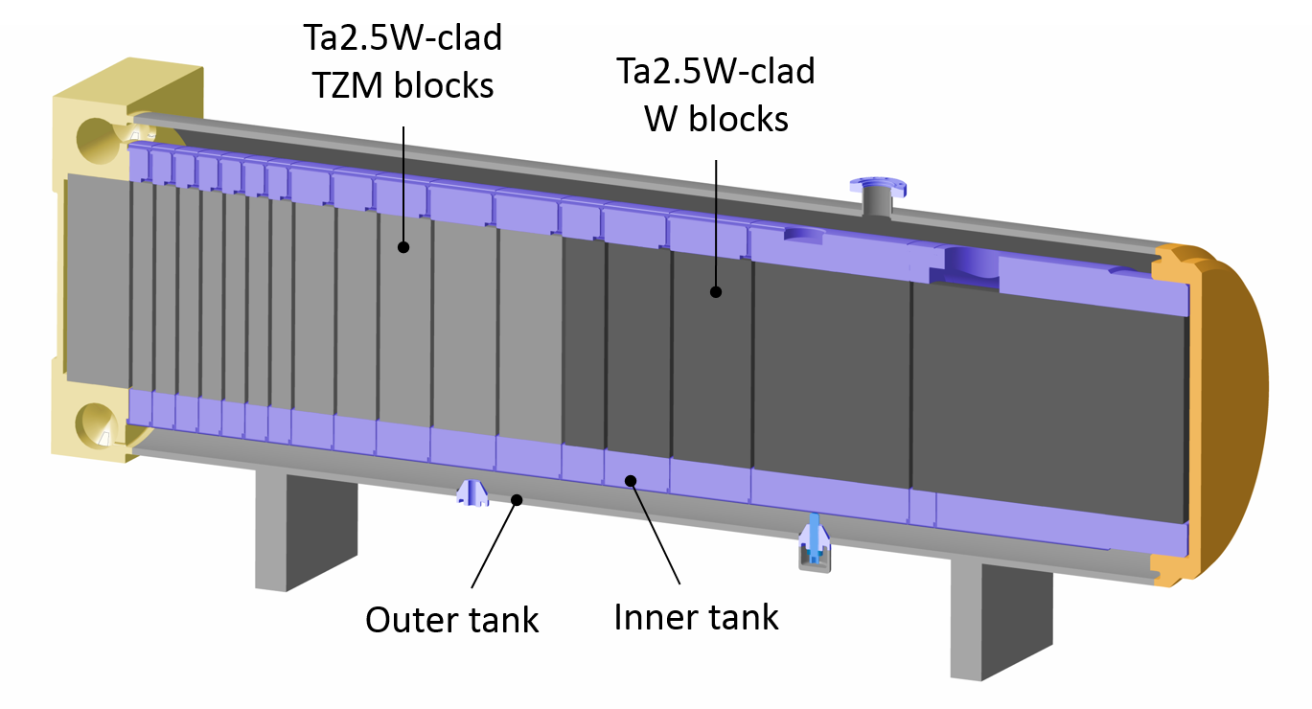
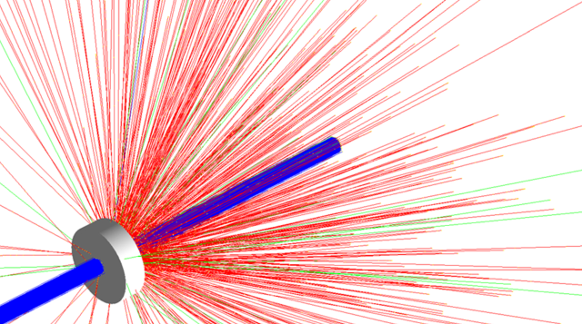
What are Beam Intercepting Devices?
Devices designed to interact with the beams in accelerators or other beam facilities.
Generally classified in 3 categories:
Particle producing devices, such as targets
Systems for beam cleaning and control, such as collimators and scrapers
Safety devices, such as beam dumps or beam stoppers
Accelerators are not just tubes surrounded by magnets; they are hundreds of machines linked together!

Slide 6
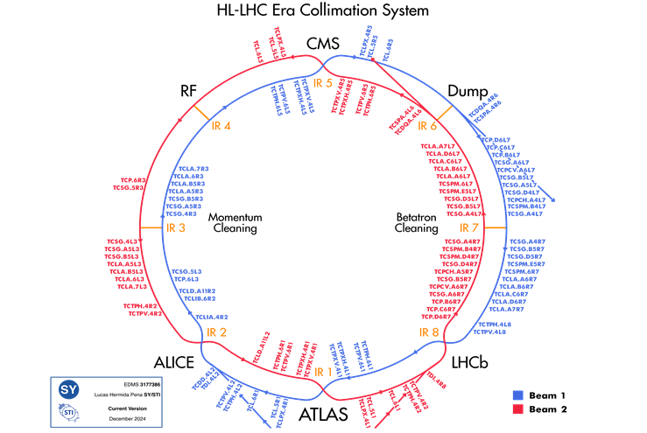
BIDs in the LHC
There are over 165 collimators and masks in the LHC. For the HiLumi upgrade this number will be increased to 201.
The total number of collimators for all of CERN is 410!
The LHC has two primary beam dumps, Target Dump External (TDE), each system is responsible for safely absorbing the energy of the proton beams.
After the HiLumi upgrades the dumps must withstand a peak power of 8.6 billion horsepower.

Slide 7
What is collimation?
Collimation means making rays, particles or waves travel in parallel, straight lines.
Even when a small fraction of particles deviates from the precise trajectory, it can lead to quenching of super-conducting magnets or even destroy parts of the accelerator.
The movable jaws of the collimator close around the beam to clean it of stray particles.
Different materials are used for different purposes, most common are Graphite, Copper and Tungsten

Slide 8
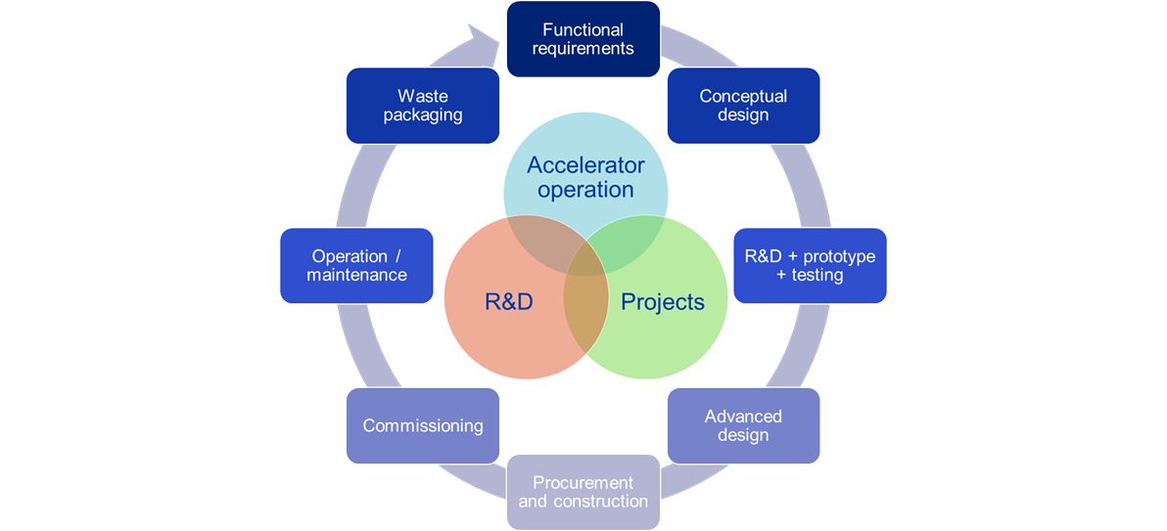
Targets, Collimators and Dumps in short
The TCD section is responsible for all primary beam-intercepting devices in the CERN accelerator complex
The section carries out conceptual studies, manufacturing, installation and maintenance of the mechanical systems and associated equipment and collaborates in the integration of mechatronics systems needed for operation
The section is responsible for all thermo-mechanical studies of all primary beam-intercepting devices in the accelerator sector
Other activities such as developing knowledge for irradiated materials, and design of cooling assemblies

Slide 9
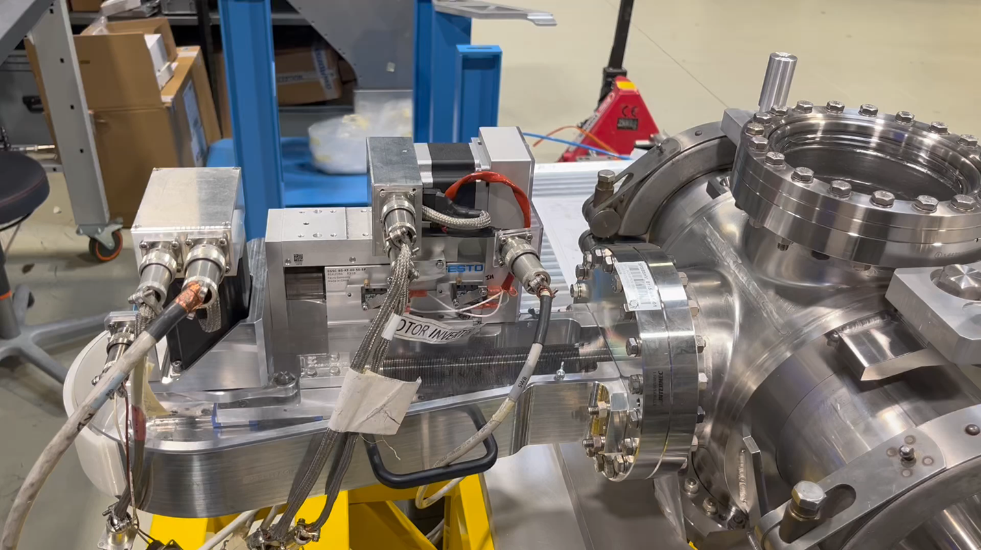
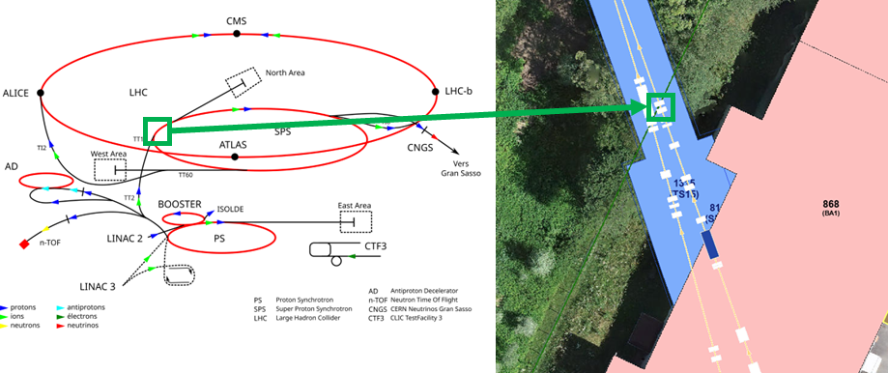
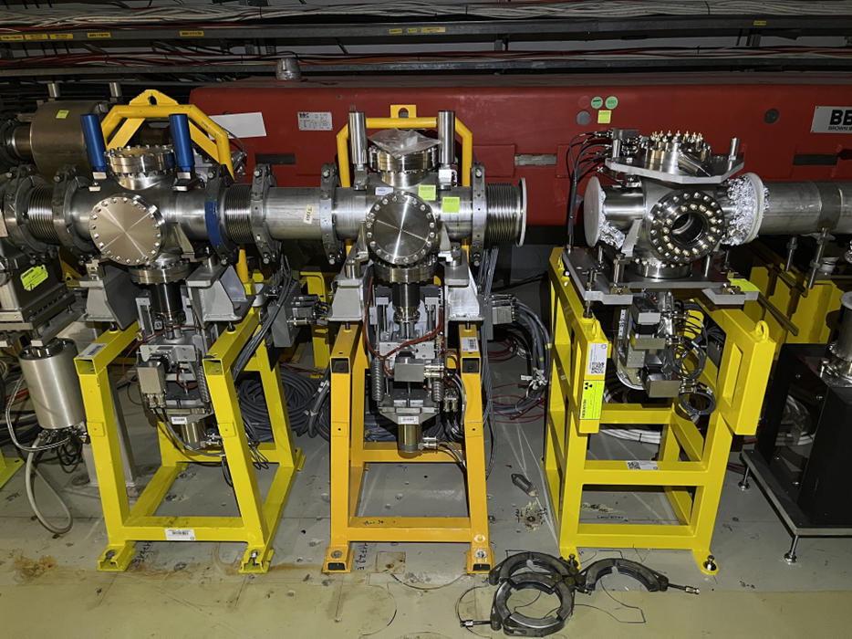

SPS scrapers
Scrapes the halo of the SPS beam, “fast-acting collimator”.
Protection system for sensitive equipment within the SPS and injection to LHC.
3 generations currently installed in the SPS machine.

Slide 10
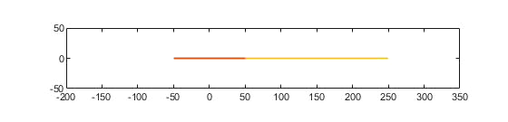
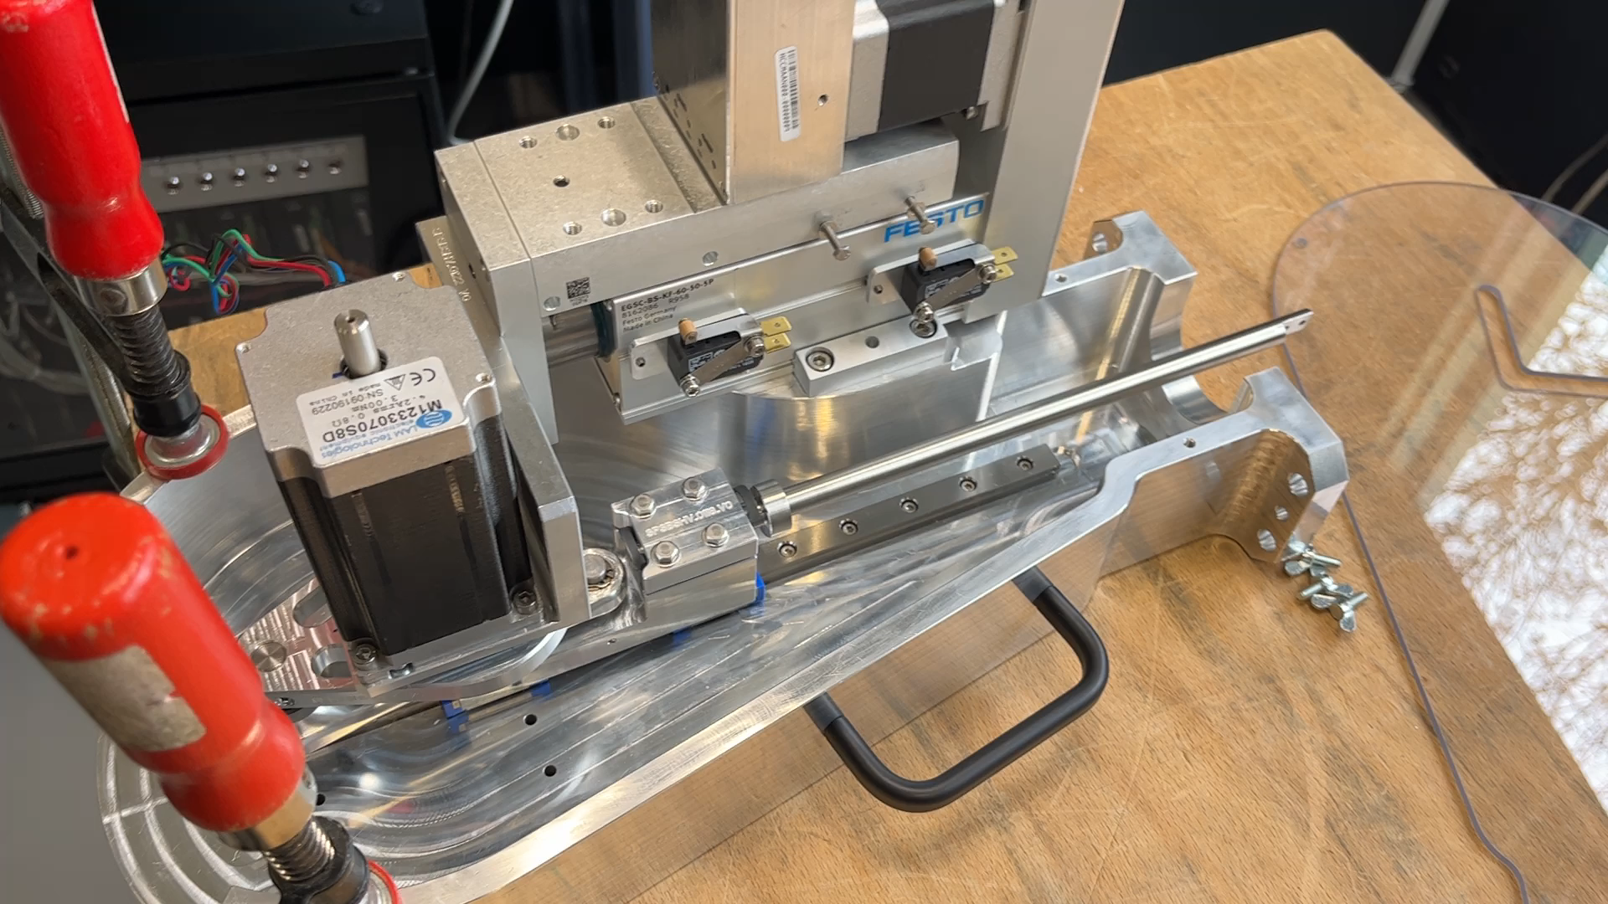
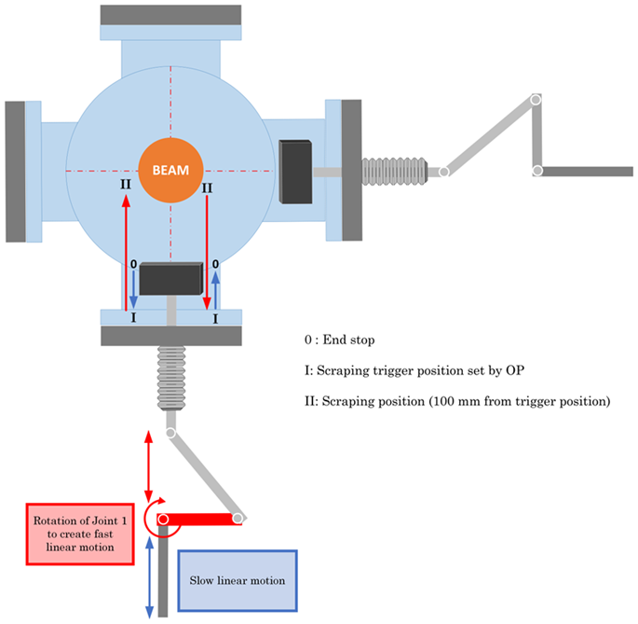
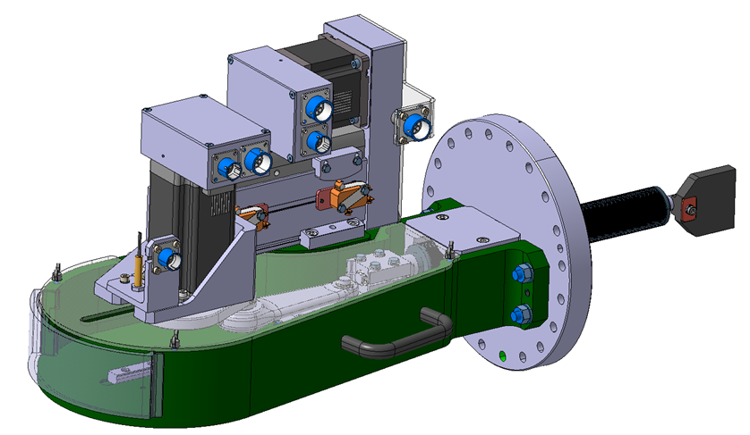
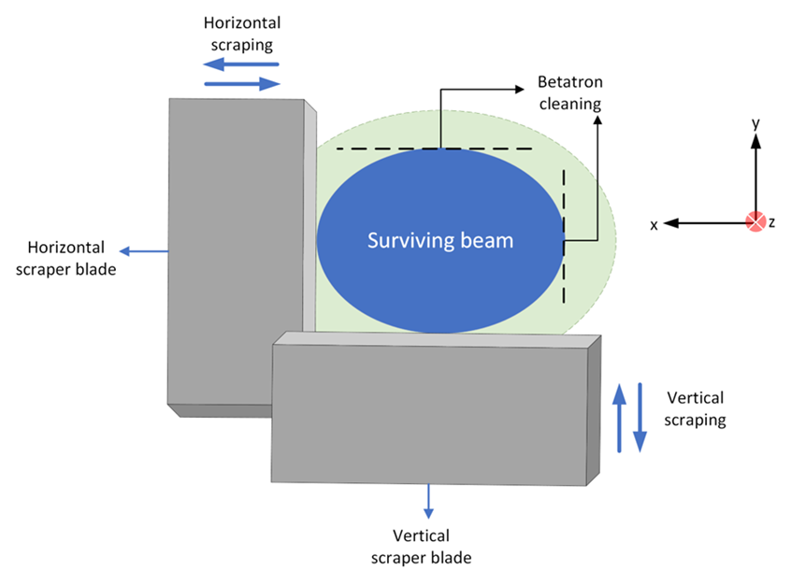
The New SPS scraper V4
Developed a new generation scraper for the HiLumi upgrade.
Uses a crankshaft system to push a graphite blade into beam trajectory and then retreat.
Cleans what we call a “halo”, i.e. particles surrounding the main beam. Only in two directions due to betatron oscillation.
Moves quickly to avoid to absorb too much of the beam, mostly scatters the part of the beam its in contact with. - Masks downstream absorbs the scattered particles.

Slide 11
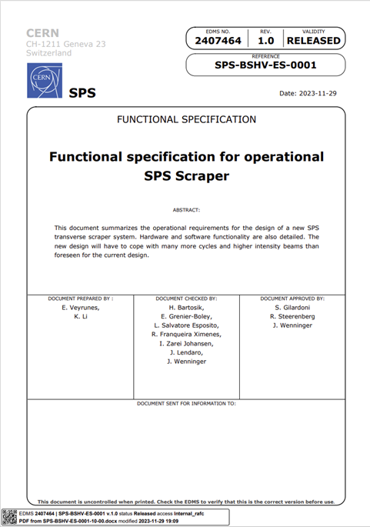


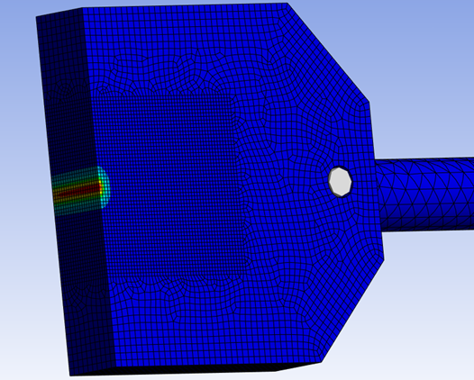
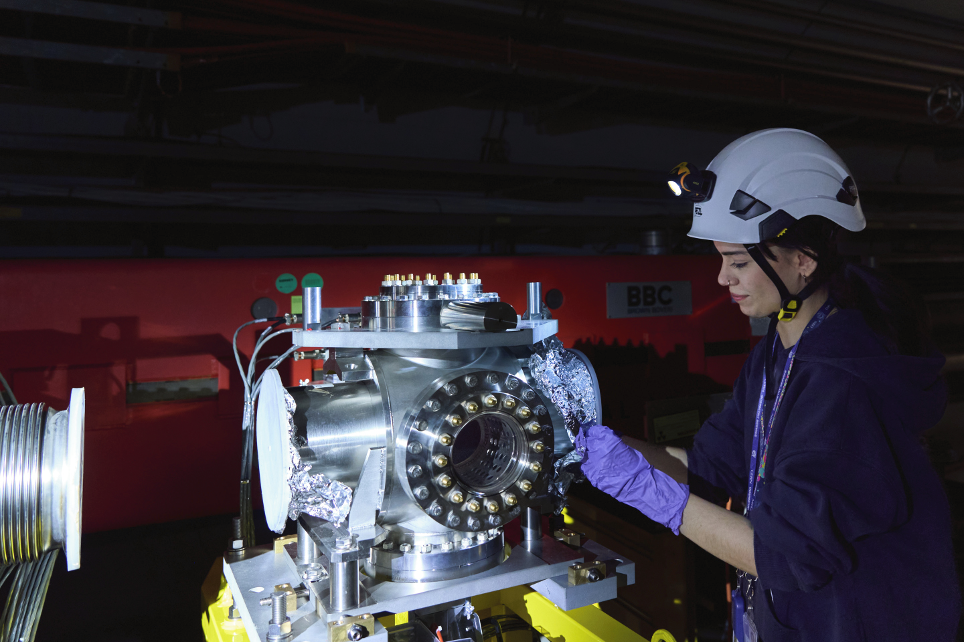
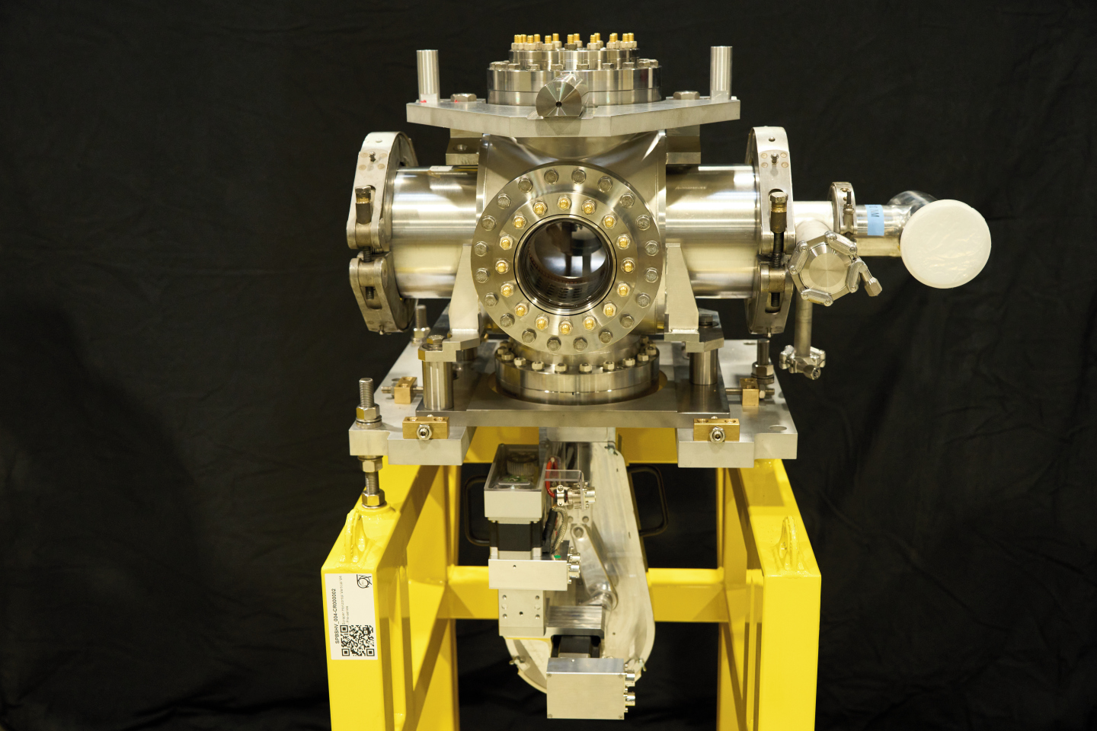
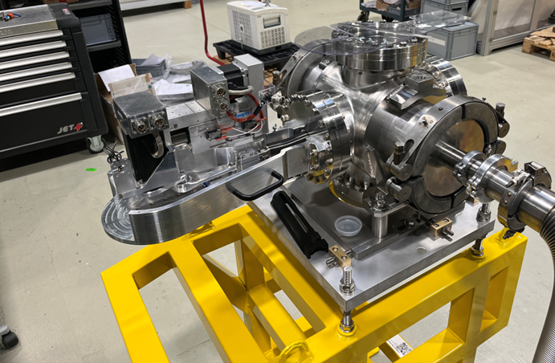
The SPS Scraper V4 work flow
Specs
Concept
Studies
Design
Installation of equipment
Final production
Prototype

Slide 12
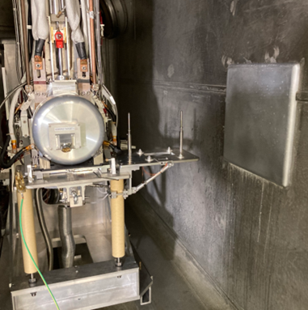
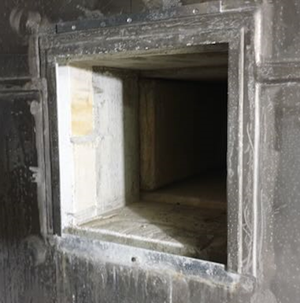
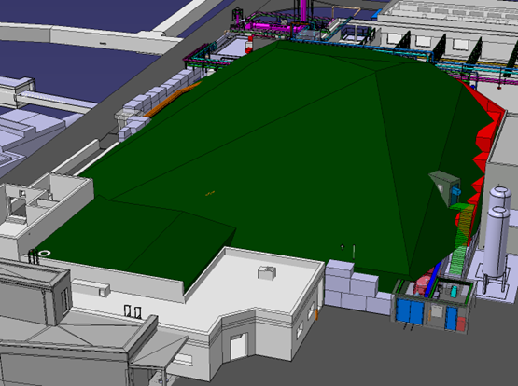
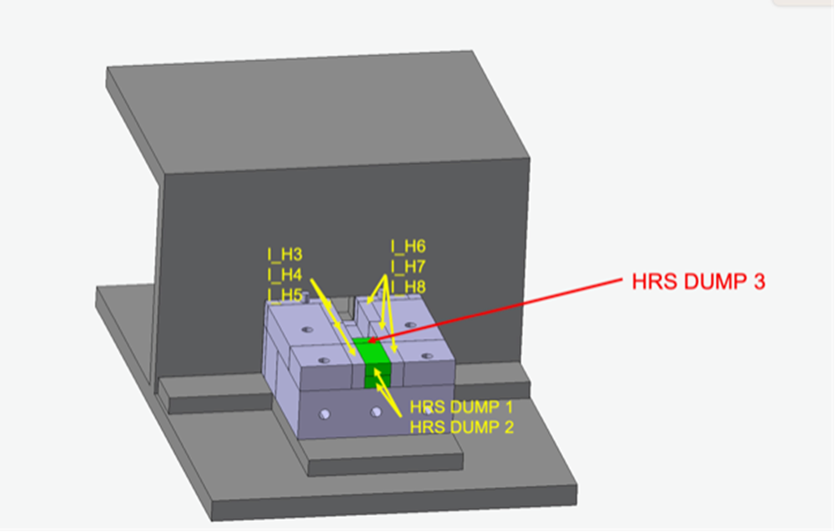
IBDRS – Isolde Beam Dump Replacement & Sustainability project
Dig out old radioactive beam dumps (radioactive earth).
Make a building on top of the beam dumps for accessibility.
Replace the beam dumps with new beam dumps designed for higher intensities and energies.
Cover everything in earth again.

Slide 13
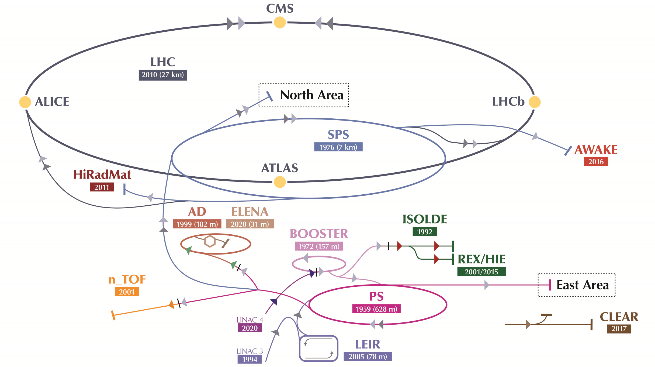
ISOLDE - Isotope Separator On Line Device
Radioactive beam production used for:
Nuclear physics – Properties of exotic nuclei
Astrophysics – Stellar nucleosynthesis studies
Weak interaction physics – Beta decay measurements
Solid-state physics & biomedical research

Slide 14
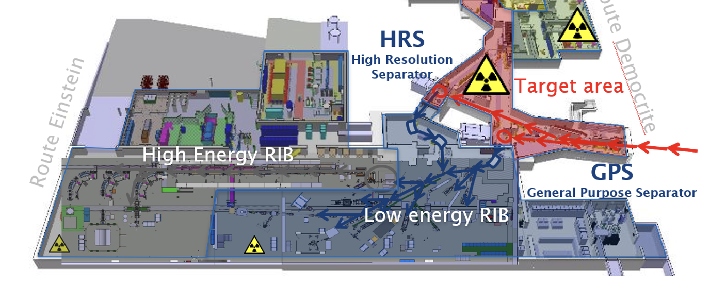
ISOLDE facility

Slide 15
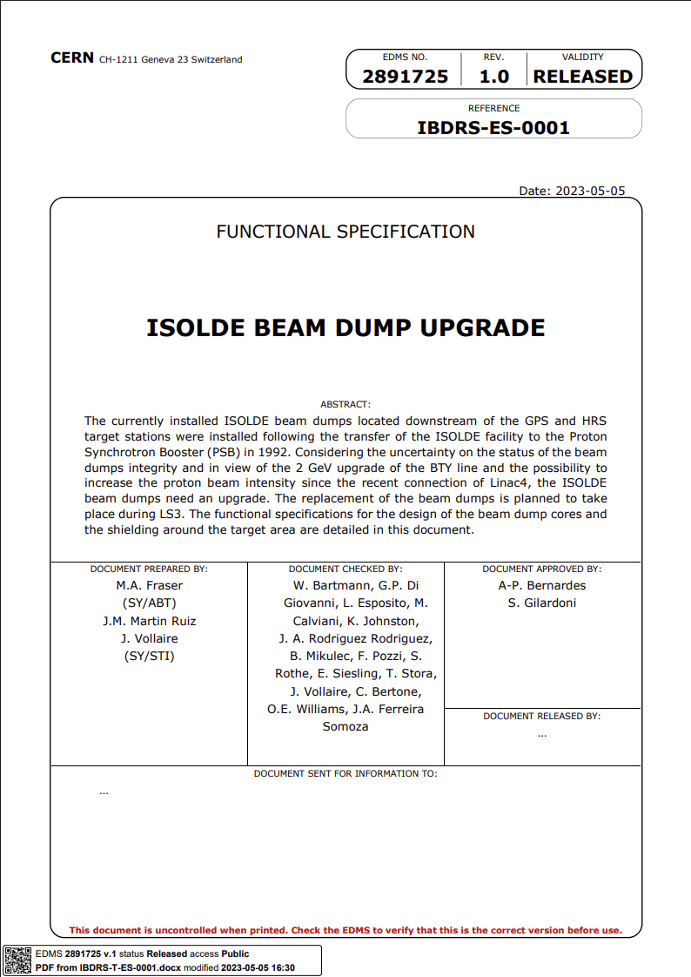
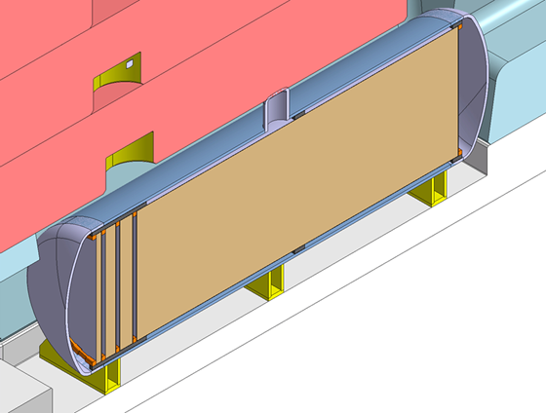
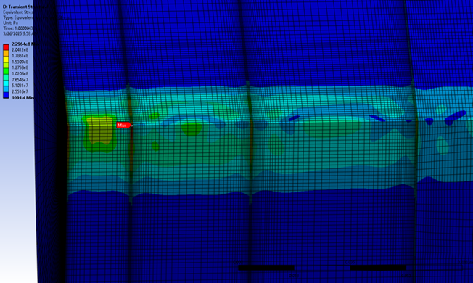
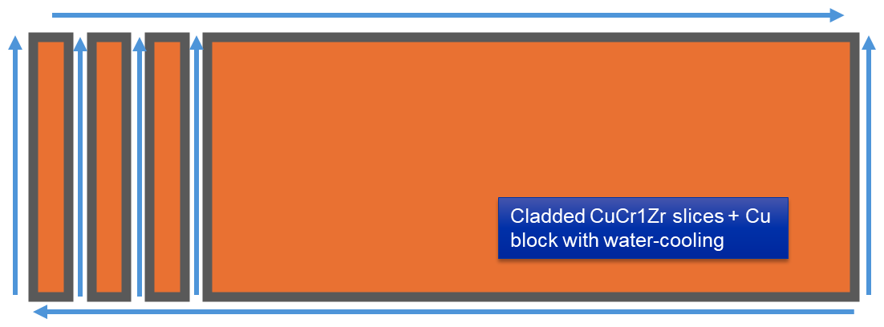
WP5 – new beam dump design
Specs
Concept
Studies
Design
To be continued…

Slide 16
If you are interested in applying for a CERN position
Dont let yourself think you are not qualified – The graduate programs are designed for you to learn new things. No one at CERN expects you to know anything about beam physics as an engineering student.
Dont worry about not having the best grades– the main values at CERN is curiosity and interest in learning!
My number one tip for the application process – include a reference letter from a professor that likes you ☺

Slide 17
Questions?
Can also be sent to ida.zarei.johansen@cern.ch

