Slide 1


Gamma-ray spectroscopy of ²²⁹Ac following the beta-decay of ²²⁹Ra
Magda Satrazani
magda.satrazani@kuleuven.be
IDS Collaboration Meeting – March 2025

Slide 2
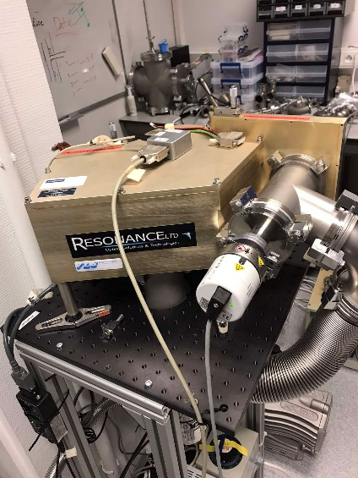
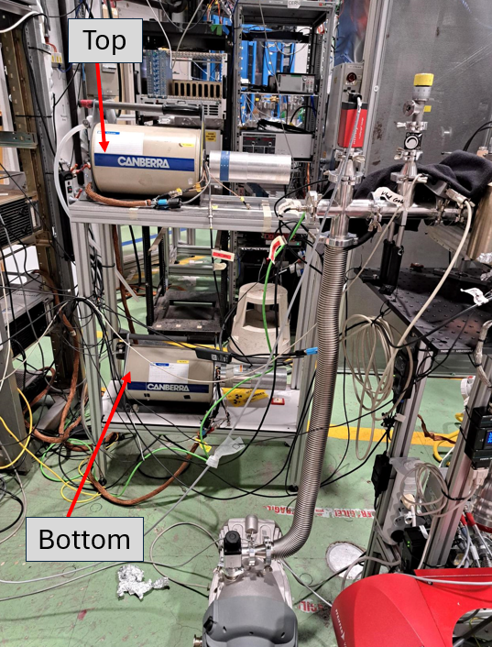
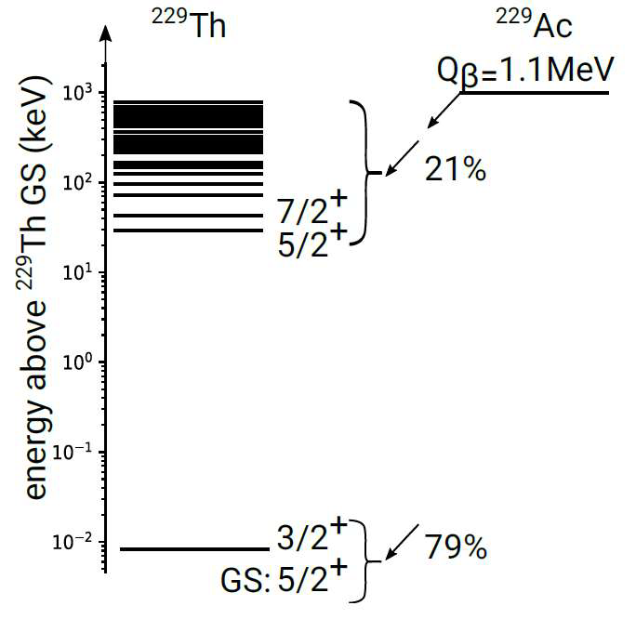
Introduction – Physics Motivation
IS715 Beamtime 2023
RIB with ²²⁹Fr and ²²⁹Ra is implanted on the crystals
Goal:
Measure how much of ²²⁹Th is implanted on the crystals
⟹ define the amount of VUV photons emitted
⟹ obtain the Radiative Decay probability

Slide 3
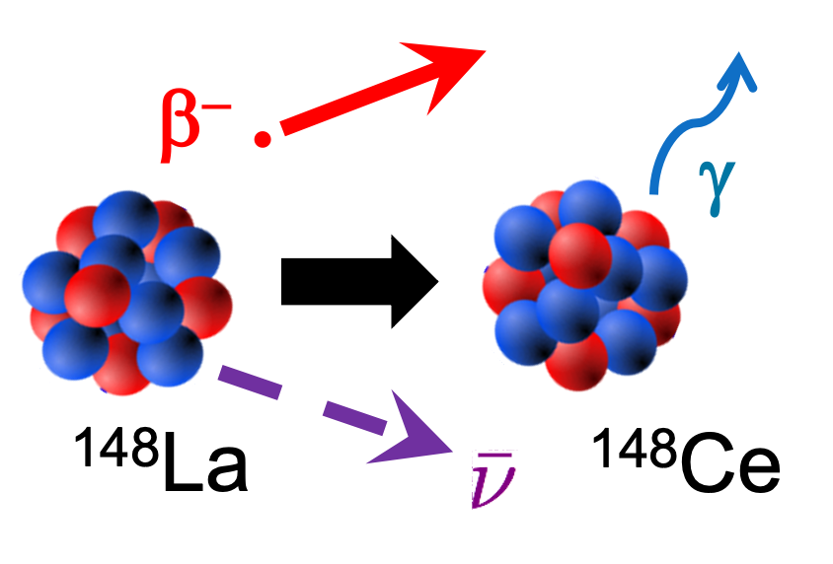
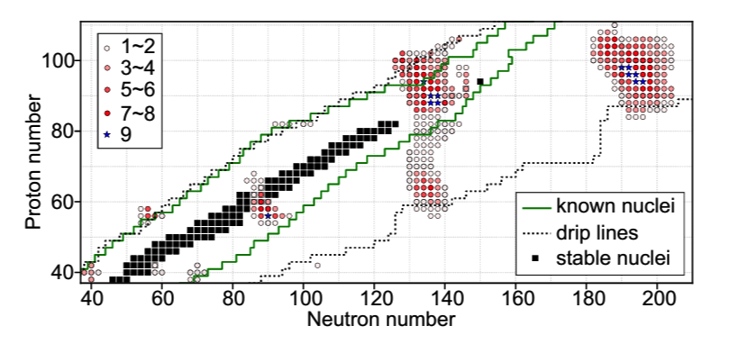
Introduction – Physics Background
The Ac, Ra, Th $(Z=89,88,90)$nuclei with mass numbers $A=225−231$are good candidates for octupole correlations in this region of the nuclide chart
Study the β-decay of ²²⁹Ra to ²²⁹Ac
Calculate the absolute γ-ray intensities
Construct the level scheme of ²²⁹Ac
Re-define more precisely the value of the T_{1/2} of ²²⁹Ra
Understand the nuclear structure of ²²⁹Ac
Y. Cao et al., Phys. Rev. C 102, 024311(2020)

Slide 4
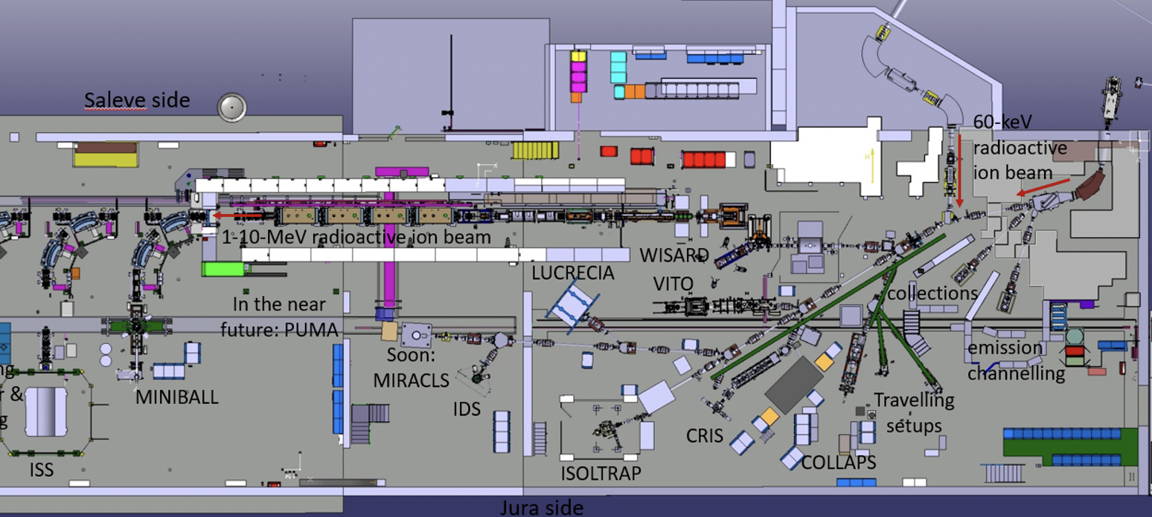
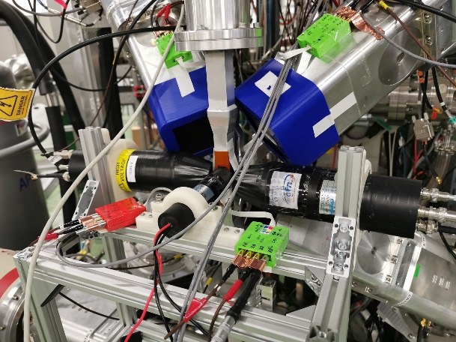
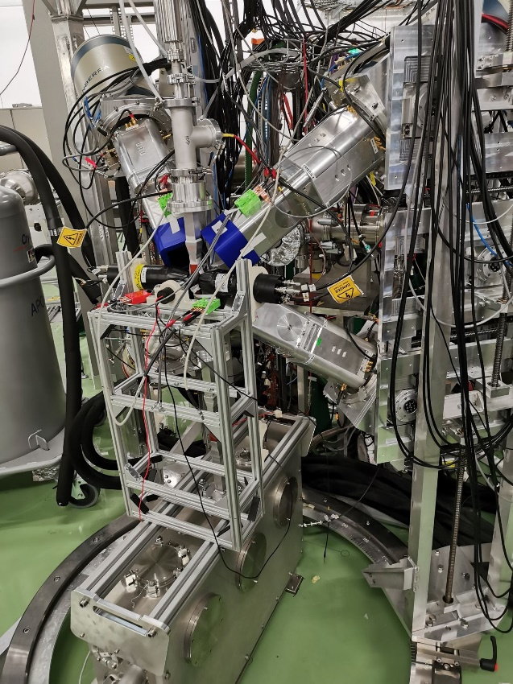
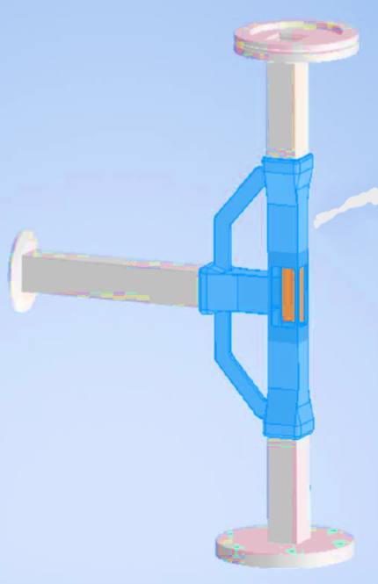
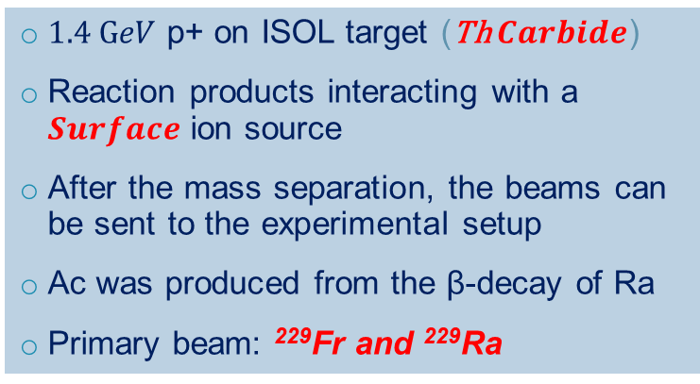
Experimental Setup
$1.4 GeV$ p+ on ISOL target (Th $Carbide$)
Reaction products interacting with a $Surface$ ion source
After the mass separation, the beams can be sent to the experimental setup
Ac was produced from the β-decay of Ra
Primary beam: ²²⁹Fr and ²²⁹Ra
3 HPGe clovers for γ-ray detection
3 scintillators for β-particle detection
2 LaBr₃ for fast-timing measurements
Tape Collector (T-piece)

Slide 5
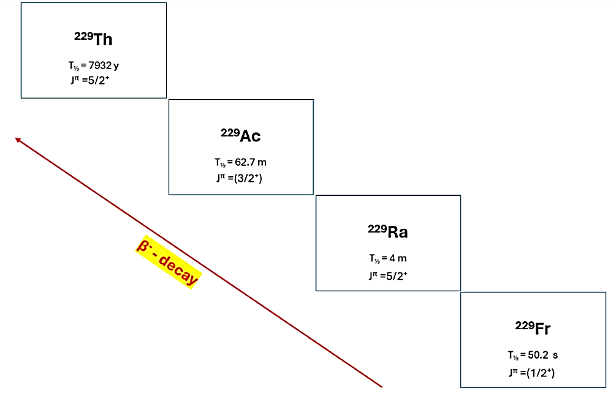
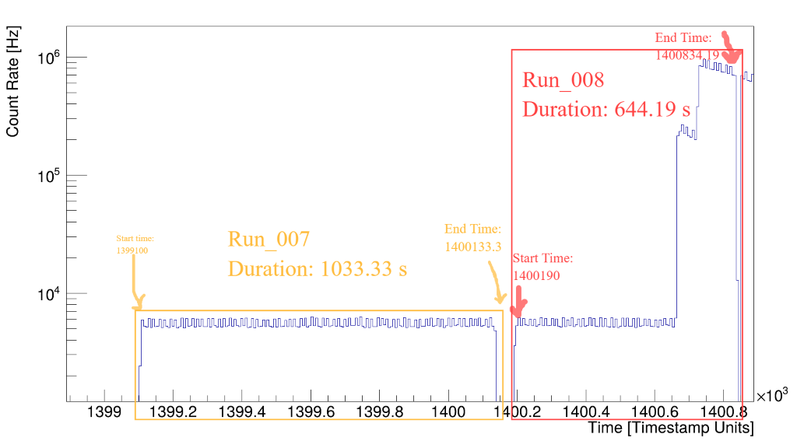
Experiment – Facts & Figures
Duration of the experiment:
~3 days in total (August 2023)
Beam Gate
Open/Close
Beam Intensity:
~2e8 pps
Nuclei:
²²⁹Fr → ²²⁹Ra → ²²⁹Ac →²²⁹Th
Total
Running time:
~47h data for bg (in total)
~10m implantation data
~12h decay data

Slide 6
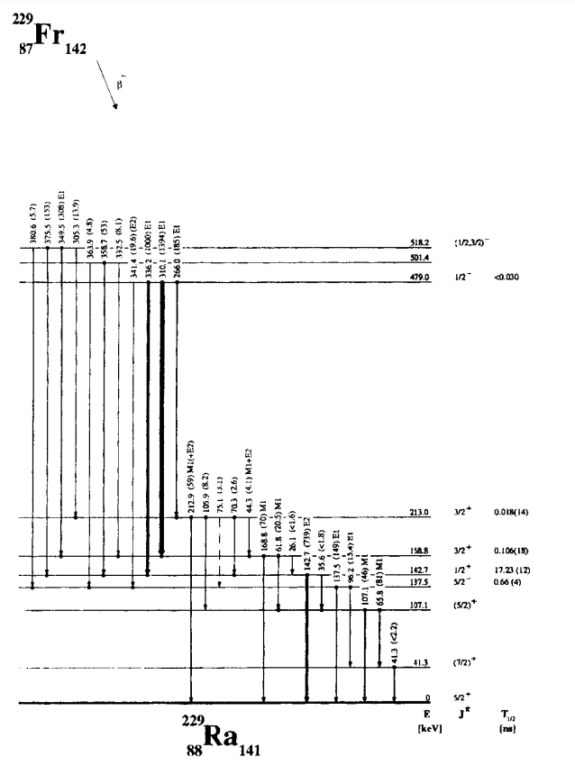
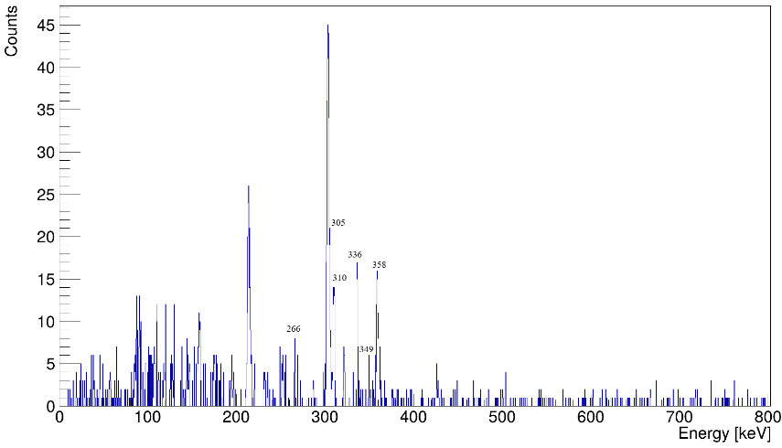
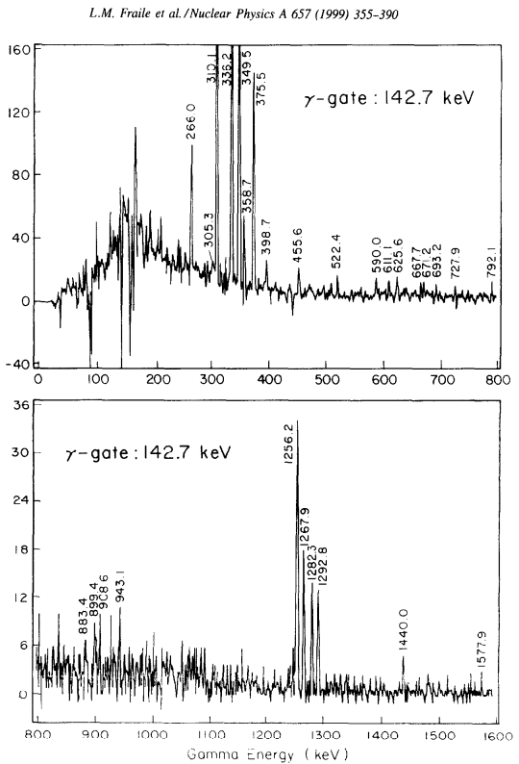
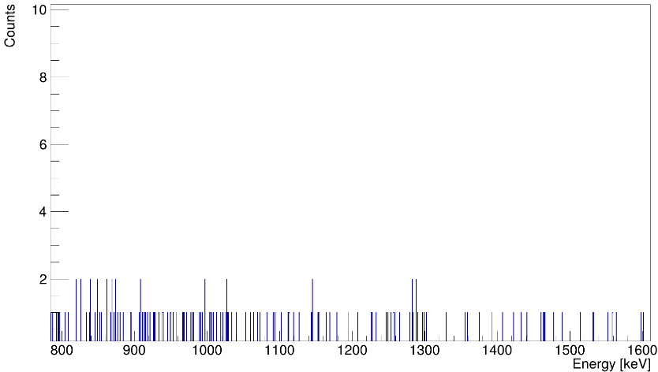
Status of Analysis: ²²⁹Fr → ²²⁹Ra
IS715 Data – Implantation Shots
L.Fraille et al., Nuclear Physics A 657, 1999

Slide 7
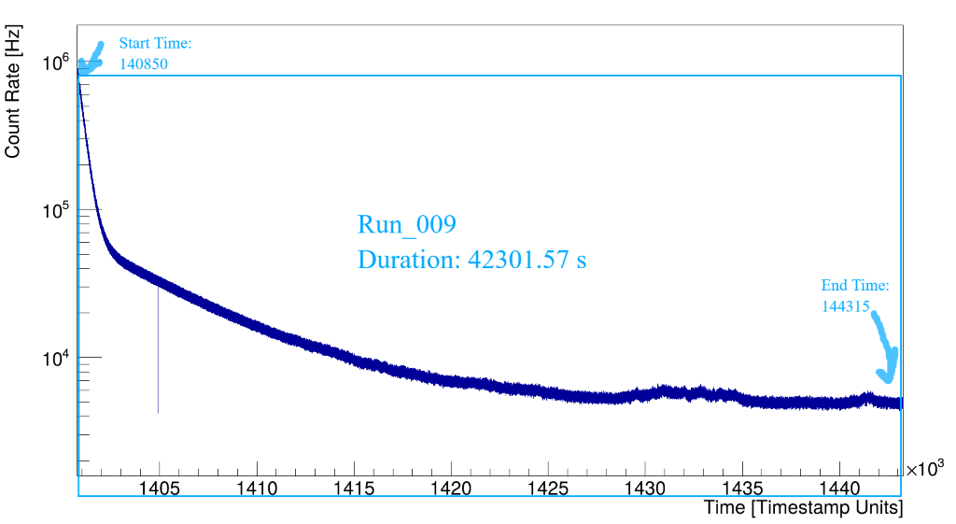
Status of Analysis: ²²⁹Ra → ²²⁹Ac
Deconstructing the timestamp….
Duration of this run file: ~12h of data
Different parts of this run file can give us different information
Decay data are mostly used in this analysis
Total

Slide 8
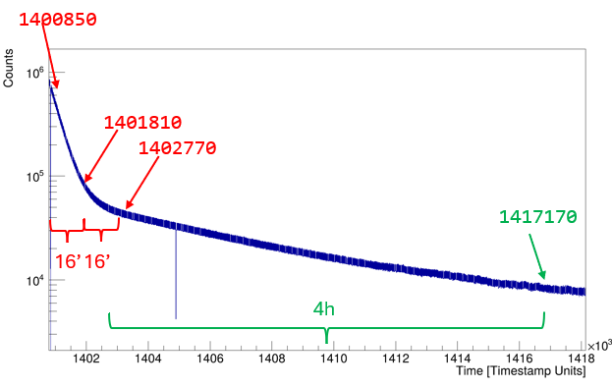
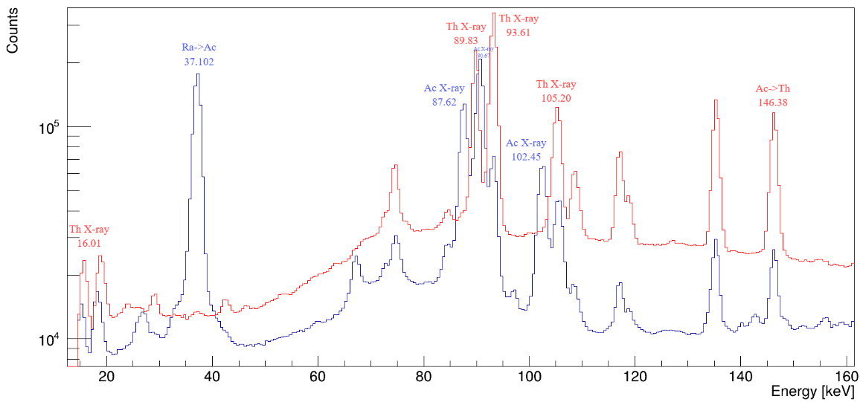
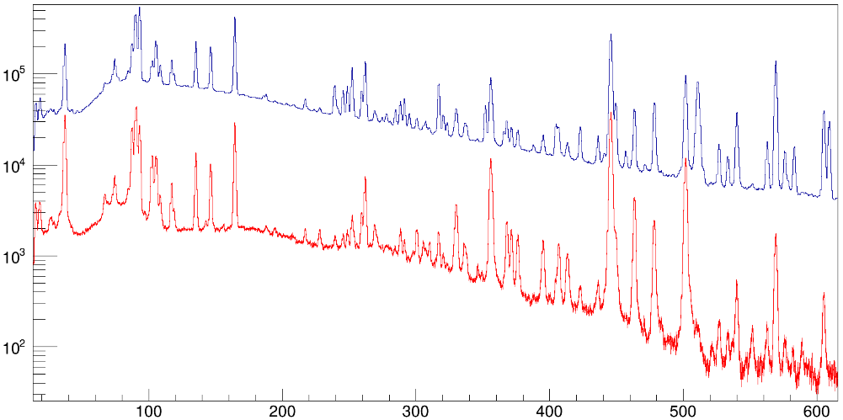
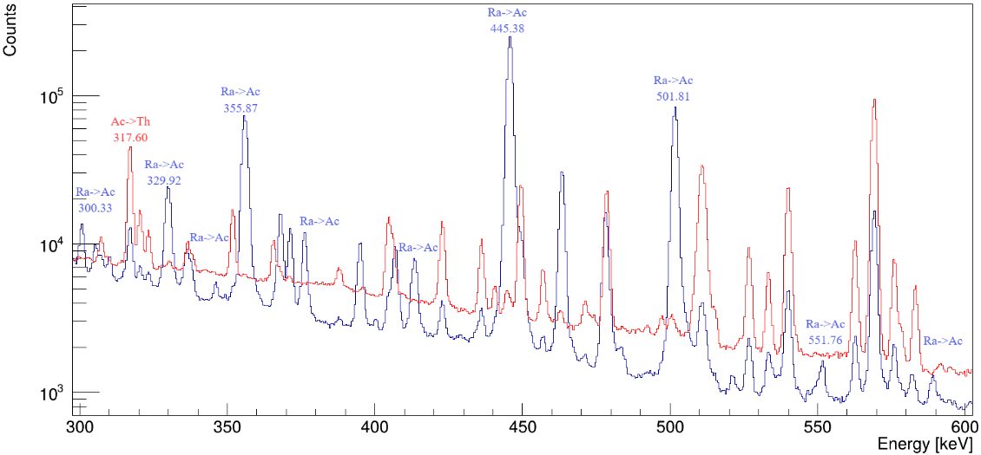
Status of Analysis: ²²⁹Ra → ²²⁹Ac
To enhance the presence of γ-rays originating from:
²²⁹Ra->²²⁹Ac, we used the first 16min
(4 * T_{1/2} of ²²⁹Ra)
²²⁹Ac->²²⁹Th, we used the time between the first 30min up to 4h
(4 * T_{1/2} of ²²⁹Ac)
First 16’ of R9
Last part of R9
Gamma singles with beta tagging
Counts
Without β-tag
With β-tag
569
E_{γ} [keV]

Slide 9
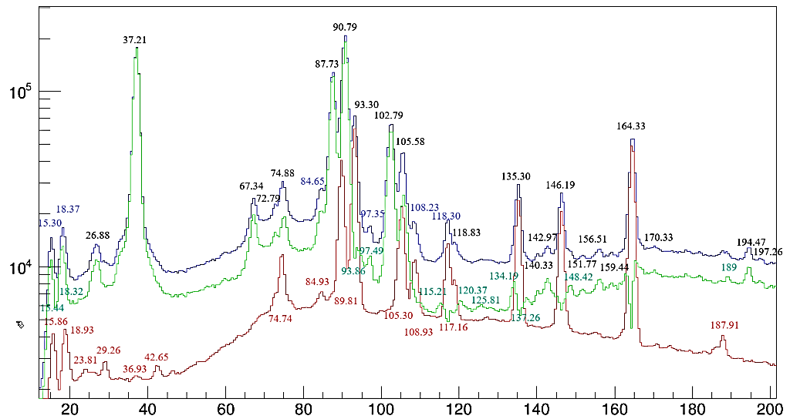
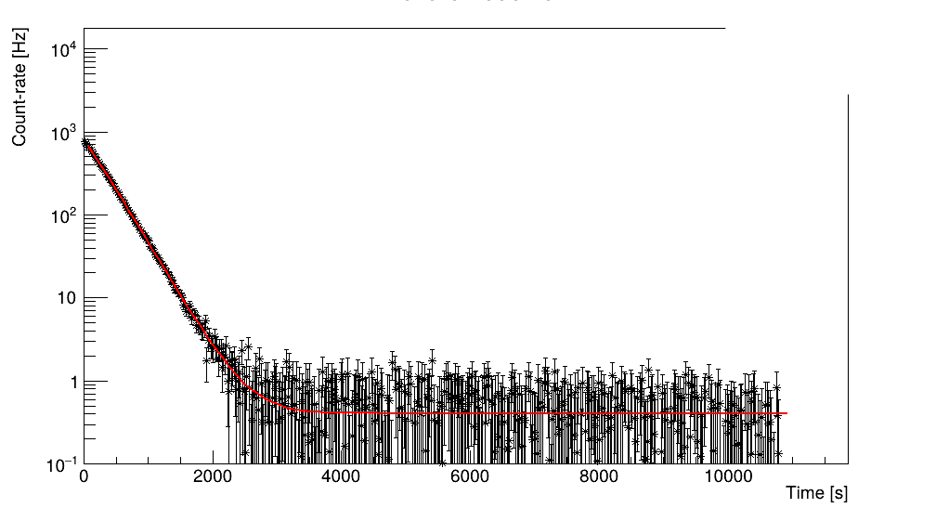
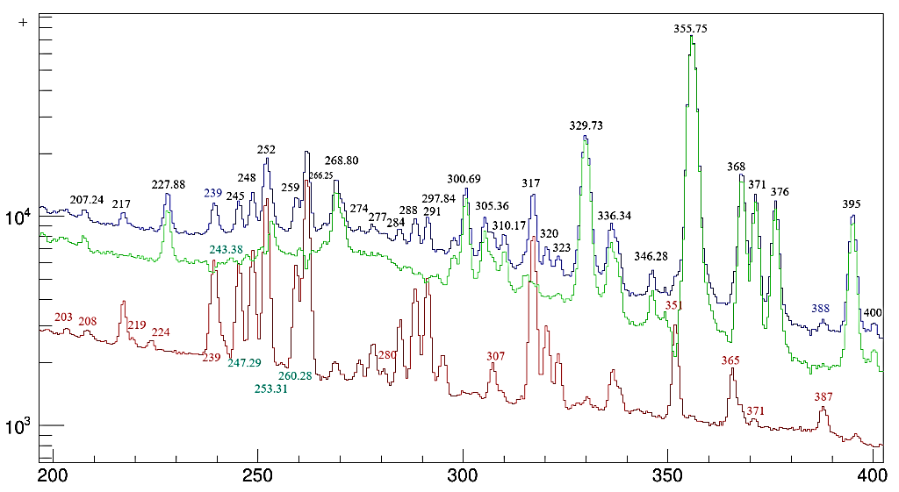
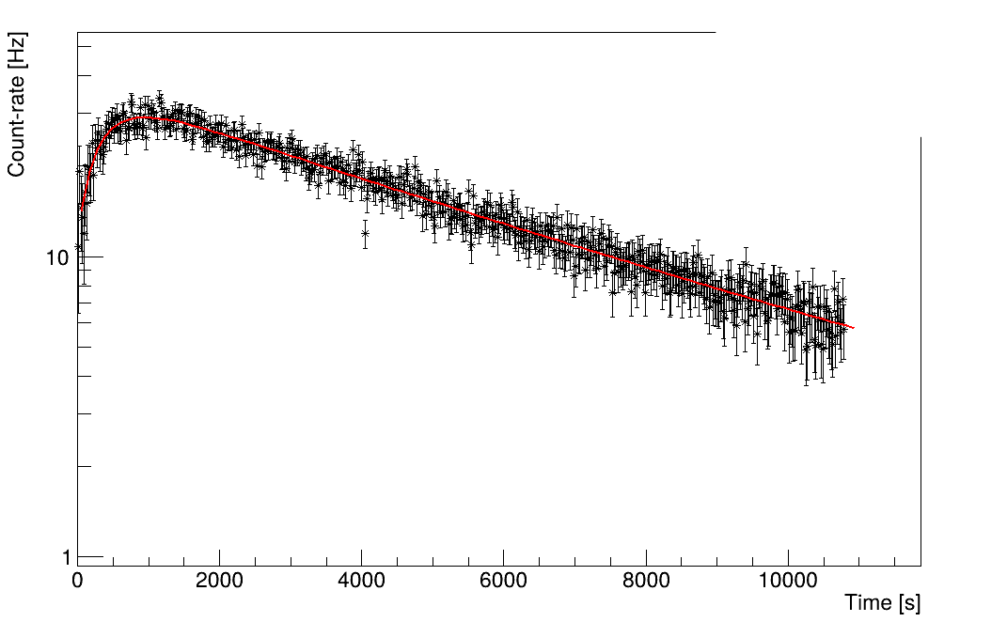
Status of Analysis: ²²⁹Ra → ²²⁹Ac
Decay Data
Blue: first 16'
Red: 30' till 4h * 0.178
Green: Blue - Red
Lifetime behaviour of gamma-rays
Counts
355 keV
117 keV
E_{γ} [keV]

Slide 10
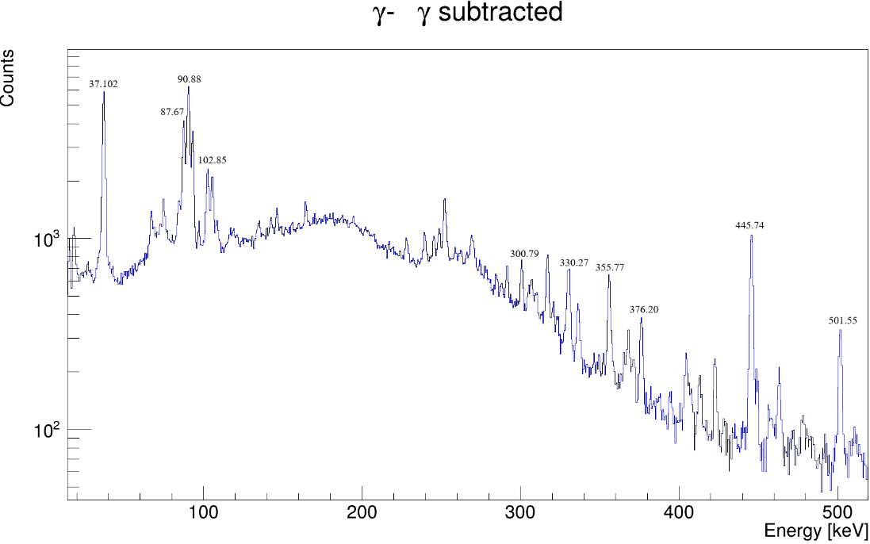
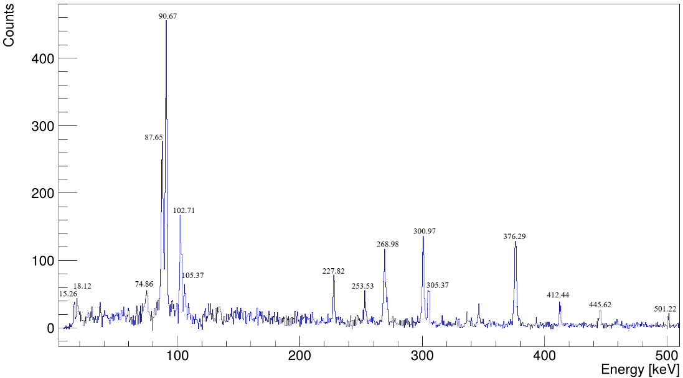
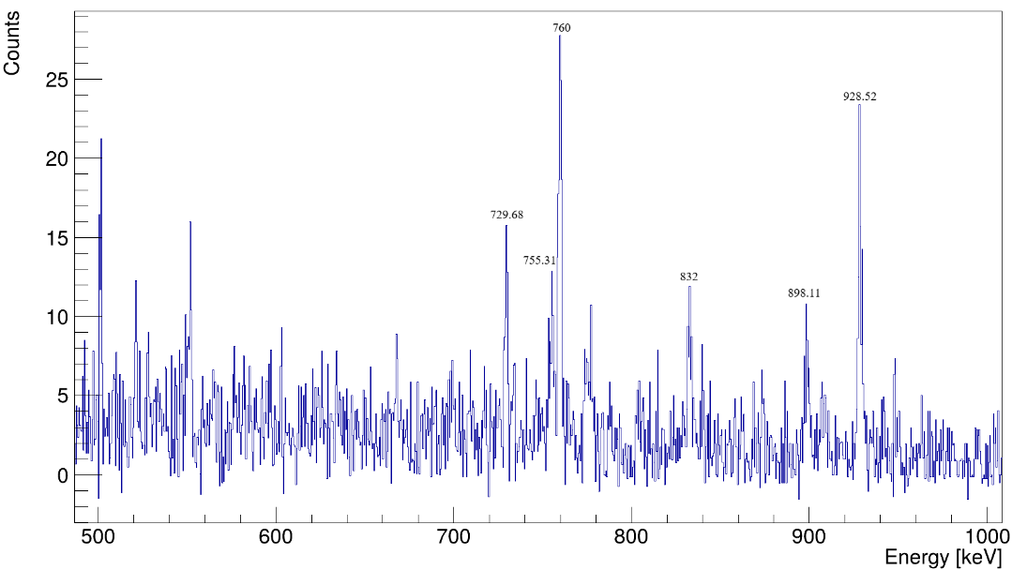
Coincidence Analysis: ²²⁹Ra → ²²⁹Ac
Gate on the 37 keV transition
Visualise the strongest γ-rays in the gamma-singles spectrum
Combine this information with the projected matrix and the gated spectra
Look for g.s. transitions and intermediate ones

Slide 11
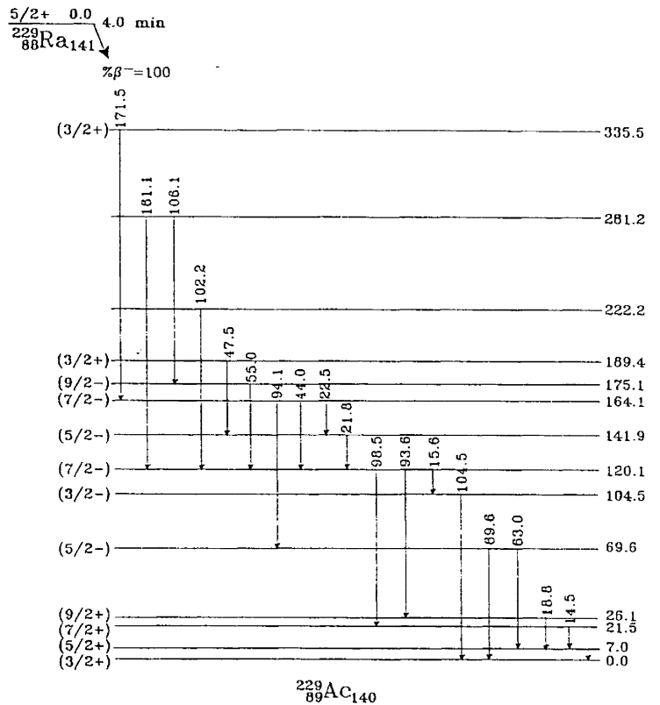
²²⁹Ra → ²²⁹Ac : What is known so far?
²²⁹Ra was produced through the reaction
²³²Th(n,a)²²⁹Ra
2 HPGe shielded detectors were used
Coincidence analysis was performed
Very low gamma-ray energies were reported
Observations look quite ambiguous
Level scheme needs to be re-evaluated
Wang, WF & Yuan, SG & Fang, KM & Shen, Shuifa & Mou, Weiming & Zhang, XQ & Zq, Li. (1997)

Slide 12
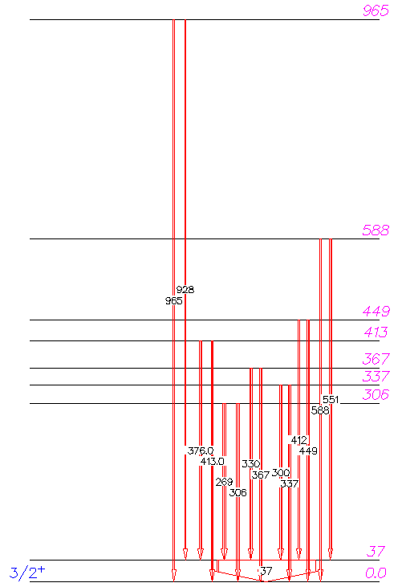
Building The Level Scheme: ²²⁹Ra → ²²⁹Ac
²²⁹Ra
PRELIMINARY
Wang, WF & Yuan, SG & Fang, KM & Shen, Shuifa & Mou, Weiming & Zhang, XQ & Zq, Li. (1997)
[1]
²²⁹Ac
[1] Private communication - Thomas Elias Cocolios and Michael Heines on behalf of the PI-LIST collaboration

Slide 13
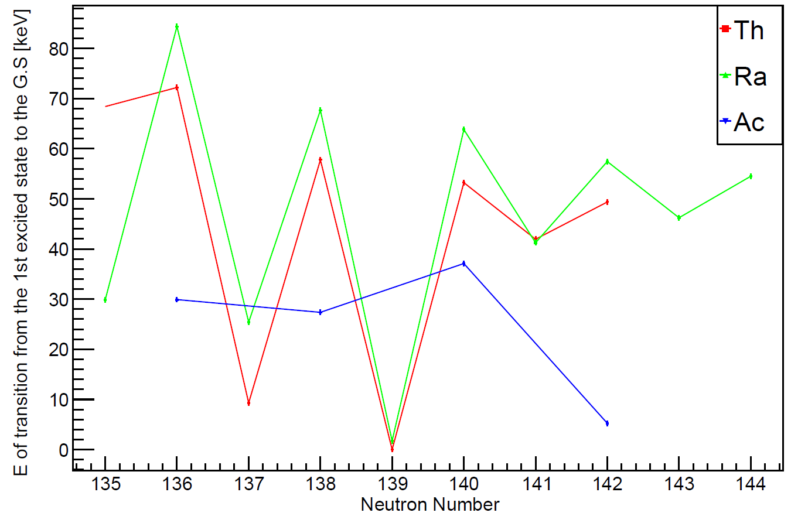
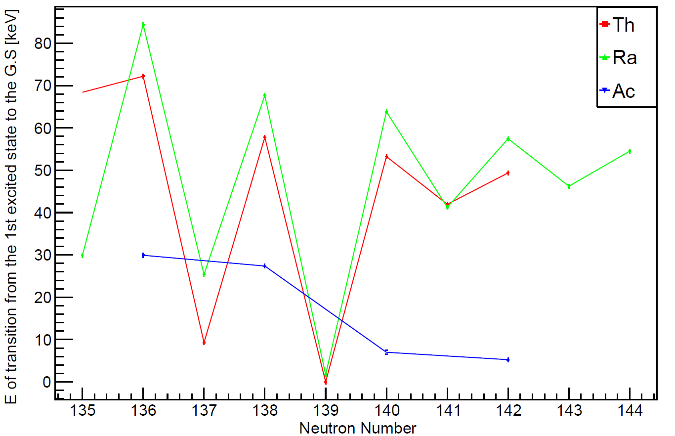
Building The Level Scheme: ²²⁹Ra → ²²⁹Ac
²²⁹Ra
Energy Systematics
PRELIMINARY
For ²²⁵⁻²³¹Th, ²²⁵⁻²³¹Ra and ²²⁵⁻²³¹Ac
with: Z_{Th}=90, Z_{Ra}=88 and Z_{Ac}=89
[1]
²²⁹Ac
[1] Private communication- Thomas Elias Cocolios and Michael Heines on behalf of the PI-LIST collaboration

Slide 14
Future Plans
Construct a new level scheme for ²²⁹Ra → ²²⁹Ac
Measure the absolute intensities of the gamma-rays involved in the transitions
Define more precisely the T_{1/2} of ²²⁹Ra
Extend our knowledge on the octupole deformation in this region of the nuclide chart
Publish !

Slide 15
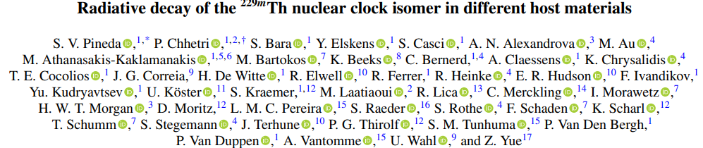
Thank you for your attention !
Especially thank you to the IDS Collaboration and to:
Piet Van Duppen, James Cubiss, Razvan Lica, Zixuan Yue, Hilde De Witte, Silvia Bara, Simone Casci, Stella Vogiatzi

Slide 16
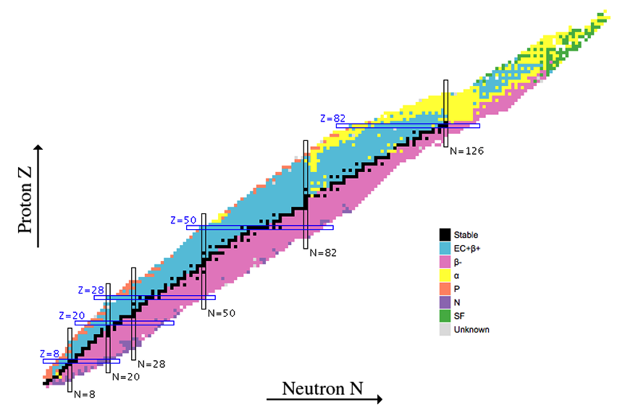
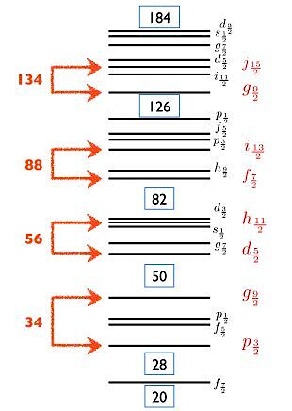
Back-up Slides
Physics Background – Octupole Deformation
Observables of interest:
low-lying negative parity states
Enhanced E1 transitions between positive and negative-parity states
Large B(E3) transition probabilities associated with intrinsic electric octupole moments

Slide 17
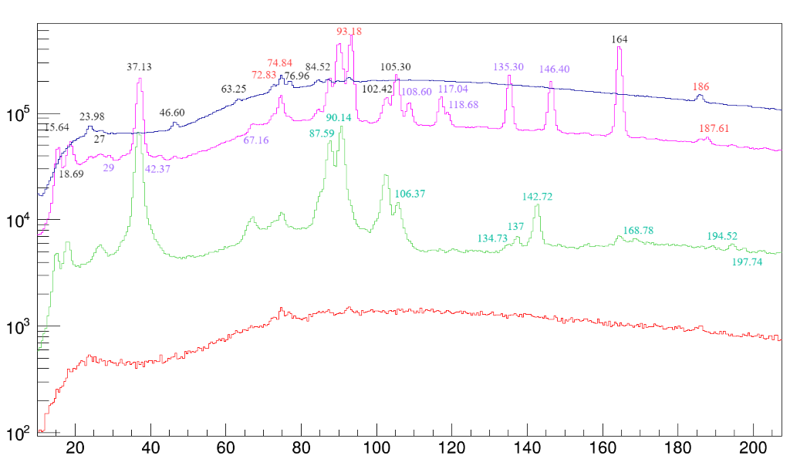
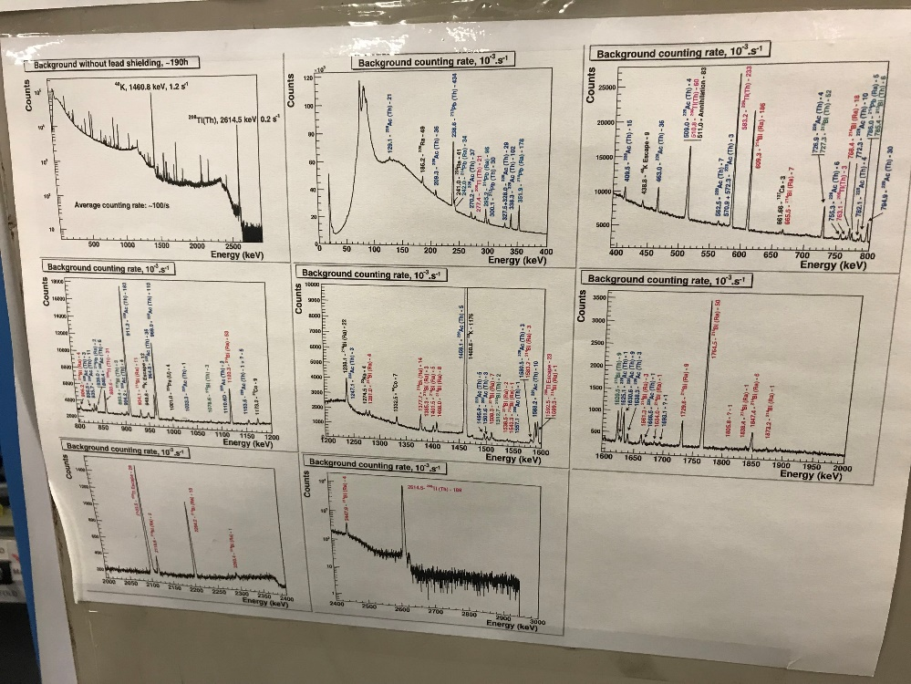
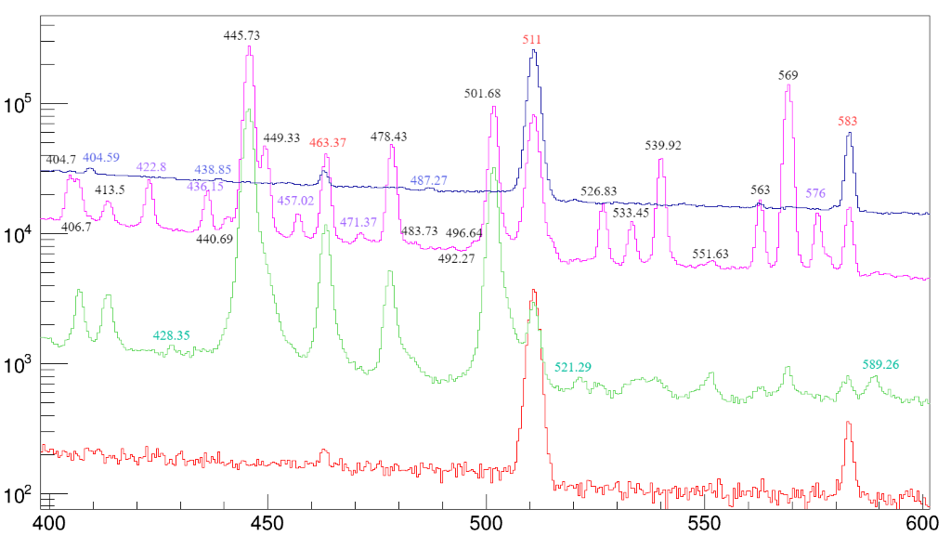
Back-up Slides
Gamma-ray energy singles spectra
Counts
Red: Bg (Run_007)
Green: Implantation (Run_008)
Purple: Decay (Run_009)
Blue: Bg (Run_010)
ISOLDE Contaminants
E_{γ} [keV]

Slide 18
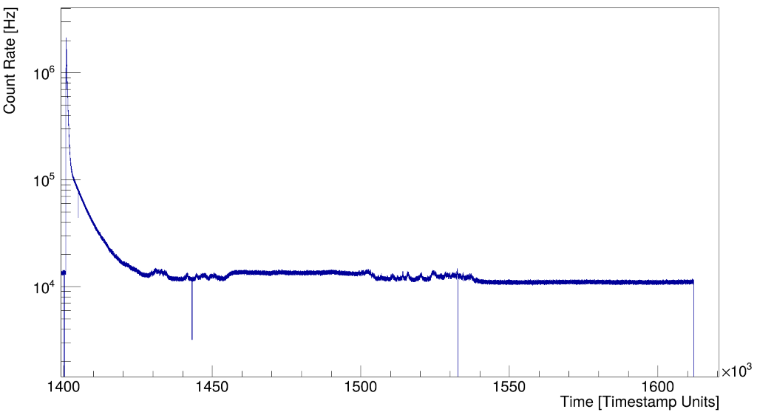
Back-up Slides
Duration of the experiment:
~3 days in total (August 2023)
Total timestamp
Implantation
Nuclei:
²²⁹Fr → ²²⁹Ra → ²²⁹Ac →²²⁹Th
Decay
More Bg
Running time:
~47h data for bg (in total)
~10m implantation data
~12h decay data
Bg

Slide 19
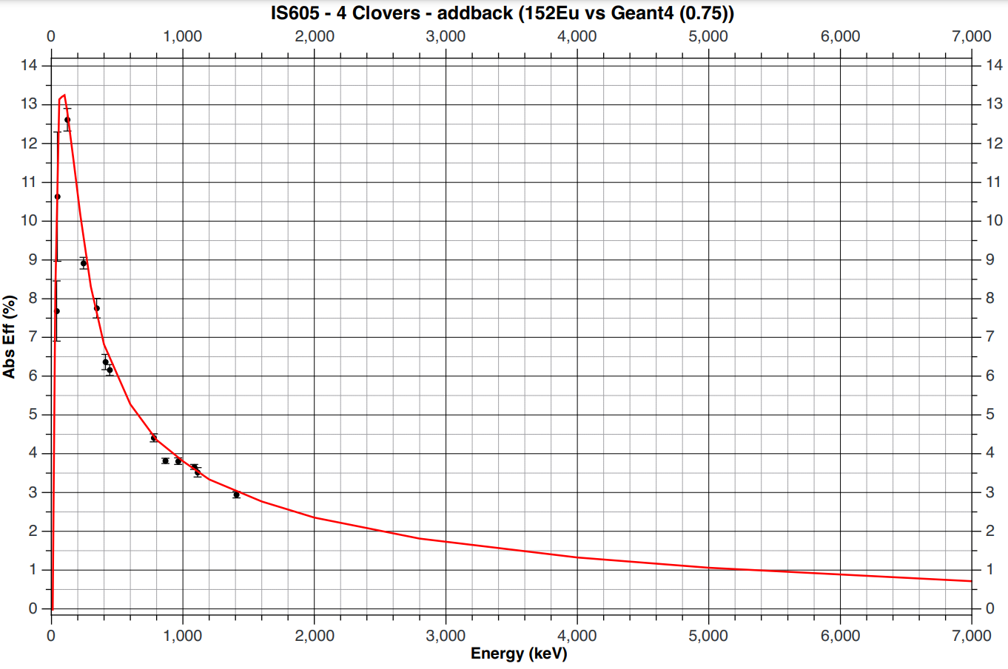
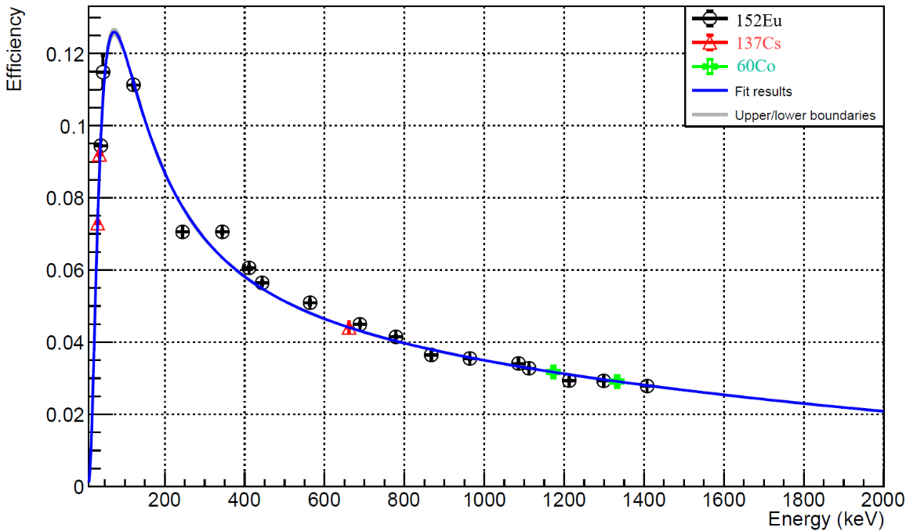
Back-up Slides
Detector Efficiency
IDS Efficiency
IS715 Efficiency
3 HPGe clovers
Addback correction: on
Calibration data: ¹⁵²Eu, ⁶⁰Co and ¹³⁷Cs
β-efficiency:
30%

Slide 20
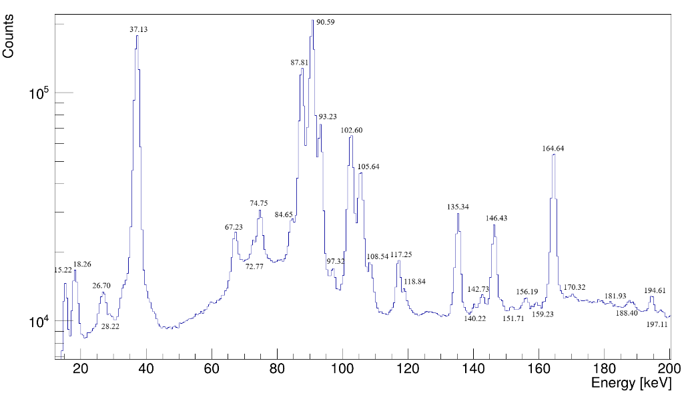
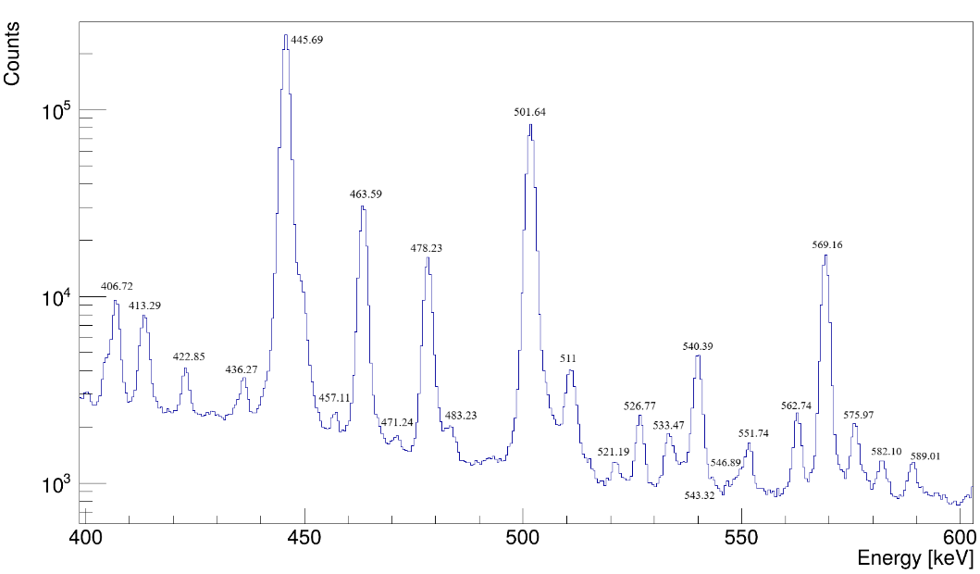
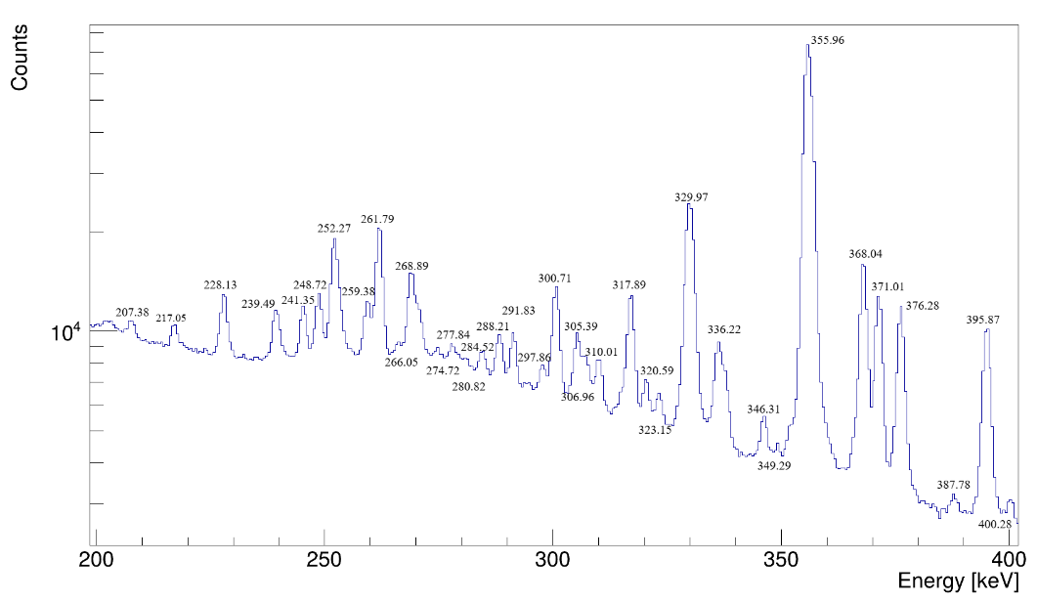
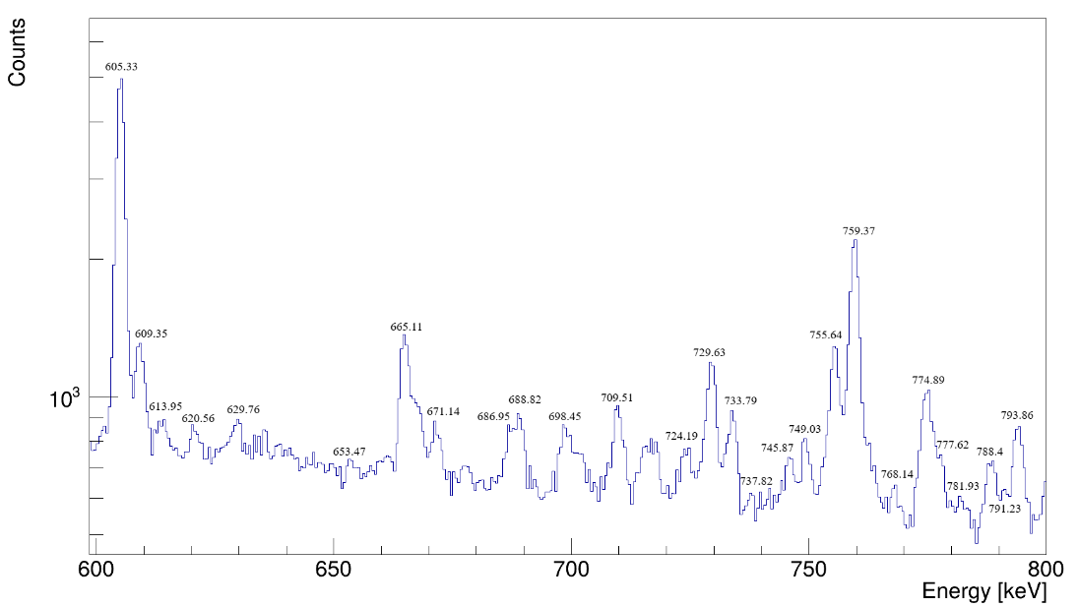
Back-up Slides
Decay Data - First 16’ of Run_009

Slide 21
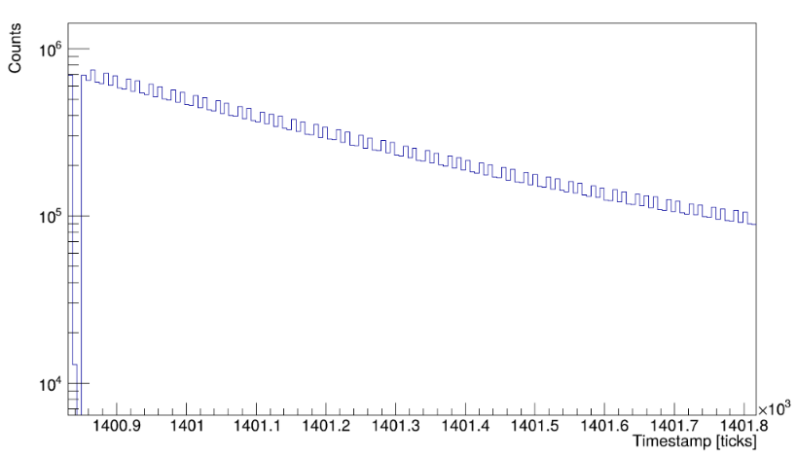
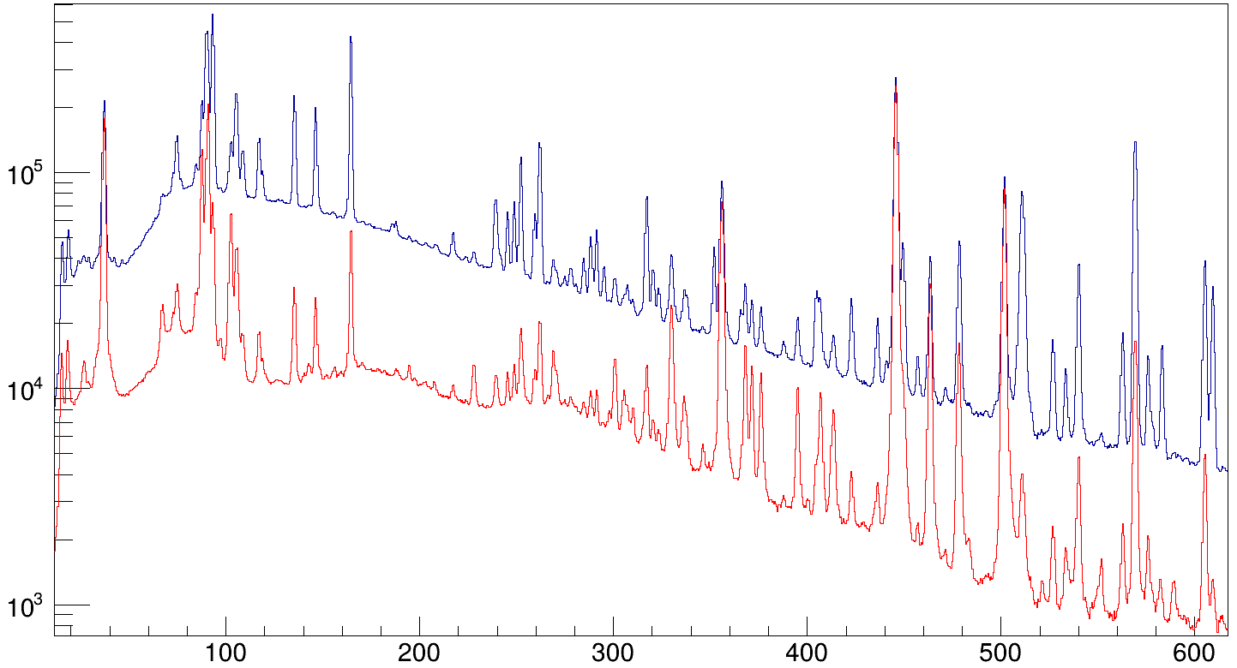
Back-up Slides
Decay Data - First 16’ of Run_009
To enhance the presence of γ-rays originating from the β-decay ²²⁹Ra->²²⁹Ac, the first 16m
(4 * T_{1/2} of ²²⁹Ra) of Run_009 can be used
Counts
Gamma-singles spectra
Full R9 length
First 16’ of R9
X-rays
 | Th | Ac | Ra
K_{α1} | 93.35 (93%) | 90.88 | 88.47
Κ_{α2} | 89.96 (61%) | 87.67 | 85.43
Κ_{β1} | 105.6 (12%) | 102.85 | 100.13
L_{β1} | 16.20 (79%) | 15.71 | 15.24
L_{β2} | 15.60 (37%) | -- | 14.84
E_{γ} [keV]

Slide 22
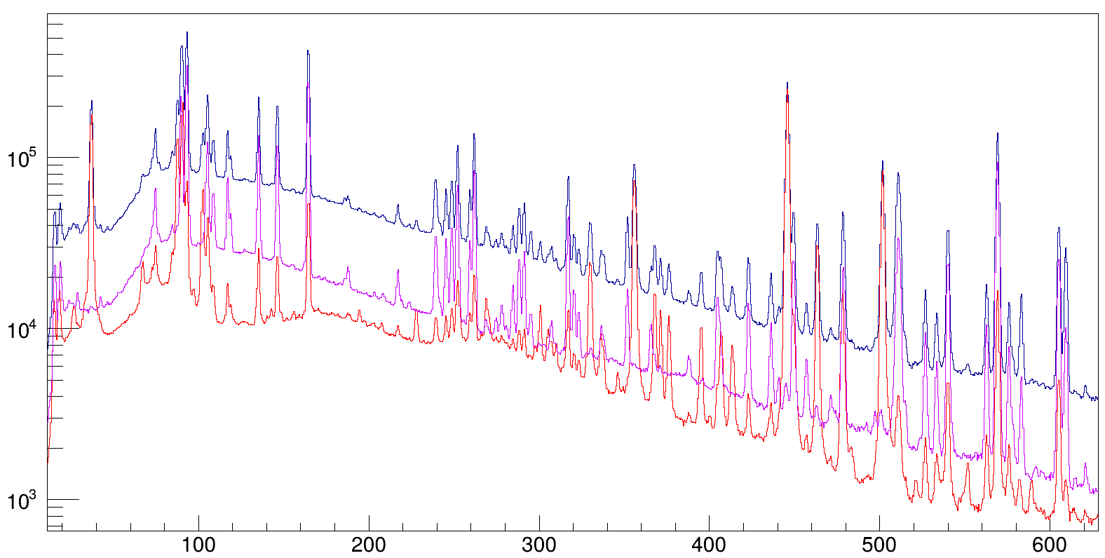
Back-up Slides
Decay Data
To enhance the presence of γ-rays originating from the β-decay ²²⁹Ac->²²⁹Th, the time between the first 30' of Run_009 up to a period of 4h
(4 * T_{1/2} of ²²⁹Ac) can be used.
Counts
Gamma-singles spectra
Full R9 length
First 16’ of R9
Last part of R9
569
E_{γ} [keV]

Slide 23
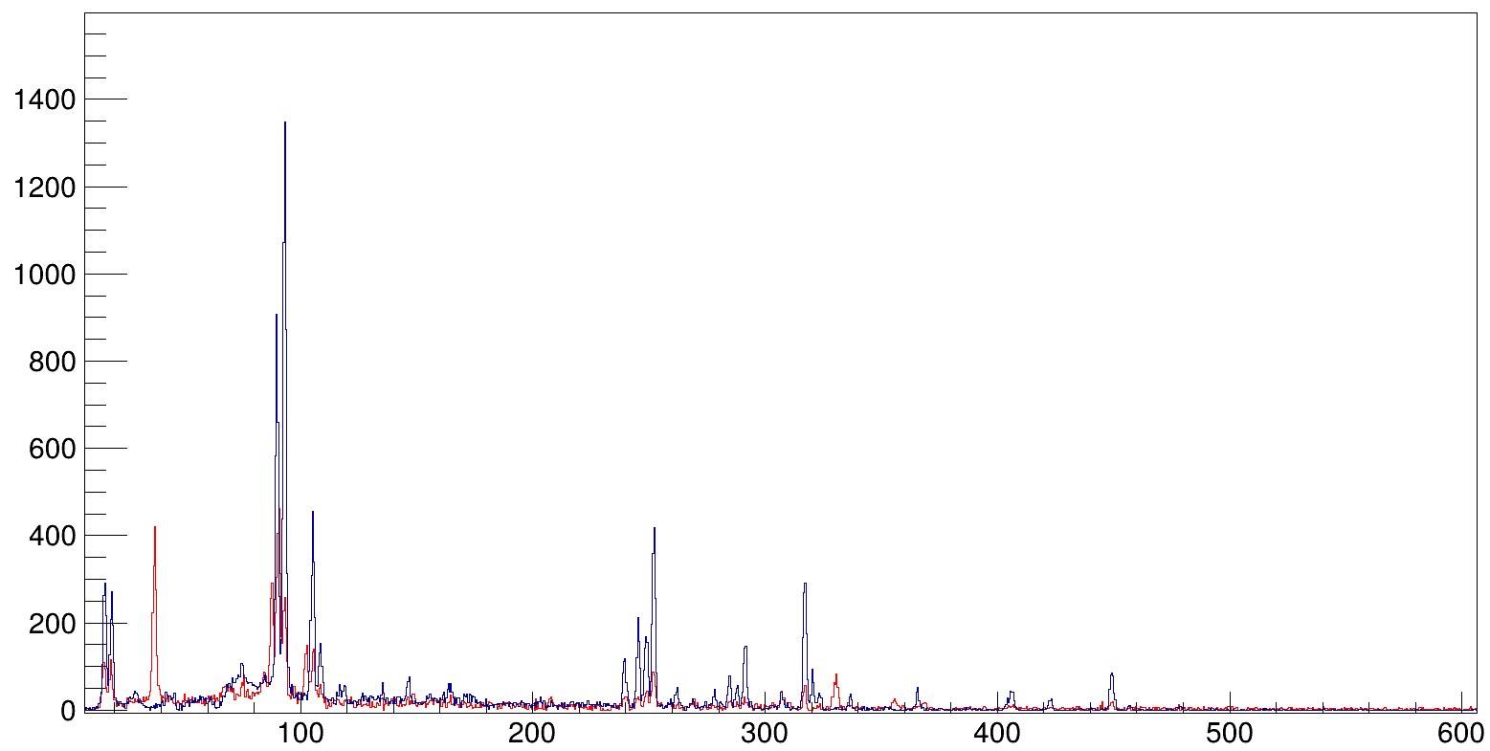
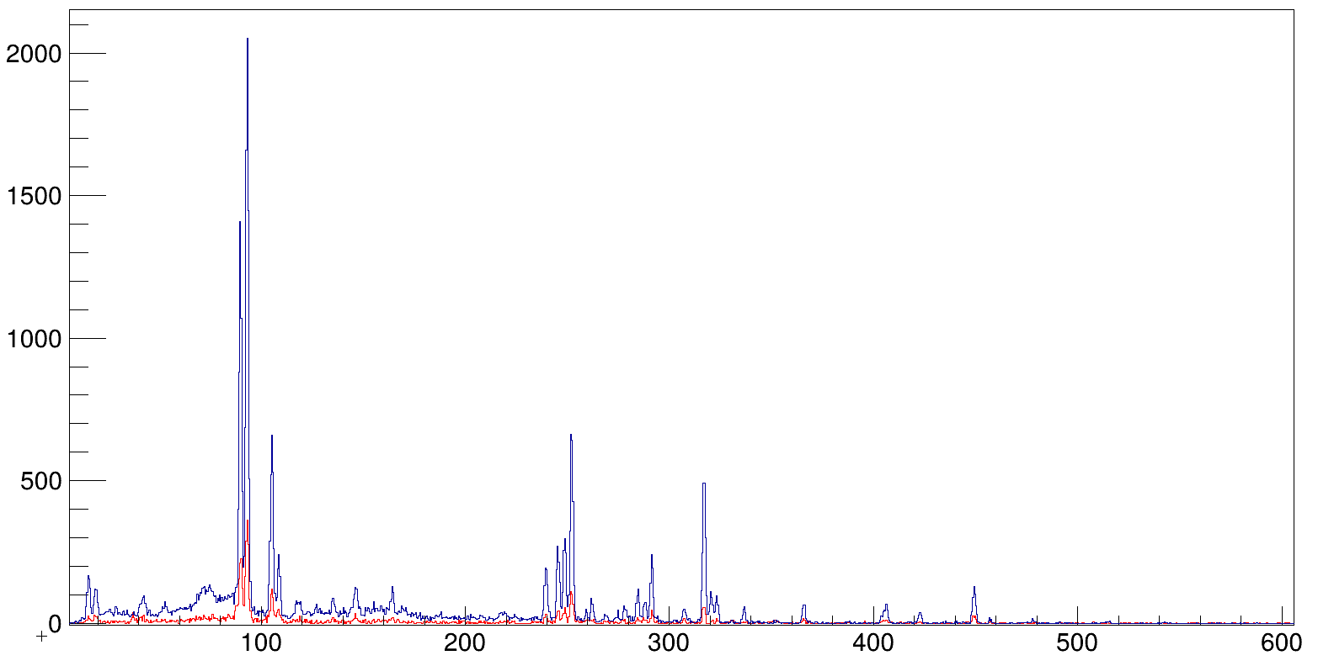
Back-up Slides
Decay Data
Gate: 90keV
Red: first 16’
Blue: from 30’ to 4h
We need to apply more filters to the data to identify the origin of the peaks !
Gate: 93keV
Red: first 16’
Blue: from 30’ to 4h

Slide 24


Back-up Slides
HPGe – β time difference
Decay Data – Gamma singles with beta tagging
Counts
E_{γ} [keV]

Slide 25



Back-up Slides
Time- Difference Plots
T_{γ} - T_{β}
T_{β} - T_{β}
T_{γ} - T_{γ}

Slide 26

Back-up Slides
Deconstructing the timestamp….

