Slide 1
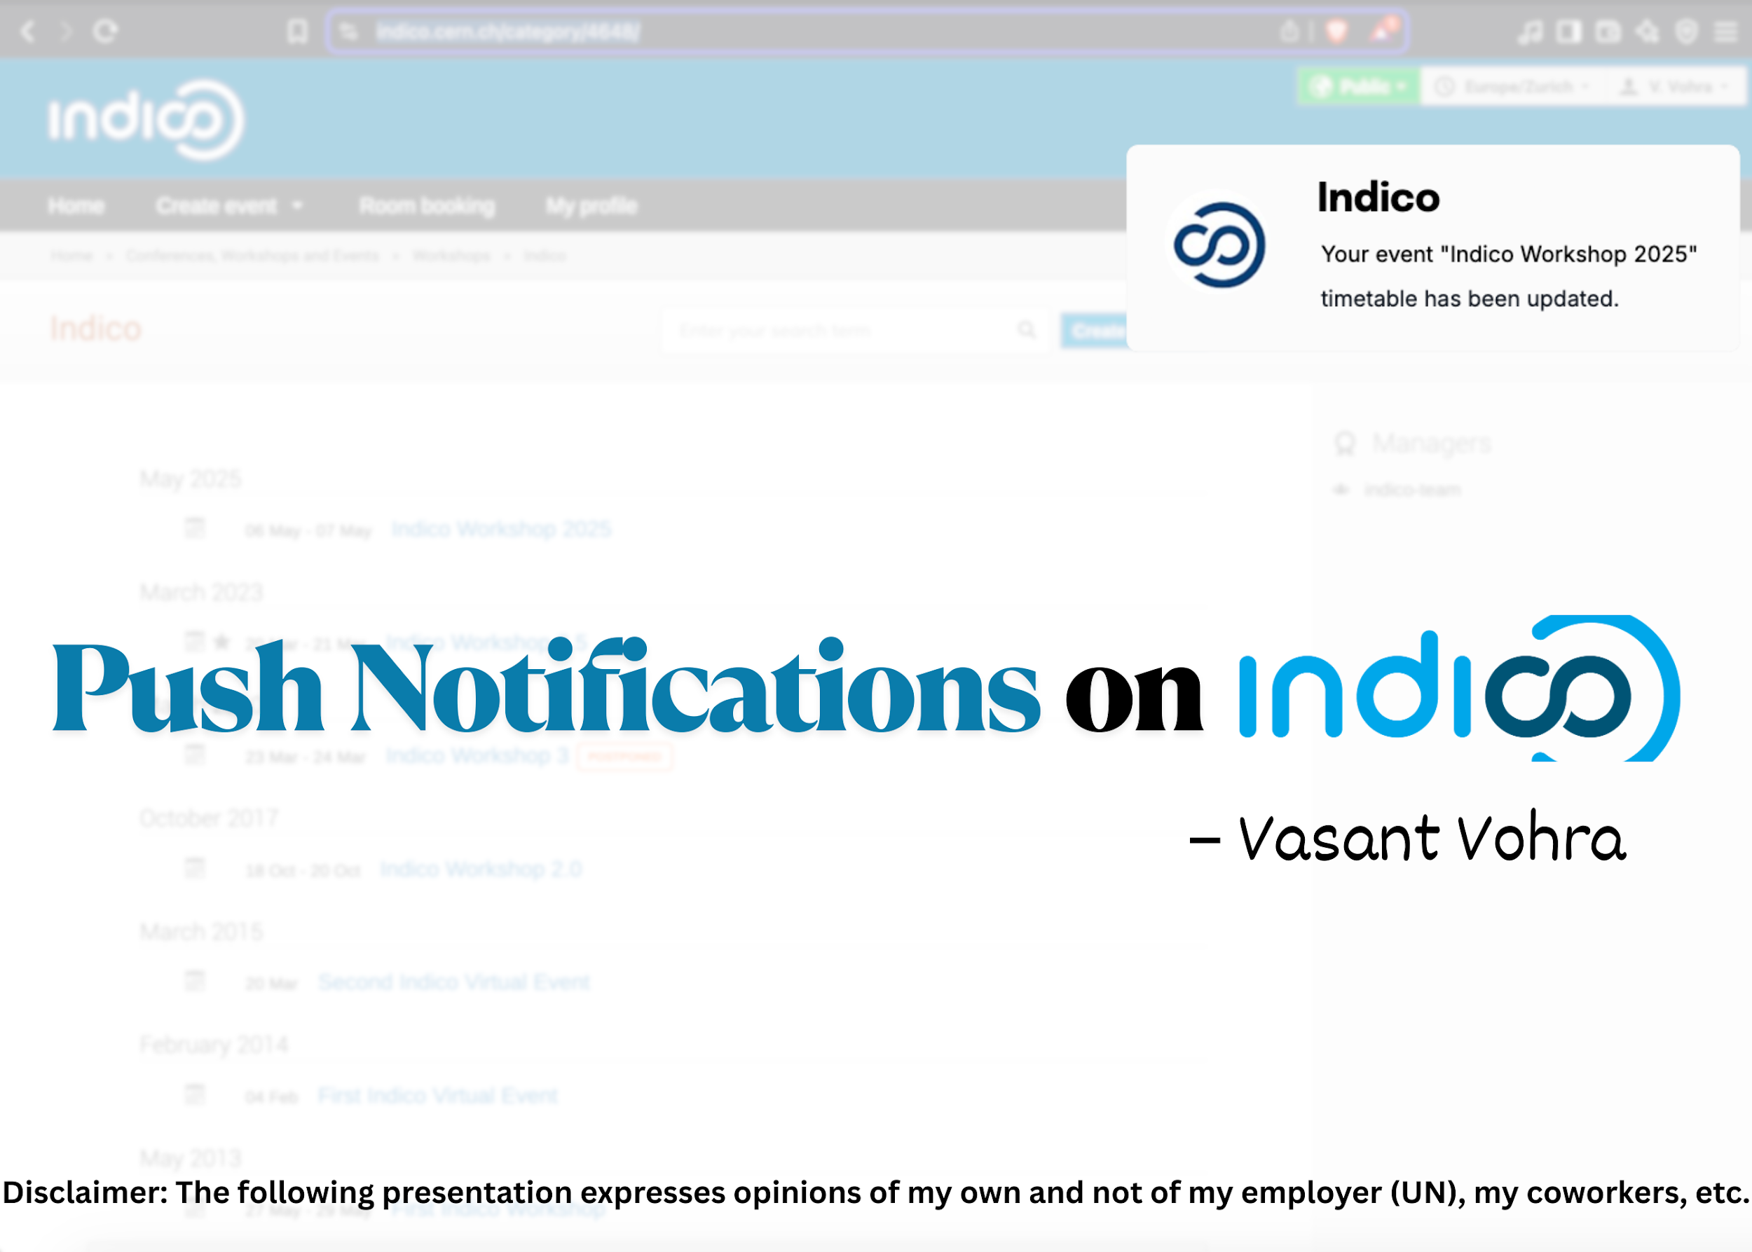

Slide 2

Agenda
01
02
03
Push notifications
Why Push notifications?
Strategy for Indico
04
Technical Implementation

Slide 3

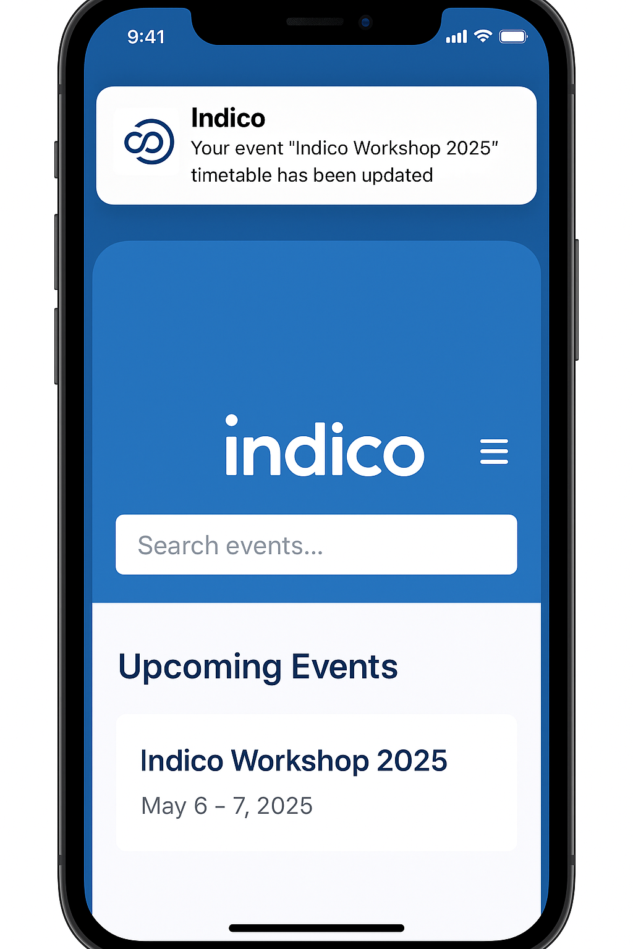
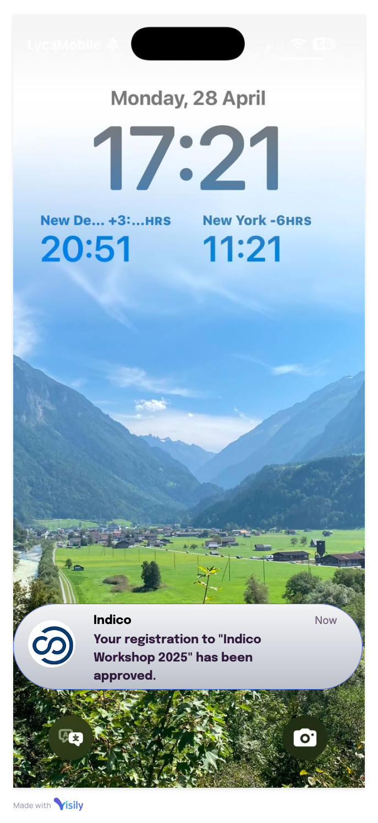
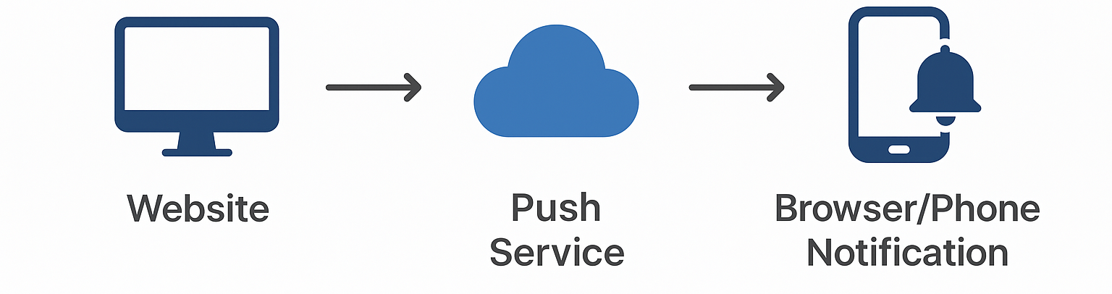
Agenda
Push notifications
Why Push notifications?
Strategy for Indico
Technical implementation
Push notifications
Push notifications bridge the gap between the website/application and the user's device, the users don't have to check emails for short timely updates. They just get notified at the right time, on the right device.

Slide 4
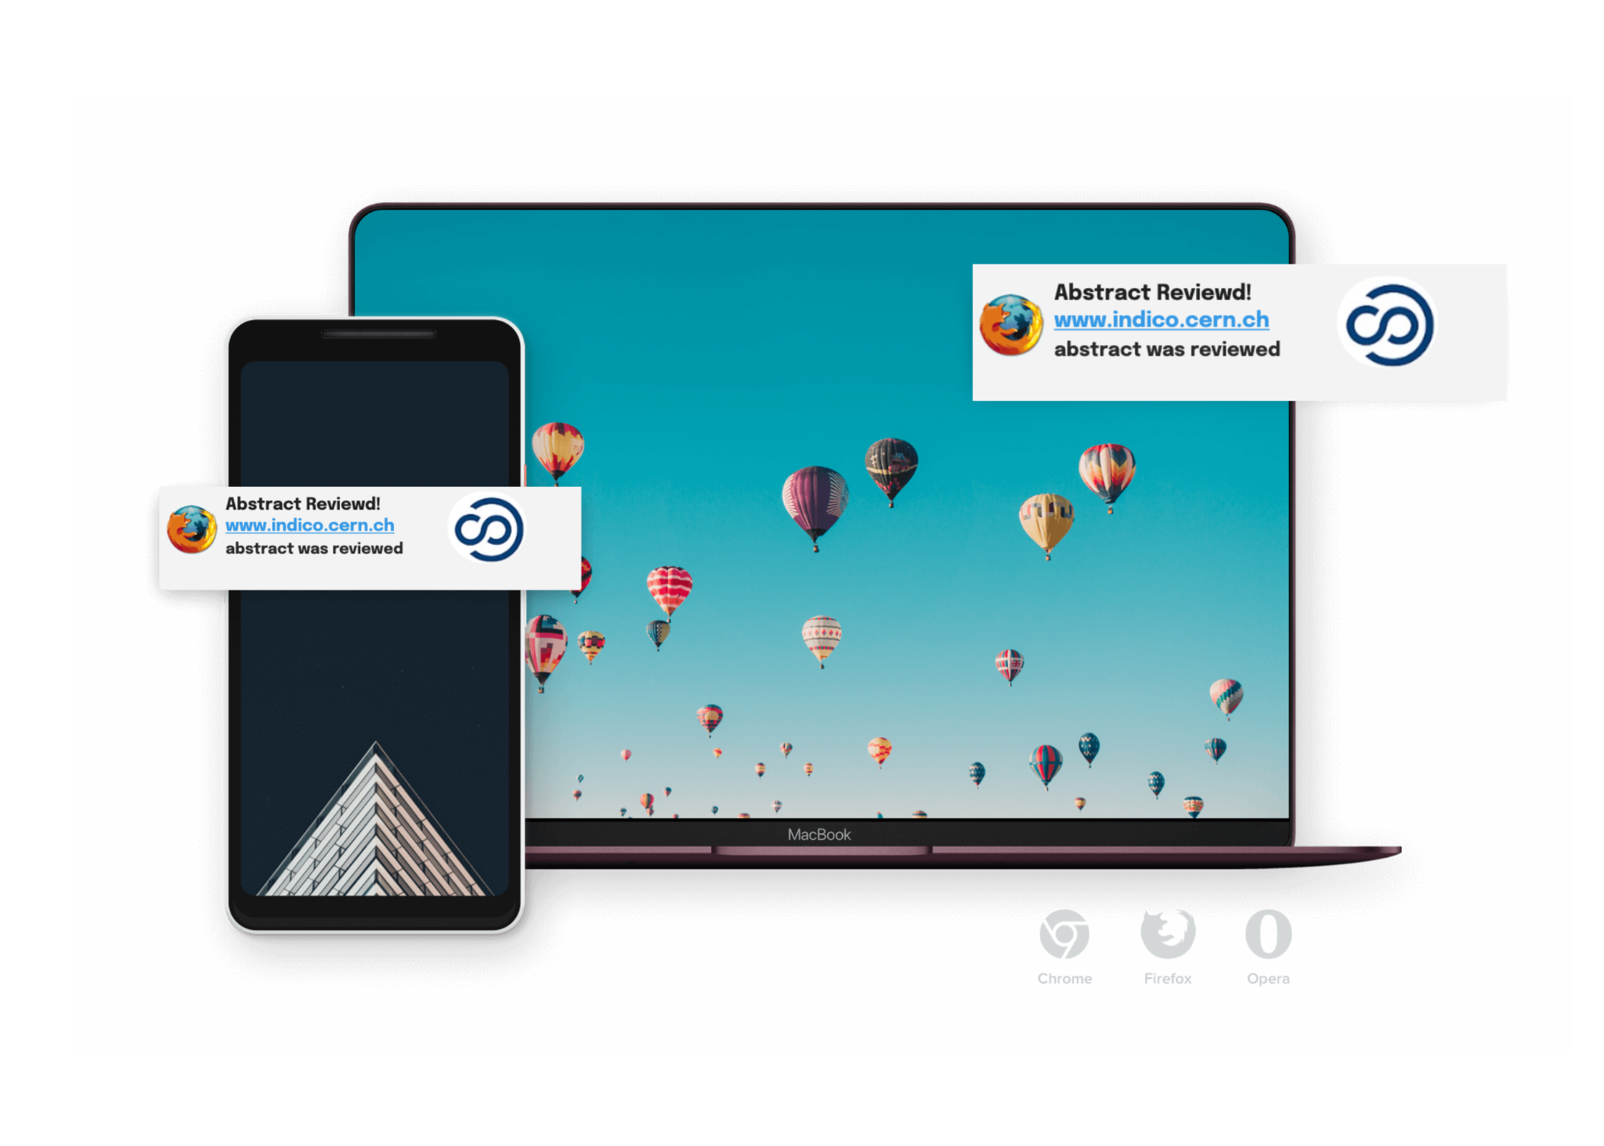
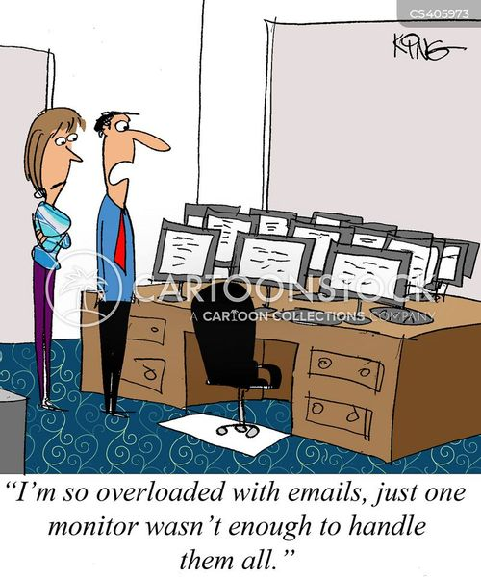
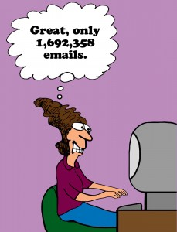
Agenda
Push notifications
Why Push notifications?
Strategy for Indico
Technical implementation
Why Push notifications?
Emails get buried.
What we need is a smarter way,
push notifications that are event
driven, targeted, and respectful!

Slide 5

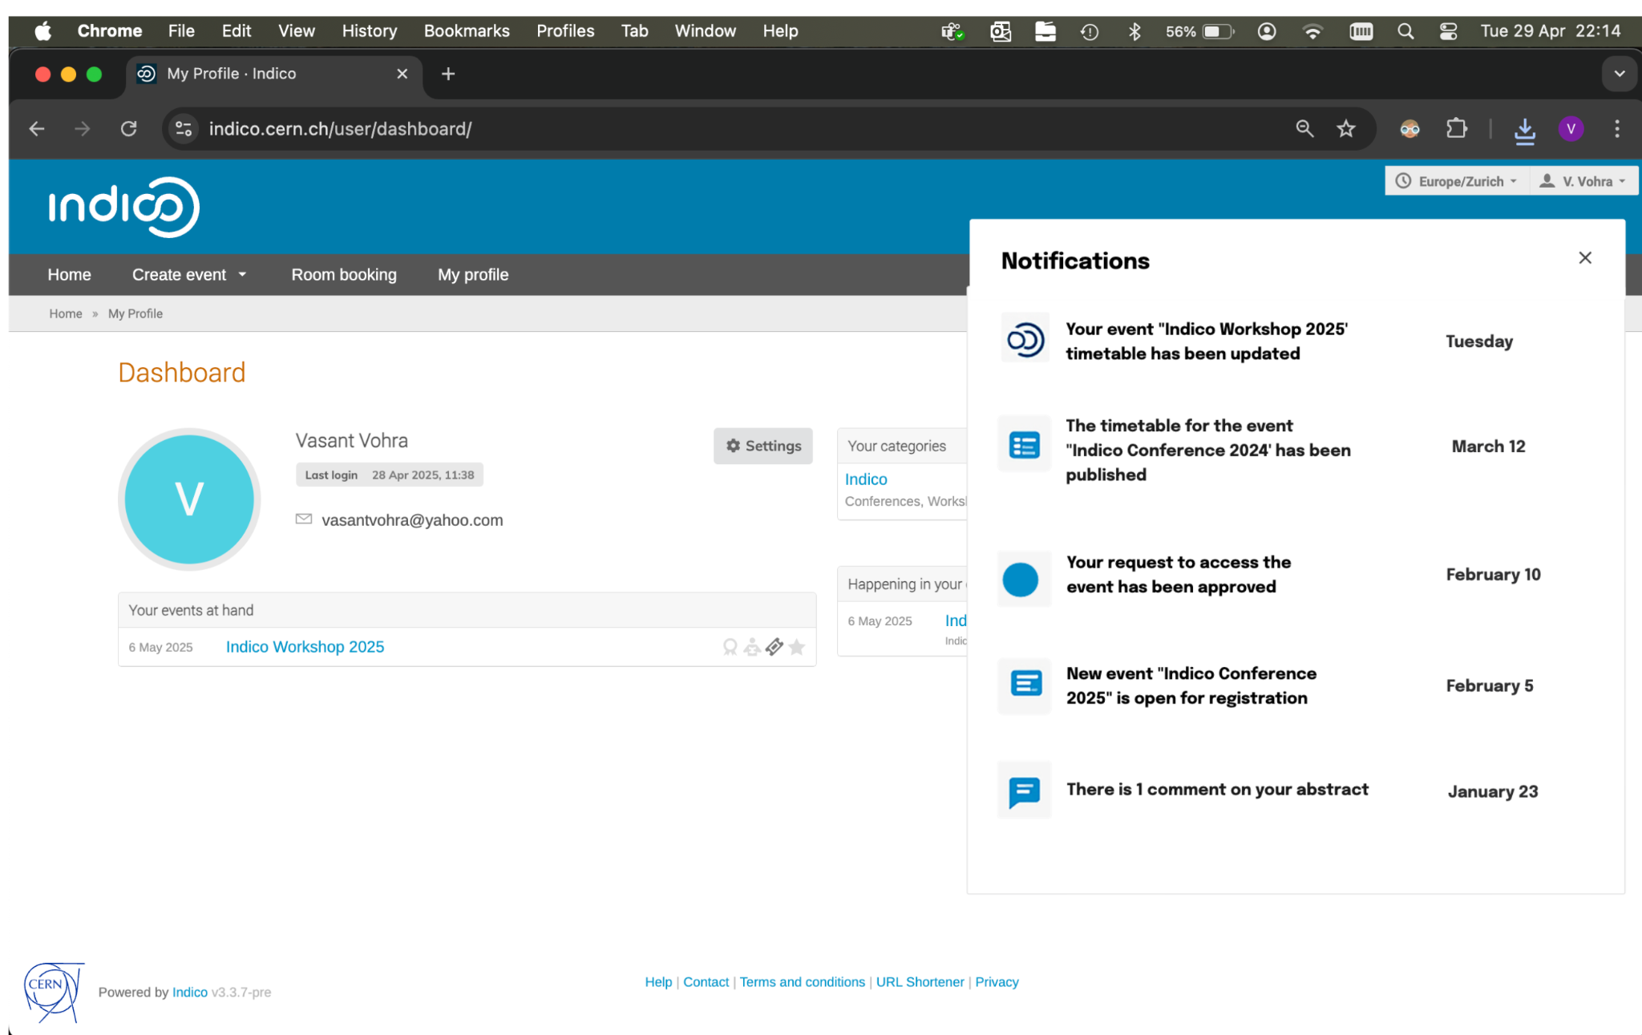
Agenda
Push notifications
Why Push notifications?
Strategy for Indico
Technical implementation
Why Push notifications?
Short, actionable messages sent directly to users' devices.
Appear even when the app/website is not open.
Better visibility compared to emails.
Can be personalized and targeted.
Image Ref: Notifications - storing email, push and in-app notifications sent to the user.

Slide 6
Agenda
Push notifications
Why Push notifications?
Strategy for Indico
Technical implementation
Why Push notifications?
How many of you would like to get a quick notification when:
  Registrations open for your favorite events or new events in your favorite category?
  Or when the timetable for an event is published?
  Or if there's a last-minute schedule change on timetable or event dates, room updates?
  What if you could get a notification for your registration on event approvals?
  Maybe even get a notification if your abstract was reviewed or badge was checked-in at the entrance?

Slide 7
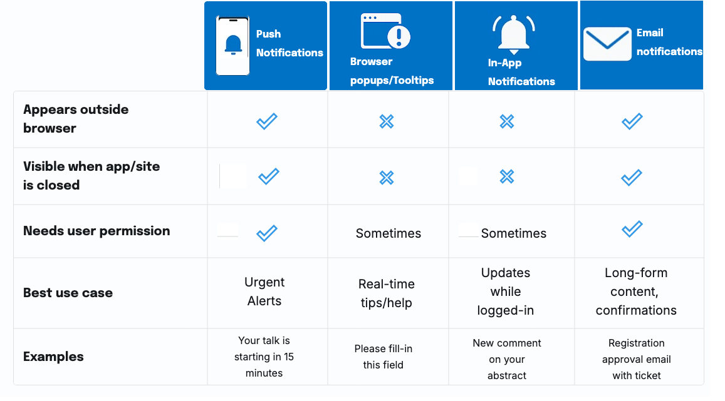
Agenda
Push notifications
Why Push notifications?
Strategy for Indico
Technical implementation
Notification Types Comparison

Slide 8
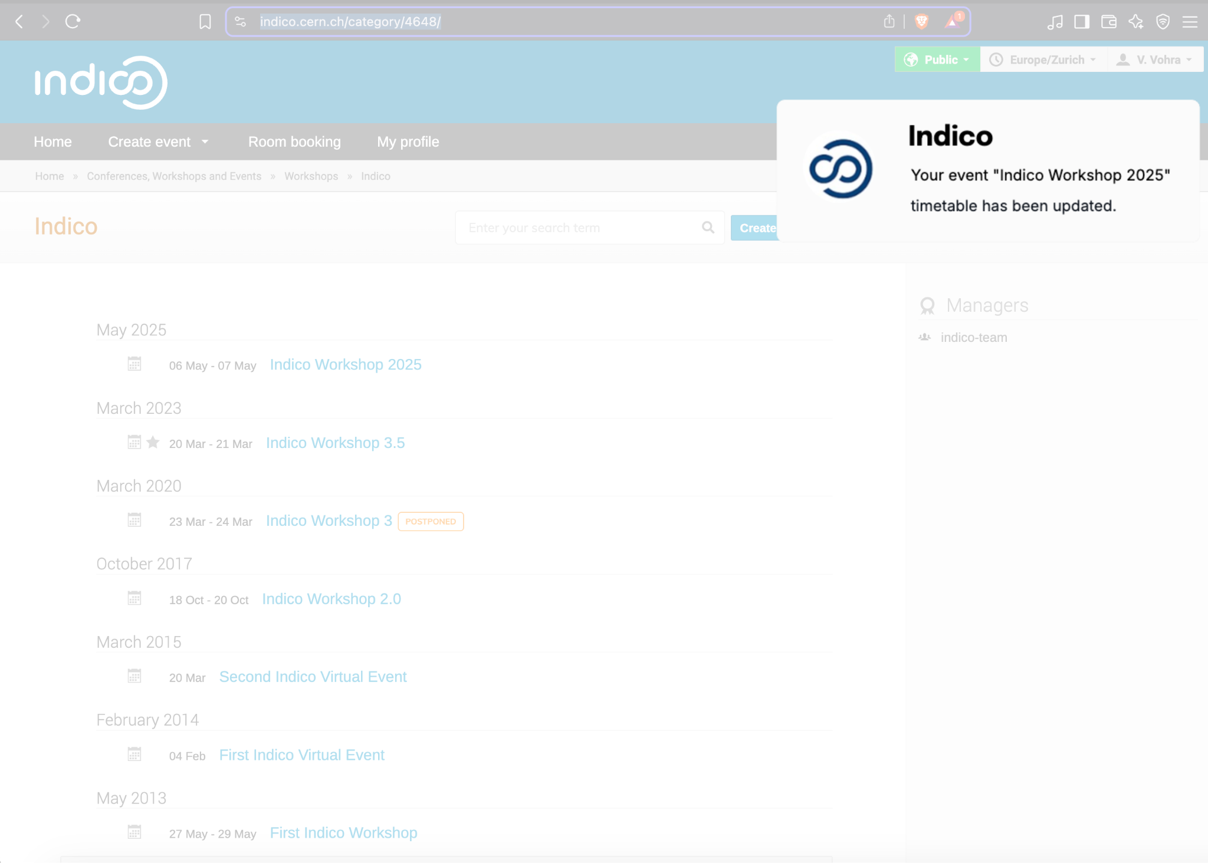
Agenda
Push notifications
Why Push notifications?
Strategy for Indico
Technical implementation
Strategy for Indico
Segmentation: Tailor notifications to user roles (e.g., participant vs. organizer), and personal preferences.
Timing: Organizer configurable trigger on key actions/events (e.g., session updates, new materials uploaded, etc).
Personalization: User-specific alerts (e.g., "Your talk is starting in 15 minutes!").

Slide 9
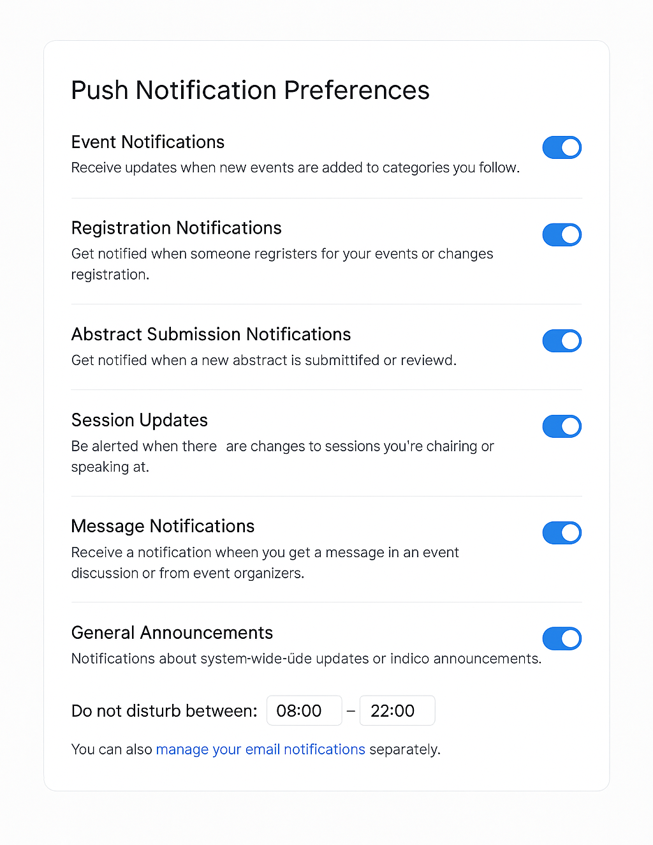
Agenda
Push notifications
Why Push notifications?
Strategy for Indico
Technical implementation
Technical Implementation
Backend: Use Web Push Protocol (e.g., VAPID + Service Workers)
Frontend: Request and manage push subscription
Server: Secure notification dispatching
Opt-In Mechanism: Respect GDPR and user preferences

Slide 10
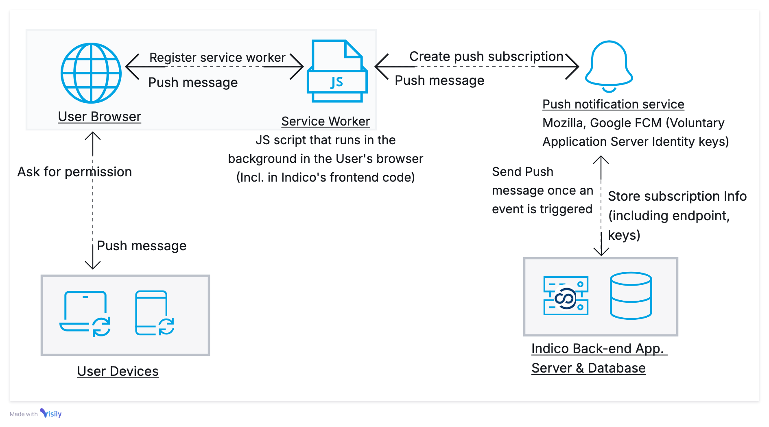
Agenda
Push notifications
Why Push notifications?
Strategy for Indico
Technical implementation

Slide 11
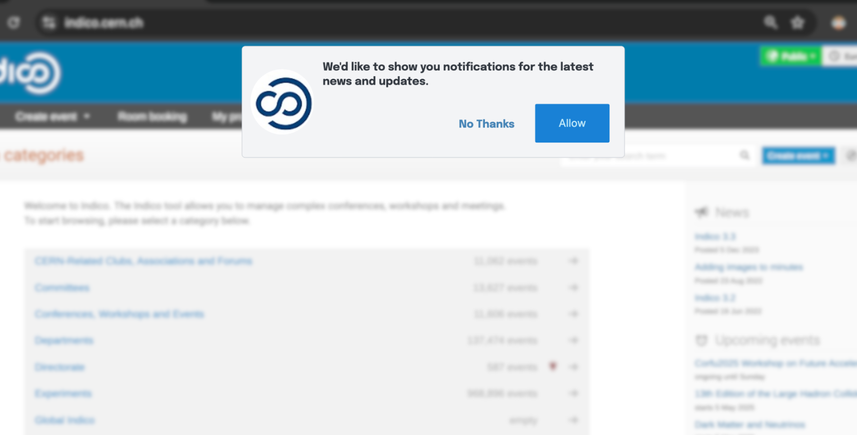
Agenda
Push notifications
Why Push notifications?
Strategy for Indico
Technical implementation

Slide 12
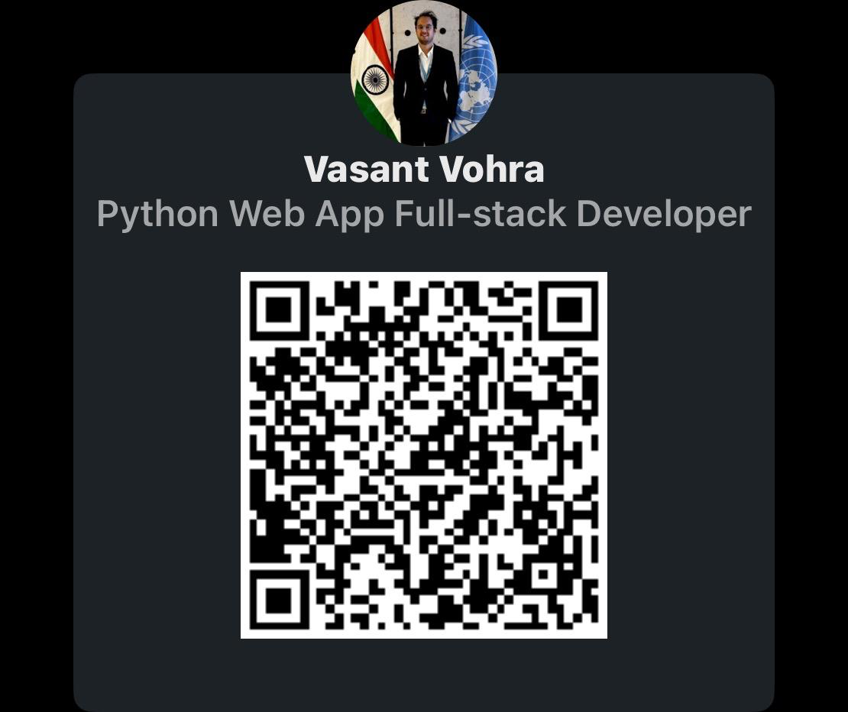
Thank You!
Agenda
Push notifications
Why Push notifications?
Strategy for Indico
Technical implementation
Do you have any questions?
Vasant Vohra
Full-Stack Web Developer
📧 vasantvohra@gmail.com
🌐 vasantvohra.github.io
🔗 linkedin.com/in/vasantvohra

