Slide 1
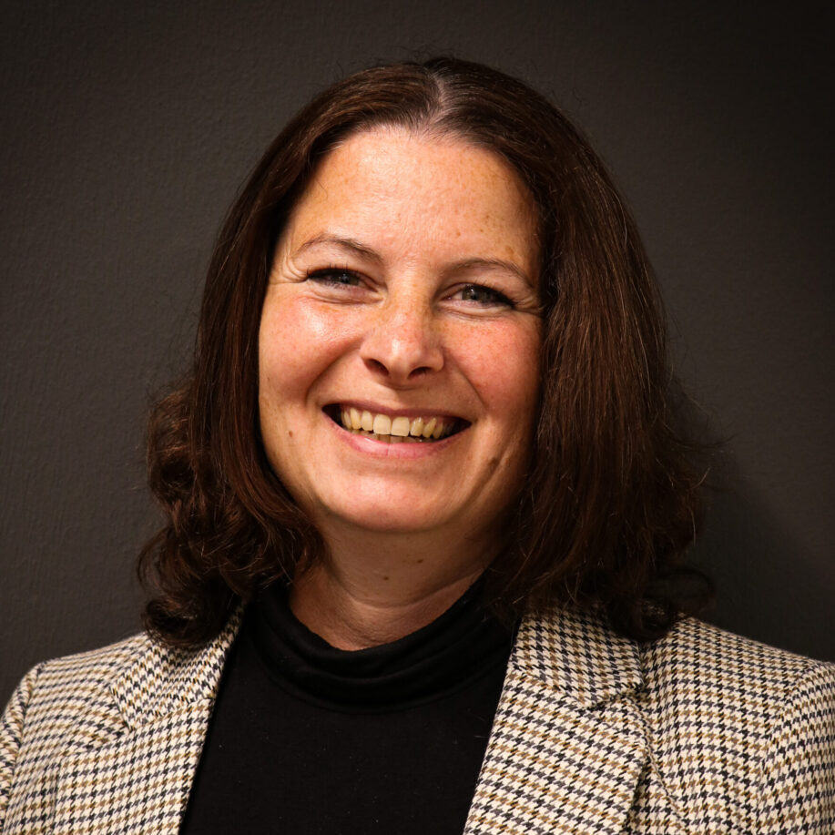

Barbara Behrend
Guest Relations Office
Mainz Institute for Theoretical Physics
Staudingerweg 9
55128 Mainz
Germany
Mainz Institute for Theoretical Physics, ©Barbara Behrend 2025

Slide 2

About our Daily Work at MITP with Indico
Mainz Institute for Theoretical Physics, ©Barbara Behrend 2025

Slide 3
Background
Originally from hotel industry
Working with different conference and room reservation programs for 30 years
Part of MITP staff since 2022
Enjoy working with Indico and learning about the tool for 3 years
Joining the community since 2023
My current projects are supervising Indico and web page
Mainz Institute for Theoretical Physics, ©Barbara Behrend 2025

Slide 4
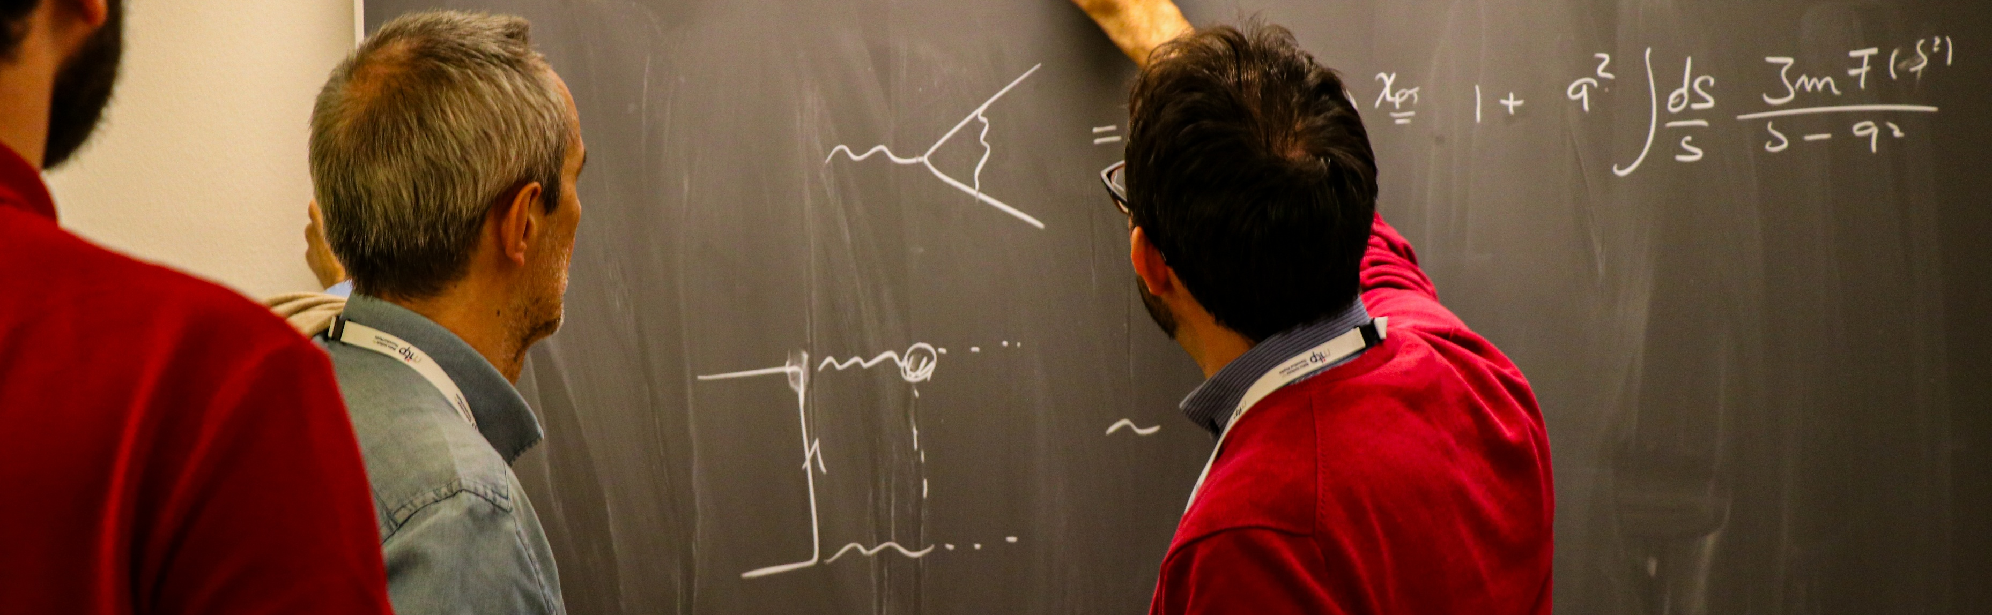
About
Mainz Institute for Theoretical Physics
Mainz Institute for Theoretical Physics, ©Barbara Behrend 2025

Slide 5
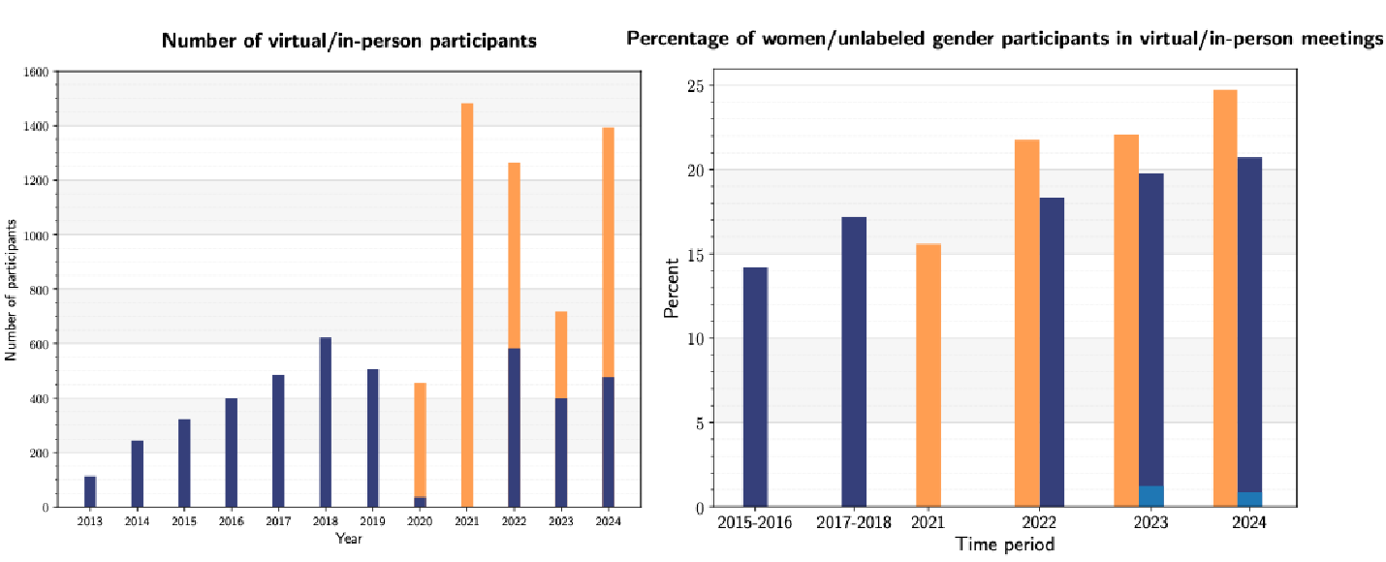
MITP was born as a part of the PRISMA Cluster of Excellence in 2013
Theory Center for international Scientists
Around 500 in person guests per year
Mainz Institute for Theoretical Physics, ©Barbara Behrend 2025

Slide 6
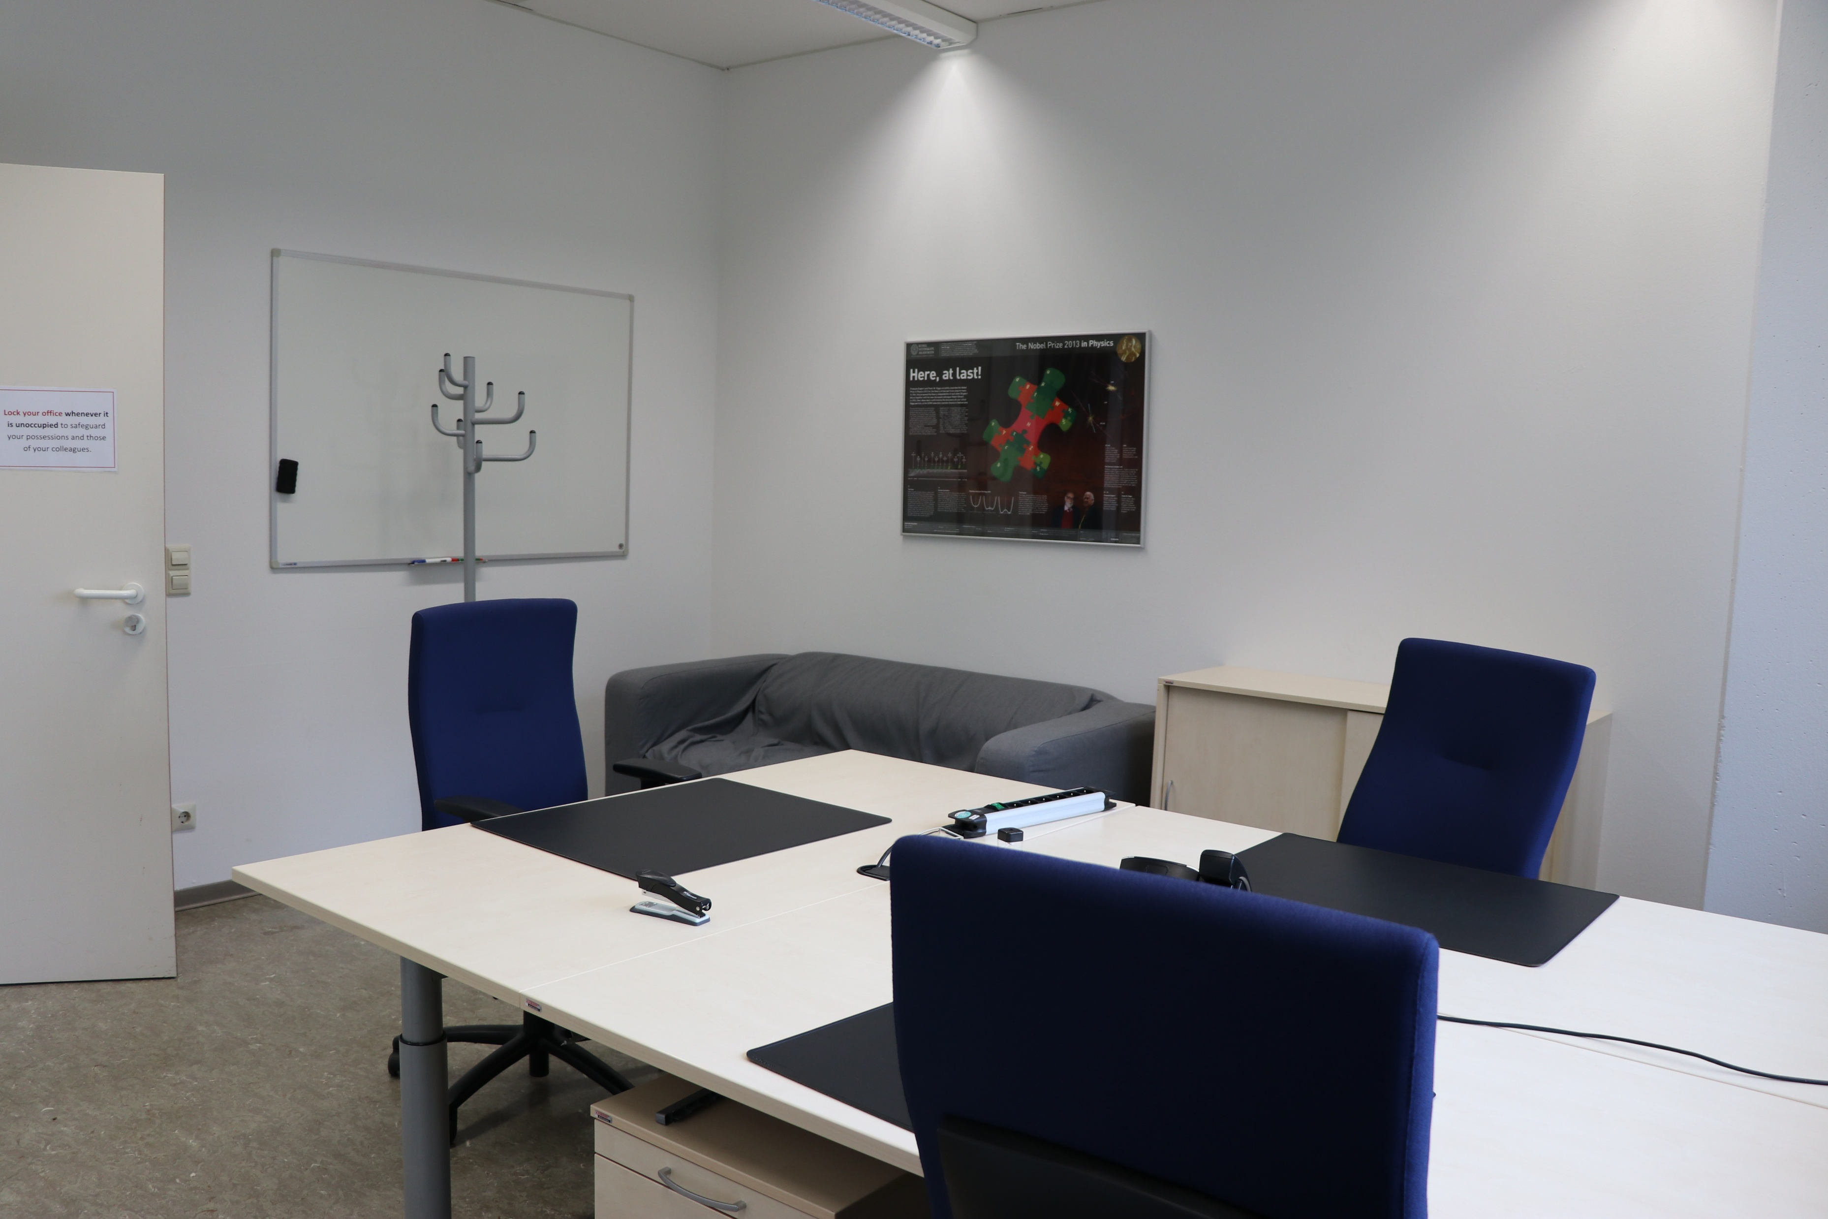
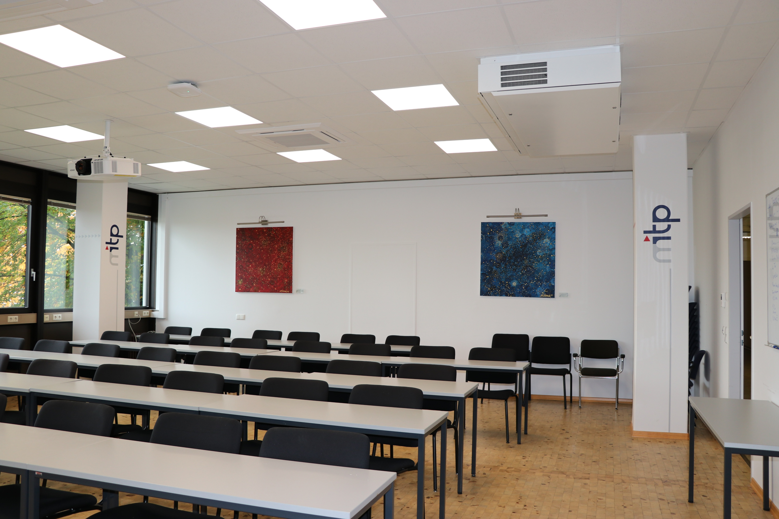
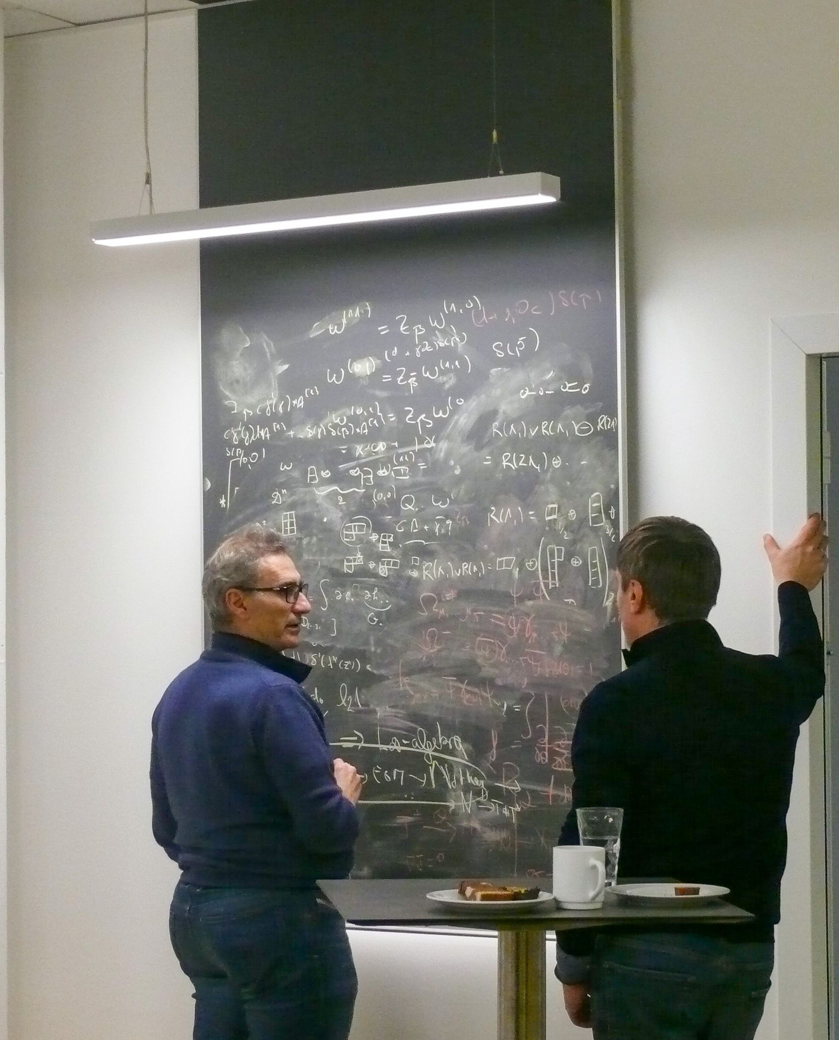
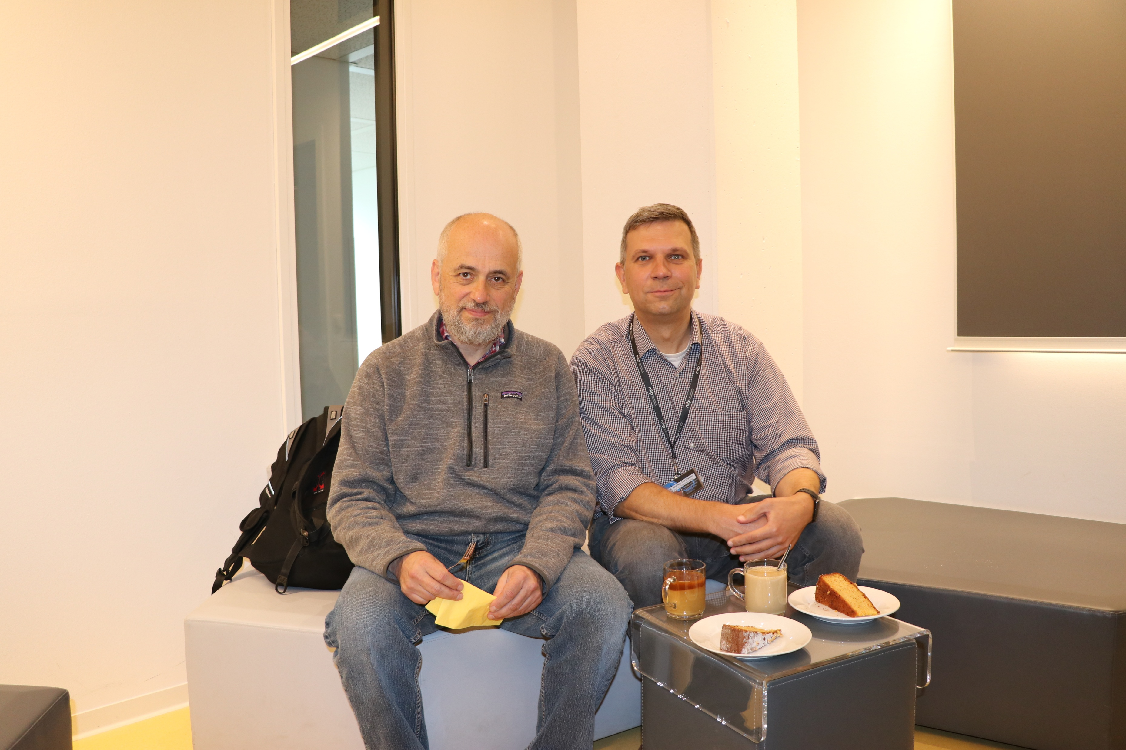
24 weeks per year with scientific programs and topical workshops
We manage our own facilities with one seminar room, one lounge, and eleven guest offices
Mainz Institute for Theoretical Physics, ©Barbara Behrend 2025

Slide 7

Short Story about MITP & Indico:
The Beginning
Mainz Institute for Theoretical Physics, ©Barbara Behrend 2025

Slide 8
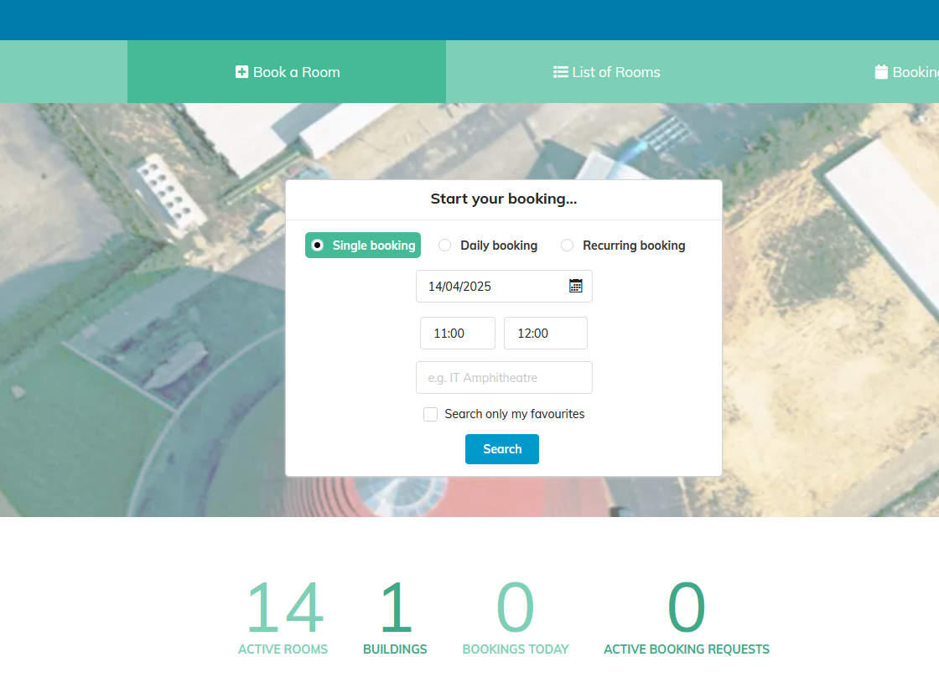
MITP’s contract with a conference booking system ended in 2020
The new manager decided to test Indico
We all knew little about the system (registration, creating lists)
One day an organizers showed us how to print badges with Indico. This was our start to discover the full opportunities of Indico…
Currently, we use Indico for calls for proposals, event registrations, room booking, surveys, badges, and tickets
Check-In app via iPad
Mainz Institute for Theoretical Physics, ©Barbara Behrend 2025

Slide 9
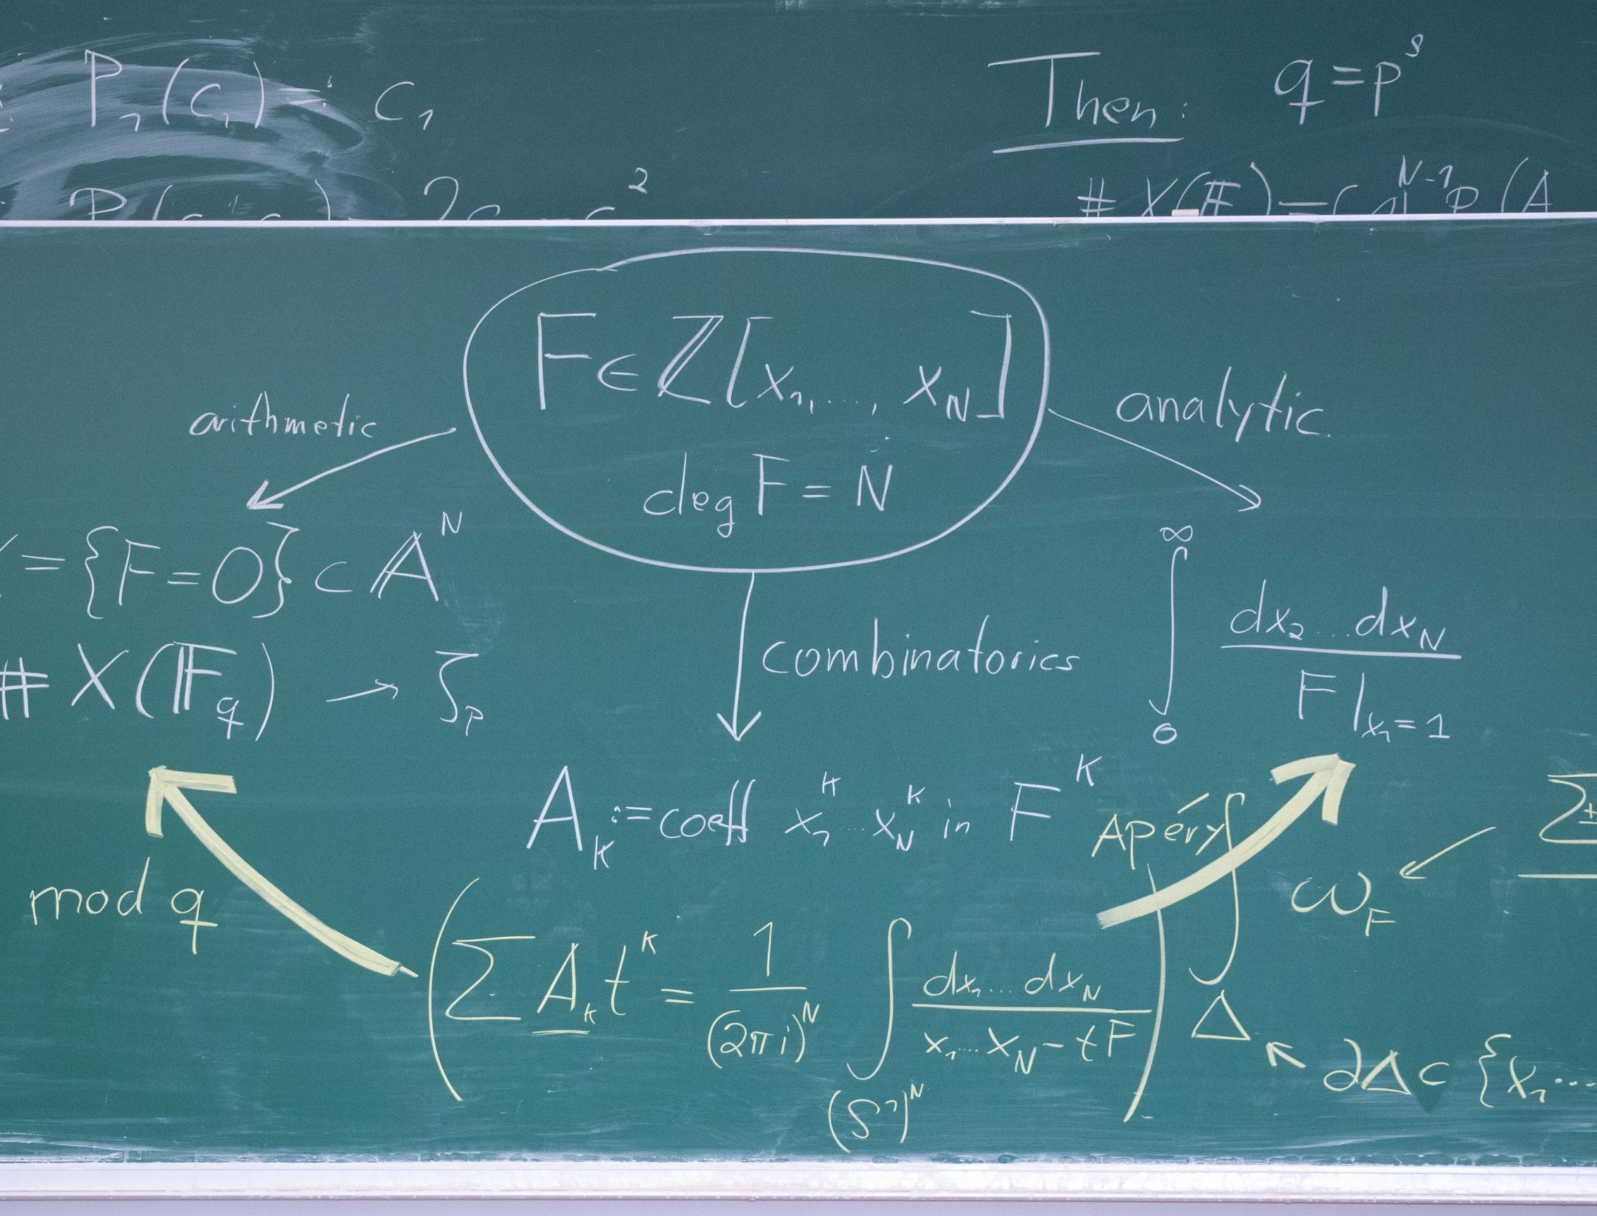
The Daily Work at the MITP Guest Relations Office and Management with Indico
Mainz Institute for Theoretical Physics, ©Barbara Behrend 2025

Slide 10
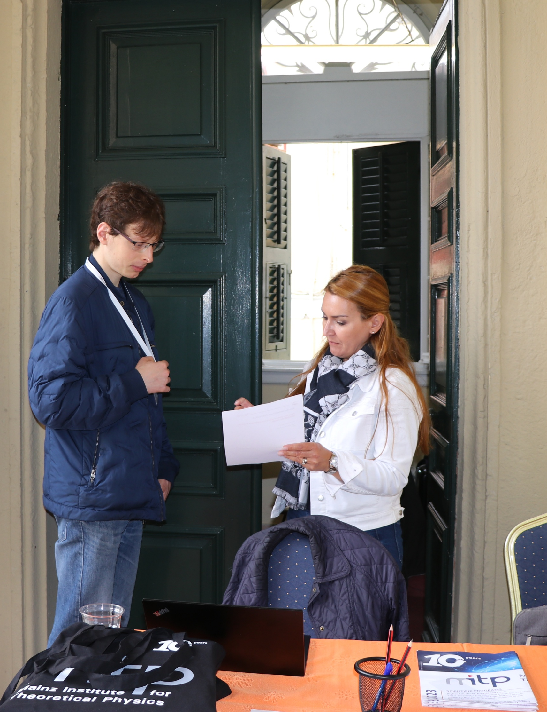
MITP Management
Mainz Institute for Theoretical Physics, ©Barbara Behrend 2025

Slide 11

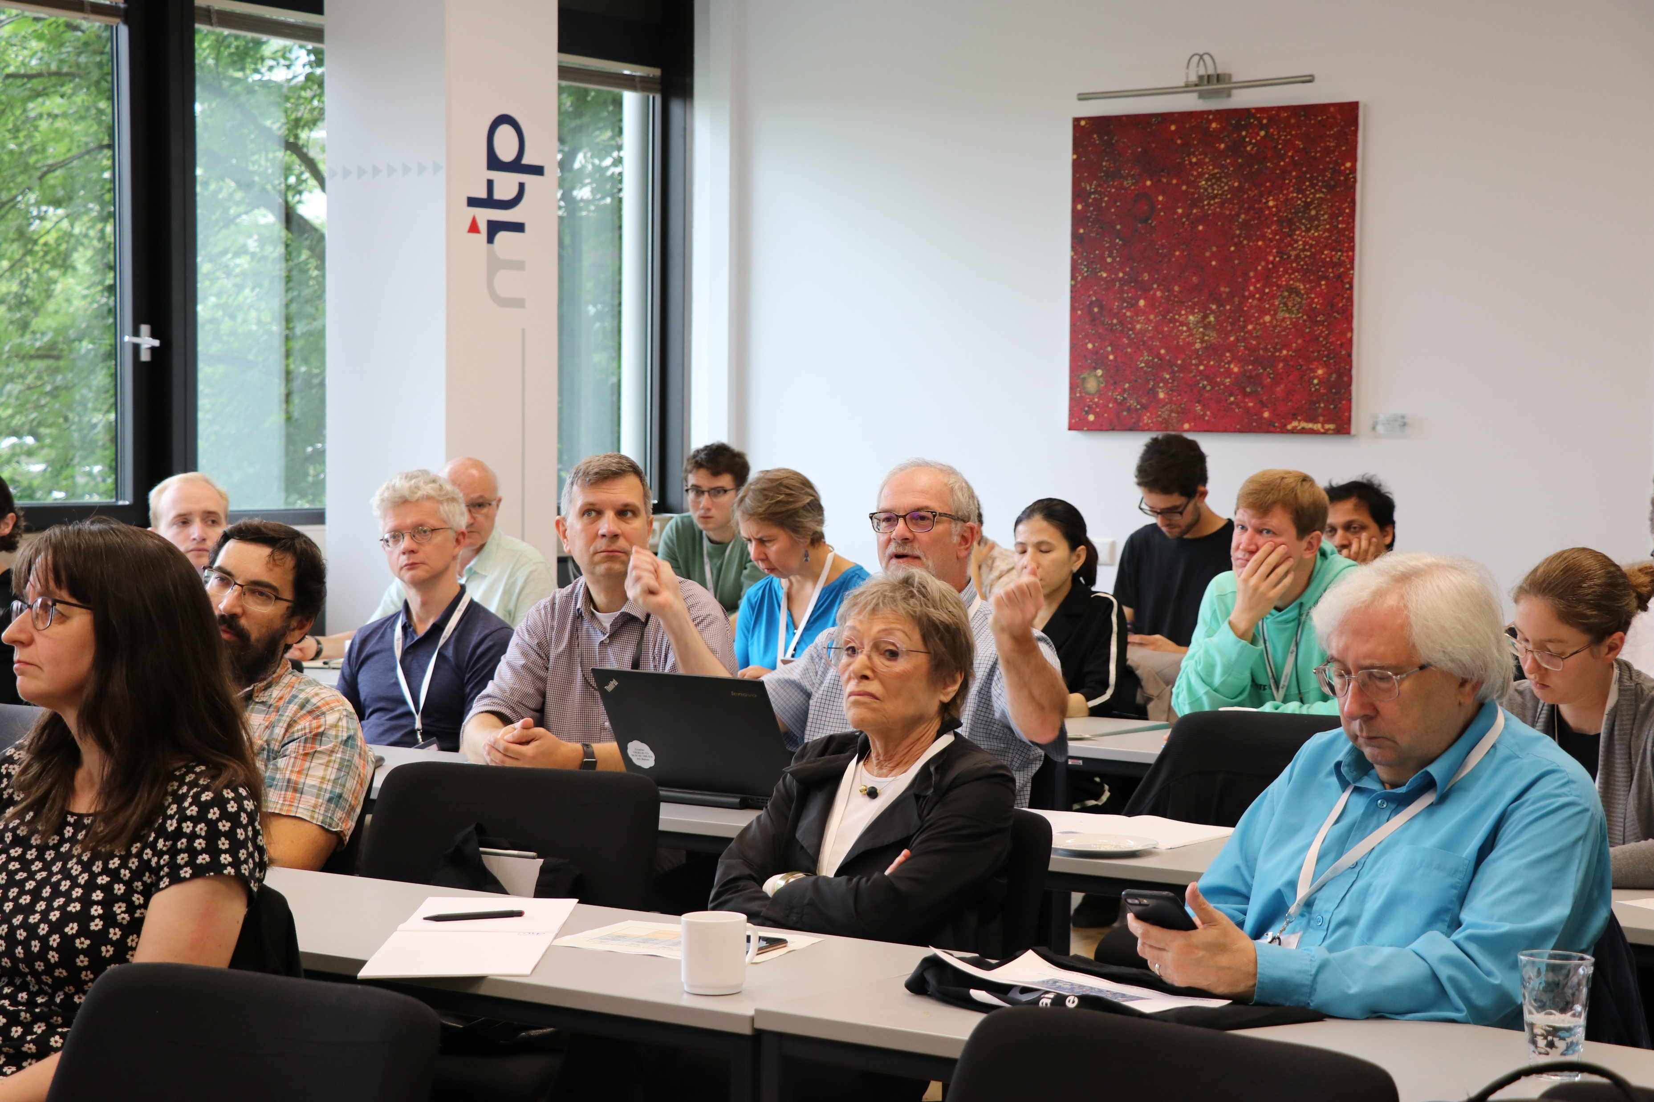
September – January: Call for proposals via Indico
March: MITP Advisory Board Meeting with evaluation and selection of submissions
Set dates for every selected event and create new templates for each of them
Mainz Institute for Theoretical Physics, ©Barbara Behrend 2025

Slide 12
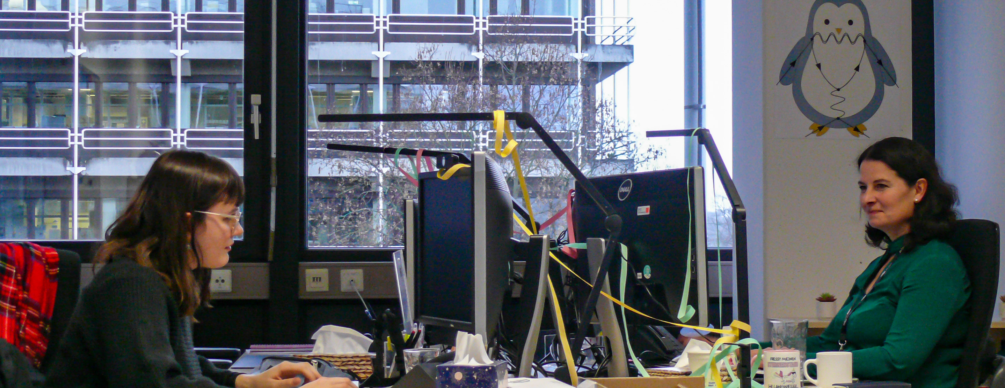
MITP Guest Relations Office
Mainz Institute for Theoretical Physics, ©Barbara Behrend 2025

Slide 13
Announcement for registration via MITP-mailing list (2700 recipients)
Separate announcement to organizers and key participants for registration with Indico link
Once deadline is reached, registration closes
Download Excel list of registrants and upload it on university cloud (Seafile)
Sending official invitation letters to selected participants and decline letters to rejected registrants via e-mail
Mainz Institute for Theoretical Physics, ©Barbara Behrend 2025

Slide 14
We are using the payment system „PayOne“, currently Visa and Mastercard payments only. No interface ☹
Checking our pre-booked accommodation facilities and allocate participants to the hotels and guest houses.
Sending housing information to all guests via e-mail
Reminding the organizers to create timetable on Indico
One week before event starts: last information with ticket via Indico e-mail sender
Mainz Institute for Theoretical Physics, ©Barbara Behrend 2025

Slide 15

How the Indico Community has already benefited the MITP
Mainz Institute for Theoretical Physics, ©Barbara Behrend 2025

Slide 16
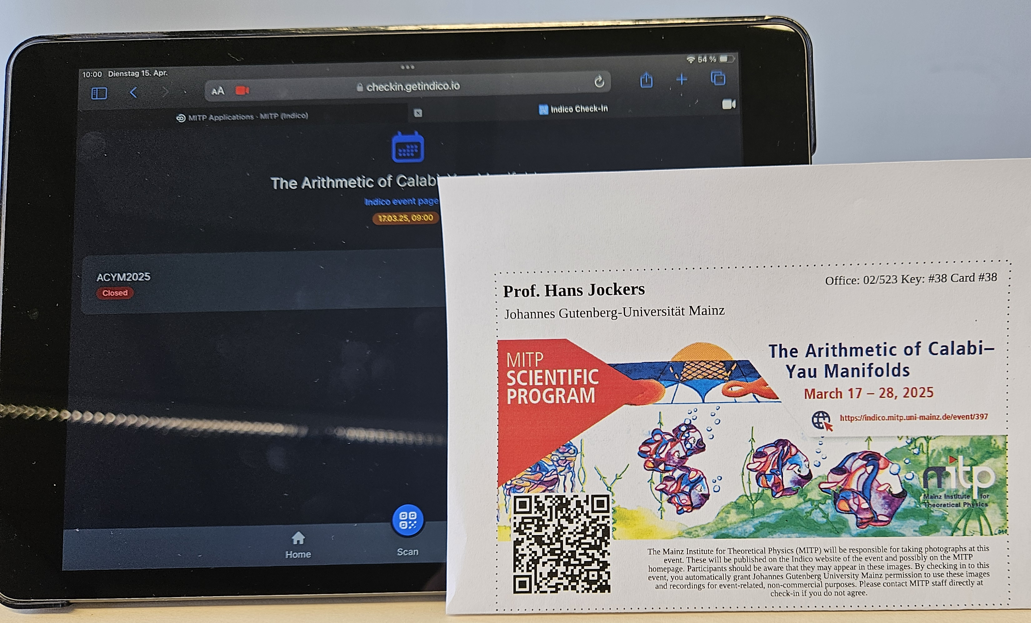
The IT officer was absent for a long period, and we searched for help via Google
First, I just read some topics in the community and did not dare to ask questions myself
Always great service from community ☺
We learned about how to use the check-in app (old and new), the room booking system, and e-mail sender
Mainz Institute for Theoretical Physics, ©Barbara Behrend 2025

Slide 17

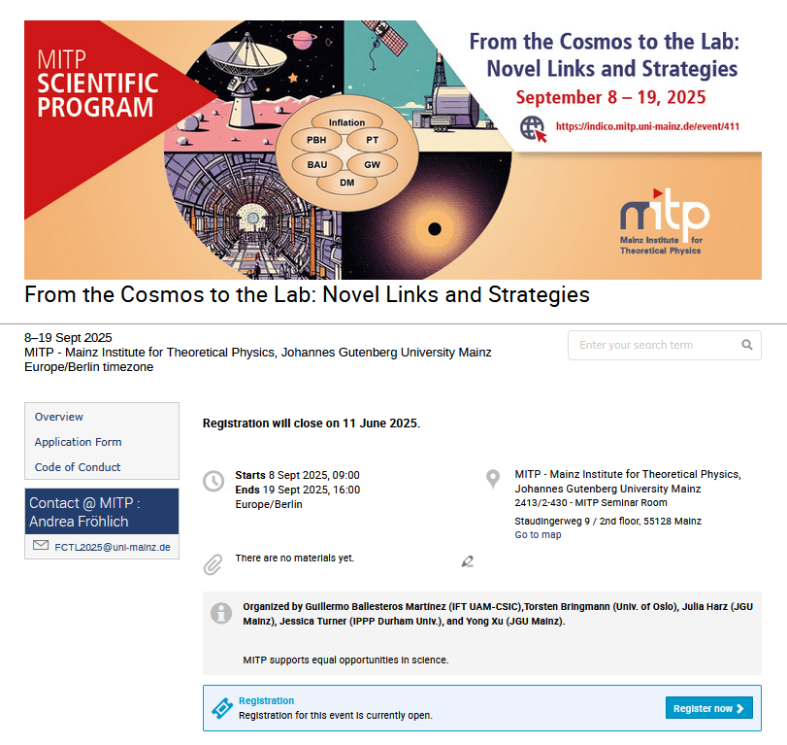
Creative student assistant created beautiful name badges for all 2025 events
Related to image scroller on Indico page
Mainz Institute for Theoretical Physics, ©Barbara Behrend 2025

Slide 18
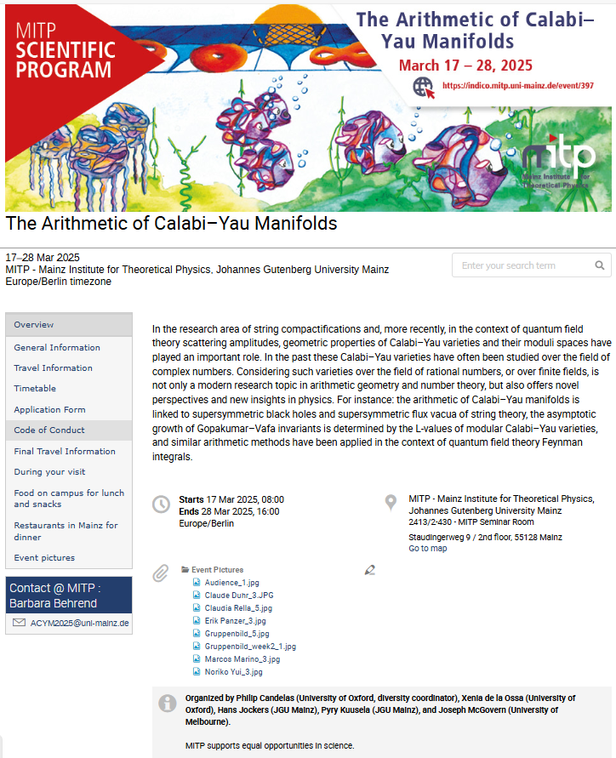
We added more information for visitors in the Indico pages
Old style: Visitor Information
Mainz Institute for Theoretical Physics, ©Barbara Behrend 2025

Slide 19
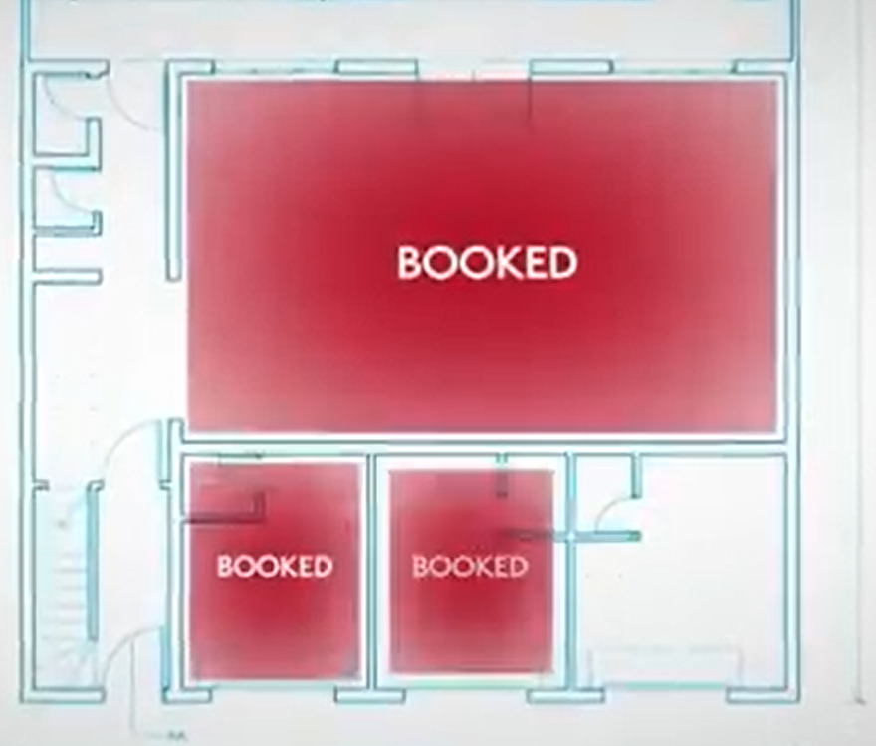
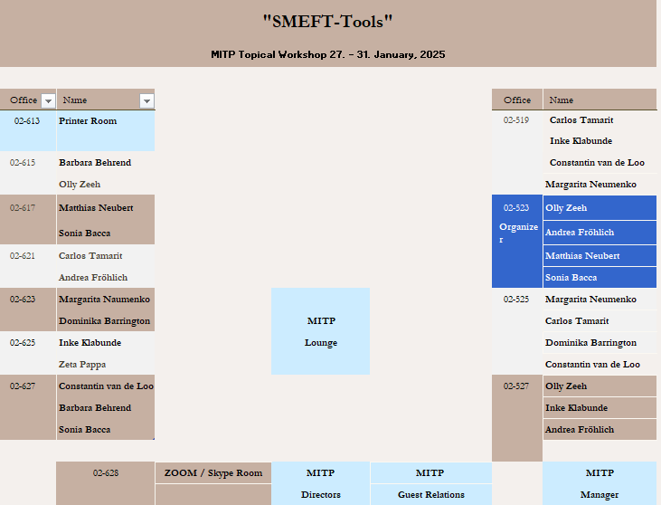
Indico image video inspired us to room overview list
Mainz Institute for Theoretical Physics, ©Barbara Behrend 2025

Slide 20

Some dreams for the future use of Indico from former hotel and tourism employees
Mainz Institute for Theoretical Physics, ©Barbara Behrend 2025

Slide 21
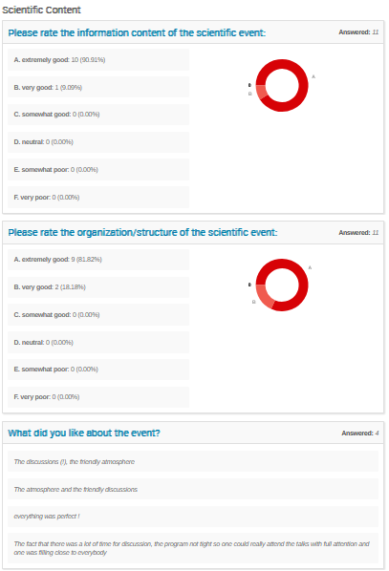
The possibility to print survey results in PDF format.
Better overview for the organizers and our management as well
Mainz Institute for Theoretical Physics, ©Barbara Behrend 2025

Slide 22
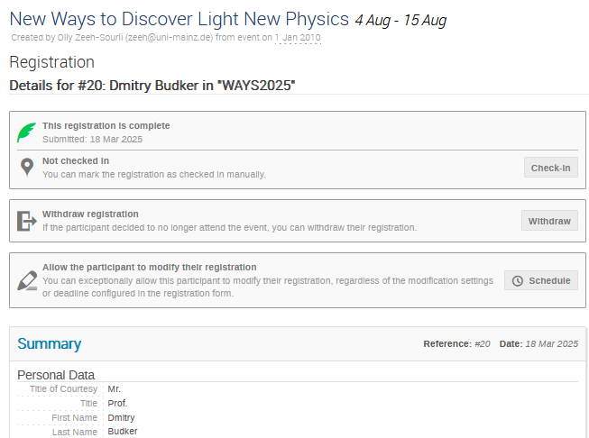

Browsing through registrations
Using an arrow for exaple to browse alphabetically through the forms would make our work easier and quicker.
Mainz Institute for Theoretical Physics, ©Barbara Behrend 2025

Slide 23
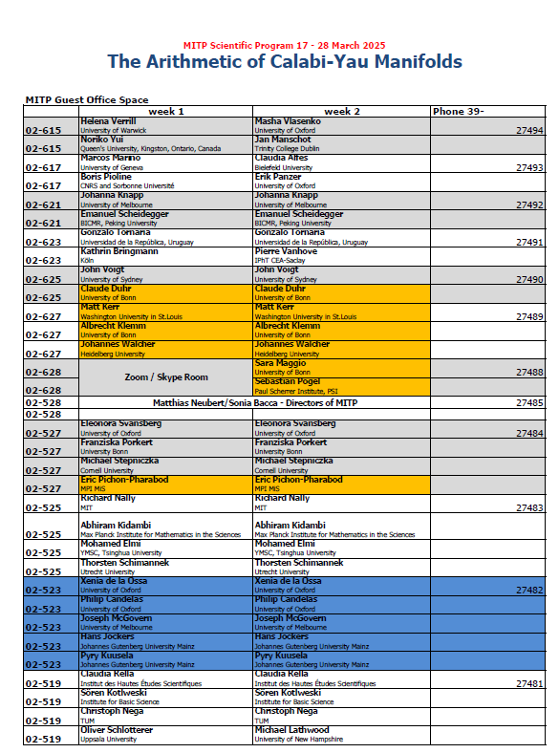
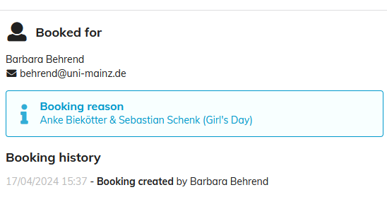
Assign individual registered participants to individual rooms
Would simplify or work in creating room overview lists.
Mainz Institute for Theoretical Physics, ©Barbara Behrend 2025

Slide 24
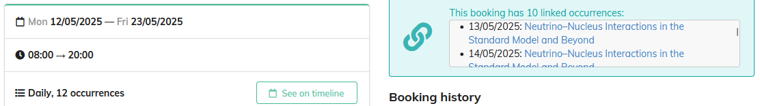
The option to download / create a list with information from the room booking system
Mainz Institute for Theoretical Physics, ©Barbara Behrend 2025

Slide 25

Thank you for listening!
Mainz Institute for Theoretical Physics, ©Barbara Behrend 2025

