Slide 1
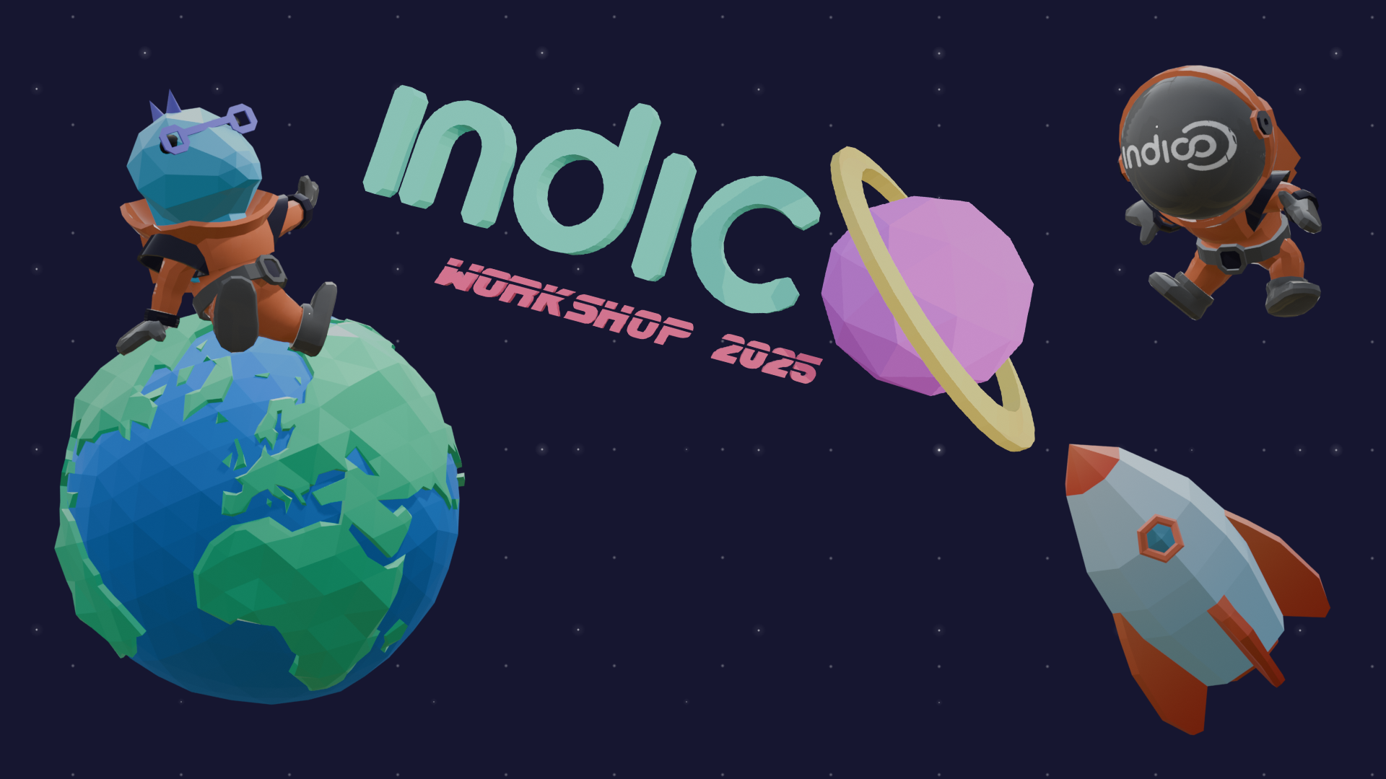

Slide 2
Community & Governance
Where are we?
Pedro Ferreira
Indico Workshop, May 2025

Slide 3
Outline
Brief recap
What we wanted
How far we’ve got
Where do we want to go?

Slide 4

Indico
Governance

Slide 5
Governance – why?
Acknowledging contributions
Collecting and organizing feedback
Coordinating community efforts
Making the Project more distributed
Present Indico as a consolidated Project with a strong community

Slide 6
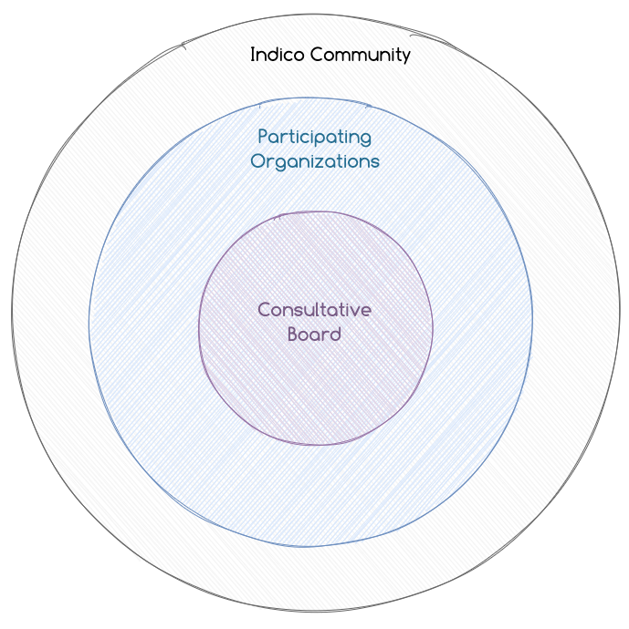
Community Bodies
Consultative Board
Participating Organizations
Wider Community

Slide 7
Bodies (1)
 | Event | Frequency | Format
Indico Community | Indico Workshop | min. 1x / 2 years | Face to face / hybrid
Participating Organizations | Community Meeting | yearly | Hybrid / remote
Consultative Board | Consultative Board Meetings | 2x / year | Face to face / hybrid

Slide 8
 | Responsibility | Term | Apppointed by
Community Manager | Chair Community Meeting Indico Workshop | 2 years | Consultative Board
Consultative Board Members | Advise the Project Identify strategic and community priorities | 2 years | Each invited organization
Product Manager | Vision / strategy as software product Chair Consultative Board | N/A | CERN
Project Manager | Management of core application and plugin development Coordination of community developments | N/A | CERN

Slide 9
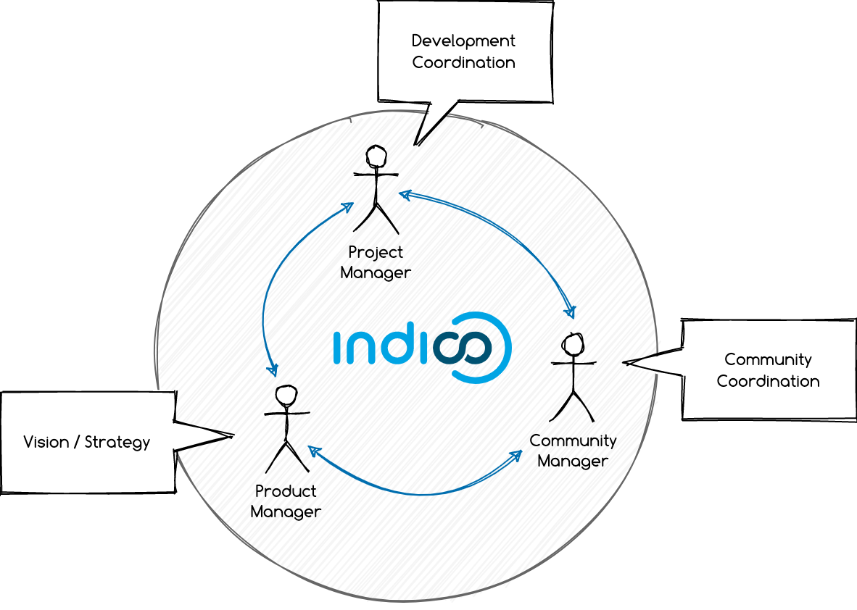
Leadership

Slide 10
How far have we got?

Slide 11
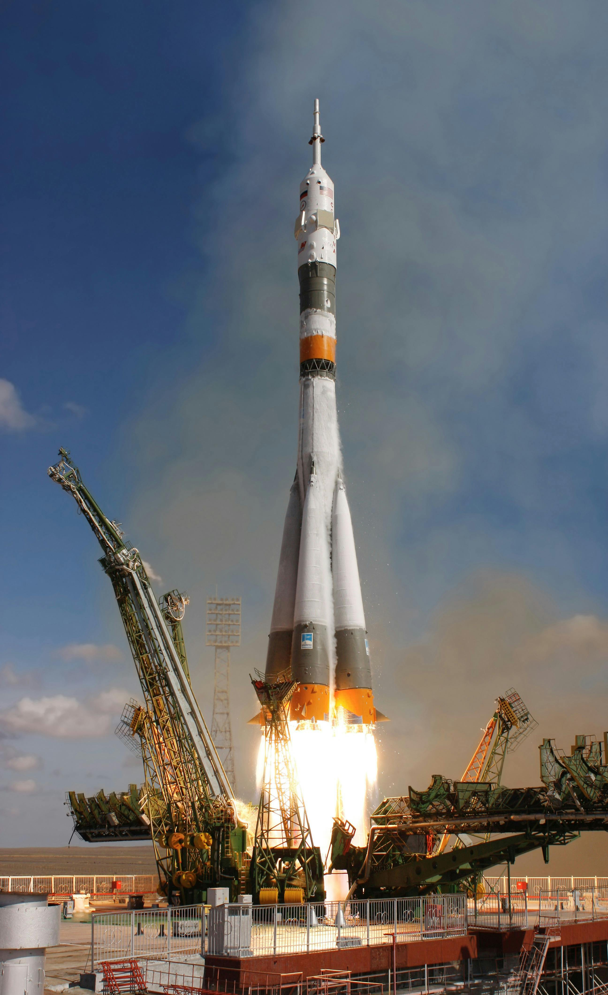
A great start!
Max Planck Institute for Physics and the United Nations invited to join the Consultative Board (and accepted!)
A first meeting in January 2024
Appointed a Community Manager (Bea Medina, UNCONVENTIONAL)!

Slide 12
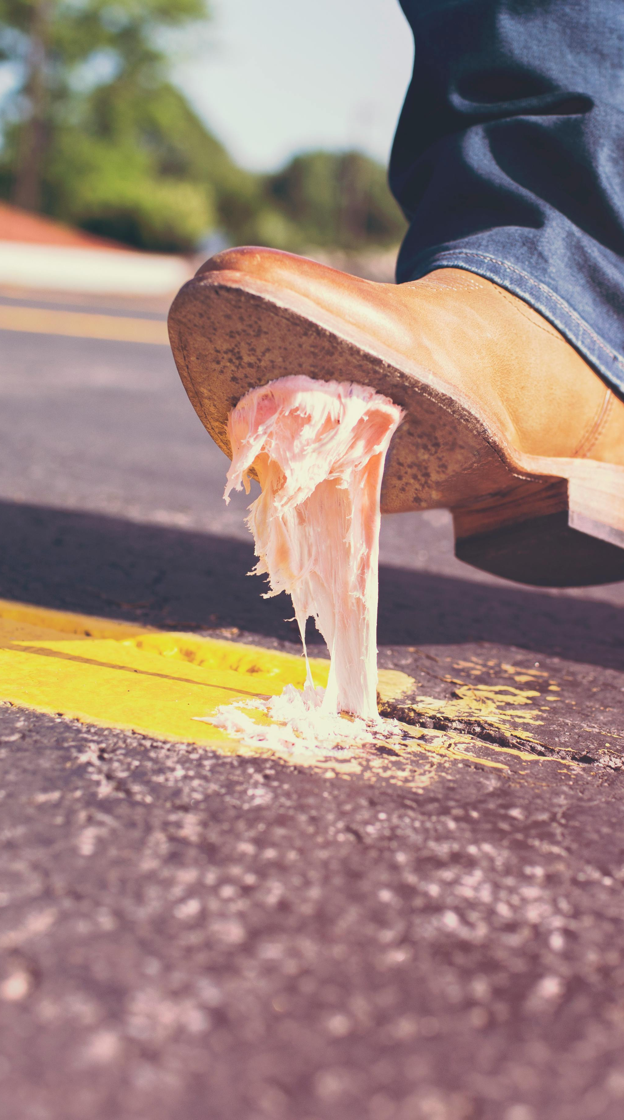
But...
Bea had to take leave of absence
... so, no Community Meeting in 2024 🙁
Also no second Consultative Board meeting in 2024 (my bad and everyone super busy!)

Slide 13

However...
We are moving slow, but we are making progress!
The problems we had were mostly external (a bit of bad luck), so no reason to lose faith in this model
We are here today because there are people who care about the community! (yes, that’s you!)

Slide 14
Next steps

Slide 15

Community Manager
Back to where we started
We are open to all expressions of interest
Profile
  Communication
  Social Media
  Community Building
  Event organization

Slide 16

Participating Organizations
We are ready to welcome you!
Benefits
  Public acknowledgement (on the Project website)
  Spot at the yearly community meeting
  More than just an “Indico user”, help us shape it!
Requirements
  Contributing in some way to the Project (e.g. code, documentation, translations, community building...)
No admission fees!

Slide 17
Thank you!

