Slide 1
Joint Accelerator Conferences
Website
Joint Accelerator Conferences on the Web
Indico @ JACoW
Indico Workshop– 7th of May 2025
Adriana Rossi as 2025-27 JACoW Chair
With contributions (slides, pictures, content!) from
M. McAteer, T. Satogata, D. Button, I. Andrian, S. Deiuri, J. Peters, R. Billen, . . .
and everyone who has contributed to JACoW

Slide 2
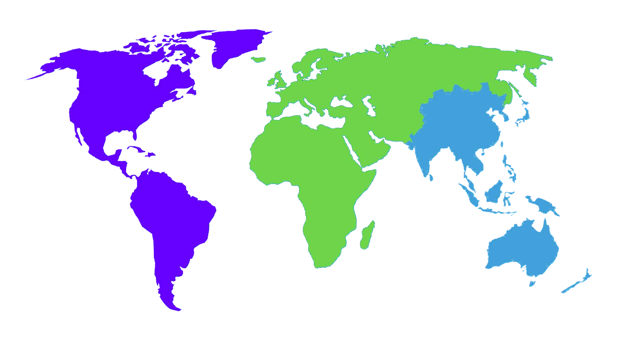
Outline
What is JACoW
  Goals
  Stakeholders
  Supporters
SPMS to Indico
Some features of JACoW Indico
Summary and outlook

Slide 3

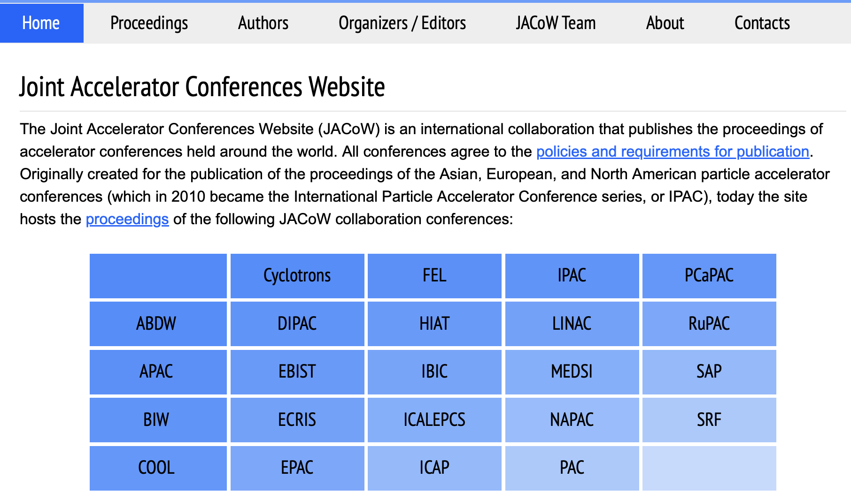
What is JACoW
18 members conference series:
IPAC (unifying PAC, EPAC, APAC from 2010)
NA-PAC (formerly PAC)
IBIC (Unifying DIPAC and BIW from 2012)
COOL, CYCLOTRONS, ECRIS, EIC, FEL, HIAT, ICAP, ICALEPCS, ICFA ABDW, LINAC, MEDSI, PCaPAC, RUPAC, SAP, SRF

Slide 4
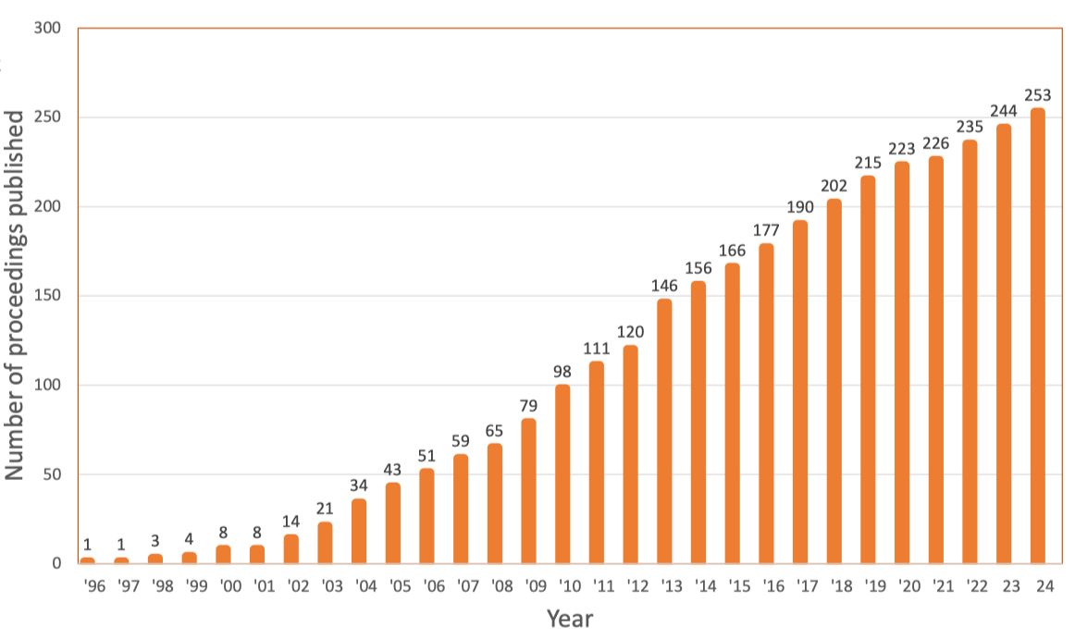
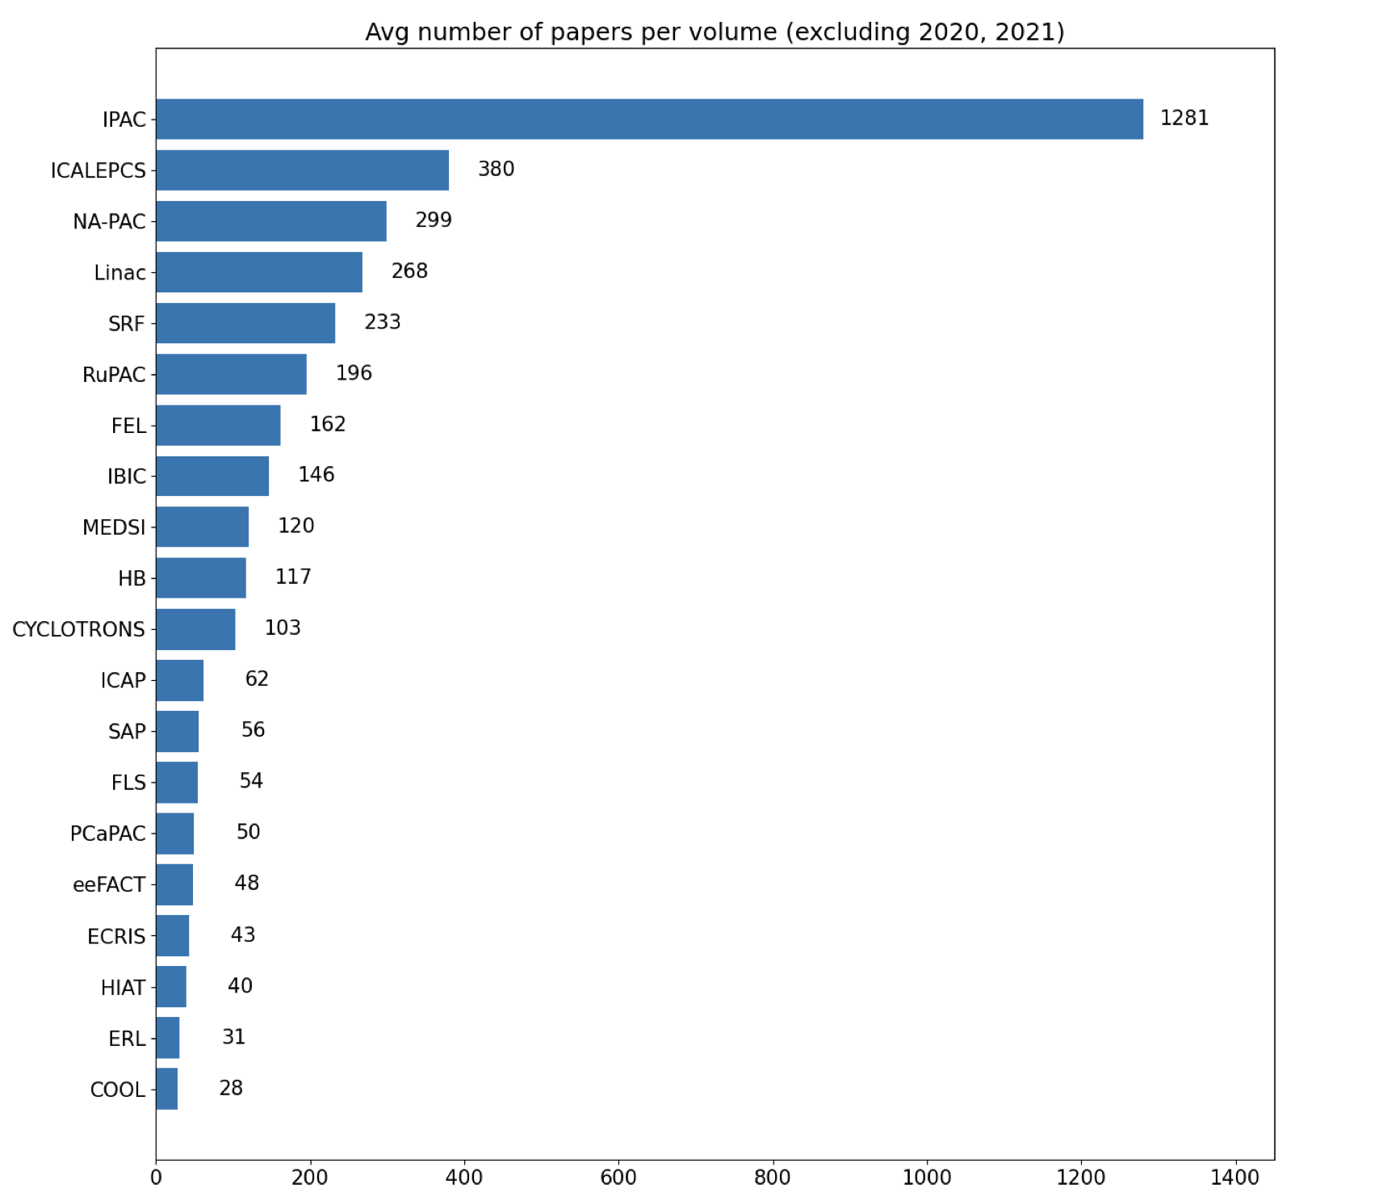
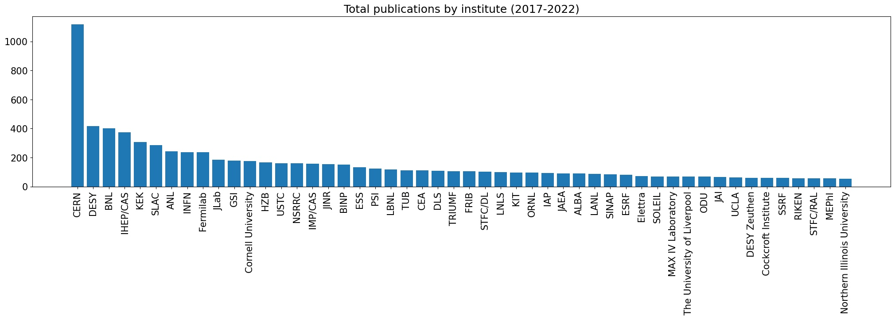
Volume of published papers
9 conferences / y
Average ~ 2550 papers/ y

Slide 5
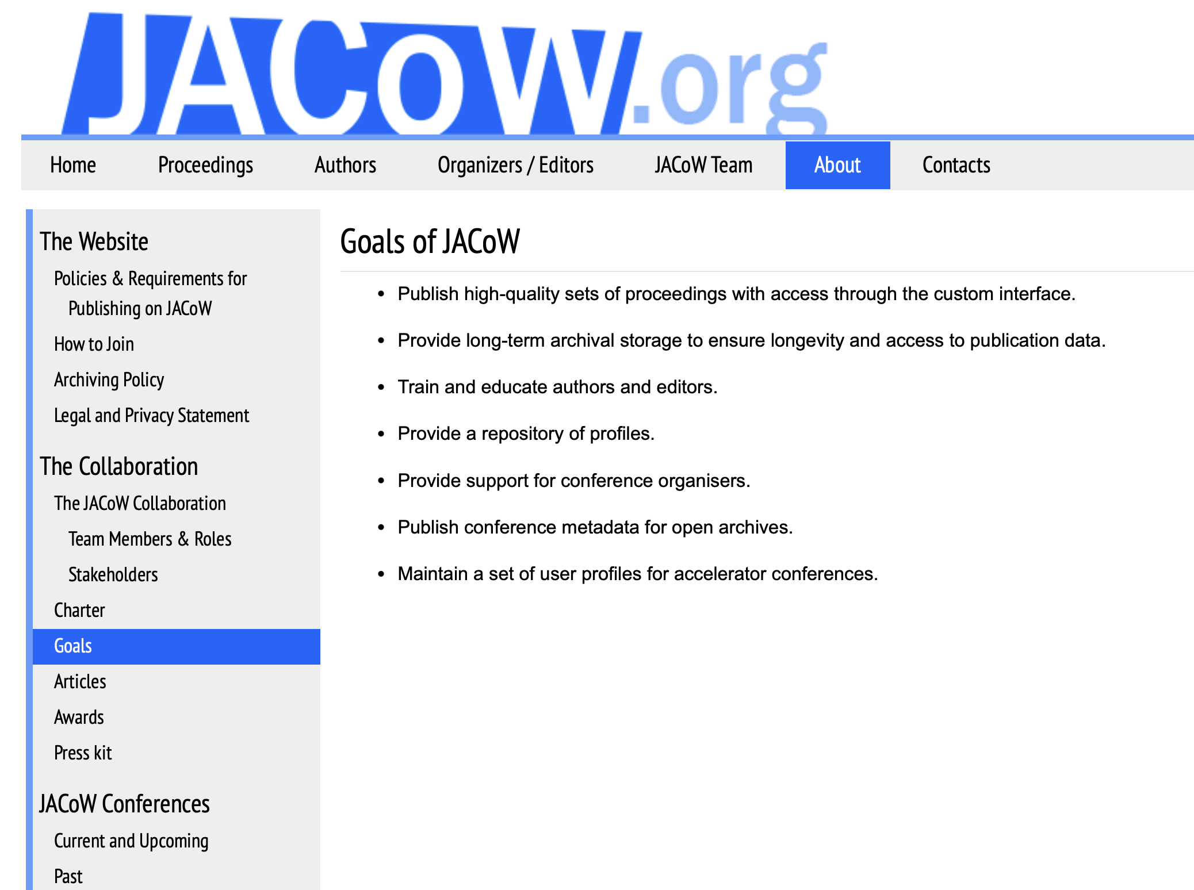
Goals
Publish high-quality conference proceedings – with JACoW Indico, from IPAC’23 – permitting wide dissemination and use.
Publish conference metadata for open archives.
Provide long-term archival storage to ensure longevity and (free) access to publication data.
Provide a repository of profiles – in JACoW Indico since March ’25 – and maintain a mailing lists for accelerator conferences (work in progress, to have dynamic mailing lists /interface with Brevo – mail provider).
Provide support for conference organisers – with JACoW Indico:
  Conference logistics
  Organizing scientific content of conferences
  Paper submission and processing
  Proceedings publication
Train and educate authors and editors, including on tools for proceedings production.
, now in JACoW Indico.

Slide 6
Stakeholders
A collaboration, NOT a service
Conference representatives
Institute representatives
BoD
Team
Users

Slide 7






Labs providing infrastructure and services
Proceedings Repository & Search
➔ moving “soon” to Elettra
SPMS Central Repository (Accounts and Profiles) and Regional Support Centre for Europe
JACoW Indico
Paper File Server for EMEA and Australasia (formerly at PSI)
High Energy Accelerator Research Organization
Proceedings server
SPMS Regional Support Centre for Australasia and the Americas (to be retired end of 2024)
JACoW.org Website Hosting
JICT tools, CAT and MEOW tool
JACoW Indico documentation pages
Paper File Server for the Americas
European Physics Society
Software licenses
Mailing system
(Brevo)
Australian Nuclear Science and Technology
References’ search tool
CAT Scan Cloud Host
JICT – JACoW Indico Conference Toolbox
CAT – Conference Assembly Tool
MEOW – Machine Editor for cOnferences Website
Notes:
MEOW tool (online processor for CAT, hosted at Elettra)
Due to the technological obsolescence of the CERN/JACoW Search Engine, certain functionalities have disappeared (e.g. keyword search). More importantly, papers generated by the CAT tool are not found by the CERN/JACoW Search Engine
The use of the new CERN search engine for JACoW is under discussion

Slide 8
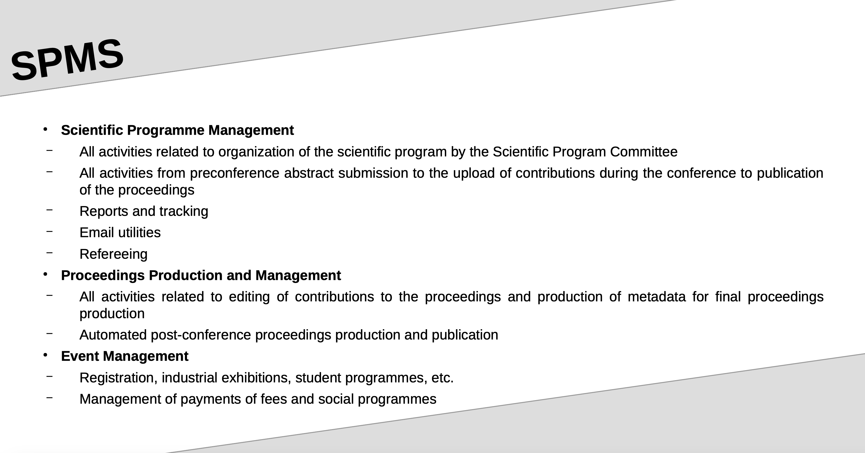

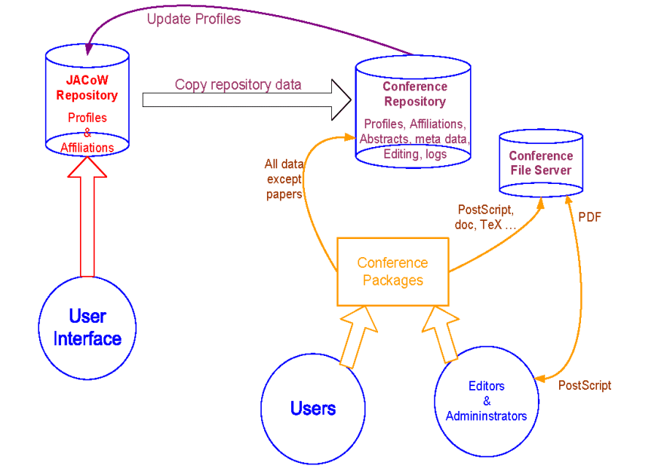
Courtesy of Ivan Adrian, presented at Indico Workshop 2023

Slide 9
Timeline of JACoW evolution and development
> 1997 Development of ‘JACoW model’, formation of the collaboration (EPAC’96, EPAC’98, APAC’98, PAC’99)
> 1998 JACoW paper size
> 2001 JACoW Steering Committee
> Development of JPSP (2004, continuing over many years)
> 2004 SPMS* (PAC’01, EPAC’02, EPAC’04) with further development of functionalities (FEL’04, FEL’05, IPAC, EPAC’08)
> Regional support centers
> 2007-08 first discussion about indexing JACoW proceedings
> 2012 JACoW charter adopted, Board of Directors formed
> 2012 ISBN numbers
> 2015 current version of JACoW charter adopted
> 2015 DOIs for all new papers
> 2017 Start of SPMS-Indico merge project
> Development of CATscan and reference search tool (IPAC’19)
> 2020 ISSN numbers for all conferences
> 2020 end of SPMS development support, closing of FNAL support center
> 2022 Last SPMS instance created
> First test of JACoW Indico (FEL’22)
> Beta test of JACoW Indico at IPAC’23, then production version rolled out
> Development of Indico proceedings module (IPAC’23, IPAC’24, IPAC’25)
> 2023 First two sets of proceedings (LINAC and IBIC) indexed in Scopus
> 2024 KEK SPMS server will be retired
> 2025 End of SPMS, with also Central Repository with JACoW Indico
*Scientific Programme Management System

Slide 10
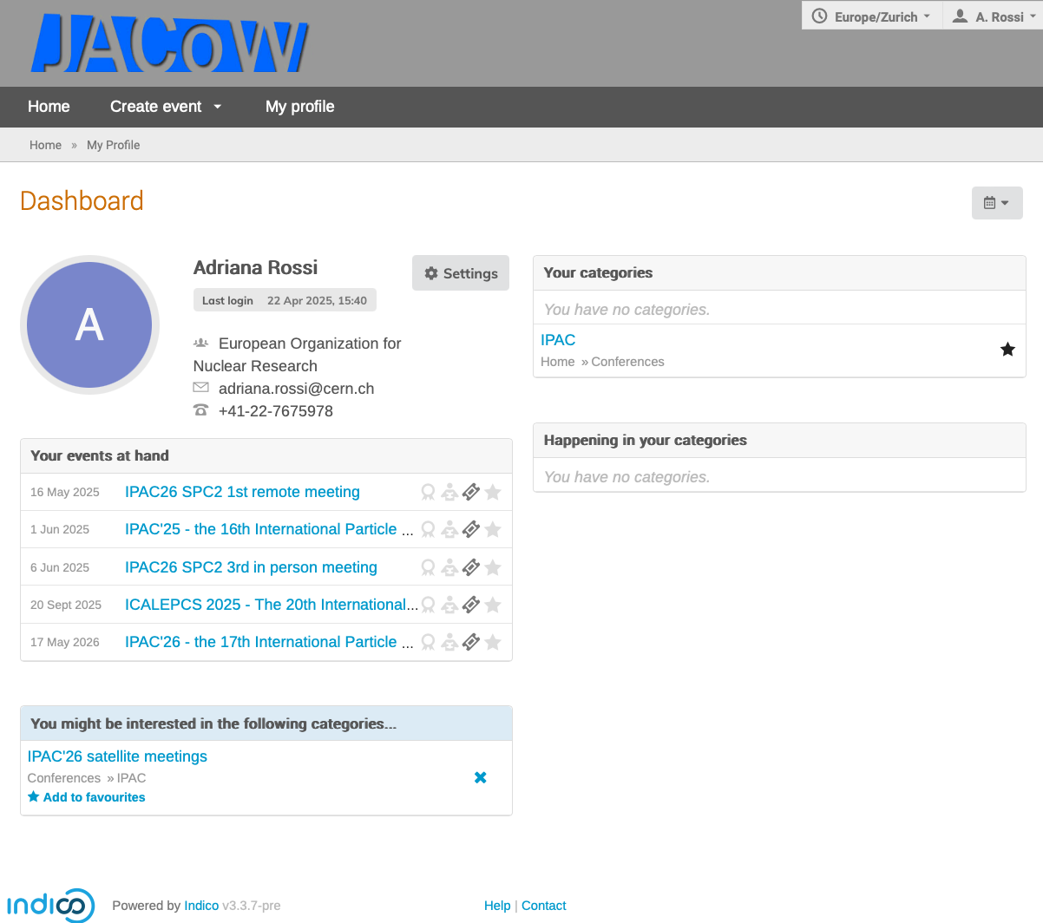
Paper process assisted by indico
Abstract submissions (> 1y earlier for invited talks selections by SPC, few month earlier for poster/contributed talks)
  For paper submission user must create/use an Indico profile → creation of local instance profile repository (to be improved)*
  NEW – possibility of multiple affiliation (necessary for paper publishing)
  Communication of acceptance of paper submission
SPC selection and composition of synoptic table
For some conferences organisation of peer reviewing
At conference paper editing with tracking of workflow (see I. Andrian @ Indico Workshop 2023)
Proceeding publication
* New Indico profiles created (by author for co-authors) at conference submission NOT retained in JACoW Indico after the conference, those created by the authors for themselves yes

Slide 11
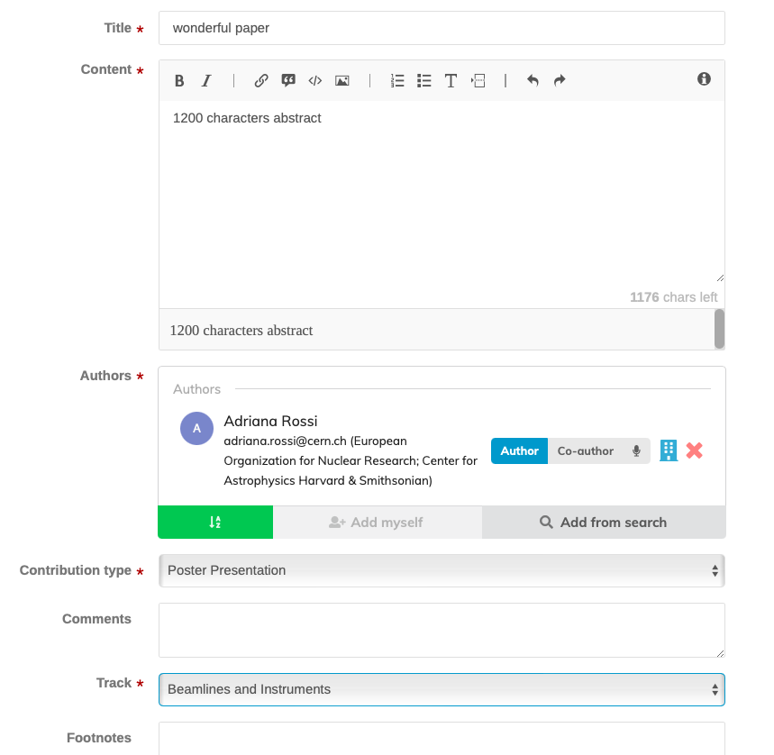
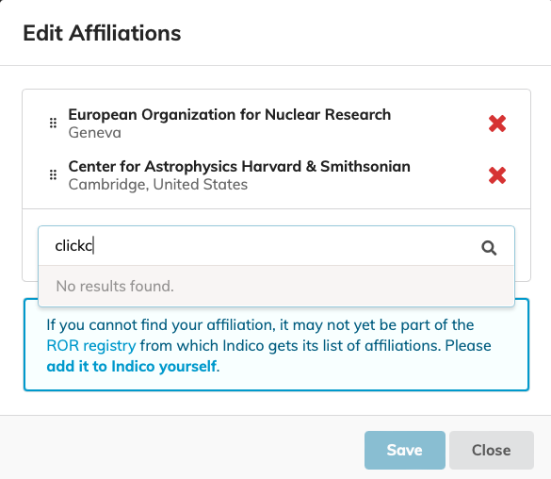
Paper submission to a conference + profile
JACoW requested affiliations from ROR*
*https://ror.org Research Organisation Registry
➔ PROBLEM due to ROR policy/scope
(https://ror.org/about/faqs/#is-my-organization-in-scope-for-ror)
and time lag
>> creation of custom affiliation in progress

Slide 12
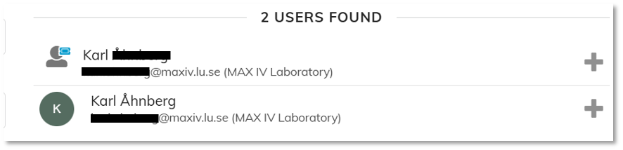
User profiles central repository
One is the Indico profile, the other the Eventperson (Ivan @ 23:25 !!)
Should we allow JACoW officers to access the central repository in Indico to help users?
Being forced to use author affiliations compiled from an external database> (and not being able to manually input an affiliation) is a real problem. As> conference organisers, we really do not want to exclude any company> participation (including small companies), because they are often a> significant and important source of revenue for the conference.
I’m less worried about having affiliations correct in order to accept abstracts. But I have checked, and as an editor, I am also unable to edit the affiliation of authors at the contribution stage. This is a real problem, because the affiliations won’t be able to show up correctly in the proceedings, or any of the material produced for the conference (e.g. book of abstracts).
Hello,
I am trying to modify my indico account like requested here: https://docs.jacow.org/General/login/
At the step where I have to reset my password (https://indico.jacow.org/reset-password/), my email (xx.xx@xx.x) is not recognized, even though I can connect to my indico account with former credentials and confirm that this is the correct one. I also received emails from indico on it.
Can you help me to finish the process?
Thanks,
We asked to remove the USERID in favour of e-mail address. Does not work if one changes job or retires!
But problems would be the same if userid is forgotten, since a mail is sent to reset the password
Dear JACoW support team,
I have a JACoW account with the e-mail address: xx@cells.es from the Spanish ALBA-CELLS Facility.
I changed jobs at the end of 2023, and now I am working at the Swiss Paul Scherrer Institut (PSI). Should my account be edited with another e-mail address or should I create a new account. I realized about this when preparing for the next ICALEPCS 2025 which redirected me to https://docs.jacow.org/General/login/
Thanks,
Solution from Adrian (@ 23:00!!) : local password manager software (either a standalone one like 1password or keepass, or that of the browser)

Slide 13
In the pipeline
Plugins for the mailing (mail provider Brevo) to be able to extract mailing lists from JACoW Indico Central Repository for conference series announcements
  Mailing list dynamically changed with preferences
Could announcement be sent directly through JACoW Indico (as it was for SPMS)?
NOT for Indico BUT: Announcements currently affected by mails from Brevo are blocked by firewalls or go to spams for some institutes
  Brevo does not provide any assistance
  To be investigated if from Brevo settings or from wordings

Slide 14
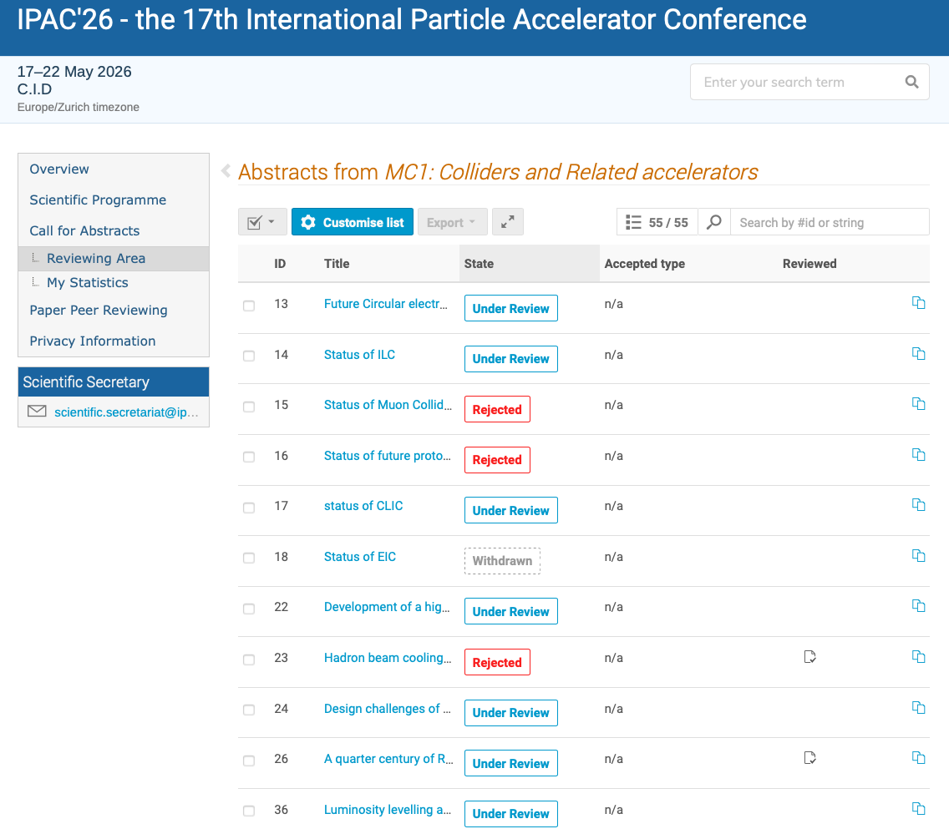
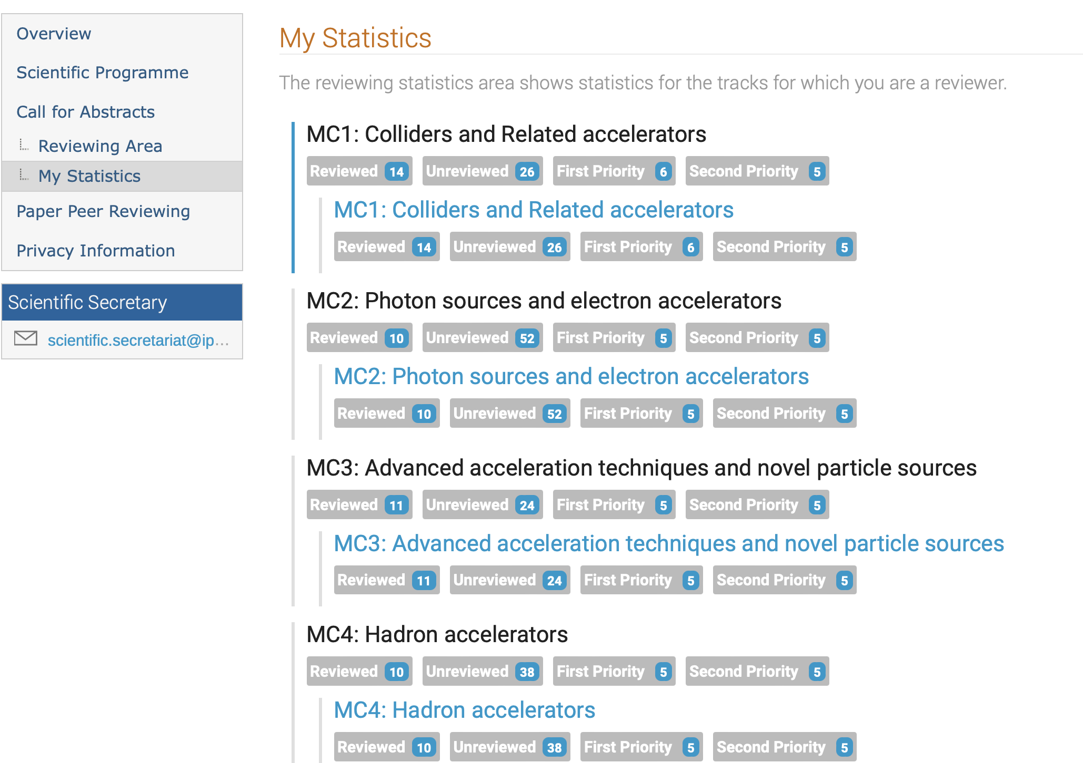
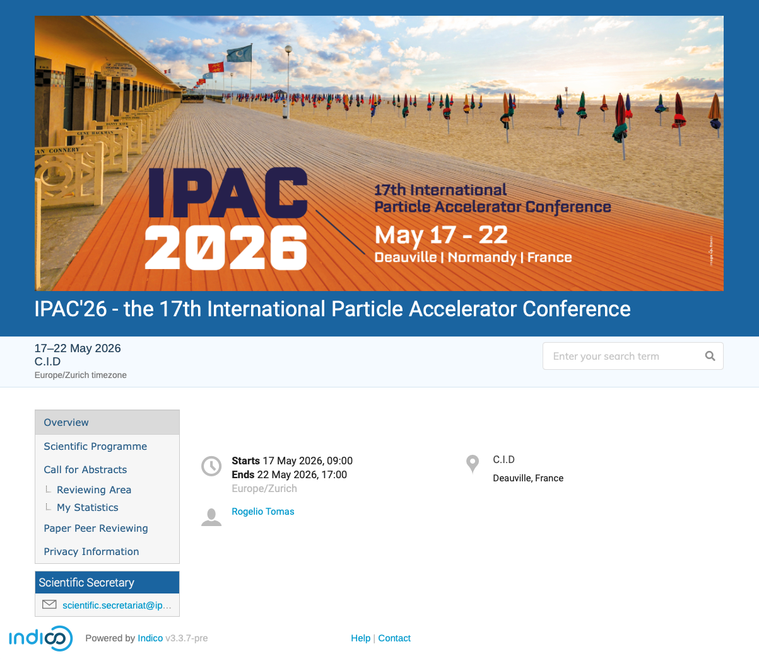
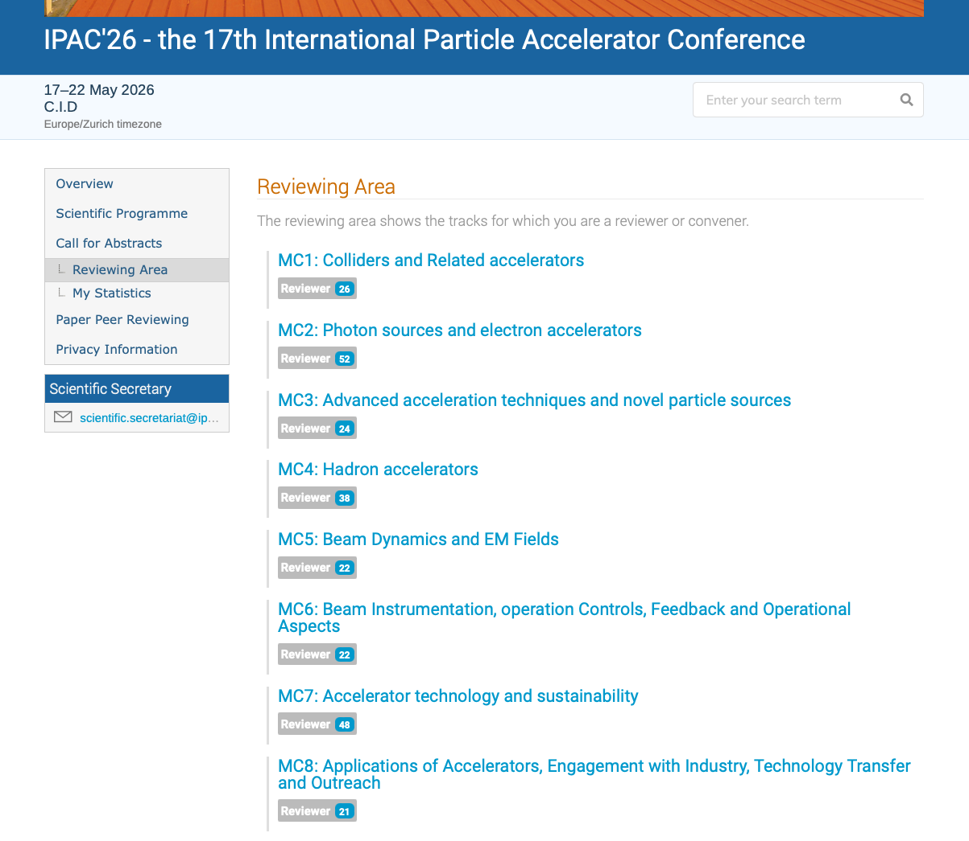
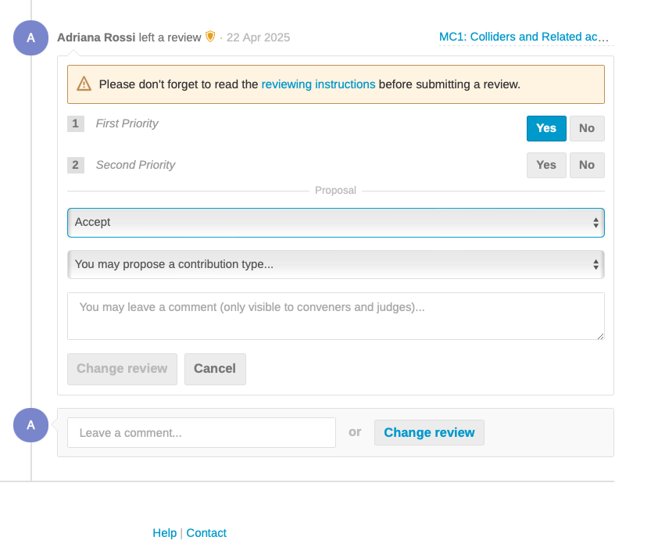
Ex. of workflow with IPAC Scientific Program Committee
Abstract can be extracted as Xcel files to have an overview

Slide 15
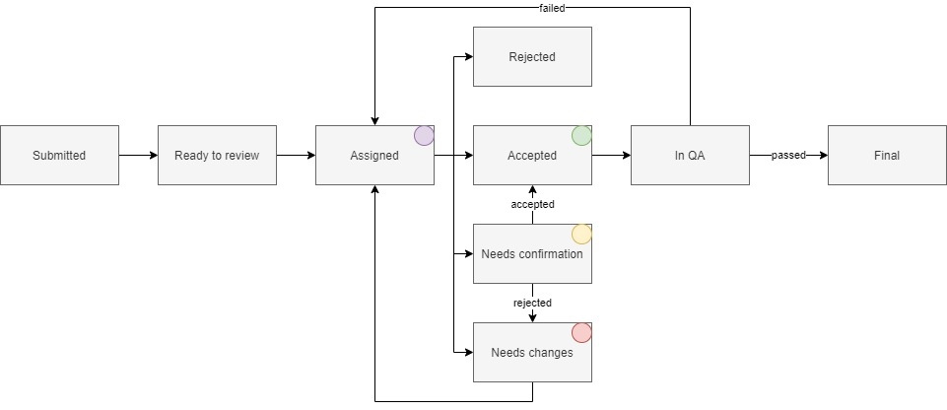
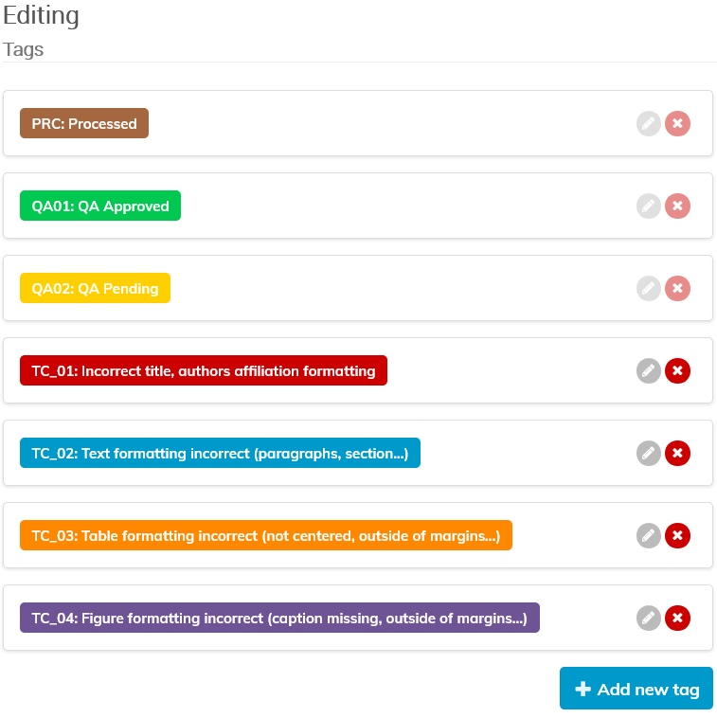
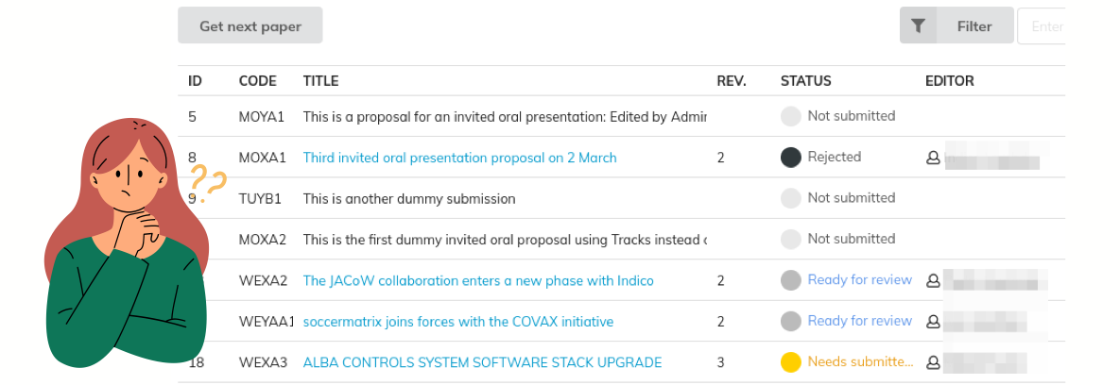
Editor Process
Courtesy of Ivan Adrian, several presentations

Slide 16
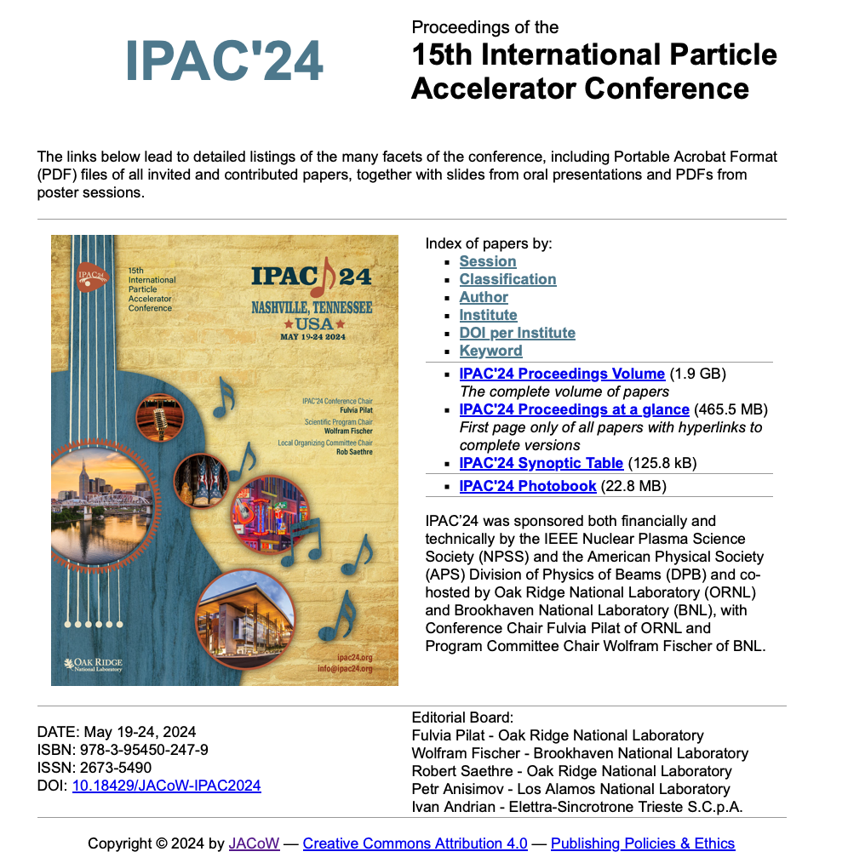
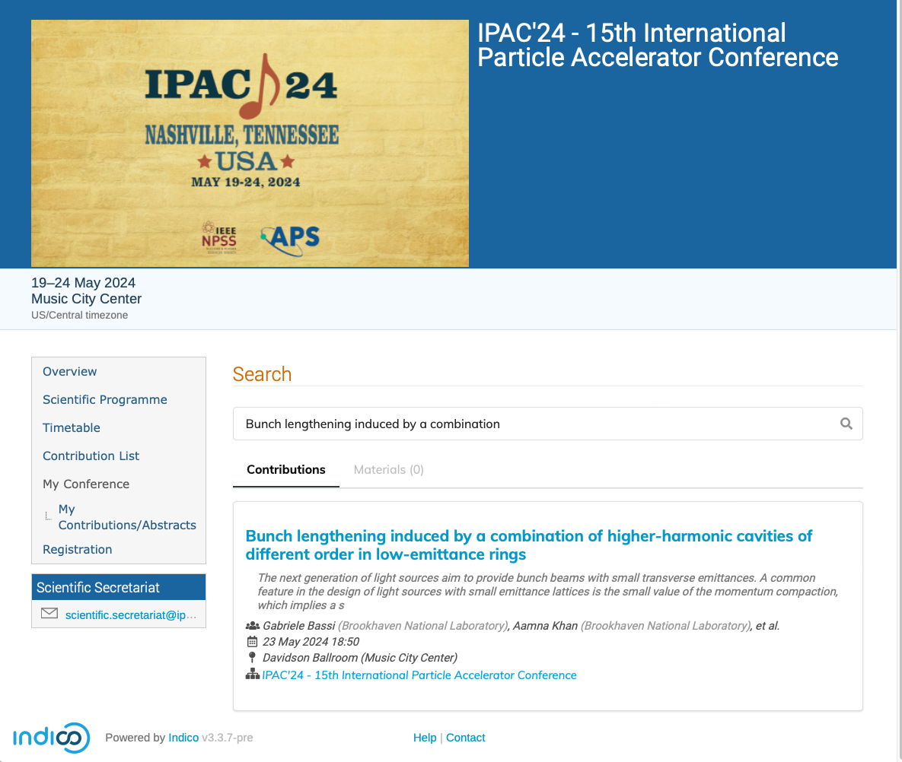
within the conference week
*
*The search works only by title

Slide 17
Summary and outlook
JACoW is an international, worldwide COLLABORATION of accelerator labs and universities
  Assisting conference organisation via Indico both for announcements, logistics and scientific programme
  Publishing (in collaboration with Indico) open-source papers on accelerator science and technology
  Maintaining via Indico user profiles (names, mail addresses, affiliations, preferences for conference series)
  FUTURE: create, via Indico, dynamic mailing lists for announcements, possibly sending them via Indico directly.
CERN is fully supporting our collaboration with Indico
I would like to extend JACoW’s warmest thanks to the Indico team for their great, dynamic, and collaborative work, which makes continuous improvements possible.

Slide 18
Spare slides

Slide 19
