Slide 1

Making Indico a first-class citizen in Kubernetes
Gabriel Dragomir
Systems Engineer - IT Infrastructure
MAX IV Lund, Sweden
Indico Workshop 2025, CERN/UN, Geneva, Switzerland

Slide 2
Overview
Migrating Indico from a VM deployment to Kubernetes
Topology of Indico as a cloud native workload
Operating Indico as a cloud native app
Indico Workshop 2025, CERN

Slide 3
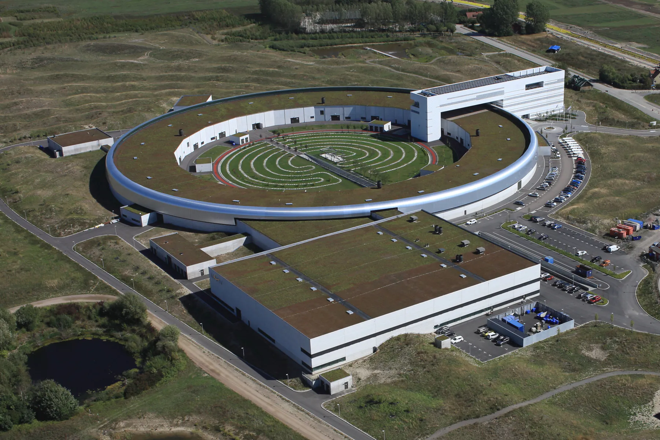
MAX IV Laboratory
Synchrotron light source facility at Lund University, Sweden
MAX IV offers access to 16 beamlines that provide modern X-ray spectroscopy, scattering/diffraction, and imaging techniques to contribute to solving scientific questions in a wide range of areas
300 employees, 1700+ users/year
Indico Workshop 2025, CERN

Slide 4
indico.maxiv.lu.se
Relatively small installation
2k events and 3.5k users
Used by various groups:
  Communications
  Science division/Beamline teams
  IT
- Occasionally gets very high traffic:
- MAX IV Annual User Meeting conference
- Other large scale conferences hosted at MAX IV
Indico Workshop 2025, CERN

Slide 5
The legacy Indico
Indico v2.x deployed in beefy VM along with dependencies
All services installed as systemd units (apps, db, proxy etc.)
Minimal customizations in the theming layer
LDAP based authentication
Major issues
Tedious to upgrade, rollback and maintain in general
Every component was co-located in the same environment
Limited scalability and resilience
Needed integration with our Keycloak based SSO
Almost no observability and insight into operations
Indico Workshop 2025, CERN

Slide 6
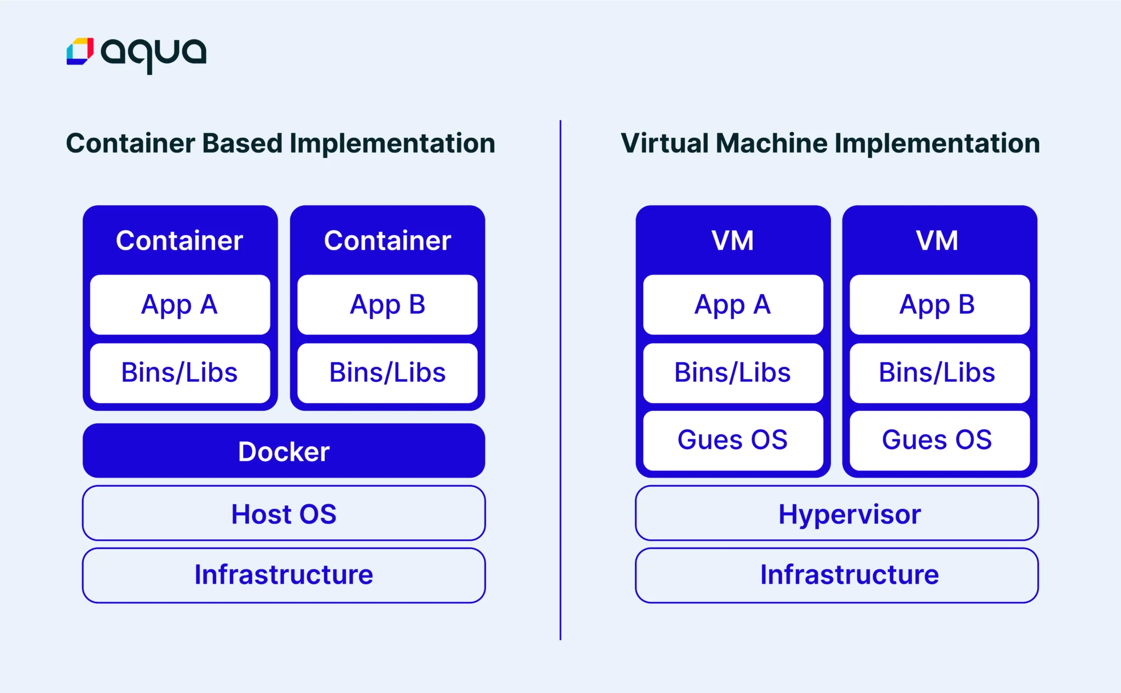
Virtualized vs cloud native
Indico Workshop 2025, CERN
Source: https://www.aquasec.com/cloud-native-academy/docker-container/containerization-vs-virtualization/

Slide 7
Indico as a cloud native workload
Challenges
No documented approach, only unofficial sparse documentation
Massive list of dependencies resulting in huge container image
Upgrade process from extremely old version
OpenShift production environment constraints:
  Security contexts - a lot more hardened environment
  Resource quotas enforced on namespace - CPU, memory
  Orchestration complexity - memory leaks, timeouts, containers OOMKilled
- Automating operations: release, rollback, zero-downtime ops
Indico Workshop 2025, CERN

Slide 8
The container images
Multi-stage build image for Indico
Gets considerably large due to TexLive packaging, but cached on k8s nodes
Community images for the rest:
  Nginx
  Redis
  PostgreSQL (driven via Zalando PG Operator)
Indico Workshop 2025, CERN

Slide 9
The Helm chart
Developed in-house
Helm chart: a declarative way of specifying everything that comprises an application using templates and run-time values
A Helm chart release is a particular “rendering” of a chart resulting in actual YAML manifests that will result in resources being created in the K8S cluster:
  Deployments, StatefulSets
  Persistent storage
  Networking resources: ingresses, network policies
  Custom resources: PostgreSQL cluster
Indico Workshop 2025, CERN

Slide 10
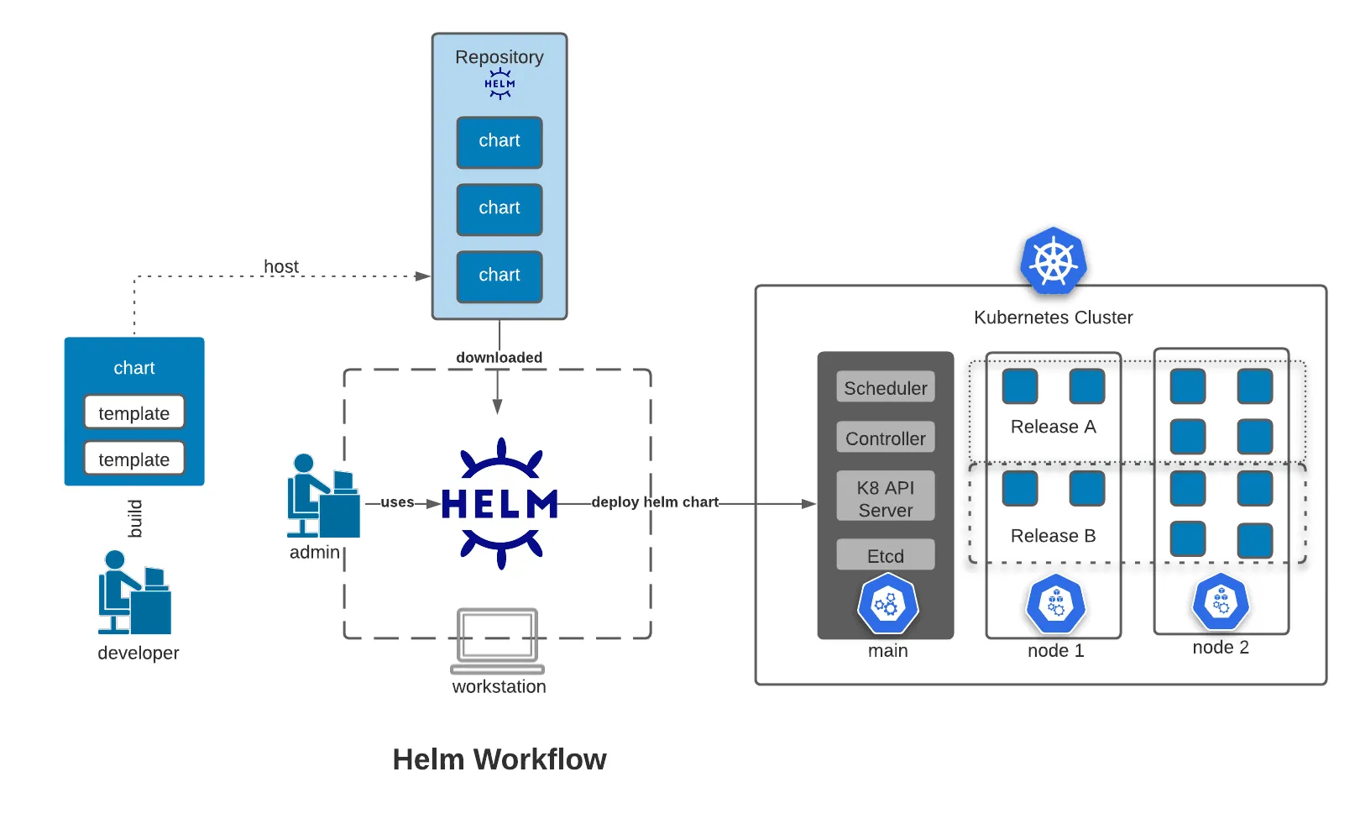


The Helm workflow
Source: https://codefresh.io/blog/using-helm-with-gitops/
Indico Workshop 2025, CERN

Slide 11
Kubernetes clusters at MAX IV
Multiple clusters, either running on bare-metal or on top of VMWare VSphere VMs
Rancher managed clusters: mostly scientific data related
  Observability infrastructure (Graylog, Grafana etc.)
  DAQ cluster
  JupyterHub SaaS
OKD/OKDev: RedHat OpenShift K8S distribution
  general purpose workloads
  production cluster: 5 worker nodes, 24 CPUs/256GB mem each
  persistent storage with Dell PowerStore array storage
  backups with Rubrik and MinIO S3
Indico Workshop 2025, CERN

Slide 12
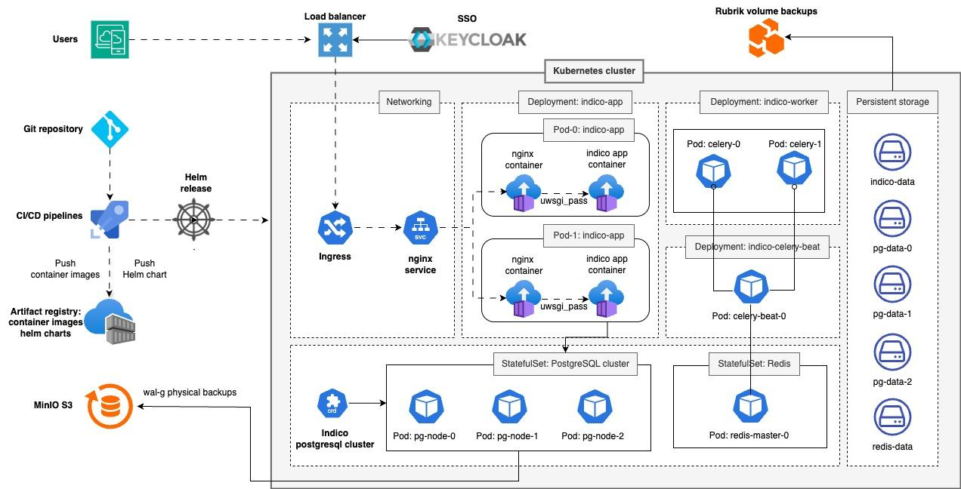
The Helm workflow
Indico topology executing in OpenShift

Slide 13
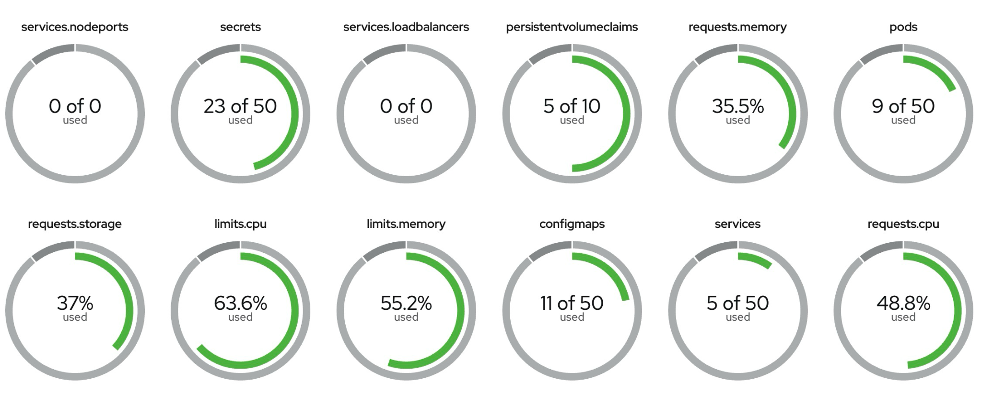
The Helm workflow
kind: ResourceQuota
apiVersion: v1
spec:
hard:
services.nodeports: '0'
secrets: '50'
services.loadbalancers: '0'
persistentvolumeclaims: '10'
pods: '50'
configmaps: '50'
services: '50'
requests.cpu: '12'
requests.memory: 28Gi
requests.storage: 300Gi
limits.cpu: '24'
limits.memory: 36Gi
Resource allocation is tuned a bit higher than actual use

Slide 14
Operating Indico
Observability and monitoring:
  Prometheus metrics and Grafana
  Logs: aggregated in Graylog
Stable workload, good performance at peak times
The only major issue arises from PDF generation
  We had to extend backend timeouts on HAProxy to 300s
  AI crawlers are a nuisance and can cause crashes of the indico workloads
Indico Workshop 2025, CERN

Slide 15
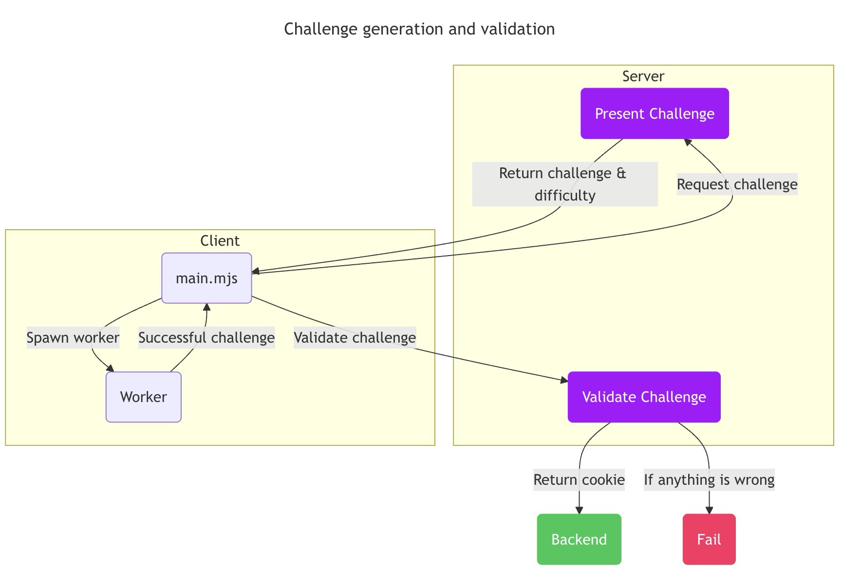
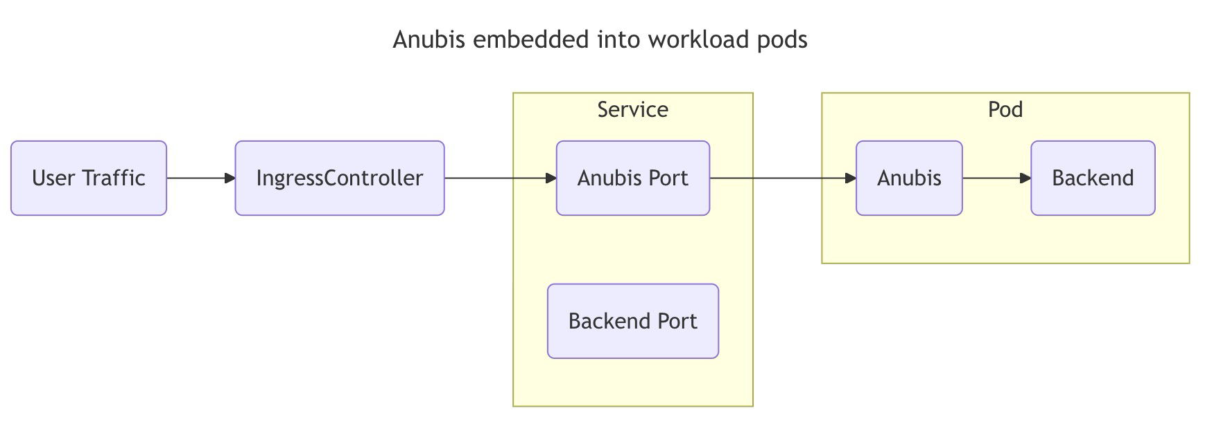
Protecting Indico from unruly AI crawlers
Experimented with Anubis, but found it bad for user experience.
Anubis uses a proof-of-work challenge to ensure that clients are using a modern browser and are able to calculate SHA-256 checksums.
https://anubis.techaro.lol

Slide 16
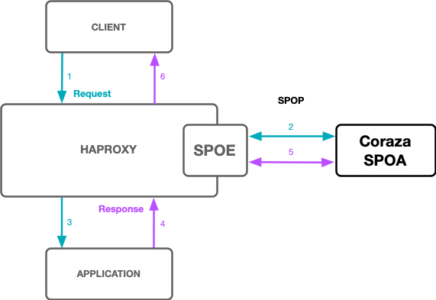
Protecting Indico from unruly AI crawlers
Now testing with OWASP Coraza WAF deployed as a HAProxy Stream Processing Offload Engine plugin (SPOE)
Coraza runs the OWASP Core Rule Set to protect from a wide range of attacks
SQL Injection (SQLi), Cross Site Scripting (XSS), PHP & Java Code Injection, HTTPoxy, Shellshock, Scripting/Scanner/Bot Detection etc.
https://coraza.io/
https://coreruleset.org/
Indico Workshop 2025, CERN

Slide 17
What is next?
Upgrade to latest Indico version: June 2025
Zoom integration - integrate with Lunds University Zoom infra
We plan to contribute the Helm chart we currently use, needs decoupling from specific infrastructure at MAX IV
Start prospecting how feasible it is to implement a Indico Operator for Kubernetes:
  Unattended deployment
  Upgrades/Rollbacks
  Scheduled backups and restores
Indico Workshop 2025, CERN

Slide 18
Thank you!
Gabriel Dragomir
gabriel.dragomir@maxiv.lu.se
Indico Workshop 2025, CERN

