Slide 1


Slide 2
About this Workshop
2-day workshop
  This morning: CERN
  This afternoon: Palais des Nations (UN)
  Tomorrow: CERN
https://indico.cern.ch/e/indico-workshop/2025
https://indi.to/workshop2025

Slide 3

Your Privacy
You might be recorded
  Video - make sure you know where the camera is
  Audio – microphones on tables
  Recording will be made available online
Group photo at 12:00
  It will be used in news articles and promotion
  By taking part you consent to its publication
Other photos – if you don’t wish to be photographed, please let us know!

Slide 4
Some practical information
Coffee/tea and snacks provided in the morning (tomorrow also in the afternoon)
Restaurant 2 (lunch) – Just across the street
  Everyone pays for their own food
Toilets – turn left, at the end of the corridor
Vending/coffee machines downstairs
Lots of useful information on the event website (“Practical Information”, including WiFi)

Slide 5
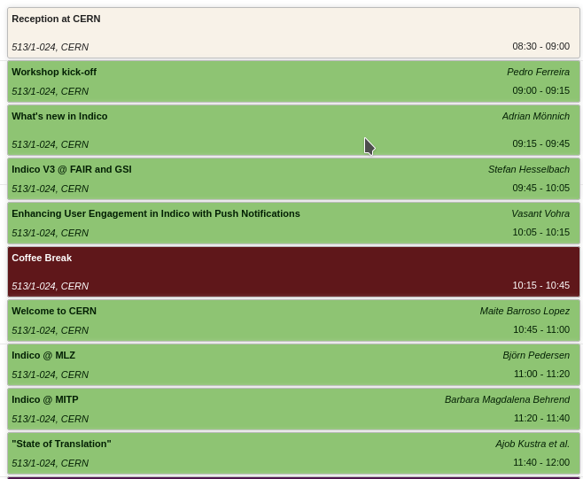
Programme (this morning)
Latest news (Adrian)
Official Welcome
Use Cases
  FAIR / GSI
  MLZ
  MTP

Slide 6
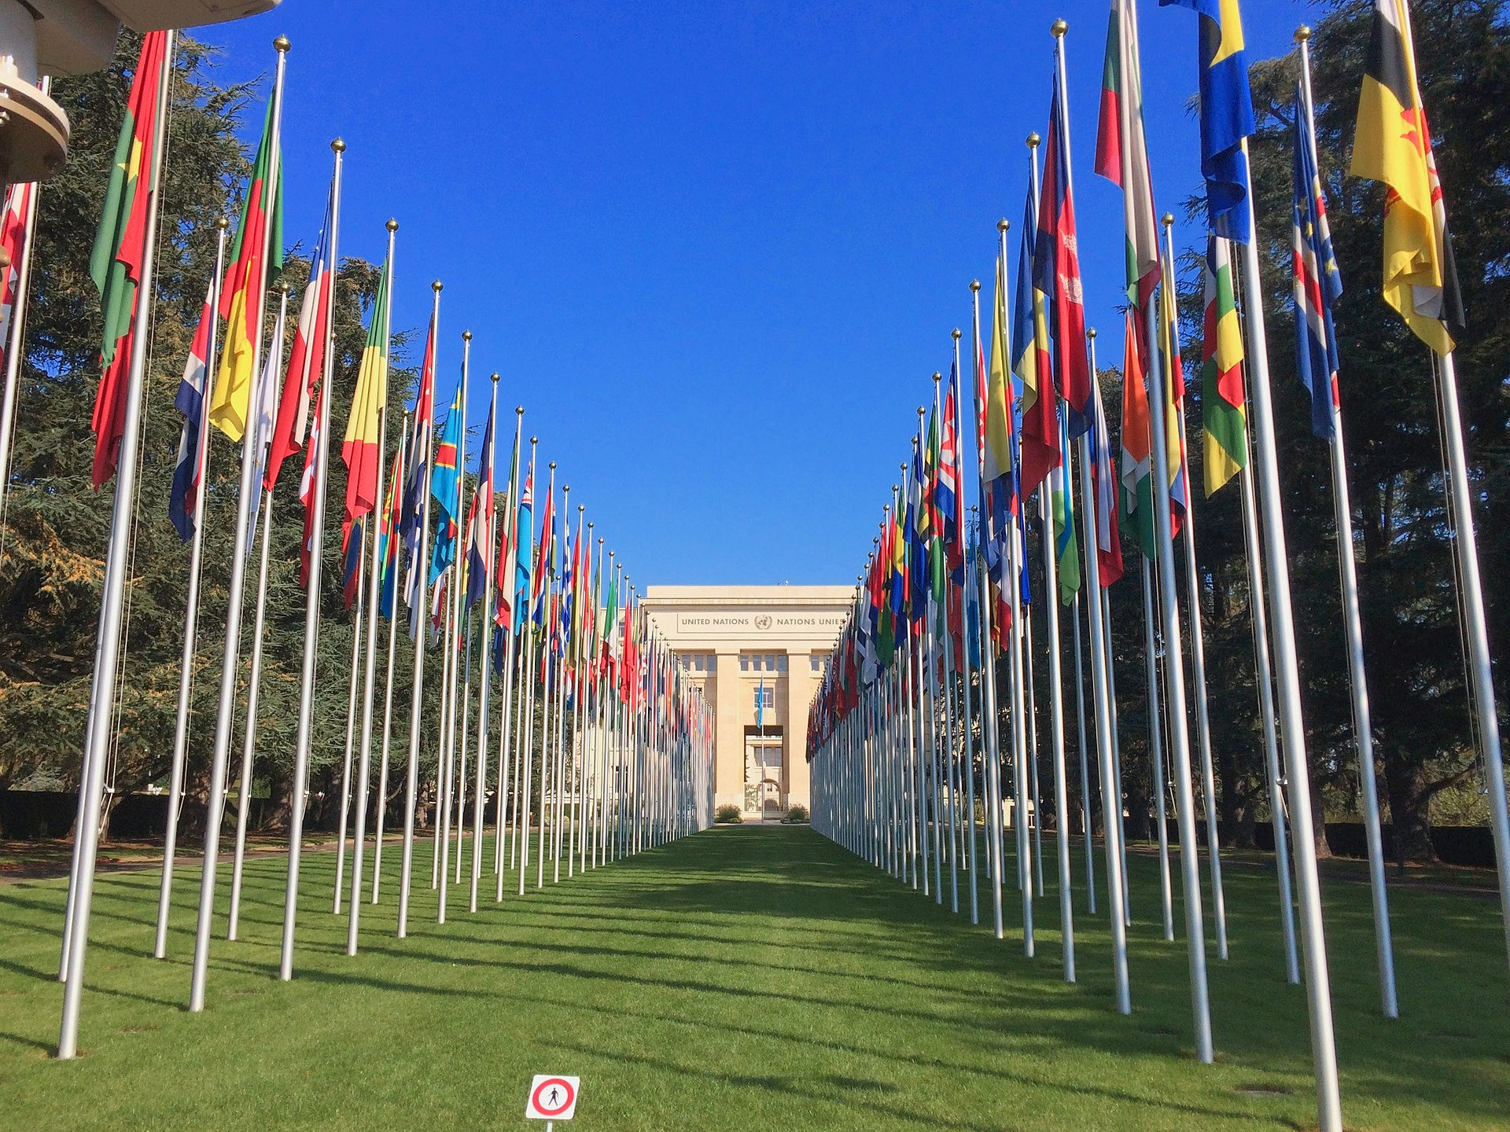
This afternoon…
Travelling to the UN
  Bus leaving at 13:00 from BUS stop next to Restaurant 2
  Arrival at 13:30
  Don’t forget to bring a EU ID or Passport!
Amin / CC BY-SA 4.0

Slide 7
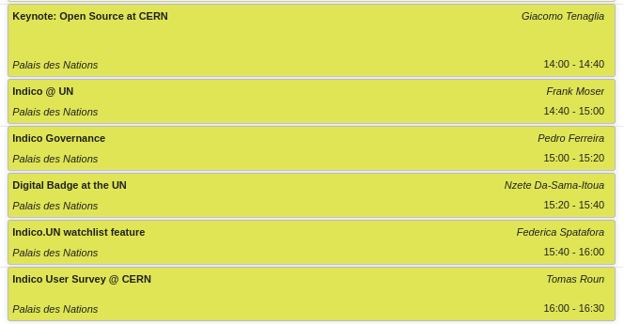
Programme (this afternoon)
Keynote by Giacomo Tenaglia (CERN OSPO)
Indico at the UN (+ features)
Presentations on Governance and User Survey @ CERN
Visit

Slide 8
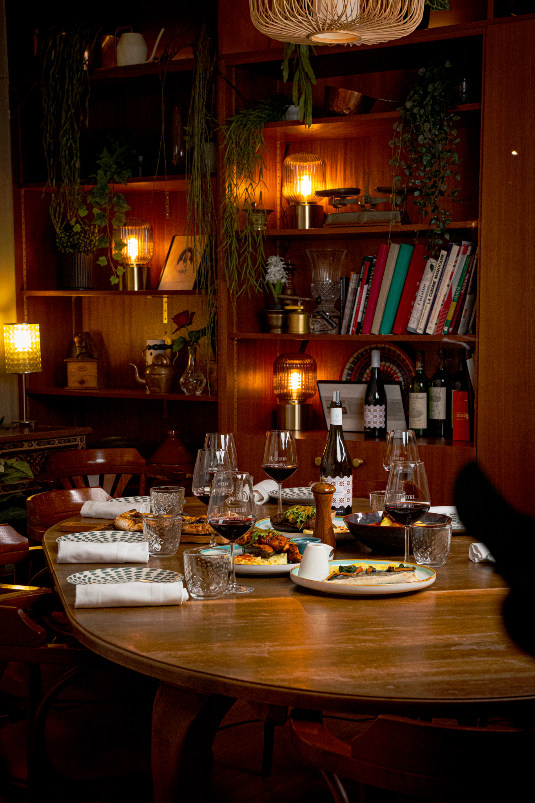
This evening…
Dinner at mama&zita, 18:45
  Check Indico page for address
  Walking distance from the UN
  Transport back to CERN at 21:00
You’re expected to pay for your own meal!

Slide 9
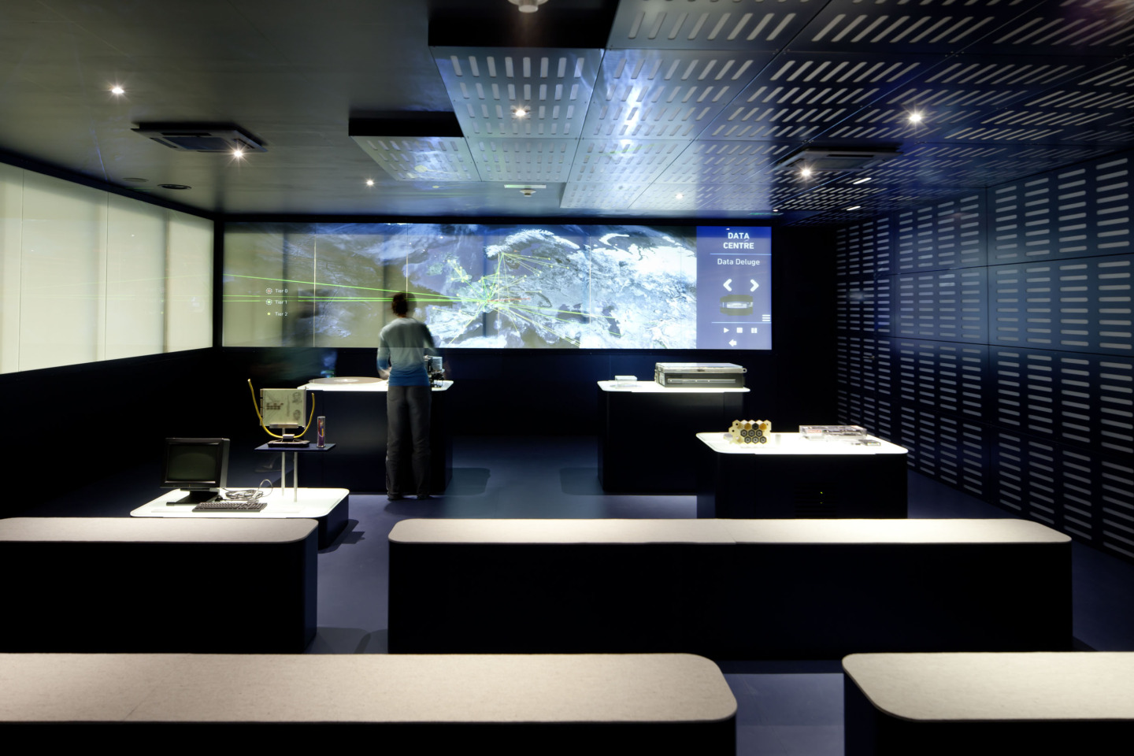
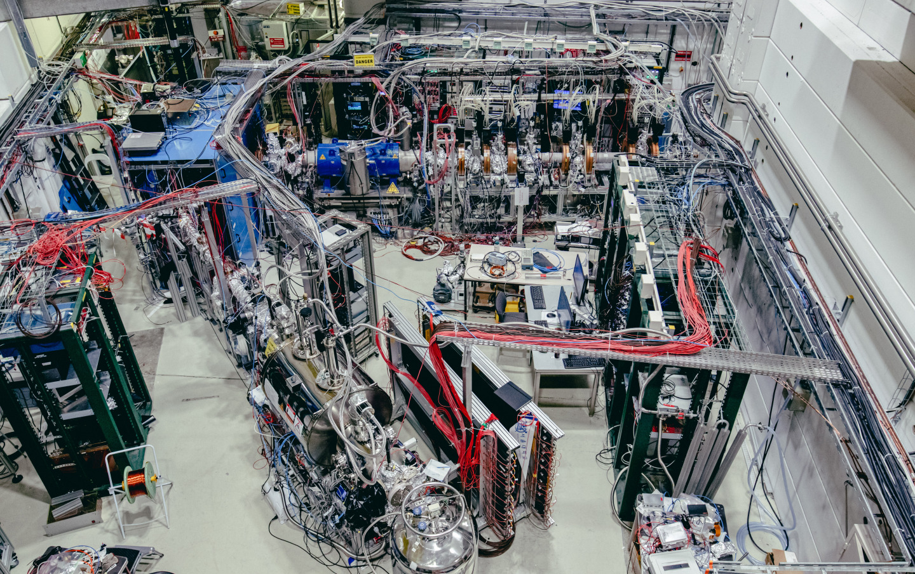
Tomorrow
We start at 8:40
13:00 – Visit to the Synchro-Cyclotron (SC) and CMS
  not recommended for pregnant women (please let us know in that case), and everyone is required to wear flat closed shoes (no open sandals or heels).
Workshop ends at 17:20

Slide 10
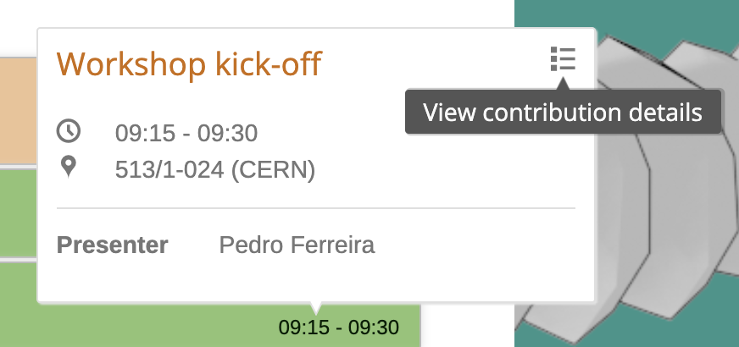
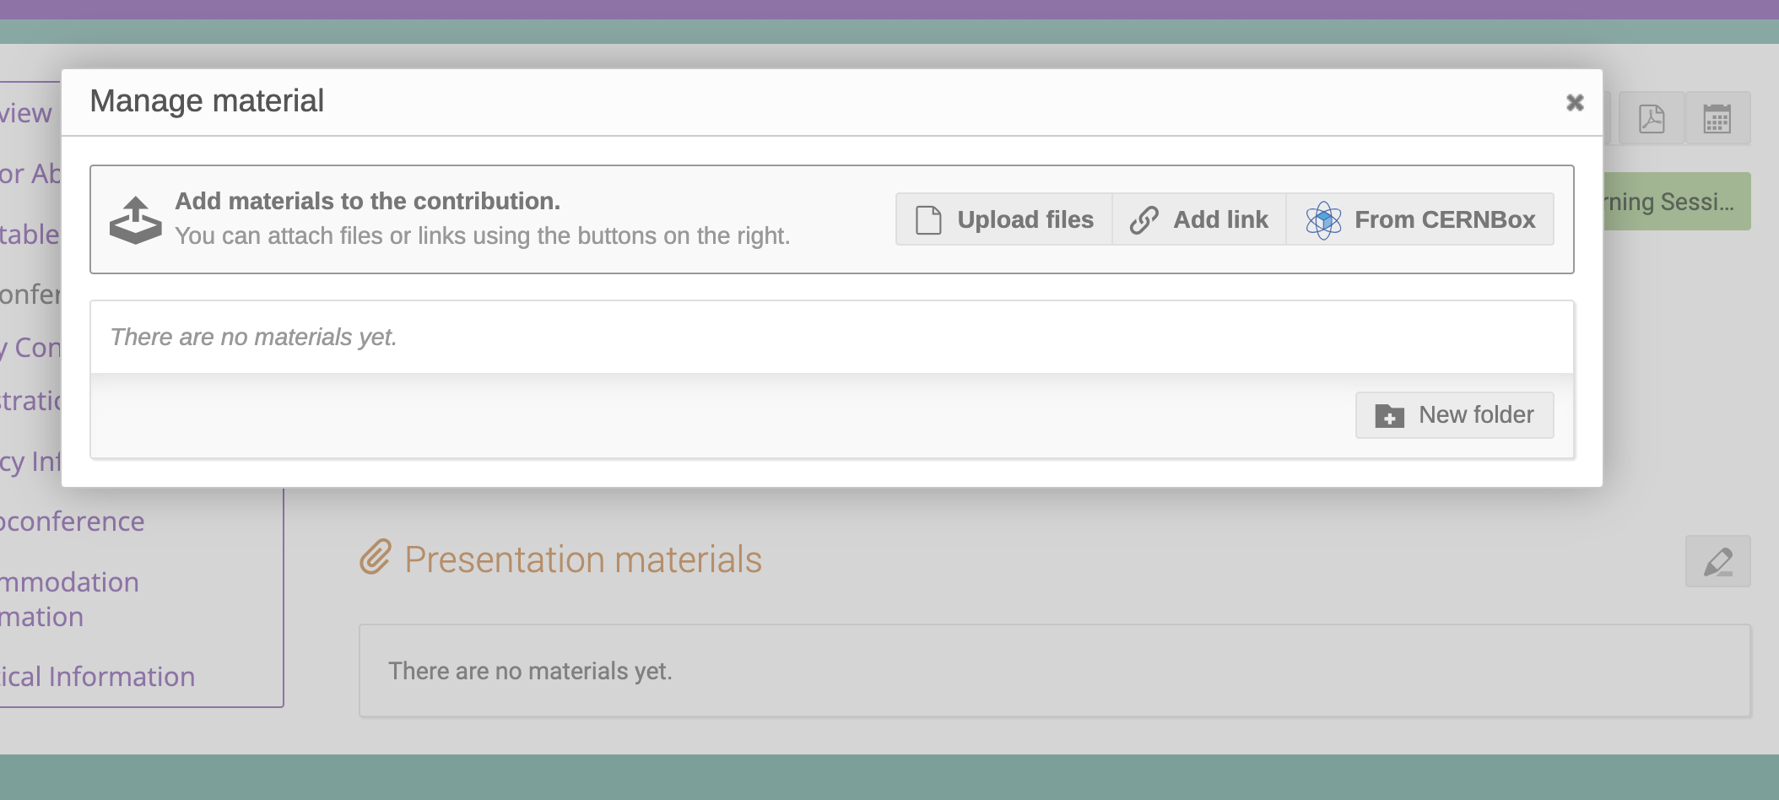
Important: Speakers
Please upload your slides to your Indico contribution on the event!

Slide 11
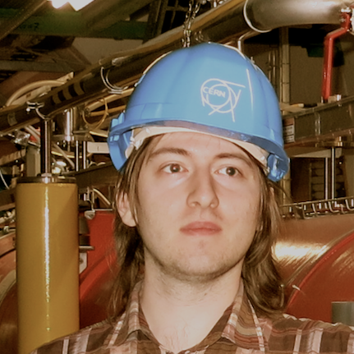
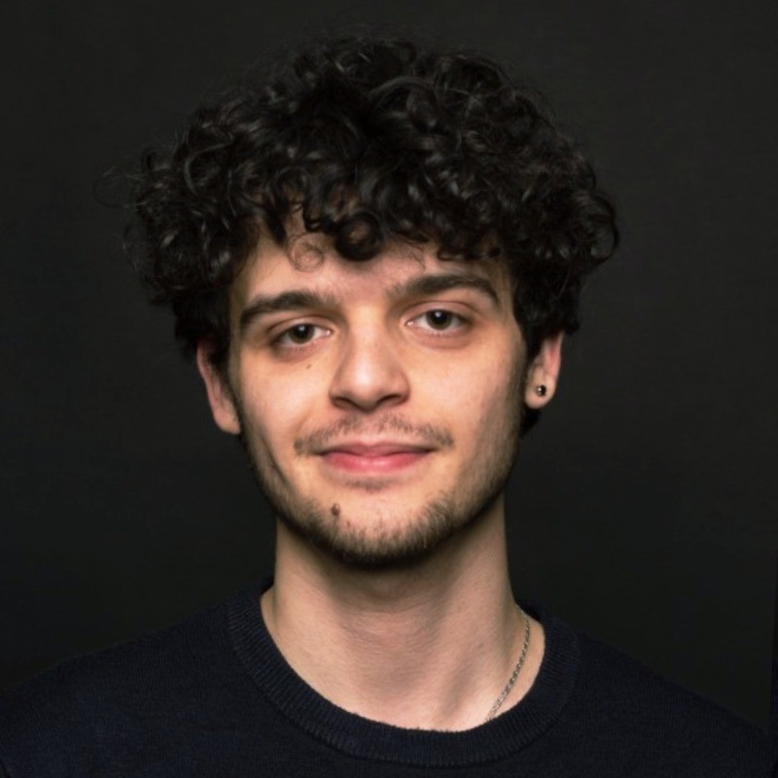
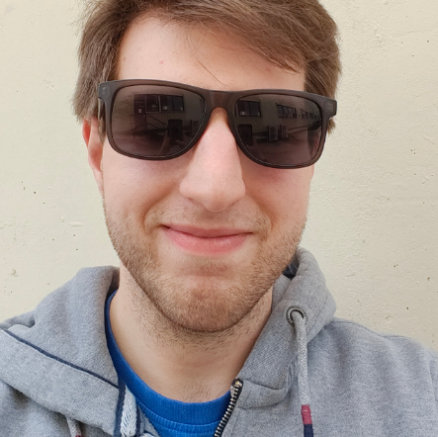
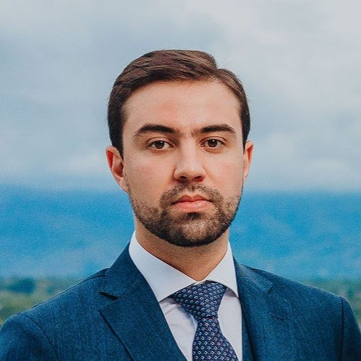
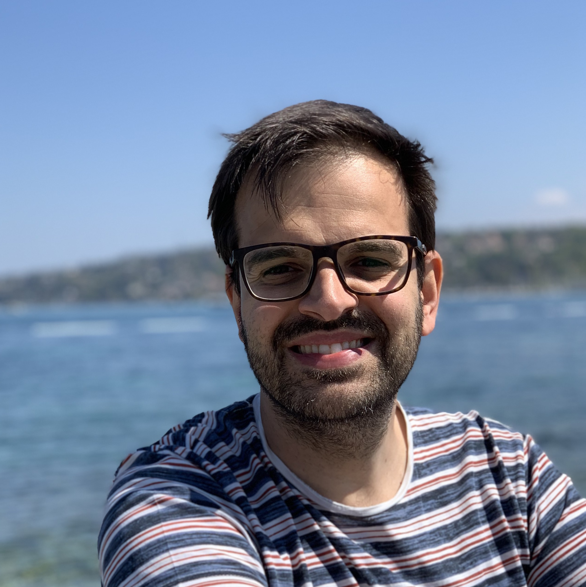
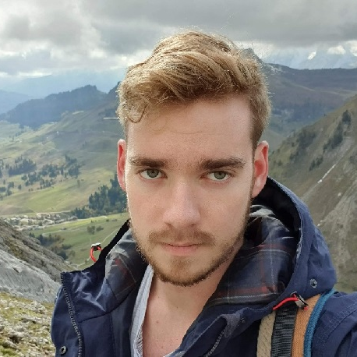
Meet the Team
Adrian
Ajob
Dominic
Michel
Pedro
Tomas

Slide 12
Thank you, have fun!
Questions?

