Slide 1
Overview WP2
Quantum materials 0, 1 & 2D
Focus on nanoscintillators
Christophe Dujardin
Institut Lumière Matière
University Lyon 1 & CNRS
Anna Paola Caricato
University of Salento

Slide 2
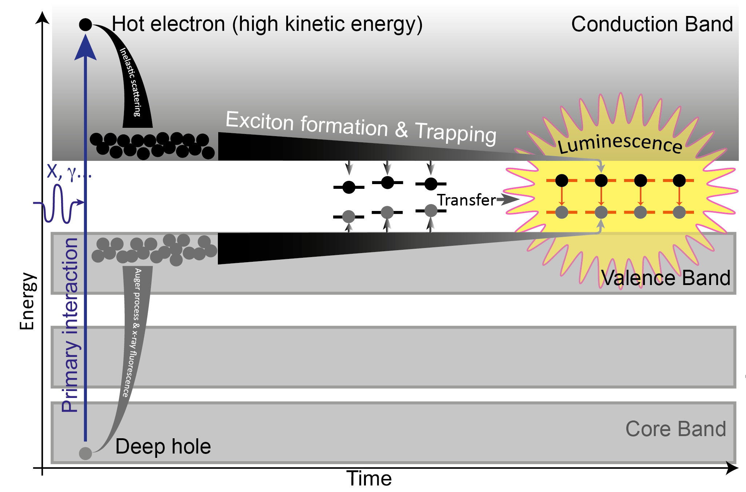
Introduction: What is scintillation?
A complex energy relaxation scheme.
Requires solid state description (excitons, phonons… not taken into account in GEANT4)
At the end of the process, the deposited energy is shared among : Light- Heat & Storage
The timing: first stage in the ps regime and ligth can be emitted days afterwards.
For calorimetry, scintillator are generally bulk (crystals) to ensure stopping power.
Important properties are: density (stopping power), Scintillation yield (Ph/MeV), timing (depends on the targetted application.

Slide 3
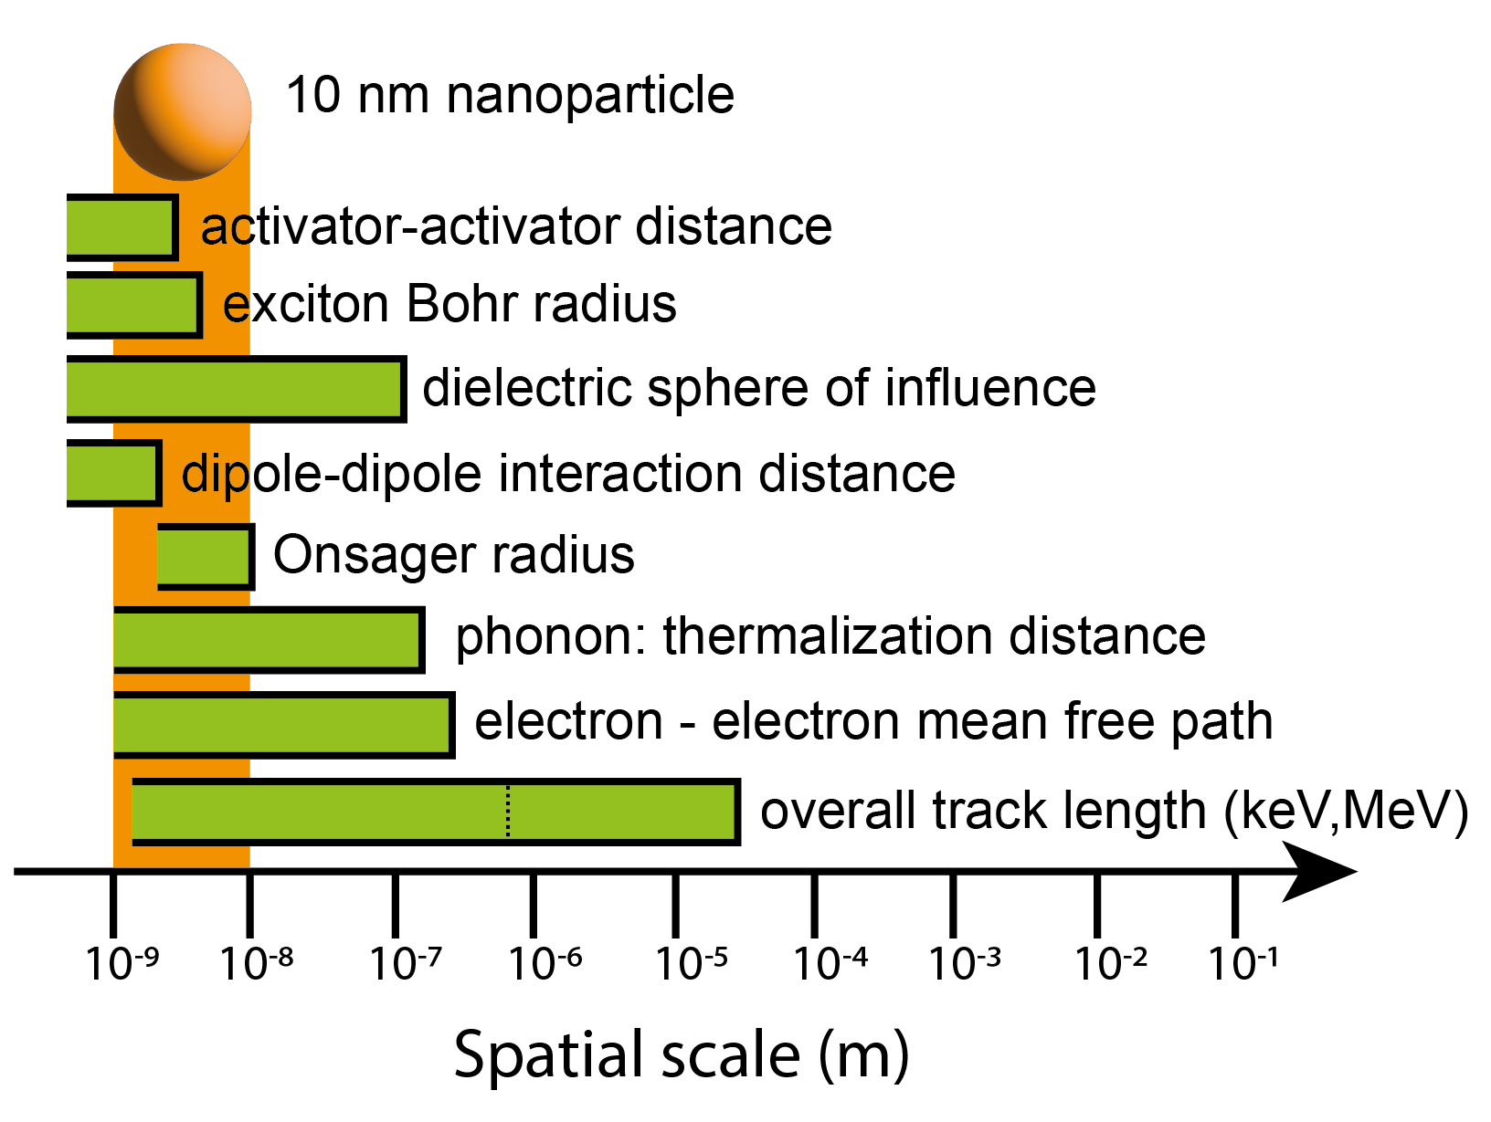
Scintillation at the nanoscale: what are the differences?
Most of the characteristic distances are larger than 10nm

Slide 4
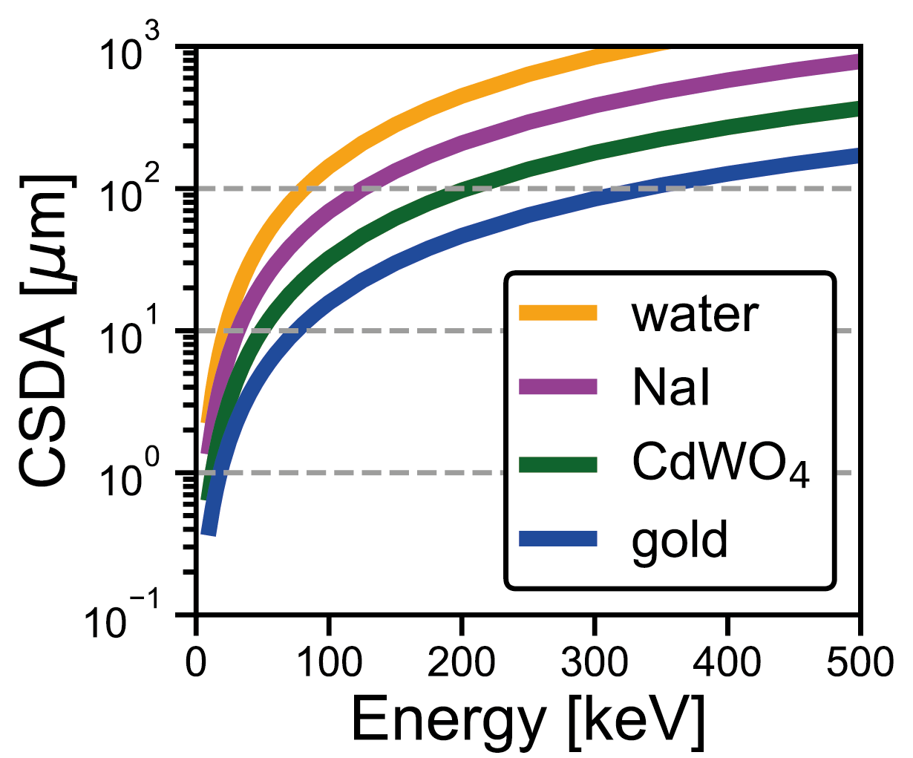
Scintillation at the nanoscale: what are the differences?
Even in the keV regime, penetration depth of electrons is larger than the NP size.

Slide 5
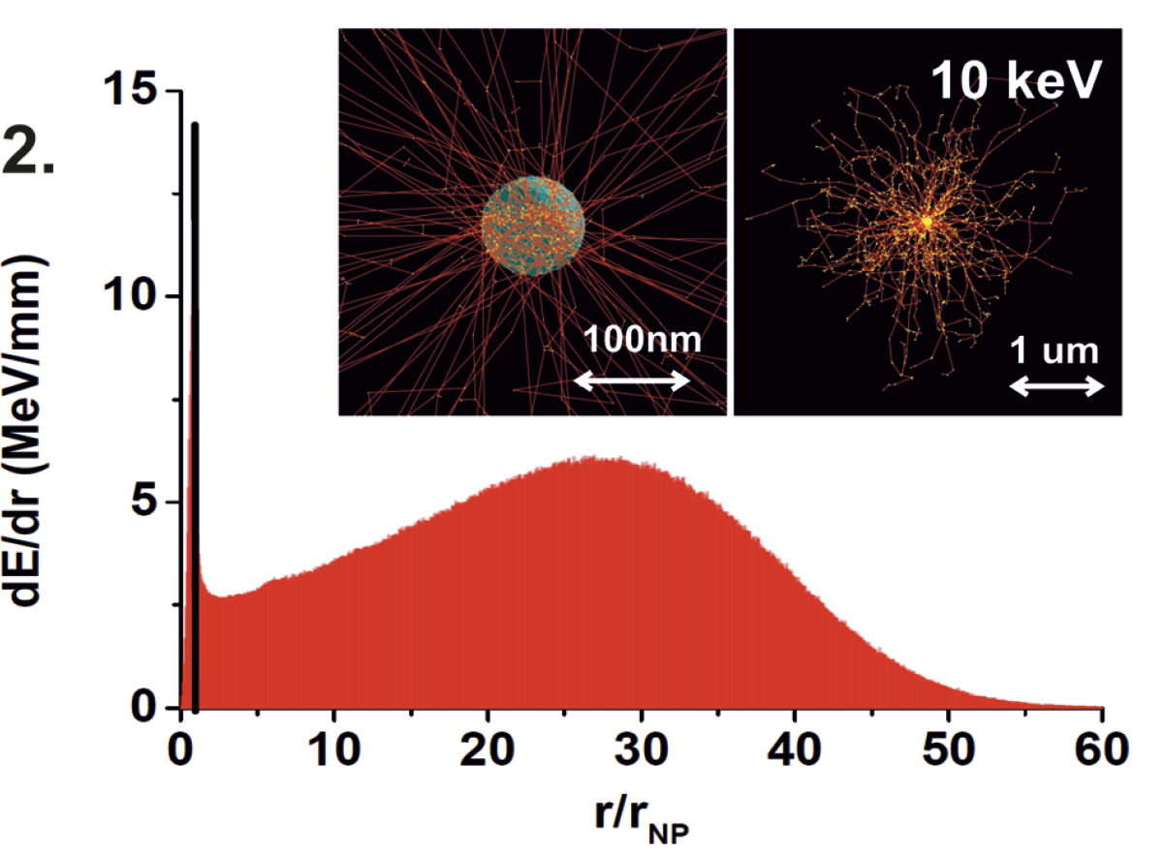
Scintillation at the nanoscale: what are the differences?
GEANT4 on a 10 nm NP, with 10keV electron… in the range of 1% of effective energy deposition
Bulin, nanoscale, 2015

Slide 6
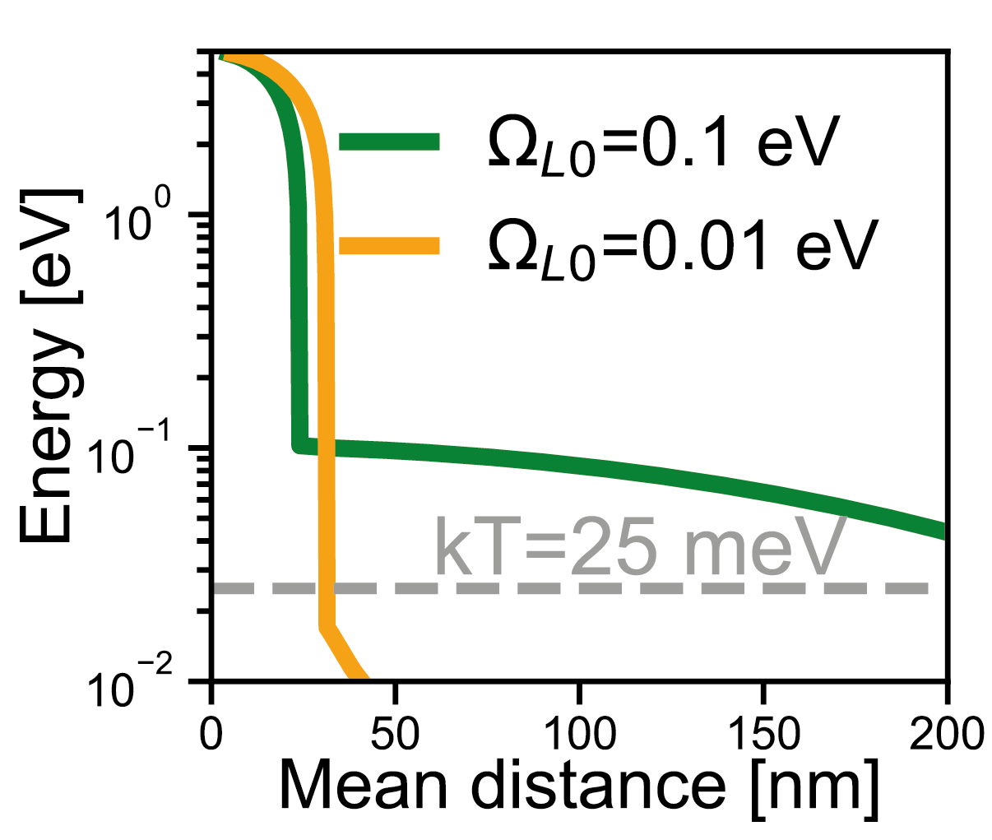
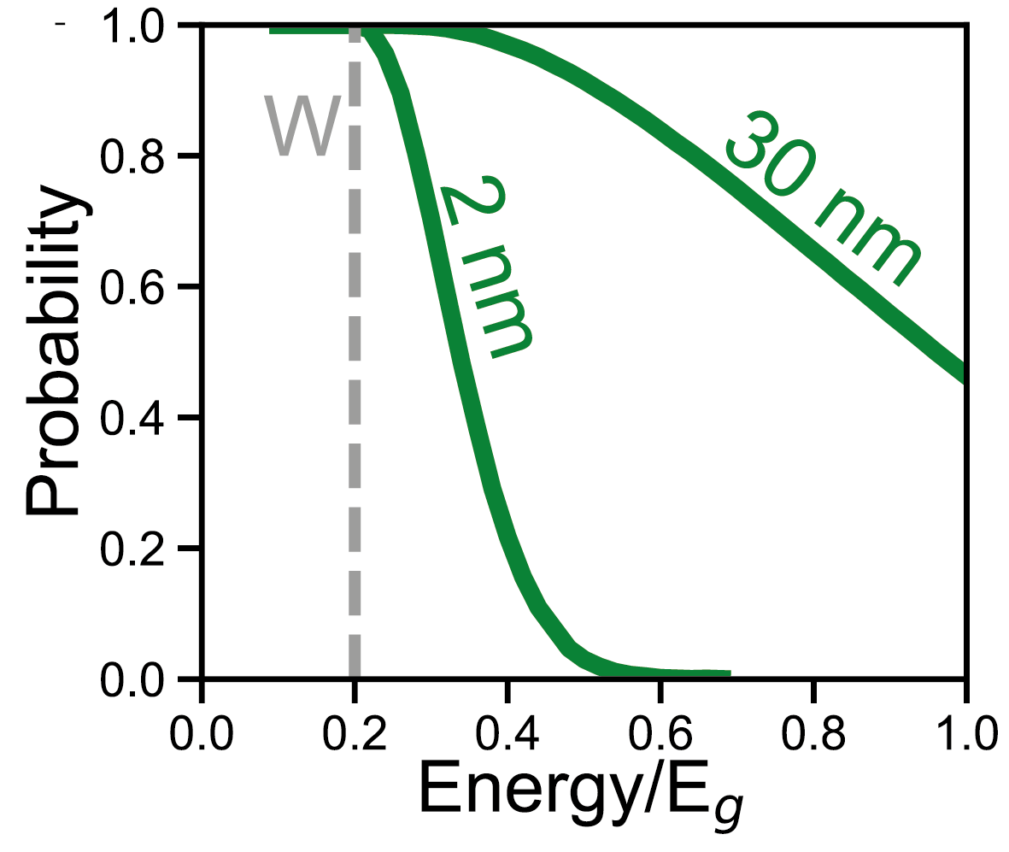
Scintillation at the nanoscale: what are the differences?
Escape occurs even during the heat generation stage
Kirkin, IEEE TNS 2012
Dujardin, Adv. Opt. Matter. 2025

Slide 7
Potential advantages of nanotechnologies
Material preparation:
The synthesis routes allow to prepare original shapes with preserved properties
(plastics, flexible, thin films, porous…)
Original emission properties (accelerated)
In quantum dots, accelerated emission may occur
Collective phenomena may accelerate the emission
Shapping the environment may lead to Purcell effect (acceleration)

Slide 8
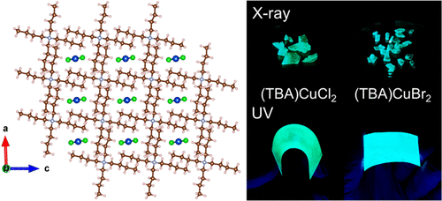
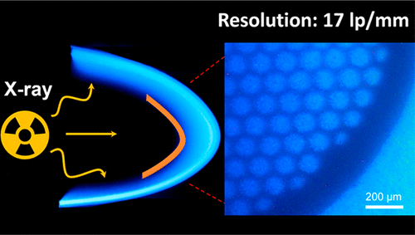
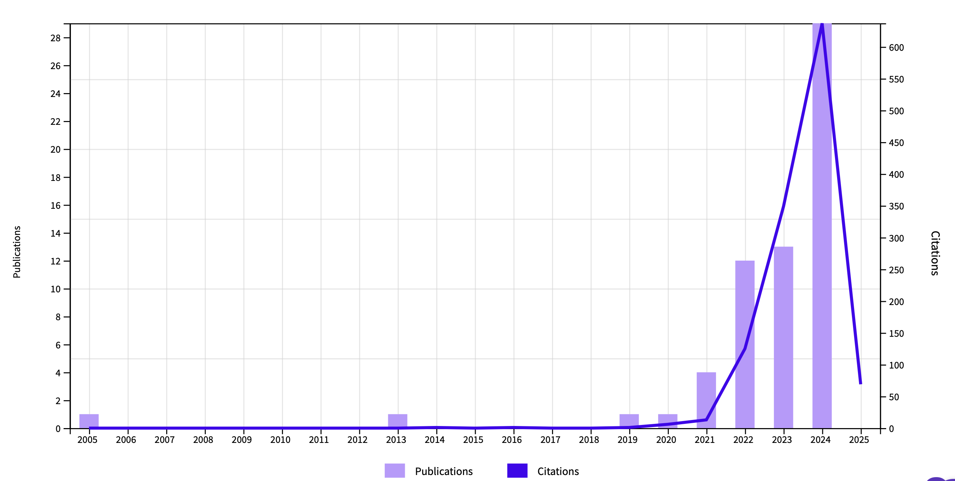
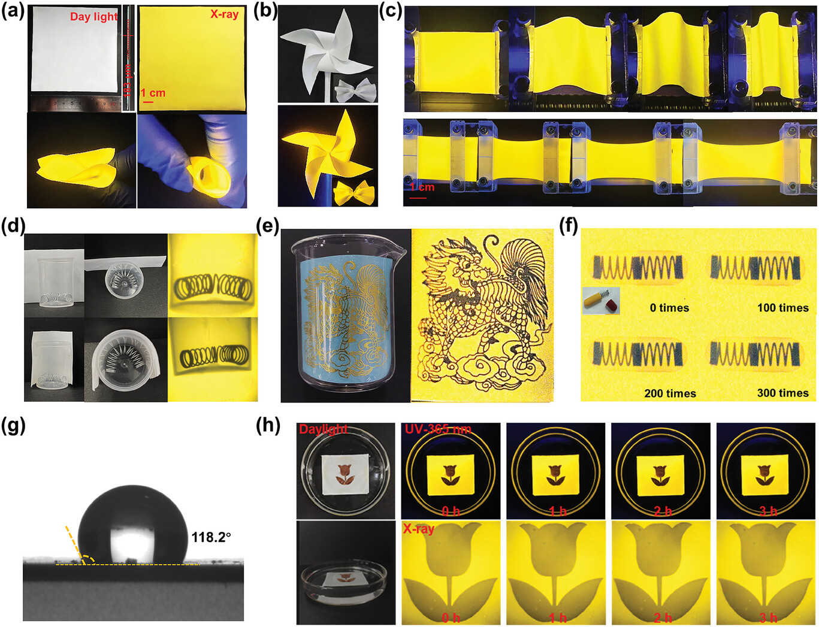
Material preparation: Plastics, flexible screens
PDMS loaded with efficient emitters
Flexible & X-ray screens
Flexible X-ray screen
Lian JPCL 2021
Zhou ACS Energ. Lett 2022
Meng, Adv. Func. Matter. 2024

Slide 9
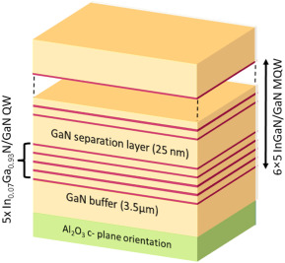
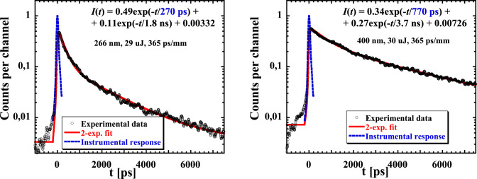
Material preparation: Ultra fast screens
Toci, J.Lum. 2019

Slide 10
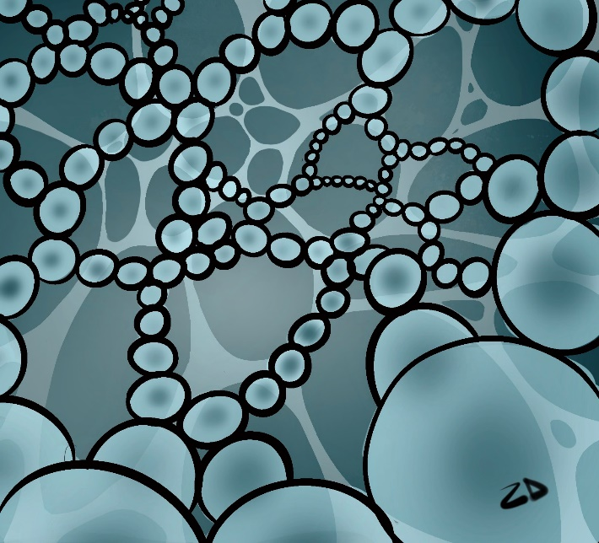
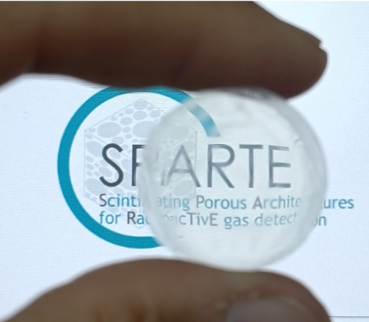
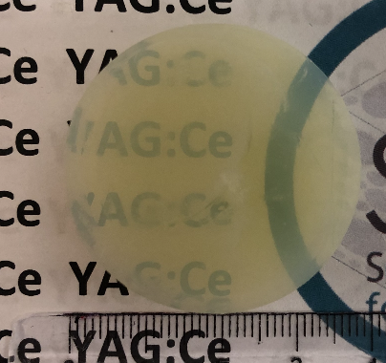
Material preparation: aerogels
Ultra-porous scintillators
Assembly of NP
YAG:Ce
for gaz detector purpose
Marie-Luce, Nat. Photon. 2024
Silica
Silica aerogels are used for beam monitoring -> adding scintillation?

Slide 11
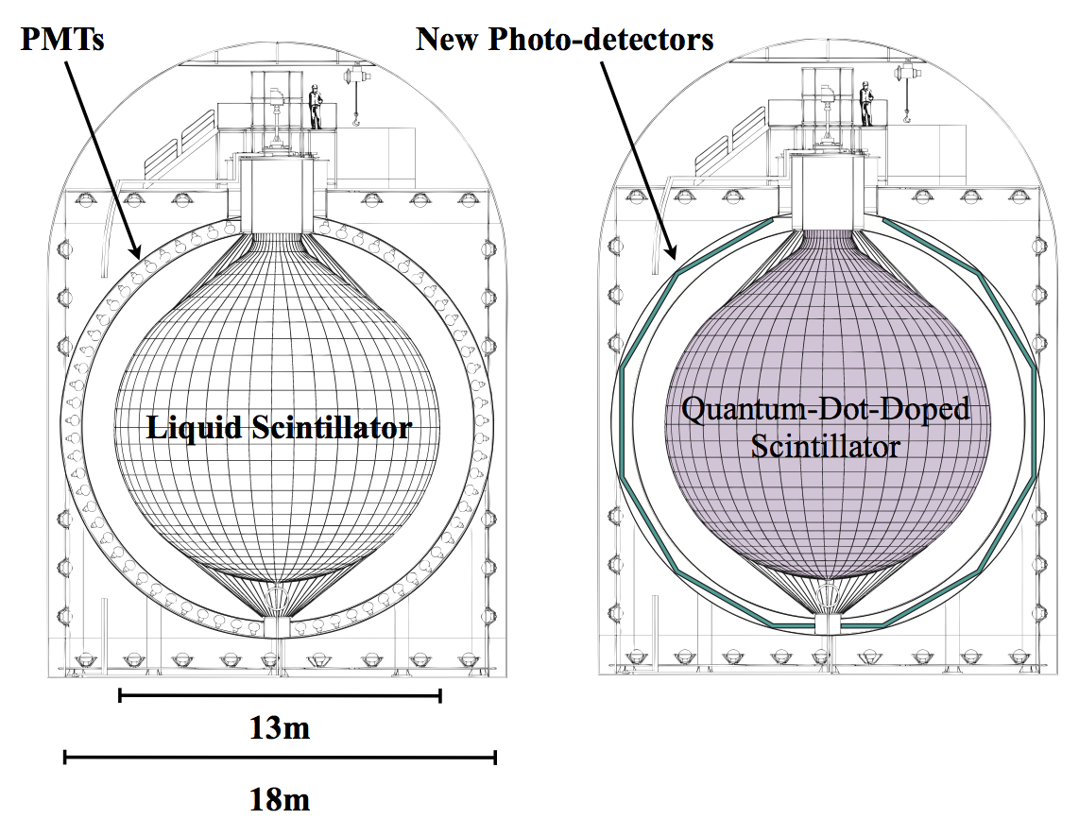
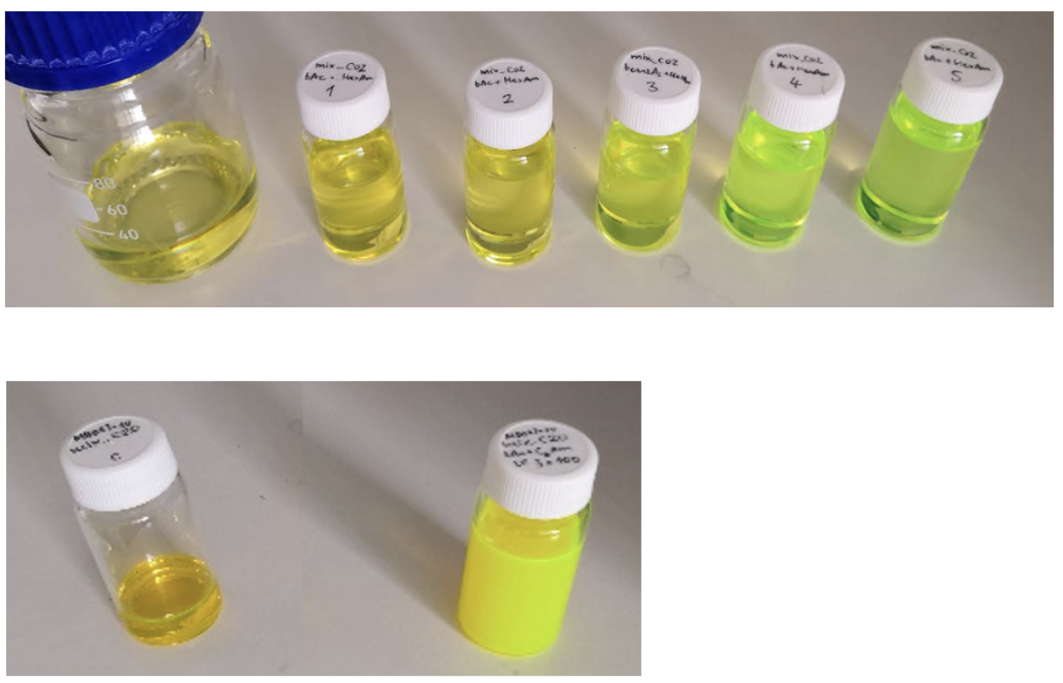
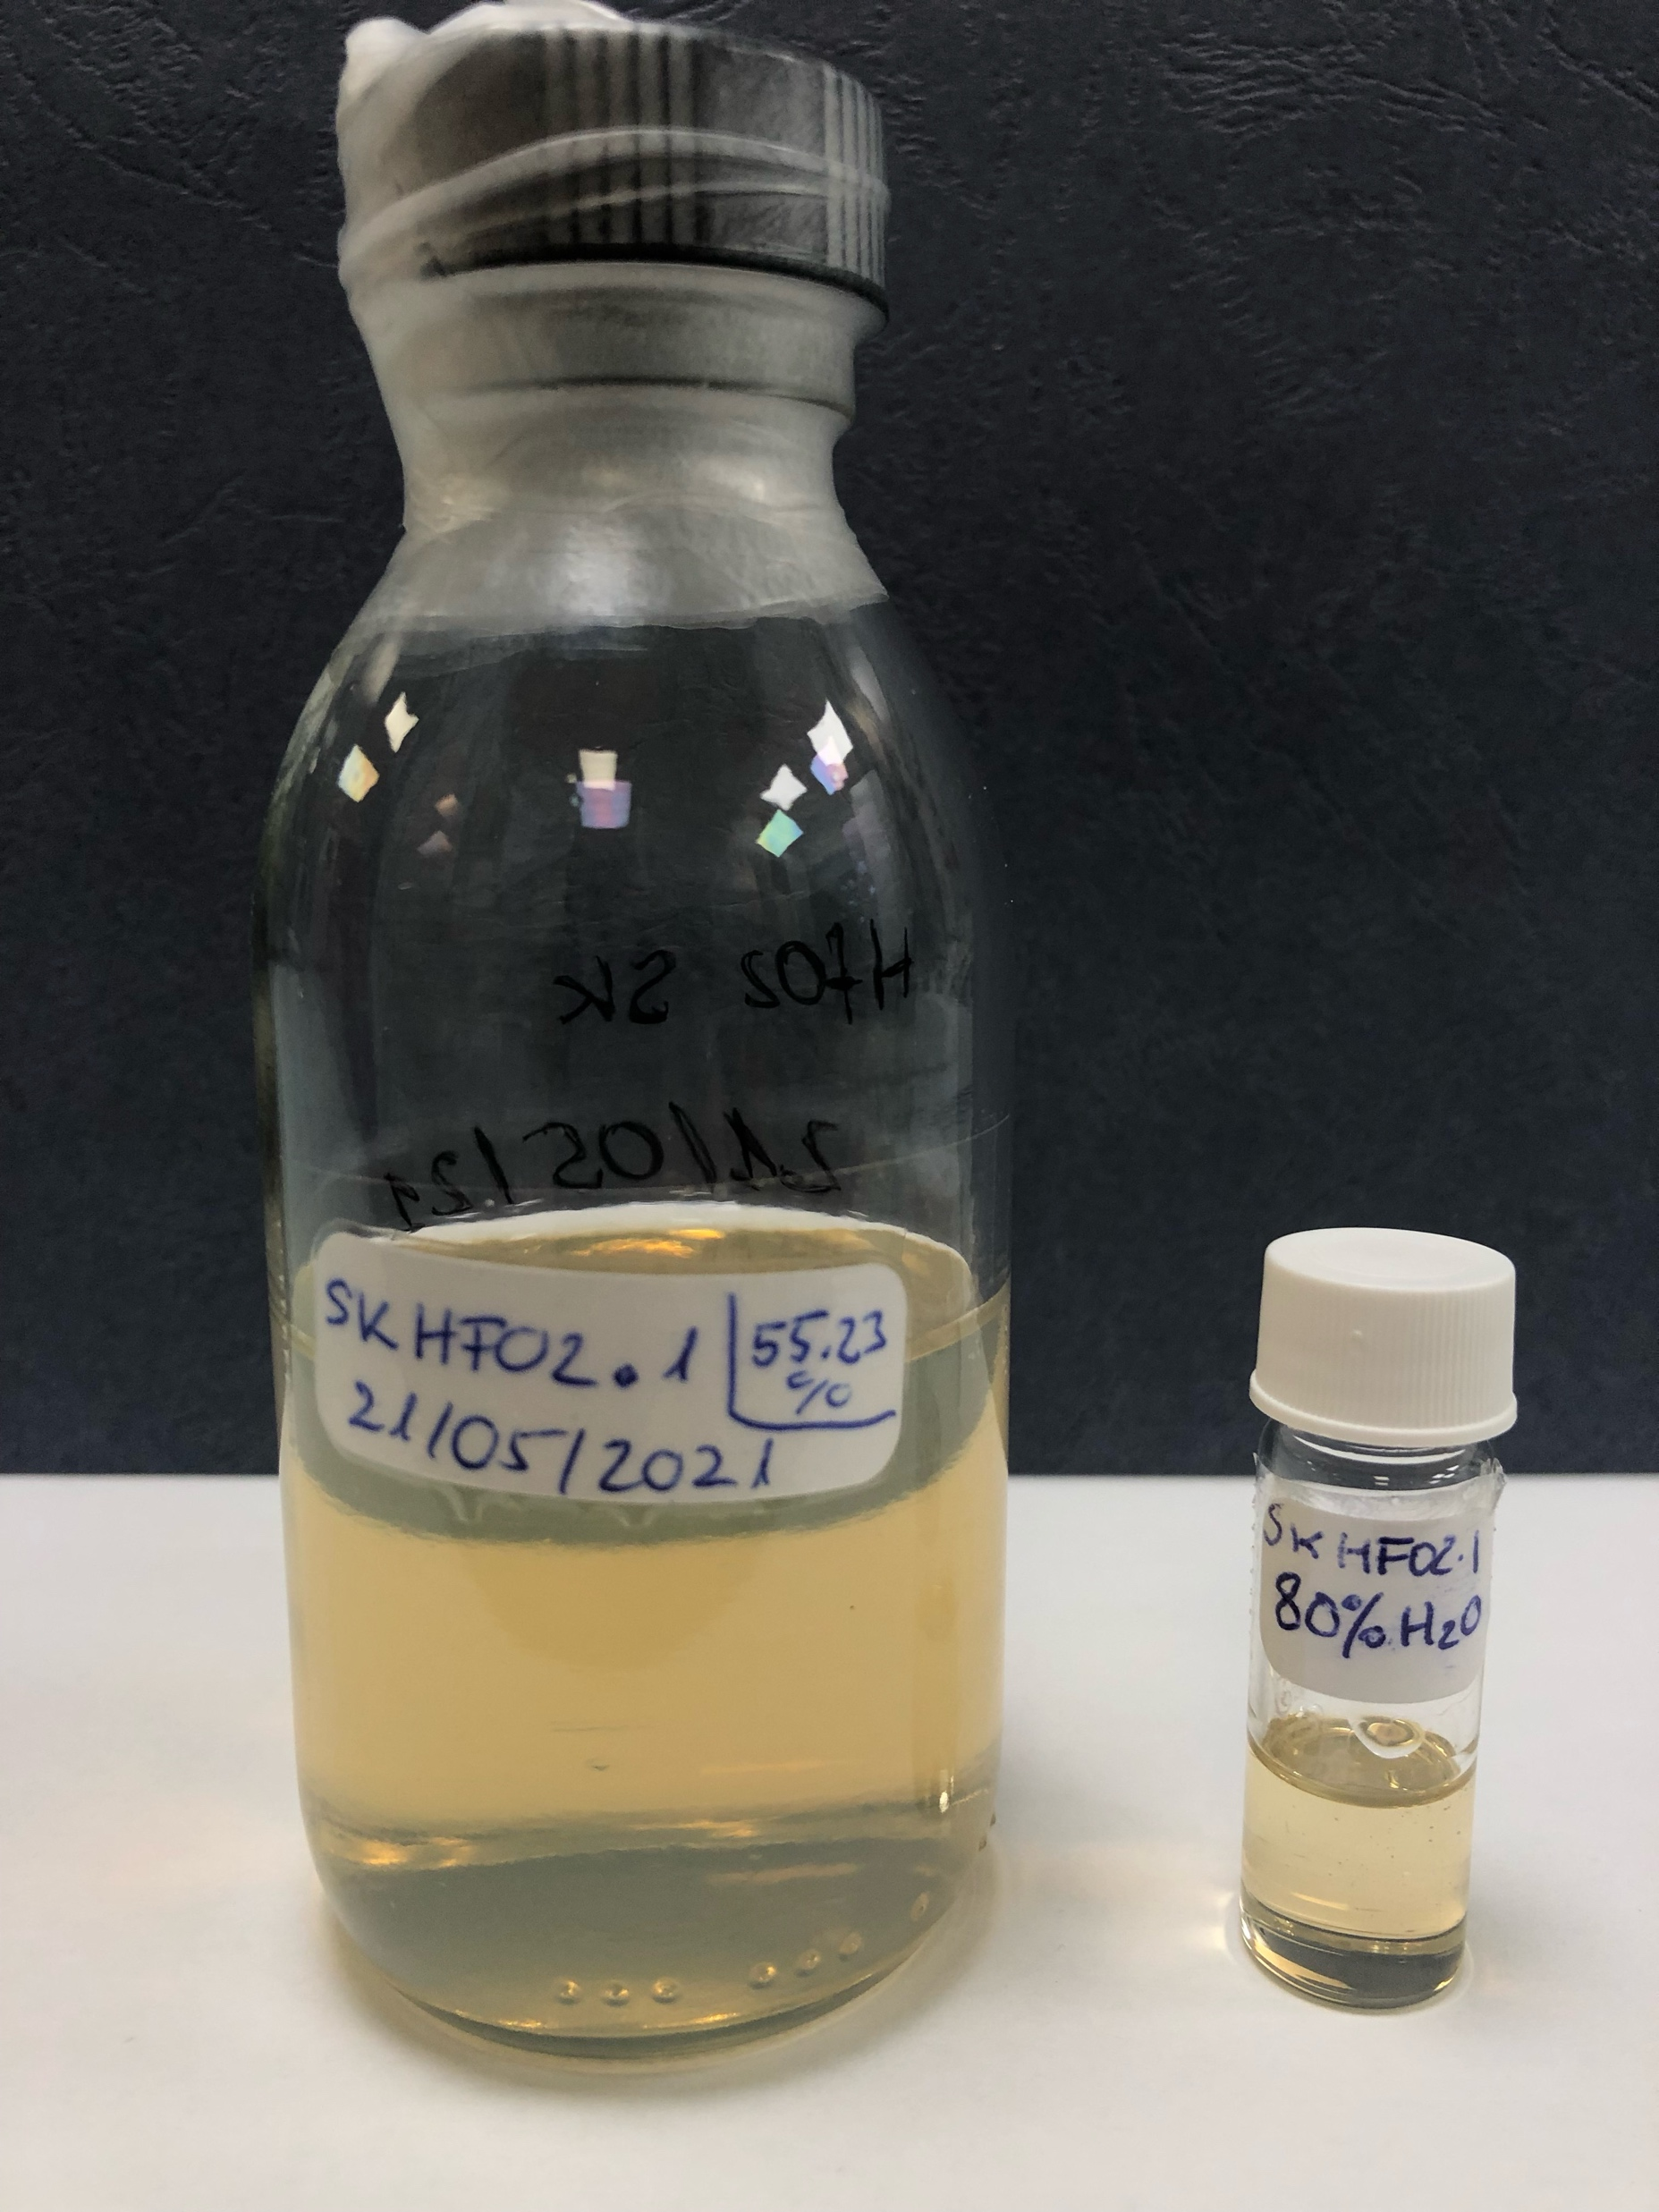
Material preparation: Liquid Scintillator (LS)
Ultra dense Liquid
HfO2 loading d=(2.5)
It includes targets (Cd) for neutrino
Other class of Liquid Scintillator
Baravaglio, Nanoscale 2024
Winslow, JINST 2012
Courtesy F.Chaput
Rather unexplored area, Nanoscintillators in liquid for Calorimetry

Slide 12
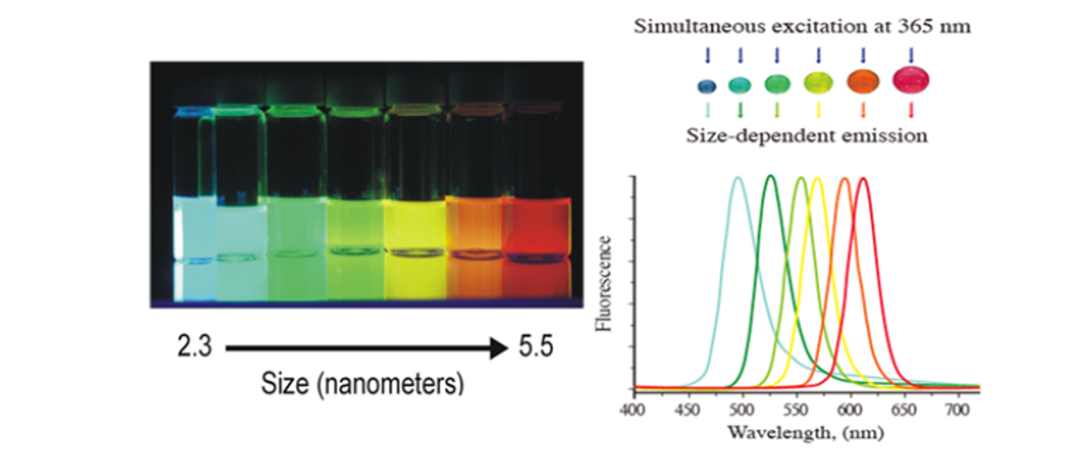
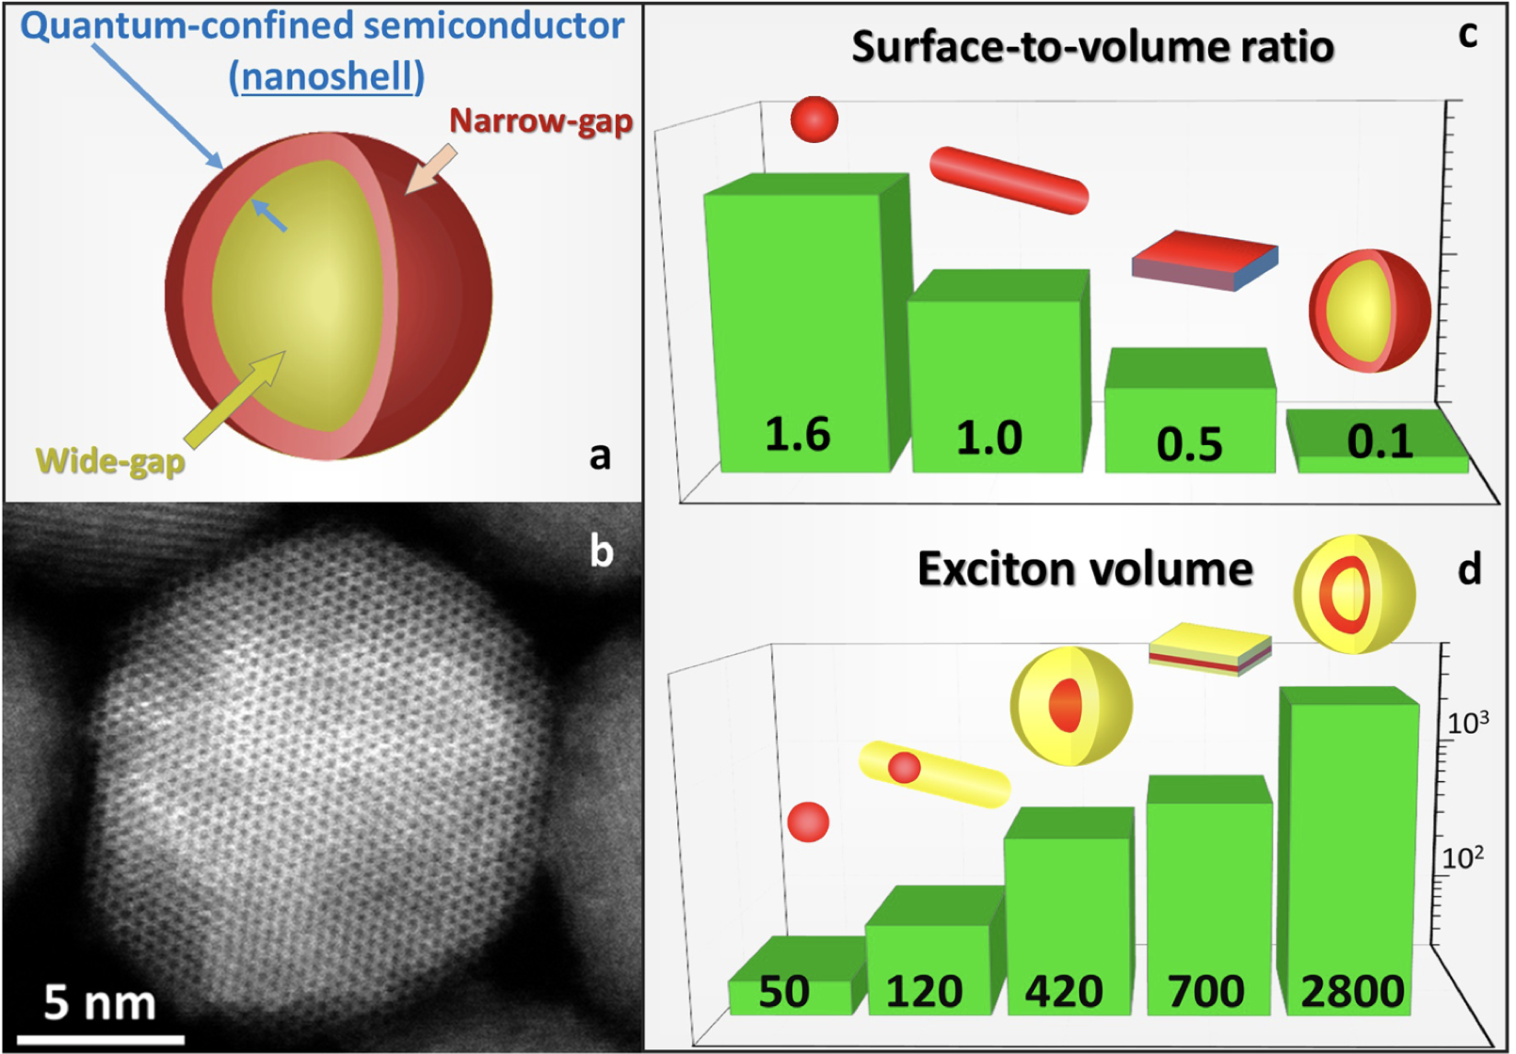
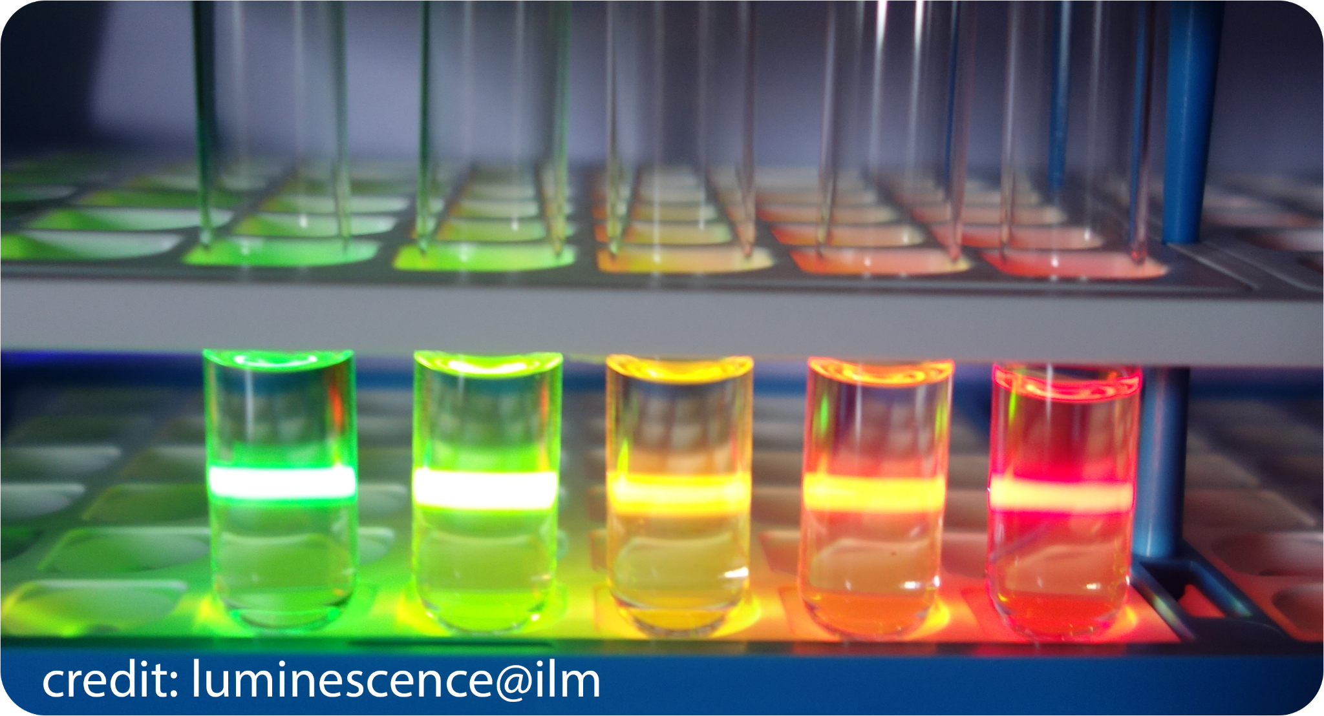
Multicolor emissions
Quantum effects in 0D materials
Quantum effects (90’s): Exciton confinement (emission rate, wavelength…)
core shell structure (effect of the shell on the electron & hole wavefunctions)
Size effect
Shell effect
Kholocheva, ACS Photonics 2024

Slide 13
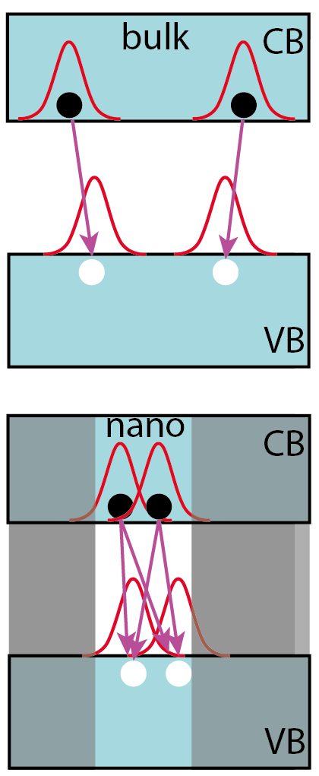
Accelerated emissions: multiexcitons
In nanosystems, ultra fast emissions may occur: multiexciton generation (MEG)
τ_{X0}, τ_{XX}= τ_{X0} /4, τ_{XX} = τ_{X0} /9…
Here Spherical QuantumWells
Meng, Nanoscale 2021

Slide 14
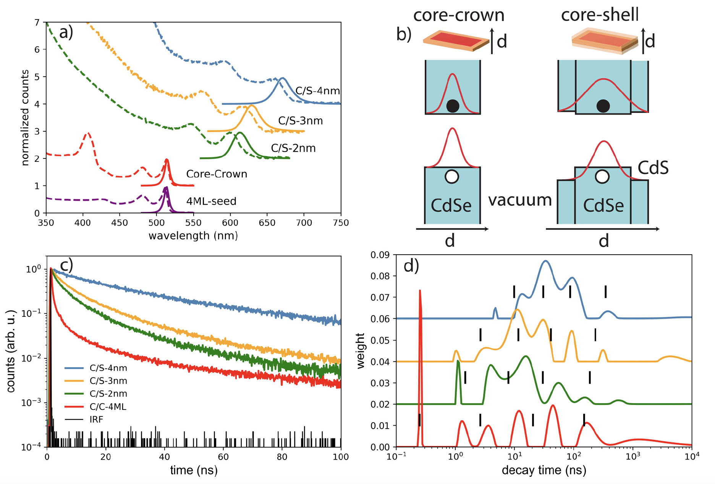
Accelerated emissions: multiexcitons
The same effect in 1D materials (Nanoplatelets)
Meng, Mat. Adv. 2022

Slide 15
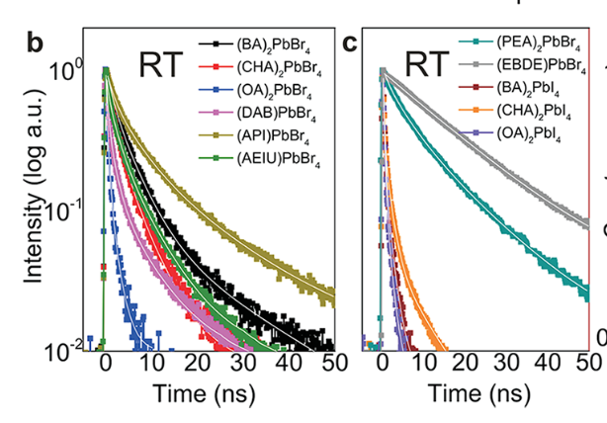
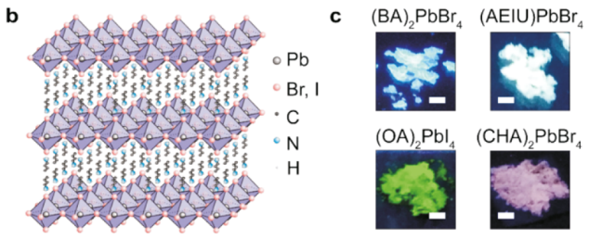
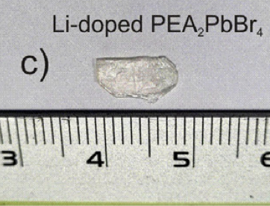
Fast emission also in 2D materiels
2D perovskites: combine bulky crystals and benefit of 2D confined systems
Xie et. al. Chem. Mat. 2020

Slide 16
Combination with dense matrix
But nanoscintillators cannot be used alone (problem of stopping power): metamaterials

Slide 17
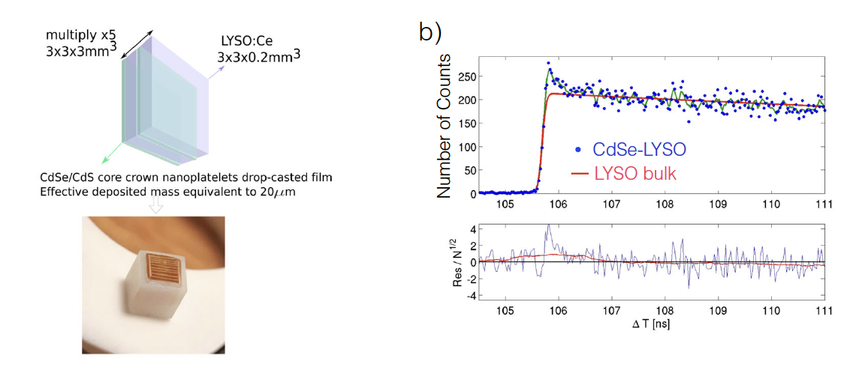
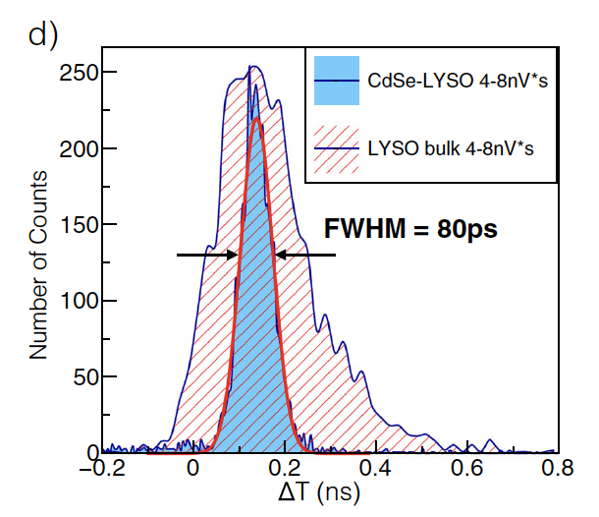
Combination with dense matrix
Example of assembly of bulk combined with Nanoplatelets: energy sharing demonstration
Turtos et. al. NPJ-2D 2019

Slide 18
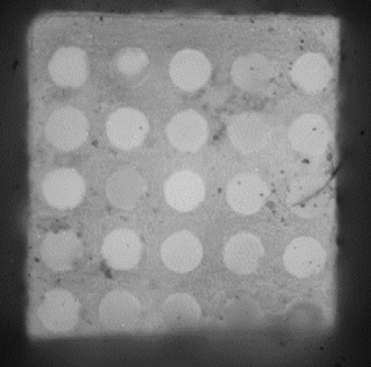
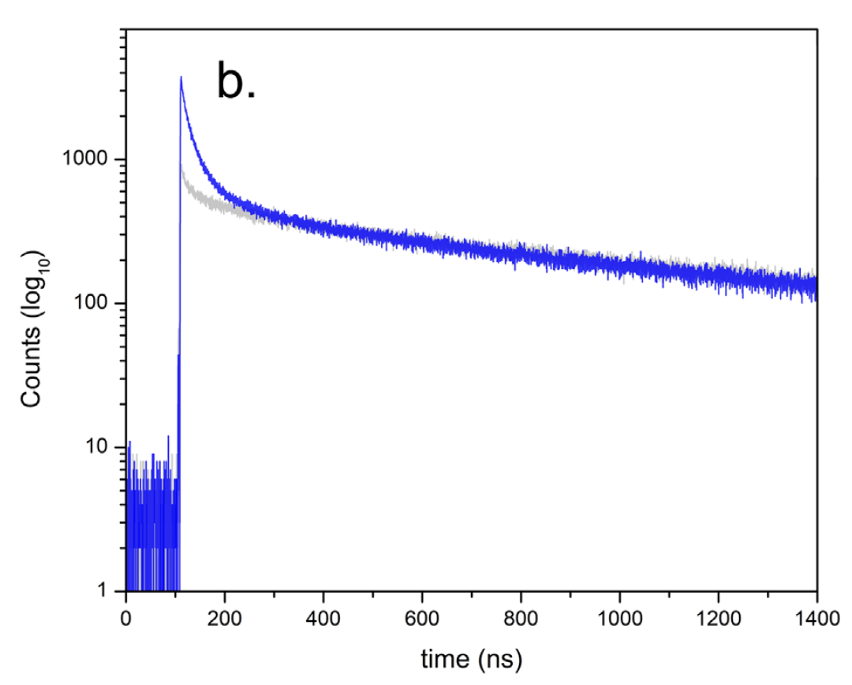
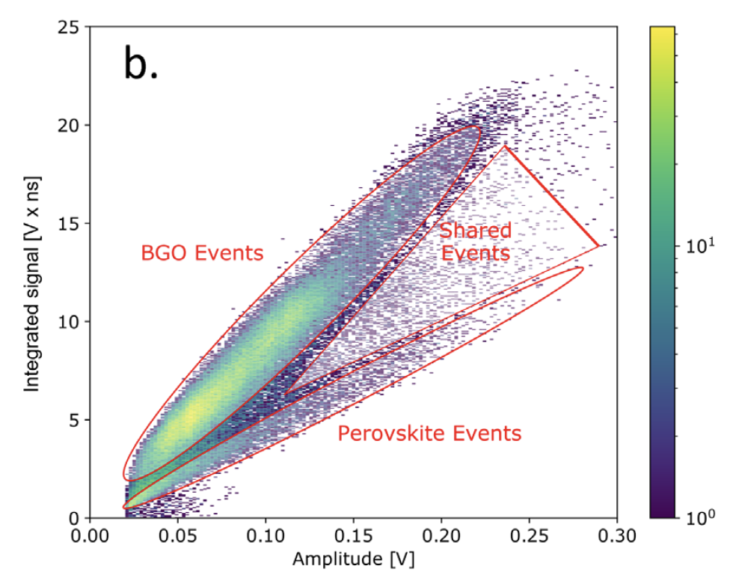
Combination with dense matrix
But it cannot be used alone (problem of stopping power): metamaterials
BGO crystal
extra fast photons (under x-rays)
shared events (γ-rays)
2D perovskites
Rogers et. al. APL 2022

Slide 19
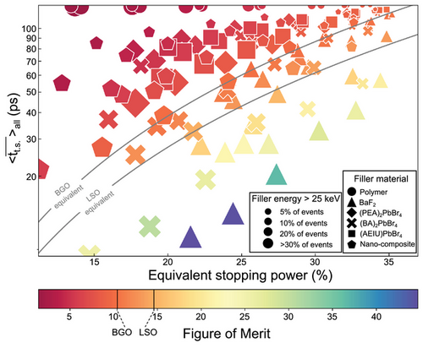
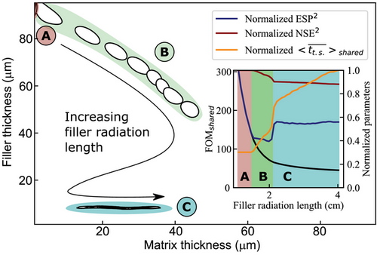
Many combinations are possible
But it is very time consuming to test every parameter
A nice monte carlo simulation paper (oriented TOF-PET)
Krause, Adv Theory and Simulations 2024

Slide 20
Some numbers…
CTR α sqrt (τ_{D}/N)
Lets start with LSO (20ph/keV, 40ns)
Assume 90% of the energy in LSO, and 10% in a « ultra fast nano* » (1ns for the ex.)
460 keV in LSO
51keV in nano*
(τ_{D}/N)_{LSO}=(τ_{D}/N)_{nano*} if N_{nano}=500 (for 51keV)
To obtain a signicative CTR improvement, the effective scintillation yield of the nano* should largely exceed 10 ph/keV….

Slide 21
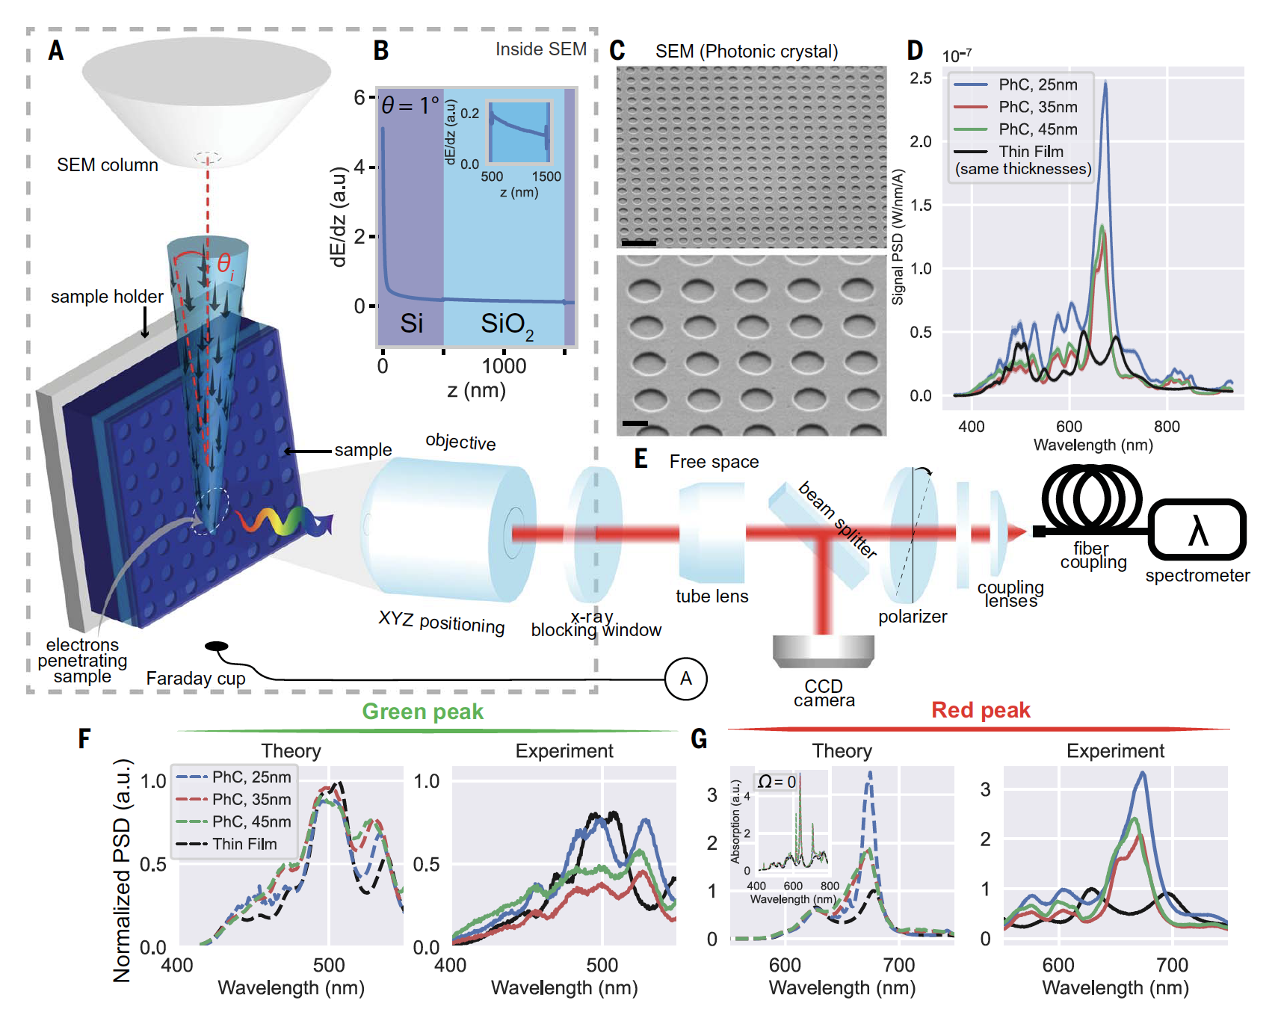
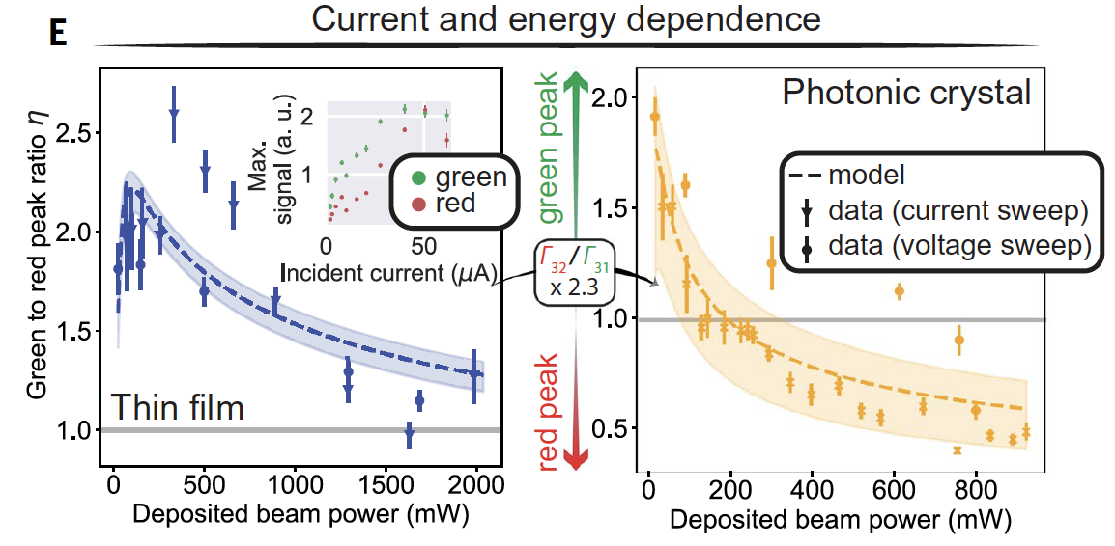
Purcell effect: nanostructure silica
Roques-Carmes, Science 2022

Slide 22
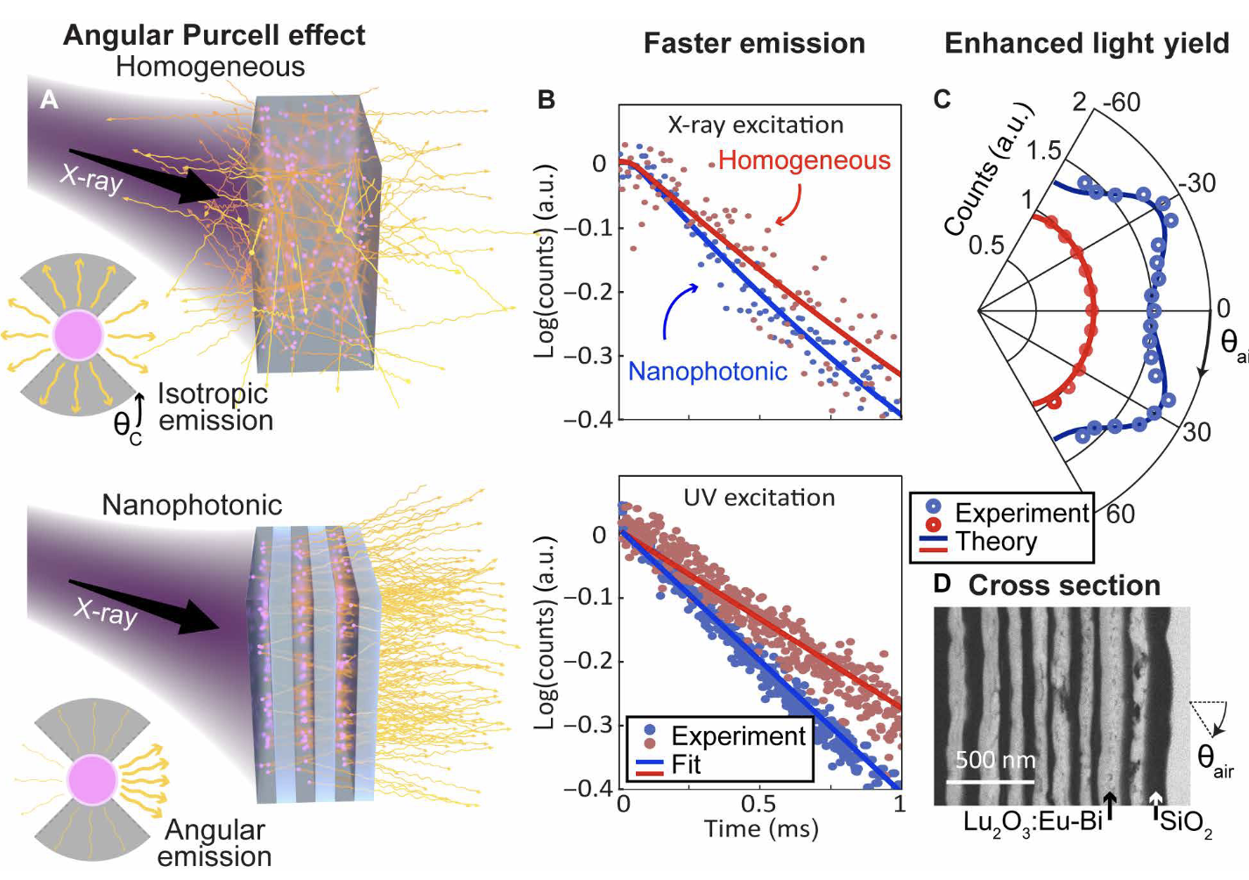
Purcell effect: modification of the radiation pattern
Kurman, Science advance 2024

Slide 23
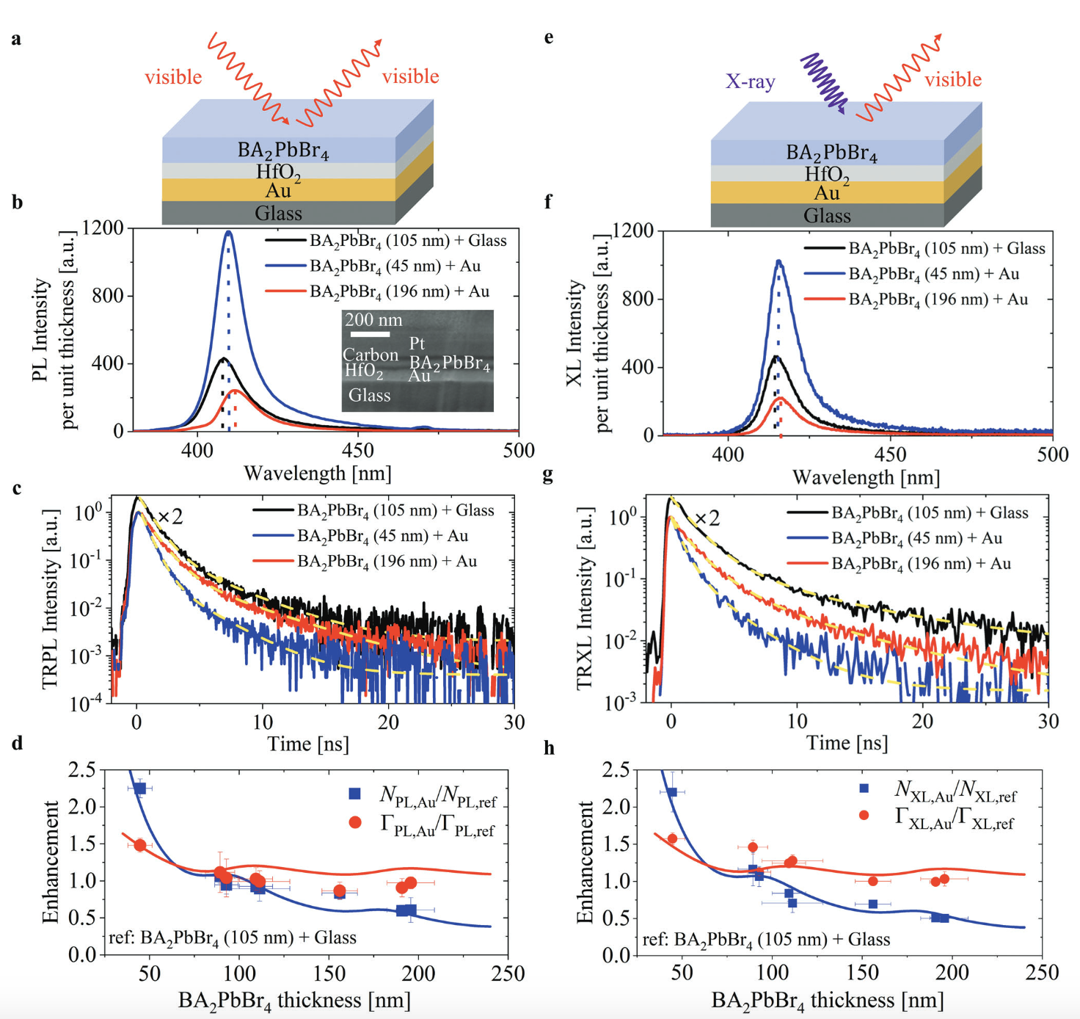
Purcell/Plasmonic effect: Accelerated time response
But 100nm thick…
Ye, Adv. Matter 2024

Slide 24
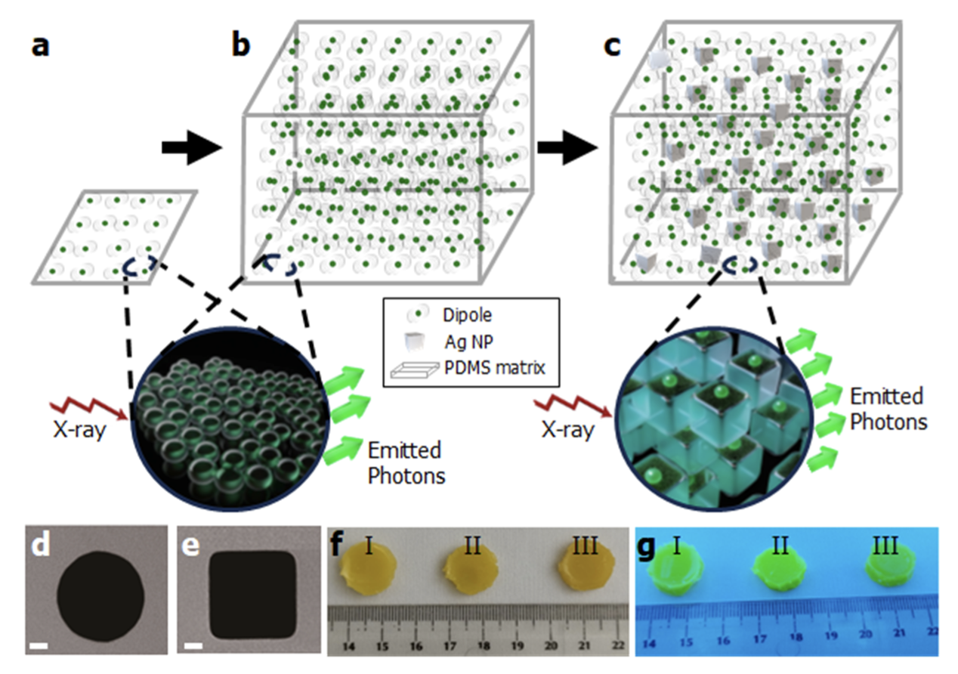
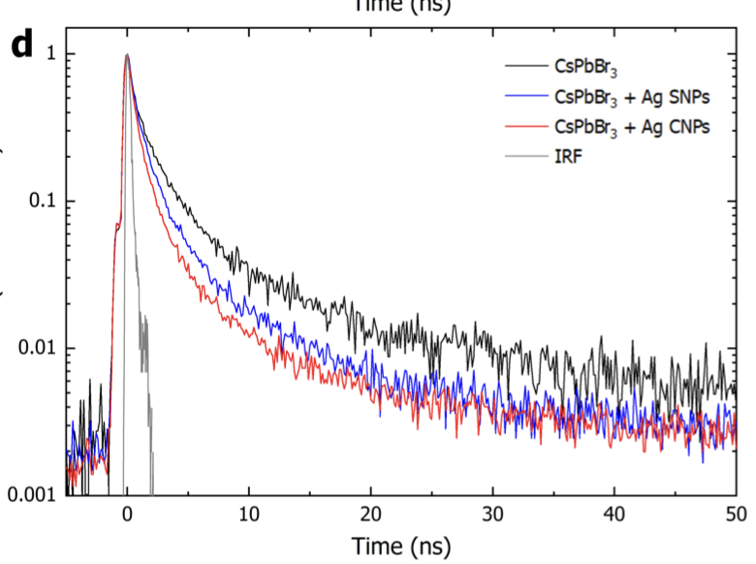
Purcell at « large » scale
Makowsky, Arxiv 2024

Slide 25
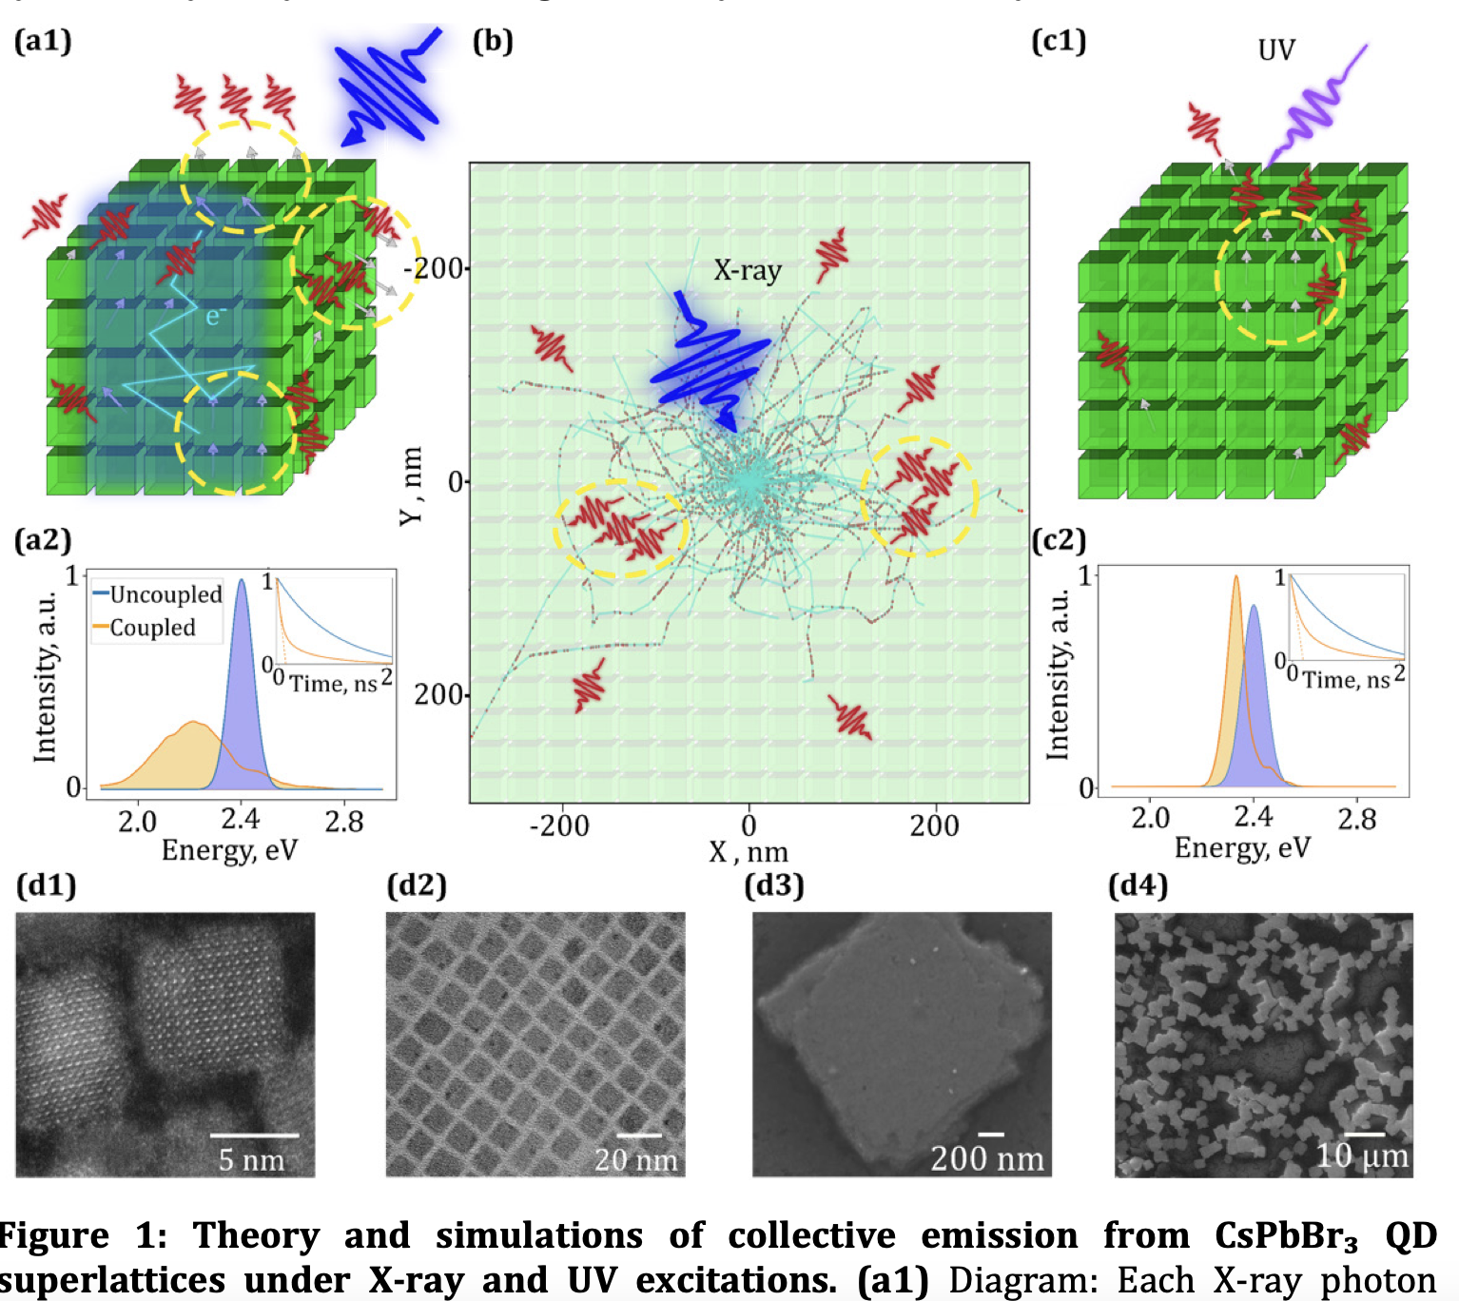
Superfluorescent scintillation: collective effect for fast emission
Katznelson, arxiv 2025

Slide 26
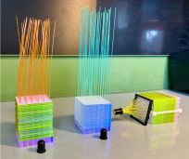
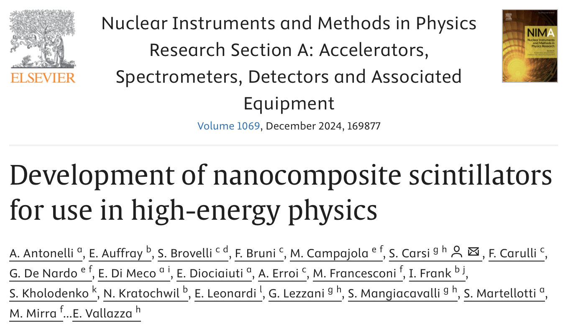
Targetting calorimetry

Slide 27
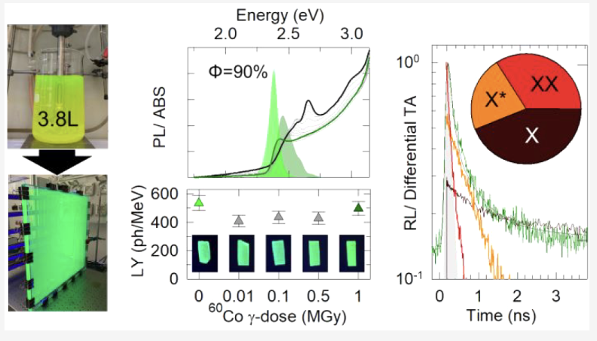
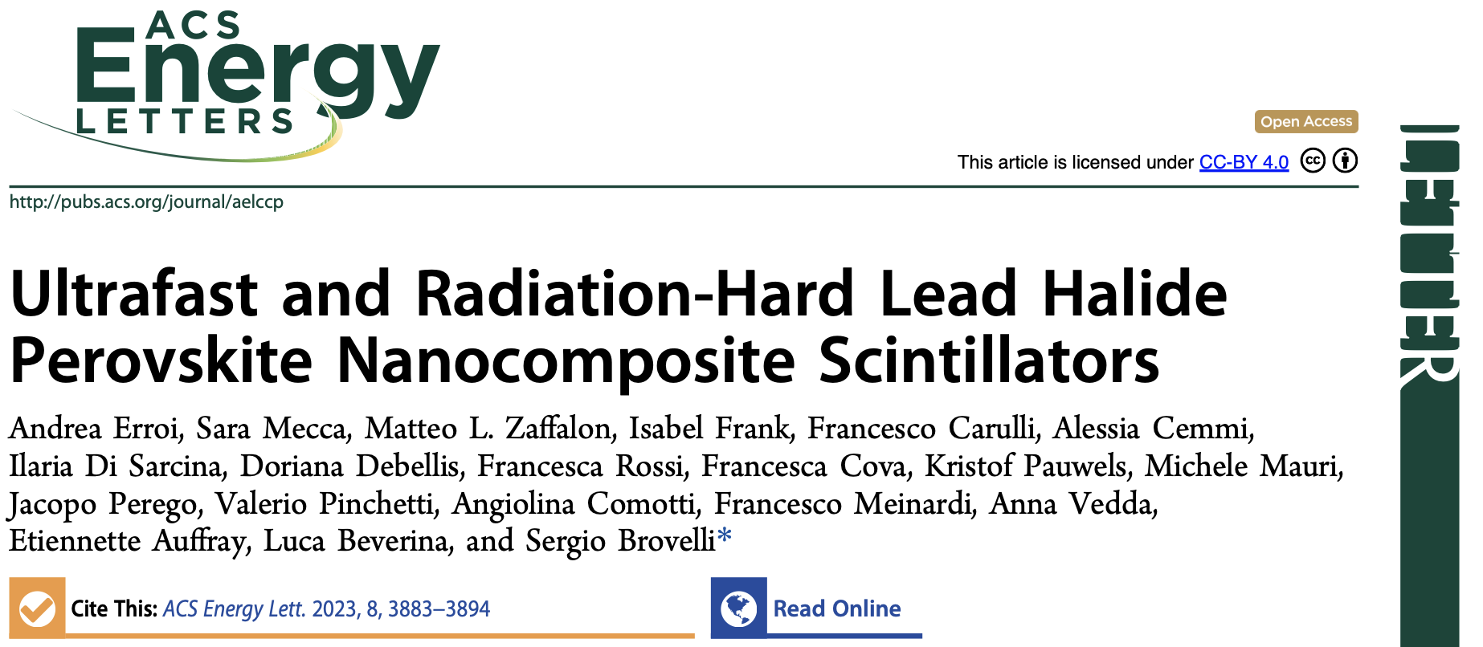
Targetting calorimetry: Radiation hardness

Slide 28
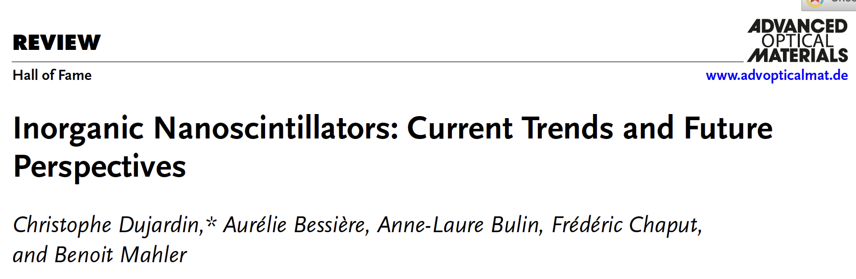
Concluding remarks about 0D,1D and 2D scintillators
The use of nanocrystals appears a bit contradictory: tiny objects to detect high energy particles
Effective media approach cannot be use to describe the systems
Nanoparticles are always embeded in media, which is never passive
Original developments at the lab scale

Slide 29
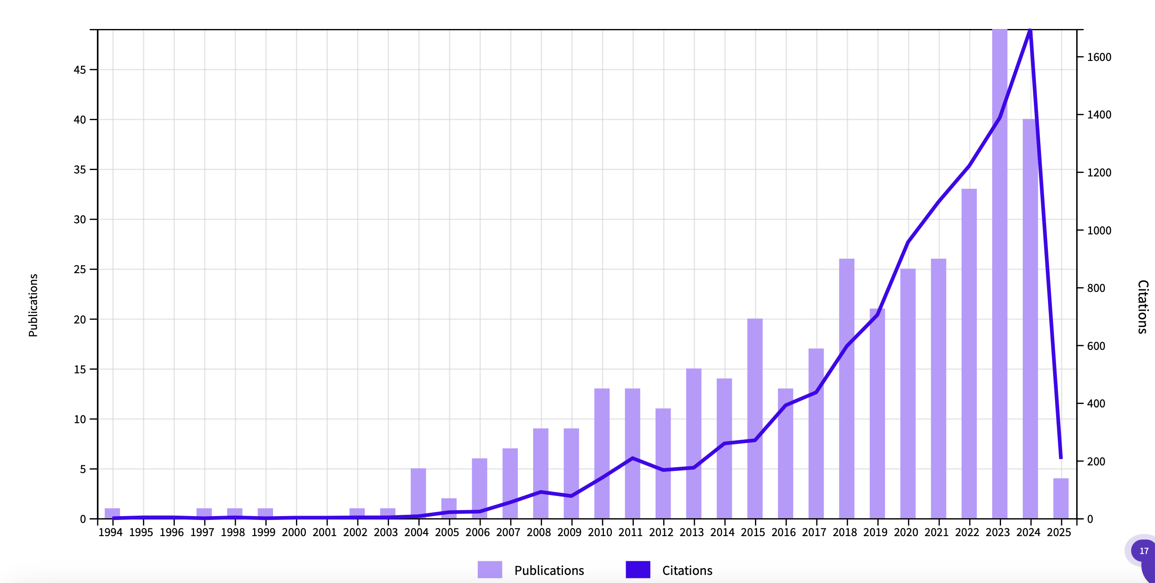
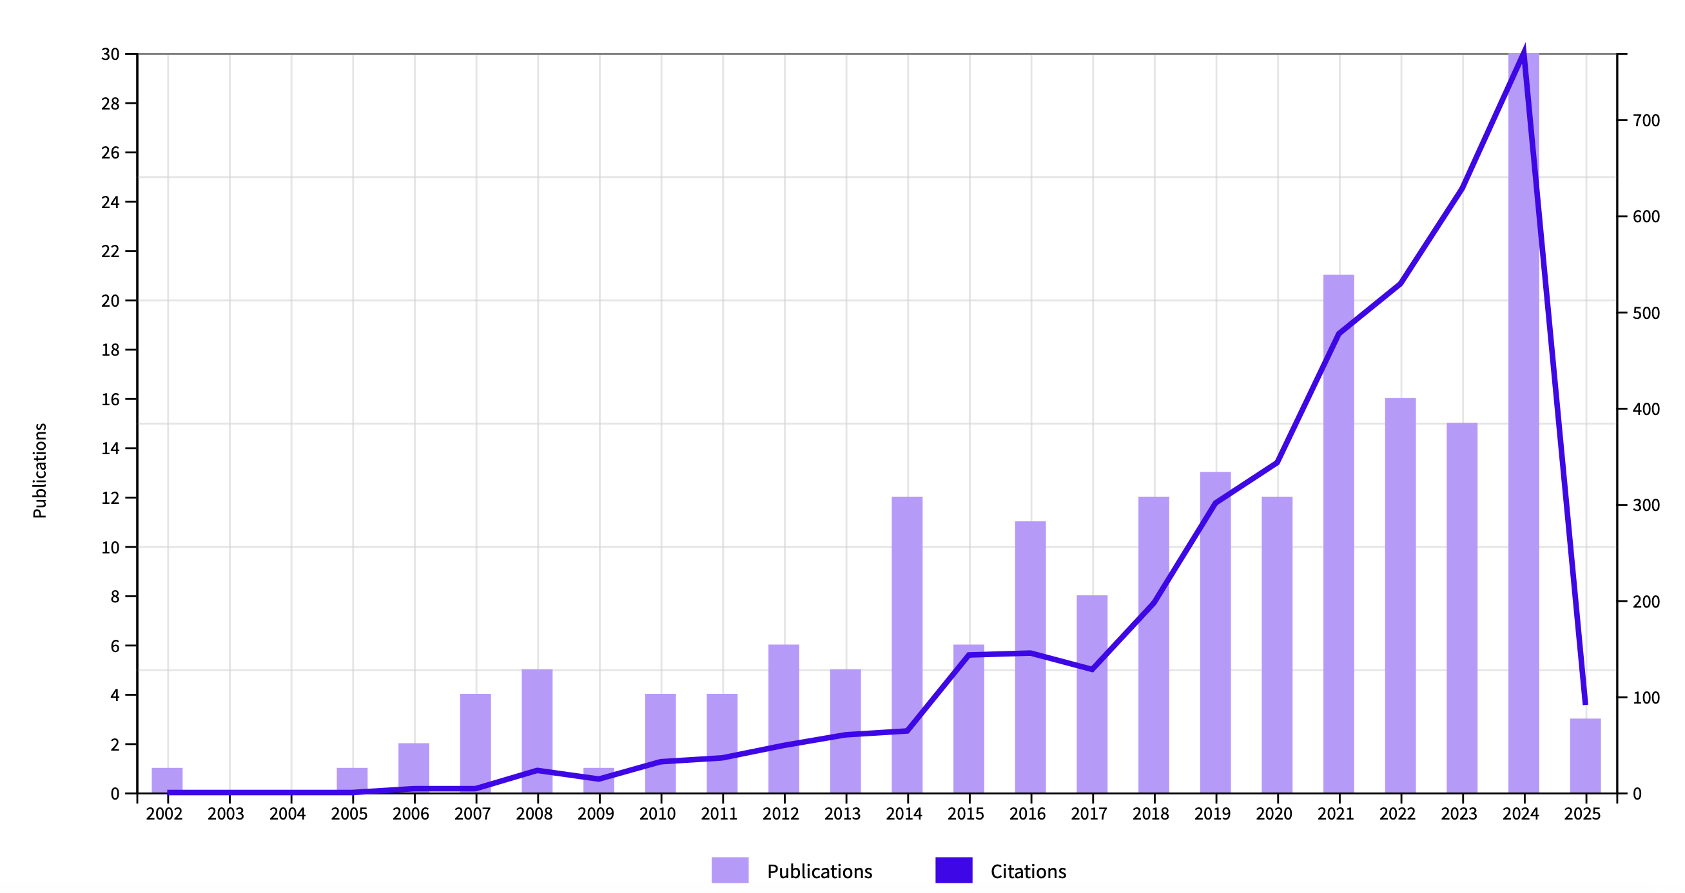
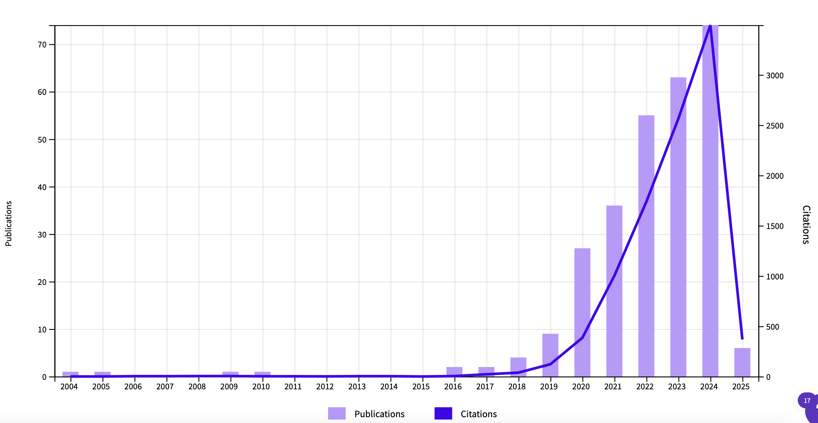
About the papers
Nanoscintillators
(almost doped insulators)
Quantum dot + Scintillat*
(CdSe + a bit of perovskite)
perovskite + Scintillat*
(CsPbBr₃ the champion)

Slide 30
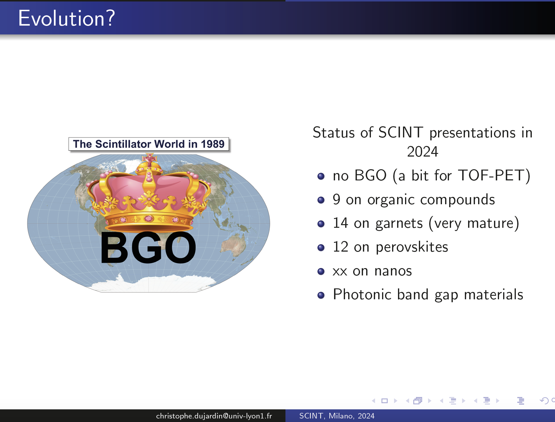
And the SCINT conference
A lot!

Slide 31
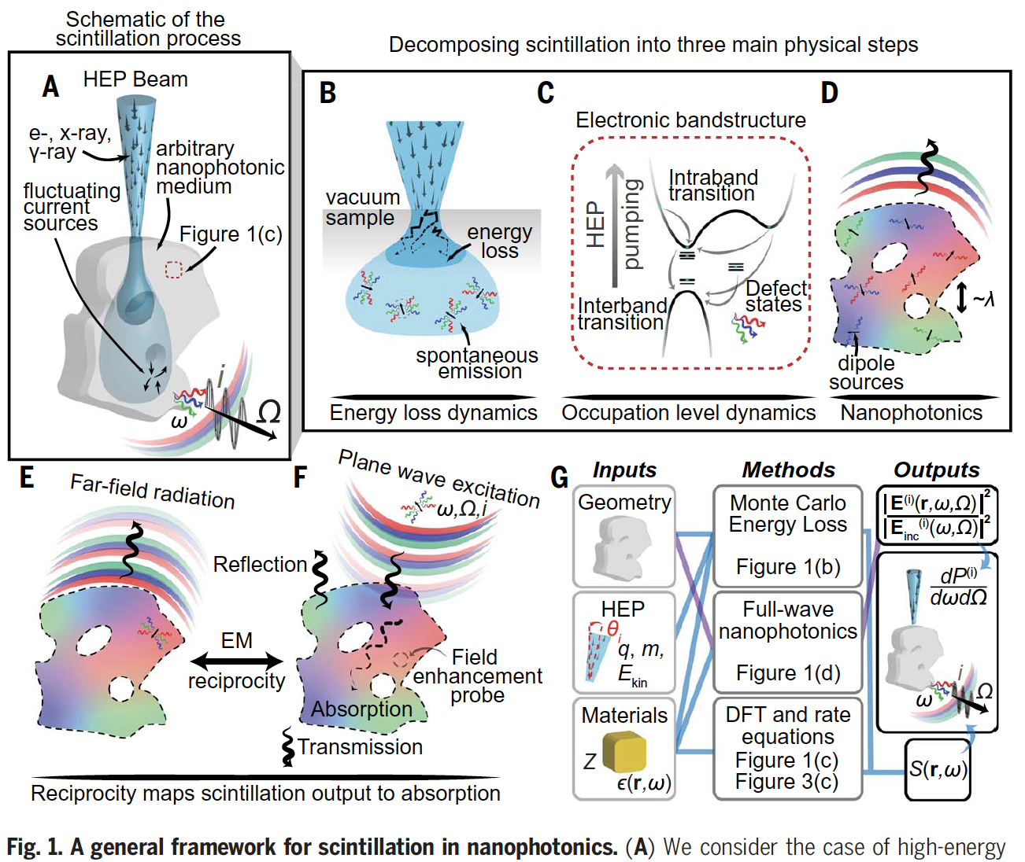
Modeling
GEANT 4, but it does not account for solid state physics
Microtheory (Vasil’ev, Engineering of Scintillation Materials and Radiation Technologies 2017)
Most recent (Roques-Carmes, Science 2022) (dedicated to Purcell effect)

Slide 32
Potential role of DRD5-WP2 in this landscape?
WP2-a: Application specific tailoring
Because of the publication "race," everyone claims to have the best sample.
However, most researchers do not come from the scintillation or end-user community. This situation requires a rationalization of the measurement protocol. Even "simple single crystals" may exhibit measurement fluctuations.
The dream scenario would be to define a standard geometry and establish a few "centers of measurement" for the community. These centers would facilitate cross-measurement for cross-calibration, focusing on transmission, scintillation spectra, scintillation yield, and time response.
One key aspect is radiation hardness, which involves defining an irradiation protocol and conducting remeasurements.
Additionally, the open data aspect is crucial.

Slide 33


Potential role of DRD5-WP2 in this landscape?
WP2-a: Application specific tailoring
And then an open database specific to nanoscintillators
Here the 30’s year old Berkeley database for bulk materials

Slide 34
Building a community
WP2-b: Extended functionalities
Requirement to define a target in terms of application
Universal scintillator will never exist!
WP2-c: modeling
Goal? Being predictive or descriptive

Slide 35

Building a community
Setting a small working group?
In Crystal Clear Collaboration and SCINT conference community?

