Slide 1
WP1
ATOMIC, IONIC, NUCLEAR AND MOLECULAR SYSTEMS AND NANOPARTICLES
IN TRAPS & BEAMS
WP Leaders: David Hume and Elina Fuchs

Slide 2
WP1
ATOMIC, IONIC, NUCLEAR AND MOLECULAR SYSTEMS AND NANOPARTICLES
IN TRAPS & BEAMS
Quantum Systems
WP Leaders: David Hume and Elina Fuchs

Slide 3
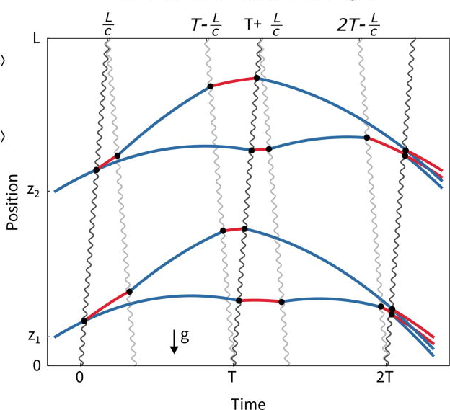
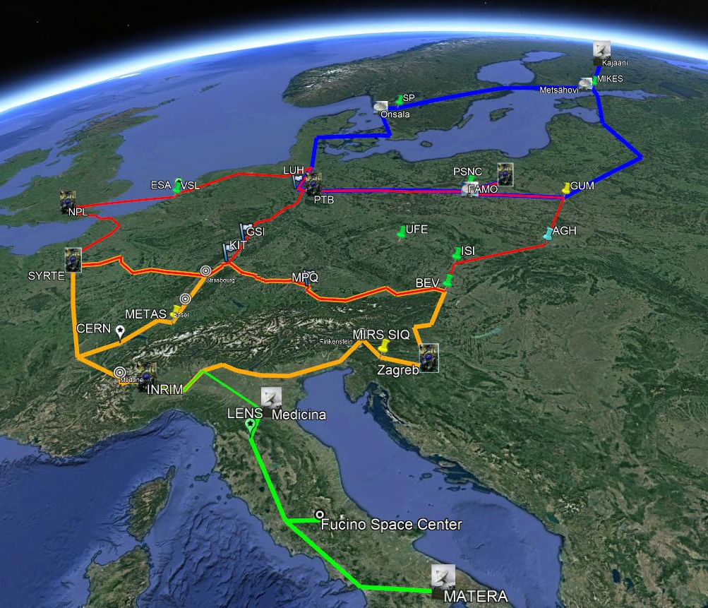
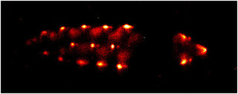
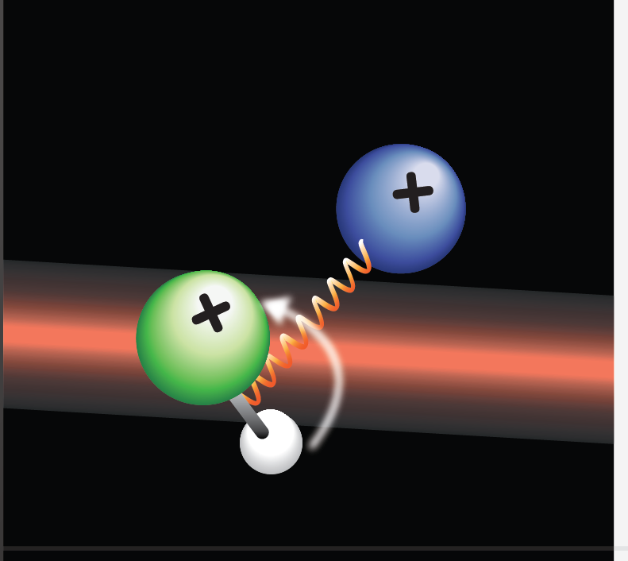
Sub-workpackages
“Testing fundamental physics at new levels of precision in quantum-limited experiments”
1a
Exotic systems in traps and beams
1b
Atom Interferometry
1c
Networks, Signal & Clock Distribution
highly-charged ions
nuclear clocks
opto-mechanical systems
radioactive nuclei/atoms/molecules
molecular ions
anti-matter particles/atoms
…

Slide 4
Sub-workpackages
“Testing fundamental physics at new levels of precision in quantum-limited experiments”
1a
Exotic systems in traps and beams
1b
Atom Interferometry
1c
Networks, Signal & Clock Distribution
Common ground
Laser cooling
Atom/ion/particle trapping
Laser stabilization
Quantum-logic spectroscopy
Spin-squeezing/ entanglement
Physics targets/ Theoretical basis
highly-charged ions
nuclear clock
opto-mechanical systems
radioactive nuclei/atoms/molecules
molecular ions
anti-matter particles/atoms
…

Slide 5
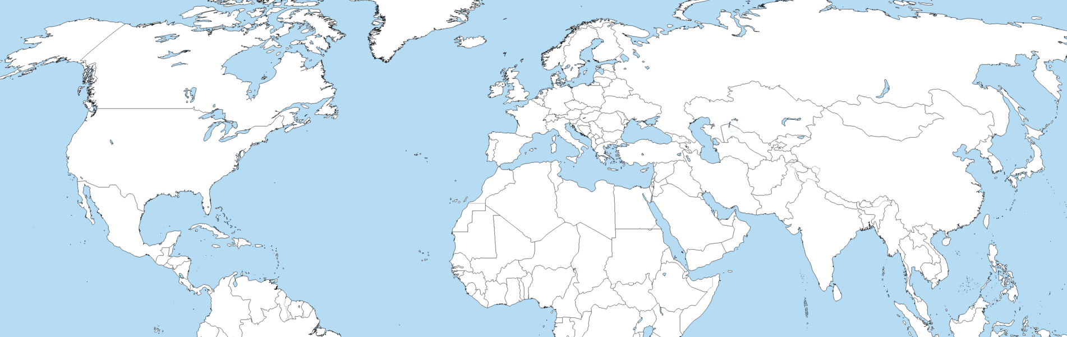
WP1 Institutions
1a: 19 institutions, 1b: 13 institutions, 1c: 17 institutions
TRIUMF, U. Lleida, IPZg, VTT, OCA, CNRS, LKB, HU Berlin, PTB, DESY, CERN, PTB, FBH Berlin, GSI, U. Düsseldorf, TU Munich, U. Bremen, DLR, TU Darmstadt, U. Ulm, U. Mainz, PTB, IIT Tirupati, IUT, Technion, U. Florence, Korea U., U. A. Aguascalientes, U. Groningen, CERN, NCNR Warsaw, NCU, ETHz, CERN, U. Birmingham, U. Sussex, NPL, U. Warwick, NIST, MIT, Northwestern, Yale, U. Delaware, LBNL

Slide 6
Developments/Trends in WP1 Technologies
Simple atomic systems complicated atomic/molecular systems
Metrology focused fundamental physics
Tabletop experiments medium scale systems / large collaborations
Standard quantum limit quantum-enhanced metrology
Laboratory experiments robust, field-deployable systems
Demonstration experiments competitive bounds on fundamental physics
Notes:
Highlight the benefit of complicated systems

Slide 7
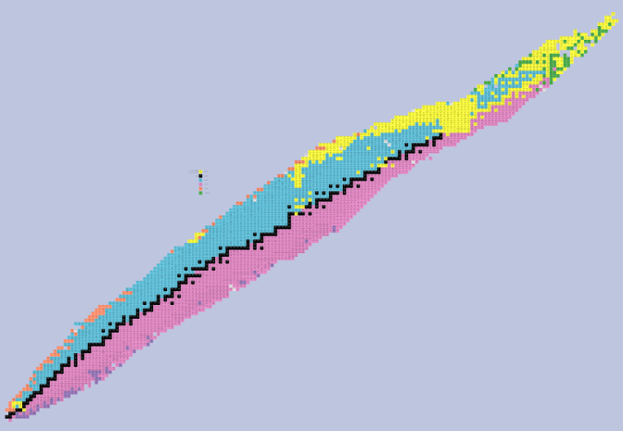
The Science Case | Fundamental constants | Dark matter | Fundamental symmetries | Fifth Force | QED | Gravitational redshift | Gravitational waves | …
 | Fine-structure α_{FS}, e-p mass ratio μ, strong α_{S} | Ultralight scalar, axion,… | Lorentz, CPT, LPI,… | King plot, long-range | Bound state, Strong-field | Small scales, terrestrial, space | Intermediate, Low frequencies
1a Exotic Systems
1b Atom Interferometry
1c Clock Networks

Slide 8
Technologies in WP1
Talks in This Session
Atomic/molecular beams
Atomic clocks
  Neutral atoms (Optical lattices, tweezer arrays)
  Trapped ions (atomic, molecular, highly-charged, ²²⁹Th^{N+})
  Time and frequency transfer
Atom interferometry
Optomechanical systems
Mia Au, CERN (ISOLDE) “Radioactive Molecules”
Matthias Keller, U. Sussex (QSNET) “QSNet and Quantum Technology for Fundamental Physics at Sussex”
Samuel Lellouch, U. Birmingham (AION) “Challenges and progress towards large-momentum transfer atom interferometry”
Andrew Geraci, Northwestern University (CFP) “Optomechanical Sensors”

Slide 9
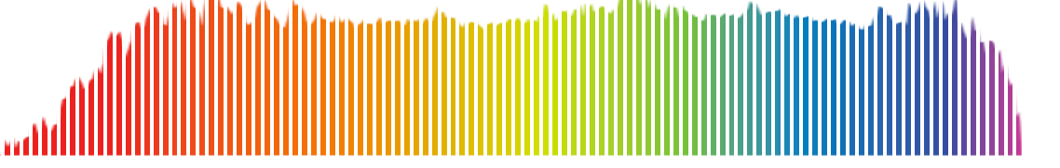
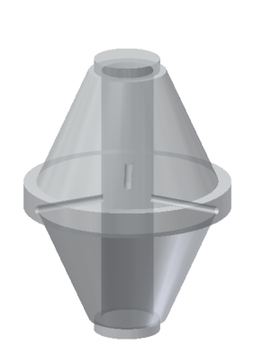
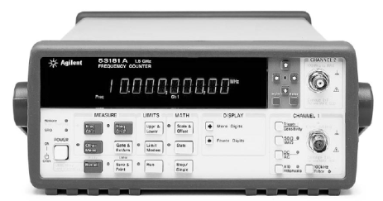


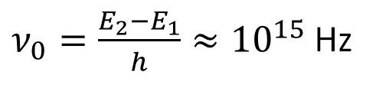
Principle of Optical Clocks
stabilized optical link
Femtosecond Laser
Drive atomic resonance 0.1 s – 10 s
Laser
Optical cavity
Atomic System
Fast feedback ~100 kHz
Slow feedback ~0.1 Hz
11:00 am
$ν_{0}=\frac{E_{2}−E_{1}}{h}≈{10}^{15}$ Hz
Clock frequency:
Notes:
At the heart of an optical clock is a stable optical resonance, typically in the range of 1 PHz. If you imagine preparing a superposition of the ground and excited state of such a resonance, it is the probability density of the electron wavefunction that oscillates back and forth at this frequency. These oscillations can have coherence times longer than a second. To translate that high q resonance outside of the atom, we need a laser capable of probing it. That typically consists of a laser stabilized to a high-finess optical cavity. I will mention a little about how these cavities work towards the end of the talk. Of course without the atomic reference this laser will drift in time, so we use it to probe the atomic resonance frequency and apply slow feedback on the time scale of seconds based on the observed atomic transition probability. Now we have a laser stabilized to the atomic resonance, but we still need to translate this into something we can in principle use to tell time. That role is filled beautifully by the femtosecond frequency comb. You can learn the details of this in the tutorial by Scott Diddams. For this talk I will just say that the femtosecond frequency comb divides the optical frequency into the microwave domain without adding any appreciable noise. At that point, electronic counters can be used for counting the ticks of the comb and recording the passage of time.

Slide 10
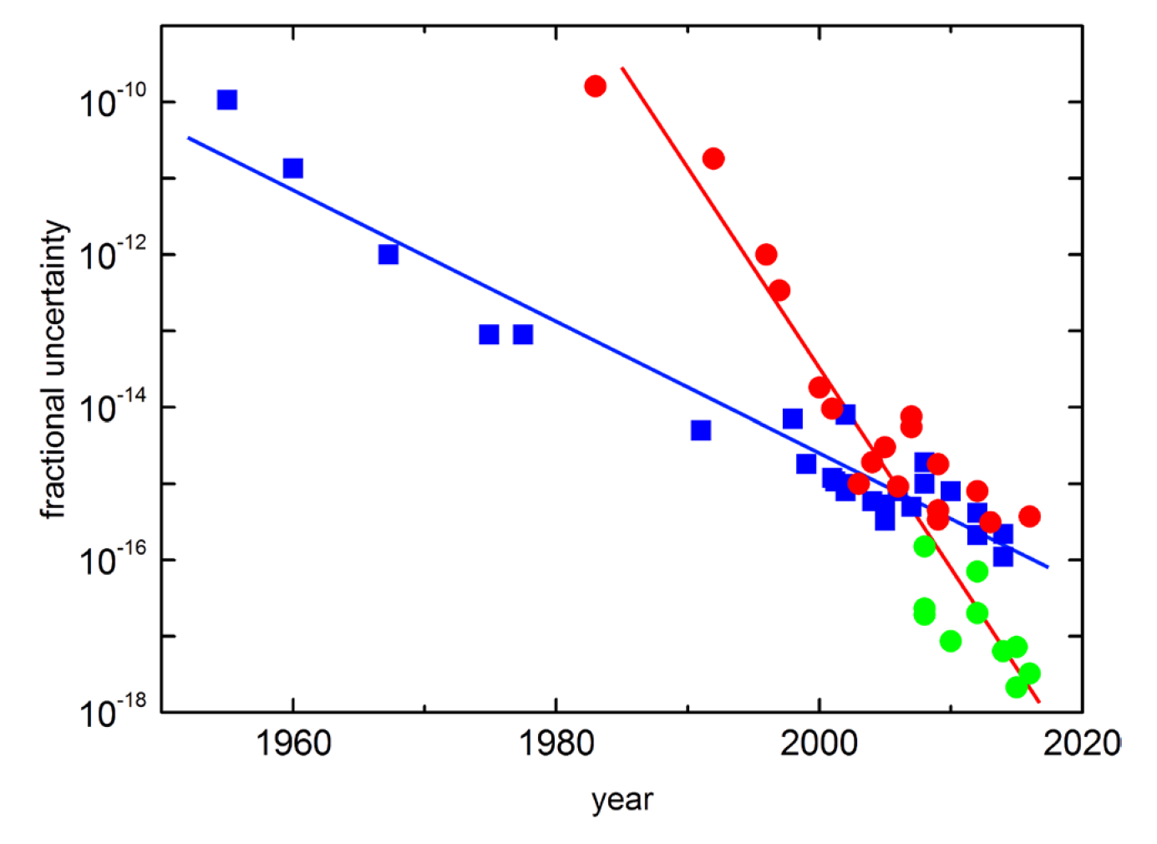
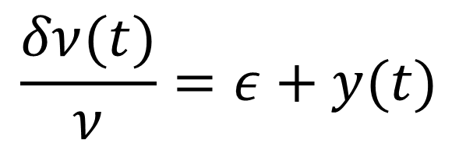
Optical Clock Performance
$$\frac{δν(t)}{ν}=ε+y(t)$$
Systematic uncertainty
Types of shifts
  Field shifts e.g. Zeeman shift and black body radiation shift
  Relativistic shifts e.g. time dilation
  Collision shifts e.g. background gas
  Technical shifts e.g. AOM phase chirp
cesium
optical
opt. beyond SI limit
Riehle et al., Metrologia 55, 188 (2018)
Notes:
The applications of optical clocks depend on these high levels of performance, so I want to describe how the performance is quantified. There are two performance metrics that are generally cited. [Click] The first is the Systematic uncertainty or “accuracy” of the clock. It describes generally describes the constant offset of the clock frequency from the unperturbed atomic resonance. It can be broken up into several categories of shifts based on the physical effects that cause them. Field shifts are caused by the differential interaction of the clock states with electric and magnetic field. Relativistic shifts have to do with our lack of knowledge of the reference frame of the atom. For example, time dilation due to the harmonic motion of the trapped atom can be an issue. Collision shifts can have components of both a field shift and relativistic effects and there are also technical shifts such as an AOM phase chirp that affect the clock frequency. [click] The stability of a clock has to do with the statistical frequency variations in the clock. These are generally assumed to average to zero at long averaging times and they are characterized by the Allan deviation. The ultimate limit of this stability comes from the atomic projection noise, which depends on parameters such as the resonance quality factor, its frequency, the number of atoms etc. I’ll be discussing both systematic uncertainty and stability in the last two sections of this talk.

Slide 11
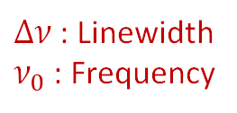
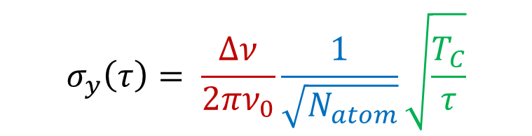

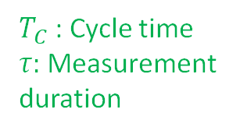
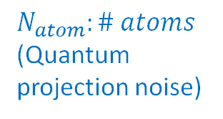
Optical Clock Performance
$$\frac{δν(t)}{ν}=ε+y(t)$$
Stability
$\left\langle y(t)\right\rangle =0$
Standard quantum limit:
$$σ_{y}\left(τ\right)= \frac{Δν}{2πν_{0}}\frac{1}{\sqrt{N_{atom}}}\sqrt{\frac{T_{C}}{τ}}$$
$Δν$: Linewidth
$ν_{0}$: Frequency
$N_{atom}:\# atoms$ (Quantum projection noise)
$T_{C}$: Cycle time
$τ:$Measurement duration
Notes:
The applications of optical clocks depend on these high levels of performance, so I want to describe how the performance is quantified. There are two performance metrics that are generally cited. [Click] The first is the Systematic uncertainty or “accuracy” of the clock. It describes generally describes the constant offset of the clock frequency from the unperturbed atomic resonance. It can be broken up into several categories of shifts based on the physical effects that cause them. Field shifts are caused by the differential interaction of the clock states with electric and magnetic field. Relativistic shifts have to do with our lack of knowledge of the reference frame of the atom. For example, time dilation due to the harmonic motion of the trapped atom can be an issue. Collision shifts can have components of both a field shift and relativistic effects and there are also technical shifts such as an AOM phase chirp that affect the clock frequency. [click] The stability of a clock has to do with the statistical frequency variations in the clock. These are generally assumed to average to zero at long averaging times and they are characterized by the Allan deviation. The ultimate limit of this stability comes from the atomic projection noise, which depends on parameters such as the resonance quality factor, its frequency, the number of atoms etc. I’ll be discussing both systematic uncertainty and stability in the last two sections of this talk.

Slide 12
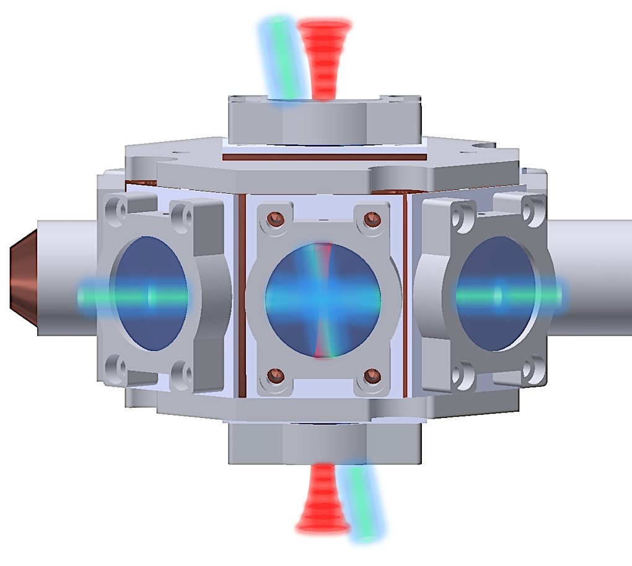
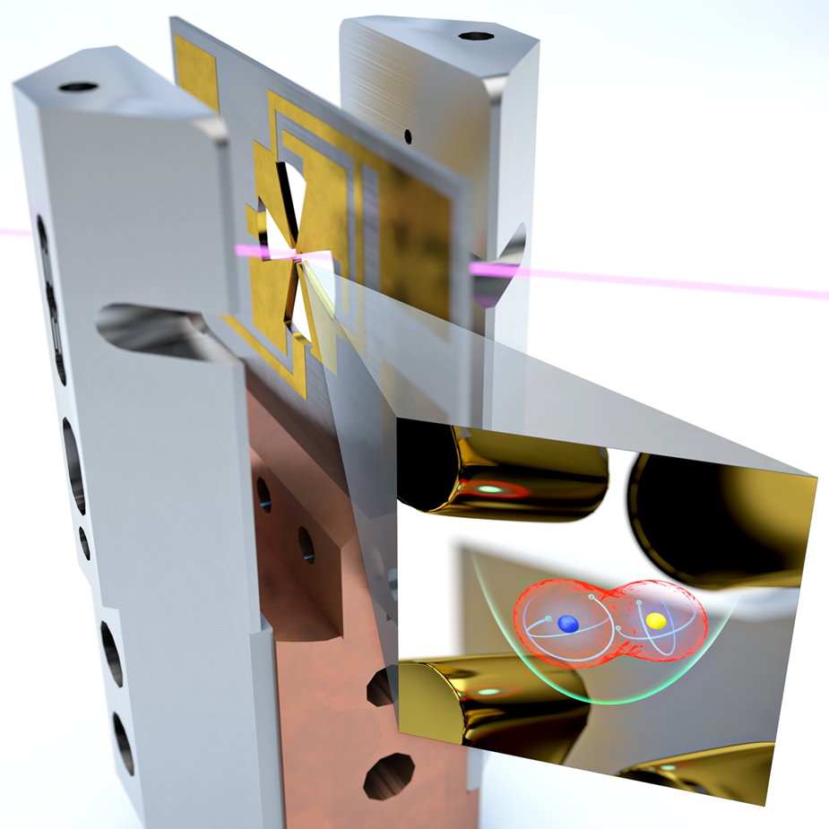
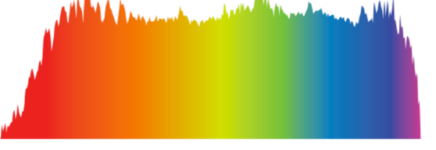
Measuring frequency ratios
Ratios are unitless (not limited by the accuracy of the SI second)
Ratios are transportable (can be used for intercontinental comparisons)
Using a self-referenced frequency comb, can be measured with accuracy and stability limited by the clocks themselves
Based on different atomic species and/or different reference frames, can be sensitive to the values of fundamental constants and symmetries of nature
12

Slide 13

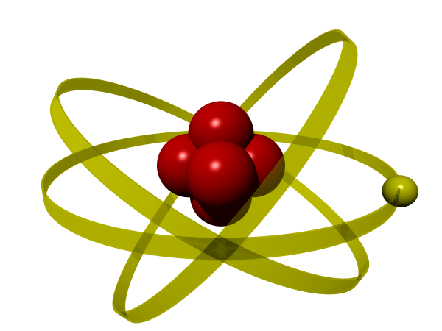
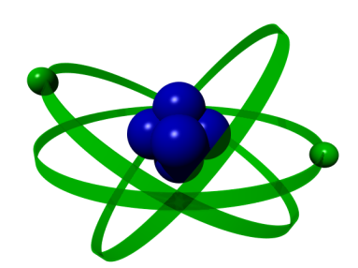
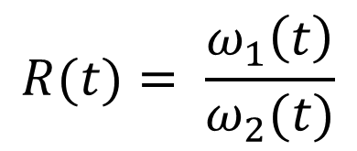
Tests of Fundamental Physics
M. S. Safronova, D. Budker, D. Demille, D. J. Kimball, A. Derevianko and C. W. Clark
Space-time variation in clock frequency
Drifts of the fundamental constants
(α, μ,…)
Violations of relativity theory
(LPI, Lorentz invariance)
Coupling to exotic particles or fields (dark matter, mass ~ 10⁻²² – 10⁻¹⁵ eV)
$$R(t)= \frac{ω_{1}\left(t\right)}{ω_{2}(t)}$$
Notes:
Another application of optical clock measurements is for testing fundamental physics, which has been reviewed recently in a Review of Modern Physics article here. The basic tool that we have for performing these kind of tests is to measure the frequency ratio between two clocks in time. Since these clock frequencies depend on the laws of physics and the fundamental constants they can serve as a very sensitive tests of those things. One of the basic approaches is to look for Space-time variations in the clock frequency. So what can cause that kind of effect. Drifts in the fundamental constants are one example. Since the clock frequencies depend differently on the values of the fine structure constant or the electron-proton mass ratio, drifts in their values will be revealed in the frequency ratio of two clocks varying in time. [click] Clocks in different reference frames will tick at different frequencies according to relativity. And that can be measured with great precision using optical clocks. This gives us a sensitive means to test for violations of relativity theory. [click] In addition, we know that the Standard model is not complete. It doesn’t include, for example, the dark matter that makes up most of the material universe. We can search for particular models of this dark matter using the clock ratio measurements.

Slide 14

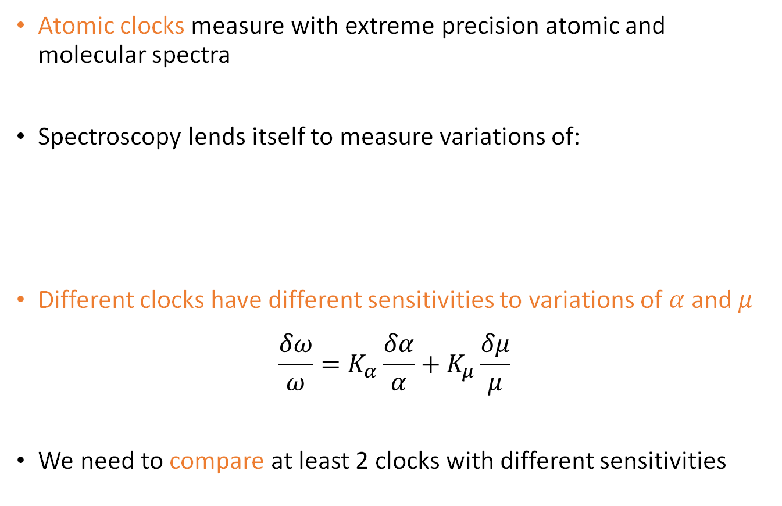
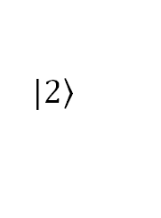
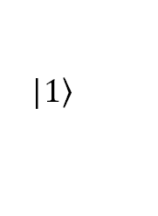

Fundamental constants
Atomic clocks measure with extreme precision atomic and molecular spectra
Spectroscopy lends itself to measure variations of:
Different clocks have different sensitivities to variations of $α$ and $μ$
$$\frac{δω}{ω}=K_{α}\frac{δα}{α}+K_{μ}\frac{δμ}{μ}$$
We need to compare at least 2 clocks with different sensitivities
$$|\left.1\right\rangle$$
$$α=\frac{1}{4πε_{0}}\frac{e^{2}}{ℏc}$$
α
μ
$$μ=\frac{m_{p}}{m_{e}}$$
$$|\left.2\right\rangle$$
α

Slide 15
Ultralight dark matter
Low-mass spinless bosons may form a coherently oscillating classical field, which in the rest frame is given by:
This would induce apparent oscillations of the fine structure constant and electron mass
Therefore we would observe atomic frequencies undergoing small oscillations in time around their mean value:

Slide 16
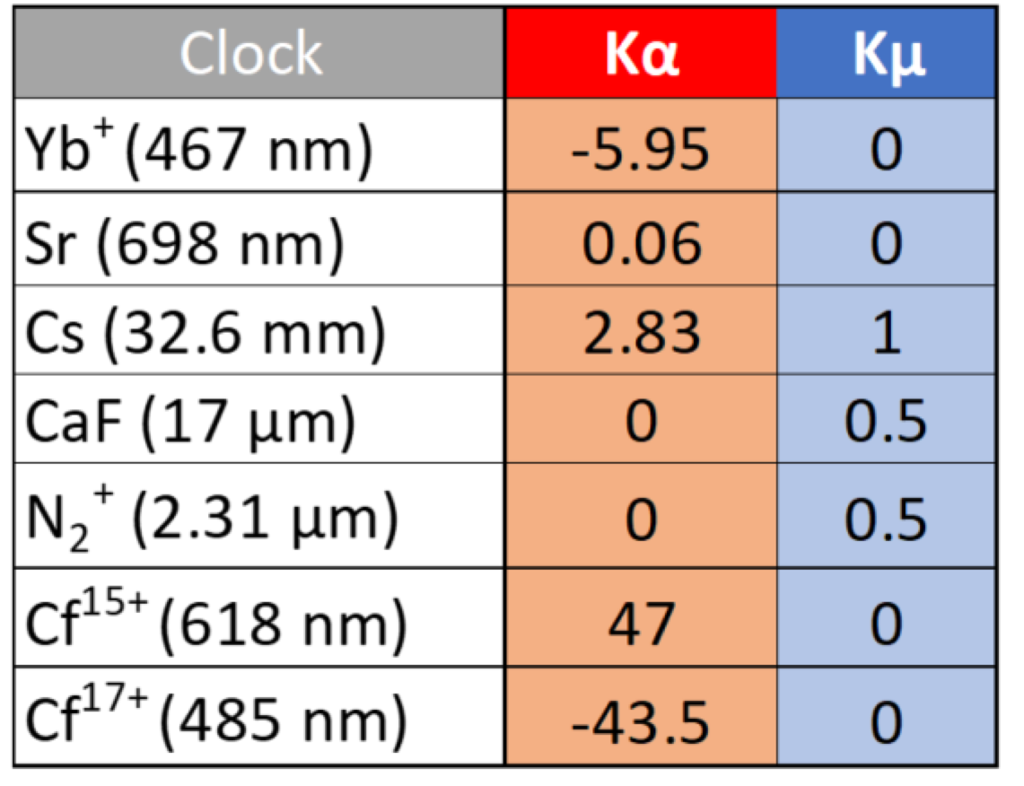
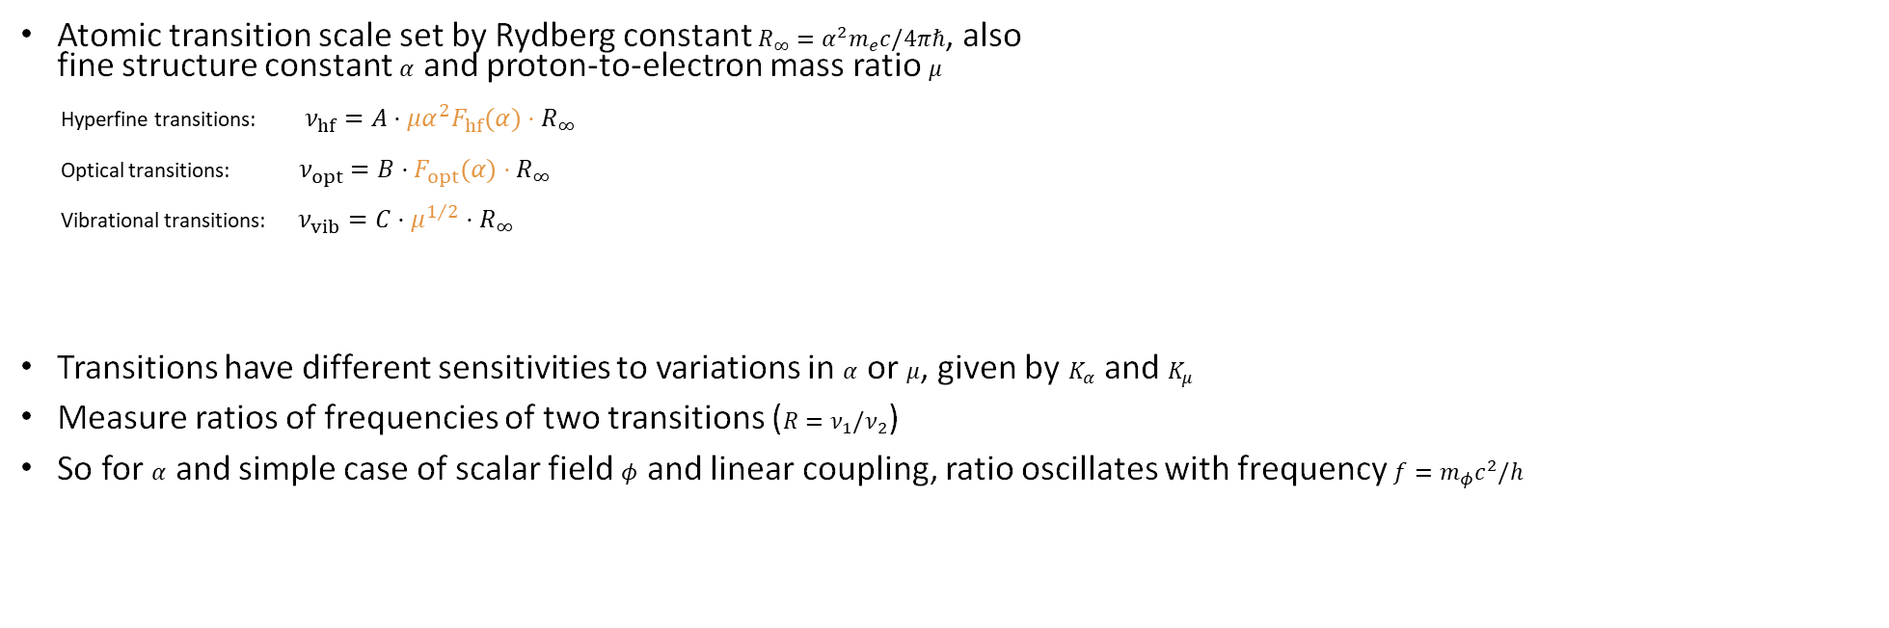


Clock Transitions and Sensitivities
Atomic transition scale set by Rydberg constant $R_{∞}=α^{2}m_{e}c/4πℏ$, also fine structure constant $α$ and proton-to-electron mass ratio $μ$
Hyperfine transitions: $ν_{hf}=A⋅μα^{2}F_{hf}(α)⋅R_{∞}$
Optical transitions: $ν_{opt}=B⋅F_{opt}(α)⋅R_{∞}$
Vibrational transitions: $ν_{vib}=C⋅μ^{1/2}⋅R_{∞}$
Transitions have different sensitivities to variations in $α$ or $μ$, given by $K_{α}$ and $K_{μ}$
Measure ratios of frequencies of two transitions ($R=ν_{1}/ν_{2}$)
So for $α$ and simple case of scalar field $φ$ and linear coupling, ratio oscillates with frequency $f=m_{φ}c^{2}/h$
²²⁹Th (148 nm) | 5900 | 0
Al⁺ (267 nm) | 0.008 | 0
$$\frac{dR}{R}=[K_{α,1}−K_{α,2}]\frac{dα}{α}$$
$$∝[K_{α,1}−K_{α,2}]cos(2πft)$$

Slide 17
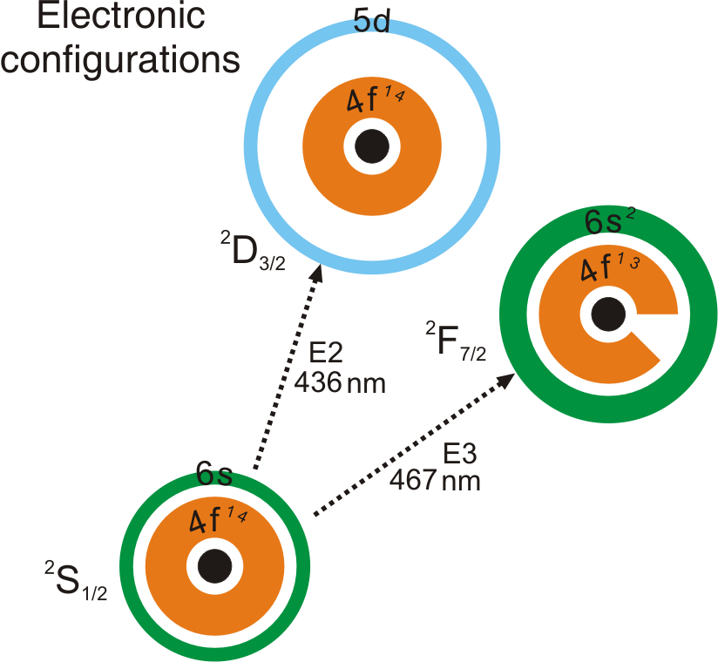
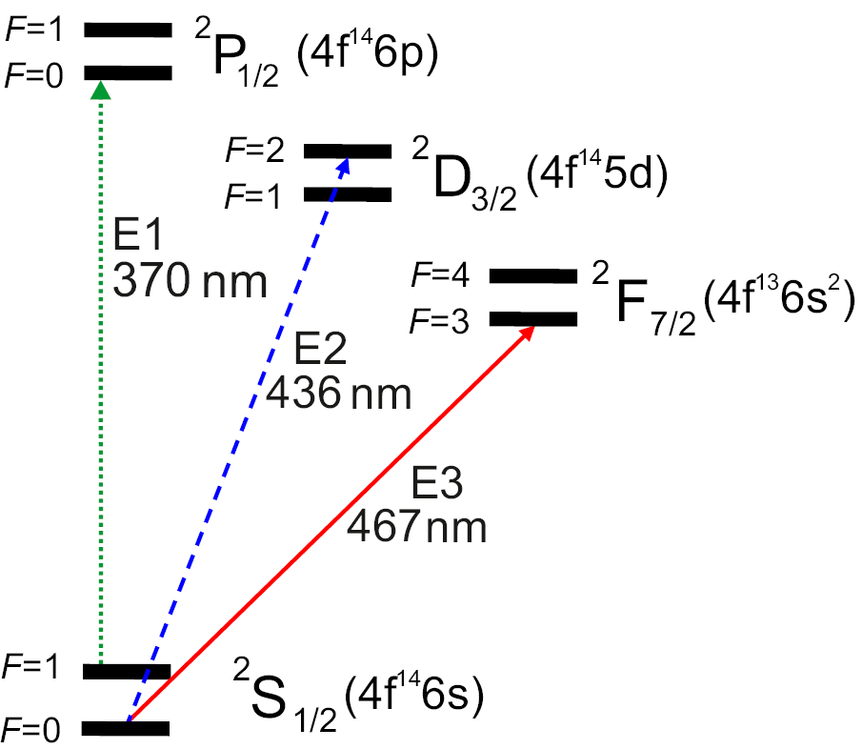
Search for new physics with ¹⁷¹Yb⁺ ion clocks
Advantages of ¹⁷¹Yb⁺
large atomic mass
permits long storage times (months; photodissociation of YbH⁺)
¹⁷¹Yb⁺: nuclear spin ½: non-degenerate (F=0,m=0) ground state
Suitable E1 cooling transition
Two clock transitions (E2 and E3)
Very different atomic structure of the excited states:
→ different sensitivities to perturbations by external fields
→ different sensitivities to variations in the fine structure constant α
→ High sensitivity to α of octupole (E3) transition
clock transitions | E2 | E3
transition | electric quadrupole | electric octupole
natural linewidth | 3 Hz | nHz
α sensitivity coefficient | 1.00 | -5.95

Slide 18
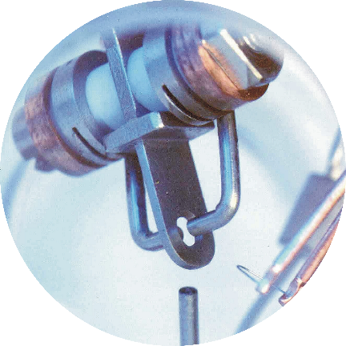
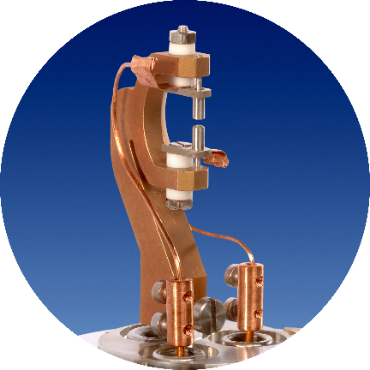
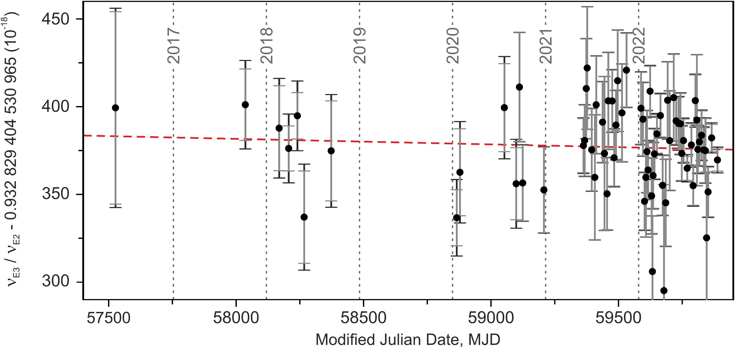
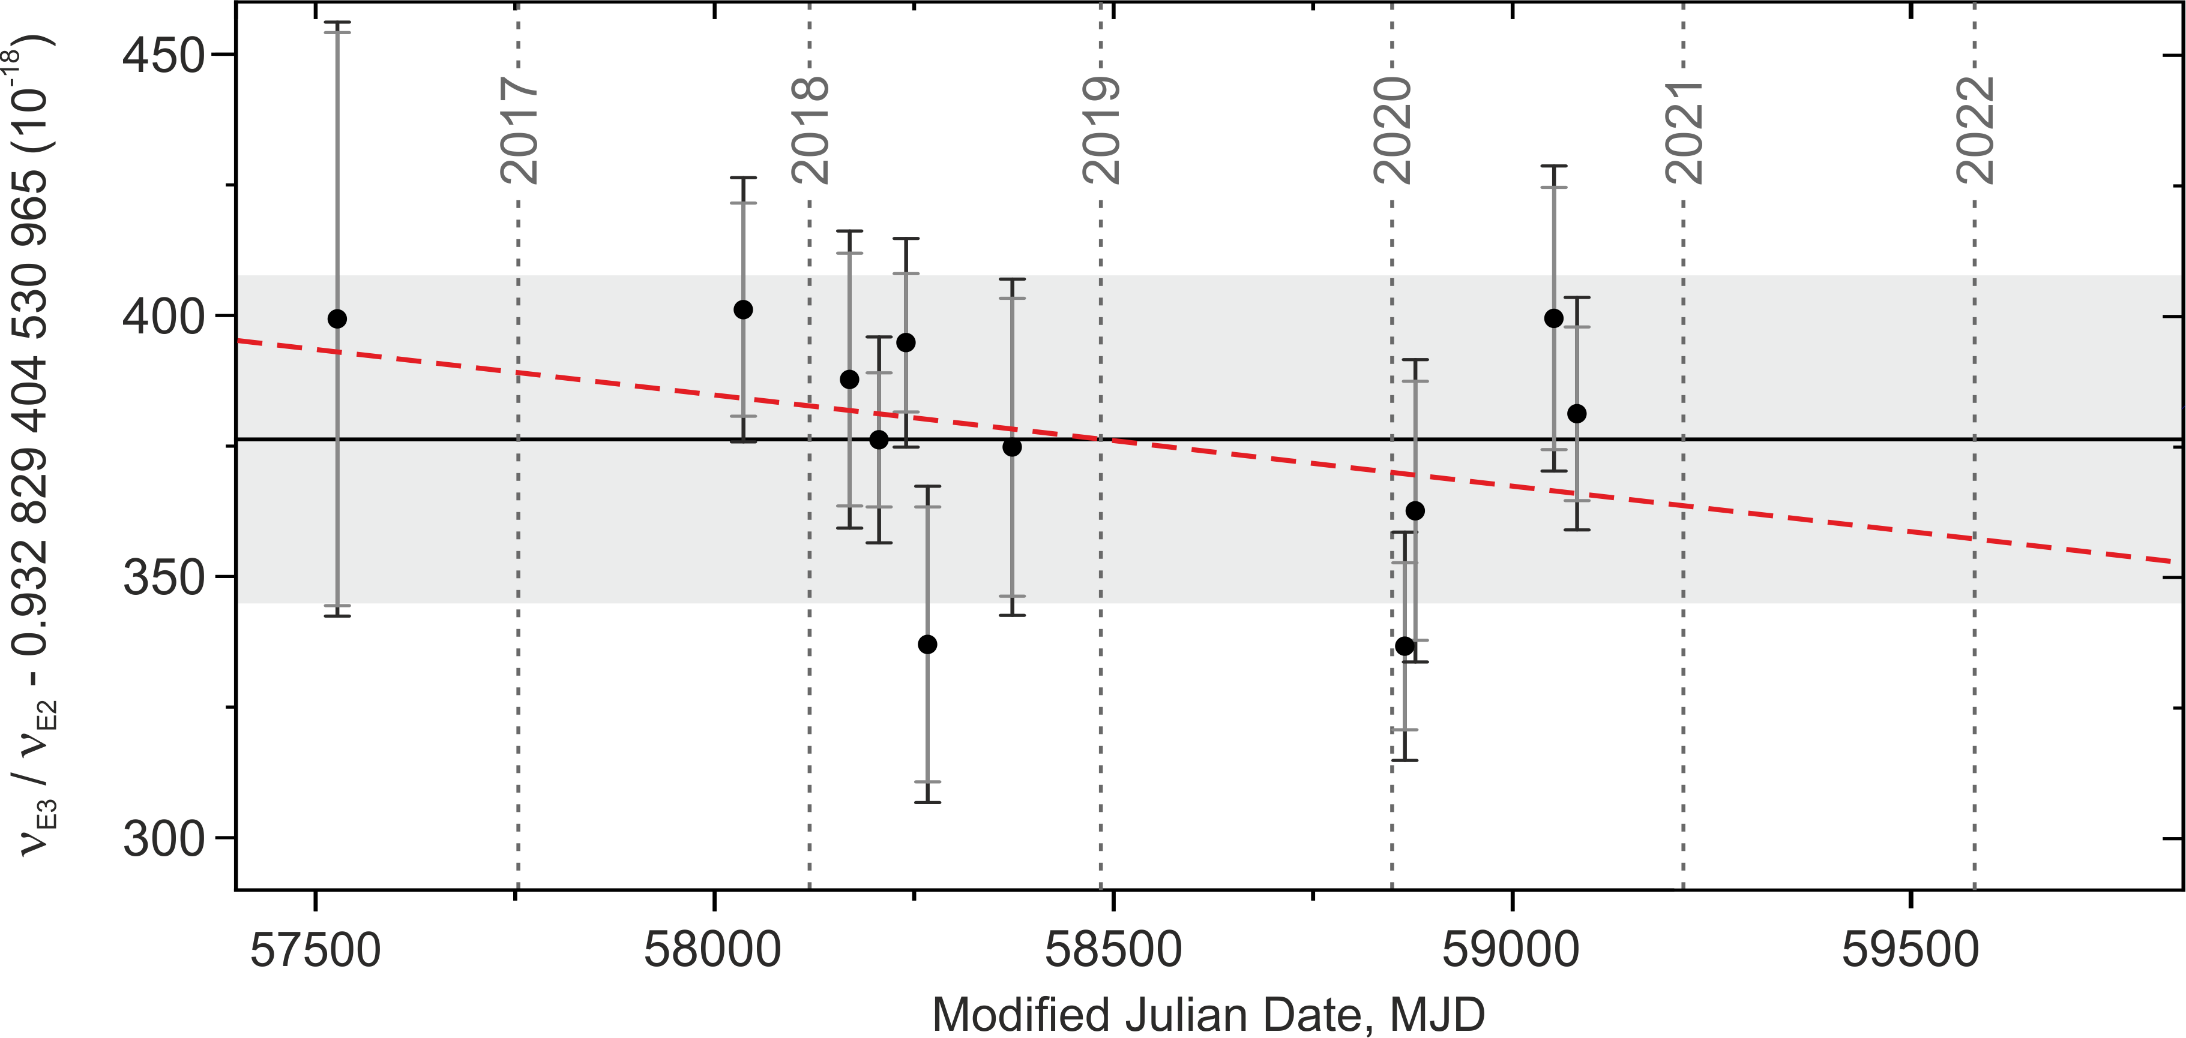
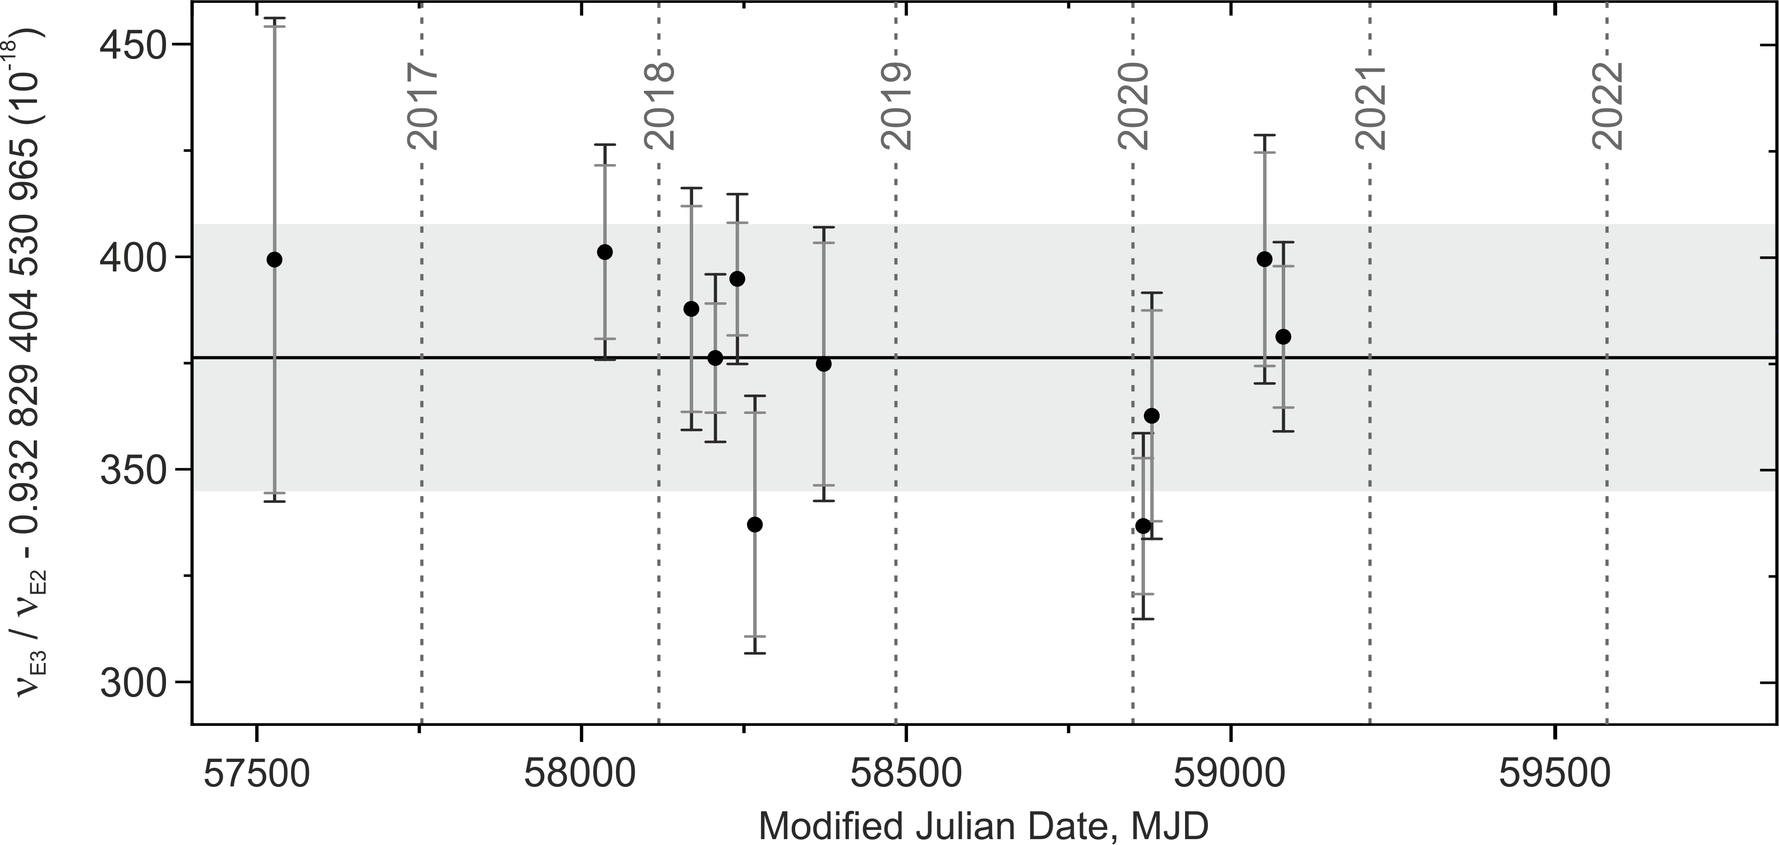
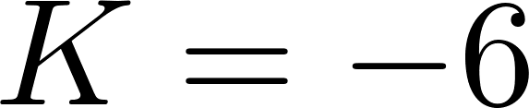

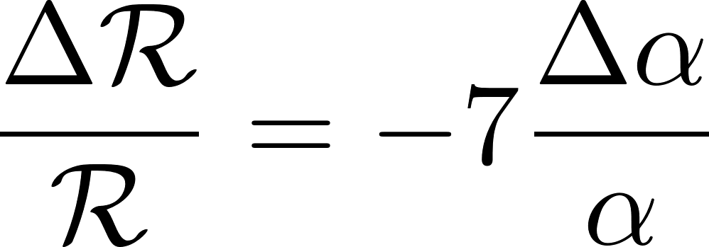
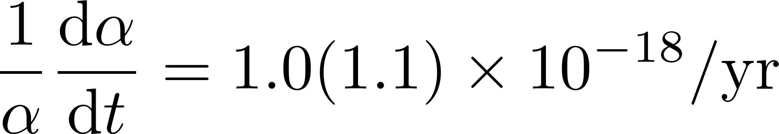
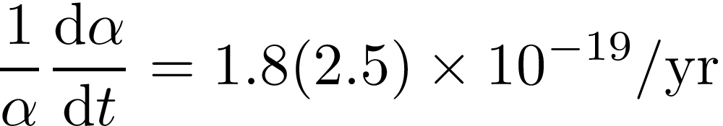
Limits on local position invariance (LPI)
Yb1
Yb2
  Non-gravitational experiment independent of where and when
  it is performed.
dependence on fundamental constant α
the search continues …
new limit
R. Lange et al., PRL 126, 011102 (2021)
M. Filzinger et al., arXiv 2301.03433 (2023)

Slide 19

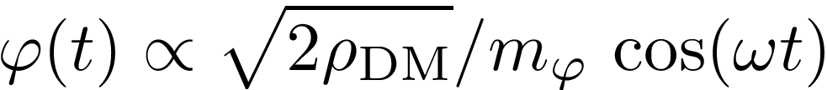
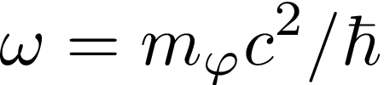
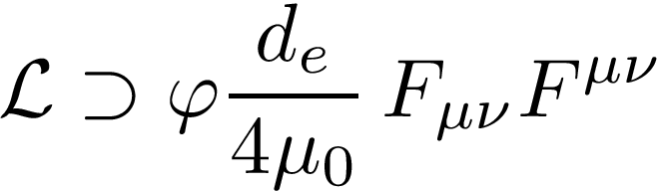

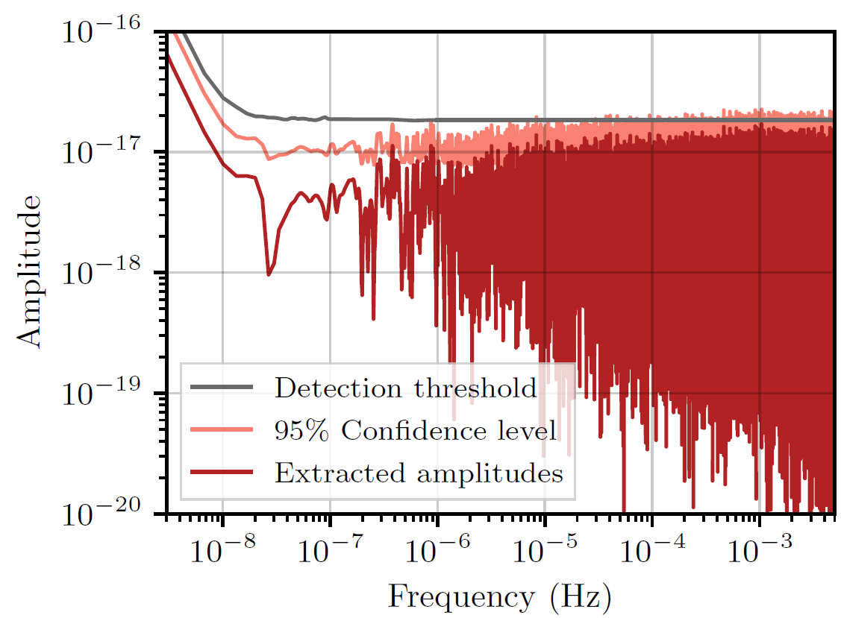
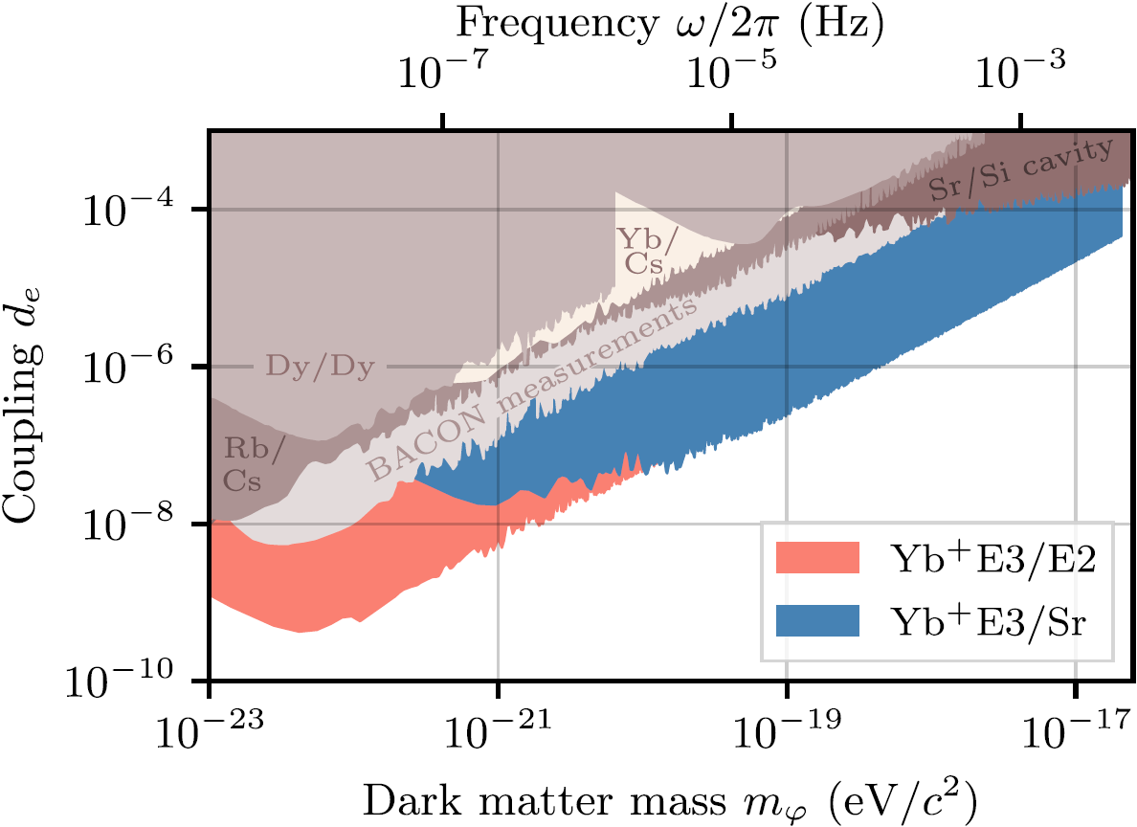
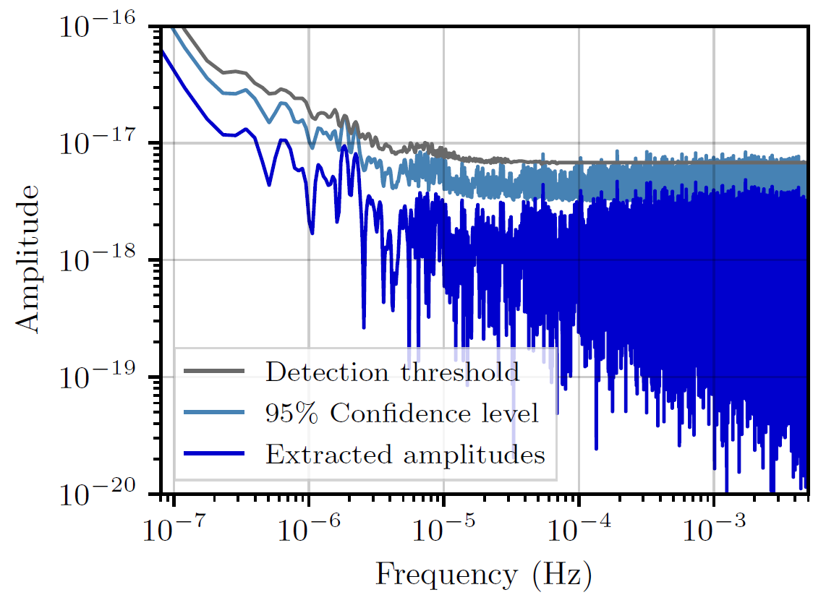
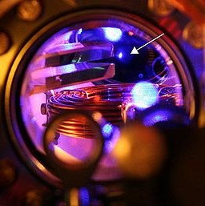
Ultralight dark matter : new limits
Ultralight bosonic dark matter ( ) expected to locally behave like a classical field
with a frequency given by the Compton frequency [1]
A coupling d_{e} of such a dark matter field to photons
would lead to coherent oscillations of the fine-structure constant [1]:
Can translate limits on oscillations in atomic clock comparisons into limits on dark matter couplings
E3/E2
Yb1
Sr3
E3/Sr
Yb1
This work: Filzinger et al., arXiv 2301.03433 (2023)
[Dy/Dy] K. Van Tilburg et al., PRL 115, 011802 (2015)
[Rb/Cs] A. Hees et al., PRL 117, 061301 (2016)
[Sr/Si cav] C. J. Kennedy et al., PRL 125, 201302 (2020)
BACON collab., Nature 564, 564 (2021)
[Yb/Cs] T. Kobayashi et al. PRL 129, 241301 (2022)
Yb1
Sr3
[1] A. Arvanitaki et al., PRD 91, 015015 (2015)
Notes:
Extending the mass range through dynamically decoupling

Slide 20
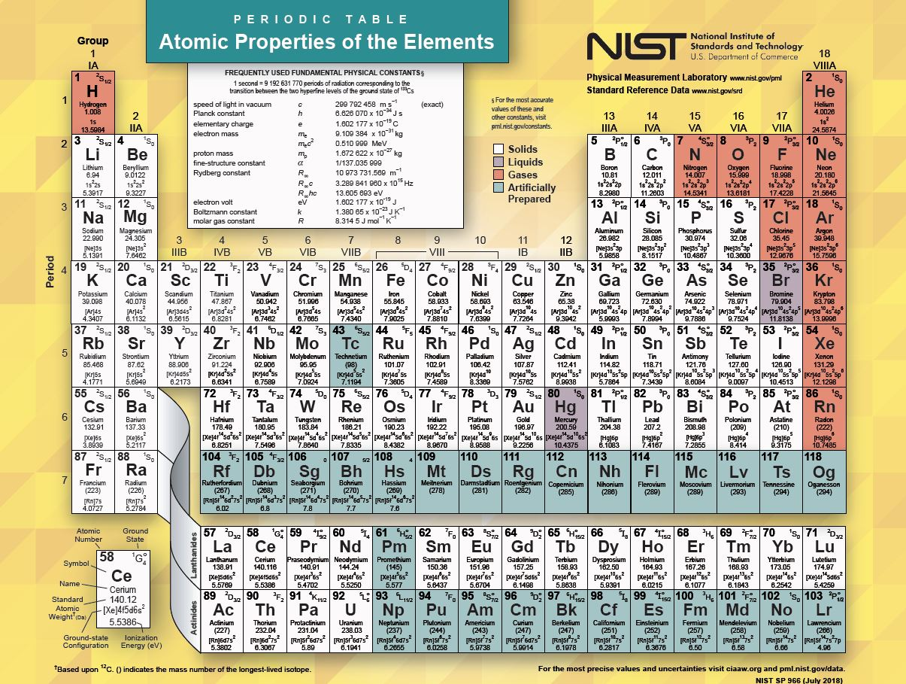
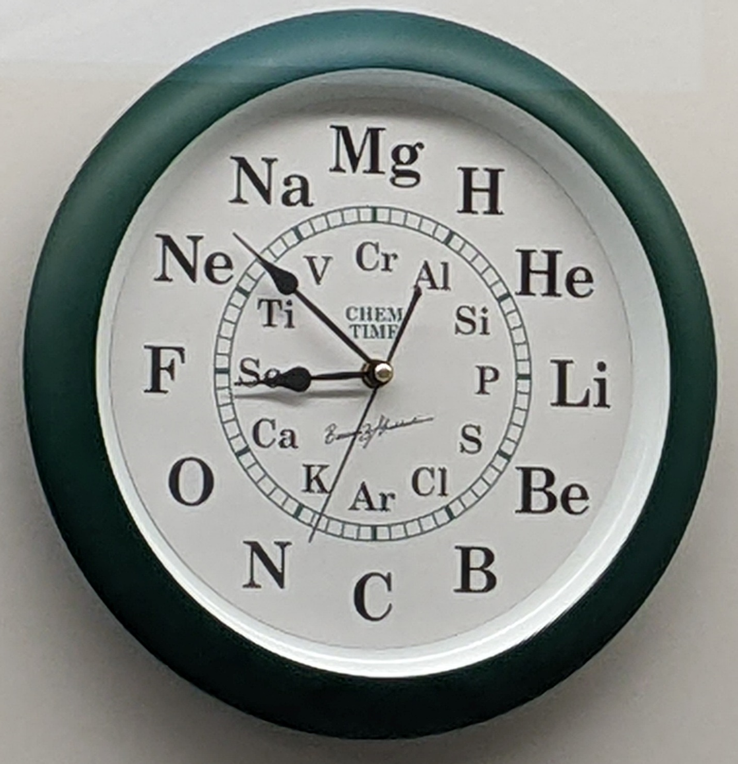
Trapped-Ion Species
An atomic clock in the wild
Commonly used ion species
  Simple atomic structure
  Laser-accessible, strongly-allowed cycling transition
Many other interesting candidates
  Complicated structure, deep-UV wavelengths
  Highly-charged ions
  Light ions
  Molecular Ions

Slide 21

Sympathetic cooling and
Quantum logic spectroscopy (QLS)
Qubit
Isolated two-level system
Strong cycling transition for laser cooling
State-dependent detection
Spectroscopy target
(e.g., Clock ion, highly-charged ion, molecular ion, thorium-229)
See: Matthias Keller’s talk

Slide 22




Sympathetic cooling and
Quantum logic spectroscopy (QLS)
Cool to motional ground-state with qubit
Sideband pulse on Al⁺ (excites state-dependent motion)
Detect vibrational quantum with qubit
$$\left.\left|↑\right.\right\rangle$$
²⁵Mg⁺
red
sideband
Projective measurement can also serve as state preparation
$$\left.\left|↓\right.\right\rangle$$
²⁷Al⁺ ¹S₀
²⁷Al⁺ ³P₀
³P₀, m_{F} = 5/2
³P₁, m_{F} = 7/2
²⁷Al⁺
blue
sideband
¹S₀, m_{F} = 5/2

Slide 23

Ultrastable frequency transfer
Beloy et al., Nature 591, 564 (2021)

Slide 24

Recall…
Cancelling noise in frequency transfer

Slide 25


Work towards longer distance networks
Quantum-limited performance over 300 km
Caldwell et al., arXiv:2212.12541 [physics.ins-det] (2022)
See also: Shen, Q. et al. Nature 610, 661 (2022)

Slide 26
WP1 Institutions
1a: 19 institutions, 1b: 13 institutions, 1c: 17 institutions
TRIUMF, U. Lleida, IPZg, VTT, OCA, CNRS, LKB, HU Berlin, PTB, DESY, CERN, PTB, FBH Berlin, GSI, U. Düsseldorf, TU Munich, U. Bremen, DLR, TU Darmstadt, U. Ulm, U. Mainz, PTB, IIT Tirupati, IUT, Technion, U. Florence, Korea U., U. A. Aguascalientes, U. Groningen, CERN, NCNR Warsaw, NCU, ETHz, CERN, U. Birmingham, U. Sussex, NPL, U. Warwick, NIST, MIT, Northwestern, Yale, U. Delaware, LBNL

Slide 27






Transportable clock efforts
Ca⁺
Sr
Sr
Ohmae et al., Adv. Quant. Tech. 4, 2100015 (2021)
Zeng et al., arXiv:2303.07566 (2023)
Grotti et al., Nat. Phys. 14, 437 (2018)
Yb⁺
Yb
Al⁺
NIST Transportable Yb-lattice clock
Fasano PhD thesis (2021)
Hannig et al., RSI 90, 053204 (2019)
Stuhler et al., Measurement: Sensors 18, 100264 (2021)

Slide 28

Atom Interferometry
⁸⁷Sr
See: Samuel Lellouch’s talk

Slide 29





Radioactive Nuclides
Roussy et al., Science 381, 46 (2023)
Udrescu et al.,(2024) Nat. Phys. 20, 202
Fundamental
Symmetries
collaboration
Fitch et al., Q.Sci.T. 6, 014006 (2021)
Athanasakis-Kaklamanakis et al.,(2024) in preparation
Morris et al., Phil. Trans. R. Soc. A. 3822 (2023)
RIB
Precision measurement
Work in progress
  collaboration
Making radioactive probes
  Beams, traps, targets
Characterizing radioactive probes
  Spectroscopy, chemistry
  Properties and states
Techniques for bulk systems
M. Au
See: Mia Au’s talk

Slide 30

Optically levitated particles
Precision sensors of acceleration, torque, EM fields,…
Applications:
  Gravitational force
  High-frequency gravitational waves
  Dark matter
  Test of quantum foundations
See: Andrew Geraci’s talk
Winstone et al., arXiv:2307.11858 [quant-ph] (2024)

Slide 31


Optomechanical sensors for dark matter and gravity
Precision sensors of acceleration, torque, EM fields,…
Applications:
  Gravitational force
  High-frequency gravitational waves
  Dark matter
  Test of quantum foundations
Nanofabricated and bulk
mechanical sensors
Levitated (opto)-mechanical sensors
See: Andrew Geraci’s talk
Optical cavity based dark matter detectors

Slide 32




Detection of single nuclear decays
As proof-of-principle, have recently demonstrated the detection of the force imparted by a single nuclear decay within a micron-sized particle
Sphere recoil
Candidate ²¹²Po decay:
Loading of spheres with ²¹²Pb:
²²⁰Rn
²¹⁶Po⁺
²¹²Pb
$$\vec{E}$$
~100 nm
3 $μ$m
T_{1/2} = 56 s
T_{1/2} = 0.14 s
T_{1/2} = 10.6 h
Charge change
Wang et al., PRL 133, 023602 (2024), arXiv:2402.13257

Slide 33
Challenges/Outlook
Experimental challenges
  Distributing ultrastable clock signals to all locations in an expanding network (microwave, optical-fiber, free-space, portable clocks)
  General, robust techniques for trapping, cooling, detecting and accelerating atoms/ions/molecules
  Scaling table-top experiments to larger systems and longer distances
  Application of quantum-enhanced metrology to high-accuracy measurements (spin-squeezing, entanglement, dynamical decoupling)
Theory challenges
  Development of theory for more complicated systems (data-driven approaches, nuclear theory, nuclear deformations, differential approaches)
  Bound-state QED
  Combining data/measurements from many systems and sensor types across network
Organizational challenges
  Coordination of multiple experiments to allow for synchronous, multi-sensor measurements (data structuring, data analysis)
  What is DRD5’s role in these efforts?
Notes:
Production/acquisition of portable reference clocks to reach isolated locations

