Slide 1
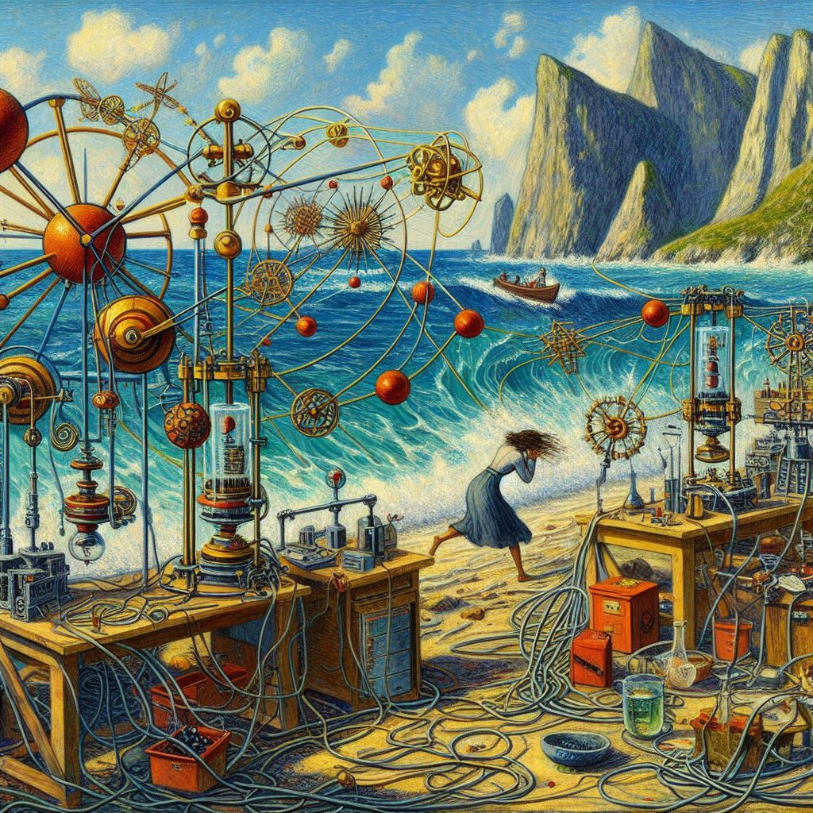
SQUEEZING for (He) physics ?
"Spin Squeezing and Entanglement in the style of Paul Gauguin”.
Made with Microsoft Copilot.
Dmitry Budker
Helmholtz Institute, JGU Mainz, Germany
University of California, Berkeley, USA
DRD5 Collaboration Meeting, CERN, January 19, 2024
Notes:
Watch for MMMMMM and EEEEEEEE
Not all will be magnetometry and not all optical

Slide 2
Content
Standard Quantum Limit (SQL): “Eq. (1)”
What is squeezing? Why squeezing?
How to squeeze?
    Orientation-to-alignment conversion (spins)
    Measurement ! (spins)
    Polarization self-rotation (light)
Is squeezing useless? (limitations)
Squeezing can be useful!
Applications: gravitational waves; dark matter, fifth forces,…

Slide 3
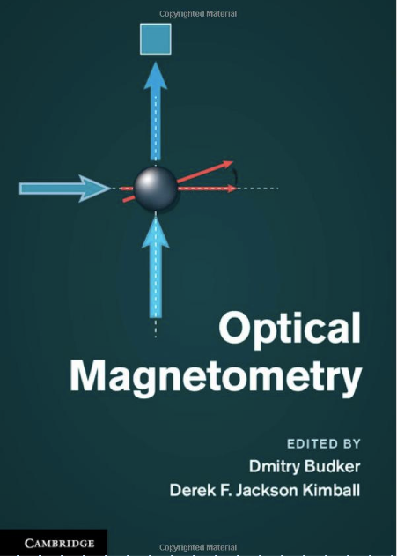
Opt. Pumping
“Precession”
Opt. Probing

Slide 4
What limits magnetic sensitivity?
In principle, “Equation One”
Ground-state gyromagnetic ratio
Number of atoms
Dmitry Budker and Mikhail G. Kozlov, Sensing: Equation One, Optical Memory and Neural Networks 32, Suppl. 3, S409–S414 (2023);
arXiv:2011.11043
Spin-relaxation time
Measurement time

Slide 5
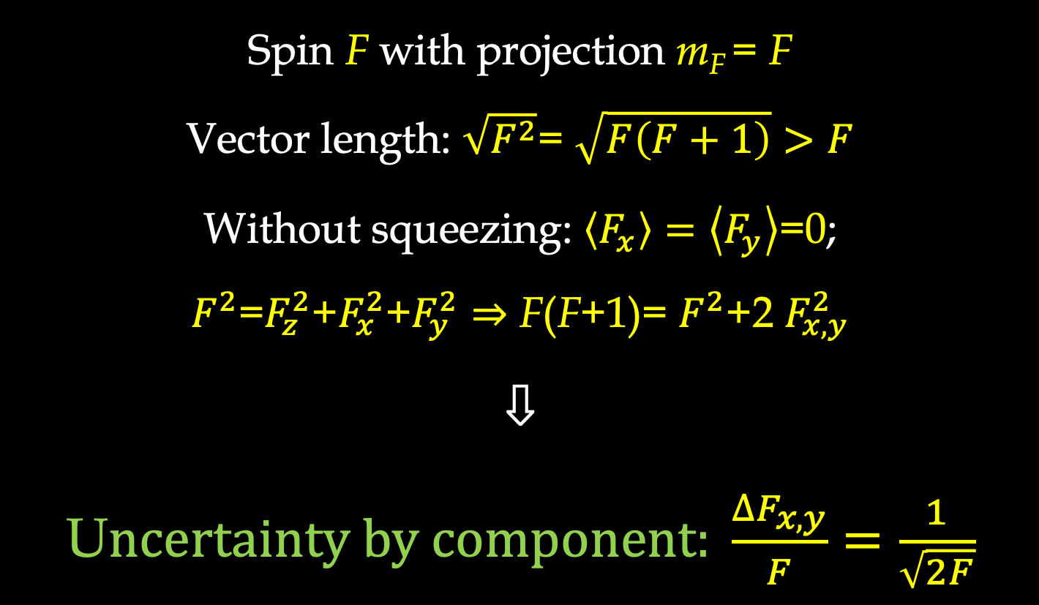
What is the physics?
Spin F with projection m_{F} = F
Vector length: $\sqrt{F^{2}}$= $\sqrt{F\left(F+1\right)}>F$
Without squeezing: $\left\langle F_{x}\right\rangle =\left\langle F_{y}\right\rangle$=0;
$F^{2}$=$F_{z}^{2}$+$F_{x}^{2}$+$F_{y}^{2}⇒$ F(F+1)= $F^{2}$+2 $F_{x,y}^{2}$
⇩
U$ncertainty by component: \frac{∆F_{x,y}}{F}=\frac{1}{\sqrt{2F}}$
Notes:
The length of the vector is longer than F as a consequence of commutation relations

Slide 6
Spin squeezing
Deformation of uncertainty area
Area is preserved
Component with small uncertainty ⇒ metrology
Heisenberg scaling!
Notes:
The length of the vector is longer than F as a consequence of commutation relations

Slide 7
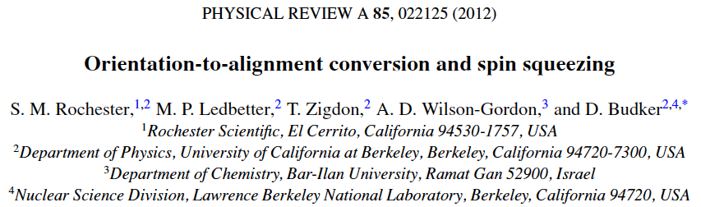
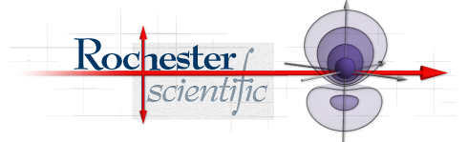

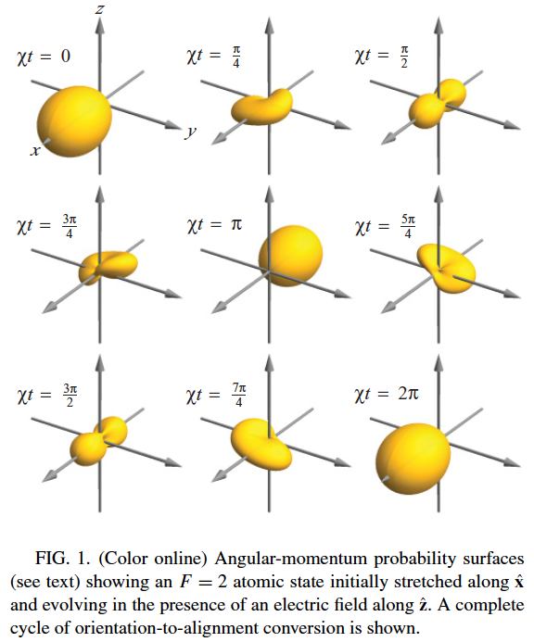

Slide 8
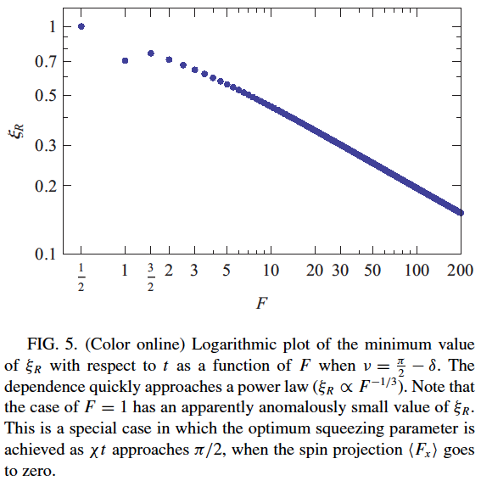

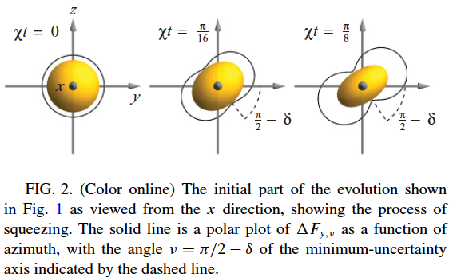
Notes:
Interesting squeezing occurs only for large J. This may not be the most exciting application, but this is why I personally started thinking about the problem.

Slide 9

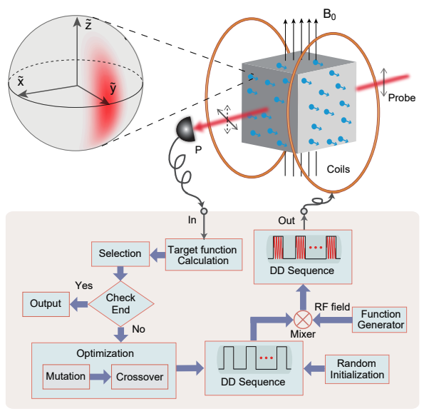
Exciting recent work (example)
https://arxiv.org/pdf/2309.11855

Slide 10
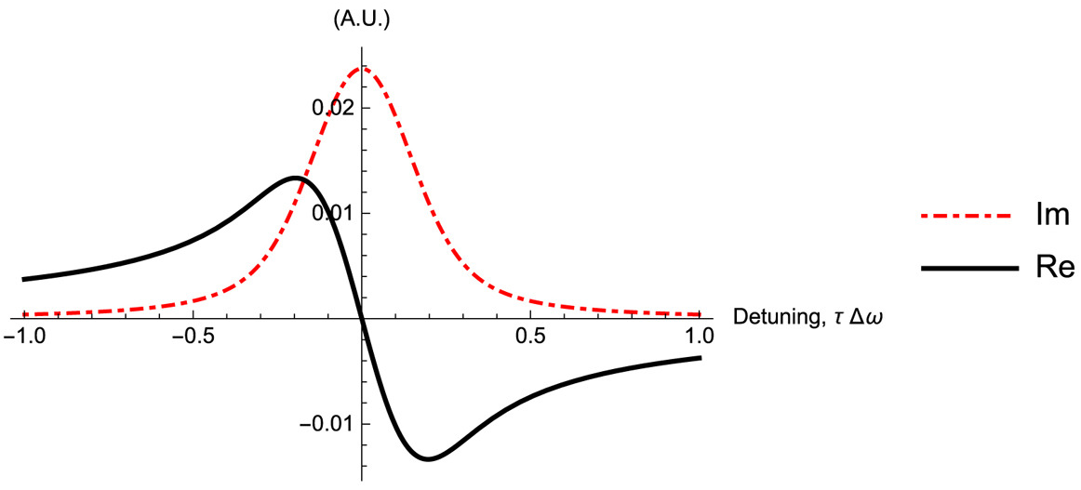
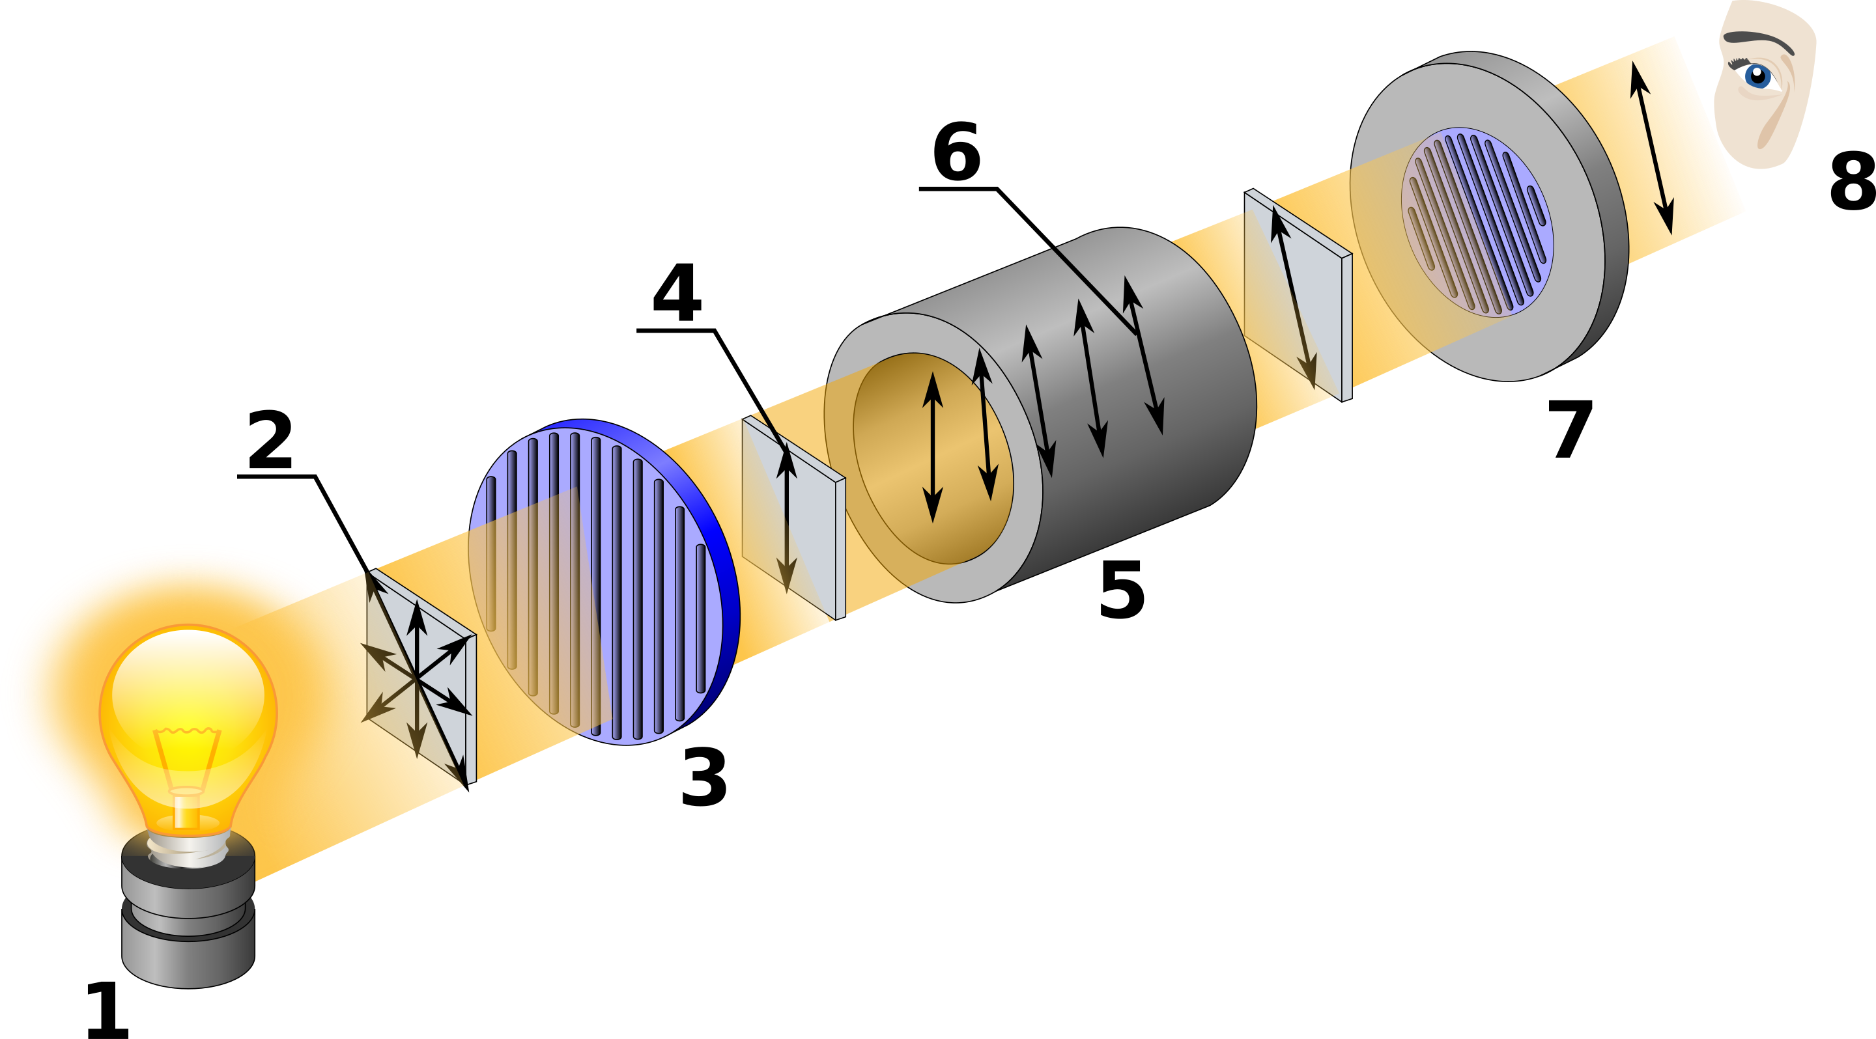






Another way to Squeeze Spins:
(quantum nondemolition) measurement-induced squeezing
$$Γ=1/τ$$
$$Δω$$
$$1/(Δω)2$$
$σ$⁺
$σ$ ⁻
$$1/Δω$$
QND = “dispersive” measurement
Keep measuring ⇒ squeezing
https://en.wikipedia.org/wiki/Polarimeter

Slide 11
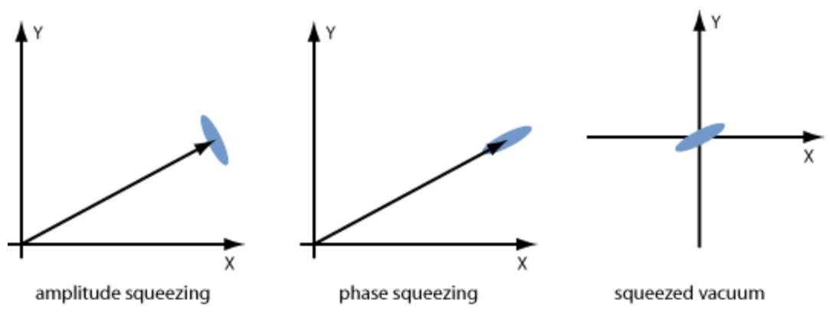
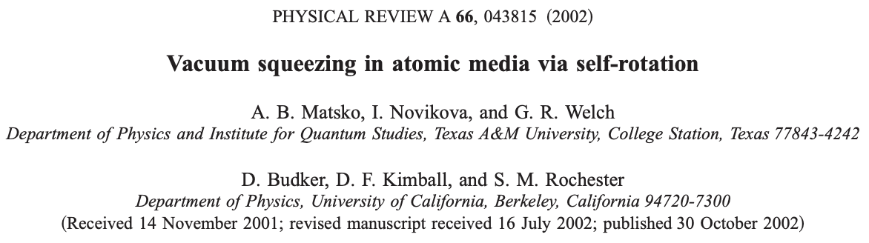
Squeezed Light
www.rp-photonics.com/squeezed_states_of_light.html
Recent experimental work: e.g., by I. Novikova and E. Mikhailov

Slide 12
Polarization self-rotation (SR) and squeezing
Alkali-atom vapor cell
SR = the Maker-Terhune effect
Self-rotating medium (choose proper sign of the effect)
Input linearly polarized light
Quantum noise in orthogonal polarization ⟹ ellipticity
SR rotates ellipse to null the noise field ⟹ vacuum squeezing !
Squeezing at useful wavelength!

Slide 13
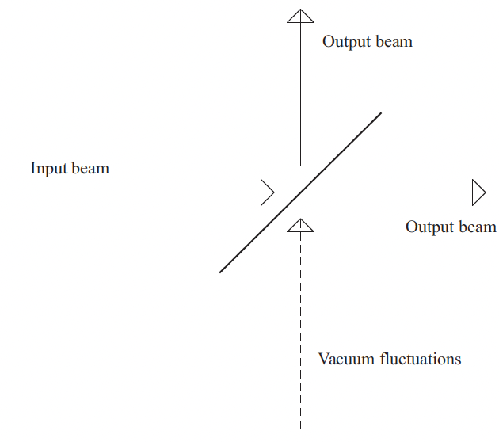
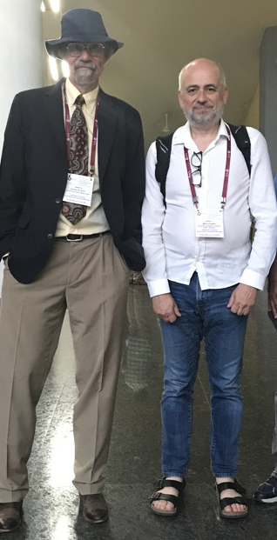
Useful squeezed vacuum
Beamsplitter!
Carlton Caves
Bangaluru, 2023
Insert squeezed vacuum here

Slide 14
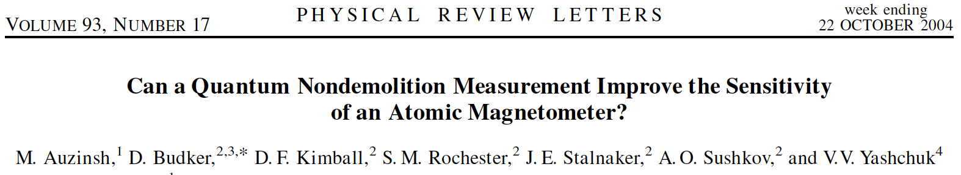
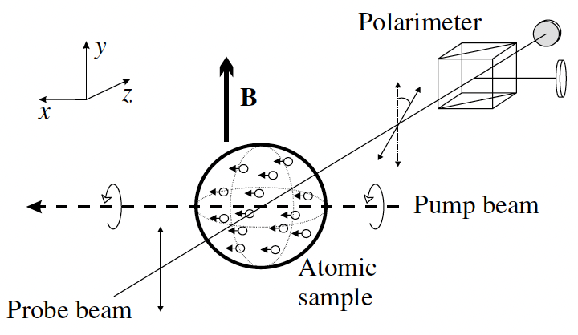
Are squeezing/entanglement/QND useful?
No gain in sensitivity (nonclassical states are fragile)
Similarly for clocks: S. F. Huelga, et al, Phys. Rev. Lett. 79, 3865 (1997)
Demonstrations often start with unoptimized sensors
Improved bandwidth!
M.V. Romalis: gain for nonexponential relaxation!
Quantum feedback (≈ error correction)
Single-photon detection!
⟹ “Quantum 2.0” is useful! (with caution)

Slide 15

How to squeeze?
Nolinear interaction
Squeezed
atoms
PRA 85, 022125 (2012)
Quantum non-demolition measurements
Nature 581, 159(2020)
PRA 47, 5138 (1993)
Dissipation
…
Squeezed
states
PRL 110, 120402(2013)
Optical parametric amplification
Squeezed
light
NC 5, 3049(2014)
Optical self rotation
PRA 66, 043815(2002)
Nature 306, 141(1983)
Optical Faraday rotation
…
PRL 97, 143602(2006)
Dr. Guzhi Bao

Slide 16
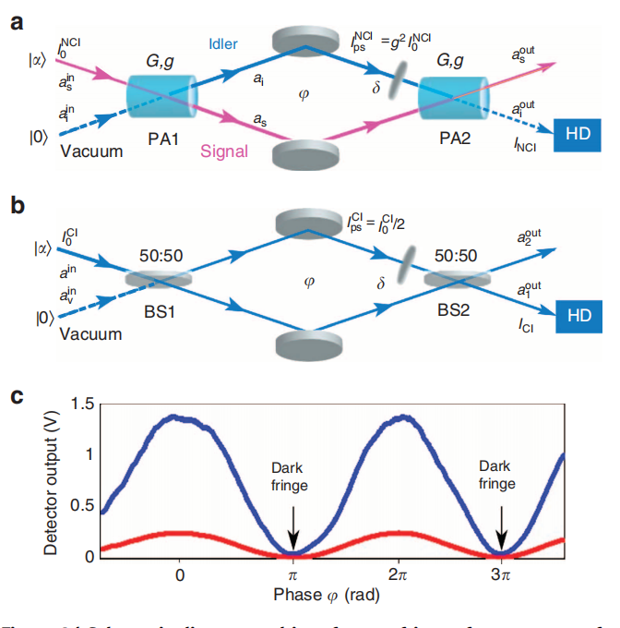
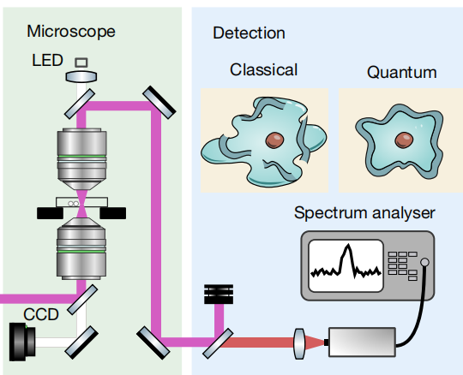
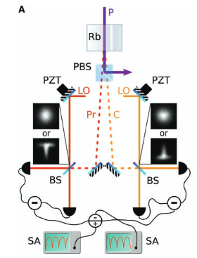

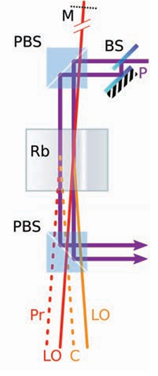
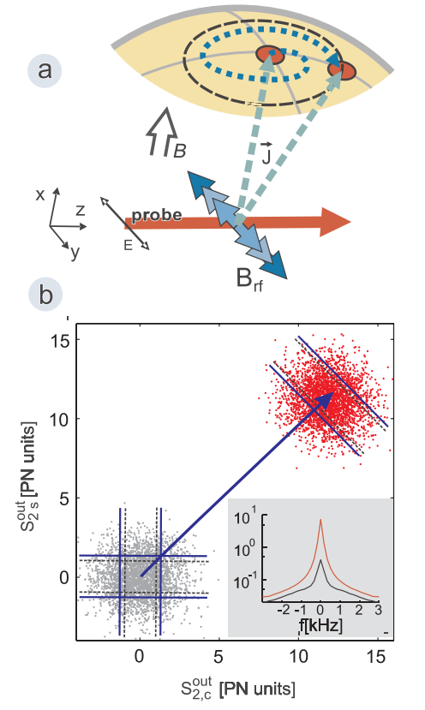
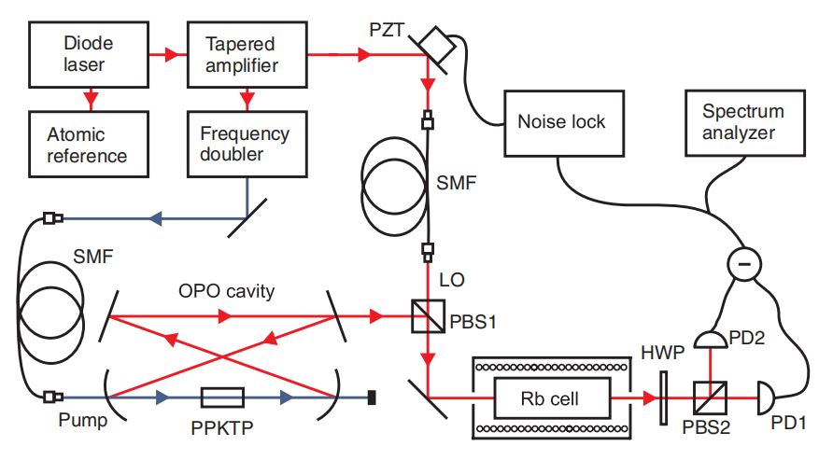
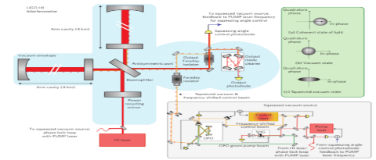
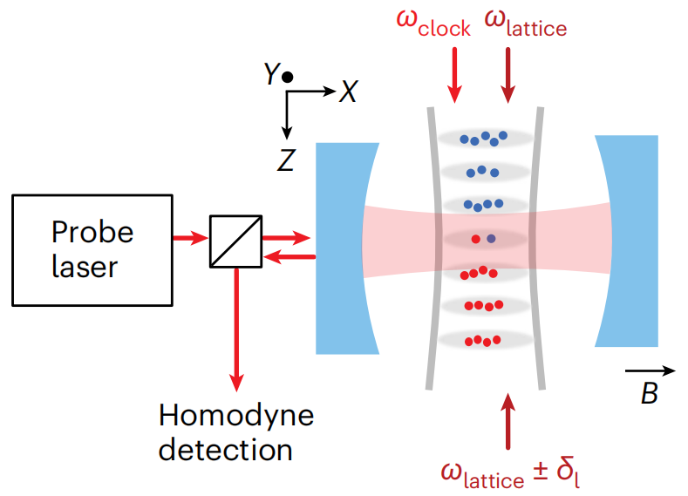
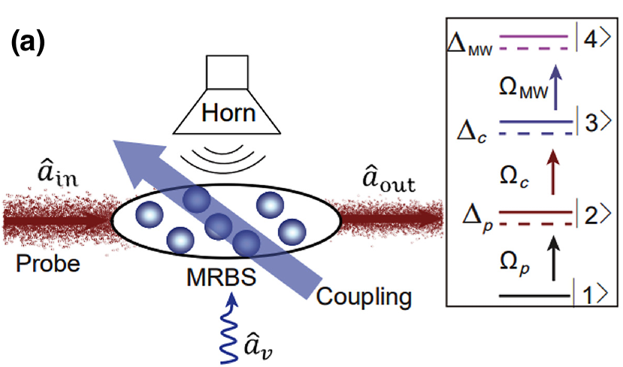
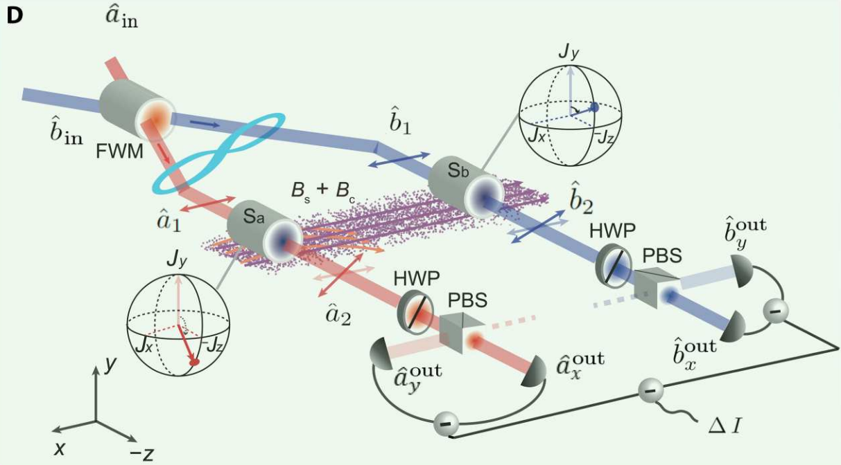

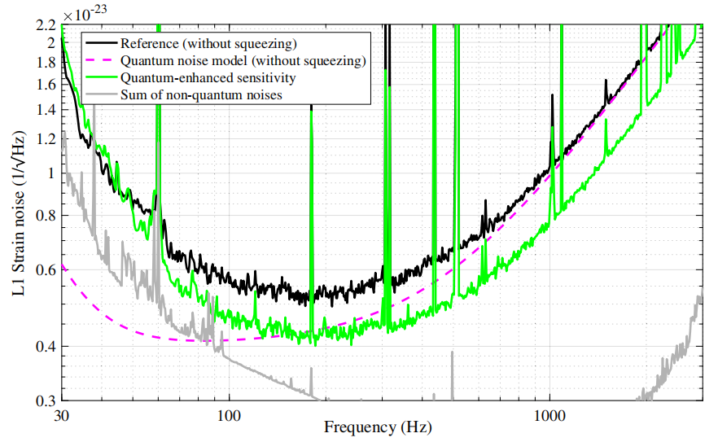
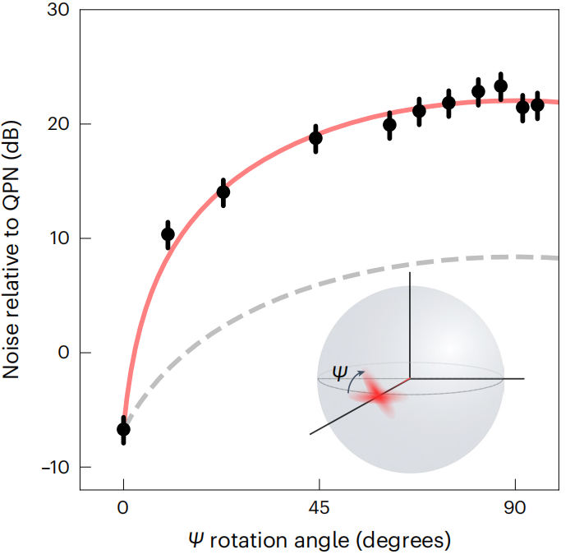
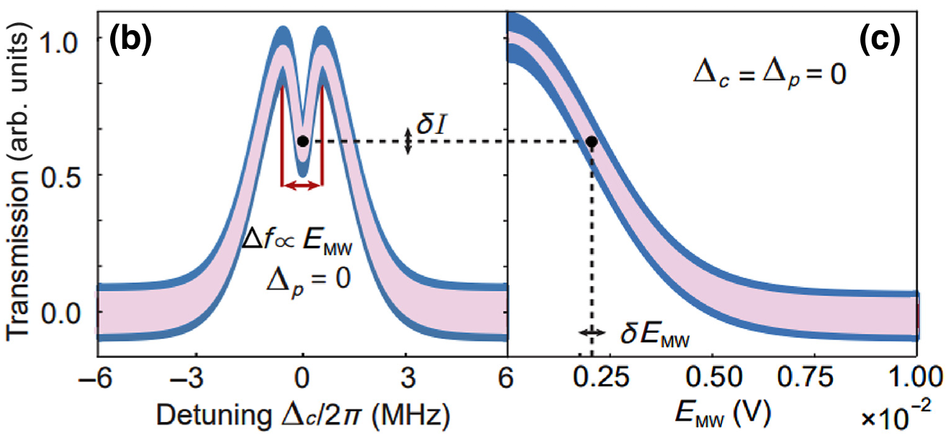
Interferometers
Microscopy
Imaging
Magnetometry
Nat. Commun 5, 3049 (2014)
Nature, 594 201-206 (2021)
Science321,544-547(2008)
PRL 104, 133601 (2010)
PRL 105, 053601 (2010)
Applications
LIGO
Atomic clocks
Electrometers
Gradiometers
Dr. Guzhi Bao
PRL 123, 231107 (2019)
PR Applied 20, 064028 (2023)
Sci. Adv. 9, eadg1760 (2023)
Nat. Phys. 20, 208–213 (2024)

Slide 17
Content
Standard Quantum Limit (SQL): “Eq. (1)”
What is squeezing? Why squeezing?
How to squeeze?
    Orientation-to-alignment conversion (spins)
    Measurement ! (spins)
    Polarization self-rotation (light)
Is squeezing useless? (limitations)
Squeezing can be useful!
Applications: gravitational waves; dark matter, fifth forces,…

