Slide 1
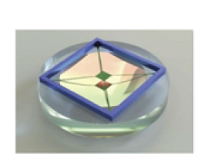
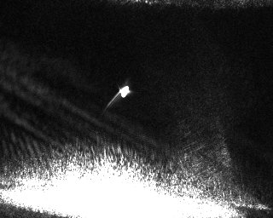
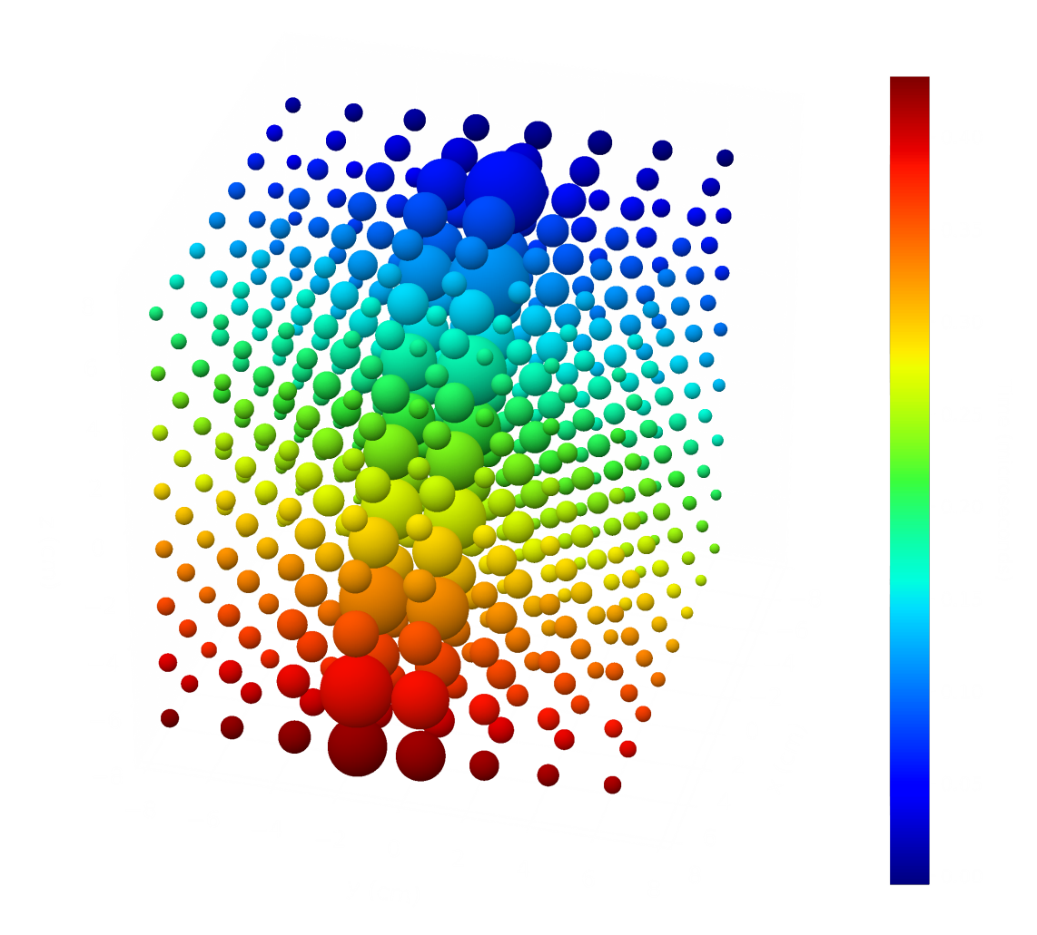
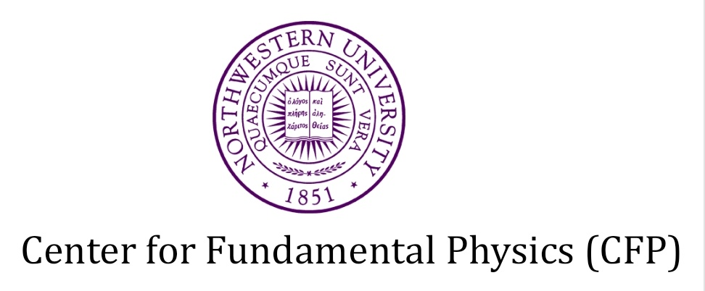
Optomechanical detectors for dark matter and tests of gravity
A.Geraci
Northwestern University
DRD5 Collaboration meeting17 Feb 2025 – WP 1 talk

Slide 2
Optomechanical sensors for dark matter and gravity
Nanofabricated and bulk
mechanical sensors
Superfluid
Helium dark
Matter detectors
Levitated (opto)-mechanical sensors
Optical cavity based dark matter detectors
Large array
mechanical detectors
Also talks: WP-5 and WP-4 (Tues: Mazumdar, Higgins, Wed: Wilson, Datta, Marino)

Slide 3
Outline
Wavelike DM
-Scalar-like: Optical-cavity-based detectors
-Vector-like: Accelerometer detectors
Particle/extended-object DM
-Gravitational Wave detectors for DM (also Axions)
-Levitated microspheres
Tests of Gravity in quantum systems
Future opportunities / directions

Slide 4
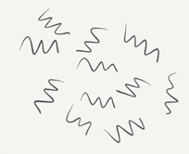
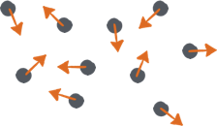
Dark Matter
Field-like
1eV/c²
Particle-like
Neutrinos
Dark Energy
Standard Model
Hubble
LHC
Planck
10⁻³³
10⁻²¹
10⁻³
10⁵
10¹¹
10²⁸
Axions
WIMPs
~10⁻²eV to 10⁻¹¹eV
~10-1000 GeV
10⁻²²
Possible Dark Matter Mass Range

Slide 5


Ultra-light scalar Dark Matter
Dark Matter mass scales:
>10⁻²² eV (size of dwarf galaxies)
Ultralight DM looks like coherent field rather than particle
Techniques for detecting oscillating scalar DM:
Atomic clocks
Bar detectors
Torsion Balances
Atom Interferometers
Asimina Arvanitaki, Savas Dimopoulos, and Ken Van Tilburg, Phys. Rev. Lett. 116, 031102 (2016)
Asimina Arvanitaki, Junwu Huang, and Ken Van Tilburg, Phys. Rev. D 91, 015015 (2015)
Asimina Arvanitaki, Peter W. Graham, Jason M. Hogan, Surjeet Rajendran, and Ken Van Tilburg
Phys. Rev. D 97, 075020 (2018)
Peter W. Graham, David E. Kaplan, Jeremy Mardon, Surjeet Rajendran, William A. Terrano
Phys. Rev. D 93, 075029 (2016)

Slide 6
Detecting ultra-light scalar dark matter with optical cavities
oscillations in size of atoms (and strain in material objects)
Dark matter field causes strain in rigid cavity at f_{φ}
Suspended cavity cannot respond quickly enough for f_{φ} in audio-band (100 Hz- 100 kHz)
AG, C. Bradley, W. Gao, J. Weinstein, A. Derevianko, PRL (2019)

Slide 7
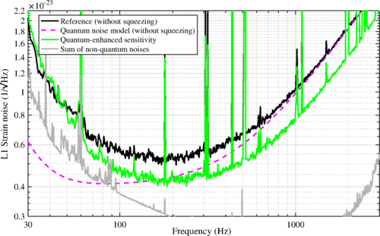
Reach for variation of electron mass d_{me}
-Cryogenic experiment for low thermal noise to reach the shot noise limit
- quantum squeezing techniques can improve sensitivity >1 kHz
Borrow proven methods from GW community (LIGO, VIRGO):
AG, C. Bradley, W. Gao, J. Weinstein, A. Derevianko, PRL (2019)

Slide 8
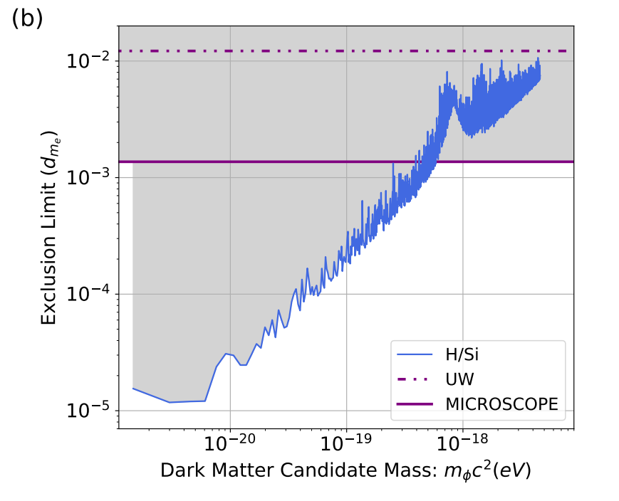
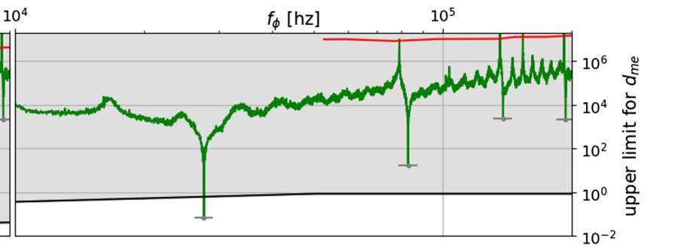
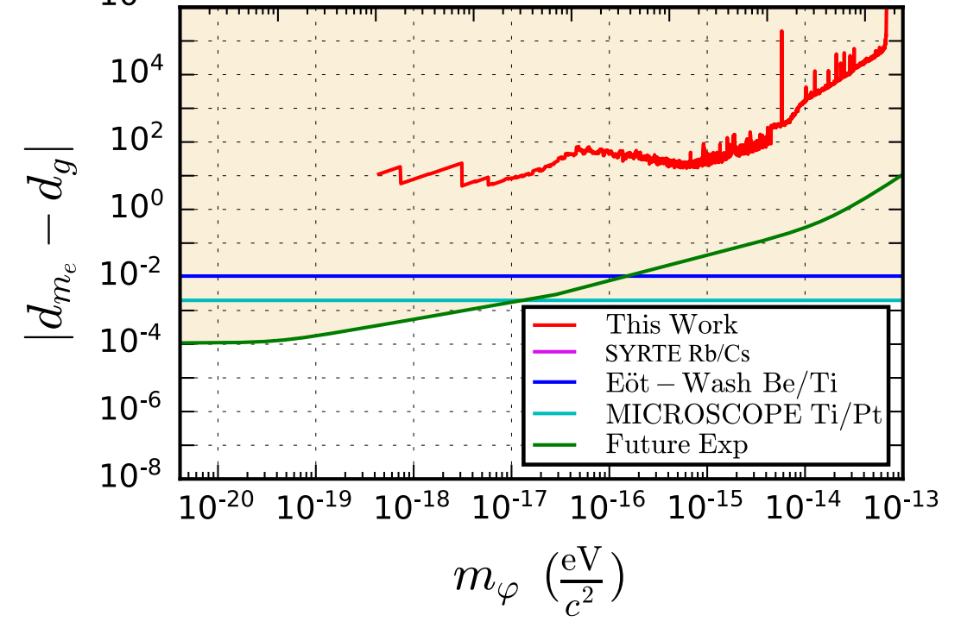
Recent DM limits from other cavity experiments
Experiments are already constraining scalar dark matter!
Savalle et al. PRL 126, 051301 (2021).
Kennedy et al. PRL 125, 201302 (2020).
Campbell et al. PRL 126, 071301 (2021)

Slide 9
New results from cavity comparison DM search
T. Deshpande, A.Ionescu, N. Miller, Z. Wang,G.Gabrielse, AG,, T. Kovachy, arxiv: 2412.20623

Slide 10
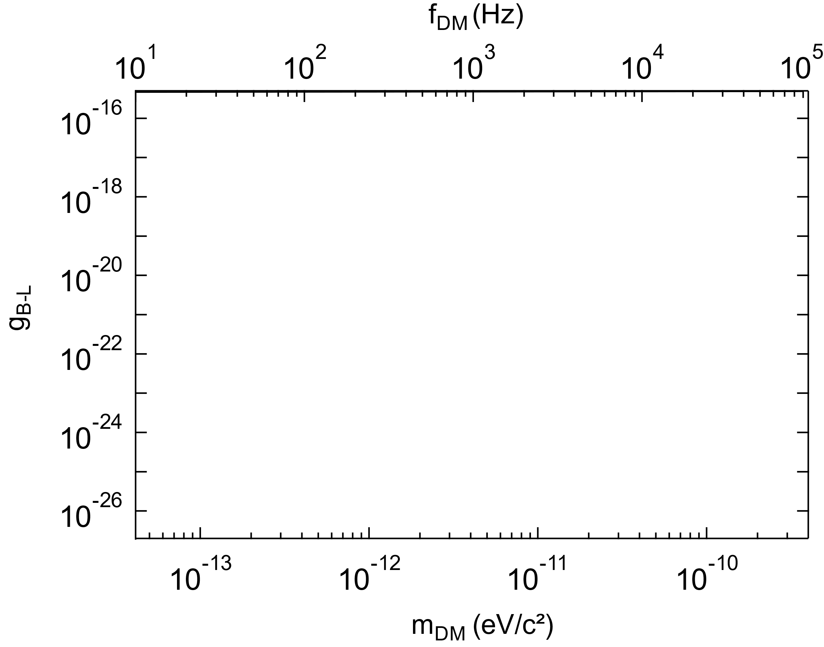
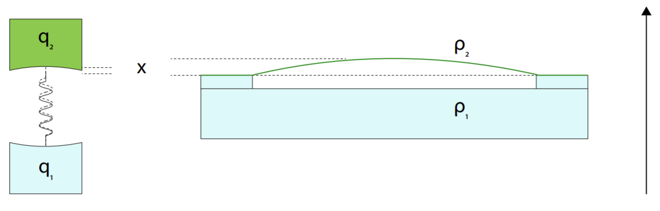
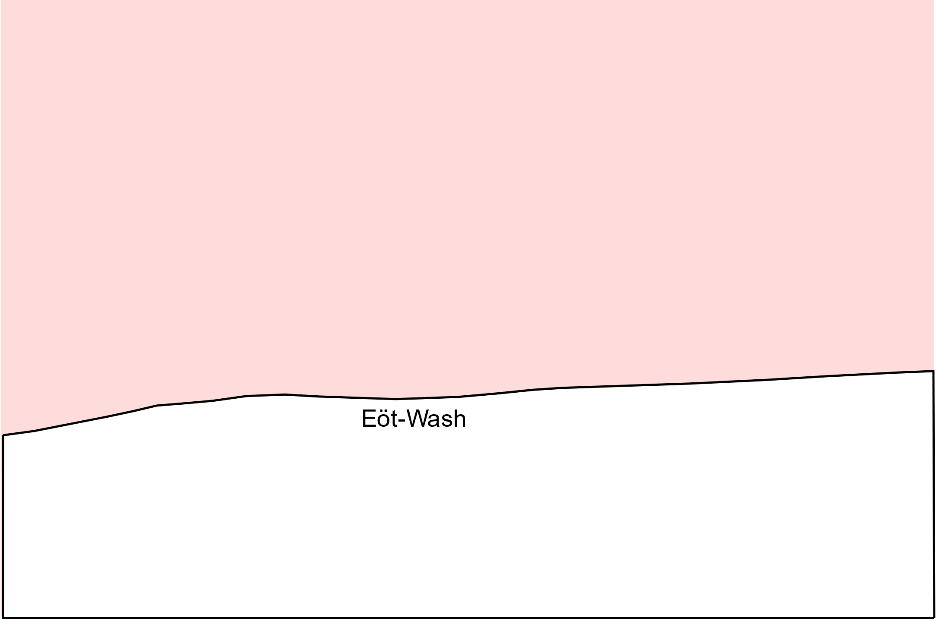
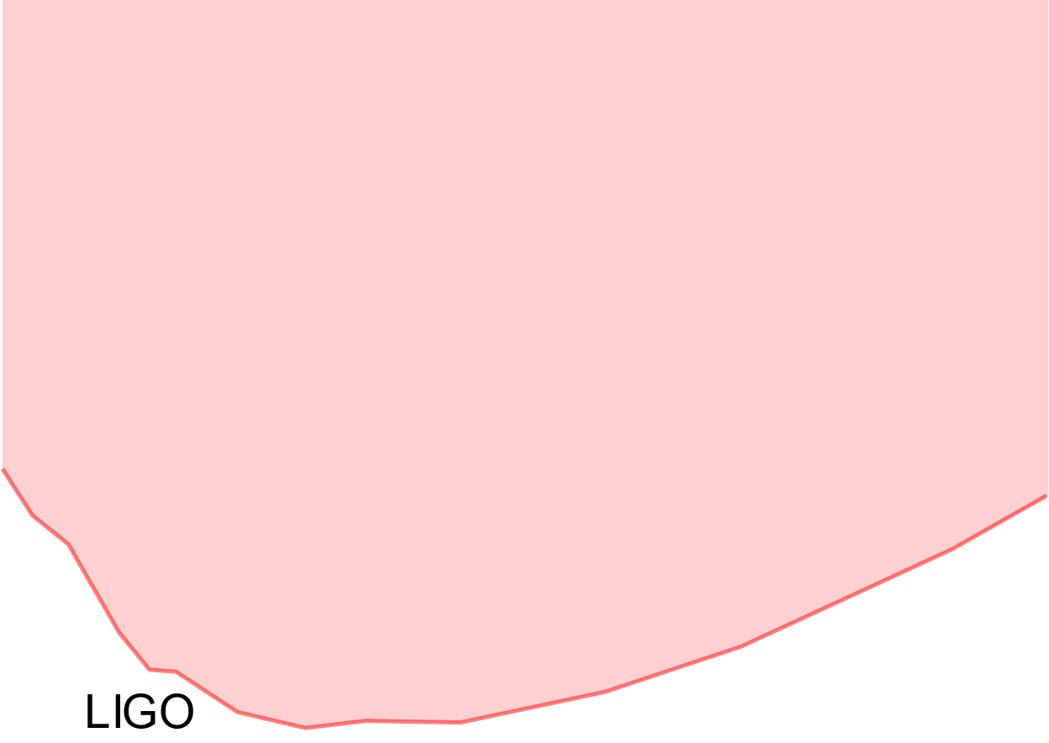
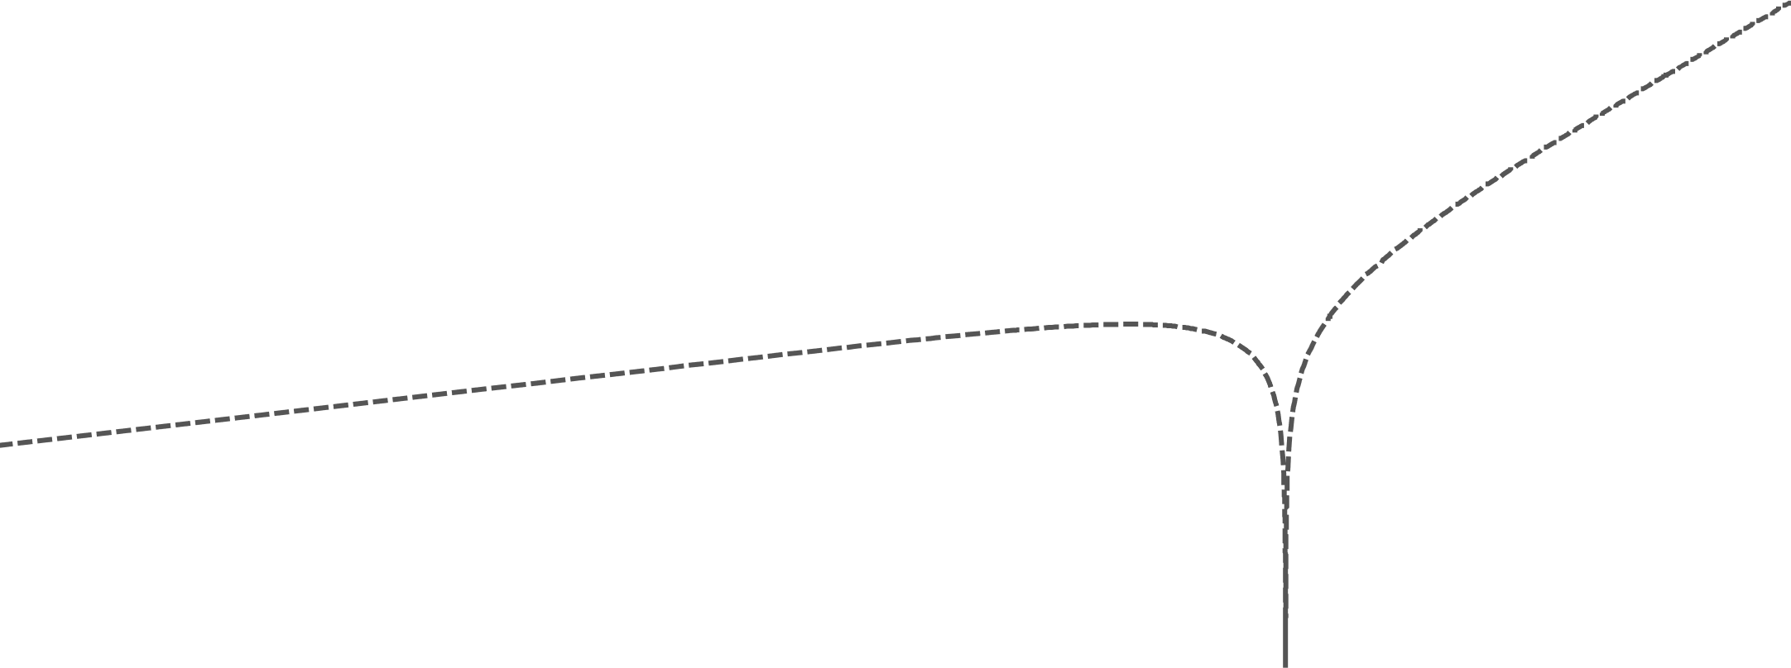
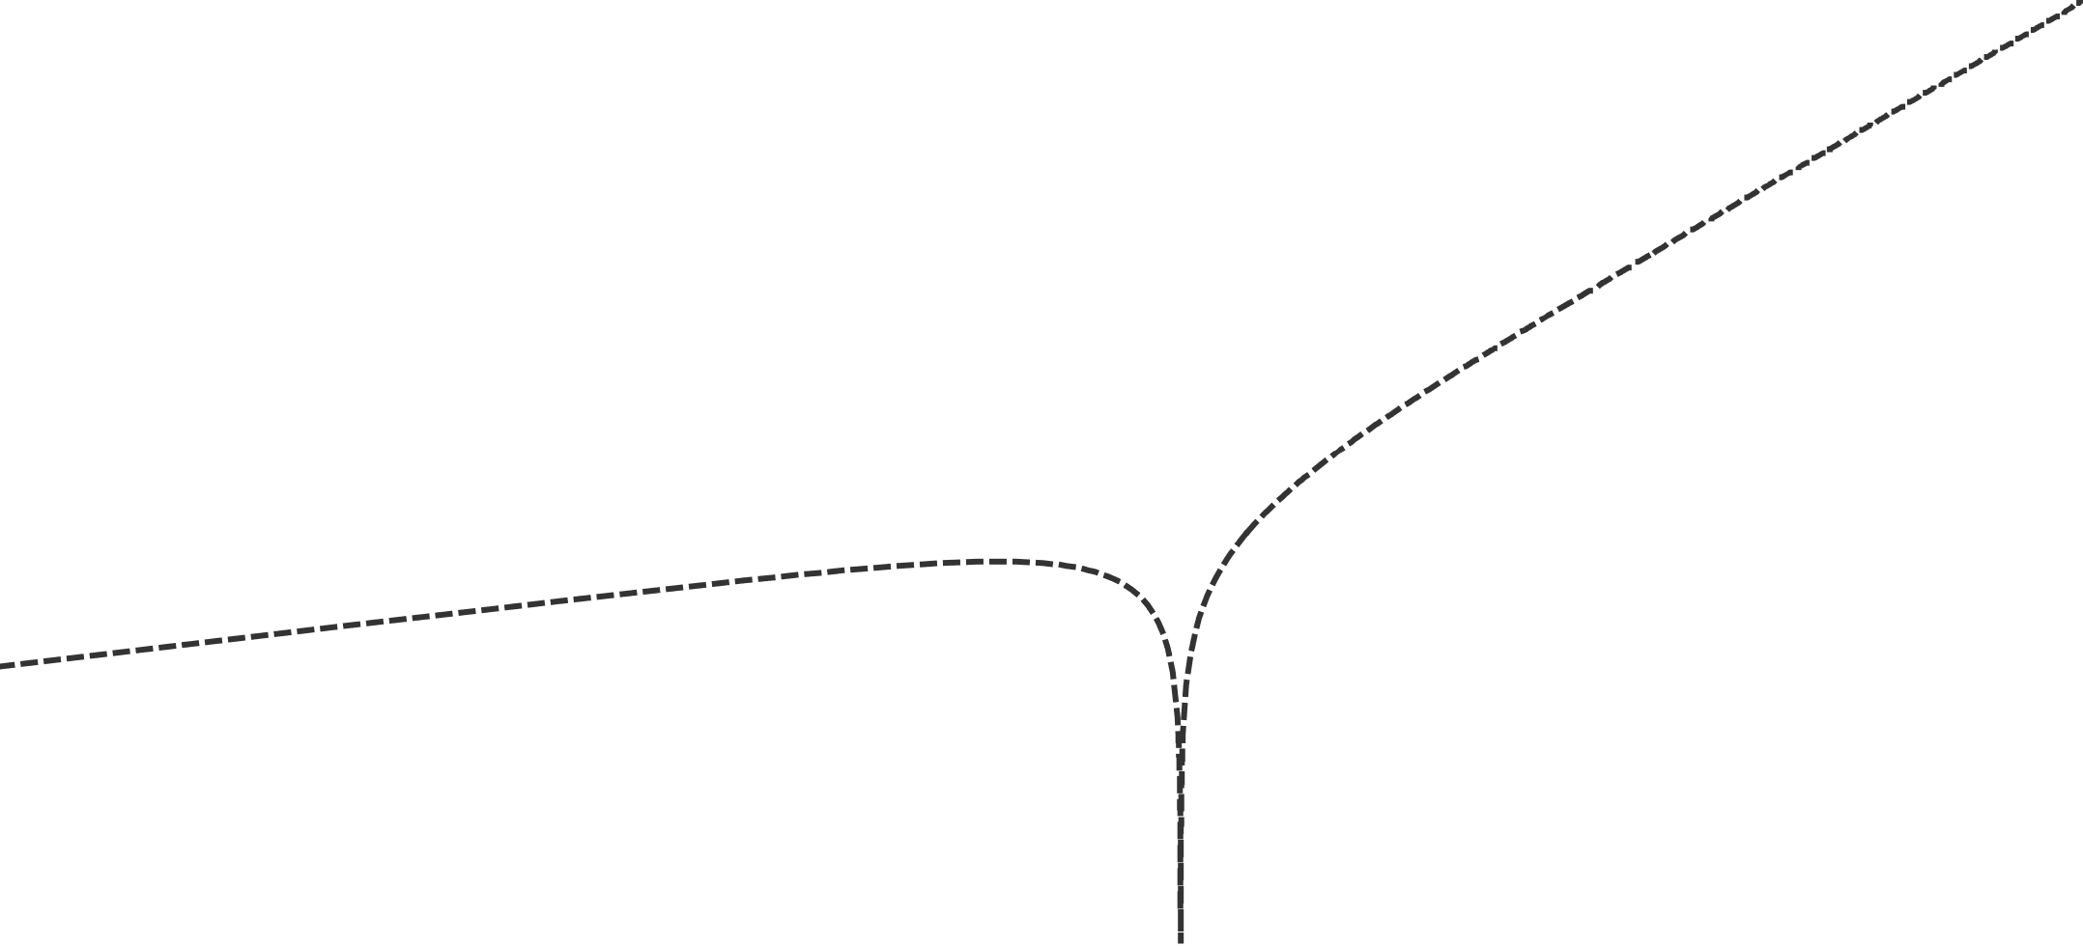
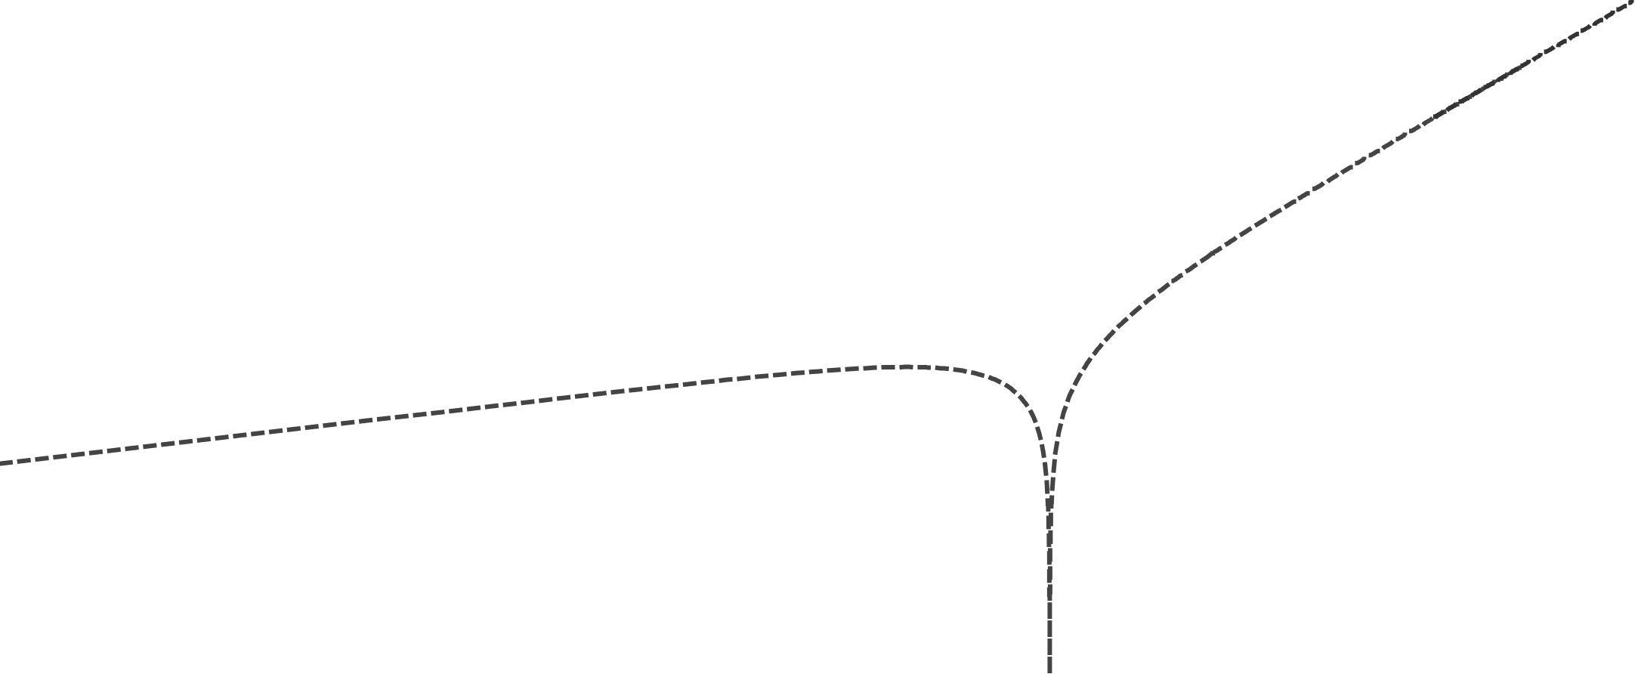
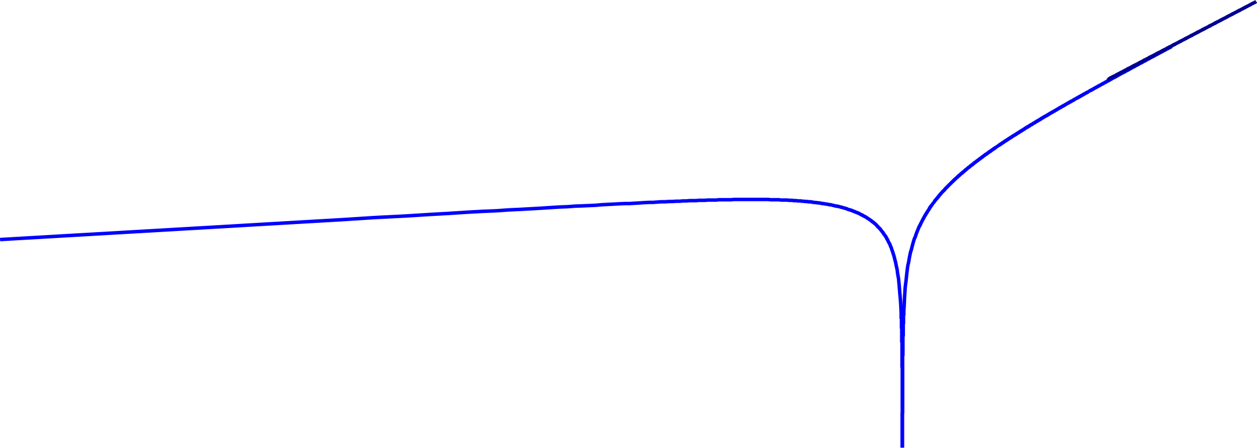
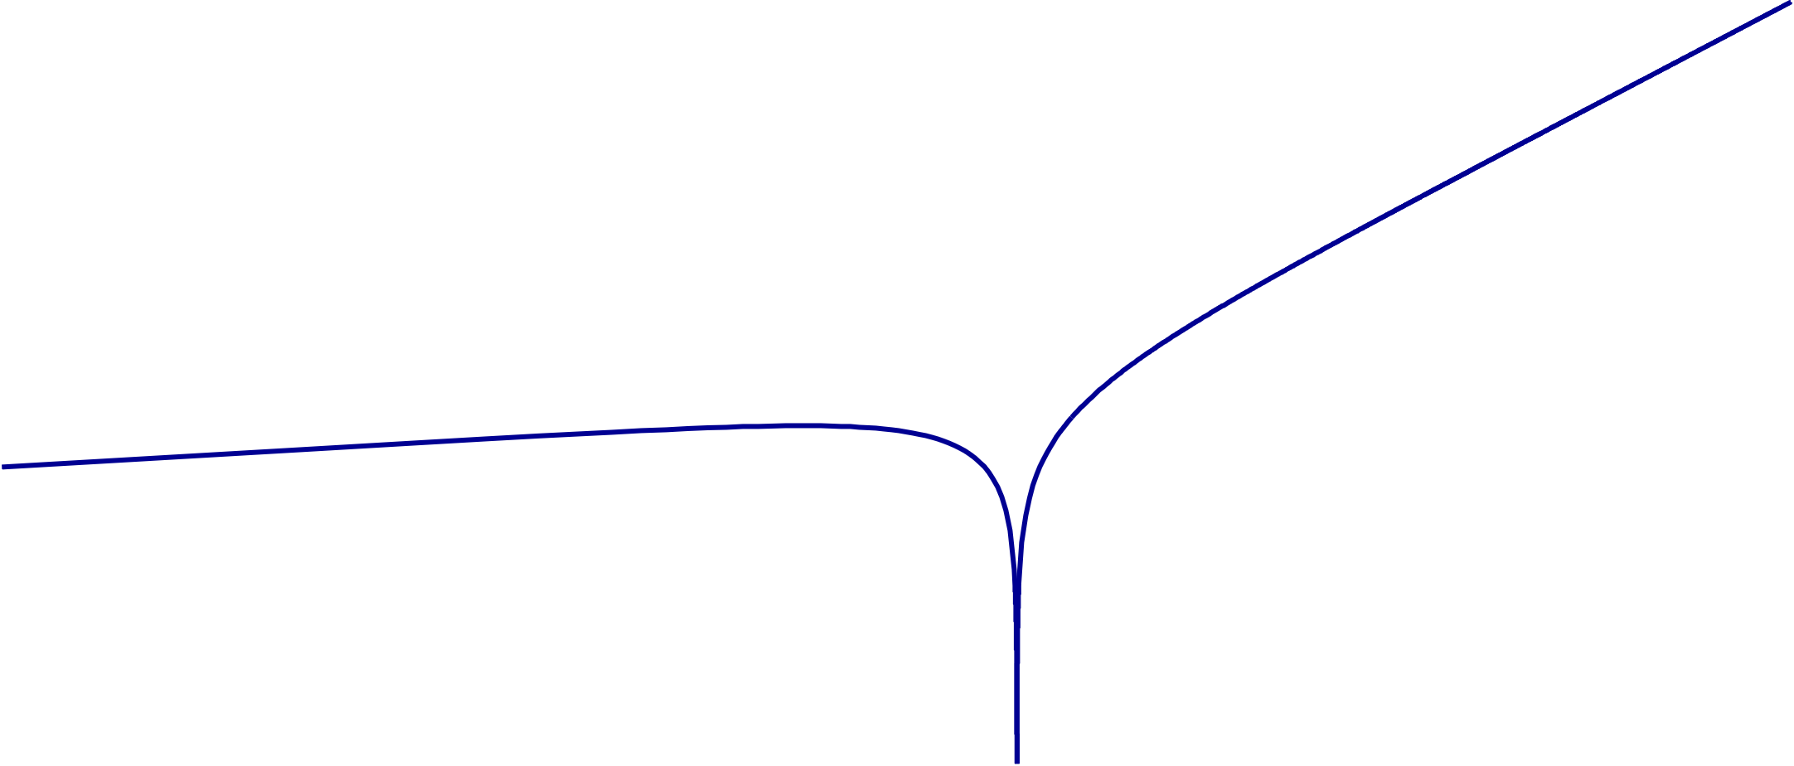
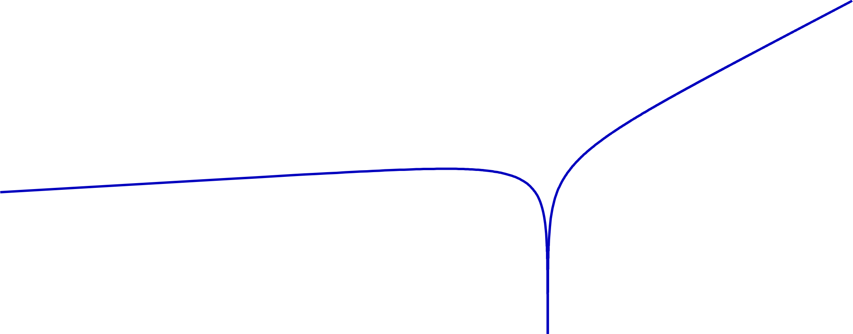
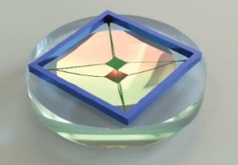
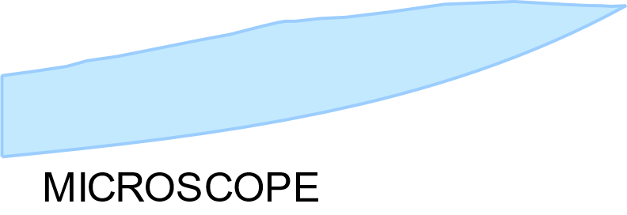


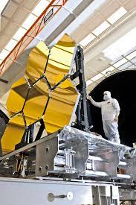
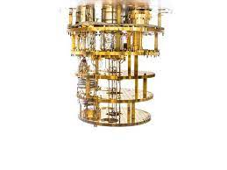

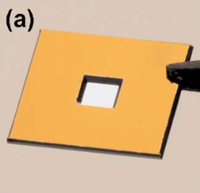
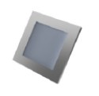
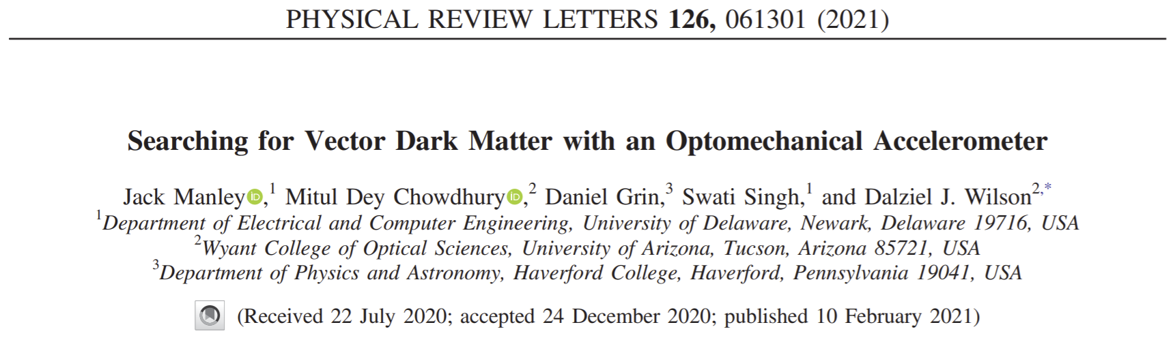


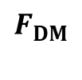
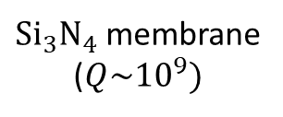

A membrane-based dark photon detector
Differential acceleration between materials (e.g. if coupled to B-L)
SiN
$$F_{DM}$$
$$τ=τ_{DM}≈90s$$
$τ=1$ year
Be
+
+
$Si_{3}N_{4}$ membrane
($Q\sim {10}^{9})$
Cryogenics
(100 mK)
Be Mirror
(Webb telescope)
$$L$$
Manley et. al. PRL 126 061301 (2021)

Slide 11
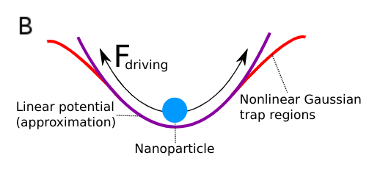
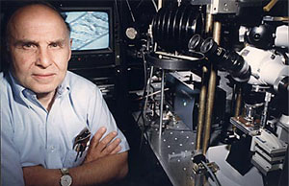
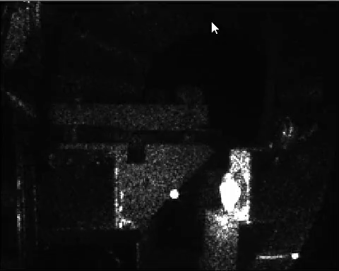
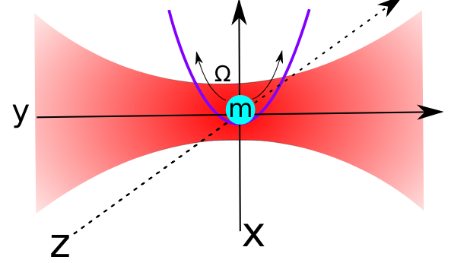
Levitated optomechanics - brief introduction
Ashkin, Bell Labs, 1970s
Ashkin (76) Levitation in high vacuum
Optical tweezers → biology, biophysics
Polarisable neutral glass particles act as high field seekers - trapped in laser focus
High Q factors ~ 10^12 → excellent force sensors
Can reduce the effective motional ‘temperature’ of such objects through feedback schemes

Slide 12
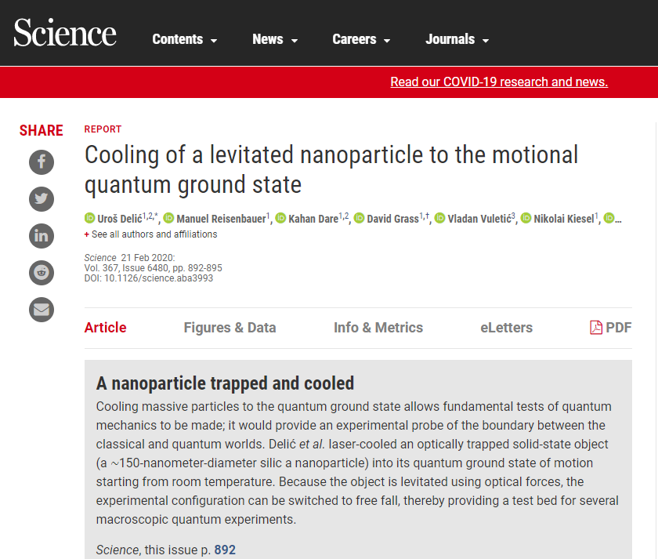
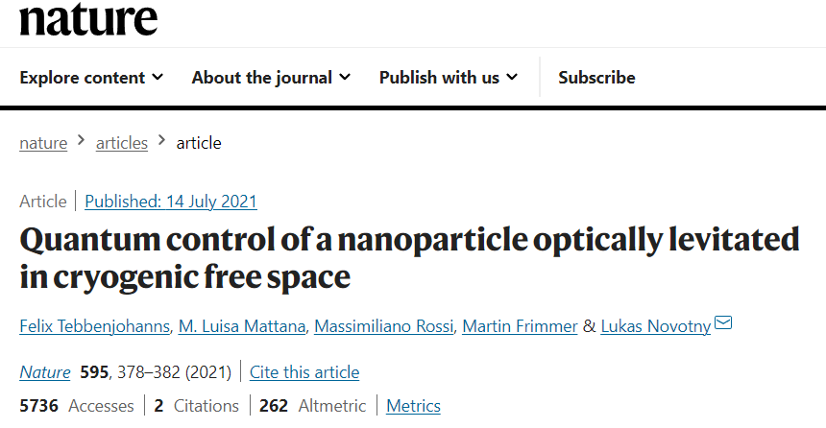
(Ground) state of the art:
Dynamical backaction:
Measurement based cooling:
Notes:
Coherent scattering

Slide 13
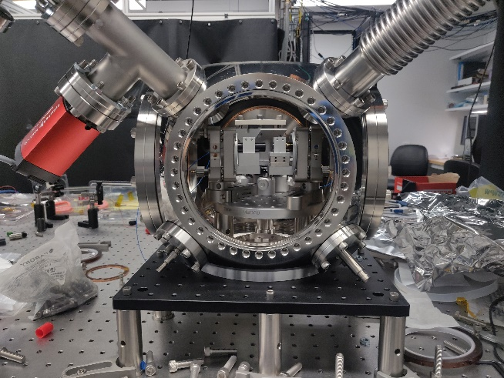
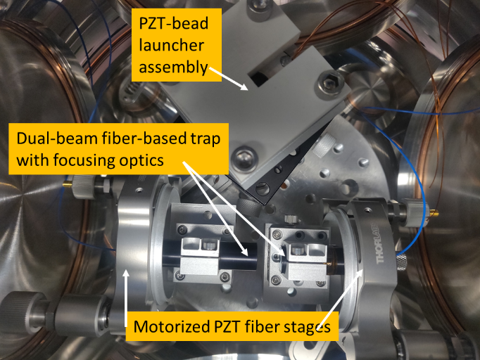
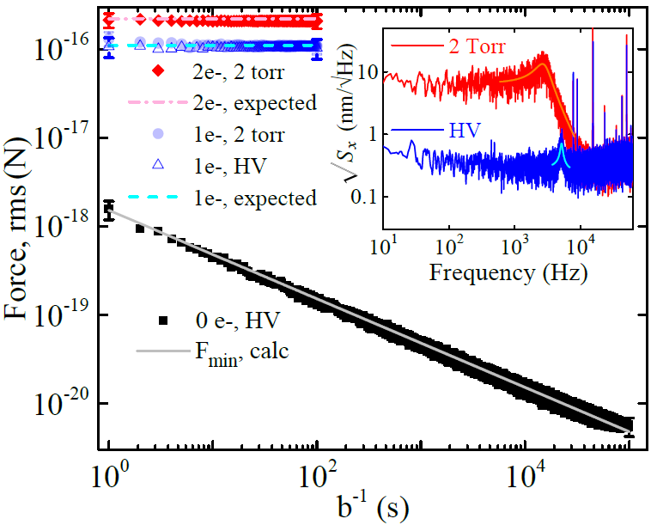
Levitated optomechanical sensors
Ripples in space-time
nanoparticle standing-wave trap (optical lattice) in UHV
zeptonewton sensing
6 zN
G. Ranjit, et.al. , Phys. Rev. A, 93, 053801 (2016)
C. Montoya et. al. arXiv:2103.03420 (2021)

Slide 14
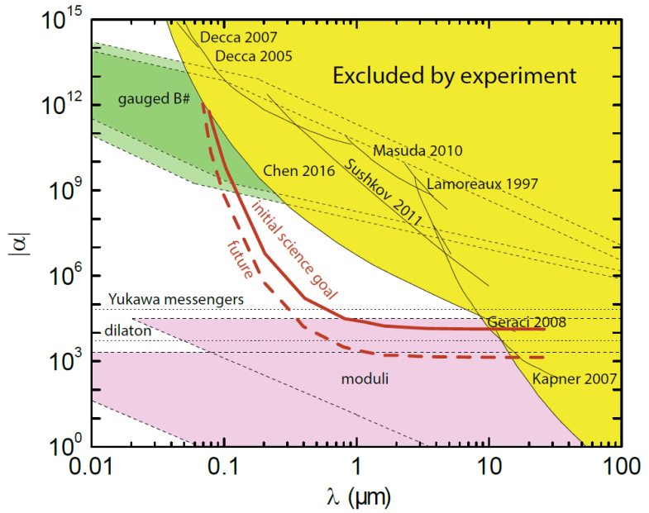
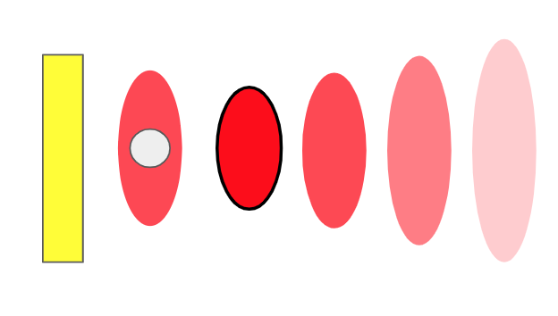
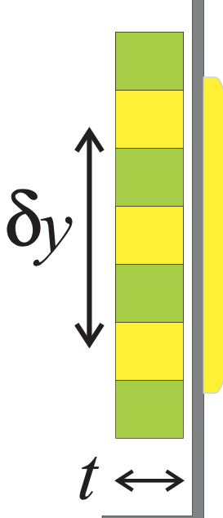
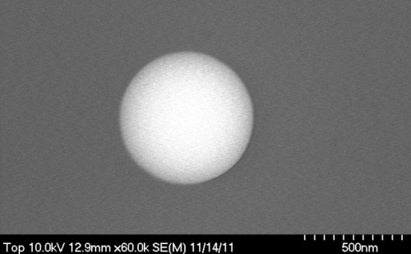


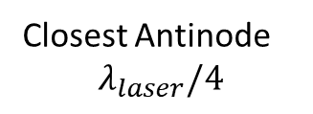
Levitated nanospheres – testing gravity at um-range
Closest Antinode
$$λ_{laser}/4$$
Test mass
300 nm silica bead
Drive mass
(Au/Si)
Exotic particles (new physics)
-Supersymmetry, string theory
Au coated
SiN membrane
Notes:
The Casimir force while interesting in itself, is a significant background. We use the retro-reflecting mirror (Au coated SiN membrane) as an electromagnetic screen to keep the strong casimir background constant, not varying when we move the source mass behind the mirror.

Slide 15
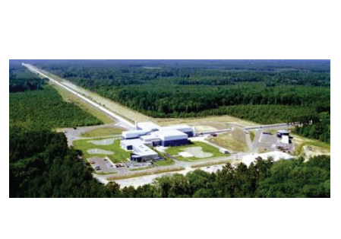
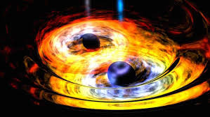
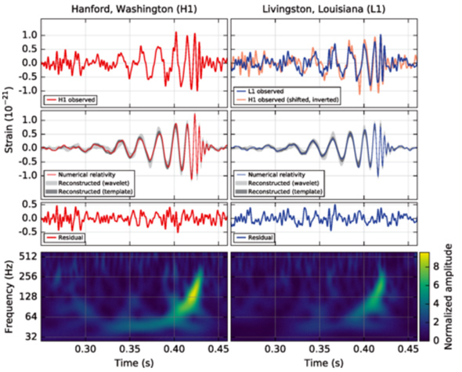
Gravitational waves
Ripples in space-time
Discovered by LIGO Sep 2015 !!
Sources:
  Inspirals of astrophysical objects
  Inflation, Phase transitions, etc.
B. P. Abbott et al. (LIGO Scientific Collaboration and Virgo Collaboration)
Phys. Rev. Lett. 116, 061102 (2016).

Slide 16
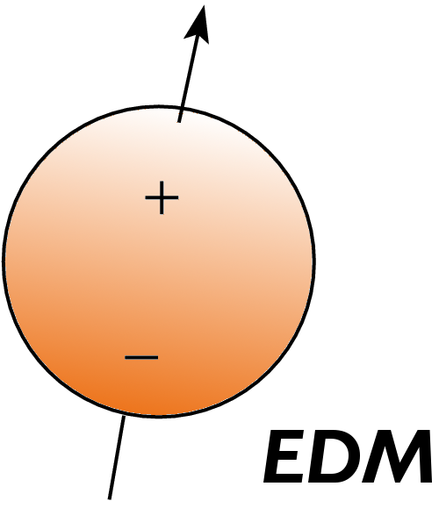
The Dark Sector
GW detectors are a probe of the Dark Sector
Axions
Primordial Black Holes (PBHs)
Peccei-Quinn Axion (QCD) solves “strong-CP problem”
Dark matter candidate
R. D. Peccei and H. R. Quinn, Phys. Rev. Lett. 38, 1440 (1977); S. Weinberg, Phys. Rev. Lett. 40, 223 (1978); F. Wilczek, Phys. Rev. Lett. 40, 279 (1978).
Remnant from early universe
Wide range of possible masses (sub-M_{sun})

Slide 17
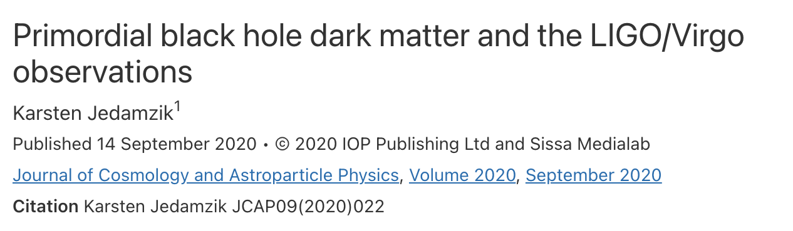
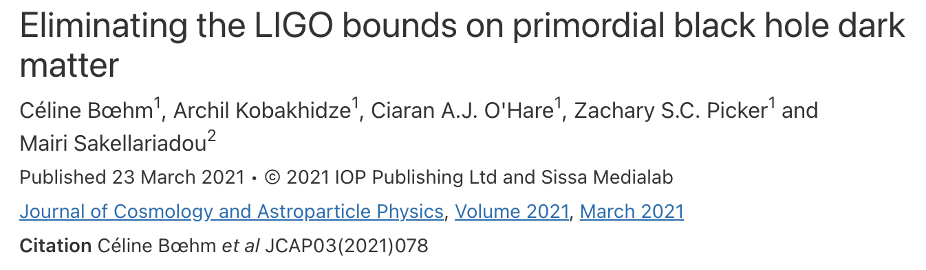
GWs from Dark Matter?
LIGO
Seismic noise
Laser shot noise
Coating thermal noise

Slide 18
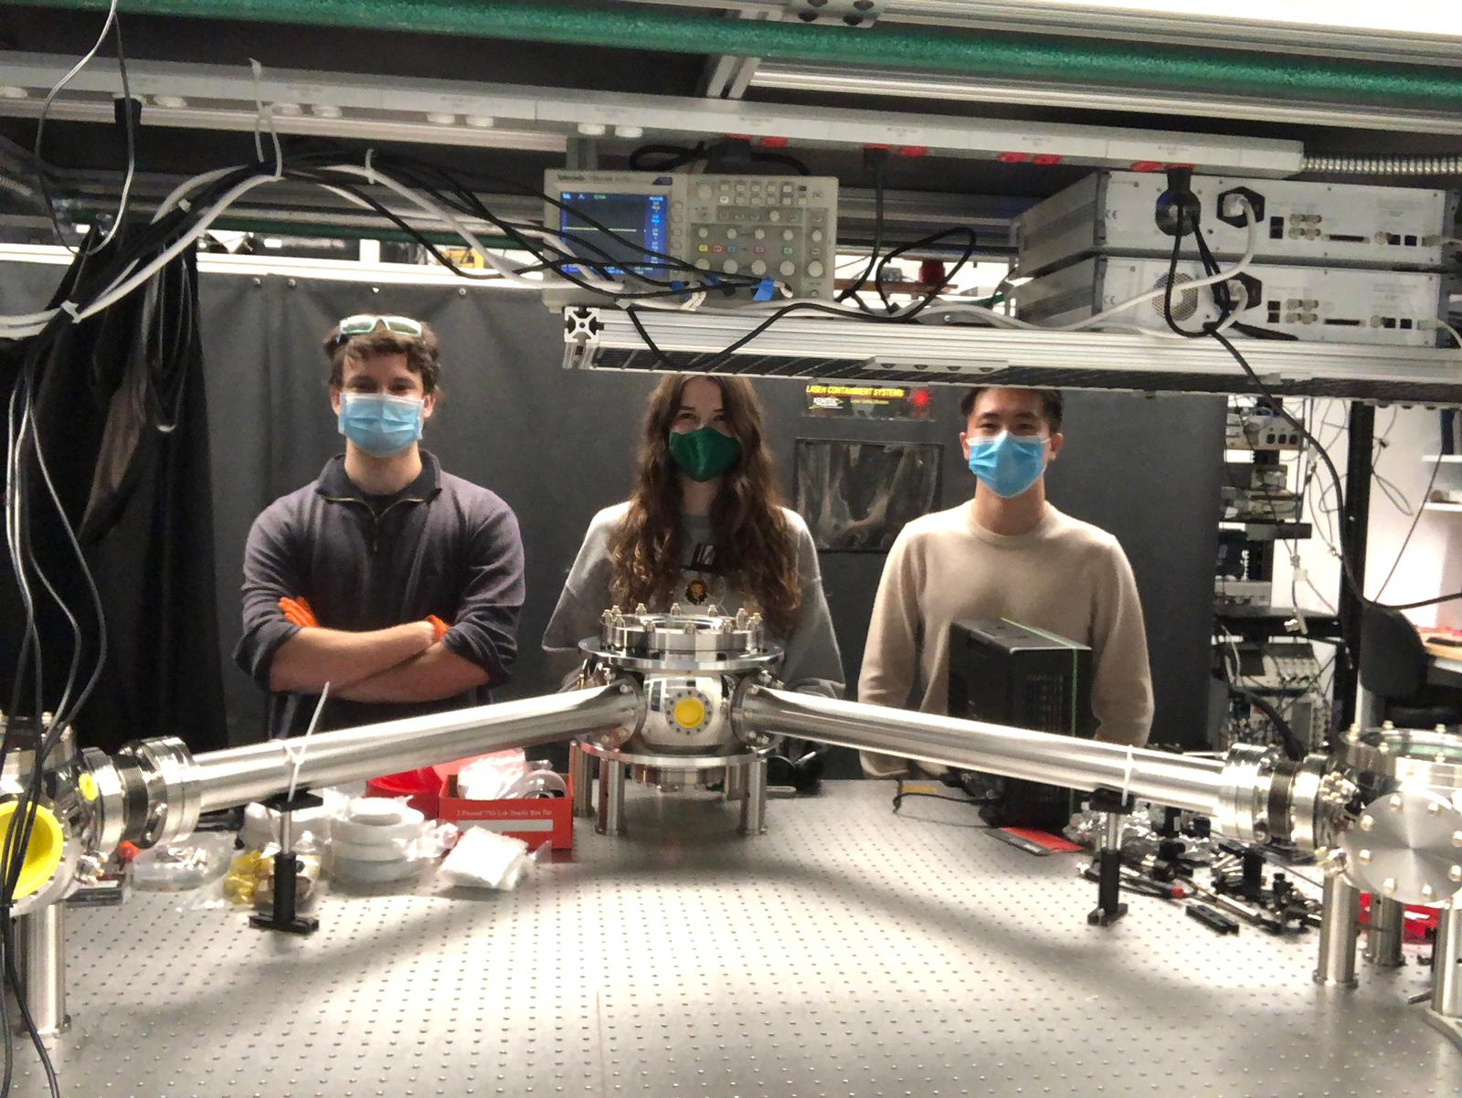



Novel gravitational wave detector for > 10 kHz
Ripples in space-time
1-100m
GW Strain h = ΔL/L
1-meter Levitated Sensor Detector (LSD) prototype
Laser intensity changed to match trap frequency to GW frequency
For a 10m cavity, h ~ 10⁻²² Hz ^{-1/2} at high frequency (100kHz)
Novelty: Limited by thermal noise in sensor (not laser shot noise) → much better at high frequency!
A. Arvanitaki and AG, Phys. Rev. Lett. 110, 071105 (2013), Aggarwal et. al., Phys. Rev. Lett. 128, 111101 (2022).

Slide 19
High frequency gravitational waves probe dark sector
Estimated signals from axion annihilation in BH superradiance
black hole
1 m
10 m
100 m
axion cloud
Distance to source: 10 kpc
(within our galaxy)
J. Sprague et.al, arXiv:2409.03714
Aggarwal et. al., Phys. Rev. Lett. 128, 111101 (2022).

Slide 20




Levitated object optimization: disc/plate vs sphere
Ideal sensor: high mass, high frequency, low photon recoil
SiO2 disks & NaYF hexagons
Less isotropic scattering reduces photon recoil noise
Aggarwal et. al., Phys. Rev. Lett. 128, 111101 (2022).
G. Winstone et.al., Phys. Rev. Lett. 129, 053604 (2022)
Notes:
We propose that the sensitivity limit due to photon recoil heating can be lowered by strategically choosing shapes and sizes for our levitated particles, that are not the typical spheres. For small spheres, the scattering is nearly isotropic which means the recoil from photon momentum transfers will be in random directions. Larger, flatter objects do a better job of forward scattering, so for sufficiently large cylindrical shaped particles, the photons will be scattered much more into the cavity mode, so the recoil has less variance and this reduces decoherence.
For various reasons, we also prefer to have more massive levitated objects. For that reason and others, we plan to use these cylindrically shaped objects with layers of Silicon and Silica where the thickness of the layers is chosen for perfect transmission and internal reflections that will improve the trapping potential without substantially increasing the photon recoil rate.

Slide 21

Vision for HF gravitational wave astronomy
Need a network
of detectors!
D.C. Moore and AG, Quantum Sci. Technol. 6 014008 (2021)

Slide 22

Composite DM search with Levitated microspheres
Ripples in space-time

Slide 23
Quantum Regime: Matter wave interference

Slide 24



Quantum Regime: Matter-wave interferometry
Nano-g acceleration sensing
A.G. and H. Goldman, Phys. Rev. D 92, 062002 (2015).

Slide 25




Experimental layout

Slide 26


Does Gravity participate in Quantum Entanglement?
Gravity entangles in less than a second for micro-diamonds for $Δx∼10μm$ superposition!
Gravitational Interaction is Quantum
Space-time is Quantum
S. Bose, A. Mazumdar, G. W. Morley, H. Ulbricht, M. Toroš, M. Paternostro, AG, P. F. Barker, M. S. Kim, and G. Milburn (PRL 2017)
Elahi, Schut, Grinin, Dana, AG, Bose, Mazumdar (arxiv:2024)
Schut, AG, Bose, Mazumdar, Phys.Rev.Res. (2024)

Slide 27
Summary
Optomechanical detection of DM looks very promising
- narrowband mechanical resonators/accelerometers
- broadband cavities
- gravitational wave searches for the Dark Sector (axions, PBHs)
- search for composite or Planck mass DM with levitated microspheres or arrays of sensors (e.g. Windchime)
(also torsion balances, atom interferometers, superfluid He…)
→ Opportunities for networking detectors for e.g. coincidence detection/spatial correlation, scaling up arrays of sensors
Massive quantum superpositions could test quantum behavior of gravity
→ Technical limiting factors in many (opto)-mechanical experiments (external vibration, gravity gradient noise) could be addressed by suitable shared underground facilities (cavity experiments, torsion balances, matter wave interferometers)
→ Exciting road ahead in coming decade(s)!

Slide 28












Acknowledgements
Collaborators (GW):
Nancy Aggarwal (Davis)
Peter Barker (UCL)
Peter Pauzauskie (UW)
Astro Theory:
Asimina Arvanitaki (Perimeter)
Masha Baryakhtar (Perimeter)
Mae Hwee Teo (Stanford)
Shane Larson (NU)
Vicky Kalogera (NU)
From left to right: Alexey Grinin (PD), Nancy Aggarwal (UC Davis), William Eom (G), Nia Burrell (G), Aaron Zhiyuan Wang (G), Chethn Galla (G), Andrew Geraci (PI), Cris Montoya (PD), George Winstone (PD), Chloe Lohmeyer (G), Shelby Klomp (G), Evan Weisman (PD), Andrew Poverman (G), Eduardo Alejandro (G), Andrew Laeuger (UG)

