Slide 1

Techwatch WG Restart
WLCG Grid Deployment Board Monthly Meeting
February 14, 2024
Presenter: Shigeki Misawa
Scientific Data and Computing Center (SDCC)
Brookhaven National Laboratory

Slide 2
Introduction
HEP/NP experiments are heavily dependent on timely advancements in compute, network, and storage technologies to analyze their data.
Changes in the trajectory of these advances will have an impact on current and future research
The HEPiX Techwatch WG was created in 2018 to monitor trends in technology and provide periodic reports to the HEPiX community on the state of technology
  Outgrowth of previous work by Bernd Panzer and Helge Meinhard
The group has been dormant since the start of the Covid 19 epidemic with the last meeting in Feb 2020 and the last major presentation at CHEP 2019

Slide 3
Restarting Techwatch
New co-conveners: Andrea Chierici, Shigeki Misawa and Andrea Sciabà
First meeting of a reconstituted Techwatch group in 17/01/2024
  Introduce the purpose of the group and deliverables as originally envisioned by Bernd and Helge as well as the technologies of interest.
Significant discussions on the nature of the working group
  Mid term or long term view of technology ?
    Long term is considerably more speculative. E.g., what’s beyond CMOS
  Component vs system level technology focus or both ?
  Role of commercially available, for fee, research reports, if any ?
    Previous group utilized publicly available information, e.g. news sites, press releases, freely available conference presentation
  Extent of focus on market analysis in addition to technical overviews
  Mechanics of how the group should be organized and operate.

Slide 4
Areas of Interest of Previous Techwatch 2018 Group
General market trends
Server market
CPUs and accelerators
  Semiconductor process technology
  Chiplets and die interconnect
  x86, ARM and Power CPUs
  GPU
  AI/ML processors
Memory
  State of static and dynamic RAM
Storage
  Disk
  Flash (solid state)
  Tape
Network
  WAN
  LAN
Partitioning of subject areas for the new Techwatch group are being worked out

Slide 5
Proposed Subgroup/Subject Area Mapping
Market Trends Subgroup
Server and data center infrastructure
CPUs, accelerators, and APUs
Memories, busses and interconnects
Online Storage (HDD/SSD)
Offline Storage (Archive disk, tape)
Network

Slide 6
Deliverables and Audience
Presentations at HEPiX meetings
  Current expectation is one or more presentation from the working group at each meeting
  Presentation topic - TBD
Presentations at other venues
Reports
  “Executive” summaries
    Short documents for consumption by project planners
    Identify technologies worthy of more in depth investigation to the HEPiX board
  In-depth reports
    A longer document providing details on current state of technologies, major milestones and decision points in the evolution of technology
    Targeted at the entire HEP/NP community
  Live documents
    Expectation is that all deliverables will be updated on a periodic basis

Slide 7
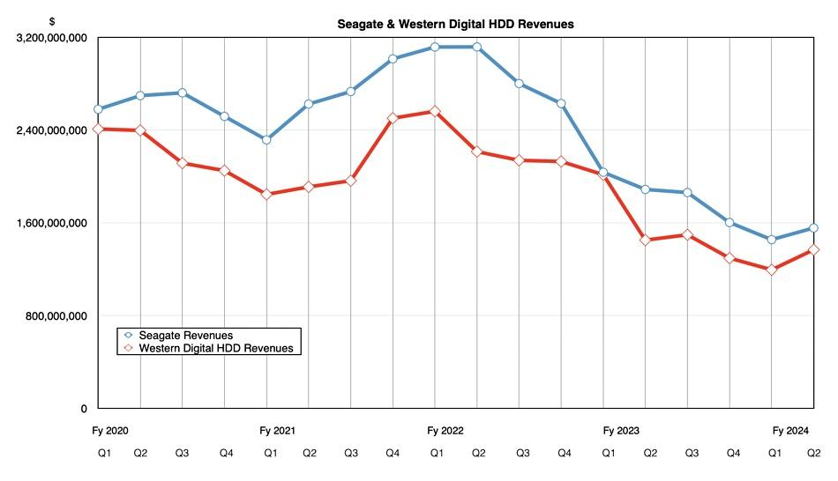
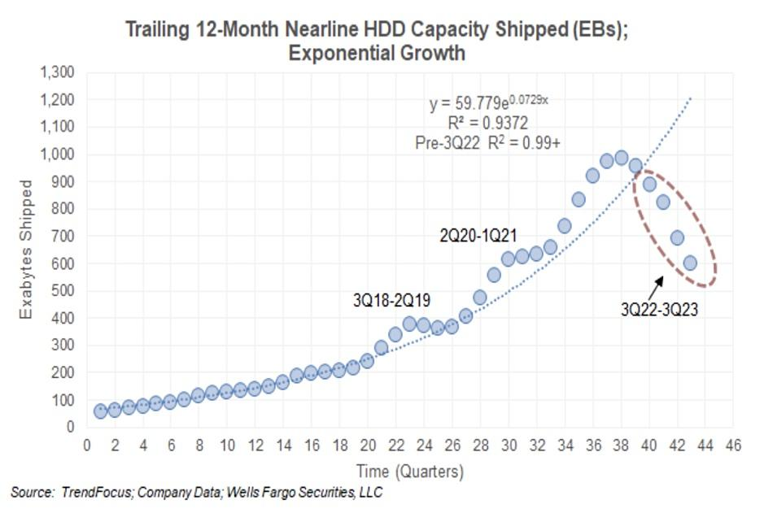
Preview of Updates in HDD Storage
HAMR drives have finally arrived
  Seagate Mosaic 3+ 30TB HAMR drives shipping in Q1 2024
  No word on HAMR products from Western Digital or Toshiba
    Latest WD CMR drive is 22TB
~50% of exabytes shipped by Western Digital are SMR drives
Majority of exabytes shipped and revenue are nearline HDD
    But market was down for 2023
Western Digital roller coaster continues as Seagate brings down the HAMR – Blocks and Files
Nearline drives will be last HDD holdout by 2028 – Blocks and Files

Slide 8
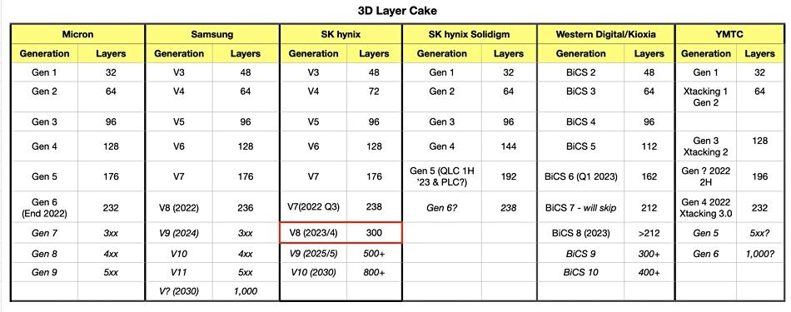
Preview of Updates in Flash Storage
~ 200+ Layer 3D NAND flash chips from all five major vendors
  Roadmaps for more layer beginning to appear
Viability of penta level cells unclear
PCI-e Gen 5 SSDs now available
Samsung and SK Hynix dominate
Western Digital spinning off flash business
Total revenues recovering from dip in late 2022/early 2023
SK hynix breezes past 300-layer 3D NAND mark – Blocks and Files

Slide 9
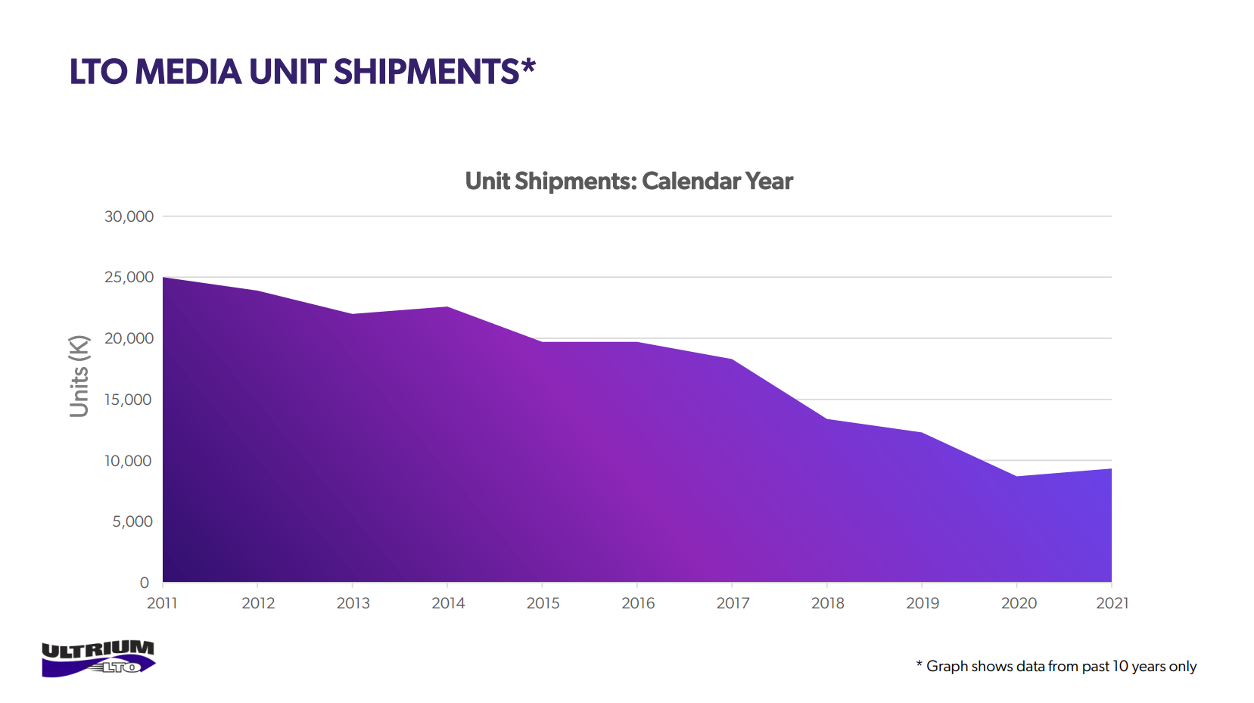
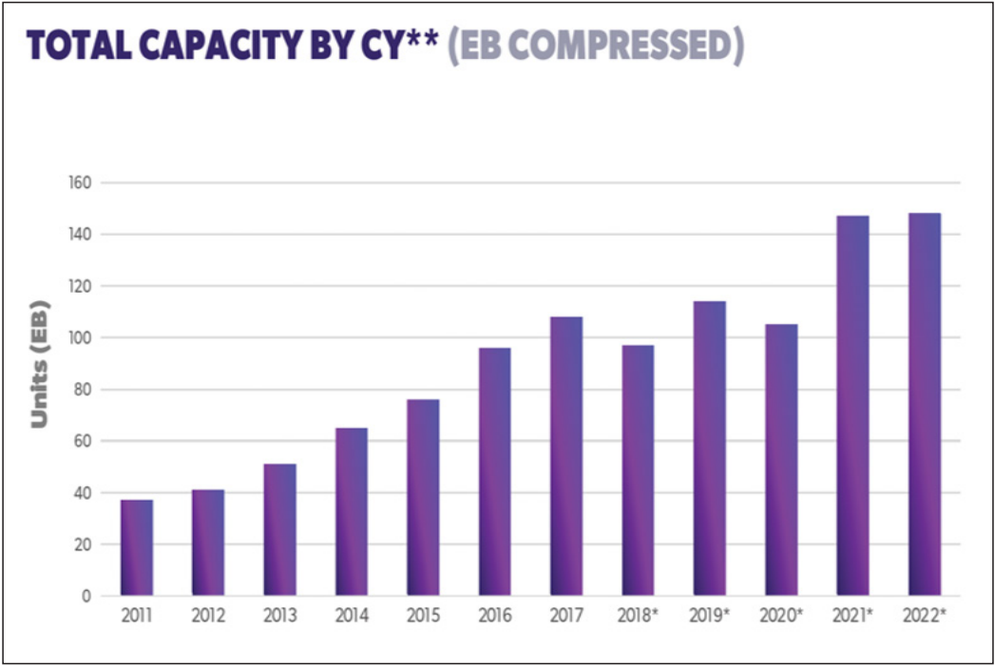
Preview of Updates in Archive Storage
Magnetic Tape
  Strategy change at IBM for enterprise drives
    TS1170 - 50TB / cartridge. No backward compatibility
  IBM Diamondback “library in a rack” targets cloud and Redundant Array of Independent Libraries (RAIL)
    Divergence of cloud and enterprise markets ?
  Total LTO cartridges shipped has been declining, total exabytes shipped is flat
Optical disk dead
  Panasonic and Sony discontinued Archival Disc drives and libraries.
On the horizon
  Cerabyte “ceramic nano-memory” - Data etched in material via laser or particle beam
  Folio Photonics - No news since 2022
https://www.lto.org/wp-content/uploads/2022/04/LTO-Ultirum-2021-Media-Shipment-Report-Slides_FINAL-1.pdf
https://www.lto.org/wp-content/uploads/2022/04/LTO-Ultirum-2021-Media-Shipment-Report-Slides_FINAL-1.pdf

Slide 10
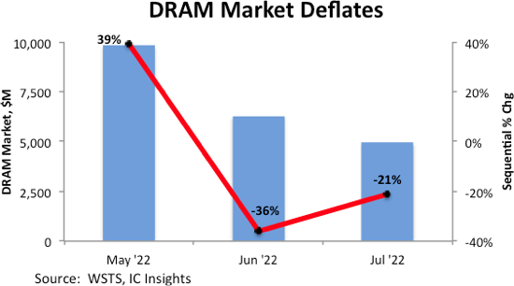
Previews in Logic and Memory Since 2018
All major logic foundries (TSMC/Samsung/Intel) now have EUV in production
  Intel last with “Intel 4”
  Next transition is high NA EUV or multi pattern EUV
Advanced packaging increasingly important
  Chiplets/die connectivity
  Power delivery and cooling
DRAM memory
  CPU’s transitioning from DDR4 to DDR5 memory
  HBM3 introduced in 2022. Higher bandwidth “HBM3E” products introduced in 2023
  All major manufacturers except Micron have transitioned to EUV
  DRAM market recovering from collapse in late 2022/early 2023
Dram Market Deflates Cyclical Downturn Looms (icinsights.com)

Slide 11
Preview of Advances in CPUs Since 2018
Segmentation in CPU product lines
  HPC (higher frequency)
    Intel “Granite Rapids”
    AMD “Genoa” (Zen4)
  Cloud (more cores)
    Intel “Sierra Forest”
    AMD “Bergamo” (Zen4c)
  Edge (lower power)
ARM resurgence
  Ampere Ultra/Ampere One
  NVidia Grace
  Amazon Graviton 4
  Microsoft Cobalt 100
Single package GPU/CPU systems (“APUs”)
  AMD Mi300A, Nvidia Grace Hopper
In package memory
  AMD 3D V-Cache (SRAM on die)
  Intel Xeon Max (HBM2E DRAM)
  Nvidia Grace (LPDDR5X DRAM)

Slide 12
Previews in Accelerators Since 2018
GPU accelerators and related technology
  Nvidia H200 released in 2023
  AMD Mi300X released in 2023
  Intel Data Center Max in 2023
  Broadcom announces support for AMD Infinity Fabric in its next generation PCI-e switch chips. This allows interconnection of more AMD GPUs, similar to NVSwitch for Nvidia GPUs.
AI Accelerators
  Captive processors from Amazon (Trainium2), Google (TPU v5) and Microsoft (Maia 100)
  Intel Gaudi2, SambaNova SN40L, and others.

Slide 13
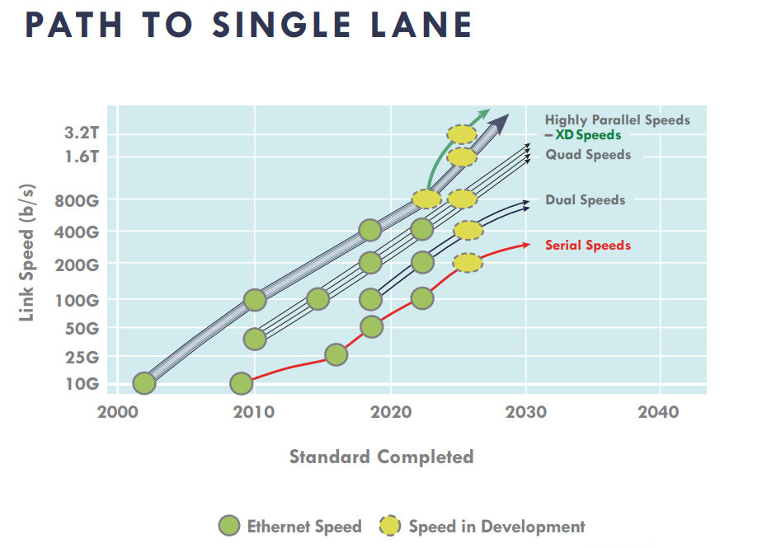
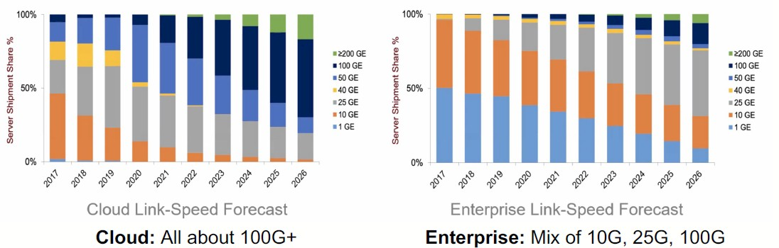
Preview of Network Technology
Transition to 400GbE (4x100Gbs) in progress
800GbE (8x100Gbs) specification released in 2020
Cloud adoption of higher bandwidth Ethernet outpaces rate in the enterprise
Ultra Ethernet Consortium formed to make Ethernet more competitive with Infiniband for AI workloads
Co-packaged optics in the works
  Reduce power consumption
2023 Ethernet Roadmap - Ethernet Alliance
Paving The Way For 800 Gb/sec Ethernet In The Enterprise (nextplatform.com)

Slide 14
Some Technology Open Questions
What is the future $/TB for HDD with the arrival of HAMR and will multi-actuator drives change the trajectory ?
How healthy is the tape market and will the public clouds use of tape make things worse or better ?
Are APUs, single package GPU + CPU, a better fit for HEP/NP compared to discrete GPU + CPU.
How viable are both fully custom and Neoverse derived ARM CPUs in the open market given the clouds use of internally sourced CPUs ?
Is there a place for AI/ML processors in the open market?
Goal of the TechWatch WG is to answer these and other questions about technology that are of interest to the community

Slide 15
Next Steps
Develop schedule for future presentations
  HEPiX meetings (next HEPiX is April 2024/Paris)
  Identify other venues
Determine collaborative tools needed to create and maintain deliverables
Organize subgroups and begin work on gathering information on subject areas
Work on updating the TechWatch WG website
  Technology Watch Working Group (hepix.org) (https://w3.hepix.org/techwatch.html)

Slide 16
Call for Participants
We need people to volunteer to lead subgroups or contribute information.
Meeting times and agenda are posted in CERN indico.
  https://indico.cern.ch/category/10621/
Techwatch mailing is available for communication.
  hepix-techwatch-wg@hepix.org
NEXT Meeting is Wednesday February 21 @ 16:00 CET/10:00 AM EST
See you there !

