Slide 1

Future-Ready Organizations:
Attractiveness and
Agility in a Changing Workforce Landscape
Workshop on Remunerations, Allowances, and Pensions
OCTOBER 10, 2025
Presented by:
Dr RANYA NEHMEH
HR Strategist, Author, Adjunct Professor

Slide 2




CONTENT
Introduction
Redefining Attractiveness
Th Future Workforce
The Challenge for International Organizations
Are IOs Future-Ready
Building Future Readiness
Closing Insights

Slide 3
Global C-Suite Priorities: Attract Talent. Build Agility.
CB Survey: Asked CEOs what is the No. 1 factor affecting their business? Acquiring Talent and No. 2 was modifying strategy to remain agile.
Deloitte’s C-level Survey: Two goals tied for the top position: transform the core business and get better at talent acquisition.
PwC Survey: CEOs report that hiring talent and digital business transformation were tied as No. 1 priorities. Just behind is increasing agility.

Slide 4

WHAT DOES ATTRACTIVENESS MEAN?

Slide 5

TRADITIONAL DEFINITION
Pay + Allowances + Pensions + Stability
FUTURE DEFINITION
A total value proposition that combines financial
and non-financial elements

Slide 6

THE FUTURE WORKFORCE
By 2030, Millennials and Generation Z will account for nearly 70% of employees worldwide
DIFFERENT EXPECTATIONS
Flexibility
Mental health
Continuous growth
Regular feedback
Sense of purpose
Challenge hierarchy
Value authenticity from leaders

Slide 7

WHAT THEY WANT MOST
Meaning & Impact
They want their daily work to align with a mission.
Growth & Development
They expect continuous learning, faster career progression, and mobility opportunities.
Wellbeing & Belonging
Mental health, diversity, and inclusion are not optional, they are essential.
Flexibility
Not just hours, but where and how they work (hybrid, digital).

Slide 8

GENERATIONAL TENSION
IOs traditionally attract through stability, pensions and allowances
New workforce values impact and flexibility today
THE DANGER:
If IOs don’t modernize policies, top talent may bypass them for organizations that better align with their lifestyle and expectations

Slide 9


The Challenge for International Organizations
How to preserve the strengths of our system while adapting to the workforce’s demand
to ensure we attract top talent

Slide 10
ARE IOs FUTURE-READY?
STRENGTHS
PURPOSE AND MISSION
STABILITY AND SECURITY
CREDIBILITY AND PRESTIGE
DIVERSITY AND EXPOSURE

Slide 11
SURVEY INSIGHTS (ICSC)
Please indicate the most important factors in your decision to accept your first offer of employment in a UN Common System Organization
Opportunity to use my skills & competencies | 43%
Salary | 43%
Benefits | 39%
I believe strongly in the goals and objectives of my organization | 35%
What are the main reasons that make you want to stay in the UN Common System
I believe strongly in the goals and objectives of my organization | 50%
Pension | 46%
Salary | 38%
Other Benefits (health insurance) | 32%
Opportunity to use my skills & competencies | 25%
Taken from the International Civil Service Commission (ICSC) Global Staff Survey on Conditions of Service, 2023

Slide 12
ARE IOs FUTURE-READY?
GAPS
AGILITY
AND SPEED
RIGID POLICIES
WORK DEISGN
CAREER PROGRESSION

Slide 13
SURVEY INSIGHTS (ICSC)
What are the main reasons that you would like to leave your organization
I do not have opportunities for career progression and promotion | 59%
My organization does not reward individual performance | 48%
Salary | 44%
Insufficient work-life balance | 35%
My knowledge, skills, competencies are underutilized | 35%
The culture of my organization (toxic work conditions, leadership practices) | 31%
My organization is too bureaucratic | 24%
Taken from the International Civil Service Commission (ICSC) Global Staff Survey on Conditions of Service, 2023

Slide 14

International Organizations Must Evolve to Remain the Employer of Choice for those driven by global purpose

Slide 15

BUILDING FUTURE READINESS
AGILITY IN….
HR
POLICIES
Faster recruitment, flexible contracts,
WORK
Project-based roles, digital skills, hybrid by design
CAREERS
Reskilling, clearer progression, mobility as opportunity (ITM)

Slide 16

THE ROLE OF LEADERSHIP
Entrepreneurial
Leaders
Architecting
Leaders
Enabling
Leaders

Slide 17
WHAT DOES ATTRACTIVENESS MEAN?

Slide 18

Attractiveness in the Future =
PAY + PURPOSE + CULTURE + AGILITY

Slide 19
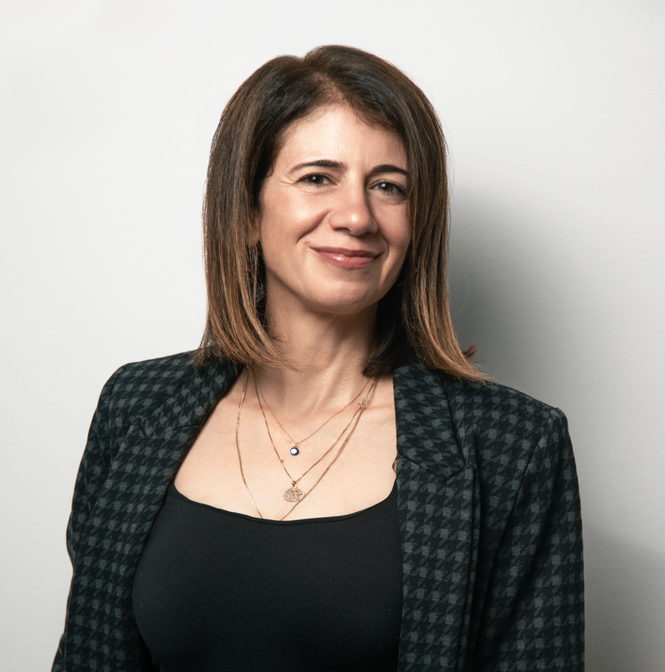
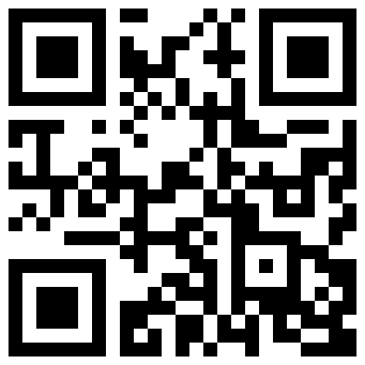




DR. RANYA NEHMEH
HR STRATEGIST, AUTHOR AND ADJUNCT PROFESSOR
THANK YOU
SUBSCRIBE TO ELEVAR:
MY MONTHLY NEWSLETTER
WWW.RANYANEHMEH.COM
INFO@RANYANEHMEH.COM
WWW.LINKEDIN.COM/IN/RANYANEHMEH.COM

