Slide 1
DRD8
Memorandum of Understanding
Burkhard Schmidt
January 20, 2025

Slide 2
Memorandum of Understanding (MoU) for the DRD collaborations
MoU Core Part → Common to all DRDs
  This part is (still) being finalized by Helge Meinhard from CERN, taking into account the feedback received from some of the large national Funding Agencies. It underwent several iterations since June 2024.
MoU Annexes → Specific of each DRD
  This part should be prepared by us in the coming weeks, so that the approval process can be launched in the coming months.

Slide 3
Core MoU (all DRDs)
The following slides refer to the draft version 6 received from CERN on the 15th of October 2024
https://indico.cern.ch/event/1504002/contributions/6330343/attachments/2998879/5284098/DRDx-MoU-Draft6-full.pdf

Slide 4
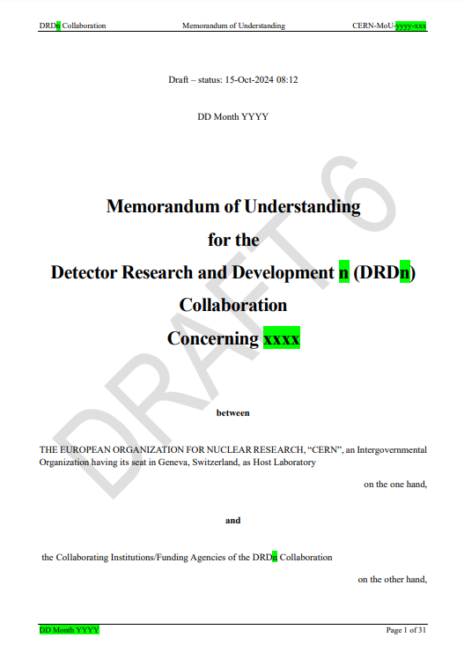
List of Articles (core part)
Article 1 Purpose of the MoU
Article 2 Parties to the MoU
Article 3 Obligations of CERN as Host Laboratory
Article 4 Obligations of the Collaborating Institutions
Article 5 Equipment
Article 6 Structure of the Collaboration
Article 7 Collaboration Accounts
Article 8 Work Packages, Working Groups and other Work Entities
Article 9 Theses, Publications and Conference Contributions
Article 10 Intellectual Property
Article 11 Compliance with Export Control and Sanctions
Article 12 Conflicts of Interest
Article 13 Industrial Partners
Article 14 Observance of the MoU and the General Conditions
Article 15 Duration of Validity of the MoU and its Extension
Article 16 Withdrawal and Termination of Participation of Funding Agencies or Collaborating Institutions
Article 17 Participation of Additional Institutions
Article 18 Amendments and Annexes
https://indico.cern.ch/event/1504002/contributions/6330343/attachments/2998879/5284098/DRDx-MoU-Draft6-full.pdf

Slide 5
Feedback to the first MoU Drafts
In the next slides, only the major aspects will be discussed.

Slide 6
Feedback on the Core part of MoU Draft 3.1(I)
R&D Collaboration (Rephrasing)
Part of the proposed MoU should be rephrased to better match with an R&D Collaboration. As it is, it reflects well needs of an experiment, but it can create confusion in institutes and funding agencies when applied to R&D Collaborations as the DRDs. Examples are Article 5 (Equipment) and the corresponding Annex 3 (Sub-Detector Structure and Technical Participation of the Collaborating Institutions), Technical Coordinator duties, etc.

Slide 7
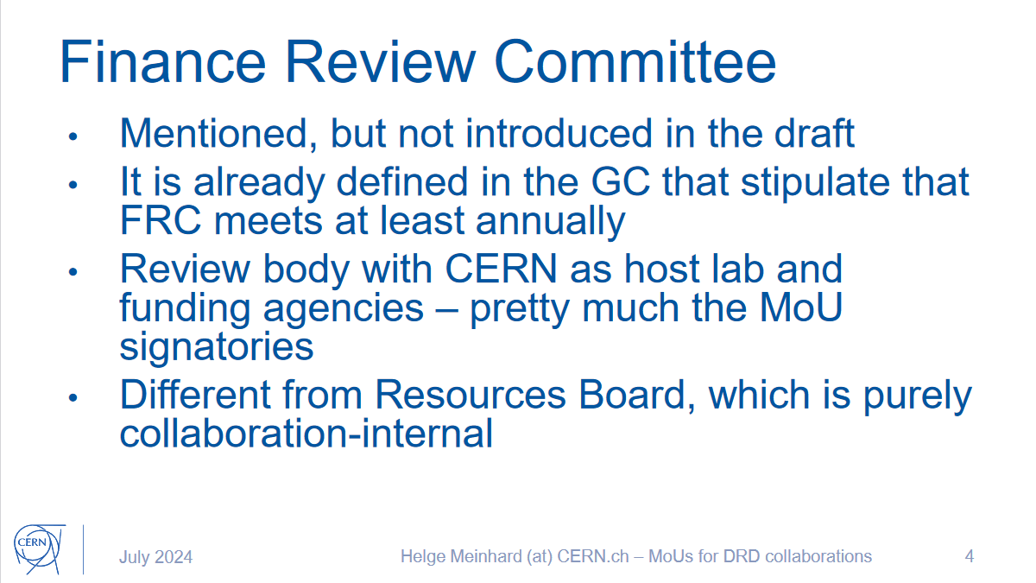
Feedback on the Core part of MoU Draft 3.1(II)
Meeting (9 July 2024) on the draft MoU with the CERN Research Director

Slide 8
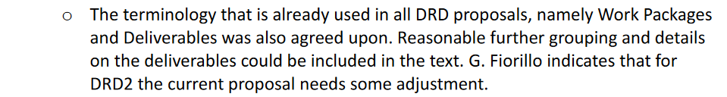


Feedback on the Core part of MoU Draft 3.1(III)
Terminology Issue: Tasks and Work Packages (Article 8)
Replace “Task” with “Work Package” in Article and Annex (*)
(*) Agreed on the DRDs Manager Forum Meeting (18 July 2024)

Slide 9
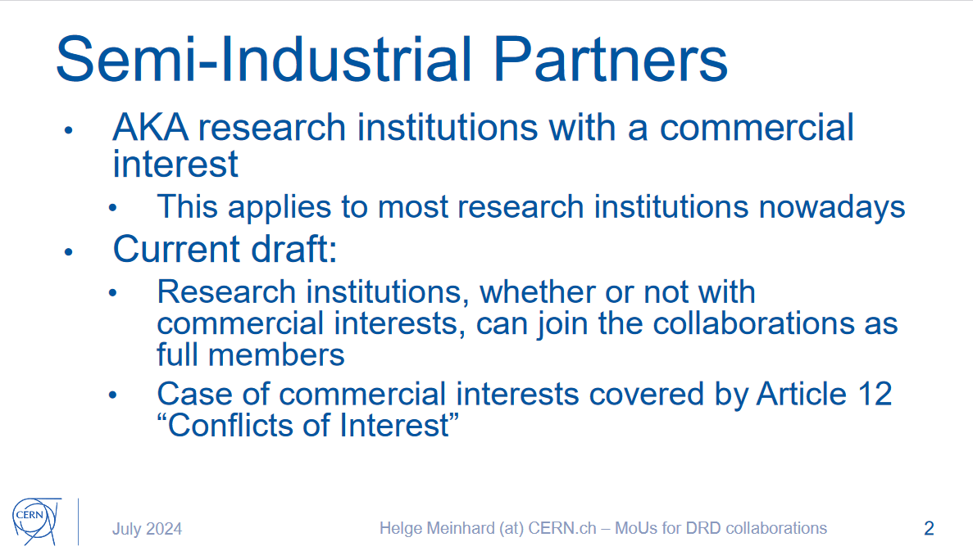
Feedback on the Core part of MoU Draft 3.1(IV)
Industrial Partners (Article 13)
Status of Semi-Industrial and Research Foundations to be clarified (*).
Access to CERN for industrial partner signing an agreement with Collaborating Institution.
(*) Addressed at the Meeting (9 July 2024) on the draft MoU with the CERN Research Director to discuss the first draft and the comments received.

Slide 10
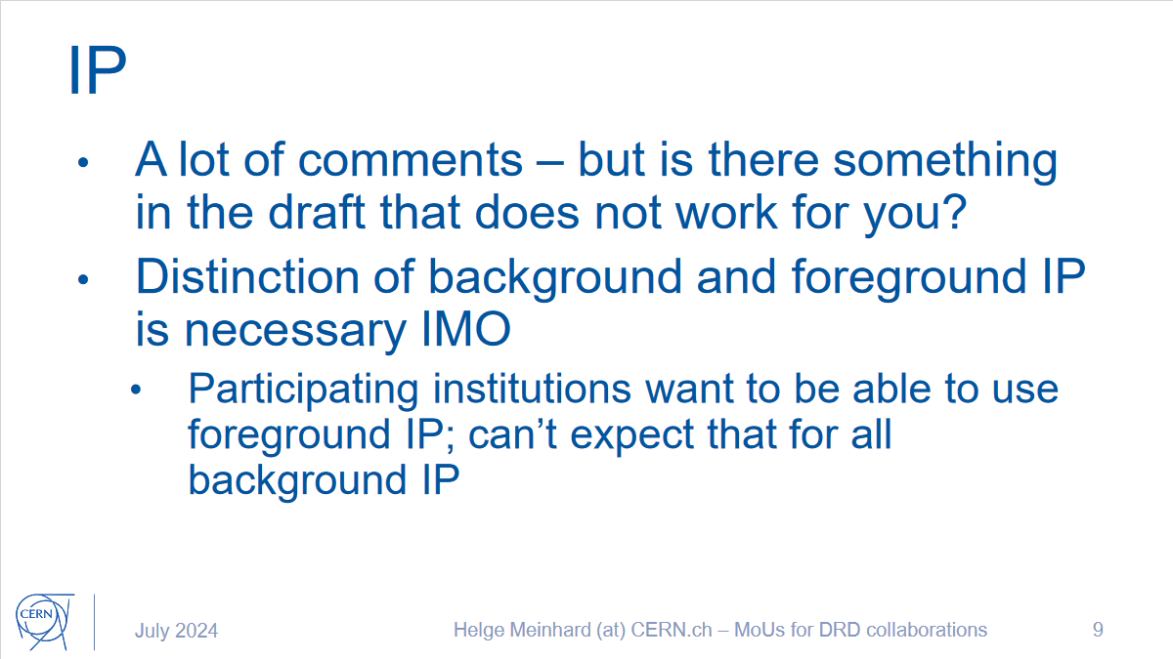
Feedback on the Core part of MoU Draft 3.1(V)
Intellectual Property
(*) Discussed at the Meeting (9 July 2024) on the draft MoU with the CERN Research Director.

Slide 11
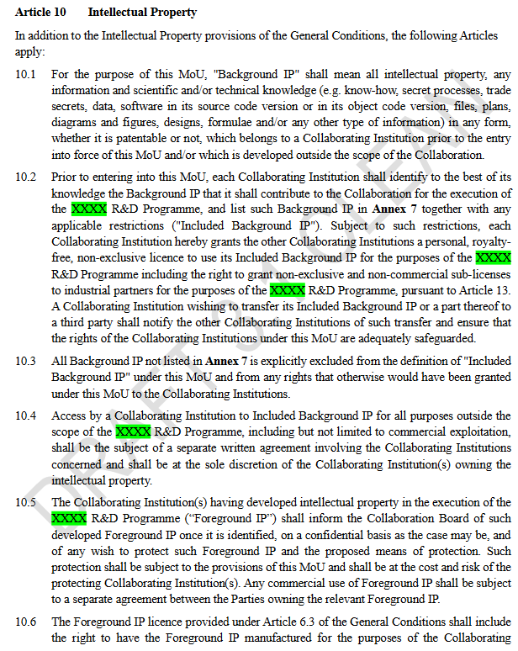
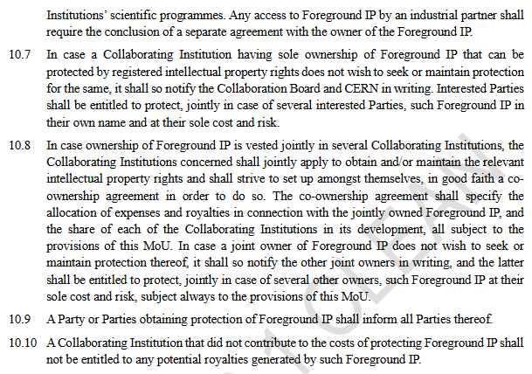
Feedback on the Core part of MoU Draft 3.1(VI)

Slide 12
Core MoU Status
  CERN (Helge Meinhard) and ECFA Detector Panel are working on it
  To be released soon…

Slide 13
MoU Annexes (DRD8 specific)

Slide 14
List of Annexes
Annex 1 Collaborating Institutions and their Contact Persons
Annex 2 Funding Agencies and their Representatives
Annex 3 Sub-Detector Structure and Technical Participation of the Collaborating Institutions
Annex 4 The Organisational Structure of the Collaboration
Annex 5 Overview of the Financial Participation of the Funding Agencies
Annex 6 Specific Obligations and Responsibilities of CERN as the Host Laboratory of the DRDn Collaboration
Annex 7 Work Packages
Annex 8 Working Groups
Annex 9 Other Work Entities
Annex 10 Included Background IP
Annex 11 Conflict of Interest Disclosure Form
Annex 12 CERN General Conditions Applicable to Experiments

Slide 15
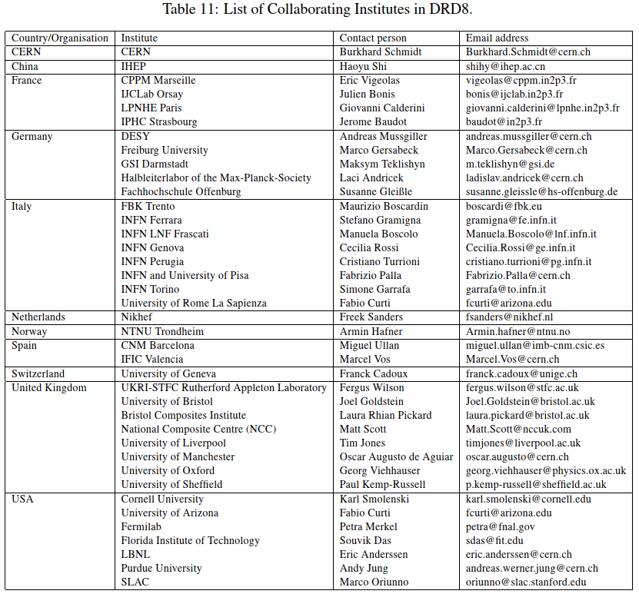
Annex 1
Collaborating Institutions and their Contact Persons
Table 11 from the Proposal
- needs some updates
- kindly get in touch with me:
Burkhard.Schmidt@cern.ch

Slide 16
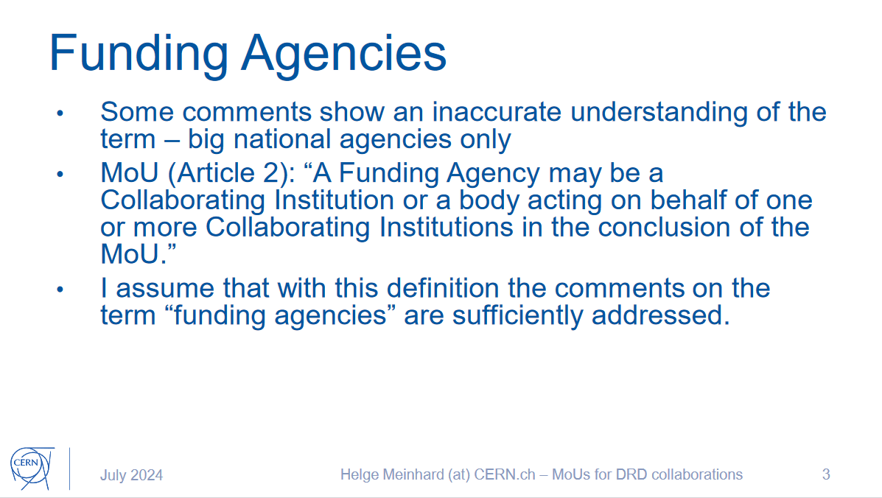
Annex 2
Funding Agencies and their Representatives
(*) Addressed at the Meeting (9 July 2024) on the draft MoU with the CERN Research Director to discuss the first draft and the comments received.
Funding Agencies signing the MoU are not necessarily the same as the Funding Agencies listed in the Work Packages.
The list of those FAs signing the MoU needs to be established.

Slide 17
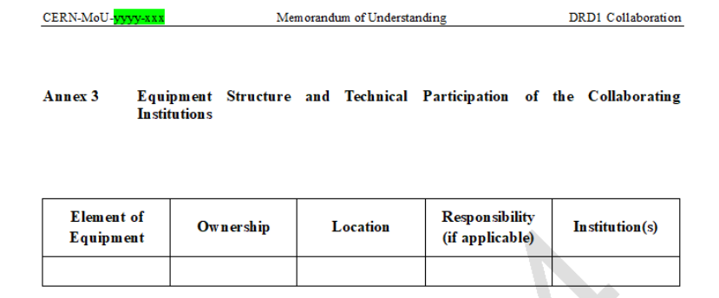
Annex 3: Sub-Detector Structure and Technical Participation of the Collaborating Institutions
Required for insurance and the removal of the equipment at the end of the collaboration.
It will be used also for equipment owned by Work Packages.

Slide 18
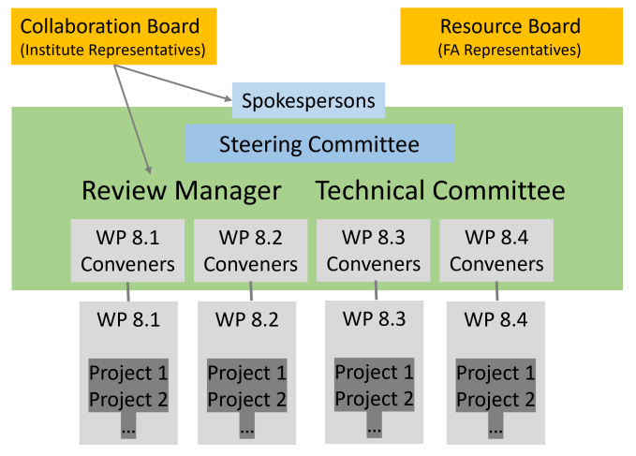
Annex 4 The Organisational Structure of the Collaboration
All DRD8 bodies (Collaboration Board, Resource Board, Steering Committee and Technical Committee) and positions (Spokespersons, Review Manager etc.) are described in Annex 4.

Slide 19

Annex 5
Overview of the Financial Participation of the FAs
This Annex does not concern Work Package resources – only Common Fund
At this stage, DRD8 doesn’t foresee to have a Common Fund. However, we are open for discussion on this point.
Examples for the use of Common Funds:
Support for Collaboration Meetings
Common Projects
Investment in common activities
Support for Common Facilities (Laboratories)
…

Slide 20
Annex 6
Specific Obligations and Responsibilities of CERN as the Host Laboratory of the DRDn Collaboration
  6.1 Irradiation Facilities
Access for members of the DRD8 Collaboration to CERN irradiation facilities.
  6.2 Laboratories
Access for members of the DRD8 Collaboration to laboratories at CERN such as Metrology, Composite Lab when appropriate.
  6.3 Computing Resources
Access for members of the DRD8 Collaboration to CERN Computing resources in terms of processing, storage and software.

Slide 21
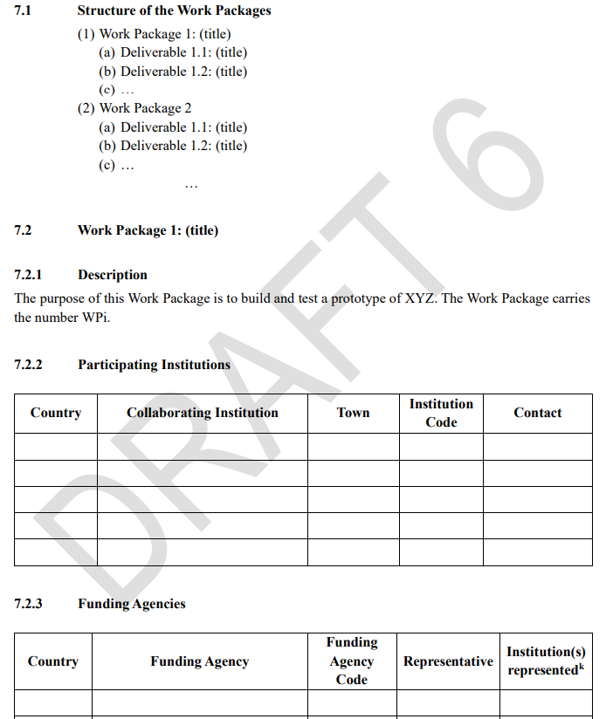
Annex 7 Work Packages
Annex 7 with the description of the DRD
specific WPs and related Deliverables is
the most important Annex of the MoU.

Slide 22
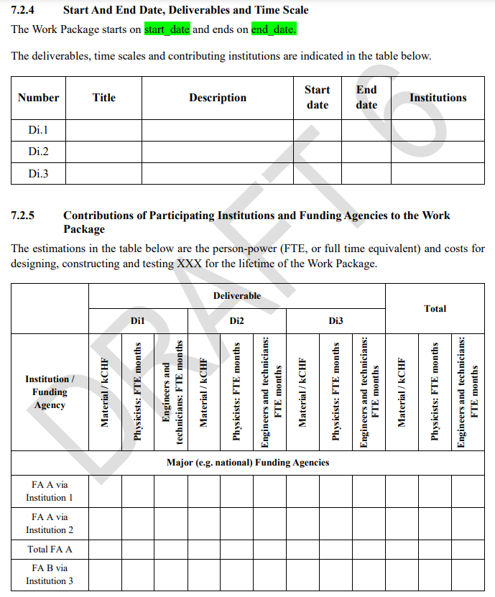
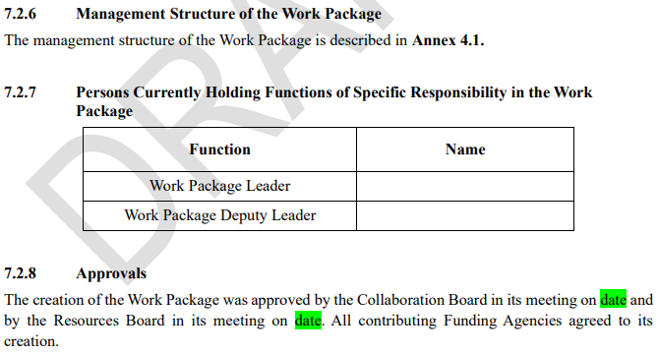
Annex 7 Work Packages
To some extent it is up to us to decide which
level of information we include in Annex 7.
We should avoid to complicate/delay the signature of the MoU.
Can be changed

Slide 23
Annex 8 Working Groups
- DRD8 has a present no Working Groups
- However, should the resources to realize the Work Packages not
become available at the required level, we might transform a
Work Package into a Working Group

Slide 24
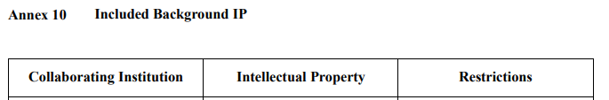
Annex 9 Other Work Entities
There are currently no Other Work Entities
Conceptually this allows us to introduce Common Projects), should the need arise.
Annex 10 Included Background IP
Probably not relevant at this stage

Slide 25
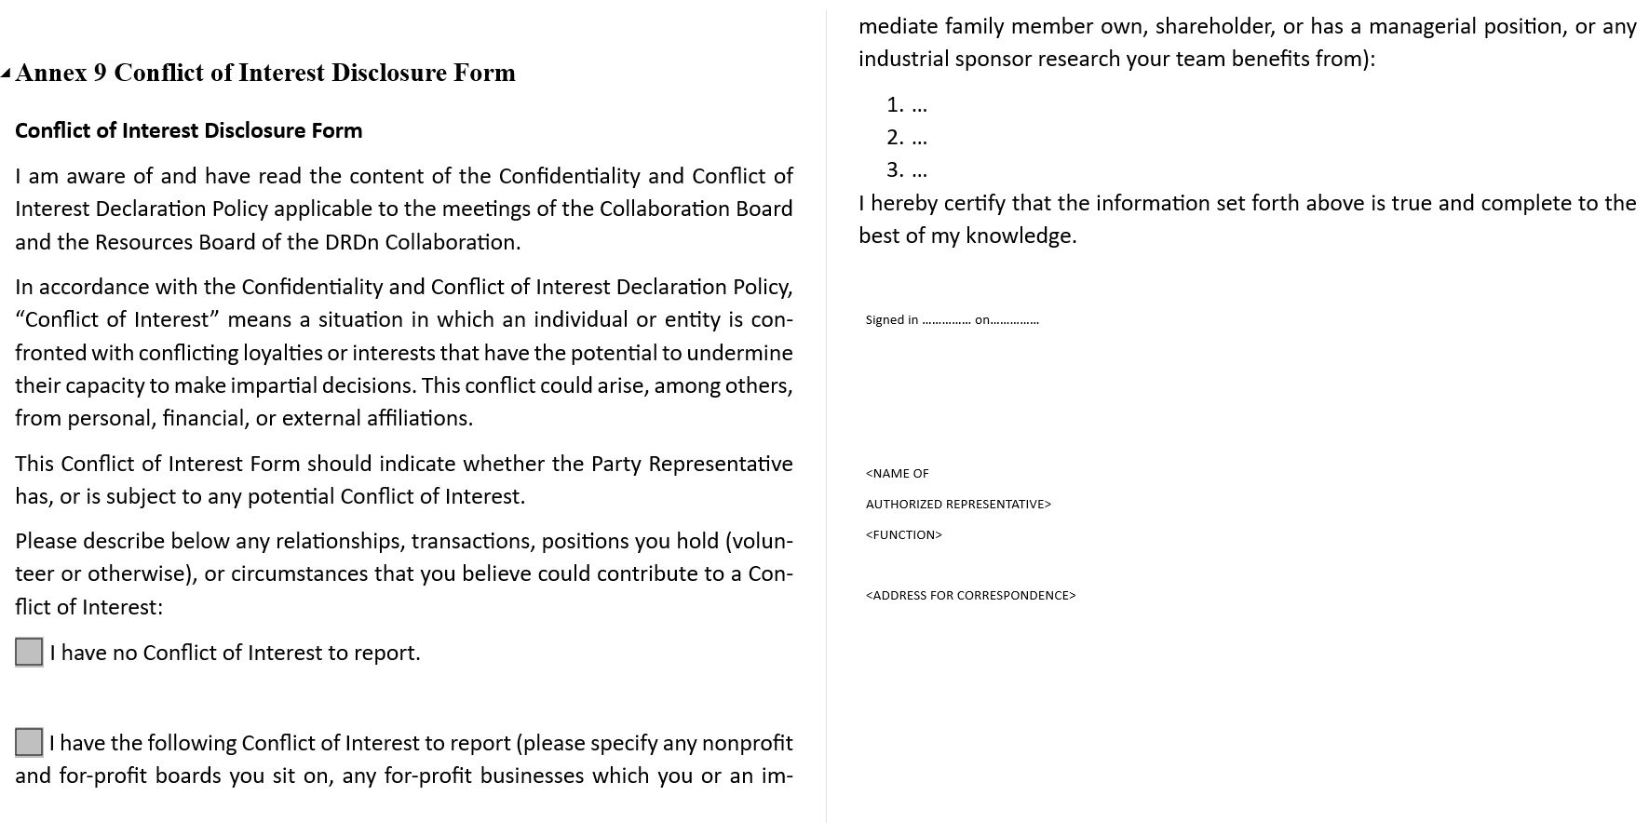
Annex 11 Conflict of Interest Disclosure Form

Slide 26
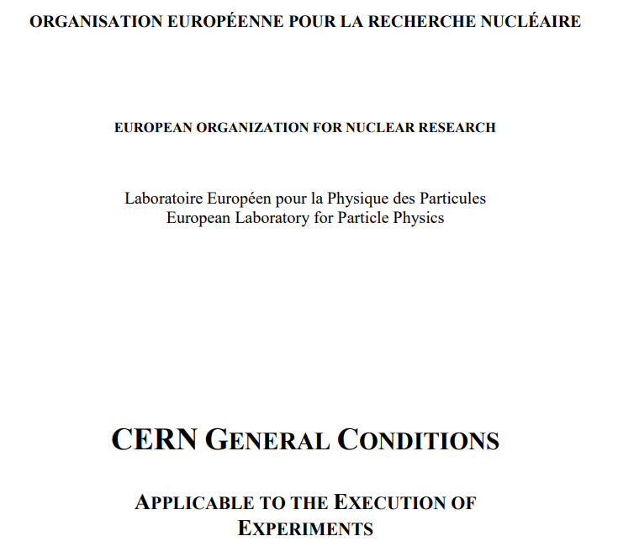
Annex 12
https://cds.cern.ch/record/2728154/files/General-Conditions_CERN_experiments.pdf

Slide 27
Summary and timeline
Core MoU:
  To be released soon…
  CERN (Helge Meinhard) and ECFA Detector Panel are working on it
  It is not clear whether there will be another DRD Managers Forum (DRDs SPs, ECFA Detector Panel, CERN) before the Core MoU will be released.
Annexes:
  A version of the DRD8 Annexes, in particular Annex 7, will be prepared in the coming weeks in order to be rediscussed in a CB meeting in a month from now.

