Slide 1
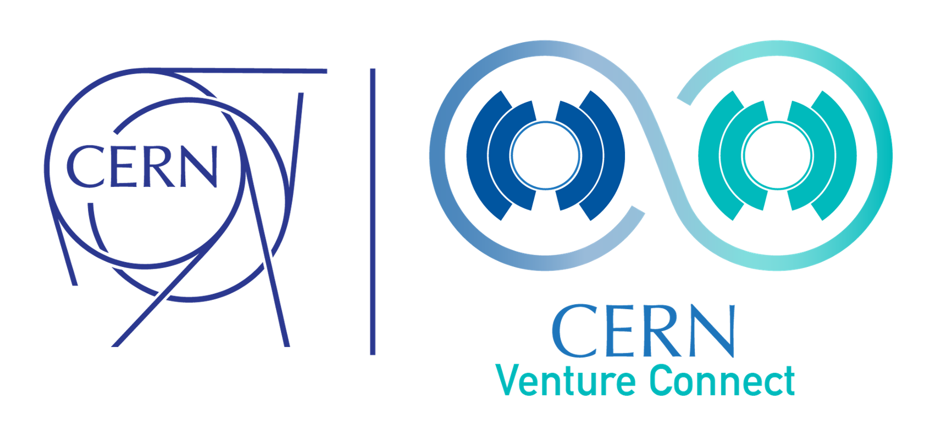
CERN Venture Connect
Deep Tech Startup Programme by CERN

Slide 2
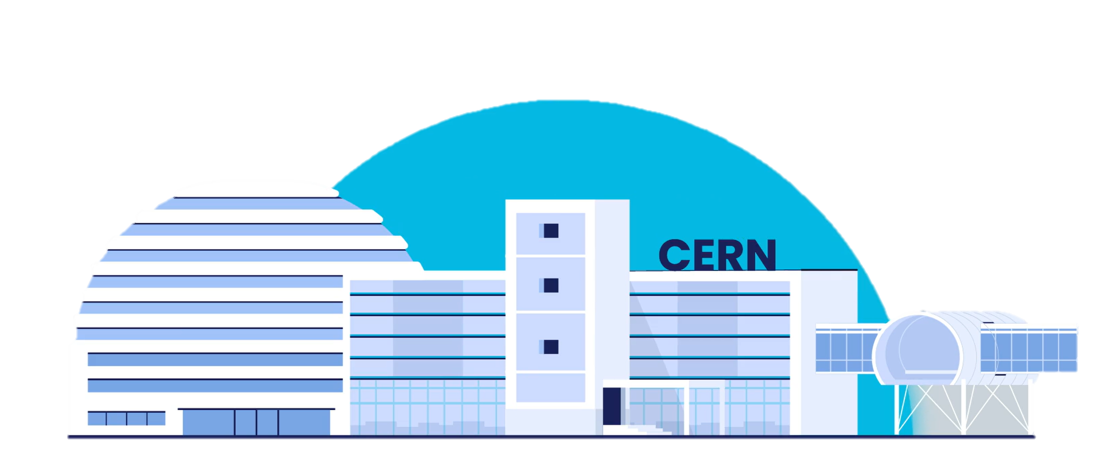
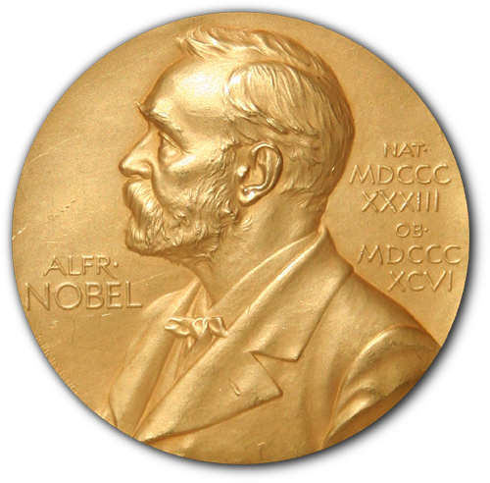
About CERN.
Home to the world’s largest experiment, pushing the boundaries of technology
The European Organization for Nuclear Research researches fundamental questions of the universe and the basic building blocks of matter.
Operating at -271°C - colder than outer space – CERN’s accelerator complex propels particles to 99.9999% the speed of light, enabling up to 1 billion particle collisions per second. These events are monitored by massive detectors with over 100 million sensors, producing 1 petabyte of raw data daily, analyzed in the world's largest computing grid across 170 sites globally.
CERN's research has garnered multiple Nobel Prizes and led to innovations like the World Wide Web and the very first touchscreen.

Slide 3
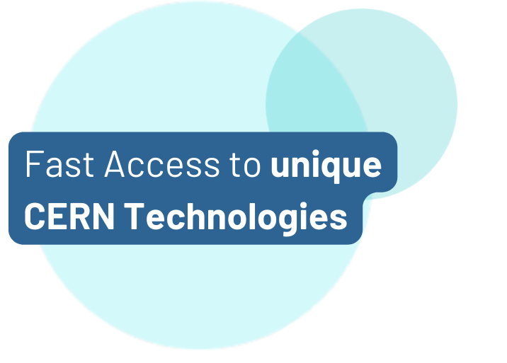
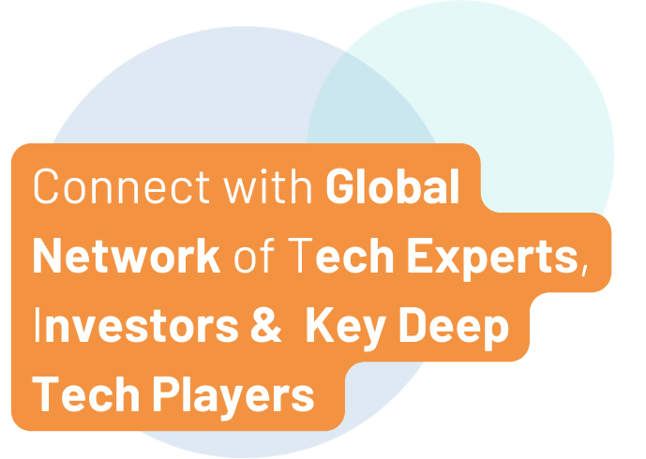
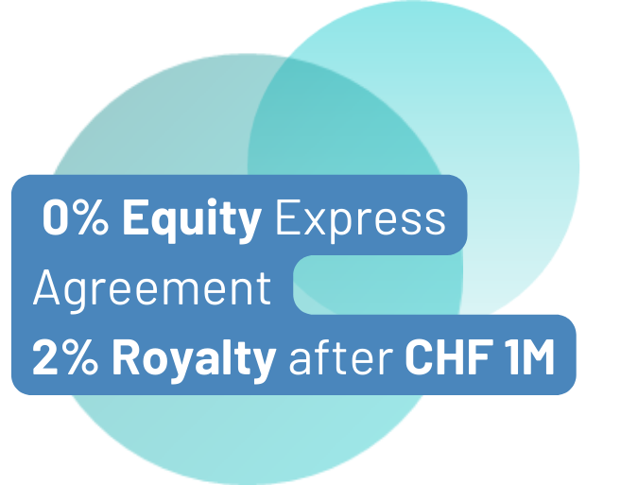
What We Do.
Fundamental research fuelling societal impact
Launched in 2023, CERN Venture Connect (CVC) bridges the gap between cutting-edge scientific research and commercial deep tech ventures.
Our community across 34 countries connects entrepreneurs, researchers and key deep tech partners to create innovative, high-impact startups.

Slide 4
Who We Support.
CERN Venture Connect supports Deep Tech Startups
CERNTREPRENEUR or EXTERNAL VISIONARY
Whether already part of the CERN community or an external entrepreneur, CVC provides valuable resources and connections to visionary founders.
From a seed-stage idea to a thriving scale-up that aims to solve a technological challenge, we support every step of the startup journey.
from ENTREPRENEUR to SCALE-UP

Slide 5


What We Offer.
Strategic partnership with CERN to advance your business
Engage with our deep tech community & expand your professional network.
Ecosystem
Support.
CERN Tech.
Receive a license for CERN’s cutting-edge tech & unlock expert support.
Workshops.
Participate in expert-led workshops tailored to enhance your skills.
Funding Opportunities.
Connect with your next investor among our network of 20+ deep tech VCs.
Talent.
Leverage the CERN Alumni pool to recruit top-tier talent for your team.

Slide 6


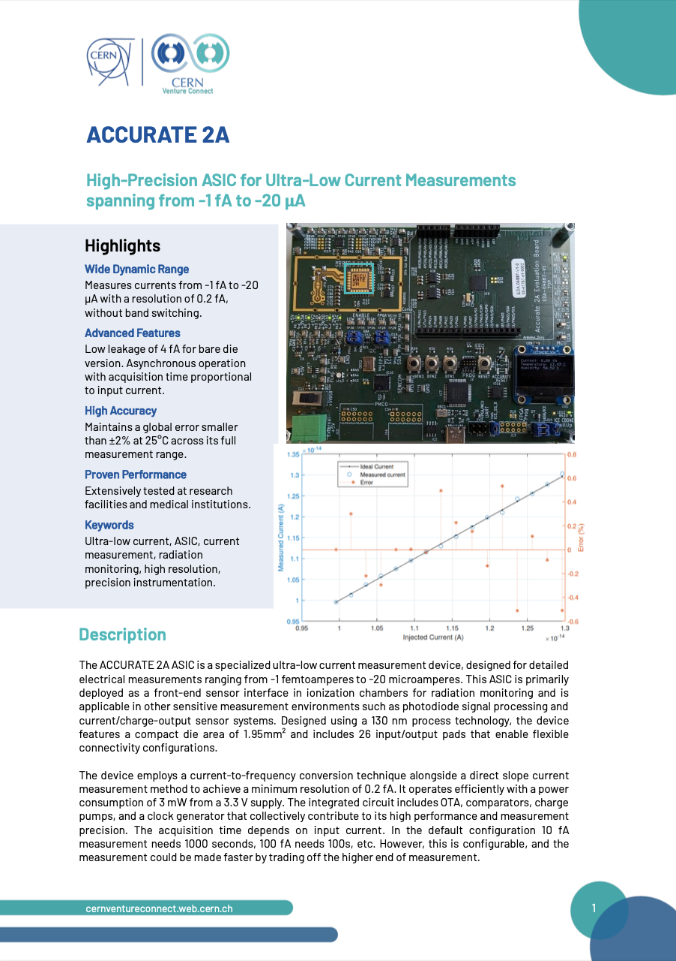



Our Technology Portfolio.
Seven startup-friendly technologies ready to use
ACCURATE 2A
Structured Laser
Beam
Single Frequency
Laser
AstroMesh
High-Precision ASIC measuring current at femtoampere levels
Satellite mesh networking with radiation monitoring
Collimation system for focused laser beams
Ultra-narrow, multi-wavelength laser system
CVC
Tech
Briefs
White Rabbit
Rucio
Ultralight Carbon
Coldplate
Sub-nano second time synchronization
Management of very large, distributed datasets
Lightweight thermal management
Learn about our CVC Tech here

Slide 7
Our Terms And Conditions.
No-fuss express agreement with founder-friendly terms
2%
PROGRAMME FEE
On revenue generated with CERN Tech applicable after exceeding CHF 1 million in annual sales.
Equity-free, non-exclusive worldwide license to commercialize the tech for 10 years
Exclusive access to technical support, resources, and activities to network and gain visibility
Official endorsement from CERN (use of CVC Logo)
Possibility for material transfer (where applicable)

Slide 8






How To Join.
Straight-forward selection process
Apply via ventureconnect.cern
Introductory Meeting
CERN Technology Matching
CERN Tech
Expert Consultation
Feasibility Assessment with CVC Prototype
Contract Signing
Deep tech startups, scaleups or entrepreneurs that are
based in one of CERN’s member states or associated member states*
driven by a passionate team with an ambitious vision
looking to leverage CERN technology to gain a competitive edge
operating in non-military and non-defense-related industries
Eligibility Criteria
No Deadlines
Applications considered
on a rolling basis
* List of CERN Member States

Slide 9
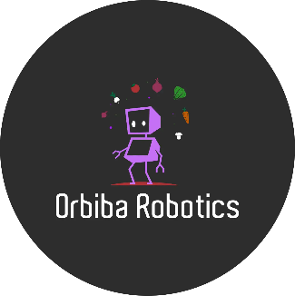







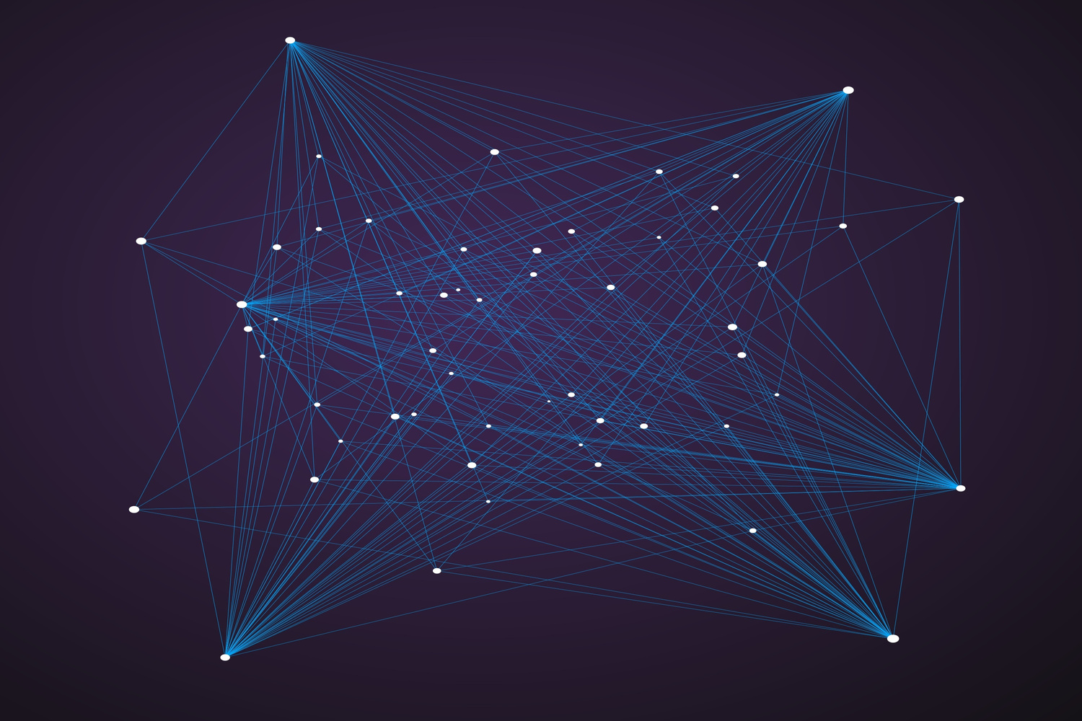
CVC Startups.
8 CVC Startups within the first 18 months
SIGNING
Revolutionizing product marking with structured laser beams.
Automating risk analysis of complex engineering systems with Gen AI.
Regenerative farming using weed control robots.
Magnet Simulation Tools.
Imaging technology using cosmic particles.
Open-source event management from CERN to the World.
Long-range fiber optic thermo-hygrometer sensors.
Carbon capture for atmospheric gas.
CERN Venture Connect

Slide 10
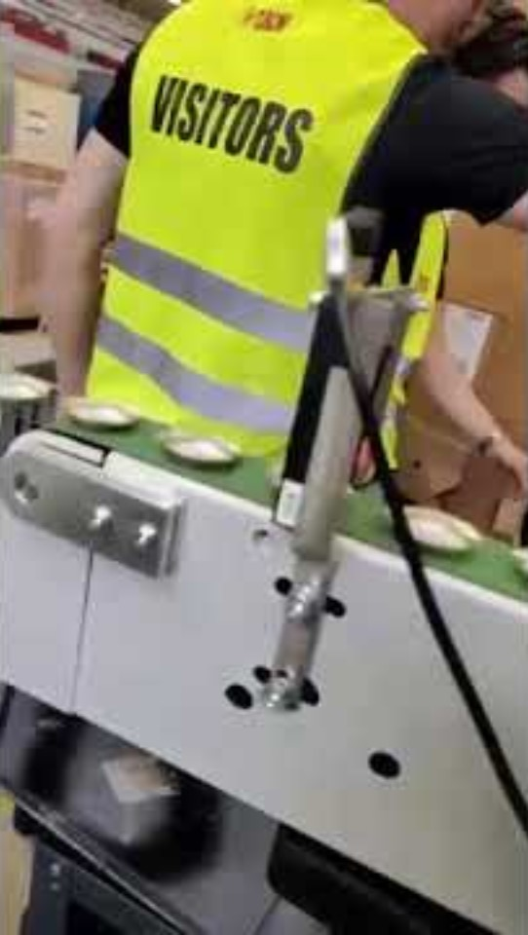
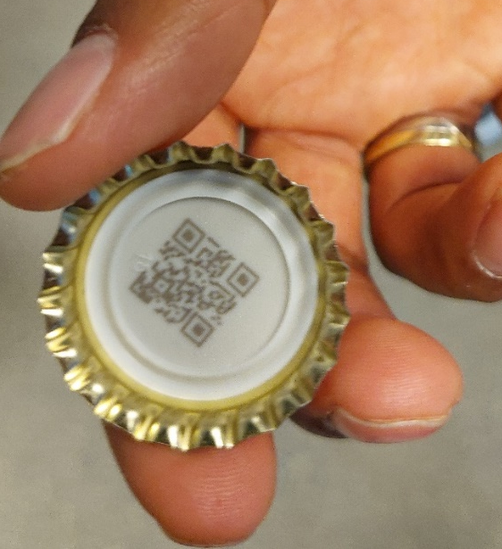

Revolutionizing product marking with structured laser beams.
Remplacing ink printing with precision laser.
Product marking on products,
Even on cuved surfaces

Slide 11
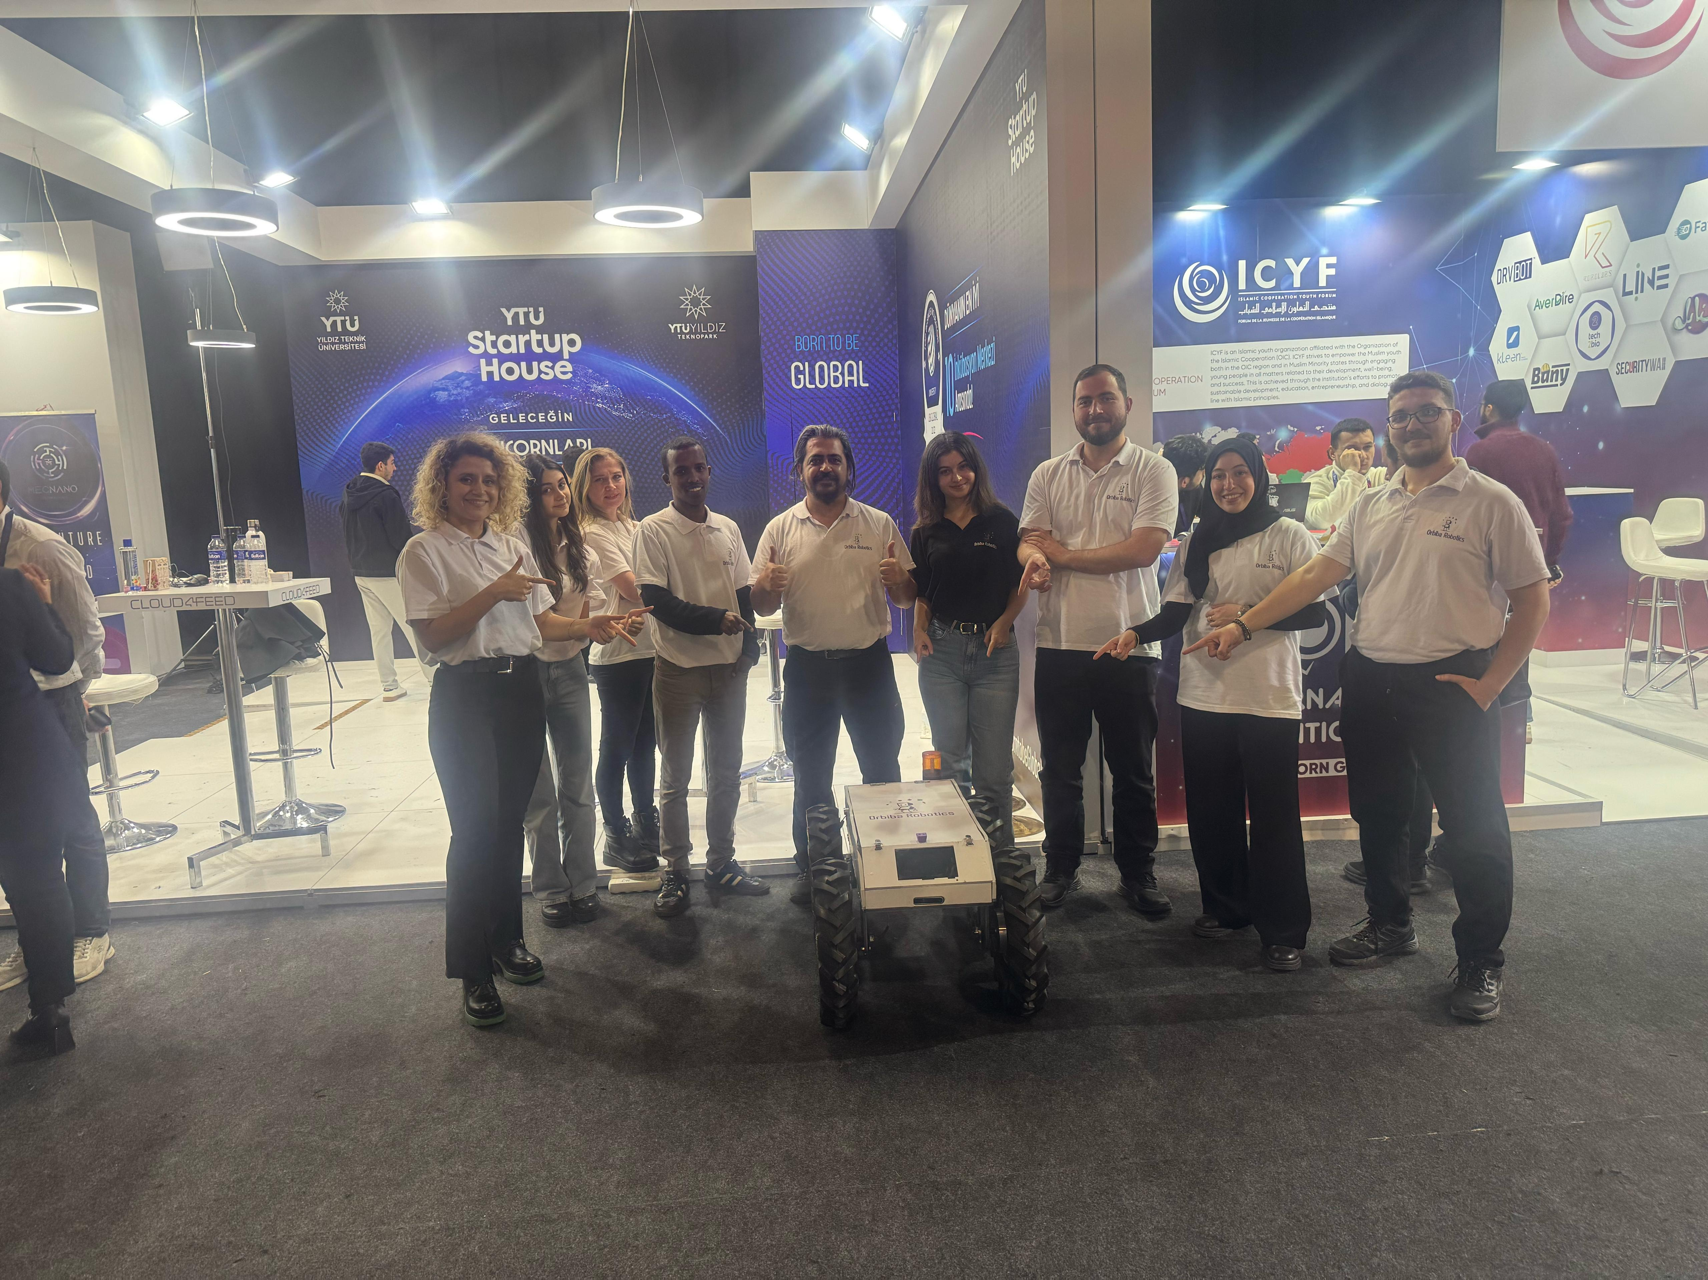
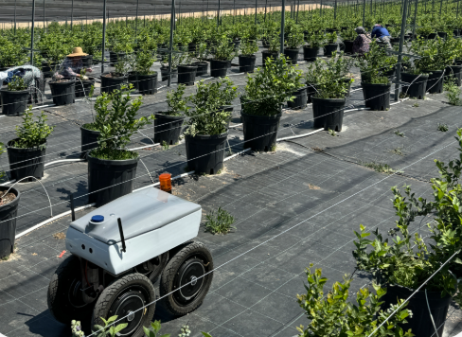

Robots to eliminate bad weeds
Orbiba Robotics uses Structured Laser Beam for data collection and weed elimination.
Decrease usage of pesticide and regenerative agriculture.

Slide 12
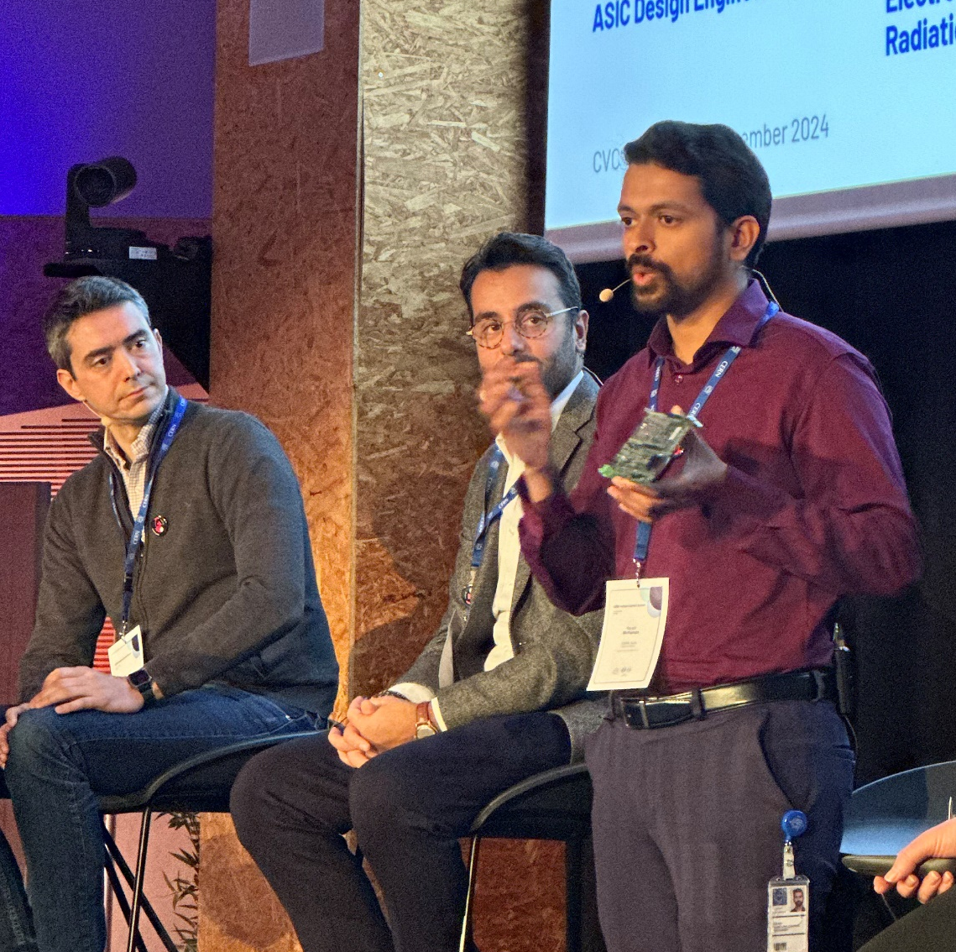
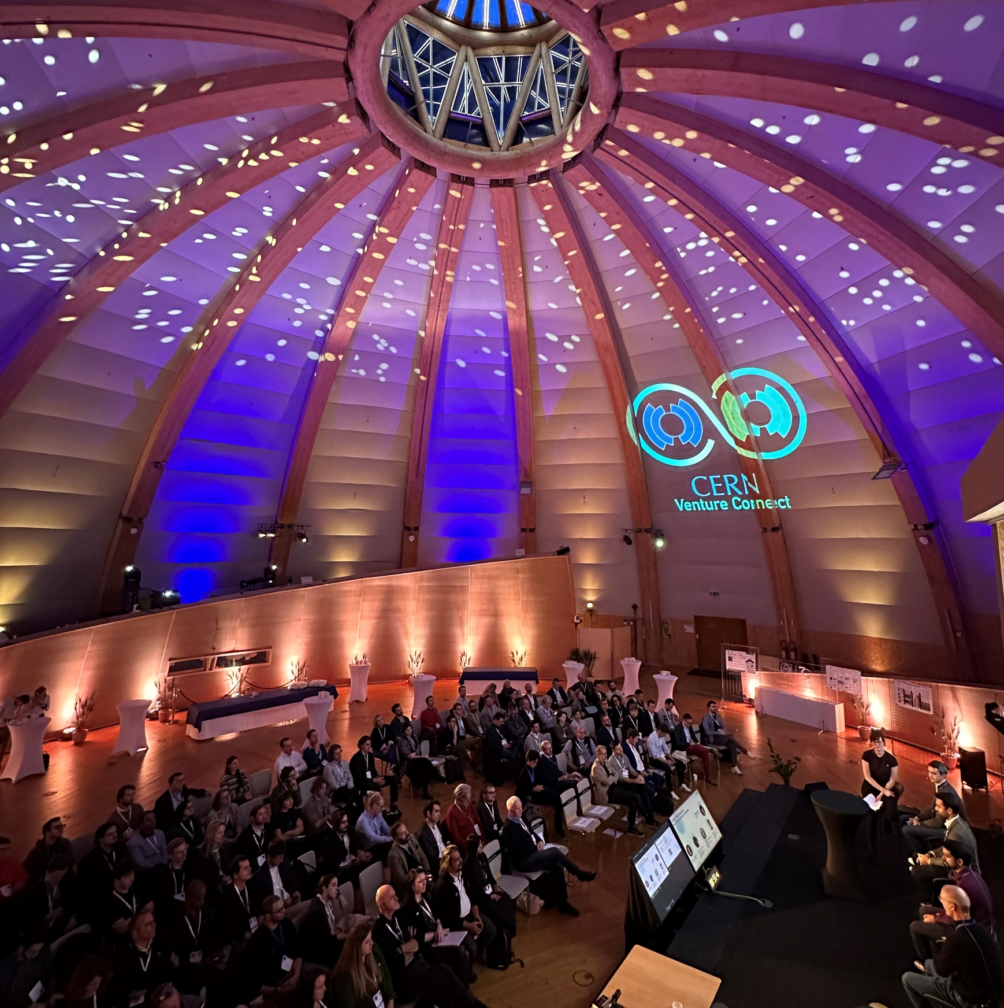
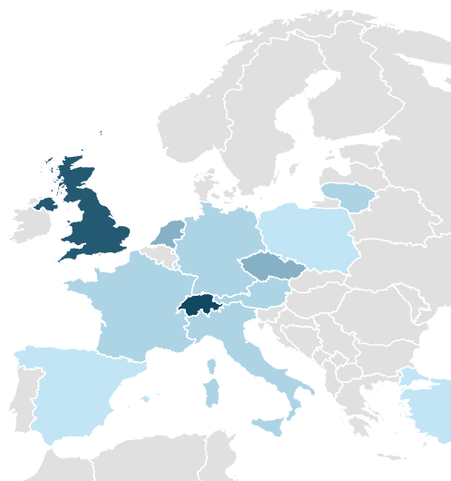
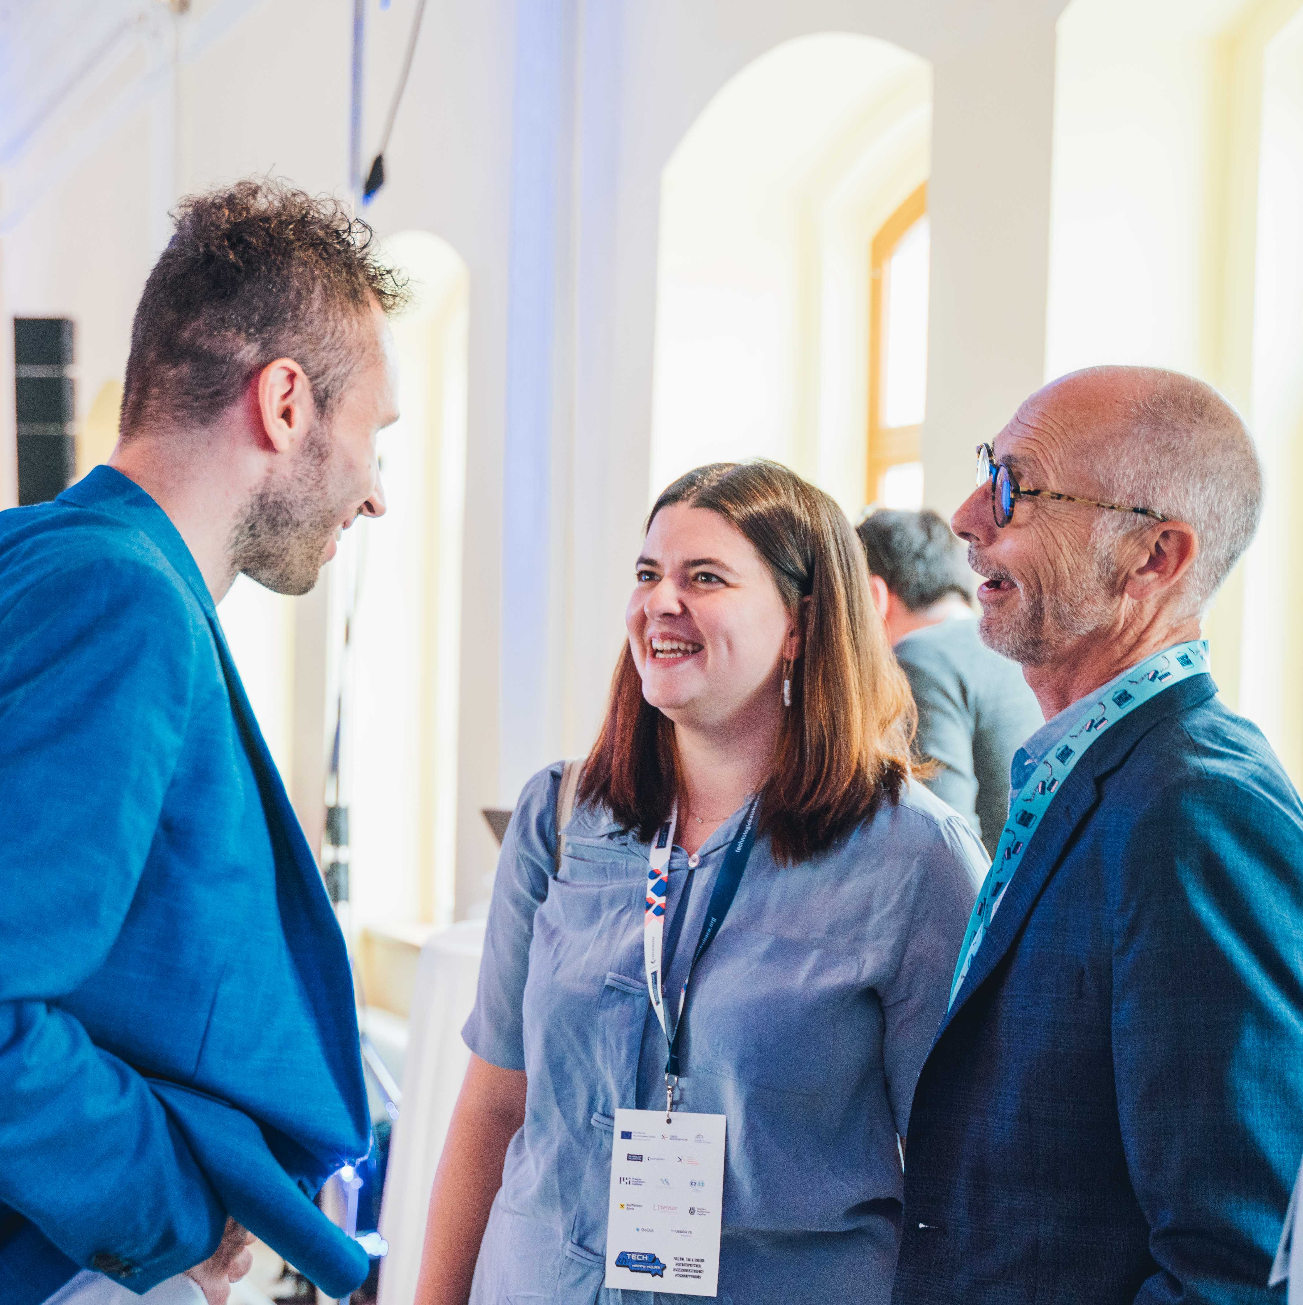
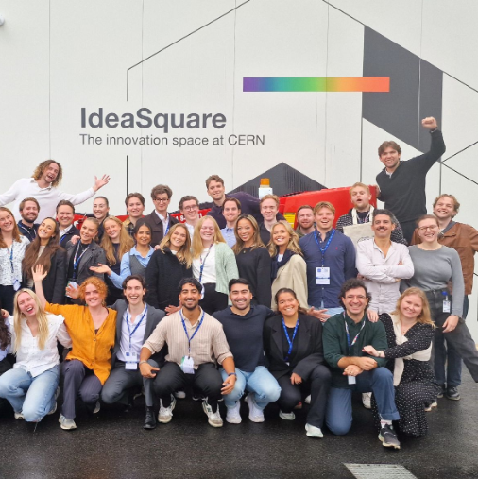













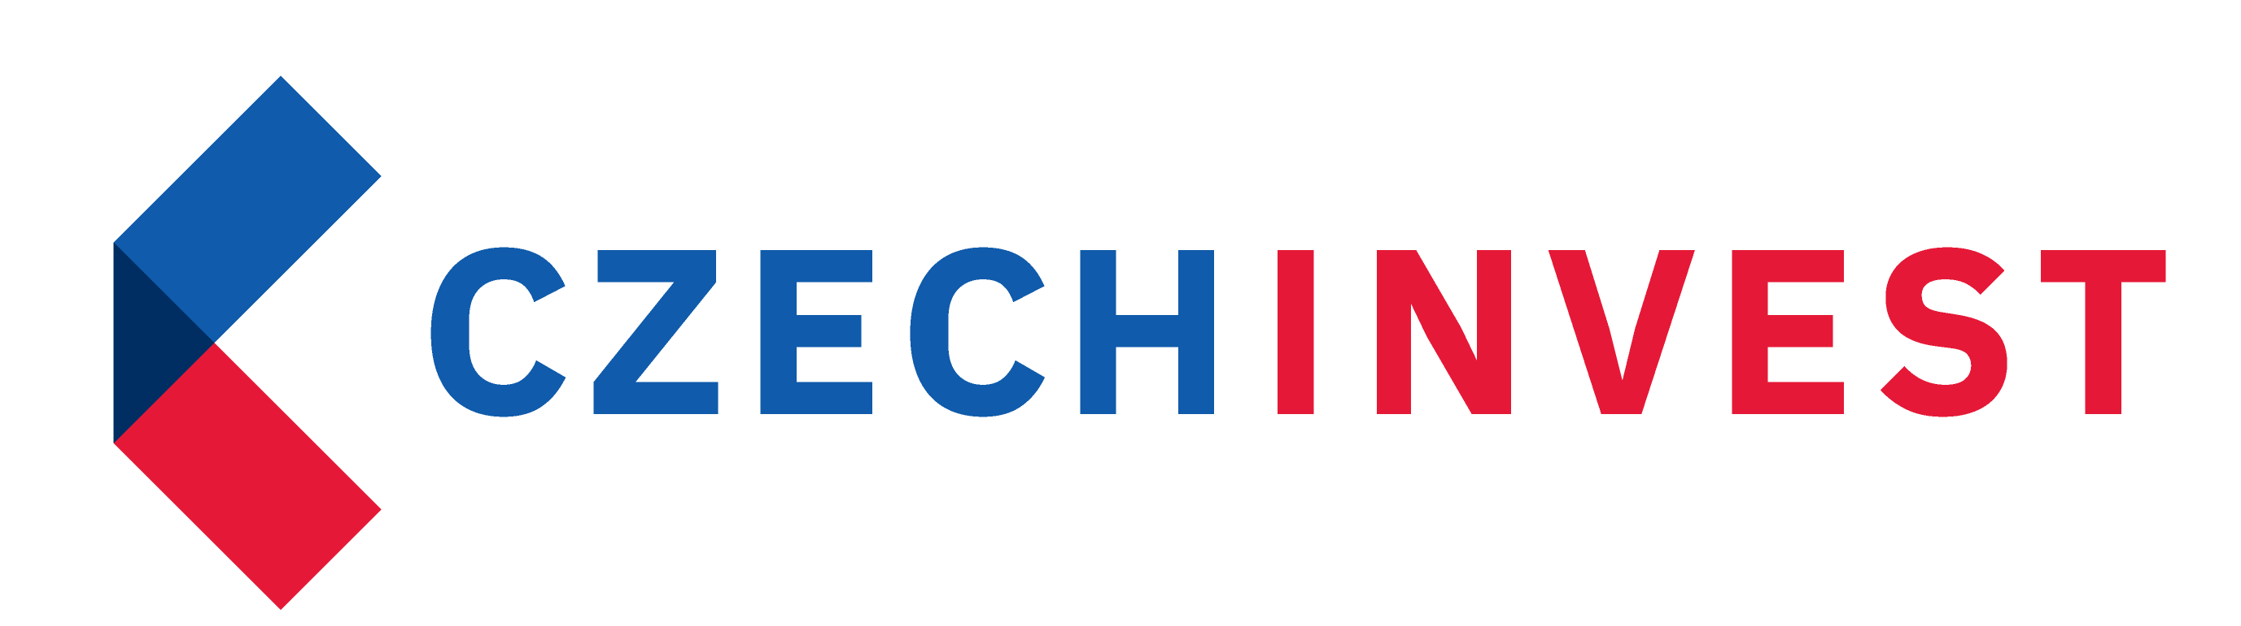


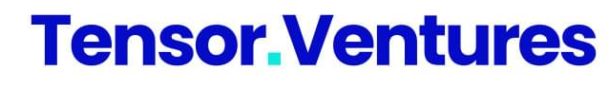



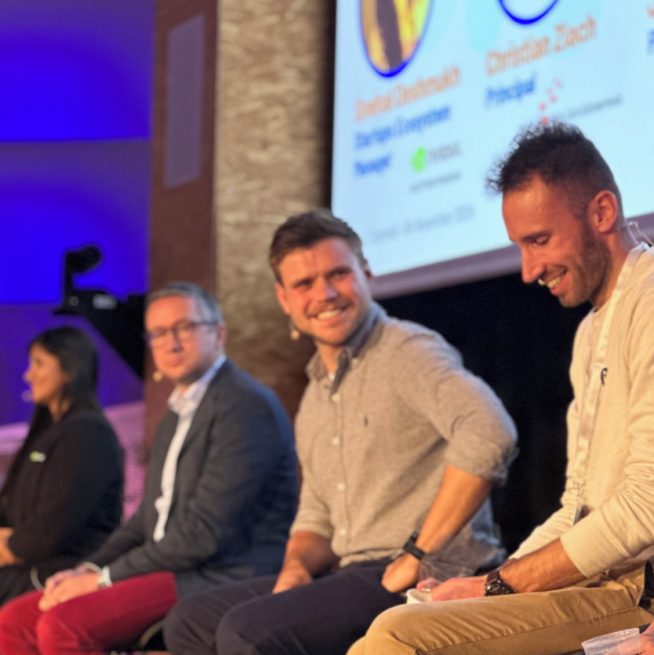
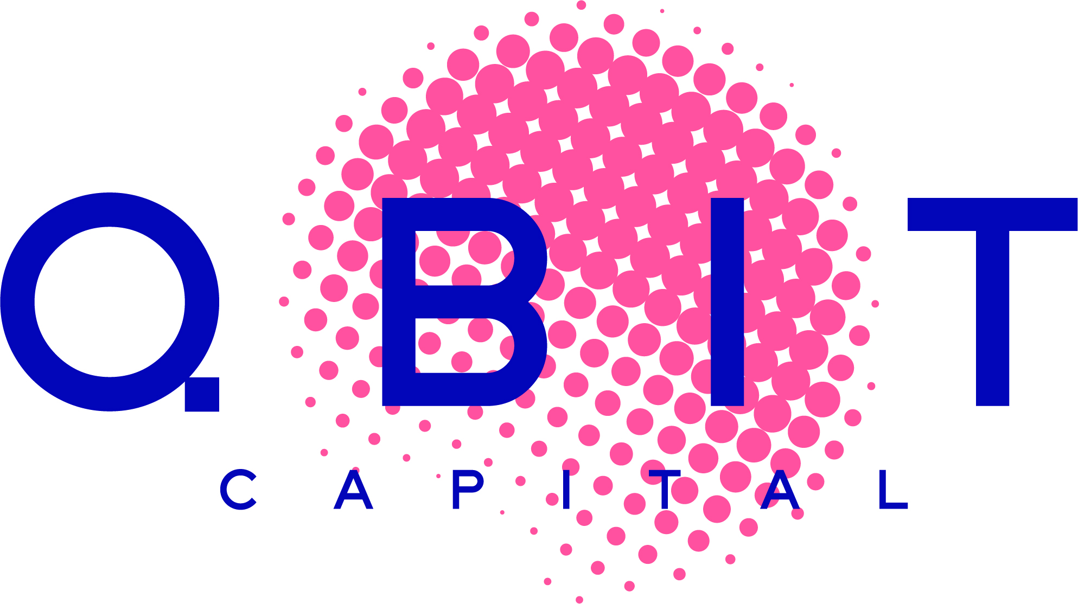


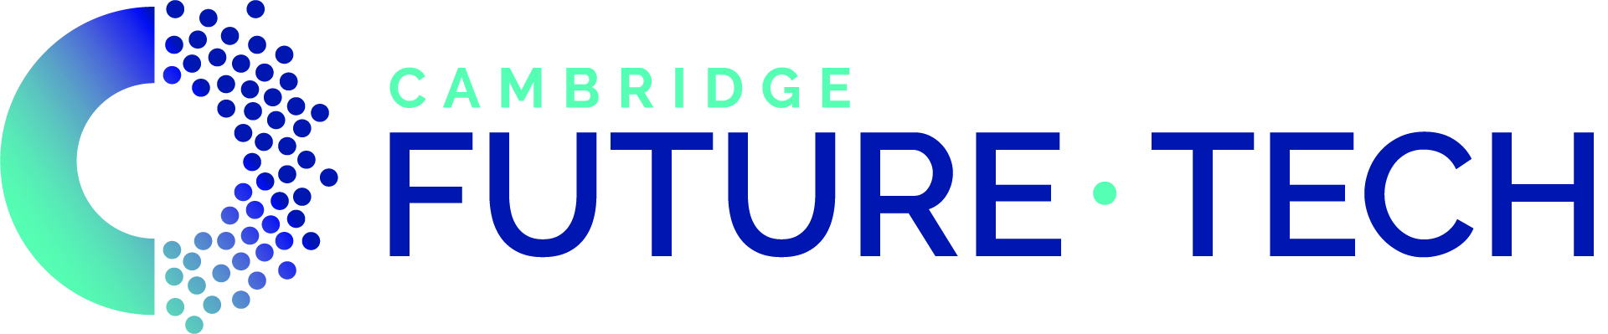












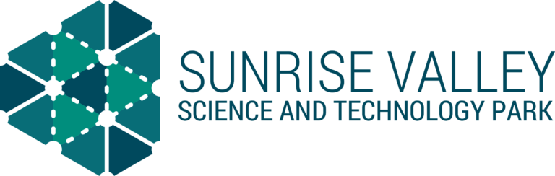



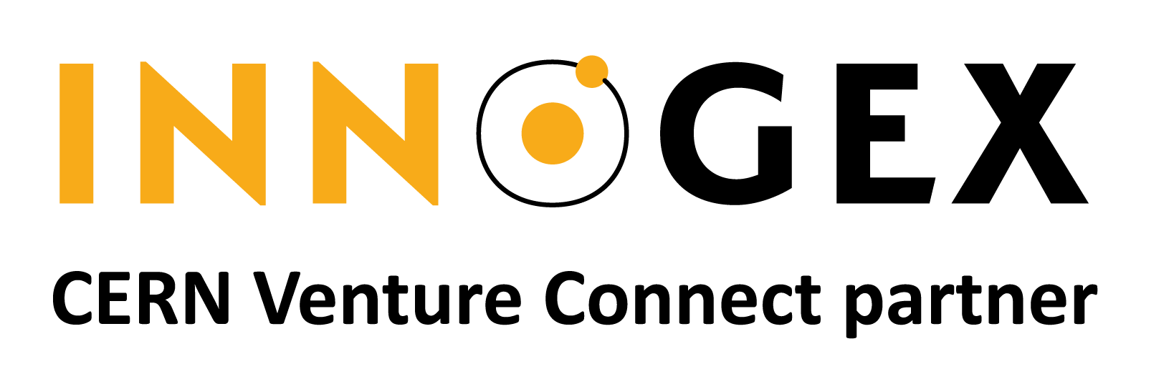


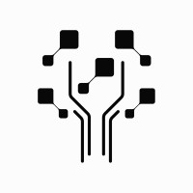












Become Part Of Our Community.
Benefit from our regular networking events
Join us and connect with our 50 partners globally. Whether you look for funding, lab space, legal advice, your first customers or industry expertise, our network has got you covered.

Slide 13

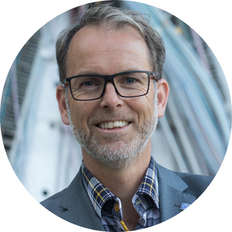


Thank you!
Han Dols
Linn Kretzschmar
Hanaé Taxis
Entrepreneurship & Innovation Networks Section Lead
CVC
Programme Lead
Communications & Partnerships
Linn.Kretzschmar@cern.ch
Hanae.Taxis@cern.ch
Han.Dols@cern.ch
Learn More.
Get In Touch.
CERN Venture Connect

