Slide 1




Particle therapy Masterclass
INFN-CS group report
28 students from Calabria high schools and
6 students from Ecuador:
Liceo Scientifico “Rita Levi Montalcini” - Filadelfia
Liceo Scientifico Statale "G. Berto” - V.Valentia
Liceo Scientifico "A. Volta" - R.Calabria
Polo Liceale Scalea Praia A Mare - Scalea
IIS Ferrari - Chiaravalle Centrale
Liceo Scientifico "Stefano Patrizi"- Cariati
Liceo Scientifico "Leonardo Da Vinci" - R.Calabria
Liceo Scientifico “L. Costanzo” - Decollatura
Liceo Scientifico “Scorza” - Cosenza
IIS “Da Vinci - Nitti” - Cosenza
Liceo Scientifico “Fermi” - Cosenza
Liceo Scientifico Statale Filolao - Crotone

Slide 2
Hands-on session
20 groups of students to compare the different properties of the external particle beams
(photons, protons and carbon ions)
and to evaluate how to optimize the maximum dose
on cancer by protecting organs at risk.
This is the summary of our studies and observations.

Slide 3
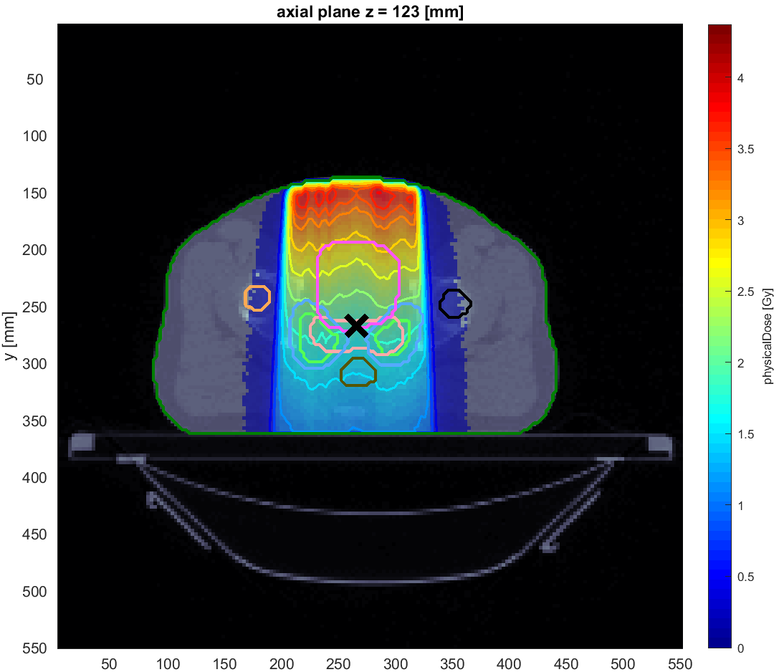
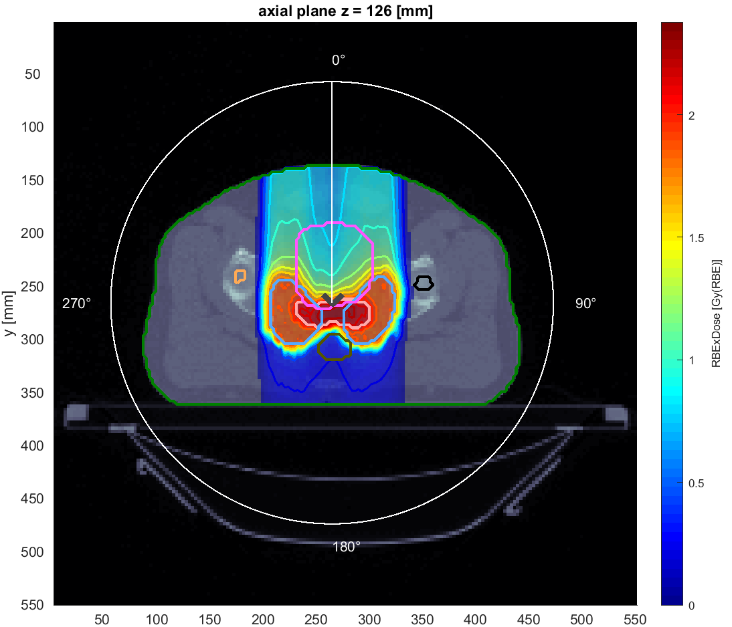
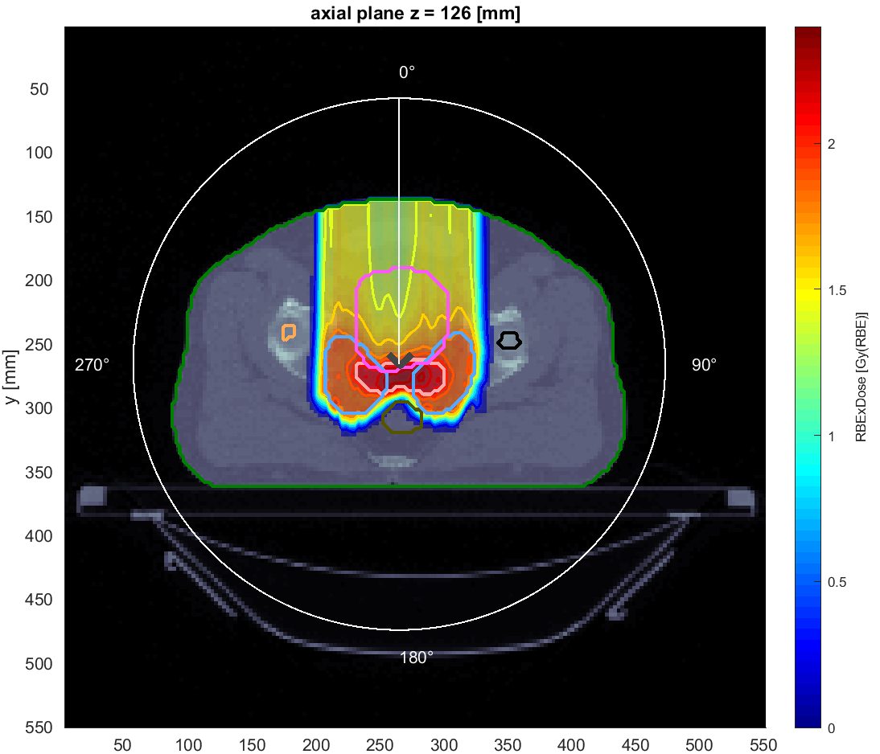
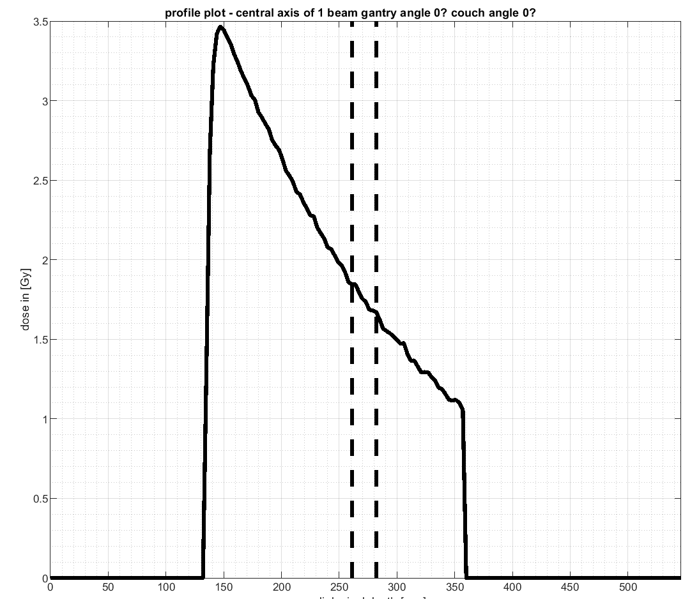
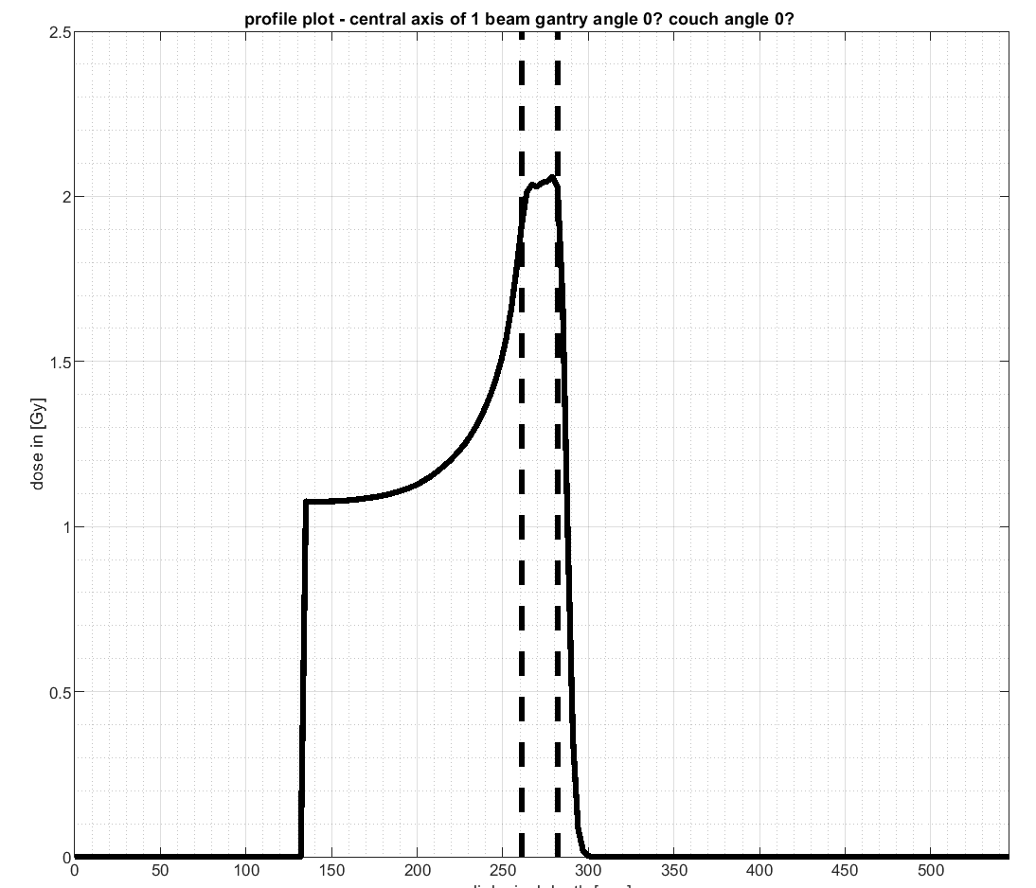
Comparison between photon, Proton and ion beams for prostate (same angle)
Objective: compare the various interaction-matter effects
in relation to beam quality
Photons
Carbon ions
Protons
Observations:
OAR are better protected with a proton beam
It is important to clearly define an OAR

Slide 4
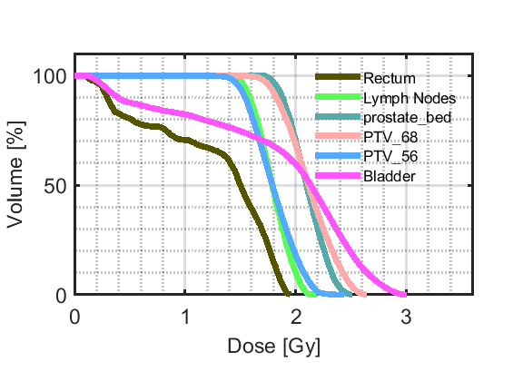
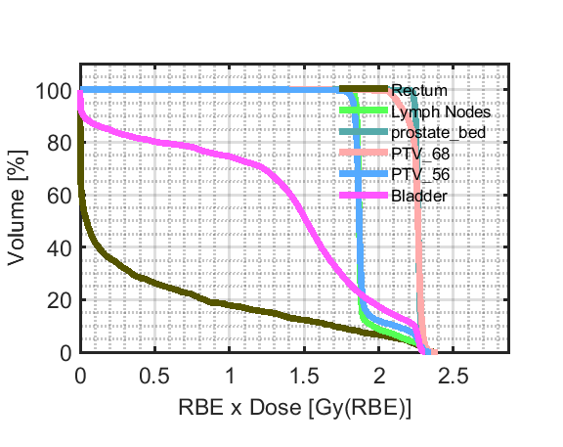
prostate DVH Comparison at 0°
We focus on an important OAR: the rectum (dark green line)
Photons
Carbon ions
Protons
It is clearly visible from the DVH plots that we have a better treatment plan with protons or carbon ions.
Should we avoid photon treatment?

Slide 5
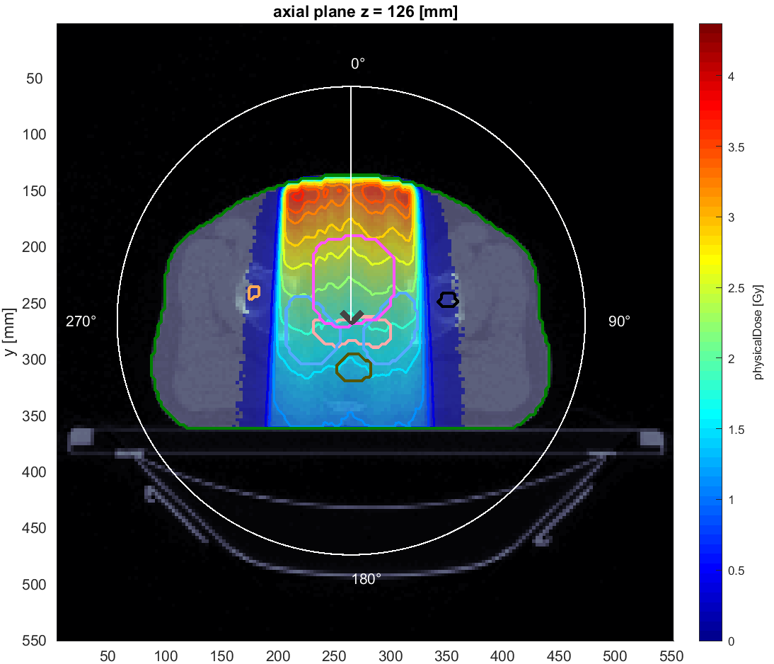
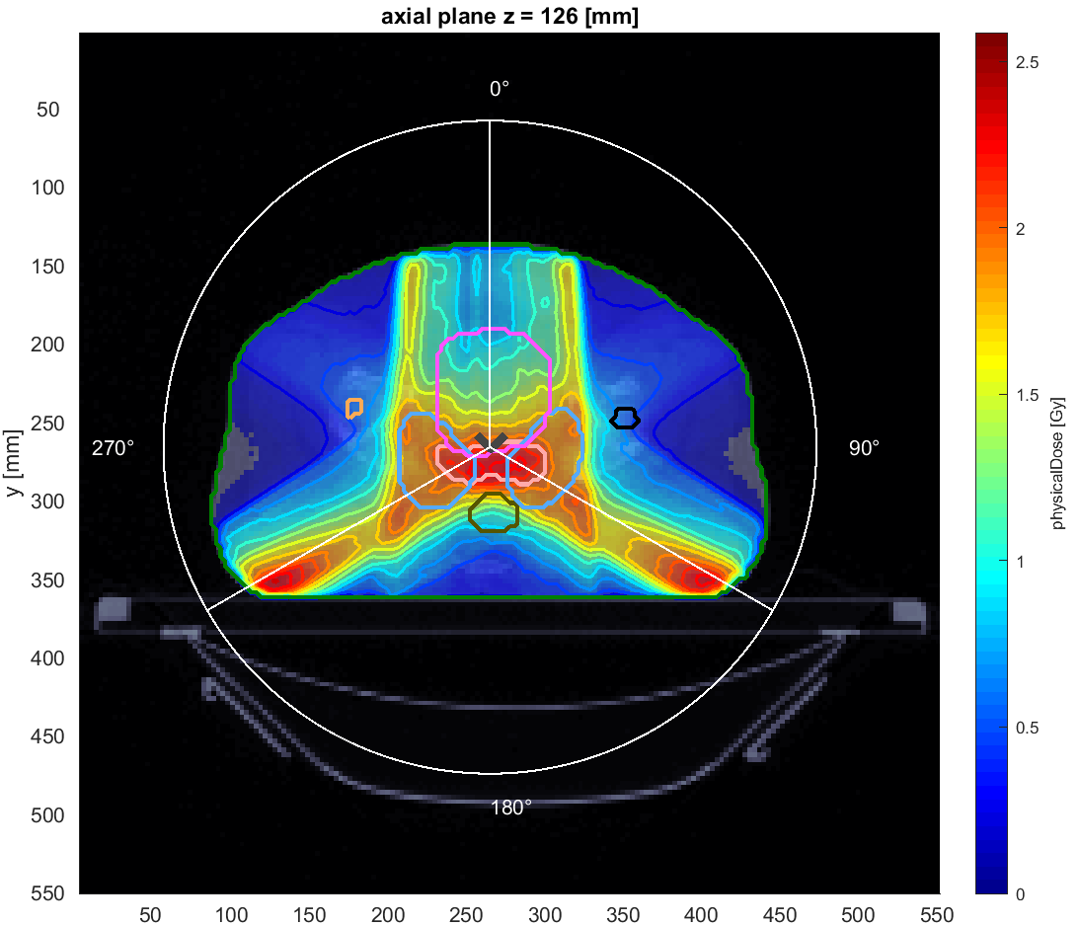
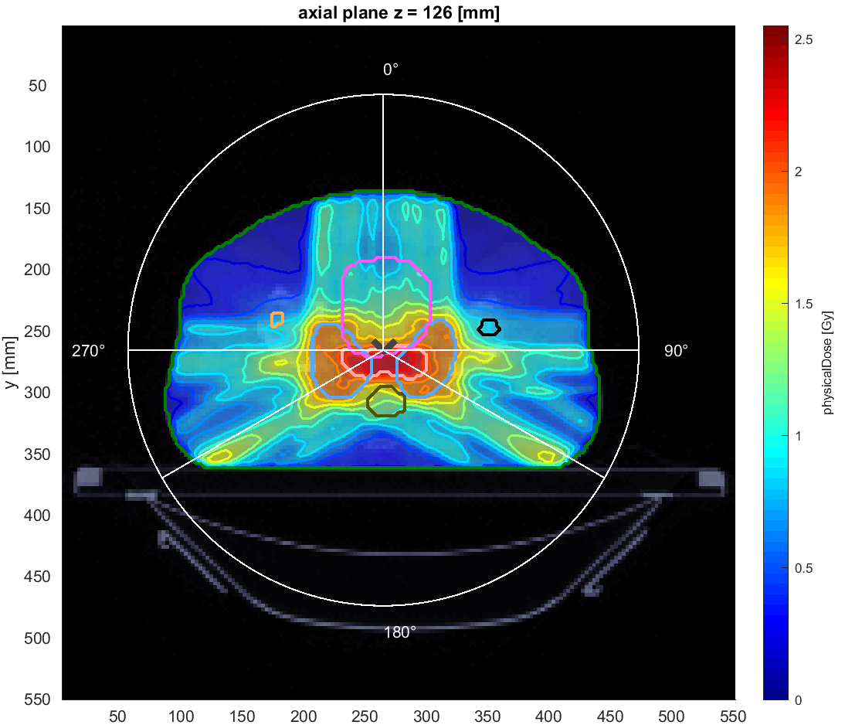
No, A better result with photons can be obtained using multiple beams and choosing the best angular distribution
Five beams
One beam
Three beams

Slide 6
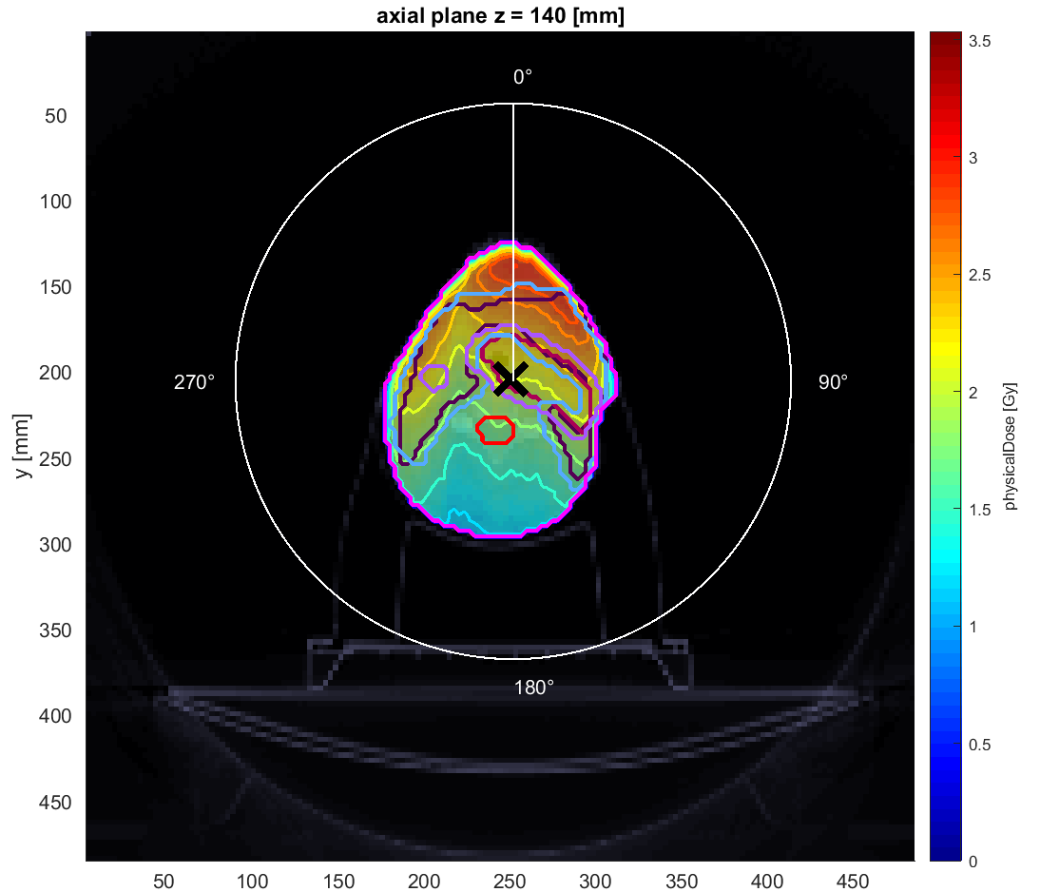
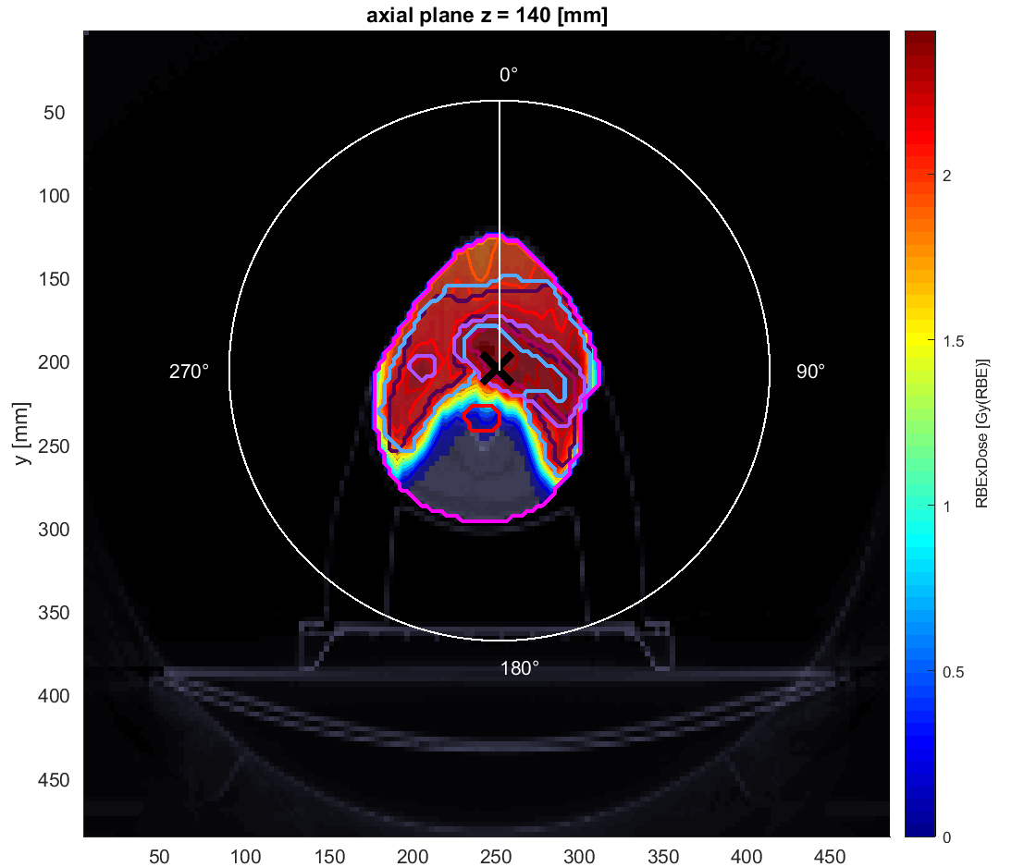
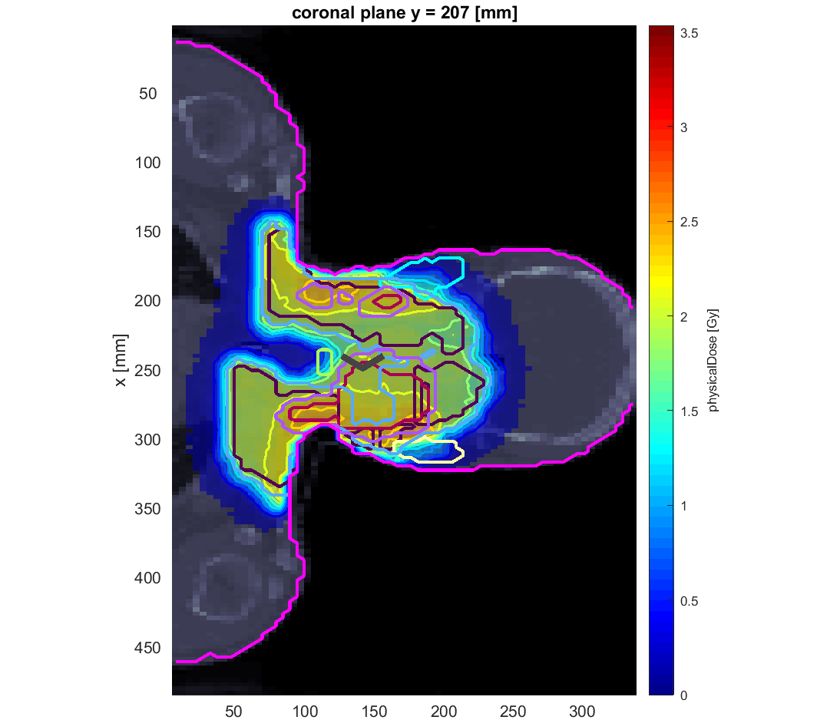
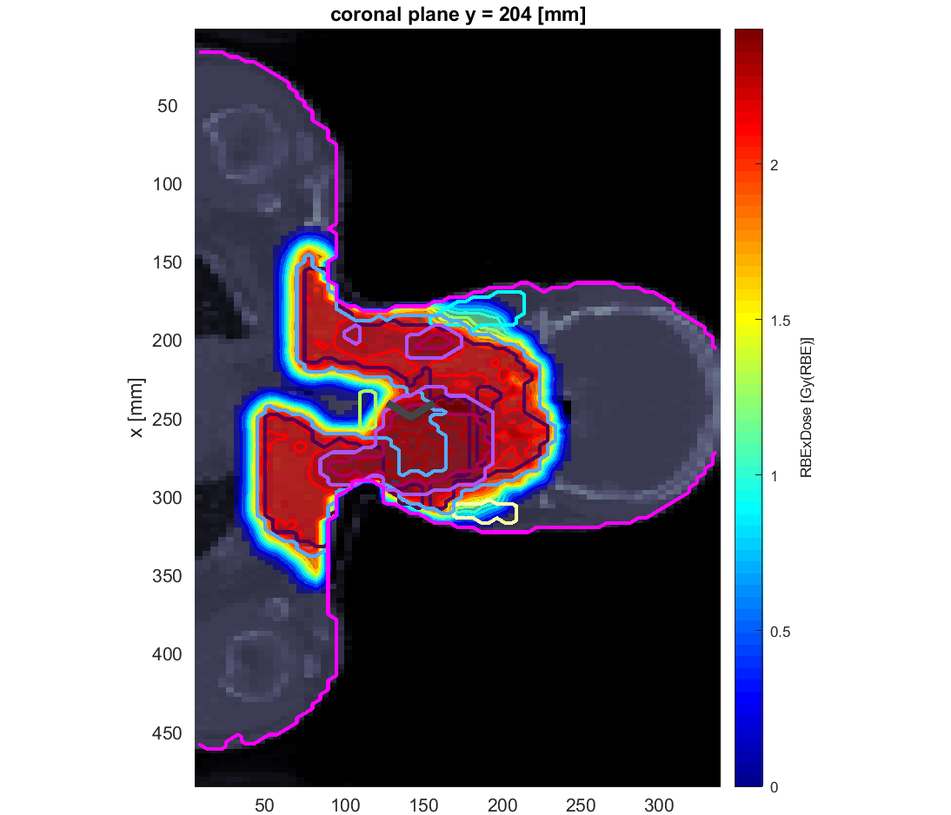
comparison photons-protons in the case of
head cancer
Protons
Photons
In the head there are various OAR, it may be useful to use multiple beams (even in the case of protons)

Slide 7
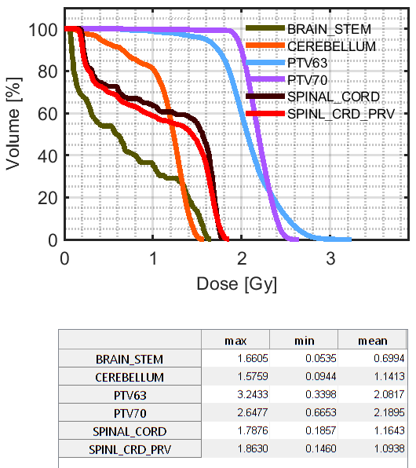
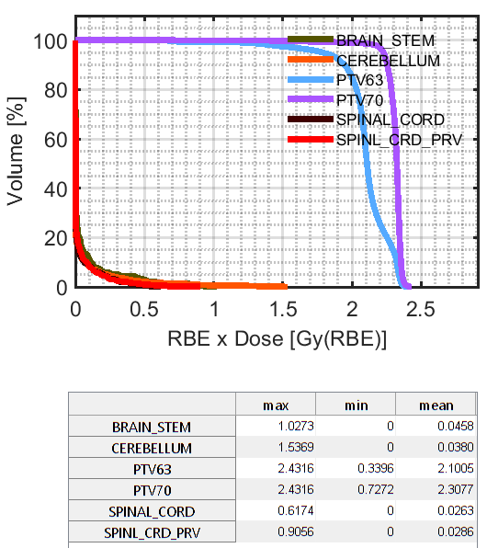
comparison photons-protons in the case of
head cancer
Photons
Spinal cord mean dose 1,16
RBExGy and max 1,8
Protons
Spinal cord mean dose 0,03
RBExGy and max 0,6
It is not easy to plan a treatment to the head,
despite the high symmetry among important organs

Slide 8
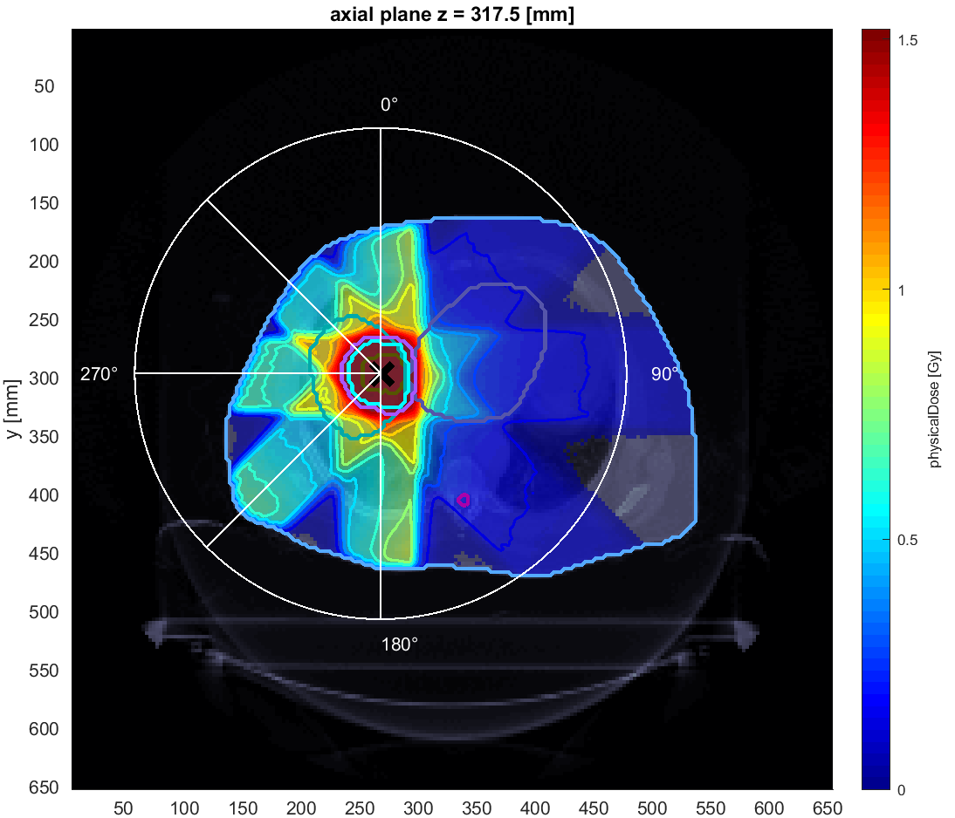
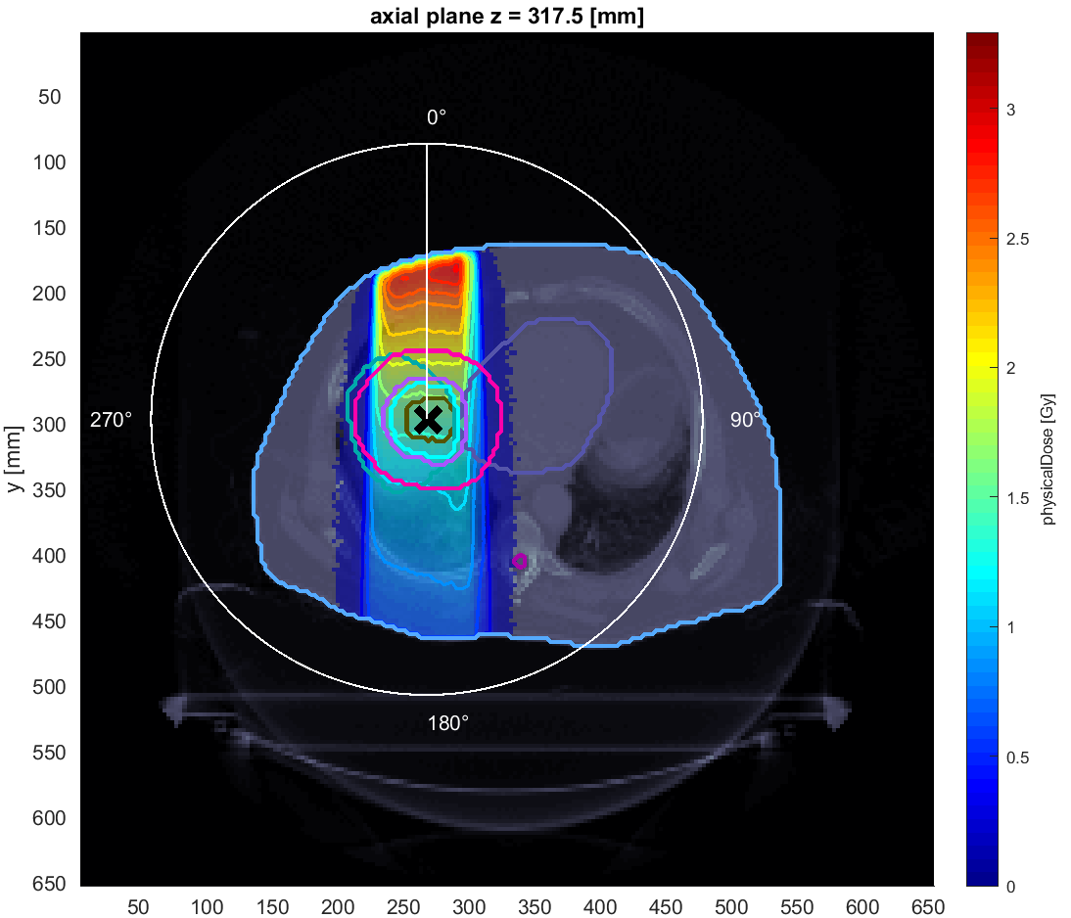
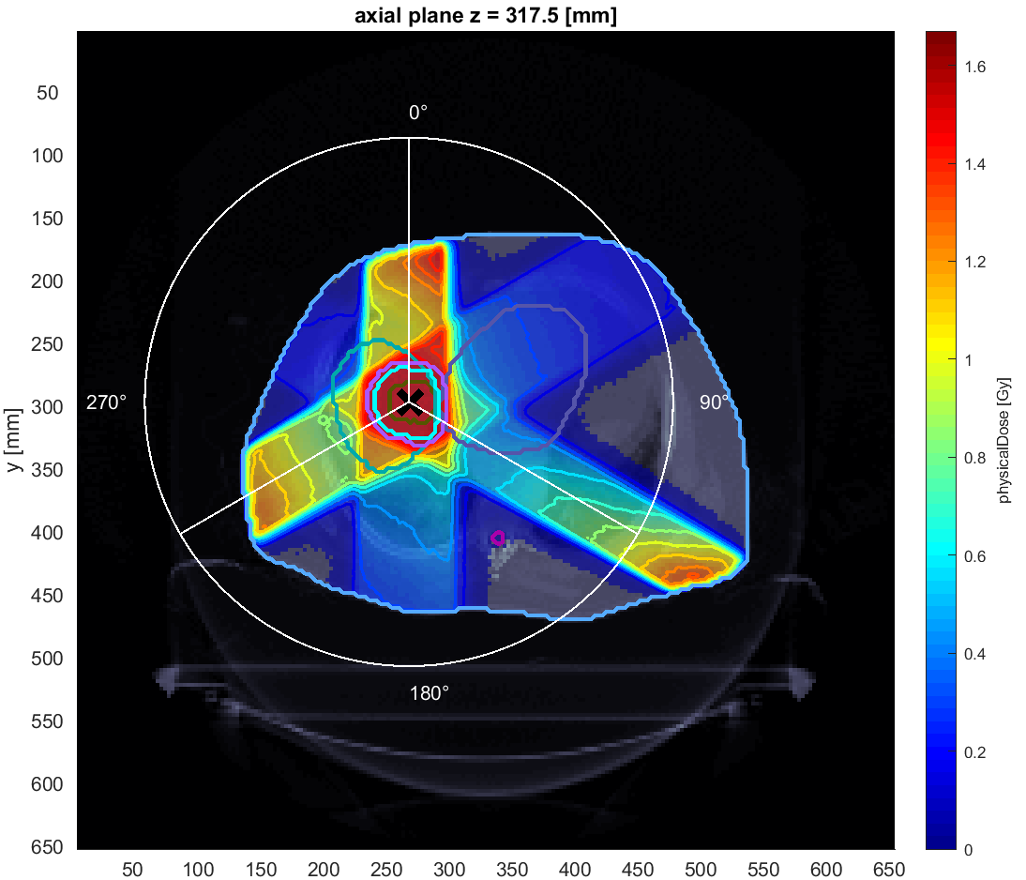
liver TP: Comparison between single photon beam and multiple photon beams (0,180,225,270,315) and (0,120,240)
Unlike the head, here there is no particular symmetry.
The choice of multiple beams is preferable

Slide 9
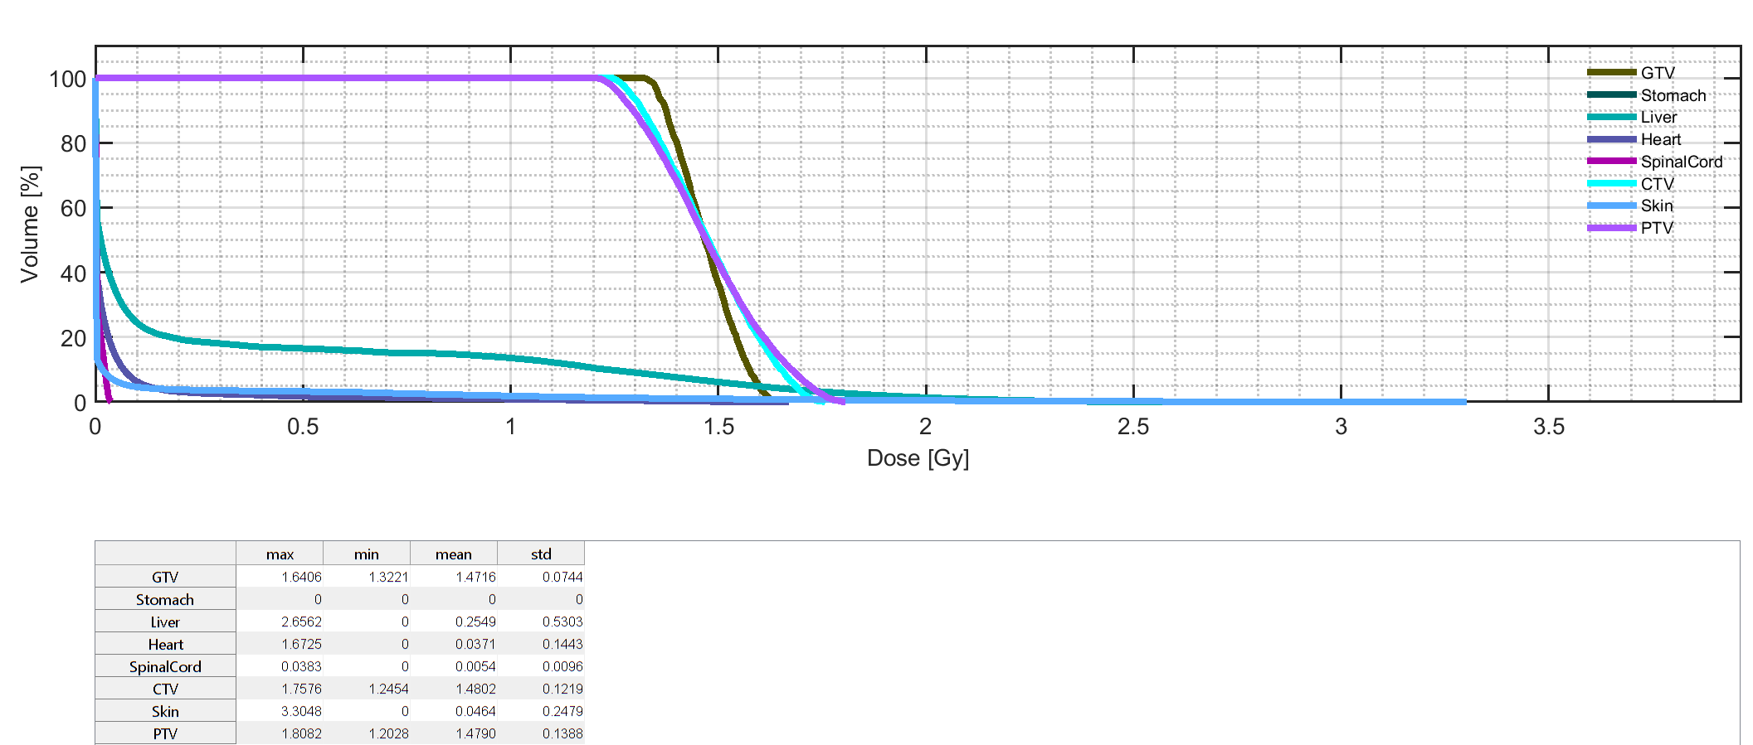
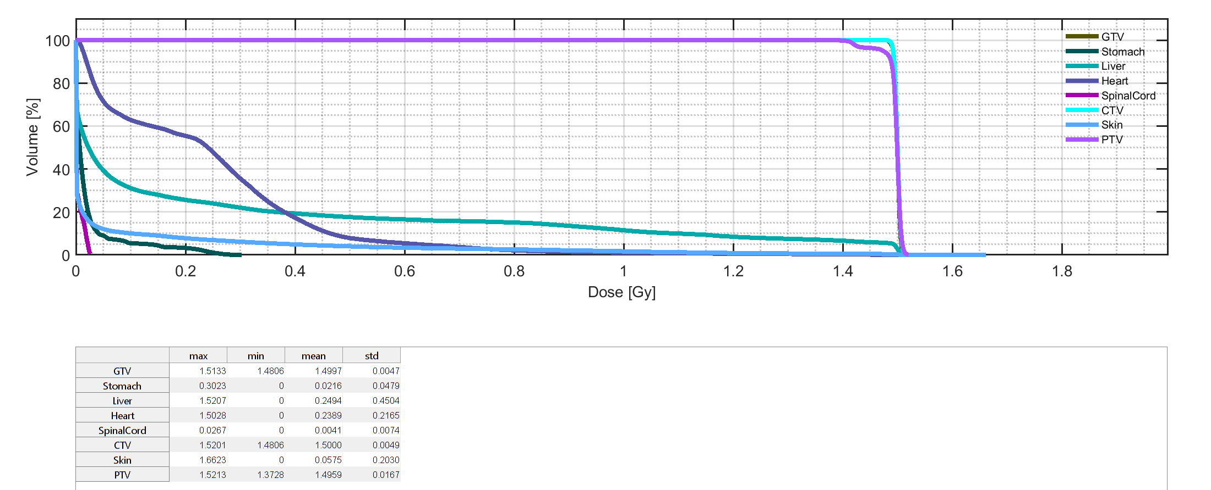
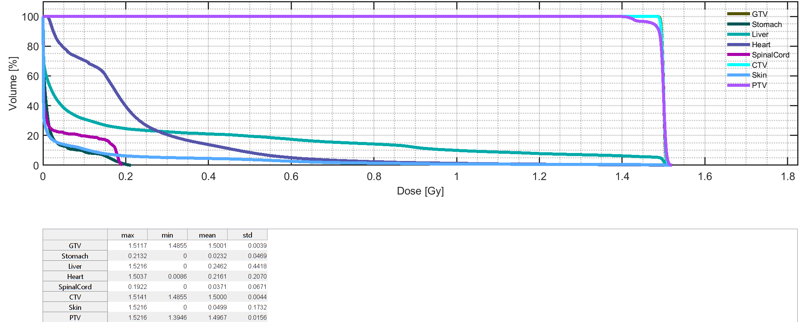
liver TP: Comparison between single photon beam and multiple photon beams (0,180,225,270,315) and (0,120,240)
0°
0°,120°,240°
0°,180°,225°,270°,315°
We can obtain a better treatment plan by choosing multiple beams

Slide 10
A beautiful day,thanks!

