Slide 1


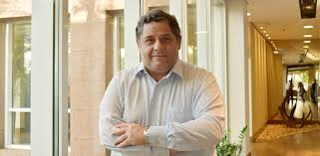
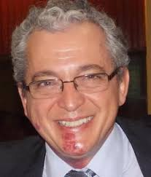
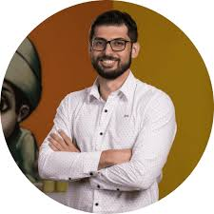
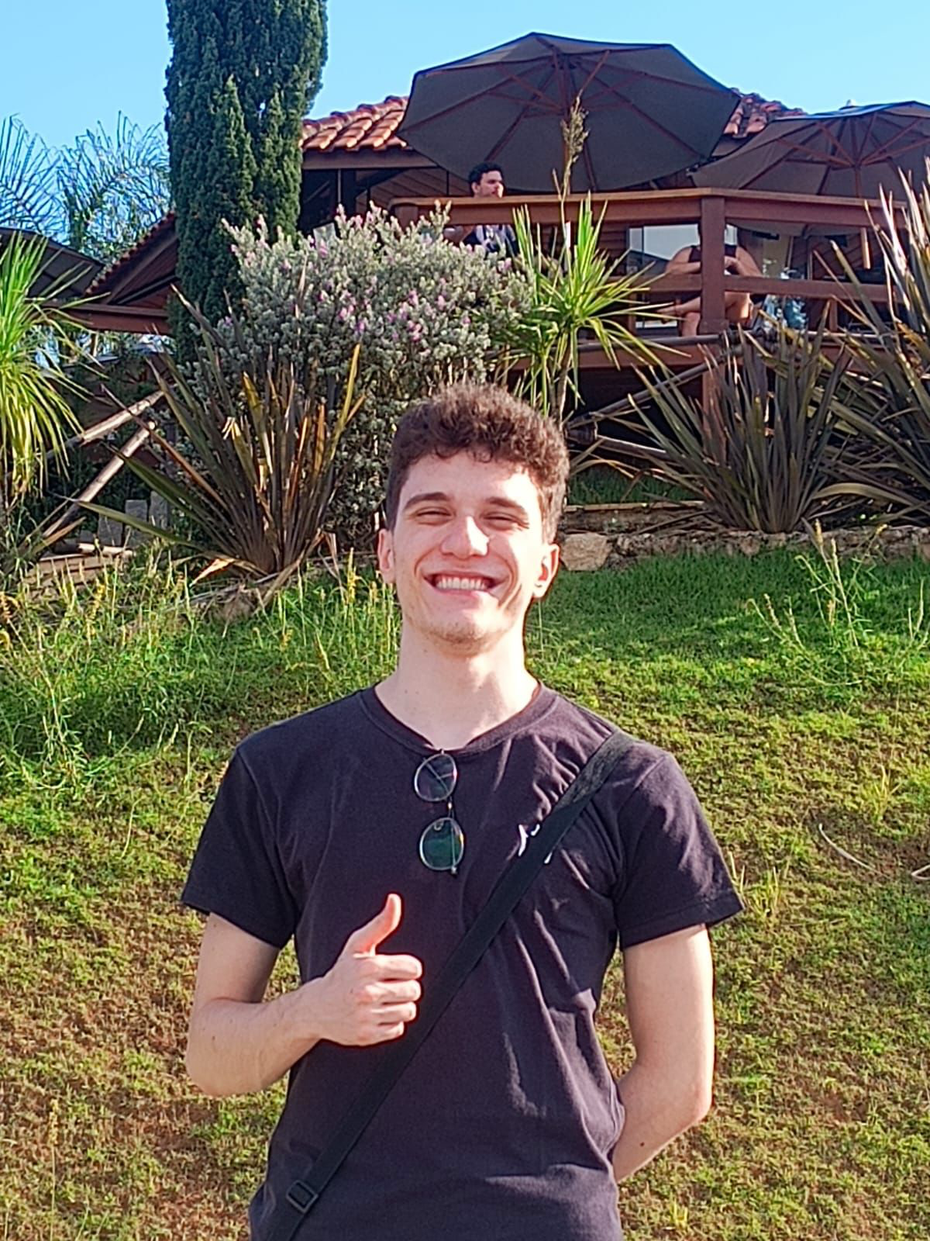
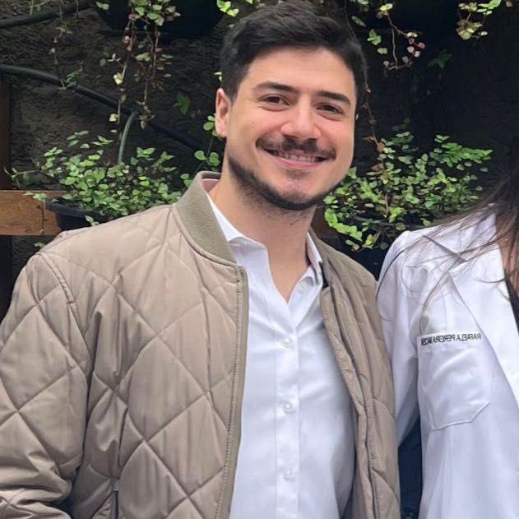
Particle Therapy Master Class
Vitor Premero / Wagner Marques 3 de abril de 2025

Slide 2
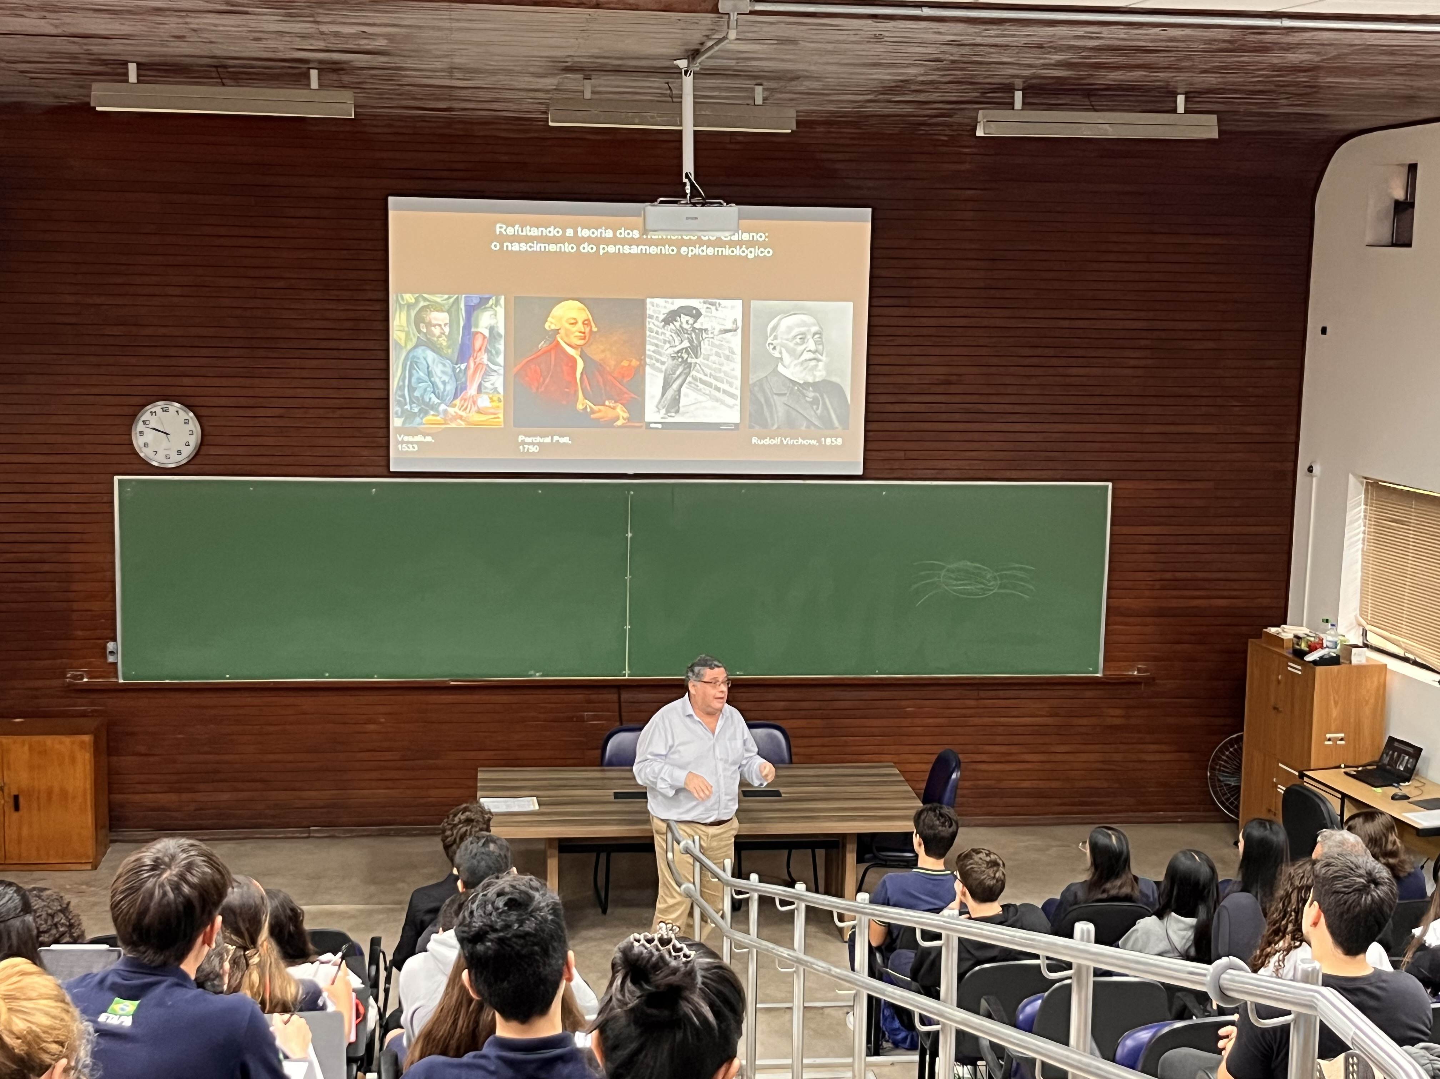

Slide 3
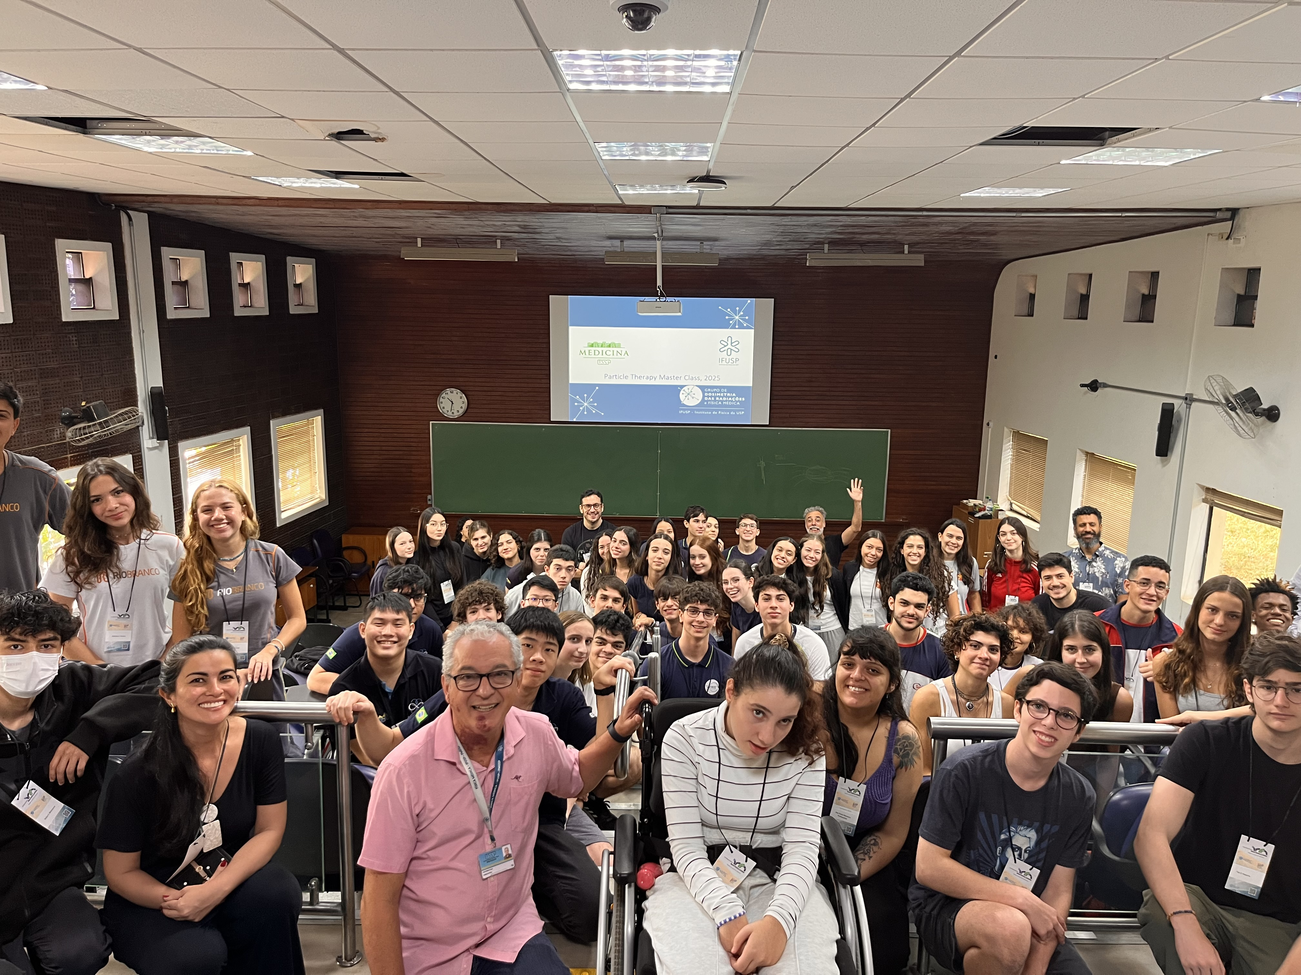

Slide 4
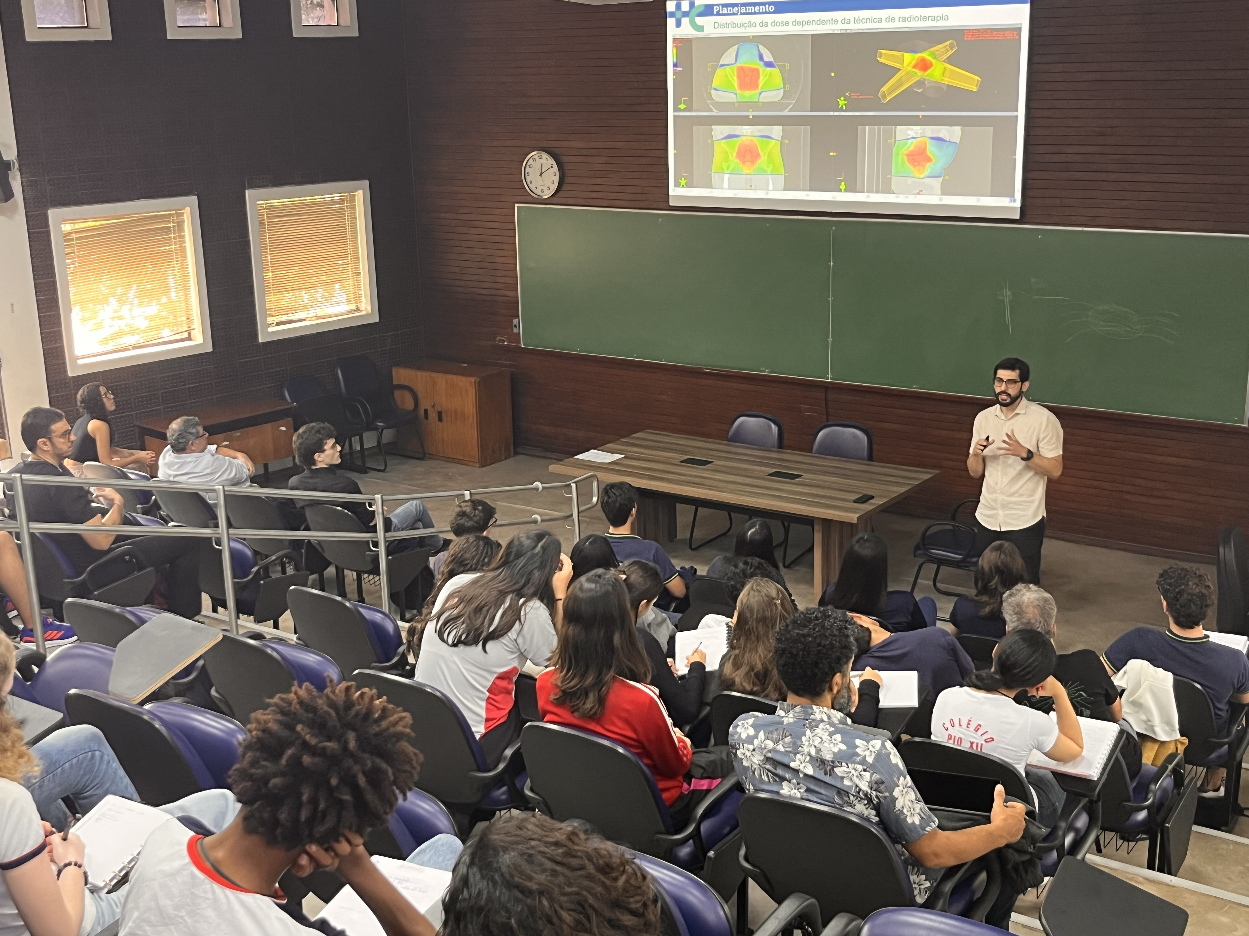

Slide 5
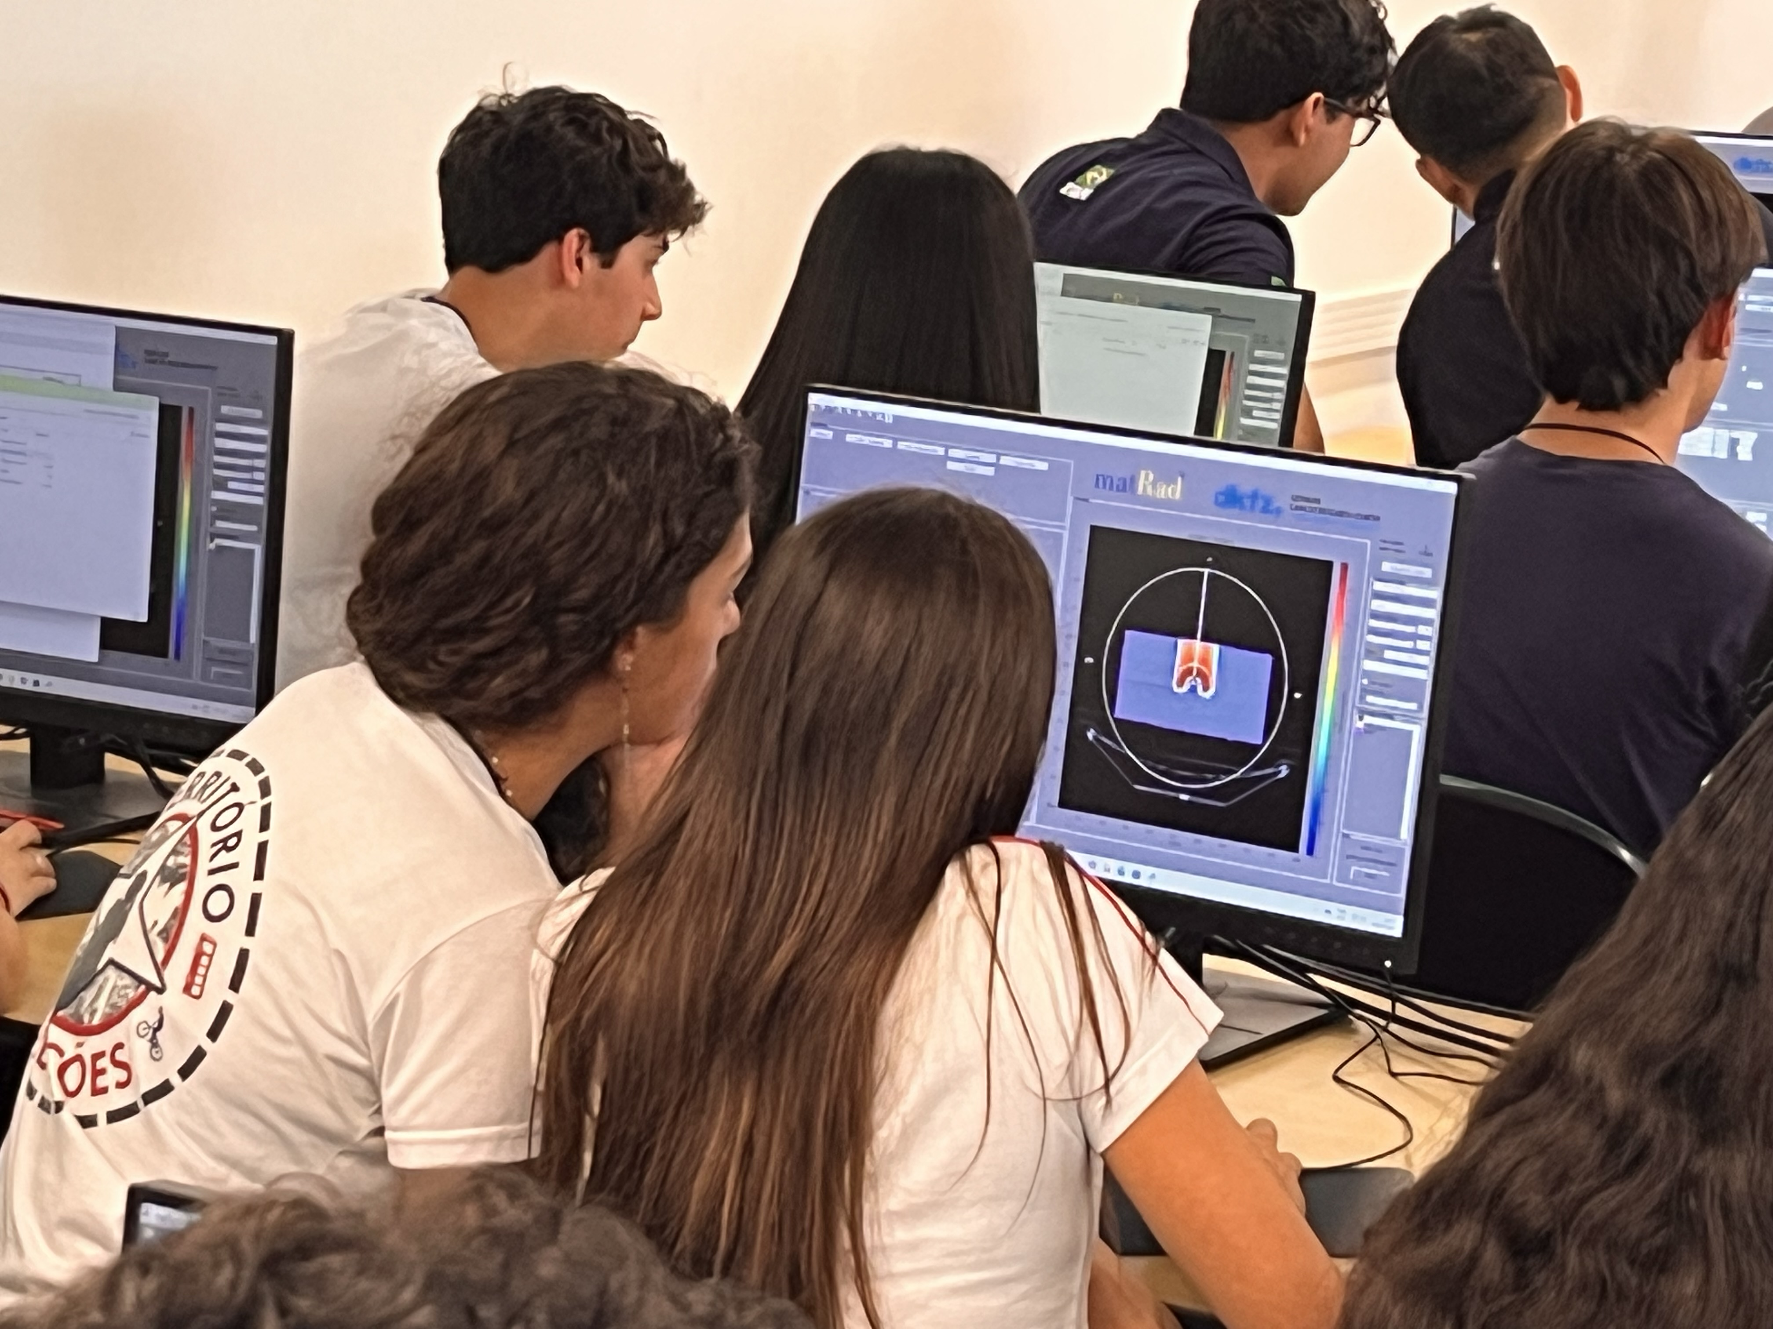

Slide 6
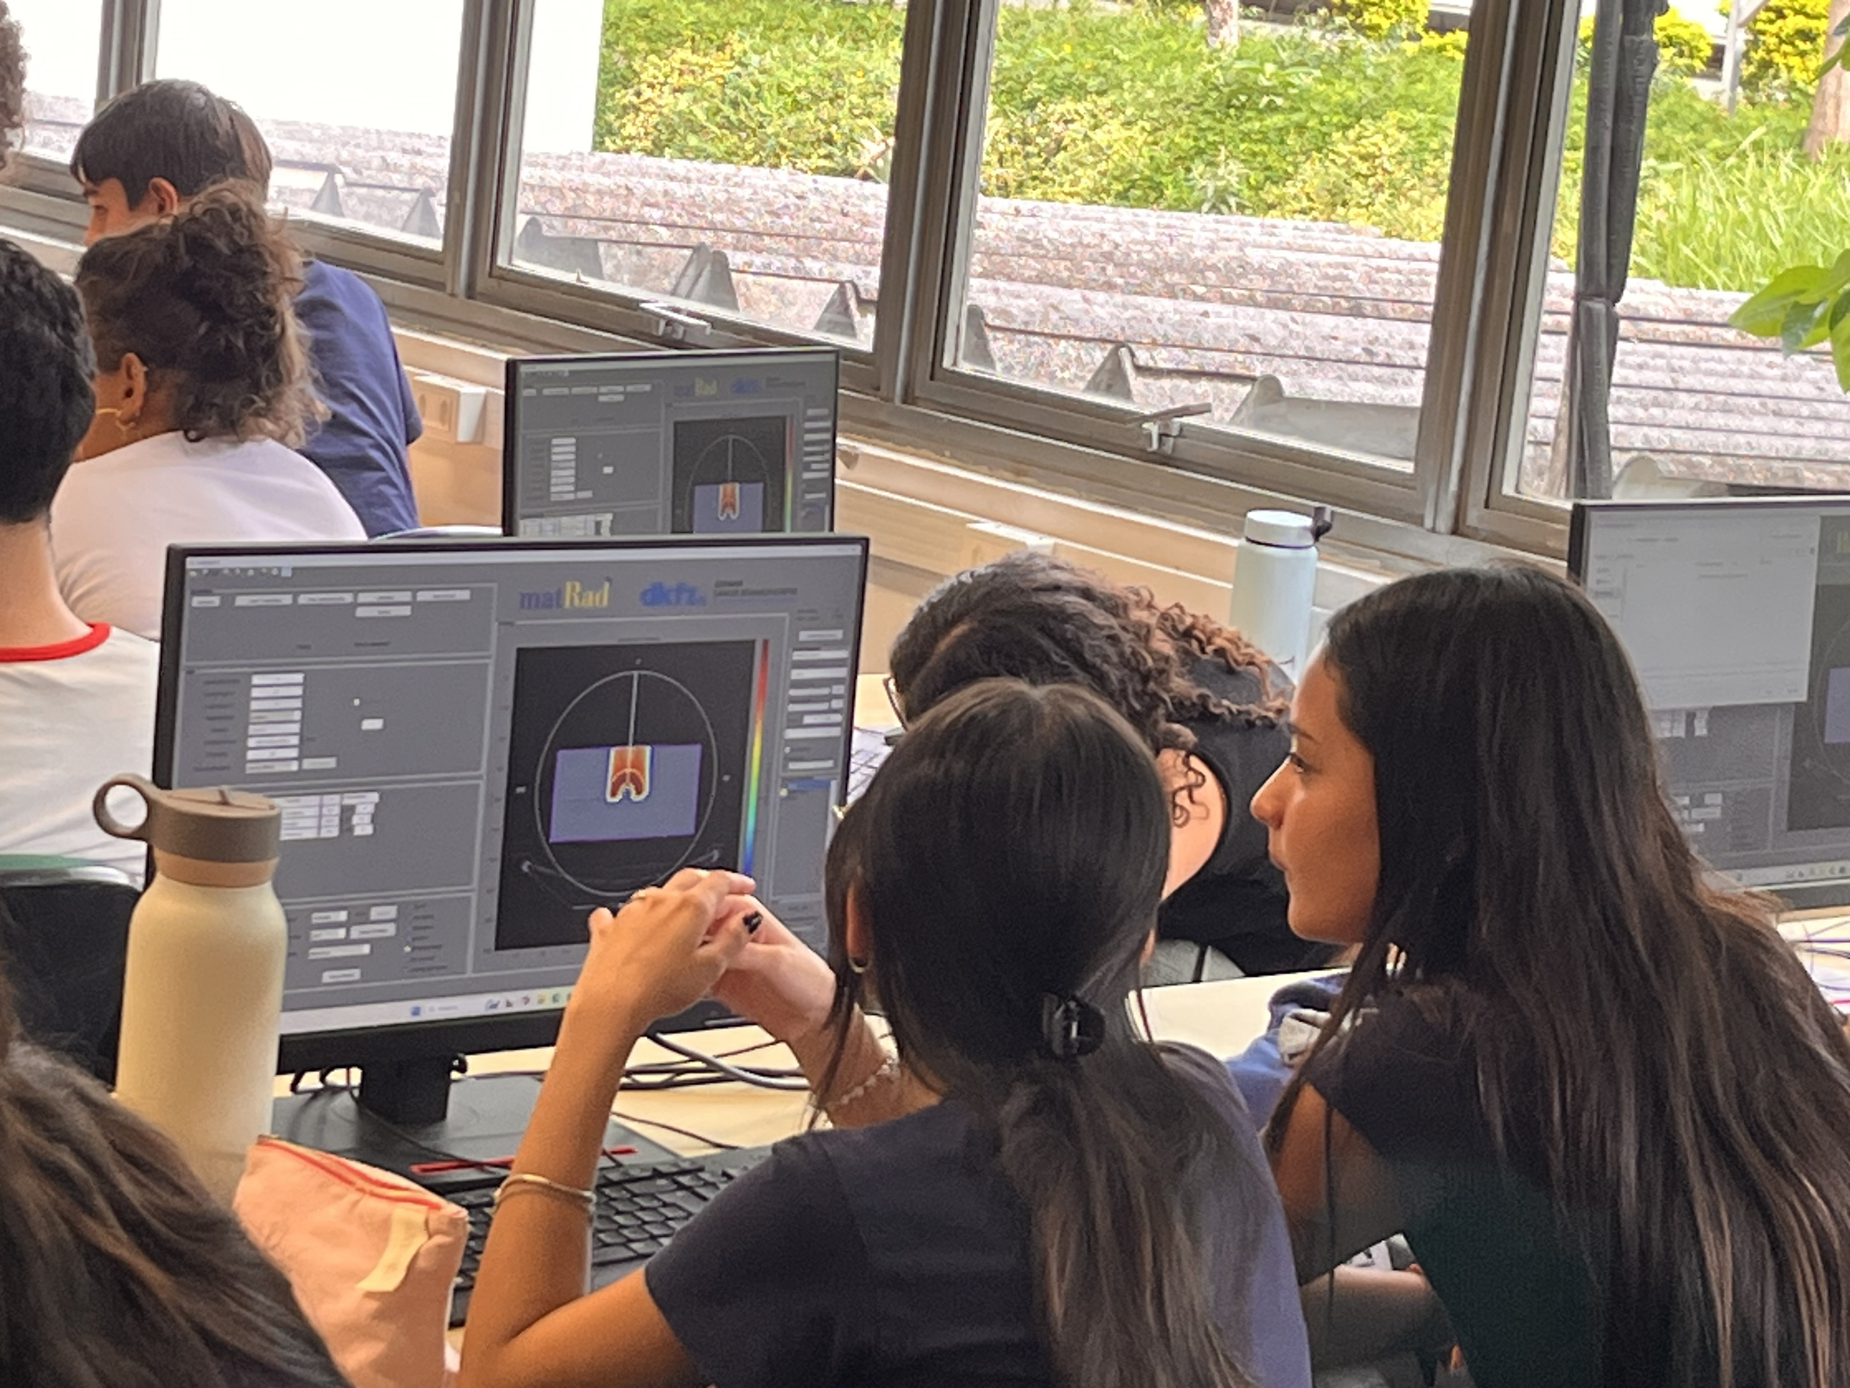

Slide 7
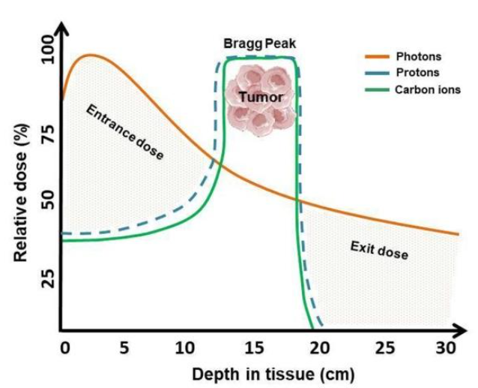
Basis of radiation physics
Particle Therapy Master Class
Bragg peak

Slide 8



O que é o matRad?
Particle Therapy Master Class
”

Slide 9
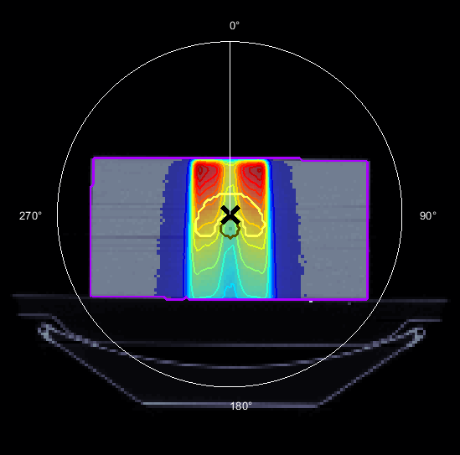
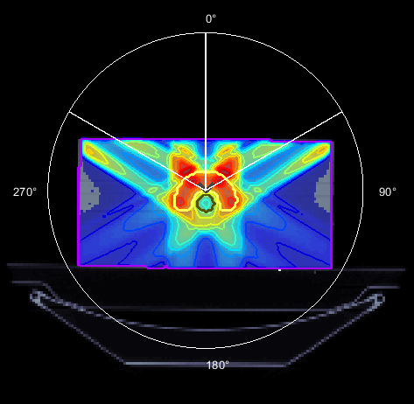
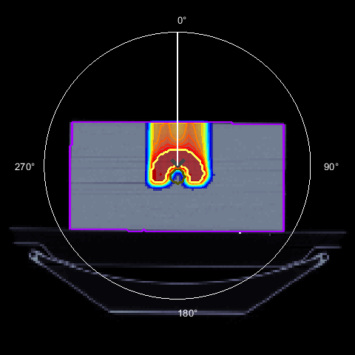
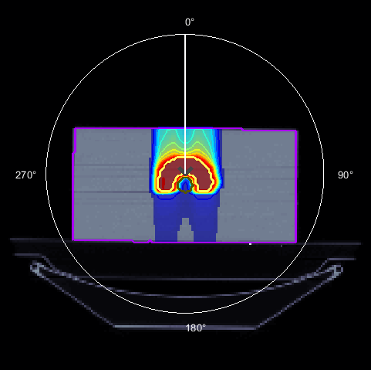
Análise das imagens formadas
Particle Therapy Master Class
1 photon beam
3 photon beams
Protons
Carbon ions
CORE 1.0615
OuterTarget 1.5905
BODY 0.1373
CORE 0.8567
OuterTarget 1.6462
BODY 0.1876
CORE 0.2259
OuterTarget 1.6652
BODY 0.0652
CORE 0.2975
OuterTarget 1.6659
BODY 0.0582

Slide 10
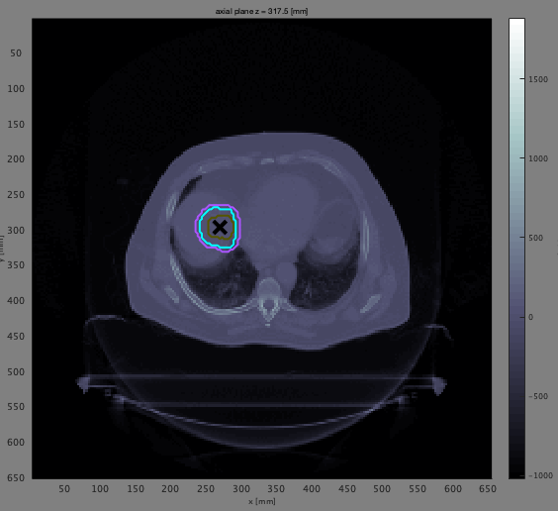
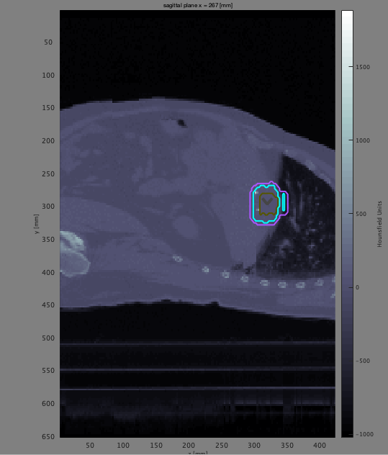
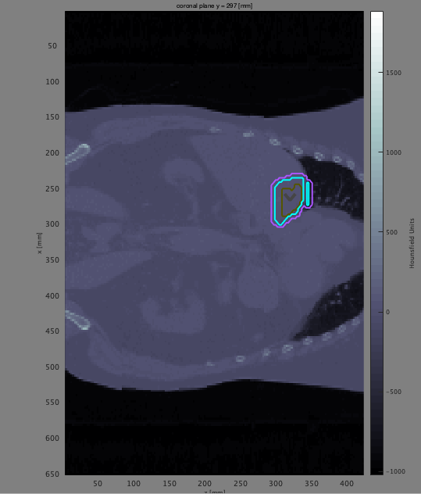
Case 1: Liver cancer
Particle Therapy Master Class
Axial
Sagital
Coronal
X
X

Slide 11
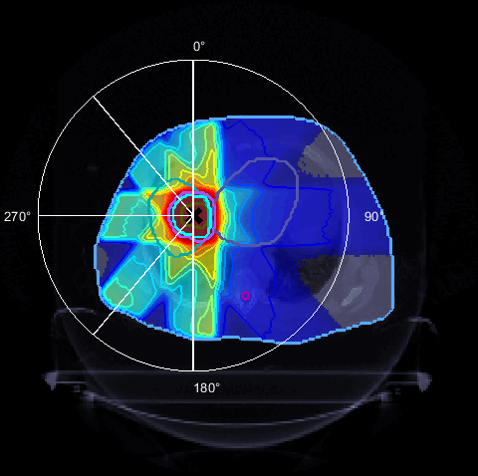
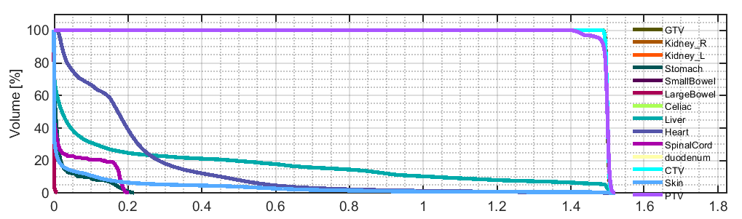
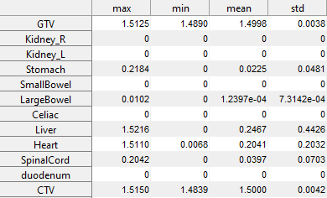
Suggested solution
Particle Therapy Master Class

Slide 12
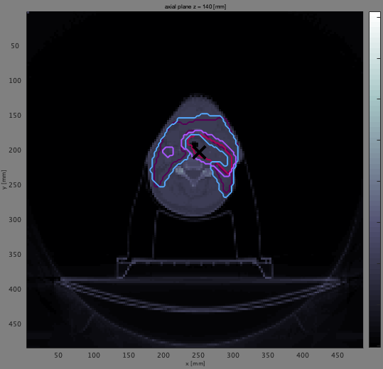
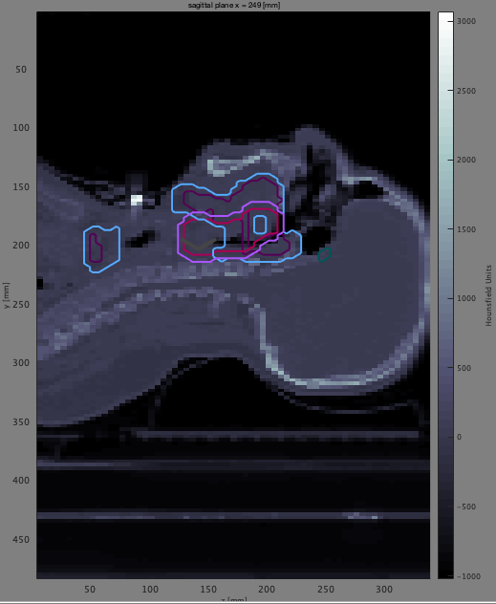
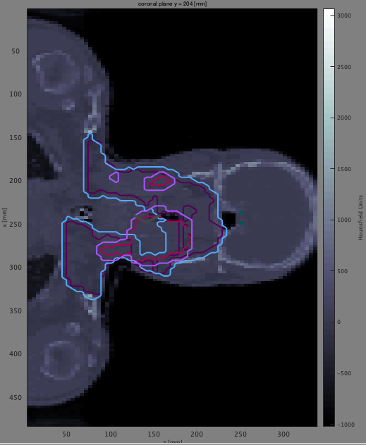
Case 2: Head and neck cancer
Particle Therapy Master Class
Axial
Sagital
Coronal

Slide 13

Kahoot!
Particle Therapy Master Class
https://kahoot.it/

Slide 14
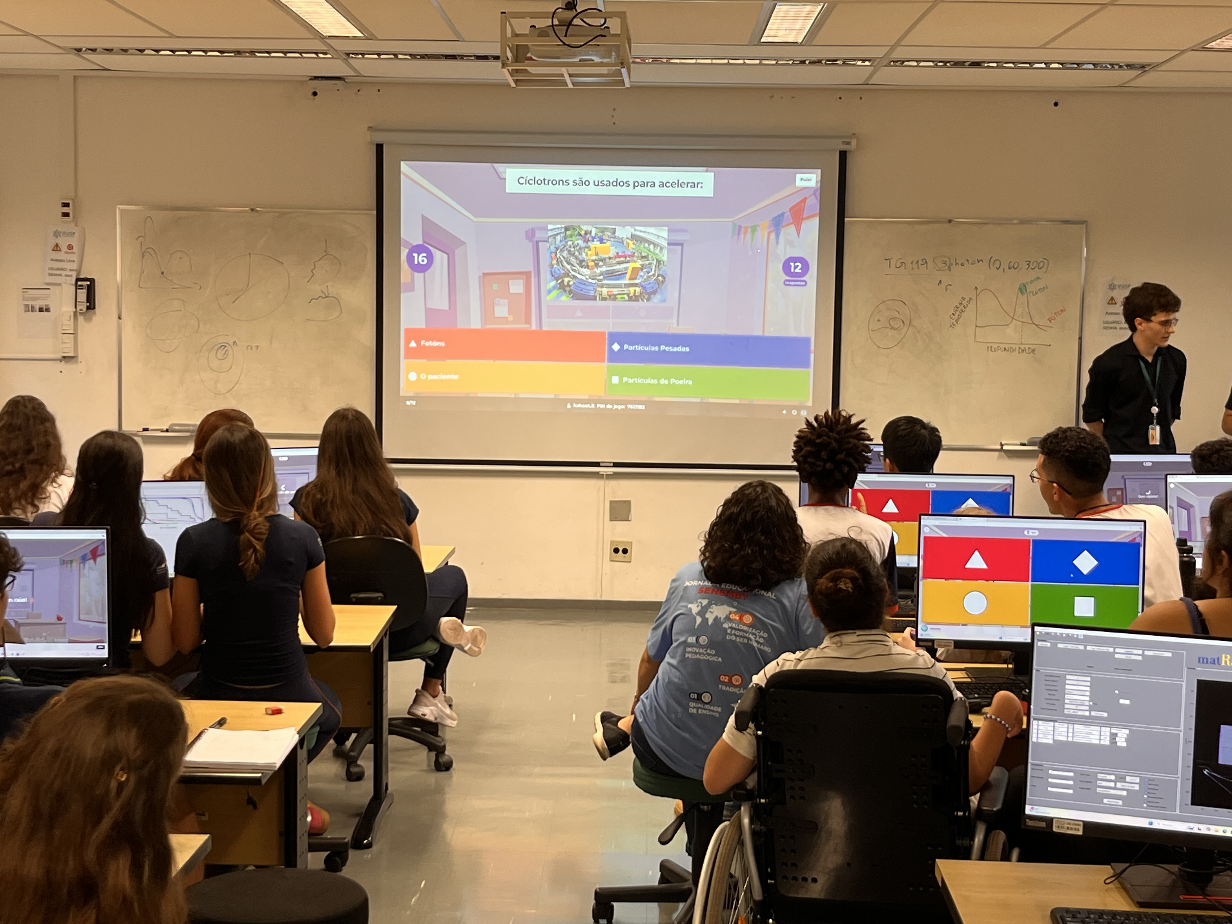

Slide 15
Particle Therapy Master Class
Thank you for the comitment!!!
Vitor Premero / Wagner Marques 3 de abril de 2025

