Slide 1
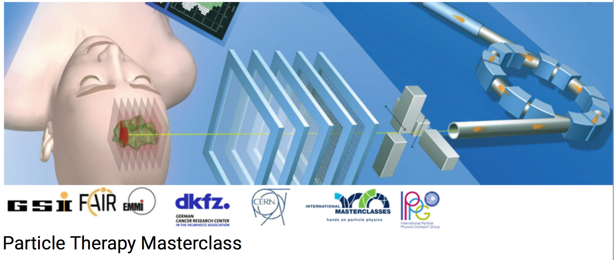


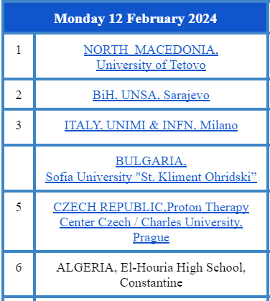
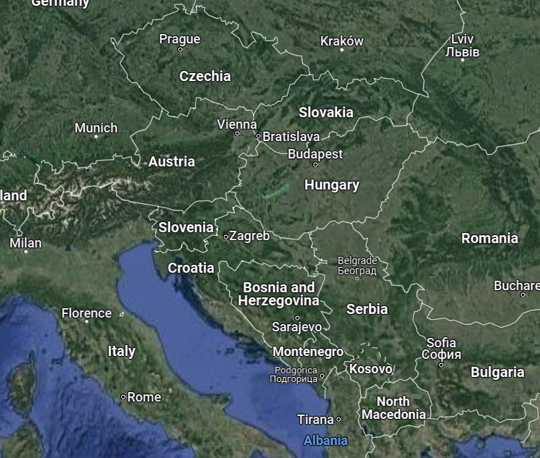
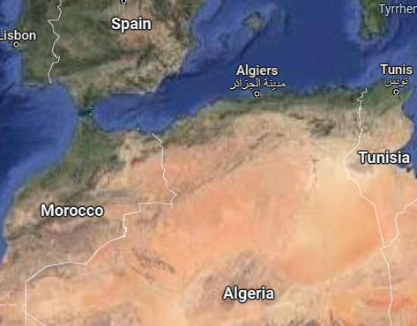
PTMC Video Conference 12 February 2024
PARTICLE THERAPY MASTERCLASS

Slide 2
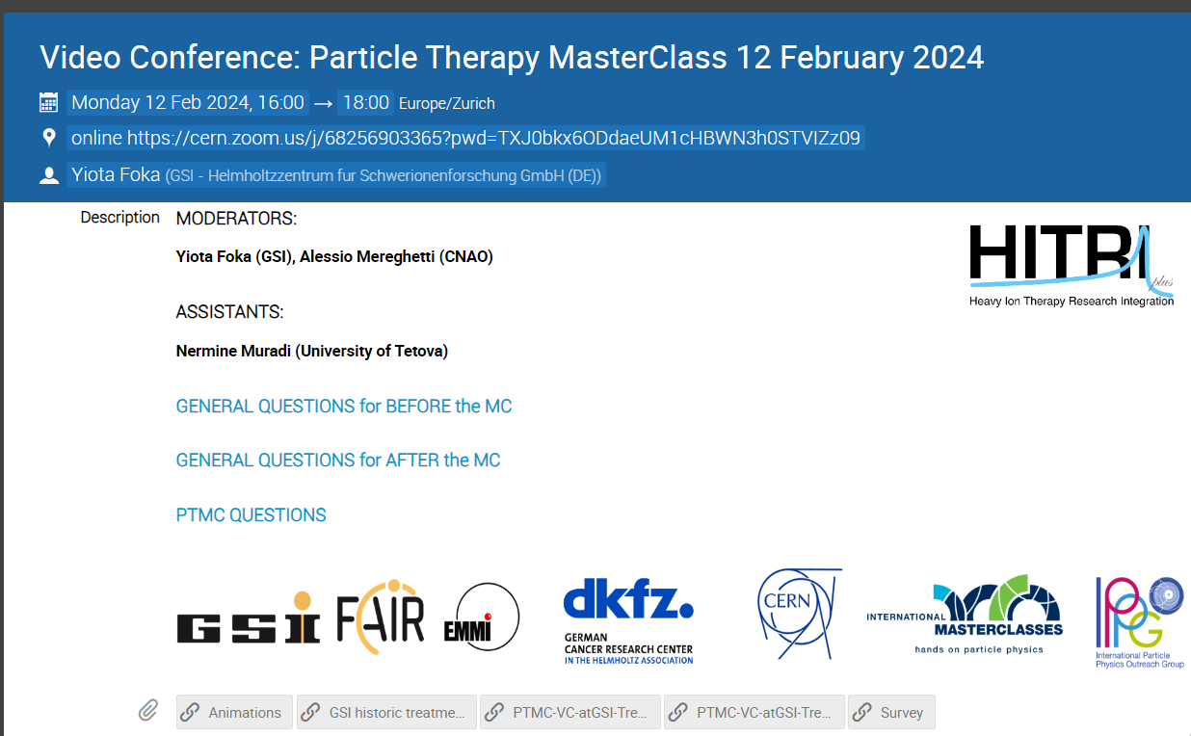
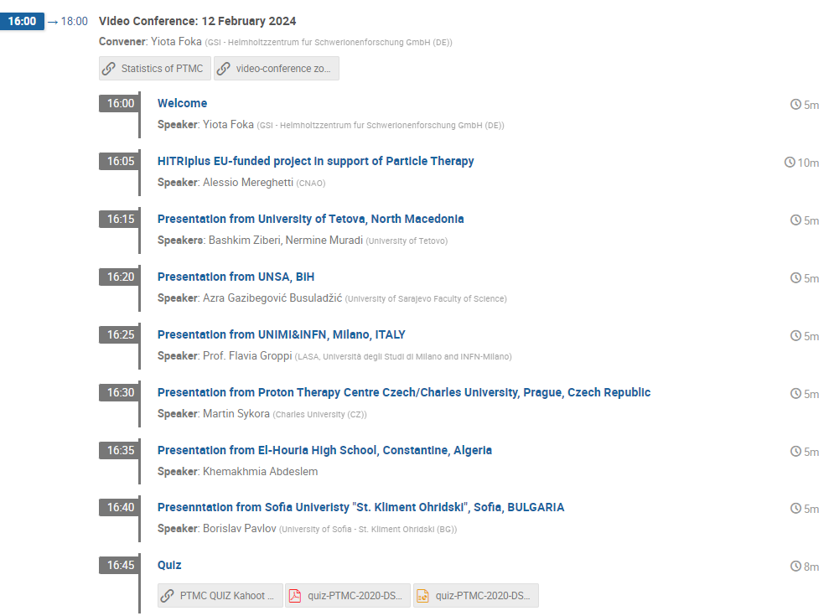
PTMC Video Conference 12 February 2024
https://indico.cern.ch/event/1246300/
Moderators: Yiota Foka (GSI), Alessio Mereghetti (CNAO)

Slide 3
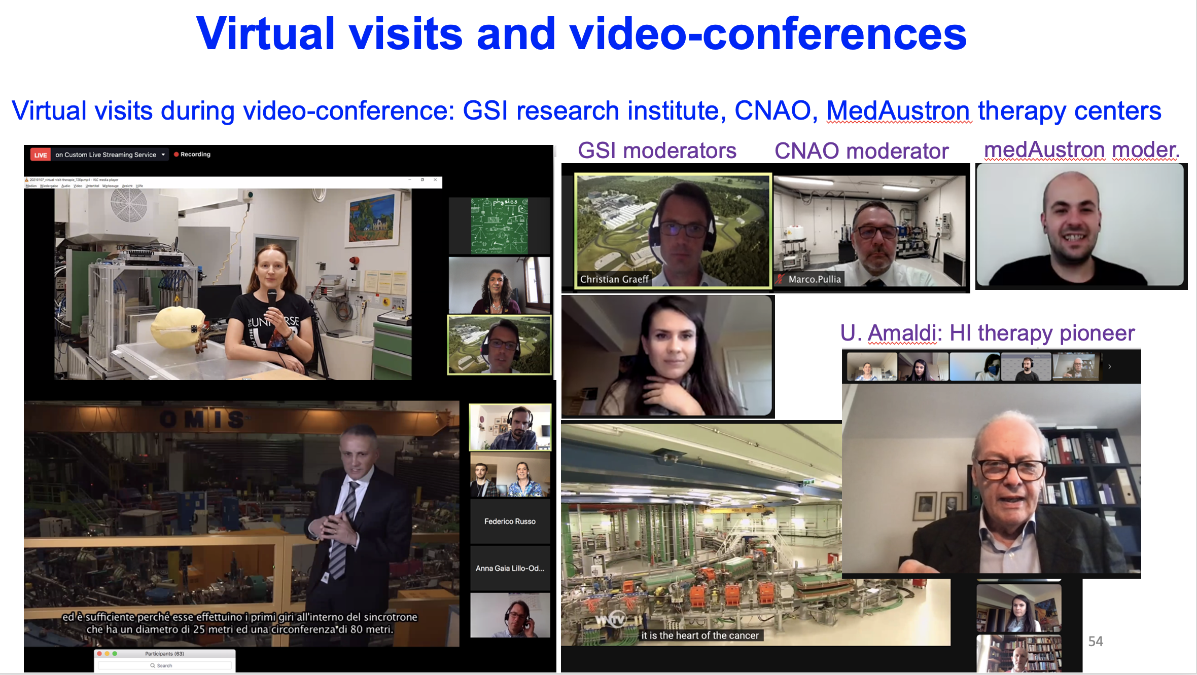

Slide 4
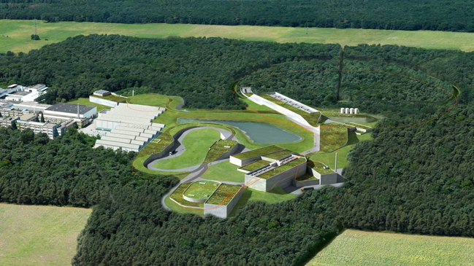
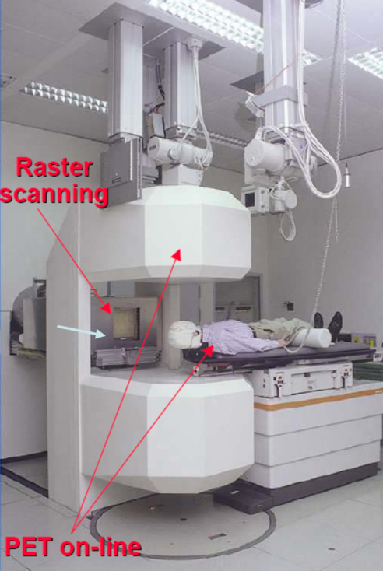
Heavy-ion research and heavy-ion therapy at GSI
Pioneered heavy-ion (carbon) therapy for cancer tumours in Europe (90s).

Slide 5
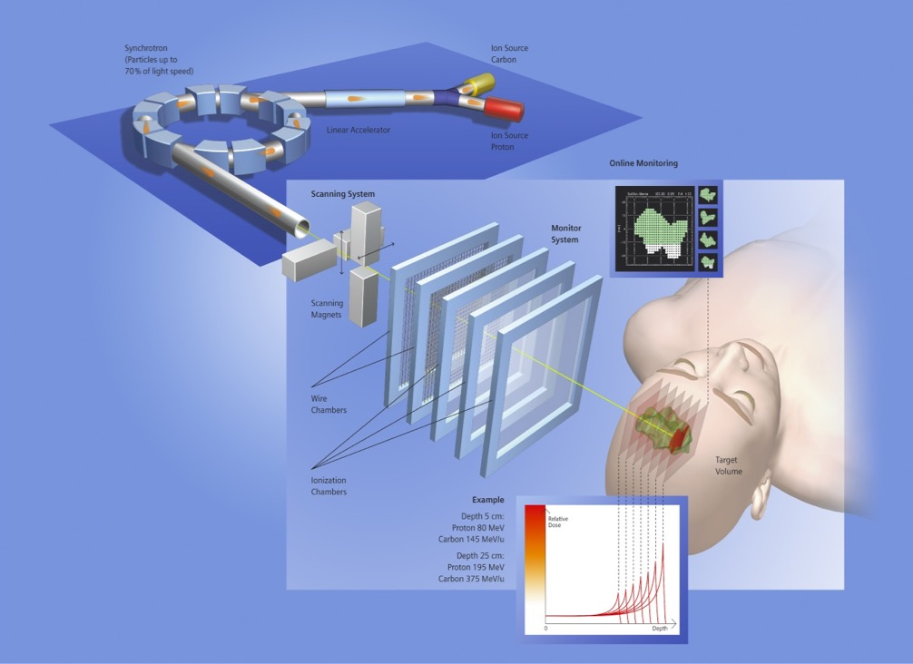
Heavy-ion research and heavy-ion therapy at GSI
Rasterscan Method
Haberer et al., NIM A , 1993
  Implemented in the Heidelberg and Marburg Ion Treatment centers
  (HIT and MIT) in Germany
Haberer et al., NIM A , 1993
Notes:
5

Slide 6
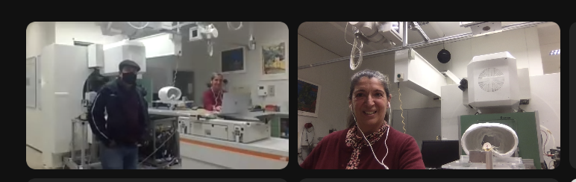
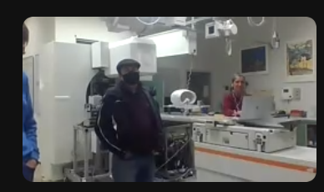
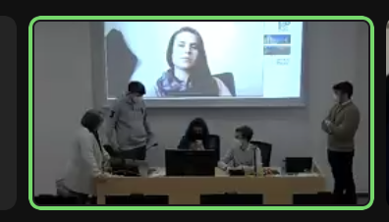
From the historic GSI therapy room Cave M
https://www.dropbox.com/scl/fo/y32povwa5jdj7gwrdmmu2/h?dl=0&preview=05-20210609_virtual-visit_therapie_en.mp4&rlkey=cqplic473dlrjy1dyi95mfoje

Slide 7
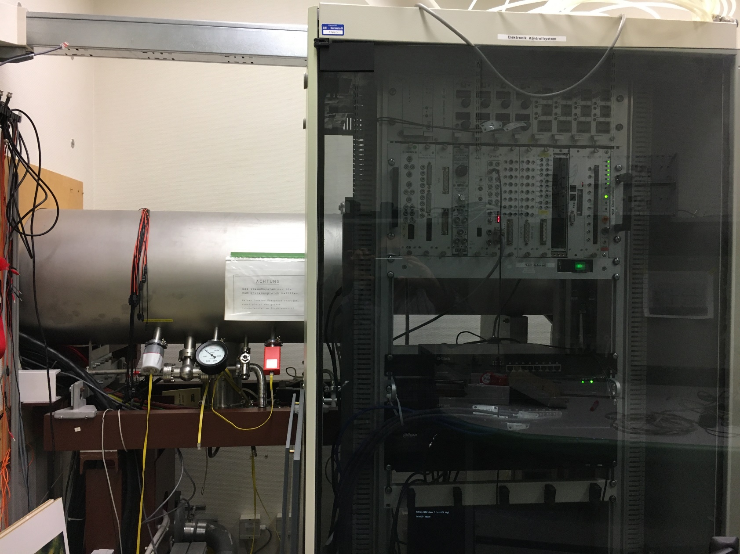
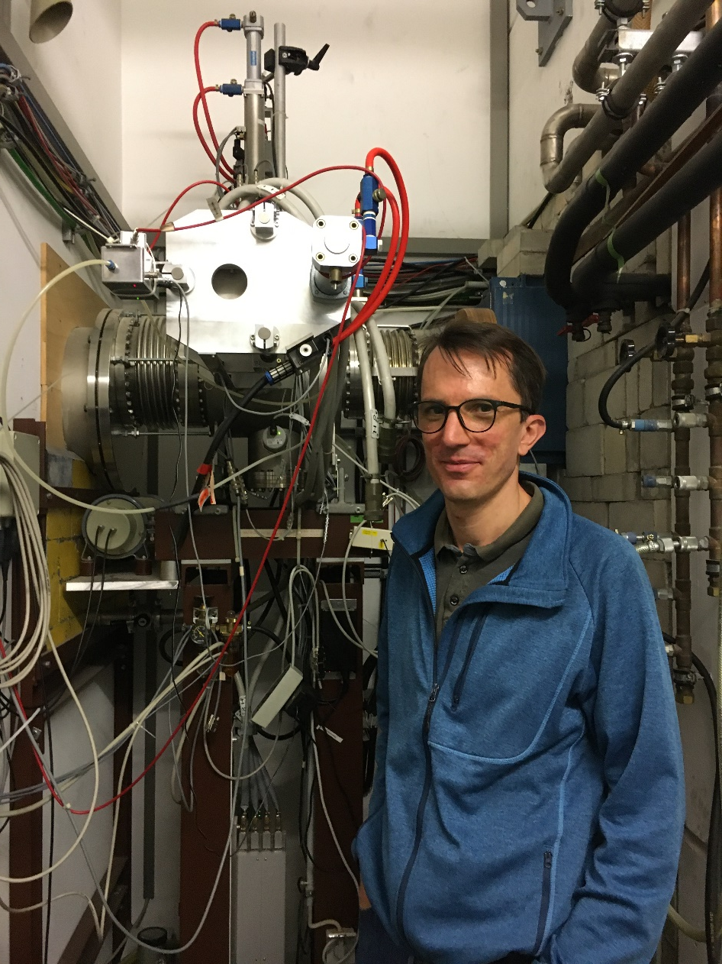
What is behind the wall?

Slide 8
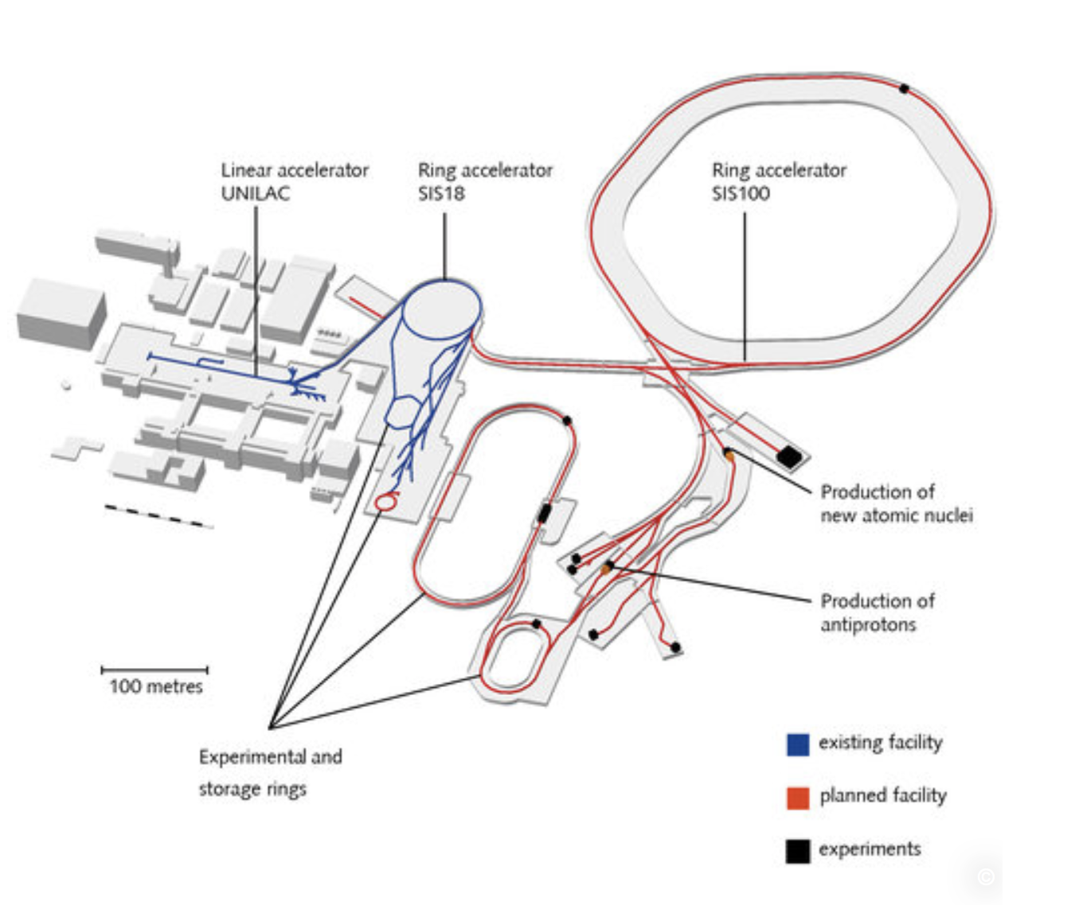
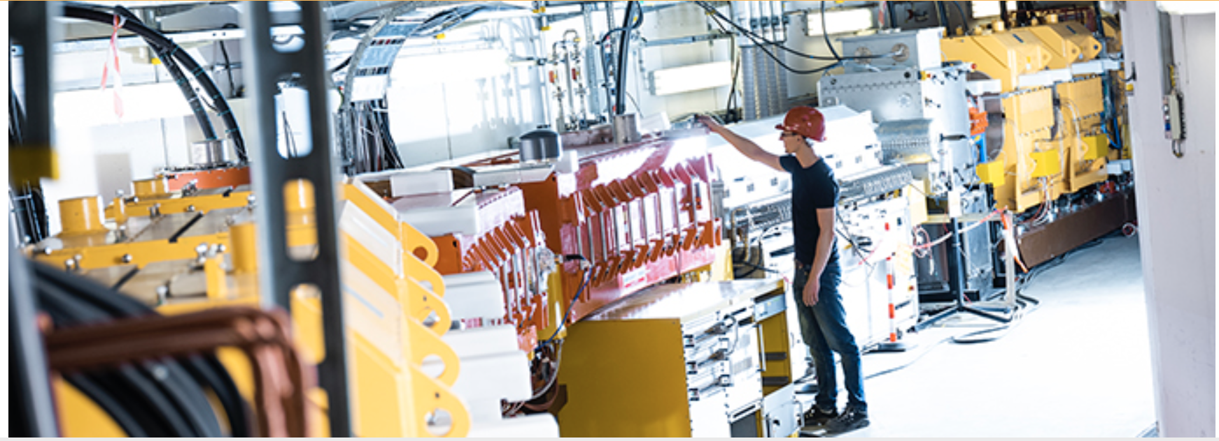
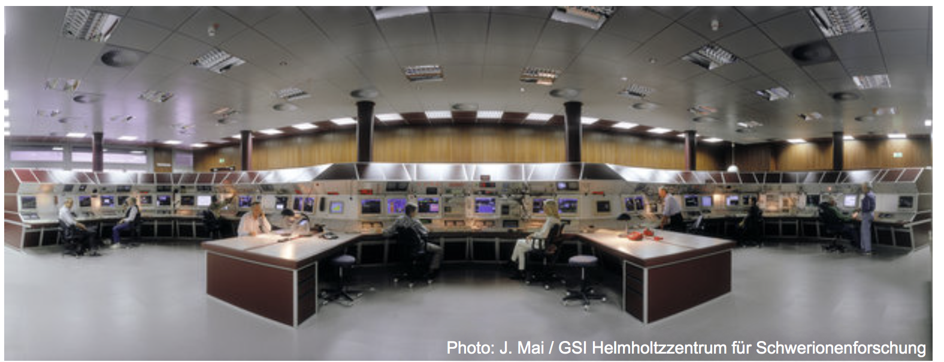
What is behind the wall?

Slide 9
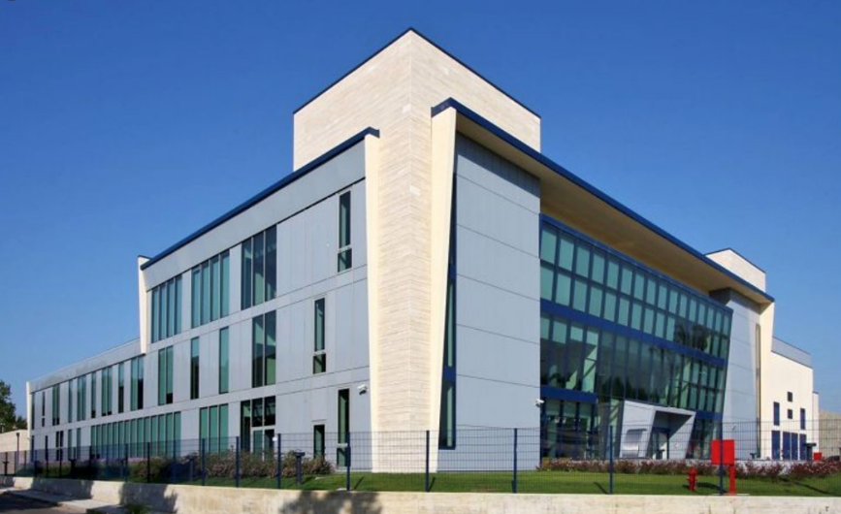
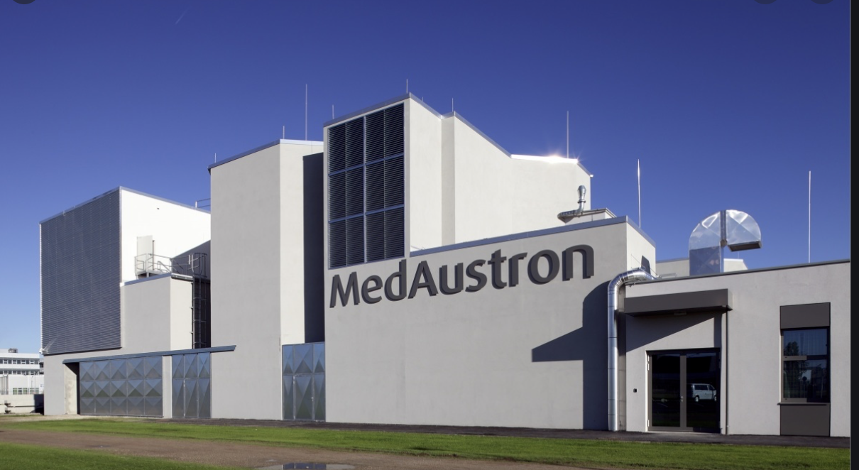
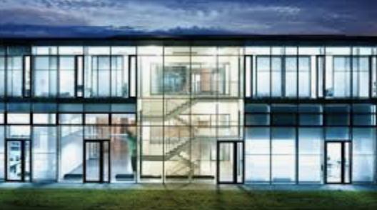
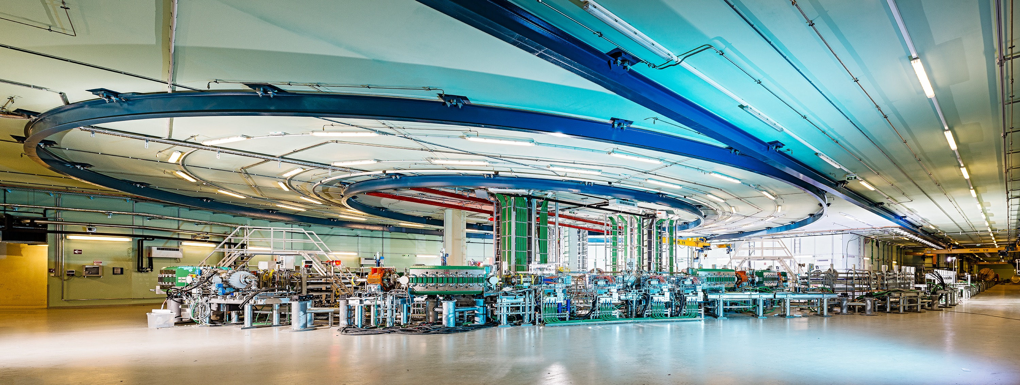
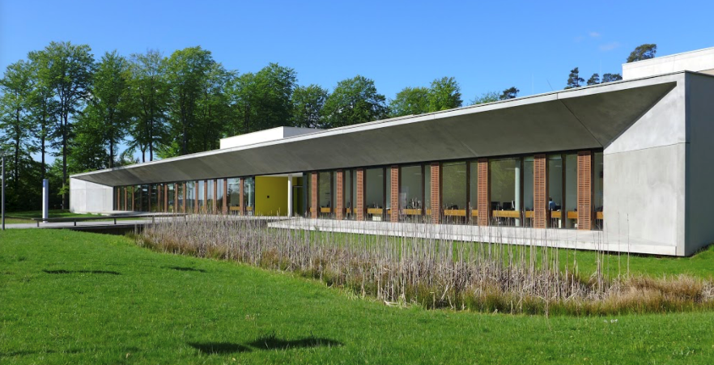
Four carbon-ion cancer therapy centers in Europe
MedAustron, Αustria
CNAO, Ιtaly
HIT, Germany
MIT, Germany

Slide 10

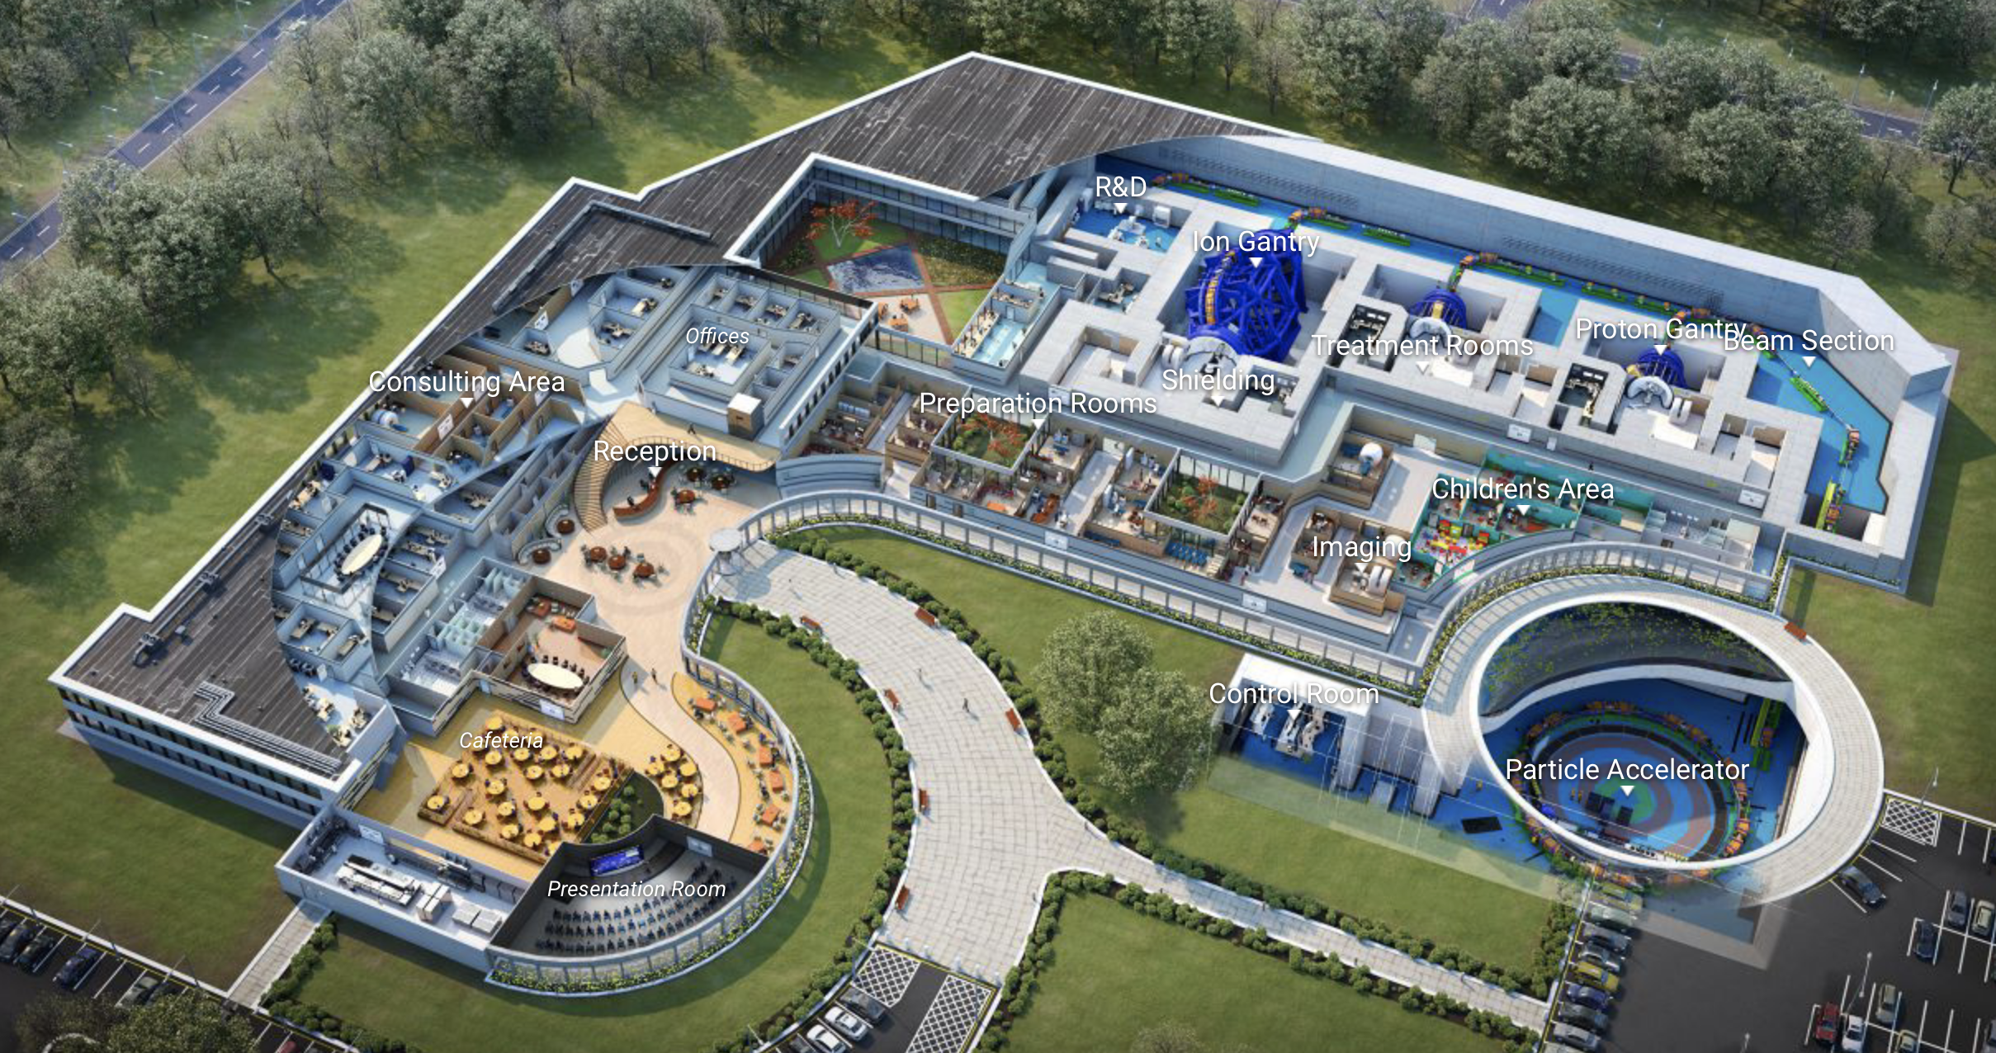
Virtual Hadron Therapy Center

Slide 11
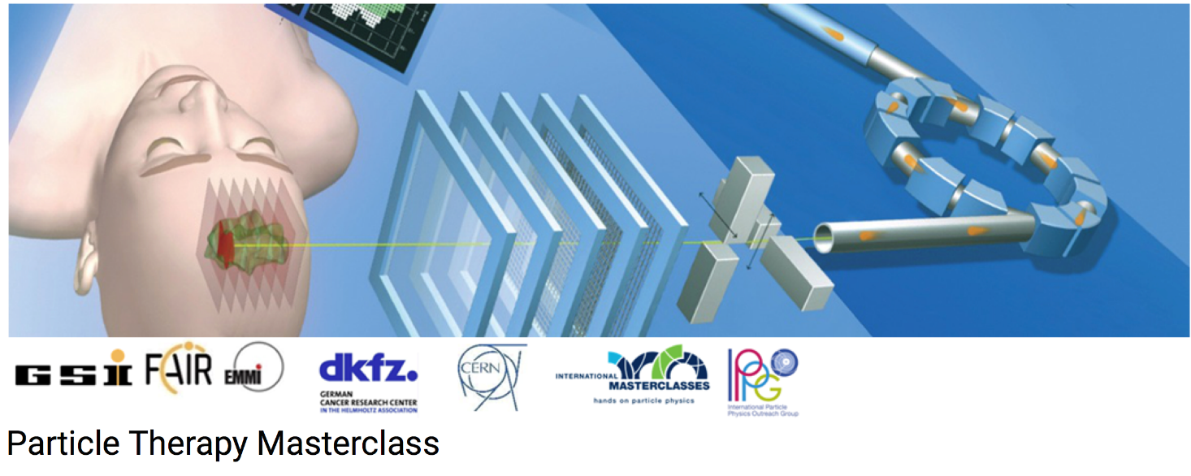
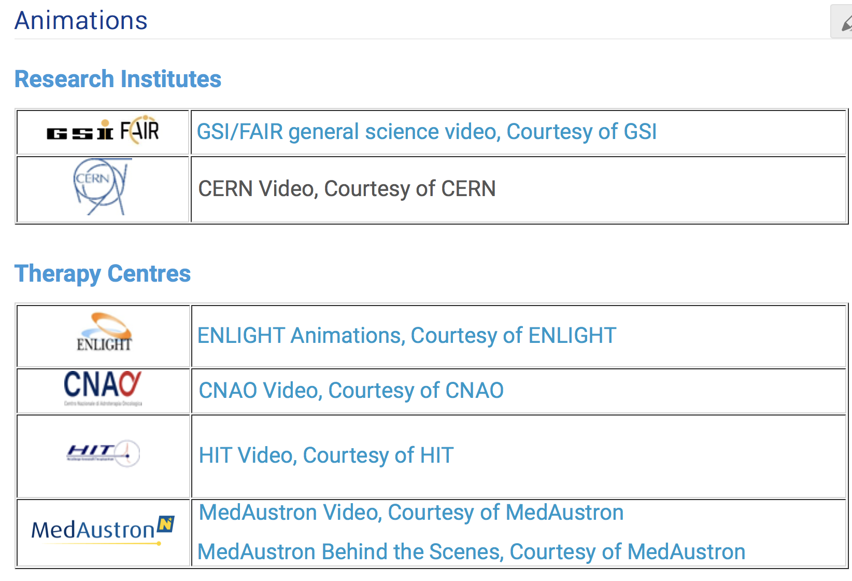
https://indico.cern.ch/event/840212/page/18000-animations

Slide 12
PTMC Video Training 18 January 2024
Many thanks to the PTMC core team,
all moderators and local organisers,
the HITRIplus project
for contributions and support

Slide 13
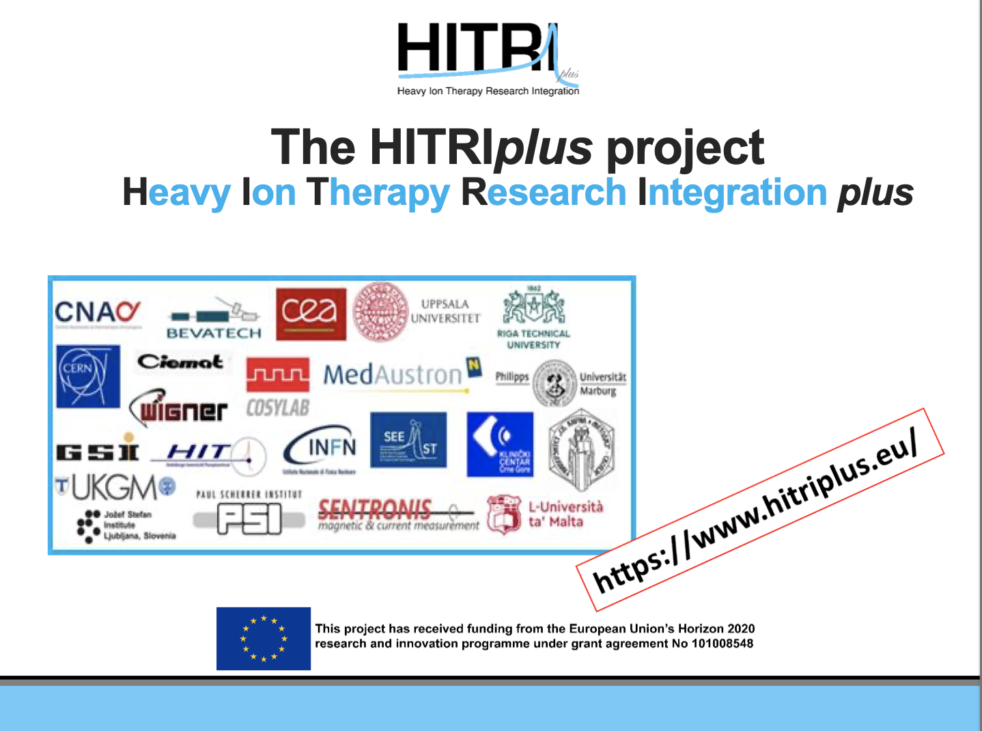

Slide 14
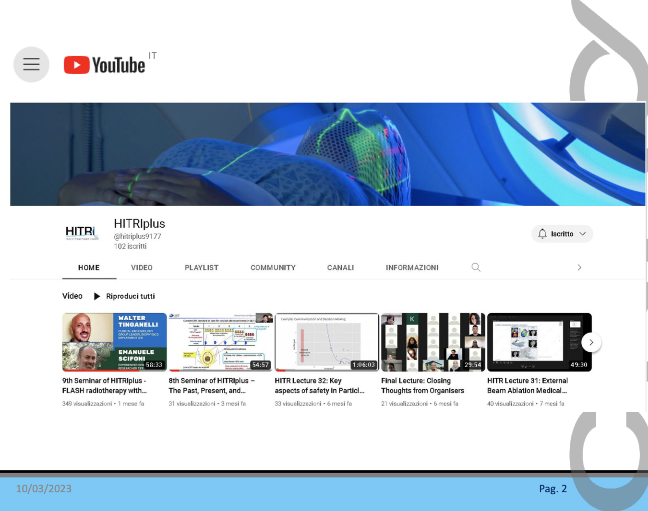

Slide 15
