Slide 1


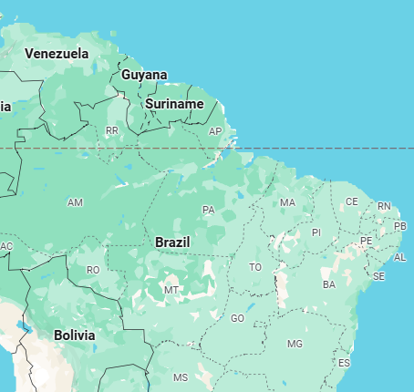
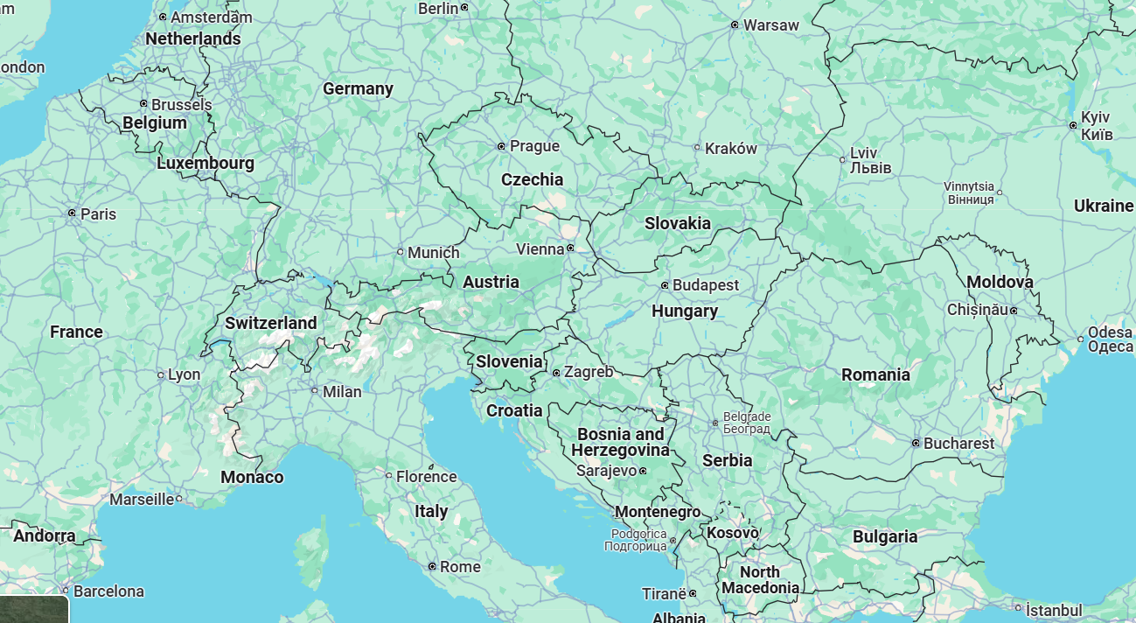
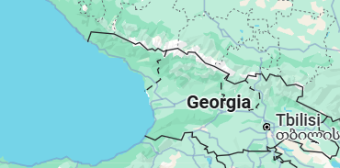

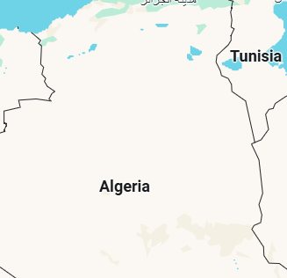
PTMC Video Conference 4 April 2025
PARTICLE THERAPY MASTERCLASS

Slide 2
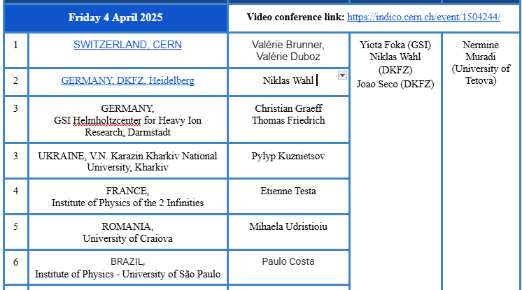
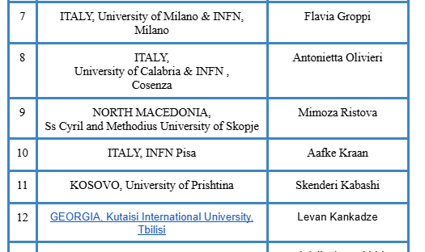
PTMC Video Conference 4 April 2025
PARTICLE THERAPY MASTERCLASS

Slide 3
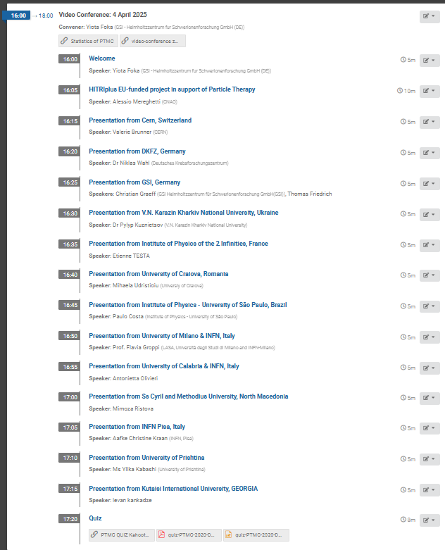
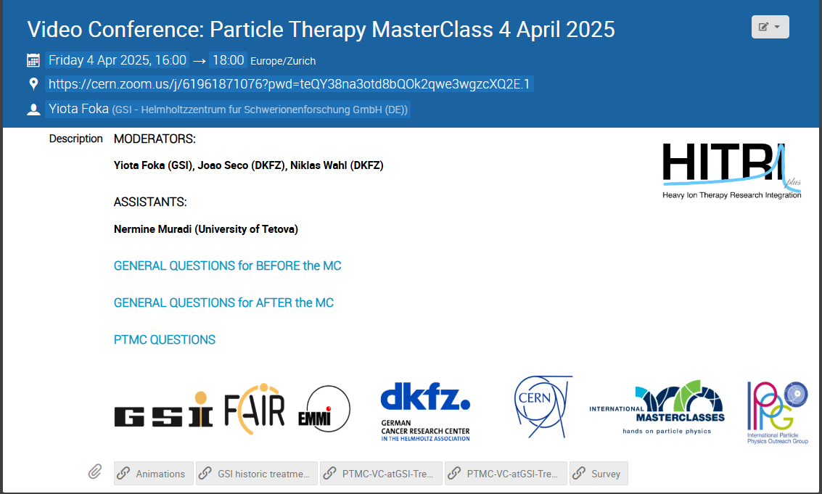
PTMC Video Conference 4 April 2025
https://indico.cern.ch/event/1504244/
Moderators: Yiota Foka (GSI), Joao Seco (DKFZ), Niklas Wahl (DKFZ)
Asistants : Nermine Muradi (Uni Tetova)

Slide 4
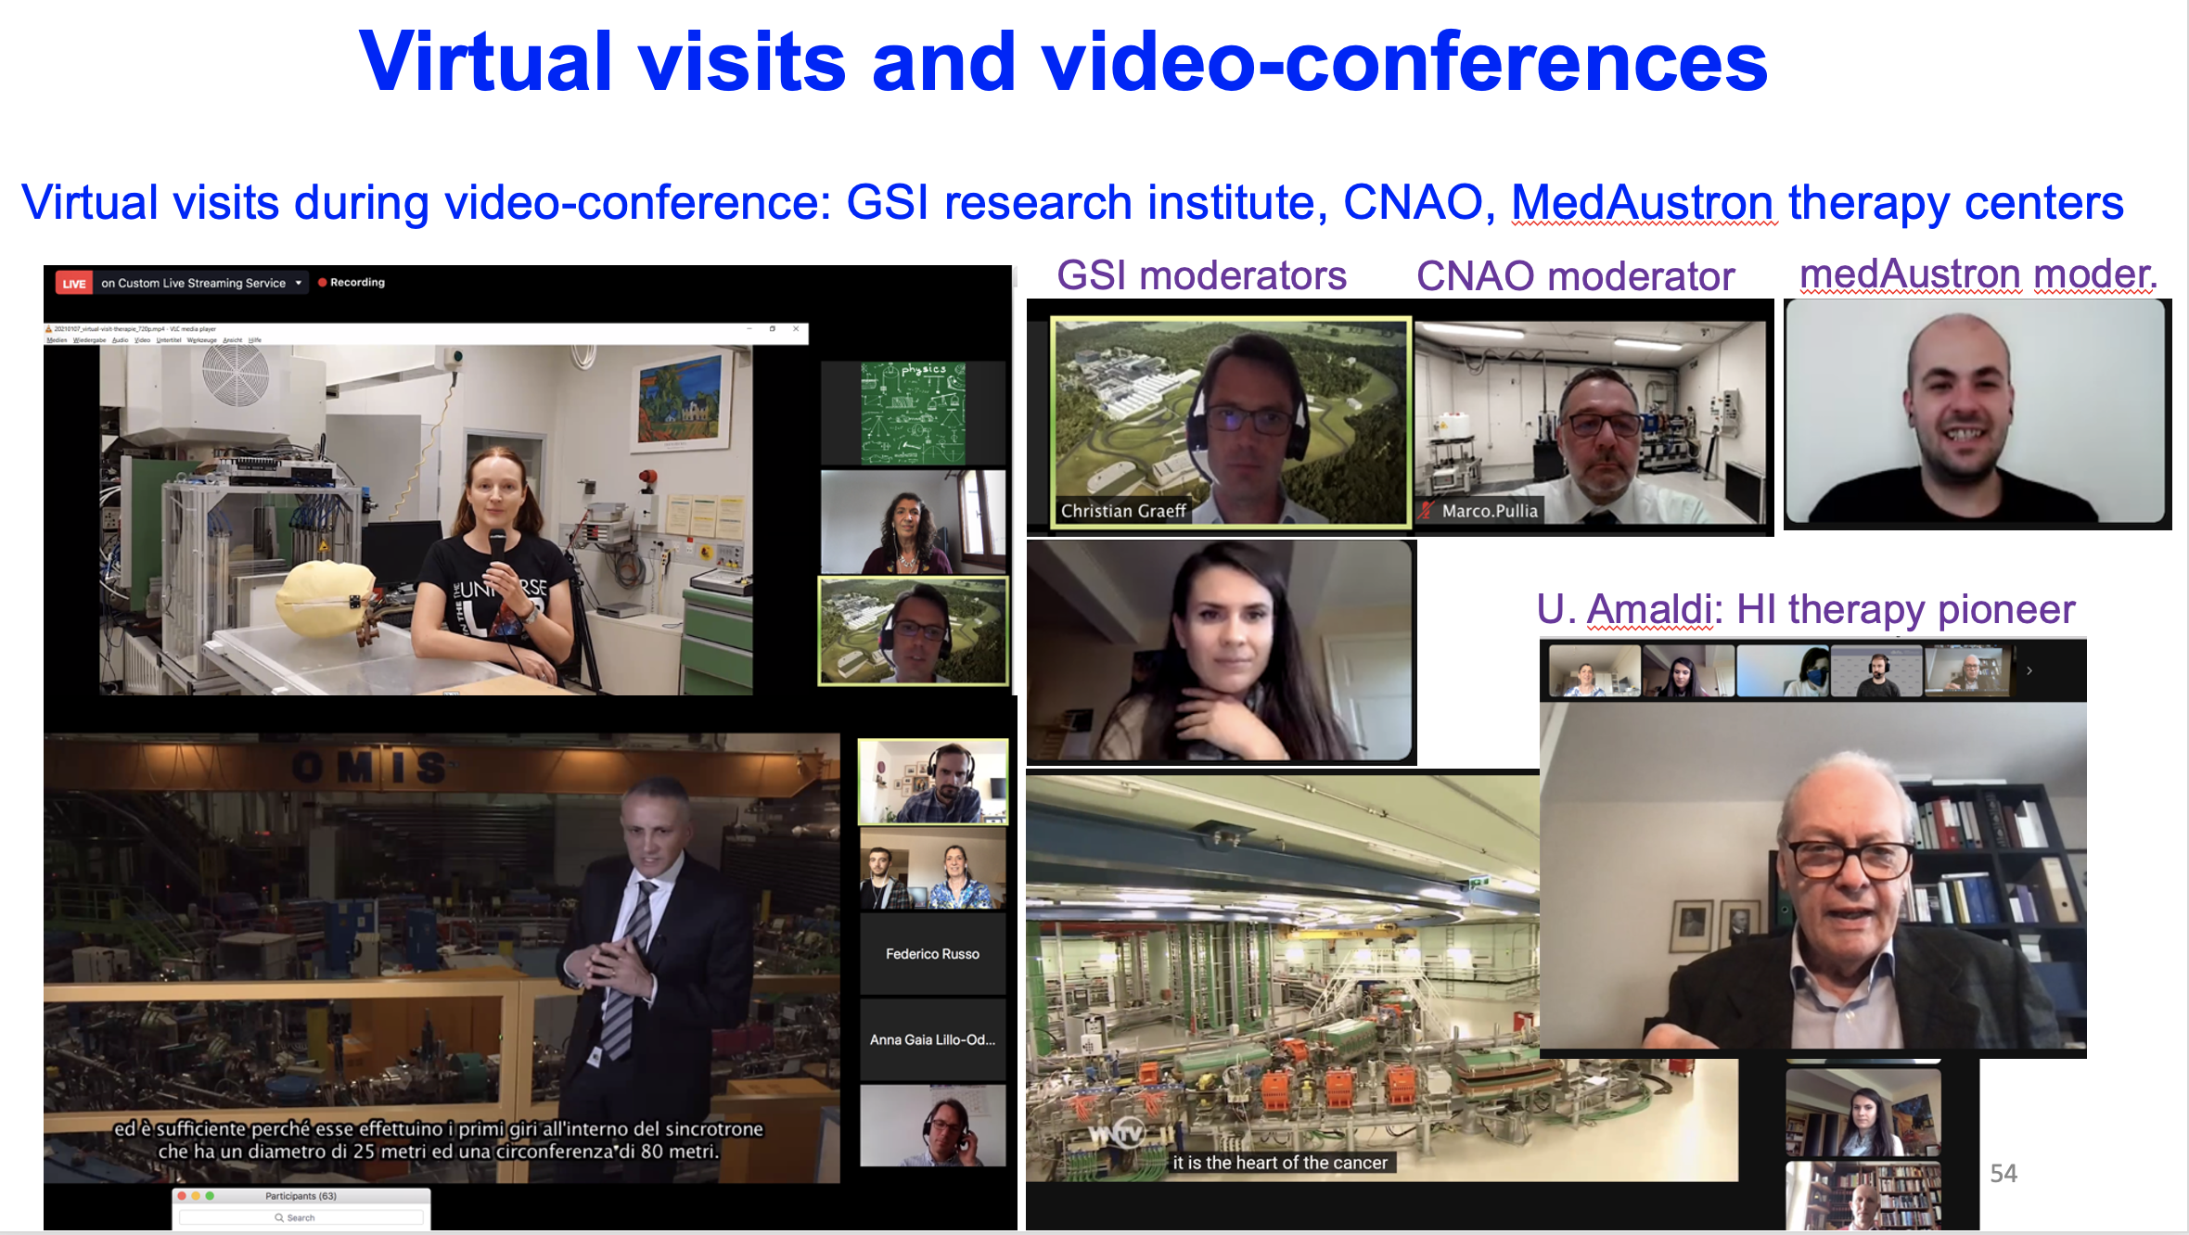

Slide 5

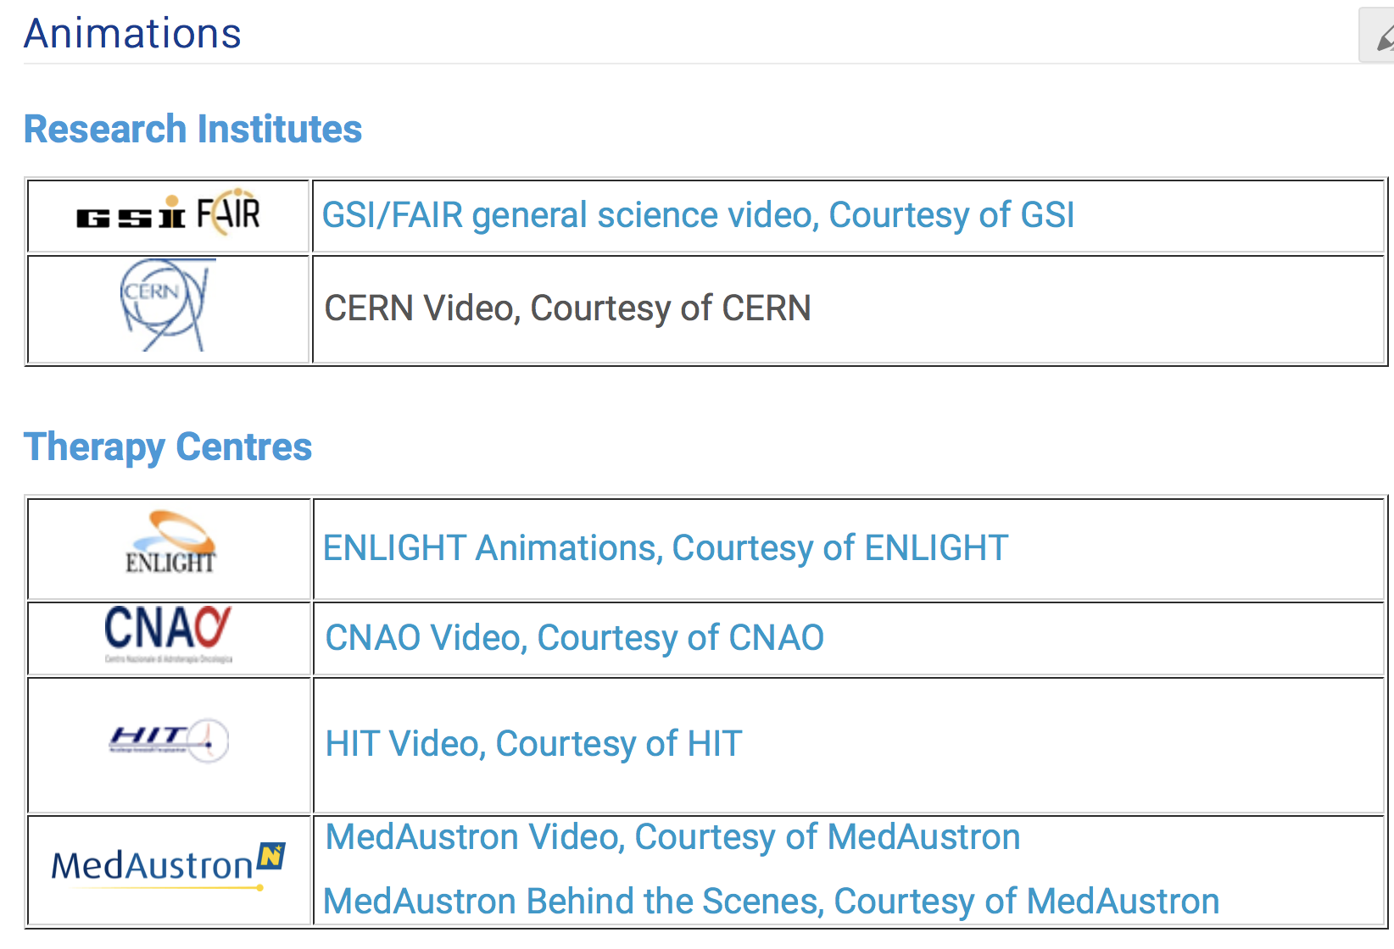
https://indico.cern.ch/event/840212/page/18000-animations

Slide 6
PTMC Video Training 18 January 2024
Many thanks to the PTMC core team,
all moderators and local organisers,
the HITRIplus project
for contributions and support

Slide 7


