Slide 1

Falcon Dipole
Inner layer winding test ASG
R.U. Valente
INFN LASA and Genova
Superconducting Magnet Group

Slide 2
Outline
Winding parameters
Measurement method
Visual inspection
Data analysis
Tooling issues
Conclusions

Slide 3
Winding parameters
Winding tension 20 kgf
Nb3Sn Rutherford Cable insulated (fiberglass) – spool 3 (50 m)
Winding direction: favorable w.r.t. cable twist

Slide 4
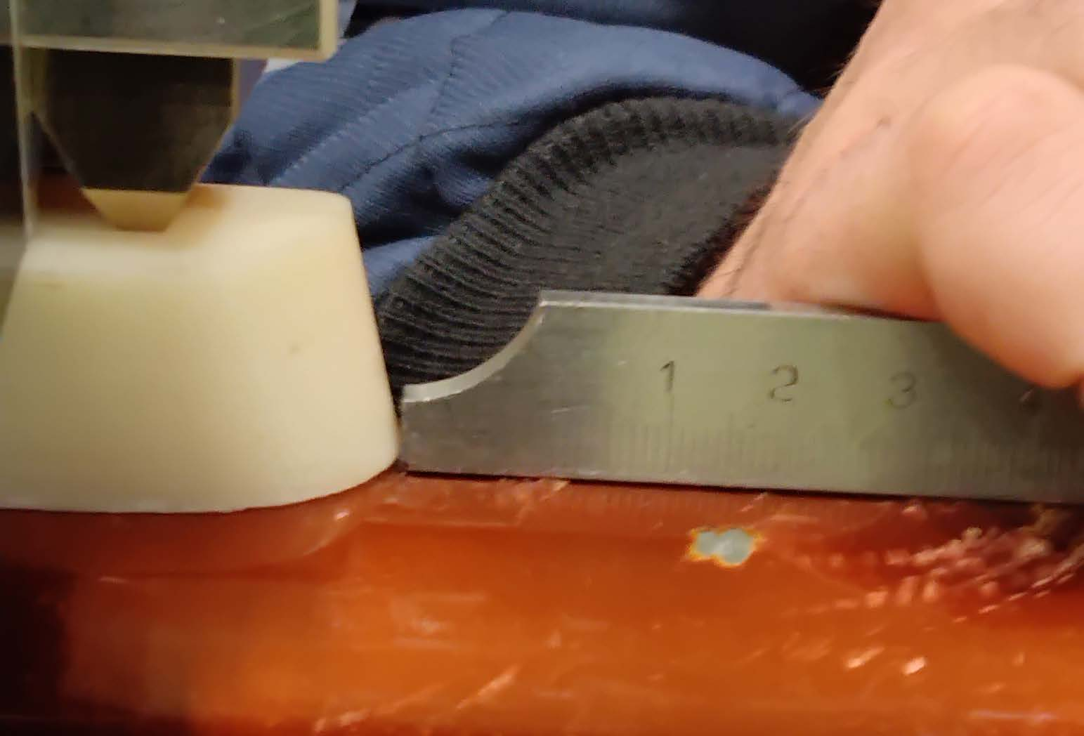
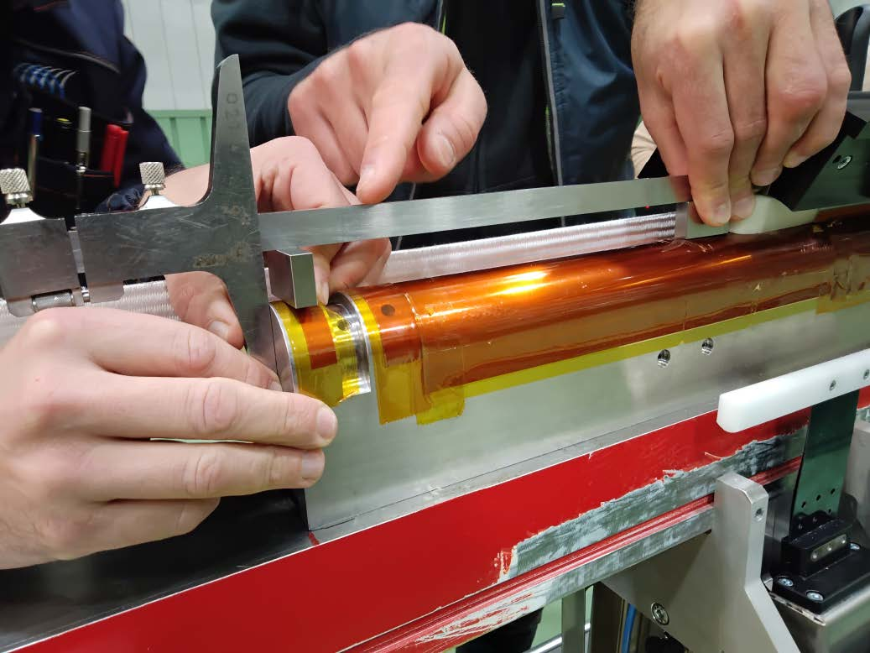
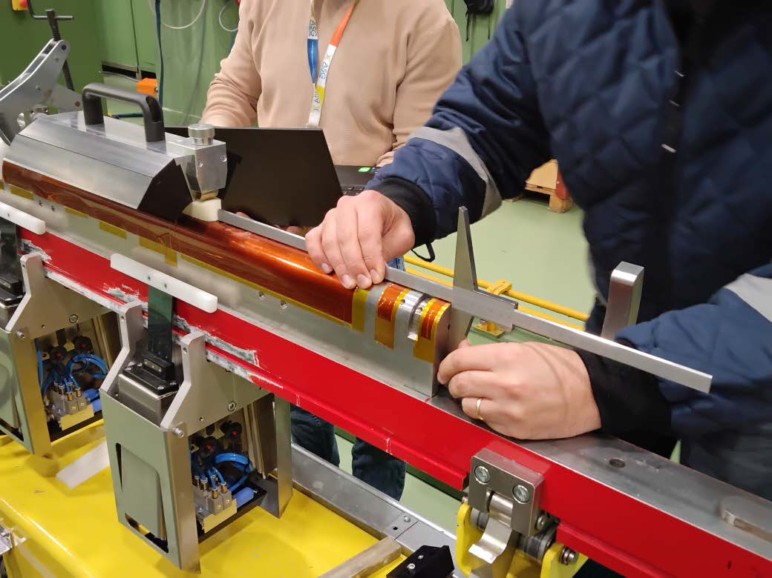
Measurement method
The distance between the mandrel corner of the cable and the reference surface is measured
The distance between the top corner of the cable and the reference surface is measured
The beta angle is computed using those distances and compared with the model

Slide 5
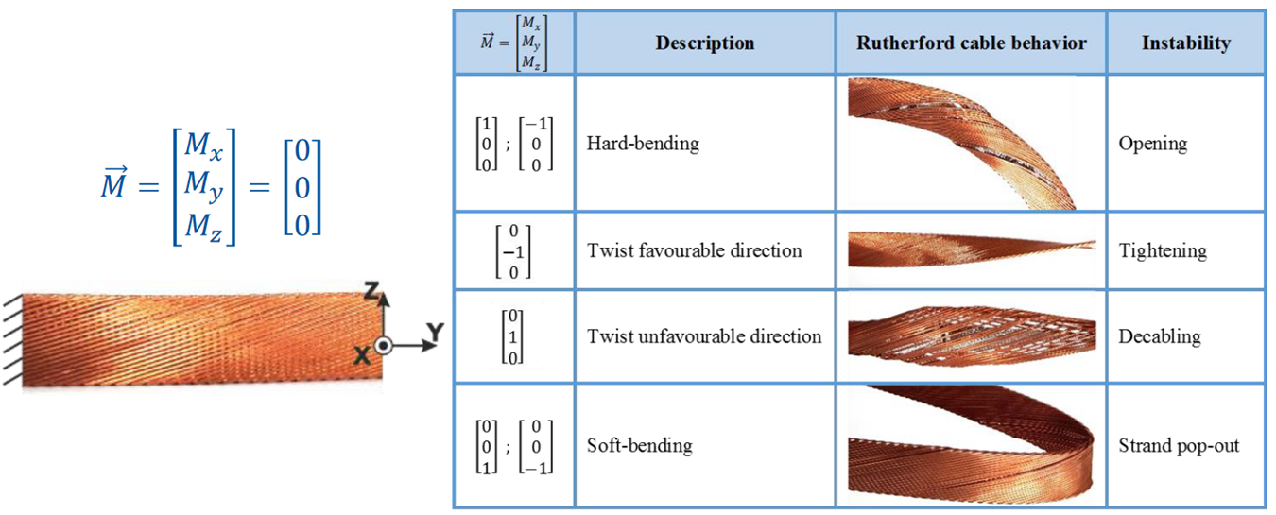
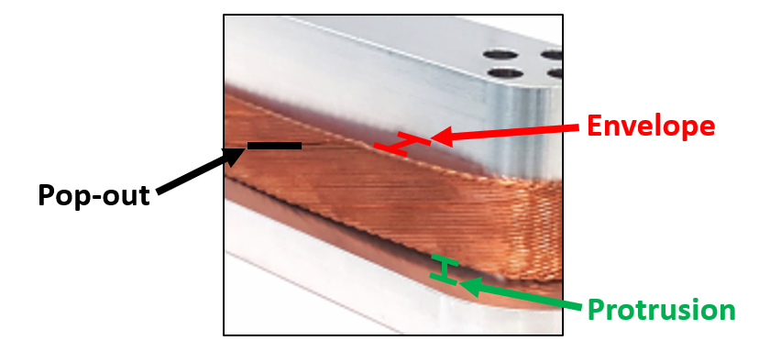
Visual inspection
By visual inspection we determine the cable instability:
Opening and decabling never observed
Tightening and pop out the most instabilities observed
The protrusion, i.e. gap between cable and mandrel, measured with a caliper and feeler gauge
→ 0.5 mm of error
d

Slide 6
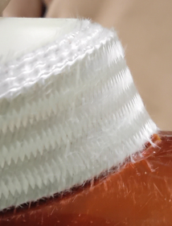
Data analysis – beta angle
We evaluate a measurement error of ±1°
The spacer beta angle is well measured → measurement method is accurate enough
The beta angle of the midplane block decreases fast in the return ends, while in the exit ends is stable around 57°
The beta angle in the second block decreases
The beta angle discrepancy in the pole turns of the return is worse than in the exit ends, even if they have similar inclination

Slide 7
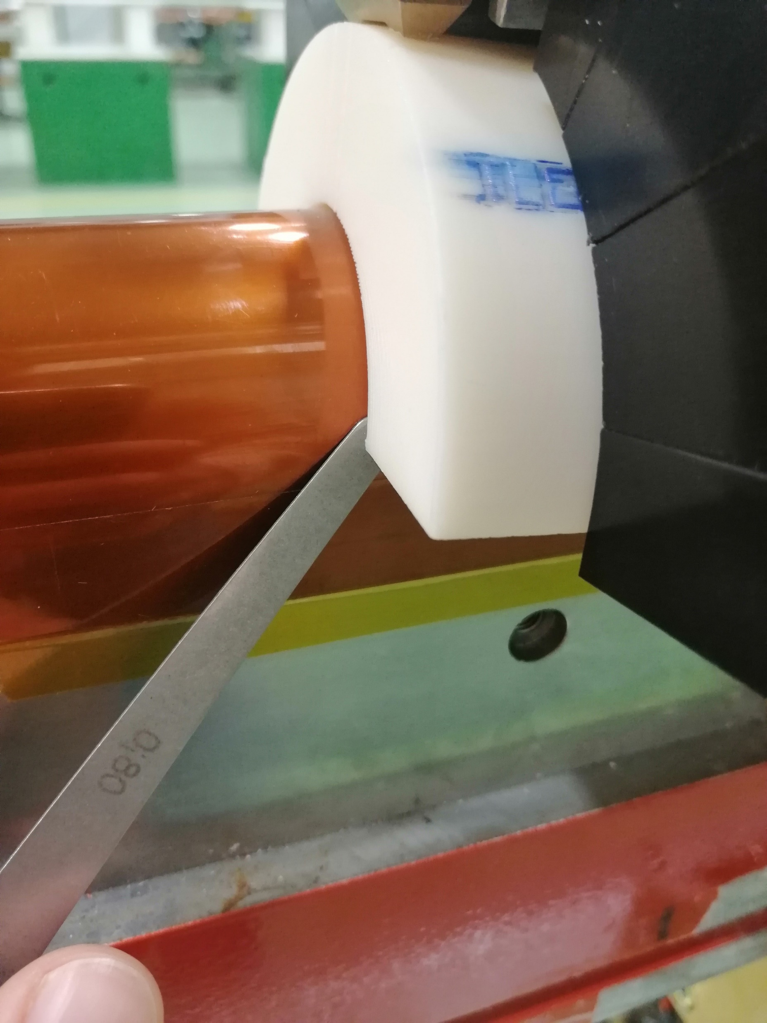
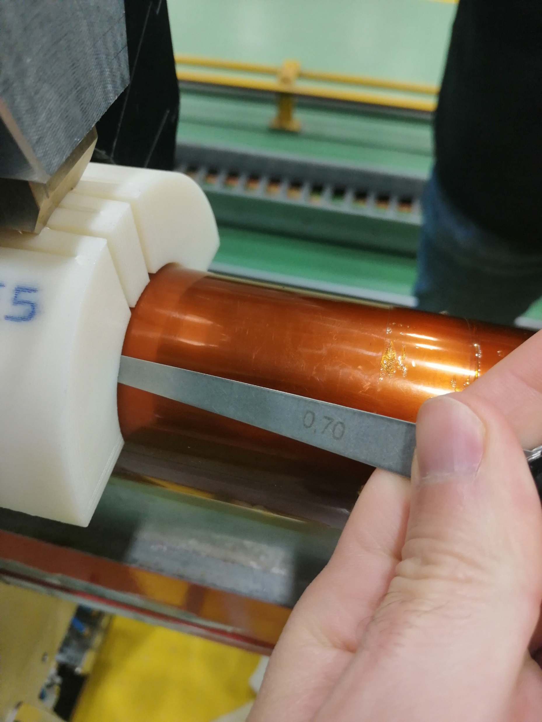
Data analysis – end shoes
The end-shoes are not well positioned:
The shoes are not perpendicular w.r.t. the mandrel
Gap between the mandrel and end-shoe
→ 0.8 mm exit ends, 0.7 mm return ends

Slide 8
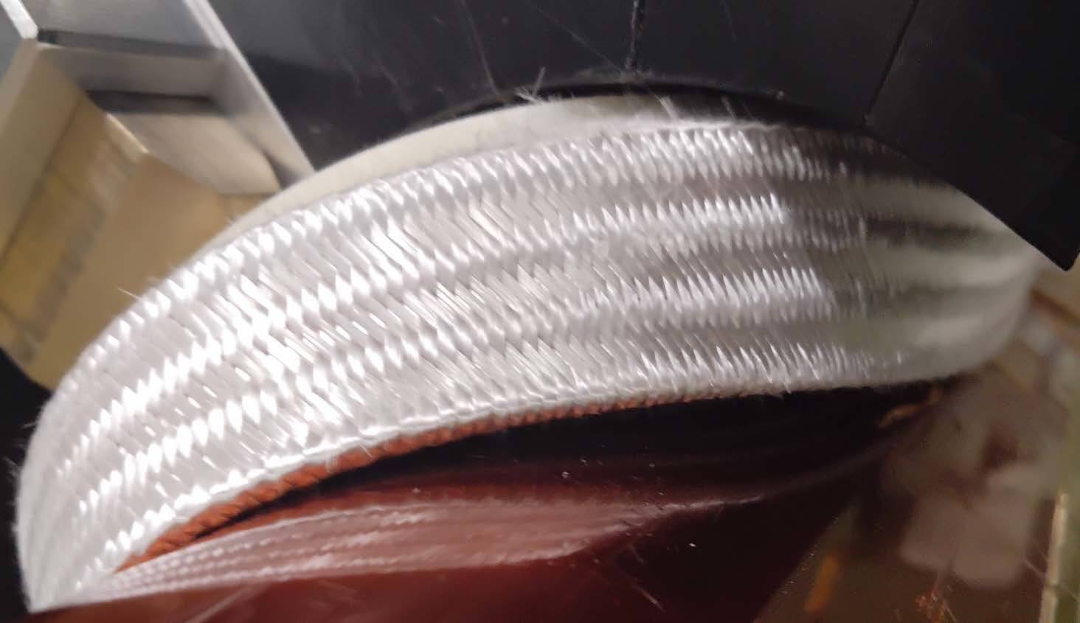
Data analysis – protrusion
There is always protrusion:
Return ends → 0.5 mm/turn in the second block, 1 mm/turn in the midplane block
Exit ends → 0.7 mm/turn in the second block, 1.5 mm/turn in the midplane block

Slide 9
Data analysis – visual inspection
Return Ends
Turn number | Manual torque (Y/N) | pop out (Y/N) | Opening (Y/N) | Tightening (Y/N) | decabling (Y/N)
ILR1 | N | N | N | N | N
1 | N | N | N | N | N
ILR2 | N | N | N | N | N
2 | N | N | N | Y | N
ILR3 | N | N | N | N | N
3 | N | Y | N | Y | N
4 | N | Y | N | Y | N
5 | Y | Y | N | Y | Y
6 | N | N | N | Y | N
7 | N | N | N | N | N
ILR4 | N | N | N | N | N
8 | N | Y | N | Y | N
9 | N | N | N | Y | N
10 | N | N | N | Y | N
11 | N | N | N | Y | N
12 | N | N | N | Y | N
ILR5 | N | N | N | N | N
Exit Ends
Turn number | Manual torque (Y/N) | pop out (Y/N) | opening (Y/N) | tightening (Y/N) | decabling (Y/N)
ILE1 | N | N | N | N | N
1 | N | N | N | N | N
ILE2 | N | N | N | N | N
2 | Y | N | N | N | N
ILE3 | N | N | N | N | N
3 | N | N | N | Y | N
4 | N | Y | N | Y | N
5 | N | N | N | Y | N
6 | N | N | N | Y | N
ILE4 | N | N | N | N | N
7 | N | N | N | Y | N
ILE5 | N | N | N | N | N
8 | N | N | N | Y | N
9 | N | N | N | Y | N
10 | N | N | N | Y | N
11 | N | Y | N | Y | N
ILE6 | N | N | N | N | N
The pop outs are more present in the second block of the return ends
The tightening is always present, even if there is protrusion
Hammering the cable is not sufficient to keep the cable in contact with the mandrel, moreover there is the risk of generate pop out

Slide 10
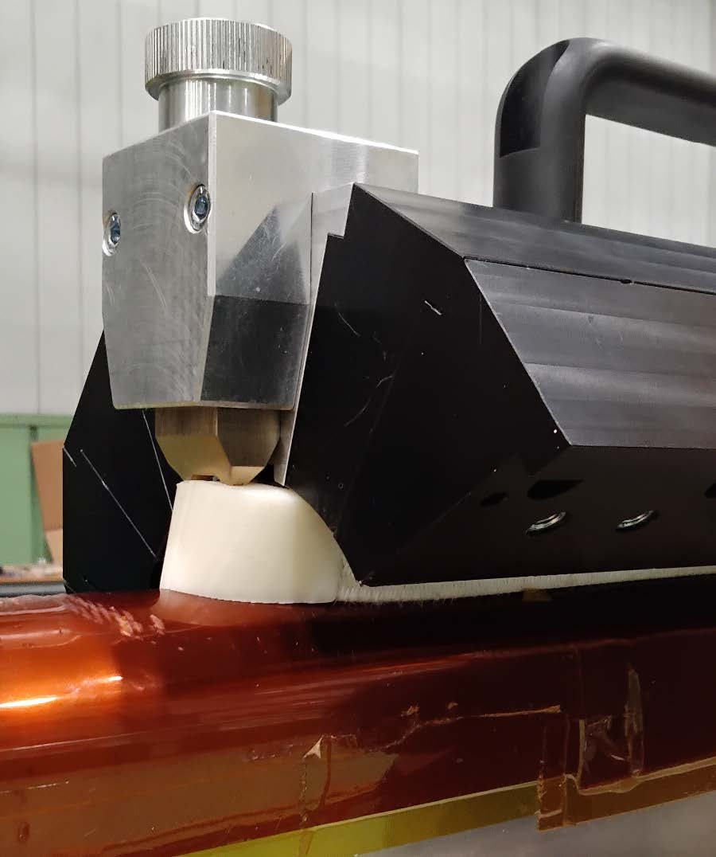
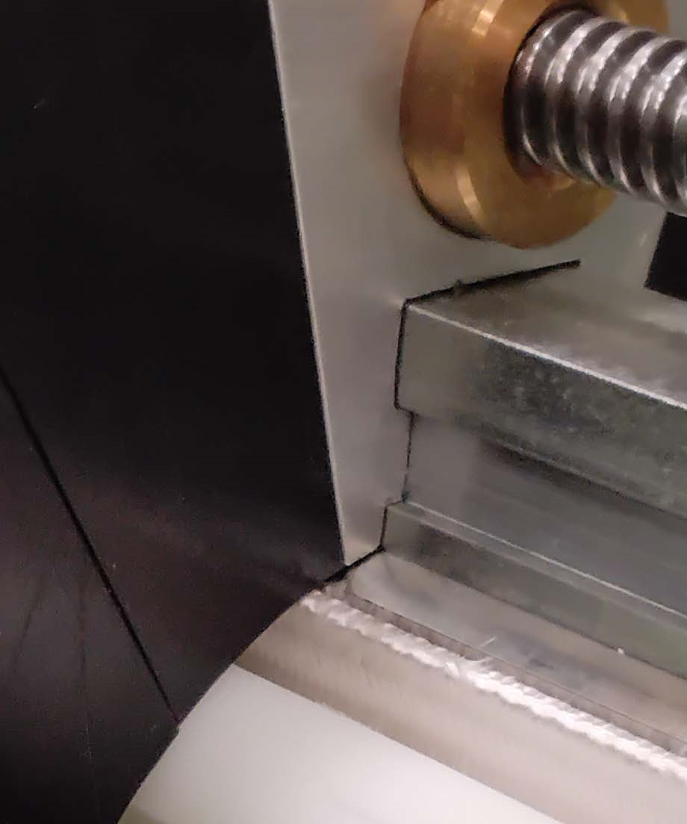
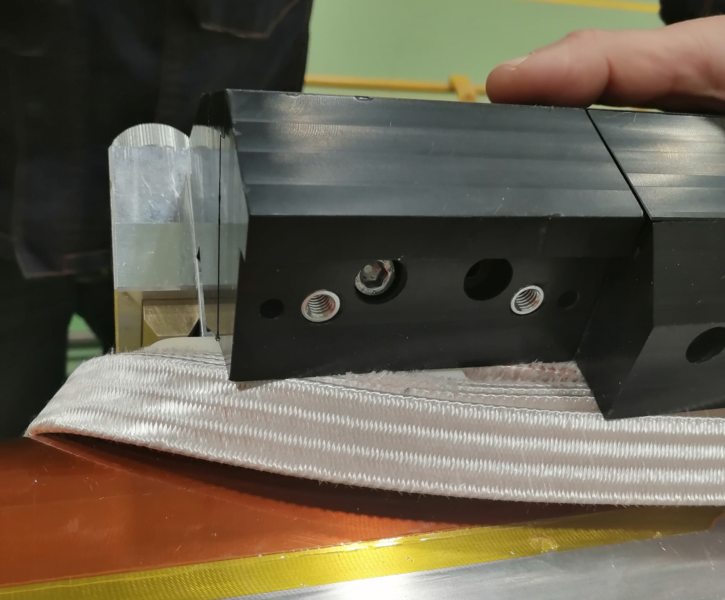
Tooling issues – radial clamp
The un-reacted cable width is 21 mm, while the spacer and wedge width is 21.4 mm to leave space for the cable expansion after reaction
→ the clamp cannot push the cable
There is space also between the clamp and the wedges
→ the coil is radially free to move
The insertion direction of the clamp pieces is from the exit to the center
→ interference with the cable and insulation damaging
Radial clamp
Free space
insertion

Slide 11
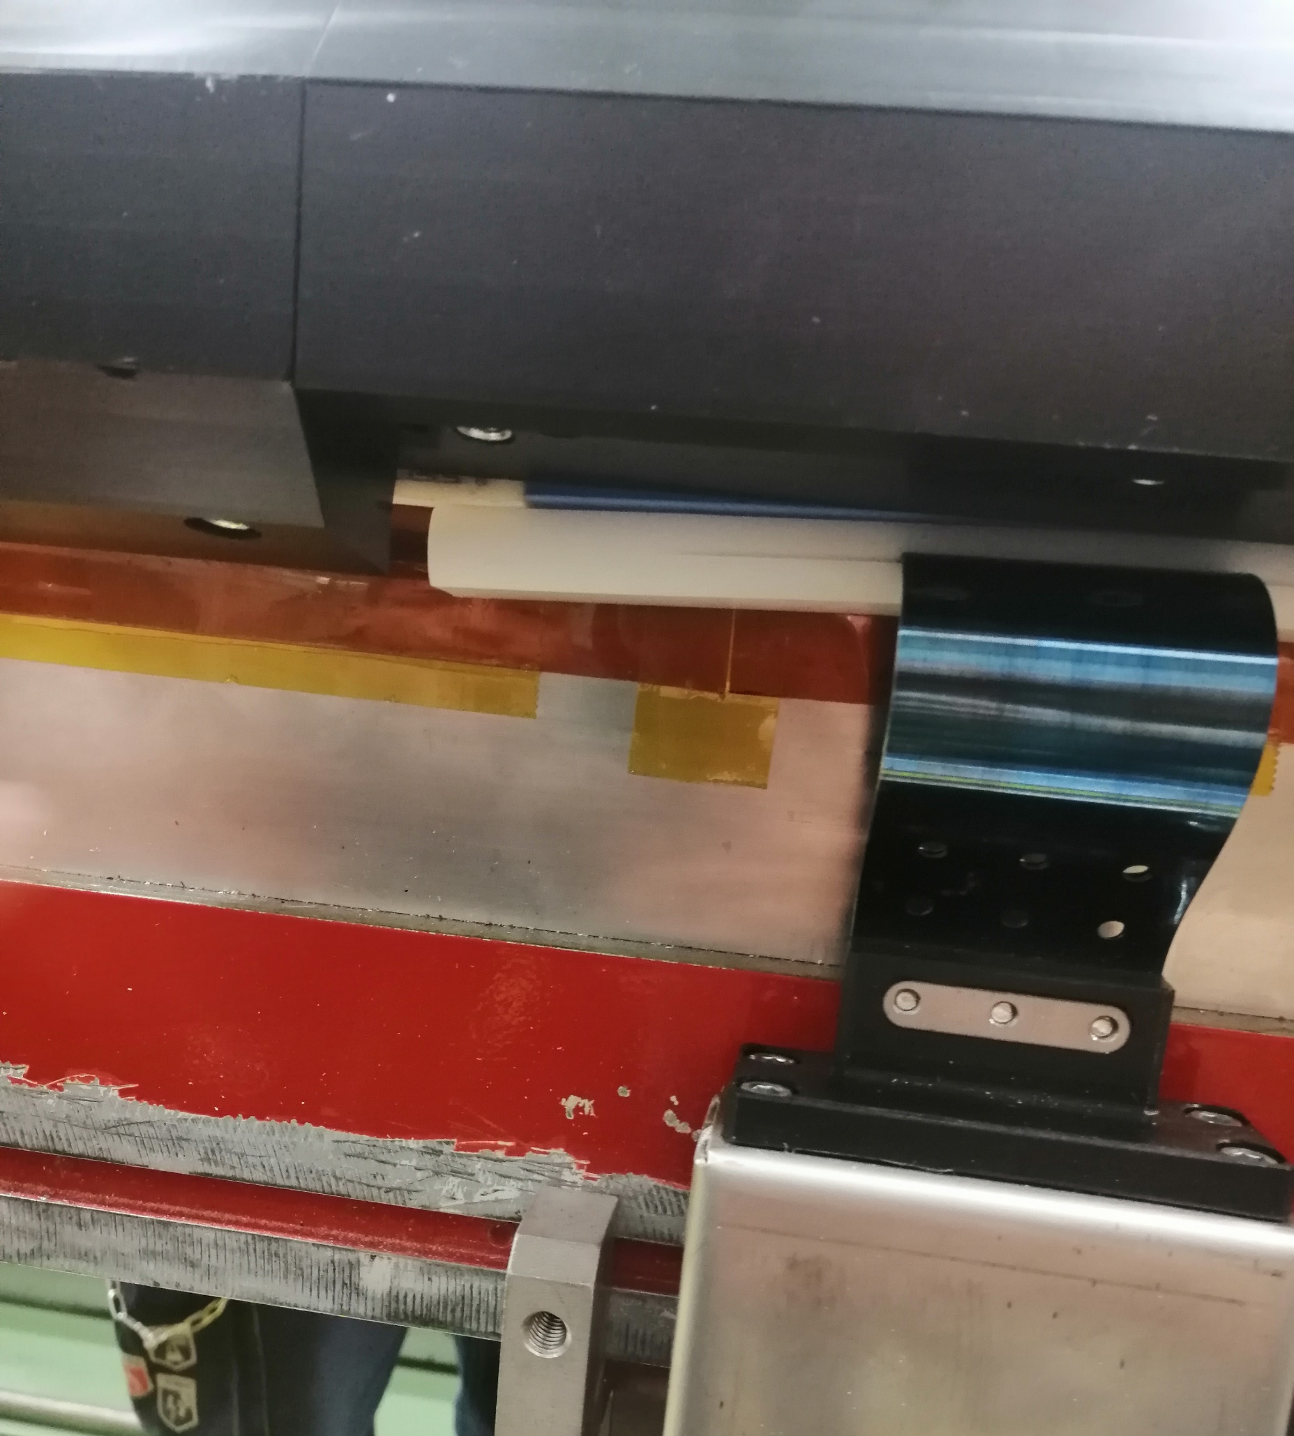
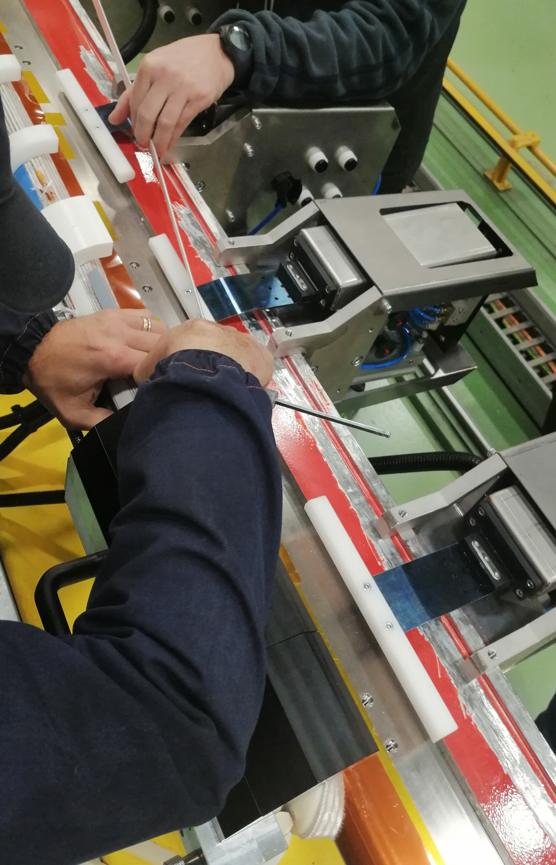
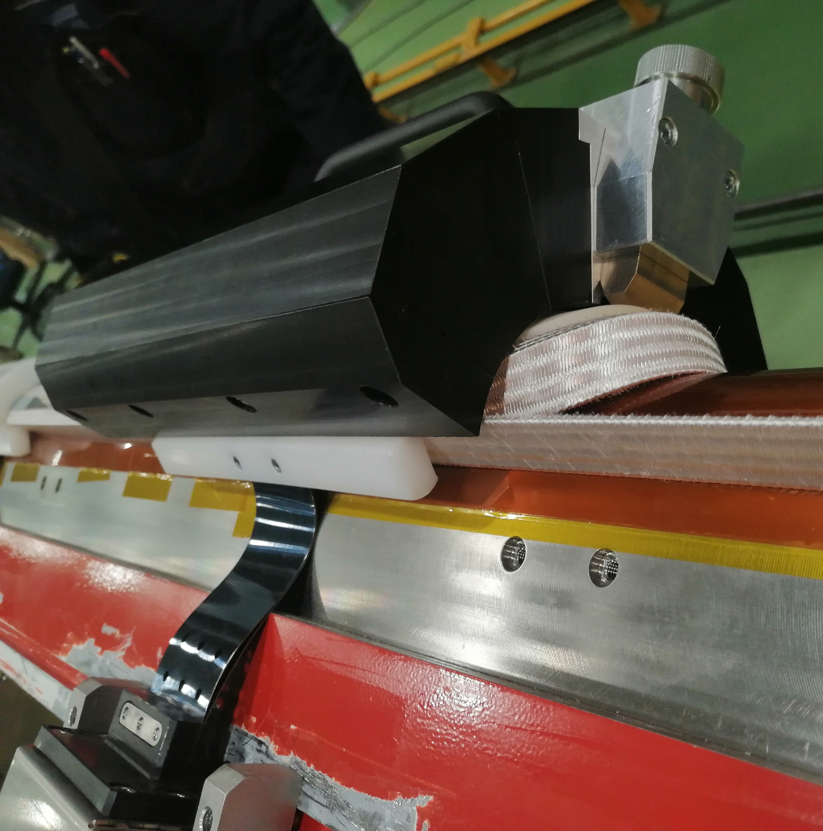
Tooling issues – lateral pressors
The Teflon bar is flexible and cannot apply force uniformly along the straight part
The thickness of the Teflon bar should match the cable thickness to properly push the cable azimuthally
The length of the flexible plate should be corrected (shortened to follow the turns toward the midplane)
The force of the pressors cannot be adjusted because it is an on/off system with a max pressure of 7 bars (that are not sufficient for the midplane block)
The cable touches the pressors during the winding of the midplane block turns
deformation
interference
Flexible plate

Slide 12
Conclusions
ASG actions
Check the radial clamp gap
Solve the pressors issues (teflon bar, plate length, max force)
Think about a different clamp system for the ends
INFN actions
Re-design the beta angles using the experimental data
Think about the cable and wedge width difference (too much extra space for expansion after heat treatment

Slide 13
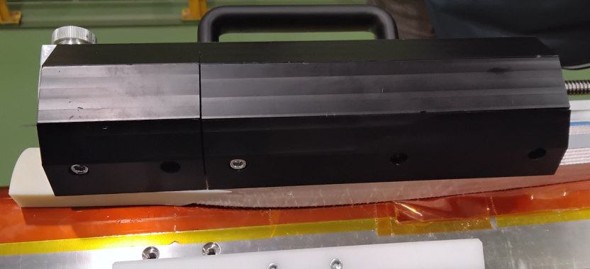
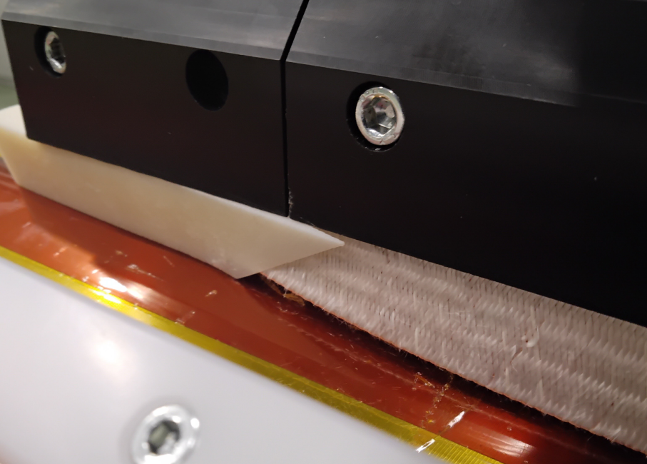
Protrusion on Midplane
Relevant protrusion of the coil end.
The final spacer tends to tilt upward.

Slide 14
Proposal for next step
ASG, INFN-GE and INFN-MI will perform studies focused on finding the natural curvature of the cable with the 50 mm mandrel by extending the length of the head.
INFN-MI will implement the measured beta angles in Roxie and will produce a new set of plastic endspacers.
ASG will explore the possibility of improving the tooling by using clamps that try to provide better support for the turn ends.
Final Winding Test

