Slide 1
Computational Accelerator Physics (CAP)
section meeting
Giovanni Iadarola
7 Feb 2024

Slide 2
Information
IPAC25: for those who’s participation is confirmed, please book aby Feb 10!!!
CERN accelerator schools (CAS)
  Intensity Limitations in Hadron Beams, 15 – 27 June 2025, Borovets, Bulgaria → Paula added to the list
  Introduction to Accelerator Physics, 21 September – 4 October 2025, Santa Susanna, Spain → Please let me know by 14 Feb!
  Beam Instrumentation, 16 – 29 November 2025, Split, Croatia
Thematic schools of computing
  https://indico.cern.ch/event/1496679/overview
  Bernardo and Vlad added to the list
Muon Collider School in Chicago on August 3-6
Any other schools/courses that you might be interested in attending in 2025?
For CAS lecturers, a memorandum has been circulated for traveling rules
  Anybody concerned in the section?
TSC-2025-2 Student committee
  Proposals for TECH and DOCT need to be prepared by mid-February!

Slide 3
Information
BE-FCC workshop being organized for 11 February
  Input from ABP will be collected by Yannis
  I will give a short presentation on “Computing for FCC-ee”. Don’t hesitate to send me material!
FCC week 2025 (Vienna) announced (https://indico.cern.ch/event/1408515/)
  Attendance list still to be defined by project and groups

Slide 4
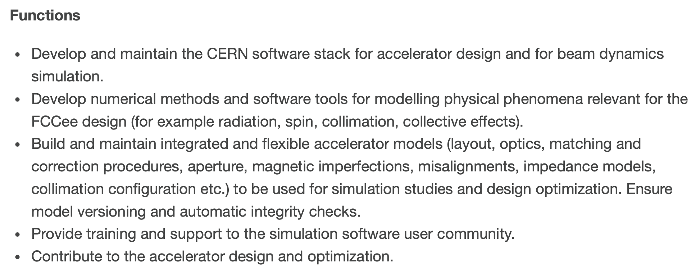
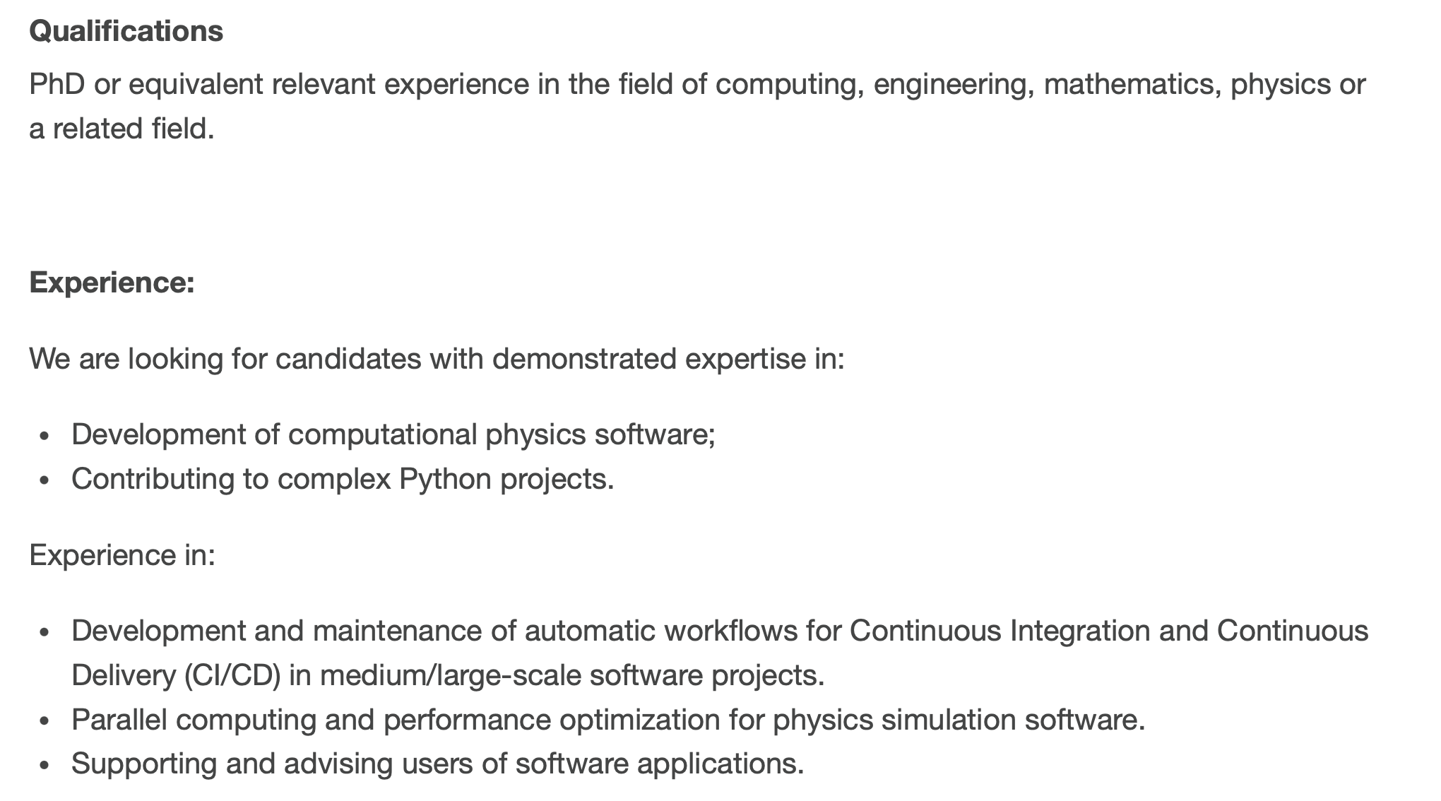
LD post in our section is now open (deadline 26 Feb)
Link: BE-ABP-CAP-2025-8-LD

