Slide 1
Computational Accelerator Physics (CAP)
section meeting
Giovanni Iadarola
31 Jan 2024

Slide 2
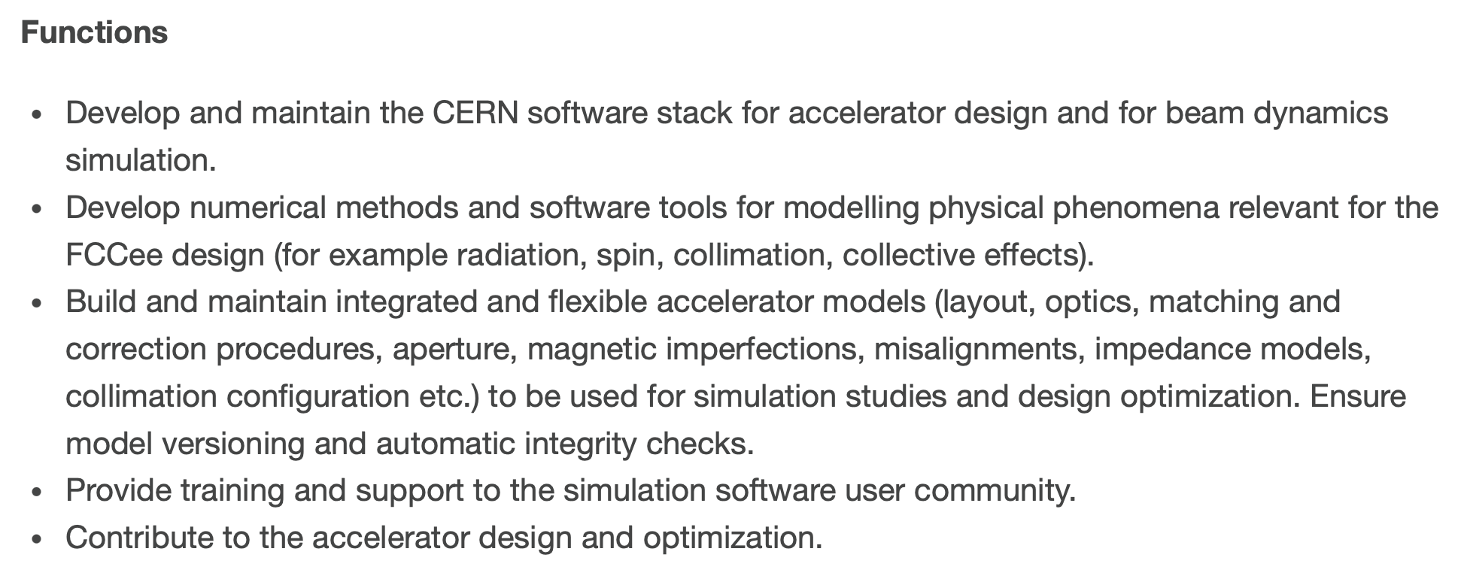
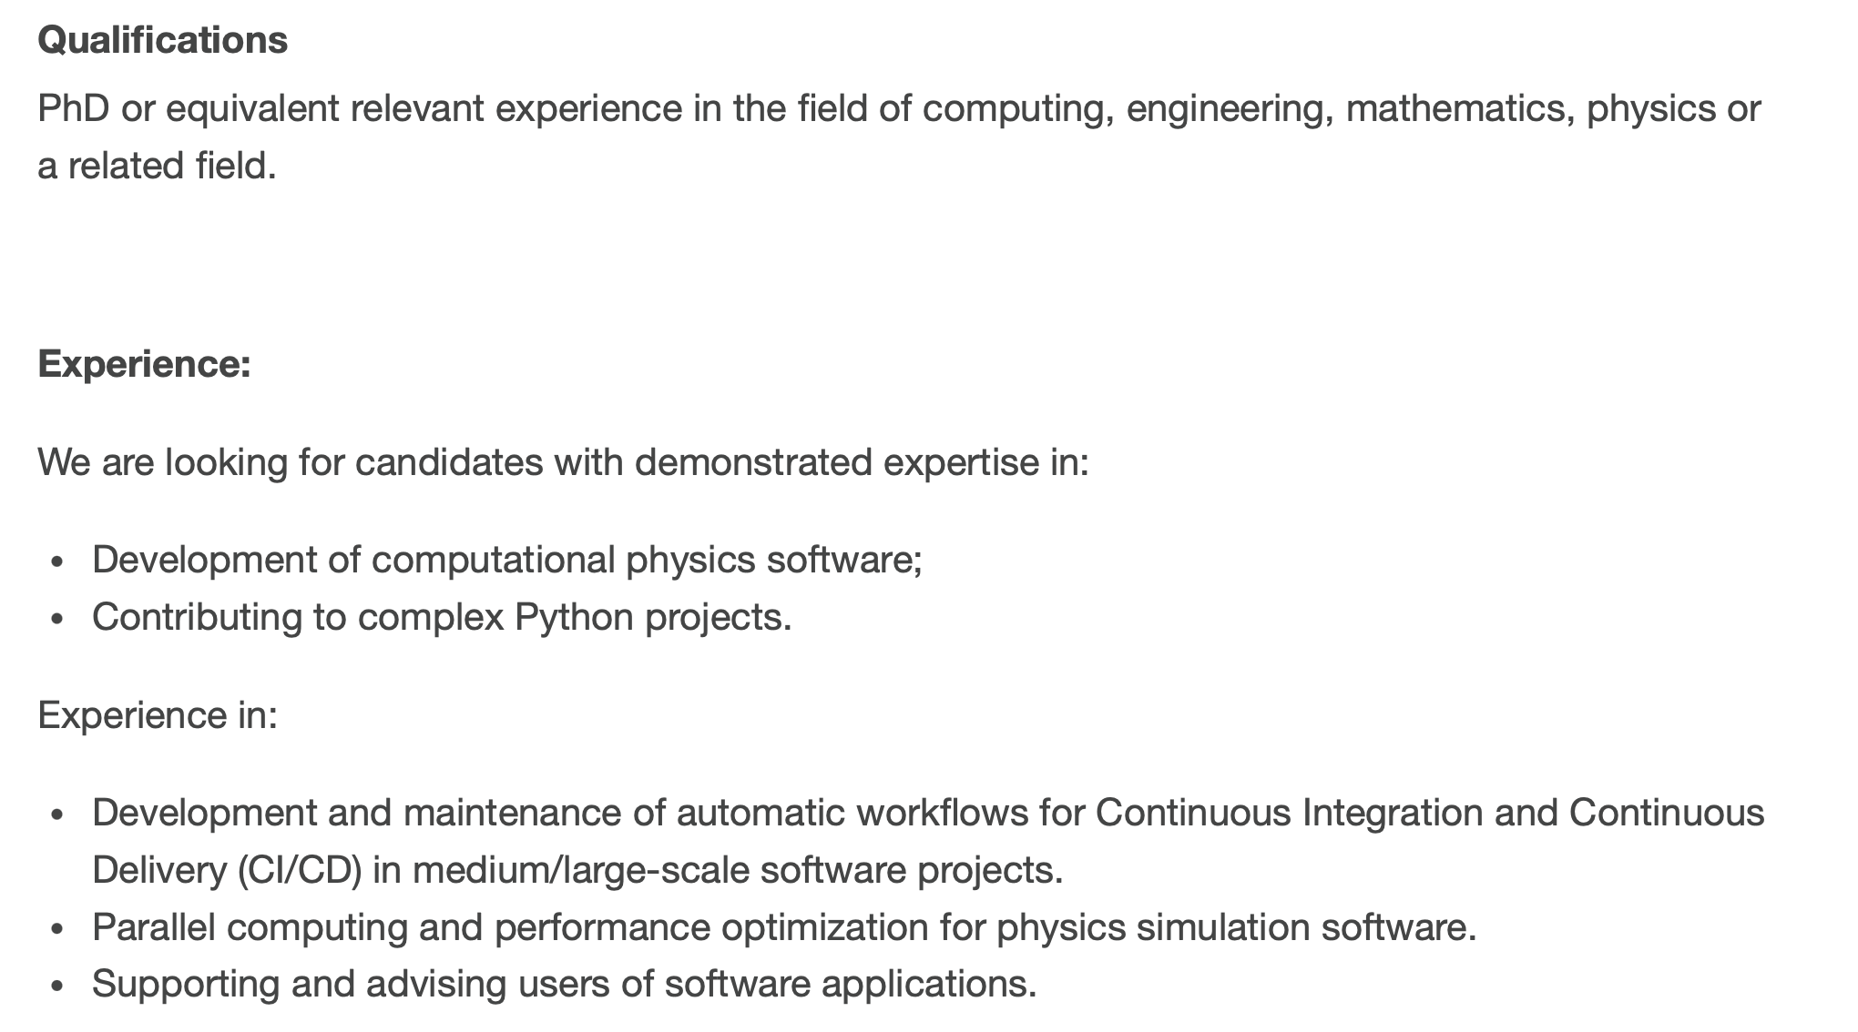
LD post in our section is now open (deadline 26 Feb)
Link: BE-ABP-CAP-2025-8-LD

Slide 3
Information
IPAC25: for those who’s participation is confirmed, please book as soon as possible!
CERN accelerator schools (CAS), please let me know your wishes
  Intensity Limitations in Hadron Beams, 15 – 27 June 2025, Borovets, Bulgaria → if interested, please inform me by end of this week!
  Introduction to Accelerator Physics, 21 September – 4 October 2025, Santa Susanna, Spain
  Beam Instrumentation, 16 – 29 November 2025, Split, Croatia
Thematic schools of computing
  https://indico.cern.ch/event/1496679/overview
  Bernardo interested in participating, anybody else?
Any other schools/courses that you might be interested in attending in 2025?
TSC-2025-2 Student committee
  Proposals for TECH and DOCT need to be prepared by mid-February

Slide 4
Information
BE-FCC workshop being organized for 11 February, input from ABP will be collected by Yannis + there might be more technical and brief talks in the afternoon
FCC week 2025 (Vienna) announced (https://indico.cern.ch/event/1408515/)
  Attendance list still to be defined by project and groups
Chamonix Workshop took place this week (reviewed entire CERN accelerator program, present and future)
  Material available here: https://indico.cern.ch/event/1469359/

