Slide 1
IPPOG Collaboration Board – Friday the 16th of May 2025
18th IPPOG Collaboration Board Meeting
P. Abreu, LIP and IST, (Co-)Chair
C. Adam, LAPP, (Co-)Chair
F. Cacciatori, U.Notre-Dame, Coordination Team
H.Pillot, CERN, Coordination Team
H. Olgunsoy, CERN, Coordination Team

Slide 2
Collaboration Board Meeting
Agenda
  Welcome to new members
  Establishing the quorum and Adoption of agenda [vote]
  Approval of minutes from 17th Collaboration Board (November 2025) [vote]
  IFAAB updates (endorsement)
  Finances Statement 2024 [vote]
  New Members (Declarations of Interest) [votes]
  Autumn 2025 and Spring 2026 meetings [votes]
  Election of Chair(s) for 2026–2028 [vote]
  2026 Budget Estimate & Scientific Secretary Recruitment Process
  CB Chair & Code of Conduct Follow Up
  AOB

Slide 3
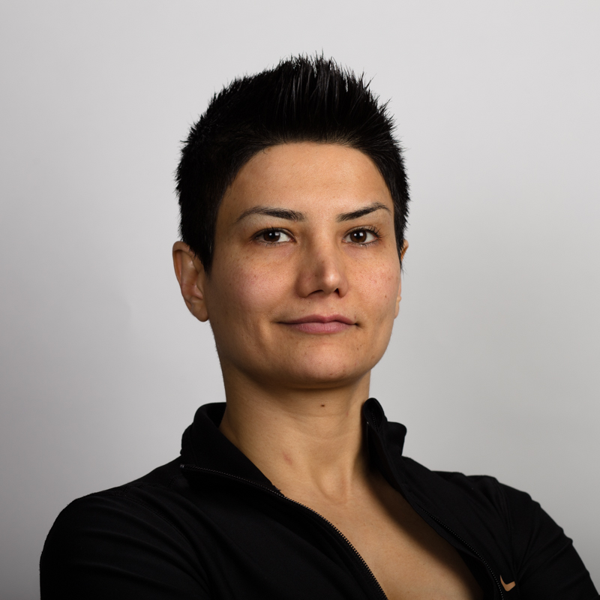
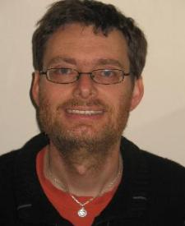
Welcome to the Collaboration Board
Ireland
replacing
Welcome
Venus Keus
Thank you,
Jonivar Skullerud

Slide 4
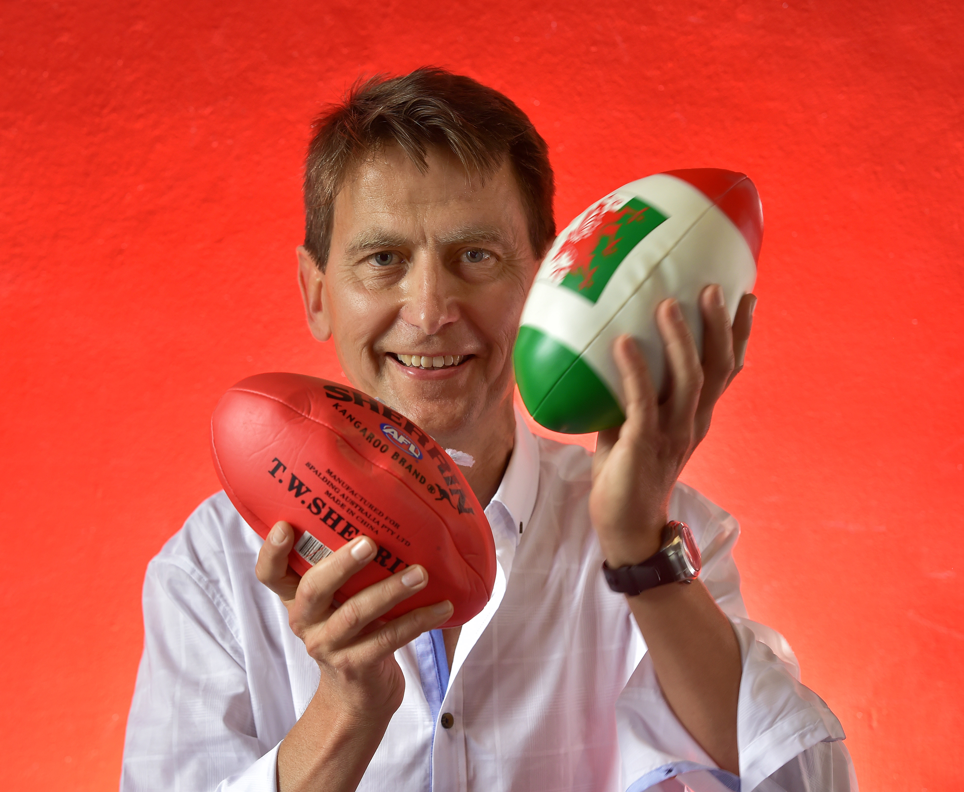
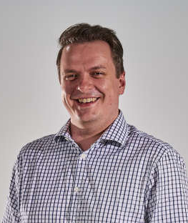
Welcome to the Collaboration Board
United Kingdom
replacing
Welcome
Chris Allton
Thank you,
Darren Price

Slide 5
Establishment of Quorum and Agenda
Current IPPOG Members
  34 Countries
  7 Experiments
  1 International Laboratory (CERN)
Current IPPOG Associate Members
  2 National Laboratories (DESY, GSI)
Quorum
  Number of Members x 2/3 = 42 x 2/3 = 28 → Need 28 members.
  We have ?? members registered as of Wednesday 13:00 (CET – UTC+1).
Do you approve the agenda for this meeting?

