Slide 1
Injection Background
STATUS
24/03/2025 FCC-ee Collimation meeting
Giulia Nigrelli
G. Nigrelli^{1,2,3}, M. Boscolo², G. Broggi^{1,2,3}, R. Bruce¹, S. Redaelli¹, K. Skoufaris¹
¹ CERN, Geneva, Switzerland,
² INFN-LNF, Frascati, Italy,
³ Sapienza Università di Roma, Roma, Italy

Slide 2
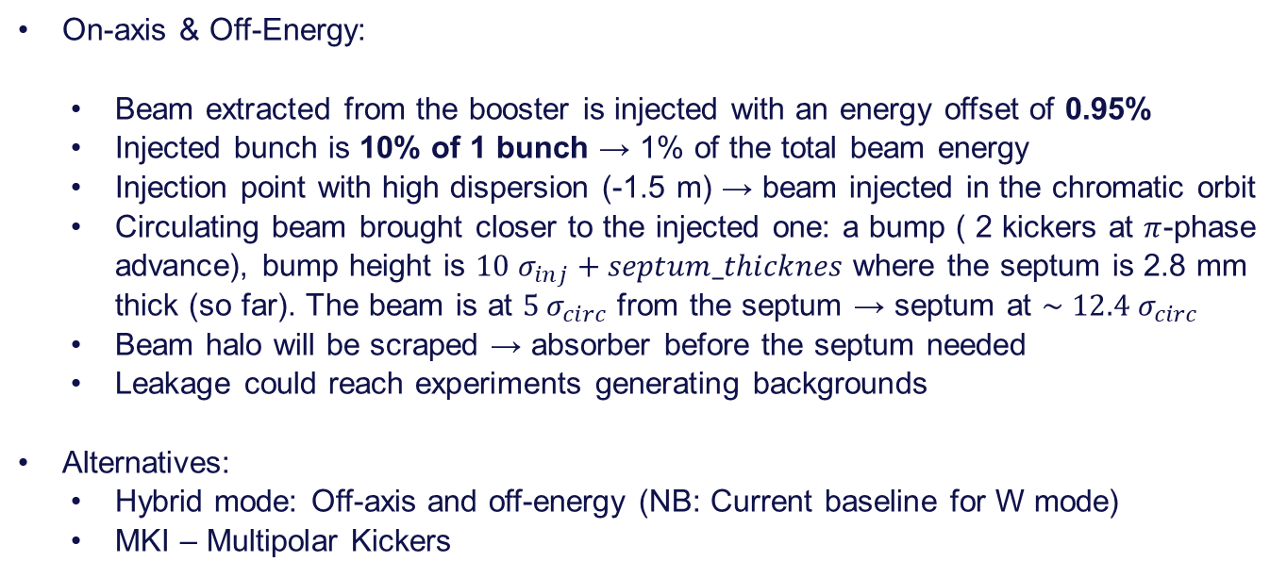
Baseline injection scheme
On-axis & Off-Energy:
  Beam extracted from the booster is injected with an energy offset of 0.95%
  Injected bunch is 10% of 1 bunch → 1% of the total beam energy
  Injection point with high dispersion (-1.5 m) → beam injected in the chromatic orbit
  Circulating beam brought closer to the injected one: a bump ( 2 kickers at $π$-phase advance), bump height is $10 σ_{inj}+septum_thicknes$ where the septum is 2.8 mm thick (so far). The beam is at $5 σ_{circ}$ from the septum → septum at $∼12.4 σ_{circ}$
  Beam halo will be scraped → absorber before the septum needed
  Leakage could reach experiments generating backgrounds
Alternatives:
  Hybrid mode: Off-axis and off-energy (NB: Current baseline for W mode)
  MKI – Multipolar Kickers

Slide 3
Simulation framework
Usual collimation studies tools: Xsuite + BDSIM
Current framework under optimization, in collaboration with Kyriacos, to make the simulation more accessible and more universal. Specially for the implementation of the bump which is now ‘lattice independent’.
Simulated injected beam:
  Beam distribution is generated at the injection point with injection parameters
  Efficiency can be studied (currently assessed between 80-75% for V24.4-GHC)
  Losses are expected along the whole ring with a peak at off-momentum collimator (preliminary results show higher losses in the vertical tertiaries due to particles reaching the DA)
  An emittance blow up, in all planes have been observed from different studies. Probably due to the mismatch of the initial distribution ( beam not matched to the chromatic twiss parameters but to the on momentum once, under investigation!)

Slide 4
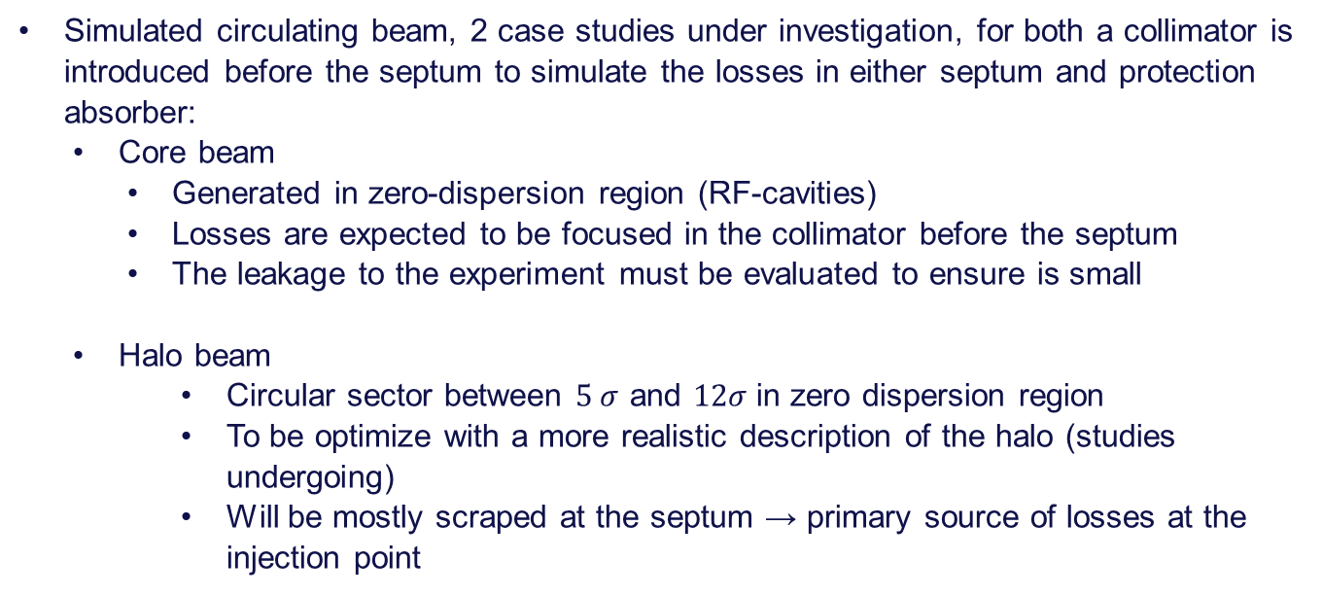
Simulation framework
Simulated circulating beam, 2 case studies under investigation, for both a collimator is introduced before the septum to simulate the losses in either septum and protection absorber:
  Core beam
    Generated in zero-dispersion region (RF-cavities)
    Losses are expected to be focused in the collimator before the septum
    The leakage to the experiment must be evaluated to ensure is small
  Halo beam
      Circular sector between $5 σ$ and $12σ$in zero dispersion region
      To be optimize with a more realistic description of the halo (studies undergoing)
      Will be mostly scraped at the septum → primary source of losses at the injection point

Slide 5
Thank you for your attention.
24/03/2025 FCC-ee Collimation meeting
Giulia Nigrelli

Slide 6
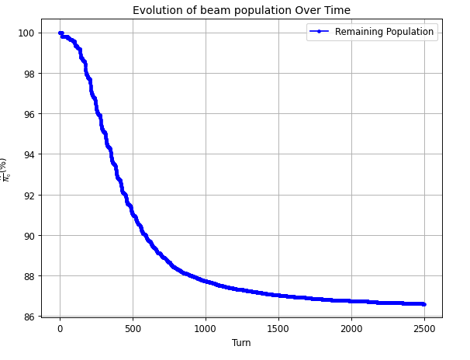
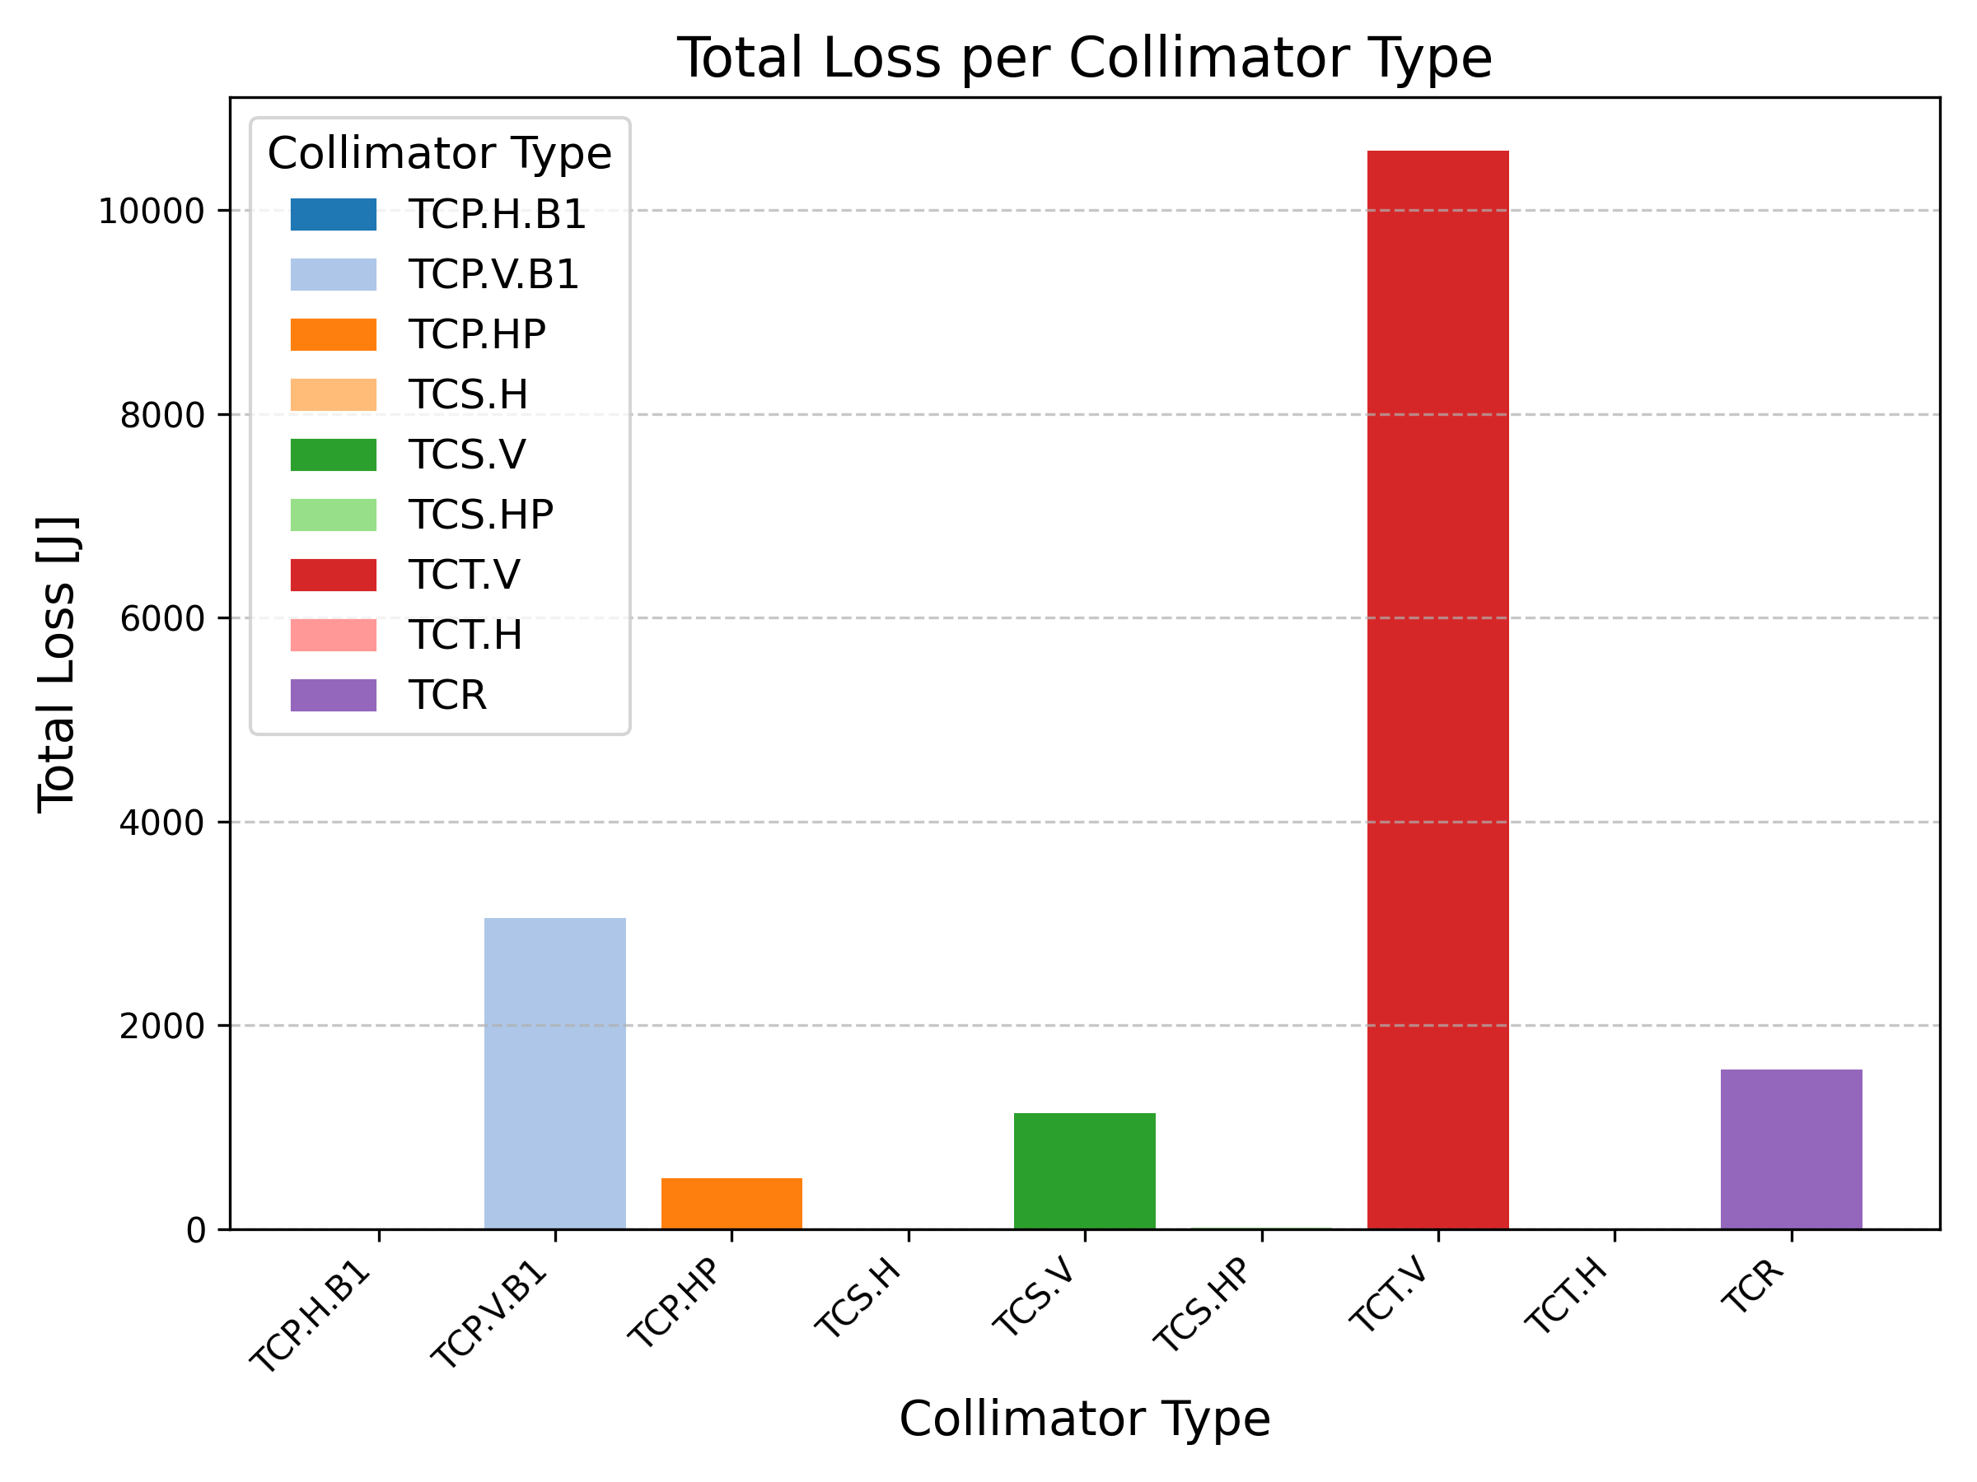
Preliminary results – Injected beam

Slide 7
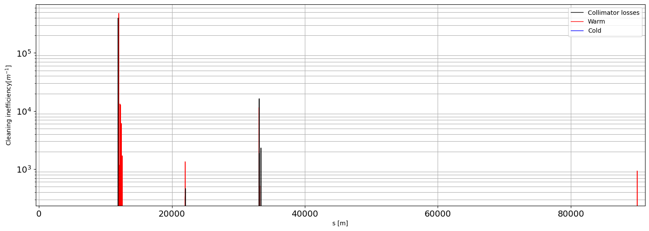
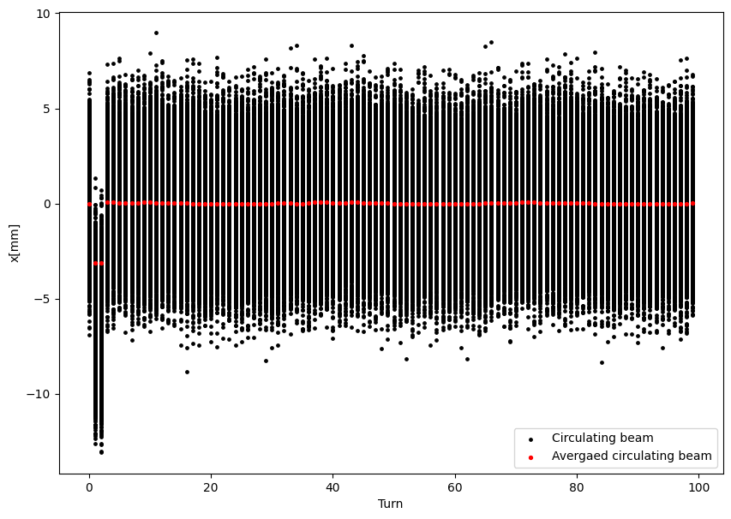
Preliminary results – Circulating core beam

Slide 8
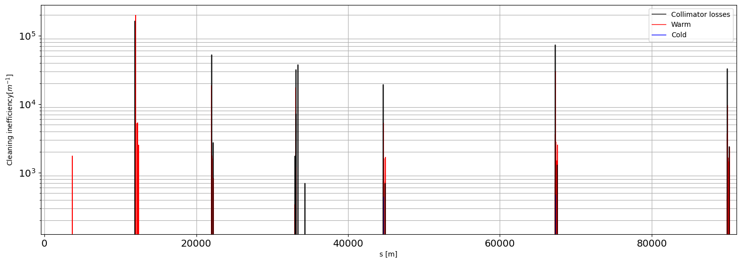
Preliminary results – Circulating halo beam

Slide 9
Colors
Backgrounds
Background Blue
Background Purple
Background Yellow
Background Grey
Use for Layout
Radiant Blue
Flash
Energy
Green
Red
Deep
Blue

Slide 10
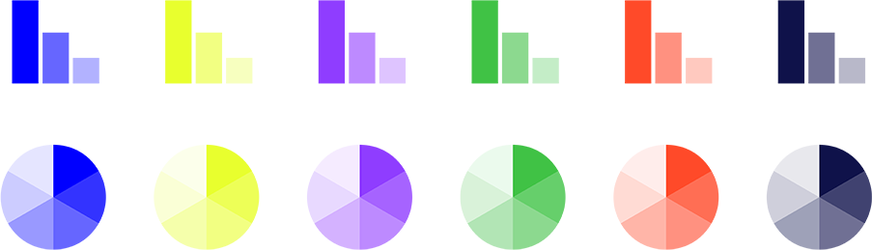
Graphical Elements
Badges
This information is a badge because it is important!
This information is a badge because it is important!
Separation lines 1.5 pt
Arrows
Use blue badges on light backgrounds
Infographics
This information is a badge because it is important!
This information is a badge because it is important!
Use light badges on dark backgrounds

