Slide 1
Processes of science and the standard model
Jackie Flaherty
Jed Marshall
Notes:
Some resources adapted from Perimiter Institute and TALC with permissions.

Slide 2
SPEED DATE
Who? What?
Where?
Why?

Slide 3

How Do Scientists Think?
Scientists Ask Questions
Notes:
https://undraw.co/license

Slide 4
Reflections
How are observations & inferences different?
Are all predictions equally valid?
Can scientists draw different inferences based on the same observations?
How does it feel when someone disagrees with your prediction?
What role does experiment play in developing good models?

Slide 5
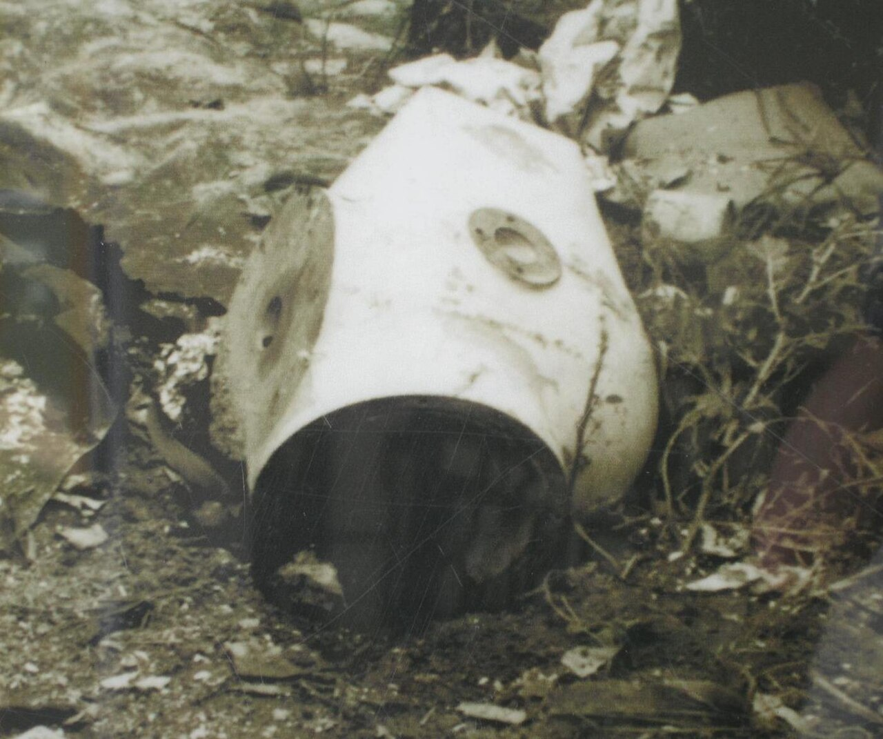
What makes a scientist?
The Goiânia Mystery
Listen, reflect.
How do scientists think?
CC2.0 https://commons.wikimedia.org/wiki/File:02010019_radioactive_cesium_source_Goi%C3%A2nia_accident.jpg

Slide 6
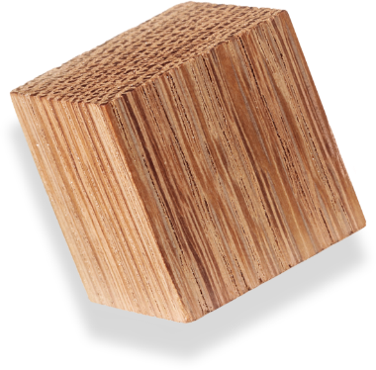
How Do Scientists Think?
Scientists Build and Revise Models
Notes:
(About 10-15 min) Using the Wooden Blocks:
-Put one block on the table between four people (blank side down)
-Ask the participants to observe the vertical face closest to them, without touching the blocks
-Discuss observations and look for patterns.
-Test your pattern on the top face
-After a few minutes ask them to create a model to predict what the hidden face will say
-Explain how nature can be described using models. We test these model/theories until they are proven wrong. At that point, they need to be thrown out or revised. Several, different models are capable of describing the same thing.
-Discuss the various answers.
-It is important to build vocabulary such as “predict, observe, model, etc.”

Slide 7
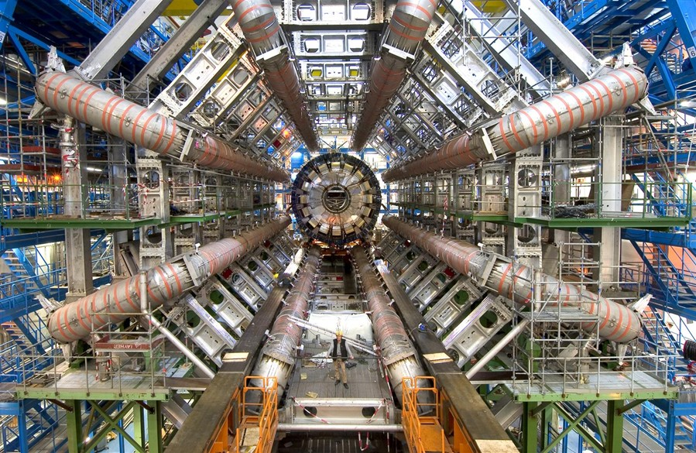
Why is it Like That?
CC4.0 https://commons.wikimedia.org/wiki/File:ATLAS.jpg

Slide 8
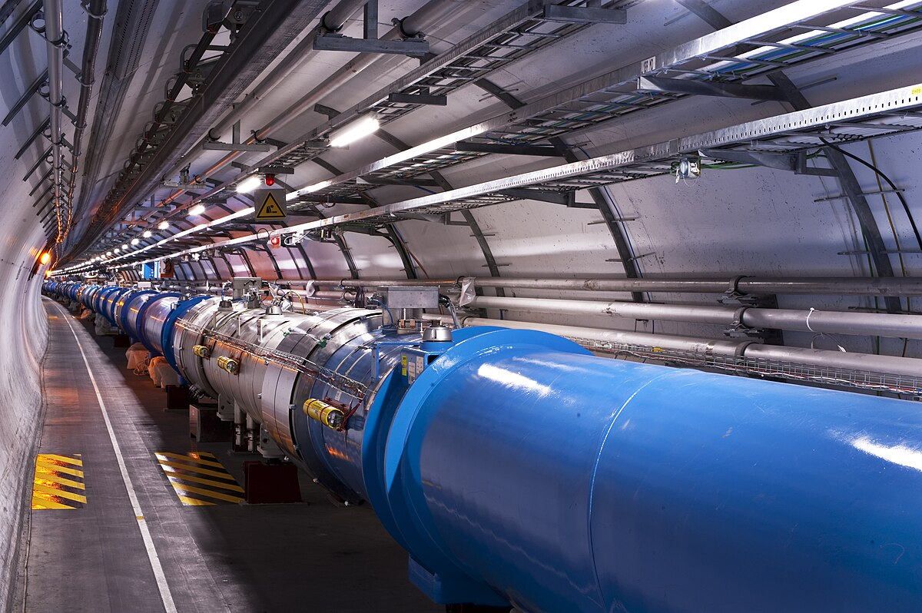
Why is it Like That?
CC3.0 https://commons.wikimedia.org/wiki/File:Views_of_the_LHC_tunnel_sector_3-4,_tirage_2.jpg

Slide 9
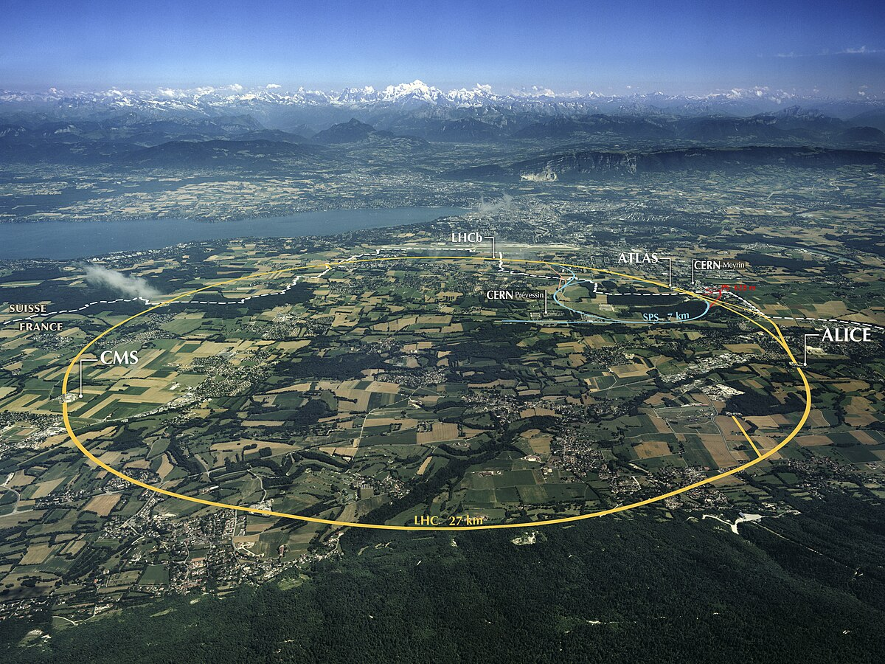
Why is it Like That?
CC4.0 https://commons.wikimedia.org/wiki/File:ATLAS.jpg

Slide 10
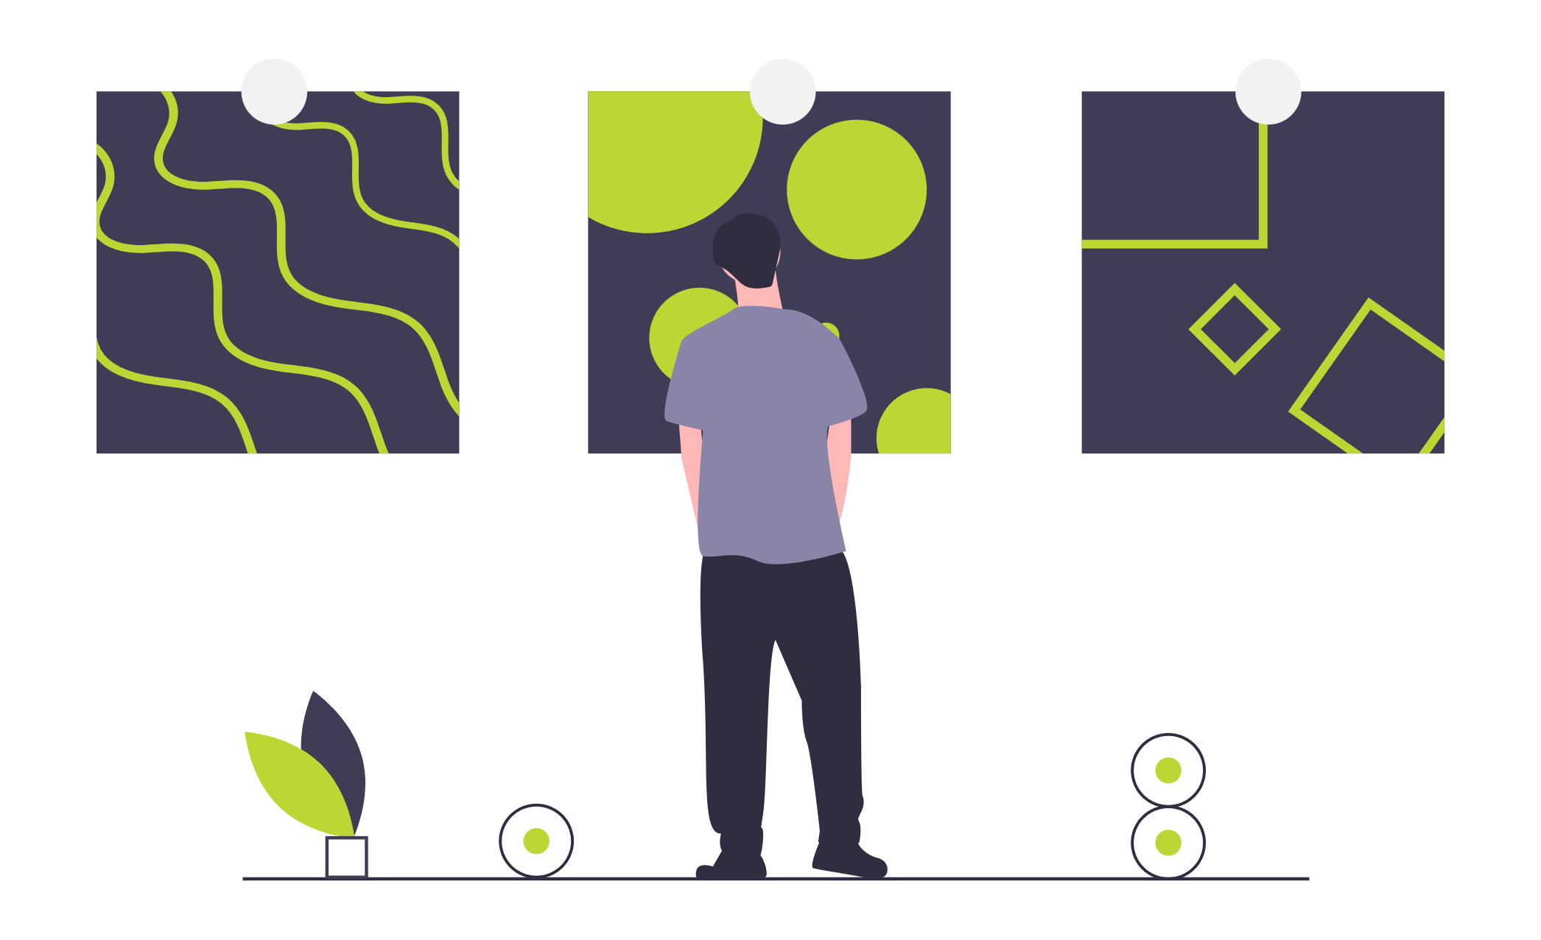
How Do Scientists Think?
Scientists look for patterns
Notes:
https://undraw.co/license

Slide 11
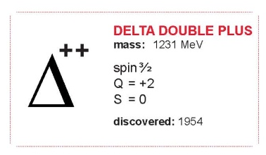
Scientists look for patterns
name
mass
spin
electric charge (Q)
strangeness (S)
date
symbol

Slide 12
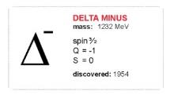
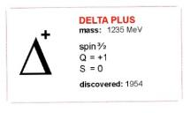
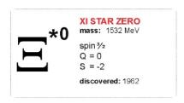
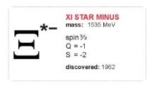
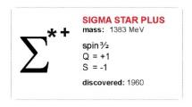
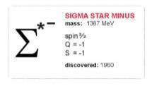

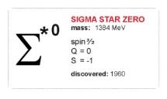
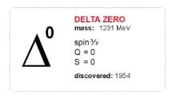
Scientists look for patterns

Slide 13
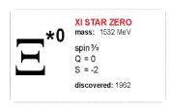
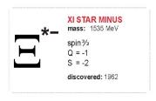

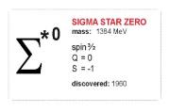



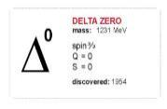

Scientists look for patterns
Column:
Same Charge
Increasing Mass
Row:
Same Strangeness

Slide 14
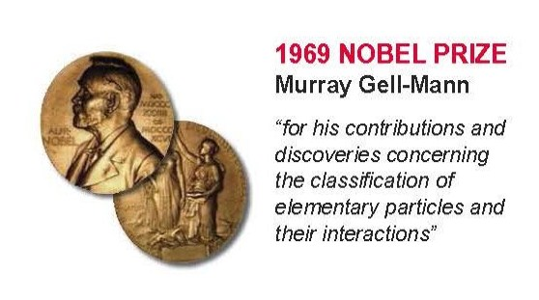
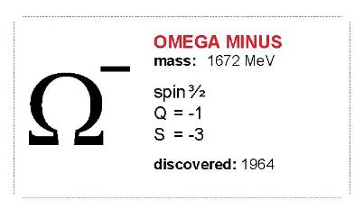
Scientists look for patterns
Missing particle?
spin 3/2
charge = -1
strangeness = -3
mass ≈ 1680 MeV

Slide 15
Reflections
What expertise/processes can you bring from your area of scientific expertise?
When are these resources appropriate to use?

Slide 16
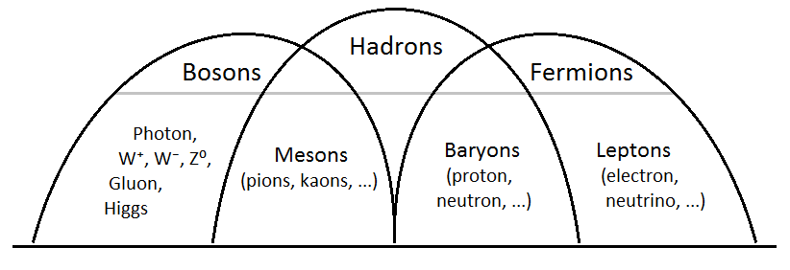
Building blocks

Slide 17
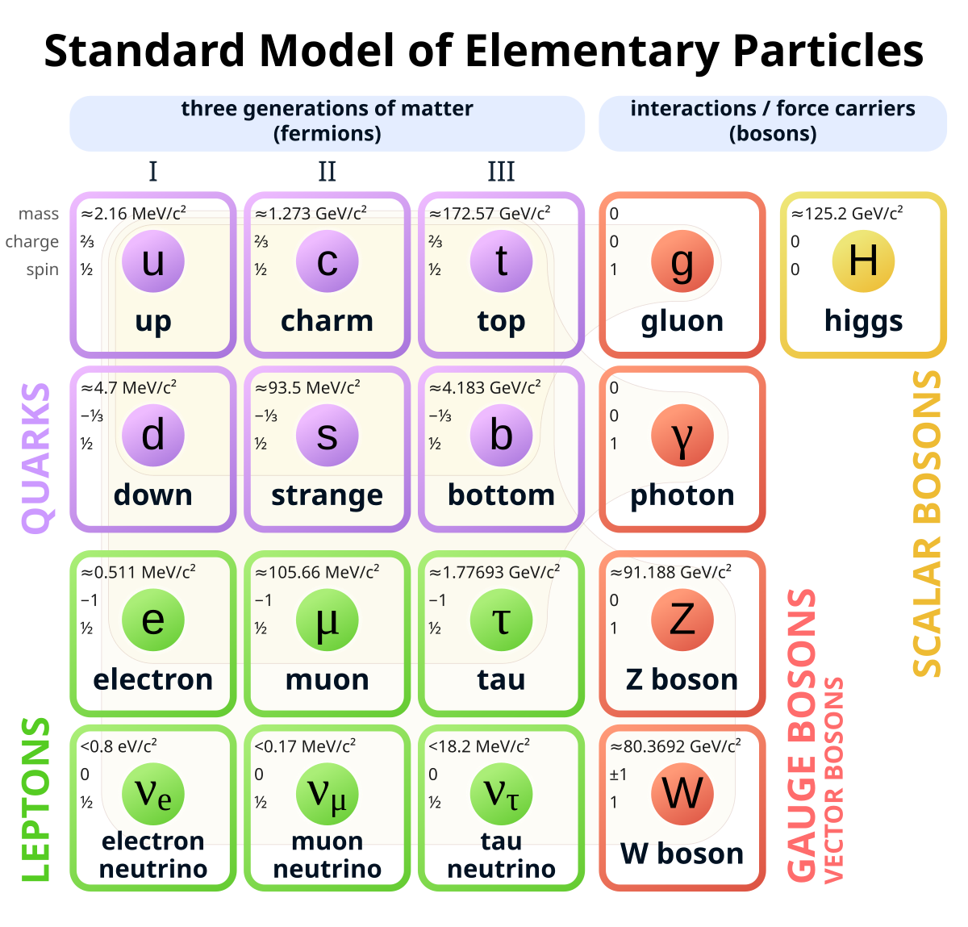

Slide 18
Fields
Jackie Flaherty
Jed Marshall

Slide 19
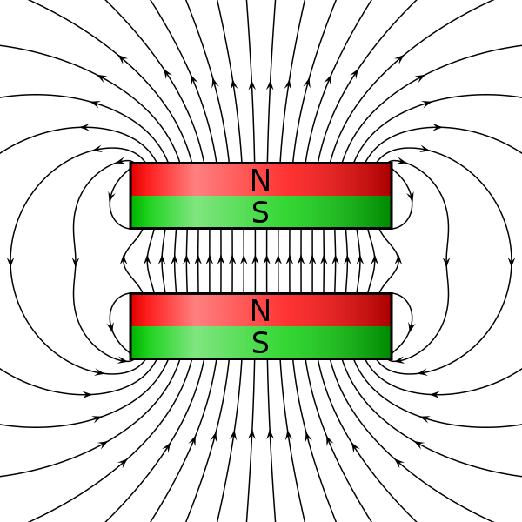
Fields
What do you see?
Potential? Energy? Strength? Flux? Density? Line? Direction?
Additional: Sequencing
CC4.0 https://en.wikipedia.org/wiki/Dipole_magnet
Notes:
Encourage more detail – such as what do the lines being close represent, what does an arrow mean, why can’t lines cross?

Slide 20
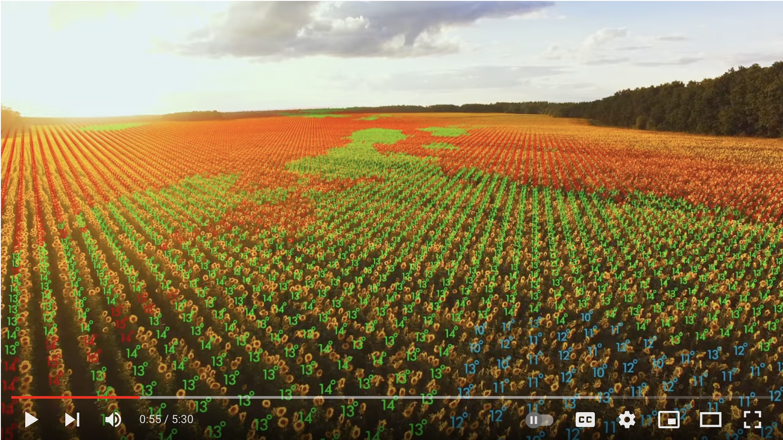
Fields
https://www.youtube.com/watch?v=cTWwFX5hwfo

Slide 21
Prior knowledge
field lines can stretch into empty space beyond an object, and will indicate the direction
field lines closer together represent a stronger field
like charges or magnetic poles repel, but opposites attract

Slide 22
Similarities and differences?
Electric
Magnetic
Gravitational
Notes:
Encourage people to unmute and explain their ideas before revealing the next slide.

Slide 23
Similarities and differences?
Electric fields | Magnetic fields | Gravitational fields
They tell you how big the force will be on object due to some property of that object.
Affects charged particles | Affects moving charges. | Affects mass
Can draw with field lines closer field lines = higher field strength parallel field lines = constant field strength
Mediated by photons |  | ?
Can attract or repel |  | Can only attract
Pole can exist individually | Poles always are together | Only one pole

Slide 24
What is a field?
Let’s model a field using a stretchy material
What does the fabric represent?
What does the marble represent?
How could we use this model to investigate different types of charges and charge interactions?
Notes:
This is best done with a helper, and you may need two pieces of stetchy fabric (lycra). Start with the first one – the second will be used later.
One piece of fabric is attached (perhaps by clamps) to the edges of a large rigid hoop. This represents a neutral field. You can then pull up, or pull down the fabric to create a radial field (tip – place a marble in the fabric, then from the other side grab the marble – it makes it easier to hold). If you then place a marble on top of the fabric you can see the direction that it will feel a force.
One piece of fabric is wrapped around two parallel metre rulers about 50 cm apart. If you place this at an angle you can represent a constant field – for example with gravitiational fields being close to the surface of the Earth, or with electric fields between parallel plates.

Slide 25
What is a field?
How can we model the following five configurations of charges?
A positive charge.
A negative charge.
A positive charge and a negative charge separated by approximately 15cm.
Two positive charges separated by approximately 15cm.
Two negative charges separated by approximately 15cm.

Slide 26
How do we draw fields?
Let’s add to our fabric model.
Note – the same misconception exists with Newton’s first law. The direction of the arrow tells us the direction that it will feel a force/acceleration not necessarily the direction of movement.

Slide 27
Gravitational fields

Slide 28
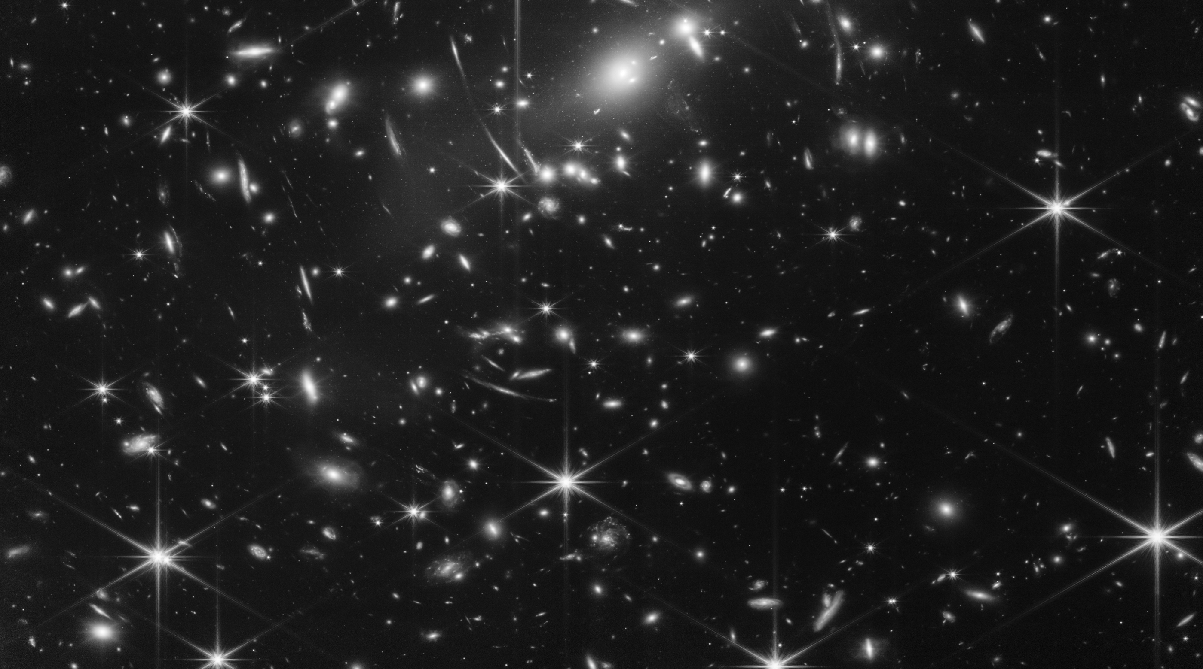
What do the blue lines represent?
What do the red circles represent?
How are the circles spaced?
What is the relationship between
the lines and circles?
Image credit: NASA, ESA, CSA, and STScI
Notes:
Ask the questions and wait for responses via chat before revealing the answers.
What do the blue lines represent? – field lines
What do the red circles represent? - equipotential
How are the circles spaced? – closer when you are close the planet
What is the relationship between the lines and circles? - at right angles.

Slide 29
What physical property causes this field?
Mass

Slide 30
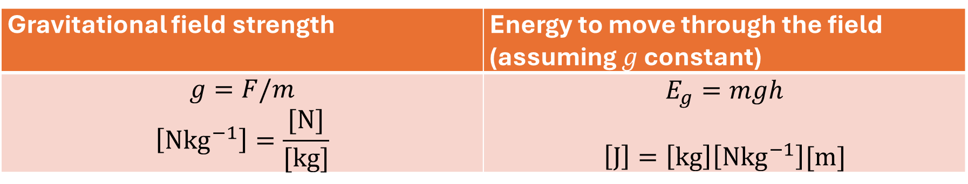

What are the equations?
Gravitational field strength | Energy to move through the field (assuming $g$ constant)
$$g=F/m$$ $$\left[Nkg^{−1}\right]=\frac{[N]}{[kg]}$$ | $$E_{g}=mgh$$ $$\left[J\right]=\left[kg\right]\left[Nkg^{−1}\right][m]$$
The gravitational field strength is the force that would be exerted on a unit mass.
Note – The lines are parallel close to the surface of a planet. So, gravitational field strength does not change much when we change altitude on Earth. Hence, we say $g$is constant.
.

Slide 31

What are the equations?
Force between two masses
$F_{grav}=−\frac{GMm}{r^{2}}$
Can you explain this in words?
Notes:
Ask one (fairly confident) participant to explain it unmuted.

Slide 32


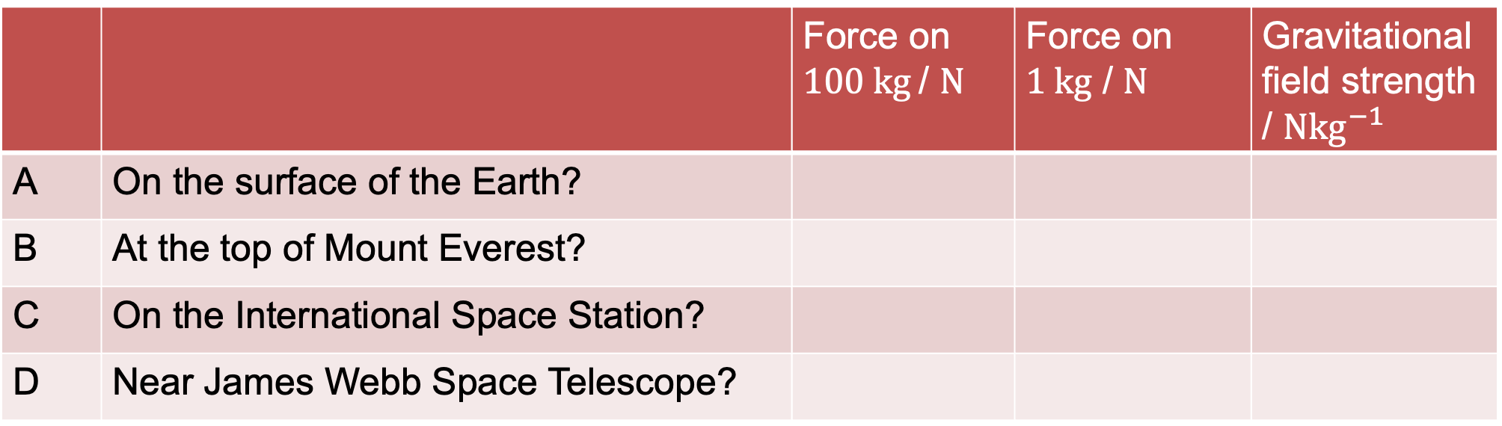
Force due to Earth’s mass
$$G=6.67 × {10}^{−11} m^{3}{kg}^{–1}s^{–2}$$
$$ISS orbit height = 408 km$$
$$JWST distance = 1.5 × {10}^{6} km$$
$$Everest height = 8 849 m$$
$$Earth radius= 6 371 km$$
$$m_{Earth}=5.97 × {10}^{24} kg$$
$F_{grav}=−\frac{GMm}{r^{2}}$
 |  | Force on $100 kg$/ $N$ | Force on $1 kg$ / $N$ | Gravitational field strength / $Nkg^{−1}$
A | On the surface of the Earth?
B | At the top of Mount Everest?
C | On the International Space Station?
D | Near James Webb Space Telescope?
Notes:
Ask participants to calculate some of these before revealing the answers.

Slide 33
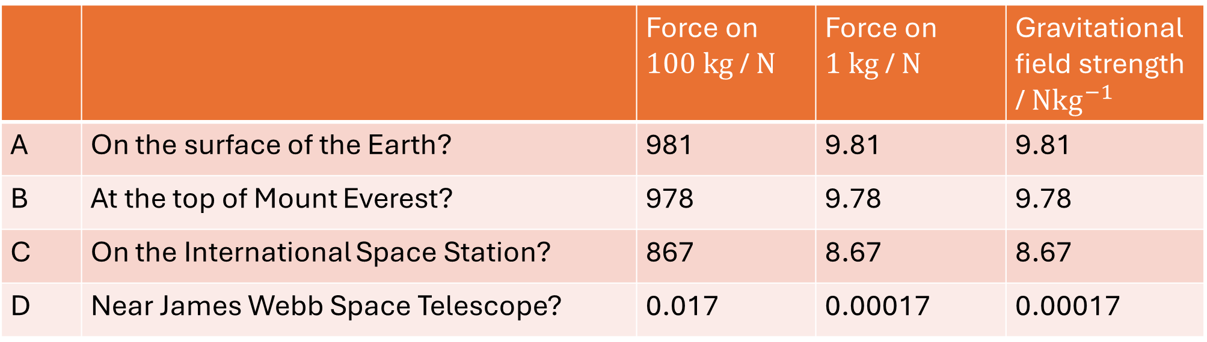
Force between two masses
$$G=6.67 × {10}^{−11} m^{3}{kg}^{–1}s^{–2}$$
$$ISS orbit height = 408 km$$
$$JWST distance = 1.5 × {10}^{6} km$$
$$Everest height = 8 849 m$$
$$Earth radius= 6 371 km$$
$$m_{Earth}=5.97 × {10}^{24} kg$$
$F_{grav}=−\frac{GMm}{r^{2}}$
 |  | Force on $100 kg$/ $N$ | Force on $1 kg$ / $N$ | Gravitational field strength / $Nkg^{−1}$
A | On the surface of the Earth? | 981 | 9.81 | 9.81
B | At the top of Mount Everest? | 978 | 9.78 | 9.78
C | On the International Space Station? | 867 | 8.67 | 8.67
D | Near James Webb Space Telescope? | 0.017 | 0.00017 | 0.00017
Notes:
Ask participants to calculate some of these before revealing the answers.

Slide 34
Electric fields

Slide 35
+
Notes:
This should be familiar from the gravitational slides. You can ask again what the blue and red lines represent, and what the similarities/differences are from electric field diagrams to gravitational field ones (the primary difference being that the field lines can go in multiple directions).

Slide 36
What physical property causes this field?
Charge
It is mediated through photons.

Slide 37
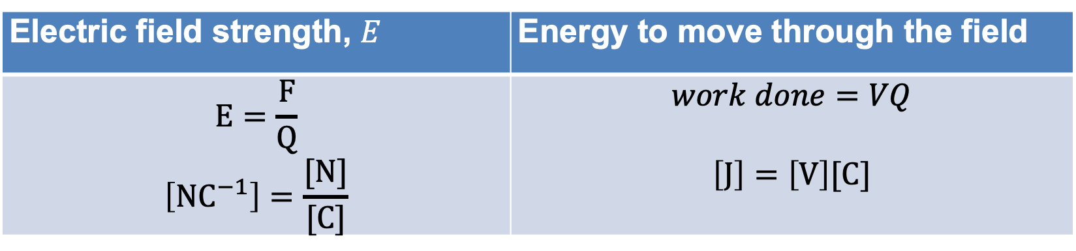
Electric field
Electric field strength, $E$ | Energy to move through the field
$$E=\frac{F}{Q}$$ $$\left[NC^{−1}\right]=\frac{[N]}{[C]}$$ | $$work done=VQ$$ $$\left[J\right]=\left[V\right][C]$$
The electric field strength is the force that would be exerted on a unit charge.

Slide 38
What does the electric field look like between two charges?
+
-
+
+
https://phet.colorado.edu/en/simulations/charges-and-fields
https://phet.colorado.edu/en/simulation/electric-hockey
Notes:
Ask participants to sketch for themselves and hold up the answer.

Slide 39
Has anyone made a website which helps teachers use PhET?
Anyone?
Here?
Anyone?

Slide 40
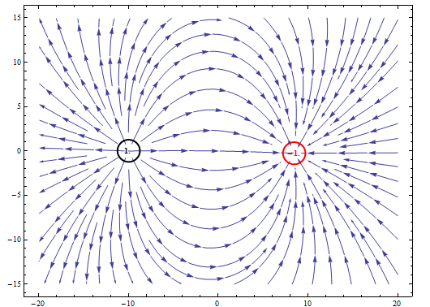
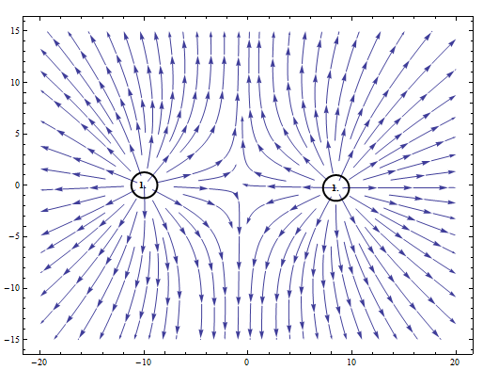
http://demonstrations.wolfram.com/ElectricFieldsForThreePointCharges/
Contributed by: S. M. Blinder (March 2011) Open content licensed under CC BY-NC-SA
Notes:
There are various field simluators that you can use to demonstrate this.

Slide 41

In a radial field
Force between two charges
$F_{electric}=\frac{1}{4πε_{0}}\frac{Qq}{r^{2}}$
$$r = distance between centres of charge$$
$$Q,q=charges$$
$$ε_{0}=permittivity of free space$$

Slide 42
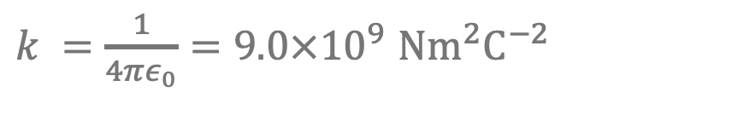
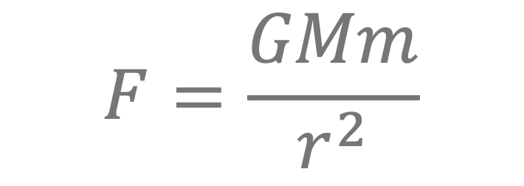
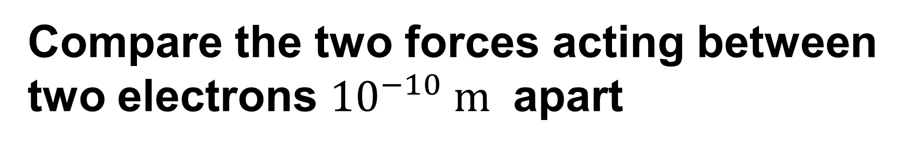


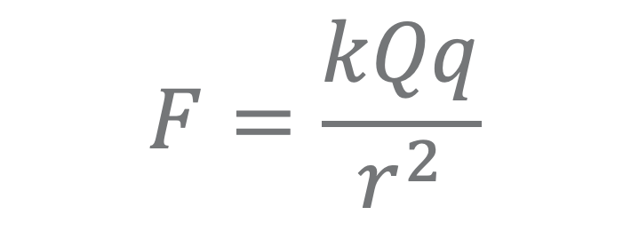
Compare the two forces acting between two electrons ${10}^{−10} m$ apart
$$F=\frac{GMm}{r^{2}}$$
$$F=\frac{kQq}{r^{2}}$$
$k =\frac{1}{4πε_{0}}=9.0×{10}^{9}$ $Nm^{2}C^{−2}$
$$G = 6.67 ×{ 10}^{−11}{ m}^{3}{kg}^{−1}s^{−2}$$
$$mass of electron = 9.11 × {10}^{−31} kg$$
$$charge of electron = 1.6 × {10}^{−19} C$$
Notes:
This is worth spending the time to ask participants to do, it checks:
they are using both equations correctly;
they know how to use their calculator with large powers.
It is also perhaps a surprising result – with a difference of 10^42.
Demonstrate how to calculate this easily on the calculator yourself, under the visualiser.

Slide 43

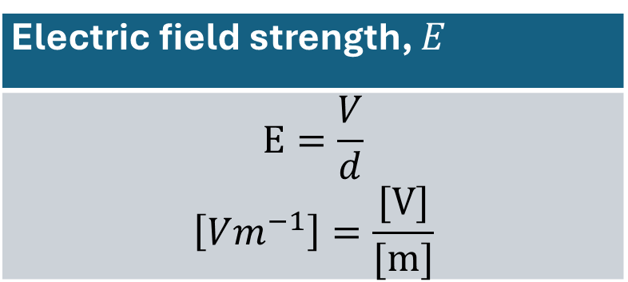
Field between parallel plates
We can model this using
charge simulation
fabric sheet
Between parallel plates
Electric field strength, $E$
$$E=\frac{V}{d}$$ $$\left[Vm^{−1}\right]=\frac{[V]}{[m]}$$
$$d=distance between plates$$
$$V=potential difference between plates$$
Notes:
You can now show the field between parallel plates using the fabric wrapped over metre rulers.

Slide 44
Returning to our model
Positively Charged Plate
Negatively Charged Plate

Slide 45
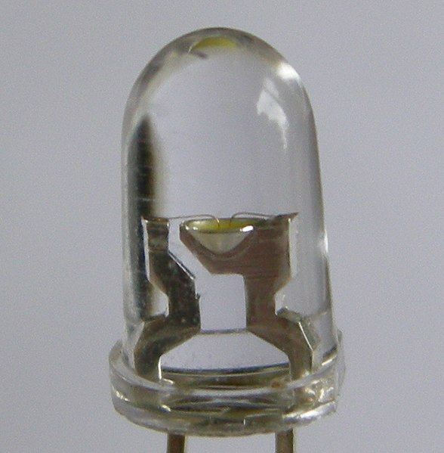
An LED
Current can only flow one way (orientation matters)
Requires a minimum potential difference ∆V across the leads before lighting up
CC3.0 https://commons.wikimedia.org/wiki/File:Witte_led_close_up.jpg

Slide 46
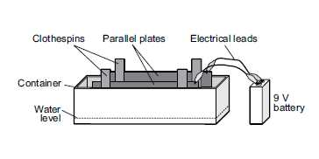
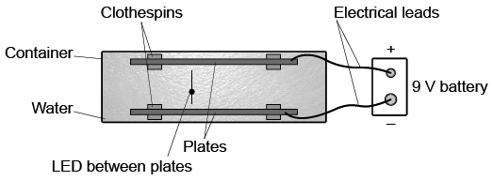
Mapping Electric Fields
Perimiter Institute

Slide 47
Mapping Electric Fields
Gently bend your LED leads so that their ends are more than 3 cm apart.
Position the LED so that the longer lead is toward the plate connected to the
+ terminal, and place both leads in the water between the parallel plates.
Gently bend the leads closer together until the LED just lights up.
Move the LED around, keeping the same orientation. What do you observe? Why?

Slide 48
Reflection
Mapping Electric Fields
LED, Fabric, Simulations

Slide 49

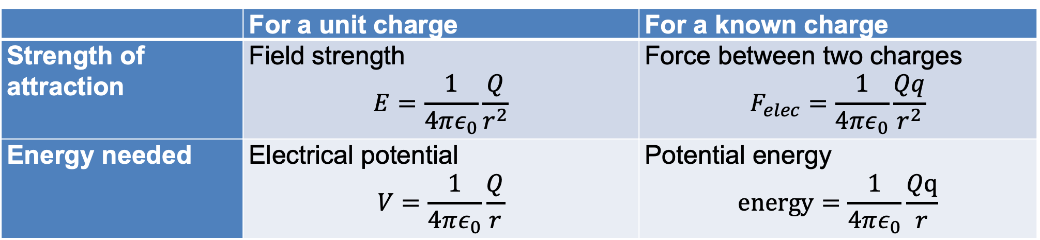
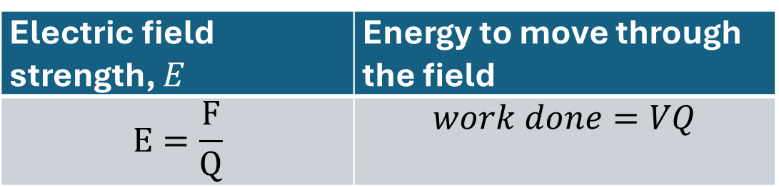
All equations
Electric field strength, $E$ | Energy to move through the field
$$E=\frac{F}{Q}$$ | $$work done=VQ$$
Electric field strength, $E$
$$E=\frac{V}{d}$$
Between parallel plates:
 | For a unit charge | For a known charge
Strength of attraction | Field strength $$E=\frac{1}{4πε_{0}}\frac{Q}{r^{2}}$$ | Force between two charges $$F_{elec}=\frac{1}{4πε_{0}}\frac{Qq}{r^{2}}$$
Energy needed | Electrical potential $$V=\frac{1}{4πε_{0}}\frac{Q}{r}$$ | Potential energy $$energy=\frac{1}{4πε_{0}}\frac{Qq}{r}$$

Slide 50
Magnetic fields

Slide 51
What physical property causes this field?
Charge?
Intrinsic Magnetic Moment
It is mediated through photons.

Slide 52
Resource design challenge
“Edutainment” videos are popular, common, and used by students.
Resource design challenge: https://www.youtube.com/watch?v=1TKSfAkWWN0
For either: Y10 taste of A Level, or Y13 Electromagnetism

Slide 53
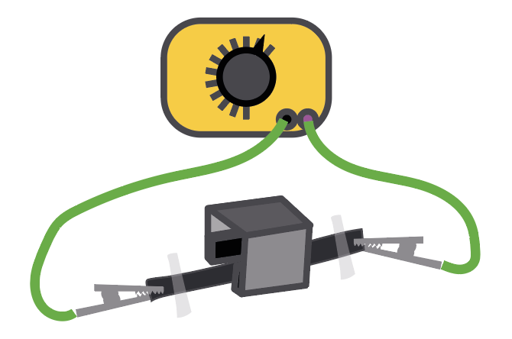
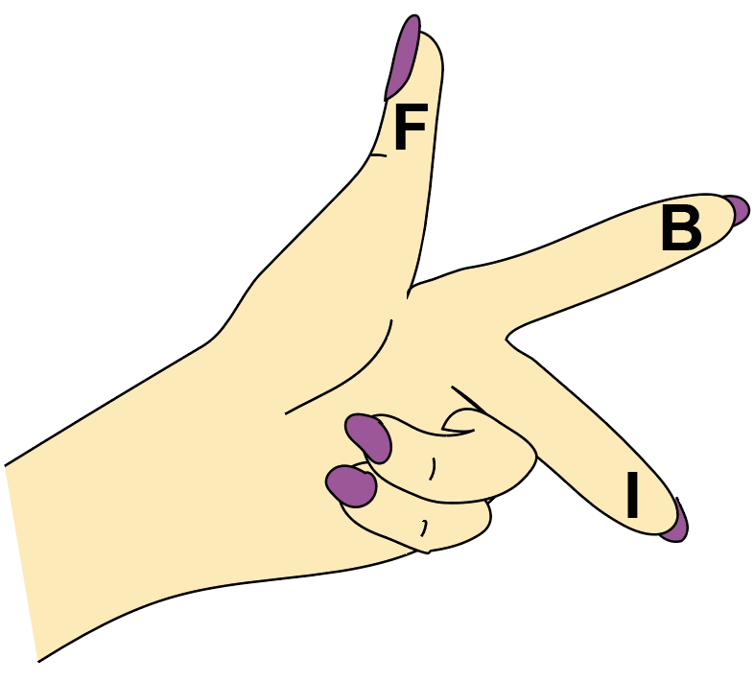
Fleming’s Left-Hand Rule
Images created by Alan Denton
Notes:
Imag

Slide 54
Lorentz Force
F = BILsinθ
BIL and BeV?
https://www.walter-fendt.de/html5/phen/lorentzforce_en.htm

Slide 55
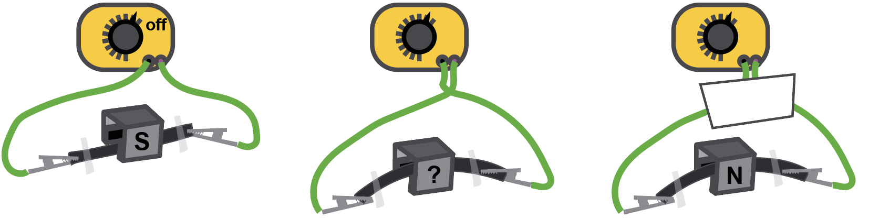
Wire moving in a magnetic field
Images created by Alan Denton
Notes:
Here, we can ask students to do a little bit of assessment for learning on each other, by setting up the apparatus in three different ways.
Firstly, you can show the directions of the magnetic field, and the direction of the current, and ask each other to determine the direction it will move.
Or, you can show the direction it moves, and the direction of the current, and ask each other to infer the direction of the magnetic field.
Finally, you can hide the wires, so it’s not obvious which direction the current is flowing, and ask each other to work that out.

Slide 56

Inducing a current
How can we generate more current?
Faster
More loops
Bigger magnet
Images created by Alan Denton

Slide 57

Magnetic field around a wire
Coming towards you
Heading away from you
Can represent field lines, direction of current, etc.

Slide 58
What’s wrong with this diagram?
Put your right thumb in the direction the current is flowing.
Your fingers ‘wrap’ in the direction of the magnetic field.
The magnetic field is stronger close to the wire (so the rings are closer).
Current carrying wire
going into page
Notes:
This is badly drawn diagram on purpose. It gives participants a chance to interpret the corkscrew rules before revealing a good example of the diagram.

Slide 59
Corkscrew rule
Put your right thumb in the direction the current is flowing.
Your fingers ‘wrap’ in the direction of the magnetic field.
The magnetic field is stronger close to the wire (so the rings are closer).

Slide 60
Motion
Jackie Flaherty
Jed Marshall

Slide 61
Motion
Building links
Types of motion?
Linking particles and motion?
Notes:
Expected types of motion for different scenarios.

Slide 62
Types of motion
Linear motion
1D – same direction
2D – at angle to direction (projectile motion)
Circular motion
2D - constant force
2D – possibility of angles to direction

Slide 63
Prior knowledge
Before teaching Projectile Motion, students should know the following:
how to take use simple trigonometry – both in terms of how to apply it, and how to use their calculator;
what acceleration is, and how to perform calculations using ‘suvat’;
that displacement, velocity, and acceleration are vectors.
Symbol | Variable | Unit
s | displacement | m
u | initial velocity | m/s
v | final velocity | m/s
a | acceleration | m/s²
t | time | s

Slide 64

When do we use this equation?
$$speed=\frac{distance}{time}$$
At a constant speed or to calculate an average speed

Slide 65

When do we use these equations?
$$s=\frac{1}{2}\left(u+v\right)t$$
$$s=ut+\frac{1}{2}at^{2}$$
$$a=\frac{v−u}{t}$$
$$v^{2}=u^{2}+2as$$
When there is a constant acceleration

Slide 66

Example question
$$s= \frac{1}{2}\left(u+v\right)t$$
An eagle swoops from $10 m/s$to $40 m/s$, over $10 s$. How far does it travel during this time?

Slide 67

Example question
$$v^{2}=u^{2}+2as$$
A lion accelerates from $3 m/s$ to $5 m/s$ at a constant rate of $4 m/s^{2}$. How far does it travel during this time?

Slide 68


A ball kicked up at an angle $45 °$ moves through a parabola

Slide 69

Ignoring air resistance, what are the forces acting at A, B, C, D, E?

Slide 70

How do the velocities change?
Notes:
Using two colours to show clearly that horizontal and vertical are being considered completely separately.
Horizontal does not change because no horizontal resultant force.
Vertical does change due to force due to gravity.

Slide 71
Consider the two components
$$v_{horizontal}$$ | $$v_{vertical}$$
There is no force and therefore no acceleration. | The only force is the weight, this is acting downwards. The only acceleration is therefore that due to gravity: $$a=−9.8 m/s^{2}.$$
We can use $speed=\frac{distance}{time}$ | We can use the equations of motion for a uniformly accelerated object, SUVAT.

Slide 72

Example problem
A ball is kicked up at an angle of $55 °$, with a velocity of $27 ms^{−1}$.
Ignoring air resistance, how far will it travel before it lands.
$$27 ms^{−1}$$
$$55 °$$
Notes:
If you have time it is worth asking students to calculate their answers first before you reveal the answers/method.
The first one is the classic projectile motion question.

Slide 73
Example problem
$$27 ms^{−1}$$
$$55 °$$
Starting conditions
Time for vertical movement
Distance for horizontal travel
$$v_{horizontal}=v cos\left(θ\right)=27\cos\left(55\right)=15.5 ms^{−1}$$
$v_{vertical}=v sin\left(θ\right)=27\sin\left(55\right)=22.1 ms^{−1}$
$$v=u+at$$
$$(time to apex)$$
$$0=22.1−9.81 t$$
$$t=2.25 s$$
$$total time of flight=2.25 × 2=4.51 s$$
$$displacement_{horizontal}=v_{horizontal} × time of flight =15.5 × 4.51=70 m$$

Slide 74
Circular Motion
You have the following:
Rubber bung
String
Metal straw
Marbles
Select a random amount of marbles – keep this secret. Get into order.

Slide 75



$$F_{centripetal }=\frac{mv^{2}}{r}$$
There are many things you can investigate using this:
keep $r$ constant, change $F$ (by changing the weight pulling down), measure $v;$
keep $F$ constant, change $v$ and measure $r$.;
use a range of mystery weights, and get students to put them in order by spinning (my favourite).
Notes:
We have demonstrated just one way that we can do investigations using the spinner, but there are others listed here.

Slide 76

Centripetal force
$$F=\frac{mv^{2}}{r}$$
This only describes what size force is needed to make things move in a particular circle at a given speed… it does not tell us what the force actually is!
Notes:
Many students believe that centripetal force is a new force, just like attention, or reflection. It’s not, it’s a mathematical description of the size of force needed to move something in a circle. That force however, will be provided by some other real force.

Slide 77




What forces can make things move in a circle?
Tension
Electrostatic attraction
Gravitational attraction
Friction
Notes:
Here are some of the examples of forces that can actually cause something to move in a circle:
Tension Electrostatic
Gravitational Friction

Slide 78
What forces can make things move in a circle?
$$F_{electrostatic}=\frac{q_{1}q_{2}}{4πε_{0}r^{2}}$$
$$F_{tension}$$
$$F_{gravitational}=\frac{{Gm}_{1}m_{2}}{r^{2}}$$
$$F_{friction}$$

Slide 79

Maths tells us
$F_{centripetal }=\frac{mv^{2}}{r}$
When combined with the physics behind the forces we can learn many things
For example…
$$F_{centripetal }=\frac{m_{earth }v^{2}}{r}=F_{gravity }=\frac{Gm_{sun }m_{earth }}{r^{2}}$$

Slide 80


Slide 81

Shutter speed: 1/37 second
This means the camera is capturing “light” for 1/37 of a second.
Radius from centre of drill to lit sparkler: 15 cm
Calculate RPM of drill
Approx 90 degrees

Slide 82
Particles – fields and motion
Jackie Flaherty
Jed Marshall

Slide 83
Which fields - proton
Which fields will “affect” a proton, why?
How will they affect a protons motion.
Relate to particle beam.

Slide 84
Charged particle in fields
https://ophysics.com/em6.html
https://ophysics.com/em7.html

Slide 85
Proton in a Uniform Electric Field – Linear Acceleration
Two parallel plates create a uniform electric field.
Proton starts at rest near the positive plate and is accelerated toward the negative plate.
Force on proton: 𝐹=𝑞𝐸 F=qE (constant, because E is uniform).
Acceleration: 𝑎=𝐹/ 𝑚=𝑞𝐸/𝑚 (constant).
Motion is linear along the field lines — displacement follows 𝑠=𝑢𝑡+0.5𝑎𝑡²
Kinetic energy gained comes from the work done by the electric field: qV = 0.5mv²

Slide 86
Proton in Electric and No-Field Regions – Projectile Motion
Proton enters a region between plates with initial horizontal velocity
.Electric field between plates produces a vertical acceleration (just like gravity in projectile motion).
Horizontal motion: constant velocity (no horizontal force).
Vertical motion: constant acceleration

Slide 87
Magnetic field on moving charges
+
Imagine a proton moving to the right, passing into a magnetic field going into the page.
Notes:
Animated
We are not doing this in detail. As it stands, we don’t even mention the equation $F=Bqv$, but it could be added if you have time.

Slide 88
Magnetic field on moving charges
-
What about an electron moving to the right, with the magnetic field coming out of the page.

Slide 89
Application
Jackie Flaherty
Jed Marshall

Slide 90
Linear Accelerator
Marbles and straws!

Slide 91
Linear Accelerator
You have been provided with infinite amounts of tubing, an AC supply (which outputs square wave, 50kHz at 1000 V) and a source of slow-moving electrons.
Task: Design a linear accelerator which could accelerate protons to 90% the speed of light (ignoring relativistic effects).
How long would the first tube be? How many tube sections would you need? Roughly how long do you think your accelerator would be?

Slide 92

Linear Accelerator - Assumptions
CC3.0 https://commons.wikimedia.org/wiki/File:Wideroe_linac_en.svg
Notes:
Small gap – quick acceleration.
Zero field in cylinder.
Use velocity

Slide 93
Given Values
Frequency f = 50 kHz → half-period t = 1/(2f) = 10 μs
Proton charge q = 1.602 × 10⁻¹⁹ C
Proton mass mₚ = 1.673 × 10⁻²⁷ kg
Speed of light c = 2.998 × 10⁸ m/s
Gap voltage per stage V = 1,000 V

Slide 94
Step 1: Speed after n gaps
Energy after n gaps:
E= nqV
Non-relativistic kinetic energy:
E = ½ mₚ vₙ²
Therefore: vₙ = (2nqV / mₚ)^{0.5}

Slide 95
Step 2: Length of the n^{th} tube
Lₙ = vₙt = t(2nqV / mₚ)^{0.5}

Slide 96
Bubble Chamber Detective

Slide 97

Bubble chamber
The photograph shows 7 kaons entering a bubble chamber from the bottom. There is a uniform magnetic field directed into the page.
Figure from bubble chamber, credit: CERN

Slide 98
*01. The kaon trails are curving slightly to the right. What is the charge of the kaons?
a) -1
b) +1
c) 0
d) Not enough information
VOTE!

Slide 99
02. At point P the single trail of a kaon branches into two trails. What is the charge of the particle on the right?
a) -1
b) +1
c) 0
d) Not enough information

Slide 100
*03. Compare the total charge going into point P with the total charge going out. The single charged kaon… [hint]
a) has decayed into two oppositely charged particles.
b) has decayed into two identically charged particles.
c) has interacted with a proton and produced two oppositely charged particles.
d) has interacted with a proton and produced two identically charged particles.

Slide 101
*04. Compare the tracks going into point P with the tracks going out. What can you infer?
a) A charged particle has been produced that moves up and to the left.
b) A charged particle has been produced that moves up and to the right.
c) A neutral particle has been produced that moves up and to the left.
d) A neutral particle has been produced that moves up and to the right.

Slide 102
*05. There is a kink in the track at point T. The particle making the track has
a) interacted with a neutral particle.
b) interacted with a positively charged particle.
c) decayed into a positively charged particle and a neutral particle.
d) decayed into a negatively charged particle and a neutral particle.

Slide 103
06. There is a very slight kink in the track at point R as the curvature increases. The particle making the track has
a) interacted with a neutral particle.
b) interacted with a positively charged particle.
c) decayed into a positively charged particle and a neutral particle.
d) decayed into a negatively charged particle and a neutral.

Slide 104
*07. The two charged particles that appear at point S pass by each other at point U. Draw a straight line from this intersection to point S, where the particles were created from a neutral particle. This line gives the direction of the original neutral particle. Extend the line back down the page. Where did the neutral particle originate?
a) at point P
b) at point Q
c) at point R
d) Not enough information

Slide 105
08. Two new particles appear at point Q. What can we infer about the event happening at point Q?
a) A stationary charged particle has decayed into two new particles.
b) A stationary neutral particle has decayed into two new particles.
c) A charged particle moving up and to the left has decayed into two new particles.
d) A neutral particle moving up and to the left has decayed into two new particles.

Slide 106
09. Extend the curved trails from point Q to find their intersection point by tracing the existing curve onto another piece of paper and using this to extend the path. Where did the neutral particle that decayed to form these particles originate?
a) at point P
b) at point Q
c) at point R
d) not enough information

Slide 107
Summarize the whole picture!
… 7 kaons (K⁻)entering a magnetic field directed into the page…
K⁻ interacted with p ➔

Slide 108
μ-
υ⁰
π⁻
p
Λ⁰
K-
π⁻
p
p
K⁰
K⁺
Ω⁻
K-

Slide 109
μ-
υ⁰
π⁻
p
Λ⁰
K-
π⁻
p
p
K⁰
K⁺
Ω⁻
K-

Slide 110
Design Challenge
Magento Hydro Dynamic Drive

Slide 111
Jed Marshall
jmarshall@alexandrapark.school

