Slide 1

ECR/Documents for Information and Approval
Giulia Romagnoli and Natalya Kahn for BE-EA, 2025-01-21
EA Documents - Agile Board - CERN Central Jira

Slide 2
LIST OF DOCUMENTS for Info
FOR INFORMATION EATM
Summary | Reporter | EA Projects | EDMS number | EDMS Status
Integration Study of the Cooling Cells Demonstrator in TT7 | Lukasz Krzempek | Experimental Areas | 3200071 | Released
Procedure to Follow in the Event of a Broken Beryllium Window on the HiRadMat Dump | Nicola Solieri | HiRadMat | 3136124 - HRM-T-SYP-0001 | Engineering check
Seismic Risk Assessment of a Shielding Block Configuration in EHN1 - PPE144 Bridge Shielding Modification | Tiago Nico | North Area | 3212641 - SPSX-K-SSR-0002 | Engineering check
Impact of HI-ECN3 on NA-CONS Phase 1 in TCC2, BA80 & P4 | Dipanwita Banerjee | North Area | 3172465 - SPSX-PM-MEMO-0003 | Under Approval

Slide 3
LIST OF DOC for FUTURE APPROVAL
ECR INFO/FUTURE APPROVAL EATM
Summary | Reporter | EA Projects | EDMS number | EDMS Status
Low-energy Beams in the T10 Beamline of the East Area | Maarten Van Dijk | East Area | 3174332 – PSZ-L-EC-0003 | In Work
Creation of New Lorry and Personnel Doors in Building 911 | Jean-Louis Grenard | North Area, HI-ECN3 | 3173295 – SPSX-J-EC-0008 | Engineering check
GIF++ extension | Martin Jaekel | North Area | 3223563 - SPSX-J-EC-0011 | In Work
GIF++ gas balcony | Sylvain Girod | North Area | 3214920 - SPSX-J-EC-0010 | Engineering check
Installation of a New Hydrogen Buffer outside EHN1 for the NA61/SHINE Experiment | Bartosz Maksiak | North Area | 3197663 – SPSX-J-EC-0009 | In Work
Move XFFH022.489 | Nikos Charitonidis | North Area |  | In Work
Install 2nd CEDAR on H6 | Miguel Santos | North Area |  | In Work
User Requirement for the XABS Absorbers in M2 Line in North Area | Dipanwita Banerjee | North Area | 3012379 – SPSX-T-ES-0007 | Under Approval
Additional Platform above ALPHA Local Control Room in AD Hall | Francois Butin | AD | 2897943 – AD-LJ-EC-0023 | Engineering check

Slide 4
LIST OF DOCs for APPROVAL
ECR APPROVAL EATM
Summary | Reporter | EA Projects | EDMS number | EDMS Status
AUG installation EHN2+ AUL removal EHN1, GIF++/H8 and EHN2/M2/BA82 | Marcin Szewczyk | North Area | 3178530 - SPSX-SF-EC-0016 | Under Approval
Asset Replacement Request – Replacement/Installation Tables XTDV.041.528, XTDV.042.500, XTDV.021.612 | Miguel Santos | North Area | 3168393 – SPSX-H-ARR-0001 | Under Approval

Slide 5
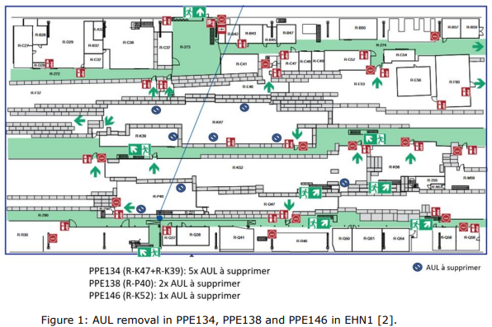
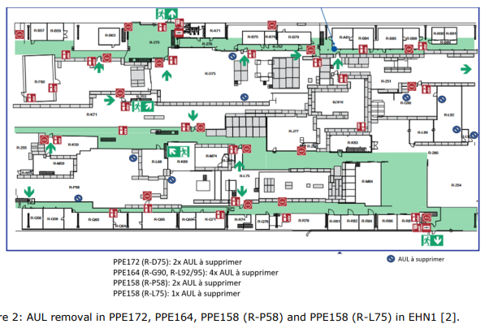
ECR for Approval
SPSX-SF-EC-0016
Version 0.2
AUG installation EHN2+ AUL removal EHN1, GIF++/H8 and EHN2/M2/BA82
By Marcin Szewczyk
“Arrêts d’urgence locaux” (AUL) will be removed from EHN1 and EHN2 and its security function will be replaced by existing “arrêts d’urgence généraux” (AUG). In EHN2, new AUG buttons will be added.
In line with the strategy agreed with HSE, EP, EN-EL and BE-EA, AULs are being removed and replaced by AUGs. In EHN1 and EHN2 in particular, this is due to faulty MN coils and non-compliance with IS-5 requirements. Obsolete NANO PLC systems will also be removed.

Slide 6
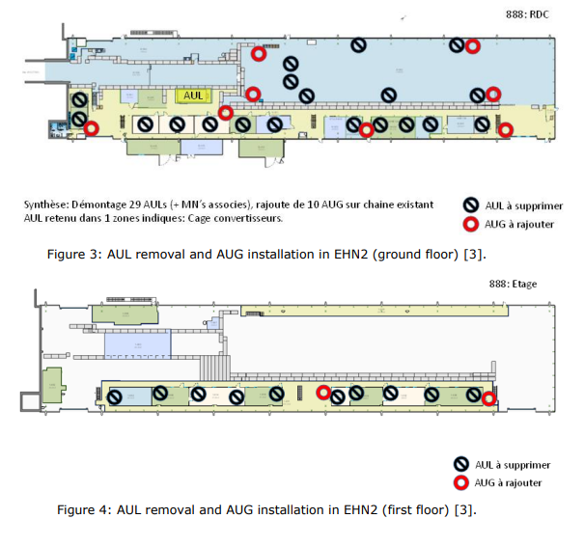
ECR for Approval
SPSX-SF-EC-0016
Version 0.2
AUG installation EHN2+ AUL removal EHN1, GIF++/H8 and EHN2/M2/BA82
By Marcin Szewczyk
In EHN2, one AUL zone will be retained (marked in Figure 3).
The short power cuts needed to remove MN coils may affect AMBER equipment operation in EHN2.

Slide 7
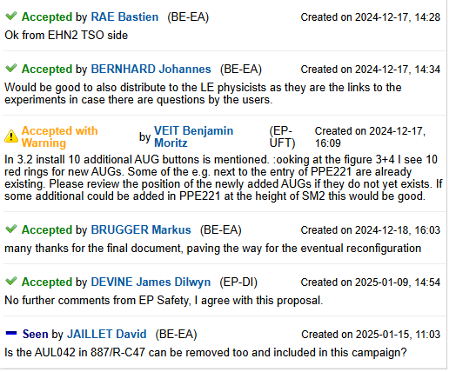
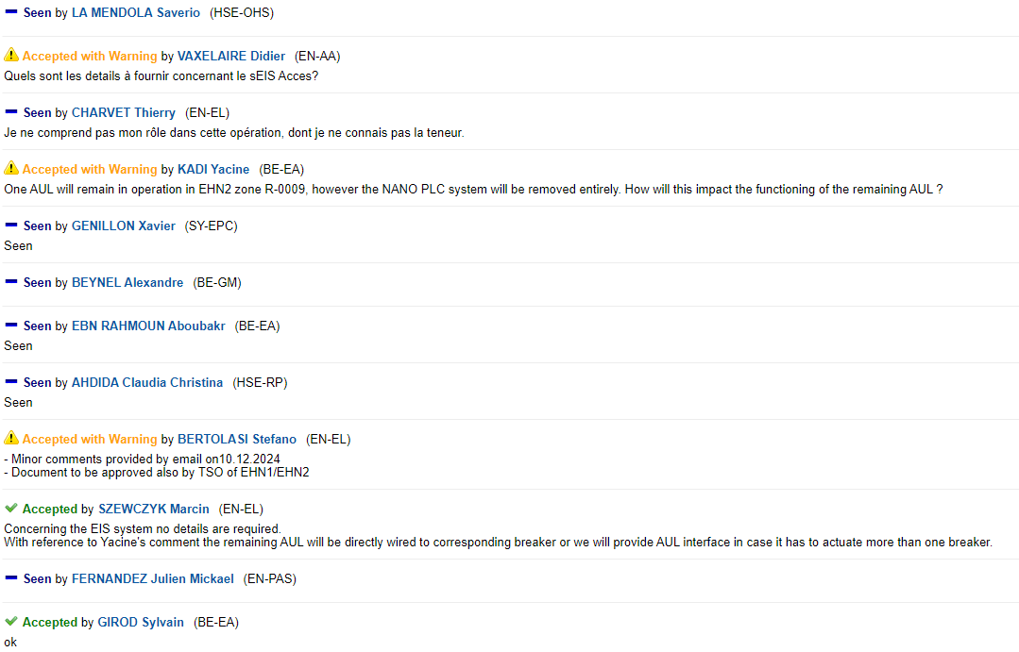
ECR for Approval
SPSX-SF-EC-0016
Version 0.2
AUG installation EHN2+ AUL removal EHN1, GIF++/H8 and EHN2/M2/BA82
By Marcin Szewczyk
Seeking approval from EATM

Slide 8
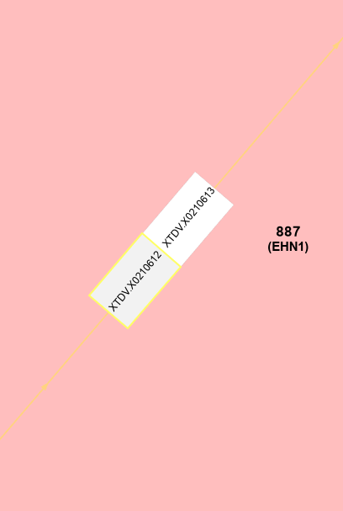
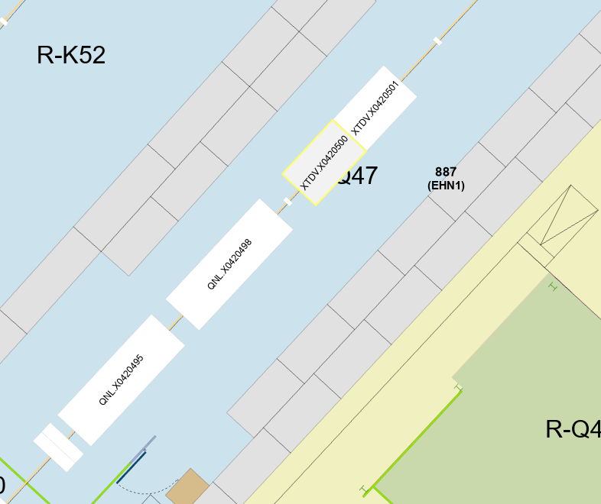
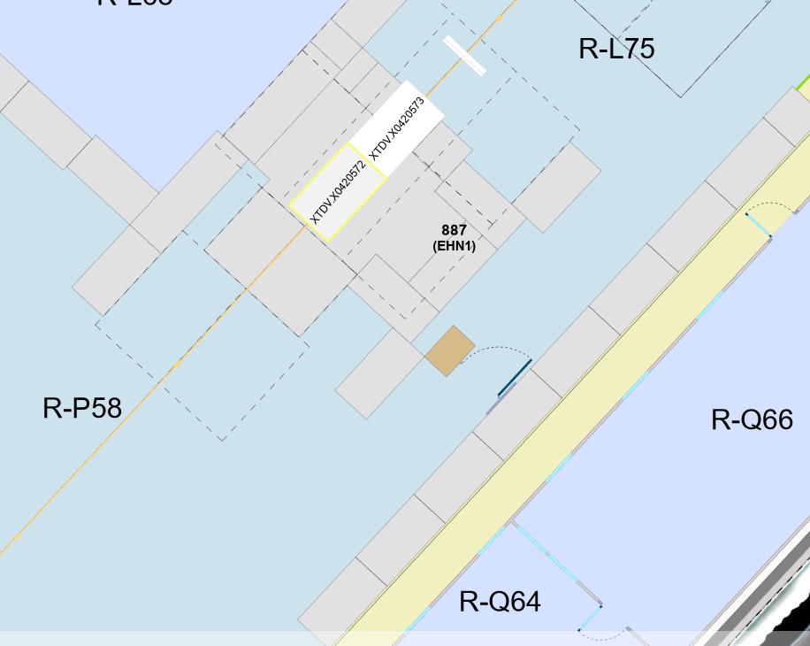
ARR for Approval
SPSX-H-ARR-0001
Version 0.1
Asset Replacement Request – Replacement/Installation Tables XTDV.041.528, XTDV.042.500, XTDV.021.612
By Miguel Santos
XTDV.041.528, XTDV.042.500 and XTDV.021.612 must be replaced for operation.

Slide 9
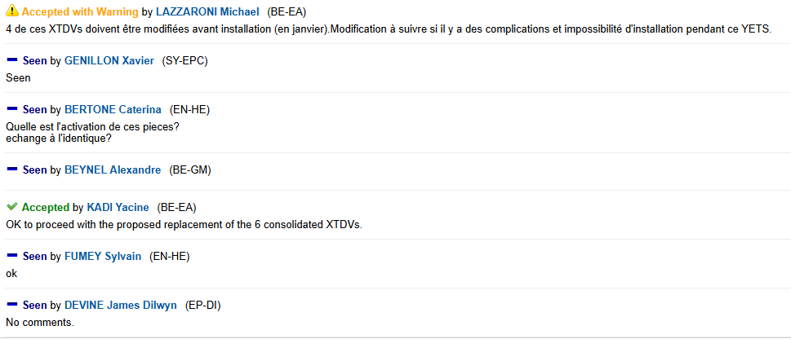
ARR for Approval
SPSX-H-ARR-0001
Version 0.1
Asset Replacement Request – Replacement/Installation Tables XTDV.041.528, XTDV.042.500, XTDV.021.612
By Miguel Santos
Seeking approval from EATM

Slide 10
Thank you!

