Slide 1
Bond
CAD Design update
N.Peray
21/01/2025

Slide 2
40x1.1 cross section
40x1.1 layer jump geometry
Coil design status
Tooling design
Planning

Slide 3
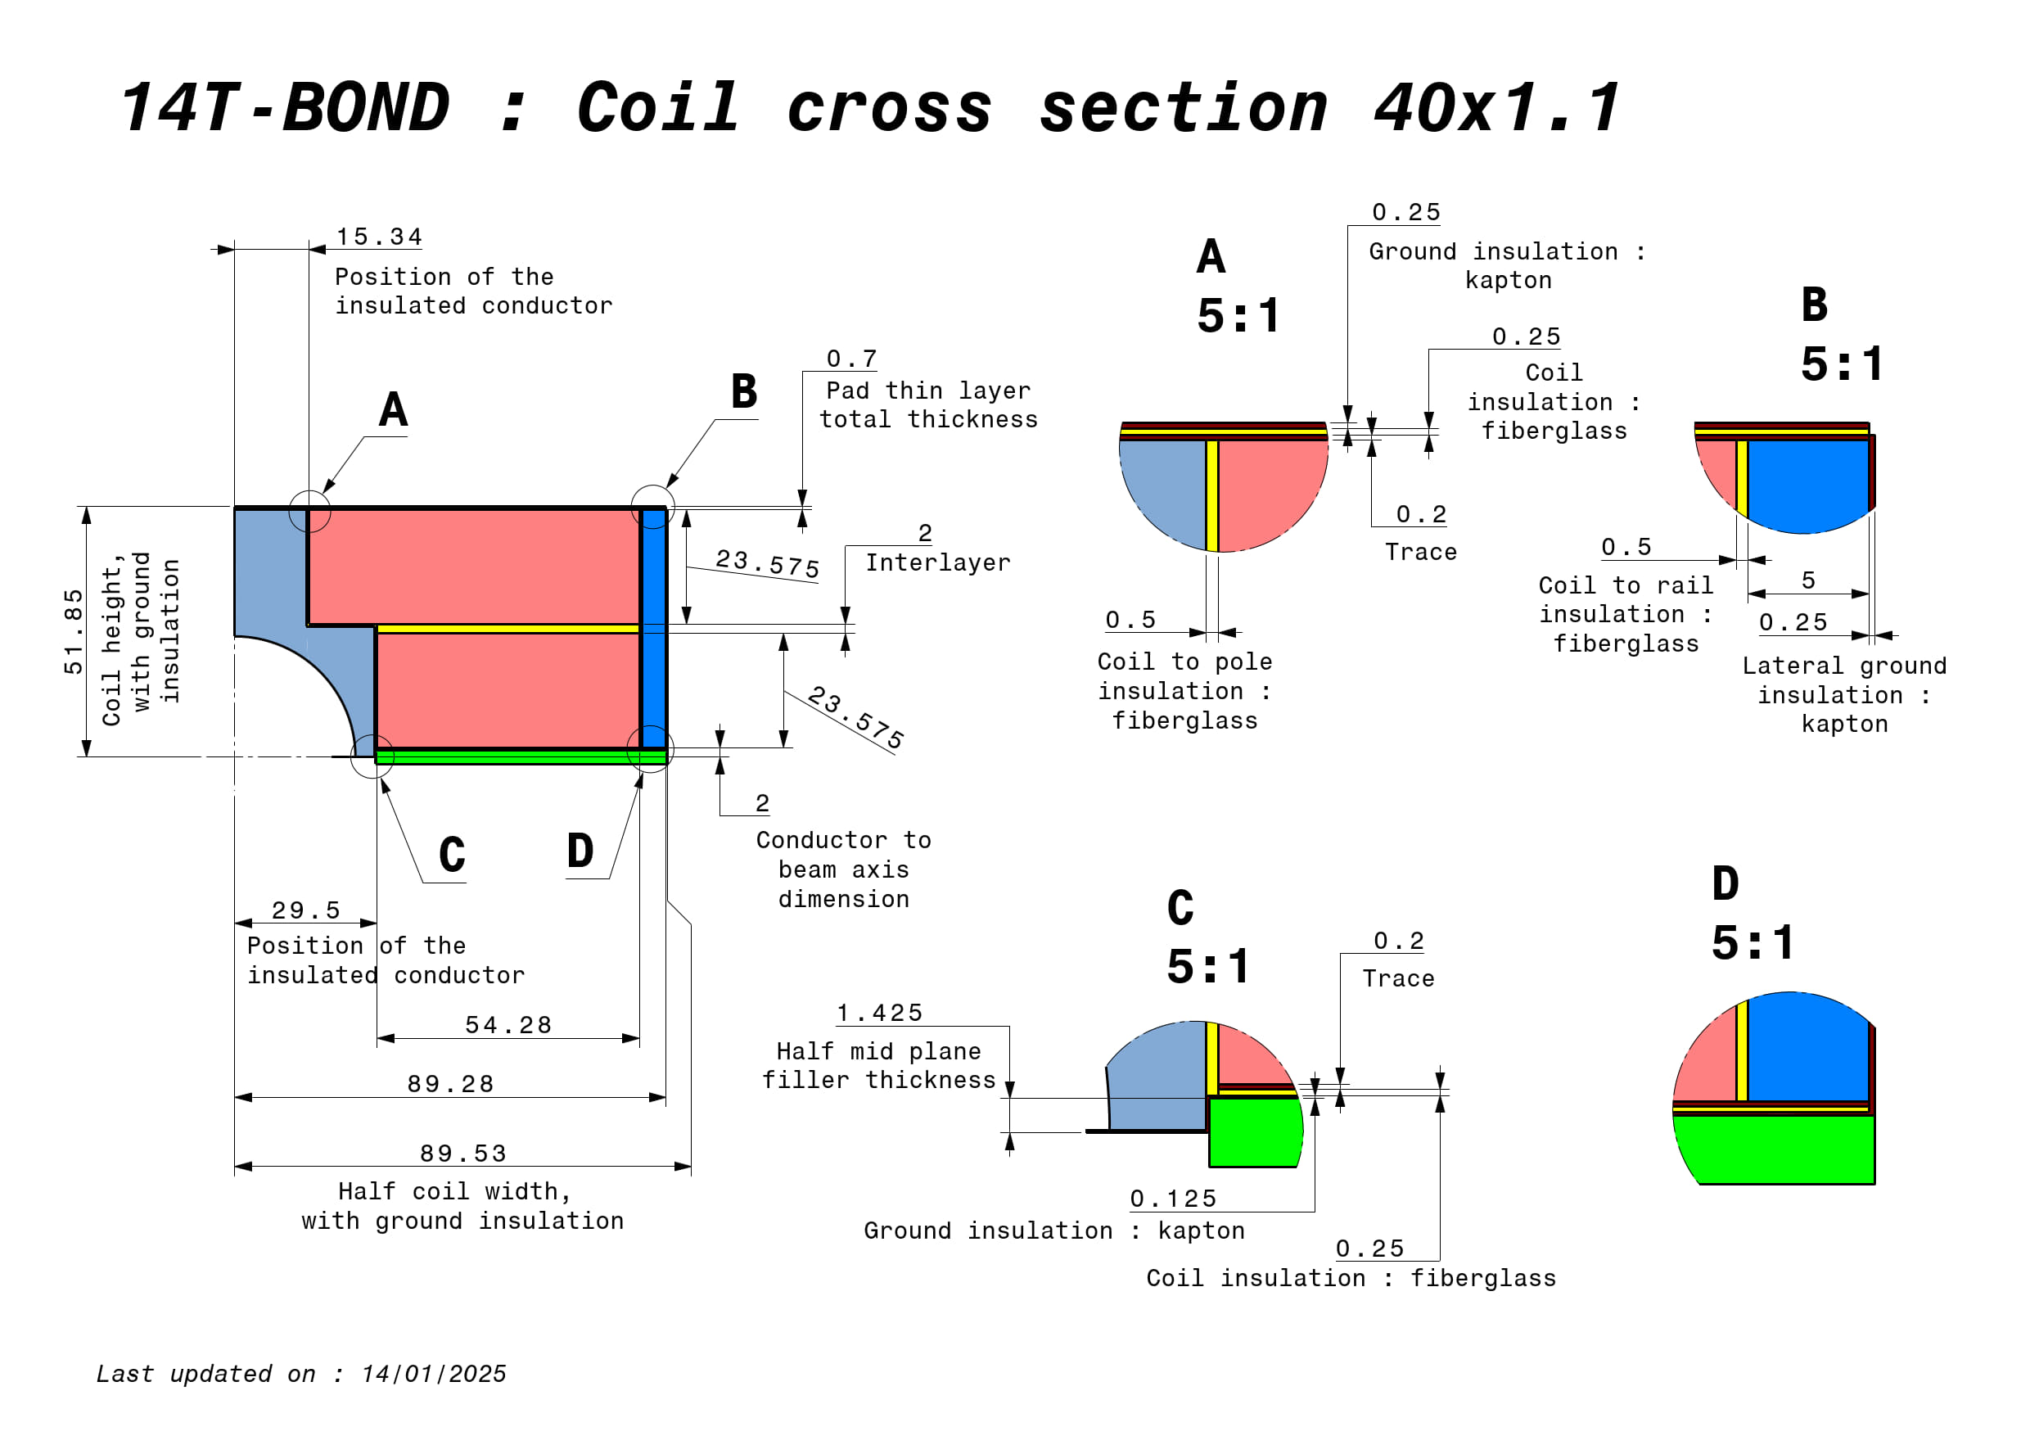
https://plm.cern.ch/p/CAD/number:ST2412841_02

Slide 4
40x1.1 cross section
40x1.1 layer jump geometry
Coil design status
Tooling design
Planning

Slide 5
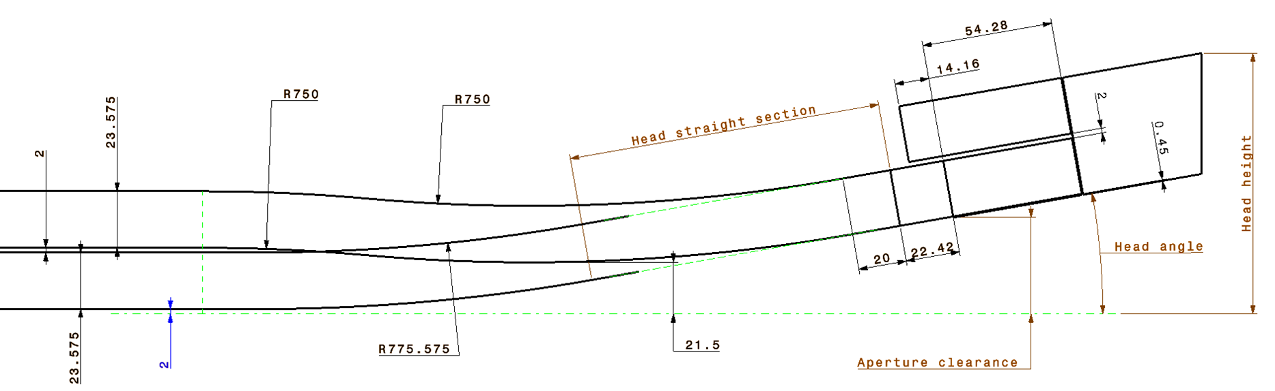
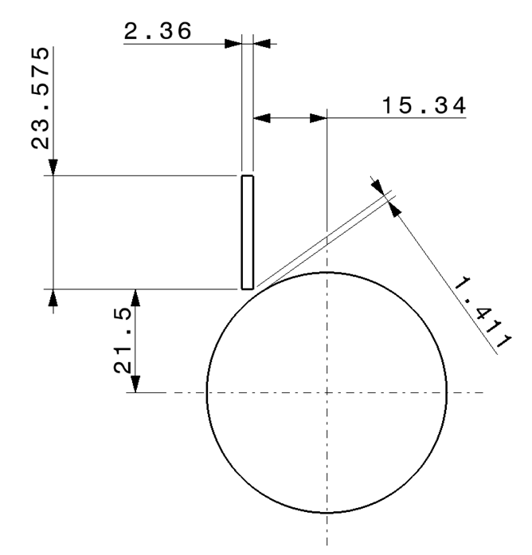
Layer jump geometry study
Lower layer cable stack (23x2.36)
Upper layer extra turn stack (6*2.36)
 | Double turn layer jump
Head angle | Overall head length | Head height | Apperture clearance | Head straight section length
° | mm | mm | mm | mm
4 | 480.6 | 82.9 | 25.9 | 298.7
5 | 436.1 | 86.6 | 27.7 | 242.6
6 | 414.2 | 90.6 | 29.7 | 205.2
7 | 400.8 | 94.7 | 32.0 | 178.4
8 | 394.0 | 99.2 | 34.5 | 158.3
9 | 391.6 | 103.8 | 37.2 | 142.6
10 | 392.2 | 108.7 | 40.2 | 130.1
Layer jump transition bending radius
(29.5+15.34)/2
Parameter that could be changed if needed

Slide 6
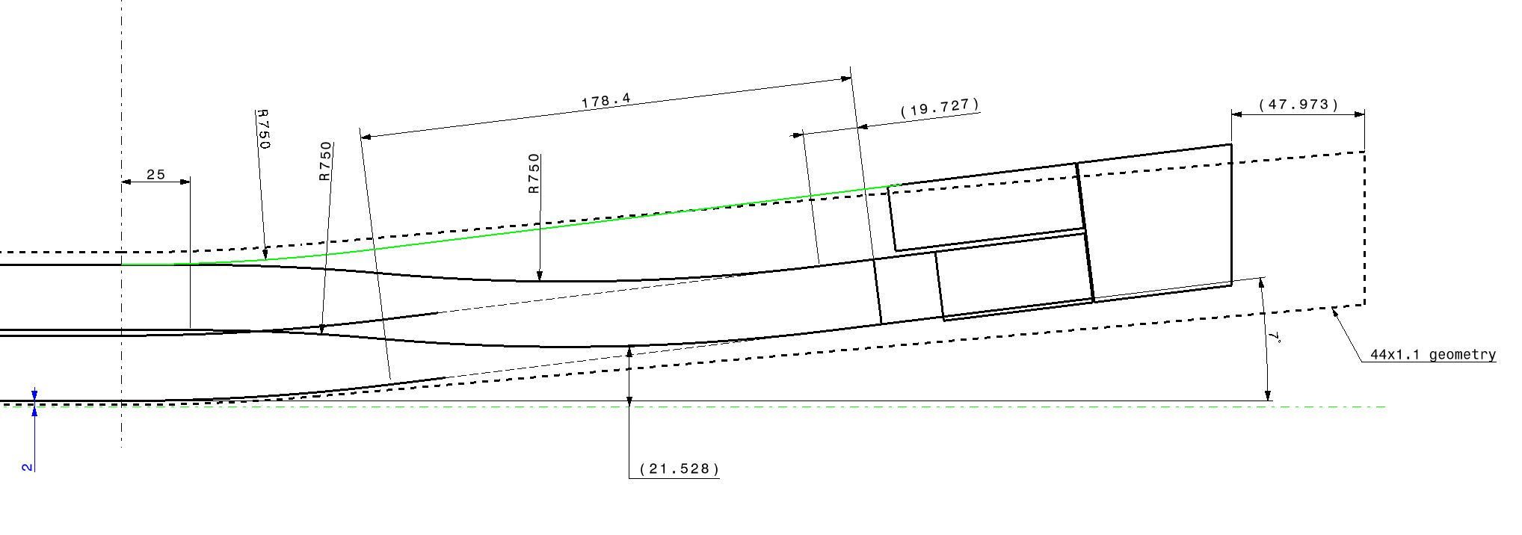
Layer jump final geometry
Pilot dimensions

Slide 7
40x1.1 cross section
40x1.1 layer jump geometry
Coil design status
Tooling design
Planning

Slide 8
Coil CAD design
Most of the component are designed
Next step : insulation detailed layers
Open question :
1) Side rails : Should the side rails cover the head spacer on the non-connection side ?
2) Lead : what NbTi cable will we use?

Slide 9
40x1.1 cross section
40x1.1 layer jump geometry
Coil design status
Tooling design
Planning

Slide 10
Coil fabrication tooling CAD design
Reaction tool detailed design can start even without knowing which guiding solution we will use.
Impregnation mold detailed design can start, if we all agree on the concept.

Slide 11
40x1.1 cross section
40x1.1 layer jump geometry
Coil design status
Tooling design
Planning

Slide 12
Planning
Coil component and tooling design
Coil component and tooling fabrication
First winding
January | February | March | April | May | June | July | August | September
Drawing “released”
Estimated time
 | CAD | Drawing | sub total
 | Days | Days | Days
Impregnated coil | 5 | 8 | 13
Reacted coil | 8 | 7 | 15
Winding | 6 | 6 | 12
Splicing | 4 | 6 | 10
Reaction | 10 | 10 | 20
Impregnation | 10 | 10 | 20
 |  | Total | 90 | Days
 |  |  | 18 | weeks
Optimistic time estimation
18 weeks of work (at least) to be fitted into 8 to 10 weeks.

Slide 13
Thanks for your attention

