Slide 1
2D Roxie magnetic model
Conductor

Slide 2

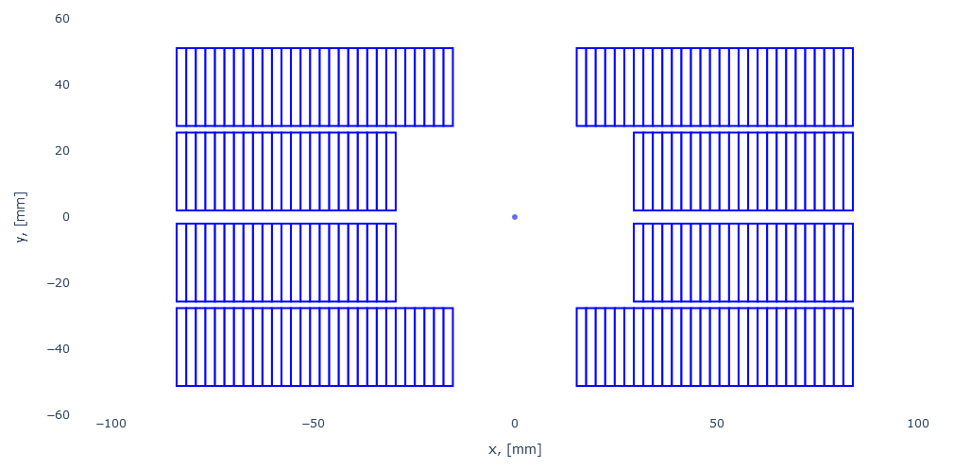
2D Roxie magnetic model
Insulated conductor coil
X = 15.34 mm
Y = 51.15 mm
X = 83.78 mm
Y = 51.15 mm
X = 15.34 mm
Y = 27.575 mm
X = 83.78 mm
Y = 27.575 mm
2.0 mm
X = 29.50 mm
Y = 25.575 mm
X = 83.78 mm
Y = 25.575 mm
4.0 mm
X = 29.50 mm
Y = 2.0 mm
X = 83.78 mm
Y = 2.0 mm
2.0 mm

Slide 3
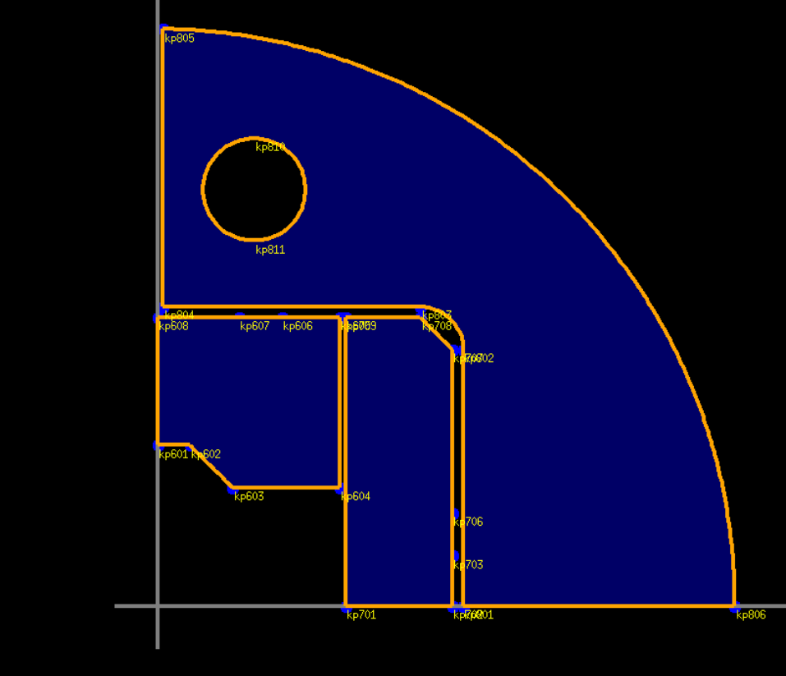
2D Roxie magnetic model
R=24
X0: 45
Y0: 195
R=270
R=20
86.905
15
25
140
135
25
57.85
50
89.53
144.53

Slide 4
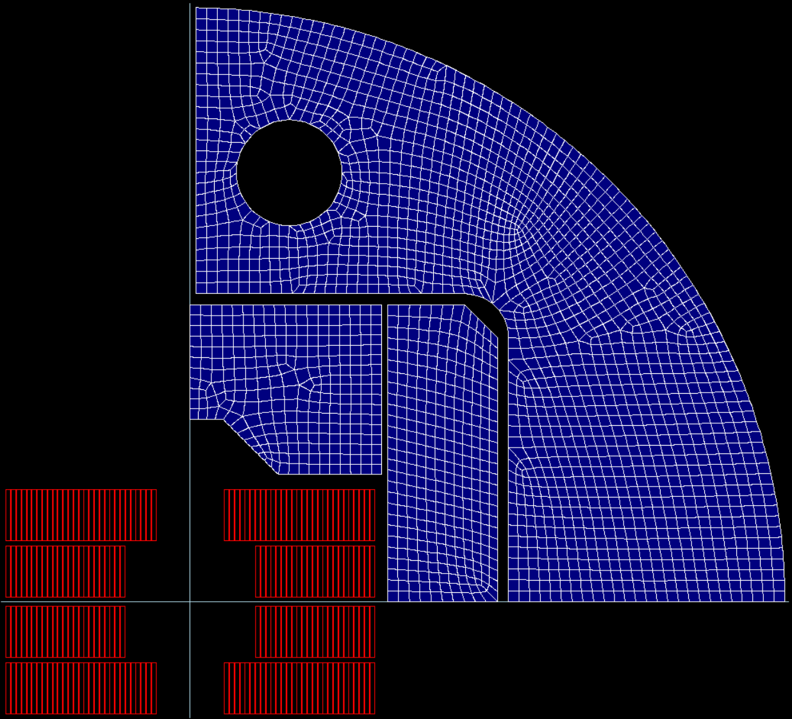
2D Roxie magnetic model
Mesh

Slide 5
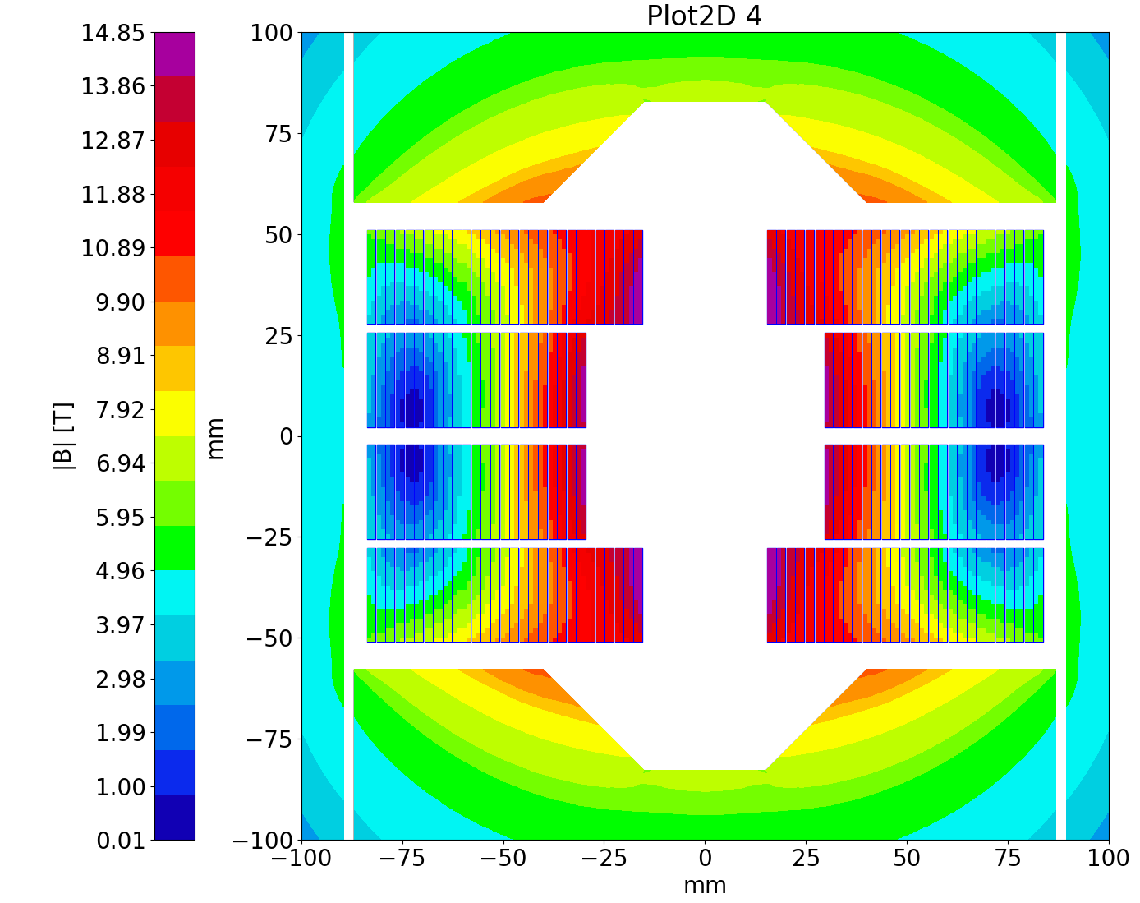
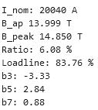

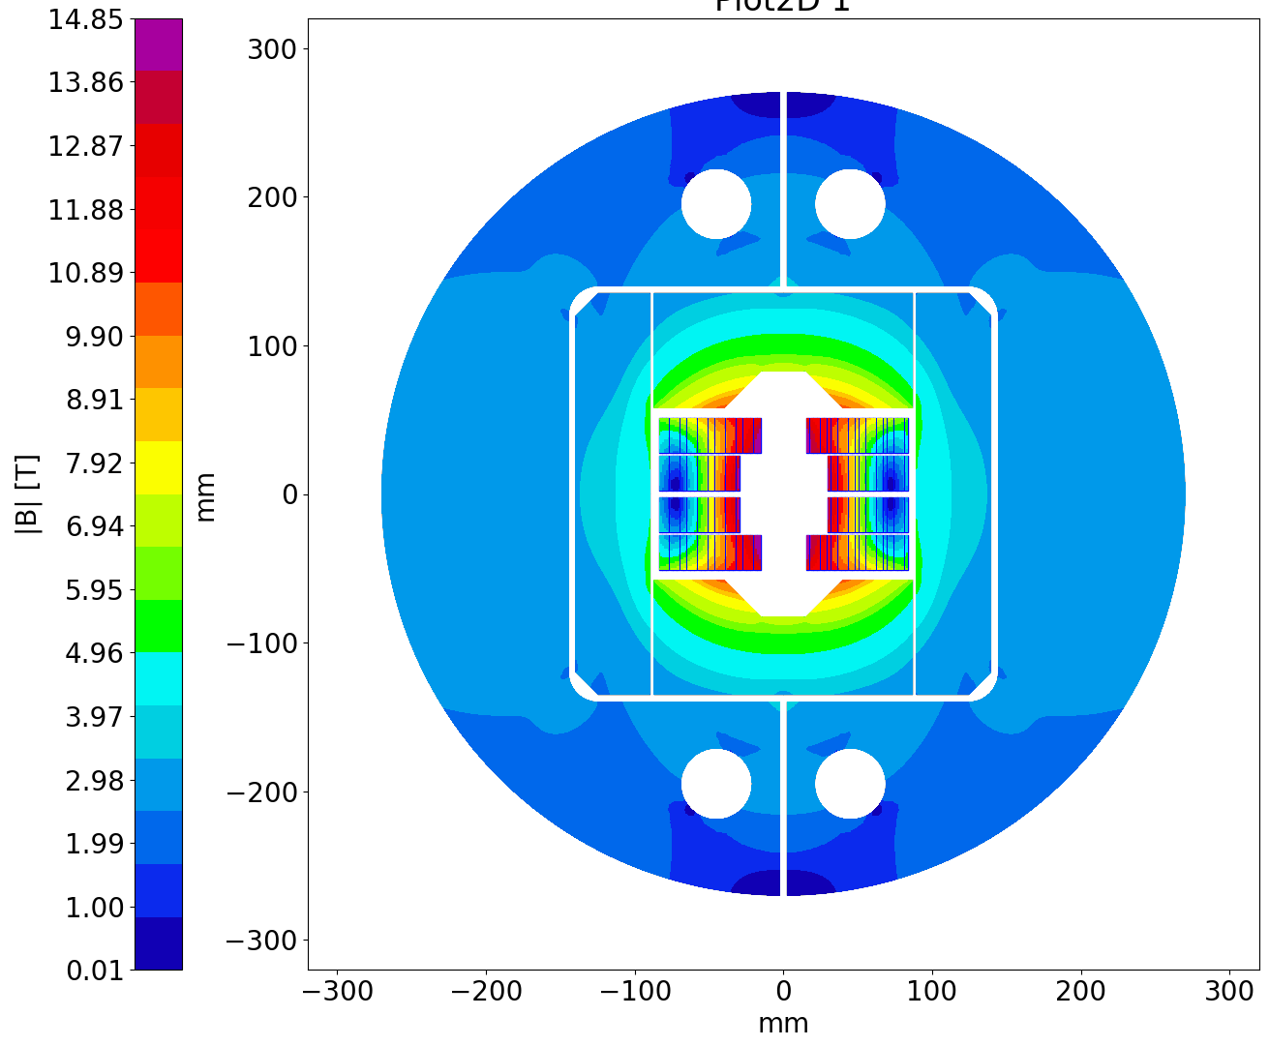
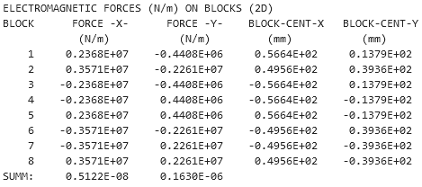
2D Roxie magnetic model

Slide 6
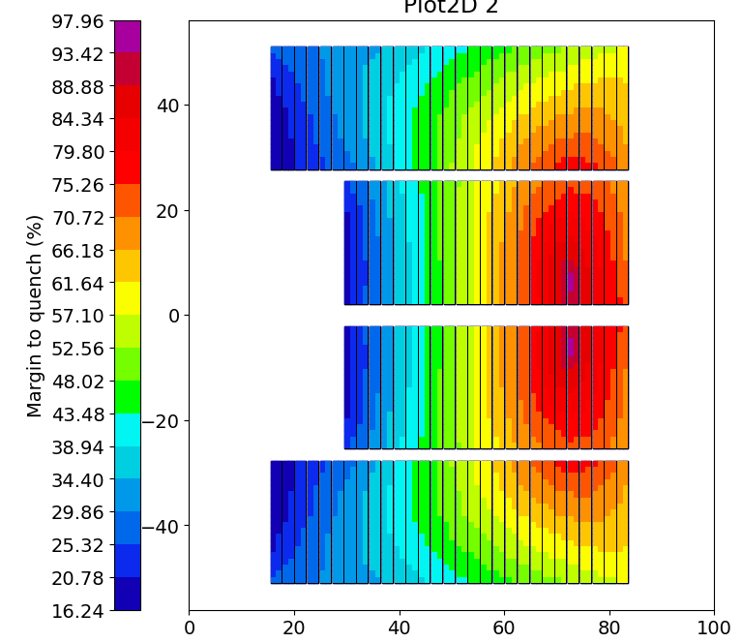
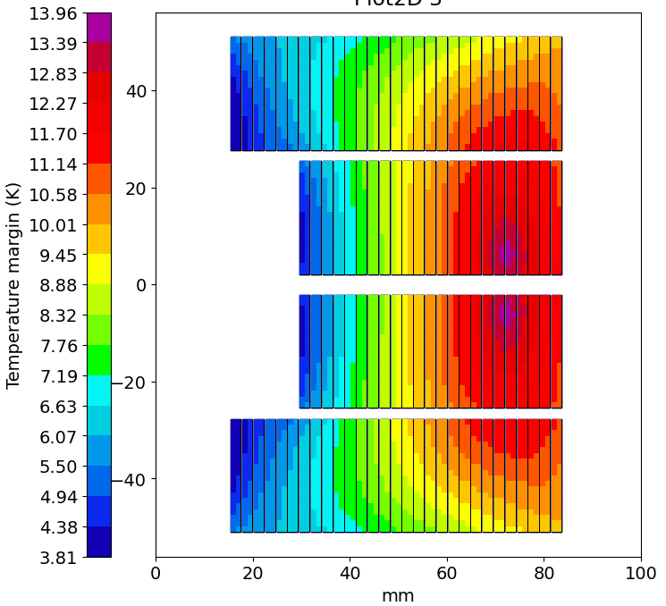
2D Roxie magnetic model

Slide 7
2D Roxie magnetic model

Slide 8
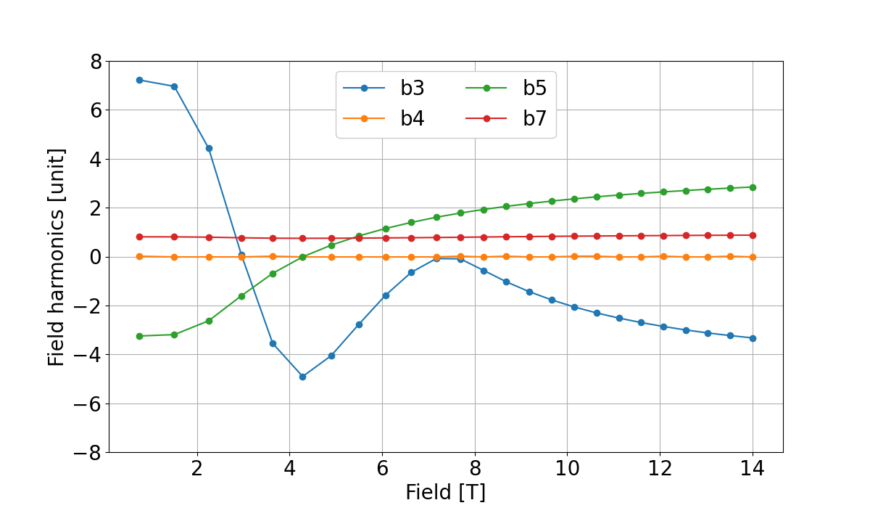
2D Roxie magnetic model
 | Current | Field | b3 | b4 | b5 | b7
0 | 1012.75 | 0.947432 | -4.97937 | 0.00E+00 | 0.098241 | 1.670289
1 | 2025.5 | 1.89003 | -5.36176 | -1.00E-09 | 0.361623 | 1.658117
2 | 3038.25 | 2.793089 | -7.0591 | 4.00E-09 | 1.484866 | 1.618708
3 | 4051 | 3.646638 | -8.45153 | 0.00E+00 | 2.617854 | 1.59978
4 | 5063.75 | 4.439872 | -5.3787 | 0.00E+00 | 3.371568 | 1.614647
5 | 6076.5 | 5.195366 | -1.51547 | 0.00E+00 | 3.931972 | 1.638507
6 | 7089.25 | 5.92393 | 1.923914 | 0.00E+00 | 4.372062 | 1.664129
7 | 8102 | 6.627591 | 4.620256 | 0.00E+00 | 4.726693 | 1.690591
8 | 9114.75 | 7.304855 | 6.557743 | 0.00E+00 | 5.026548 | 1.71853
9 | 10127.5 | 7.950086 | 7.420358 | -1.00E-09 | 5.278161 | 1.748724
10 | 11140.25 | 8.569847 | 7.590178 | 1.00E-09 | 5.494344 | 1.779553
11 | 12153 | 9.181582 | 7.711372 | 1.00E-09 | 5.684748 | 1.8078
12 | 13165.75 | 9.789683 | 7.843692 | 1.00E-09 | 5.851374 | 1.833146
13 | 14178.5 | 10.39514 | 7.988018 | 0.00E+00 | 5.997986 | 1.855959
14 | 15191.25 | 10.99875 | 8.134241 | 0.00E+00 | 6.127536 | 1.876549
15 | 16204 | 11.60088 | 8.276461 | 0.00E+00 | 6.242761 | 1.895219
16 | 17216.75 | 12.20175 | 8.412851 | 0.00E+00 | 6.345956 | 1.912224
17 | 18229.5 | 12.80166 | 8.54383 | 1.00E-09 | 6.438799 | 1.92776
18 | 19242.25 | 13.40075 | 8.671774 | 0.00E+00 | 6.522774 | 1.942005
19 | 20255 | 13.99921 | 8.798234 | -1.00E-09 | 6.599235 | 1.955106

Slide 9
2D Roxie magnetic model
 | Current | Peak field
0 | 1519.125 | 1.489816
1 | 3038.25 | 2.927751
2 | 4557.375 | 4.243899
3 | 6076.5 | 5.441524
4 | 7595.625 | 6.574741
5 | 9114.75 | 7.651605
6 | 10633.88 | 8.662589
7 | 12153 | 9.638424
8 | 13672.13 | 10.605291
9 | 15191.25 | 11.566988
10 | 16710.38 | 12.525294
11 | 18229.5 | 13.481065
12 | 19748.63 | 14.434974
13 | 21267.75 | 15.387546
14 | 22786.88 | 16.339165
15 | 24306 | 17.290012
16 | 25825.13 | 18.240197
17 | 27344.25 | 19.189825
18 | 28863.38 | 20.138891
19 | 30382.5 | 21.087465

