Slide 1
Introduction
Kieran Flanangan

Slide 2

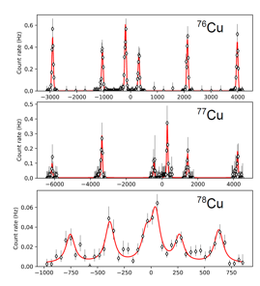

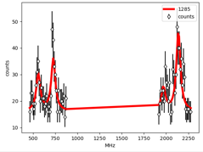
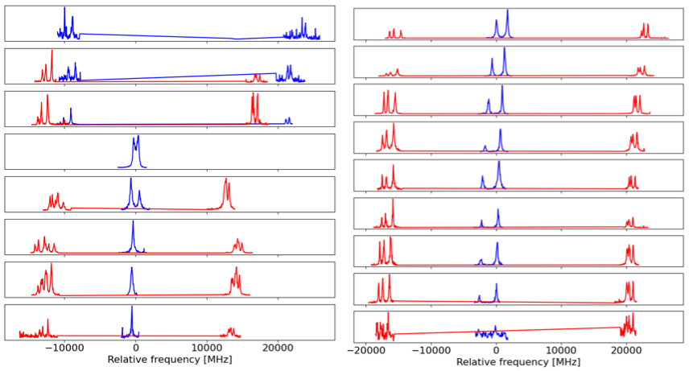
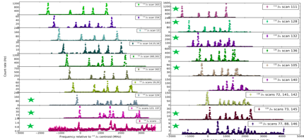
Sn
Cu
Ra
Since 2012 over 100 radioactive isotopes and molecules studied (Al, K, Sc, Cr, Cu, Ga, Zn, Ag, In, Sn, Sb, Au, Fr, Ra, RaF, AcF)
30 Papers
14 PhD Theses
8 Masters Theses
K
Ag
In

