Slide 1
Summary of neutron-deficient gold
(IS737)
CRIS Collaboration Meeting 2025
Speakers: Yinshen Liu, Osama Ahmad
Supervisors: Xiaofei Yang, Gerda Neyens

Slide 2
Outline
Motivation
Experiment
Data Analysis
Results
Summary and Outlook

Slide 3
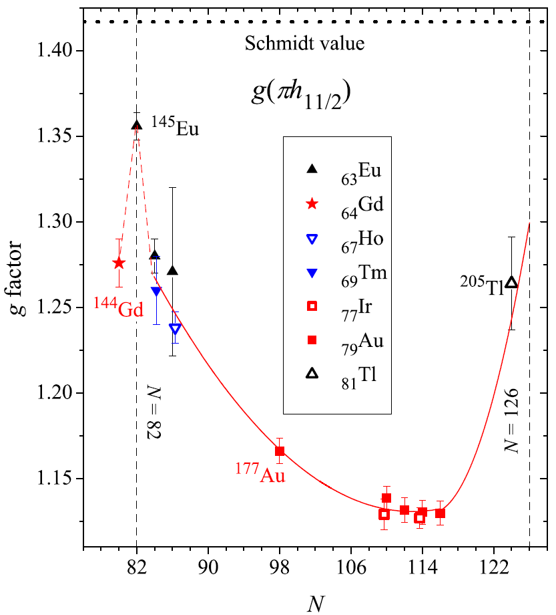
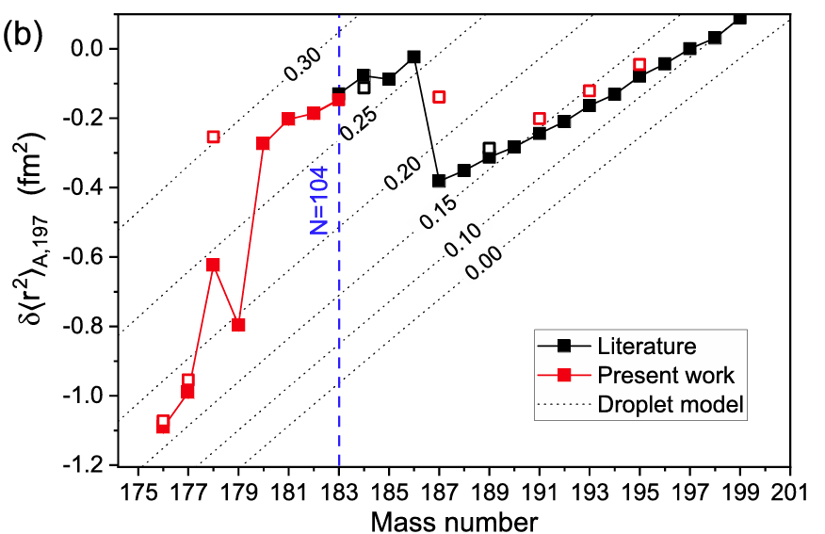
Motivation
Quadrupole moments of neutron-deficient gold (Z = 79)
For:
Island of deformation (180-186g)
Shape coexistence (187m, 178m)
11/2- isomers (177m, 189m, 191m, 193m,195m,197m)
…
*: this work
#: literature values available

Slide 4
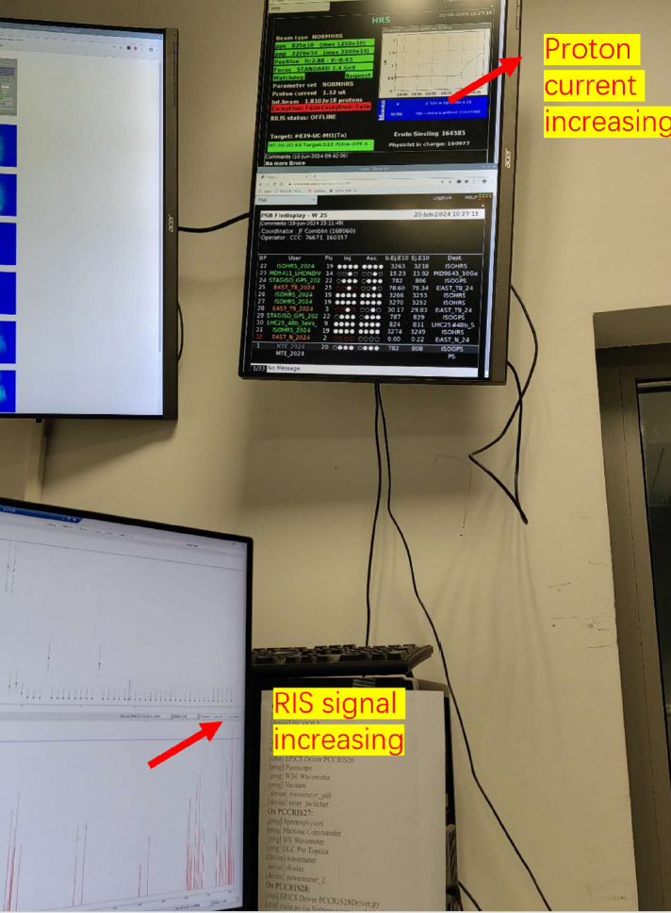
Experiment
Production: 1.4 GeV P + UC_{X}
Laser scheme: D2 line for 1st
Scan strategy: V scan for 2 sides
Ref isotope: 197
Isotopes: 180, 181, 182, 183, 185, 187g&m, 188, 189g&m, 190, 191, 192, 193, 195
AI 84806.3 cm⁻¹
OPO
673.9 nm
IP 74409 cm⁻¹
8d ²D_{3/2} 69971.42 cm⁻¹
347.2 nm
Cobra + SHG
Main issues:
Mass marker;
Contamination;
Shared proton beam intensity;
Seeking for isomers…
6p ²P_{3/2} 41174.613 cm⁻¹
242.8 nm
Matisse + Jyvis + THG
6s ²S_{1/2} 0 cm⁻¹

Slide 5
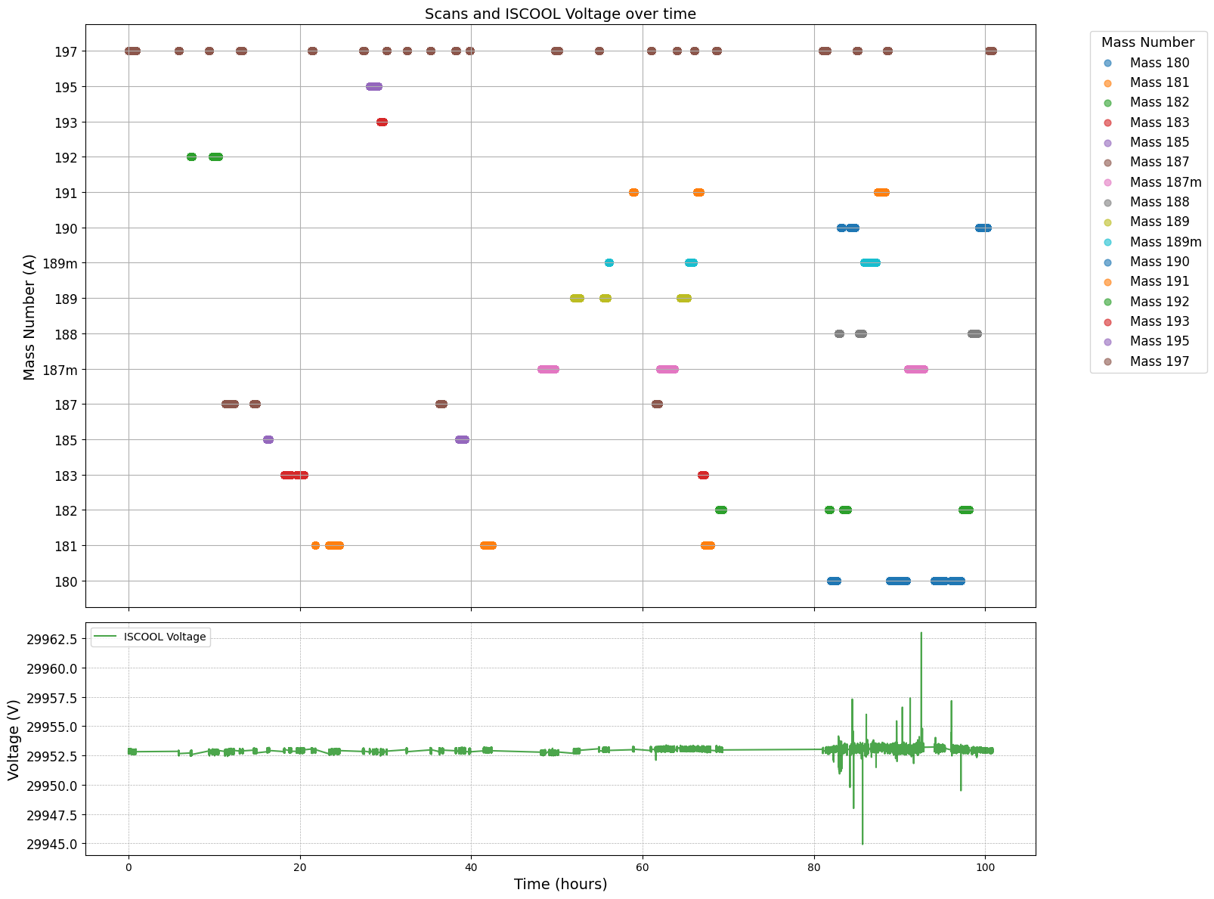
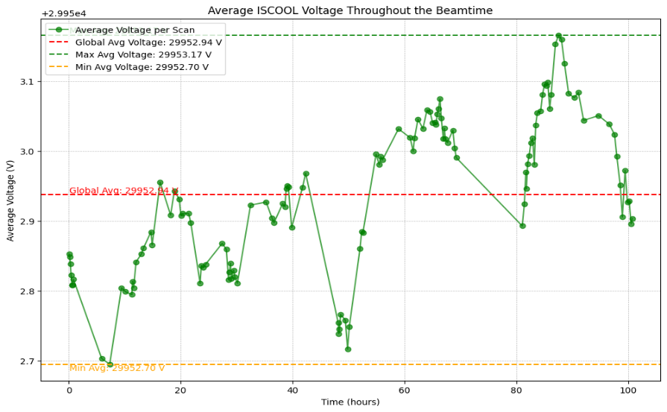
Experiment
Plots and contents thanks to Osama!
Avg ISCOOL voltage = 29952.94 V
Max and Min ISCOOL Voltage fluctuation throughout the beamtime was 18V.
Avg max and min ISCOOL Voltage fluctuation throughout the beamtime was ~ 0.5V.

Slide 6
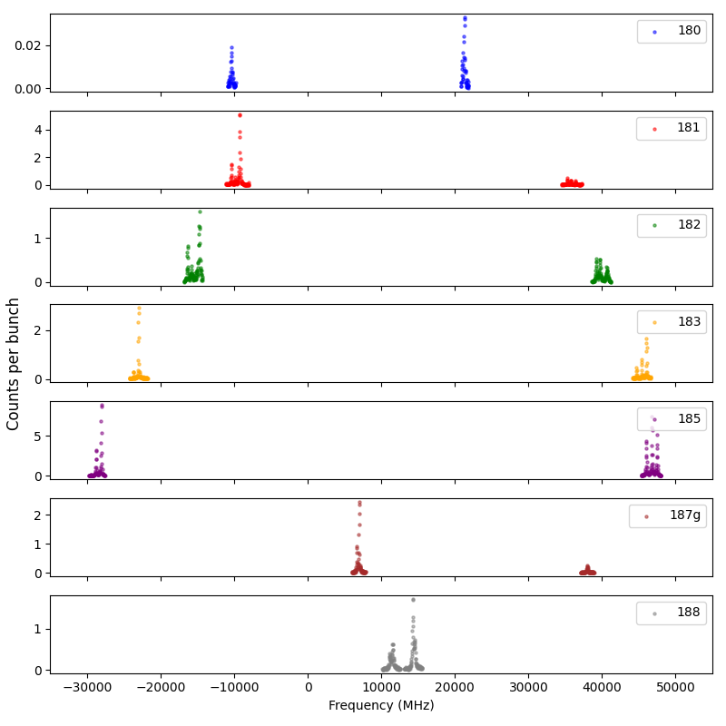
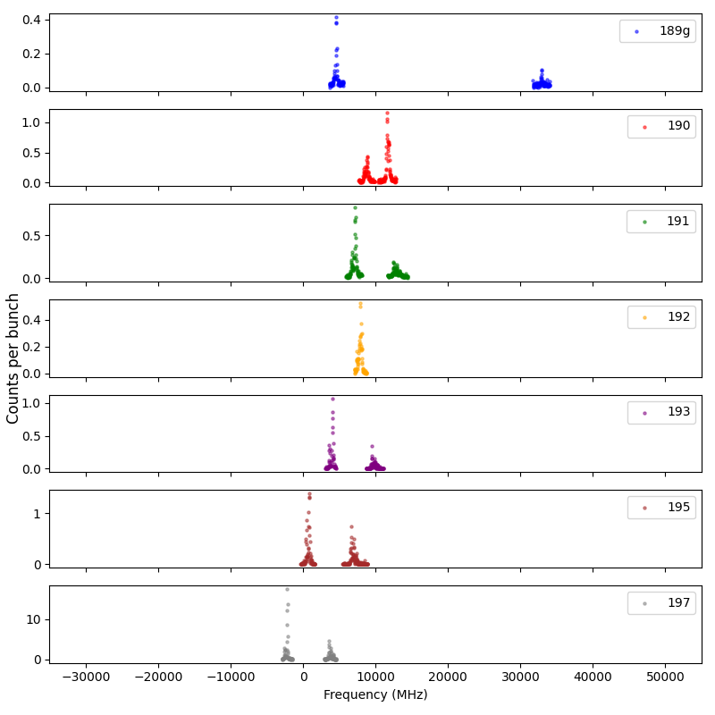
HFS Spectrum
14 ground states + 2 isomers

Slide 7
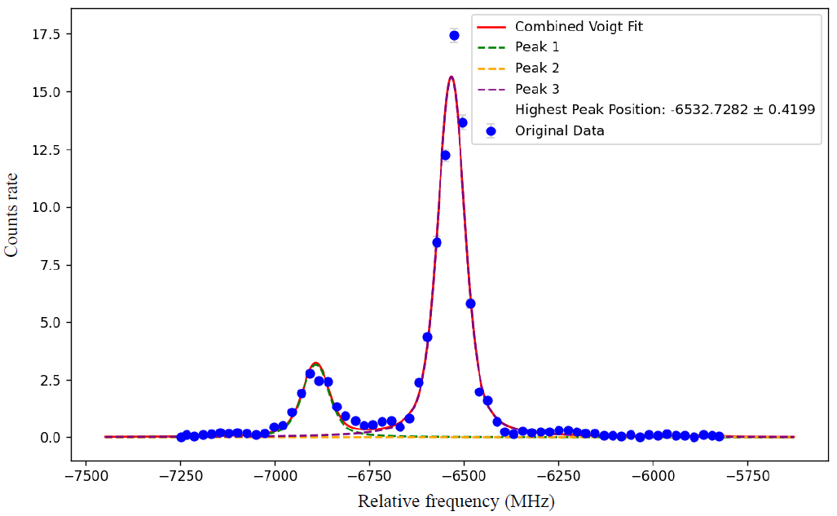
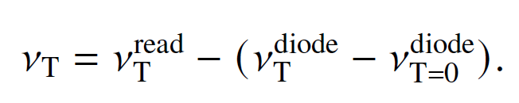
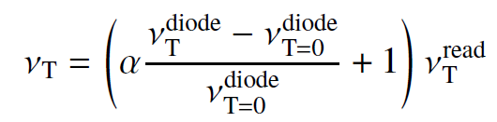
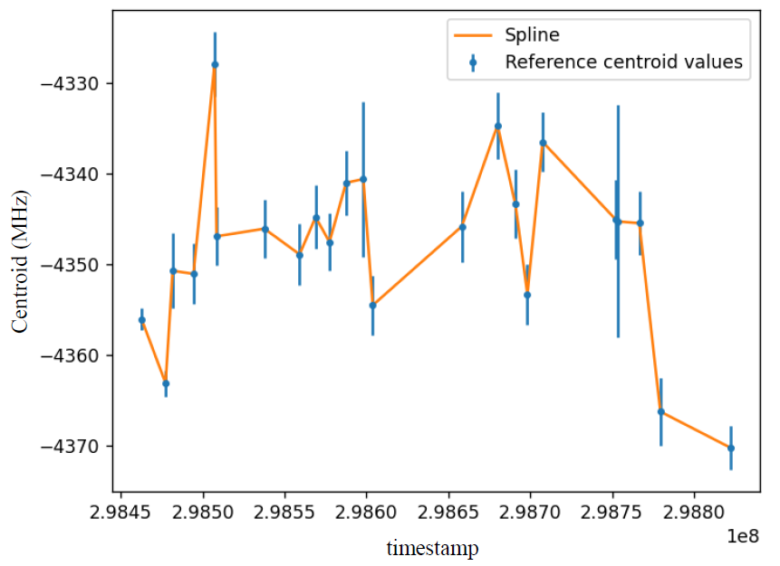
Data analysis
Diode correction:
vs
Reference scan: only LHS for most cases
Strategy I: fix Al (Au), fit Bu, centroid, fitting with 3 (overlapped) peaks on LHS;
→ saw relatively large ref errors (compare with CRIS 2023 experiments)
Strategy II:
fit all full ref scans to get a offset (Δ) from highest peak to centroid;
use Voigt fitting for LHS highest peak (P);
deduce centroid from P and Δ.
Reference correction only affects isotope shift!
Notes:
Diode: 795 nm

Slide 8
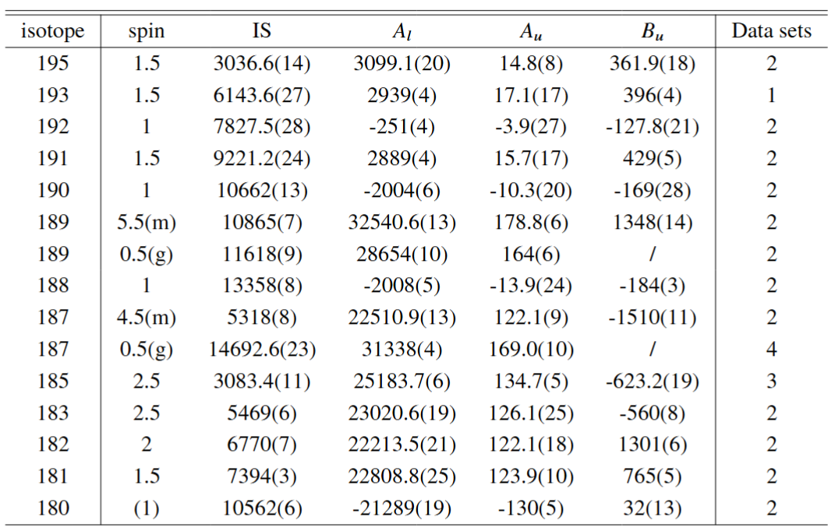
Data analysis
A_{l} | A_{u} | B_{u}
3098.4 (21) | 13.8(12) | 360.4(17)
2935.4(31) | 15.4(14) | 402.4(36)
-251.9(38) | -3.6(24) | -128.7(19)
2890.7(33) | 14.2(17) | 427.7(45)
-1998.6(94) | -10.5(17) | -167.3(22)
28654.8(93) | 161.7(48)
32540.5(8) | 179.2(7) | 1339.2(87)
-2004.8(45) | -12.9(22) | -187.0(32)
31341.8(56) | 169.9(11)
22511.8(11) | 122.08(9) | -1502(12)
25183.09(39) | 135.63(65) | -621.6(12)
23021.5(13) | 125.01(47) | -566.2(26)
22214.1(24) | 122.3(21) | 1300.9(62)
22809.7(17) | 124.42(68) | 763.5(52)
-21308(18) | -132.2(51) | 42(9)
Satlas2 analysis result by Yinshen
analysis result by Osama
Analysis parallelly and independently, all hfs constants are within 1-sigma!

Slide 9
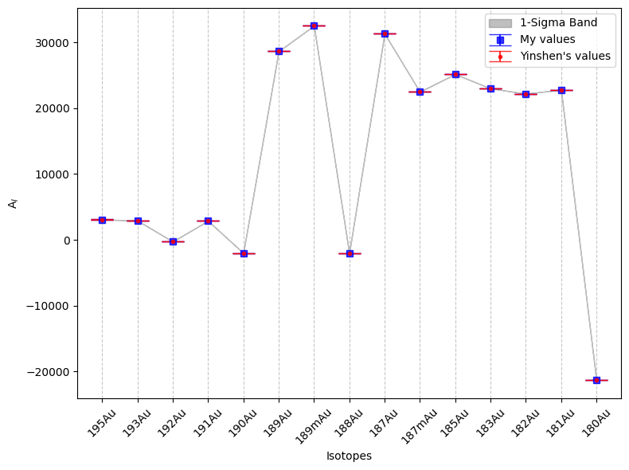
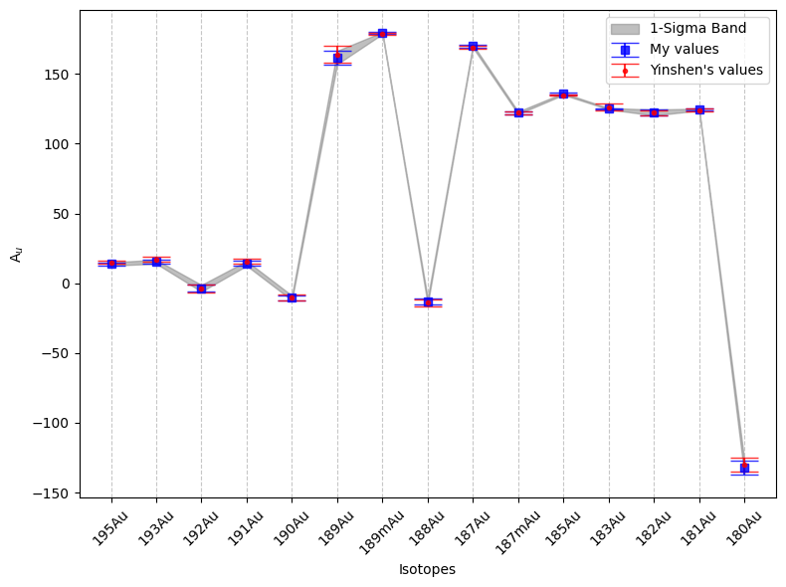
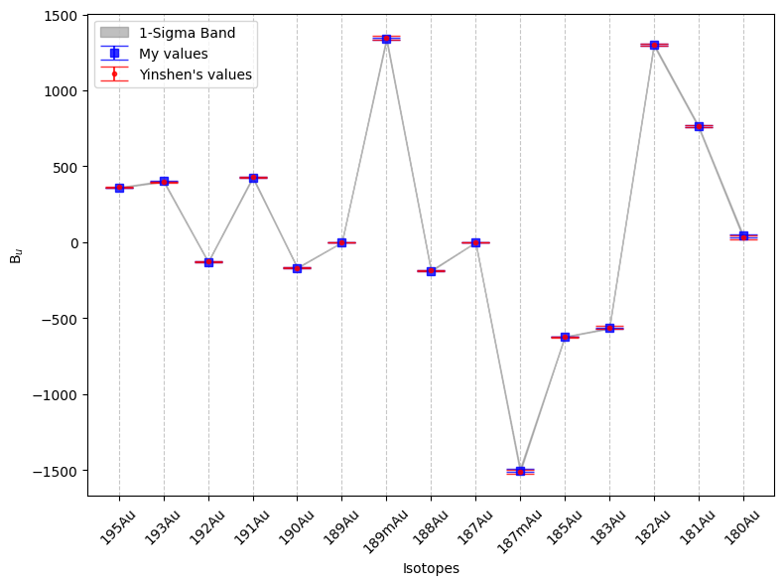
Data analysis
A_{l}
A_{u}
Plots thanks to Osama!
B_{u}
Analysis parallelly and independently, all hfs constants are within 1-sigma!

Slide 10
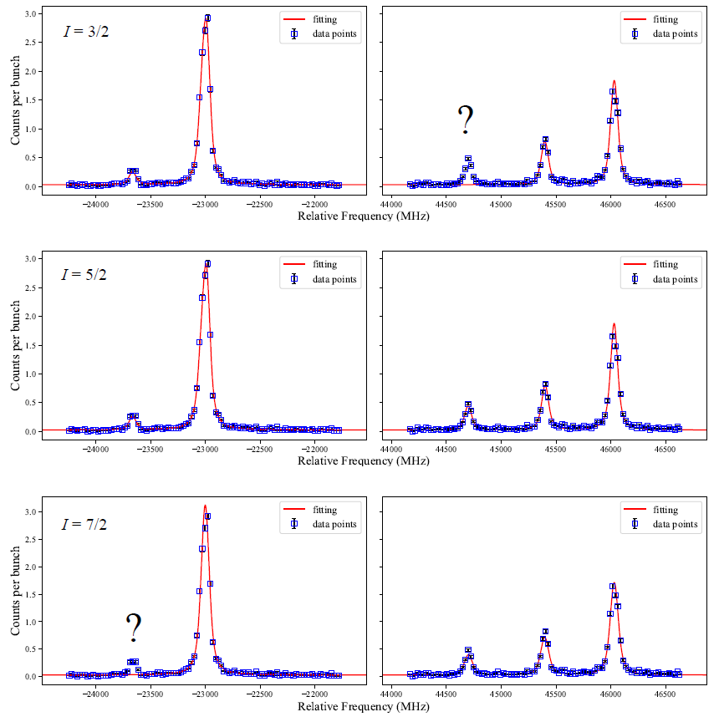
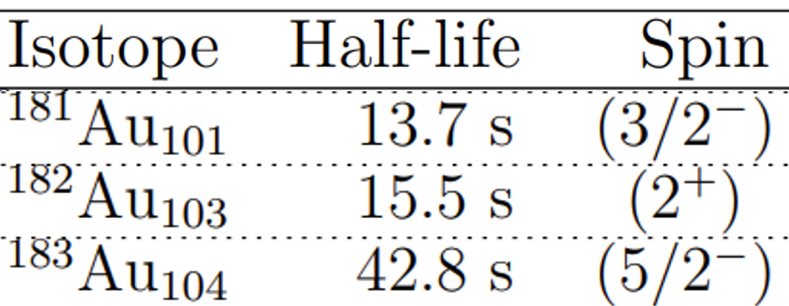
Results
Spins:
  ¹⁸³Au
  ¹⁸¹Au: I = 3/2;
  ¹⁸²Au: I = 2;
  ¹⁸³Au: I = 5/2;
Tentatively assigned in the literature,
Confirmed by us for the first time.
  ¹⁸³Au
  ¹⁸³Au
  ¹⁸⁰Au: low statistic
Notes:
Tentatively/first time
Useful for 182 beta-decay

Slide 11
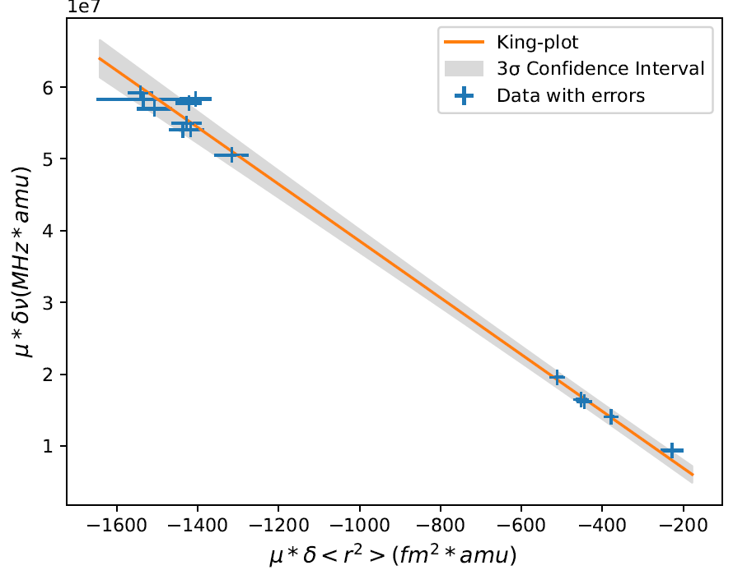
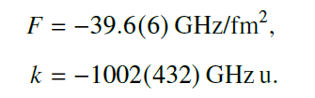
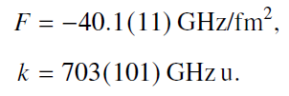
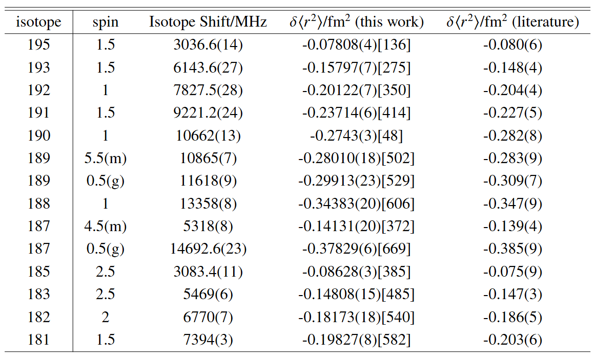
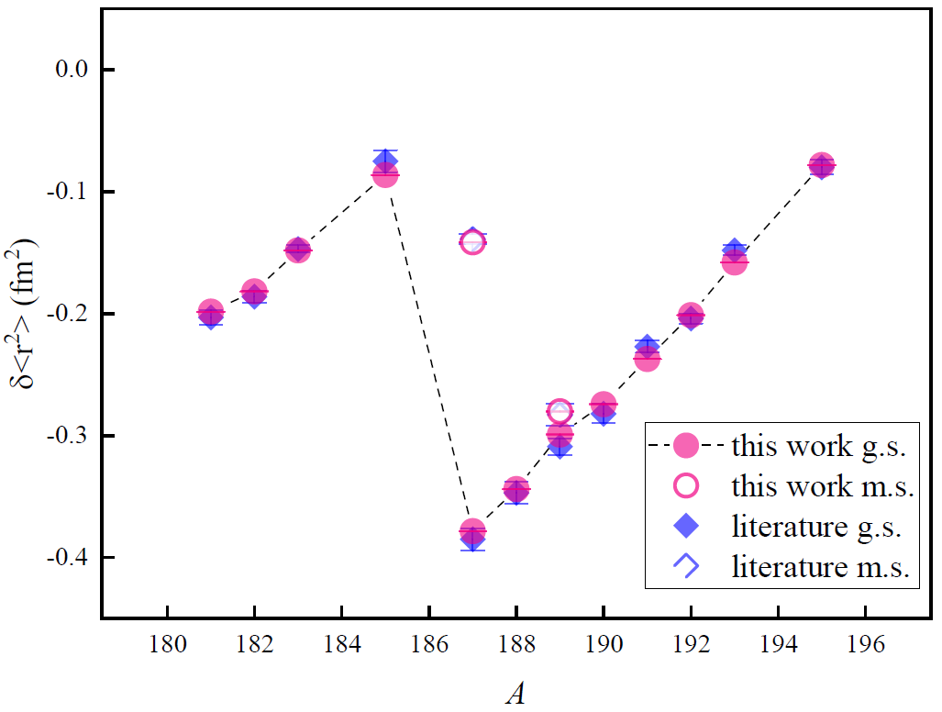
Results
Charge radii
D2 line (King-plot):
D1 line (atomic cal):
(): statistical errors; []: systematic errors from F & k.

Slide 12
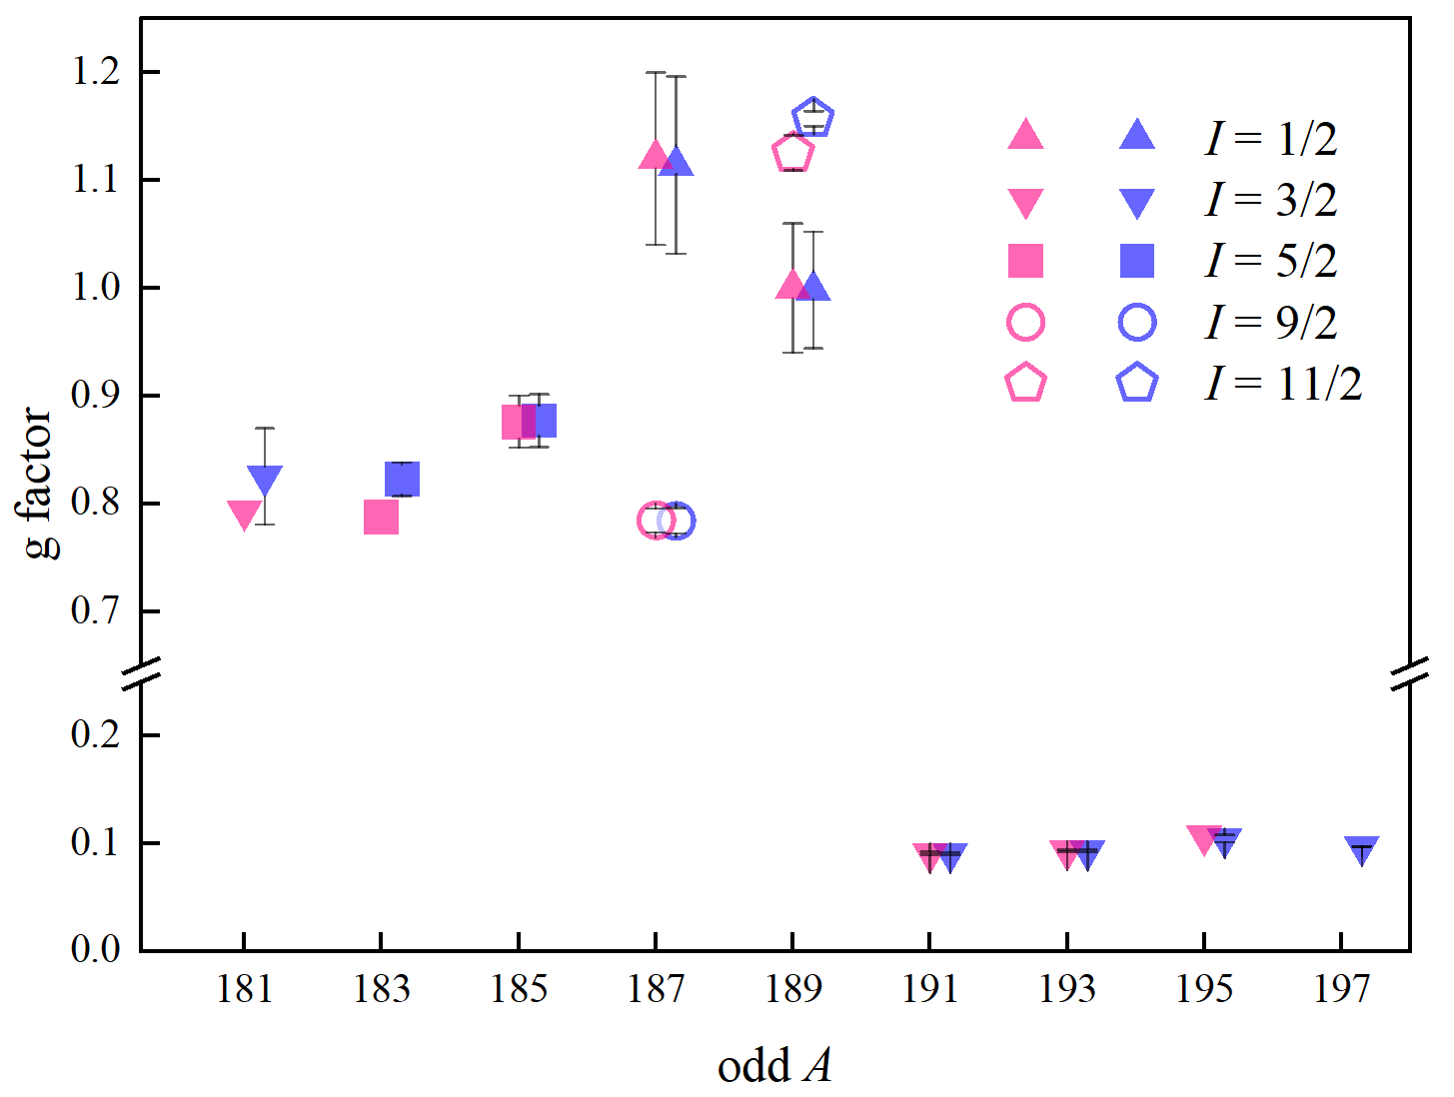

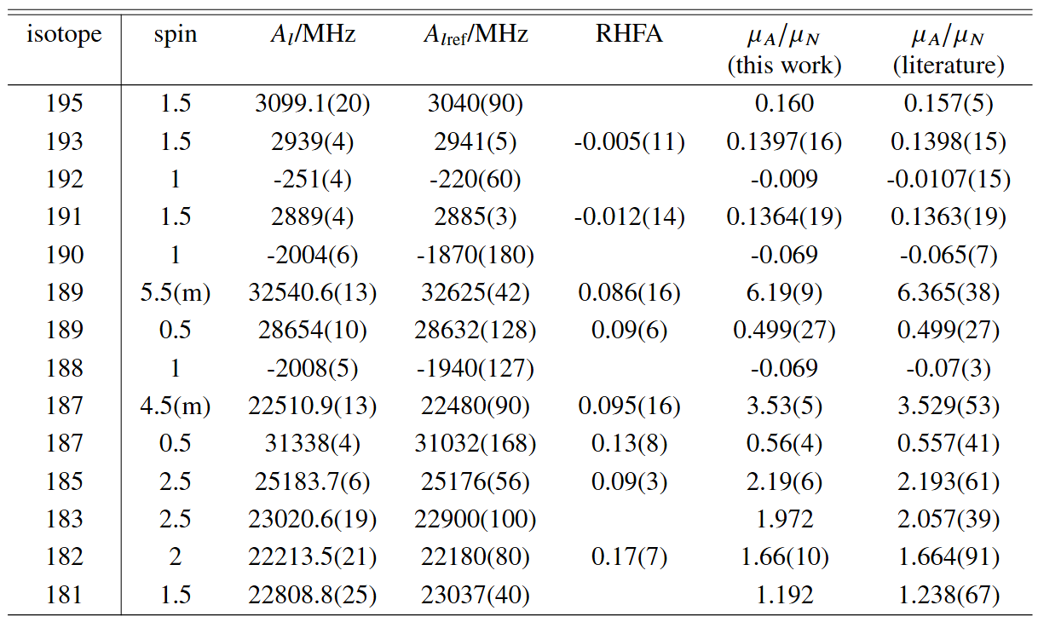
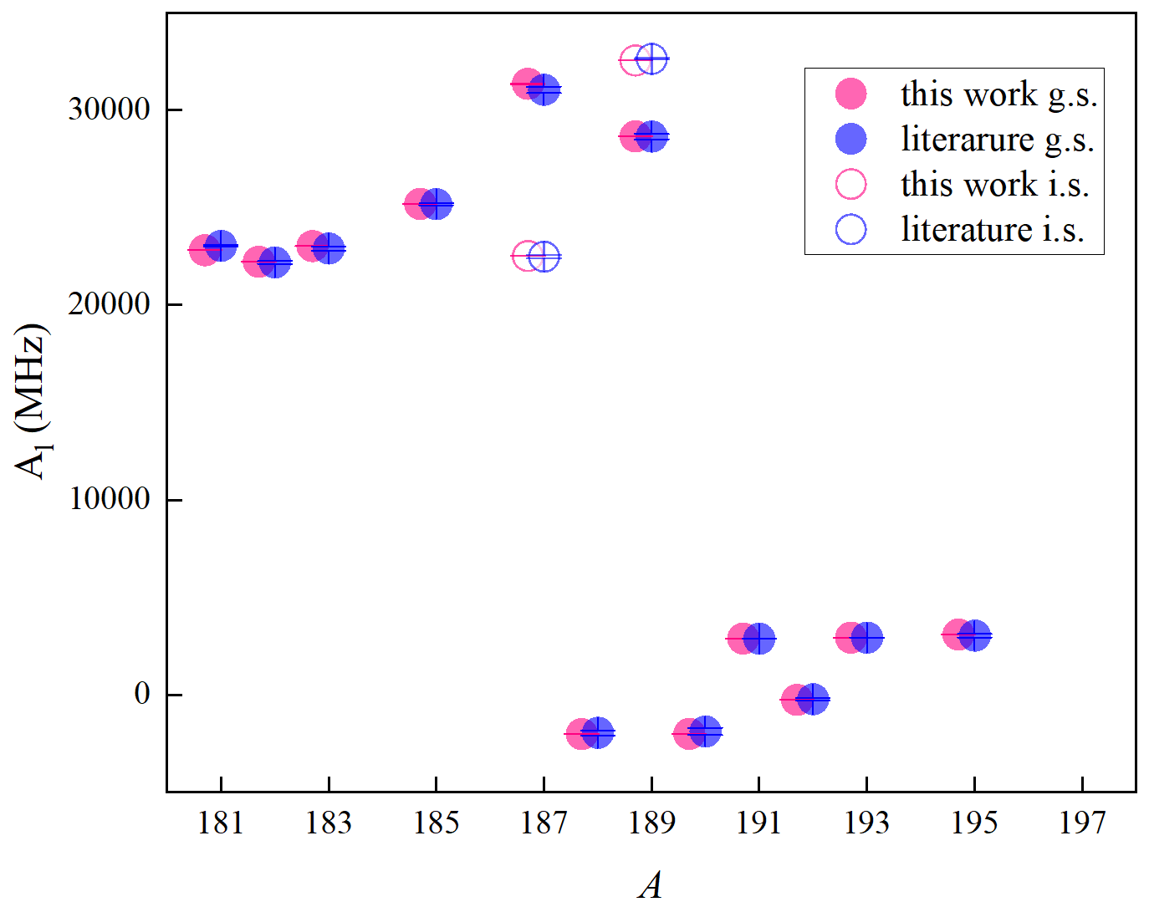
Results
Magnetic moments:
μ errors mainly come from relative hyperfine anomaly calculation (RHFA)
μ without available RHFA information are evaluated with empirical ML rule. In this case errors are not given.

Slide 13
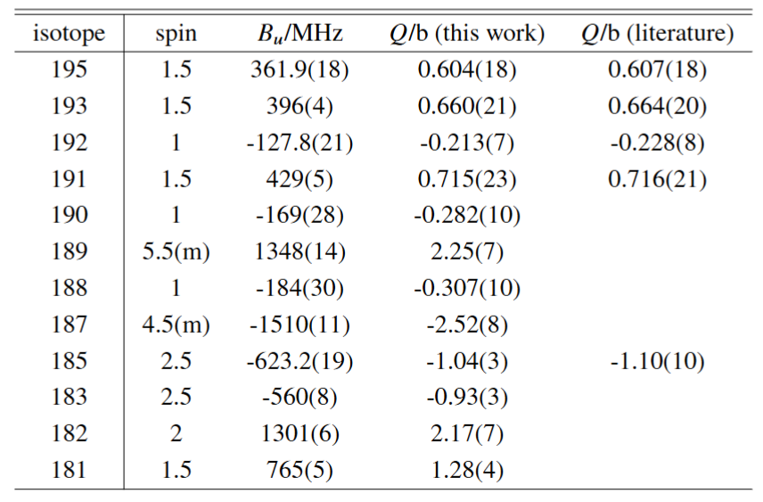

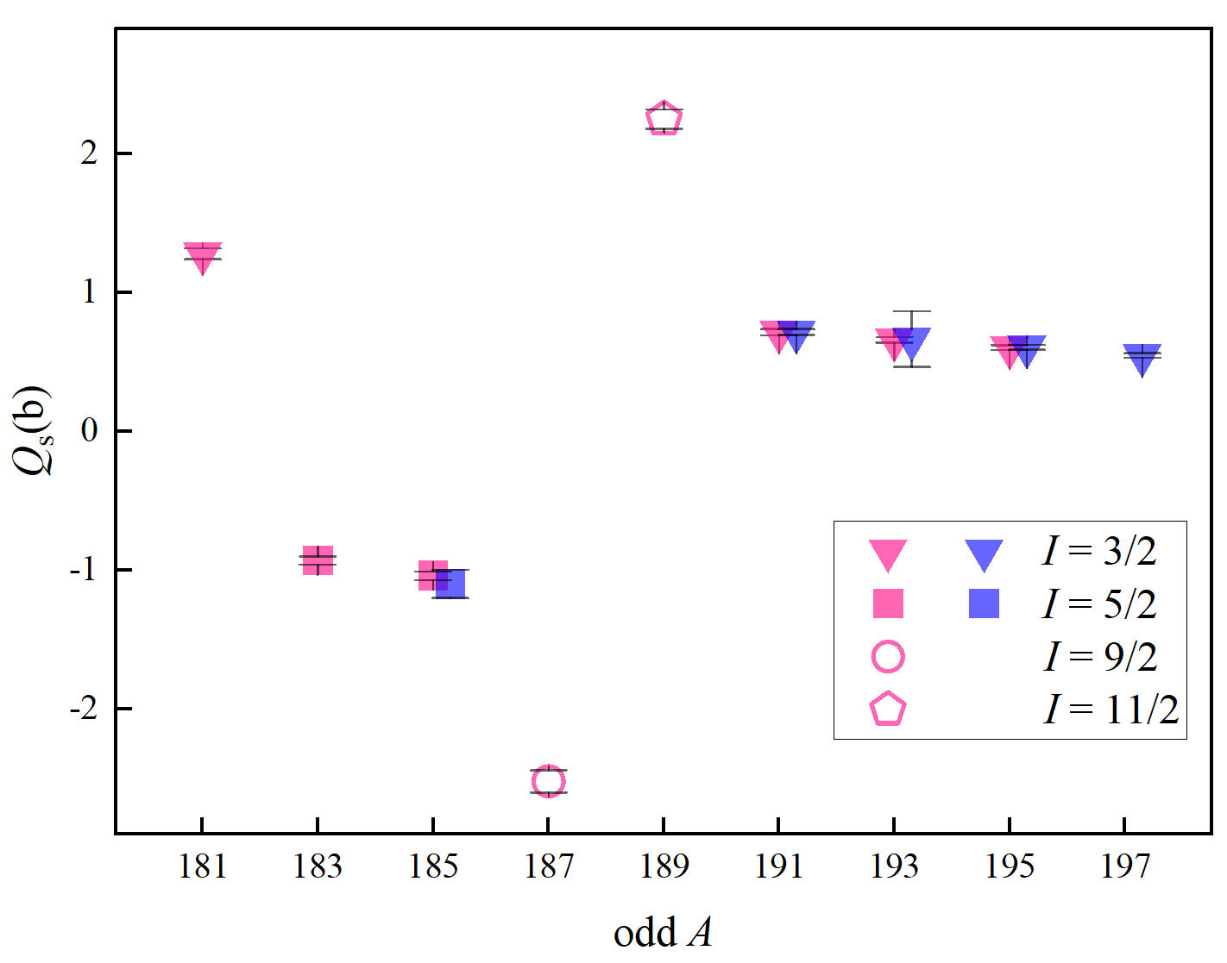
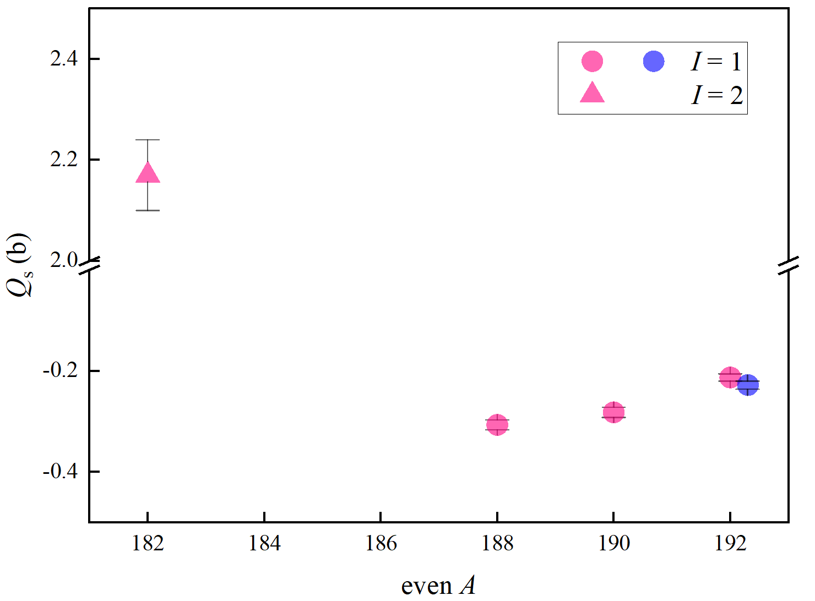
Results
Quadrupole moments:
Bu₁₉₇ = 328(2) MHz
Q₁₉₇ = 0.547(16) b

Slide 14

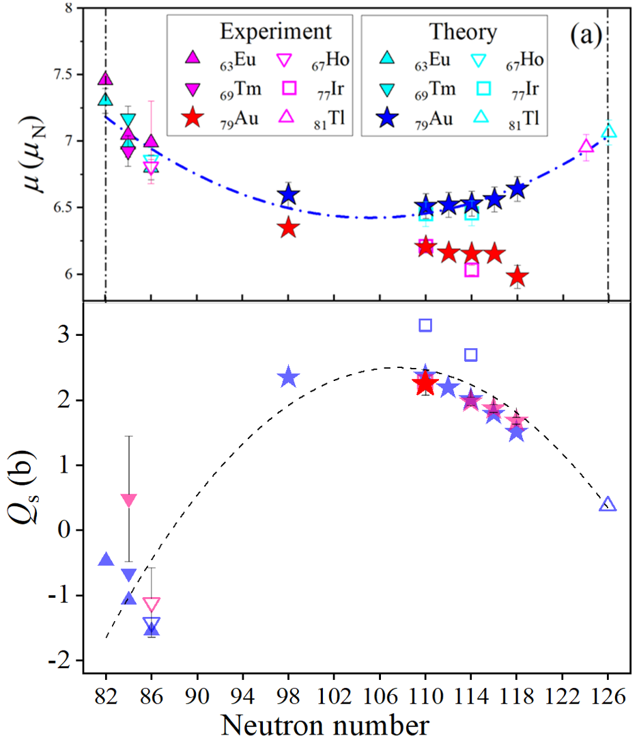
Results
189m: πh_{11/2} state in odd Z even N ( )
Both μ and Q_{s} show the nearly parabolic trends;
Previous interpretation for μ: 1st order core-polarization correction due to νf_{7/2} → νf_{5/2}
DFT calculations reproduced μ and spectroscopic Q_{s} without using effective charges, including the ^{189m}Au (this work), and 193,195,197 gold isomers (literature)
time-reversal symmetry breaking impacts very little (<1%) on Q_{s}, while Angular Momentum Projection plays a vital role in spectroscopic Q_{s} calculation;
effective test for the validity of DFT.
J. Bonnard, et al. Phys. Lett. B, 843 (2023) 138014

Slide 15
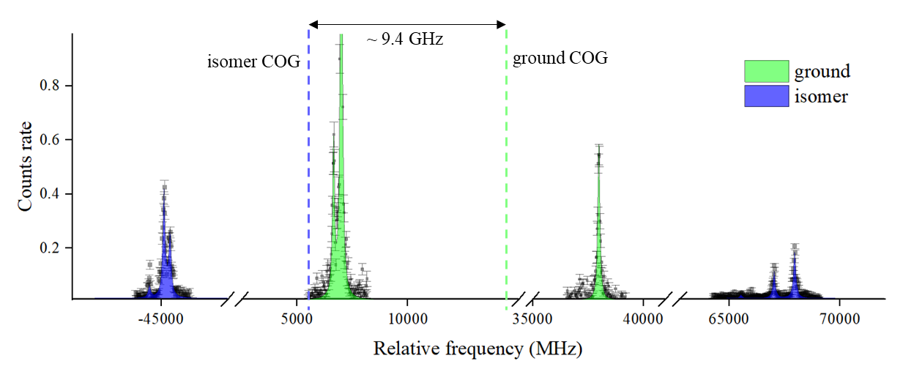
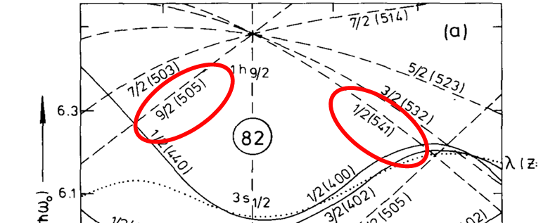
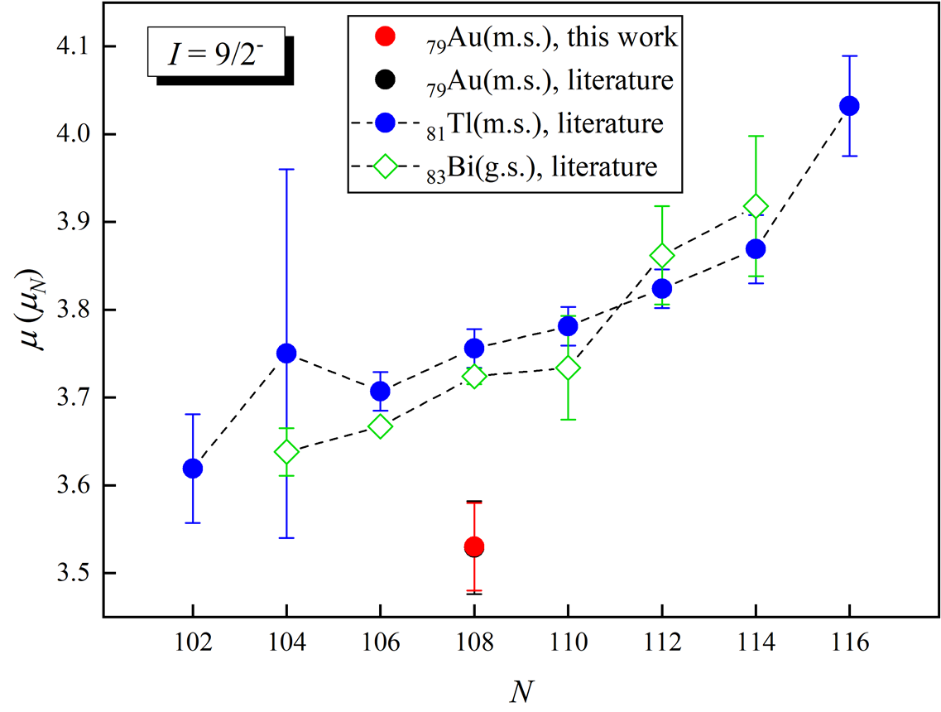
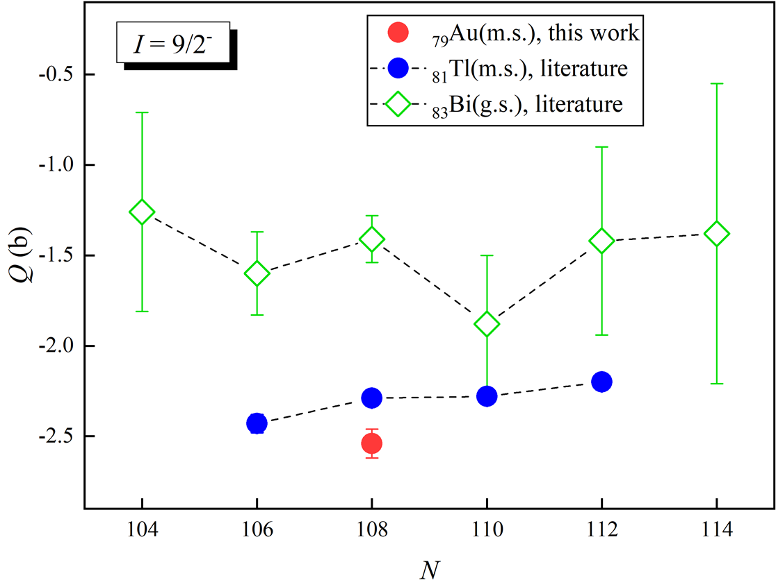
Results
187m: shape coexistence
Previous interpretation based on μ suggested a rotation band build on 1/2[541], e.g. prolate deformation;
Q_{s} < 0, the 9/2- isomer is likely to be formed as 9/2[505] at moderate oblate deformation just like nearby Tl isomer;
A. E. Barzakh et al., Phys. Rev. C, 101, 064321 (2020)

Slide 16
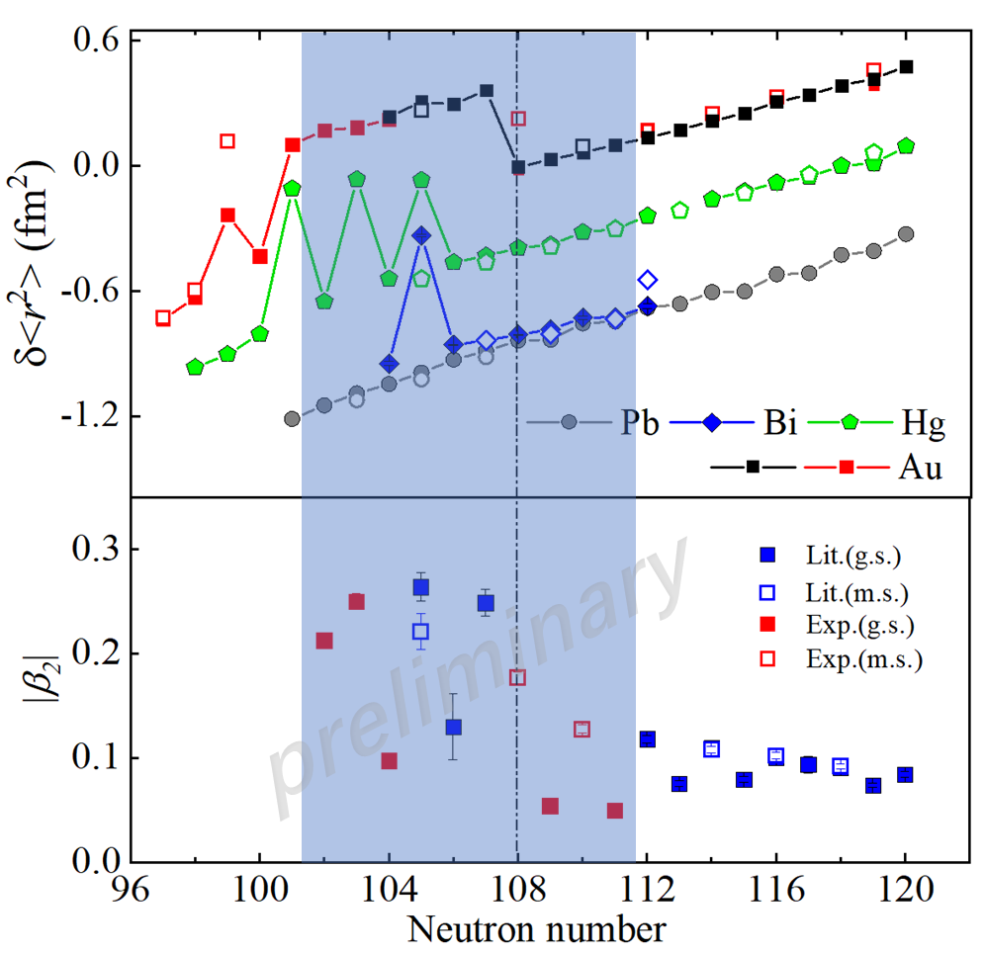


Results
Island of deformation
For now the strong coupling assumption (K = I) is used in β₂ extraction;
potential of nonaxial deformation?
…
B. Bally, et al., Eur. Phys. J. A 59, 58 (2023)
Y. Oktem et al., Phys. Rev. C, 86, 054305 (2012)
L. K. Peker et al., Phys. Rev. C, 20, 855 (1979)

Slide 17
Summary and Outlook
Summary:
Firmly determine the spins of 181-183;
Quadrupole moments of 7 states;
3 physics cases are (partially) investigated;
Outlook:
Approaching more neutron-deficient side (e.g. 176-180) and isomers in the next gold run (13 shifts remaining);
Calculation and interpretation for Q_{s} and deformation parameters;
…

Slide 18
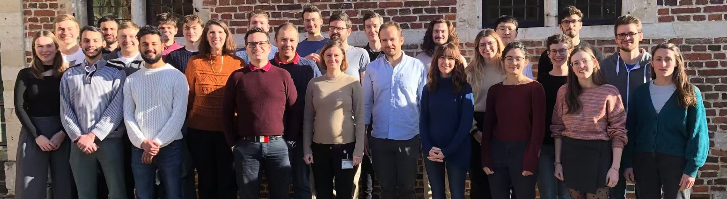
Thanks for your attention!

Slide 19
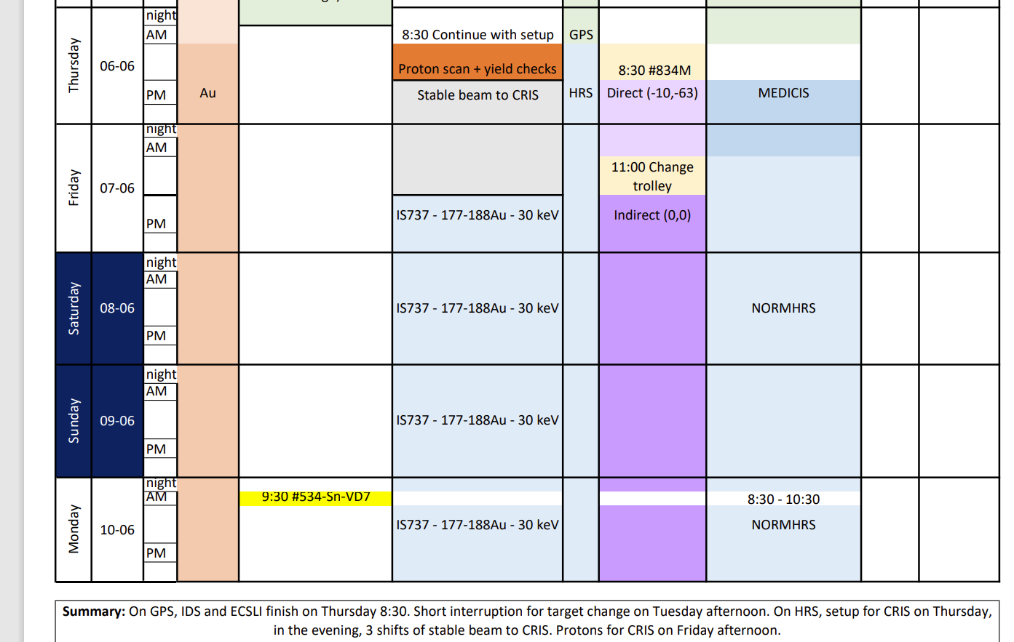
Shift schedule: original
“Due to the technical stop, our run will be divided into 2 parts:
1st: 06/06(Thur) afternoon- 11/06(Tue) morning
2nd: 14/06(Fri) afternoon- 18/06(Tue) afternoon”
11 shifts with protons at 1st half according to the plan
Failed to see any gold RIS signal before the end of 1st half
Mainly due to ISOLDE side ☹:
No gold mass marker;
Contamination.

Slide 20
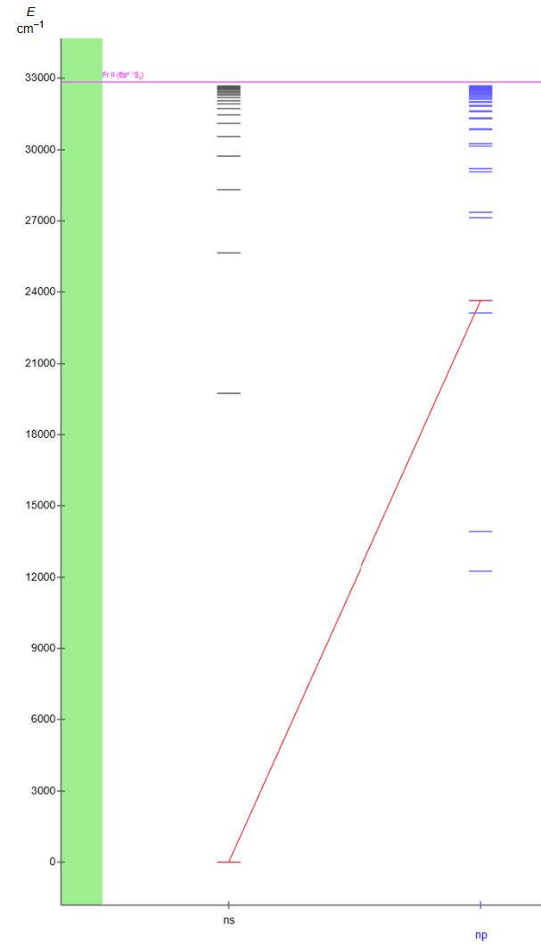
1st half summary
What we managed to achieve:
Successfully find out ²²¹Fr RIS signal to make sure our setup is working ideally and a beneficial training for fresh blood
Beamtune with stable K&U
Set up correct laser/beam timing, prepare proton beamgate
Locate the source of heating up downstairs laser tent which cause unstable OPO
1064 nm from TRLi
Fr I: S_{1/2} – P _{3/2}
422.36 nm from OPO

Slide 21
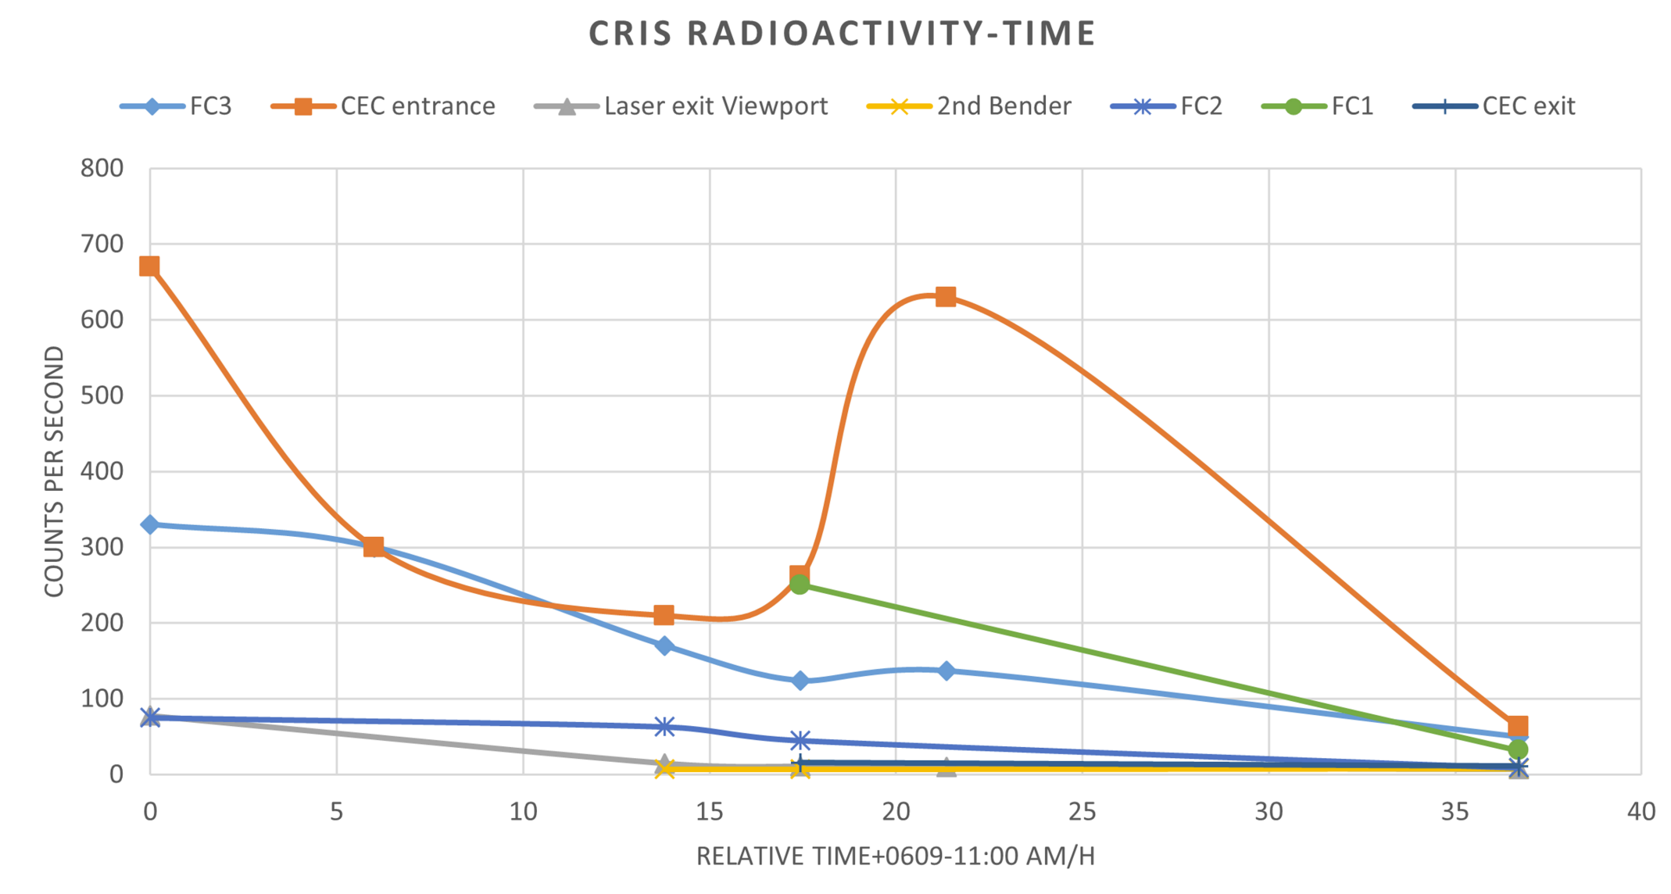
2nd part preparation
New gold target with mass marker (#839-UC-MI1(Ta)), “pure” gold beam from mass marker&RILIS
Beam time extended (stable beam started at Fri. afternoon, gave proton to ISOLTRAP next Thur. afternoon)
Proton sharing with solid physics
…

Slide 22
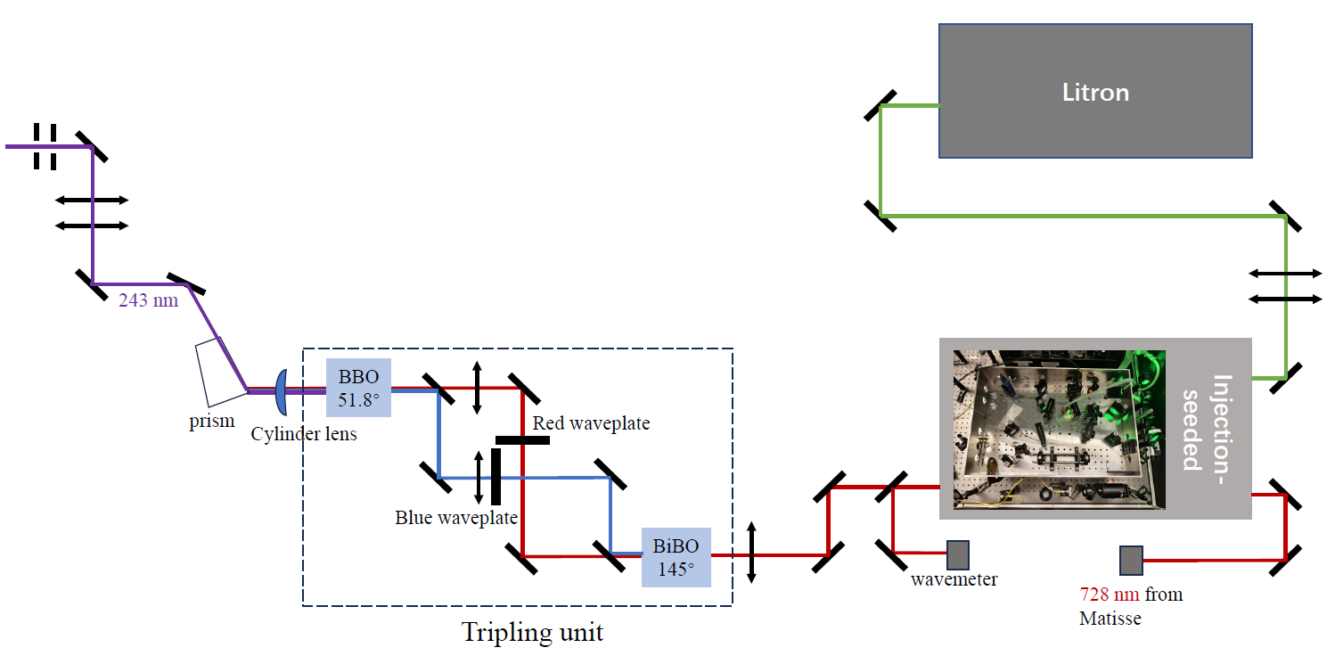

Slide 23
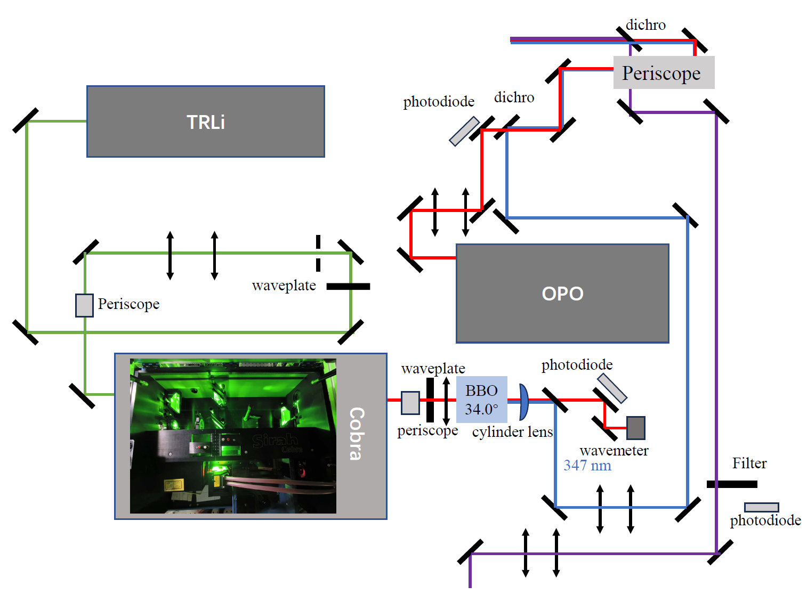

Slide 24
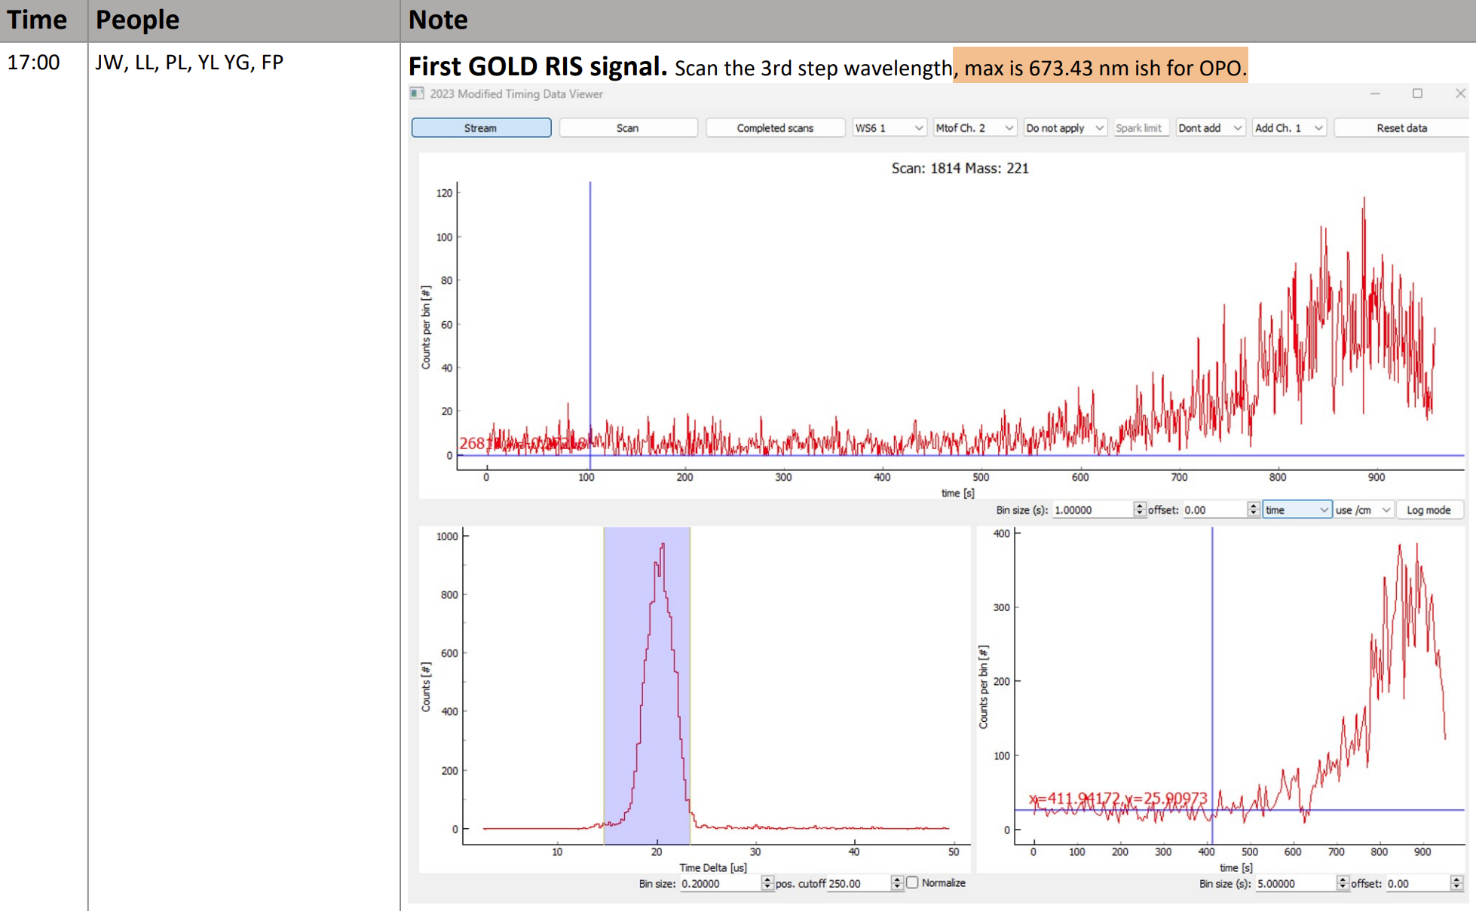
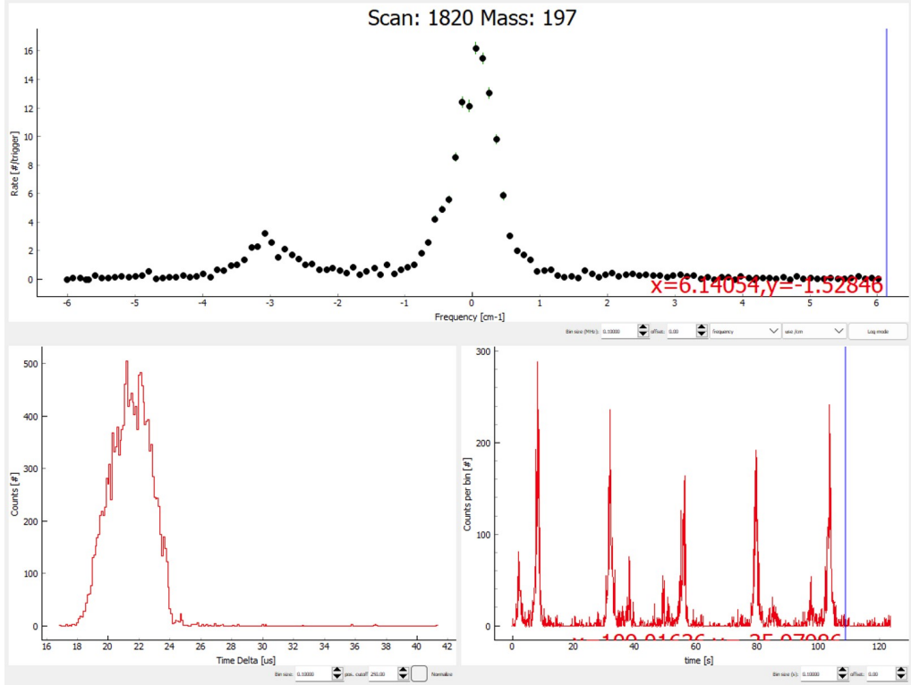
1st gold RIS and 1st scan
Strange TOF (multipole peaks) – overfilled ISCOOL by wrong QC setting
1st RIS signal of gold when optimizing laser frequency.
Reshaped laser profile, optimized timing (ISCOOL, lasers) and laser position, beamtuning
Saturation curve. Efficiency (best 1:800) vs linewidth (best ~ 100 MHz ). Laser on/off = 800:1 (versus collisional bkg)
After located every peak position, 1st voltage scan: scan 1820 (LHS of 197g)

Slide 25
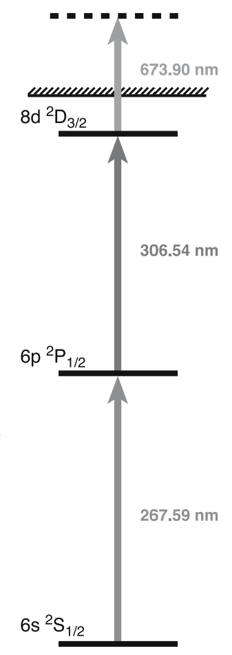
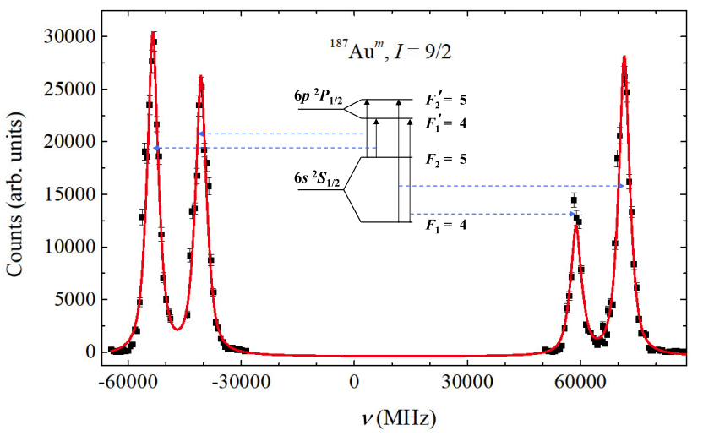
Searching for g.s & i.s.
Used 197&192 to adjust prediction, almost every g.s. could be easily located around predicted value (off by ~ 0.004 cm⁻¹)
But we could not see even one single isomer with scanning 1st & 2nd steps.
RILIS 1st step is broad but may not be broad enough. Especially for isomers with large spins (e.g. 9/2-, 11/2-) we are expecting over 100 GHz for D1 transition.
Shifted 1st step of RILIS and we saw our 1st isomer at predicted wavenumber!

Slide 26
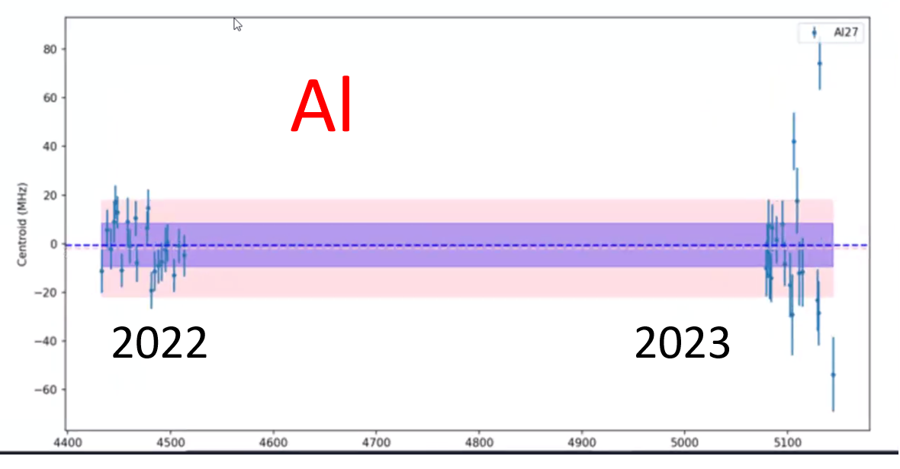
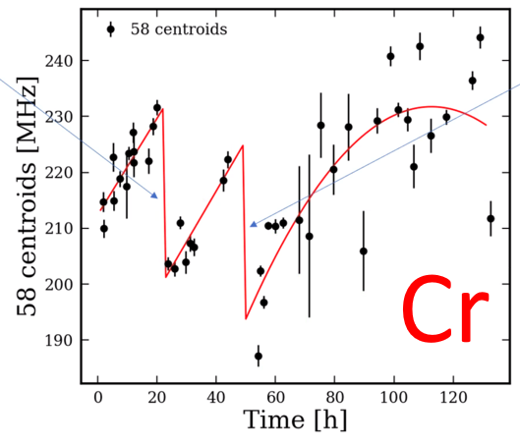
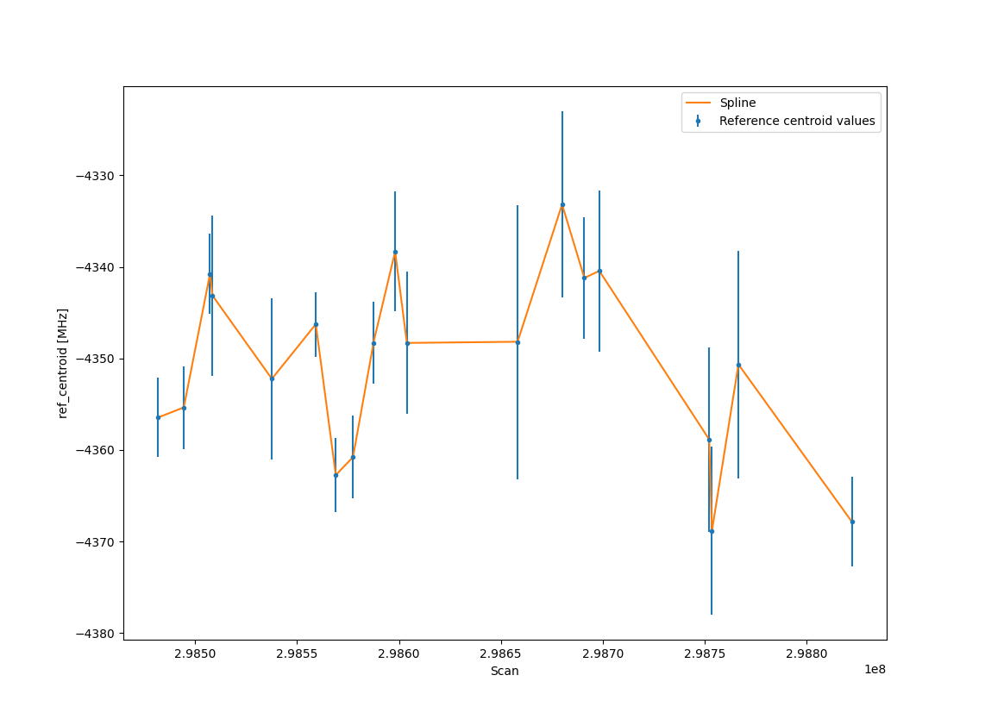
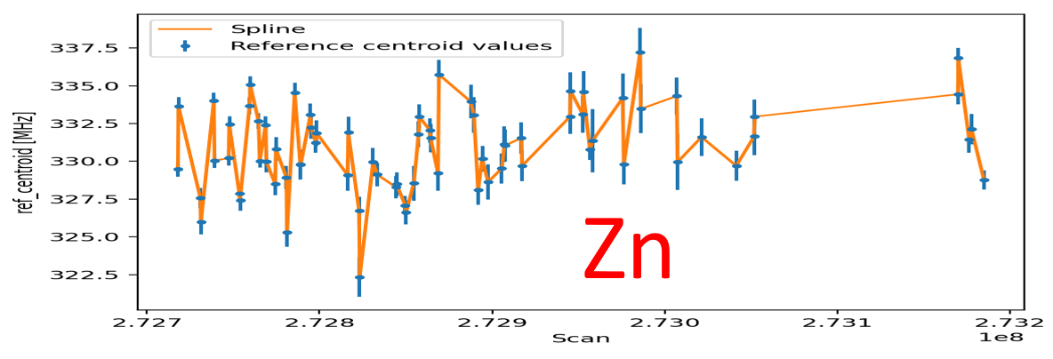
Details in reference analysis
Ref scans: only LHS for most cases
Strategy in Round I: fix Al (Au), fit Bu, centroid with 3 (overlapped) peaks
Comments: large ref errors (compare with CRIS 2023 experiments)
Au 2024

Slide 27
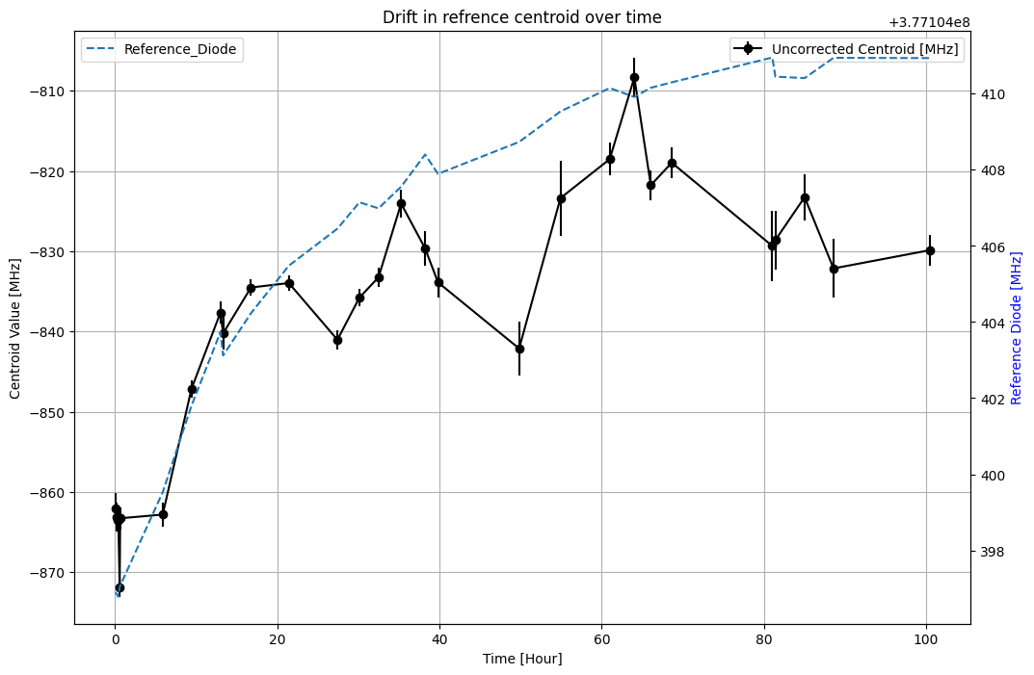
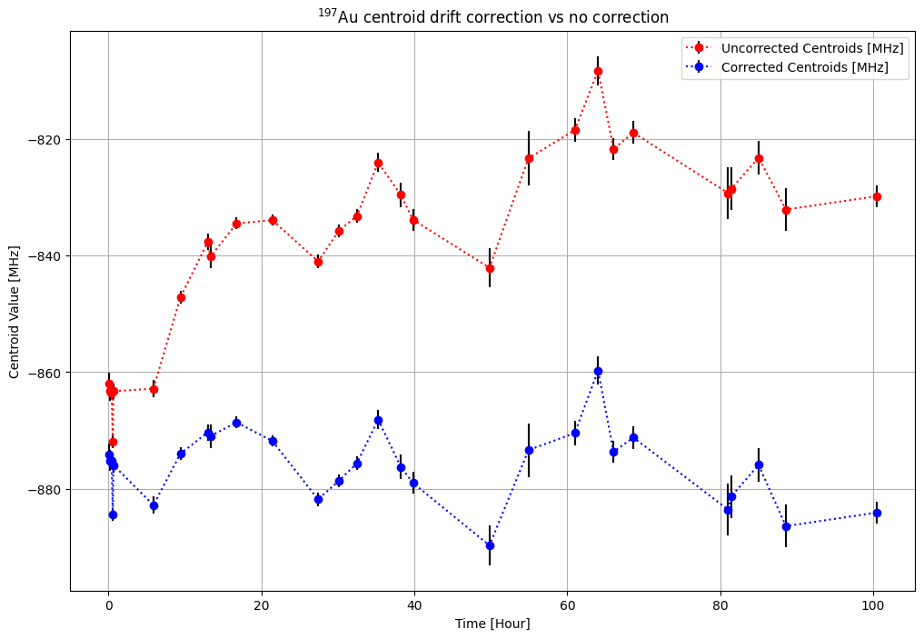

Slide 28



reference analysis

Slide 29


Slide 30


Slide 31


