Slide 1



Atomic physics studies of the heaviest alkaline
P. Lassègues, R. P. de Groote, A. Kastberg et al.
1

Slide 2
Atomic studies in 221 Francium :
  New atomic levels identified in Fr
  Lifetime measurements performed for excited P-states
  Identified 6D state (broadband)
  New Rydberg series observed

Slide 3
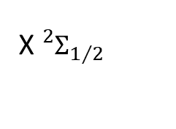
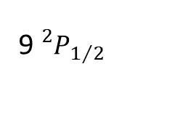
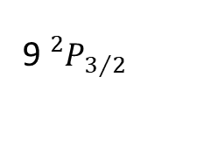
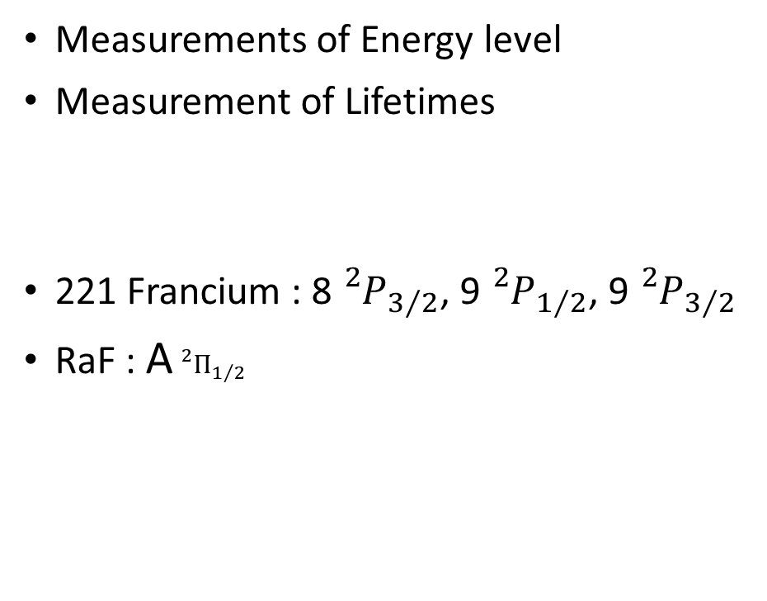
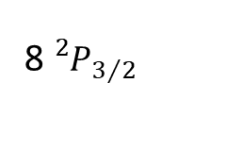
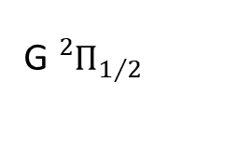
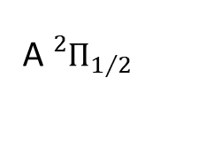
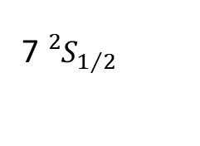
Results December 2023
Fr
RaF
Measurements of Energy level
Measurement of Lifetimes
221 Francium : 8${}_{}^{2}{P_{3/2}}$, 9${}_{}^{2}{P_{1/2}}$, 9${}_{}^{2}{P_{3/2}}$
RaF : A${}_{}^{2}{Π_{1/2}}$
532 nm
1064 nm
G${}_{}^{2}{Π_{1/2}}$
9${}_{}^{2}{P_{3/2}}$
646 nm
9${}_{}^{2}{P_{1/2}}$
365 nm
368 nm
A${}_{}^{2}{Π_{1/2}}$
8${}_{}^{2}{P_{3/2}}$
753 nm
422 nm
7${}_{}^{2}{S_{1/2}}$
X${}_{}^{2}{Σ_{1/2}}$

Slide 4
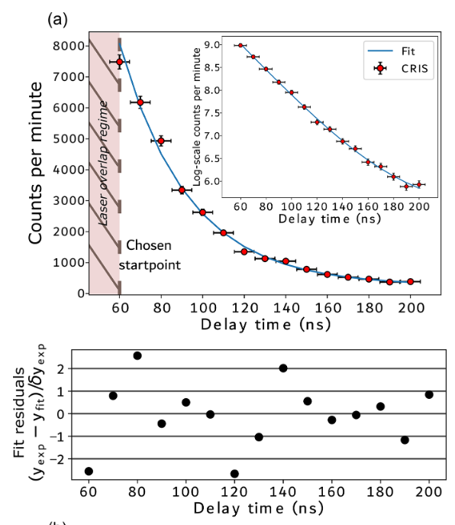
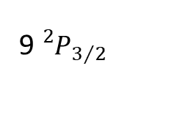
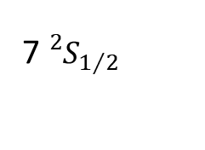
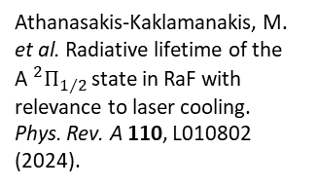
Results December 2023
Fr
RaF
1064 nm
532 nm
G${}_{}^{2}{Π_{1/2}}$
9${}_{}^{2}{P_{3/2}}$
646 nm
9${}_{}^{2}{P_{1/2}}$
365 nm
368 nm
A${}_{}^{2}{Π_{1/2}}$
8${}_{}^{2}{P_{3/2}}$
Athanasakis-Kaklamanakis, M. et al. Radiative lifetime of the A${}_{}^{2}{Π_{1/2}}$state in RaF with relevance to laser cooling. Phys. Rev. A 110, L010802 (2024).
753 nm
422 nm
7${}_{}^{2}{S_{1/2}}$
X${}_{}^{2}{Σ_{1/2}}$

Slide 5
Energy Levels

Slide 6
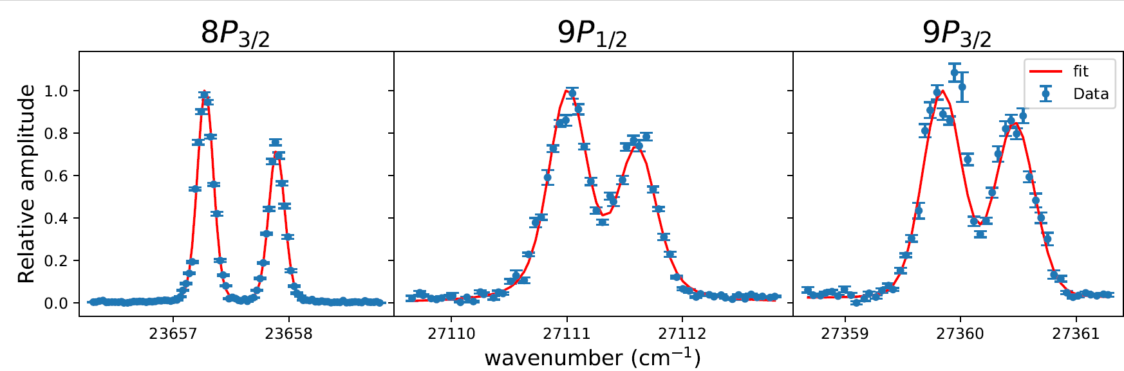
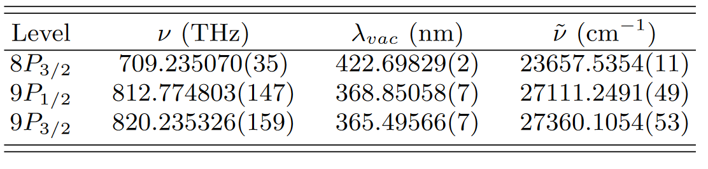
Energy levels
(Statistical Error)

Slide 7
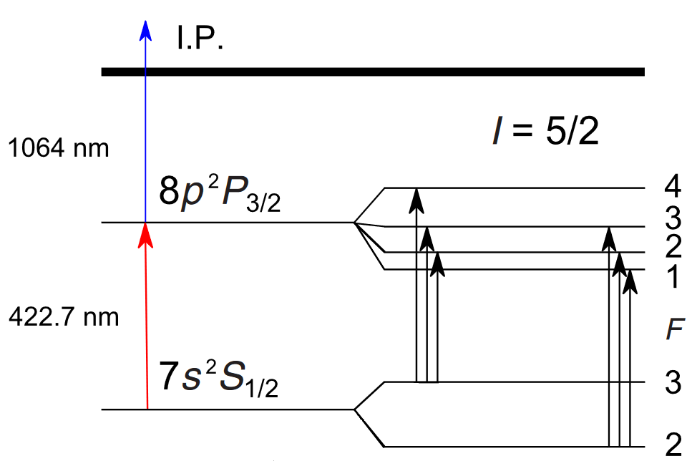
Energy levels
Figure from :Budinčević, I. et al. Laser spectroscopy of francium isotopes at the borders of the region of reflection asymmetry. Phys. Rev. C 90,(2014).

Slide 8
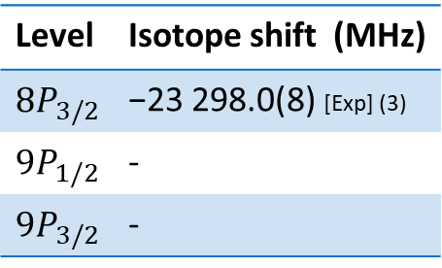
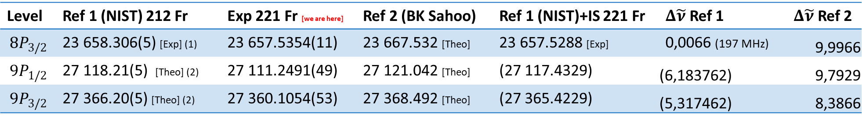
Energy levels – litterature
Level | Ref 1 (NIST) 212 Fr | Exp 221 Fr [we are here] | Ref 2 (BK Sahoo) | Ref 1 (NIST)+IS 221 Fr | $Δ\tilde{ν}$ Ref 1 | $Δ\tilde{ν}$ Ref 2
$$8P_{3/2}$$ | 23 658.306(5) [Exp] (1) | 23 657.5354(11) | 23 667.532 [Theo] | 23 657.5288 [Exp] | 0,0066 (197 MHz) | 9,9966
$$9P_{1/2}$$ | 27 118.21(5) [Theo] (2) | 27 111.2491(49) | 27 121.042 [Theo] | (27 117.4329) | (6,183762) | 9,7929
$$9P_{3/2}$$ | 27 366.20(5) [Theo] (2) | 27 360.1054(53) | 27 368.492 [Theo] | (27 365.4229) | (5,317462) | 8,3866
Level | Isotope shift (MHz)
$$8P_{3/2}$$ | −23 298.0(8) [Exp] (3)
$$9P_{1/2}$$ | -
$$9P_{3/2}$$ | -
(1) Duong, H. et al. First observation of the blue optical lines of francium. Europhysics Letters 3, 175 (1987).
(2) Biémont, E., Quinet, P. & Van Renterghem, V. Theoretical investigation of neutral francium. Journal of Physics B: Atomic, Molecular and Optical Physics 31, 5301 (1998).
(3) Sansonetti, J. E. Spectroscopic Data for Neutral Francium (FrI). Journal of Physical and Chemical Reference Data 36, 497–507 (2007).

Slide 9
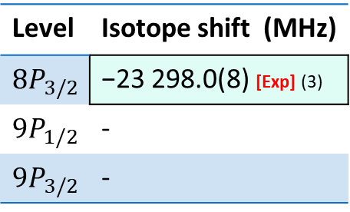
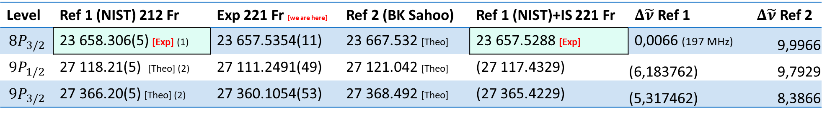
Energy levels – litterature
Level | Ref 1 (NIST) 212 Fr | Exp 221 Fr [we are here] | Ref 2 (BK Sahoo) | Ref 1 (NIST)+IS 221 Fr | $Δ\tilde{ν}$ Ref 1 | $Δ\tilde{ν}$ Ref 2
$$8P_{3/2}$$ | 23 658.306(5) [Exp] (1) | 23 657.5354(11) | 23 667.532 [Theo] | 23 657.5288 [Exp] | 0,0066 (197 MHz) | 9,9966
$$9P_{1/2}$$ | 27 118.21(5) [Theo] (2) | 27 111.2491(49) | 27 121.042 [Theo] | (27 117.4329) | (6,183762) | 9,7929
$$9P_{3/2}$$ | 27 366.20(5) [Theo] (2) | 27 360.1054(53) | 27 368.492 [Theo] | (27 365.4229) | (5,317462) | 8,3866
Level | Isotope shift (MHz)
$$8P_{3/2}$$ | −23 298.0(8) [Exp] (3)
$$9P_{1/2}$$ | -
$$9P_{3/2}$$ | -
(1) Duong, H. et al. First observation of the blue optical lines of francium. Europhysics Letters 3, 175 (1987).
(2) Biémont, E., Quinet, P. & Van Renterghem, V. Theoretical investigation of neutral francium. Journal of Physics B: Atomic, Molecular and Optical Physics 31, 5301 (1998).
(3) Sansonetti, J. E. Spectroscopic Data for Neutral Francium (FrI). Journal of Physical and Chemical Reference Data 36, 497–507 (2007).

Slide 10
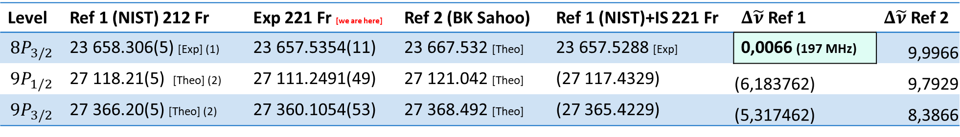
Energy levels – litterature
Level | Ref 1 (NIST) 212 Fr | Exp 221 Fr [we are here] | Ref 2 (BK Sahoo) | Ref 1 (NIST)+IS 221 Fr | $Δ\tilde{ν}$ Ref 1 | $Δ\tilde{ν}$ Ref 2
$$8P_{3/2}$$ | 23 658.306(5) [Exp] (1) | 23 657.5354(11) | 23 667.532 [Theo] | 23 657.5288 [Exp] | 0,0066 (197 MHz) | 9,9966
$$9P_{1/2}$$ | 27 118.21(5) [Theo] (2) | 27 111.2491(49) | 27 121.042 [Theo] | (27 117.4329) | (6,183762) | 9,7929
$$9P_{3/2}$$ | 27 366.20(5) [Theo] (2) | 27 360.1054(53) | 27 368.492 [Theo] | (27 365.4229) | (5,317462) | 8,3866
Level | Isotope shift (MHz)
$$8P_{3/2}$$ | −23 298.0(8) [Exp] (3)
$$9P_{1/2}$$ | -
$$9P_{3/2}$$ | -
(1) Duong, H. et al. First observation of the blue optical lines of francium. Europhysics Letters 3, 175 (1987).
(2) Biémont, E., Quinet, P. & Van Renterghem, V. Theoretical investigation of neutral francium. Journal of Physics B: Atomic, Molecular and Optical Physics 31, 5301 (1998).
(3) Sansonetti, J. E. Spectroscopic Data for Neutral Francium (FrI). Journal of Physical and Chemical Reference Data 36, 497–507 (2007).

Slide 11
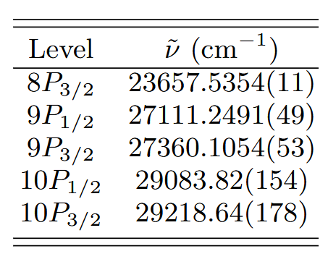
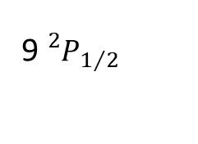
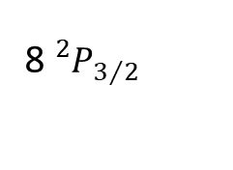
Atomic studies in Fr : Campain 2023
Fr
1064 nm
9${}_{}^{2}{P_{3/2}}$
9${}_{}^{2}{P_{1/2}}$
365 nm
368 nm
8${}_{}^{2}{P_{3/2}}$
First tests done in 2023:
First identification of 9P_{1/2, 3/2,}
PRELIMINARY
422 nm
7${}_{}^{2}{S_{1/2}}$

Slide 12
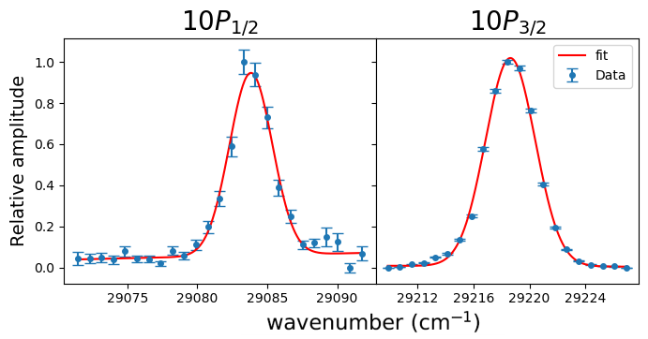
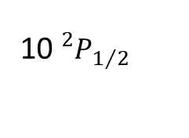
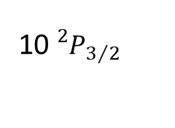
Atomic studies in Fr : Campain 2024
Fr
10${}_{}^{2}{P_{3/2}}$
1064 nm
10${}_{}^{2}{P_{1/2}}$
342 nm
9${}_{}^{2}{P_{3/2}}$
344 nm
9${}_{}^{2}{P_{1/2}}$
365 nm
368 nm
8${}_{}^{2}{P_{3/2}}$
PRELIMINARY
PRELIMINARY
PRELIMINARY
422 nm
7${}_{}^{2}{S_{1/2}}$

Slide 13
Lifetimes

Slide 14
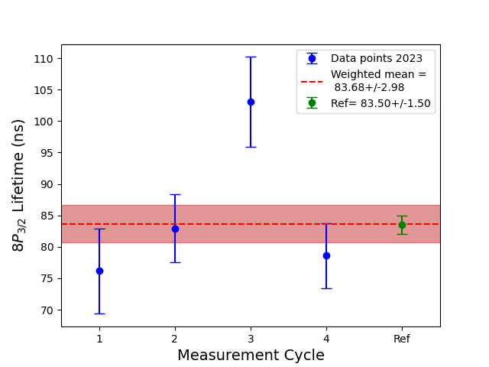
8p3/2 Lifetime reference
Fr
1064 nm
9${}_{}^{2}{P_{3/2}}$
9${}_{}^{2}{P_{1/2}}$
365 nm
368 nm
8${}_{}^{2}{P_{3/2}}$
422 nm
7${}_{}^{2}{S_{1/2}}$

Slide 15
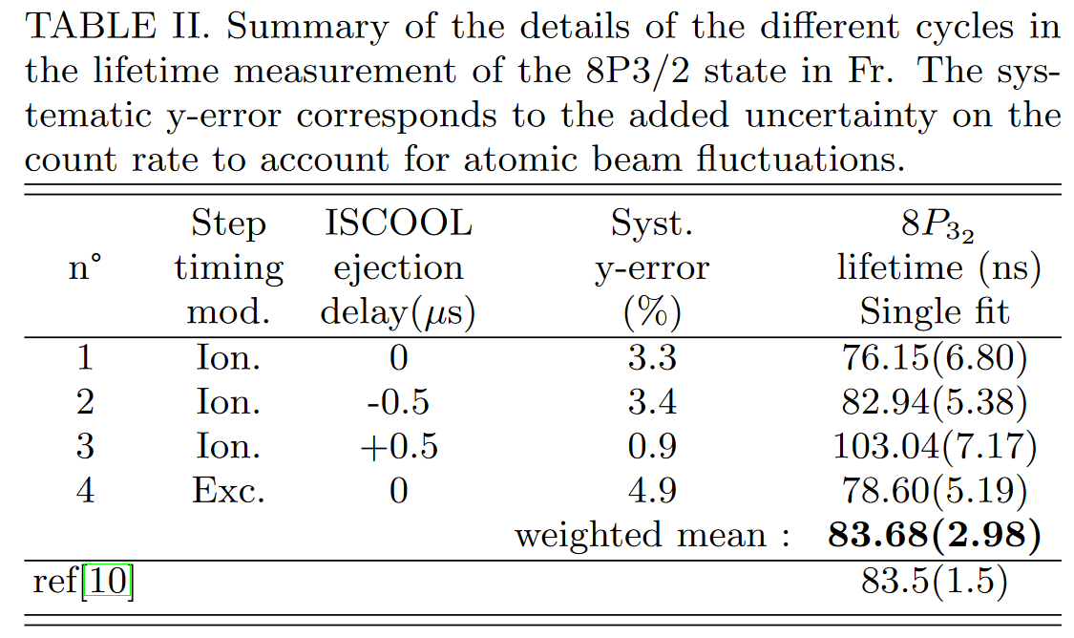
8p3/2 Lifetime reference

Slide 16
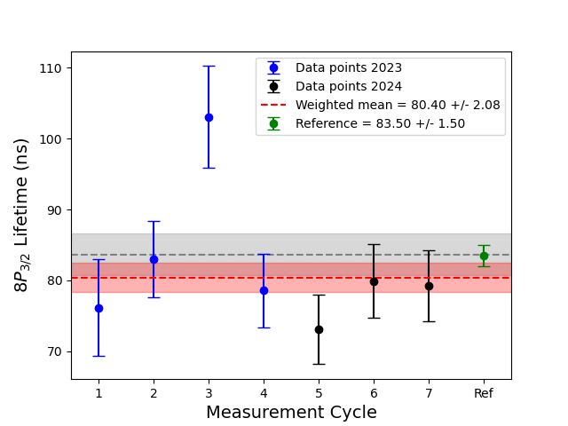
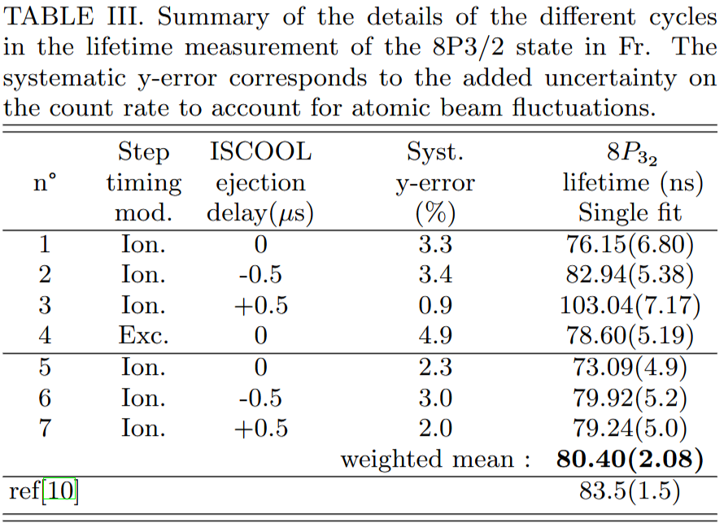
8p3/2 Lifetime reference

Slide 17
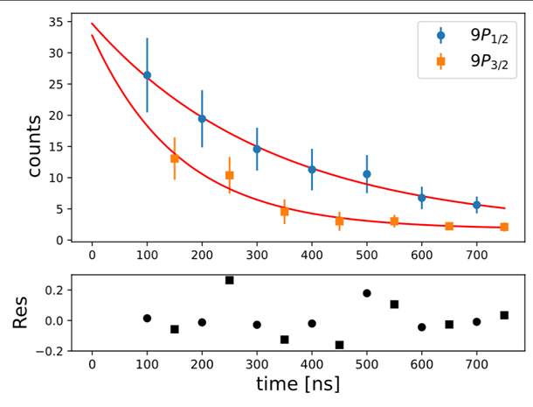
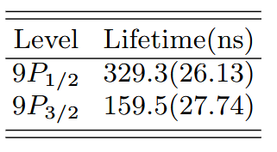
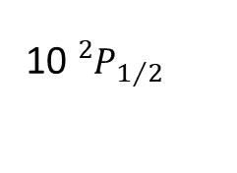
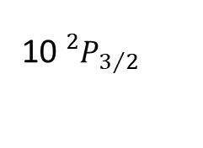
2023 campain : 9P Lifetimes
Fr
1064 nm
2023
10${}_{}^{2}{P_{3/2}}$
First tests done in 2023:
Lifetime measurements of 9P_{1/2, 3/2}
  Tentative results, need further measurements
10${}_{}^{2}{P_{1/2}}$
9${}_{}^{2}{P_{3/2}}$
9${}_{}^{2}{P_{1/2}}$
8${}_{}^{2}{P_{3/2}}$
365 nm
368 nm
7${}_{}^{2}{S_{1/2}}$

Slide 18
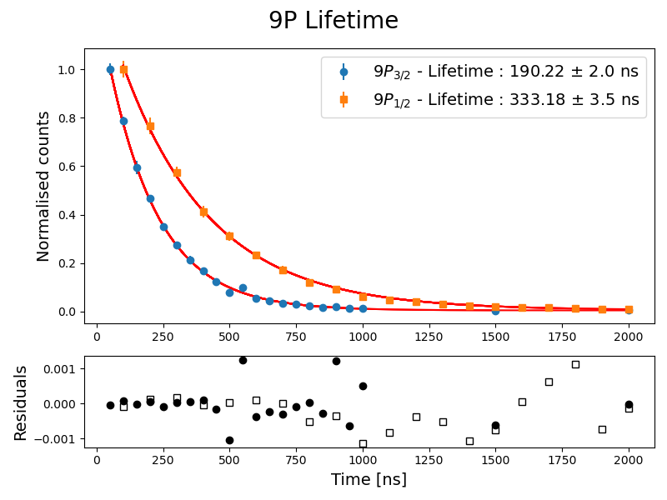
Atomic studies in Fr : 9P Lifetimes
2024
2023
PRELIMINARY

Slide 19
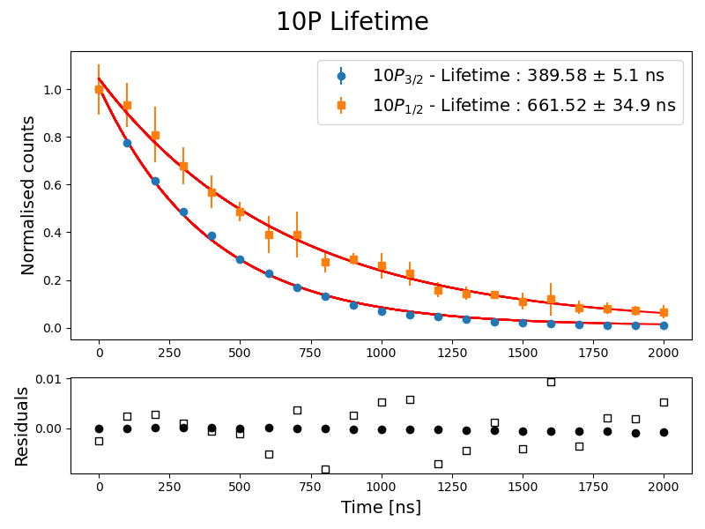
Atomic studies in Fr : Lifetimes
PRELIMINARY
PRELIMINARY

Slide 20
Atomic studies in Fr : Lifetimes
Possible Variations for final results:
PRELIMINARY

Slide 21
Atomic studies in Fr : Lifetimes
Possible Variations for final results:
Laser Overlap regime
PRELIMINARY
I
422nm
1064nm
∆t
t

Slide 22
Atomic studies in Fr : Lifetimes
Possible Variations for final results:
Laser Overlap regime
PRELIMINARY
I
422nm
1064nm
∆t
t

Slide 23
Atomic studies in Fr : Lifetimes
Possible Variations for final results:
Laser Overlap regime
PRELIMINARY
I
422nm
1064nm
∆t
t

Slide 24
Atomic studies in Fr : Lifetimes
Possible Variations for final results:
Laser Overlap regime
Background Measurements
PRELIMINARY

Slide 25
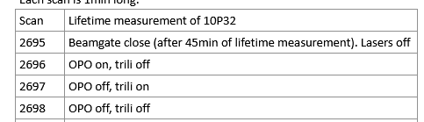

Atomic studies in Fr : Lifetimes
Possible Variations for final results:
Laser Overlap regime
Background Measurements
PRELIMINARY
$${f\left(x\right)=Ae}^{−B}+C$$

Slide 26
Atomic studies in Fr :
High interest for theoretical model :
Matrices elements used to constrain model to determine polarisability
Publication in preparation with the collaboration of Theoretician team of B.K Sahoo
PRELIMINARY

Slide 27
Main Objective

Slide 28
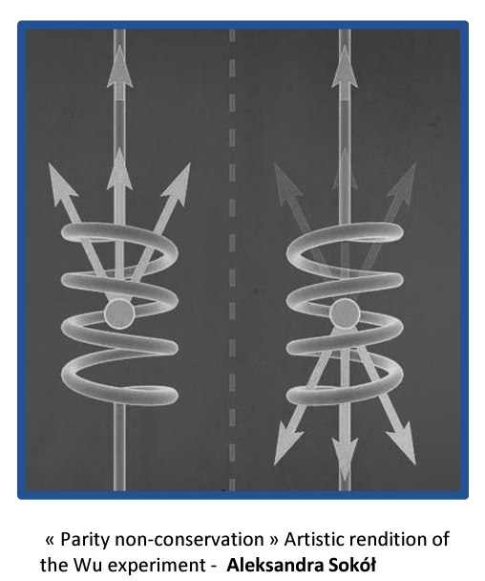
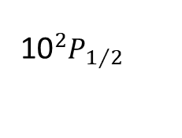
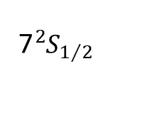
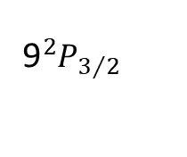
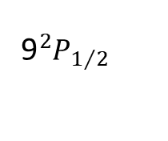

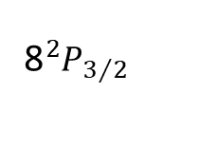

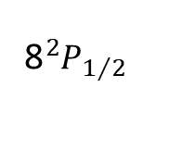
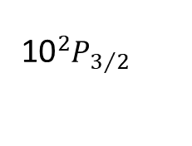
General motivation – Parity non-conservation
1064 nm
10${}_{ }^{2}{P_{3/2}}$
Towards the measurements of Parity non-conservation (PNC) in Fr
10${}_{ }^{2}{P_{1/2}}$
9${}_{ }^{2}{P_{3/2}}$
9${}_{ }^{2}{P_{1/2}}$
To date: Most accurate measurement performed on 6 ²𝑆_{1/2} → 7 ²𝑆_{1/2} transition in Cs, relative uncertainty of 0.35 %.
Predicted PNC amplitude in the 7 ²𝑆_{1/2} →6 ²𝐷_{3/2,5/2} transitions in Fr: more than 50 times larger
8${}_{ }^{2}{P_{3/2}}$
8${}_{ }^{2}{P_{1/2}}$
6${}_{ }^{2}{D_{5/2}}$
6${}_{ }^{2}{D_{3/2}}$
7${}_{ }^{2}{S_{1/2}}$
${}^{(1)}$Wood, C. S., S. C. Bennett, D. Cho, B. P. Masterson, J. L. Roberts, C. E. Tanner, et C. E. Wieman. « Measurement of Parity Nonconservation and an Anapole Moment in Cesium ». Science 275, nº 5307 (1997)
${}^{(2)}$Roberts, B. M., V. A. Dzuba, et V. V. Flambaum. « Parity nonconservation in Fr-like actinide and Cs-like rare-earth-metal ions ». Phys. Rev. A 88, nº 1

Slide 29







Atomic 6D-states in neutral Fr
IP
9${}_{ }^{2}{P_{3/2}}$
9${}_{ }^{2}{P_{1/2}}$
8${}_{ }^{2}{P_{3/2}}$
8${}_{ }^{2}{P_{1/2}}$
6${}_{ }^{2}{D_{5/2}}$
6${}_{ }^{2}{D_{3/2}}$
Experimentally identifying the 6D levels
Direct excitation forbidden → need different route
~608 nm
7${}_{ }^{2}{S_{1/2}}$

Slide 30
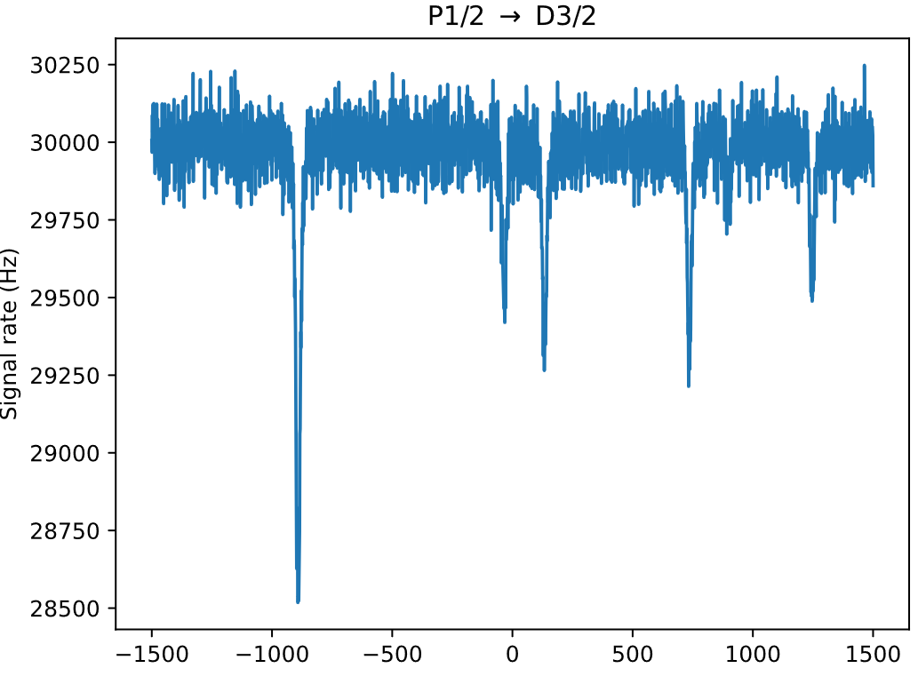



Atomic 6D-states in neutral Fr
IP
Simulated spectra of the 8P1/2 → 6D3/2 transitions
1064 nm
n${}_{ }^{2}{P_{ }}$/n${}_{ }^{2}{F_{ }}$
9${}_{ }^{2}{P_{3/2}}$
9${}_{ }^{2}{P_{1/2}}$
8${}_{ }^{2}{P_{3/2}}$
Lambda-scheme:
Driving population into 6D states via 9P
8${}_{ }^{2}{P_{1/2}}$
~912 nm
6${}_{ }^{2}{D_{5/2}}$
6${}_{ }^{2}{D_{3/2}}$
365 nm
Two step ionization scheme → detect laser ions
Additional laser driving depopulation into the 6D state → dip in ion rate
~608 nm
7${}_{ }^{2}{S_{1/2}}$

Slide 31
Atomic 6D-states in neutral Fr
FIU
IP
n${}_{ }^{2}{P_{ }}$/n${}_{ }^{2}{F_{ }}$
9${}_{ }^{2}{P_{3/2}}$
9${}_{ }^{2}{P_{1/2}}$
8${}_{ }^{2}{P_{3/2}}$
~611 nm
N-scheme:
4 steps Ionization
8${}_{ }^{2}{P_{1/2}}$
~912 nm
6${}_{ }^{2}{D_{5/2}}$
6${}_{ }^{2}{D_{3/2}}$
365 nm
Excitation to 9P lvl
Additional laser driving depopulation into the 6D state → dip in ion rate
Excitation to Rydberg states (+plus bonus of characterizing Rydberg series)
Field ionization = previous new developments necessary
7${}_{ }^{2}{S_{1/2}}$

Slide 32









Atomic 6D-states in neutral Fr
FIU
IP
n${}_{ }^{2}{P_{ }}$/n${}_{ }^{2}{F_{ }}$
9${}_{ }^{2}{P_{3/2}}$
9${}_{ }^{2}{P_{1/2}}$
8${}_{ }^{2}{P_{3/2}}$
~611 nm
N-scheme:
4 steps Ionization
8${}_{ }^{2}{P_{1/2}}$
~912 nm
6${}_{ }^{2}{D_{5/2}}$
6${}_{ }^{2}{D_{3/2}}$
365 nm
Excitation to 9P lvl
Additional laser driving depopulation into the 6D state → dip in ion rate
Excitation to Rydberg states (+plus bonus of characterizing Rydberg series)
Field ionization = previous new developments necessary
7${}_{ }^{2}{S_{1/2}}$

Slide 33

Atomic 6D-states in neutral Fr
FIU
IP
n${}_{ }^{2}{P_{ }}$/n${}_{ }^{2}{F_{ }}$
9${}_{ }^{2}{P_{3/2}}$
9${}_{ }^{2}{P_{1/2}}$
8${}_{ }^{2}{P_{3/2}}$
~611 nm
8${}_{ }^{2}{P_{1/2}}$
~912 nm
6${}_{ }^{2}{D_{5/2}}$
6${}_{ }^{2}{D_{3/2}}$
365 nm
Excitation to 9P lvl
Additional laser driving depopulation into the 6D state → dip in ion rate
Excitation to Rydberg states (+plus bonus of characterizing Rydberg series)
Field ionization = previous new developments necessary
7${}_{ }^{2}{S_{1/2}}$

Slide 34
Atomic 6D-states in neutral Fr
FIU
IP
n${}_{ }^{2}{P_{ }}$/n${}_{ }^{2}{F_{ }}$
9${}_{ }^{2}{P_{3/2}}$
9${}_{ }^{2}{P_{1/2}}$
8${}_{ }^{2}{P_{3/2}}$
~611 nm
8${}_{ }^{2}{P_{1/2}}$
~912 nm
6${}_{ }^{2}{D_{5/2}}$
6${}_{ }^{2}{D_{3/2}}$
365 nm
Excitation to 9P lvl
Additional laser driving depopulation into the 6D state → dip in ion rate
Excitation to Rydberg states (+plus bonus of characterizing Rydberg series)
Field ionization = previous new developments necessary
7${}_{ }^{2}{S_{1/2}}$

Slide 35
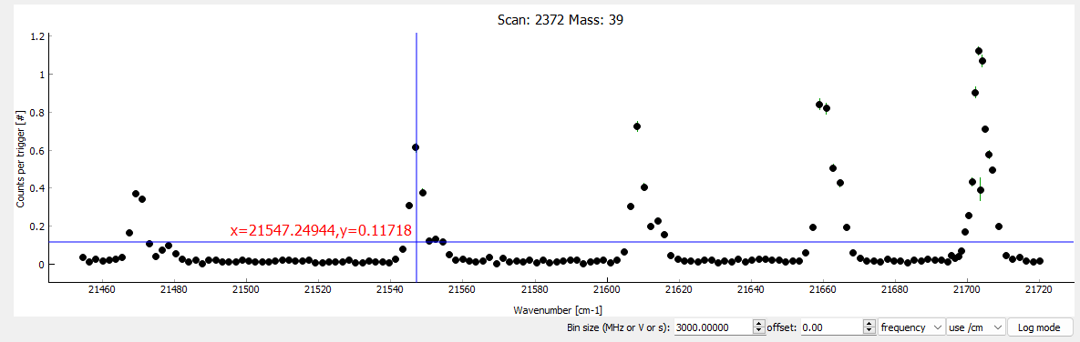
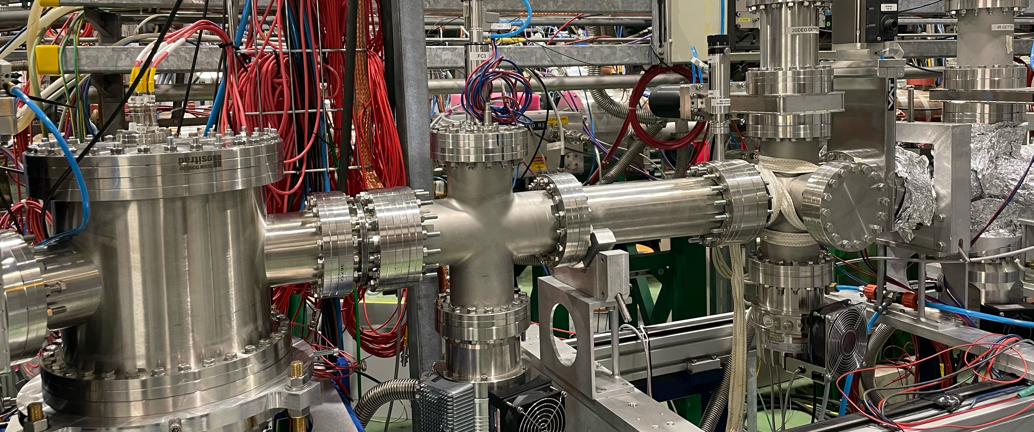
Atomic 6D-states in neutral Fr
FIU
IP
n${}_{ }^{2}{P_{ }}$/n${}_{ }^{2}{F_{ }}$
9${}_{ }^{2}{P_{3/2}}$
9${}_{ }^{2}{P_{1/2}}$
8${}_{ }^{2}{P_{3/2}}$
~611 nm
8${}_{ }^{2}{P_{1/2}}$
~912 nm
6${}_{ }^{2}{D_{5/2}}$
6${}_{ }^{2}{D_{3/2}}$
365 nm
Excitation to 9P lvl
Additional laser driving depopulation into the 6D state → dip in ion rate
Excitation to Rydberg states (+plus bonus of characterizing Rydberg series)
Field ionization = previous new developments necessary
7${}_{ }^{2}{S_{1/2}}$

Slide 36
Atomic 6D-states in neutral Fr
IP
n${}_{ }^{2}{P_{ }}$/n${}_{ }^{2}{F_{ }}$
9${}_{ }^{2}{P_{3/2}}$
9${}_{ }^{2}{P_{1/2}}$
8${}_{ }^{2}{P_{3/2}}$
~611 nm
8${}_{ }^{2}{P_{1/2}}$
~912 nm
6${}_{ }^{2}{D_{5/2}}$
6${}_{ }^{2}{D_{3/2}}$
365 nm
Excitation to 9P lvl
Additional laser driving depopulation into the 6D state → dip in ion rate
Excitation to Rydberg states (+plus bonus of characterizing Rydberg series)
Field ionization = previous new developments necessary
7${}_{ }^{2}{S_{1/2}}$

Slide 37

Atomic 6D-states in neutral Fr
FIU
IP
n${}_{ }^{2}{P_{ }}$/n${}_{ }^{2}{F_{ }}$
9${}_{ }^{2}{P_{3/2}}$
PRELIMINARY
9${}_{ }^{2}{P_{1/2}}$
8${}_{ }^{2}{P_{3/2}}$
~611 nm
8${}_{ }^{2}{P_{1/2}}$
6${}_{ }^{2}{D_{5/2}}$
6${}_{ }^{2}{D_{3/2}}$
Charge exchange population
∼2%
7${}_{ }^{2}{S_{1/2}}$

Slide 38

Atomic 6D-states in neutral Fr
FIU
IP
n${}_{ }^{2}{P_{ }}$/n${}_{ }^{2}{F_{ }}$
9${}_{ }^{2}{P_{3/2}}$
PRELIMINARY
9${}_{ }^{2}{P_{1/2}}$
8${}_{ }^{2}{P_{3/2}}$
~611 nm
8${}_{ }^{2}{P_{1/2}}$
6${}_{ }^{2}{D_{5/2}}$
VERY PRELIMINARY !
6${}_{ }^{2}{D_{3/2}}$
Charge exchange population
∼2%
First FIU online implementation
New Rydberg series observed
7${}_{ }^{2}{S_{1/2}}$

Slide 39

Atomic 6D-states in neutral Fr
IP
n${}_{ }^{2}{P_{ }}$/n${}_{ }^{2}{F_{ }}$
9${}_{ }^{2}{P_{3/2}}$
PRELIMINARY
9${}_{ }^{2}{P_{1/2}}$
8${}_{ }^{2}{P_{3/2}}$
~611 nm
8${}_{ }^{2}{P_{1/2}}$
6${}_{ }^{2}{D_{5/2}}$
6${}_{ }^{2}{D_{3/2}}$
Excitation to 9P lvl
Additional laser driving depopulation into the 6D state → dip in ion rate
Excitation to Rydberg states (+plus bonus of characterizing Rydberg series)
Field ionization = previous new developments necessary
7${}_{ }^{2}{S_{1/2}}$

Slide 40
Lifetime measurements of 6D_{5/2}
IP
1064 nm
n${}_{ }^{2}{P_{ }}$/n${}_{ }^{2}{F_{ }}$
9${}_{ }^{2}{P_{3/2}}$
9${}_{ }^{2}{P_{1/2}}$
8${}_{ }^{2}{P_{3/2}}$
8${}_{ }^{2}{P_{1/2}}$
~912 nm
6${}_{ }^{2}{D_{5/2}}$
6${}_{ }^{2}{D_{3/2}}$
Excitation to 9P lvl
Additional laser driving depopulation into the 6D state → dip in ion rate
Excitation to Rydberg states (+plus bonus of characterizing Rydberg series)
Field ionization = previous new developments necessary
7${}_{ }^{2}{S_{1/2}}$

Slide 41

Lifetime measurements of 6D_{5/2}
IP
1064 nm
n${}_{ }^{2}{P_{ }}$/n${}_{ }^{2}{F_{ }}$
9${}_{ }^{2}{P_{3/2}}$
9${}_{ }^{2}{P_{1/2}}$
8${}_{ }^{2}{P_{3/2}}$
8${}_{ }^{2}{P_{1/2}}$
~912 nm
Lifetime measurements by delaying excitation laser
6${}_{ }^{2}{D_{5/2}}$
6${}_{ }^{2}{D_{3/2}}$
Excitation to 9P lvl
Additional laser driving depopulation into the 6D state → dip in ion rate
Excitation to Rydberg states (+plus bonus of characterizing Rydberg series)
Field ionization = previous new developments necessary
7${}_{ }^{2}{S_{1/2}}$

Slide 42

Lifetime measurements of 6D_{5/2}
IP
1064 nm
n${}_{ }^{2}{P_{ }}$/n${}_{ }^{2}{F_{ }}$
9${}_{ }^{2}{P_{3/2}}$
9${}_{ }^{2}{P_{1/2}}$
8${}_{ }^{2}{P_{3/2}}$
8${}_{ }^{2}{P_{1/2}}$
~912 nm
Lifetime measurements by delaying excitation laser
6${}_{ }^{2}{D_{5/2}}$
6${}_{ }^{2}{D_{3/2}}$
Charge exchange population
∼2%
7${}_{ }^{2}{S_{1/2}}$

Slide 43
Atomic 6D-states in neutral Fr
FIU
IP
n${}_{ }^{2}{P_{ }}$/n${}_{ }^{2}{F_{ }}$
9${}_{ }^{2}{P_{3/2}}$
9${}_{ }^{2}{P_{1/2}}$
8${}_{ }^{2}{P_{3/2}}$
~611 nm
8${}_{ }^{2}{P_{1/2}}$
N-scheme:
Work indirectly !
~912 nm
6${}_{ }^{2}{D_{5/2}}$
6${}_{ }^{2}{D_{3/2}}$
365 nm
Excitation to 9P lvl
Additional laser driving depopulation into the 6D state → dip in ion rate
Excitation to Rydberg states (+plus bonus of characterizing Rydberg series)
Field ionization = previous new developments necessary
7${}_{ }^{2}{S_{1/2}}$

Slide 44
Atomic 6D-states in neutral Fr
FIU
IP
Simulated spectra of the 8P1/2 → 6D3/2 transitions
1064 nm
n${}_{ }^{2}{P_{ }}$/n${}_{ }^{2}{F_{ }}$
9${}_{ }^{2}{P_{3/2}}$
9${}_{ }^{2}{P_{1/2}}$
8${}_{ }^{2}{P_{3/2}}$
~611 nm
8${}_{ }^{2}{P_{1/2}}$
N-scheme:
Work directly ?
~912 nm
6${}_{ }^{2}{D_{5/2}}$
6${}_{ }^{2}{D_{3/2}}$
365 nm
Excitation to 9P lvl
Additional laser driving depopulation into the 6D state → dip in ion rate
Excitation to Rydberg states (+plus bonus of characterizing Rydberg series)
Field ionization = previous new developments necessary
~608 nm
7${}_{ }^{2}{S_{1/2}}$

Slide 45
More Atomic measurements in neutral Fr !
FIU
IP
1064 nm
n${}_{ }^{2}{P_{ }}$/n${}_{ }^{2}{F_{ }}$
9${}_{ }^{2}{P_{3/2}}$
9${}_{ }^{2}{P_{1/2}}$
VERY PRELIMINARY !
8${}_{ }^{2}{P_{3/2}}$
~611 nm
8${}_{ }^{2}{P_{1/2}}$
~912 nm
6${}_{ }^{2}{D_{5/2}}$
6${}_{ }^{2}{D_{3/2}}$
365 nm
Good opportunity to Scan all P serie to IP
Further tests on λ and N Scheme
Search for D level Fine and Hyperfine structure
~608 nm
7${}_{ }^{2}{S_{1/2}}$

Slide 46

More Atomic measurements in neutral Fr !
Fluctuations of the Beam:
Unable to do High precision Spectroscopy
At least 2 shifts losts
Same problem during Antimony ? And Gold ?
VERY PRELIMINARY !
6${}_{ }^{2}{D_{3/2}}$
365 nm
~608 nm
7${}_{ }^{2}{S_{1/2}}$

Slide 47


Conclusion
  Atomic studies in 221 Francium :
  New atomic levels identified in Fr
  Lifetime measurements performed for excited P-states
  Identified 6D state (broadband)
  New Rydberg series observed

Slide 48
Outlook
More measurements to be done on 6Ds
Scan Rydberg series further for unambiguous identification
More precise lifetime measurements
Ionization potential
Hyperfine structure of 6Ds
With 6D identification: first stepping stone towards high-precision studies

Slide 49









Acknowledgments
CRIS collaboration

