Slide 1

Systematic study of ²²³RaF from the 2023 campaign
Proposal by
M. Athanasakis-Kaklamanakis, S. Wilkins, R.F. Garcia-Ruiz
INTC-P-555-ADDENDUM
PhD student: Carlos M. Fajardo-Zambrano
CRIS collaboration meeting, January 2025.

Slide 2
Quick introduction
2

Slide 3
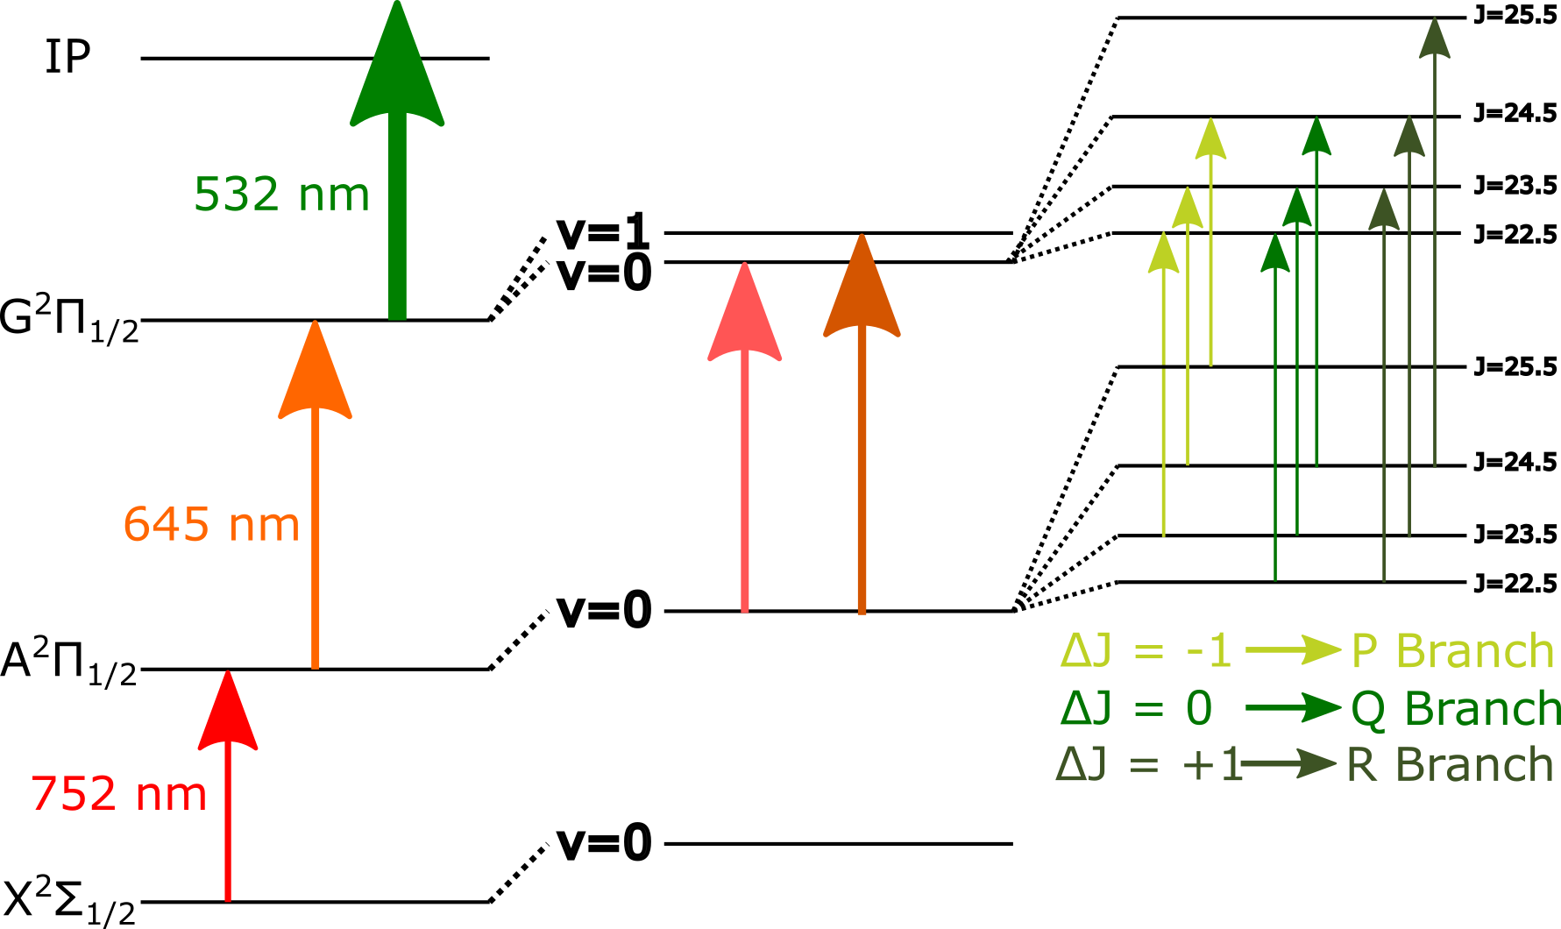
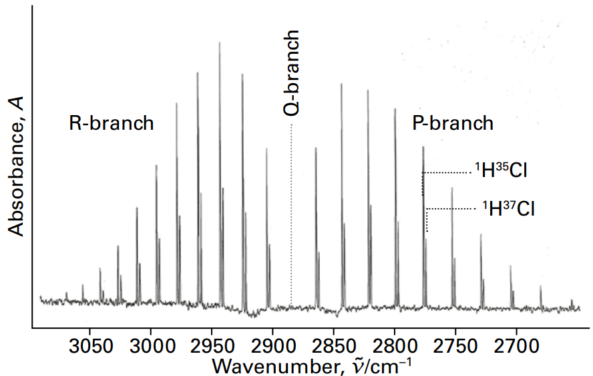

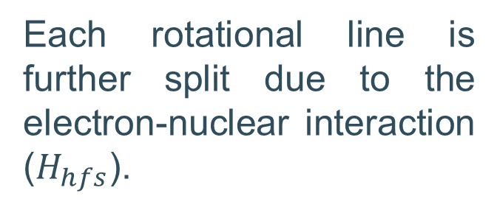


Laser spectroscopy on molecules
The spectrum of a rovibrational transition is divided in three different branches: R ($ΔJ=+1$), Q ($ΔJ=0$), P ($ΔJ=−1$).
Each rotational line is further split due to the electron-nuclear interaction ($H_{hfs}$).
Typical textbook spectrum for HCl
$$H_{el}$$
$$H_{vib}$$
$$H_{rot}$$
[1] Atkins, Physical chemistry, P. Atkins, P. W., & de Paula, J. (2014).

Slide 4
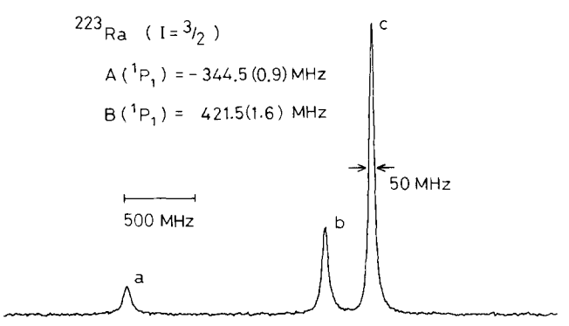




High-resolution in atoms and molecules
$$H_{hfs}=H_{m}+H_{Q}=A\left(I,J\right)+B(I,J)$$
$$F=1/2$$
²P_{1/2}
$$F=3/2$$
$$F=5/2$$
²S_{1/2}
$$F=3/2$$
²²³Ra (I=3/2)
F = |J + I|
$$H_{hfs,R}=H_{m}+H_{Q}=A_{∥}\left(I_{z},J_{z}\right)+A_{⊥}(I_{\left(x,y\right)},J_{\left(x,y\right)}) +eq_{0}Q\left(I_{z},J_{z}\right)−eq_{2}Q(I_{\left(x,y\right)},J_{(x,y)})$$
Each rotational transition is one HFS spectrum of ²²³RaF like the one above
²²³RaF (I=3/2)
$$H_{el}$$
$$H_{vib}$$
$$H_{rot}$$
$$H_{hfs}$$
[2] Ahmad, S. A., et al. Physics Letters B 133.1-2 (1983): 47-52.
Notes:
$a$, is the nuclear spin-electron orbit interaction, $b_{F}$ is the Fermi contact interaction, $c$ and $d$ are the nuclear spin-electron spin axial and perpendicular dipole interaction
$eq_{0}Q$ and $eq_{2}Q$ are the nuclear quadrupole axial and perpendicular coupling constants.

Slide 5
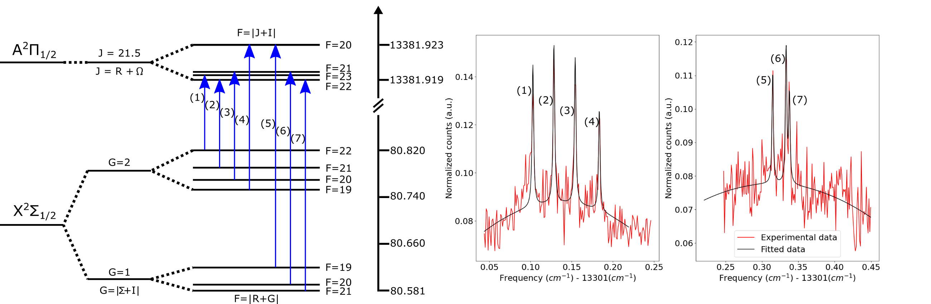
High resolution ²²³RaF (I =3/2) spectrum (R-branch)

Slide 6
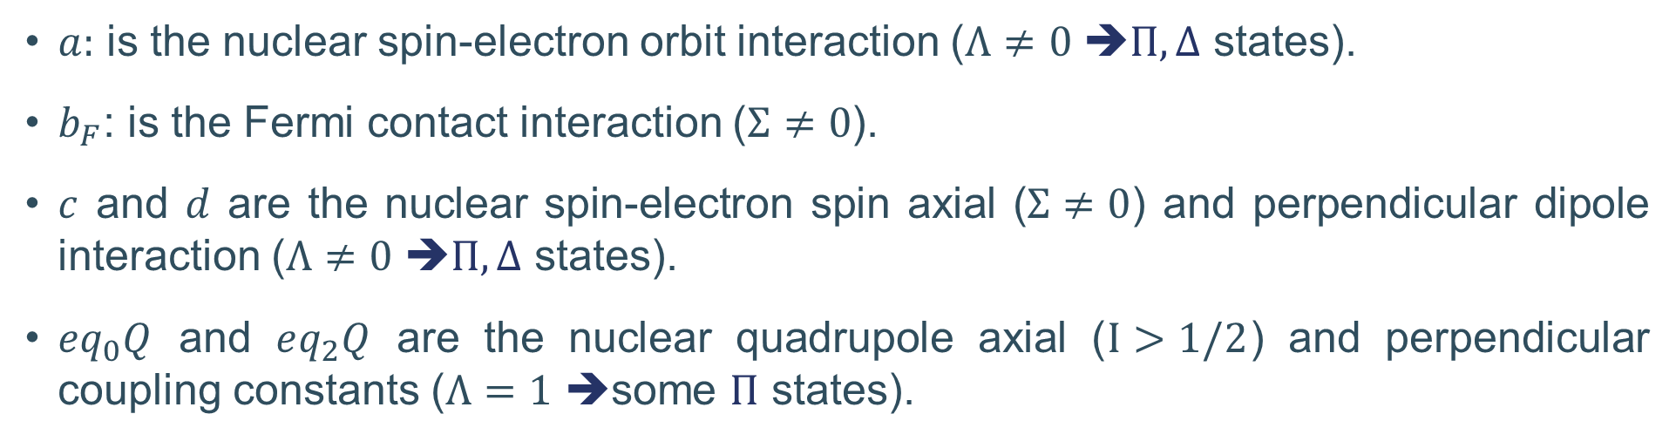


Frosch and Foley molecular constants
$$H_{hfs}=H_{m}+H_{Q}=a\left(I,L\right)+b_{F}\left(I,S\right)+c\left(I,S\right)+d\left(S_{+}I_{+},S_{−}I_{−}\right)+eq_{0}Q\left(I,S\right)−eq_{2}Q(S_{+}I_{+},S_{−}I_{−})$$
$a:$ is the nuclear spin-electron orbit interaction ($Λ≠0$ ➔$Π, Δ$ states).
$b_{F}$: is the Fermi contact interaction ($Σ≠0$).
$c$ and $d$ are the nuclear spin-electron spin axial ($Σ≠0$) and perpendicular dipole interaction ($Λ≠0$ ➔$Π, Δ$ states).
$eq_{0}Q$ and $eq_{2}Q$ are the nuclear quadrupole axial ($I>1/2$) and perpendicular coupling constants ($Λ=1$ ➔some $Π$ states).
$$Σ(molecules)↔S(atomic)$$
$$Λ(molecules)↔L(atomic)$$
Notes:
Magnetic HFS constants. The first of these describes the orbital/spatial distribution of the unpaired electrons. The other three parameters give information on the electron spin distribution within the molecule. bF is the spin density at the nucleus, while c and d are associated with the angular spin distributions
(d and eq2Q are only different than zero for Pi states). The latter measures the asymmetry of the EFG perpendicular to the z axis. unlike the magnetic hyperfine interactions, the electric quadrupole interaction depends on all the electrons in the molecule , which makes its calculation more arduous.
Seems to me that for eq2Q to be nonzero, the state has to be Sigma = 1, Pi state and Omega = 1. Based on PGOPGER simulations.

Slide 7
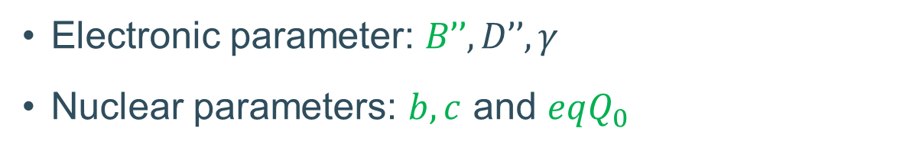
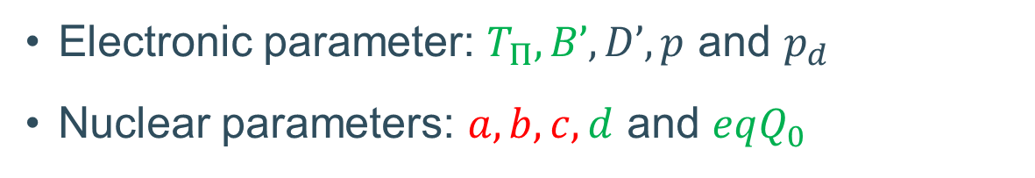



The ²²³RaF case
IP
532 nm
Electronic parameter: $T_{Π}, B’, D’, p$ and $p_{d}$
Nuclear parameters: $a, b, c, d$ and $eqQ_{0}$
G²$Π_{1/2}$
Not-constrained
645 nm
A²$Π_{1/2}$
Electronic parameter: $B’’, D’’,γ$
Nuclear parameters: $b, c$ and $eqQ_{0}$
752 nm
X²$Σ_{1/2}$
²²³RaF

Slide 8
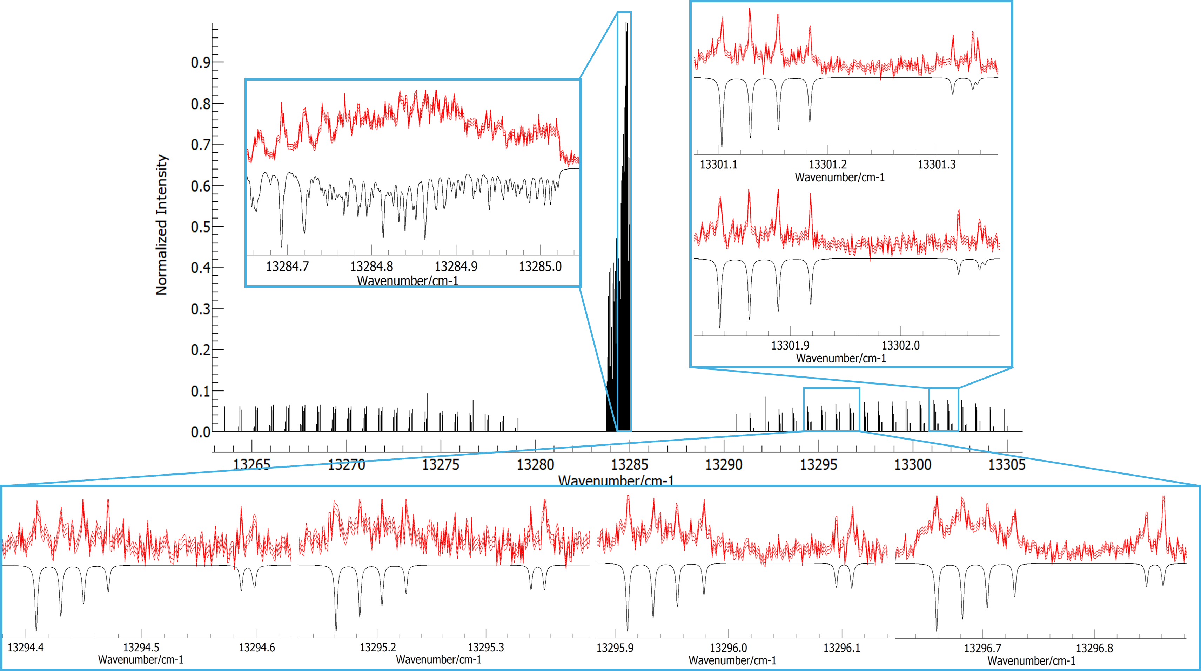
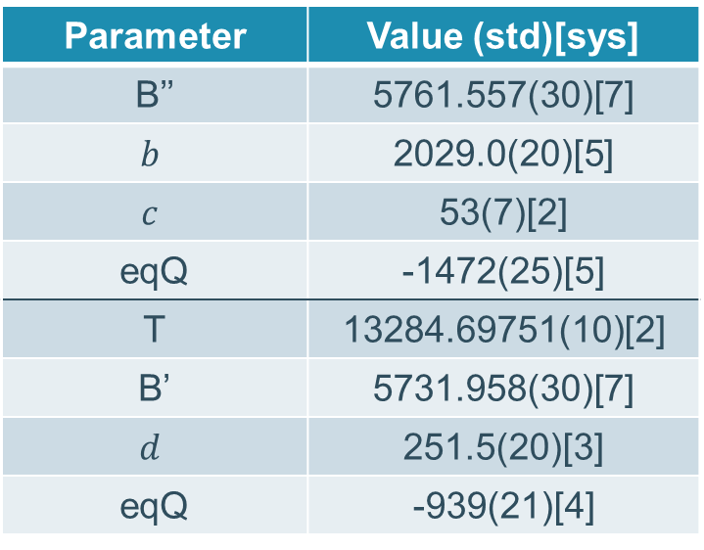
Fitting of the ²²³RaF spectra (PGOPHER).
Parameter | Value (std)[sys]
B’’ | 5761.557(30)[7]
$$b$$ | 2029.0(20)[5]
$$c$$ | 53(7)[2]
eqQ | -1472(25)[5]
T | 13284.69751(10)[2]
B’ | 5731.958(30)[7]
$$d$$ | 251.5(20)[3]
eqQ | -939(21)[4]
Total of 6 R-branch lines were measured ➔ 6 HFS spectra.

Slide 9
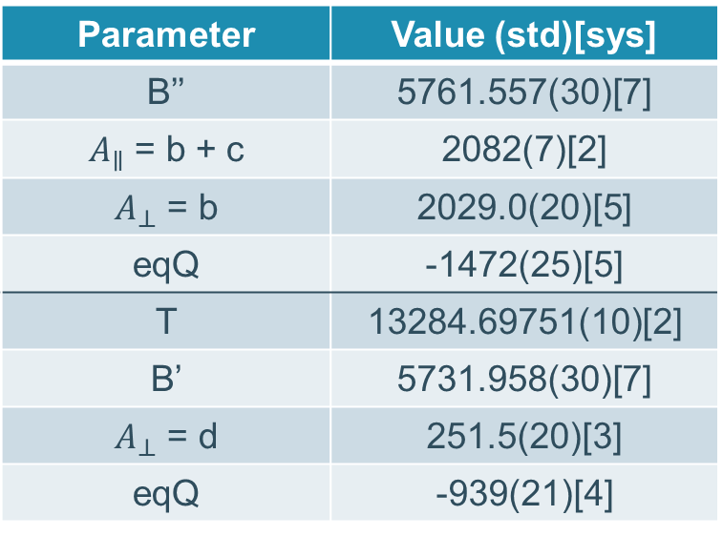
Fitting of the ²²³RaF spectra (PGOPHER).
Parameter | Value (std)[sys]
B’’ | 5761.557(30)[7]
$A_{∥}$ = b + c | 2082(7)[2]
$A_{⊥}$ = b | 2029.0(20)[5]
eqQ | -1472(25)[5]
T | 13284.69751(10)[2]
B’ | 5731.958(30)[7]
$A_{⊥}$ = d | 251.5(20)[3]
eqQ | -939(21)[4]

Slide 10
Fitting procedure:
Initial R-branch fit
Fit including the Q-branch
10

Slide 11
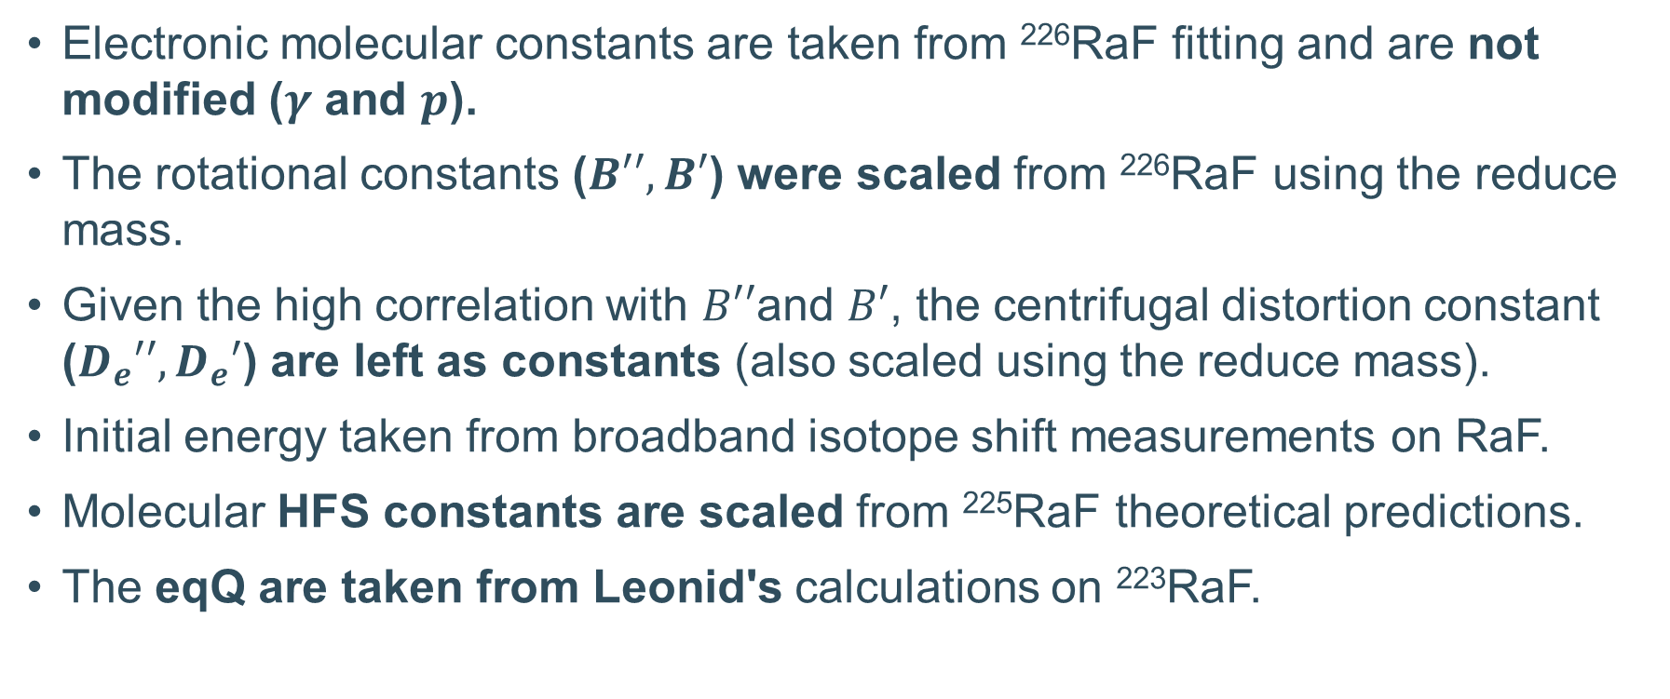
Assumptions for the initial fit
Electronic molecular constants are taken from ²²⁶RaF fitting and are not modified ($γ$ and $p$).
The rotational constants ($B′′, B′$) were scaled from ²²⁶RaF using the reduce mass.
Given the high correlation with $B′′$and $B′$, the centrifugal distortion constant ($D_{e}′′,D_{e}′$) are left as constants (also scaled using the reduce mass).
Initial energy taken from broadband isotope shift measurements on RaF.
Molecular HFS constants are scaled from ²²⁵RaF theoretical predictions.
The eqQ are taken from Leonid's calculations on ²²³RaF.

Slide 12
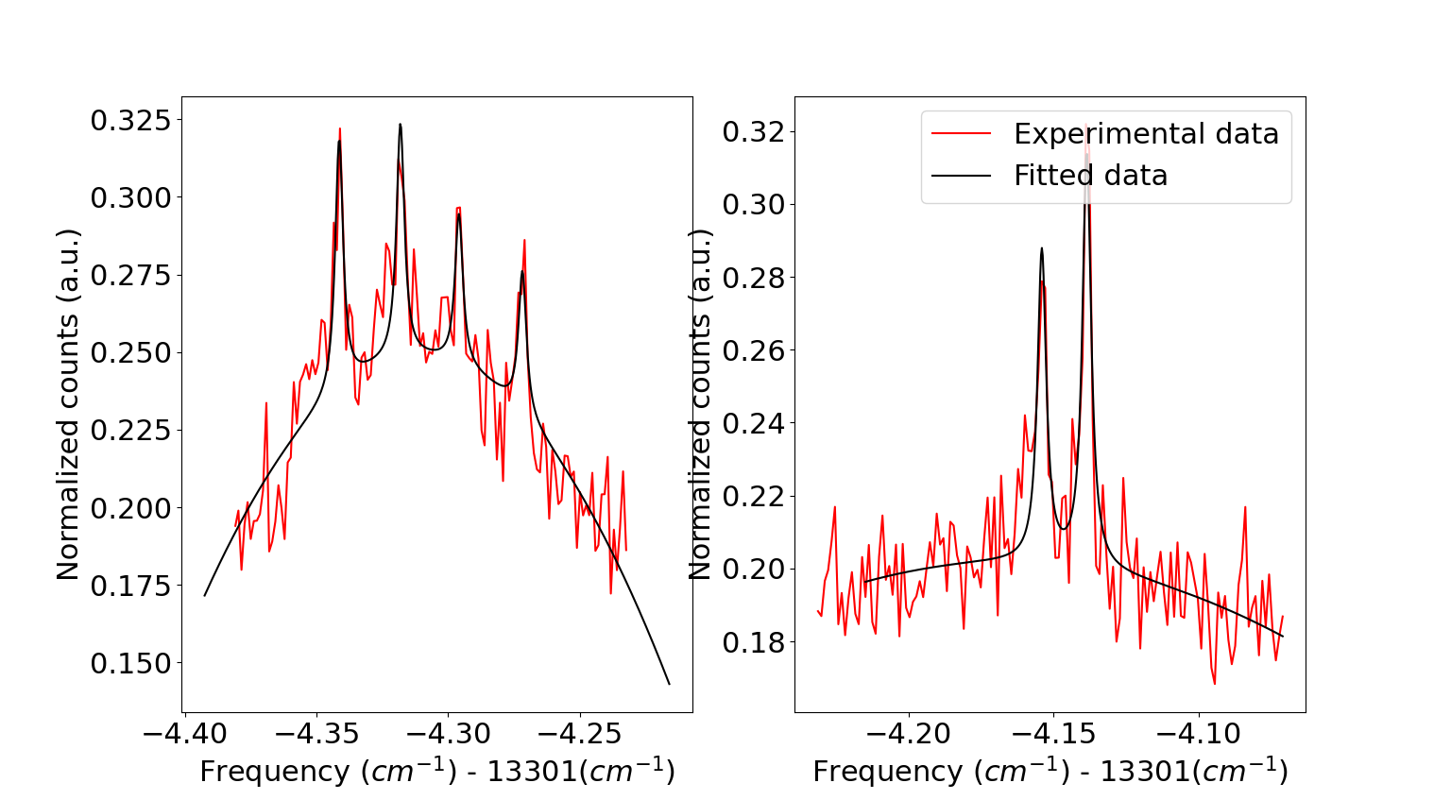
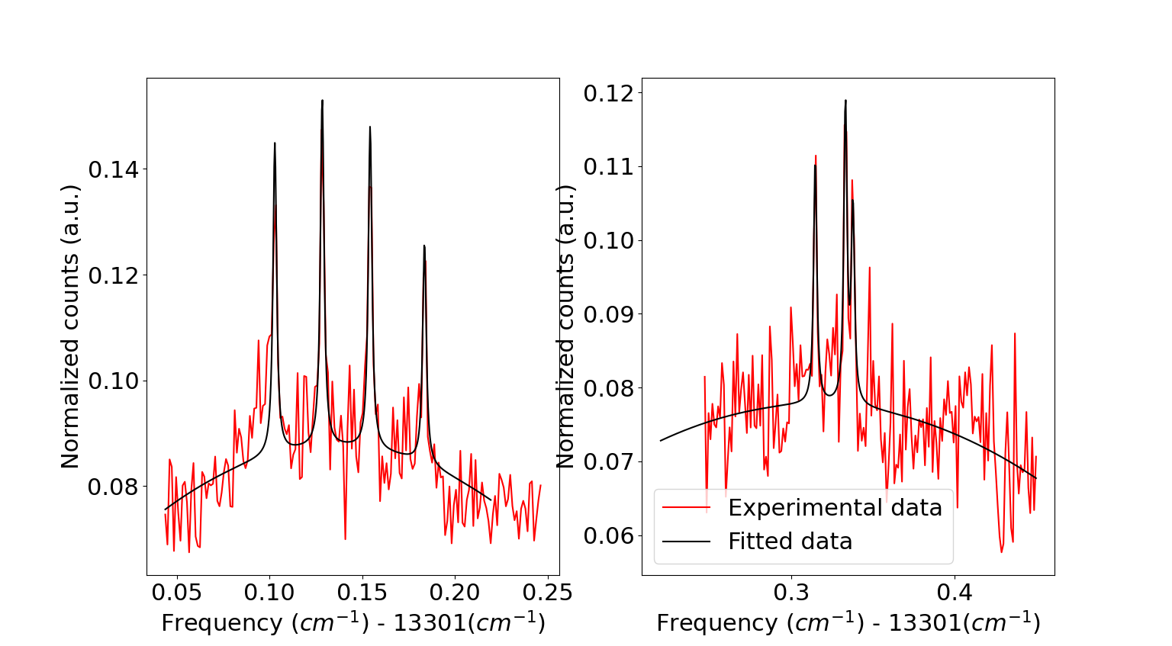
Linewidth determination
To define the linewidth of each of the HFS peaks, the peaks were fitted using SATLAS 2.
Such fitting allow the inclusion of the bkg (taken as a polynomial of second order). The error on the peaks center ranges between ~3 and ~21 MHz.

Slide 13
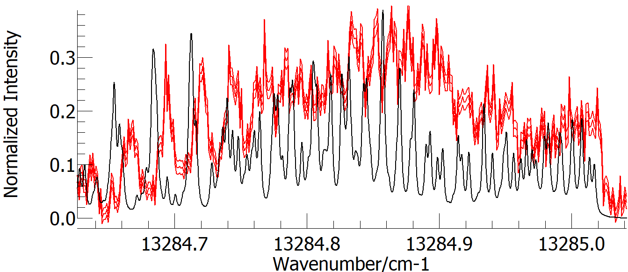
Q-branch unconstrained, R-branch fitted
Q-branch dependent on the J levels included
Experimental spectrum
“Fitted” spectrum
The initial fit (R-branch) gives an idea of the peaks to be fitted in the Q-branch.
The Q-branch needs to be included to constraint the fit (E, B’, B’’).
Band head

Slide 14
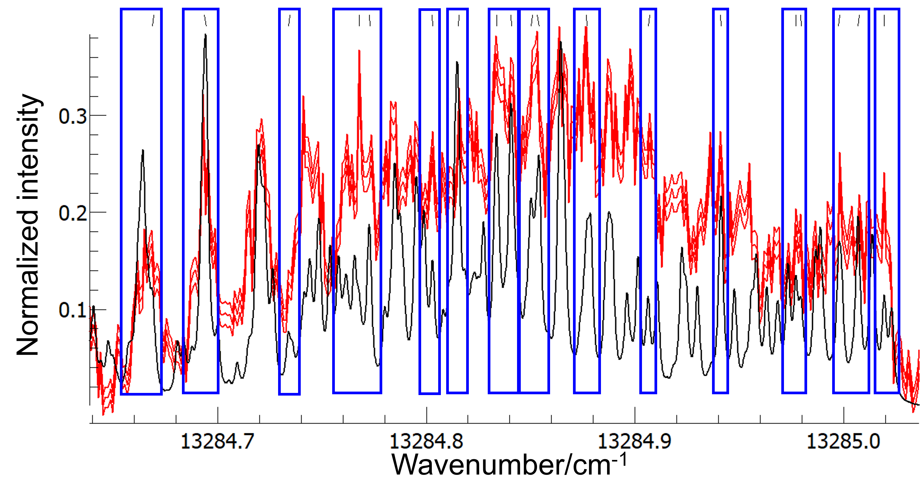
Peaks taken from the Q-branch
19 arbitrary peaks were selected. These peaks are needed to constrain the rotational constants and the energy of the excited state.

Slide 15
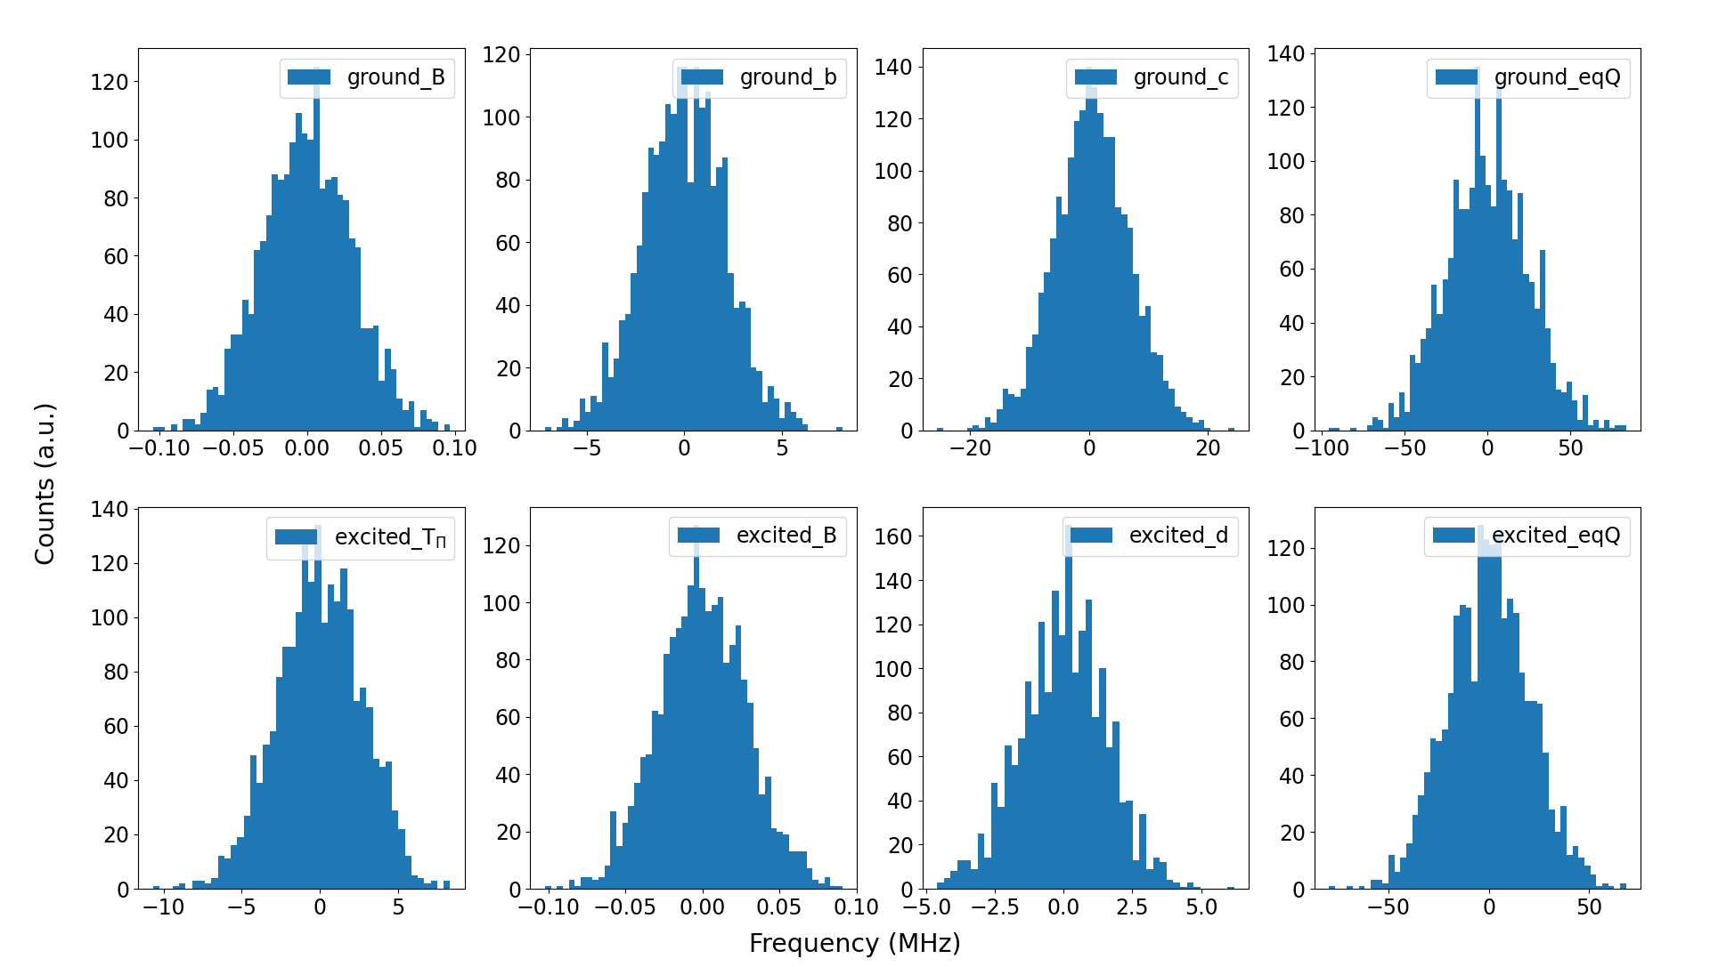
Final fit and estimation of statistical errors
Once the fitted spectrum matched the experimental data, the fitting was automatize using Python.
Based on the uncertainty in each HFS peak, a Gaussian distribution was created: (centroid = HFS peak centroid) and (width = HFS peak uncertainty).
Re-fitting of the spectra with new peak centroids taken from the Gaussians.
Store the fitted molecular constants and re-fit the spectra (total = 5000).
The retrieved distribution from each constant gives its nominal value and uncertainty.

Slide 16
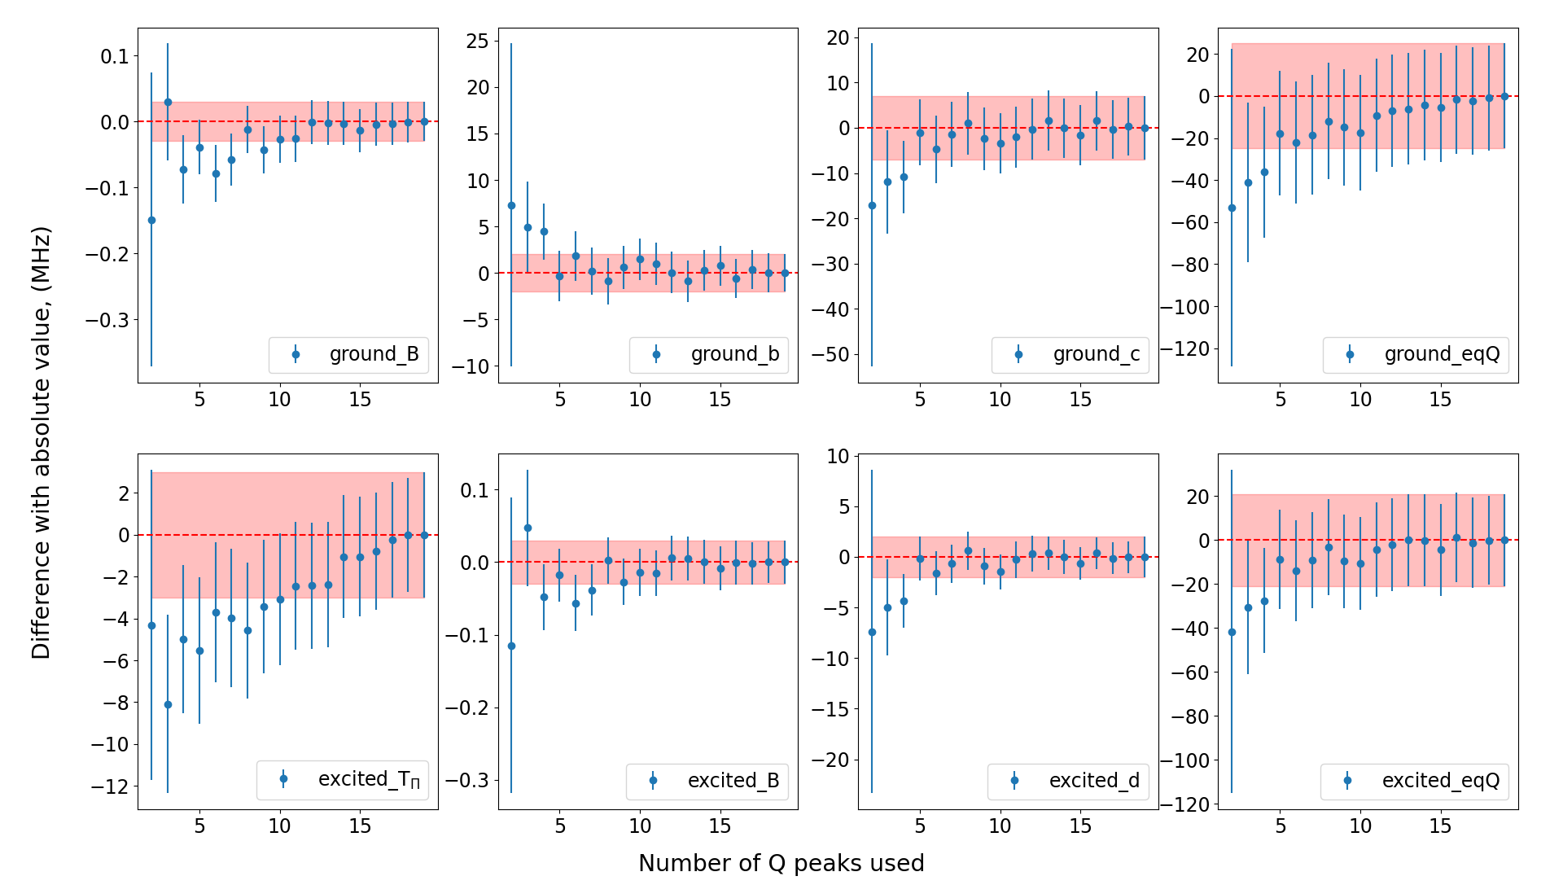
Molecular constants with Q lines (mean)

Slide 17
Systematic error
17

Slide 18
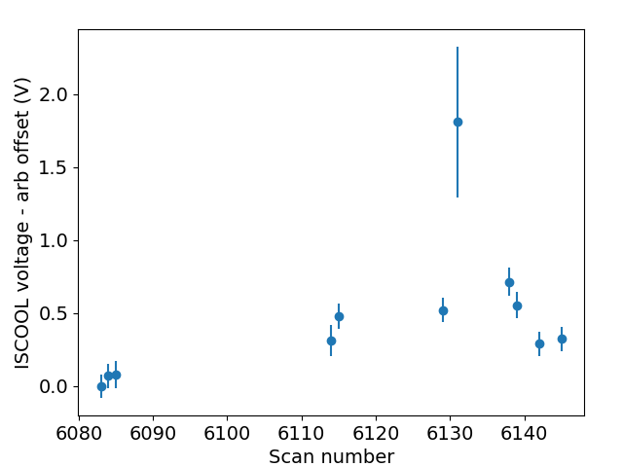
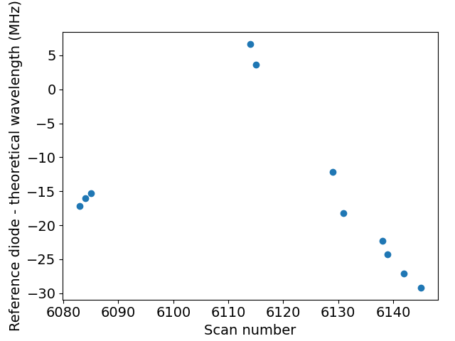
ISCOOL voltages and reference diodes across scans
Notes:
Max difference between used scans in voltage is 1.8V. But the individual ones are good.
For the diode is 36MHz

Slide 19
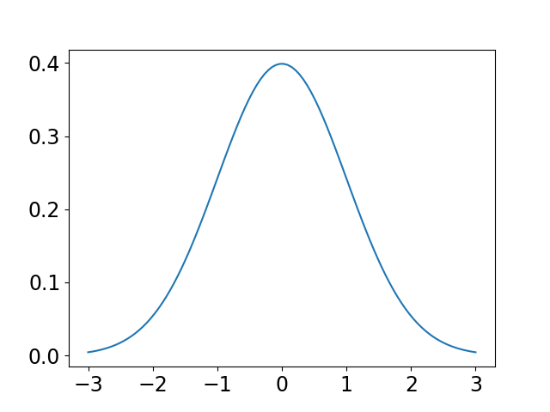
ISCOOL voltage systematic error contribution
Calculate ISCOOL voltage mean for each scan
Doppler shift to the ion frame at 30KeV
Add an uncertainty on the voltage = voltage std
Uncertainty on the wavelength used for the fit as systematic
Doppler shift back to the lab frame
This error was obtained individually for each of the 38 peaks on the R-branch
The same procedure was done for the voltage divider calibration factor
FWHM = centroid uncertainty
FWHM = voltage + diode uncertainties

Slide 20
Sources of systematic error (MHz)
Rotational Line | ISCOOL variation | ISCOOL voltage divider | Reference diode variation | Total new peak FWHM
1 | 0.3 | 0.5 | 0.6 | 1.4
2 | 0.3 | 0.5 | 0.3 | 1.1
3 | 0.5 | 0.5 | 1 | 2.0
4 | 2 | 0.5 | 0.9 | 3.4
5 | 0.5 | 0.5 | 1 | 2.0
6 | 0.5 | 0.5 | 1 | 2.0
Error due to ISCOOL variations were calculated for each individual peak.
Error due to Reference diode was obtained for the whole rotational line.
Notes:
Max difference between used scans in voltage is 1.8V. But the individual ones are good.
For the diode is 36MHz

Slide 21
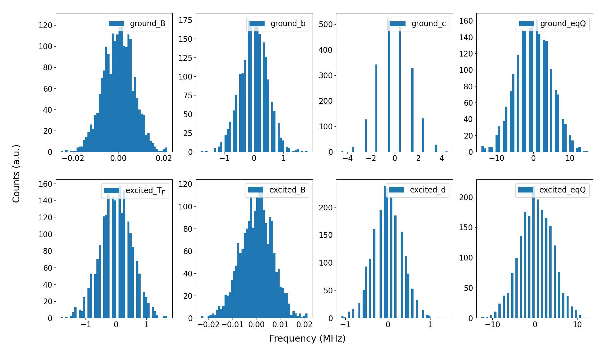
Systematic errors on the molecular constants of ²²³RaF
Based on the previous uncertainty a Gaussian distribution was created: (centroid = HFS peak centroid) and (width = systematic uncertainty).
Re-fitting of the spectra with new peak centroids taken from the Gaussians.
Store the fitted molecular constants and re-fit the spectra using new peak centroids.
The retrieved distribution from each constant gives its nominal value and uncertainty.

Slide 22
Nuclear moments
22

Slide 23



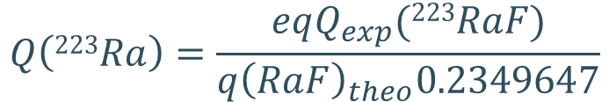
Extracting the nuclear moments
We can calculate the EFG of Leonid based on his theoretical eqQ and assumed Q = 1.21.
Ground state EFG_{theory} | Excited state EFG_{theory}
-5.18(28) | -3.20(17)
Extract the electric quadrupole moment using the predicted EFG (main source of uncertainty).
Quadrupole coupling constant
Quadrupole moment
$$Q\left(223Ra\right)=\frac{eqQ_{exp}(223RaF)}{q{\left(RaF\right)}_{theo}0.2349647}$$
EFG
$Q$(²²³RaF)_{ground} = 1.21(7) b
$Q$(²²³RaF)_{excited} = 1.25(7) b
$Q$(²²³Ra)_{ground} = 1.21(7) b
[3] Petrov, A. N., & Skripnikov, L. V. (2020). Physical Review A, 102(6), 062801.

Slide 24
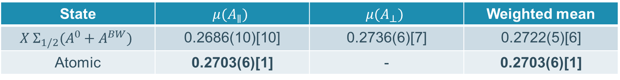
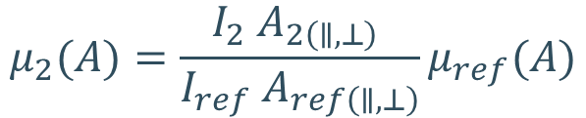
Extracting the nuclear moments
Similarly, we can extract the magnetic dipole moment using the known moments of an isotope (²²⁵RaF)
$$μ_{2}(A)=\frac{I_{2} A_{2\left(∥,⊥\right)} }{I_{ref} A_{ref\left(∥,⊥\right)}}μ_{ref}(A)$$
State | $$μ(A_{∥})$$ | $$μ(A_{⊥})$$ | Weighted mean
$$X Σ_{1/2}(A^{0}+A^{BW})$$ | 0.2686(10)[10] | 0.2736(6)[7] | 0.2722(5)[6]
Atomic | 0.2703(6)[1] | - | 0.2703(6)[1]
[4] Lynch, K. M., et al. (2018). Physical Review C, 97(2), 024309.
[5] Wilkins, S., et al. (2023). arXiv preprint arXiv:2311.04121.

Slide 25
Conclusions and outlook
The selected peaks on the Q-branch does not affect the retrieved molecular constants.
The nuclear moments of ²²³RaF has been extracted and are in close agreement with the atomic data.
Determine the number of R-lines needed to extract nuclear moments with enough precision (work in progress).

Slide 26
Thank you for your attention
26

Slide 27
Backup slides

Slide 28
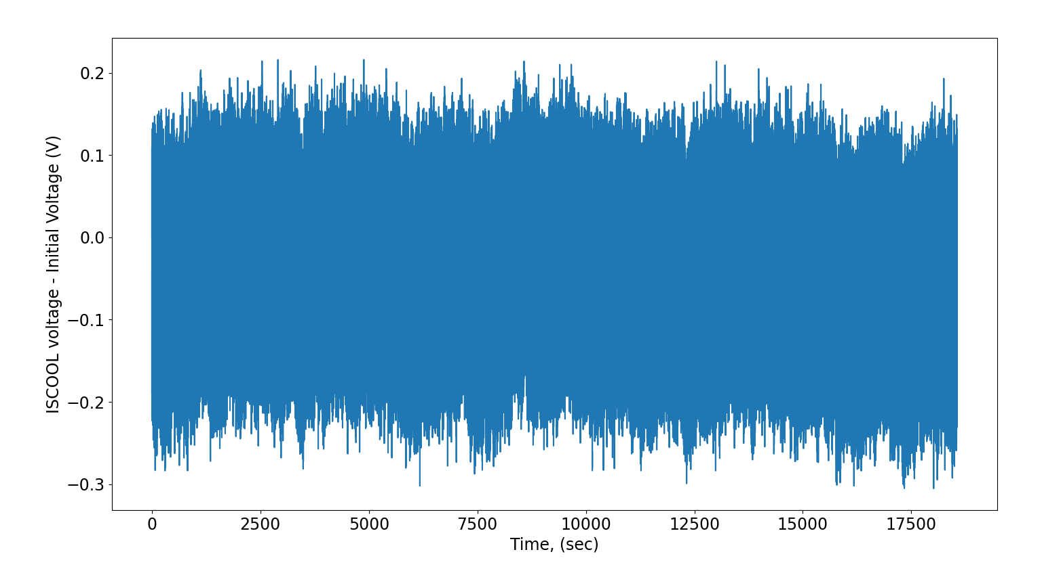
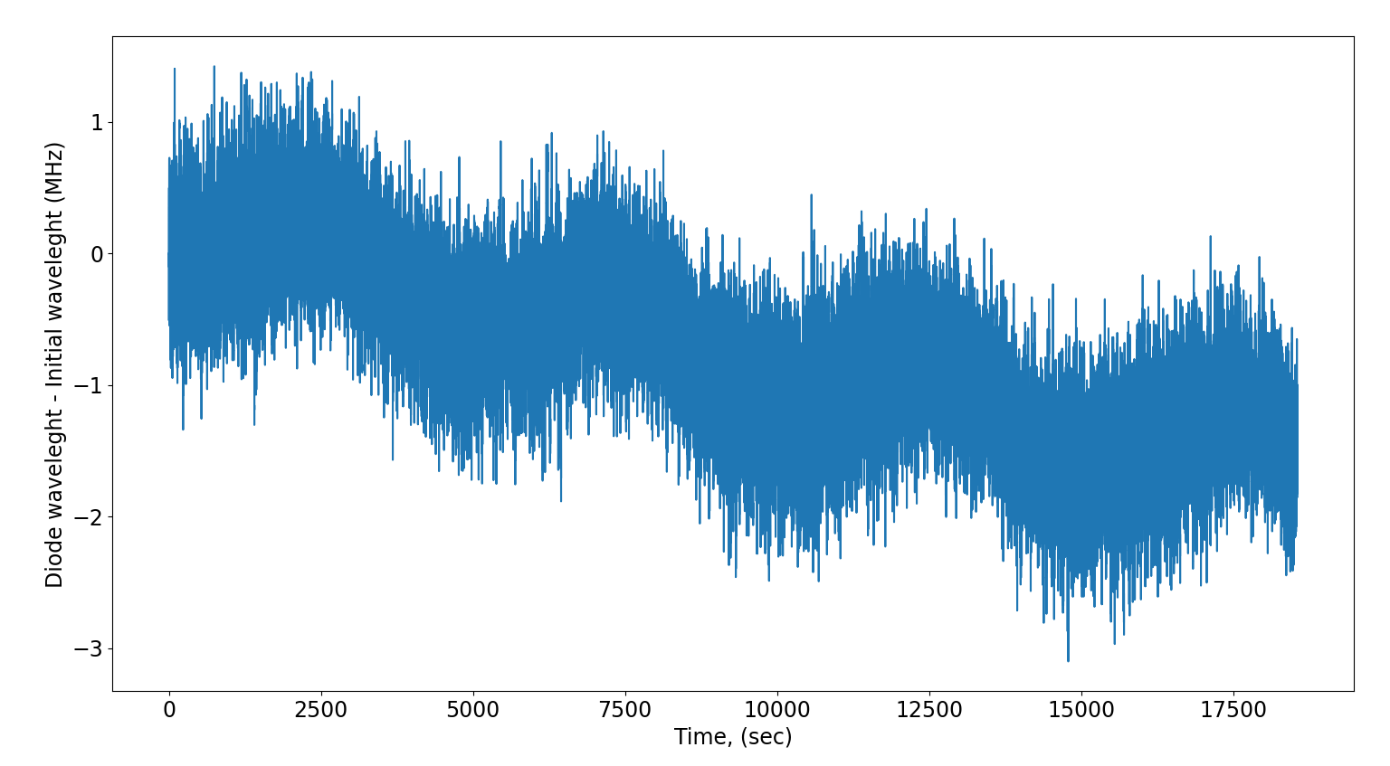
Scan 6145 variation of ISCOOL and diode (example)

Slide 29
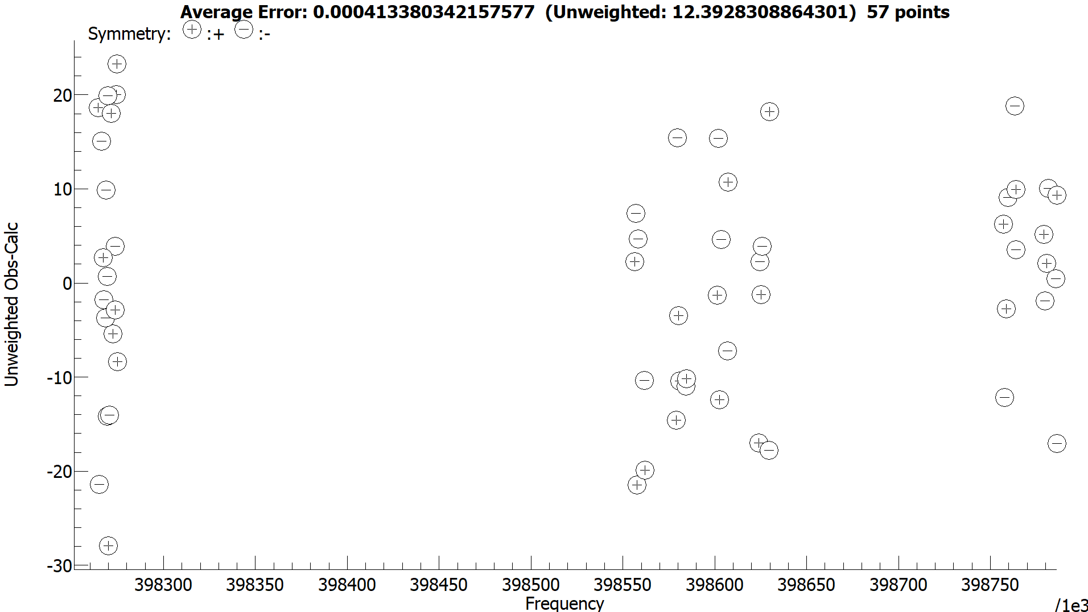
Residuals on the second fit (assigned lines)
Q-branch
R-branch

Slide 30
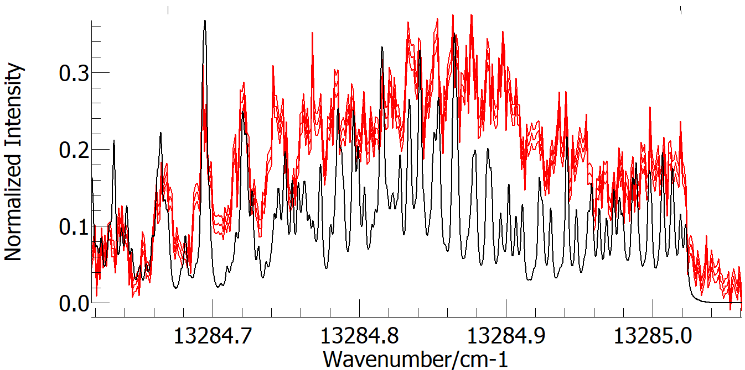
Considerations for the second fitting
The second fit starts by adding the farthest most peak on the spectrum.

Slide 31
Considerations for the second fitting
The rotational constants must fall within the error bar of the scaled ones from ²²⁶RaF and ²²⁵RaF (not a constraint but a good check of the fit).
The result from the second fit must match the band head of the Q-branch.
This second fitting is with the intention to have a better idea for the assignments on the Q-branch.
Note: The Q-branch was measured for low and medium J rotational lines. The latter rotational Q-branch was selected for the fit as it has more resolved peaks, a narrower band head, and the measured R-branch correspond to medium rotational lines (J = 11.5 to 21.5).

Slide 32
The selection of peaks
The peaks on the spectra can be made from different rotational transitions (lines), thus, when selecting a peak, the constrain can be impose over ill define rotational lines. Thus,
Lines are added if the transition strength is clearly differentiated, or no other lines are present.
Example of ill define peak
Example of a well define peak

Slide 33
The selection of peaks
The peaks on the spectra can be made from different rotational transitions (lines), thus, when selecting a peak, the constrain can be impose over ill define rotational lines. Thus,
Lines are added if the transition strength is clearly differentiated, or no other lines are present.
The added peaks should be as separated as possible.
After the addition of each peak, the spectrum is fitted, and the residuals are checked.

Slide 34
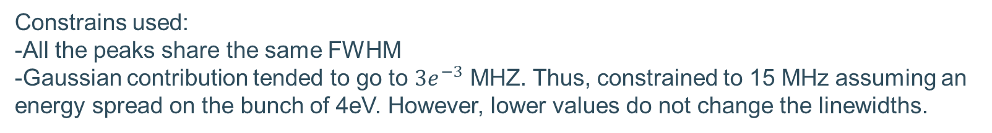
Linewidth determination
Rotational Line | FWHM (MHz). With Gauss = 15MHz | FWHM (MHz). With Gauss = 6MHz
1 | 61(11) | 58(12)
2 | 119(18) | 118(18)
3 | 87(11) | 86(11)
4 | 102(10) | 101(10)
5 | 71(7) | 69(8)
6 | 68(7) | 66(8)
Weighted mean | 78(4) | 77(4)
Constrains used:
-All the peaks share the same FWHM
-Gaussian contribution tended to go to $3e^{−3}$ MHZ. Thus, constrained to 15 MHz assuming an energy spread on the bunch of 4eV. However, lower values do not change the linewidths.

Slide 35
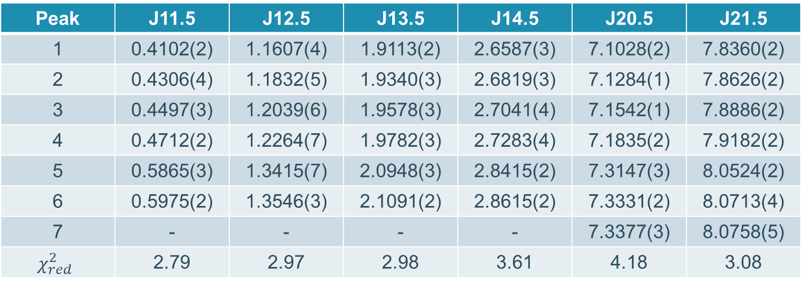
Peak position + 13294 (arb offset) cm-1
Peak | J11.5 | J12.5 | J13.5 | J14.5 | J20.5 | J21.5
1 | 0.4102(2) | 1.1607(4) | 1.9113(2) | 2.6587(3) | 7.1028(2) | 7.8360(2)
2 | 0.4306(4) | 1.1832(5) | 1.9340(3) | 2.6819(3) | 7.1284(1) | 7.8626(2)
3 | 0.4497(3) | 1.2039(6) | 1.9578(3) | 2.7041(4) | 7.1542(1) | 7.8886(2)
4 | 0.4712(2) | 1.2264(7) | 1.9782(3) | 2.7283(4) | 7.1835(2) | 7.9182(2)
5 | 0.5865(3) | 1.3415(7) | 2.0948(3) | 2.8415(2) | 7.3147(3) | 8.0524(2)
6 | 0.5975(2) | 1.3546(3) | 2.1091(2) | 2.8615(2) | 7.3331(2) | 8.0713(4)
7 | - | - | - | - | 7.3377(3) | 8.0758(5)
$$χ_{red}^{2}$$ | 2.79 | 2.97 | 2.98 | 3.61 | 4.18 | 3.08
The retrieved centroids were taken to PGOPGER for the initial fit keeping the rotational contribution constants.
The error on the peaks center ranges between ~3 and ~21 MHz.

Slide 36
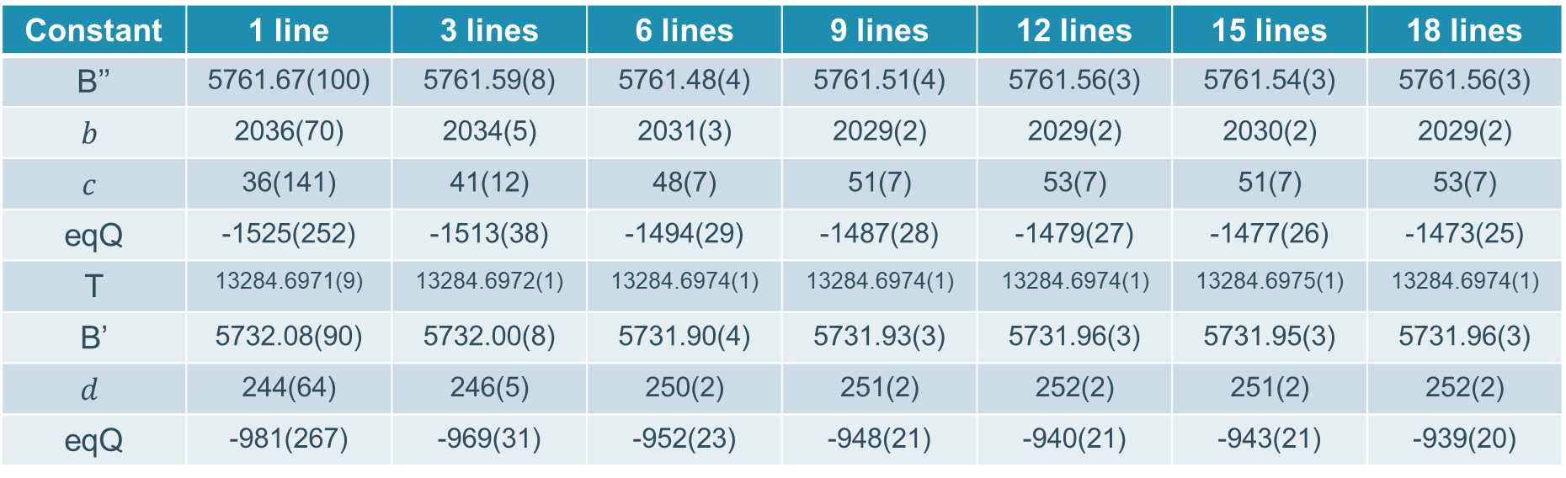
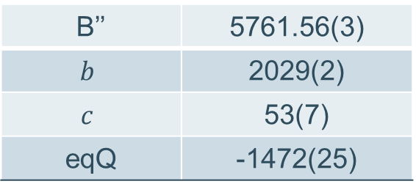
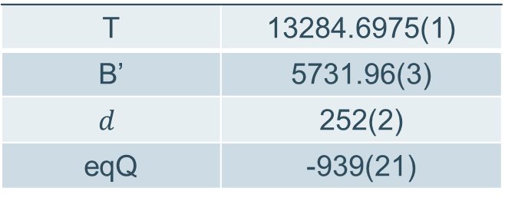
Molecular constants with Q lines (mean)
Constant | 1 line | 3 lines | 6 lines | 9 lines | 12 lines | 15 lines | 18 lines
B’’ | 5761.67(100) | 5761.59(8) | 5761.48(4) | 5761.51(4) | 5761.56(3) | 5761.54(3) | 5761.56(3)
$$b$$ | 2036(70) | 2034(5) | 2031(3) | 2029(2) | 2029(2) | 2030(2) | 2029(2)
$$c$$ | 36(141) | 41(12) | 48(7) | 51(7) | 53(7) | 51(7) | 53(7)
eqQ | -1525(252) | -1513(38) | -1494(29) | -1487(28) | -1479(27) | -1477(26) | -1473(25)
T | 13284.6971(9) | 13284.6972(1) | 13284.6974(1) | 13284.6974(1) | 13284.6974(1) | 13284.6975(1) | 13284.6974(1)
B’ | 5732.08(90) | 5732.00(8) | 5731.90(4) | 5731.93(3) | 5731.96(3) | 5731.95(3) | 5731.96(3)
$$d$$ | 244(64) | 246(5) | 250(2) | 251(2) | 252(2) | 251(2) | 252(2)
eqQ | -981(267) | -969(31) | -952(23) | -948(21) | -940(21) | -943(21) | -939(20)
B’’ | 5761.56(3)
$$b$$ | 2029(2)
$$c$$ | 53(7)
eqQ | -1472(25)
T | 13284.6975(1)
B’ | 5731.96(3)
$$d$$ | 252(2)
eqQ | -939(21)
Using all 19 lines

Slide 37
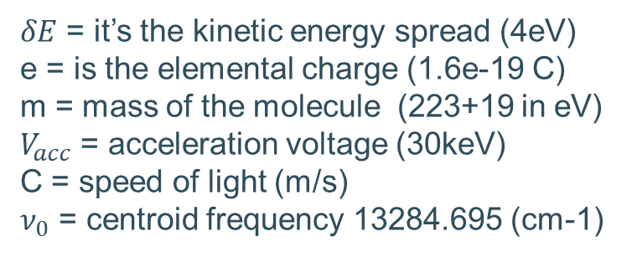
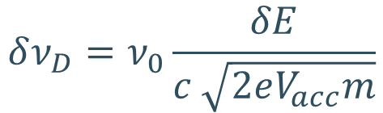
Doppler contribution to linewidth
$$δν_{D}=ν_{0}\frac{δE}{c \sqrt{2eV_{acc}m}}$$
$δE$ = it’s the kinetic energy spread (4eV)
e = is the elemental charge (1.6e-19 C)
m = mass of the molecule (223+19 in eV)
$V_{acc}$ = acceleration voltage (30keV)
C = speed of light (m/s)
$ν_{0}$ = centroid frequency 13284.695 (cm-1)
Gaussian contribution = 14 MHz for 4eV
Gaussian contribution = 7 MHz for 2eV

Slide 38
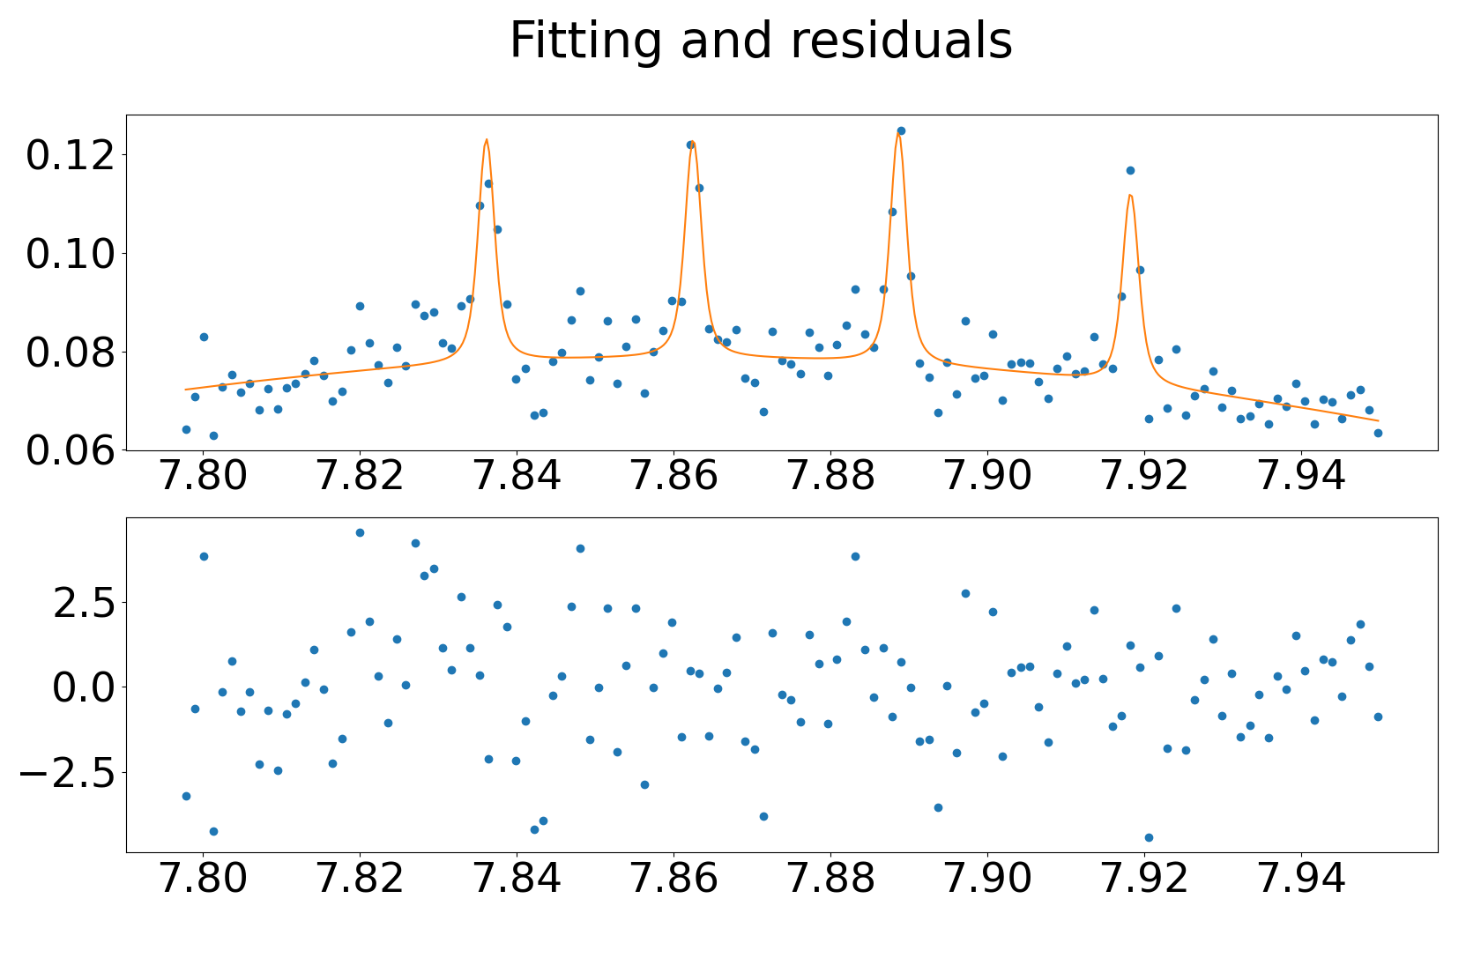
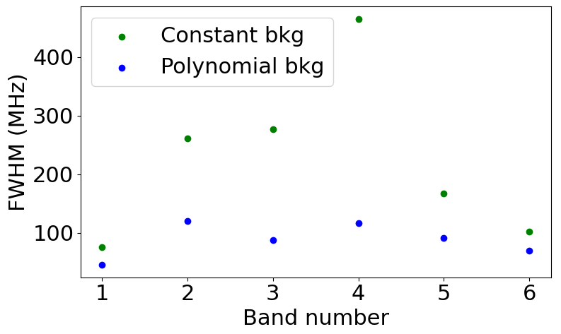
Polynomial background and residuals

Slide 39
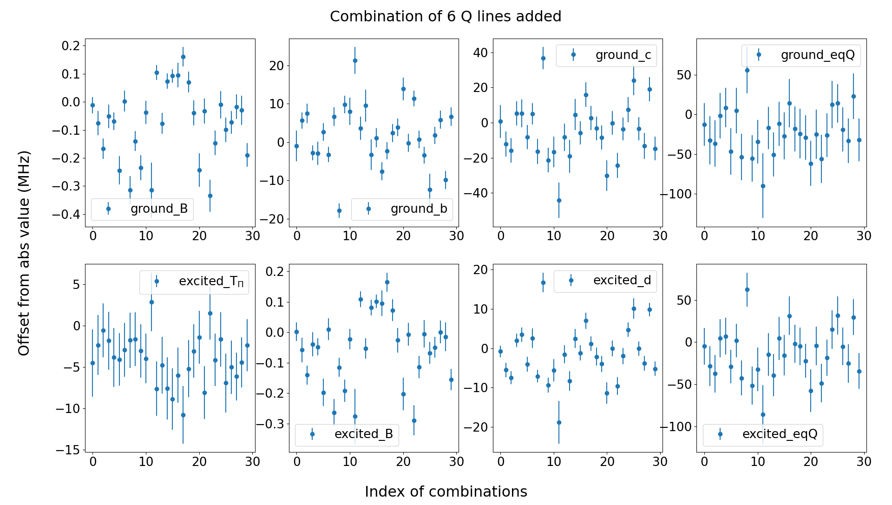
Molecular constants with 6 Q lines (statistical errors)

Slide 40
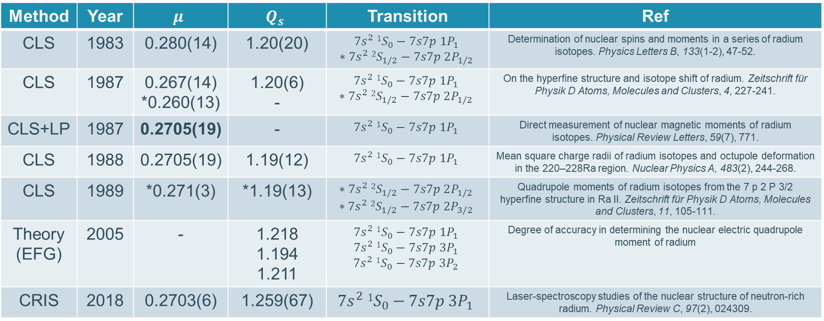
Reported nuclear moments ²²³Ra
Method | Year | $$μ$$ | $$Q_{s}$$ | Transition | Ref
CLS | 1983 | 0.280(14) | 1.20(20) | $$7s^{2} 1S_{0}−7s7p 1P_{1}$$ $$∗7s^{2} 2S_{1/2}−7s7p 2P_{1/2}$$ | Determination of nuclear spins and moments in a series of radium isotopes. Physics Letters B, 133(1-2), 47-52.
CLS | 1987 | 0.267(14) *0.260(13) | 1.20(6) - | $$7s^{2} 1S_{0}−7s7p 1P_{1}$$ $$∗7s^{2} 2S_{1/2}−7s7p 2P_{1/2}$$ | On the hyperfine structure and isotope shift of radium. Zeitschrift für Physik D Atoms, Molecules and Clusters, 4, 227-241.
CLS+LP | 1987 | 0.2705(19) | - | $$7s^{2} 1S_{0}−7s7p 1P_{1}$$ | Direct measurement of nuclear magnetic moments of radium isotopes. Physical Review Letters, 59(7), 771.
CLS | 1988 | 0.2705(19) | 1.19(12) | $$7s^{2} 1S_{0}−7s7p 1P_{1}$$ | Mean square charge radii of radium isotopes and octupole deformation in the 220–228Ra region. Nuclear Physics A, 483(2), 244-268.
CLS | 1989 | *0.271(3) | *1.19(13) | $$∗7s^{2} 2S_{1/2}−7s7p 2P_{1/2}$$ $$∗7s^{2} 2S_{1/2}−7s7p 2P_{3/2}$$ | Quadrupole moments of radium isotopes from the 7 p 2 P 3/2 hyperfine structure in Ra II. Zeitschrift für Physik D Atoms, Molecules and Clusters, 11, 105-111.
Theory (EFG) | 2005 | - | 1.218 1.194 1.211 | $$7s^{2} 1S_{0}−7s7p 1P_{1}$$ $$7s^{2} 1S_{0}−7s7p 3P_{1}$$ $$7s^{2} 1S_{0}−7s7p 3P_{2}$$ | Degree of accuracy in determining the nuclear electric quadrupole moment of radium
CRIS | 2018 | 0.2703(6) | 1.259(67) | $$7s^{2} 1S_{0}−7s7p 3P_{1}$$ | Laser-spectroscopy studies of the nuclear structure of neutron-rich radium. Physical Review C, 97(2), 024309.
Measured in Ra+
LP: Larmor precession
Notes:
LIF: laser induced fluoresence

Slide 41
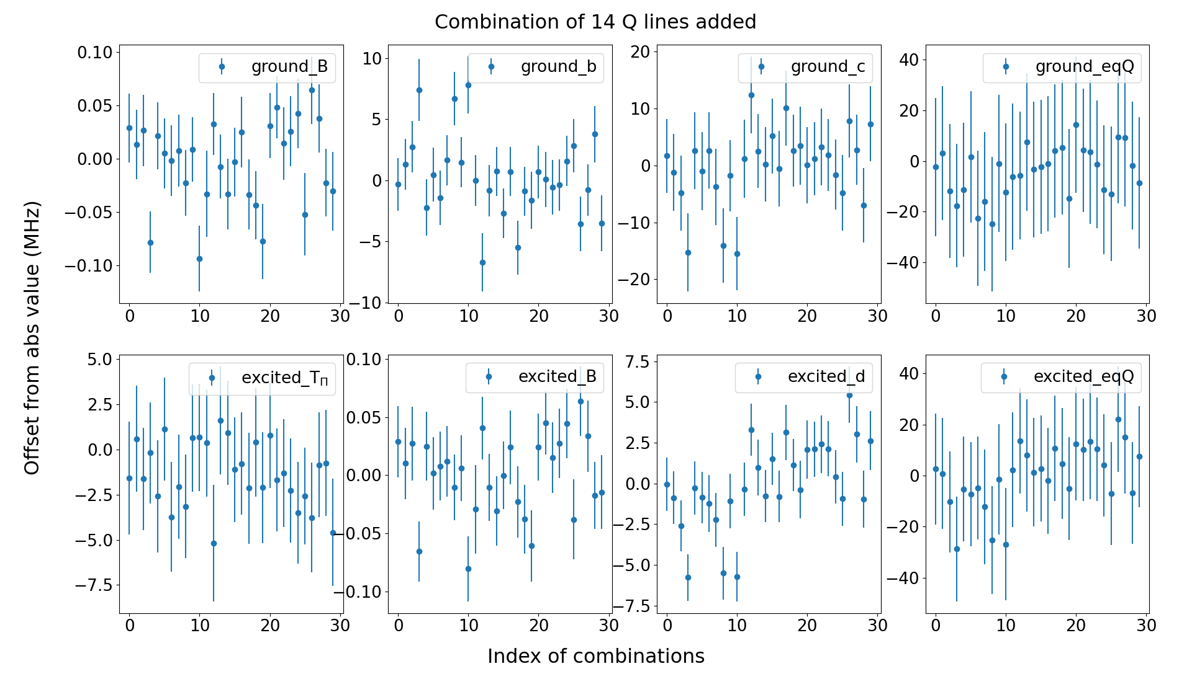
Molecular constants with 14 Q lines (statistical errors)

Slide 42


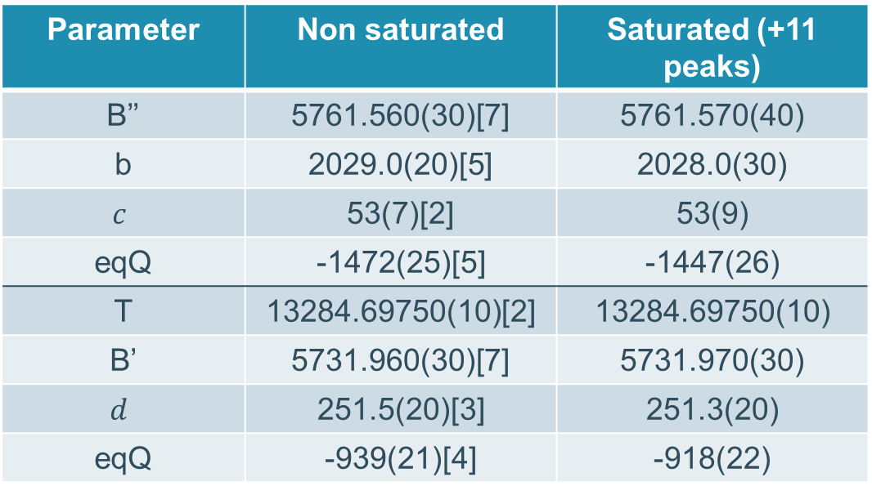



Fitting of the ²²³RaF saturated spectra.
Parameter | Non saturated | Saturated (+11 peaks)
B’’ | 5761.560(30)[7] | 5761.570(40)
b | 2029.0(20)[5] | 2028.0(30)
$$c$$ | 53(7)[2] | 53(9)
eqQ | -1472(25)[5] | -1447(26)
T | 13284.69750(10)[2] | 13284.69750(10)
B’ | 5731.960(30)[7] | 5731.970(30)
$$d$$ | 251.5(20)[3] | 251.3(20)
eqQ | -939(21)[4] | -918(22)
$Q$(²²³RaF)_{ground} = 1.21(7) b
$Q$(²²³RaF)_{ground} = 1.19(7) b
$Q$(²²³RaF)_{excited} = 1.25(7) b
$Q$(²²³RaF)_{excited} = 1.22(7) b
$Q$(²²³Ra)_{ground} = 1.21(7) b

Slide 43
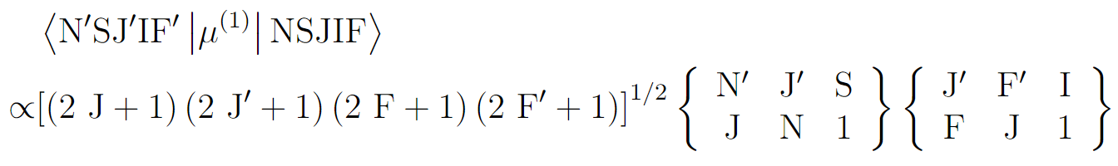
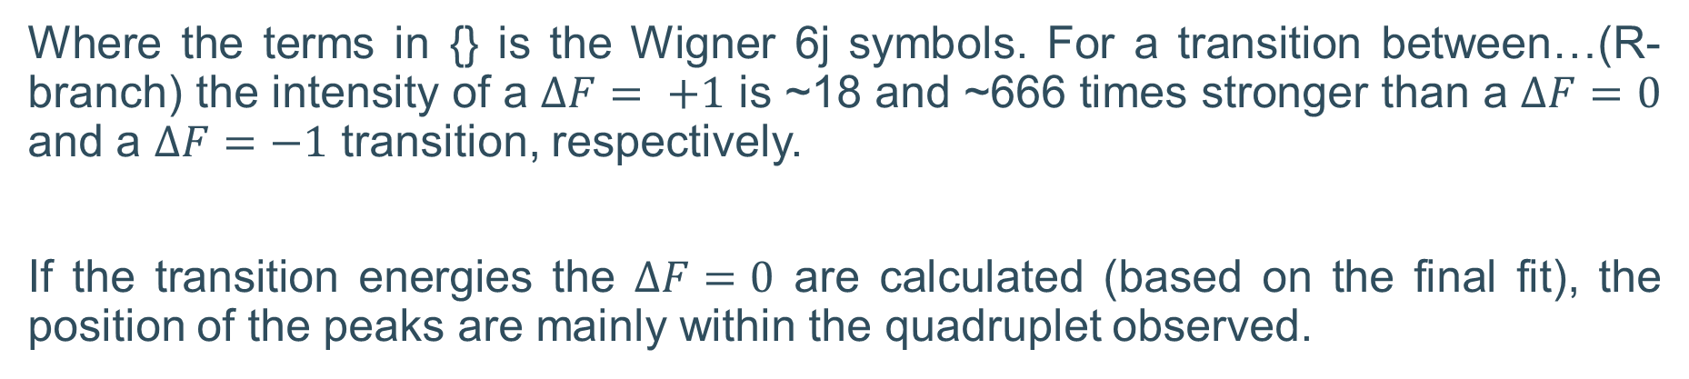
Background present on the spectra
The line strength of a molecular dipole transition between HFS states is proportional to,
Where the terms in {} is the Wigner 6j symbols. For a transition between…(R-branch) the intensity of a $ΔF= +1$ is ~18 and ~666 times stronger than a $ΔF=0$ and a $ΔF=−1$ transition, respectively.
If the transition energies the $ΔF=0$ are calculated (based on the final fit), the position of the peaks are mainly within the quadruplet observed.
[2] Campbell, W. C. (2008), Doctoral dissertation, Harvard University.
[3] Breier, A. A. (2019). Doctoral dissertation, kassel university press GmbH.
Notes:
F1_N14 = 0.99569, F0_N14=0.08023. Ratio = 12.40967
F1_N20 = 0.9977, F0_N20 = 0.0576. Ratio = 17.3205

Slide 44
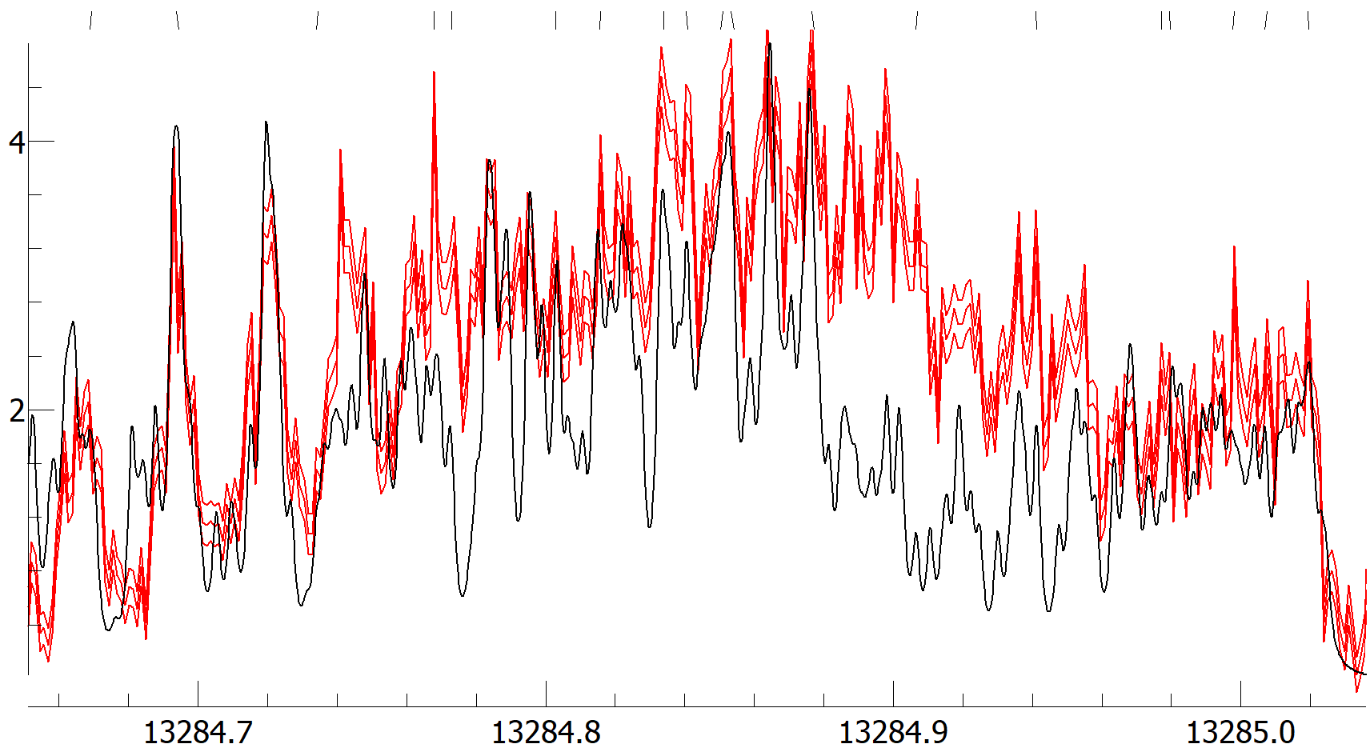
Final Q-branch result
Normalized intensity
Wavenumber/cm⁻¹

Slide 45
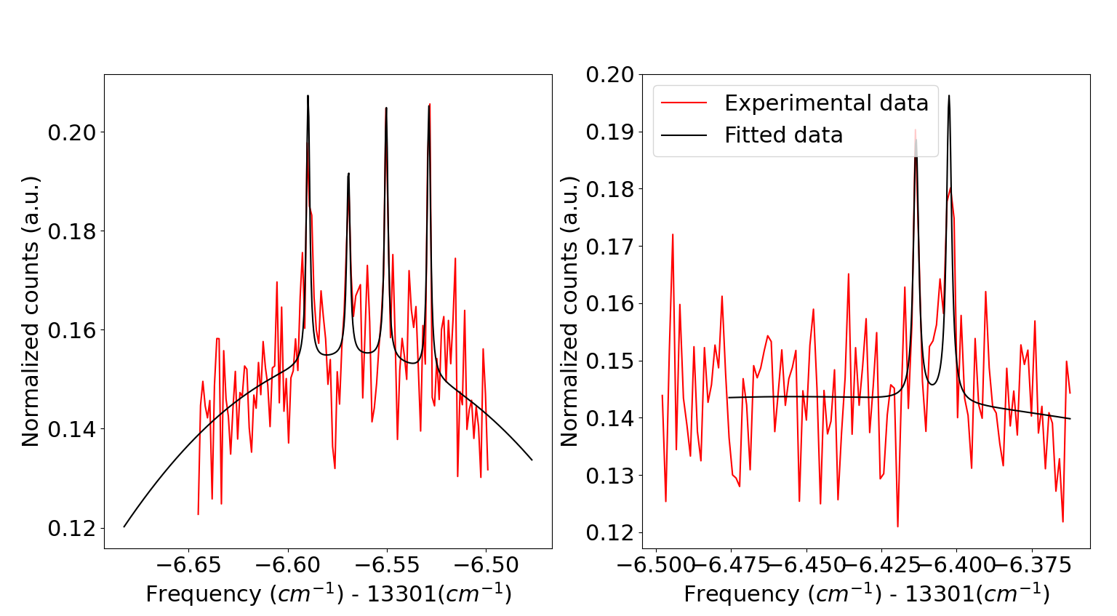
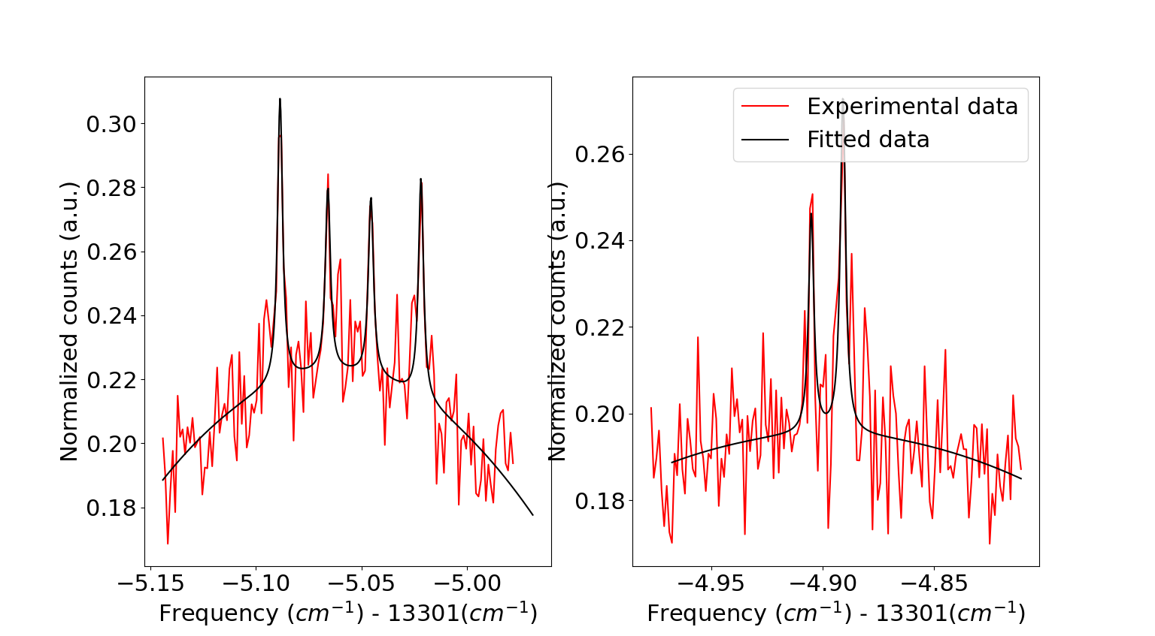
Lineshapes examples
First rotational line
Third rotational line
Forth rotational line
Fifth rotational line

Slide 46
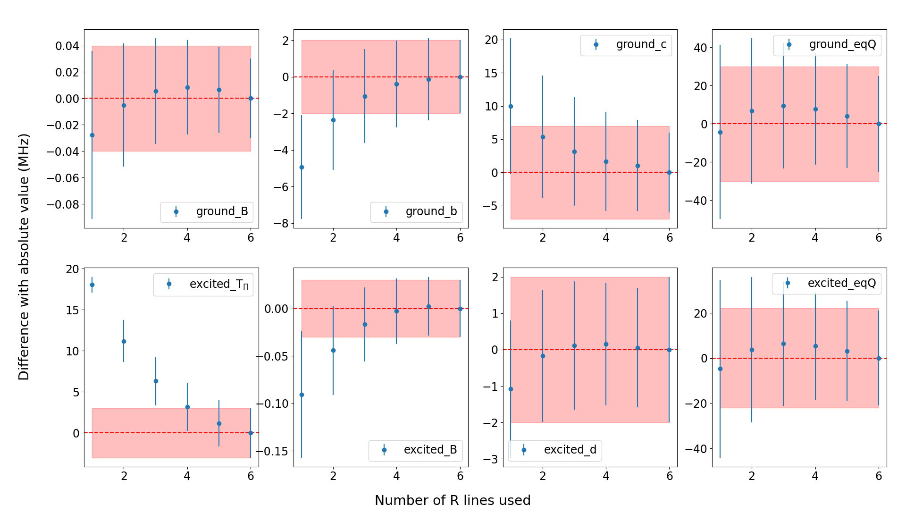
Molecular constants with different number of R lines

