Slide 1

AcF 2025 proposed plan
Proposal by
M. Athanasakis-Kaklamanakis, S.G. Wilkins and M. Au
INTC-P-615
15 shifts without protons and 14 with protons
Carlos M. Fajardo Z.
Justus Berbalk
CRIS collaboration meeting, January 2025.

Slide 2
The original proposal and experiment

Slide 3
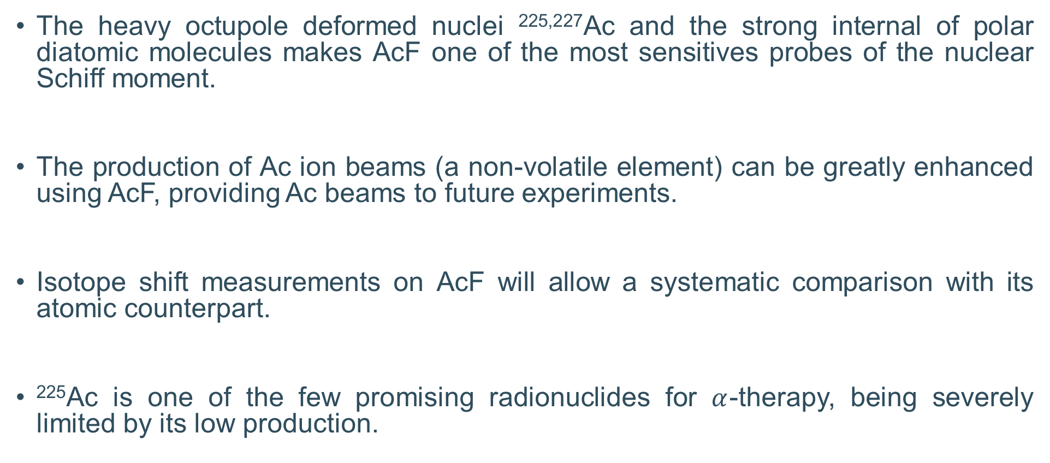
Motivation
The heavy octupole deformed nuclei ^{225,227}Ac and the strong internal of polar diatomic molecules makes AcF one of the most sensitives probes of the nuclear Schiff moment.
The production of Ac ion beams (a non-volatile element) can be greatly enhanced using AcF, providing Ac beams to future experiments.
Isotope shift measurements on AcF will allow a systematic comparison with its atomic counterpart.
²²⁵Ac is one of the few promising radionuclides for $α$-therapy, being severely limited by its low production.
[1] Athanasakis-Kaklamanakis, M., et al. No. CERN-INTC-2021-053.

Slide 4
Goals of the experiment (as in 2021 proposal)
First measurement of an electronic transition in AcF (as no electronic states were known).
Isotope shift measurements in ²²⁵⁻²³⁰AcF.
Ionization potential (IP) and dissociation energy measurements on AcF ➔ require to extract Ac from AcF.
[1] Athanasakis-Kaklamanakis, M., et al. No. CERN-INTC-2021-053.

Slide 5
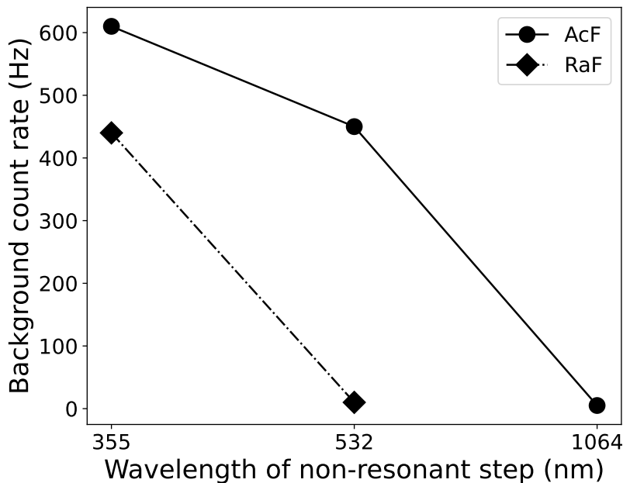
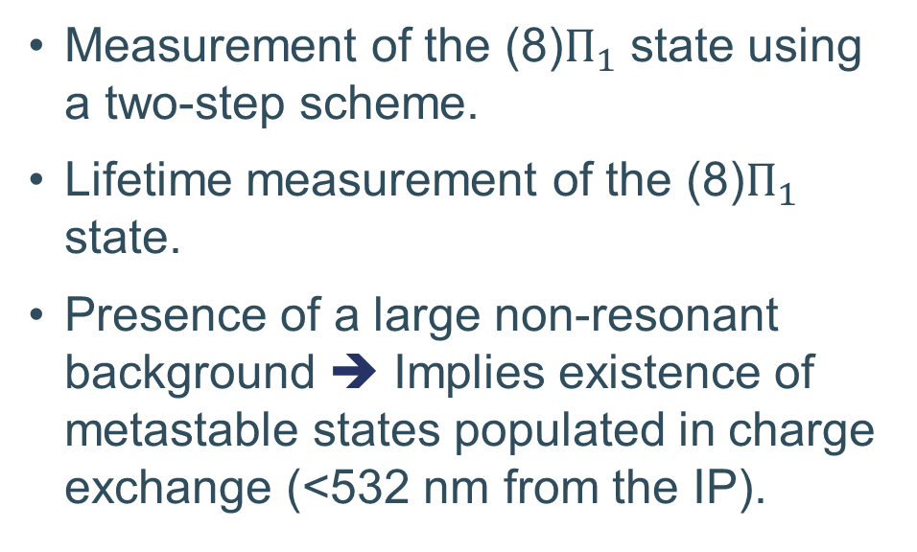
Summary of the 2021 AcF campaign
Measurement of the (8)$Π_{1}$ state using a two-step scheme.
Lifetime measurement of the (8)$Π_{1}$ state.
Presence of a large non-resonant background ➔ Implies existence of metastable states populated in charge exchange (<532 nm from the IP).
To avoid the large non-resonant background a three-step scheme using 1064 nm was pursued (800 cm⁻¹ already excluded).
[2] Athanasakis-Kaklamanakis, M. (2023). Doctoral dissertation, KU Leuven, Belgium.
Notes:
200 cm-1 also scanned using Tisa+PDL+532 nm

Slide 6
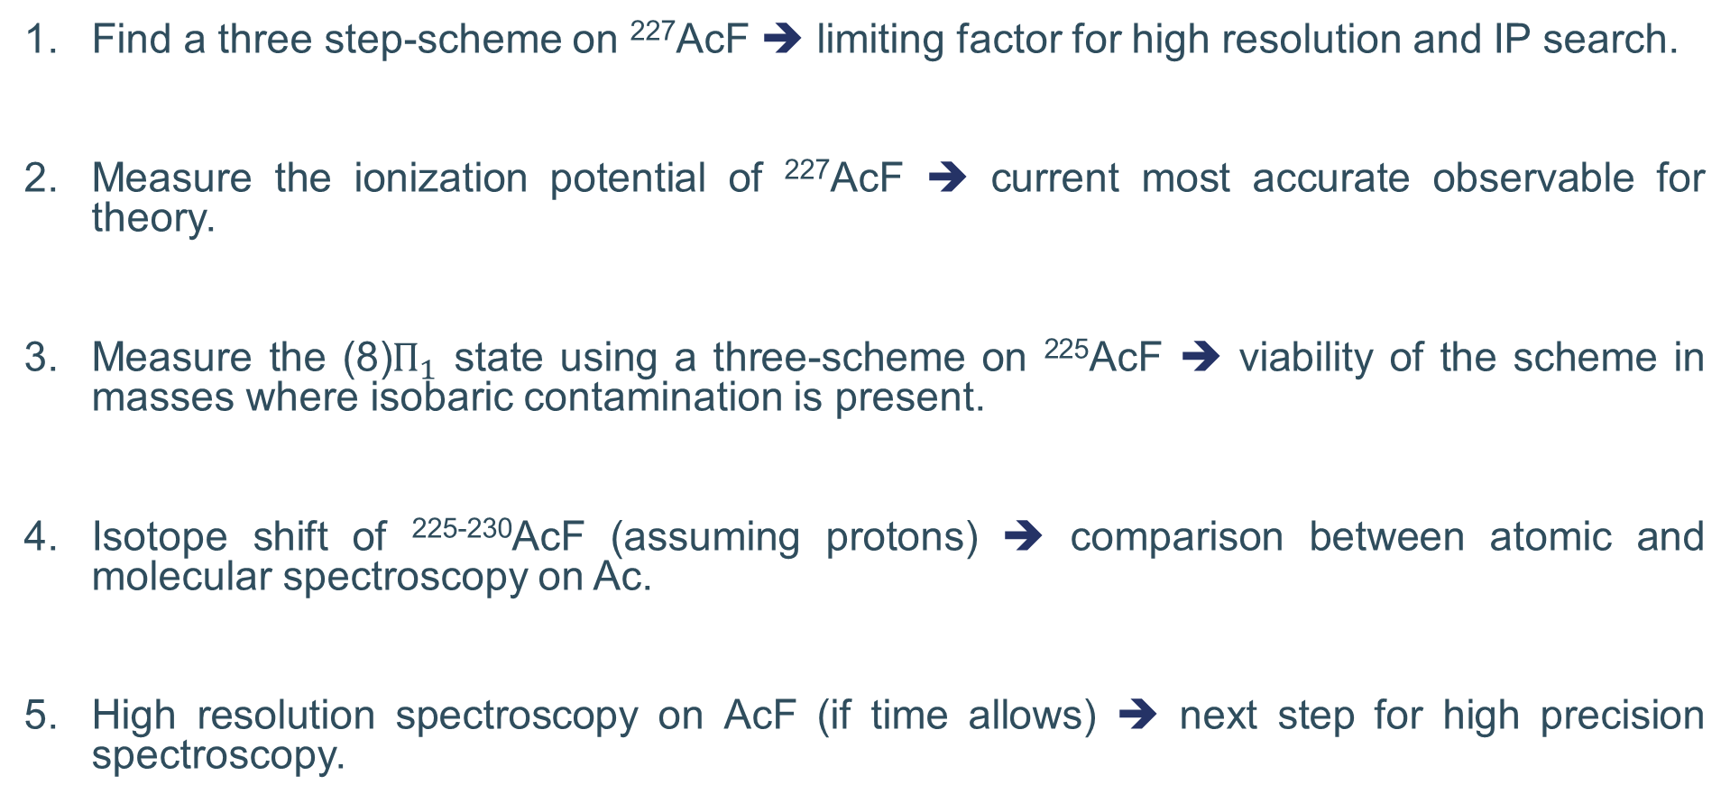
Goals of the AcF 2025 campaign.
Find a three step-scheme on ²²⁷AcF ➔ limiting factor for high resolution and IP search.
Measure the ionization potential of ²²⁷AcF ➔ current most accurate observable for theory.
Measure the (8)$Π_{1}$ state using a three-scheme on ²²⁵AcF ➔ viability of the scheme in masses where isobaric contamination is present.
Isotope shift of ²²⁵⁻²³⁰AcF (assuming protons) ➔ comparison between atomic and molecular spectroscopy on Ac.
High resolution spectroscopy on AcF (if time allows) ➔ next step for high precision spectroscopy.

Slide 7
Proposed plan

Slide 8
First RIS signal
Two step scheme on ²²⁶RaF (“surface” and plasma mode) ➔ temperature distribution of the molecules and laser/ion overlap reference.
Two step scheme on ²²⁷AcF (isobaric pure mass).

Slide 9
Metastable state search
Use a binary search to find the metastable state (search based on eliminating regions where the laser-induced background is not present).
532 nm
798 nm
1064 nm
532 nm
665 nm
798 nm
Laser bkg not present
Laser bkg is present
665 nm
731 nm
798 nm

Slide 10
Metastable state search
Use a binary search to find the metastable state (search based on eliminating regions where the laser-induced background is not present).
Gives an additional spectroscopical information.
The relative position of the metastable state would determine the feasibility of alternative schemes three-step schemes.
Current known laser bkg
Non-resonant wavelengths that could be use in a three-step scheme based on the binary search

Slide 11
Proposed laser schemes
The predicted most intense three step scheme are the following:
Notes:
Scheme a) is 2.12. Scheme b) is 0.96. Scheme c) is 1.49, and Scheme d) is 1.39

Slide 12
Unmeasured region using a three-step
Two three-step scheme were already attempted during the 2022 campaign.
In case all the previous scheme fails, these are the unmeasured regions that would be compatible with a 1064 nm scheme

Slide 13
Flowchart for the three-step scheme search
Based on the energy of the metastable state, the search for a three-step scheme is the following.

Slide 14
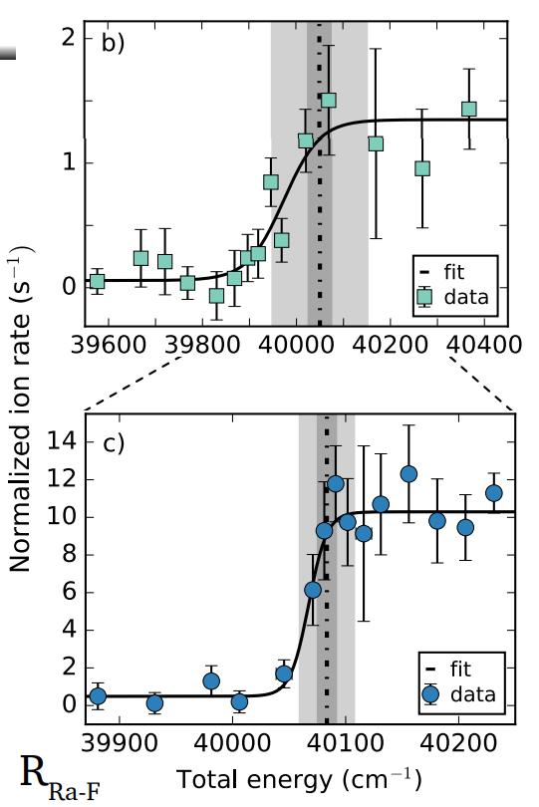
AcF ionization potential search
Two-step scheme
Once a three-step scheme is found, the IP of AcF can be obtained fitting a Sigmoid function of the count rate vs laser wavelength.
The measurement of the IP has already been attempted with a two-step scheme with no success.
The search of the IP using the FIU could be attempted, but given the congested Rydberg structure on molecules, its measurement is unlikely.
Three-step scheme
[3] Wilkins, S. G., et al. (2024). Ionization potential of radium monofluoride.

Slide 15
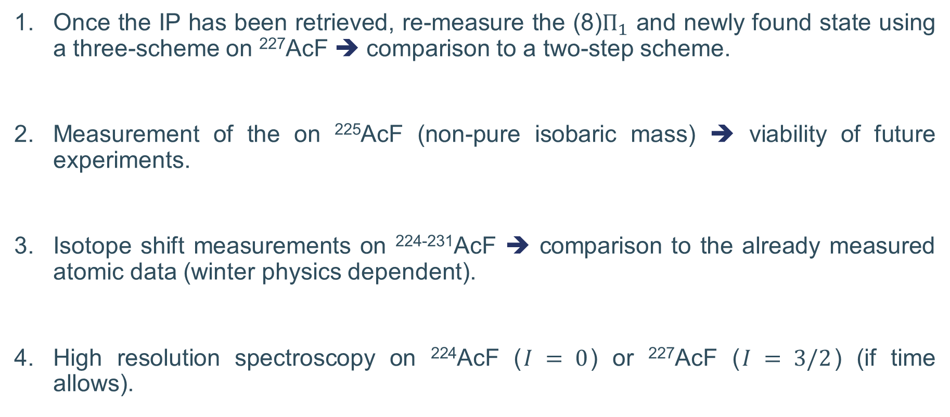
²²⁴⁻²³¹AcF measurements
Once the IP has been retrieved, re-measure the (8)$Π_{1}$ and newly found state using a three-scheme on ²²⁷AcF ➔ comparison to a two-step scheme.
Measurement of the on ²²⁵AcF (non-pure isobaric mass) ➔ viability of future experiments.
Isotope shift measurements on ²²⁴⁻²³¹AcF ➔ comparison to the already measured atomic data (winter physics dependent).
High resolution spectroscopy on ²²⁴AcF ($I = 0$) or ²²⁷AcF ($I = 3/2$) (if time allows).

Slide 16
Requirements for the experiment.
Given the large scanning range required for each laser, position and power stabilization systems are needed.
In case scheme b) (using a 1064 non-resonant step) is successful, the measurement of the IP could only be performed using the OPO, meaning that a spectrometer to record the OPO wavelength would be needed.
Since some of the schemes would require having more than one broadband TiSa laser, a second scannable TiSa laser would be helpful (upgrade the Z-cavity?).

Slide 17
Thanks for your attention

Slide 18
Backup slides

Slide 19
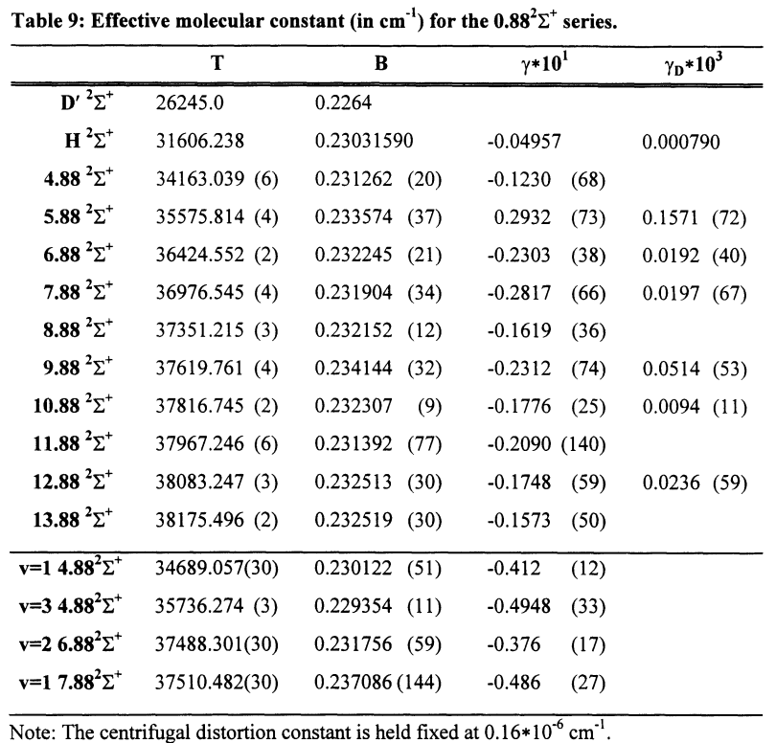
Rydberg states in molecules
Molecular Rydberg series are divided based on the orbital angular momentum (like in atoms).
However, each member of a given series can be seen as a “normal” electronic state, composed by vibrational and rotational states, creating a considerably congested electronic structure.
[4] Jakubek, Z. J. (1995). Doctoral dissertation, MIT, USA.
Notes:
This table is one of the four \Sigma series found in BaF

Slide 20
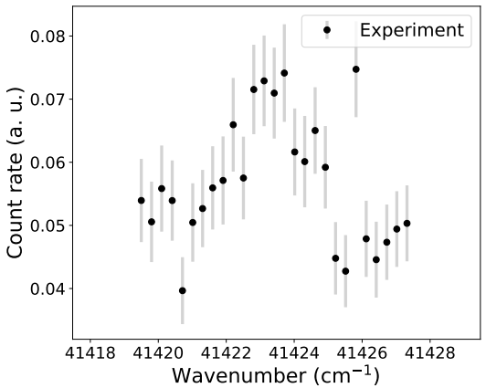
A suspect peak from 2022
From the data set taken on 2022, a small RIS seem to have been overserved at around 41,423 cm-1. However, the recorded data is not enough to clearly resolve a peak. The remeasurement of this peak would be attempted.
[2] Athanasakis-Kaklamanakis, M. (2023). Doctoral dissertation, KU Leuven, Belgium.

Slide 21
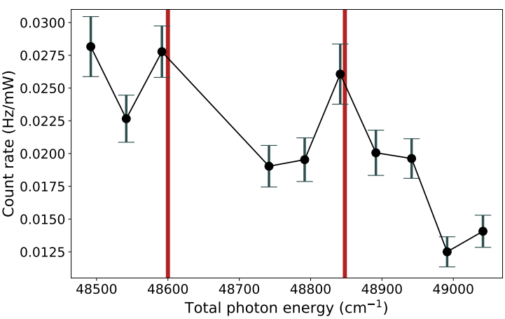
Two-step scheme search in 2022
The measurement of AcF IP was attempted using a double TiSa scheme with no success.
[2] Athanasakis-Kaklamanakis, M. (2023). Doctoral dissertation, KU Leuven, Belgium.

Slide 22
OPO laser power at 100Hz
Wavelength (nm) | Power (mW)
672 | 75
682 | 65
692 | 43
702 | 22
712 | 4
722 | 22
732 | 30
742 | 40
752 | 58
762 | 73
772 | 70
Notes:
This table is one of the four \Sigma series found in BaF

